Slide 1
CEPC Polarization Study Status
Zhe Duan
On behalf of CEPC Beam Polarization Working Group
2023. 02. 15
IAS Program on High Energy Physics (HEP 2023)
Feb 14-16, 2023

Slide 2
CEPC Beam polarization working group
Physics design:
  Tao Chen, Zhe Duan, Hongjin Fu, Jie Gao, Sergei Nikitin (BINP), Dou Wang, Jiuqing Wang, Yiwei Wang, Wenhao Xia(graduated)
Polarized electron source & linac:
  Xiaoping Li, Cai Meng, Jingru Zhang
Polarimeter:
  Shanhong Chen, Yongsheng Huang, Guangyi Tang, Yuting Wang
Discussions with D. P. Barber (DESY) on polarization theories and simulations are illuminating.
Helpful discussions with E. Forest (KEK) & D. Sagan (Cornell) on usage of Bmad/PTC are acknowledged.

Slide 3
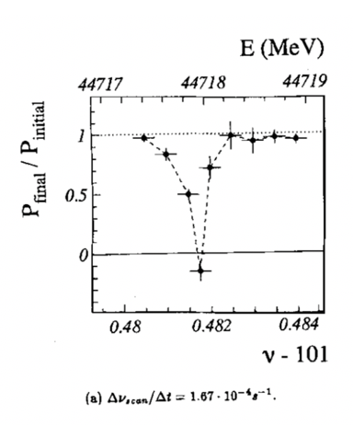
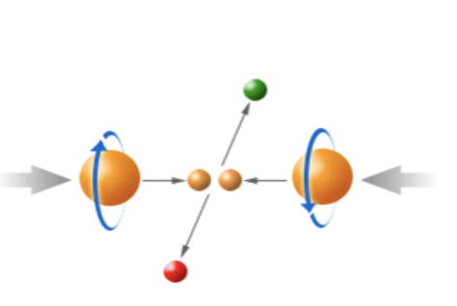
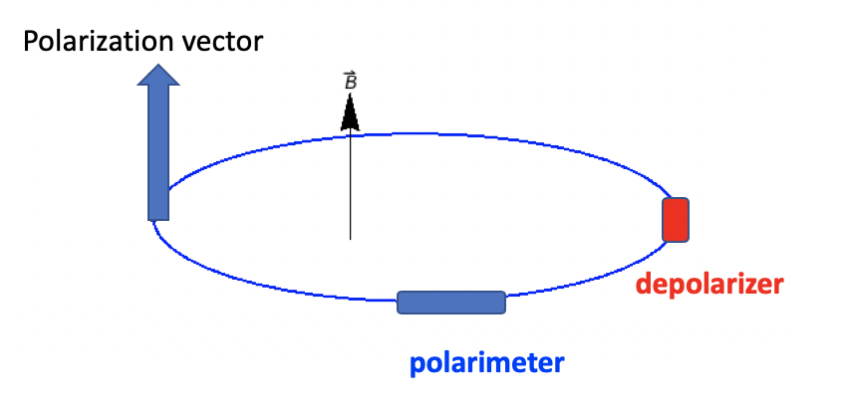
Motivation of CEPC polarized beam program
Vertically polarized beams in the arc
  Beam energy calibration via the resonant depolarization technique
  Essential for precision measurements of Z and W properties
  At least 5% ~ 10% vertical polarization, for both e+ and e- beams
Longitudinally polarized beams at IPs
  Beneficial to colliding beam physics programs at Z, W and Higgs
  Figure of merit: Luminosity * f( Pe+, Pe- )
  ~50% or more longitudinal polarization is desired, for one beam, or both beams
L. Arnaudon, et al., Z. Phys. C 66, 45-62 (1995).
Supported by National Key R&D Program 2018-2023 to design longitudinally polarized colliding beams at Z-pole.
The study in this presentation is based on CEPC CDR lattice & parameters.
Will be included as a Chapter in the Appendix in the CEPC TDR.

Slide 4
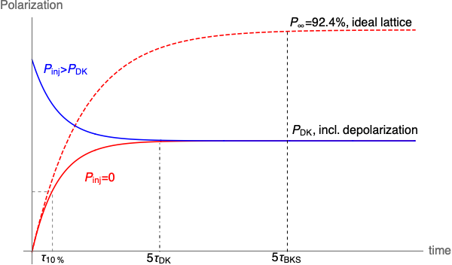

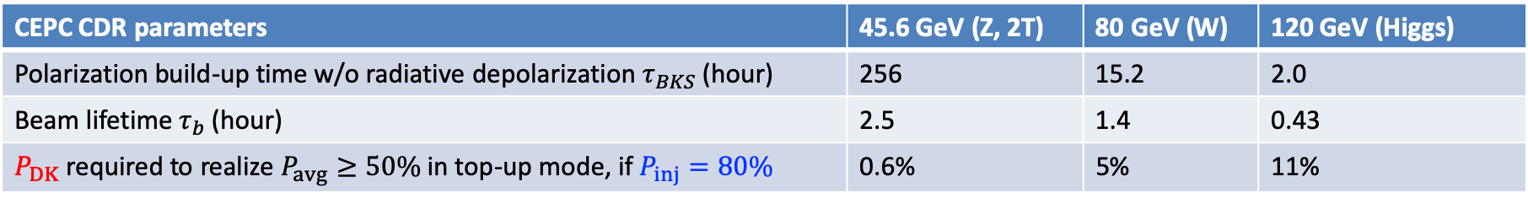
Beam polarization in the collider rings
Non-colliding “pilot” bunch: decay mode
Colliding bunch: top-up injection
Bunch charge
Polarization
  If $τ_{DK}≫τ_{b}$, then $P_{avg}≈P_{inj}$
time
Injection of polarized beams is required
  to achieve high-level longitudinal polarization without significantly sacrificing luminosity
  also benefits resonant depolarization measurements w/ pilot bunches.
CEPC CDR parameters | 45.6 GeV (Z, 2T) | 80 GeV (W) | 120 GeV (Higgs)
Polarization build-up time w/o radiative depolarization $τ_{BKS}$ (hour) | 256 | 15.2 | 2.0
Beam lifetime $τ_{b}$ (hour) | 2.5 | 1.4 | 0.43
$P_{DK}$ required to realize $P_{avg}≥50\%$ in top-up mode, if $P_{inj}=80\%$ | 0.6% | 5% | 11%

Slide 5
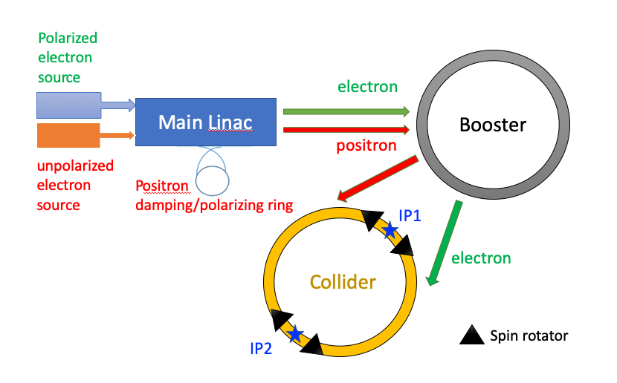
Preparation and injection of polarized beams
Polarized electon source
Parameter | ILC(TDR) | CLIC(3TeV) | CEPC
Electrons/microbunch | 2×10¹⁰ | 0.6×10¹⁰ | >0.94×10¹⁰
Charge / microbunch | 3.2nC | 1nC | 1.5nC
Number of microbunches | 1312 | 312 | 1
Macropulse repetition rate | 5 | 50 | 100
Average current from gun | 21μA | 15μA | 0.15μA
Polarization | >80% | >80% | >80%
Aspect | Key issue | Pages in this presentation
Polarized beam acceleration in booster | How serious is depolarization, possible mitigation? [1,2] | 6-10
Equilibrium beam polarization in collider rings | What are the mechanisms of radiative depolarization?[3] | 11
Resonant depolarization | How to generate polarized e+ beam?[1] | 12-14
Longitudinally polarized colliding beams | How to design spin rotators in the collider rings?[1,4] | 15
[1] Z. Duan, talk on eeFACT 2022, FCC EPOL Workshop 2022;
[2] T. Chen, Z. Duan, D. H. Ji, D. Wang, arXiv:2302.05321v1 [physics,acc-ph]
[3] W. H. Xia, Z. Duan, D. P. Barber, Y. W. Wang, B. Wang, J. Gao, arXiv:2204.12718v1 [physics.acc-ph], submitted to PRAB
[4]W. Xia, Z. Duan, J. Gao and Y. W. Wang, RDTM (2022) doi: 10.1007/s41605-022-00344-2

Slide 6
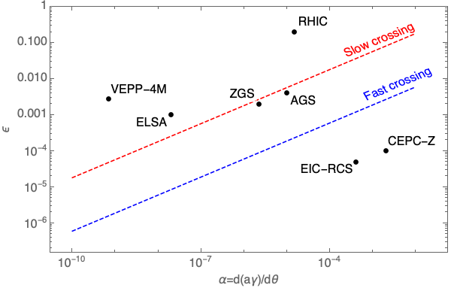
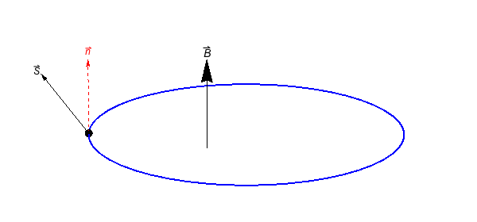
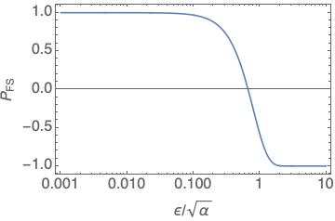
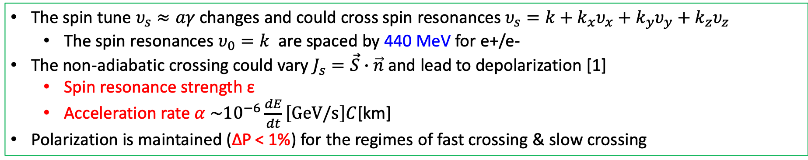
Depolarization in the booster
The spin tune $υ_{s}≈aγ$ changes and could cross spin resonances $υ_{s}=k+k_{x}υ_{x}+k_{y}υ_{y}+k_{z}υ_{z}$
  The spin resonances $υ_{0}=k$ are spaced by 440 MeV for e+/e-
The non-adiabatic crossing could vary $J_{s}=\vec{S}∙\vec{n}$ and lead to depolarization [1]
  Spin resonance strength ε
  Acceleration rate $α \sim {10}^{−6}\frac{dE}{dt}\left[GeV/s\right]C$[km]
Polarization is maintained (ΔP < 1%) for the regimes of fast crossing & slow crossing
Fast crossing
Slow crossing
[1] Froissart and Stora, NIM 7, 297 (1960) [2] A. K. Barladyan, et al., PRAB 22, 112804, (2019)
[3] S. Nakamura, et al., NIM A 411, 93 (1998) [4] T. Khoe et al., Part. Accel. 6, 213 (1975)
[5] Configuration Manual: Polarized Proton Collider at RHIC, 2006 [6] V. Ranjbar, et al., PRAB 21, 111003 (2018)

Slide 7
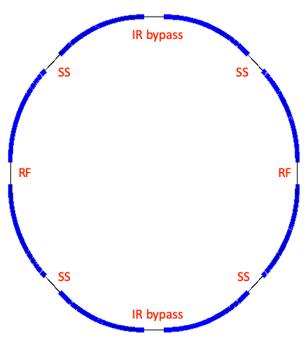
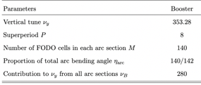
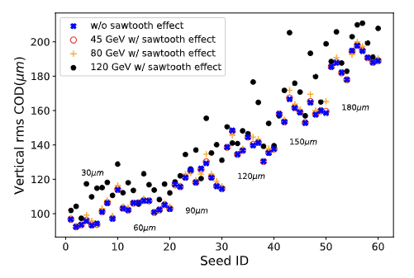
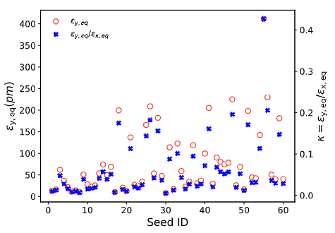
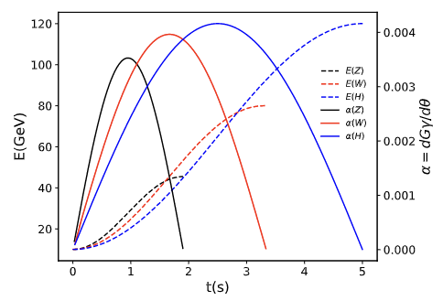
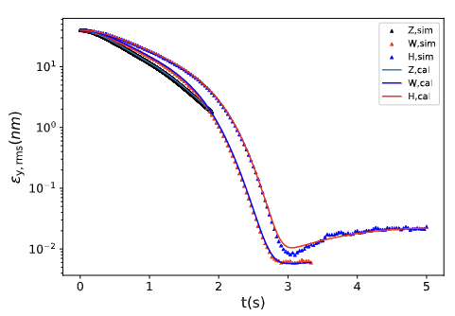
Setup of CEPC booster lattice
Arc region covers ~ 80% of circumference
General structure of the CEPC booster lattice
  8 arcs each containing 140 FODO cells
  interleaved with 8 straight sections
60 imperfection lattice seeds
  Misalignment error & field error, scan BPM offset
  Closed orbit correction & tune correction
Multi-particle tracking in Bmad
  Energy and RF ramping in the whole process
  Element-by-element tracking with radiation damping & quantum excitation

Slide 8
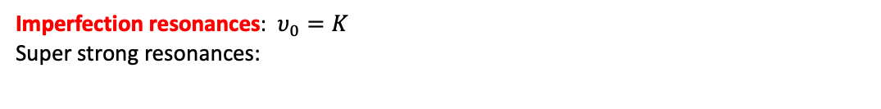
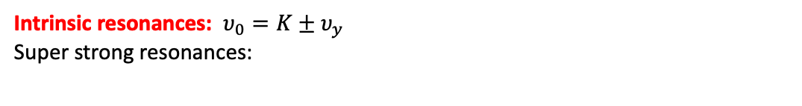
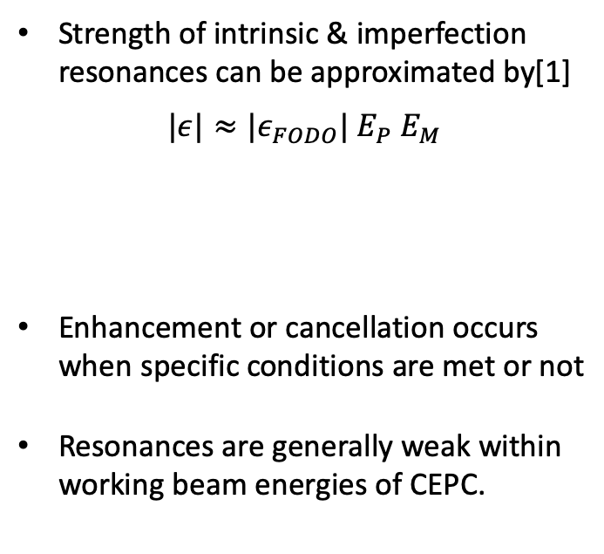
Spin resonance structure of CEPC Booster
Strength of intrinsic & imperfection resonances can be approximated by[1]
$$|ε|≈{|ε}_{FODO}| E_{P} E_{M}$$
Enhancement or cancellation occurs when specific conditions are met or not
Resonances are generally weak within working beam energies of CEPC.
Intrinsic resonances: $υ_{0}=K±υ_{y}$
Super strong resonances:
due to M identical FODOs in each arc
due to P superperiods
Imperfection resonances: $υ_{0}=K$
Super strong resonances:
[1] S. Y. Lee, Spin dynamics and snakes in synchrotrons (World Scientific, 1997).

Slide 9

Estimation of depolarization with Froissart-Stora formula
Assumption:
single crossing of imperfection & intrinsic resonances
there are no interference between resonance crossings
Imperfection resonance
Intrinsic resonance

Slide 10
Depolarization effects: simulation vs. estimation
In the acceleration to Z & W
  The spin resonances are generally weak
  Polarization is mostly maintained
  Estimations agree fairly well with simulations
In the acceleration H
  The spin resonances become stronger at higher energies
  Severe depolarization occurs
  Mitigation methods to be explored
Z-mode
W-mode
H-mode

Slide 11
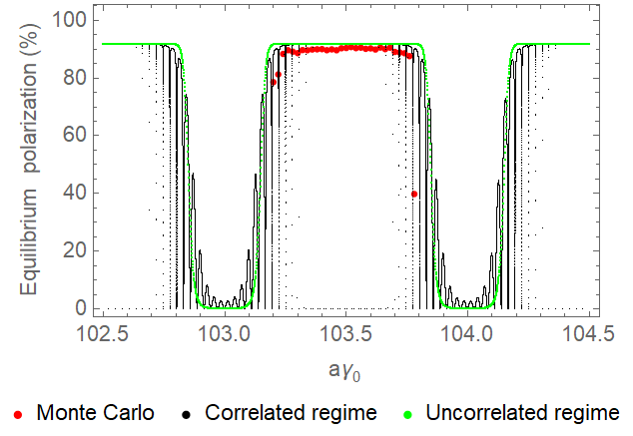
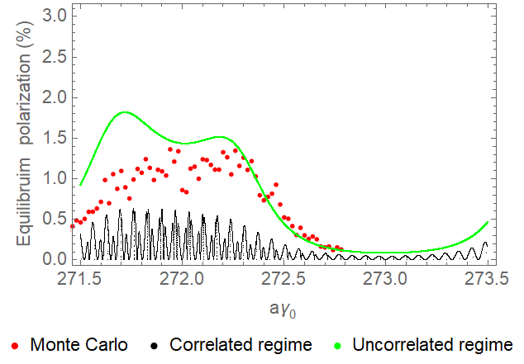
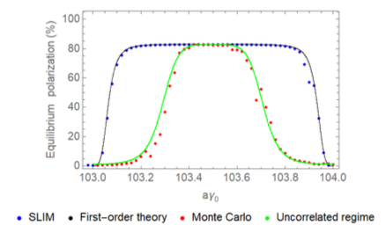
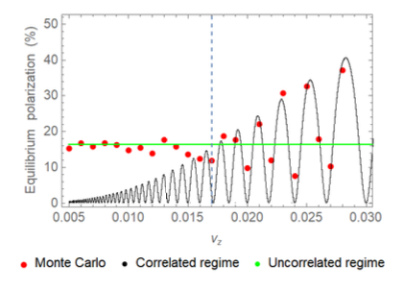

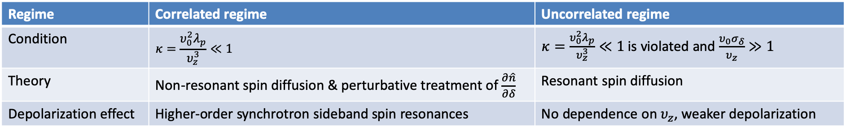
Radiative depolarization in the collider rings
Two distinct spin diffusion mechanisms were proposed in [1] in 1970s, regarding the regimes of spin resonance crossing, in the combined effects of synchrotron oscillation and synchrotron radiation
Regime | Correlated regime | Uncorrelated regime
Condition | $$κ=\frac{υ_{0}^{2}λ_{p}}{υ_{z}^{3}}≪1$$ | $κ=\frac{υ_{0}^{2}λ_{p}}{υ_{z}^{3}}≪1$ is violated and $\frac{υ_{0}σ_{δ}}{υ_{z}}≫1$
Theory | Non-resonant spin diffusion & perturbative treatment of $\frac{∂\hat{n}}{∂δ}$ | Resonant spin diffusion
Depolarization effect | Higher-order synchrotron sideband spin resonances | No dependence on $υ_{z}$, weaker depolarization
Monte-Carlo simulations were compared with these theories[2], showing a gradual evolution from the correlated regime to the uncorrelated regime in parameter scan, suggesting existing theories are incomplete, requiring further development
Case A: dependence on beam energy
Case B: influence of harmonic RF cavity
Z
Higgs
optimal lengthening condition
Scan harmonic RF voltage
$$κ=\frac{{\text{ν}}_{0}^{2}λ_{p}}{{\text{ν}}_{z}^{3}}→∞$$
[1] Derbenev, Kondrantenko and Skrinsky, Part. Accel. 9, 247 (1979) [2] W. H. Xia, Z. Duan, D. P. Barber, Y. W. Wang, B. Wang, J. Gao, arXiv:2204.12718v1 [physics.acc-ph], submitted to PRAB

Slide 12
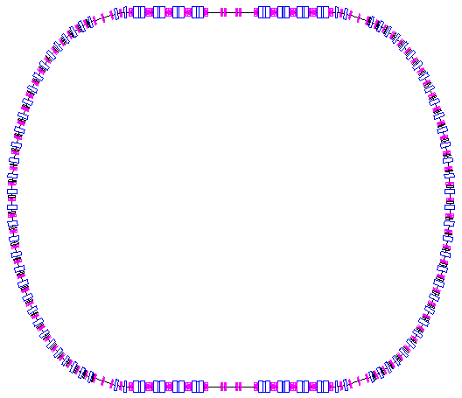
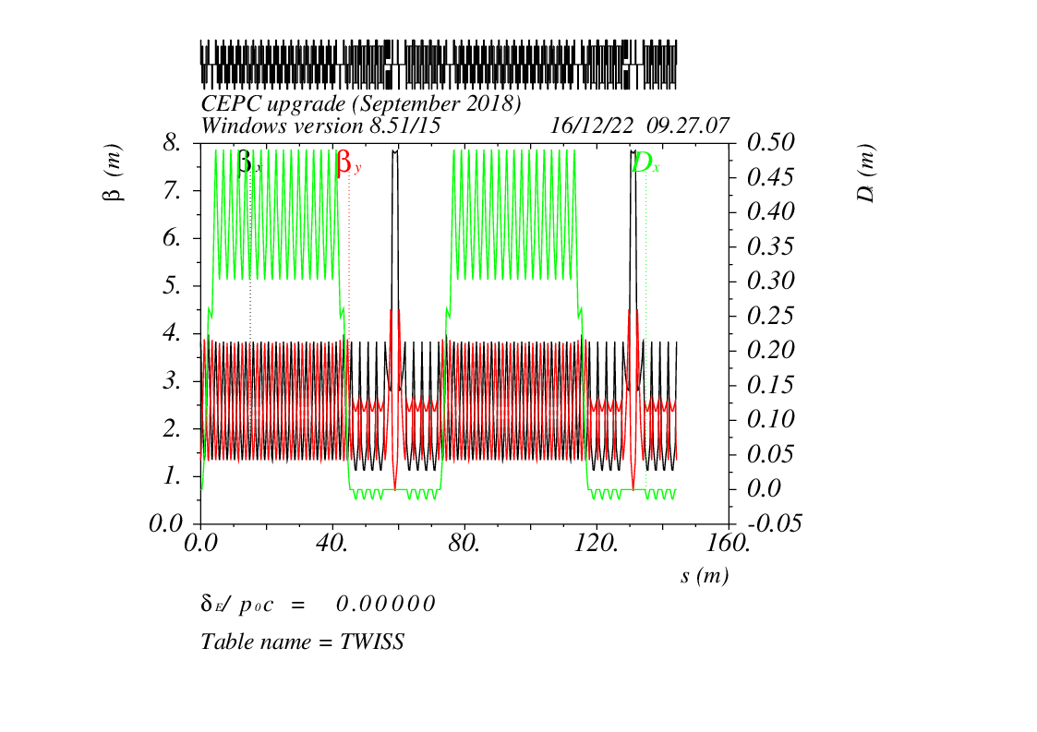
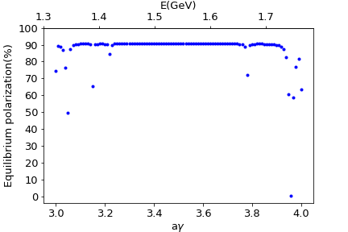
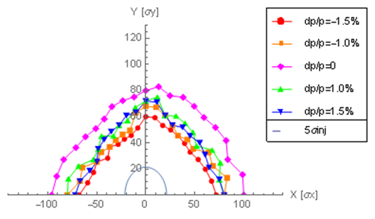
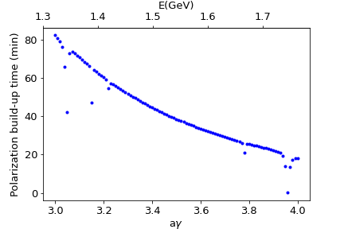
e+ damping/polarizing ring
DR V4.0 | unpolarized e+ | polarized e+
Energy (Gev) | 1.542
Circumference (m) | 144.2
Number of trains | 2(4)
Number of bunches/trian | 1(2)
Total current (mA) | 12.4
Bending radius (m) | 3.44
Dipole strength B₀ (T) | 1.07
Wiggler strength B₊ (T) | 1.8
Wiggler cell length (m) | 1.5
U₀ (kev/turn) | 190.9
Damping time x/y/z (ms) | 7.77/7.77/3.89
Momentum compaction | 0.015
Storage time | 20 ms | 10 min
δ₀ (%) | 0.072
ε₀ (mm.mrad) | 138
injection σ_{z} (mm) | 6
Extract σ_{z} (mm) | 5.7 | 5.6
ε_{inj} (mm.mrad) | 2500
ε_{ext x/y} (mm.mrad) | 151/15 | 138/14
δ_{inj} /δ_{ext} (%) | 0.18 /0.072
RF acceptance (%) | 1.8
f_{RF} (MHz) | 650
V_{RF} (MV) | 3.95
Longitudinal tune | 0.044
Asymmetric wigglers
B₊=1.8T=-5 B₋
cell length=1.5m
16 such cells
+1(2)

Slide 13
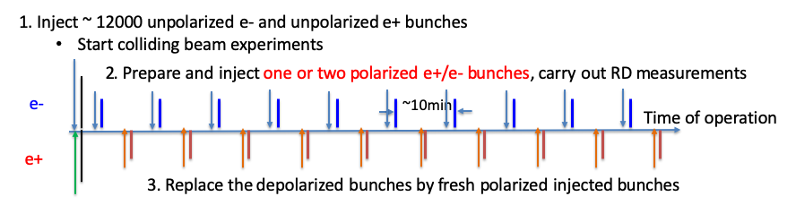
RD scenario & e+ damping/polarizing ring
bunches stay ~10 min to accumulate ~ 20% polarization, for RD
Positron damping ring
bunches stay ~ 20 msec without gaining beam polarization, for regular refill
Preparation and injection of polarized e+/e- bunches alternates with unpolarized bunches.

Slide 14
What we can gain from injecting polarized beams for RD?
Scenarios of polarized beam generation |  | Self-polarization in the collider[1] | Injection of polarized beams[2]
Hardware | Polarized electron gun | None | Yes
 | Asymmetric wigglers | In the collider | In the positron damping ring
Polarization level |  | 5% ~ 10% | > 70% for e-, > 20% e+
Dead time for physics |  | Initial 1~2 hours in each fill | None
Frequency of RD measurements |  | Every ~10 min per beam | More frequent for e- beam
RD on colliding beams |  | None | Possible, especially at lower bunch charge
Horizontal polarization for free spin precession method |  | Strong spin flipper in the collider | Spin rotator in the transfer line; much higher polarization
[1] The FCC-ee Energy and Polarization Working Group, arXiv:1909.12245v1, 2019.
[2] Zhe Duan, talk on 2nd EPOL Workshop, Sep 29, 2022

Slide 15
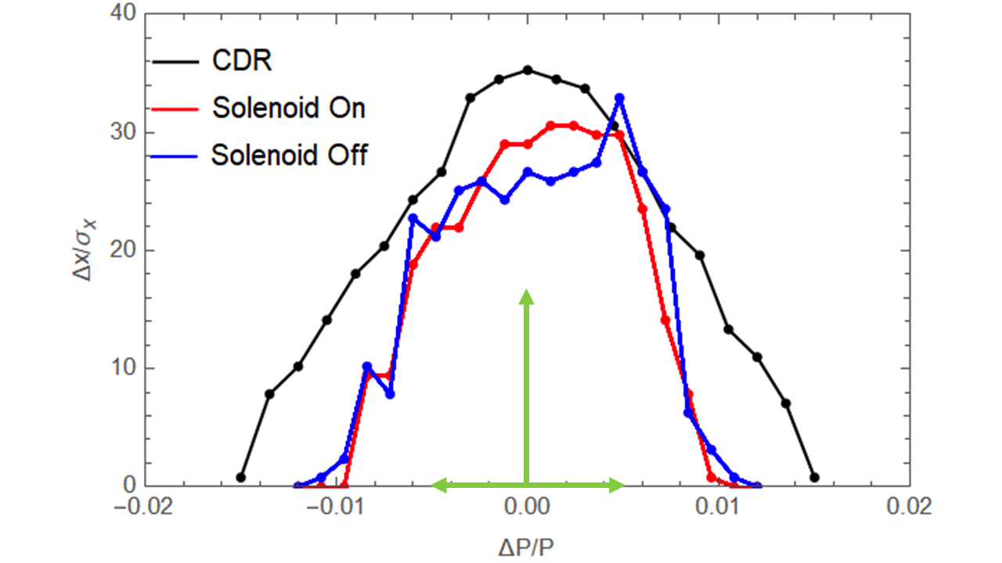
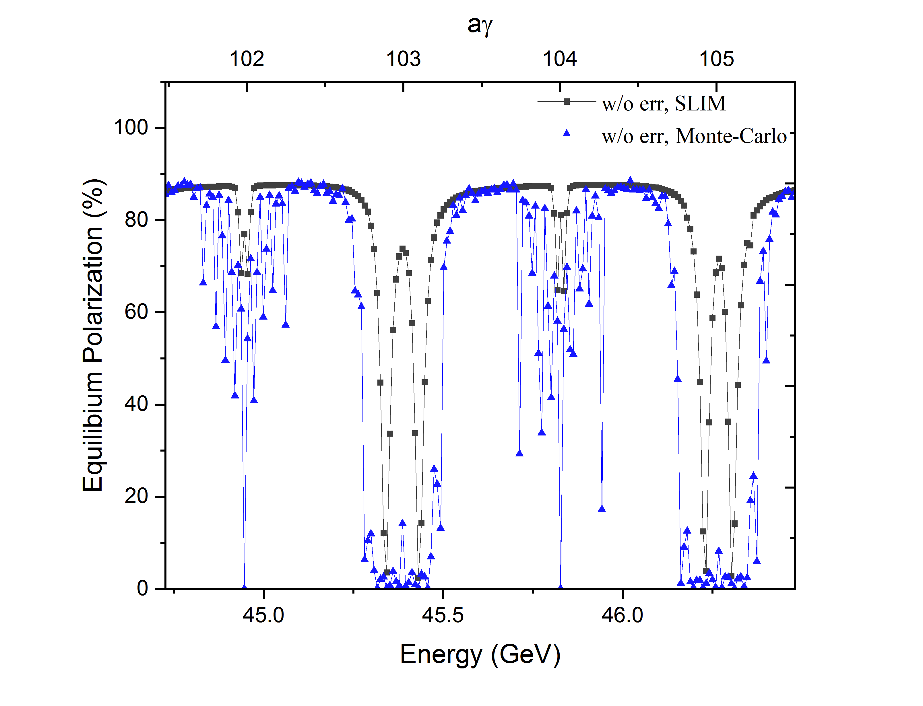
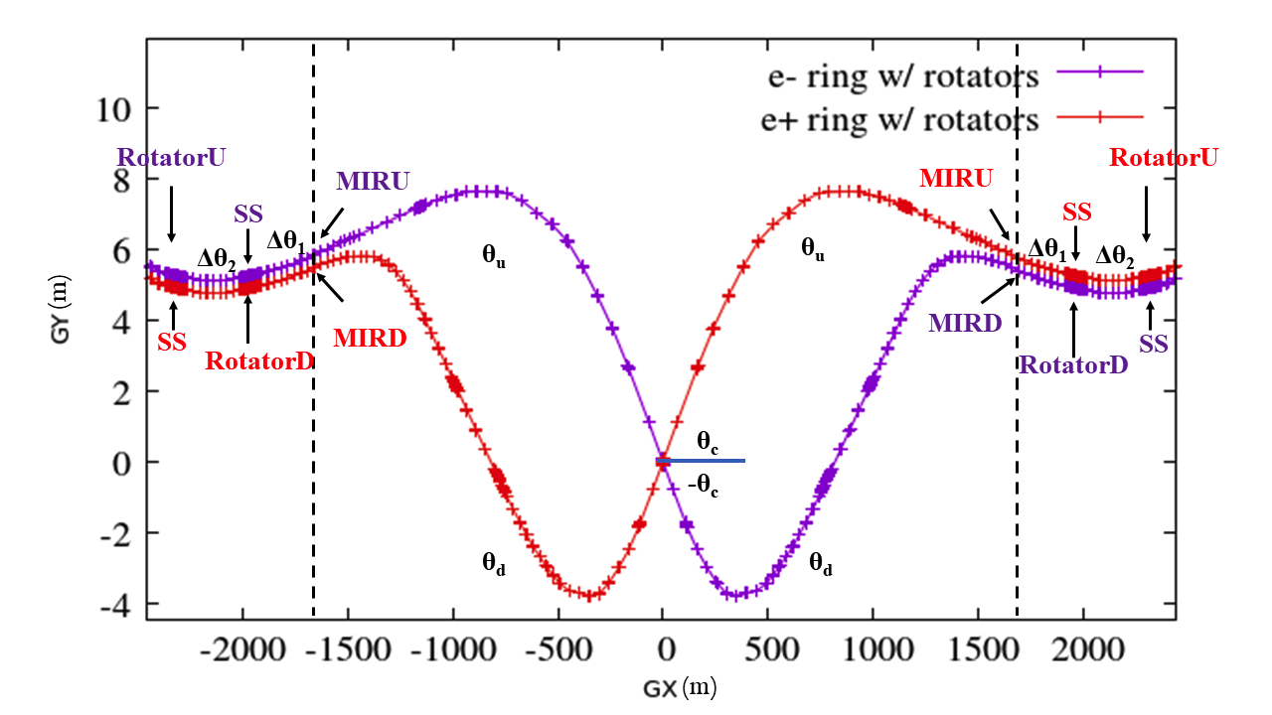
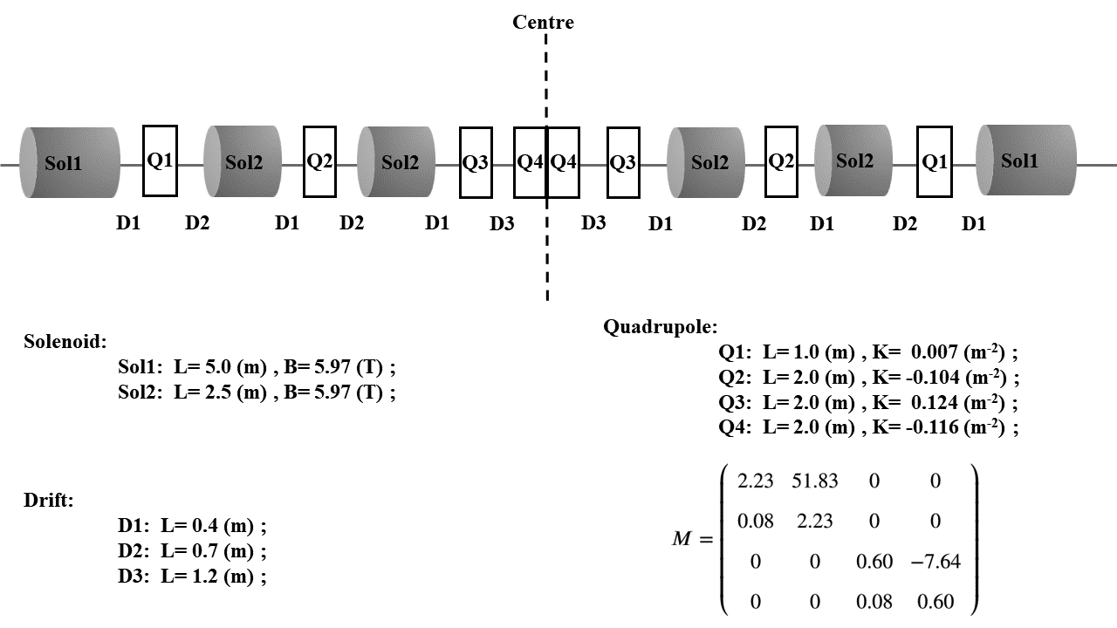
Spin rotators in the collider ring @ Z-pole
Solenoid-based spin rotators
  interleaved solenoid + quads [1] to cancel coupling effects
Anti-symmetric insertion just outside interaction region [2,3,4]
Influence[4]
  Increase of circumference ~ 2.8 km, can be optimized
  DA shrinks but still sufficient, can be further optimized
  Depolarization is relatively weak near 45.6 GeV, confirmed by simulations
    Cancellation of energy dependence with the anti-symmetric design
[1] D. Barber, et al., A solenoid spin rotator for large electron storage rings. Part. Accel. 17 (1985) 243.
[2] I. Koop, Longitudinally polarized electron in SuperB, eeFACT’08
[3] S. Nikitin, IJMPA 34, 1940004 (2019), IJMPA 45, 2041001 (2020).
[4] . W. Xia, Z. Duan, J. Gao and Y. W. Wang, RDTM (2022) doi: 10.1007/s41605-022-00344-2

Slide 16
Summary
For polarized beam applications at CEPC, we’ve studied the possibility of generating polarized beams from the source and injecting into the collider rings. Some key issues have been addressed
  Beam polarization can be mostly preserved in the booster up to 45.6 GeV and 80 GeV.
  Polarized e+ beam can be generated in the e+ damping/polarizing ring, for RD measurements.
  Spin rotators have been implemented into the collider rings @Z-pole, with promising performance.
Mechanisms of radiative depolarization effect still require further investigation.

Slide 17
Thank you for your attention!

Slide 18
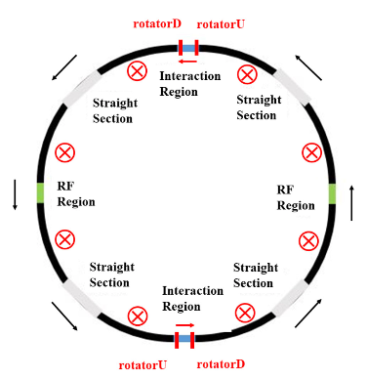
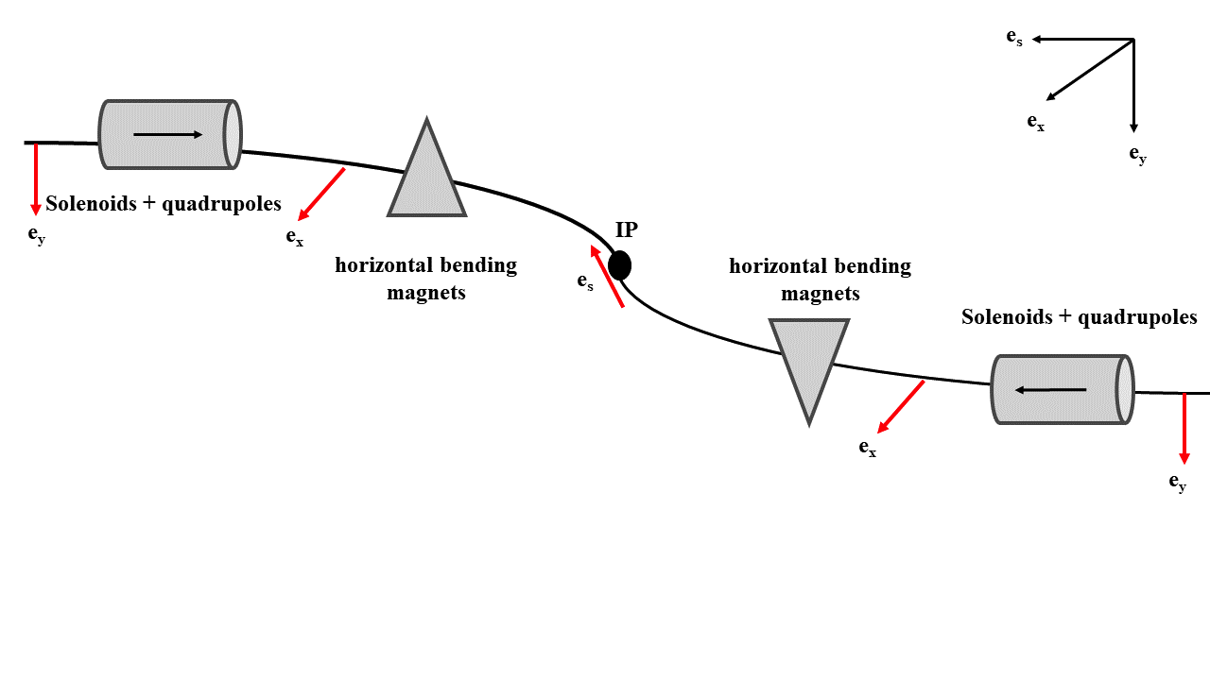
Spin rotators @ Z-pole for LP
Solenoid-based spin rotator + anti-symmetric arrangement [1,2,3] (W. Xia et al., RDTM (2022) doi: 10.1007/s41605-022-00344-2 )
  Successfully implemented in the collider ring lattice
  Now focus on Z-pole, extendable to cover higher beam energies using interleaved solenoid+dipole scheme [4]
[1] D. Barber, et al., A solenoid spin rotator for large electron storage rings. Part. Accel. 17 (1985) 243.
[2] I. Koop, Longitudinally polarized electron in SuperB, eeFACT’08
[3] M. Biagini et al., Super-B lattice studies, IPAC 2010, TUPEB004.
[4] P. Chevtsov et al., Universal synchronous spin rotators for Electron-Ion Colliders, arXiv:1606.02419.

Slide 19
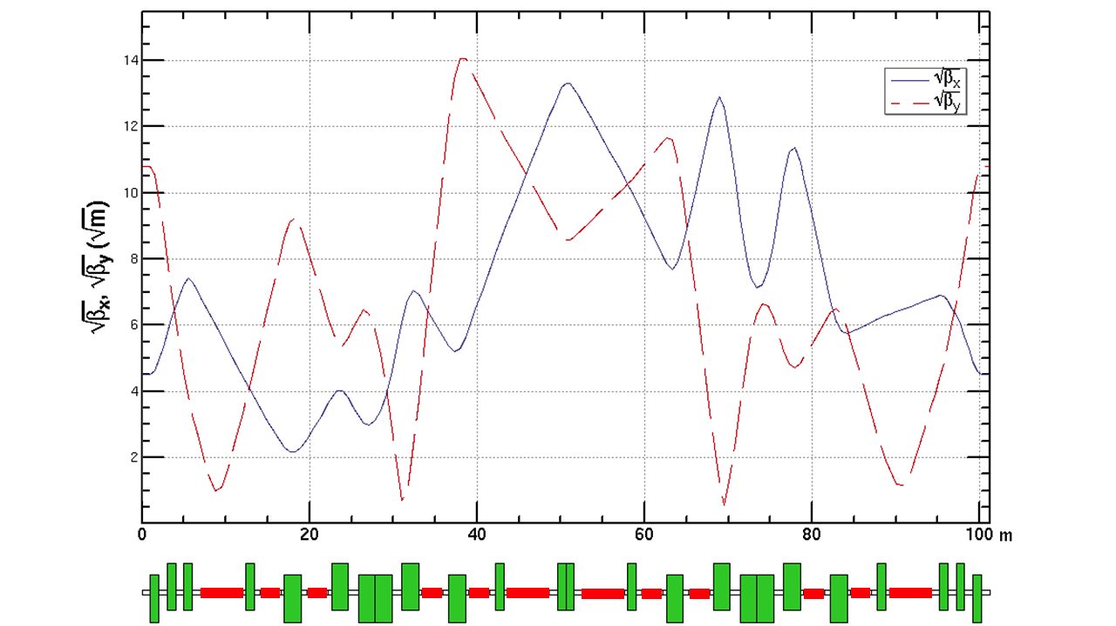
Spin rotators @ Z-pole for LP
Solenoid-based spin rotators
  Integral solenoid field strength = 240 T m @ 45.6 GeV
  Utilize the solenoid decoupling model developed for HERA [1]
  Each solenoid section contains two modules (~100 m total length)
[1] D. Barber, et al., A solenoid spin rotator for large electron storage rings. Part. Accel. 17 (1985) 243.
Optics matching
Optics matching

Slide 20
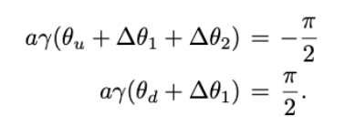
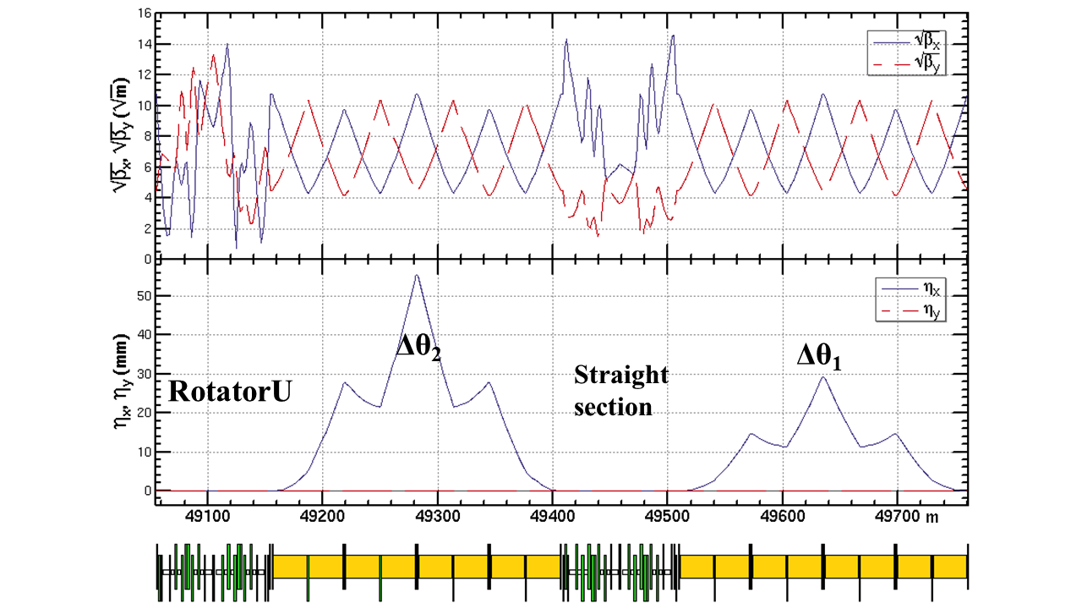
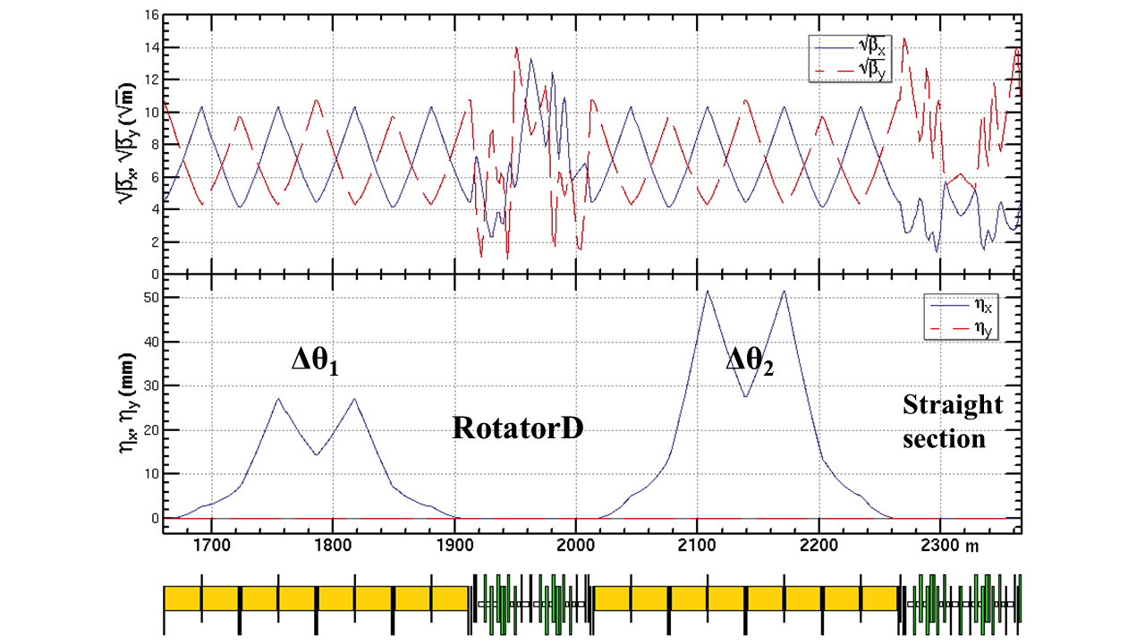
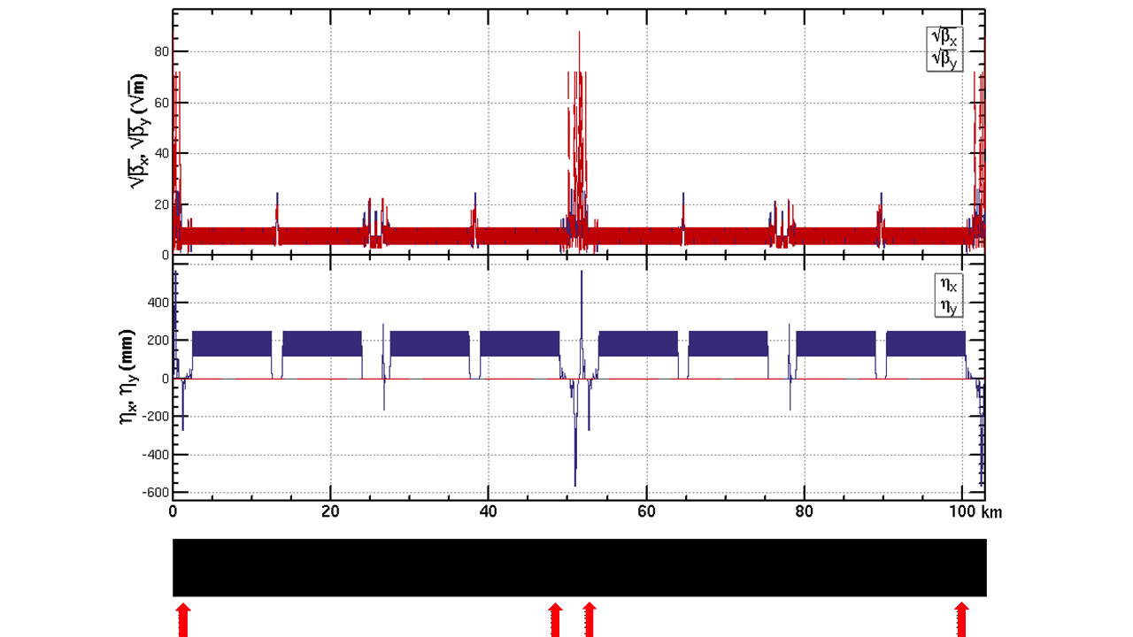
Spin rotators @ Z-pole for LP
Anti-symmetric arrangement [1,2,3]
  θ_{c}=2*16.5 mrad, rather than the ideal value 2*15.17 mrad
  Angle compensation sections Δθ₁(1.39mrad) and Δθ₂(2.65mrad)
  Straight sections (SS) w/o solenoids
[1] I. Koop, Ideas for longitudinal polarization at the Z/W/H/top factory, eeFACT 2018.
[2] S. Nikitin, Opportunities to obtain polarization at CEPC, IJMPA, 34, 194004 (2019)
[3] S. Nikitin, Polarization issues in circular electron-positron super-colliders, IJMPA, 35 (2020).

Slide 21
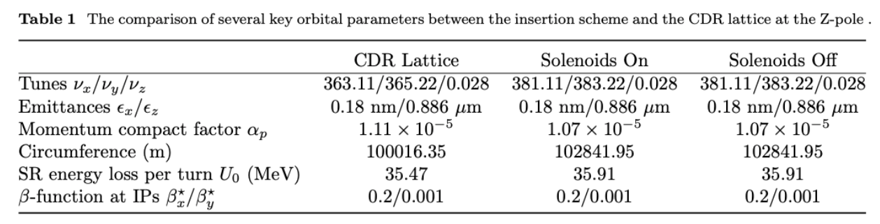
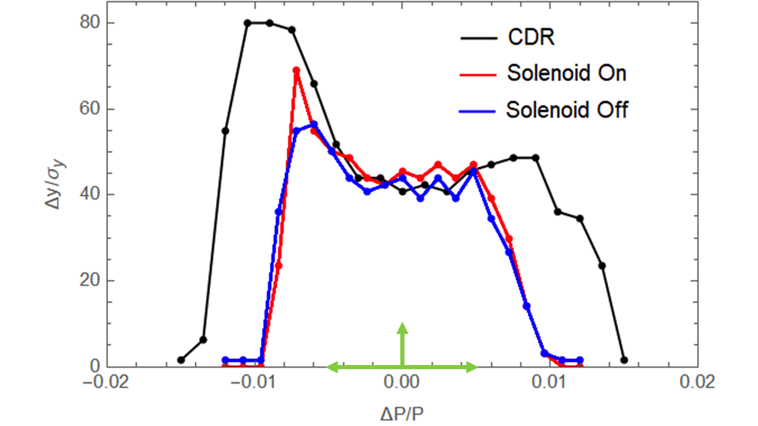
Orbital motion performance for LP
Changes in optics parameters
  Increase of circumference ~ 2.8 km, can be optimized.
  Increase of integer betatron tunes by 18 units
Dynamic aperture shrinks a bit, but further optimization using more sextupole families could help recover.

Slide 22
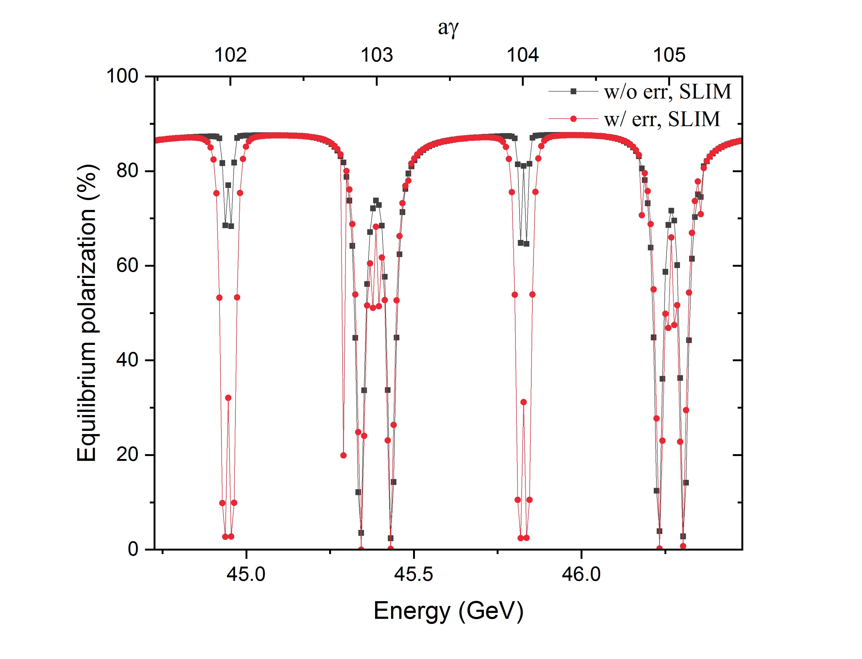
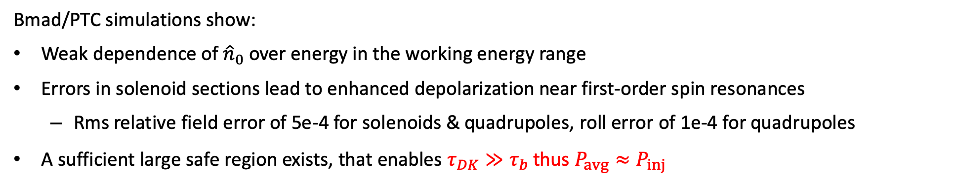
Polarization performance for LP
Bmad/PTC simulations show:
Weak dependence of ${\hat{n}}_{0}$ over energy in the working energy range
Errors in solenoid sections lead to enhanced depolarization near first-order spin resonances
  Rms relative field error of 5e-4 for solenoids & quadrupoles, roll error of 1e-4 for quadrupoles
A sufficient large safe region exists, that enables $τ_{DK}≫τ_{b}$thus $P_{avg}≈P_{inj}$

Slide 23
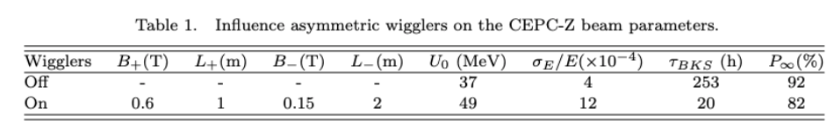
Operation scenario @ Z-pole
1. Inject 144 unpolarized non-colliding e+ and e- bunches
Turn-on asym. wigglers to boost self-polarization
Turn-off asym. wigglers
3. Resonant depolarization measurements
4. After each RD, the corresponding non-colliding bunch is refilled
e- non-colliding bunches
2.6 hours
12.5min
Time of operation
e+ non-colliding bunches
2. Inject ~ 12000 unpolarized e- and e+ bunches
  Start colliding beam experiments
Polarization(%)
144 bunch * 12.5 min/bunch = 30 hours
10
30
2.6
Time(hour)

Slide 24
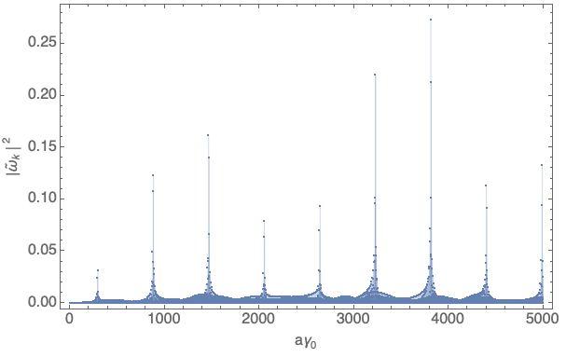
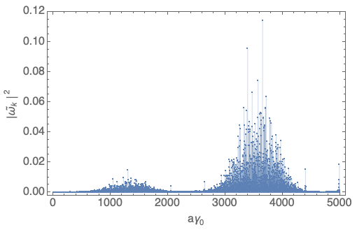
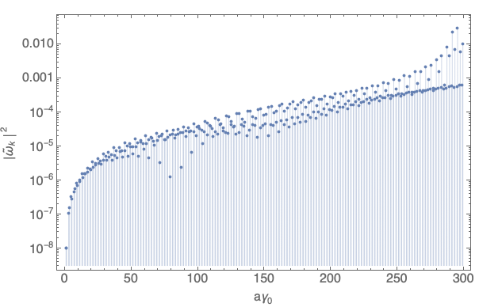
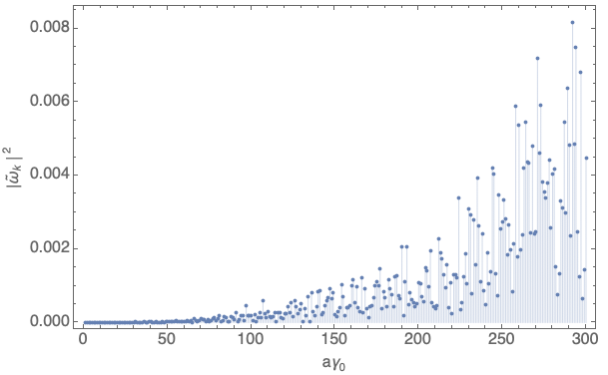
CEPC collider ring
Intrinsic resonance spectrum
Imperfection resonance spectrum

Slide 25



Polarized e+ beam generation for RD
e+ damping/polarizing ring w/ 3-pole asymmetric wigglers could deliver > 20% polarization in 10 min
  Sufficient for resonant depolarization
  Wiggler parameters are moderate, lattice design ongoing
~20 ms store, extracted e+ bunches are unpolarized
~11 min interval in top-up operation
Timing of e+ damping ring
~10 min store, extracted e+ bunches
become polarized
Parameter |  | Value
Beam energy, aγ₀ |  | 1.542 GeV, 3.5
Circumference |  | 145m
Asymmetric wiggler | B+ / B- | 1.8 T / 0.36 T
 | Total length | 24 m
$P_{∞}$ in the presence of wigglers |  | 90%
Polarization build-up time $τ_{BKS}$ | w/o wigglers | 52 min
 | w/ wigglers | 34 min
Storage time |  | 10 min
Polarization of extracted beam |  | 22%
H. Wiedemann, Particle accelerator physics, 4th edition.
Designed by Wang Dou
Asymmetric wigglers

Slide 26



Beam polarization in the collider rings
Decay mode (pilot bunch)
  $P\left(t\right)=P_{DK}\left(1−e^{−t/τ_{DK}}\right)+{P_{inj}e}^{−t/τ_{DK}}$,
    $\frac{1}{τ_{DK}}=\frac{1}{τ_{BKS}}+\frac{1}{τ_{dep}}$ , $P_{DK}≈\frac{P_{∞}}{1+τ_{BKS}/τ_{dep}}$
Top-up injection (colliding bunch)
  $P_{avg}≈\frac{P_{DK}}{{1+τ}_{DK}/τ_{b}}+\frac{P_{inj}}{{1+τ}_{b}/τ_{DK}}$
    If $τ_{DK}≫τ_{b}$, then $P_{avg}≈P_{inj}$
Bunch charge
Polarization
time
CEPC CDR parameters | 45.6 GeV (Z, 2T) | 80 GeV (W) | 120 GeV (Higgs)
Polarization build-up time w/o radiative depolarization $τ_{BKS}$ (hour) | 256 | 15.2 | 2.0
Beam lifetime $τ_{b}$ (hour) | 2.5 | 1.4 | 0.43
$P_{DK}$ required to realize $P_{avg}≥50\%$ in top-up mode, if $P_{inj}=80\%$ | 0.6% | 5% | 11%
Asymmetric wigglers to boost the self-polarization @Z for RD measurements in FCC-ee

Slide 27



CEPC booster – intrinsic resonance
Resonance strength
Enhancement factor
One FODO
when x = integer , $ζ_{N}\left(x\right)=N$
Super strong resonances

Slide 28



CEPC booster – imperfection resonance
Resonance strength
One FODO
Super strong resonances
When both the following conditions are nearly met

Slide 29


Alternative design of positron damping ring
B₋
B₊
B₋
By Wang Dou
DR V4.0 | unpolarized e+ | polarized e+
Energy (Gev) | 1.542
Circumference (m) | 144.2
Number of trains | 2(4)
Number of bunches/trian | 1(2)
Total current (mA) | 12.4
Bending radius (m) | 3.44
Dipole strength B₀ (T) | 1.07
Wiggler strength B₊ (T) | 1.8
Wiggler cell length (m) | 1.5
U₀ (kev/turn) | 190.9
Damping time x/y/z (ms) | 7.77/7.77/3.89
Momentum compaction | 0.015
Storage time | 20 ms | 10 min
δ₀ (%) | 0.072
ε₀ (mm.mrad) | 138
injection σ_{z} (mm) | 6
Extract σ_{z} (mm) | 5.7 | 5.6
ε_{inj} (mm.mrad) | 2500
ε_{ext x/y} (mm.mrad) | 151/15 | 138/14
δ_{inj} /δ_{ext} (%) | 0.18 /0.072
RF acceptance (%) | 1.8
f_{RF} (MHz) | 650
V_{RF} (MV) | 3.95
Longitudinal tune | 0.044
Asymmetric wigglers
B₊=1.8T=-5 B₋
cell length=1.5m
16 such cells
+1(2)

Slide 30


Beam polarization performance of an imperfect lattice
 | Misalignment Δx/Δy (μm) | Roll error (rad) | Relative field error
Quads, Sextupoles | 150/150 | 2e-4 | 3e-4
Bend | None | 2e-4 | 3e-4
BPM offset: 50μm rms,
Residual closed orbit distortion: H: 0.15 mm/V: 0.27 mm rms
w/o wigglers, P_{DK} ~52 min
w/ wigglers, P_{DK} = 90.6% , P_{DK} = 38.5min
After 10 min store, the beam polarization of extracted bunch can reach 20.7%
Stronger wigglers -> higher polarization
$$P_{DK}≈\frac{P_{∞}}{1+τ_{BKS}/τ_{dep}}$$
$$\frac{1}{τ_{DK}}=\frac{1}{τ_{BKS}}+\frac{1}{τ_{dep}}$$

Slide 31

Orbital motion performance
By Wang Dou
DA
LMA & Touschek lifetime of imperfect lattice
  LMA limited by RF bucket height = 1.8%
  Touschek lifetime = 50 min @ bunch population = 4e10
Bare lattice
Imperfect lattice

Slide 32

General lattice structure of CEPC booster & collider rings
Arc region covers ~ 80% of circumference in both rings

Slide 33

快速穿越
显著退极化
绝热穿越

