Slide 1
Preliminary peak finding results with derivative method for beam test data
Shuaiyi Liu, Yaxin Shen, Guang Zhao, Siman Liu, Linghui Wu, Mingyi Dong

Slide 2
Data sets
The using data sets are from the result of the beam test at CERN SPS, July 2022.
Data of run 10, 11, 41, 44, 45, 46, 47, 49 are used in the slides
Data of run 10, 11, 47, 49 with gas mixture 90/10, 4 runs in same HV and momentum, each run is in different angle
Data of run 41, 44, 45, 46 with gas mixture 80/20, 4 runs in same HV and momentum, each run is in different angle
Gas 80/20 | Run | ch | angle
 | 41 | 4 | 45
 | 44 | 4 | 0
 | 45 | 4 | 30
 | 46 | 4 | 60
Gas 90/10 | Run | ch | angle
 | 10 | 4 | 45
 | 11 | 4 | 0
 | 47 | 4 | 60
 | 49 | 4 | 30
All 8 runs’ sampling rate are 2G

Slide 3
Peak finding algorithm
Low pass filter
Filter out high frequency noises in the waveforms to improve the S/N ratio
Moving average(MA) filter: $y\left[i\right]= \frac{1}{MA}\sum_{j=0}^{MA−1}{x[i+j]}$ .
When MA=1, $y\left[i\right]=x[i]$, which means no filter.
Derivative
First derivative(D1): D1[i] = y[i] – y[i-G]
Second derivative (D2): D2[i] = D1[i] – D1[i-G]
Parameter
Derivative: D2 threshold for hit detection(Th)
Filter: Moving average steps(MA)

Slide 4
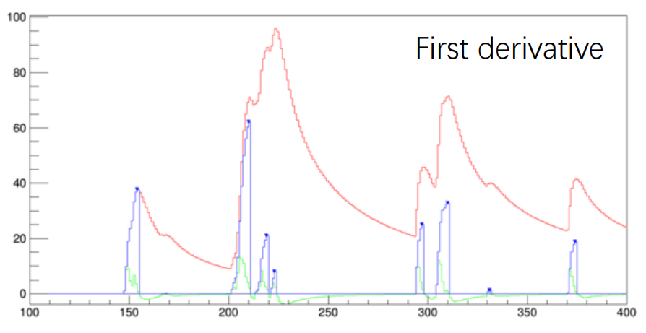
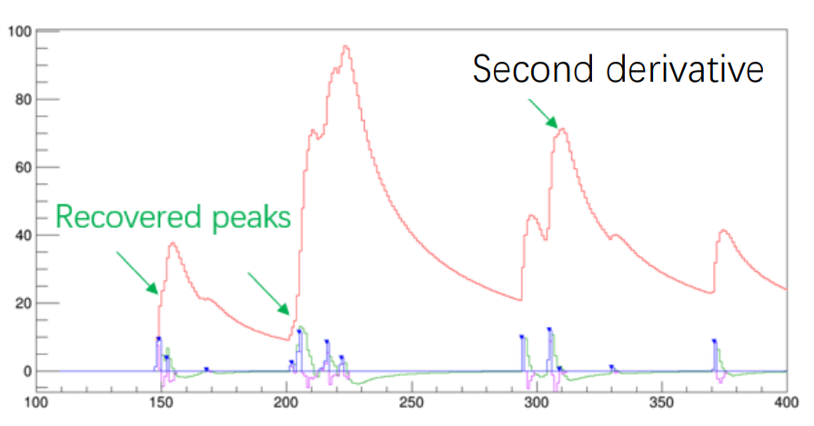
Peak finding algorithm
Use second derivative instead of first derivative
For first derivative, pile-up on the falling edge is easier to recover, but it is not easy on the rising edge.

Slide 5
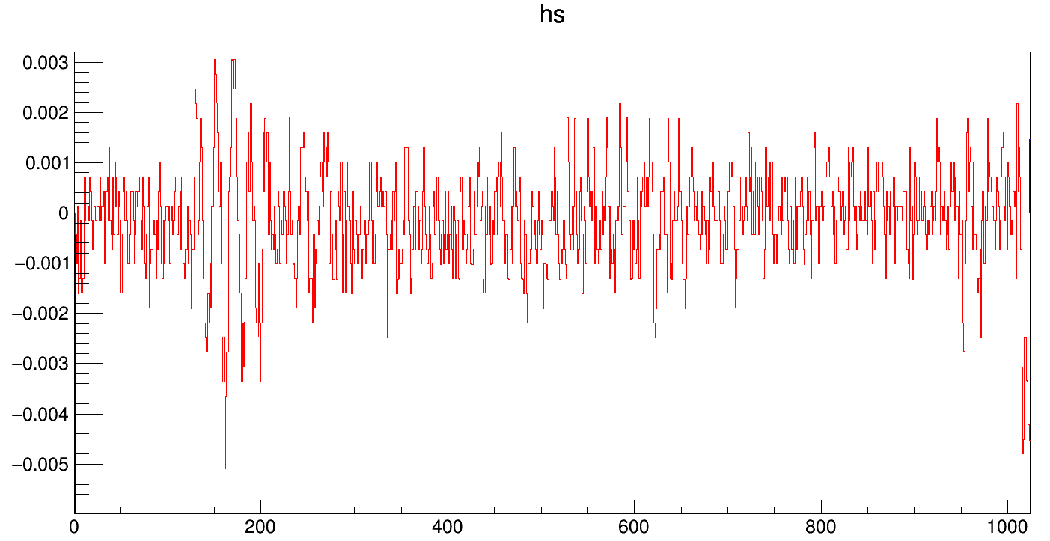
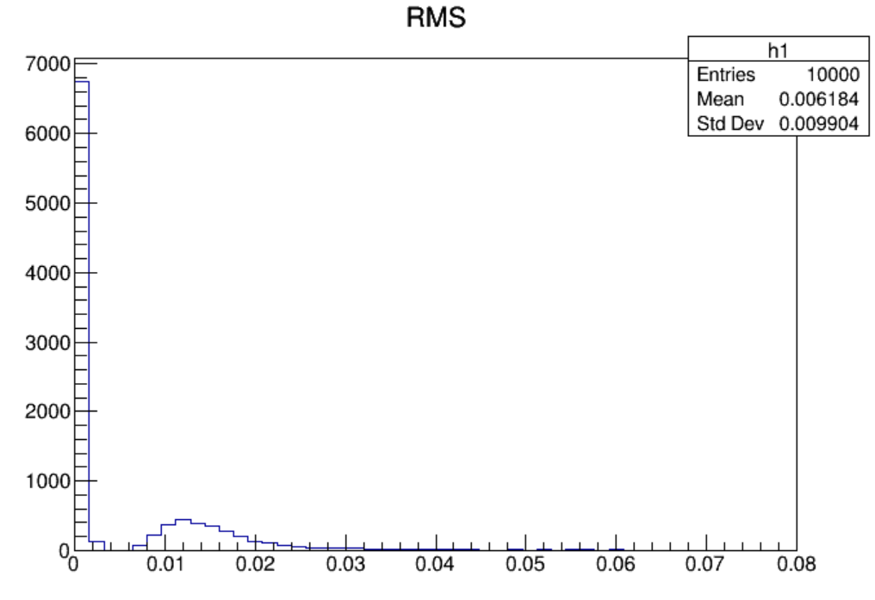
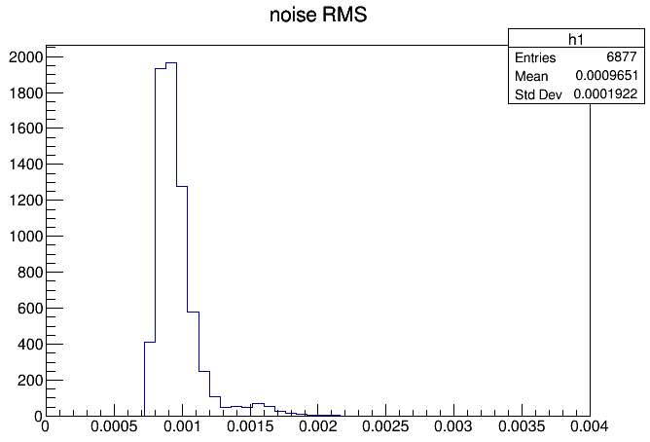
Peak finding algorithm: amplitude cut
In the RMS distribution, take the low RMS events as noises
Using 0.004 (4 times noises RMS mean value) as an amplitude cut
One noise example waveform

Slide 6
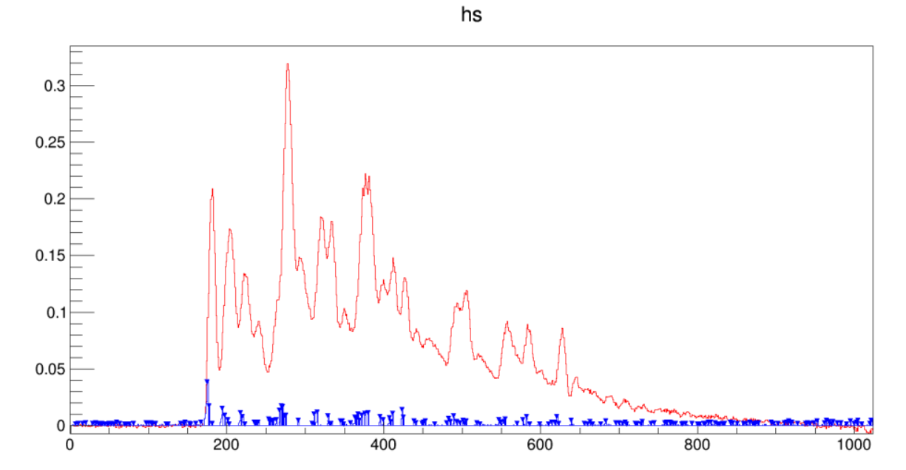
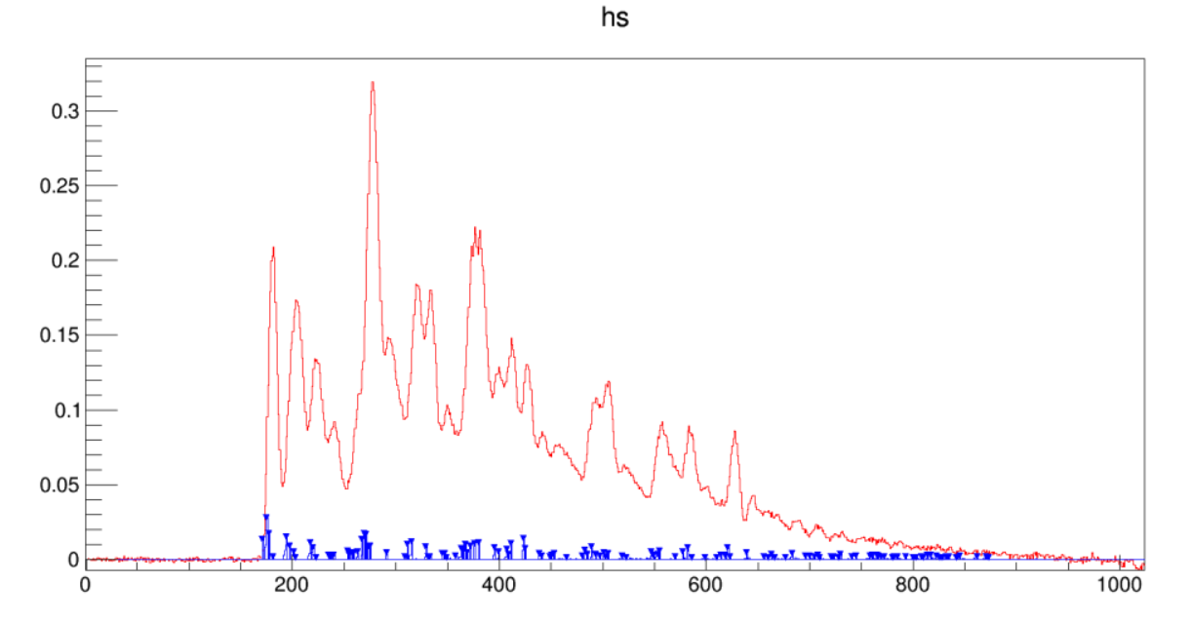
Peak finding algorithm: amplitude cut
The aera where amplitude lower than 0.004 will not be used in peak finding
Without cut
With cut
The example waveform in peak finding with and without the amplitude cut

Slide 7
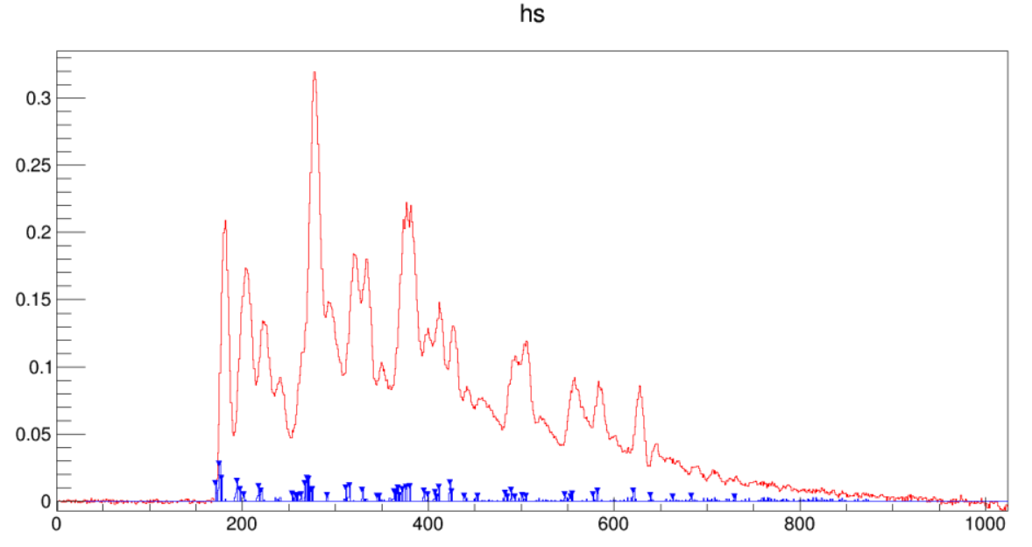
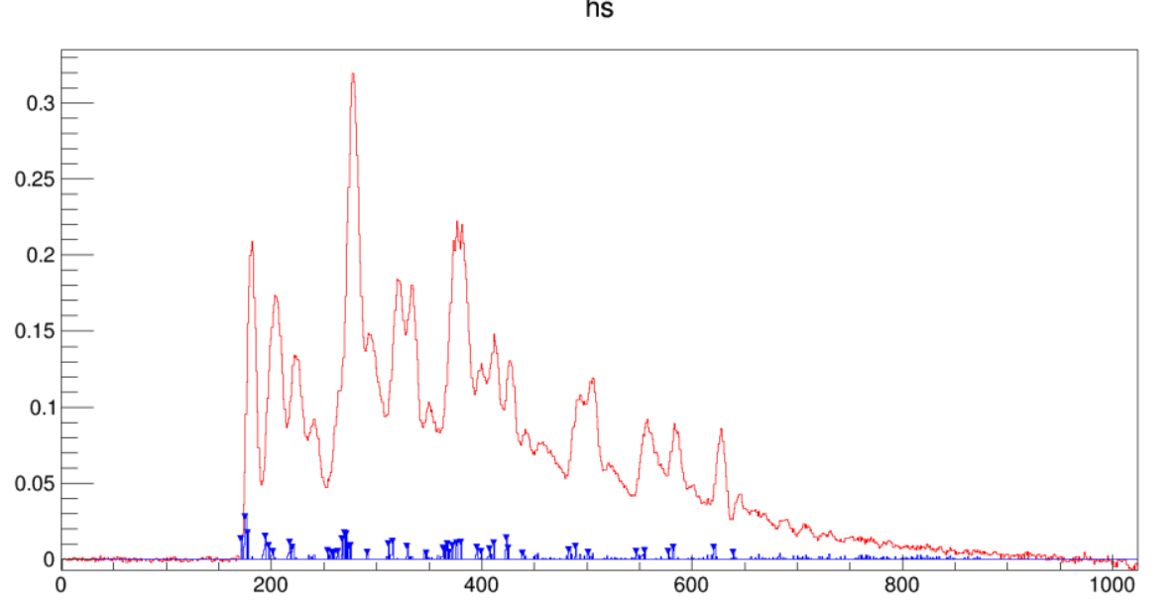
Scan Threshold (keep MA=1, means no MA)
When threshold is larger than 0.003, there are too many peaks not found, so we only use threshold smaller than 0.003 later.
Threshold | ncount
0.001 | 124
0.002 | 78
0.003 | 55
0.004 | 45
0.005 | 35
0.006 | 29
0.007 | 27
0.008 | 21
Th=0.003
Th=0.004

Slide 8
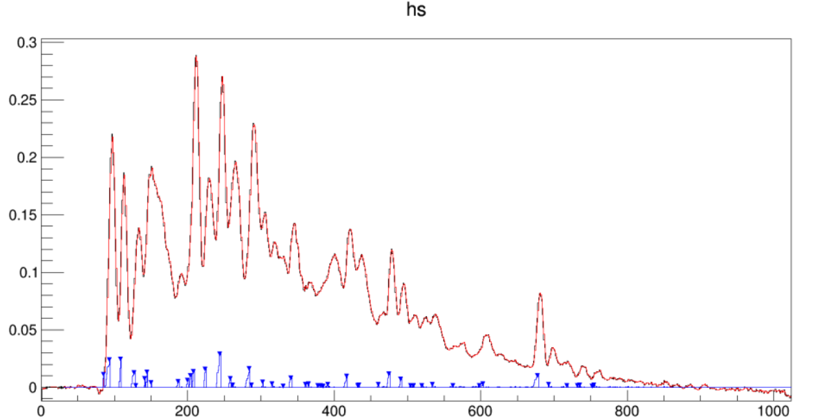
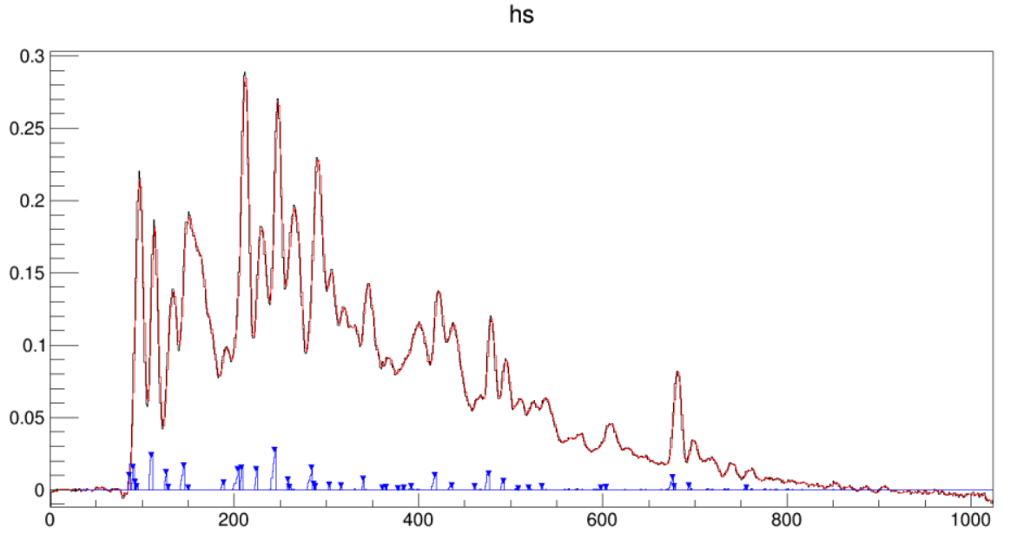
Scan MA: MA effect in a waveform example Th=0.001, MA =1~3
MA=2
Th=0.001
MA=1
MA=3
MA=1 means without filter

Slide 9
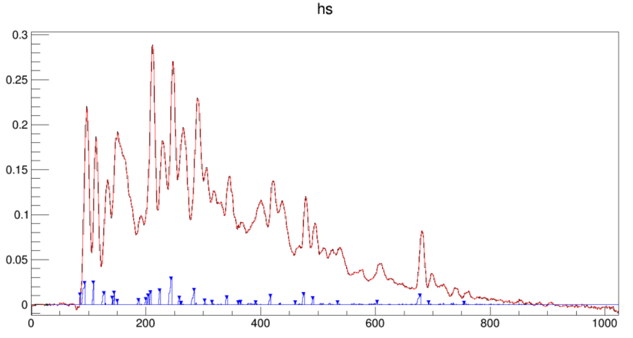
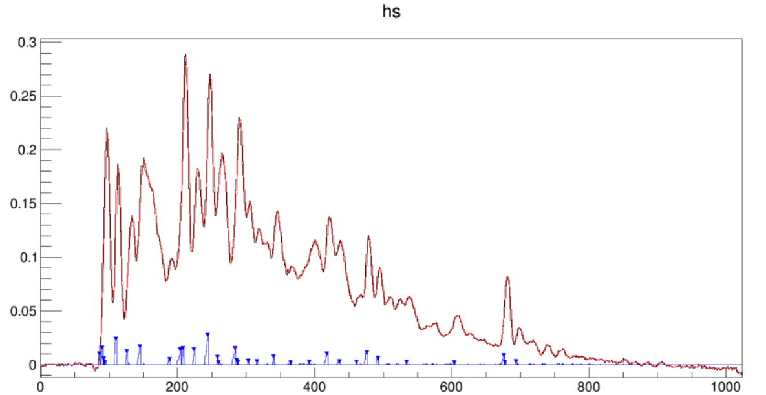
Scan MA: MA effect in a waveform example Th=0.002, MA =1~3
MA=2
Th=0.002
MA=1
MA=3

Slide 10
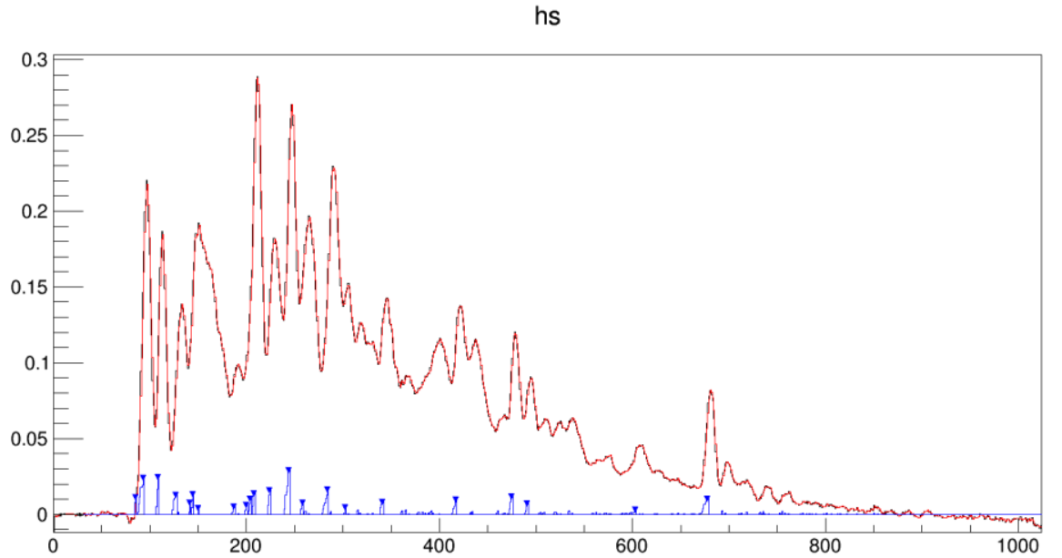
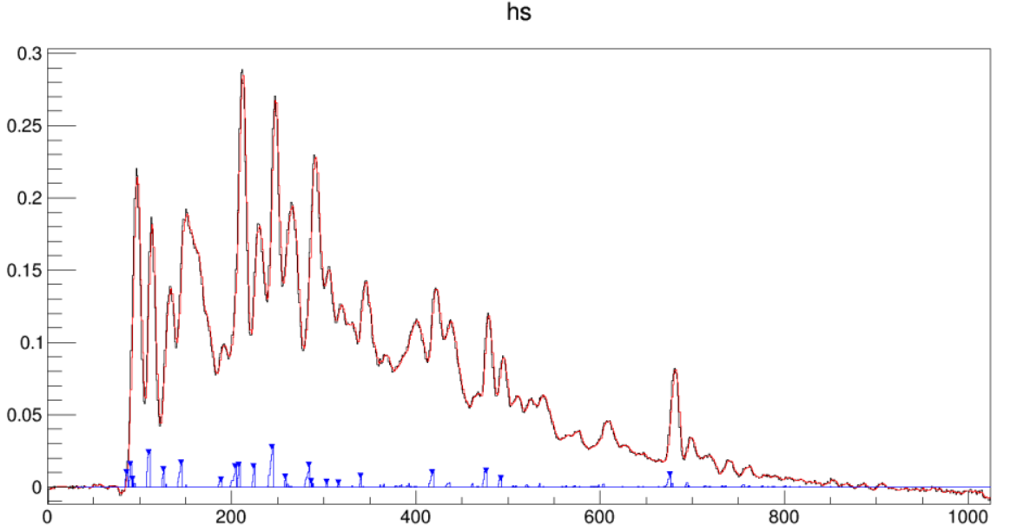
Scan MA: MA effect in a waveform example Th=0.003, MA =1~3
MA=2
Th=0.003
MA=1
MA=3

Slide 11
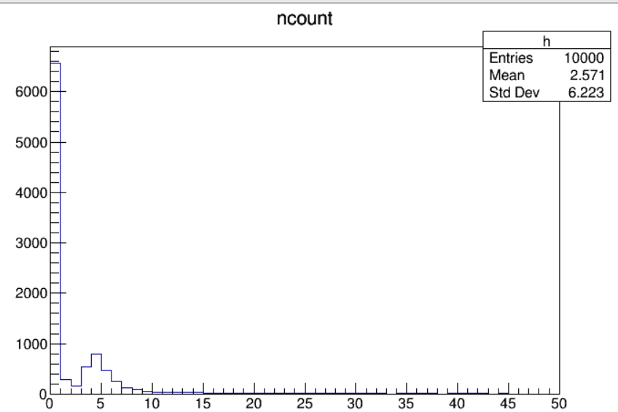
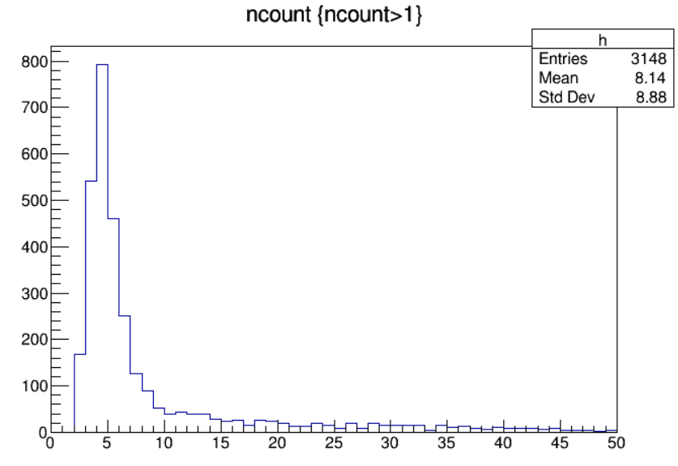
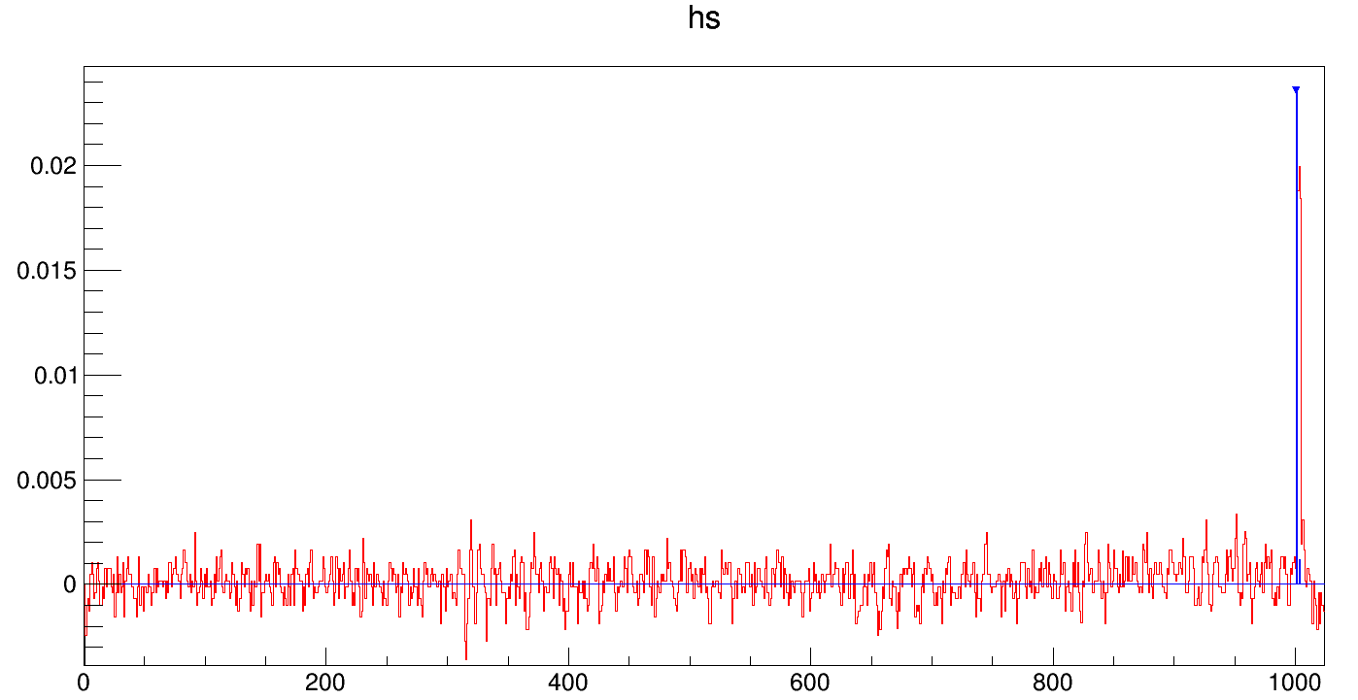
Ncount in one channel’s data
Run44 ch4
Too many noises involved
Apply the cut ncount>1 to select out the noise events.
Noise event examples
Checked one channel’s waveforms with ncount<=1 by eyes, almost noises(>99%)

Slide 12
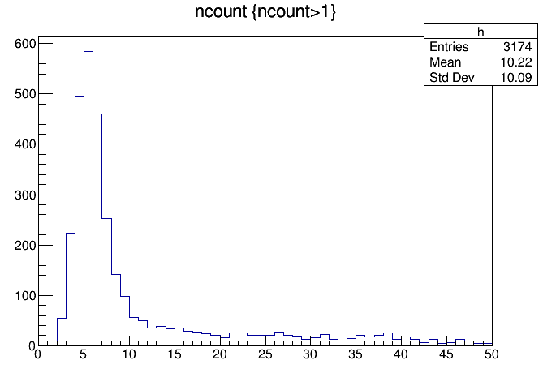
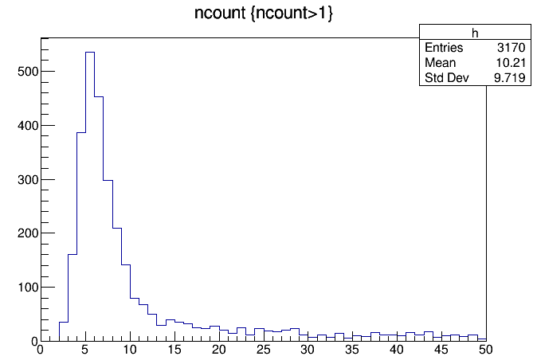
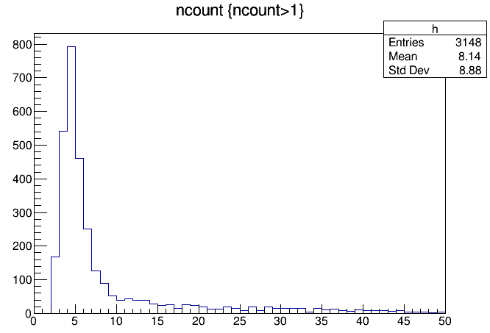
Peak finding with different Th and MA
Run44 ch4
gas:80/20 δ=18 size = 1cm α=0
Run44 ch4 ncount mean value
Th\MA | 1 | 2 | 3
0.001 | 19.77 | 10.78 | 8.50
0.002 | 12.44 | 6.59 | 5.76
0.003 | 8.71 | 5.10 | 4.79
Th=0.001,MA=2
Th=0.001,MA=1
Th=0.002,MA=1
Th=0.003,MA=1

Slide 13
Expected number of electron peaks
Get from Brunella’s talk at Feb18 2022
Run44 ch4 ncount mean value
Th\MA | 1 | 2 | 3
0.001 | 19.77 | 10.78 | 8.50
0.002 | 12.44 | 6.59 | 5.76
0.003 | 8.71 | 5.10 | 4.79
gas:80/20 δ=18 size=1cm α=0
Npeak(Expected)=18*0.8*1.3*1.6*1=29.952
The group with Th=0.001 and MA=1 is closest to the expected number

Slide 14
Compare count numbers in different gas mixture and angle
For gas 80/20:
Run 41,44,45,46
same HV and momentum
different angles(0, 30, 45, 60).
For gas 90/10:
Run10,11,47,49
same HV and momentum
different angles(0, 30, 45, 60).
Gas 80/20 | Run | ch | angle
 | 41 | 4 | 45
 | 44 | 4 | 0
 | 45 | 4 | 30
 | 46 | 4 | 60
Gas 90/10 | Run | ch | angle
 | 10 | 4 | 45
 | 11 | 4 | 0
 | 47 | 4 | 60
 | 49 | 4 | 30

Slide 15
Comparison between different angles
Run 41,44,45,46 ch4 (gas 80/20, 1cm, same HV & momentum, different angle)
MA=1
Th\Angles | 0 | 30 | 45 | 60
0.001 | 19.77 | 34.64 | 47.67 | 55.90
0.002 | 12.44 | 20.47 | 28.27 | 35.60
0.003 | 8.71 | 13.27 | 18.46 | 25.03
MA=2
Th\Angles | 0 | 30 | 45 | 60
0.001 | 10.78 | 18.72 | 25.24 | 29.80
0.002 | 6.59 | 10.46 | 14.12 | 18.21
0.003 | 5.10 | 7.09 | 9.59 | 13.17
MA=3
Th\Angles | 0 | 30 | 45 | 60
0.001 | 8.50 | 13.95 | 18.61 | 22.90
0.002 | 5.76 | 8.50 | 11.32 | 15.10
0.003 | 4.79 | 6.14 | 8.20 | 11.44
Dataset Gas 80/20 | Run | ch | angle | Expected number
 | 44 | 4 | 0 | 29.95
 | 45 | 4 | 30 | 34.59
 | 41 | 4 | 45 | 42.36
 | 46 | 4 | 60 | 59.90
MA Th , Ncount
Angle , Ncount

Slide 16
Comparison between different angle
Run 10,11,47,49 ch4 (gas 90/10, 1cm, same HV & momentum, different angle)
MA=1
Th\Angles | 0 | 30 | 45 | 60
0.001 | 36.71 | 48.74 | 60.04 | 63.25
0.002 | 15.33 | 20.60 | 26.48 | 30.64
0.003 | 8.27 | 10.95 | 13.12 | 17.29
MA=2
Th\Angles | 0 | 30 | 45 | 60
0.001 | 14.64 | 20.03 | 24.98 | 27.78
0.002 | 5.37 | 7.44 | 8.54 | 11.56
0.003 | 3.56 | 4.64 | 4.80 | 6.93
MA=3
Th\Angles | 0 | 30 | 45 | 60
0.001 | 8.93 | 12.49 | 15.10 | 19.00
0.002 | 4.69 | 6.29 | 6.74 | 9.79
0.003 | 3.38 | 4.39 | 4.38 | 6.46
Dataset Gas 90/10 | Run | ch | angle | Expected number
 | 11 | 4 | 0 | 19.97
 | 49 | 4 | 30 | 23.06
 | 10 | 4 | 45 | 28.24
 | 47 | 4 | 60 | 39.94
Count number in gas 90/10 group is larger than gas 80/20 group
But not the case in the expected number

Slide 17
Summary and outlook
Apply peak finding algorithm with derivative method to beam test data analysis
Scaning threshold and MA shows:
For gas 80/20 group, Th=0.001 & MA=1 has closest number with expected
For gas 90/10 group, Th=0.002 & MA=1 has closest number with expected
Number of found peaks increase with larger angle
To optimize the derivative algorithm
To apply the ML algorithm (currently tuning MC simulation based on data)

Slide 18
Backup

Slide 21
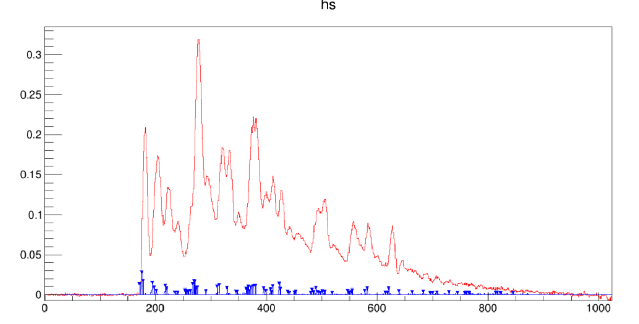
Threshold test (Run44 ch4 80/20gas 1cm)
Th=0.001
Th=0.002
Th=0.003
Th=0.004

Slide 22
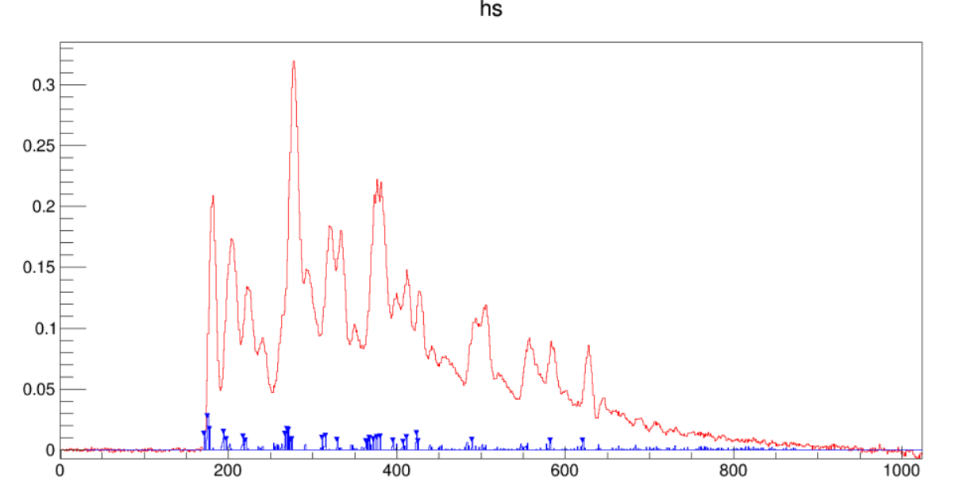
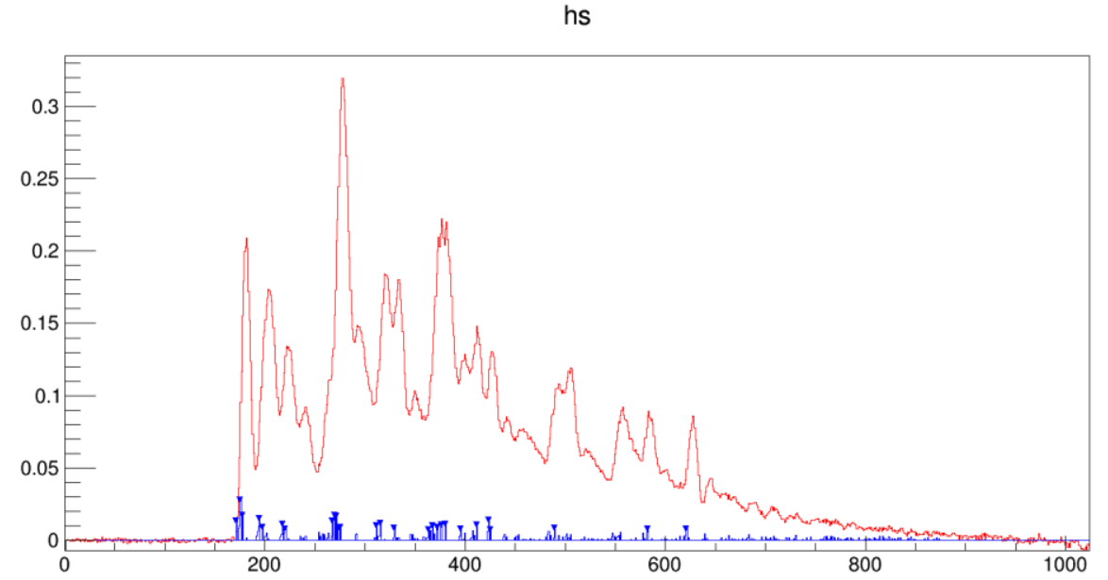
Threshold test (Run44 ch4 80/20gas 1cm)
Th=0.005
Th=0.006
Th=0.007
Th=0.008

Slide 23
Run41 ch4 waveform Th0.001~0.003&MA1~3

Slide 24
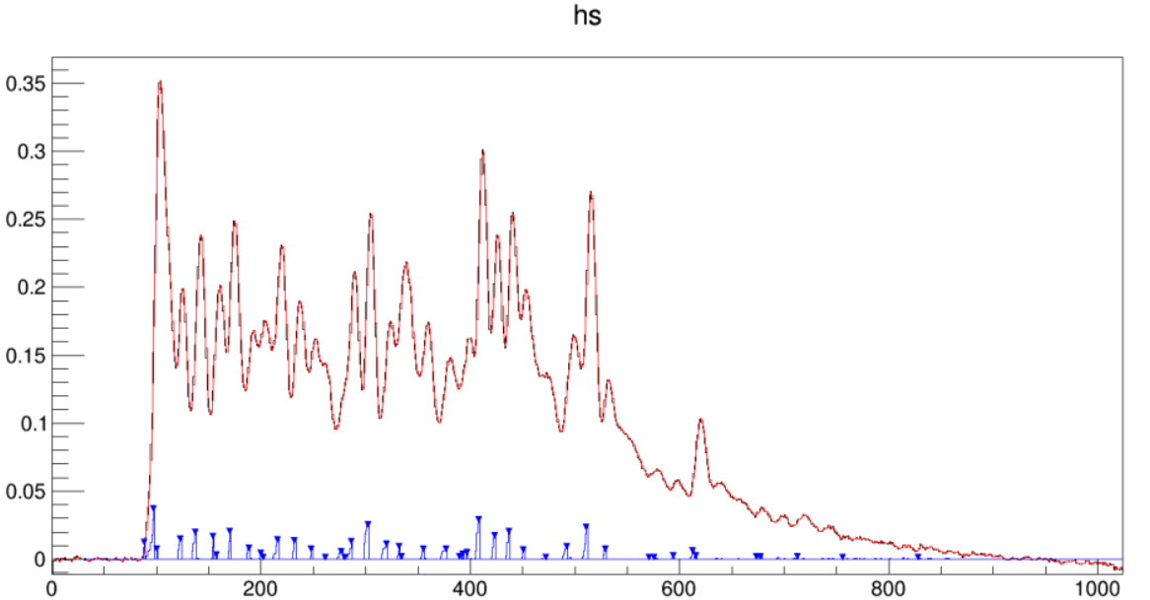

Slide 25
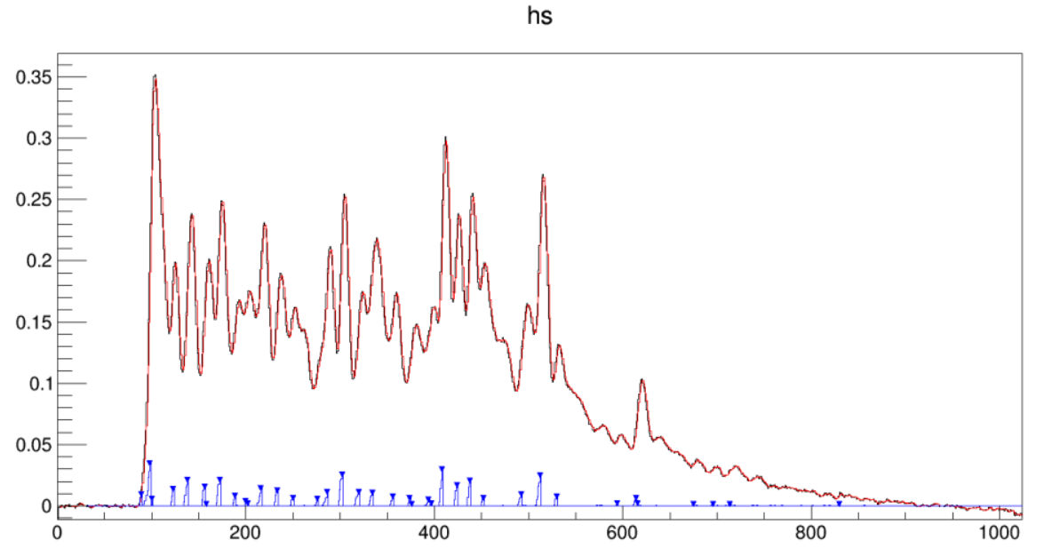

Slide 26
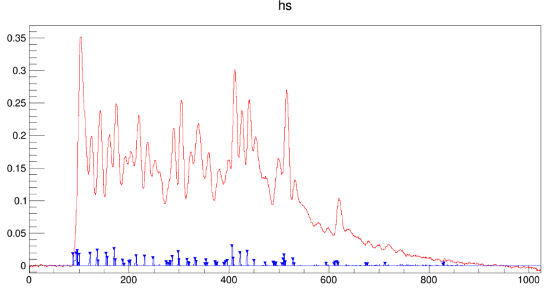

Slide 27
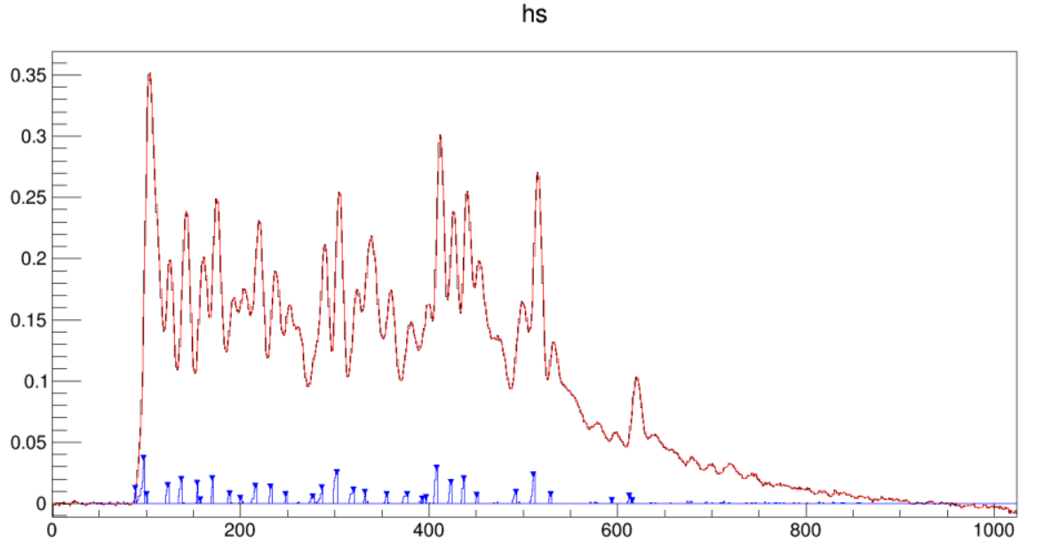

Slide 28
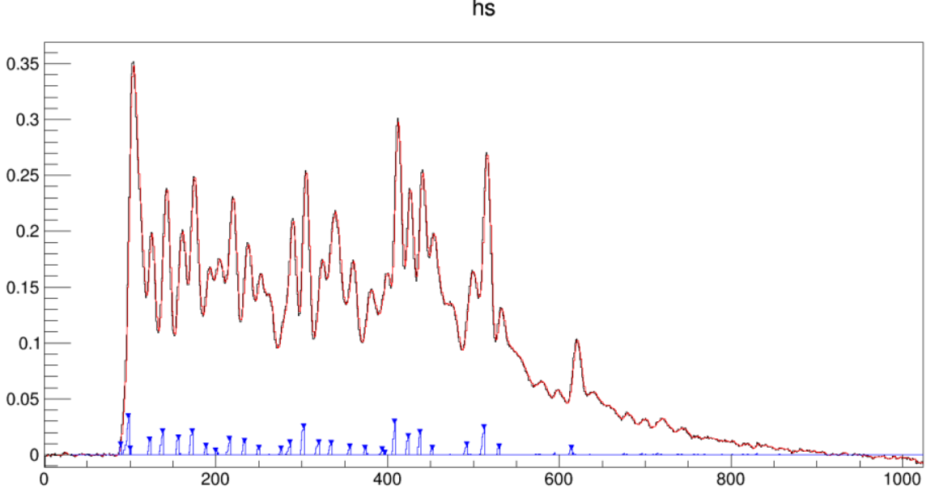

Slide 29
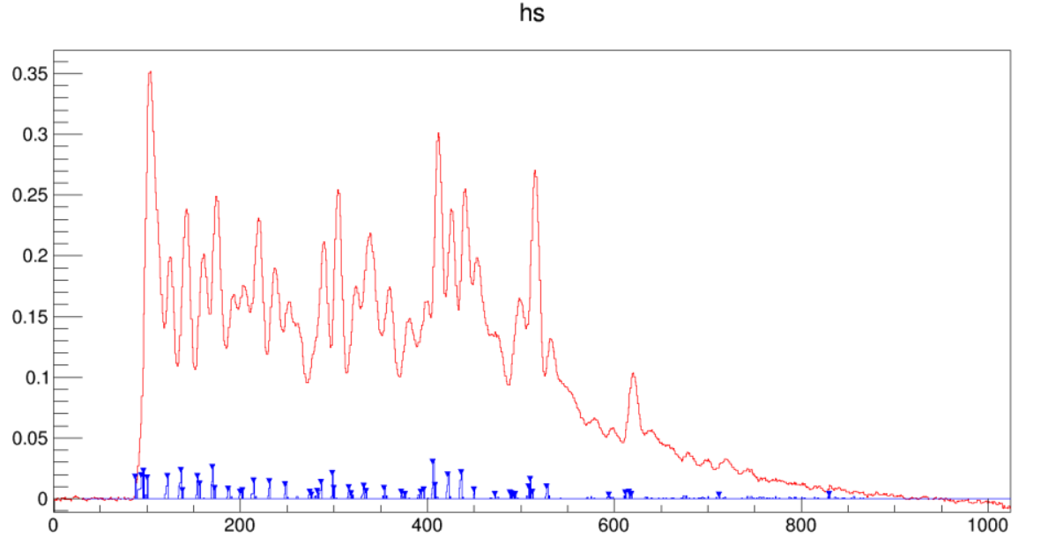

Slide 31
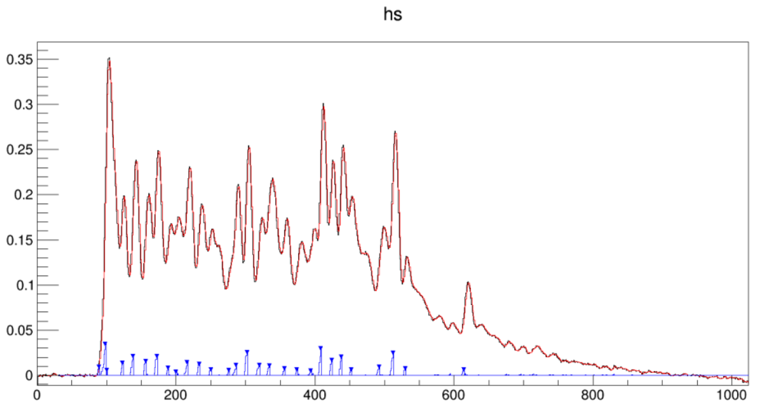

Slide 32
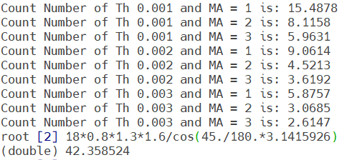
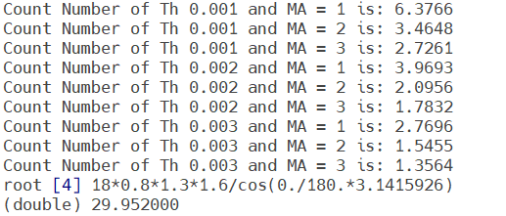
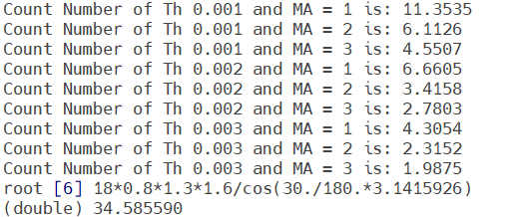
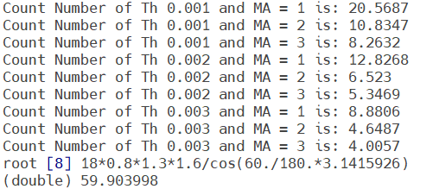
4 Runs counting numbers compare
Run 41,44,45,46 ch4 (gas 80/20, 1cm, same HV & momentum, different angle)
The showed number is the mean value of number of found peaks
Run 41 ch4 45°
Run 44 ch4 0°
Run 45 ch4 30°
Run 46 ch4 60°

Slide 33
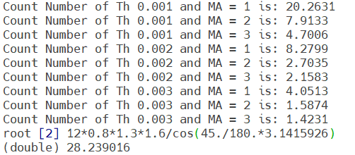
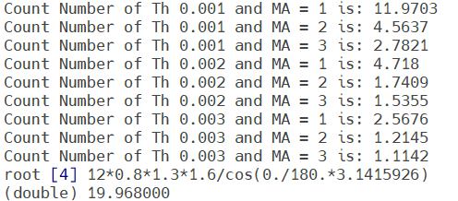
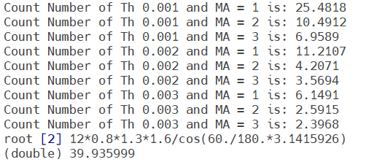
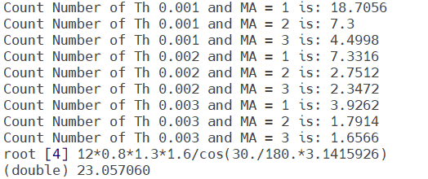
4 Runs counting numbers compare
Run 10,11,47,49 ch4 (gas 90/10, 1cm, same HV & momentum, different angle)
Run 10 ch4 45°
Run 11 ch4 0°
Run 47 ch4 60°
Run 49 ch4 30°

Slide 34
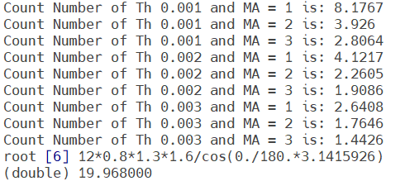
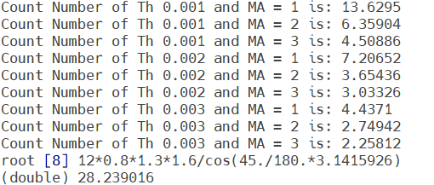
4 Runs counting numbers compare
Run 47,49,52,53 ch4 (gas 90/10, 1cm, same HV & momentum, different angle) 0° & 45° have sampling rate 1.0, while 30° & 60° have sampling rate 2.0
Run 47 ch4 60°
Run 49 ch4 30°
Run 52 ch4 0°
Run 53 ch4 45°

Slide 35
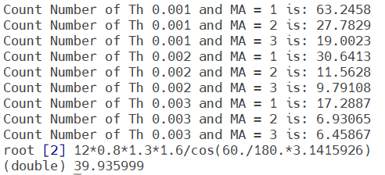
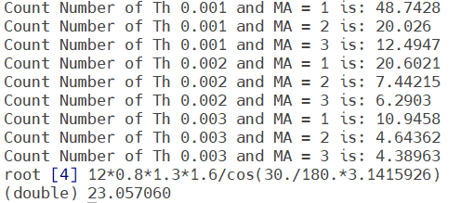
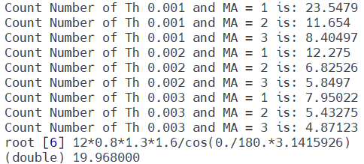
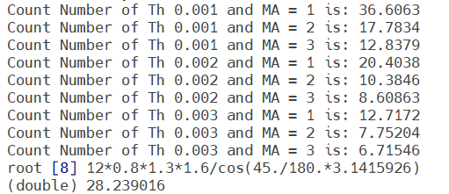
4 Runs counting numbers compare(ncount>1)
Run 47,49,52,53 ch4 (gas 90/10, 1cm, same HV & momentum, different angle) 0° & 45° have sampling rate 1.0, while 30° & 60° have sampling rate 2.0
Run 47 ch4 60°
Run 49 ch4 30°
Run 52 ch4 0°
Run 53 ch4 45°

