Slide 1
EFF_Map

Slide 2
Split chip to m*n part
split chip to 5*5 same size part
chi2<200(almost no cut)
Residual < 0.025mm count as legal
(for 1st and last chip) *1.7
12.8cm
25.6cm

Slide 3
Board5

Slide 4
Run0323: B5 W2R29 ITHR10
Y/X | 0 | 1 | 2 | 3 | 4
0 | 0.913962 | 0.915452 | 0.912603 | 0.916237 | 0.915799
1 | 0.963776 | 0.983341 | 0.983967 | 0.982843 | 0.93452
2 | 0.968424 | 0.991747 | 0.990812 | 0.99132 | 0.937641
3 | 0.95107 | 0.966914 | 0.965907 | 0.965802 | 0.92546
4 | 0.909184 | 0.911429 | 0.910635 | 0.910315 | 0.907544

Slide 5
Run0325:B5 W2R29 ITHR32
Y/X | 0 | 1 | 2 | 3 | 4
0 | 0.907496 | 0.914314 | 0.907633 | 0.912224 | 0.909345
1 | 0.958196 | 0.978822 | 0.978691 | 0.978958 | 0.927488
2 | 0.966054 | 0.991033 | 0.990823 | 0.990965 | 0.931978
3 | 0.933224 | 0.944407 | 0.946696 | 0.945004 | 0.915218
4 | 0.903059 | 0.907789 | 0.904406 | 0.902648 | 0.904099

Slide 6
Run0330: B5 W2R29 ITHR48
Y/X | 0 | 1 | 2 | 3 | 4
0 | 0.908684 | 0.906346 | 0.908088 | 0.90856 | 0.90834
1 | 0.95496 | 0.979551 | 0.979718 | 0.98001 | 0.926225
2 | 0.965761 | 0.991118 | 0.991235 | 0.991365 | 0.930833
3 | 0.944001 | 0.961028 | 0.961238 | 0.959838 | 0.918923
4 | 0.900525 | 0.902918 | 0.901771 | 0.901572 | 0.899463

Slide 7
Run0331: B5 W2R29 ITHR64
Y/X | 0 | 1 | 2 | 3 | 4
0 | 0.904656 | 0.910713 | 0.910016 | 0.905017 | 0.905866
1 | 0.956725 | 0.97874 | 0.978211 | 0.98032 | 0.924796
2 | 0.964643 | 0.991399 | 0.990784 | 0.990747 | 0.928404
3 | 0.935254 | 0.950595 | 0.94766 | 0.947752 | 0.914438
4 | 0.900273 | 0.903575 | 0.898304 | 0.899361 | 0.898064

Slide 8
Run0336:B5 W2R29 ITHR96
Y/X | 0 | 1 | 2 | 3 | 4
0 | 0.899948 | 0.905356 | 0.903184 | 0.901345 | 0.901057
1 | 0.949918 | 0.973673 | 0.974218 | 0.974501 | 0.920926
2 | 0.963336 | 0.990956 | 0.990524 | 0.99057 | 0.925464
3 | 0.933079 | 0.94806 | 0.946869 | 0.945795 | 0.909131
4 | 0.89336 | 0.899138 | 0.894593 | 0.894433 | 0.895119

Slide 9
Board2: board2 is 1st chip, rescut<=0.025*1.7
EFF in border too slow. Check total eff nows

Slide 10
Run0338:eff
Y/X | 0 | 1 | 2 | 3 | 4
0 | 0.565764 | 0.569891 | 0.573289 | 0.572157 | 0.569518
1 | 0.768081 | 0.890652 | 0.890849 | 0.890563 | 0.637669
2 | 0.824877 | 0.965317 | 0.965469 | 0.965777 | 0.65065
3 | 0.689429 | 0.769614 | 0.772126 | 0.772801 | 0.600911
4 | 0.556944 | 0.557512 | 0.560489 | 0.558383 | 0.561235

Slide 11
Run0341
Y/X | 0 | 1 | 2 | 3 | 4
0 | 0.575457 | 0.573476 | 0.580485 | 0.57782 | 0.570868
1 | 0.758912 | 0.87393 | 0.872504 | 0.871832 | 0.636102
2 | 0.82762 | 0.967398 | 0.967288 | 0.966842 | 0.651653
3 | 0.637921 | 0.687442 | 0.691104 | 0.693742 | 0.583743
4 | 0.553864 | 0.562459 | 0.563487 | 0.561739 | 0.561972

Slide 12
Run0343
Y/X | 0 | 1 | 2 | 3 | 4
0 | 0.574284 | 0.58242 | 0.576912 | 0.577411 | 0.574083
1 | 0.790175 | 0.917323 | 0.917666 | 0.915912 | 0.647372
2 | 0.825835 | 0.965683 | 0.965434 | 0.965419 | 0.652125
3 | 0.682135 | 0.755997 | 0.754012 | 0.757036 | 0.600028
4 | 0.561043 | 0.562144 | 0.561133 | 0.560489 | 0.556997

Slide 13
Run0344
Y/X | 0 | 1 | 2 | 3 | 4
0 | 0.575826 | 0.583919 | 0.580341 | 0.583336 | 0.574243
1 | 0.786588 | 0.91301 | 0.914294 | 0.913107 | 0.647093
2 | 0.824514 | 0.964948 | 0.965448 | 0.964712 | 0.651526
3 | 0.677301 | 0.746498 | 0.748213 | 0.746614 | 0.598701
4 | 0.555261 | 0.557665 | 0.559822 | 0.555837 | 0.557438

Slide 14
Run0351
Y/X | 0 | 1 | 2 | 3 | 4
0
1
2
3
4

Slide 15
Run0338: events
Y/X
 | 66130 | 92244 | 96925 | 95250 | 75613
 | 138320 | 204064 | 226099 | 225144 | 151944
 | 263986 | 394110 | 431984 | 432579 | 271513
 | 138574 | 202790 | 222680 | 223527 | 155429
 | 72528 | 102909 | 112937 | 113003 | 86666

Slide 16
Update
Take 5 chip_hit into count:
If 5 chip Cut2<Criterian, EFF denominator ++;
Draw Heatmap

Slide 17
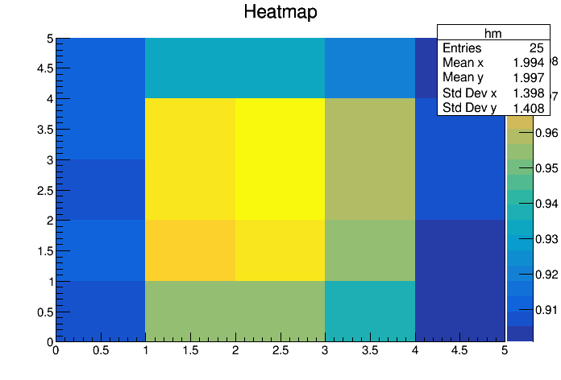
Run0323: B5 W2R29 ITHR10
x:-12.8-12.8 split to 5 part
y:-6.4-6.4 split to 5 part

Slide 18
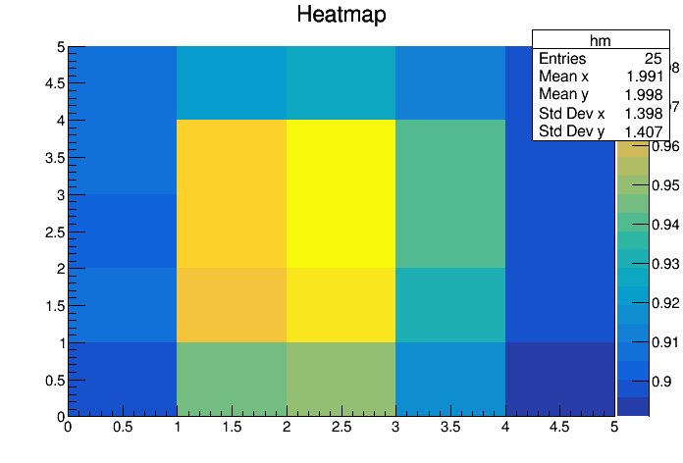
Run0325:
x:-12.8-12.8 split to 5 part
y:-6.4-6.4 split to 5 part

Slide 19
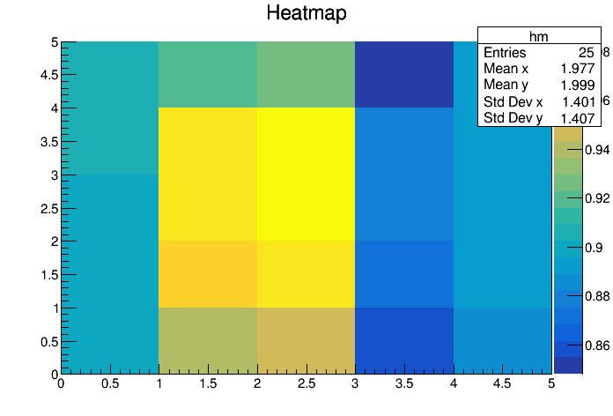
Run0330:
x:-12.8-12.8 split to 5 part
y:-6.4-6.4 split to 5 part

Slide 20
Run0331:
x:-12.8-12.8 split to 5 part
y:-6.4-6.4 split to 5 part

Slide 21
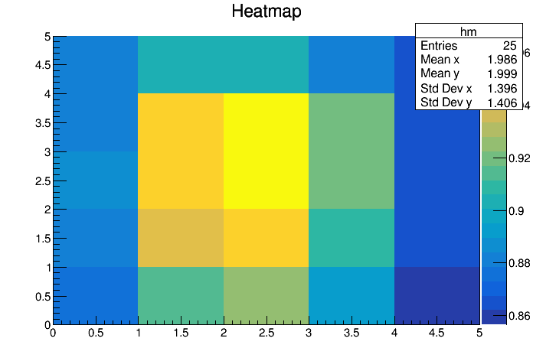
Run0336:
x:-12.8-12.8 split to 5 part
y:-6.4-6.4 split to 5 part

Slide 22
Board 2

Slide 23
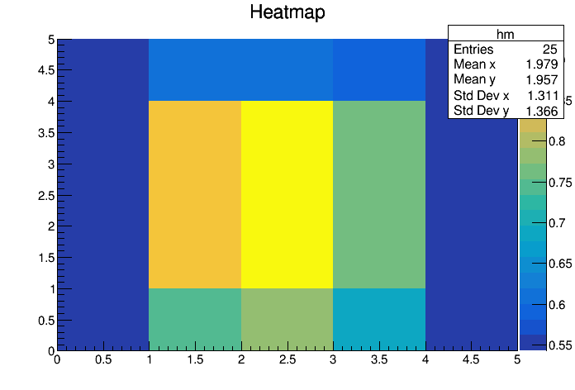
Run0338:
x:-12.8-12.8 split to 5 part
y:-6.4-6.4 split to 5 part

Slide 24
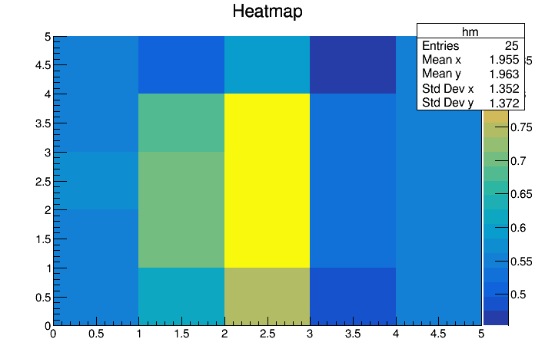
Run0341:
x:-12.8-12.8 split to 5 part
y:-6.4-6.4 split to 5 part

Slide 25
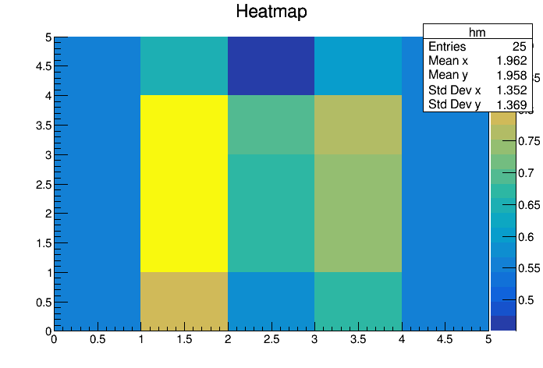
Run0343:
x:-12.8-12.8 split to 5 part
y:-6.4-6.4 split to 5 part

Slide 26
Run0344:
x:-12.8-12.8 split to 5 part
y:-6.4-6.4 split to 5 part

Slide 27
Run0351:
x:-12.8-12.8 split to 5 part
y:-6.4-6.4 split to 5 part

