Slide 2
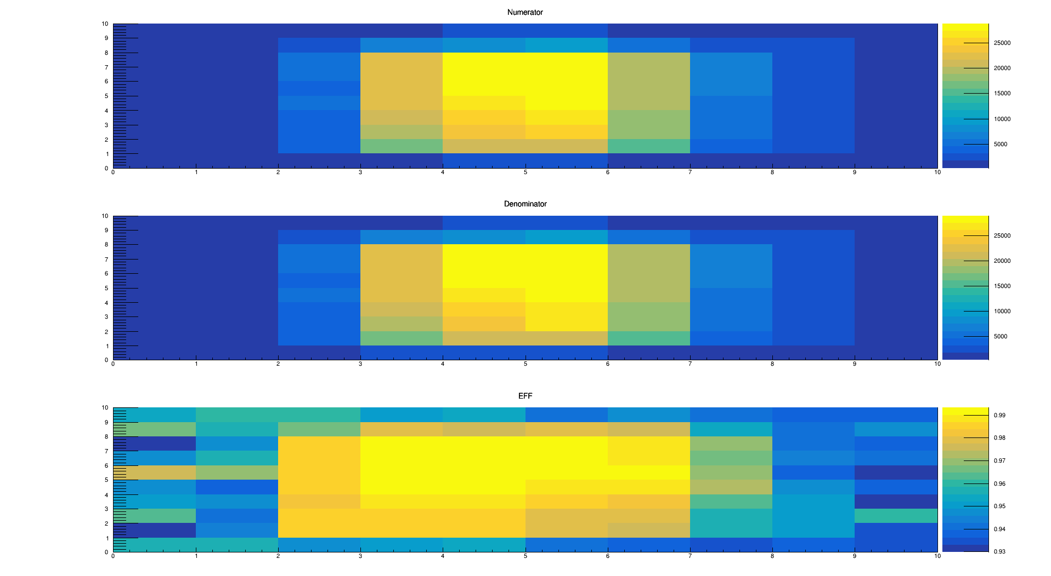
Run0323:Board 5

Slide 3
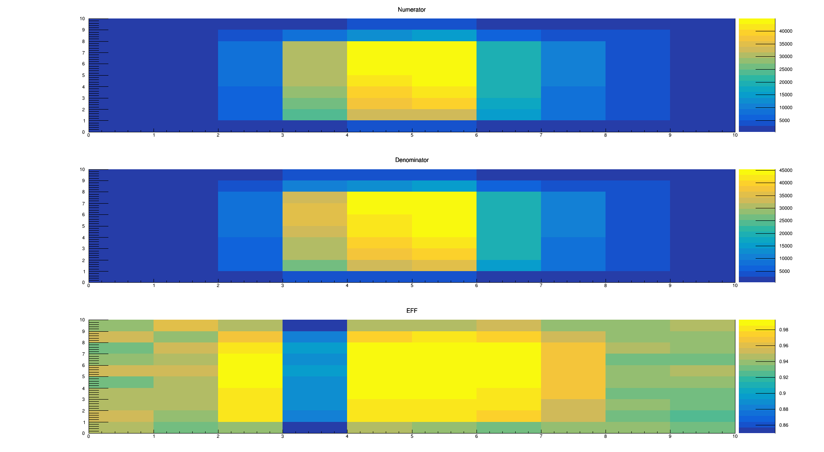
Run0325

Slide 4
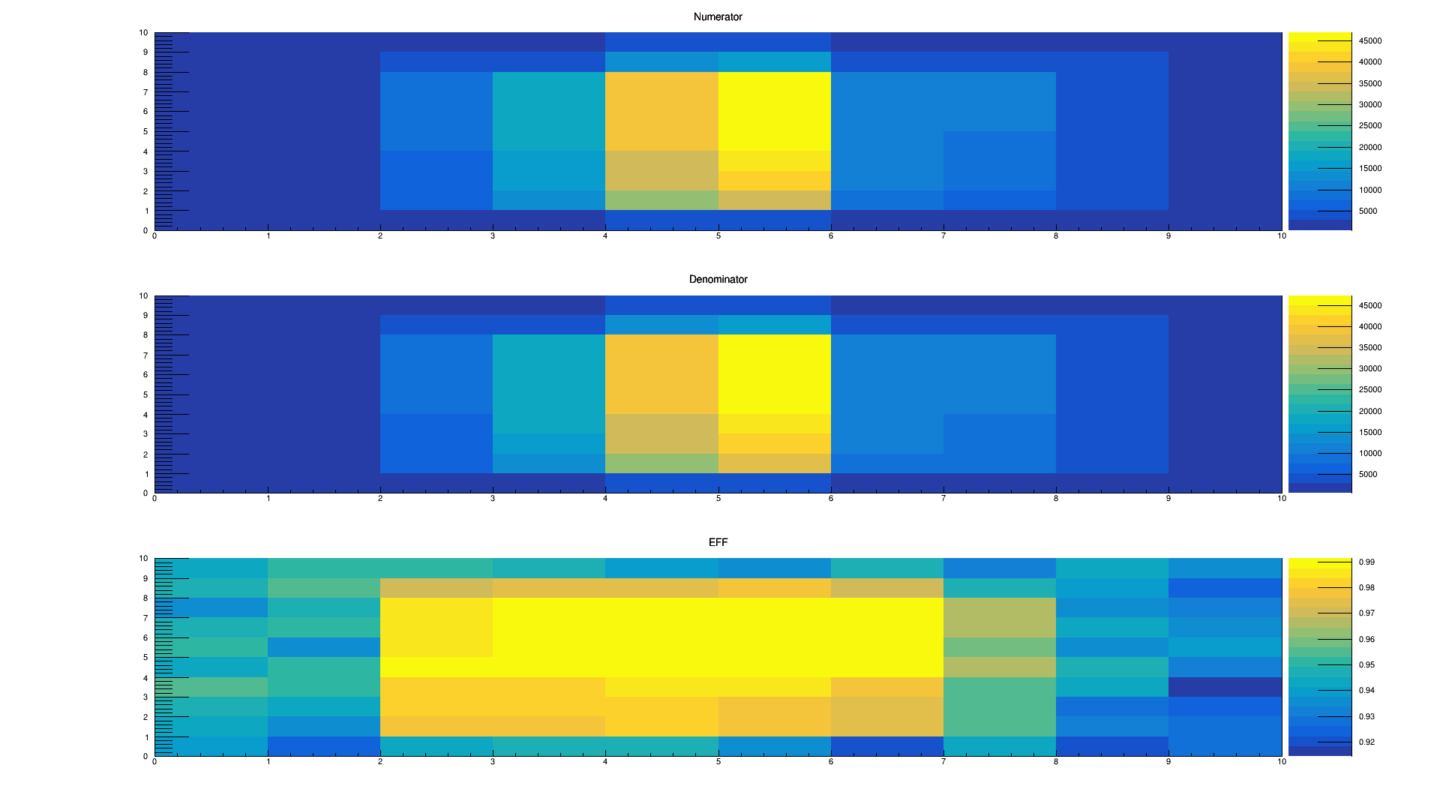
Run0325

Slide 5
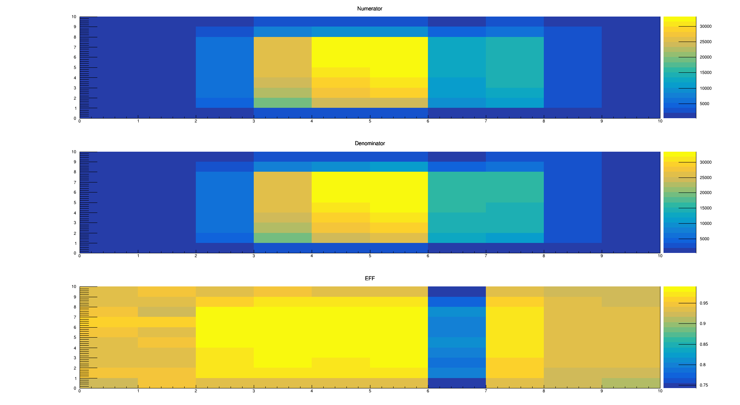
Run0330

Slide 6
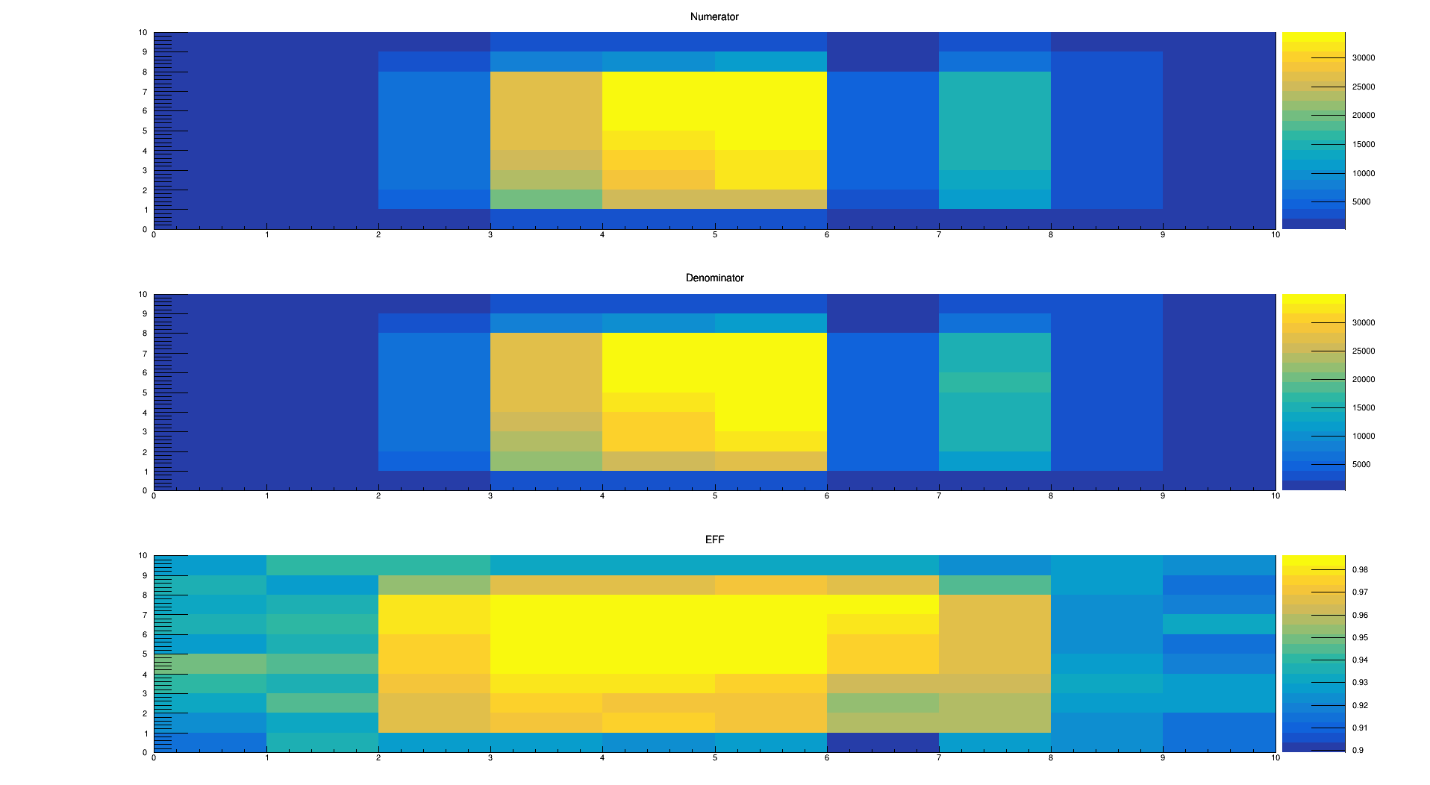
Run0331

Slide 7
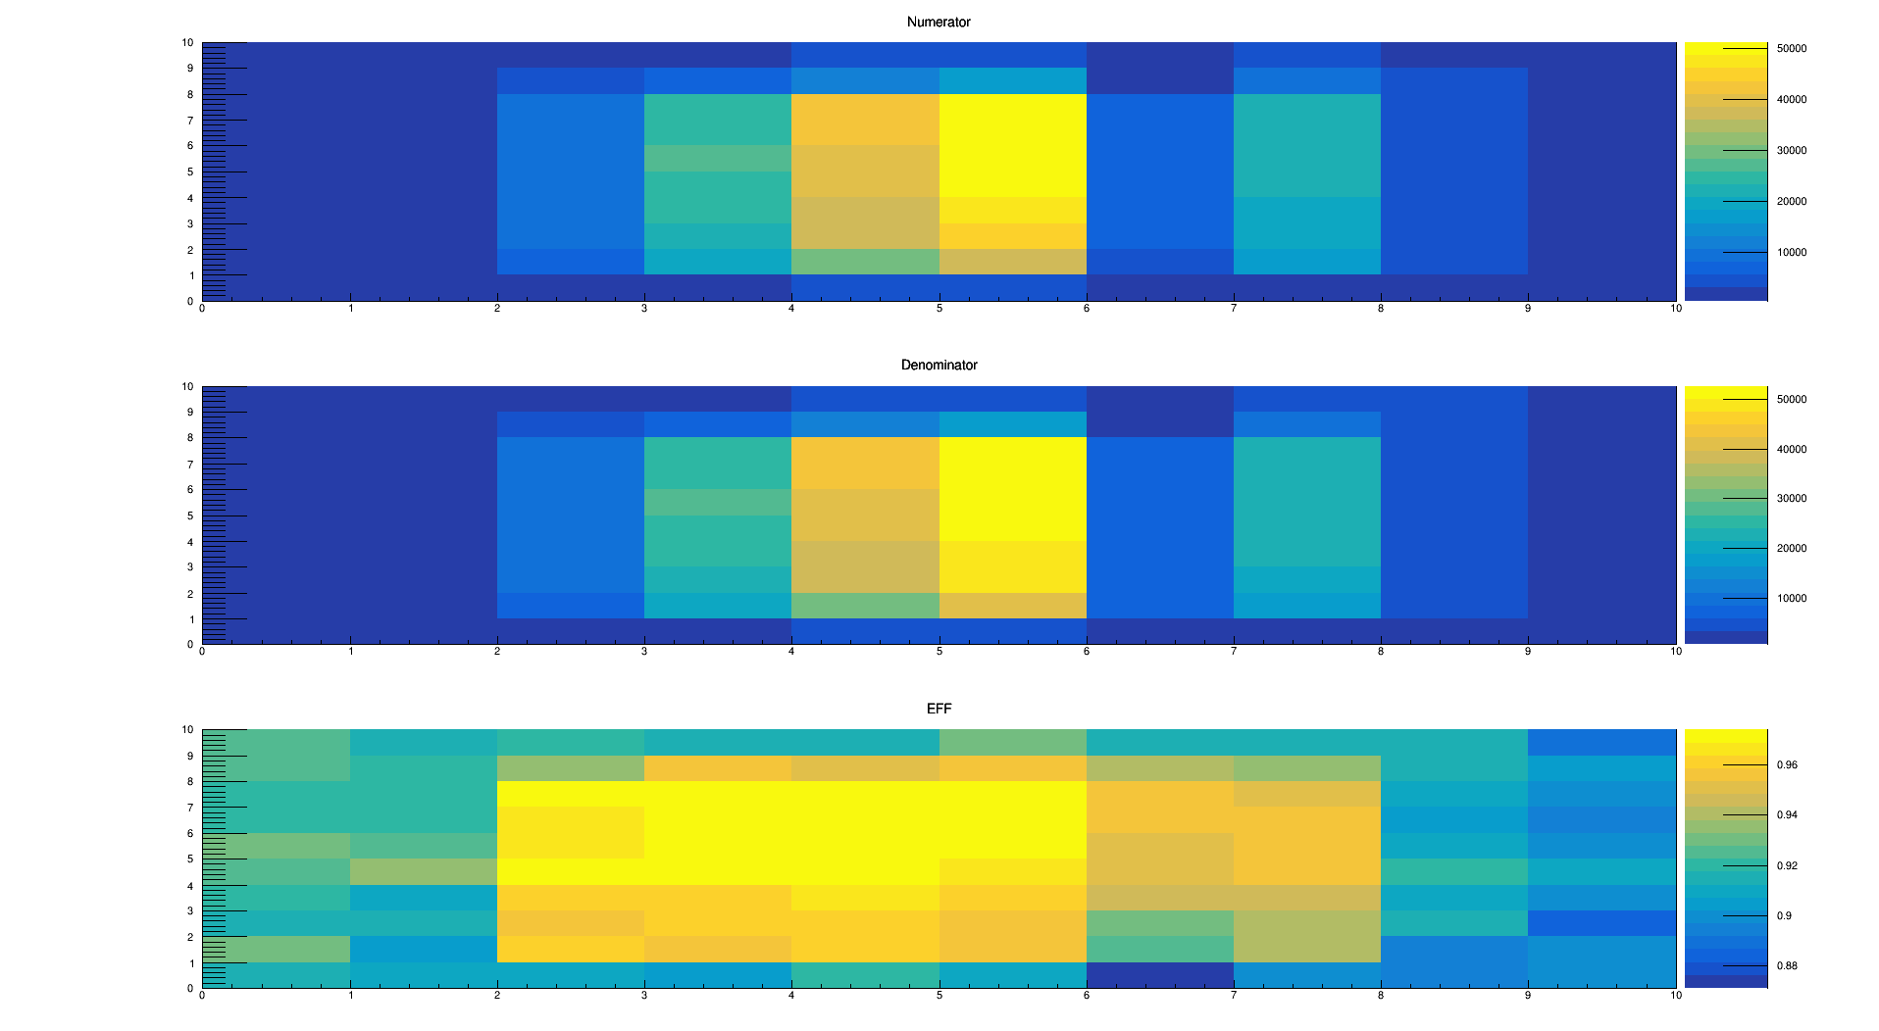
Run0336

Slide 8
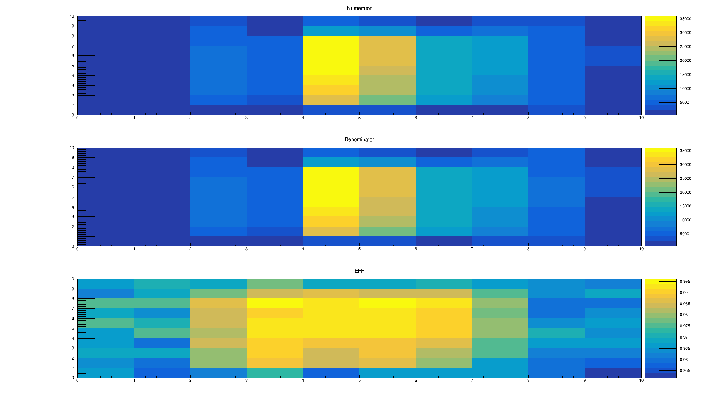
Run0365

Slide 9
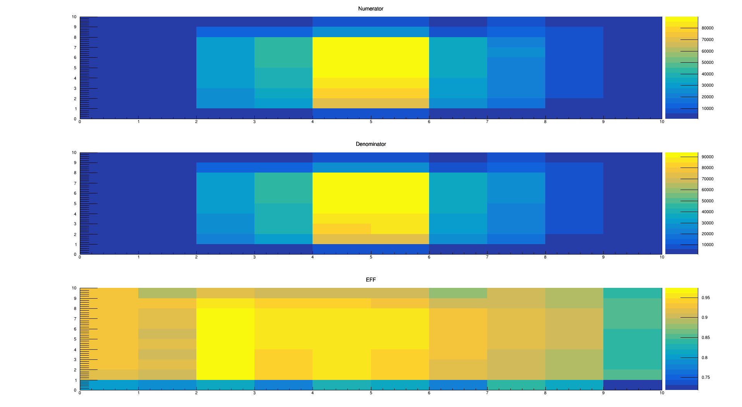
Run0338:Board 2

Slide 10
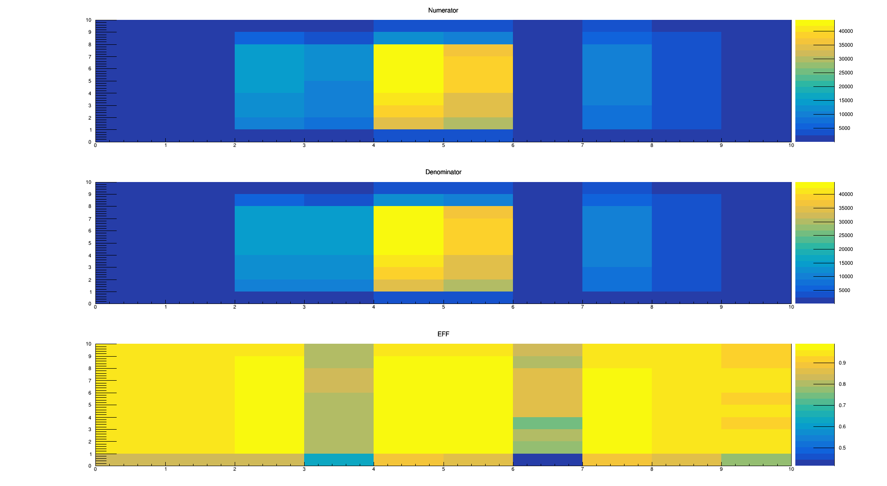
Run0341

Slide 11
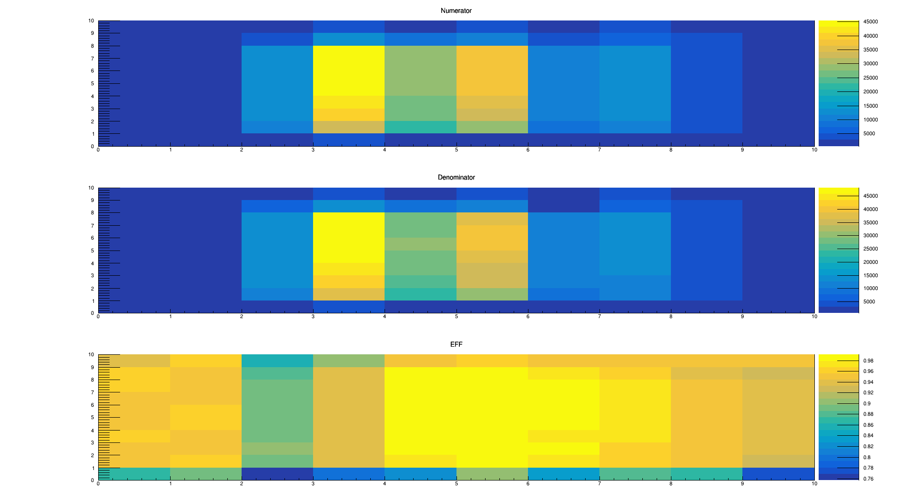
Run0343

Slide 12
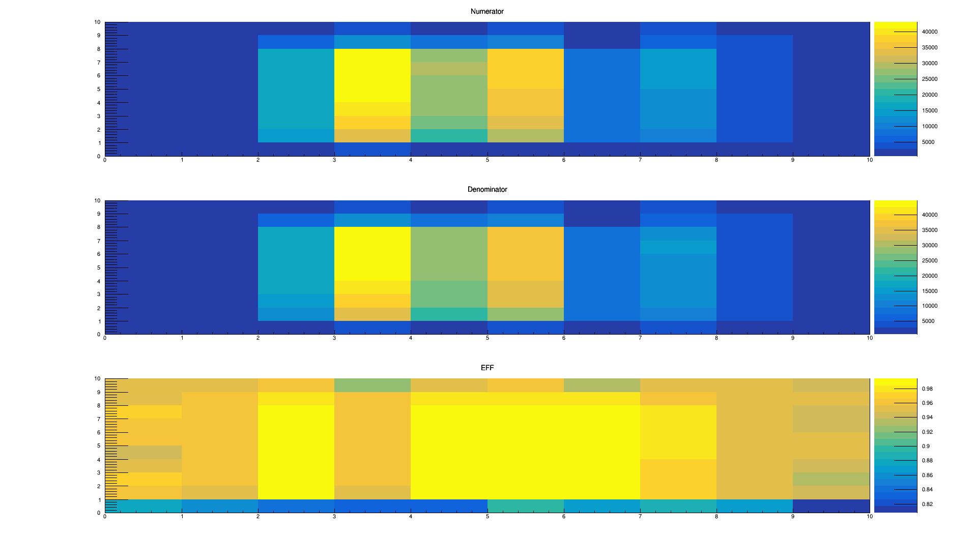
Run0344

Slide 13
EFF vs threshold
Cut2 for other 5 chip < N(not divide degree)
N take 200 50 10
Denominator++ when legal
Res < 0.025mm numerator++
All clustersize take into account

Slide 14
Board 2 Run0351->Run0344->Run0343->Run0341->Run0324->Run0338

Slide 15
Board5 Run0323->Run0365->Run0324->Run0325->Run0330->Run0331->Run0336

