Slide 1
国家重点研发计划
R&D and Verification of Key Technologies for a High Energy Circular Electron-Positron Collider
Zhijun Liang for CEPC MOST2 vertex detector team

Slide 2
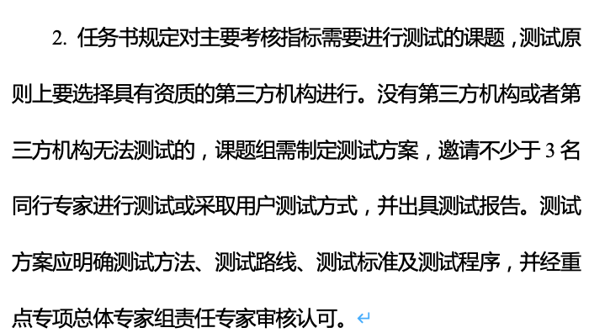
News on MOST2 project
Project timescale （执行期）： up to April 30th ,2023
June 20 –July 21: submission of final reports and review report into MOST2 system
Reviews on silicon task 2 and reviews on MOST2 project are likely take place in May/June
Final reports needs to be ready
Reviews on key parameter (考核指标）

Slide 3
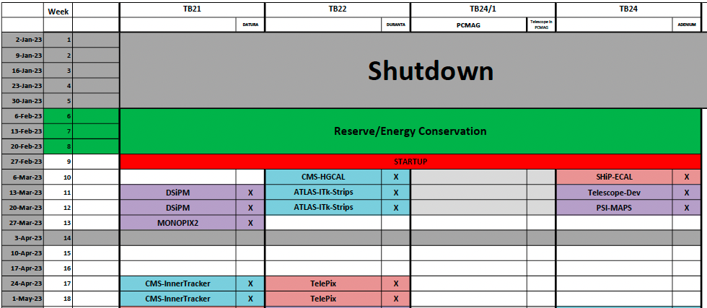
Time line for prototype
Barrel Prototype:
January : debugging the flex communication
February: Ladder assembly and testing
March: Detector assembly
Middle March: VIP visit, CEPC prototype demonstration (Samuel C.C. Ting)
Early April: Testbeam at BSRF
Apr 11- Apr 23: Testbeam at DESY(reservied)

Slide 4
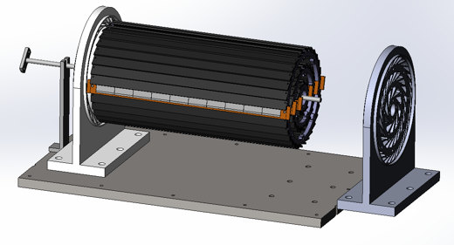
Plan for test beam (Apr 11- Apr 23,2023)
Person power, expertise
Joao (IHEP, overall)
Zhijun Liang (IHEP, overall)
Lei Zhang (NJU, overall) ?
Tianya (IHEP, ASIC)
Xiaomin WuWei(NWPU, ASIC )?
Jia Zhou (IHEP ,DAQ)
Xinhui Huang (IHEP, mechanism)
Shuqi Li (IHEP, offline)
Hao Zeng(IHEP, offline)
Xuewei Jia(IHEP, offline)
Yuhang Guo(IHEP, CSNS, testbeam)
Should Request Invitation letter now

Slide 5
Plan for February
2nd round of flex production :
submitted, expected to get ~20 more flex in one month (2 metal layer and 4 metal layer)
2nd round of Taichu chip delivery (expect to arrive in 1~2 weeks)
Wafer level testing, thinning to 100um, dicing
Focus on assembly and testing ladder
Goal: 12 flexes needed for prototype, 6~10 flex needed for flex based telescope
Aiming to build 10~12 ladder with 4 metal-layer flex (at least 2 chips on each flex )
Build ~6 ladder with 2 metal layer flex
Testing for ladder
Electronics tests
Laser tests
Beta tests

Slide 6
Publication plan
Taichu2 Laser test (NIMA): almost ready for submission
DESY Test beam 1st paper: submission date: before February 15th (!!!)
Paper about prototype testbeam : before May 15th (!!!)
Electronics for ladder and prototype (JINST): (should published before Sep 30th )
Paper about the prototype : (should published before Sep 30th )
Paper of TaichuPix3: (should published before Sep 30th )
Document about irradiation hardness: Before May (!!!)
Final report (结题科技报告）(Before May). (!!!)

