Slide 1
Double Jpsi
Taozhe Yu
2023. 2.23

Slide 2
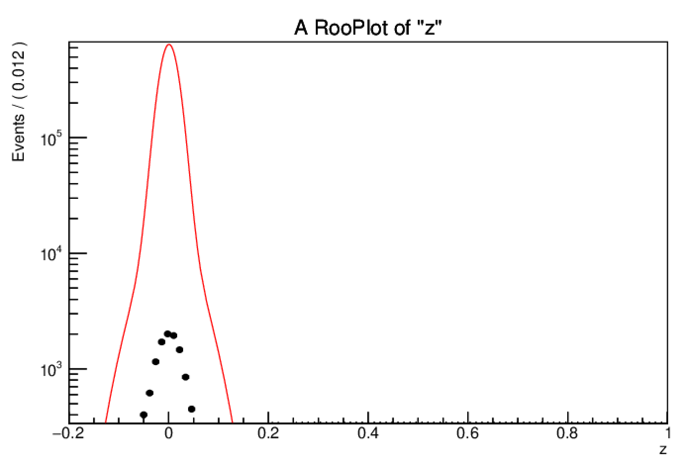
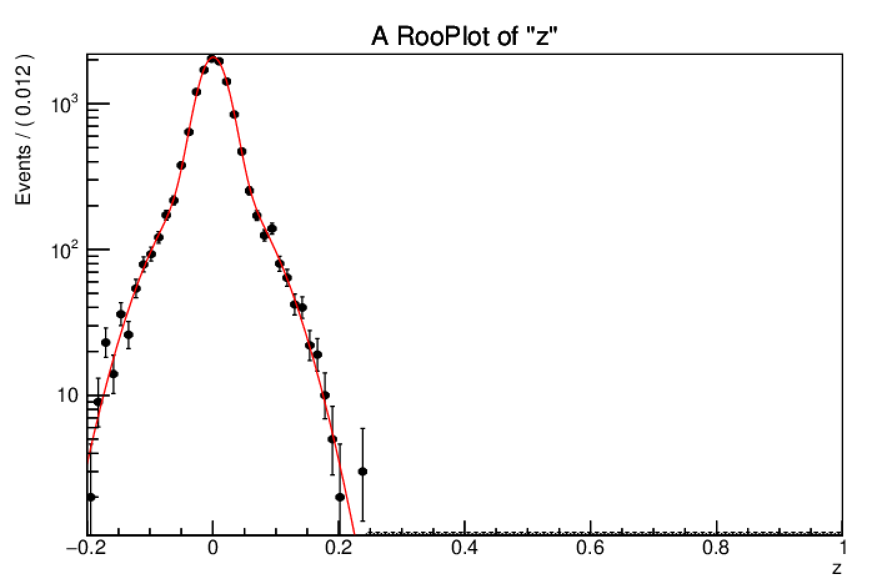
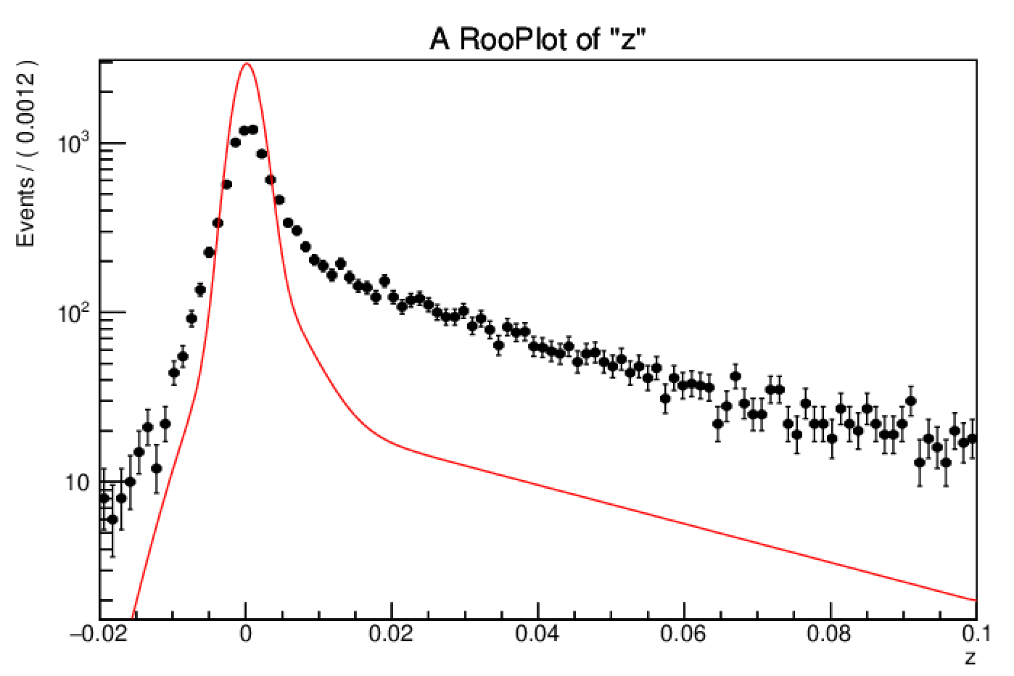
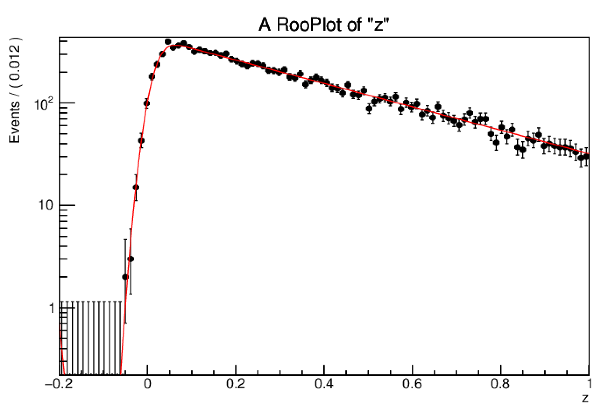
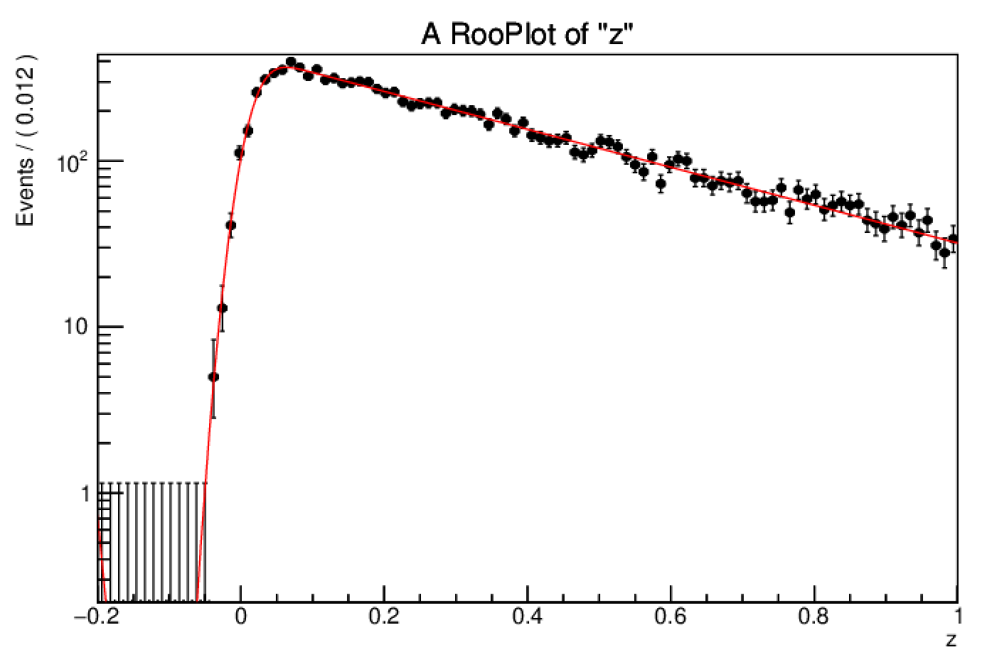
The fit issue
prompt + prompt
prompt + nonprompt
nonprompt + prompt
Nonprompt + nonprompt
When we multiply two double gauss to fit prompt + prompt components, the normlization will have issue

Slide 3
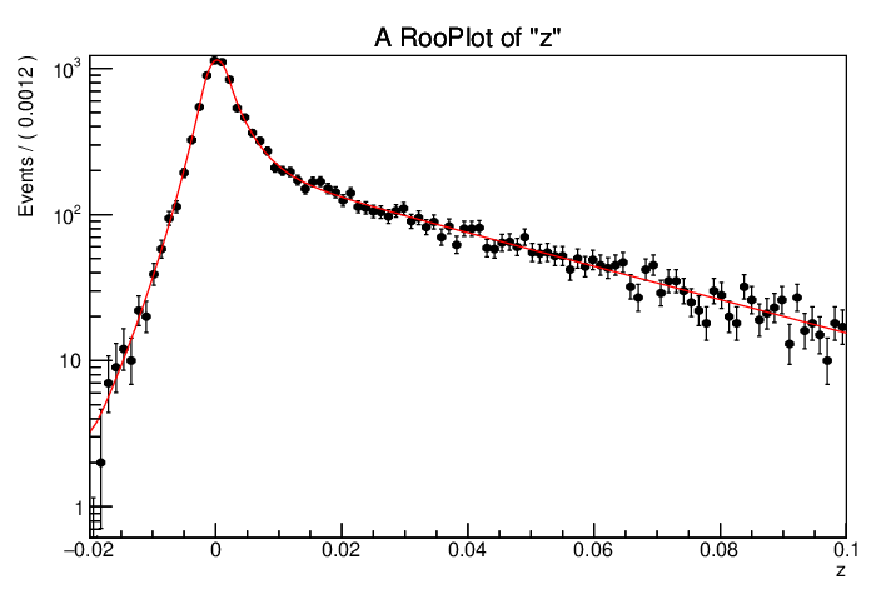
Solve the issue
I use DSCB function to replace the double gauss function to fit prompt components
The Normalization seems reasonable

Slide 4
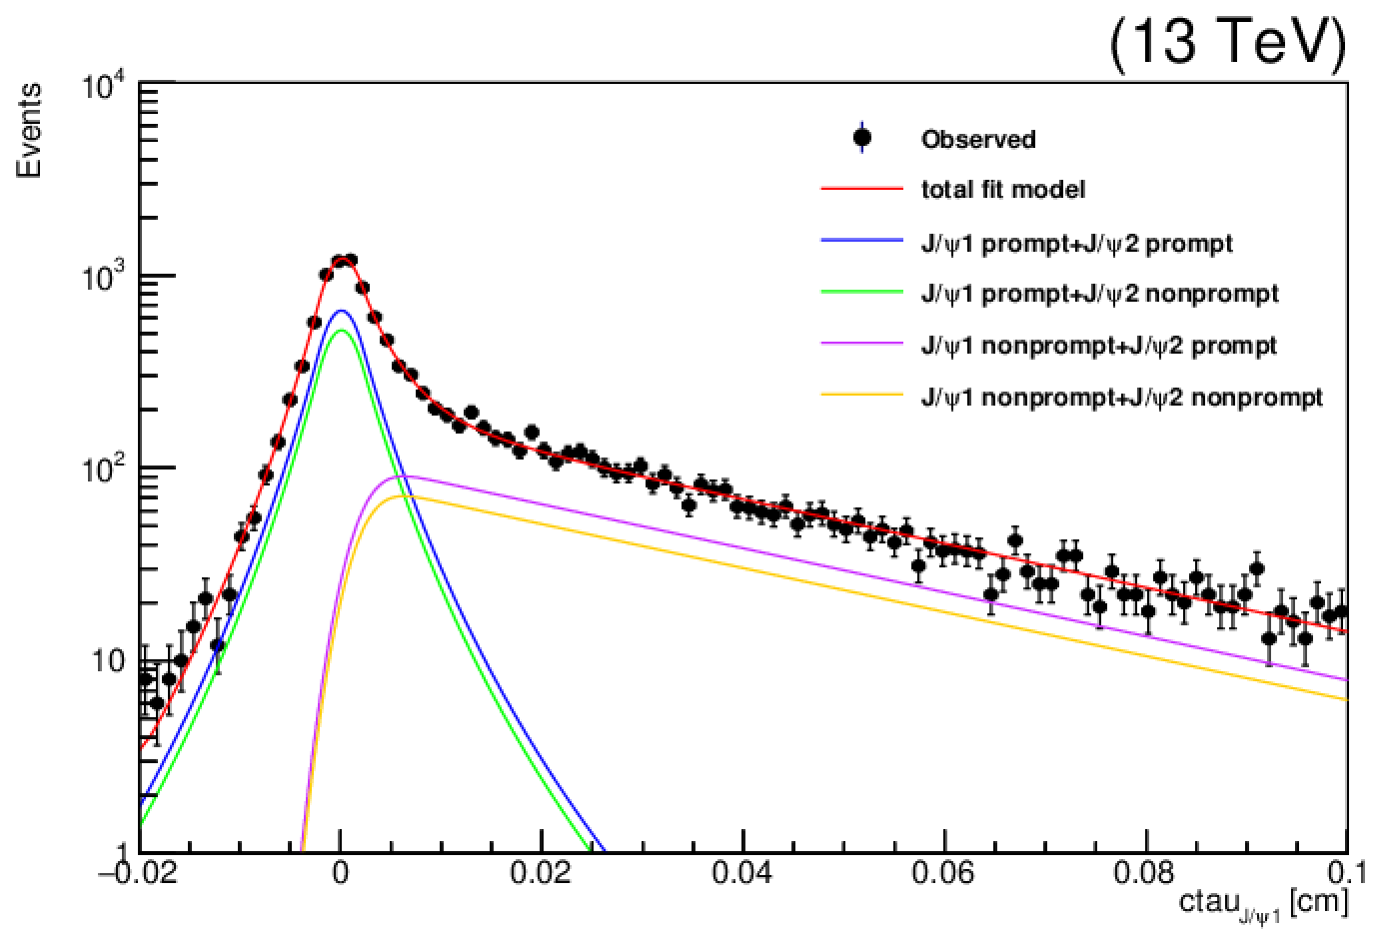
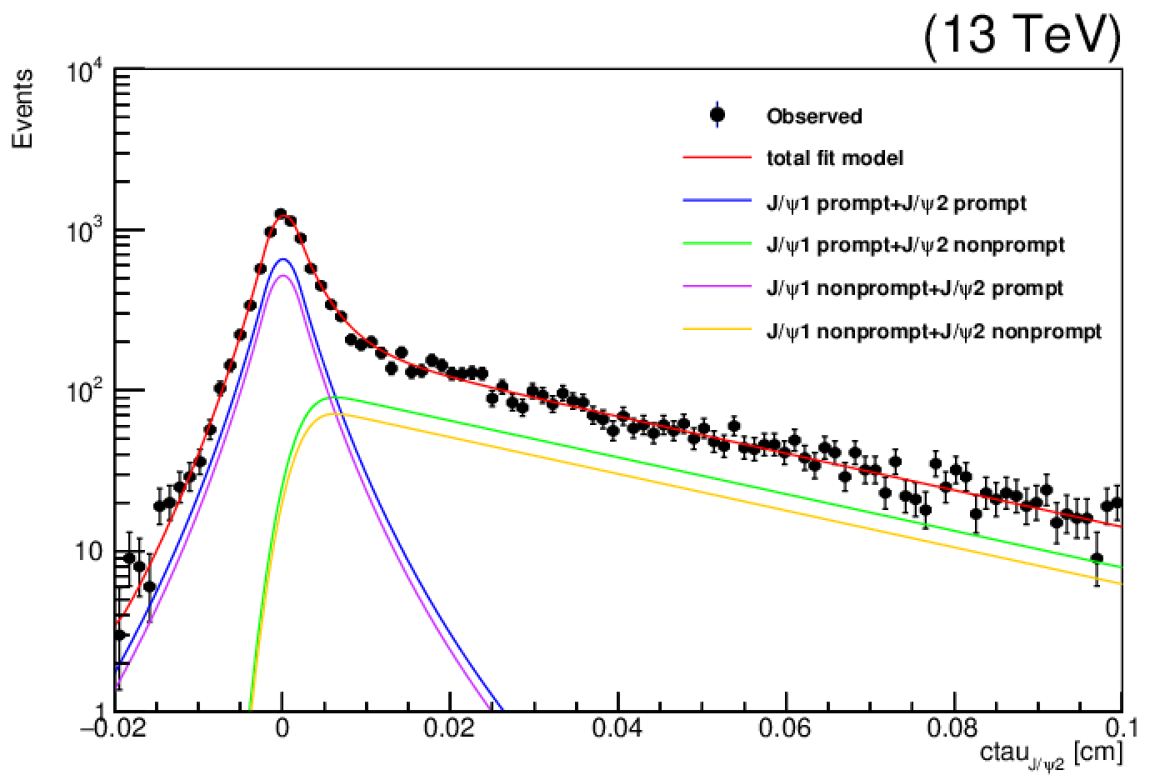
Ctau 2D fit
Ctau two dimension fit
DSCB function to fit prompt components
Gauss Convolution Exp function to fit non-prompt components

Slide 5
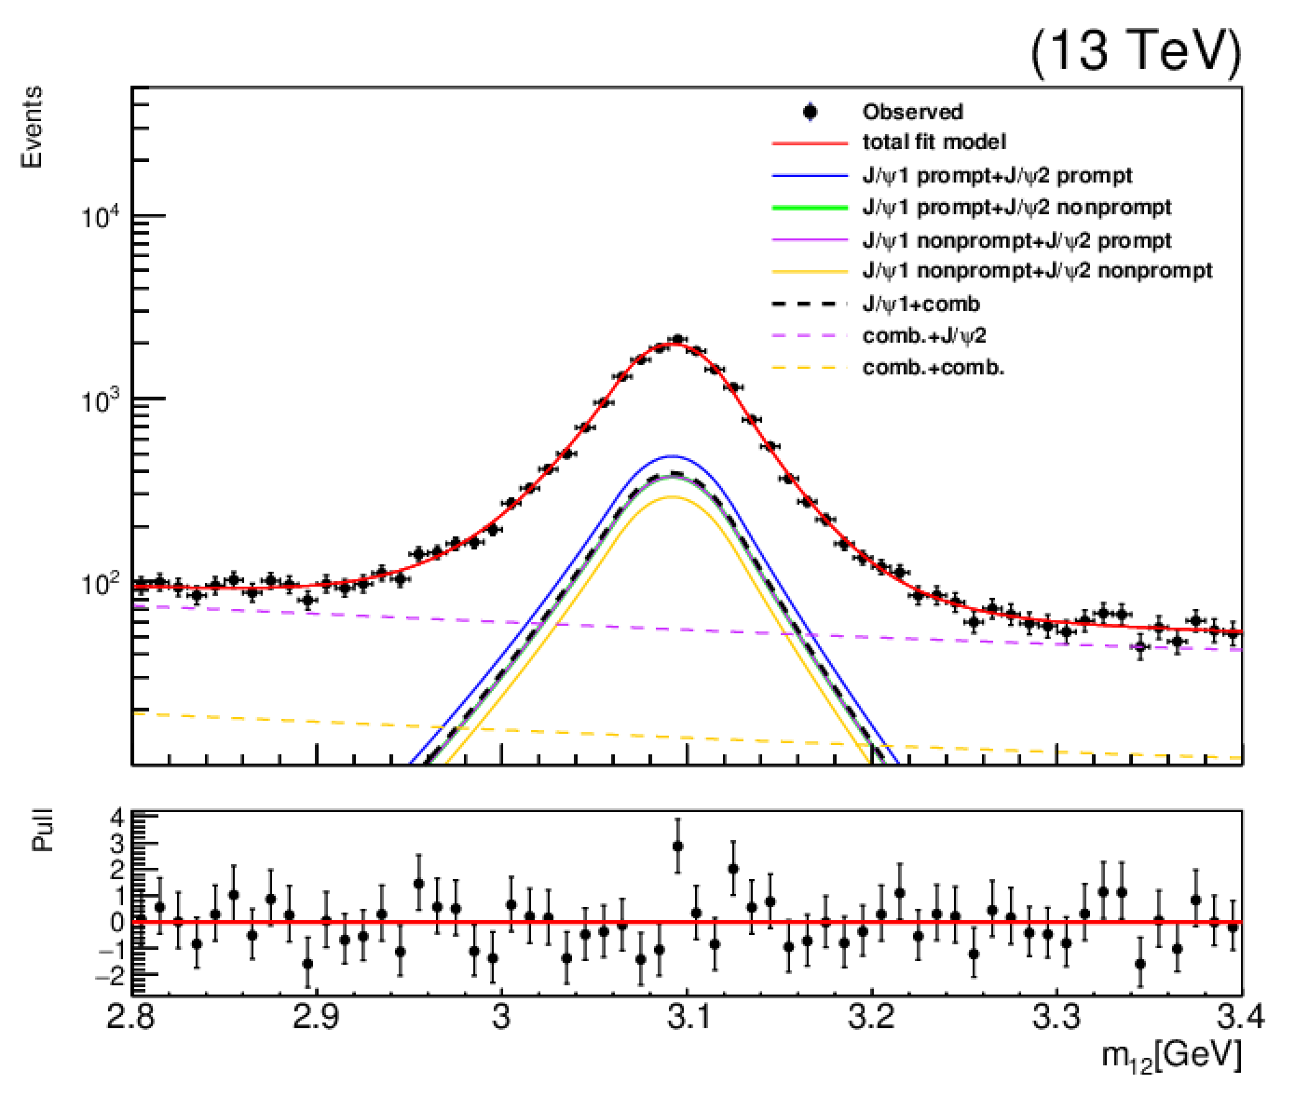
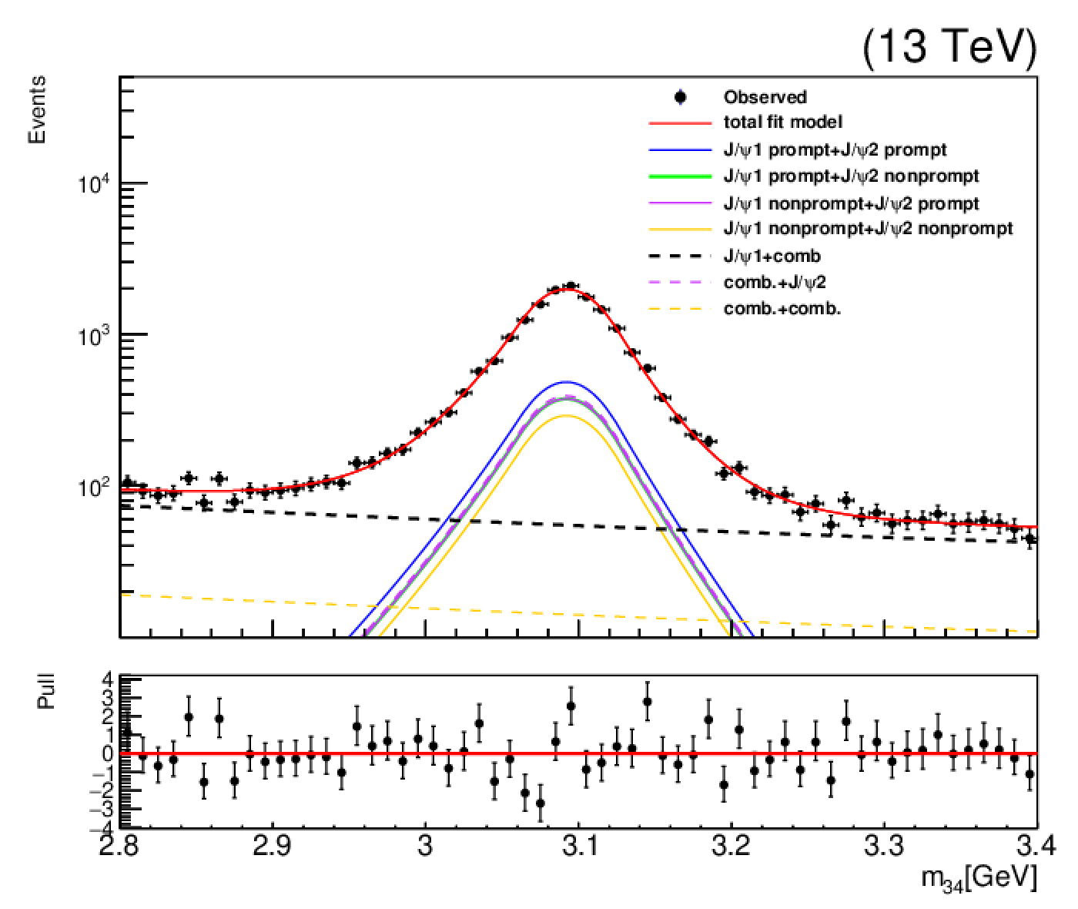
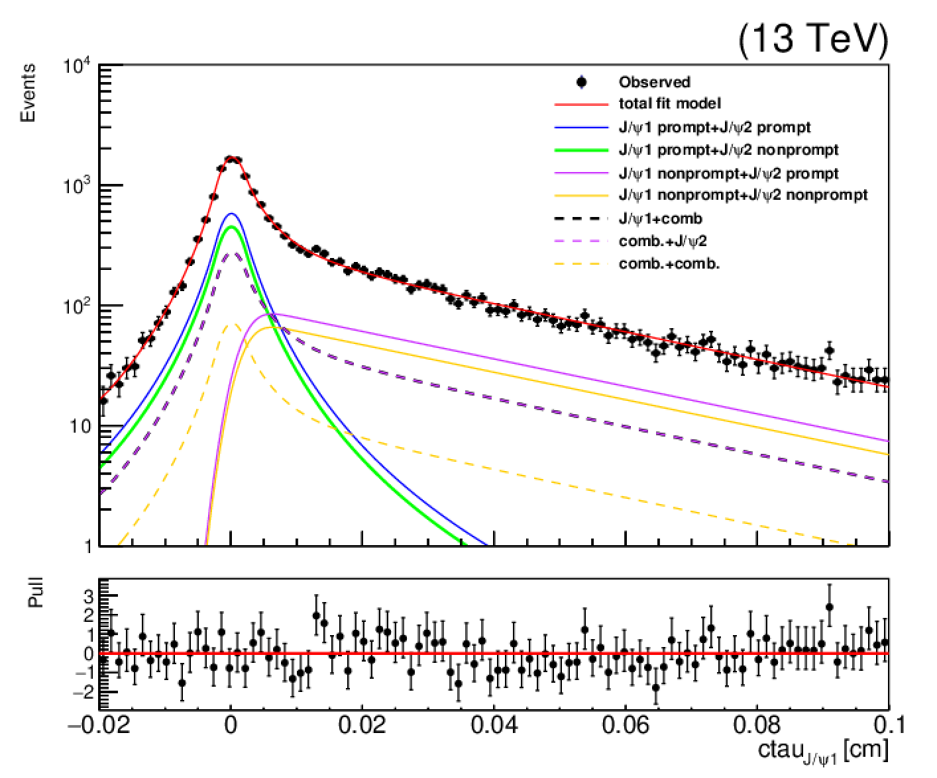
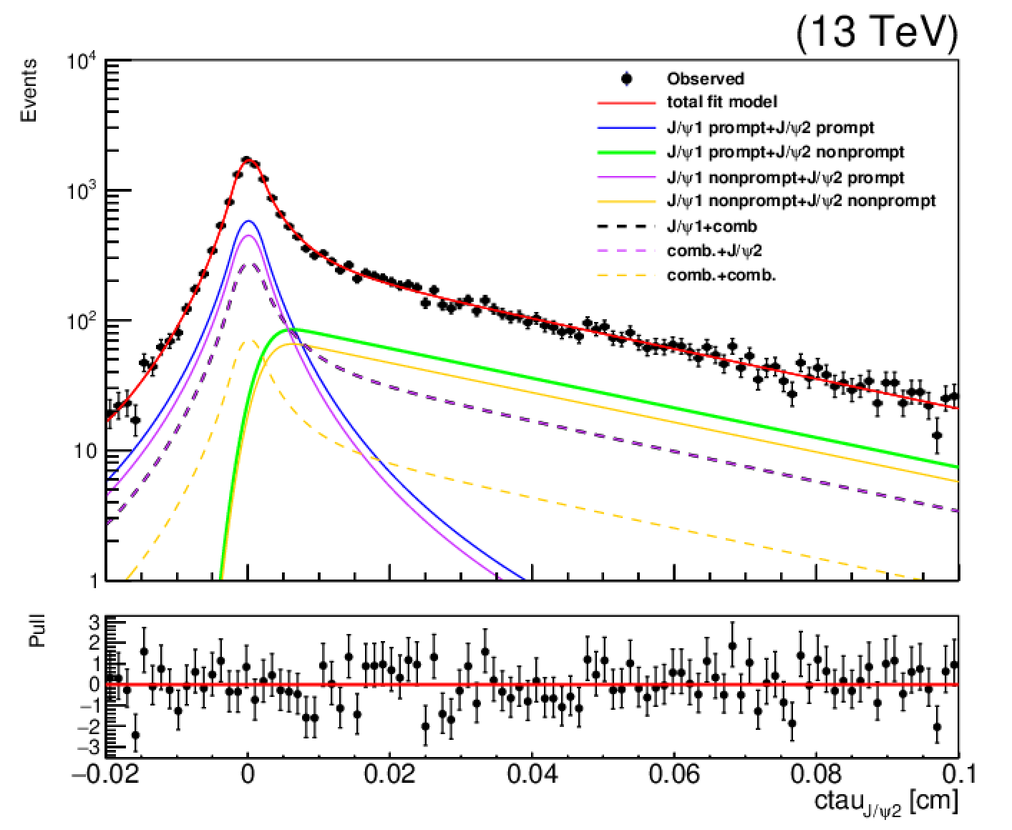
4D fit
4D fit
Use DSCB function to fit J/ψ invariance mass
The mu pair maybe comb. or J/ψ and J/ψ(comb) maybe prompt or non-prompt, so there are total 16 categories for two mu pairs
The invariance mass dimension can distinguish the J/ψ and comb.
The ctau dimension can distinguish prompt and non-prompt components
For brief, I combine the prompt and non-prompt components for two mu pairs included comb.

Slide 6
Backup

Slide 7
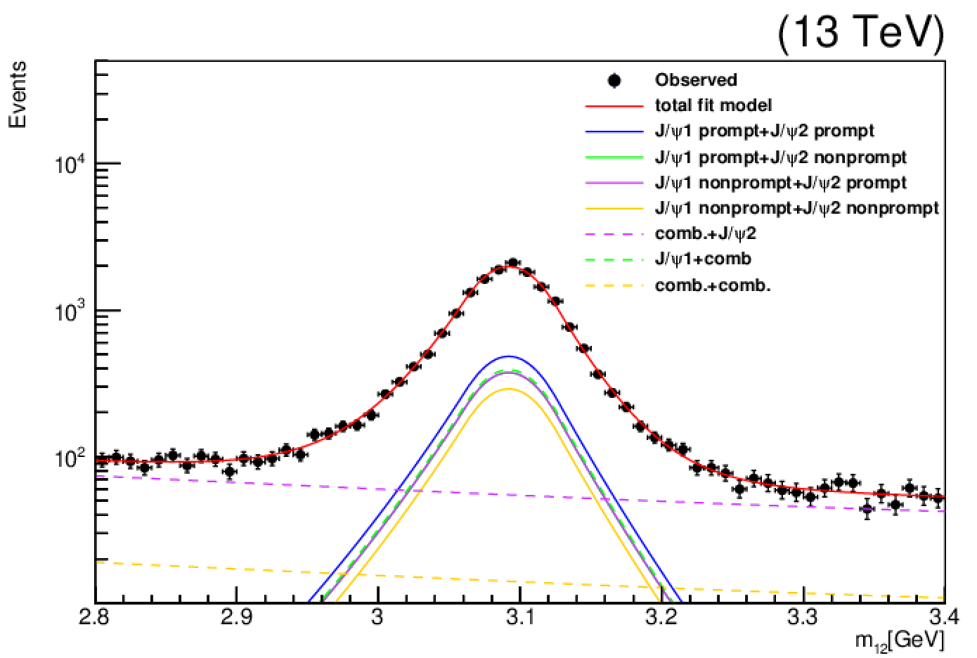
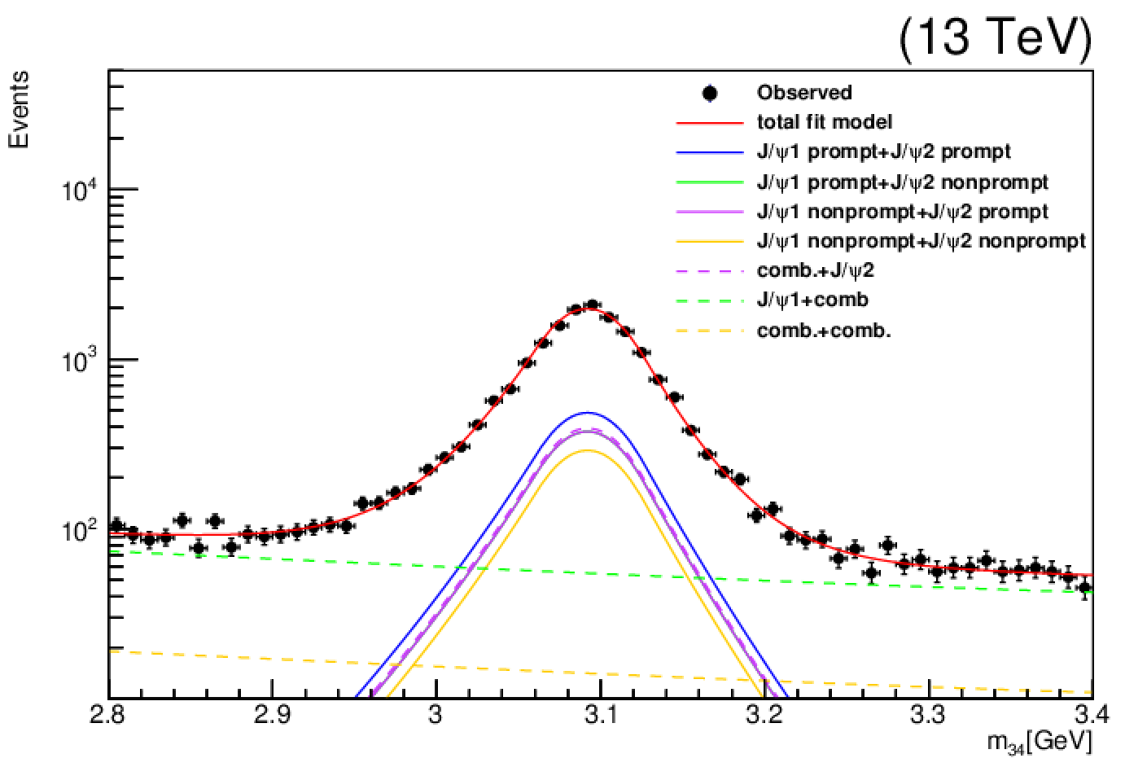
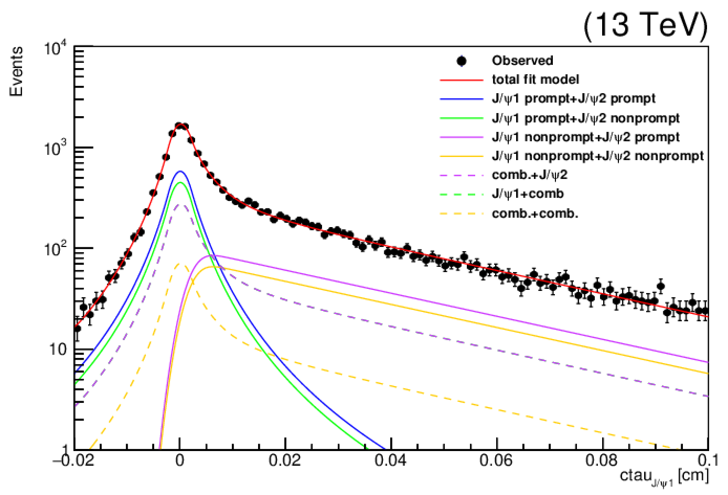
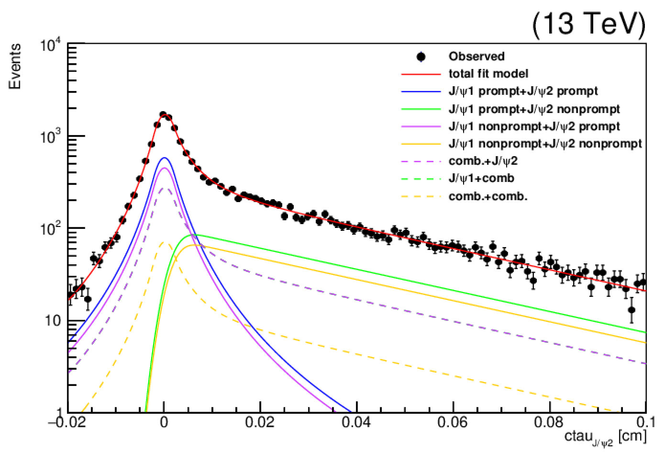
4D fit

Slide 8
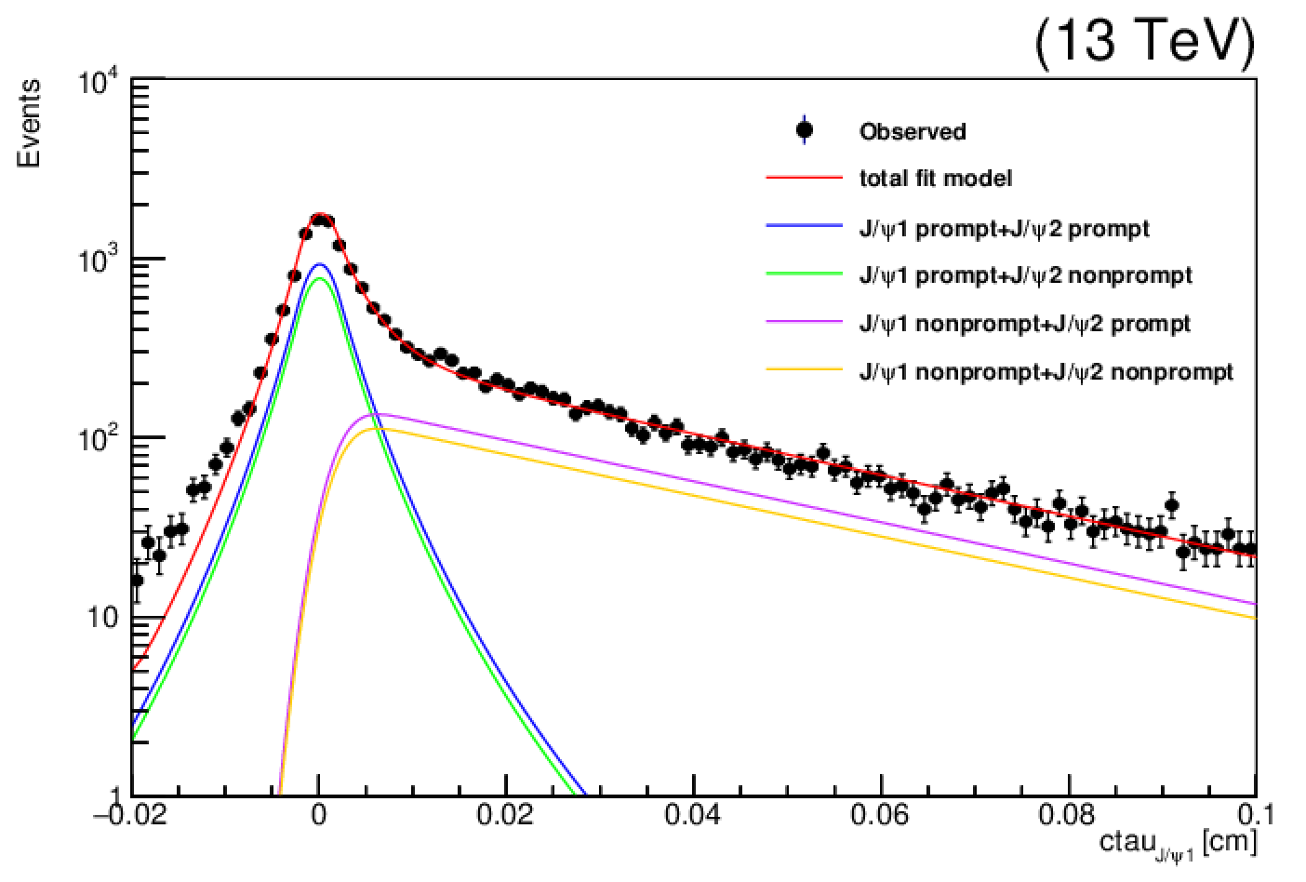
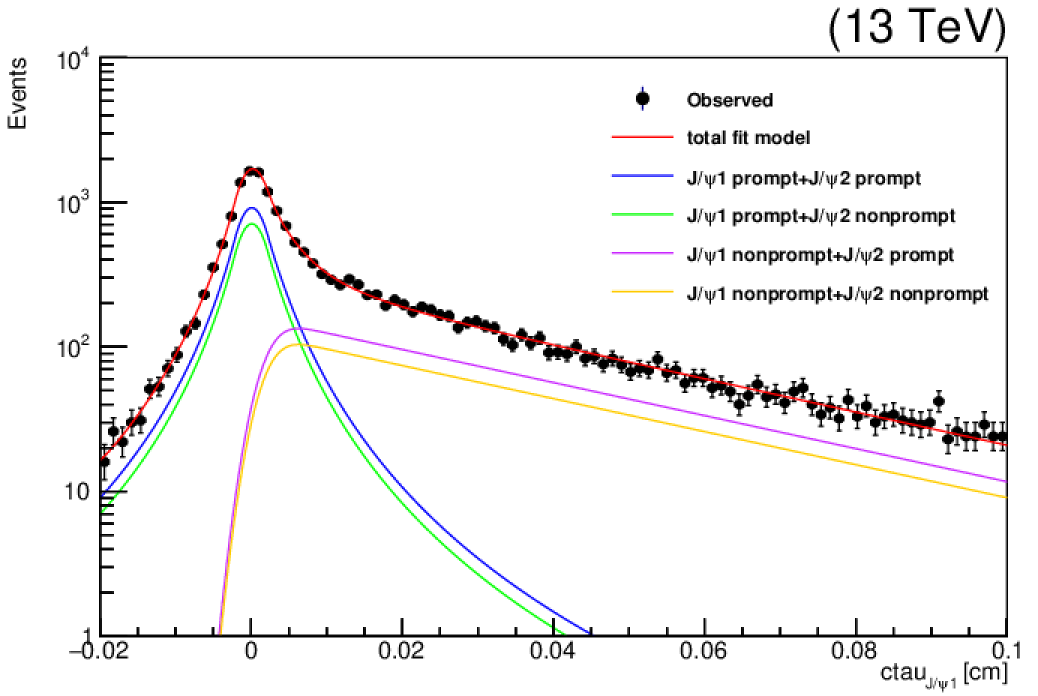
J/ψ1/2 mass [3.0, 3.2] GeV
1
J/ψ1/2 mass [2.8, 3.4] GeV

