Slide 1
High-Low Gain Ratio Calibration
2023/02/16
Wang Jiaxuan

Slide 2
Software Set-up
Pick data files
7 data files during test days
under high-low gain mode
every 12 hours
Decode and merge
Analyze
Root class TH2F
Fit range from 600 to flexible upbound
ECAL Binary Data
246.dat
264.dat
253.dat
222.dat
228.dat
272.dat
289.dat
ECAL Root File
246.root
264.root
253.root
222.root
228.root
272.root
289.root
Merge
merge_v1.root

Slide 3
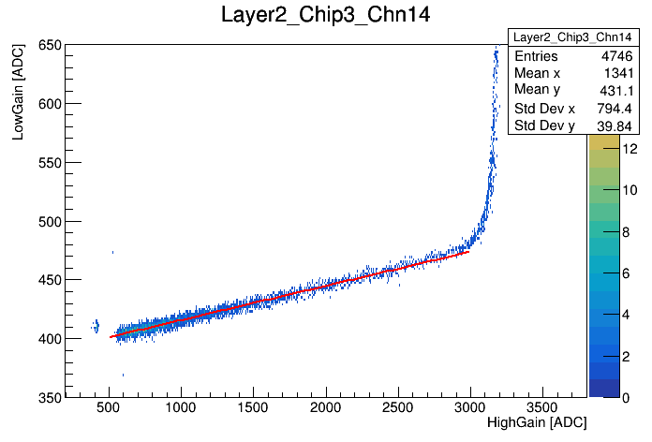
Fit Plot

Slide 4
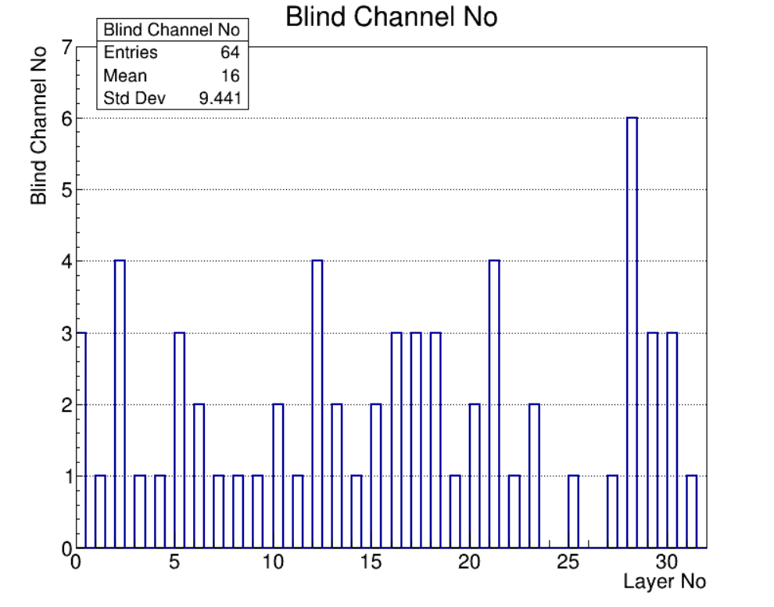
Blind Channel
Except 28 layer, 0~1.9% blind channel for each layer
No. 28 percentage of blind channel 2.85%

Slide 5
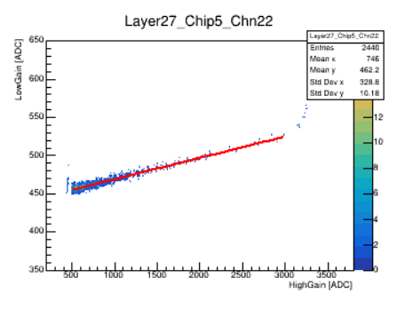
Abnormal Fit
TGraph
TH2

Slide 6
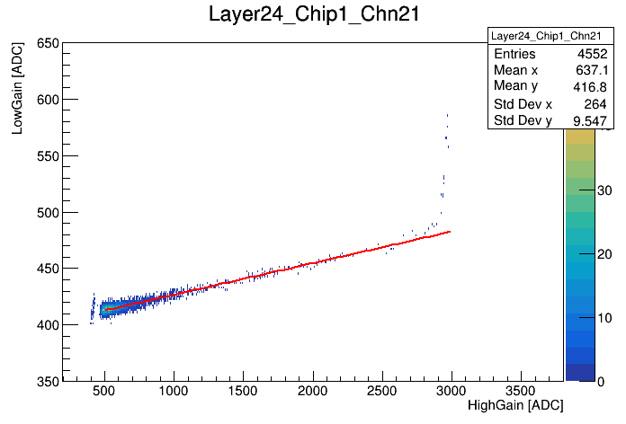
Fake signal
It occurred to almost all the plot which hit tag equals 1
Low threshold may cause this problem

Slide 7
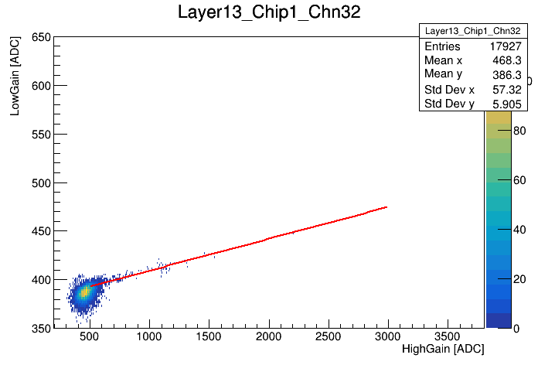
Others

Slide 8
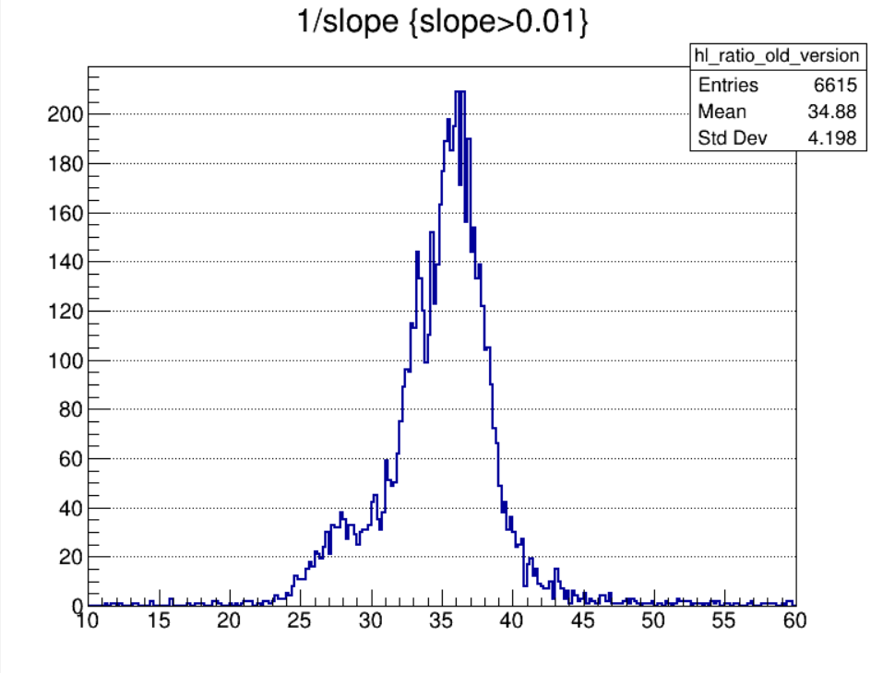
HL-Ratio Result Comparison

