Slide 1
A very biased theoretical overview on heavy quark physics
上海交通大学
王伟
15/04/2023
第三届LHCb前沿物理研讨会

Slide 2
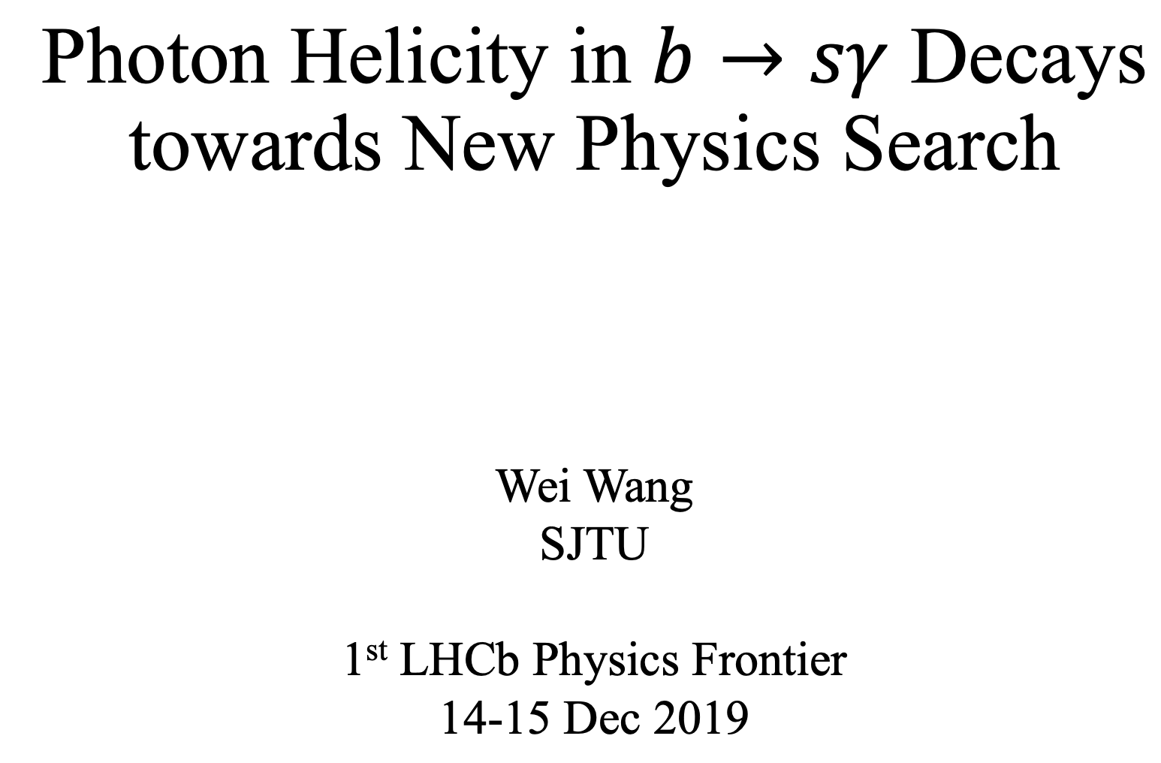
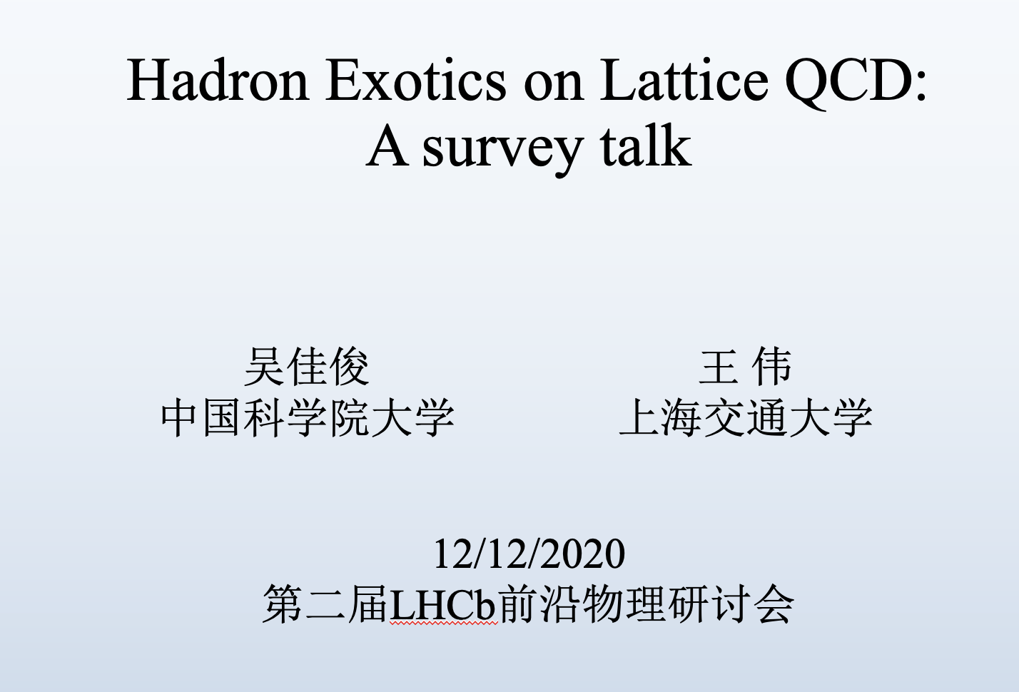
1909.13083
2207.00183

Slide 3

“灵魂三问”
你要到哪里去？
你从哪里来？
你是谁？

Slide 4
Past
Future
Present

Slide 5
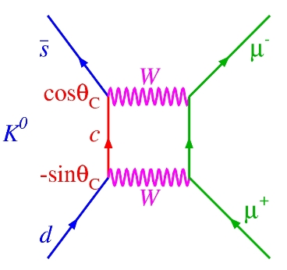
Past
5
https://www.science20.com/quantum_diaries_survivor/continuing_quest_flavorchanging_neutral_currents
GIM
1970

Slide 6
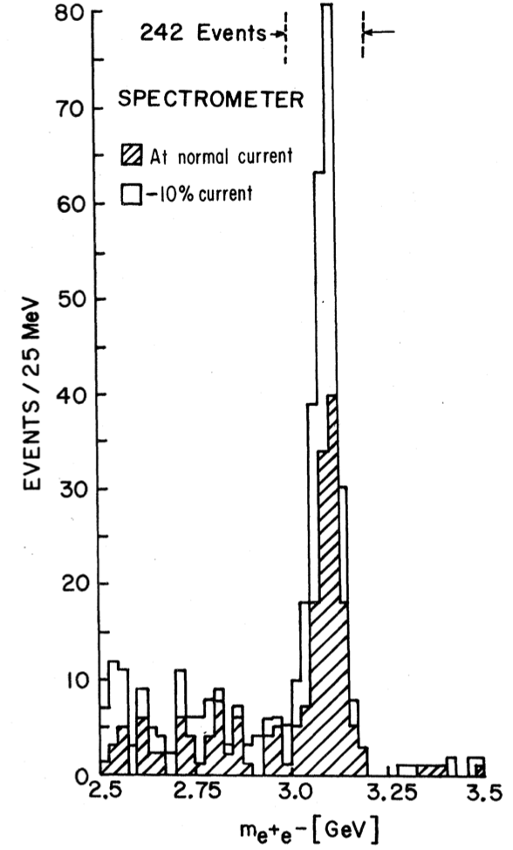
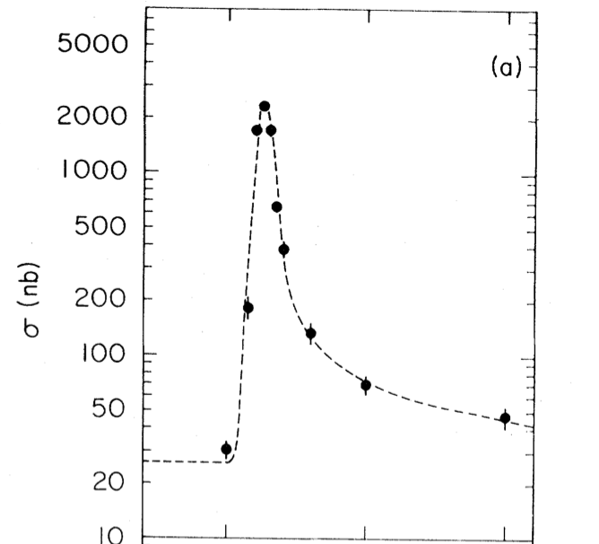
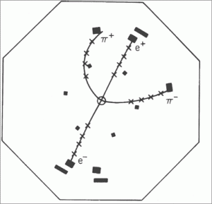

Past
6
GIM
1970
PRL 33, 1404(1974)
PRL33, 1406(1974)
$$J/ψ$$
1974

Slide 7
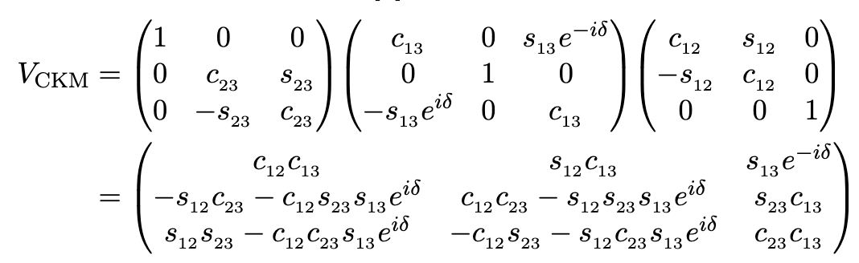
Past
7
Prog. Theor. Phys.49, 652 (1973)
GIM
1970
KM
1973
$$J/ψ$$
1974

Slide 8
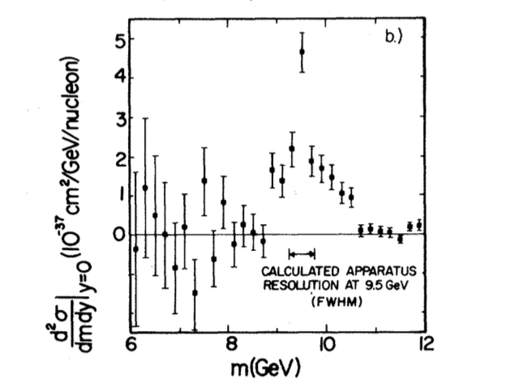
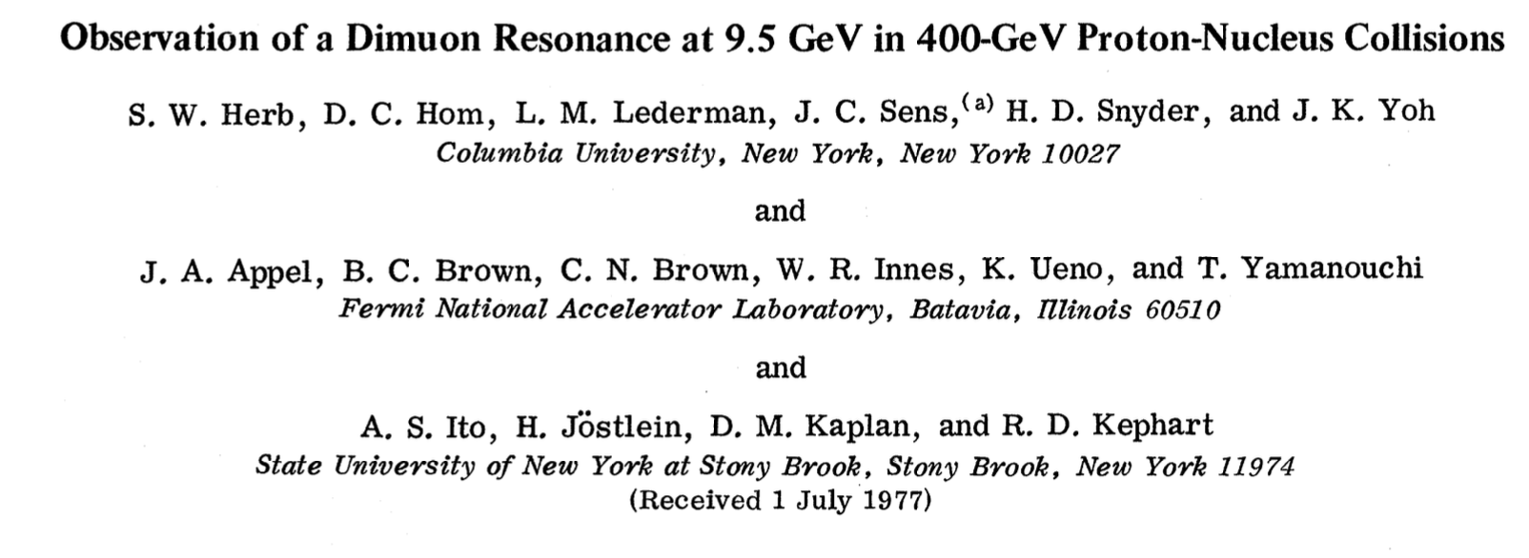

Past
8
PRL 39 (1977) 252-255
GIM
1970
KM
1973
$$J/ψ$$
1974
$$Υ$$
1977

Slide 9
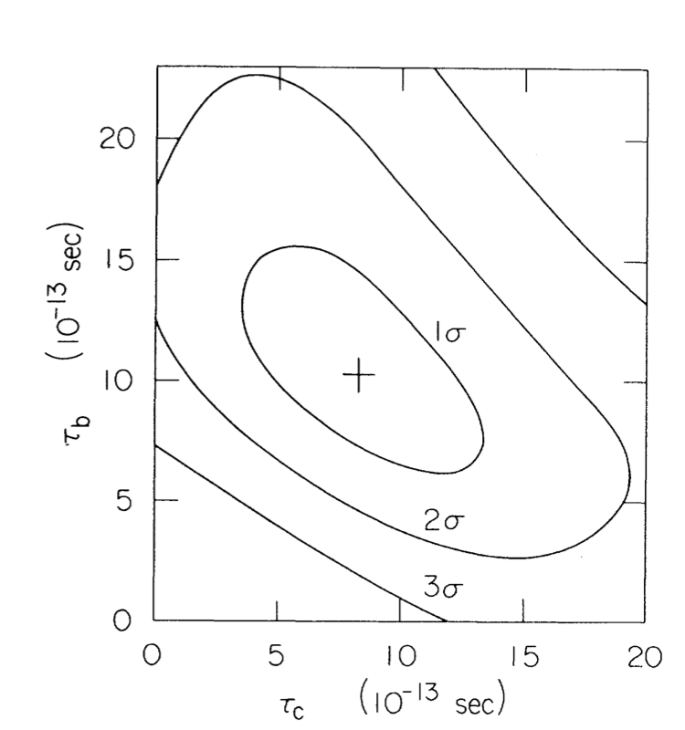
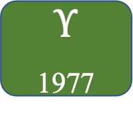

Past
9
$$τ_{b}=\left({12.0}_{−3.6}^{+4.5}±3.0\right)×{10}^{−13}s$$
PRL 51,1316(1983)
GIM
1970
KM
1973
$$J/ψ$$
1974
$$Υ$$
1977
lifetime
1983

Slide 10
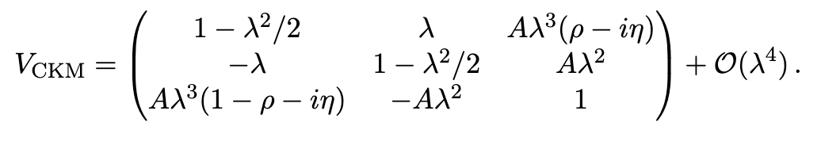

Past
10
$$λ=0.22$$
GIM
1970
KM
1973
Wolfenstein
1983
$$J/ψ$$
1974
$$Υ$$
1977
lifetime
1977

Slide 11
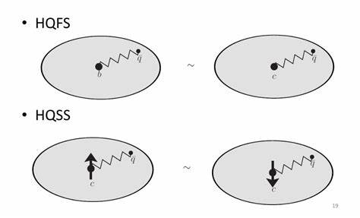
Past
11
“Weak Decays of Heavy Mesons in the Static Quark Approximation”, Nathan Isgur, Mark B. Wise, Phys.Lett.B 232 (1989) 113-117
“Weak Transition form factors between heavy mesons”, Nathan Isgur, Mark B. Wise, Phys.Lett.B 237 (1990) 527-530
GIM
1970
KM
1973
Wolfenstein
1983
HQET
1989
$$J/ψ$$
1974
$$Υ$$
1977
lifetime
1977

Slide 12
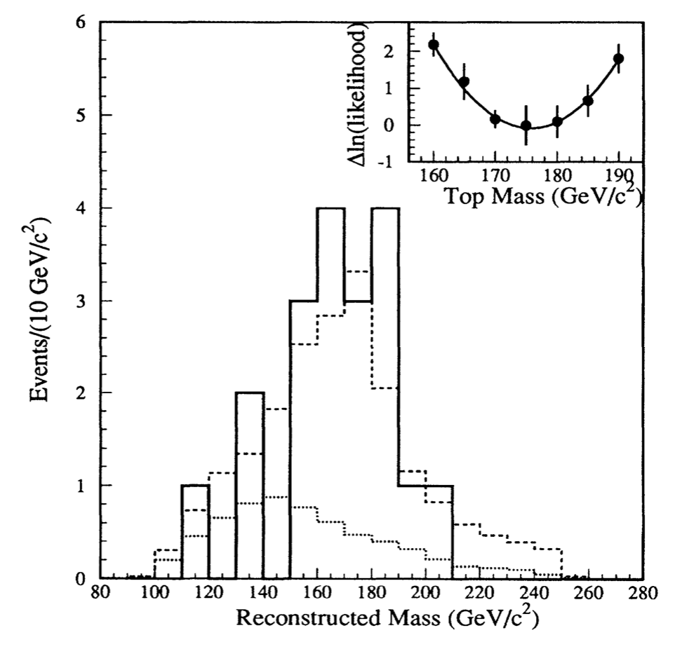





Past
12
$$\overline{d}$$
$$\overline{b}$$
$$b$$
$$d$$
$B−\overline{B}$ mixing
CDF, PRL 74, 2626(1995)
GIM
1970
KM
1973
Wolfenstein
1983
HQET
1989
$$J/ψ$$
1974
$$Υ$$
1977
lifetime
1977
Top
1995

Slide 13
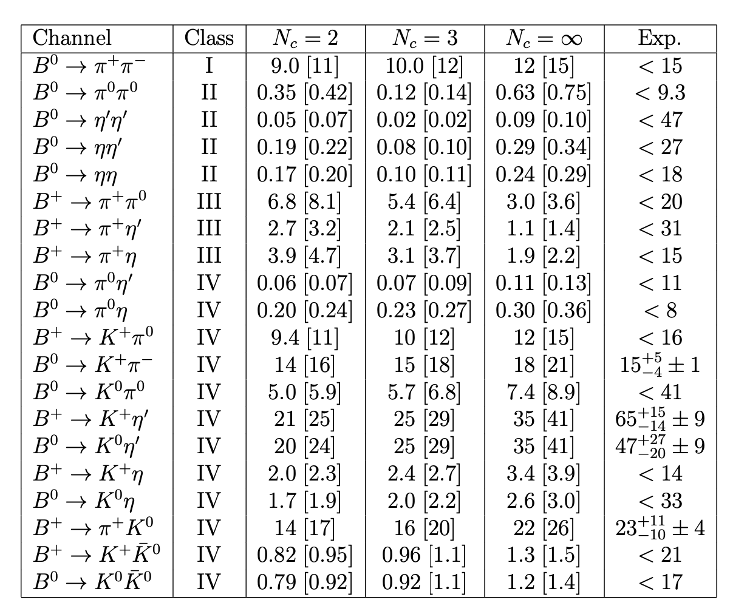
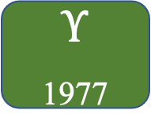
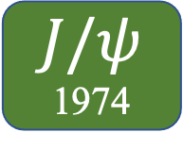
Past
13
Ali, Kramer, Lu, PRD 58, 094009(1998)
GIM
1970
KM
1973
Wolfenstein
1983
HQET
1989
Gen F
1998
$$J/ψ$$
1974
$$Υ$$
1977
lifetime
1977
Top
1995

Slide 14
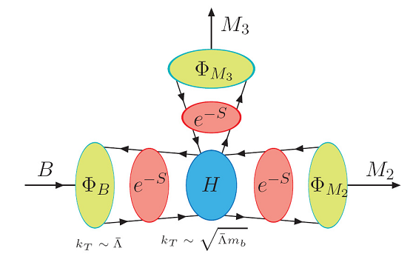
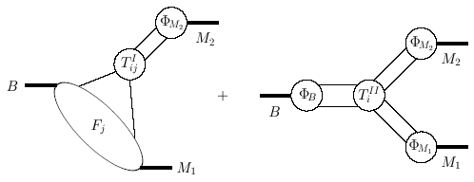
Past
14
GIM
1970
KM
1973
Wolfenstein
1983
HQET
1989
Gen F
1998
QCDF/PQCD/SCET
2000
$$J/ψ$$
1974
$$Υ$$
1977
lifetime
1977
Top
1995

Slide 15
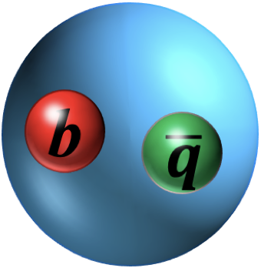
Heavy Quark Physics
15
What can one benefit from HQP?
Test of Standard Model (CPV)
Search for “New Physics”
Understanding QCD
…
See Feng-Kun Guo, Jia-Jun Wu, Wei Chen, Bing Chen’s talks
See Yan-Qing Ma’s talk

Slide 16
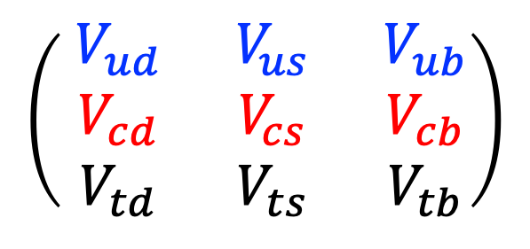

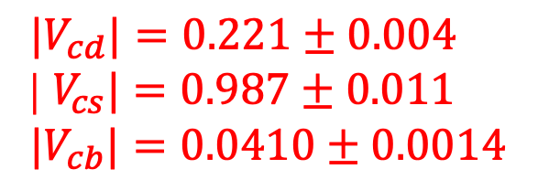
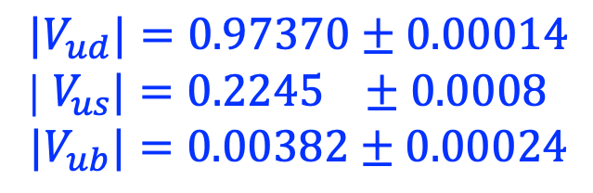
Present
16
$$\left(\begin{matrix}{ V}_{ud} & { V}_{us} & { V}_{ub} \\ { V}_{cd} & { V}_{cs} & { V}_{cb} \\ { V}_{td} & { V}_{ts} & { V}_{tb}\end{matrix}\right)$$
$${|V}_{ud}|=0.97370±0.00014$$
| $V_{us}|=0.2245 ±0.0008$
$${|V}_{ub}|=0.00382±0.00024$$
$${|V}_{cd}|=0.221±0.004$$
| $V_{cs}|=0.987±0.011$
$${|V}_{cb}|=0.0410±0.0014$$
$$α+β+γ={\left({179}_{−6}^{+7}\right)}^{°}$$

Slide 17

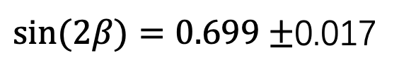
Present
17
$$\sin{(2β)}$$
$sin⁡(2β)=0.699±$0.017

Slide 18
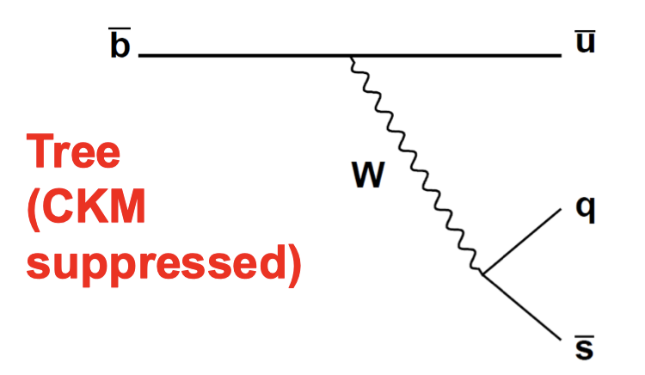

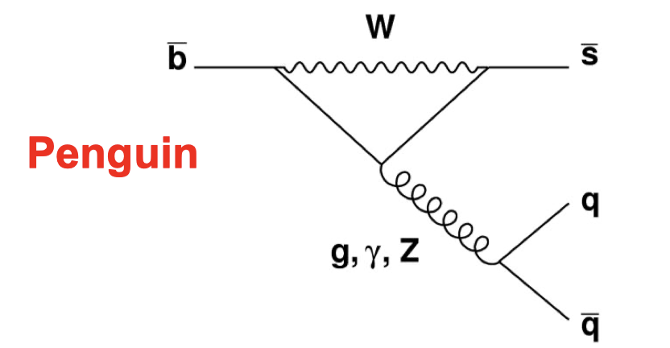

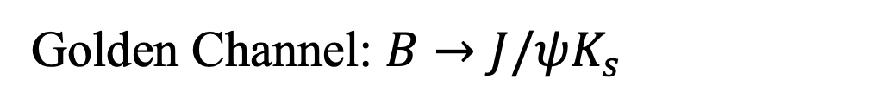
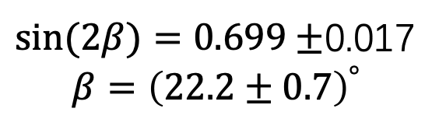
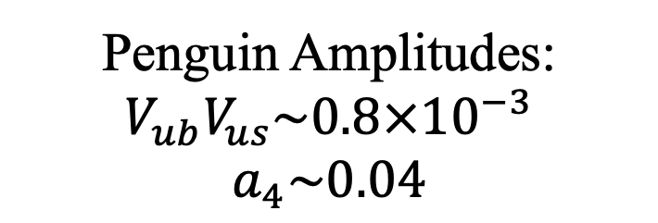

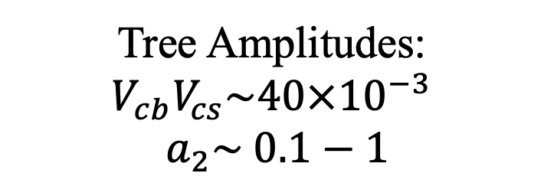
Present
18
$sin⁡(2β)=0.699±$0.017
$$β={\left(22.2±0.7\right)}^{°}$$
Golden Channel: $B→J/ψK_{s}$
b
c
Tree Amplitudes:
$V_{cb}V_{cs}\sim 40×{10}^{−3}$
$a_{2}\sim 0.1−1$
$$\overline{c}$$
s
b
s
Penguin Amplitudes:
$$V_{ub}V_{us}\sim 0.8×{10}^{−3}$$
$$a_{4}\sim 0.04$$
$$\overline{c}$$
c

Slide 19
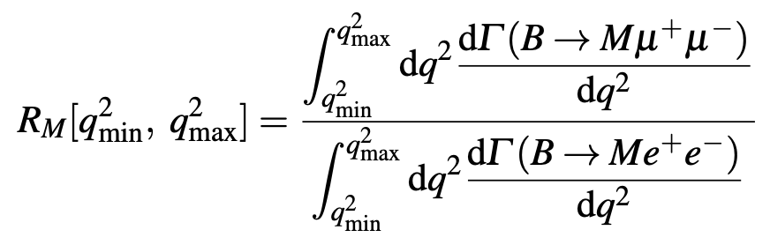
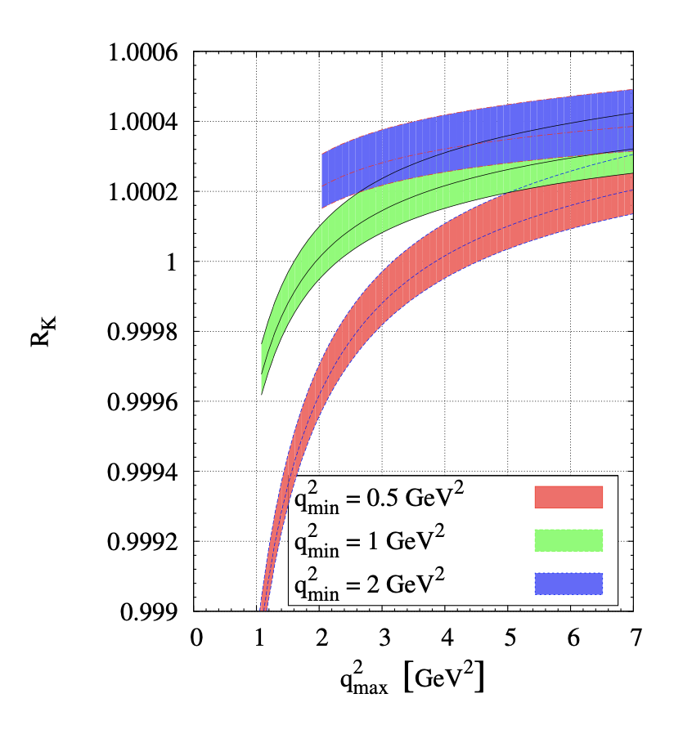
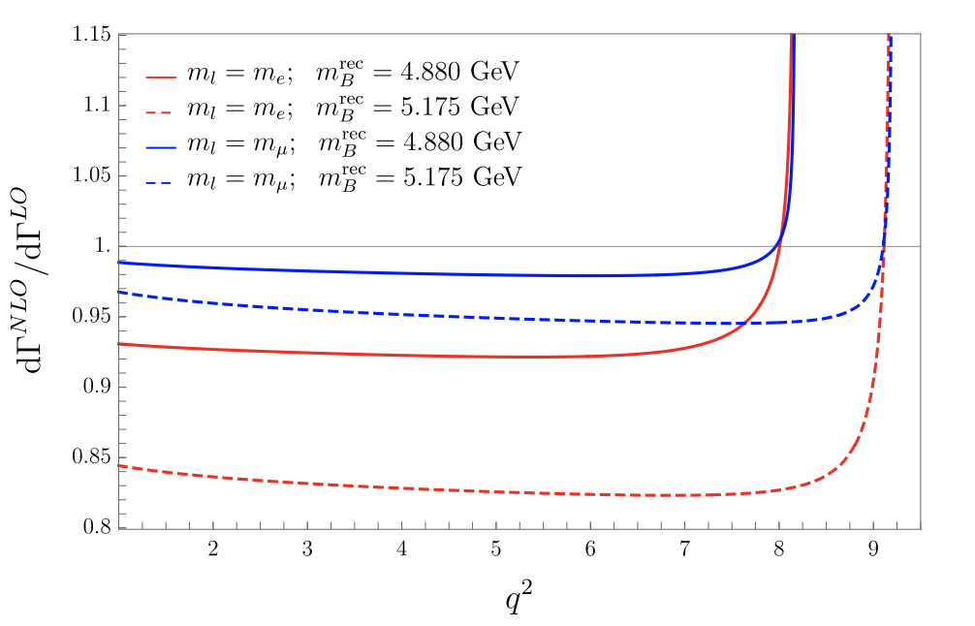
Present
19
R_{K}
C. Bobeth et al., JHEP 12 (2007) 040
M. Bordone et al., EJPC 76 (2016) 440

Slide 20
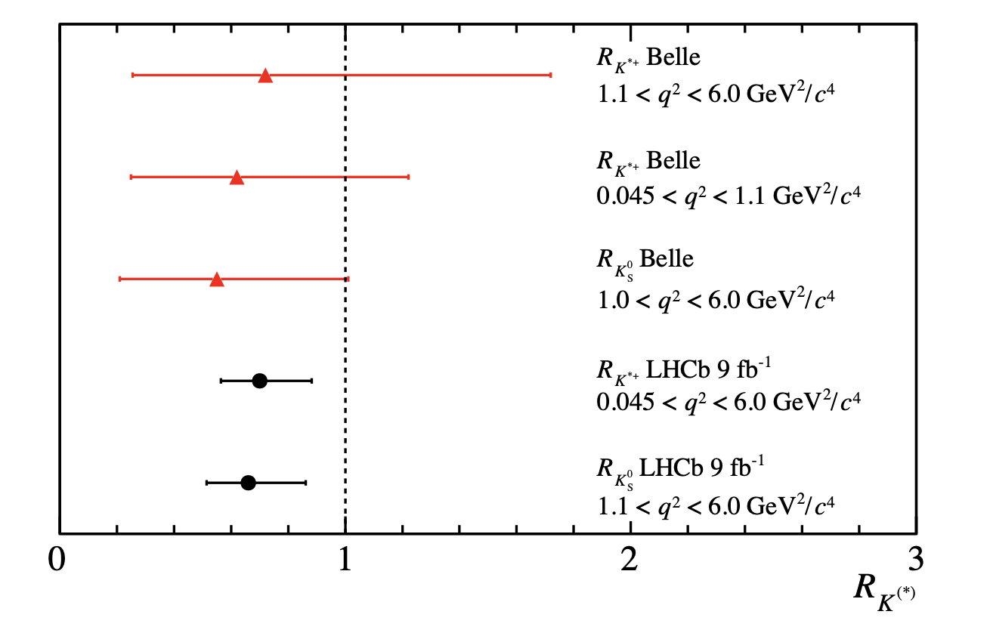
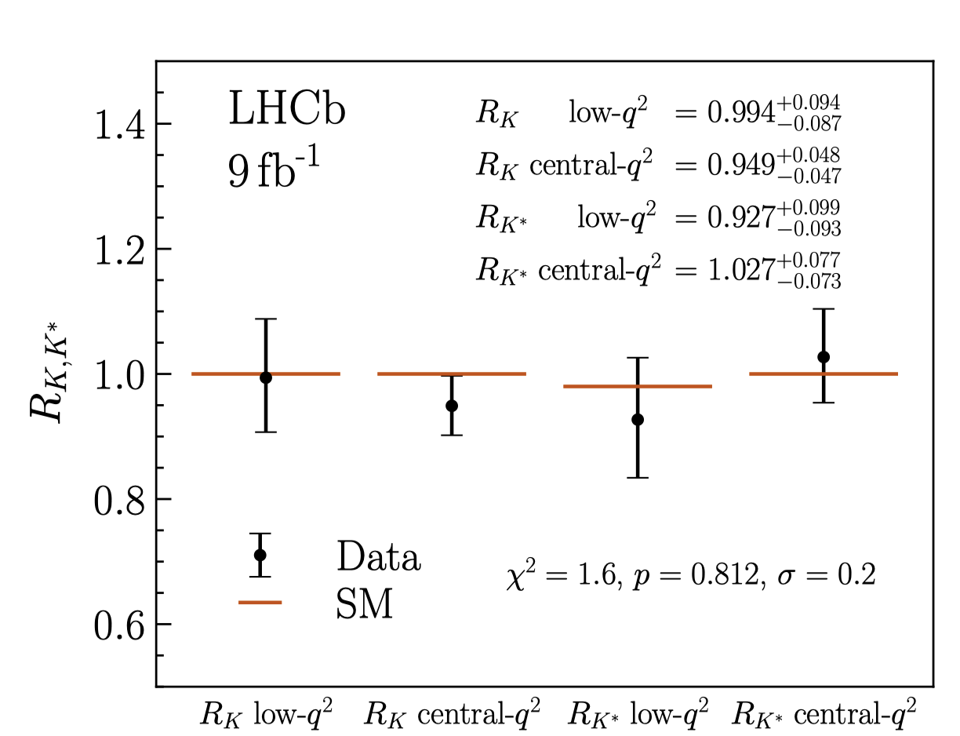
Present
20
R_{K}
PRL 128 (2022) 191802
arXiv: 2212.09153
路漫漫其修远兮，吾将上下而求索
The road ahead will be long and our climb will be steep
何吉波, 量子宇宙物理前沿：中微子宇宙学研讨会

Slide 21
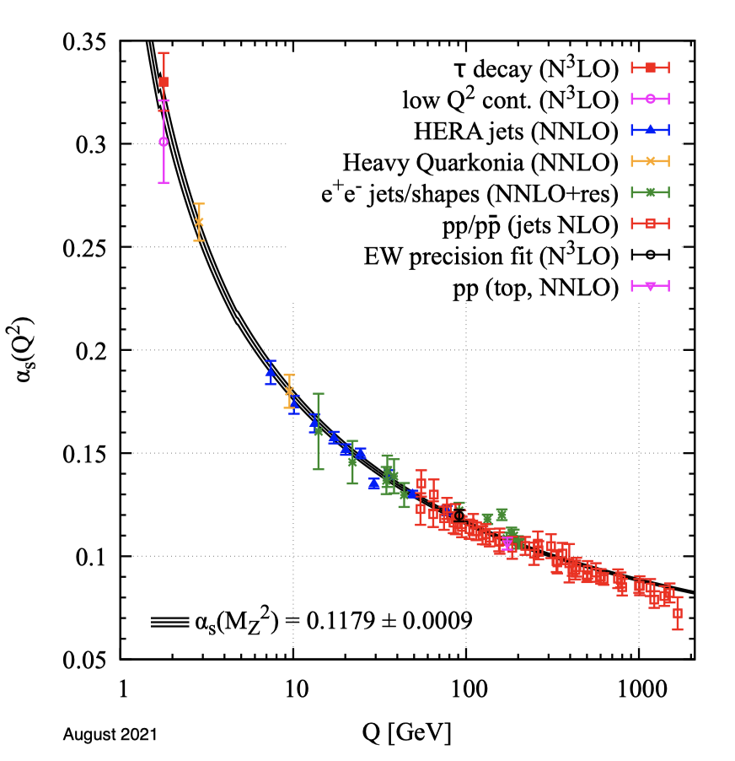
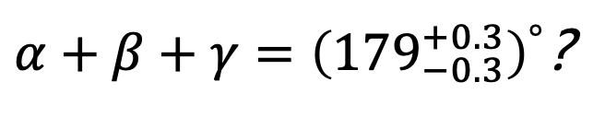
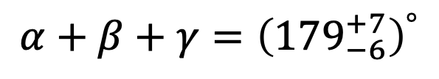
Present
21
$$α+β+γ={\left({179}_{−6}^{+7}\right)}^{°}$$
$α+β+γ={\left({179}_{−0.3}^{+0.3}\right)}^{°}$?
New Physics ?
PRL 128 (2022) 191802

Slide 22
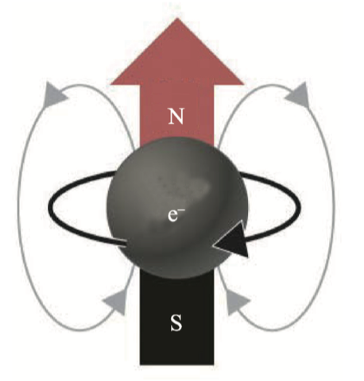
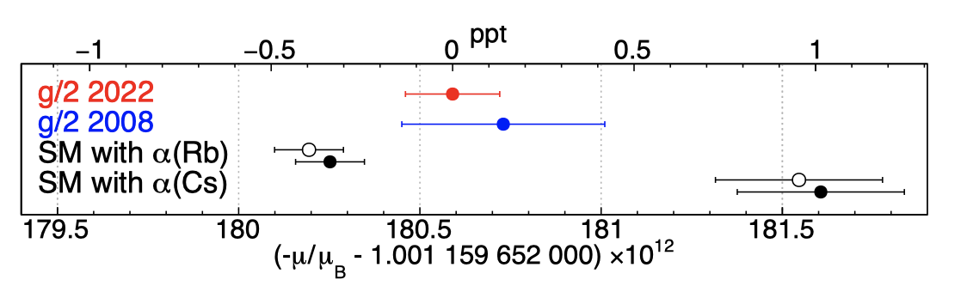
Present
22
One-loop: J. S. Schwinger, Phys. Rev. 73 (1948), 416-417
Two-loop: A. Petermann, Helv. Phys. Acta 30 (1957), 407-408
C. M. Sommerﬁeld, Ann. Phys. (N.Y.) 5, 26 (1958)
Three-loop: T. Kinoshita, Phys. Rev. Lett. 75, 4728 (1995)
S. Laporta and E. Remiddi, Phys. Lett. B 379 (1996), 283
Four-loop: T. Kinoshita and M. Nio, Phys. Rev. D 73, 013003 (2006)
S. Laporta, Physics Letters B 772, 232 (2017)
Five-loop: T. Aoyama, M. Hayakawa, T. Kinoshita and M. Nio, PRL 109(2012), 111807
T. Aoyama, T. Kinoshita, and M. Nio, Phys. Rev. D 97, 036001 (2018).
S. Volkov, Phys. Rev. D 100, 096004 (2019)
PRL 130, 071801(2022)
One-loop
1948
Three-loop
1996
Five-loop
2012
Two-loop
1957
Four-loop
2006

Slide 23
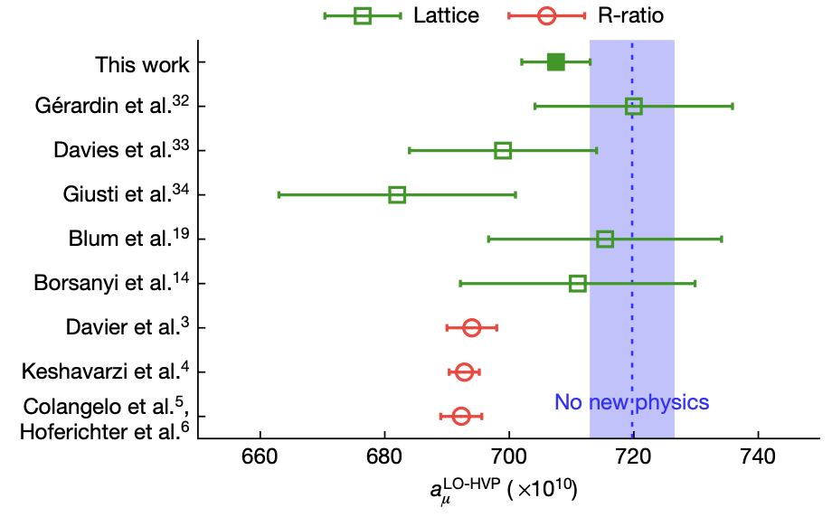
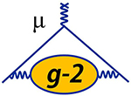
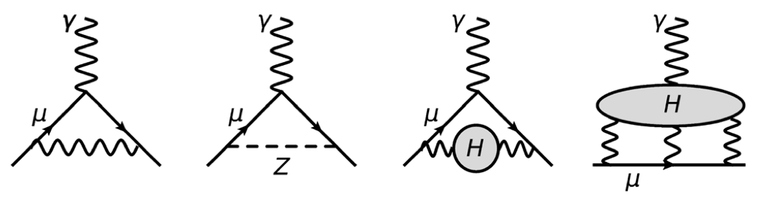
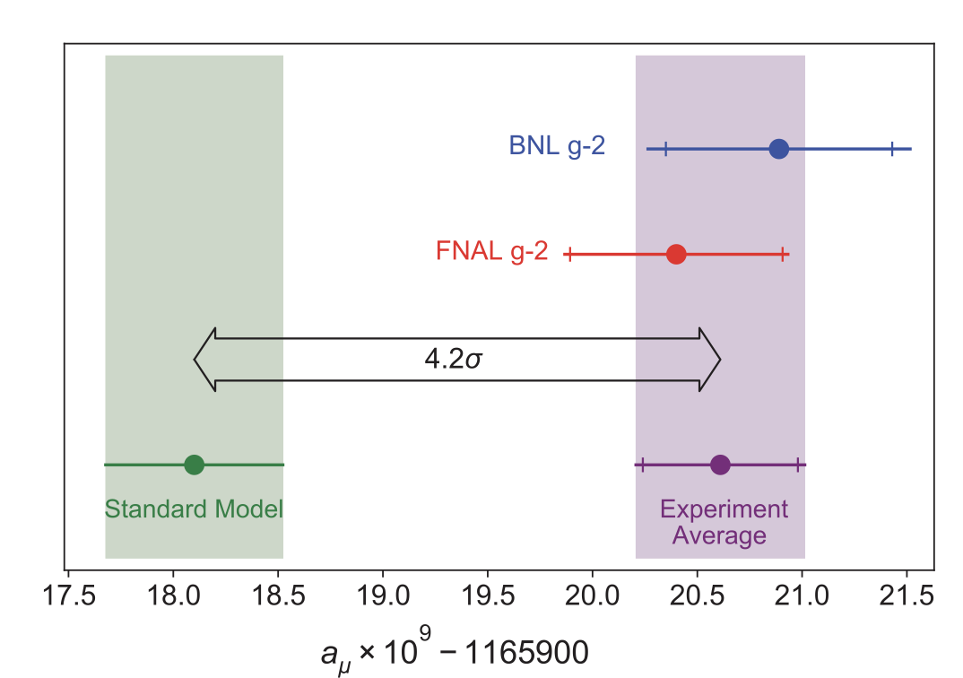
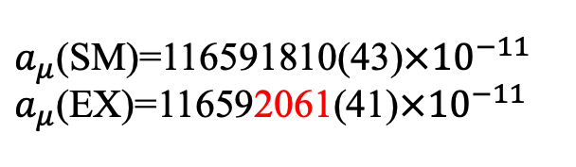
Present
23
Nature 593, 51–55 (2021)
$a_{μ}$(SM)=116591810(43)$×{10}^{−11}$
$a_{μ}$(EX)=116592061(41)$×{10}^{−11}$
PRL 126, 141801 (2021)

Slide 24
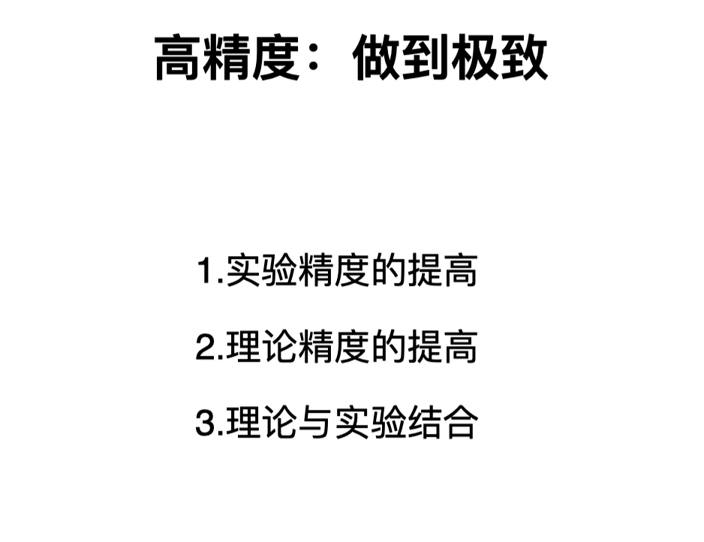
Future
24
于福升, 第19届重味物理与CP破坏会议总结报告

Slide 25
Future
25
增长点
高精度

Slide 26
Future：新的增长点
26
增长点
  新观测量：重子衰变、角分布、局域CP、光子极化
  老问题+新方法：反问题
  新现象：湮灭图可因子化
  …

Slide 27
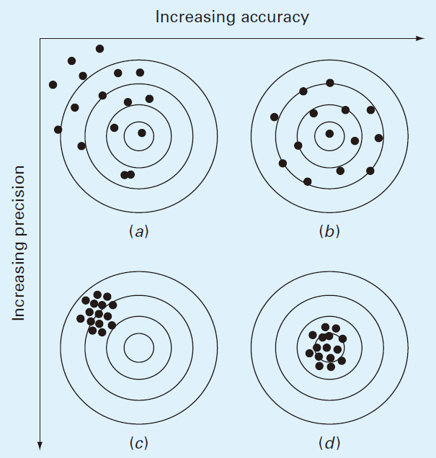
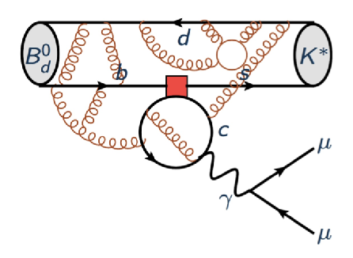
Future：高精度
27
高精度 = 正确 + 精确

Slide 28
Future：高精度
28
新的增长点
高精度
  高准确度： QED修正、LCDA/TMDWF
  高精确度: 高阶QCD修正、高幂次修正; nonfactorizable diagrams

Slide 29
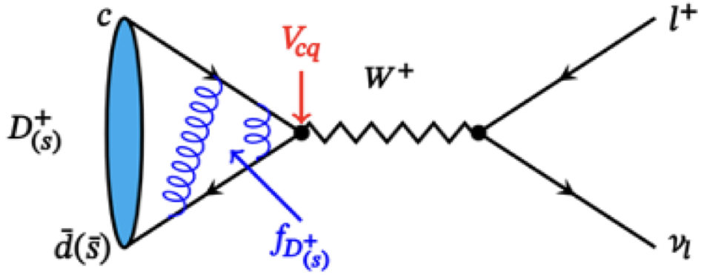
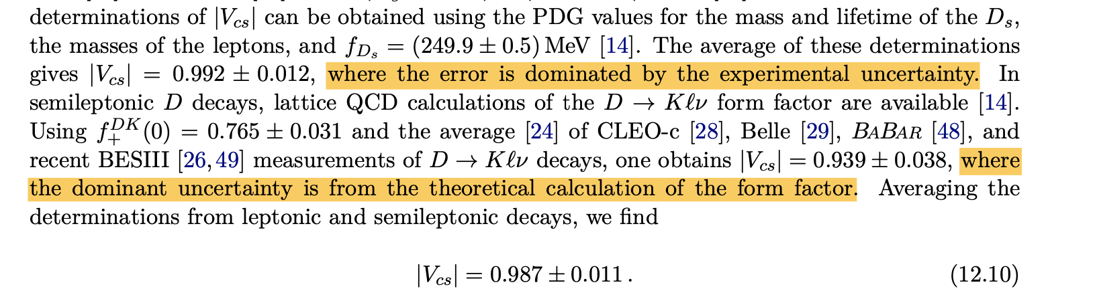
Future：高精度
29
QED修正

Slide 30
Future：高精度
30
LCDA/TMDWF
A ~ ∫d⁴k₁ d⁴k₂ d⁴k₃ Tr [ C(t) Φ_{B}(k₁) Φ₁(k₂) Φ₂(k₃) H(k₁,k₂,k₃,t) ] exp{–S(t)}

Slide 31



Future：高精度
31
LCDA/TMDWF
PRD 83,094031(2011)
PRD76, 074018 (2007)

Slide 32
Future：高精度
32
LCDA/TMDWF
Ji,PRL110, 262002(2013)
PDF:
light-cone separation;
Cannot be calculated on the lattice
Quasi-PDF :
Equal-time correlation;
Directly calculable on the lattice

Slide 33
Future：高精度
33
LCDA/TMDWF
精确度待提升
PRL 129, 132001 (2022)
PRL 127, 062002 (2021)
尚未实现格点计算
arXiv: 2302.09961
PRD 127, 062002 (2021)

Slide 34
Future：高精度
34
新的增长点
高精度
  高准确度：QED修正、LCDA/TMDWF
  高精确度: 高阶QCD修正、高幂次修正、 nonfactorizable contributions

Slide 35

Future：高精度
35
Nonfactorizable contributions: charm loop?

Slide 36




36
  理论研究内容不断丰富，研究精度不断提升
超级陶粲工厂
  没有精确的实验数据，高精度的理论研究也就少了实际意义

Slide 38

https://cerncourier.com/a/50-years-of-the-gim-mechanism/

Slide 39


过去
Samuel C. C. Ting
Phys. Rev. Lett. 33, 1404
GIM
$$J/ψ$$
B. Richter
Phys. Rev. Lett. 33, 1406

Slide 40




过去
J. H. Christenson, J. W. Cronin, V. L. Fitch, and R. Turlay, Phys. Rev. Lett. 13, 138
GIM
KCP
$$J/ψ$$

Slide 41

过去
Prog. Theor. Phys.49, 652 (1973)
GIM
KCP
KM
$$J/ψ$$

Slide 42
过去
Phys.Rev.Lett. 39 (1977) 252-255
GIM
KCP
b quark
KM
$$J/ψ$$

Slide 43

过去
GIM
KCP
b 发现
Wolfenstein 参数化
KM
b 寿命
$$J/ψ$$

Slide 44

过去
“Weak Decays of Heavy Mesons in the Static Quark Approximation”, Nathan Isgur, Mark B. Wise, Phys.Lett.B 232 (1989) 113-117
“WEAK TRANSITION FORM-FACTORS BETWEEN HEAVY MESONS”, Nathan Isgur, Mark B. Wise, Phys.Lett.B 237 (1990) 527-530
GIM
KCP
b 发现
Wolfenstein 参数化
KM
b 寿命
HQET
$$J/ψ$$

Slide 45
过去
QCDF:
M. Beneke, G. Buchalla, M. Neubert, Christopher T. Sachrajda, Nucl.Phys.B 591 (2000) 313-418
PQCD:
Cai-Dian Lv, Mao-Zhi Yang, Eur.Phys.J.C 23 (2002) 275-287
SCET:
Wolfenstein
参数化
Generalied Factorization
GIM
KCP
b 发现
KM
b 寿命
HQET
QCDF,PQCD,SCET
$$J/ψ$$

Slide 46

Future：高精度
$$α={\left({84.9}_{−4.5}^{+5.1}\right)}^{°}$$
$$β={\left(22.2±0.7\right)}^{°}$$
$$γ={\left({72.1}_{−4.5}^{+4.1}\right)}^{°}$$
高精度=正确且精确的理论预言

