Slide 1
Study of heavy baryons in the diquark picture
Bing Chen
Anhui Science and Technology University
Cooperators: Xiang Liu, Ailin Zhang, Si-Qiang Luo, Ke-wei Wei, and Takayuki Matsuki
第三届LHCb前沿物理研讨会(中国科学院大学·北京· 2023)

Slide 2
Outline
1. What is the meaning of “diquark” picture?
2. Review of our results for the heavy baryon states
3. Universal behavior of mass gaps for the heavy baryons
4. Summary and outlook
第三届LHCb前沿物理研讨会(中国科学院大学·北京· 2023)

Slide 3
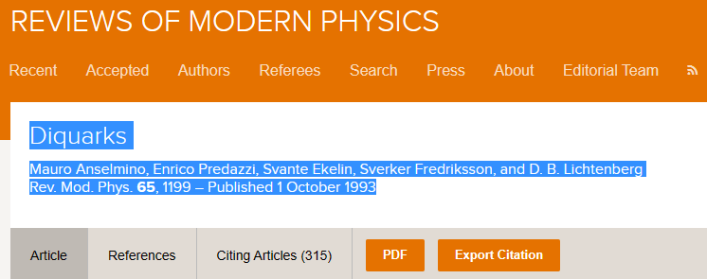
What is the meaning of “diquark” picture?
Although the concept of “diquark” has been widely used to study the different kinds of problems in hadron physics, the meaning of “diquark” is still unclear.
In our works, two light constituent quarks in a single heavy baryon are assumed to form a light cluster (or namely, the diquark) . Two light quarks in the diquark are always in the ground state.
第三届LHCb前沿物理研讨会(中国科学院大学·北京· 2023)

Slide 4
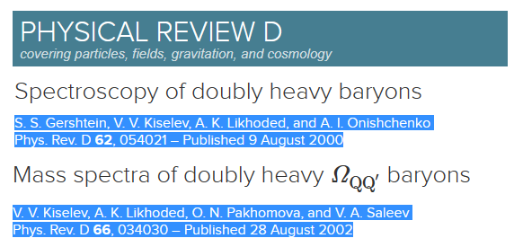
What is the meaning of “diquark” picture?
Even the “diquark” was used to study the mass spectrum of heavy baryons, different authors treated it differently. For an example
So we understand the “diquark” as follows. Due to the particular structure of QQq and Qqq baryons, the dynamics of “QQ/qq” quarks can be factorized approximatively. Then the subsystem which is composed of “QQ/qq” quarks could be regarded as an effective degrees of freedom for the heavy baryons.
第三届LHCb前沿物理研讨会(中国科学院大学·北京· 2023)

Slide 5
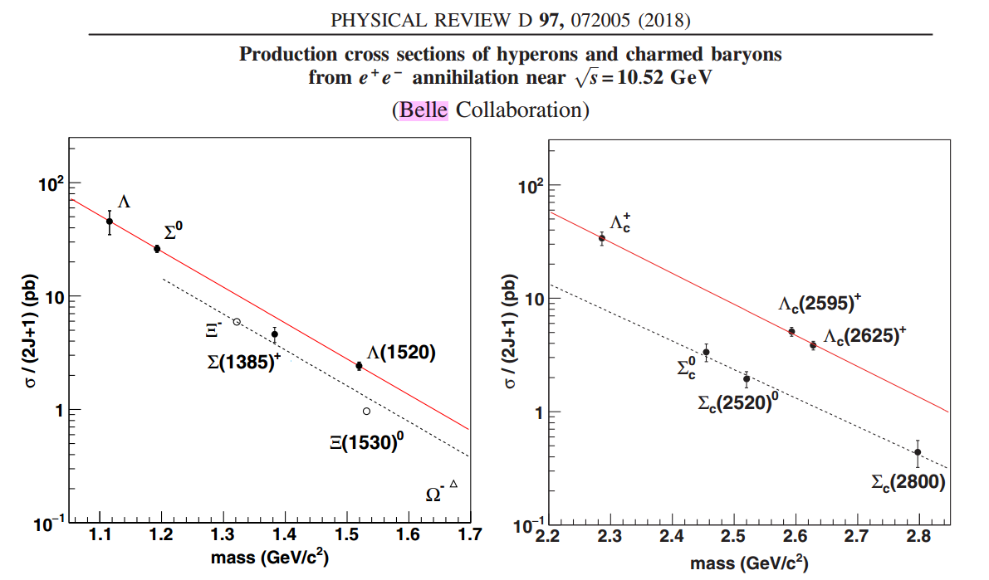
Foundation for the heavy baryons in the diquark picture
This observation supports the theory that the diquark production is the main process of charmed baryon production from $e^{+}e^{−}$ annihilation and that the diquark structure exists in the ground state and low-lying excited states of $Λ_{c}^{+}$ baryons.
第三届LHCb前沿物理研讨会(中国科学院大学·北京· 2023)

Slide 6
Our works for charm baryons
1. “Investigation of $Λ_{Q}$ and $Ξ_{Q}$ baryons in the heavy quark-light diquark picture ”,
Bing Chen, Ke-Wei Wei, and Ailin Zhang
Eur. Phys. J. A 51, 82 (2015).
2. “Low-lying charmed and charmed-strange baryon states”,
Bing Chen, Ke-Wei Wei, Xiang Liu, Takayuki Matsuki
Eur. Phys. J. C 77, 154 (2017).
3. “Newly observed $Λ_{c}{\left(2860\right)}^{+}$ at LHCb and its D-wave partners $Λ_{c}{\left(2880\right)}^{+}$, $Ξ_{c}{\left(3055\right)}^{+}$
and $Ξ_{c}{\left(3080\right)}^{+}$”,
Bing Chen, Xiang Liu, and Ailin Zhang
Phys. Rev. D 95, 074022 (2017).
4. “New $Ω_{c}$ baryons discovered by LHCb as the members of 1P and 2S states”
Bing Chen, and Xiang Liu
Phys. Rev. D 96, 094015 (2017).
第三届LHCb前沿物理研讨会(中国科学院大学·北京· 2023)

Slide 7
Our works for bottom baryons
5. “Assigning the newly reported $Σ_{b}\left(6097\right)$ as a P-wave excited state and predicting its partners”
Bing Chen, and Xiang Liu
Phys. Rev. D 98, 074032 (2018).
6. “Role of newly discovered $Ξ_{b}\left(6227\right)$ for constructing excited bottom baryon family”
Bing Chen, Ke-Wei Wei, Xiang Liu, and Ailin Zhang
Phys. Rev. D 98, 031502 (2018) (RAPID COMMUNICATIONS) .
7. “Interpretation of the observed $Λ_{b}{\left(6146\right)}^{0}$ and $Λ_{b}{\left(6152\right)}^{0}$ states as 1D bottom baryons ”
Bing Chen, Si-Qiang Luo, Xiang Liu, Takayuki Matsuki
Phys. Rev. D 100, 094032 (2019).
8. “b-hadron spectroscopy study based on the similarity of double bottom baryon and bottom
meson ”
Bing Chen, Si-Qiang Luo, Ke-Wei Wei, and Xiang Liu
Phys. Rev. D 105 074014 (2022).
第三届LHCb前沿物理研讨会(中国科学院大学·北京· 2023)

Slide 8
We mainly focus on the masses and strong decay of Qqq states
When the diquark picture is incorporated into the concrete phenomenological models, the mass spectra and the strong decay behaviors of heavy baryons were studied in our series works.
diquark picture
Flux tube model
Quark potential model
$QPC$ model
The mass spectrum (1)
The strong decays (2)
Other issues (3)
Eur. Phys. J. A 51, 82 (2015). (1) Eur. Phys. J. C 80,301(2020). (3)
Eur. Phys. J. C 77, 154 (2017). (1),(2) Eur. Phys. J. C 81,474(2021). (3)
Phys. Rev. D 95, 074022 (2017). (1),(2) Phys. Rev. D 105 074014 (2022). (3)
Phys. Rev. D 96, 094015 (2017). (1),(2)
Phys. Rev. D 98, 074032 (2018). (1),(2)
Phys. Rev. D 98, 031502 (2018). (1),(2)
Phys. Rev. D 100, 094032 (2019). (1),(2)
第三届LHCb前沿物理研讨会(中国科学院大学·北京· 2023)

Slide 9
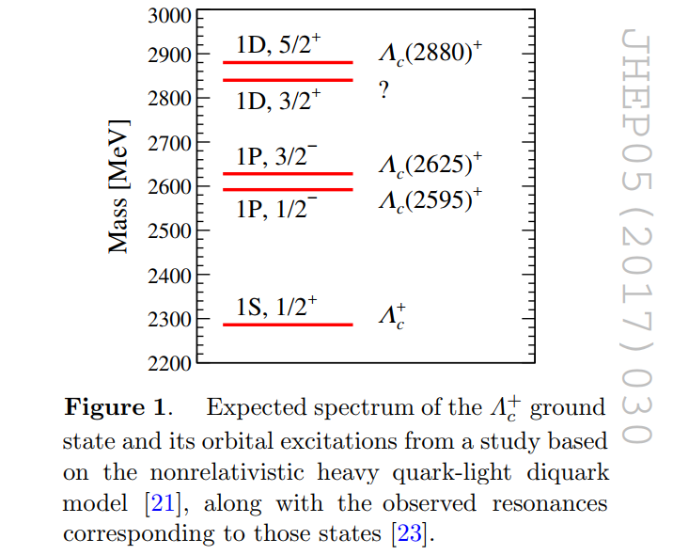
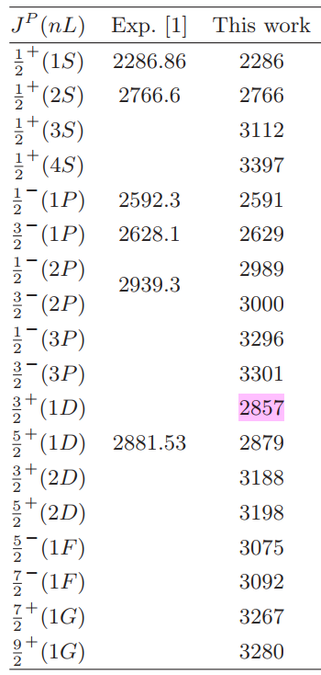
Comparisons between our results and the later experiments
LHCb Collaboration (R. Aaij (CERN) et al.), JHEP 1705 (2017) 030
Bing Chen, Ke-Wei Wei, and Ailin Zhang
Eur. Phys. J. A 51, 82 (2015).
$${\frac{3}{2}}^{+}$$
第三届LHCb前沿物理研讨会(中国科学院大学·北京· 2023)

Slide 10
Comparisons between our results and the later experiments
“Assigning the newly reported $Σ_{b}\left(6097\right)$ as a P-wave excited state and predicting its partners”
Bing Chen, and Xiang Liu, Phys. Rev. D 98, 074032 (2018)
LHCb Collaboration, Phys. Rev. Lett. 124, 082002 (2020)
第三届LHCb前沿物理研讨会(中国科学院大学·北京· 2023)

Slide 11
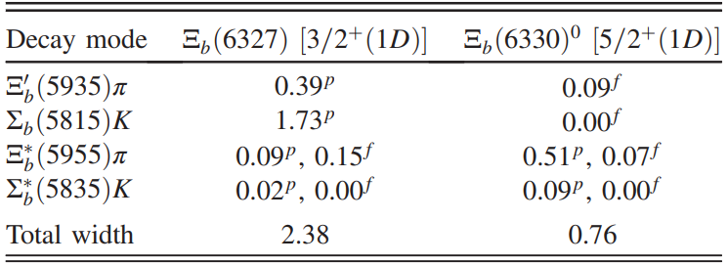
Comparisons between our results and the later experiments
“Interpretation of the observed $Λ_{b}{\left(6146\right)}^{0}$ and $Λ_{b}{\left(6152\right)}^{0}$ states as 1D bottom baryons ”
Bing Chen, Si-Qiang Luo, Xiang Liu, Takayuki Matsuki, Phys. Rev. D 100, 094032 (2019).
LHCb Collaboration: Phys. Rev. Lett. 128, 162001 (2022)
第三届LHCb前沿物理研讨会(中国科学院大学·北京· 2023)

Slide 12
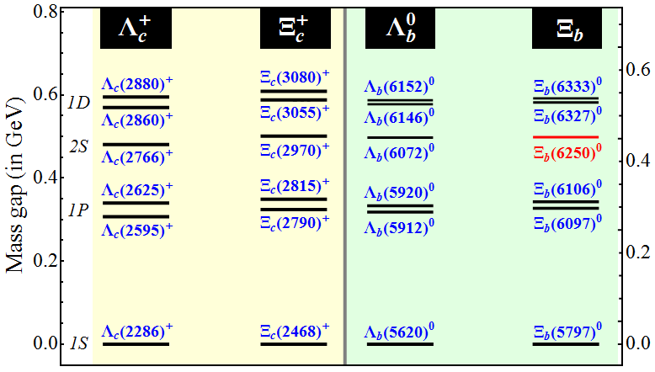
Universal behavior of mass gaps for the heavy baryons
The measured mass differences between the corresponding $Ξ_{c}$ and $Λ_{c}$ states is about 180~200 MeV.
“Investigation of $Λ_{Q}$ and $Ξ_{Q}$ baryons in the heavy quark-light diquark picture ”,
Bing Chen, Ke-Wei Wei, and Ailin Zhang, Eur. Phys. J. A 51, 82 (2015).
“Charmed Baryon Physics Circa 2021”, Hai-Yang Cheng, Chin.J.Phys. 78, 324 (2022)
第三届LHCb前沿物理研讨会(中国科学院大学·北京· 2023)

Slide 13
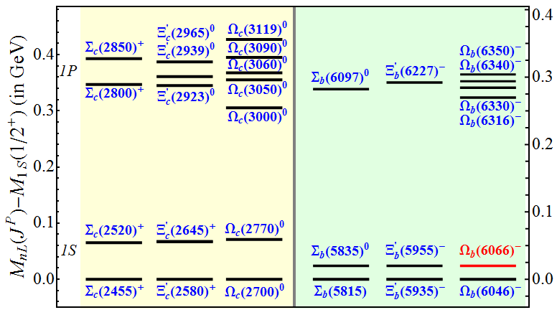
More evidences for the diquark picture
The measured mass differences the corresponding $Ξ_{c}^{′}$ and $Σ_{c}$ states is about 120~130 MeV
“Investigation of $Λ_{Q}$ and $Ξ_{Q}$ baryons in the heavy quark-light diquark picture ”,
Bing Chen, Ke-Wei Wei, and Ailin Zhang, Eur. Phys. J. A 51, 82 (2015).
“Charmed Baryon Physics Circa 2021”, Hai-Yang Cheng, Chin.J.Phys. 78, 324 (2022)
第三届LHCb前沿物理研讨会(中国科学院大学·北京· 2023)

Slide 14
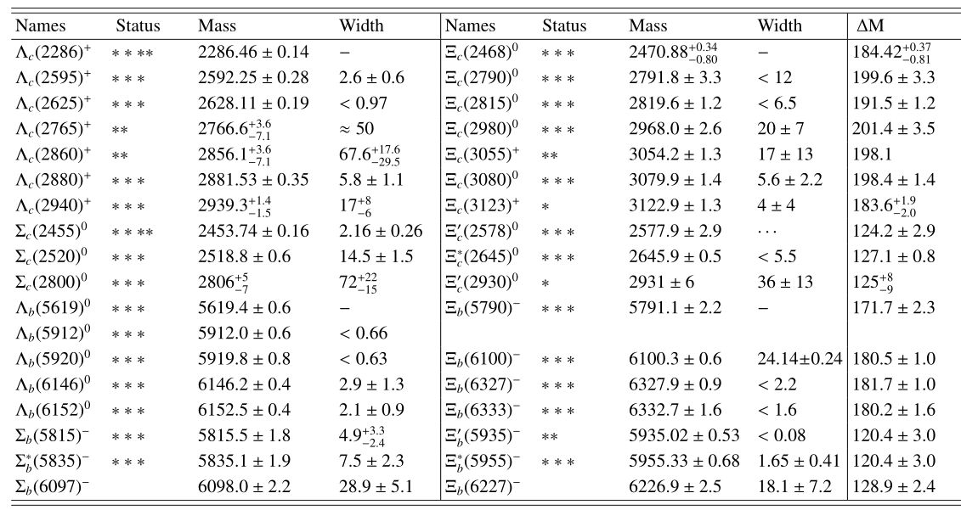
More evidences for the diquark picture
Within the diquark picture, the mass difference between the corresponding $Ξ_{c}$ and $Λ_{c}$ states is about 180~200 MeV, while the corresponding $Ξ_{c}^{′}$ and $Σ_{c}$ states is about 120~130 MeV
第三届LHCb前沿物理研讨会(中国科学院大学·北京· 2023)

Slide 15
More evidences for the diquark picture
In our recent work [ Bing Chen, Si-Qiang Luo, and Xiang Liu, Eur. Phys. J. C 81, 474 (2021) ], the mass gaps between the single baryons with the different strangeness but with same $nL\left(J^{P}\right)$ quantum numbers were ascribed to the mass difference of light quark clusters.
$$3⊗3=\overline{3}+6$$
{ss}
[ud]
$$≈125 MeV$$
$$≈190 MeV$$
{us}
{ds}
[us]
[ds]
$$≈125 MeV$$
{uu}
{ud}
{dd}
$$Λ_{Q}−Ξ_{Q}$$
$Σ_{Q}−Ξ_{Q}^{′}$ $−Ω_{Q}$
第三届LHCb前沿物理研讨会(中国科学院大学·北京· 2023)

Slide 16
Implications from the mass gaps of heavy baryons
In the diquark picture, we may have two following conclusions from the measured mass gaps of these known heavy baryon states.
$$\frac{{\overline{M}}_{n_{2}L_{2}}^{\left(Λ_{Q}\right)}−{\overline{M}}_{1S}^{\left(Λ_{Q}\right)}}{{\overline{M}}_{n_{1}L_{1}}^{\left(Λ_{Q}\right)}−{\overline{M}}_{1S}^{\left(Λ_{Q}\right)}}≈\frac{{\overline{M}}_{n_{2}L_{2}}^{\left(Ξ_{Q}\right)}−{\overline{M}}_{1S}^{\left(Ξ_{Q}\right)}}{{\overline{M}}_{n_{1}L_{1}}^{\left(Ξ_{Q}\right)}−{\overline{M}}_{1S}^{\left(Ξ_{Q}\right)}}$$
$$E_{nL}^{\left(Λ_{Q}\right)}≈E_{nL}^{\left(Ξ_{Q}\right)}$$
$$𝔸$$
$$𝔹$$
$Δ_{nL}^{\left(Λ_{Q}\right)}≅Δ_{nL}^{\left(Ξ_{Q}\right)}$ $\left(L≫1\right)$
For example, when we define the following ratios for the $Λ_{Q}$ and $Ξ_{Q}$ states
$$ℛ_{1}=\frac{M_{2S}−M_{1S}}{{\overline{M}}_{1P}−M_{1S}};$$
$$ℛ_{2}=\frac{{\overline{M}}_{1D}−M_{1S}}{{\overline{M}}_{1P}−M_{1S}};$$
Experimental results:
Ratios | $$Λ_{c}$$ | $$Ξ_{c}$$ | $$Λ_{b}$$ | $$Ξ_{b}$$
$$ℛ_{1}$$ | 1.456 | 1.472 | 1.511 | …
$$ℛ_{1}$$ | 1.774 | 1.763 | 1.780 | 1.746
第三届LHCb前沿物理研讨会(中国科学院大学·北京· 2023)

Slide 17
Implications from the mass gaps of heavy baryons
Here, we point out that the measured results of single heavy baryons could be understood in the quark potential model when the diquark picture is considered.
the power-law potential
We could compare the “$\left\langle \frac{1}{r^{3}}\right\rangle$” for the $Λ_{Q}$ and $Ξ_{Q}$ systems directly. Finally, the ratio of coefficient in the spin-orbit coupling is derived as
$V\left(r\right)$=$b_{1}r^{ν}−V_{10}$
$$−\frac{d^{2}χ_{nL}}{dr^{2}}+\left[2μb_{1}r^{ν}+\frac{l\left(l+1\right)}{r^{2}}\right]χ_{nL}=2μ\left(E_{nL}+V_{10}\right)χ_{nL}$$
$$\frac{ξ_{Λ_{Q}}}{ξ_{Ξ_{Q}}}={\left(\frac{m_{Q}+m_{\left[qs\right]}}{m_{Q}+m_{\left[ud\right]}}\right)}^{3/2}{\left(\frac{m_{\left[ud\right]}}{m_{\left[qs\right]}}\right)}^{1/2}$$
with the scaling technique
$$−\frac{d^{2}u_{nL}}{dz^{2}}+\left[z^{ν}+\frac{l\left(l+1\right)}{z^{2}}\right]u_{nL}=ε_{nL}u_{nL}$$
where the $ξ$ is defined as
we have set
$$\left\langle V_{so}\right\rangle =\left\langle \frac{4α_{s}}{3}\frac{1}{m_{di}m_{Q}}\frac{1}{r^{3}}\right\rangle s_{Q}⋅L=ξs_{Q}⋅L$$
$$z≡ηr; \frac{2μb_{1}}{η^{ν+2}}=1; ε_{nL}=\frac{2μ\left(E_{nL}+V_{10}\right)}{η^{2}}$$
Then the following ratio could be regarded as a constant for the the $Λ_{Q}$ and $Ξ_{Q}$ states
$$\frac{ξ_{Λ_{c}}}{ξ_{Ξ_{c}}}≈1.003; \frac{ξ_{Λ_{b}}}{ξ_{Ξ_{b}}}≈0.936$$
$$A_{1}=\frac{E_{nL}−E_{n^{′}L^{′}}}{ε_{nL}−ε_{n^{′}L^{′}}}=b_{1}{\left(2b_{1}μ\right)}^{−\frac{ν}{ν+2}}$$
$$m_{c}=1.55 GeV; m_{b}=4.65 GeV;$$
$${ m}_{[ud]}=0.71 GeV;{ m}_{[qs]}=0.90GeV;$$
第三届LHCb前沿物理研讨会(中国科学院大学·北京· 2023)

Slide 18
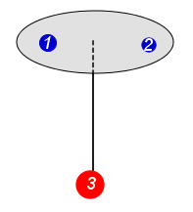
More evidences for the diquark picture
Logical framework of our recent paper
[ Bing Chen, Si-Qiang Luo, and Xiang Liu, Eur. Phys. J. C 81, 474 (2021) ]
In the diquark picture, the spin average mass of $nL$ heavy baryon multiplet could be denoted as follows
${\overline{M}}_{nL}$= $m_{Q}+m_{di}+E_{nL}$
where
$m_{di}$= $m_{1}+m_{2}+\frac{A}{m_{1}m_{2}}s_{1}·s_{2}$
For the mass gaps of corresponding heavy baryons,
$${\overline{M}}_{nL}^{Ξ_{Q}} − {\overline{M}}_{nL}^{Λ_{Q}}= m_{s}−m_{q}+\frac{3A}{4m_{q}} \left(\frac{1}{m_{q}}−\frac{1}{m_{s}}\right)= δm+3Δ$$
$${\overline{M}}_{nL}^{Ξ_{Q}^{′}} − {\overline{M}}_{nL}^{Σ_{Q}}= m_{s}−m_{q}−\frac{A}{4m_{q}} \left(\frac{1}{m_{q}}−\frac{1}{m_{s}}\right)= δm−Δ$$
$${\overline{M}}_{nL}^{Ω_{Q}} − {\overline{M}}_{nL}^{Ξ_{Q}^{′}}= m_{s}−m_{q}−\frac{A}{4m_{s}} \left(\frac{1}{m_{q}}−\frac{1}{m_{s}}\right)= δm−Δ^{′}$$
第三届LHCb前沿物理研讨会(中国科学院大学·北京· 2023)

Slide 19
More evidences for the diquark picture
Logical framework of our recent paper
[ Bing Chen, Si-Qiang Luo, and Xiang Liu, Eur. Phys. J. C 81, 474 (2021) ]
When we take the average value of the mass gaps of $Λ_{Q}$ and $Ξ_{Q}$ baryons as 195 MeV, and the mass gaps of $Σ_{Q}$ and $Ξ_{Q}^{′}$ baryons as 122 MeV, the value of A is fixed as 1.717$×{10}^{7}$ MeV. Here, the masses of u/d and s quarks are taken as $m_{u/d}=280 MeV$, $m_{s}=420 MeV$. Finally ,we may obtain
$${\overline{M}}_{nL}^{Ω_{Q}} − {\overline{M}}_{nL}^{Ξ_{Q}^{′}}=128 MeV$$
第三届LHCb前沿物理研讨会(中国科学院大学·北京· 2023)

Slide 20
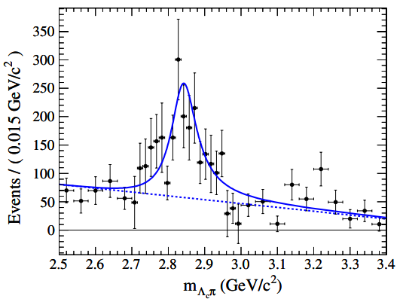
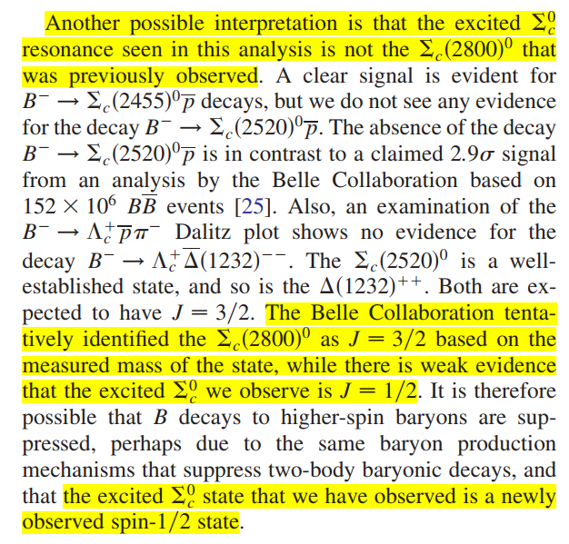
Application of the universal behavior of mass gap
(1) The puzzle of $Σ_{c}\left(2846\right)$
$$Σ_{c}\left(2846\right)$$
BABAR Collaboration
Phys. Rev. D 78, 112003 (2008)
第三届LHCb前沿物理研讨会(中国科学院大学·北京· 2023)

Slide 21
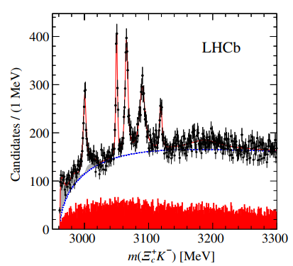
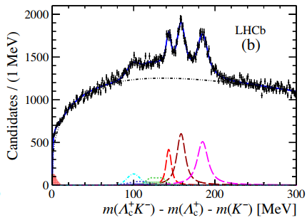
Application of the universal behavior of mass gap
(1) The puzzle of $Σ_{c}\left(2846\right)$
Phys. Rev. Lett. 118, 182001 (2017).
Phys. Rev. Lett. 124, 222001 (2020)
$$Ω_{c}\left(3050\right)$$
$$Ξ_{c}^{′}\left(2923\right)$$
$$Ξ_{c}^{′}\left(2965\right)$$
$$Ω_{c}\left(3090\right)$$
$$Ω_{c}\left(3090\right)−Ξ_{c}^{′}\left(2965\right)−Σ_{c}\left(2846\right)$$
$$Ω_{c}\left(3050\right)−Ξ_{c}^{′}\left(2923\right)−Σ_{c}\left(2800\right)$$
第三届LHCb前沿物理研讨会(中国科学院大学·北京· 2023)

Slide 22
Application of the universal behavior of mass gap
(2) Predictions of the $1P$, $1D$, and $2S$ $Ξ_{b}$ states
Our work | Experimental results
$1P$ $Ξ_{b}$: 6097 MeV, 6105 MeV | $Ξ_{b}(6100)$ [CMS: Phys. Rev. Lett. 126, 252003 (2021)]
$1D$ $Ξ_{b}$: 6331 MeV, 6337 MeV | $$\text{[}\text{LHCb}\text{:} \text{Phys}\text{. }\text{Rev}\text{. }\text{Lett}\text{. 128, 162001 (2022)]}Ξ_{b}{(6327)}^{0}, Ξ_{b}{(6333)}^{0}$$
$2S Ξ_{b}$: 6257 MeV
第三届LHCb前沿物理研讨会(中国科学院大学·北京· 2023)

Slide 23
Application of the universal behavior of mass gap
(3) Two resonance structures may exist in the observed signals of $Σ_{c}\left(2800\right)$, $Σ_{b}\left(6097\right)$, ${ Ξ}_{b}^{′}\left(6227\right)$
$$Σ_{Q}$$ | $$Ξ_{Q}^{′}$$ | $$Ω_{Q}$$
$$Σ_{b}\left(6097\right)$$ | $$Ξ_{b}^{′}\left(6227\right)$$ | $Ω_{b}(6340)$, $Ω_{b}(6340)$
$$Σ_{c}\left(2800\right)$$ | $Ξ_{c}^{′}\left(2923\right)$, $Ξ_{c}^{′}\left(2939\right)$ | $Ω_{c}(3050)$, $Ω_{c}(3065)$
第三届LHCb前沿物理研讨会(中国科学院大学·北京· 2023)

Slide 24
Outlook
In the heavy quark-light diquark picture, the properties of these discovered singly heavy baryon states can be explained including their mass spectrum and strong decays. In future, we may focus on the following questions.
The ρ- mode excited heavy baryons should be investigated carefully, where we
should solve the Schrӧdinger equation in the three-body picture.
The coupled-channel effects should be considered for some special states.
(3) The quantum numbers of five narrow $Ω_{c}$ states have not well-measured.
(4) How to distinguish the different confinement mechanism? Can we give some
definite criteria which can be tested by experiments?
If we want to disentangle the puzzles of the baryon dynamics, maybe we should
try to study the whole baryon family in a suite way.
第三届LHCb前沿物理研讨会(中国科学院大学·北京· 2023)

Slide 25
Summary : success and difficulty
Thank you！
第三届LHCb前沿物理研讨会(中国科学院大学·北京· 2023)

