Slide 1
Hadrons, Superconductor Vortices, and Cosmological Constant
- trace anomaly and confinement
PRD104,076010 (2021) [arXiv:2103.15768],
arXiv:2302.11600
Vortices in type II superconductors
Mass and rest energy – trace anomaly, Hamiltonian and gravitational form factors
Pressure balance of hadrons and role of trace anomaly
Equation of state – rest energy and equilibrium correspondence
Cosmological constant in Einstein’s equation
Pion mass and trace anomaly
CLQCD 2023
Beijing

Slide 2
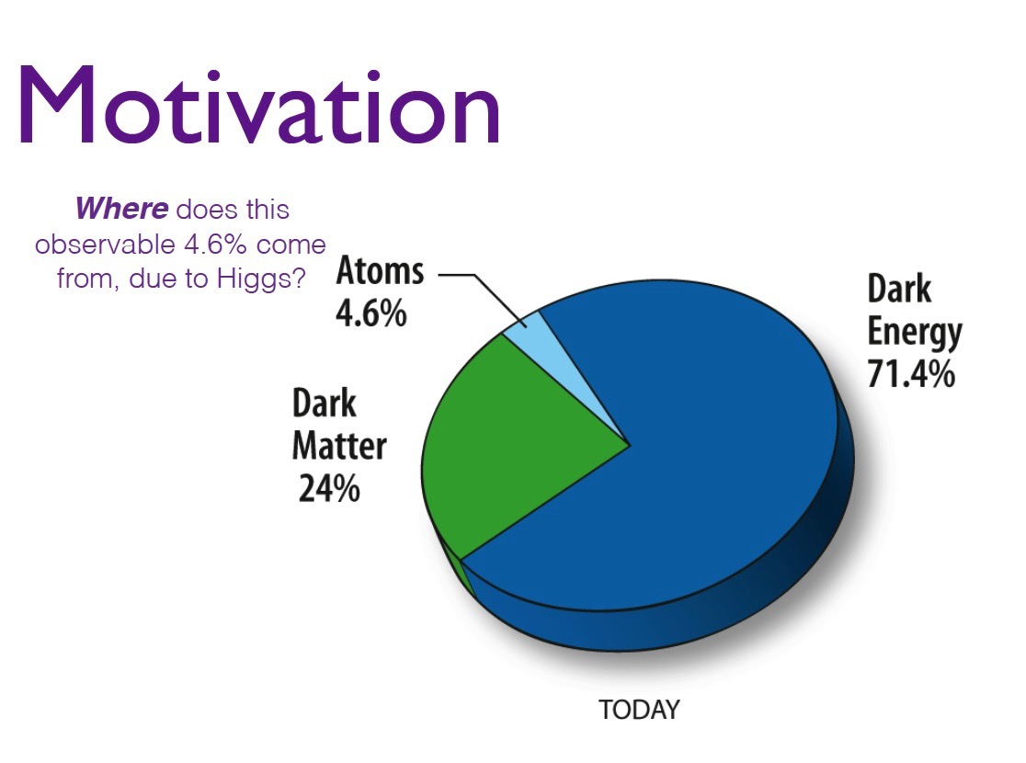
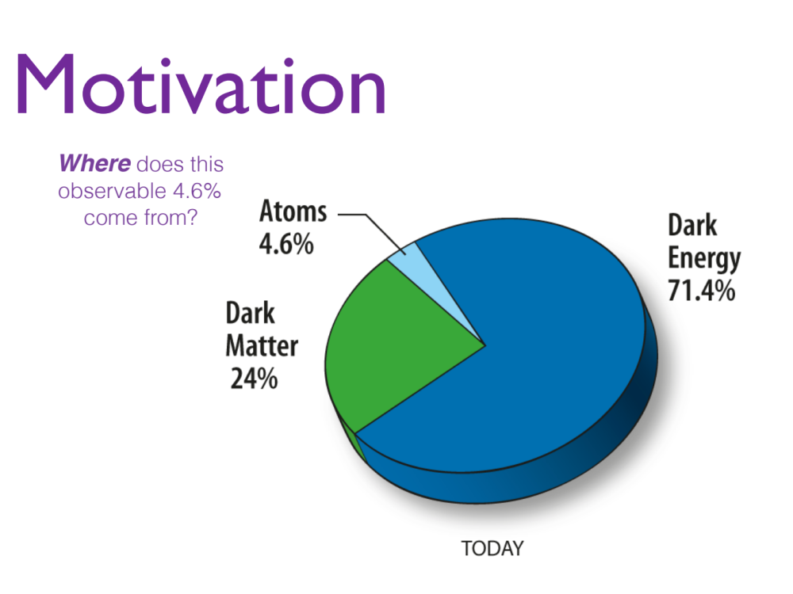
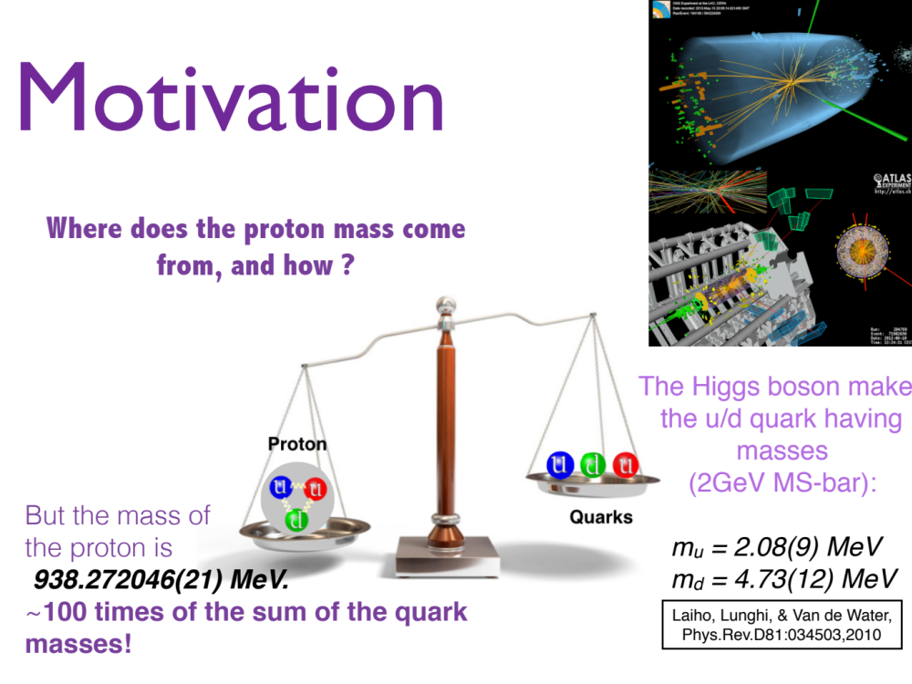

Slide 3
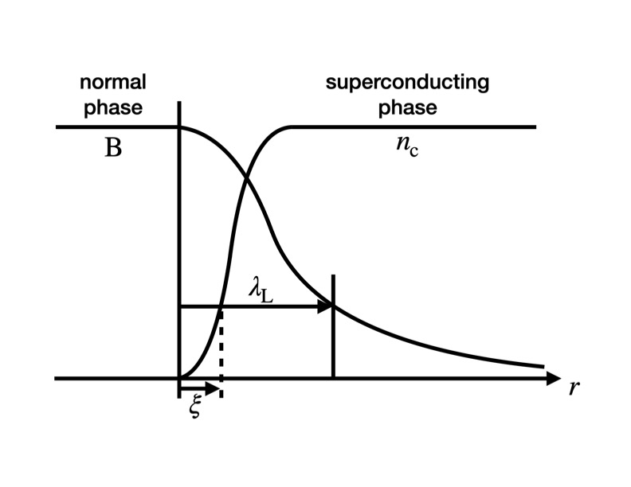
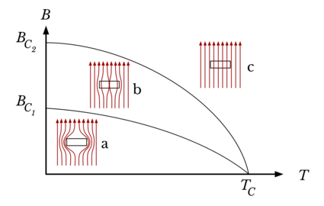

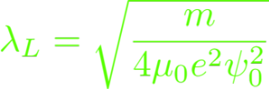




Type II Superconductor
Ginzburg–Landau equations
London penetration depth
Coherent length $ξ$
Type II:

Slide 4
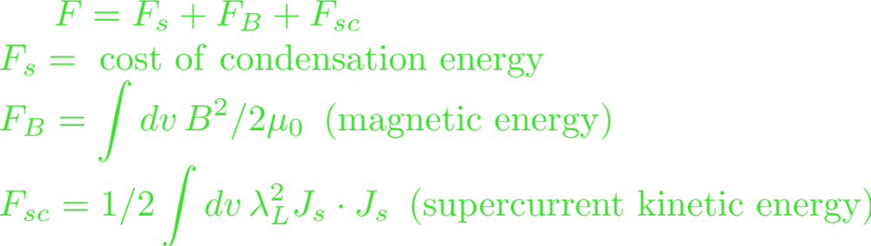
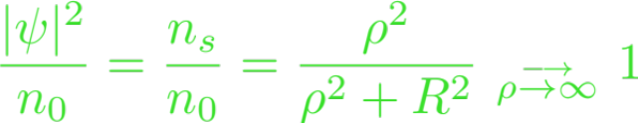


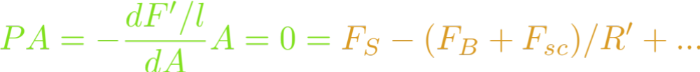


Energetics and Equilibrium
Type II superconductor
Variational model (J.R. Clem, Jour. Low Temp. Phys. 18, 5/6 (1975))
Normal Phase
Superconducting Phase
Equation of state
Energy-equilibrium condition (EEC)
- Negative constant pressure
- Origin is condensate

Slide 5

Mass and Rest Energy
E = m c² m increases with E? Converting mass to energy?
E₀ = m c² (Einstein 1905, m² = E² – p²)
e⁺ e⁻ $→$ $γγ$ (m$γγ$= 2m_{e})
Mass is a scalar and E is a component of the four vector. E and p are additive, not mass
In general relativity, the gravitational field is coupled to the EMT.
In non-relativistic limit, Newton’s law of force and universal gravitational involves E₀ or mass.
Inertial mass and gravitational mass are the same mass.
Relativistic mass in a misnomer, rest mass is redundant.
-- L.B. Okun doi:10.1134/1.1358478
cou

Slide 6
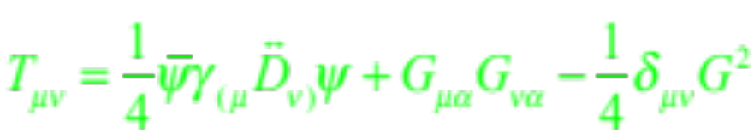

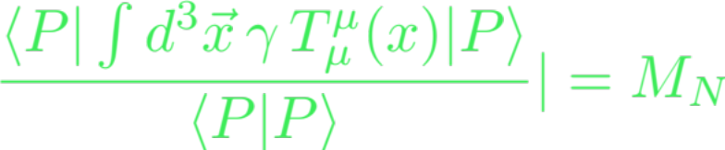
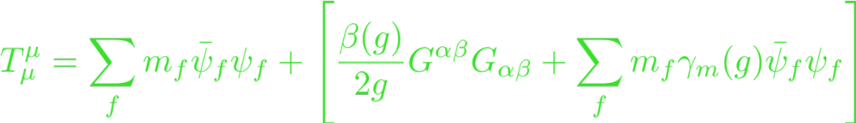
Mass of Hadrons – Energy Momentum Tensor
Energy momentum tensor
Mass from trace of EMT – scalar, frame independent, scale invariant
Chanowitz, Ellis, Crewther, Collin, Duncan, Joglekar
Sigma terms
Trace anomaly

Slide 7
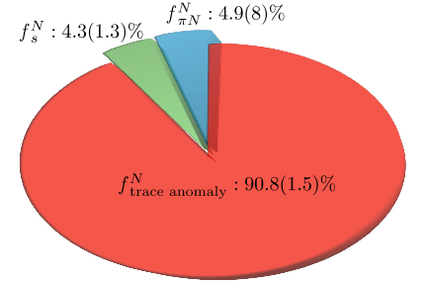
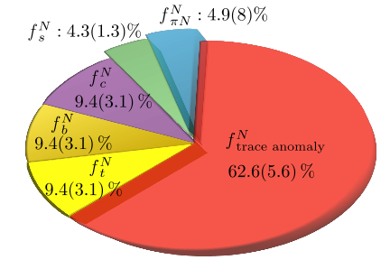
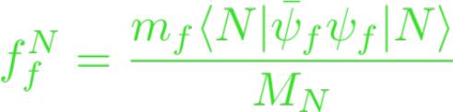


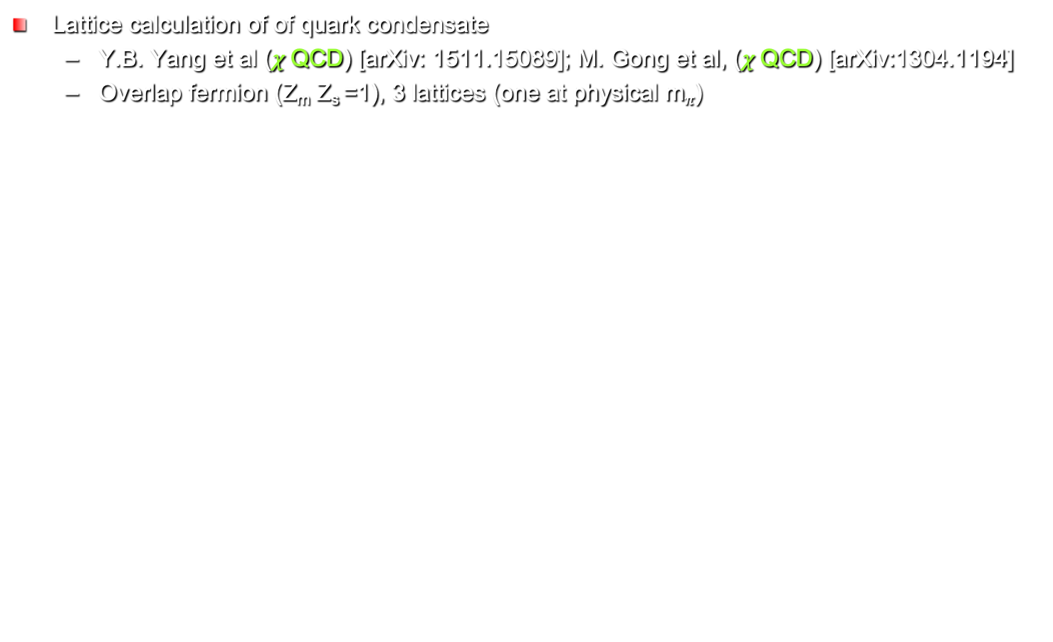
Mass from Trace of EMT
Lattice calculation of of quark condensate
  Y.B. Yang et al ($χ$QCD) [arXiv: 1511.15089]; M. Gong et al, ($χ$QCD) [arXiv:1304.1194]
  Overlap fermion (Z_{m} Z_{s} =1), 3 lattices (one at physical m$π$)
Shifman, et al., Phys.Lett. B 78, 443 (1978)
Decoupling theorem:

Slide 8
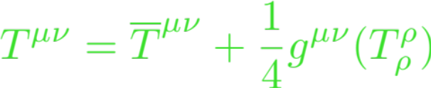
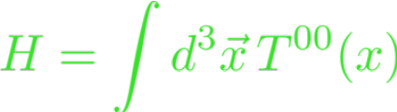
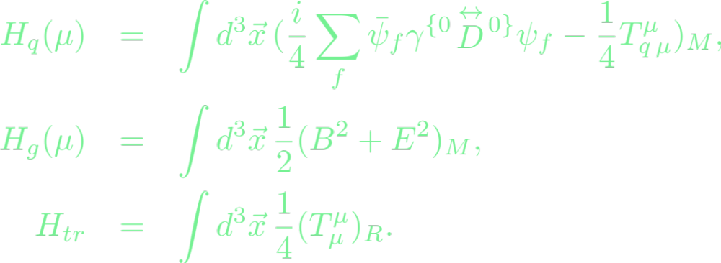
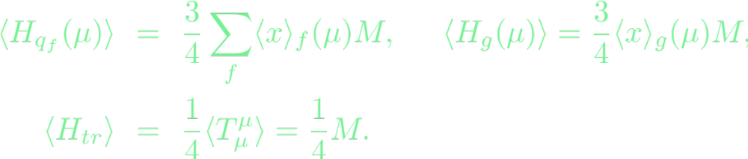
Rest Energy Decomposition from Hamiltonian
Separate the EMT into traceless part and trace part
Hamiltonian --
Rest energy --
(Ji, 1995)
Quark momentum fraction
(scale dependent)
Glue momentum fraction
(scale dependent)
Caracciolo:1989pt, Makino:2014taa,
DallaBrida:2020gux
<x> - momentum fraction
experimentally measurable
8

Slide 9
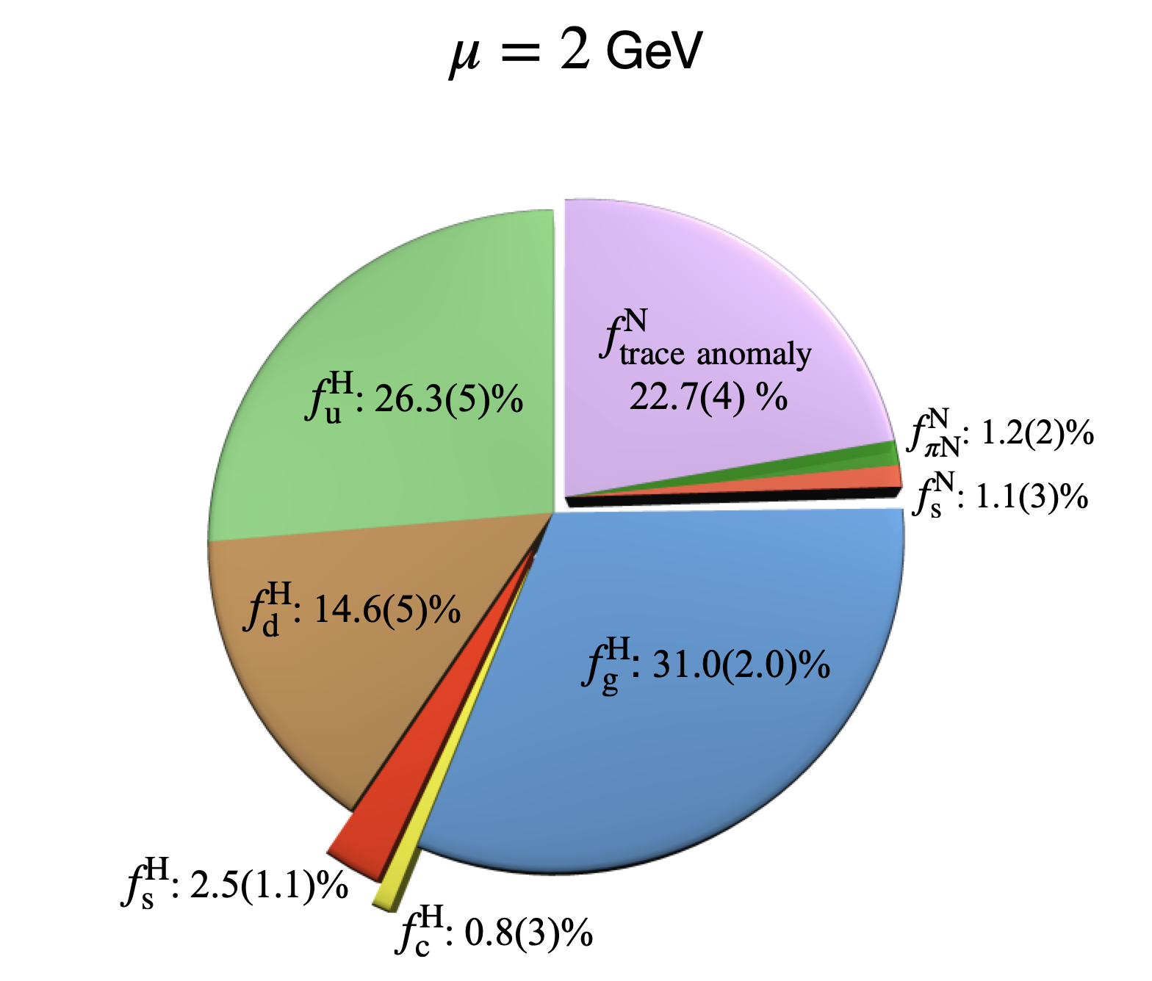
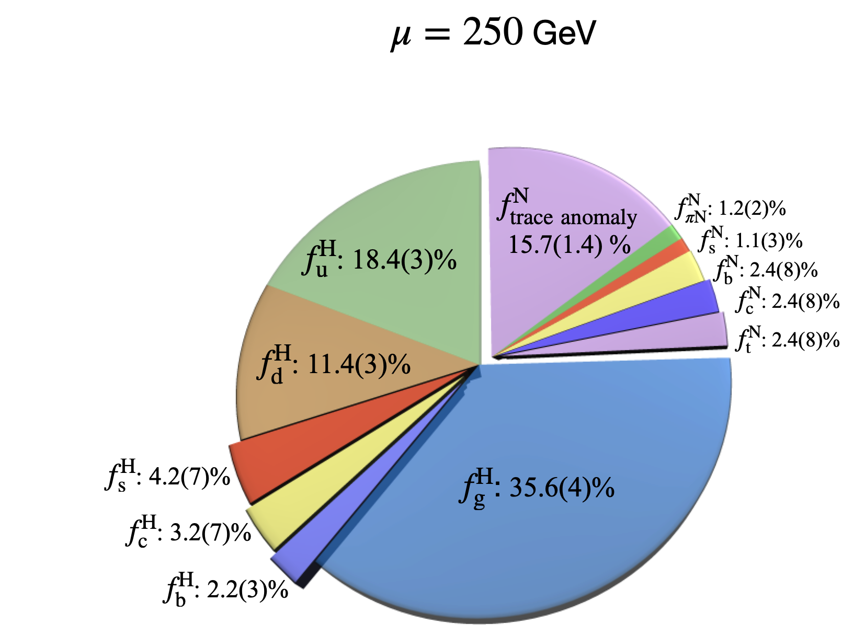

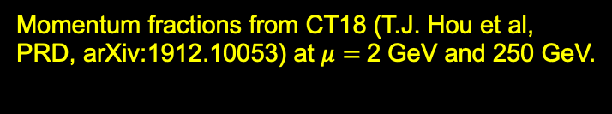
Rest Energy Decomposition from Hamiltonian
Y.B. Yang et al ($χ$QCD) [arXiv: 1511.15089]
Momentum fractions from CT18 (T.J. Hou et al, PRD, arXiv:1912.10053) at $μ=$2 GeV and 250 GeV.
9

Slide 10
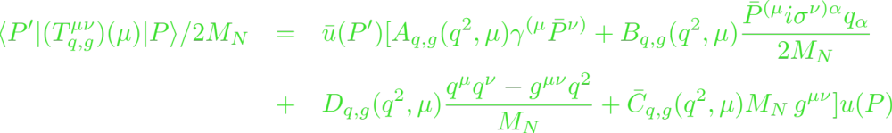
Rest Energy/Mass from Gravitational FF
Gravitational Form factors from the EMT matrix elements
  A(0) and A(0)+ B(0) : momentum and angular momentum –
  A_{q}(0) + A_{g}(0) = 1;
  [A_{q}(0) + B_{q}(0)] + [A_{g}(0) + B_{g}(0)] = 1 angular momentum sum rule
  D(0): D term (deformation of space = elastic property) - [Polyakov]
  C-bar term: pressure-volume work - [Lorce, Liu]
[Ji]
momentum sum rule

Slide 11

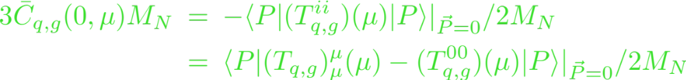

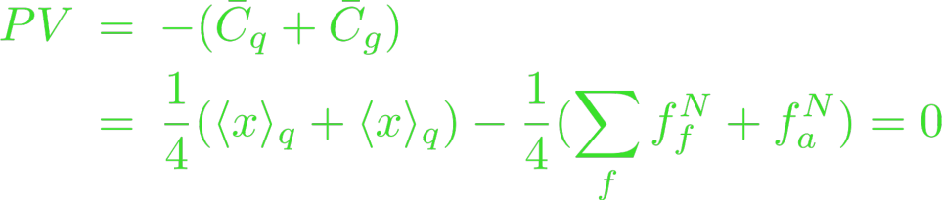
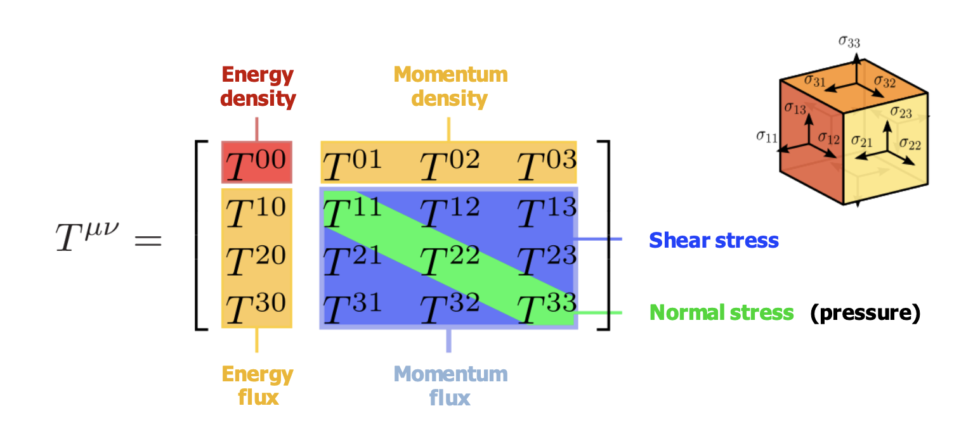

What is ?
Gravitational Form factors from the EMT matrix elements
Consequence of energy-momentum conservation
Pressure-volume work
E = E(V) ?
eq. of state

Slide 12
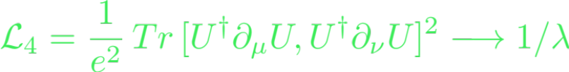


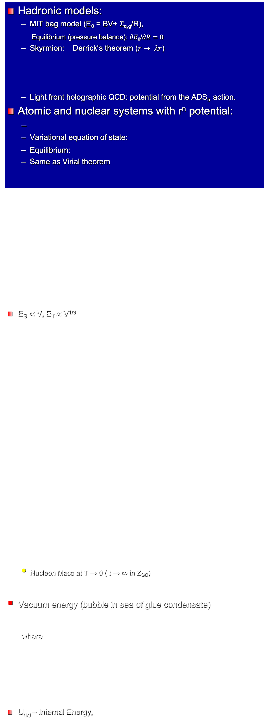


Generic bound state energy and equilibrium correspondence (EEC)
Hadronic models:
  MIT bag model (E₀ = BV+ $Σ$_{q,g}/R),
  Equilibrium (pressure balance): $∂E0$/$∂R=0$
  Skyrmion: Derrick’s theorem ($r→ λr$)
  Light front holographic QCD: potential from the ADS₅ action.
Atomic and nuclear systems with r^{n} potential:
  Variational equation of state:
  Equilibrium:
  Same as Virial theorem
E_{S} $∝$ V, E_{T} $∝$ V^{1/3}
  Nucleon Mass at T → 0 ( t → $∞$ in Z_{GC})
Vacuum energy (bubble in sea of glue condensate)
  where
U_{q,g} – Internal Energy,
dE₀/d$λ=0$
$$∂$$

Slide 13
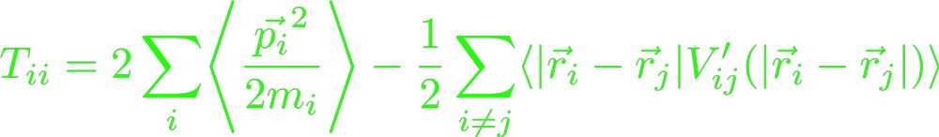
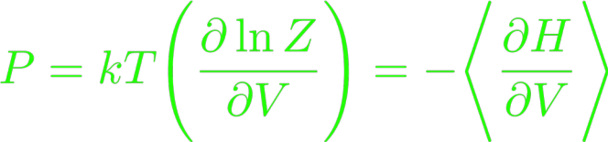
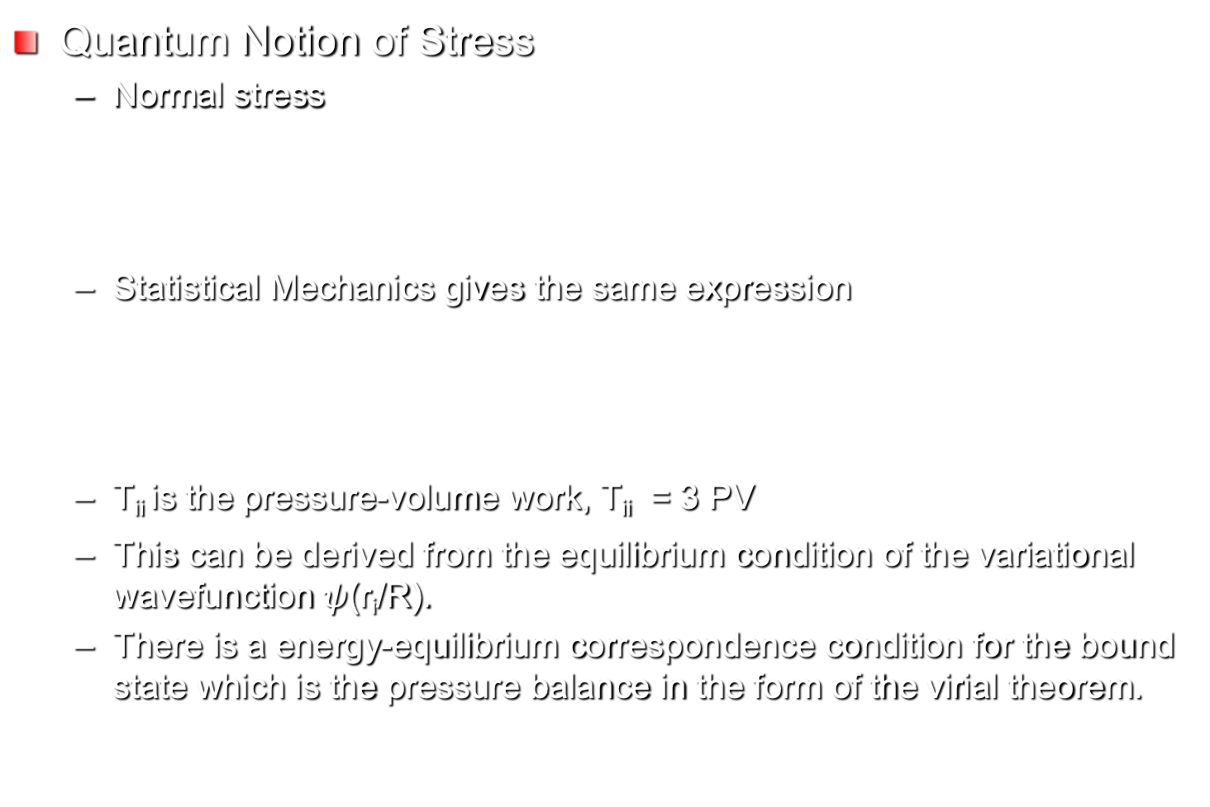
Equilibrium Condition and Pressure Balance
R. Maranganti and P. Sharma,
Proc. R. Soc, A 466, 2097 (2010)
Quantum Notion of Stress
  Normal stress
  Statistical Mechanics gives the same expression
  T_{ii} is the pressure-volume work, T_{ii} = 3 PV
  This can be derived from the equilibrium condition of the variational wavefunction $ψ$(r_{i}/R).
  There is a energy-equilibrium correspondence condition for the bound state which is the pressure balance in the form of the virial theorem.
Clausius form of virial theorem
Same result as T_{ii}. V is the volume of the bound state

Slide 14

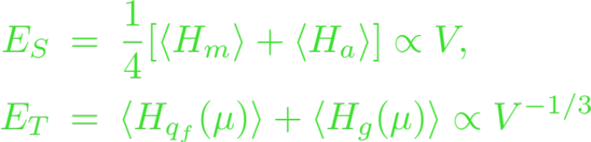
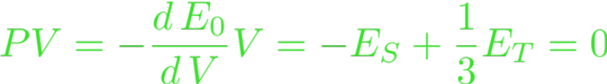
Energy - Equilibrium Correspondence (EEC)
Rest energy
Pressure balance – equilibrium
Can one deduce the equation of state – E (V) ?
Inferred volume dependence

Slide 15

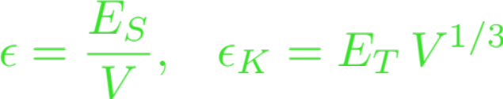

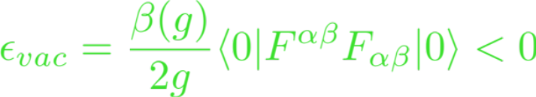
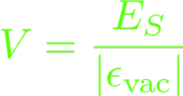


Trace Anomaly and Gluon Condensate
Equation of state
Picture: Nucleon is a bubble in the sea of gluon condensate, where
Trace anomaly gives a negative constant
pressure confinement
Many facets of color confinement
  Dual superconductor
  Magnetic monopole
  Center vortices
(MIT bag model)
where
are constants
N.B.
Same as in
charmonium
Bali (‘97), Baker (‘18)

Slide 16
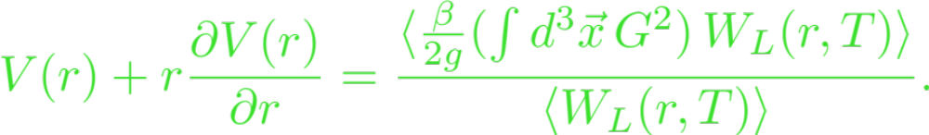
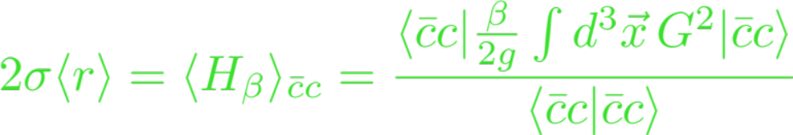

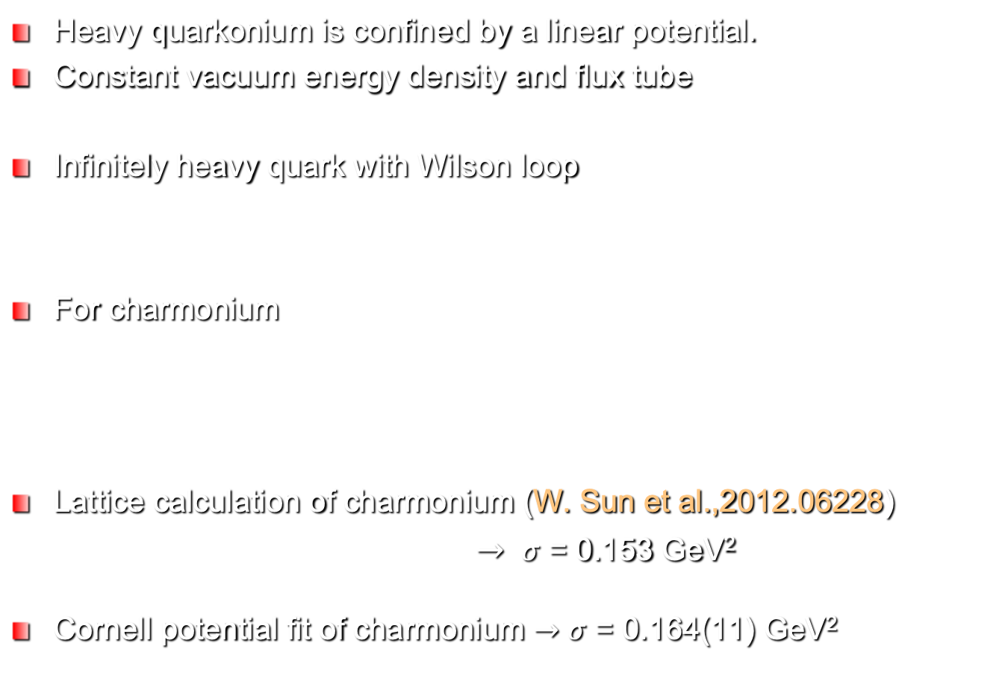
Role of Trace Anomaly --String tension in charmonium
Heavy quarkonium is confined by a linear potential.
Constant vacuum energy density and flux tube
Infinitely heavy quark with Wilson loop
For charmonium
Lattice calculation of charmonium (W. Sun et al.,2012.06228)
$→$ $σ$ = 0.153 GeV²
Cornell potential fit of charmonium $→$ $σ$ = 0.164(11) GeV²
Dosch, Nachtmann, Rueter - 9503386; Rothe - 9504102
KFL, 2103.15768
Mateu:2018zym

Slide 17

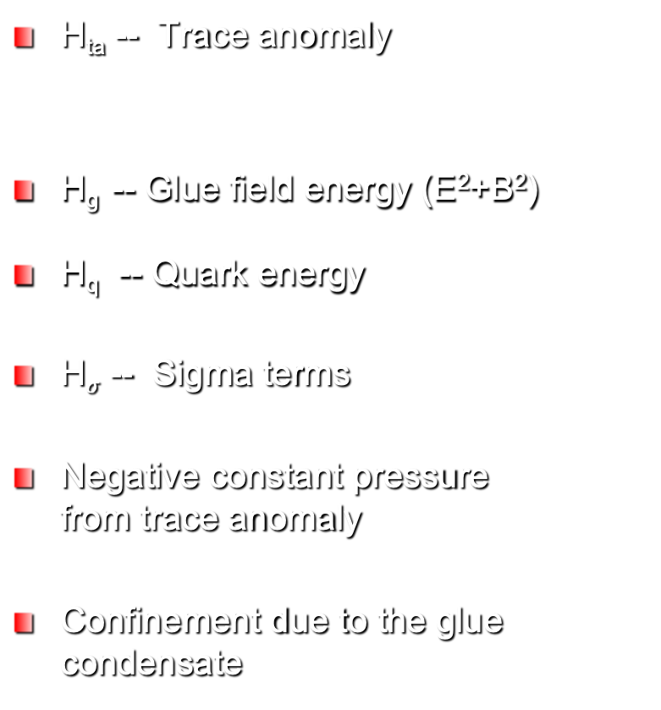
Superconductor Vortex
Hadron
F_{S} – Cost of compensation energy
F_{B} -- Magnetic field energy
F_{SC} -- Supercurrent energy
Total Electron mass
Negative constant pressure from F_{S}
Confinement due to the superconducting condensate
H_{ta} -- Trace anomaly
H_{g} -- Glue field energy (E²+B²)
H_{q} -- Quark energy
H$σ$ -- Sigma terms
Negative constant pressure from trace anomaly
Confinement due to the glue condensate

Slide 18
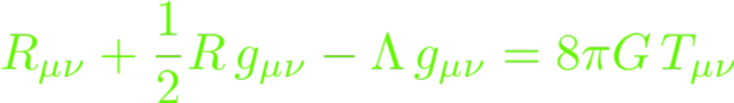

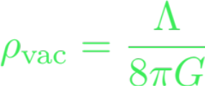
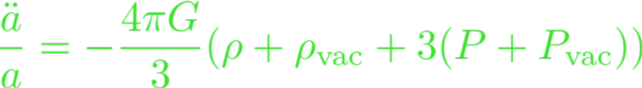
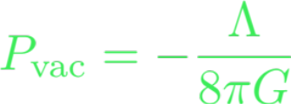
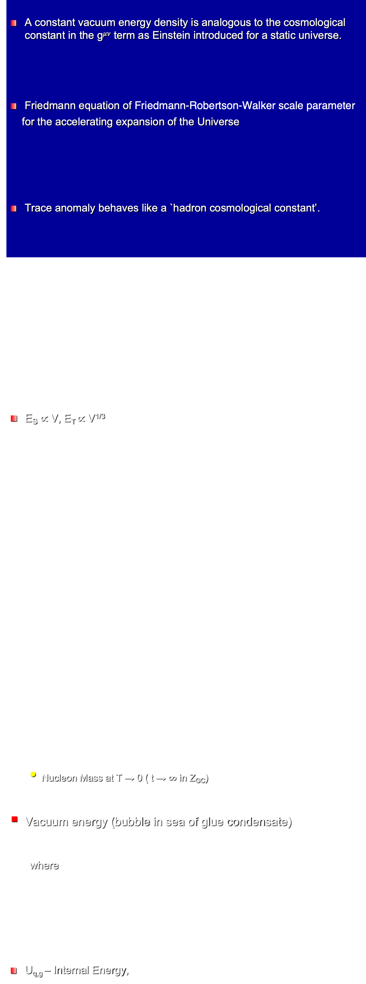
Trace Anomaly and Cosmological Constant
A constant vacuum energy density is analogous to the cosmological constant in the g$μν$ term as Einstein introduced for a static universe.
Friedmann equation of Friedmann-Robertson-Walker scale parameter
for the accelerating expansion of the Universe
Trace anomaly behaves like a `hadron cosmological constant’.
E_{S} $∝$ V, E_{T} $∝$ V^{1/3}
  Nucleon Mass at T → 0 ( t → $∞$ in Z_{GC})
Vacuum energy (bubble in sea of glue condensate)
  where
U_{q,g} – Internal Energy,
in QCD
$$∂$$

Slide 19


SC, Hadrons, Cosmos
Type II Superconductor
Hadrons
The common theme is the existence of a condensate
Hadrons: condensates from breaking of conformal and chiral symmetries. SC: Cooper pair condensate from gauge symmetry breaking.
Cosmos – cosmological constant is vacuum energy itself
Suppose: Outside of our Universe, there is a condensate with negative so that it is positive in the Universe. This scenario would be similar to hadrons and vortices.
Cf. -- S. K. Blau. E. I. Guendelman. and A. H. Guth. Phys. Rev. 035. 1747 (1987)
anti-gravitates
$$Λ,$$

Slide 20
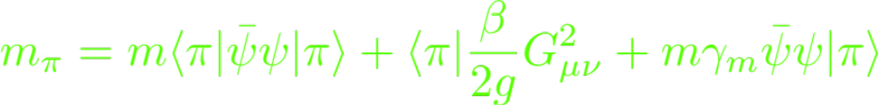

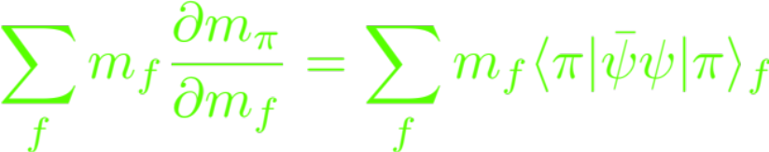


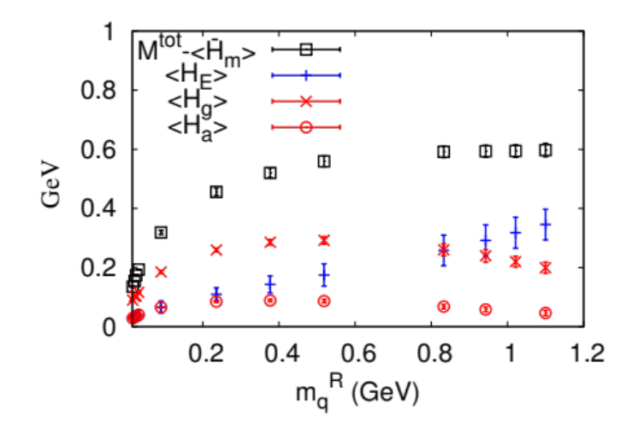

Pion Mass Puzzle (?)
Pion mass in terms of trace of EMT
Gellmann-Oakes-Renner relation and Feynman-Hellman relation
But, why should the trace anomaly be proportional to ? V → 0 ?
Y.B. Yang et al. ($χ$QCD), PRD (2015); 1405.4440

Slide 21
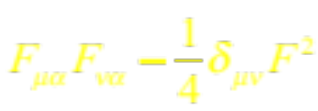





Trace anomaly Distribution
Distribution as a function of the relative distance between the glue operator and the sink positions.
F. He, P. Sun and Y.B. Yang ($χ$QCD) (PRD 2021, 2101.04942)
It changes sign in pion so that the integral approaches zero at the chiral limit.

Slide 22



Pion trace anomaly FF
m$π$ = 340 MeV
Bigeng Wang, talk at Lattice 2023
Photoproduction of J/$Ψ$ at threshold and Drell-Yan process
X.B. Tong, J.P. Ma and F. Yuan
arXiv:2203.13493

Slide 23

Summary and Challenges
Energy-equilibrium correspondence infers a hadron equation of state which leads to confinement with constant negative pressure.
It seems that from femto-scale to micro-scale, Nature adopts the same mechanism (condensates) for confinement. Similar mechanism (vacuum energy) for acceleration of the cosmos.
Glue part of trace anomaly responsible for confinement. Thus, glue condensate could be an order parameter for confinement – deconfinement transition.
m_{q} $←$ Higgs mechanism
Quark condensate $←$ chiral symmetry breaking (restoration at T and $μ)$
Trace anomaly (confinement) $←$ conformal symmetry breaking (conformal phases with multi-flavors and SU(N); finite T > T_{c})
Chiral symmetry breaking and conformal symmetry breaking may be connected in the case of the pion trace anomaly distribution → needs a better explanation.
Challenges for EIC and COMPASS is to measure the trace anomaly form factors for the proton and, particularly, the pion. Photoproduction of J/$Ψ$ at threshold is a possibility.

Slide 24
Recent work
Xiangyu Jiang, et al., ``Radiative Decay Width of J/ψ → γη(2) from N_{f} = 2 Lattice QCD’’, PRL 130 (2023) 6, 061901, [arXiv:2206.02724]
H.T. Ding et al., ``Microscopic Encoding of Macroscopic Universality: Scaling properties of Dirac Eigenspectra near QCD Chiral Phase Transition’’, [arXiv:2305.10916]
P.X. Ma, et al., "Lattice QCD Calculation of Electroweak Box Contributions to Superallowed Nuclear and Neutron Beta Decays,'' [arXiv:2308.16755 [hep-lat]]
G. Wang, et al., "Muon g-2 with overlap valence fermions," Phys. Rev. D107,no.3,034513(2023), doi:10.1103/PhysRevD.107.034513
J. Liang, et al., "Nucleon Electric Dipole Moment from the $\theta$ Term with Lattice Chiral Fermions,” [arXiv:2301.04331 [hep-lat]].

Slide 25

割圆术
割之弥细，所失弥少。割之又制，以至于不可割，则与圆周合体，而无所失矣
-- 刘徽 (225-295) `九章算法’
$π ～$ 3.1416

