Slide 1
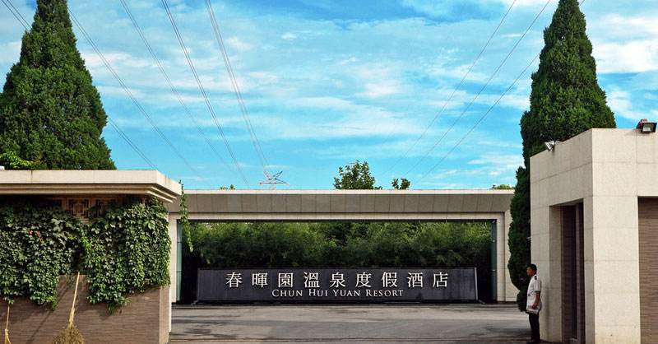
CMS上的奇特强子及其其他实验结果以及相关格点QCD
易凯
南京师范大学
第三届中国格点量子色动力学研讨会
2023年十月六--八号, 北京

Slide 2
Outline
CMS contribution to exotic hadron
CMS recent result on J/𝝍J/𝝍 structures
Near/above or below threshold structures
Below threshold bound states
Lattice result
Other theoretical results
Experimental puzzle
Summary

Slide 3
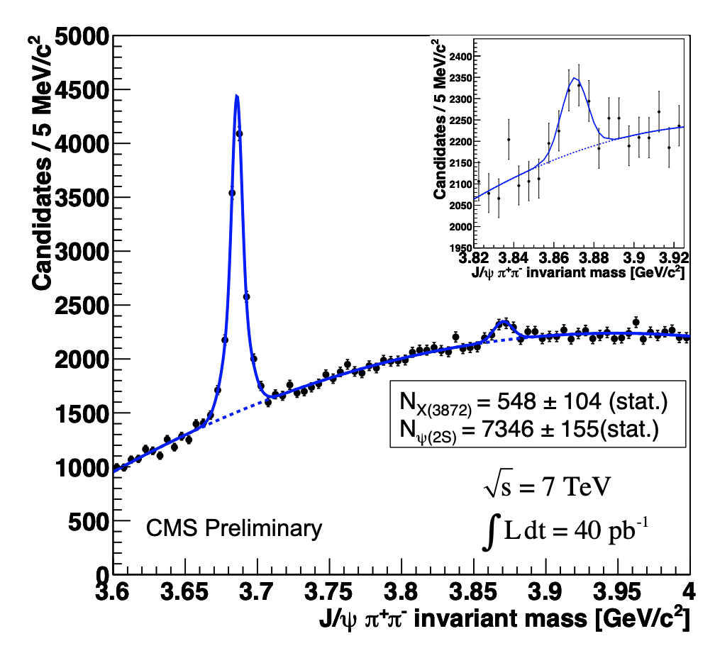
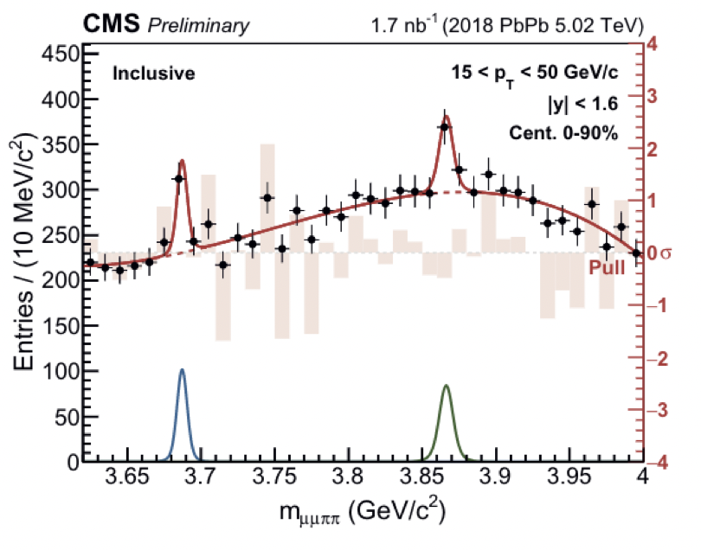
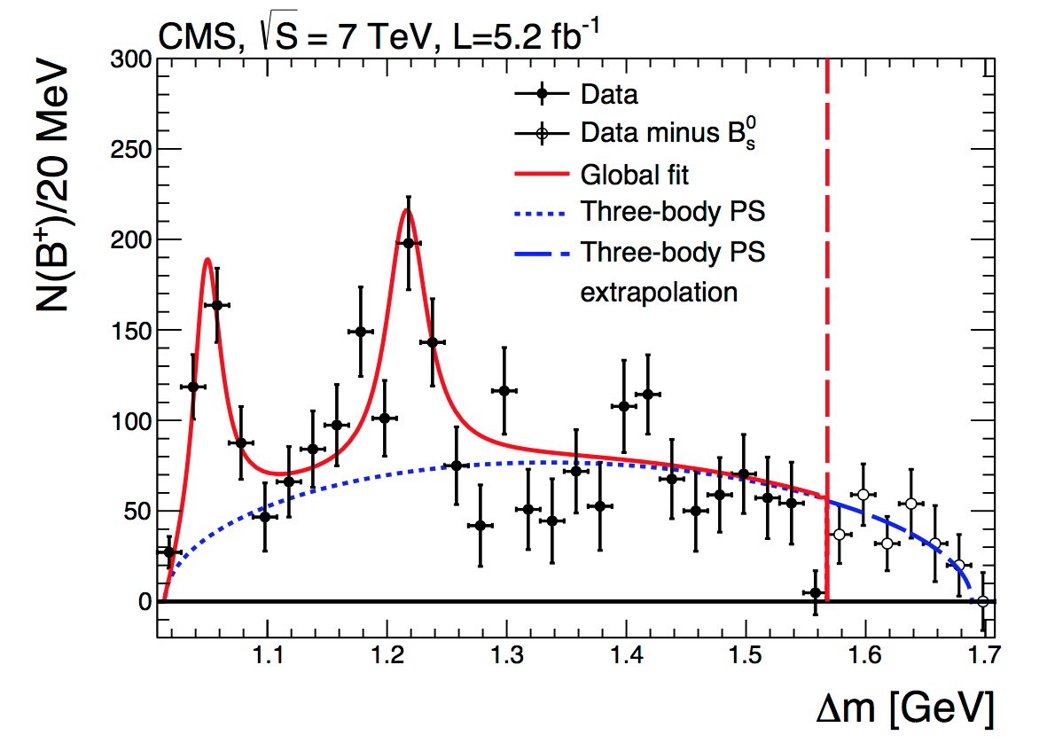
CMS contributions to heavy exotic states
First LHC experiment re-discovered X(3872)
First X(3872) signal in PbPb
Nucl. Phys. Vol 1005 (2021)121781
CMS PAS BPH-10-018
First confirmation of Y(4140)
CMS played the following leading roles
First LHC experiment to see X(3872)
First LHC experiment to see exotic hadron
First LHC experiment to see X(3872) in PbPb data
PLB 734 261 (2014)

Slide 4
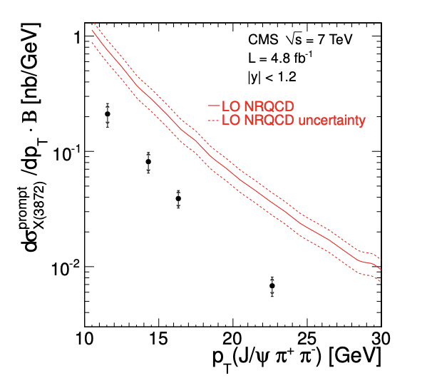
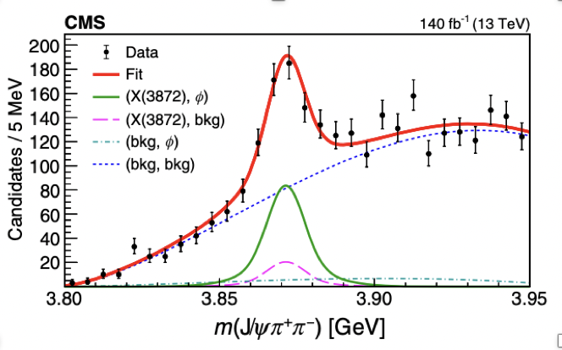
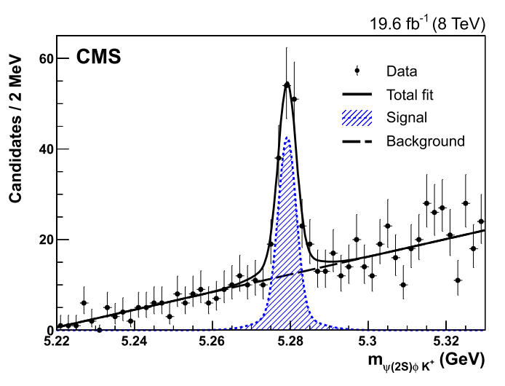
CMS contributions to heavy exotic states
X(3872) x-section
PRL 125 152001 (2020)
B_{s}→X(3872)𝛟
JHEP 04 (2013) 154
B⁺→𝝍(2S)𝛟K⁺
Phys.Lett.B 764 (2017) 66-86
BR(B⁺→𝝍(2S)𝛟K⁺)=4.0±0.4(stat) ±0.6(syst)±0.2(BR)
Right at the 𝝍(2S)𝛟 threshold
Could be complete due to threshold enhancment
To be clarified

Slide 5
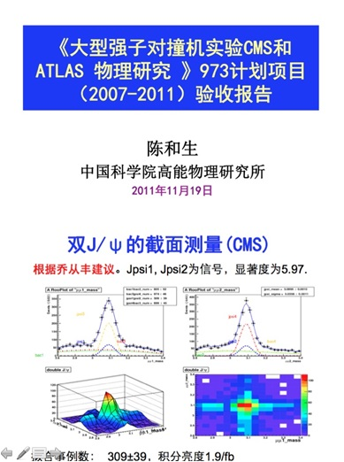
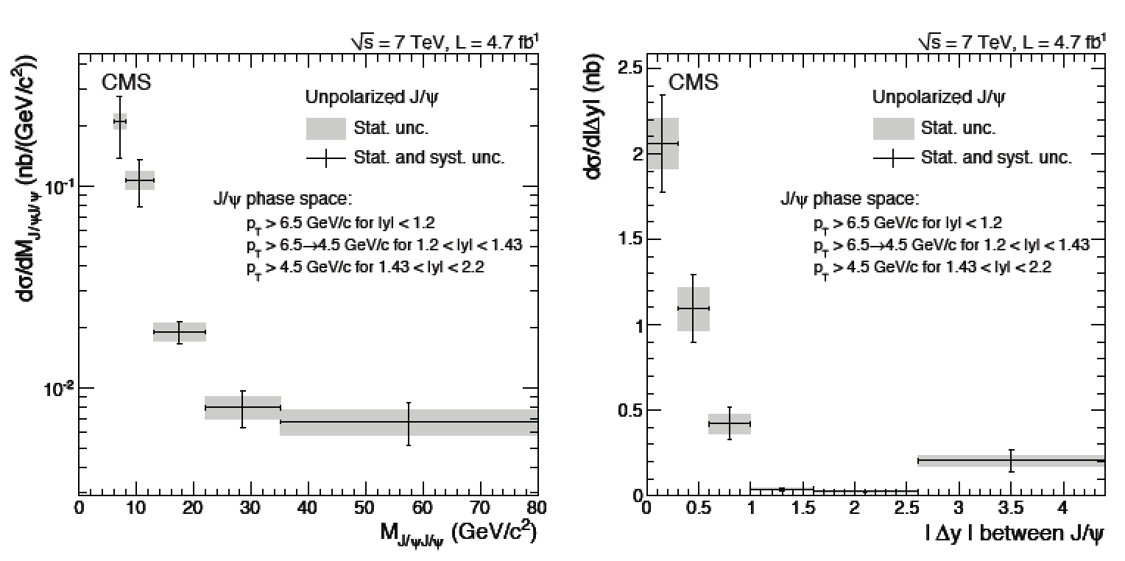
Other selected CMS contributions to heavy exotic states
JHEP 1409 (2014) 094
m(J/𝝍J/𝝍)
∆y between J/𝝍
Jianguo Bian initialized di-J/𝝍 cross section analysis
CMS has large di-J/𝝍 sample
Any surprise in di-J/𝝍 mass spectrum?

Slide 6
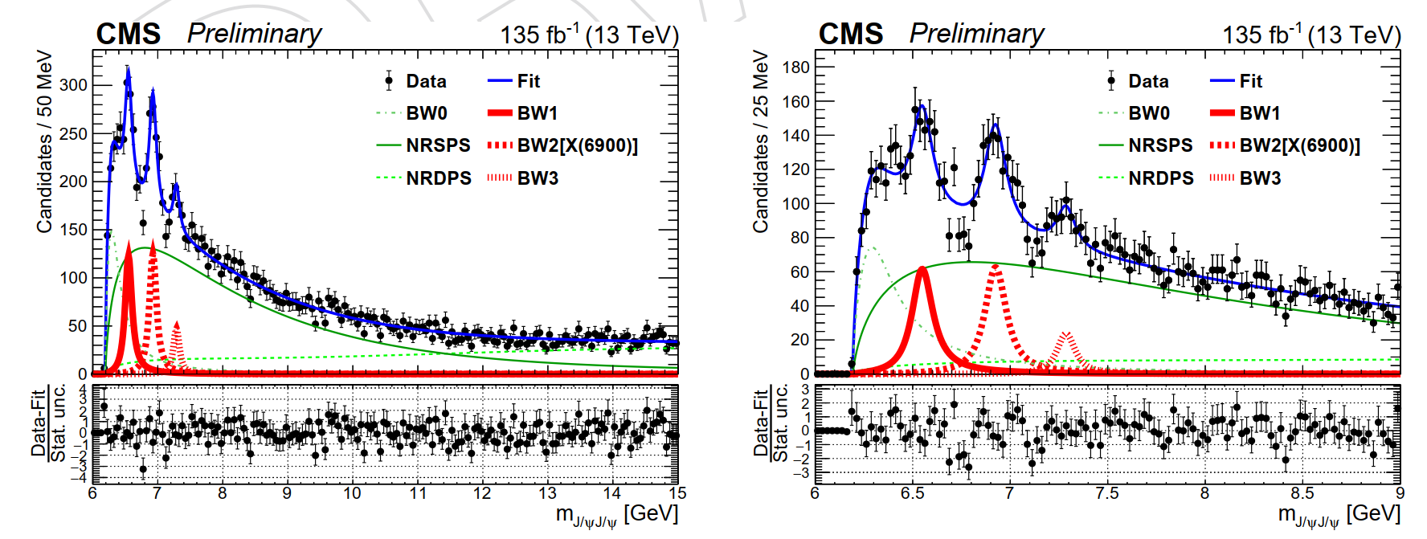
CMS J/𝝍J/𝝍 mass spectrum : 3 BWs + Backgrounds+ BW0
arXiv: 2306.07164 [hep-ex], CMS PAS BPH-21-003
Determined 4 peaks in the mass spectrum
There are issues with peak (BW0) right at threshold—treat it as background
Claimed 3 peaks:

Slide 7
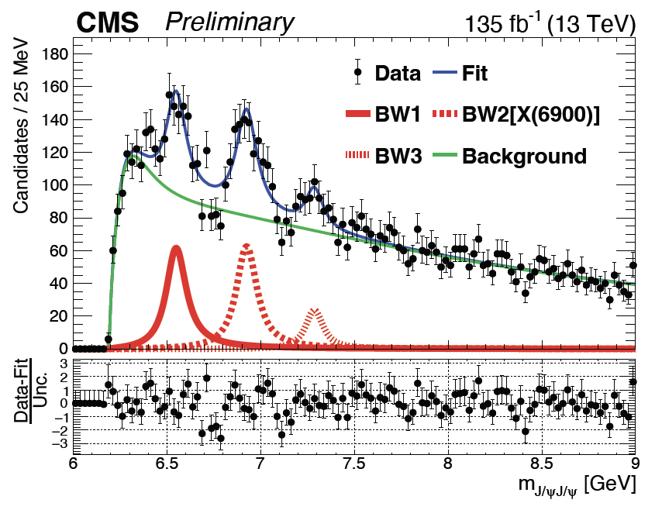
CMS result w/o interference: 3 BWs + Background (null)
6.5$σ$
9.4$σ$
arXiv: 2306.07164 [hep-ex], submitted to PRL
4.1$σ$
Statistical significance based on:
2 ln(L0/Lmax)
Two dips
BW1
BW2
BW3
 | BW1 (MeV) | BW2 (MeV) | BW3 (MeV)
m | 6552 ± 10 | 6927± 9 | 7287± 19
Γ | 124± 29 | 122± 22 | 95± 46
N | 474± 113 | 492± 75 | 156± 56
BW2[X(6900)] (9.4$σ$) – confirmation
Observation of BW1 (6.5 $σ$)
Evidence for BW3 (4.1$σ$)
Statistical significance only

Slide 8
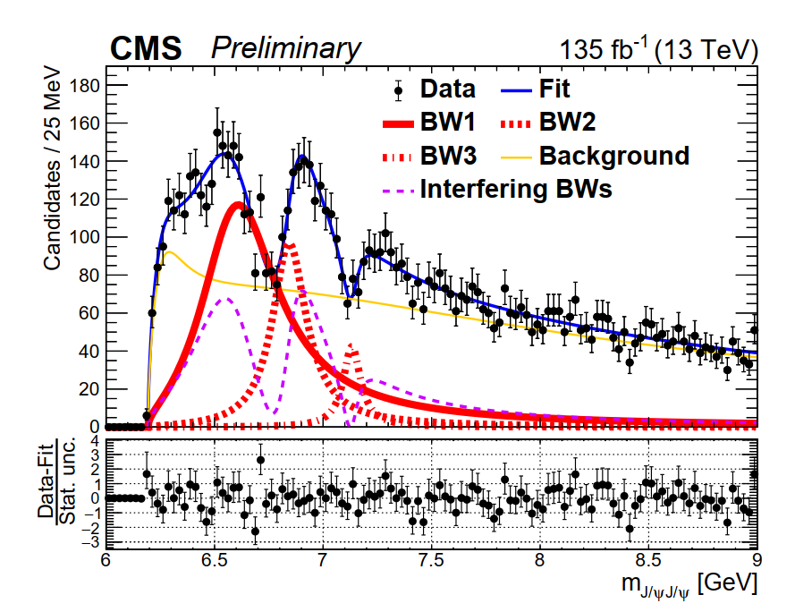
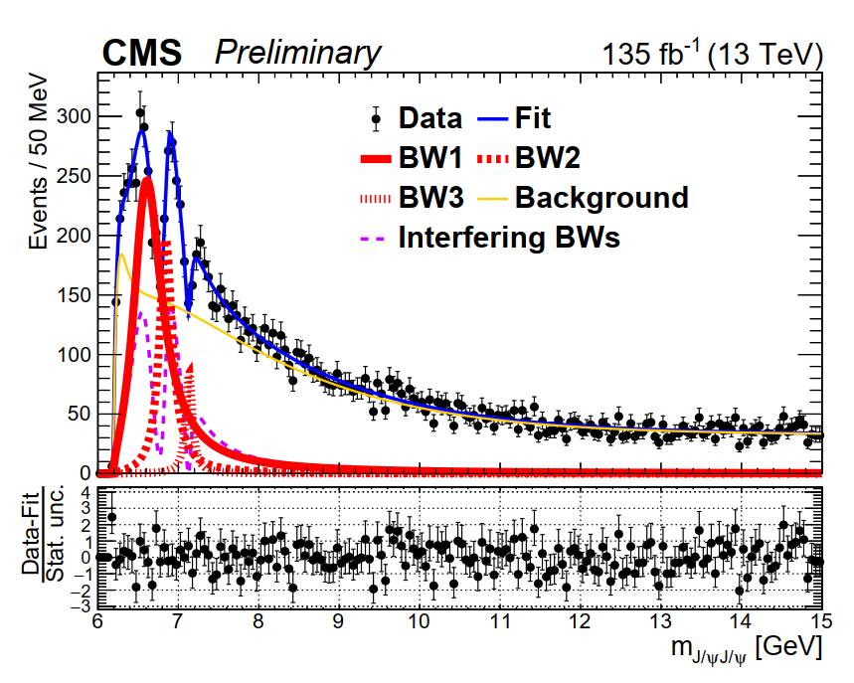
CMS interference fit
Fit with interf. among BW1, BW2 and BW3 describes data well
Measured mass and width in the interference fit
arXiv: 2306.07164 [hep-ex], submitted to PRL

Slide 9
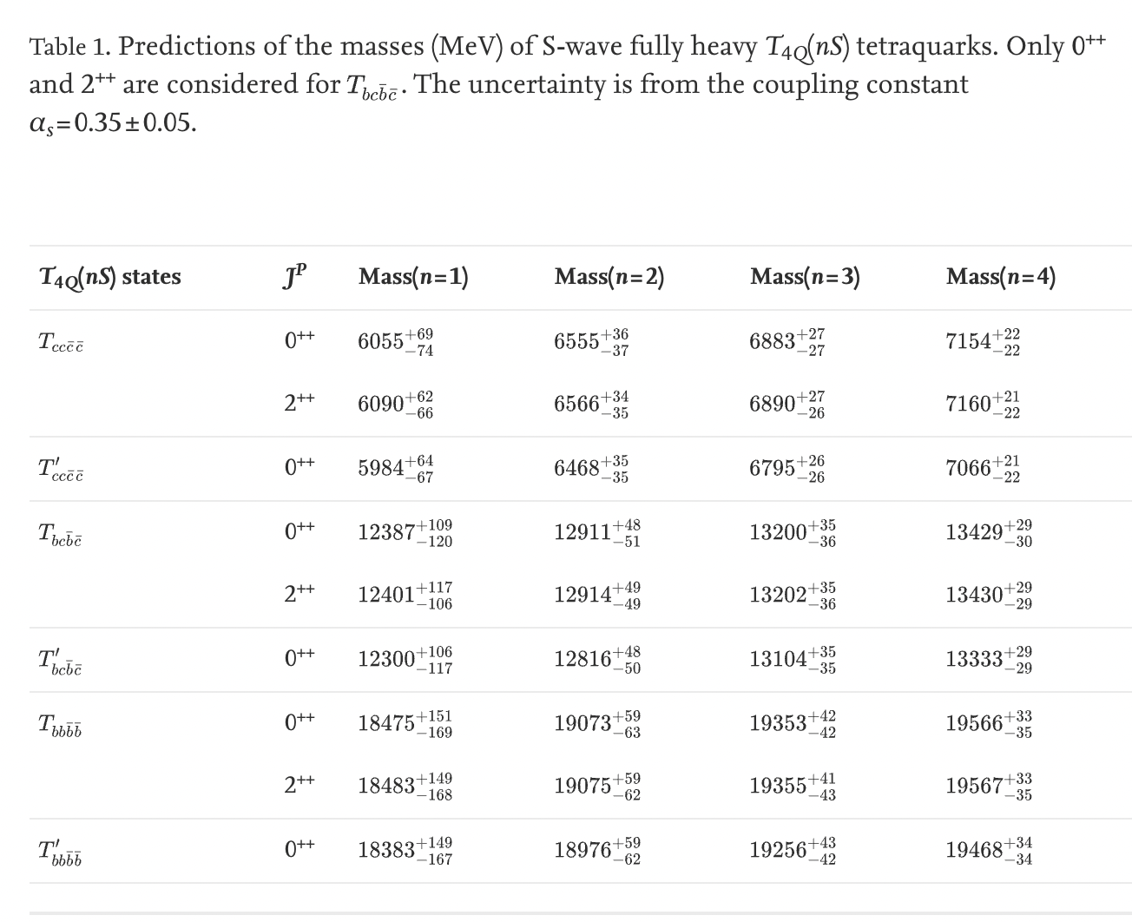
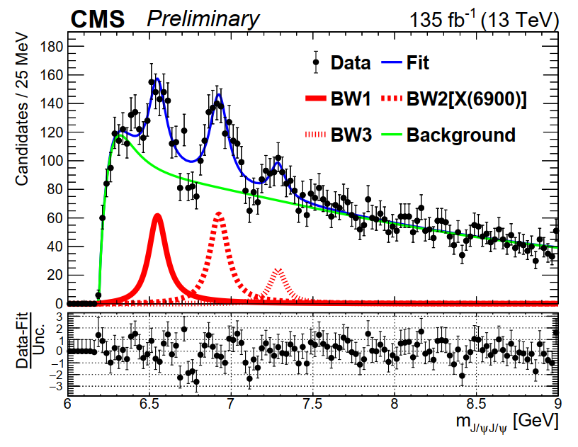
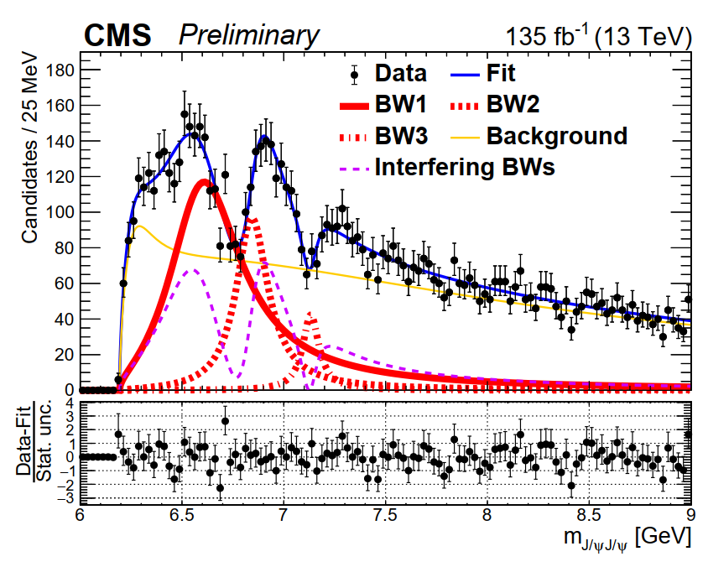
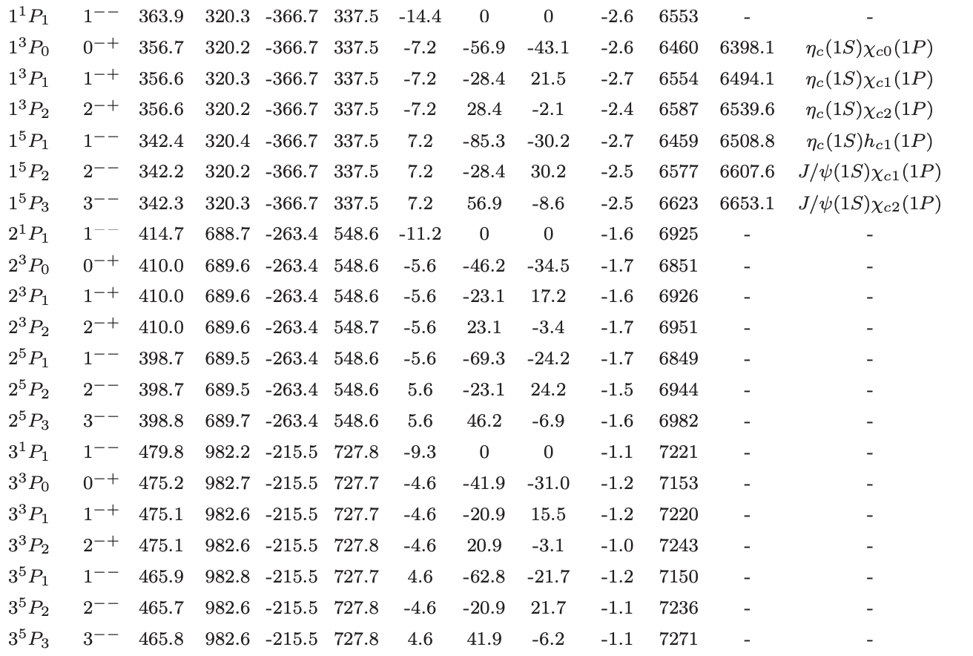
Comparison with some theoretical calculations
CMS PAS BPH-21-003
Nucl. Phys. B 966 (2021) 115393
W/o interf.
W/ interf.
M[BW1] = 6638 ± 10 ± 12 MeV
M[BW2] = 6847 ± 9 ± 5 MeV
M[BW3] = 7134 ± 19 ± 5 MeV
S-wave
arXiv:2108.04017 [hep-ph]
Radial excited p-wave states (like J/𝝍 series)?
Or Radial excited S-wave states?
Theoretical situation difficulty & confusing
Important next step: measure J^{PC} to clarify
Natural question: what about YY final state?
P-wave
M[BW1] = 6552 ± 10 ± 12 MeV
M[BW2] = 6927 ± 9 ± 5 MeV
M[BW3] = 7287 ± 19 ± 5 MeV

Slide 10
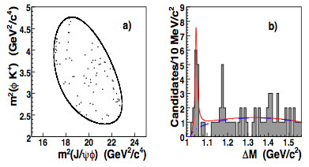
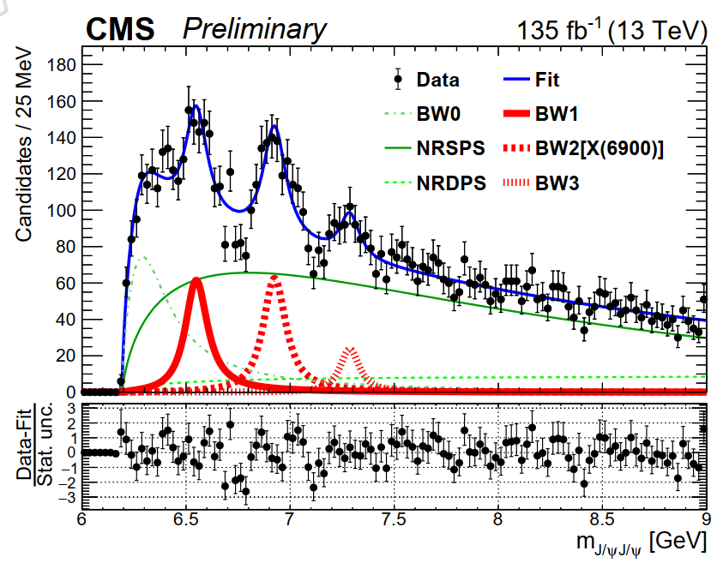
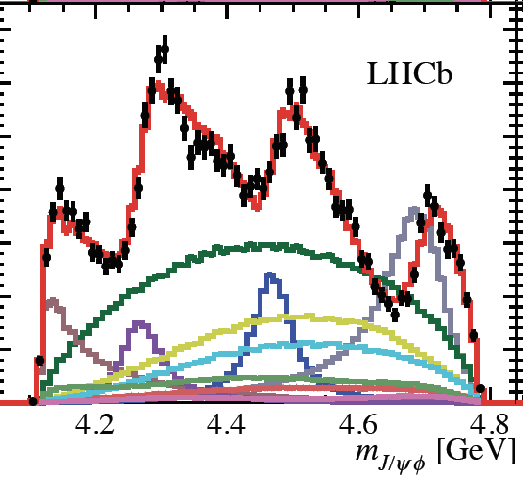
What are they?
CDF—PRL102:242002 (2009)
Mod.Phys.Lett. A32 (2017) no.26, 1750139
Y(4140)
Y(4140)
peak2?
PRL 127, 082001 (2001)
$$c\overline{c}c\overline{c}$$
IJMPA Vol. 28, No. 18 (2013) 1330020
$$c\overline{c}s\overline{s}$$
Similar X→ 1– 1⁻⁻
how about $b\overline{b}c\overline{c}$, $b\overline{b}b\overline{b}$?
Any connection with $c\overline{c}s\overline{s}$? Semi-heavy
CMS PAS BPH-21-003

Slide 11
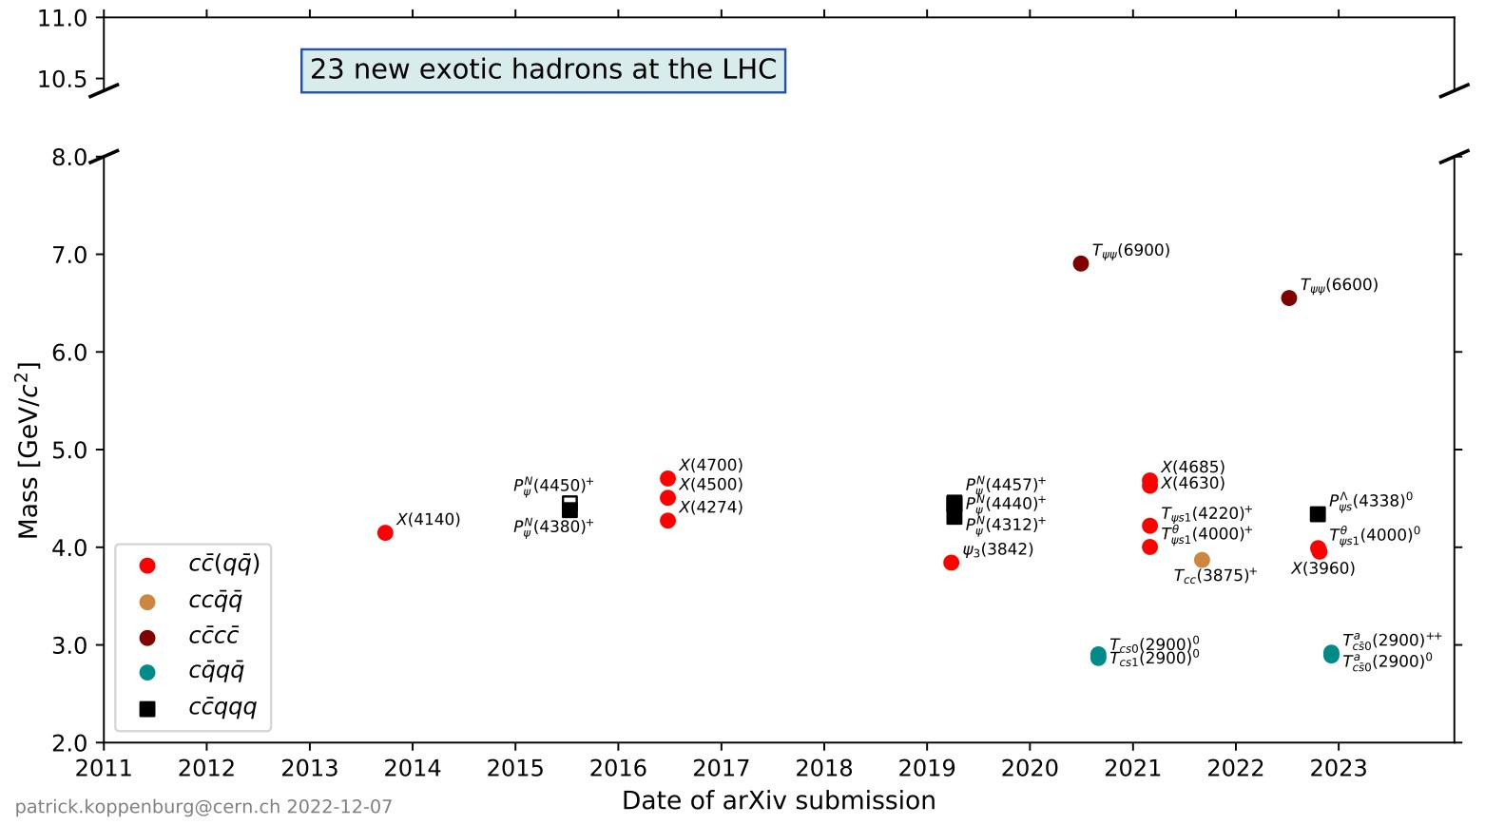
Exotic hadron—near or above threshold
Exotic hadron by LHC experiments
LHCb
CMS(中国组)
CMS，也叫Y(4140)
So far, all observed exotic hadron:
Near mass threshold: X(3872)
Above mass threshold: all others
Any bound states below thrshold?

Slide 12
All-Heavy Tetra-quarks—early predications
（cccc）
Phys. Rev. D 86, 034004 (2012)
Below double J/ψ threshold
Search via J/ψμ⁺μ⁻, J/ψ*
Above double J/ψ threshold
Search via J/ψJ/ψ
（bbcc）
Below double B_{c} threshold
J/ψΥ(1S) threshold
? …
（bbbb）
Above double B_{c} threshold
J/ψΥ(1S) threshold
Search via the above two channels
Below double Υ(1S) threshold
Search via Υ(1S)μ⁺μ⁻
Many recent theoretical studies on ($c\overline{c}c\overline{c}$), ($b\overline{b}b\overline{b}$), ($b\overline{b}c\overline{c}$):
controversial on existence of bound states below η_{b}η_{b} threshold
consistent on existence of resonant states above η_{b}η_{b} threshold
Notes:
04/01/13
12

Slide 13
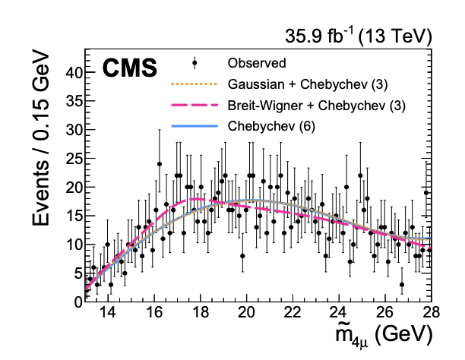
CMS unofficial and official results: controversial
Phys.Lett.B 808 (2020) 135578
2011+2012
2012
Not even a hint
Unofficial:
Taken from: http://meetings.aps.org/Meeting/APR18/Session/U09.6

Slide 14
ATLAS controversial results: 8 TeV vs 13 TeV
ATLAS observed significant excess at 18 GeV in 8 TeV data
ATLAS 13 TeV data excluded its excess observed in 8 TeV data
What is going on?
Anything (more) from Lattice QCD?

Slide 15
Summary
CMS made some contributions to exotic hadron
CMS recently found two new structures: X(6600), X(7200)
All observed exotic hadrons are near or above mass threshold
Lattice QCD finds no evidence for deeply bound states below threshold
Some theoretical results support bound states below threshold
Experimental results-–controversial
Lattice QCD can help to clarify?

Slide 16
Backup

Slide 17
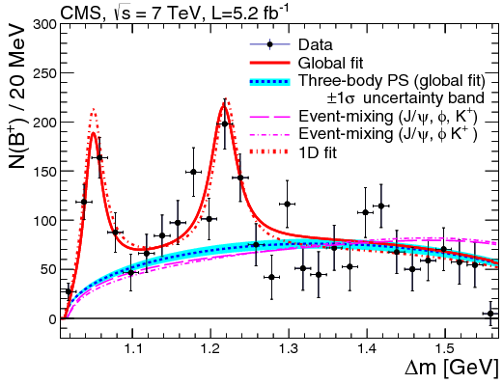
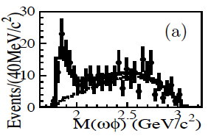
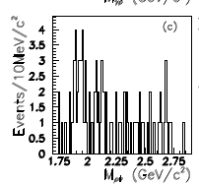
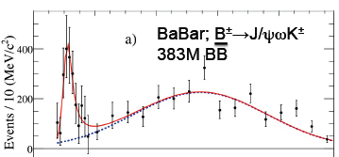
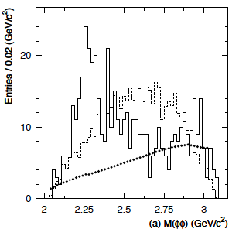
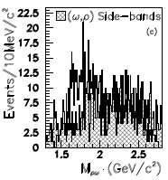
Near Threshold puzzle
J/ψϕ
CMS
ωϕ--BES
ρϕ--BES
PRD 77, 012001(2008)
ϕϕ--BES
ρω--BES
J/ψω
Clean vector-vector (VV) system (anything related to its nature?):
--excesses when both V has no isospin
--not clear when one V has isospin
extend to other VV system, where V is composed of heavy quark such as J/𝝍J/𝝍 and YY?
IJMPA Vol. 28, No. 18 (2013) 1330020

Slide 18
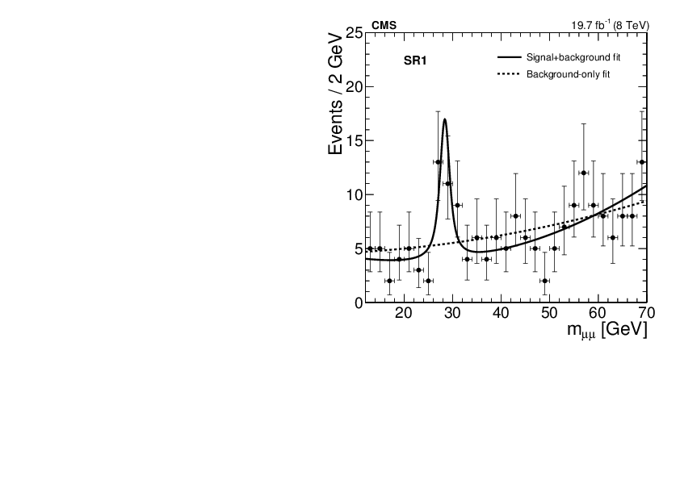
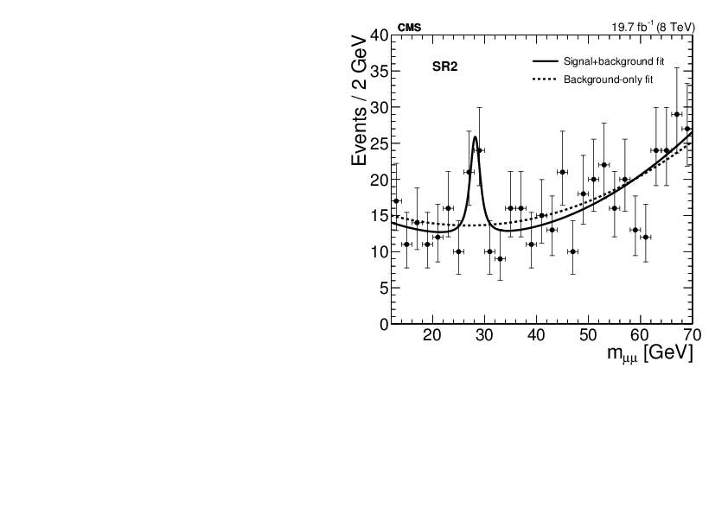
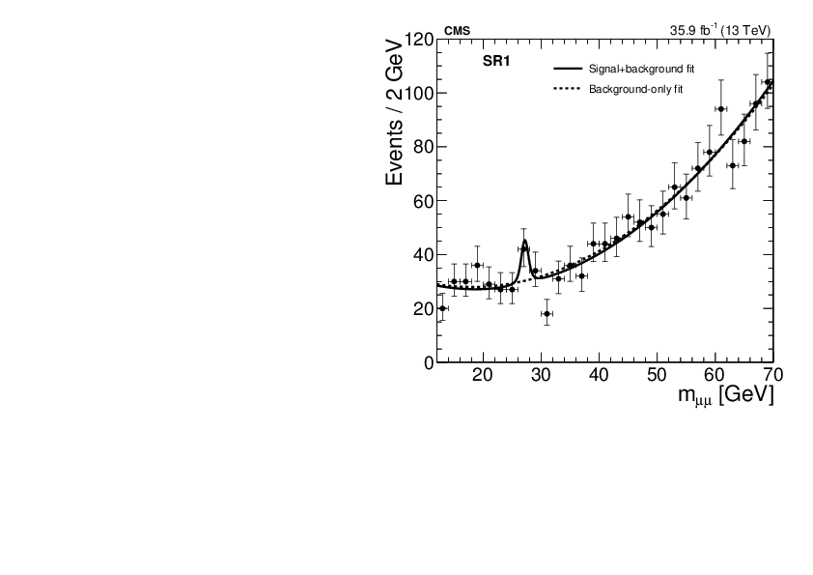
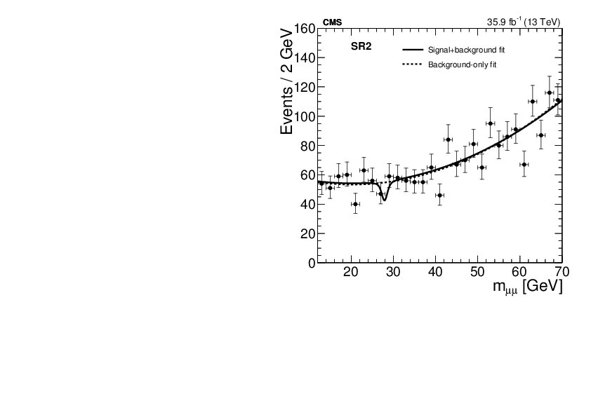
Dimuon result from CMS
JHEP 11 (2018) 161
2012
2012
ATLAS does not see
Same sensitivity?
How about 2017 ?
How about 2018?
If true → BSM
2016
2016
An exploration in the low mass region at LHC

