Slide 1

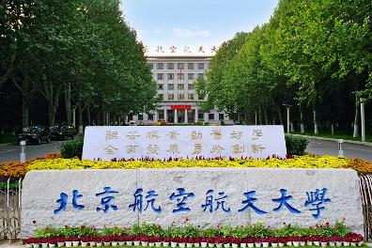

第三届中国格点量子色动力学研讨会 ，北京，2023.10.06-10.09
When EFT meets lattice QCD--selected topics
Li-Sheng Geng（耿立升）@ Beihang U.
2307.11631 , Jia-Ming Xie, Jun-Xu Lu，LSG, Bing-Song Zou
2301.00630, Tian-WeiWu, Si-QiangLuo, Ming-ZhuLiu, LSG, Xiang Liu
In preparation, Qing-Yu Zhai, Ming-Zhu Liu, Jun-Xu Lu, LSG, Bing-Song Zou

Slide 2
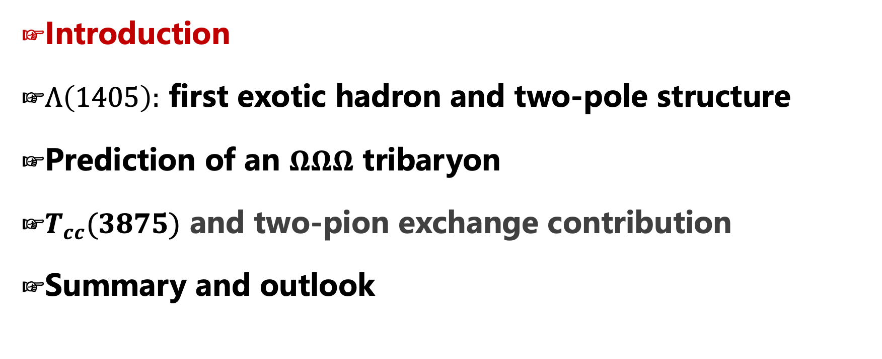
Contents
Introduction
$Λ\left(1405\right):$ first exotic hadron and two-pole structure
Prediction of an $ΩΩΩ$ tribaryon
$T_{cc}(3875)$ and two-pion exchange contribution
Summary and outlook

Slide 3




Beginning of a new era： 2003
$$Θ^{+} (1540)$$
𝜣^+ (𝟏𝟓𝟒𝟎)
$$D_{s0}^{∗}(2317)$$
𝑫_𝒔𝟎^∗ (𝟐𝟑𝟏𝟕)
$$X(3872)$$
X(𝟑𝟖𝟕𝟐)
Belle, 0309032
> 1800
BaBar, 0304021
> 900
LEPS, 0301020
> 1100
Notes:
2003 marked the beginning of a new period

Slide 4
















































Exotic mesons or baryons
Tetraquark states
Pentaquark states
$$X_{0}(2866)$$
$$X_{1}(2904)$$
$D_{s1}$(2460)
$$\text{X}\text{(4160)}$$
$$\text{Y}\text{(4220)}$$
$Z_{c}$(4100)
$$\text{Y}\text{(4660)}$$
$Z_{c}$(4020)
$$P_{c}(4380)$$
$Ξ$(1620)
$$X(6900)$$
$D_{s0}$(2317)
$$\text{Y}\text{(4260)}$$
$$\text{X}\text{(3915)}$$
$$\text{X}\text{(4274)}$$
$Z_{c}$(3900)
$$P_{c}(4450)$$
$$\text{Y}\text{(4390)}$$
$$X(7200)$$
$$\text{Y}\text{(4500)}$$
$$\text{Y}\text{(4360)}$$
$Ω$(2012)
$$P_{cs}(4459)$$
$$P_{c}(4337)$$
2003
2005
2006
2007
2009
2011
2013
2014
2015
2016
2018
2019
2020
2021
2022
$$\text{X}\text{(3960)}$$
$$\text{X}\text{(3872)}$$
$Z_{c}$(4430)
$X$(4140)
$Z_{c}$(4200)
$$P_{c}(4457)$$
$Z_{cs}$(3985)
$$P_{cs}(4338)$$
$$\text{X}\text{(5568)}$$
$$P_{c}(4440)$$
$$T_{cs}(2900)$$
$Y$(3940)
$$P_{c}(4312)$$
$T_{cc}$(3875)
$Z_{b}$(10610)
$Z_{b}$(10650)
$Λ_{c}$(2940)
Notes:
A lot more were discovered in the following years

Slide 5
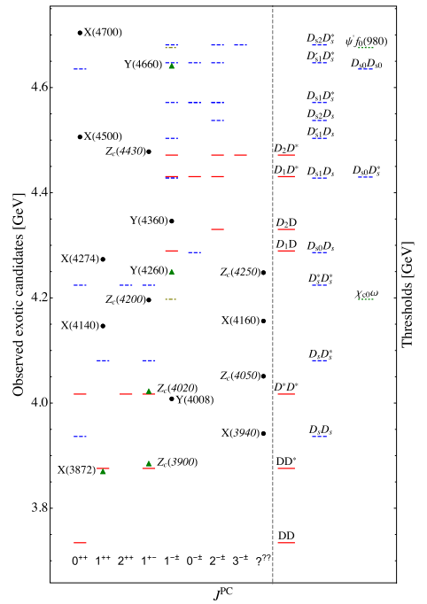
Many (if not all) of them close to thresholds
Feng-Kun Guo, Christoph Hanhart,
Ulf-G. Meißner, Qian Wang,
Qiang Zhao, Bing-Song Zou.
Rev.Mod.Phys. 90 (2018) 015004.
If this is the case, the most important work is to understand the (residual) strong interaction between the constituents (of the molecular states)
Hua-Xing Chen, Wei Chen, Xiang Liu and Shi-Lin Zhu,The hidden-charm pentaquark and tetraquark states,Phys. Rept.639 (2016) 1

Slide 6
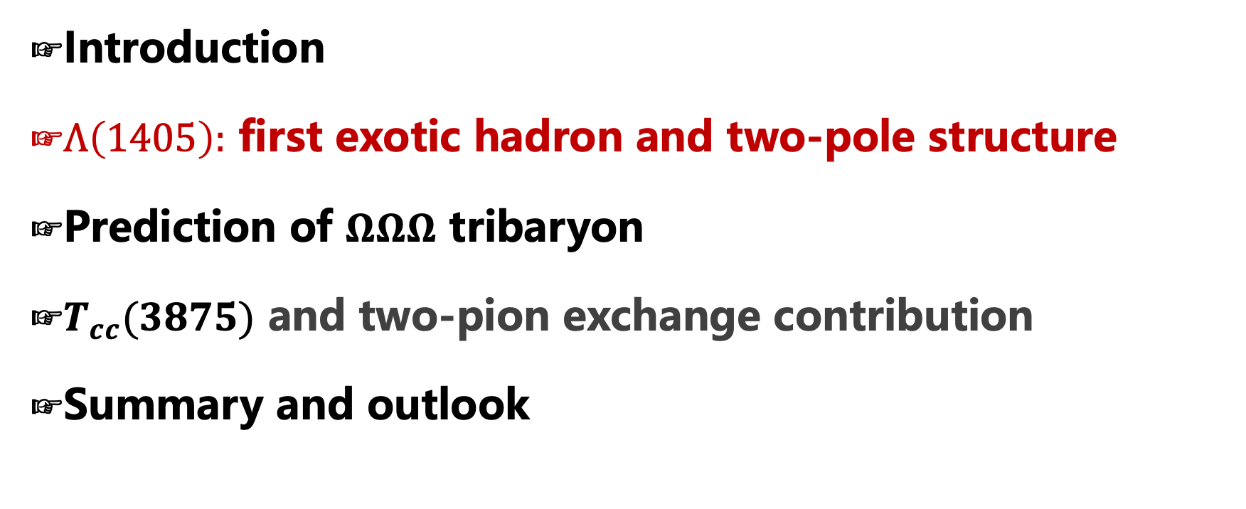
Contents
Introduction
$Λ\left(1405\right):$ first exotic hadron and two-pole structure
Prediction of $ΩΩΩ$ tribaryon
$T_{cc}(3875)$ and two-pion exchange contribution
Summary and outlook

Slide 7
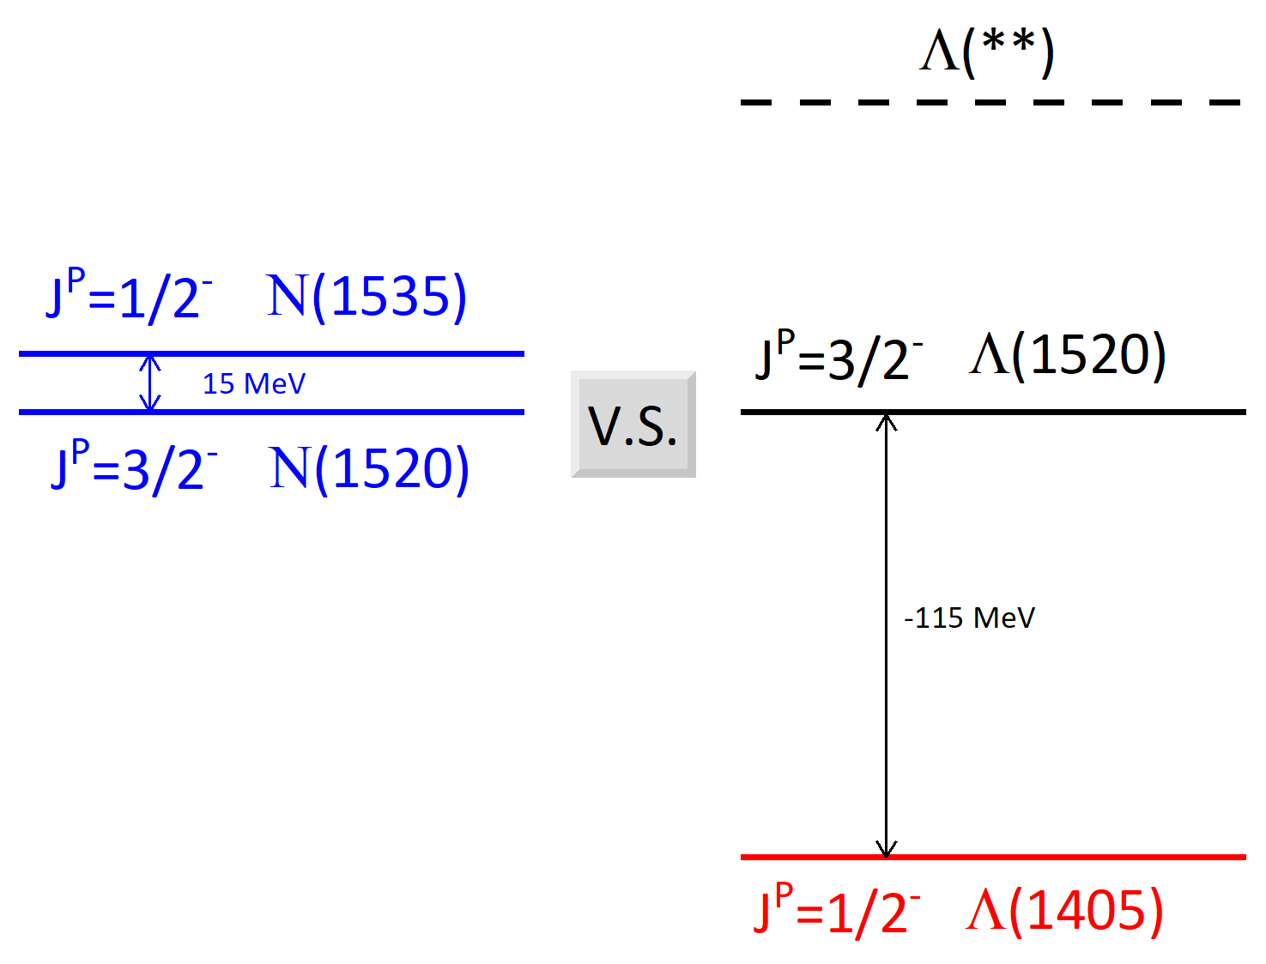

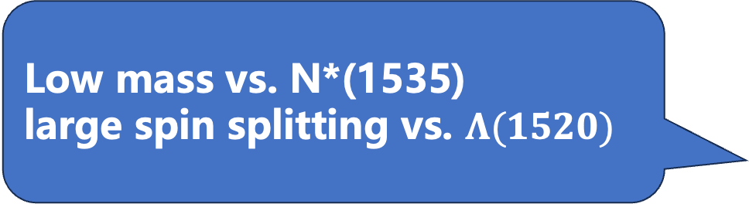
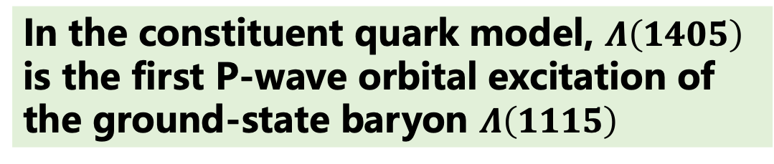
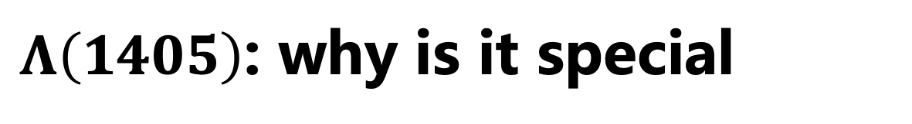
$Λ\left(1405\right)$: why is it special
PDG
In the constituent quark model, $Λ\left(1405\right)$ is the first P-wave orbital excitation of the ground-state baryon $Λ\left(1115\right)$
$I(J^{P})=0({1/2}^{−})$, $S=−1$
$M={\text{1405.1}}_{\text{−1.0}}^{\text{+1.3}}$ MeV, $Γ=50.5±2.0$ MeV
Two puzzles
Low mass vs. N*(1535)
large spin splitting vs. $Λ(1520)$
Notes:
For HO potential, the state energy is $(2n+L+3/2)ℏω$
Two strange points about \Lambda(1405):
It is lighter than its nucleon-counterpart $N^*(1535)$,
and the mass difference between $\Lambda(1405)$ and its spin-partner $\Lambda(1520)$ with $J^P=3/2^-$ is much larger than the corresponding splitting in the nucleon sector.

Slide 8
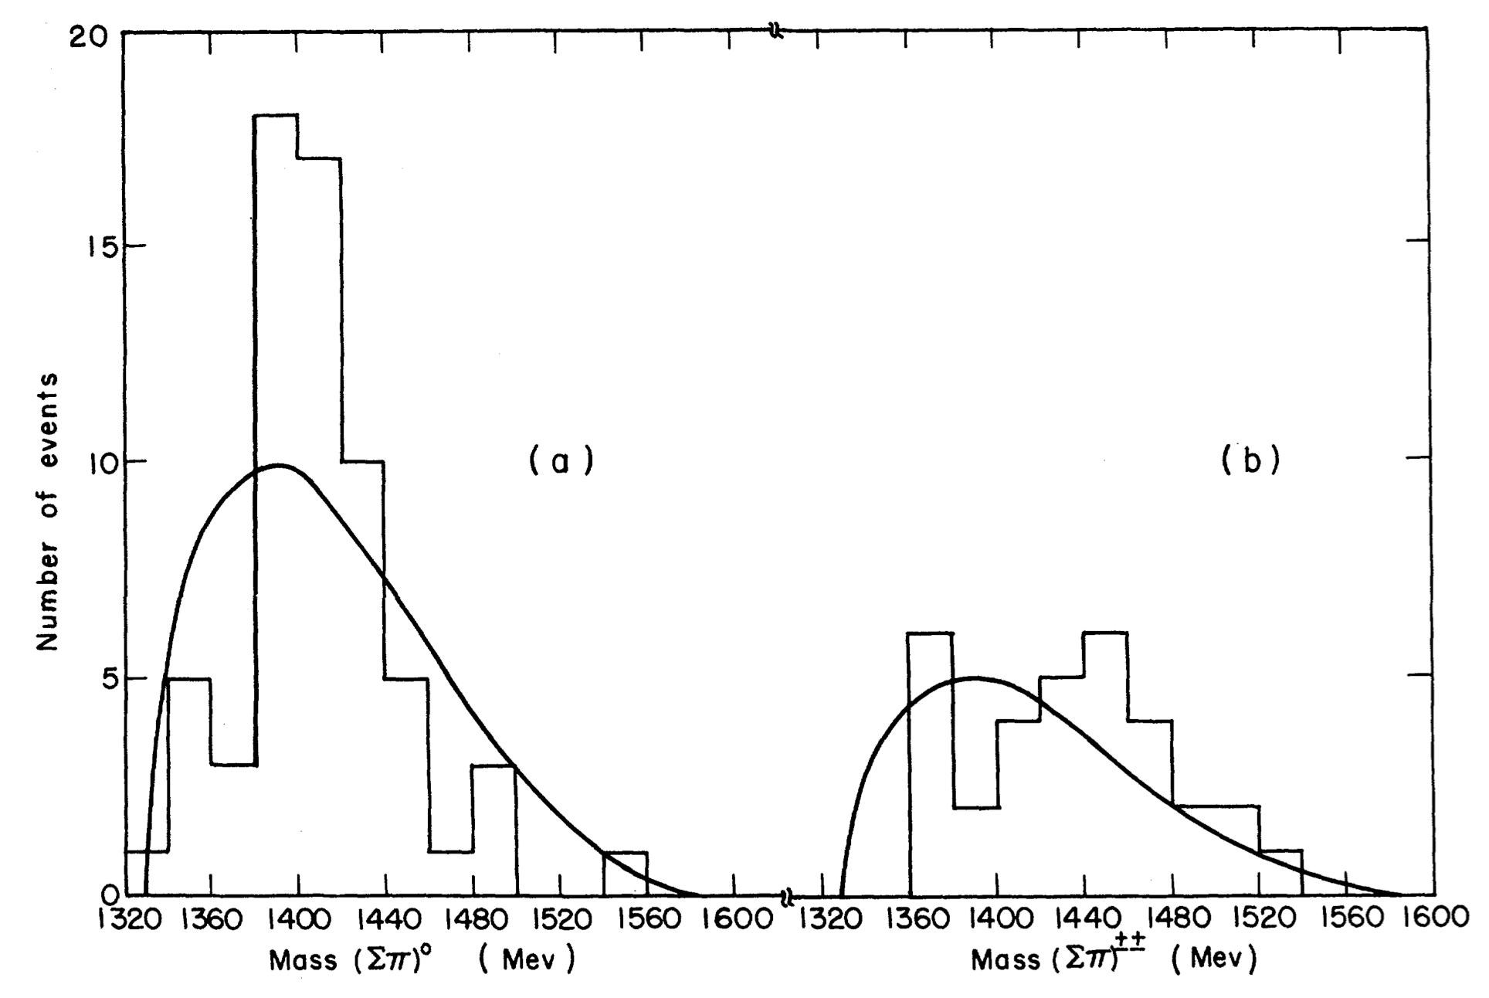
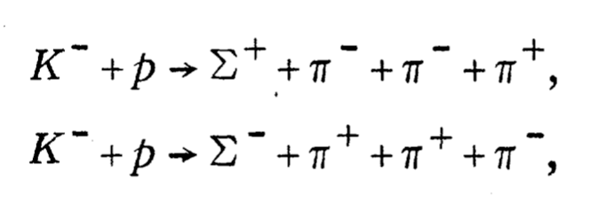

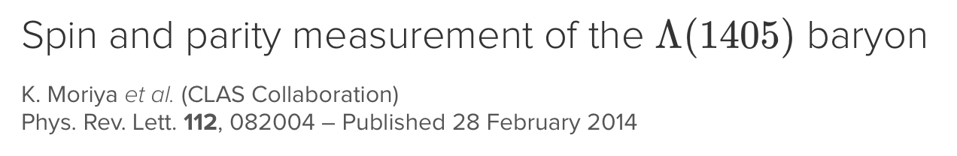

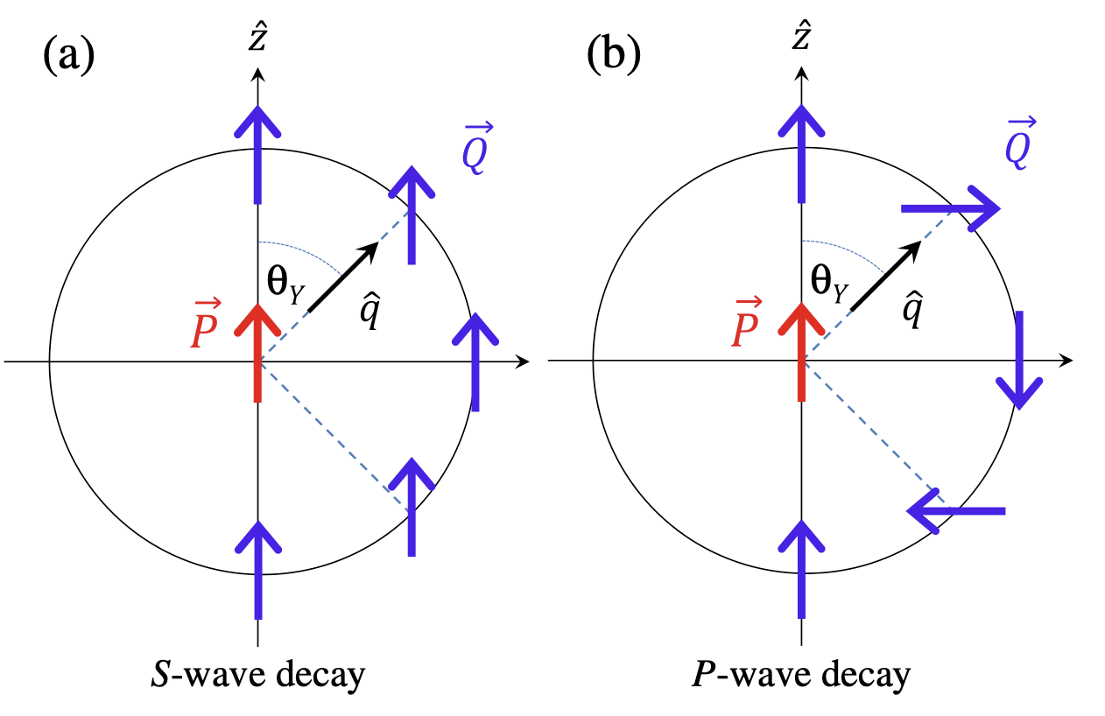
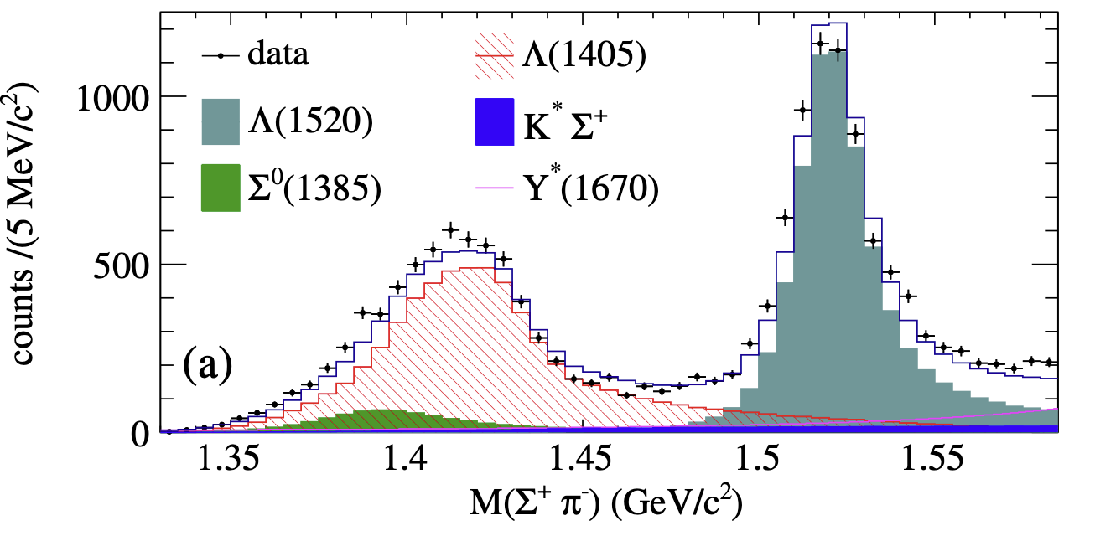
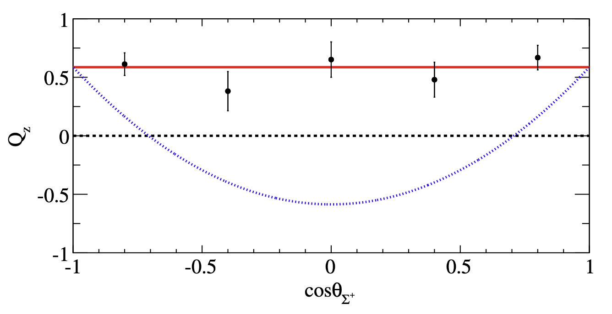
$Λ\left(1405\right)$: predicted before discovery as $\overline{K}N$ b state
PRL2,425(1959)
Notes:
For HO potential, the state energy is $(2n+L+3/2)ℏω$
Two strange points about \Lambda(1405):
It is lighter than its nucleon-counterpart $N^*(1535)$,
and the mass difference between $\Lambda(1405)$ and its spin-partner $\Lambda(1520)$ with $J^P=3/2^-$ is much larger than the corresponding splitting in the nucleon sector.

Slide 9
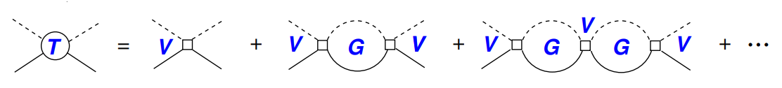
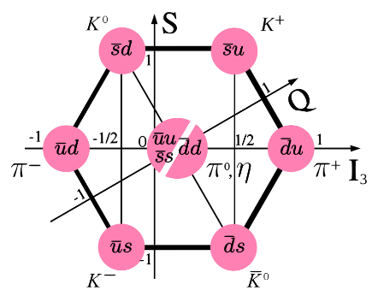
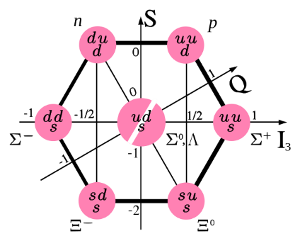
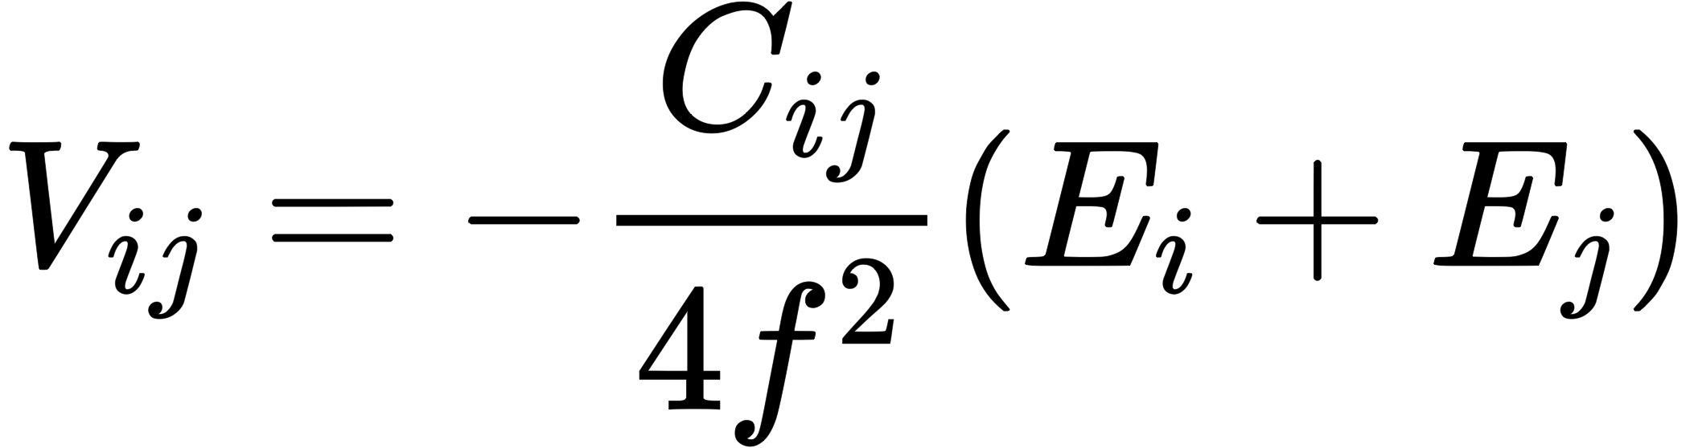
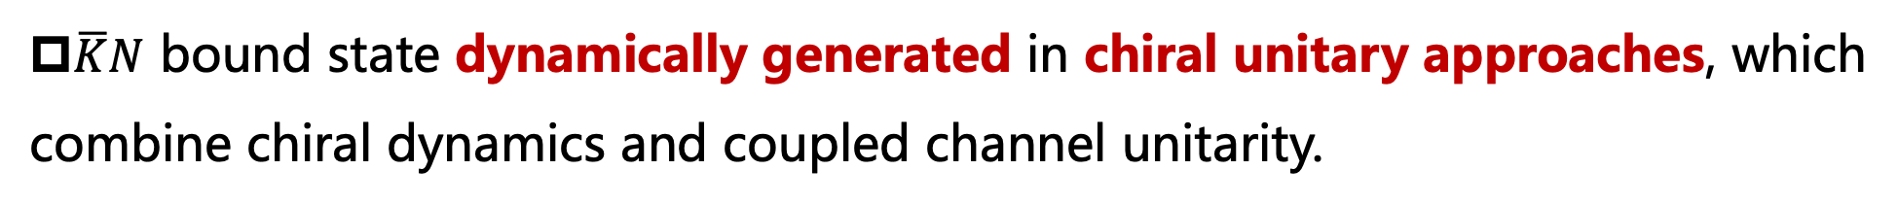
$Λ\left(1405\right)$ as a dynamically generated state
$\overline{K}N$ bound state dynamically generated in chiral unitary approaches, which combine chiral dynamics and coupled channel unitarity.
Bethe-Salpeter Equation
Weinberg-Tomozawa potential
LO&NLO, Kaiser, Siegel, Weise, NPA594, 325(1995), 720 citations
LO, Oset and Ramos, NPA635, 99(1998), 839 citations
NLO, Oller and Meissner, PLB500, 263(2001), 883 citations

Slide 10
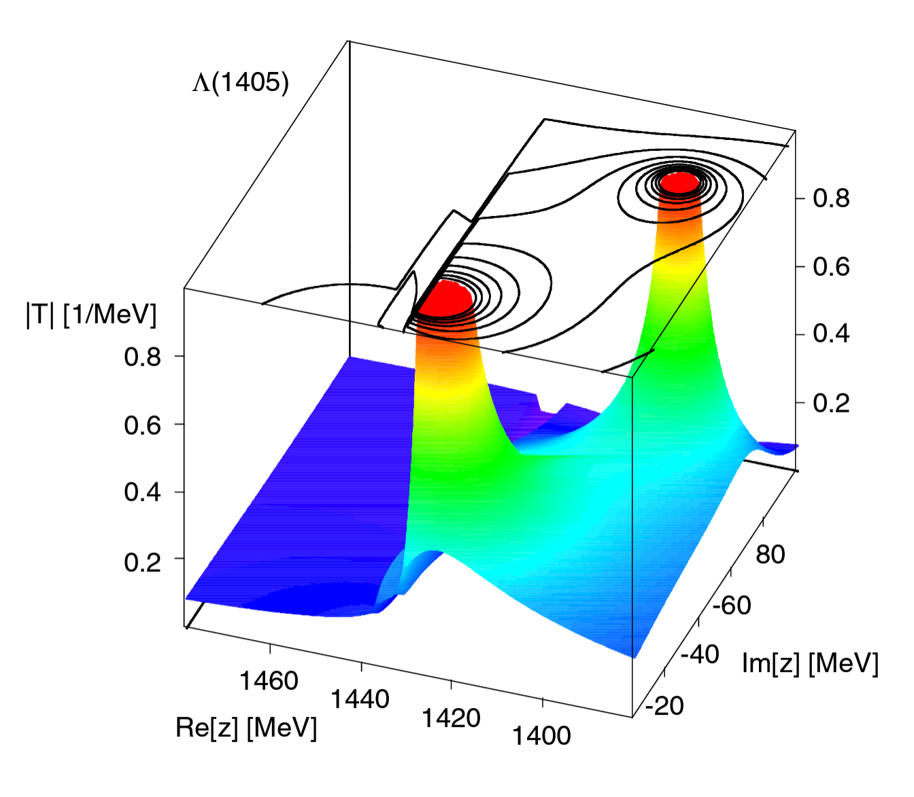
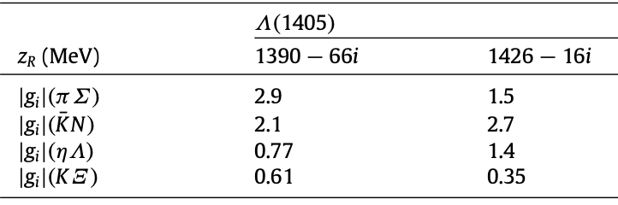
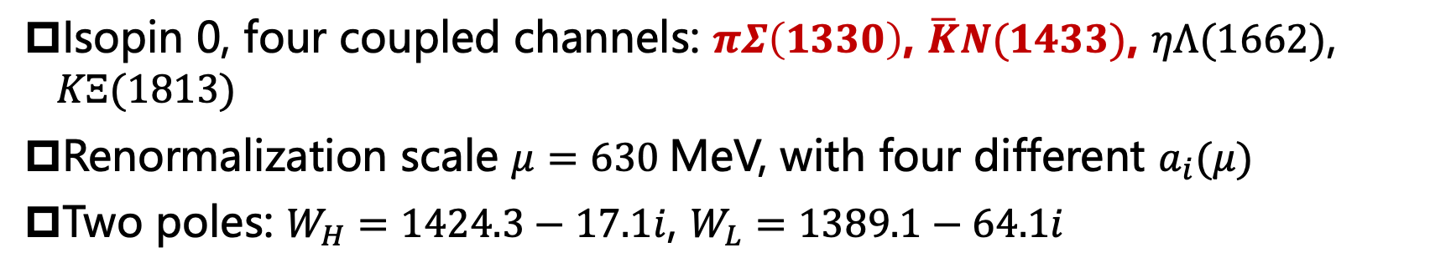
$Λ\left(1405\right)$-dynamical generated two-pole structure!
Isopin 0, four coupled channels: $πΣ\left(1330\right)$, $\overline{K}N(1433)$, $ηΛ(1662)$, $KΞ(1813)$
Renormalization scale $μ=630$MeV, with four different $a_{i}(μ)$
Two poles: $W_{H}=1424.3−17.1i$, $W_{L}=1389.1−64.1i$
Oller and Meissner, PLB500, 263(2001)
Jido, Oller, Oset, Ramos, and Meissner, NPA725, 181 (2003)
Hyodo and Jido, PPNP67, 55 (2012)

Slide 11
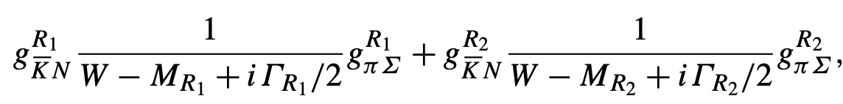
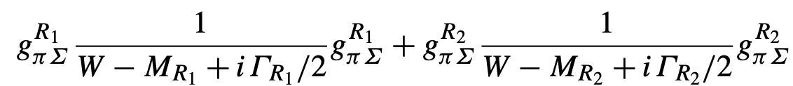
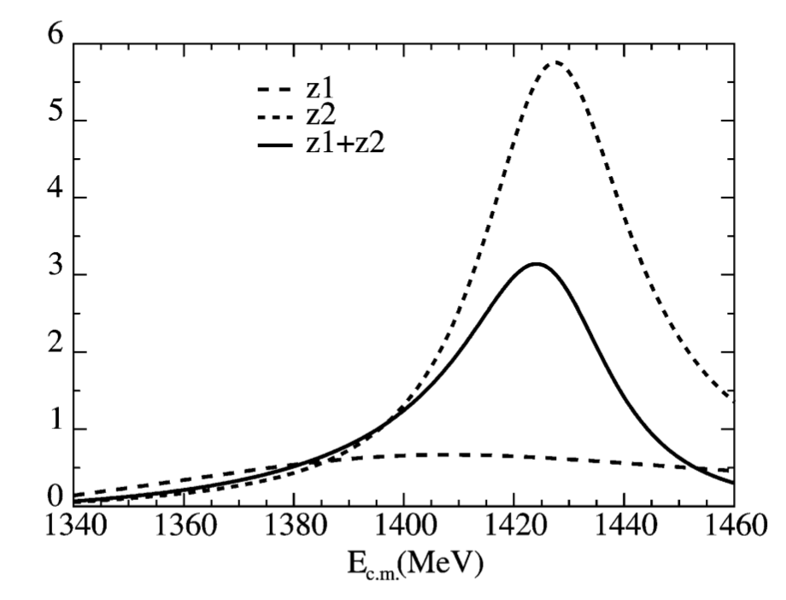
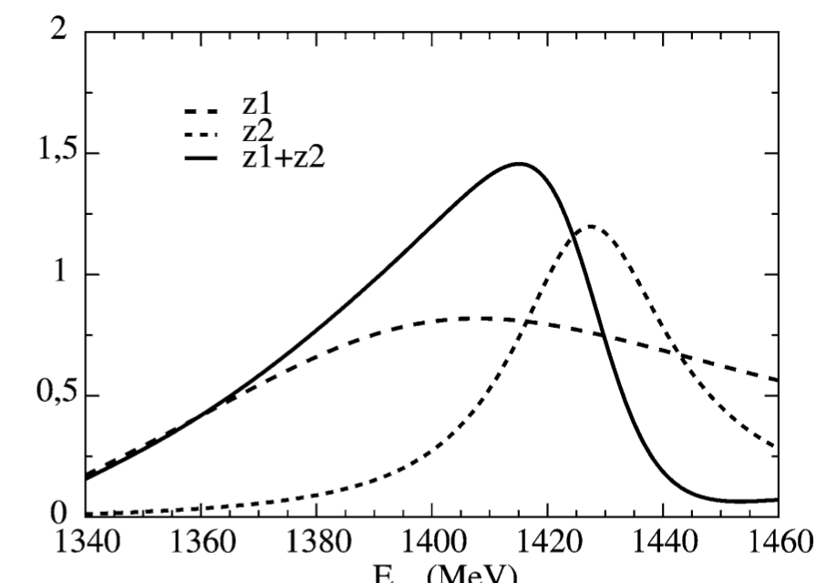
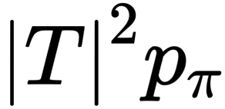


$Λ\left(1405\right)$-dynamical generated two-pole structure!
$\overline{K}N$ initiated
$πΣ$initiated
Oller and Meissner, PLB500(2001)263
Jido, Oller, Oset, Ramos, and Meissner, NPA725, 181 (2003)
Hyodo and Jido, PPNP67, 55 (2012)

Slide 12
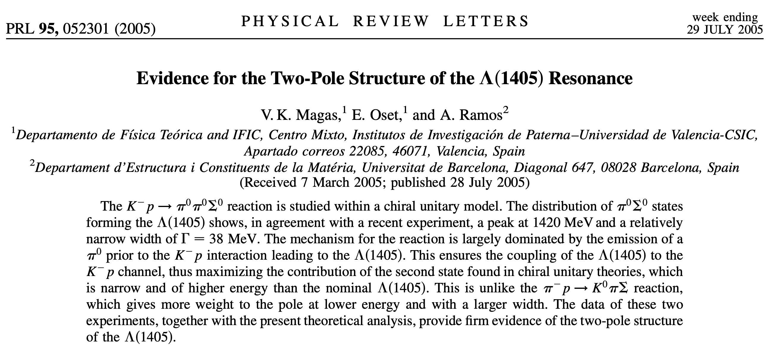
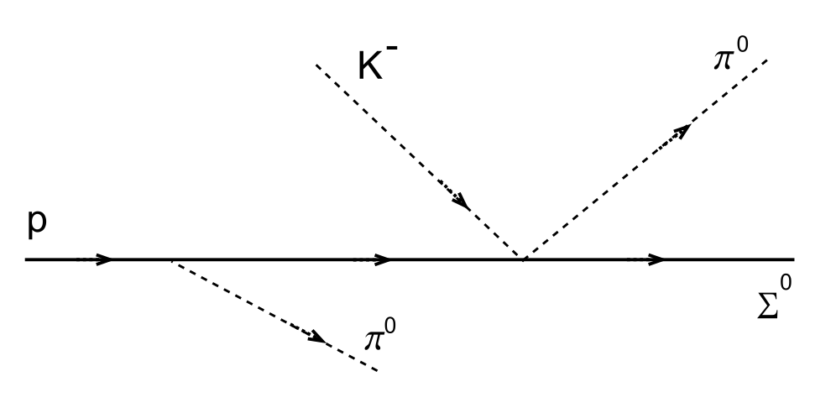
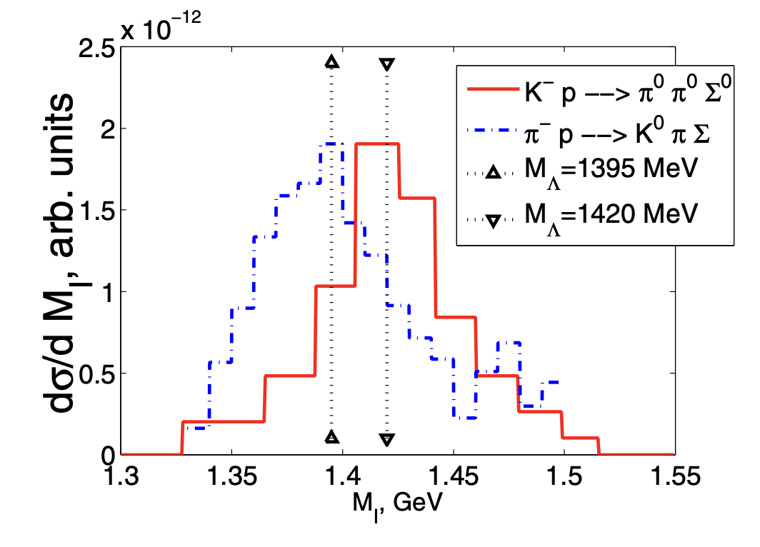
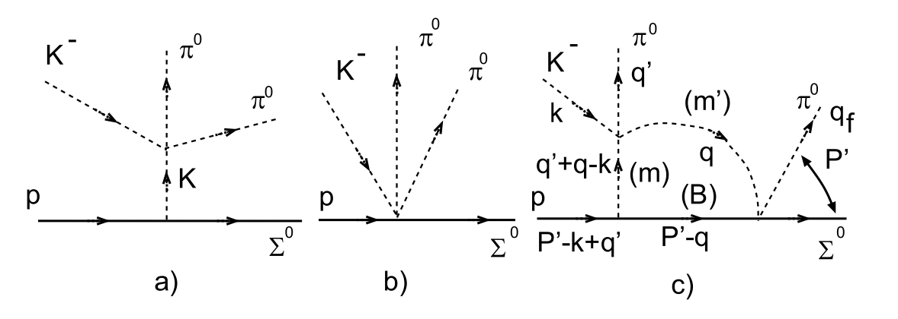
Evidence for the two-pole structure of the $Λ\left(1405\right)$ state

Slide 13
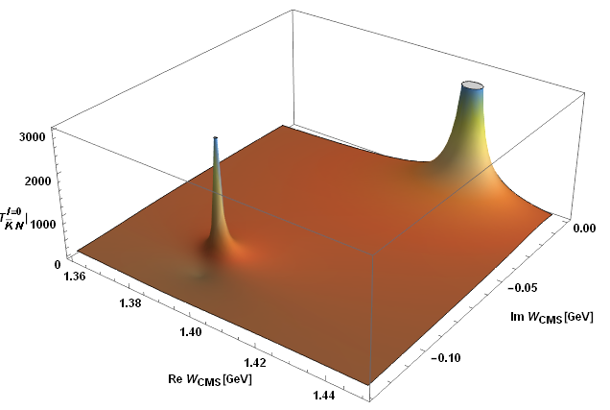
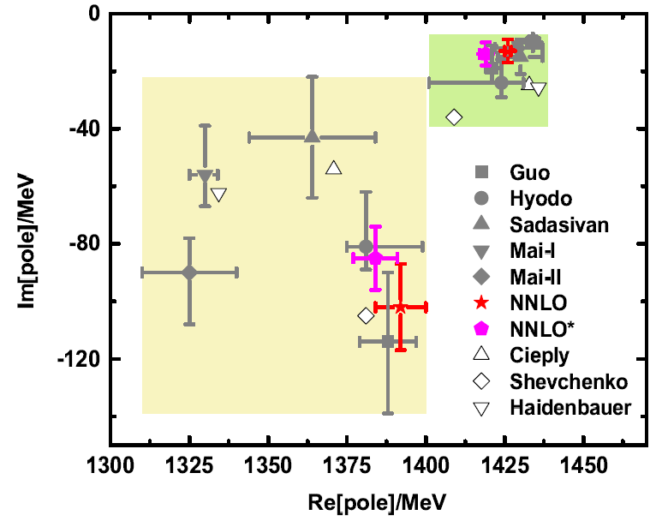


The two-pole structure persists at N2LO
First global study of meson-baryon scattering up to N2LO, Jun-Xu Lu, LSG*, M. Doering and M. Mai, PRL130, 071902(2023)
$Λ$(1405)
$Λ$(1380)
NNLO
NNLO*

Slide 14
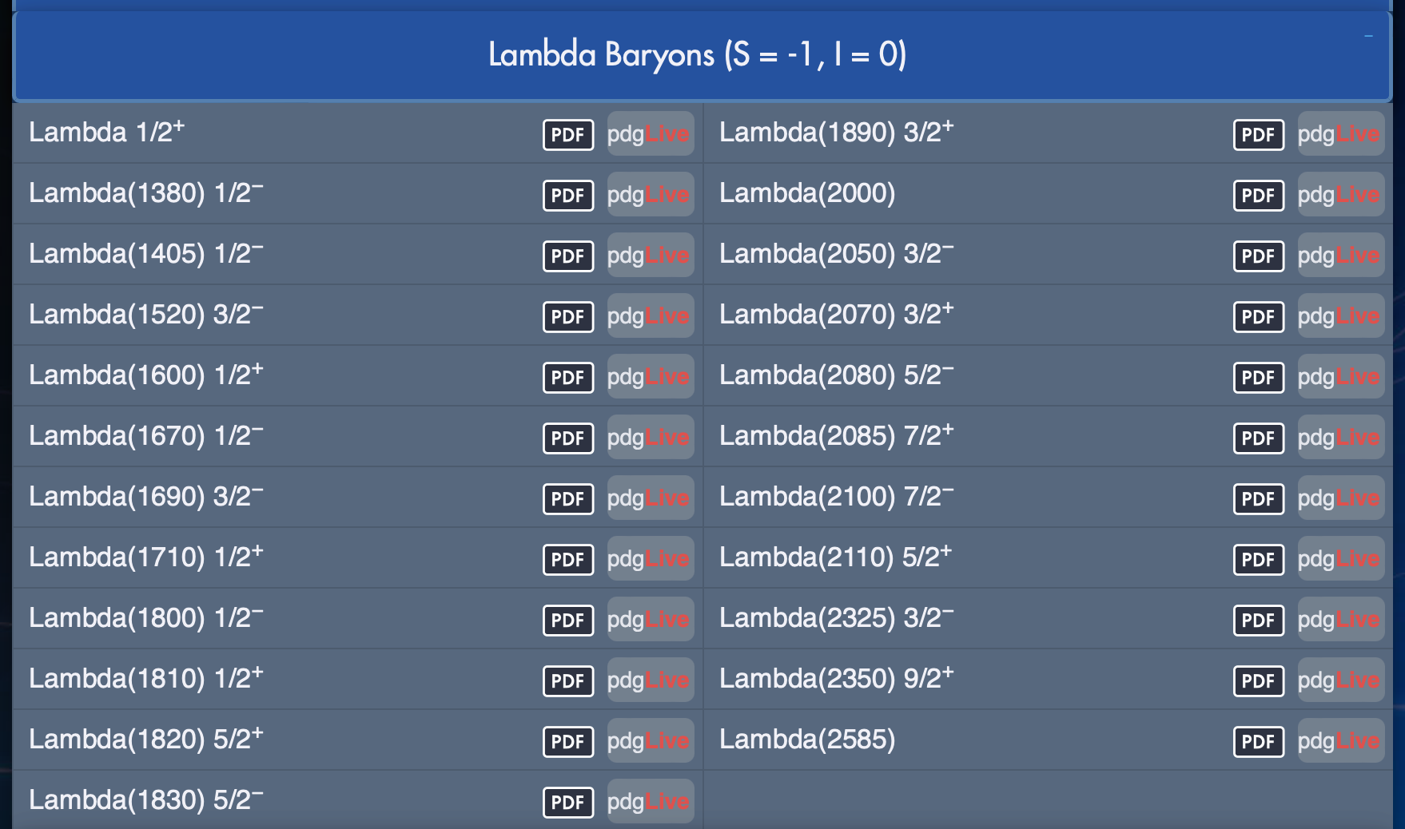
Already in the review of particle physics

Slide 15
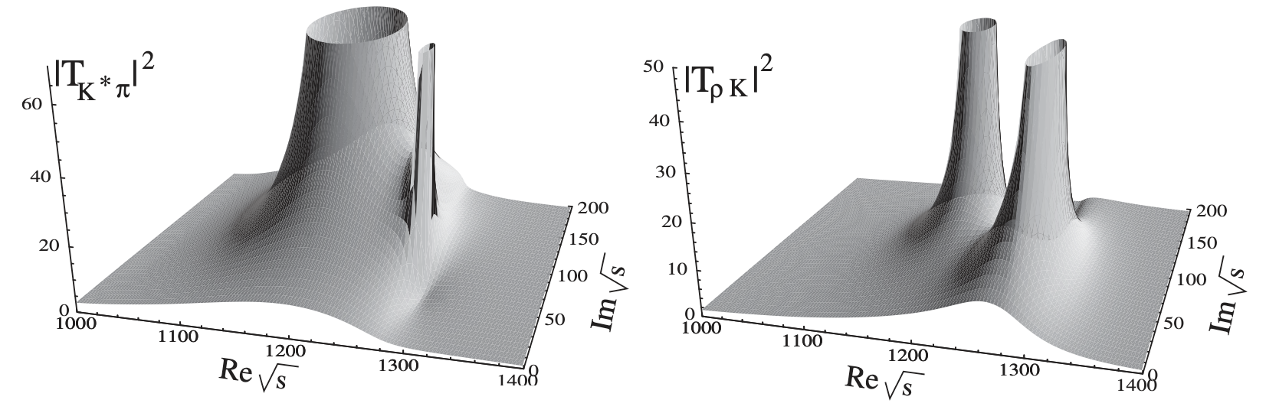
Narrow/Proper definition of two-pole structures!
Two-pole structures refer to the fact that two dynamically generated states, one resonant and one bound, are located close to each other between two coupled channels and with a mass difference smaller than the sum of their widths.
Two poles overlap, which creates the impression that there is only one state in the invariant mass distribution of their decay products.
Hyodo and Jido, PPNP67, 55 (2012)
LSG, Oset, Roca, and Oller, PRD75, 014017 (2007)
Notes:
One should note that it is difficult for two far-separated channels to generate two nearby poles without fine tuning, such as f_0(600) and f_0(980).
Left panel is for \Lambda(1405), and right panel is for K_1(1270), both of which are used to visualize the two-pole structure.

Slide 16
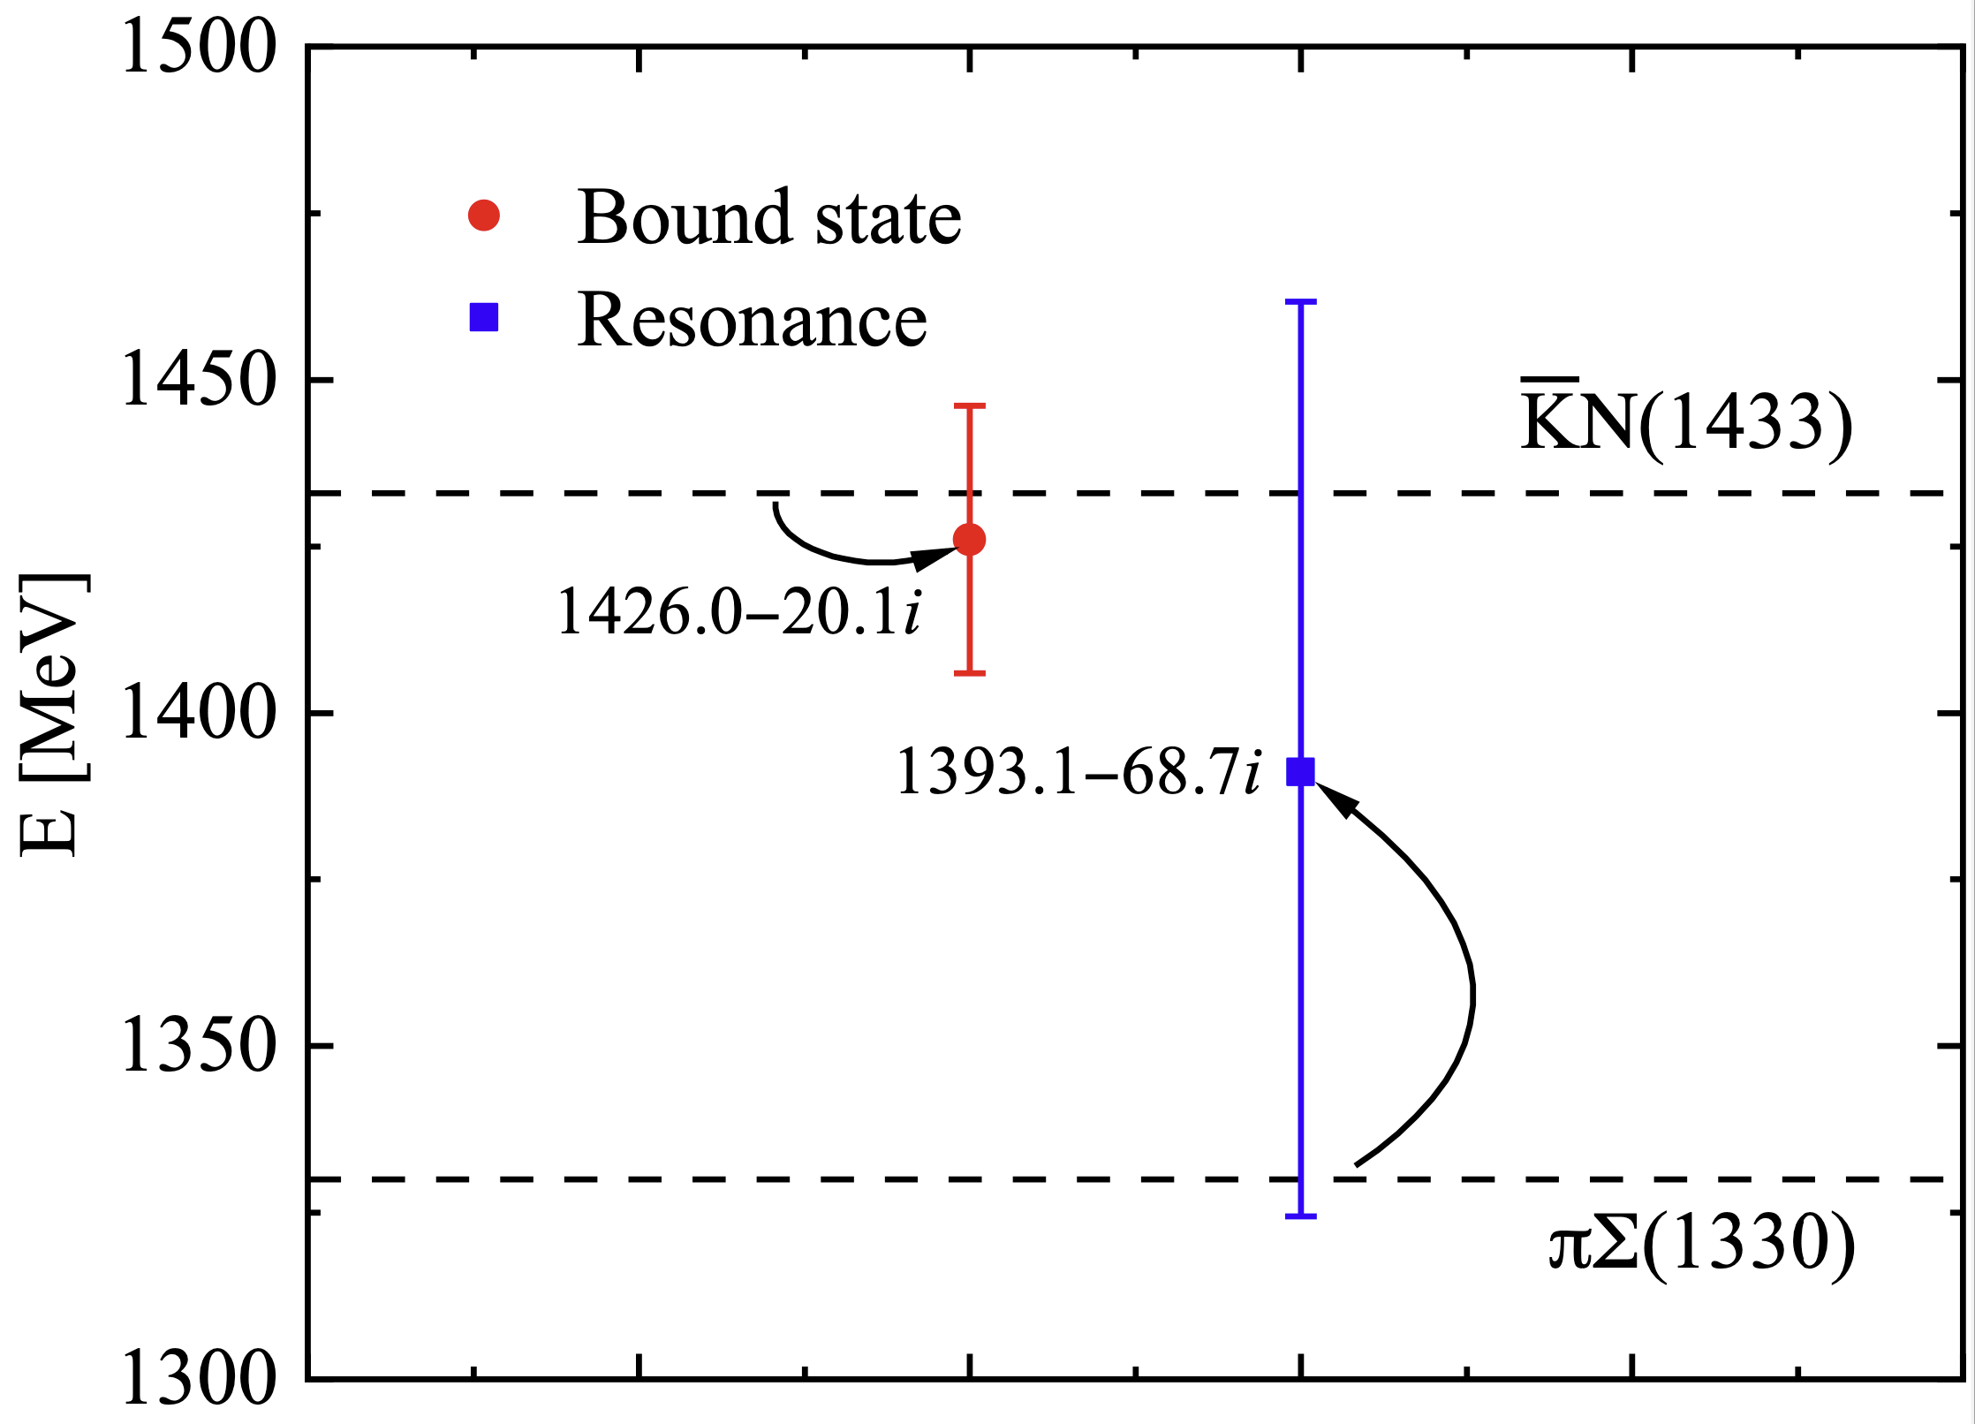
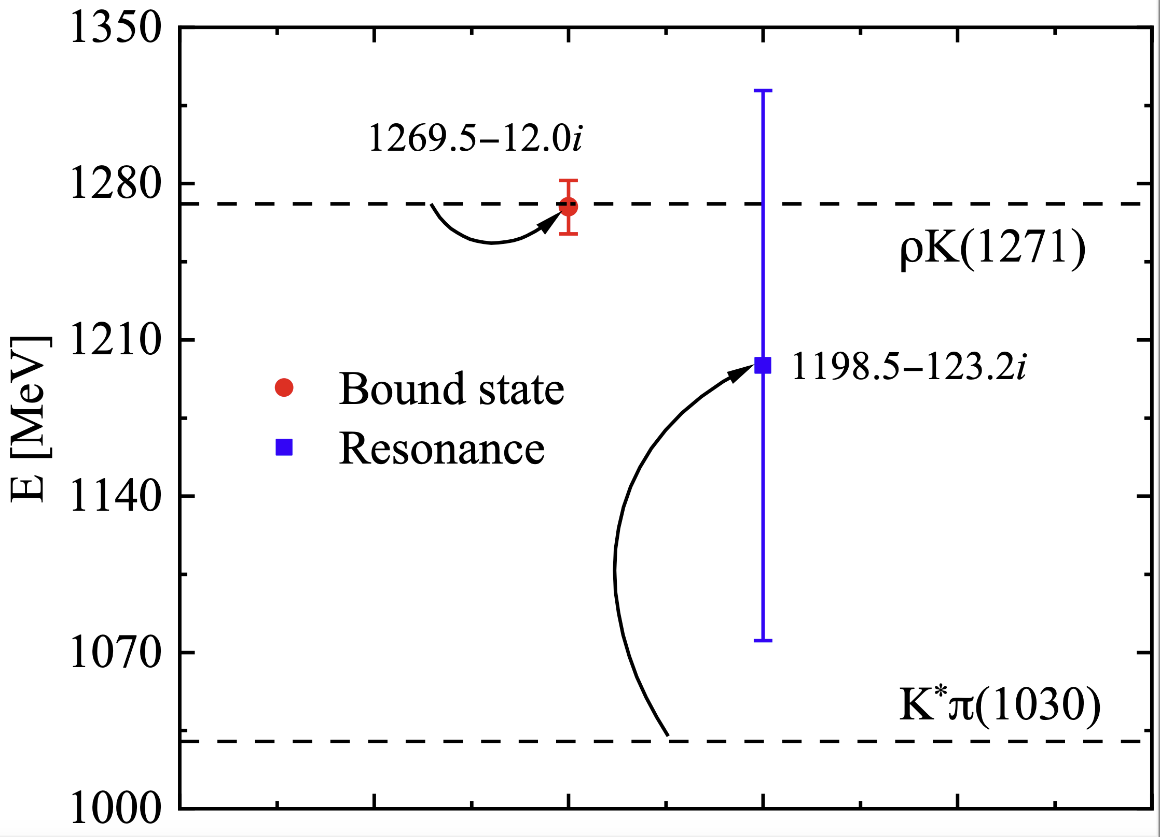
Two prominent examples: $Λ(1405)$ and $K_{1}(1270)$

Slide 17
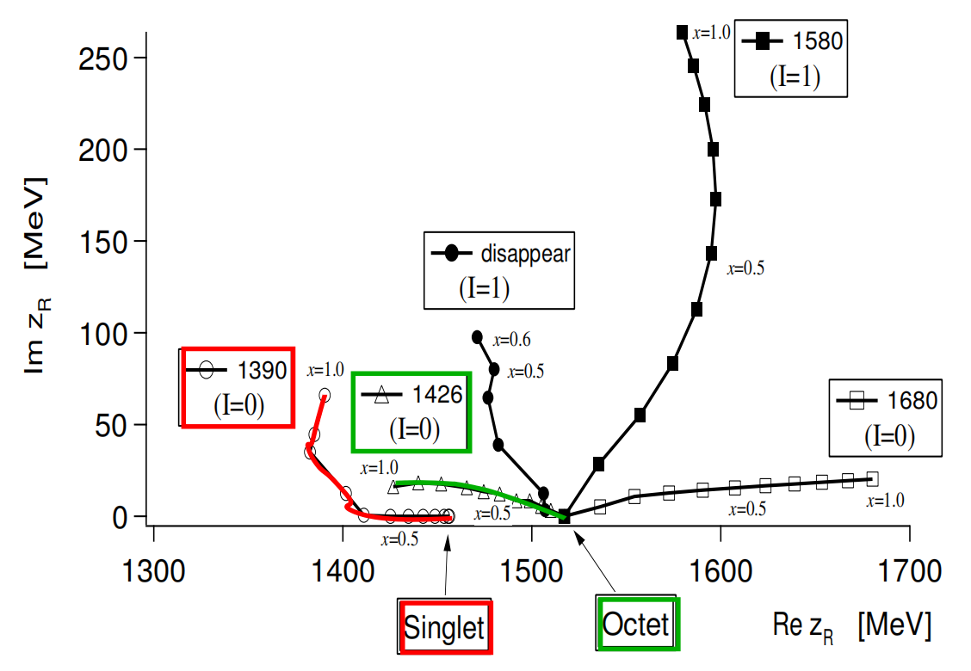

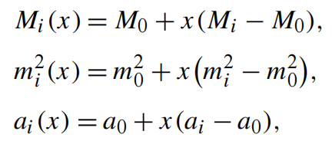
SU(3) group-theoretical explanation
SU(3) symmetry decomposition
Baryon octet-NGB octet
Potential in this basis
Is this the whole story?
attractive
The answer is no!
SU(3) symmetry breaking
Jido, Oller, Oset, Ramos, and Meissner, NPA725, 181(2003)
Feng-Kun Guo et al., 2308.07658
Notes:
The direct product of two octet states are decomposed into the direct sum of the irreducible representations of SU(3).
It is similarity transformations from particle basis to SU(3) symmetric basis, under which this SU(3)-symmetric potential is diagonal.
In our convention, the plus sign represents attractive potential, while the minus sign the repulsive.
Three SU(3) channels are possible to generate bound states, i.e. belonging to one singlet and two degenerate octets respectively.
In SU(3) symmetry limit, different channels share the same values of meson mass m_0, baryon mass M_0, and subtraction constant a_0.
SU(3) breaking still preserves the SU(2) isospin and U(1) hypercharge conservation.

Slide 18
Three questions to ask/answer (not by flavor sym.)
How does the nature of the Nambu-Goldstone bosons play a role?
Whether is the energy dependence of the WT potential relevant?
Is the coupling between $\overline{K}N$ and $πΣ$ important?
Is the coupling between 𝐾 ̅𝑁 and 𝜋Σ important?
Q1
Q2
Q3

Slide 19
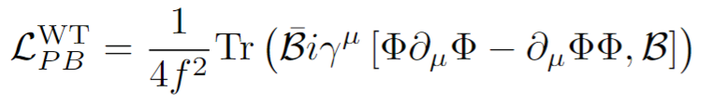
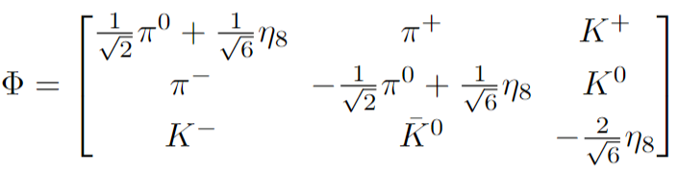
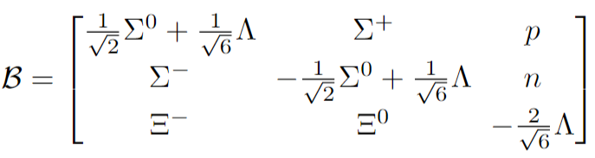
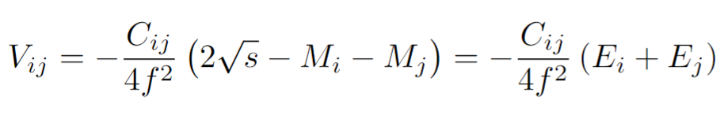
Weinberg-Tomozawa Interaction (leading order)
Leading order interaction between a NGB and a ground-state baryon
The Weinberg-Tomozawa (WT) potential--parameter free
Notes:
Covariant derivative term for the WT interaction among various terms of LO chiral Lagrangian for NGB-ground-state baryon interaction.

Slide 20
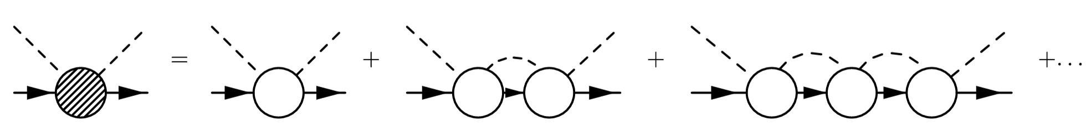

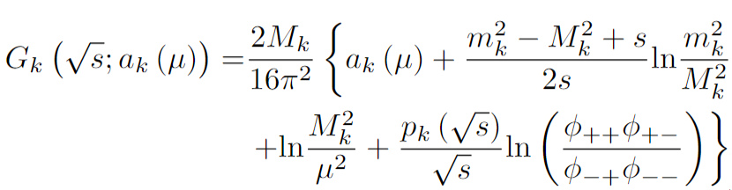
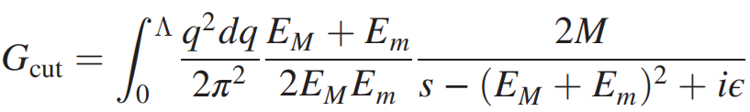
$Λ\left(1405\right)$--dynamically generated in Chiral Unitary Approaches
Chiral dynamics &. Coupled-channel unitarity
Loop function
Dim. Regularization
Cutoff regularization
Dynamically generated state — singularities of unitarized amplitude $T$
See, e.g., Oller, Oset, and Ramos, PPNP45, 157 (2000)

Slide 21
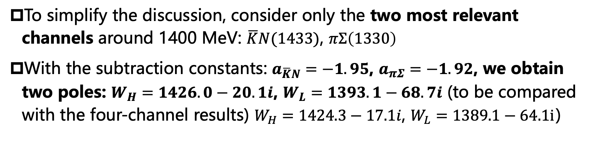
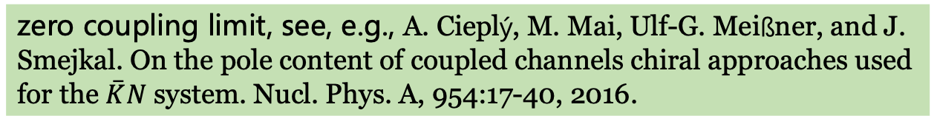
Q1: Is the coupling important?
To simplify the discussion, consider only the two most relevant channels around 1400 MeV: $\overline{K}N(1433)$, $πΣ\left(1330\right)$
With the subtraction constants: $a_{\overline{K}N}=−1.95$, $a_{πΣ}=−1.92$, we obtain two poles: $W_{H}=1426.0−20.1i$, $W_{L}=1393.1−68.7i$ (to be compared with the four-channel results) $W_{H}=1424.3−17.1i$, $W_{L}=1389.1−64.1i$）
zero coupling limit, see, e.g., A. Cieplý, M. Mai, Ulf-G. Meißner, and J. Smejkal. On the pole content of coupled channels chiral approaches used for the $\overset{‾}{K}N$ system. Nucl. Phys. A, 954:17-40, 2016.

Slide 22
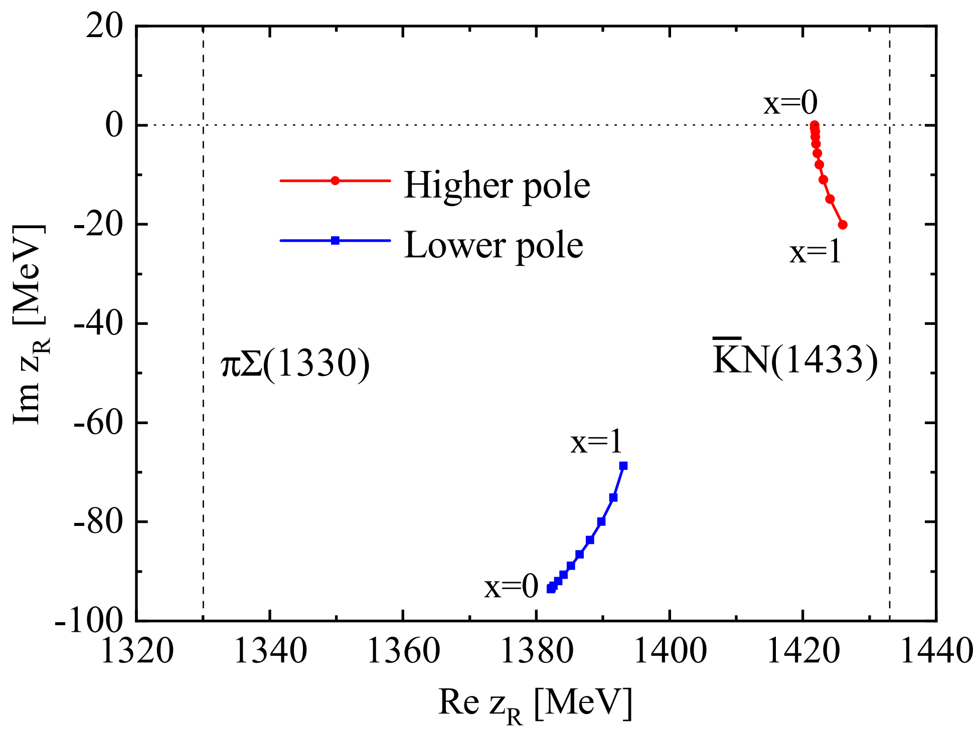




Q1: Is the coupling important?
Multiply a factor $0≤x≤1$, to the off-diagonal matrix elements of the WT potential
Even in the limit of complete decoupling ($x=0$), there are still two poles:
$W_{H}=1421.8−0i$,
$W_{L}=1382.2−93.6i$
Coupling is relevant for the decay into the lower channel
Notes:
The higher pole is a pure bound state of $\overline{K}N(1433)$ channel.
The lower pole is a pure resonance of $πΣ\left(1330\right)$ channel.
Secondly, the coupling not only pushes two poles higher, but also gives the higher pole a finite width, allowing it to decay into the lower $πΣ\left(1330\right)$ channel.
However, it does not mean that the coupled channel effect is irrelevant for emergence of the two pole structure, otherwise the higher pole will not manifest itself in the invariant mass distribution of the lower $πΣ\left(1330\right)$ channel.

Slide 23



Q2: How does the nature of NG bosons play a role?
The diagonal chiral WT potential
$m_{K}=$ 496 MeV
$m_{π}=138$ MeV
Explicit chiral symmetry breaking leads to $m_{π}≪m_{K}$. As a result, close to the thresholds, the $\overline{K}N(1433)$ interaction is stronger than the $πΣ\left(1330\right)$ one, which leads to a $\overline{K}N(1433)$ bound state
The small pion mass combined with the $q^{2}$-dependence of the interaction is responsible for the dynamical generation of a $πΣ\left(1330\right)$ resonance

Slide 24



Role of explicit chiral symmetry breaking
To study pole trajectories as a function of the light-quark (pion) mass dependence, we need the pion mass dependence of the mesons and baryons
Ren, LSG*, Camalich, Meng, and Toki, JHEP12, 073 (2012)
$M_{0}$ is the chiral limit of the baryon mass.
$ξ_{B,φ}$ are the relevant parameters containing three low-energy constants, fitted to the lattice QCD data of the PACS-CS Collaboration.
Aoki et al. (PACS-CS), PRD79, 034503 (2009)
Notes:
Maybe some introductions about the concept of explicit chiral symmetry breaking will be helpful for laymen.

Slide 25



Variation of higher pole with m_{π}：simple
As $m_{π}$ increases, both the real and the imaginary parts of the higher pole decrease, which indicates that the effective $\overline{K}N$ attraction becomes weaker and the coupling to $πΣ$ decreases as well.
Note that the two thresholds increase as well as $m_{π}$ increases.

Slide 26

Variation of lower pole with m_{π}: complicated
For a pion mass about 200 MeV, it becomes a virtual state from a resonant state.
For a pion mass about 300 MeV, it becomes a bound state and remains so up to the pion mass of 500 MeV.
The evolution of the lower pole clearly demonstrates the chiral dynamics underlying the two-pole structure of $Λ(1405)$.

Slide 27







Lattice QCD verification
2307.10413v1
$m_{π}≈200$ MeV,
a virtual bound state below $πΣ$ and a resonant state just below $\overline{K}N$

Slide 28






Quark mass evolution—QCDSF-UKQCD
QCDSF-UKQCD
PACS-CS
J. Bulava et al., (2023), arXiv: 2307.10413 [hep-lat]
J. Bulava et al., (2023), arXiv: 2307.13471 [hep-lat

Slide 29


Trajectories following the QCDSF setup
For an unphysical pion mass of about 200 MeV, a virtual pole coupling more to the $πΣ$ channel and a higher pole coupling more to the $\overline{K}N$ channel were identified.

Slide 30

Q3: Is energy dependence of WT potential relevant?
Replace the $E_{i}+E_{j}$ with $m_{i}+m_{j}$, i.e. eliminate the energy dependence.
With the original subtraction constants, we obtain only one pole at $1413.3−13.2i$, corresponding to a $\overline{K}N$ bound state.
Switching off the off-diagonal interaction affects little our conclusion.
As the pion mass is much smaller than the kaon mass, the attraction of the $πΣ$ channel is much weaker than that of the $\overline{K}N$ channel, thus cannot support a bound state.
If we increase the attractive potential, we can obtain two bound states, but not a bound state and a resonant state.
The energy dependence is responsible for the emergence of two-pole structures as we defined here.

Slide 31






$$K_{1}\left(1270\right)$$
$$I\left(J^{P}\right)=1/2\left(1^{+}\right)\text{,} S=1; M=1253±7 \text{MeV}\text{, }Γ=90±20 \text{MeV}$$
NGB scattering off （instead of a baryon) a vector meson
Simplified as the light mass of NGB and in the chiral limit of $M_{i}=M_{j}≡M$
Coupled channels: $K^{∗}π(1030)$, $ρK\left(1271\right),$ $ωK(1278)$, $K^{∗}η(1440)$, $φK(1515)$
Roca, Oset, and Singh, PRD72, 014002 (2005)
LSG, Oset, Roca, and Oller, PRD75, 014017 (2007)
Notes:
Left panel:
different convention: minus sign represents attractive potential.

Slide 32



Further two-pole structures: singly charmed baryon
NGB scattering off a single-charmed baryon
$\overline{K}Σ_{c}(2949)$, $πΞ_{c}^{′}\left(2714\right);$
$ηΞ_{c}^{′}\left(3125\right)$, $KΩ_{c}(3191)$ $;$
isospin ½, $Λ=800$ MeV
$W_{H}=2882.7−21.0i$ $W_{L}=2842.6−127.9i$

Slide 33


Further two-pole structures: singly charmed baryon
Overlapping line shapes peak at slightly different positions and have much different widths.
The $\overline{K}Σ_{c}→π{\overset{‾}{Ξ}}_{c}$ process receives more contribution from the higher pole, while the $πΞ_{c}^{′}→πΞ_{c}^{′}$ couples more to the lower pole.
$πΞ_{c}^{′}$ invariant mass distribution as functions of $E_{c.m.}$

Slide 34

Contents
Introduction
$Λ\left(1405\right):$ first exotic hadron and two-pole structure
Prediction of $ΩΩΩ$ tribaryon
$T_{cc}(3875)$ and two-pion exchange contribution
Summary and outlook

Slide 35






$ΩΩ 1S0$ Bound state
HALQCD: PRL120, 212001 (2018)
$$m_{π}≃146MeV$$
$$a≃0.0846fm$$
V=$(8.1fm)^{3}$

Slide 36




One boson exchange potential for $ΩΩ$
Ming-Zhu Liu, LSG, Chin.Phys.Lett. 38 (2021) 10, 101201

Slide 37





Existence of an $ΩΩΩ$ bound state—5S2 important
Gaussian
Expansion
Method

Slide 38




No $Ω_{ccc}$ $Ω_{ccc}$ $Ω_{ccc}$ and $Ω_{bbb}$ $Ω_{bbb}$ $Ω_{bbb}$
$Ω_{ccc}$ $Ω_{ccc}$ --Phys.Rev.Lett. 127 072003 (2021)
$Ω_{bbb}$ $Ω_{bbb}$--Phys.Rev.Lett. 130 111901 (2023)
Suppressed 5S2

Slide 39

Contents
Introduction
$Λ\left(1405\right):$ first exotic hadron and two-pole structure
Prediction of $ΩΩΩ$ tribaryon
$T_{cc}$(3875) and two-pion exchange contribution
Summary and outlook

Slide 40


𝑇cc(3875) as a $DD^{∗}$ hadronic molecule
Discovered by LHCb in 2021: NP.18, 751 (2022), NC.13, 3551 (2022))
$$M_{T_{cc}}−\left(m_{D^{0}}+m_{D^{∗+}}\right)=−273±61±5_{−14}^{+11}keV$$
$$Γ_{BW}=410±165±{43}_{−38}^{+18}keV$$
$$Γ_{BW}^{U}=48±2_{−14}^{0}keV$$
Isospin 0, spin-parity $1^{+}$
Most likely a $DD^{∗}$ hadronic molecule

Slide 41
Three follow-up Lattice QCD studies
Pole singularity: M. Padmanath and S. Prelovsek, Phys. Rev. Lett. 129 (2022) 032002
Dynamics underlying: S. Chen et al., Phys. Lett. B 833, 137391 (2022)
Interaction potential: Y. Lyu et al., arXiv:2302.04505 (hep-lat) , to appear in PRL

Slide 42






$T_{cc}^{+}(3875)$ relevant $DD^{∗}$ scattering from $N_{f}=2$ lattice QCD
S. Chen et al., Phys. Lett. B 833, 137391 (2022)
$$I=0$$
$$C_{DD^{∗}}^{\left(I\right)}\left(t\right)=D+C_{1}+\left(−{\left.\right)}^{I+1}\left(C_{2}+D^{′}\right)\right.$$
$$I=1$$

Slide 43



Doubly charmed tetraquark $T_{cc}^{+}$from Lattice QCD near Physical Point
Y. Lyu et al., arXiv:2302.04505
… which indicates that the long- range part (1~2 fm) is consistent with two-pion exchange. It is an open question why the theoretically possible one-pion exchange contribution cannot been seen in the lattice data.

Slide 44

TPE exchange in covariant chiral EFT

Slide 45



Preliminary Results
$$F\left(q^{2}\right)=\frac{m_{π}^{2}−Λ^{2}}{q^{2}−Λ^{2}}$$
Hao Xu et al., PRD99, 014027 (2019)
Bo Wang et al., PRD107, 094002 (2023)
Non-relativistic ChEFT up to NLO
Covariant ChEFT up to NLO

Slide 46


Preliminary Results
$$F\left(q^{2}\right)=\frac{m_{π}^{2}−Λ^{2}}{q^{2}−Λ^{2}}$$
Caveats: physical $f_{π}$,$g_{DD^{∗}π}$
NR: Hao Xu et al, PRD99, 014027(2019); Bo Wang et al., PRD107, 094002 (2023)
Rho-exchange: Xi-Zhe Ling et al., PLB826 (2022)136897

Slide 47

Summary and outlook
Lattice QCD combined with EFTs can provide valuable insights into hadron-hadron interactions, which in turn can help decipher the nature of many exotic hadrons discovered so far
Two-pole structures in other systems should be explored on lattice, e.g., K1(1270), and the singly-charmed system of $\overline{K}Σ_{c}(2949)$and $πΞ_{c}^{′}$
5S2 interactions between$ΩΩ$, $Ω_{ccc}Ω_{ccc}$, $Ω_{bbb}Ω_{bbb}$ should be explored
TPE exchange in $DD^{∗}$ should be better understood, which is relevant to understand the $NΩ$ and $J/ψ$-$J/ψ$interaction and related exotic hadrons
Yan Lyu et al., PRD106 (2022) 074507; Xian-Kun Dong, Sci.Bull. 66 (2021) 24, 2462-2470

Slide 48
Thanks a lot for your attention!

Slide 49



An incomplete list of other related systems
${D_{0}^{∗}\left(2300\right)=D}_{0}^{∗}\left(2100\right)+D_{0}^{∗}\left(2450\right)$
1. Three channels are at play: $Dπ(2005)$, $Dη(2415)$, $D_{s}\overline{K}(2464)$
2. LO results are much different from NLO results:
LO: $W_{H}=2439.8−43.1i$ $W_{L}=2100.0−100.9i$
Distinguishable!
NLO: $W_{H}={2451}_{−26}^{+36}−{137}_{−8}^{+7}i$ $W_{L}={2105}_{−8}^{+6}−{102}_{−12}^{+10}i$
Guo, Shen, Chiang, Ping, and Zou, PLB641, 278 (2006)
Albaladejo, Fernandez-Soler, Guo, and Nieves, PLB767, 465 (2017)
U.-G. Meißner, Symmetry 12, 981 (2020)

Slide 50




An incomplete list of other related systems
$Dη(2415)$
$Dπ(2005)$
$$D_{s}\overline{K}(2464)$$

Slide 51

An incomplete list of other related systems
Related to $Λ\left(1405\right)$ by SU(3) flavor symmetry
1. S=-2 $Ξ(1620)$ &. $Ξ(1690)$ $Λ=0.63$ MeV——natural value
Coupled channels: $πΞ(1455)$, $\overline{K}Λ\text{(1610)}$, $\overline{K}Σ\left(1688\right)$, $ηΞ(1865)$
LO: $W_{H}=1687.0−0.8i$ $W_{L}=1567.8−127.4i$
Questionable
NLO: also not good enough.
2. S=0 $Λ=0.65$ MeV——natural value
Coupled channels: $πN(1075)$, $η\text{N}\text{(1485)}$, $KΛ\left(1610\right)$, $KΣ(1688)$
LO: $W_{H}=1506.8−80.2i$ $W_{L}=1162.3−159.5i$
N*(1535)?
Ramos, Oset, and Bennhold, PRL89, 252001 (2002)
Feijoo, Valcarce Cadenas, and Magas, PLB841, 137927 (2023)
Chen, Niu, and Zheng, CPC46, 081001 (2022)

Slide 52

An incomplete list of other related systems
$f_{0}(600)$ &.$f_{0}(980)$
$ππ(276)$ and $\overline{K}K(990)$ molecules respectively.
Far-separated two channels, so that two states can be distinguished.

Slide 53

OBE model for $ΩΩ$, $Ω_{ccc}Ω_{ccc}$, $Ω_{bbb}Ω_{bbb}$ systems

Slide 54


Bo Wang et al., PRD107, 094002 (2023)

Slide 55

Two-pole structure in QCD: facts, not fantasy
3. The Story of the Λ(1405)
4. Meson Sector: The D0∗(2300) and Related States
4.1. Two-Pole Structure
4.2. Other Candidates
4.3. Analysis of B → Dππ Data
4.4. The K1 Meson

Slide 56



















$Λ(1405)$：the first exotic hadron
理论预言，实验发现$Λ$(1405)
势模型, WT term
手征有效场论
1959-1965
1967-1988
1985-1995
Kaiser, Weise, Oset,
Oller, Meissner
Dalitz,Tuan, Alston, Kim, Alexander
Dalitz, Weinberg, Tomozawa, Jennings, Weise
Ecker, Bernard, Kaiser, Meissner
1995-2001
领头阶，次领头阶
手征幺正方法
PRL2,425(1959)
PRL6,239(1961)
PRL6,698(1961)
RMP.37(1965)633
Nuovo Cimento46,707(1966)
PRL17, 616(1966)
PR153,1617(1967)
PRD31,1033(1985)
PPNP35,1(1995)
IJMPE4,193(1995)
NPA594,325(1995)
NPA635,99(1998)
PLB 500 (2001) 263-272
2003
双极点结构
次领头阶，新实验数据
Jido, Oller, Oset, Meissner
$$Λ(1405)$$
Meissner, Hyodo, Guo, Oller, Weise, Mai, Doring
NPA 725(2003), 181-200
DEAR, SIDDHARTA, CLAS
PRC74,055201(2006)
NPA881,98(2012)
PRC87,035202(2012)
NPA900,51(2013)
PLB789,329(2019)
PRL94,212302(2005)
PLB704,113(2011)
PRC87,035206(2013)
2005-2023
微扰非相对论
次次领头阶
新可观测量-关联函数
非微扰相对论次次领头阶，统一描述
ALICE, Kamiya, Hyodo
Lu, Geng, Mai, Doring, Ren, Du
Huang, Kaiser
PRL124,132501(2020)
PRL124,092301(2020)
PRD99,054024(2019)
PRL130,071902(2023)
PRD92,114033(2015)
PRD96,016021(2017)
2015
2020
2019,2023

