Slide 1
AHCAL MIP Calibration Zixun Xu

Slide 2
Motivation
Use MIP data and simulation information(ECAL+HCAL) to do energy calibration.
Select abnormal channels for furture work.
Study energy inhomogeneous of different energy unit.

Slide 3
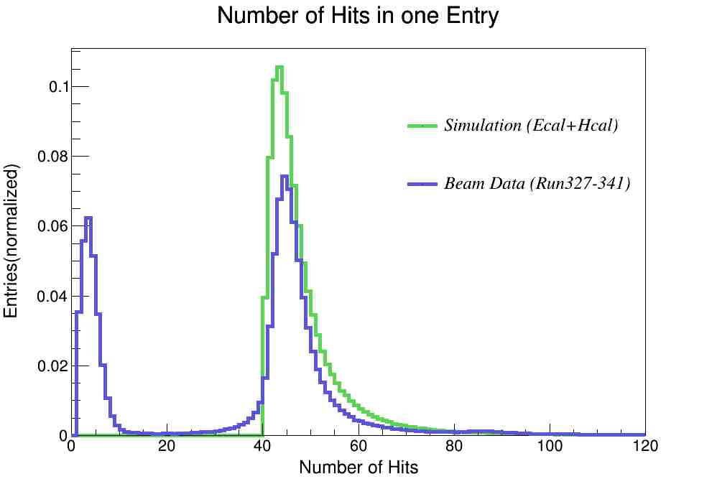
Filter Out Unavailable Entries
We select the entries whose hit numbers are larger than 30.
We don’t want to collect the shower,so we just collect the cells with the largest number of the “same position cells”.
Useless entries have the percentage of about 30%.
{3210021,3310021,3420010,3510022,3610022,3710021}
->{3210021,3310021,3710021}

Slide 4
Methods in Calibration
Fitting function :Laudau+Guassian Convolution
First fit at the chip level,then use the parameters as each channel’s initial parameters.
Fitting range :100-1500,minor adjustments have been made to a small number of channels.

Slide 5
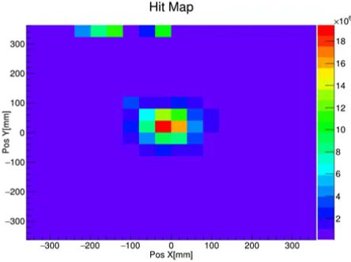
Channels Fail to be Calibrated
Light leak:46
Fail to Fit:9(all in layer38&39）
Total:55/12960=0.42%

Slide 6
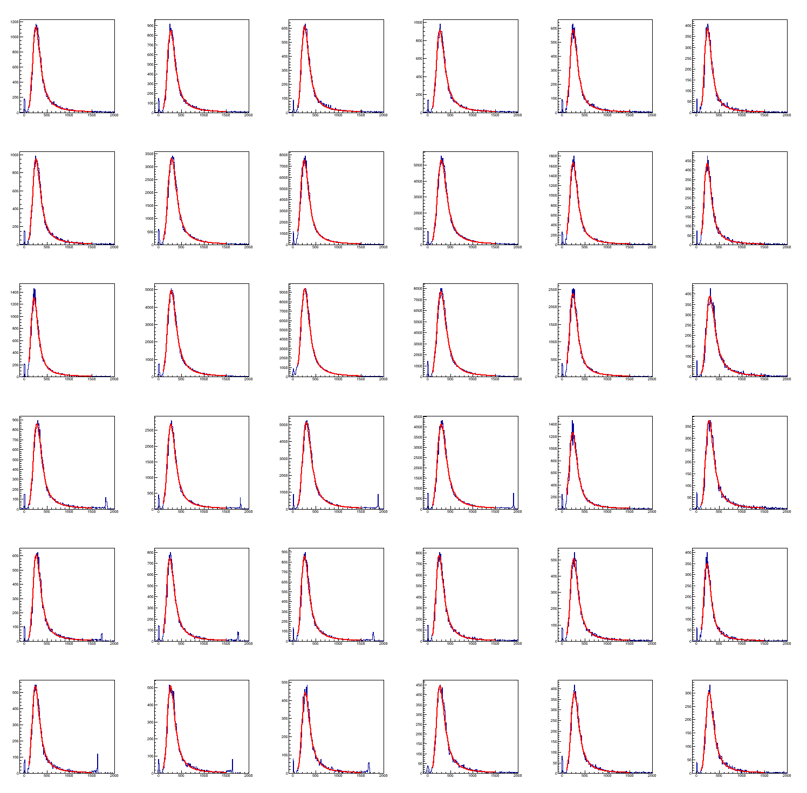
Some Results
layer3 chip4

Slide 7
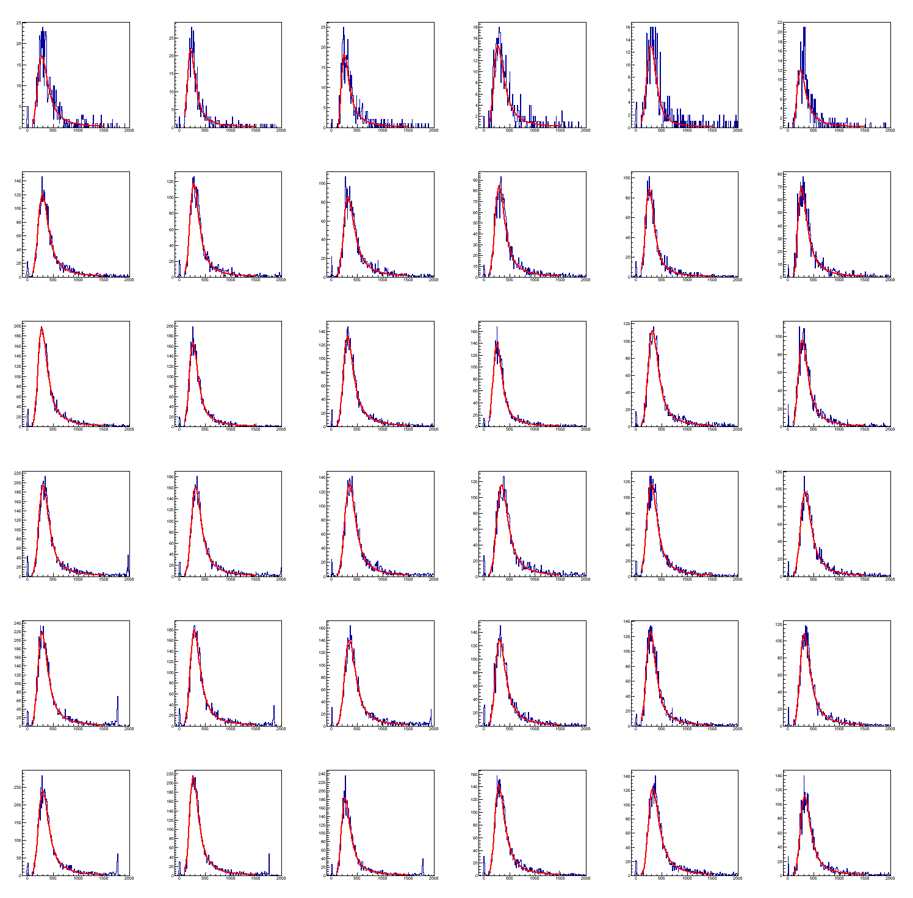
Some Results
layer11 chip0

Slide 8
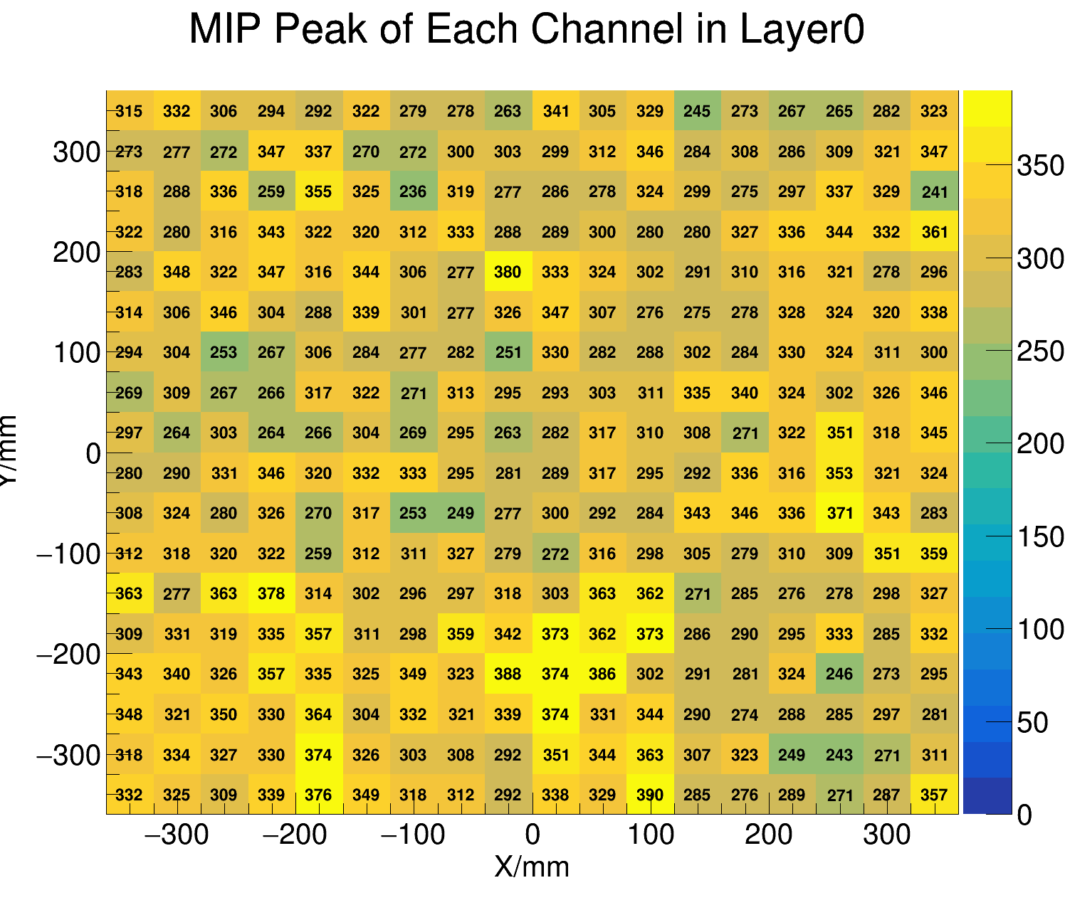
Some Results

Slide 9
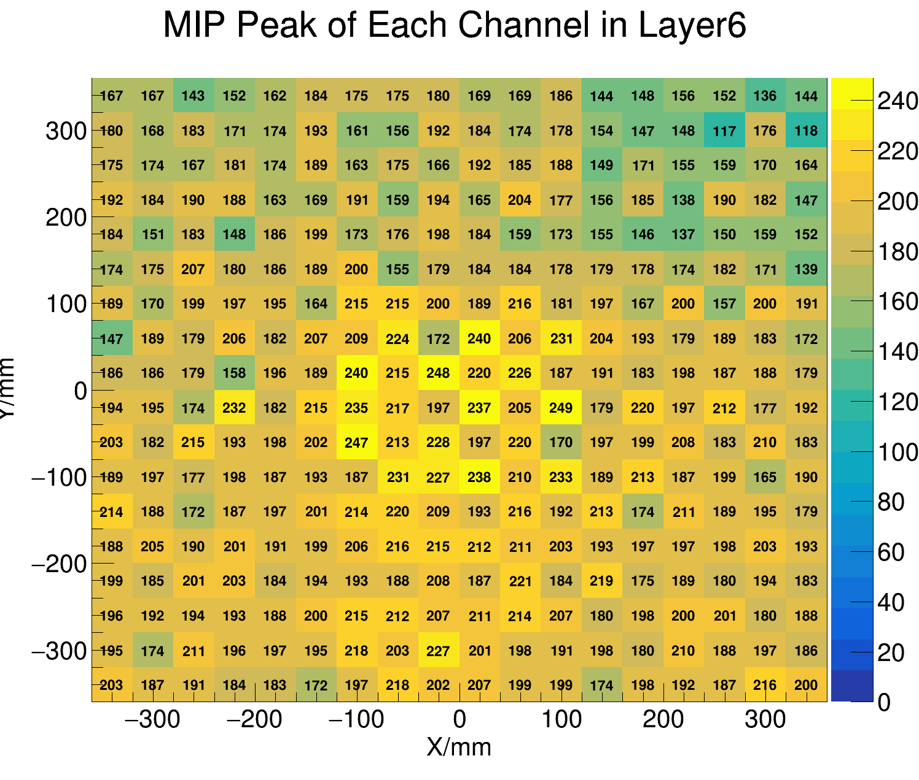
Some Results

Slide 10
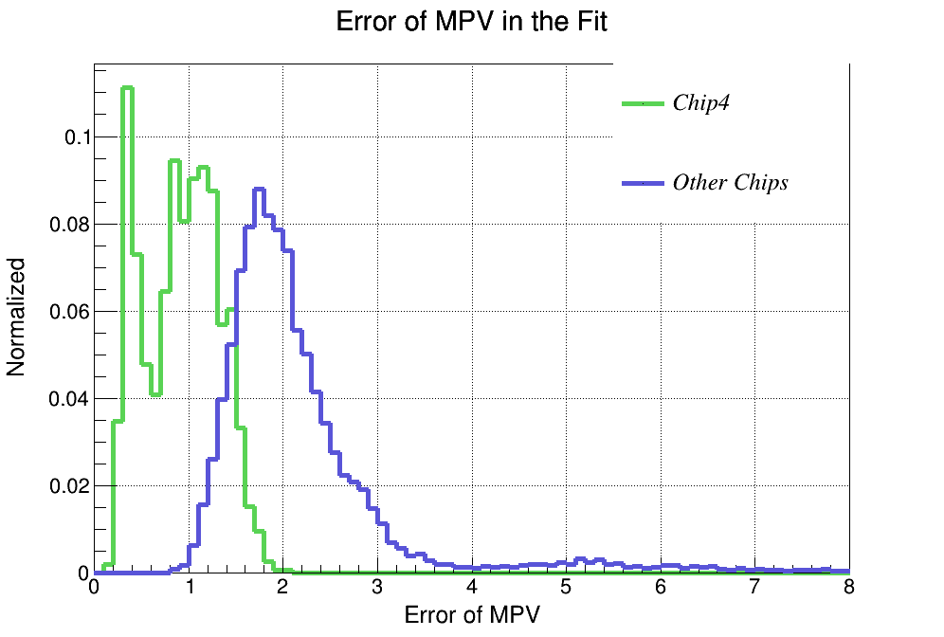
Fitting Effect

Slide 11
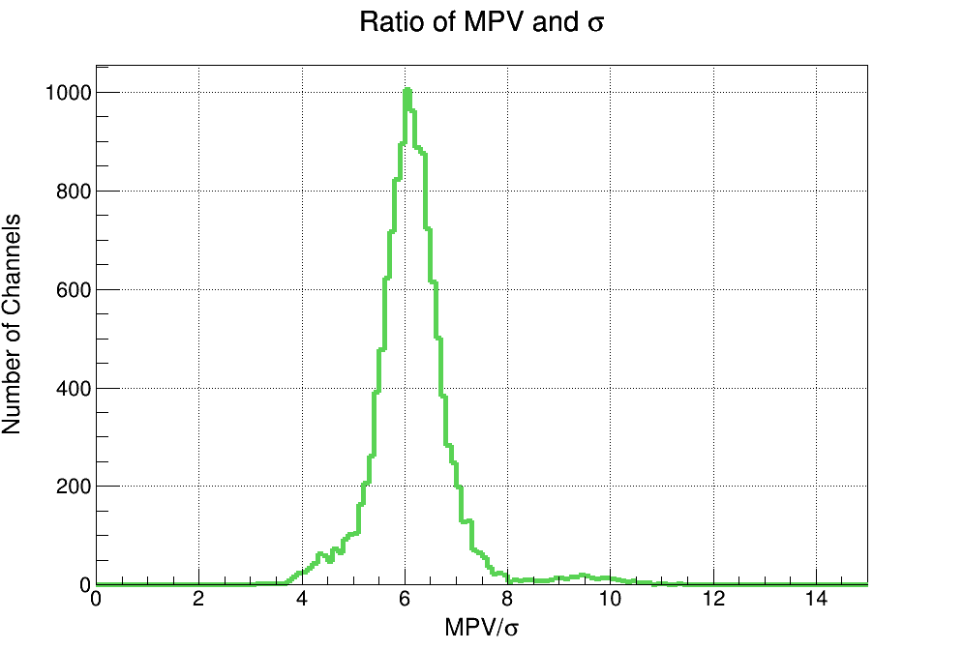
Ratio of MPV&Sigma
The ratio of MPV and sigma is almost the same in different layers in simulation result(about 14),while here shows the different situation.

Slide 12
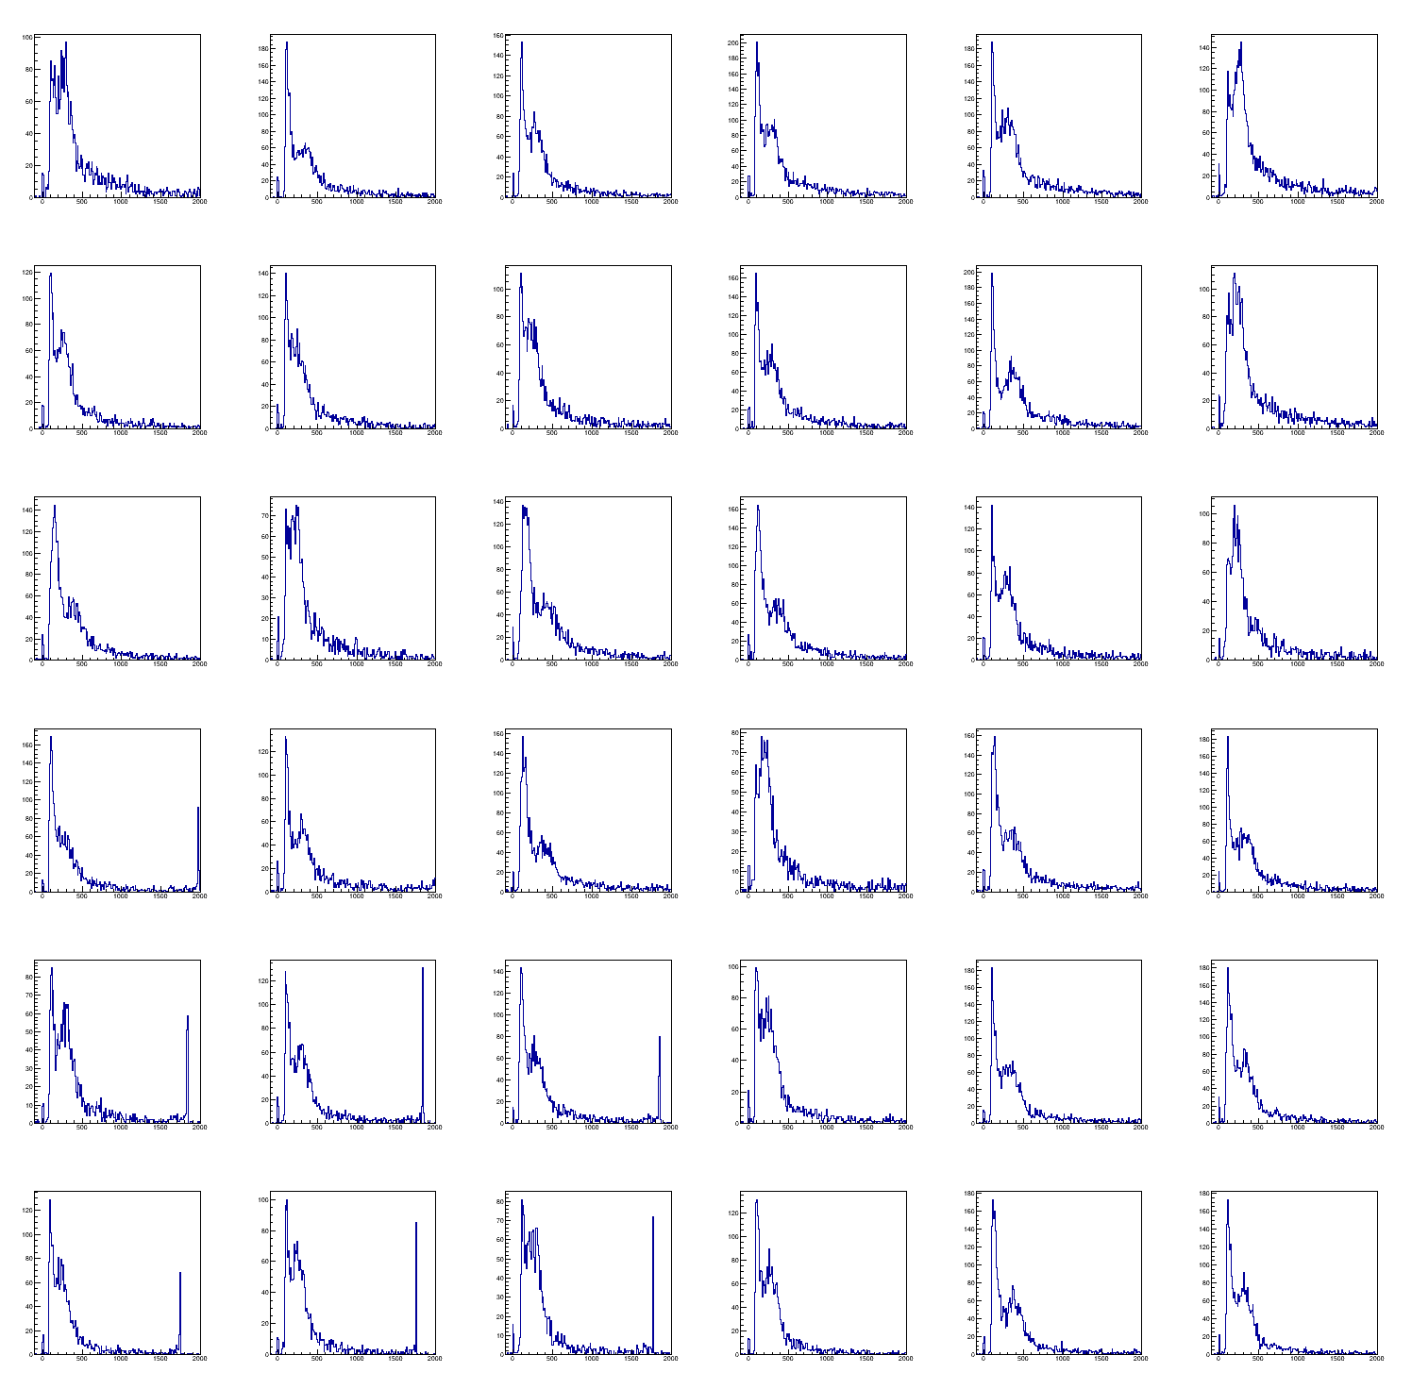
Layer38&39 Problems
Layer39 Chip8
Exponential noise mainly from Run21-29
layer38 chip6,7,8;
layer39 chip6,7,8

Slide 13
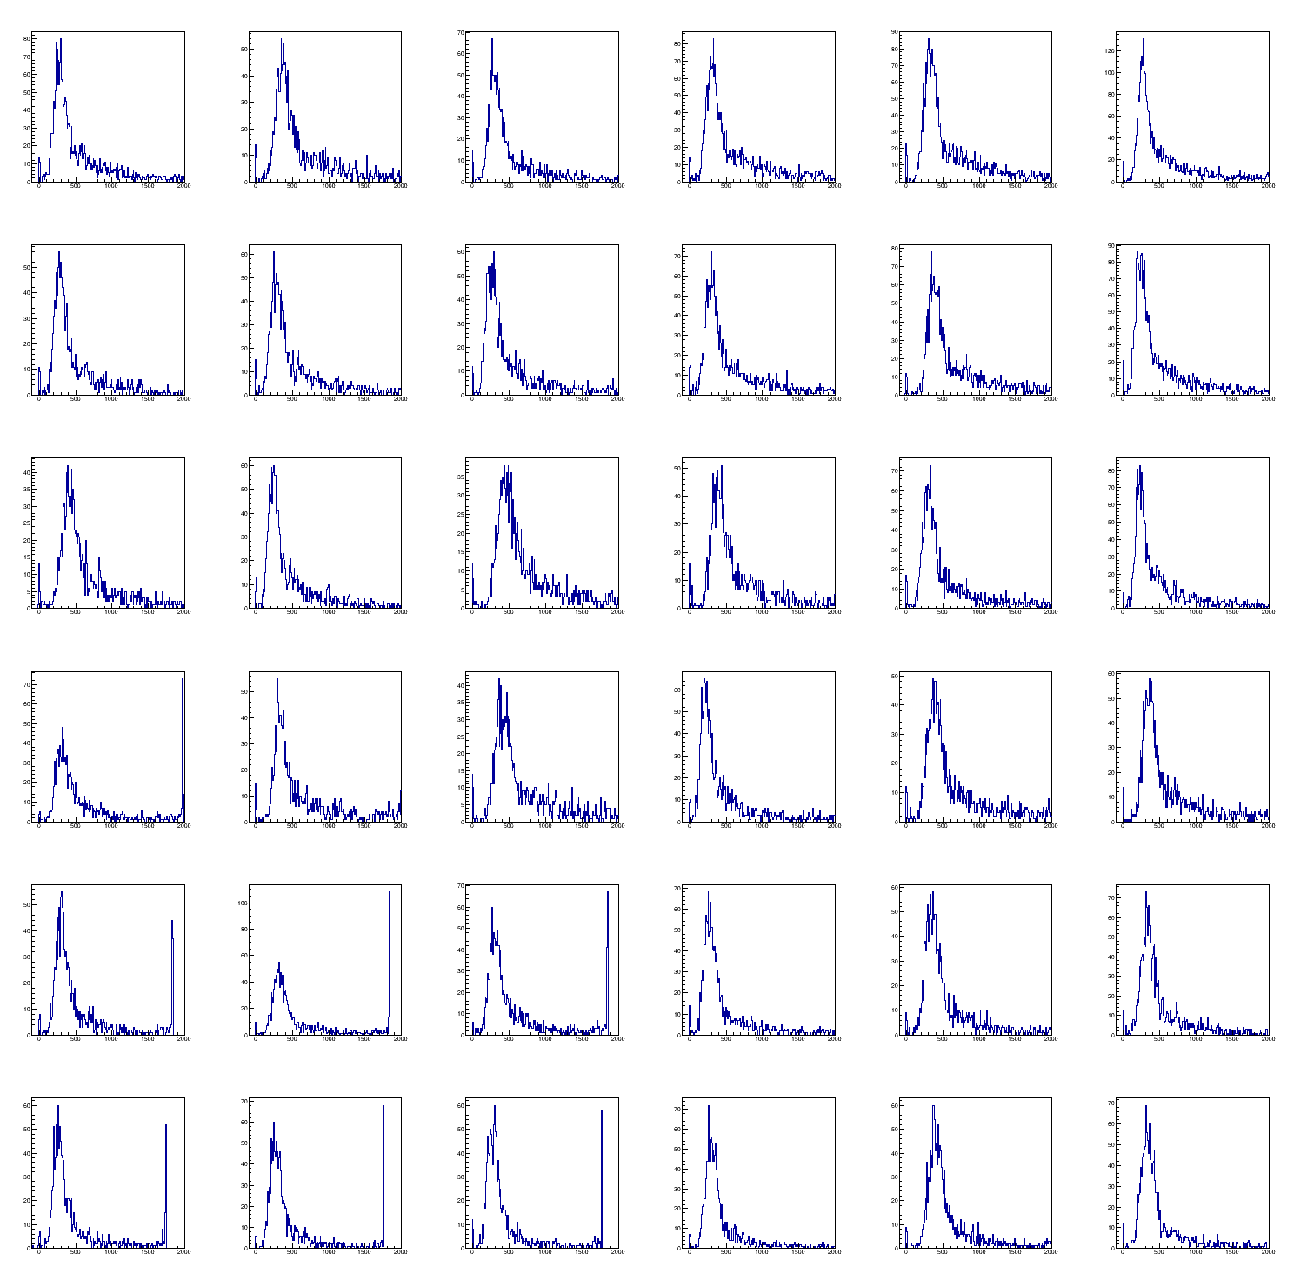
Layer38&39 Problems
Layer39 Chip8
Exponential noise disappers
Still cannot get good fit

Slide 14
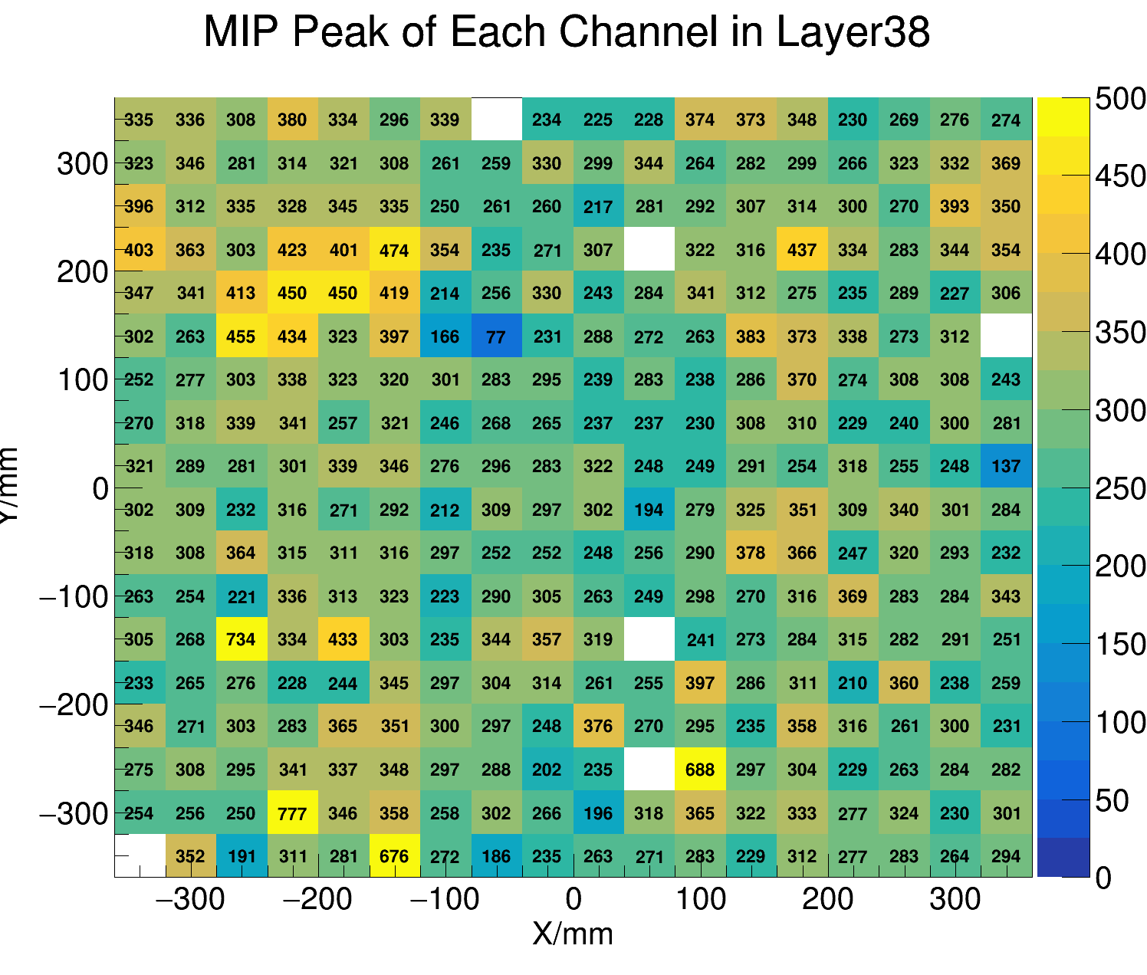
Layer38&39 Problems

Slide 15
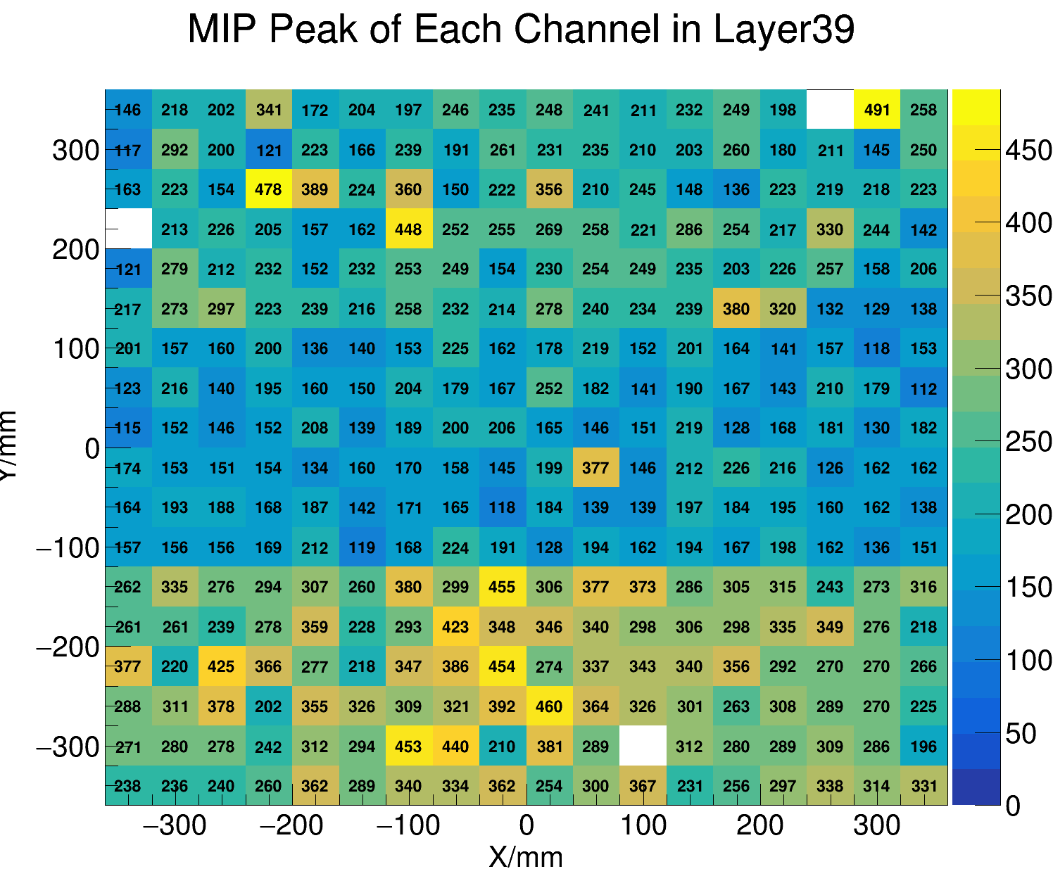
Layer38&39 Problems

Slide 16
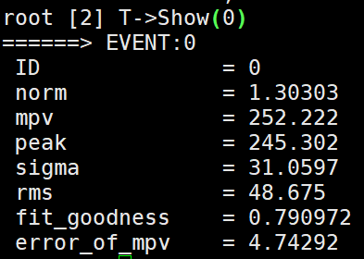
Summary&Plan
Percentage of channels fail to calibrate is about 0.42%.
Calibration results in:
/afs/ihep.ac.cn/users/z/zixunxu/public/test/mipCalib.root
norm=0 -> badchannel
Study the inhomogeous effect of different energy units.
Find better fitting plan to layer38 and 39.

Slide 17
Thanks!

