Slide 1
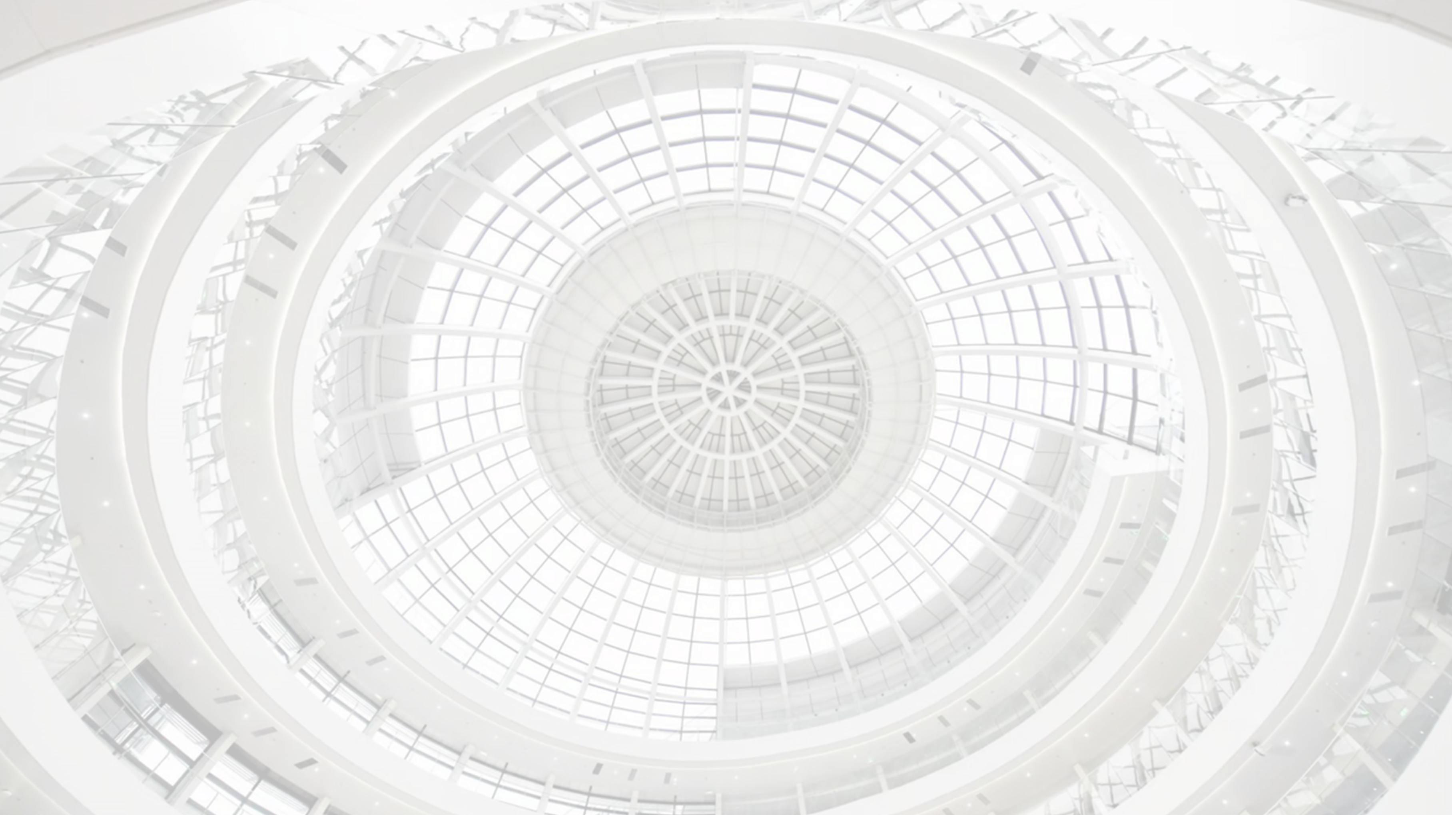


Test of Different Light Sources for SiPM Dynamic Range Research
Zhiyu Zhao(TDLI/SJTU), Jiannan Tang(SJTU)
2023.02.22

Slide 2
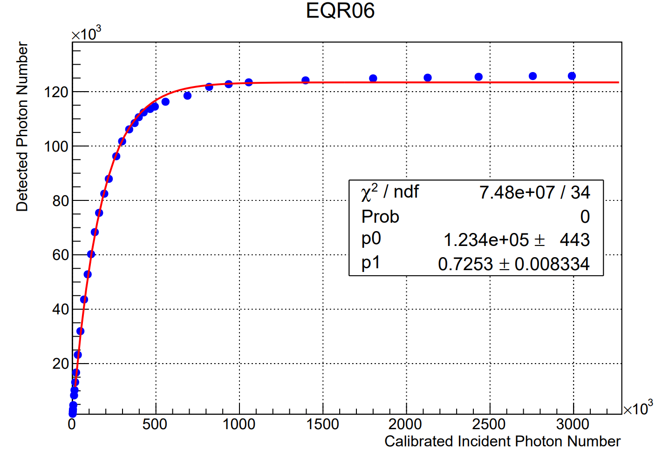
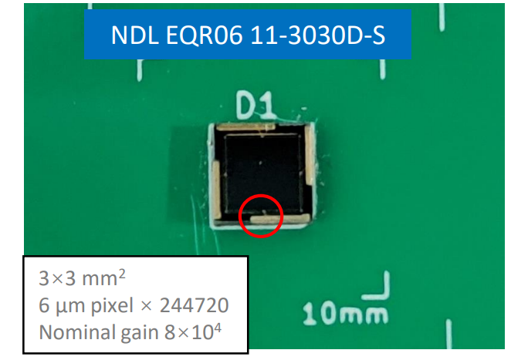
Motivation
Some SiPMs have extremely large pixels number, which can be used in the experiment with high dynamic range requirement.
The response curve of NDL-EQR06 was measured with pico-second laser as a light source. But the maximum detected photon number is only about half of the total pixels number. One possible reason is that the result was limited by the output power of pico-second laser.
Requirements on the source: high intensity, narrow pulse width

Slide 3
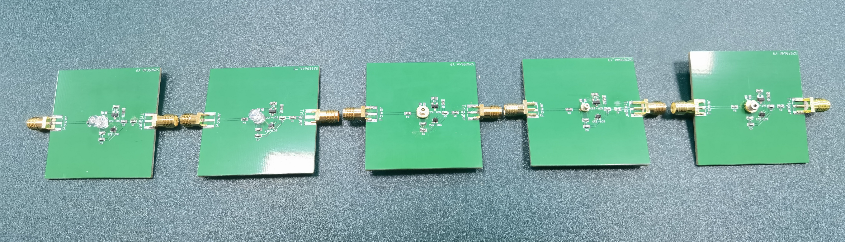
Light Sources
LED 1
LED 2
LD GH0458
LD PL450B
LD PLPB450
 | LED 1 | LED 2 | LD GH0458 | LD PL450B | LD PLPB450
Wavelength | 460-465nm | 470nm | 450nm | 450nm | 450nm
Brightness | 5000-7000mcd | 23500mcd | - | - | -
Current | 20mA | 30mA | 84mA | 100mA | 1.2A
Power | 60mW | 120mW | 85mW(optical) | 80mW(optical) | 1.6W(optical)

Slide 4
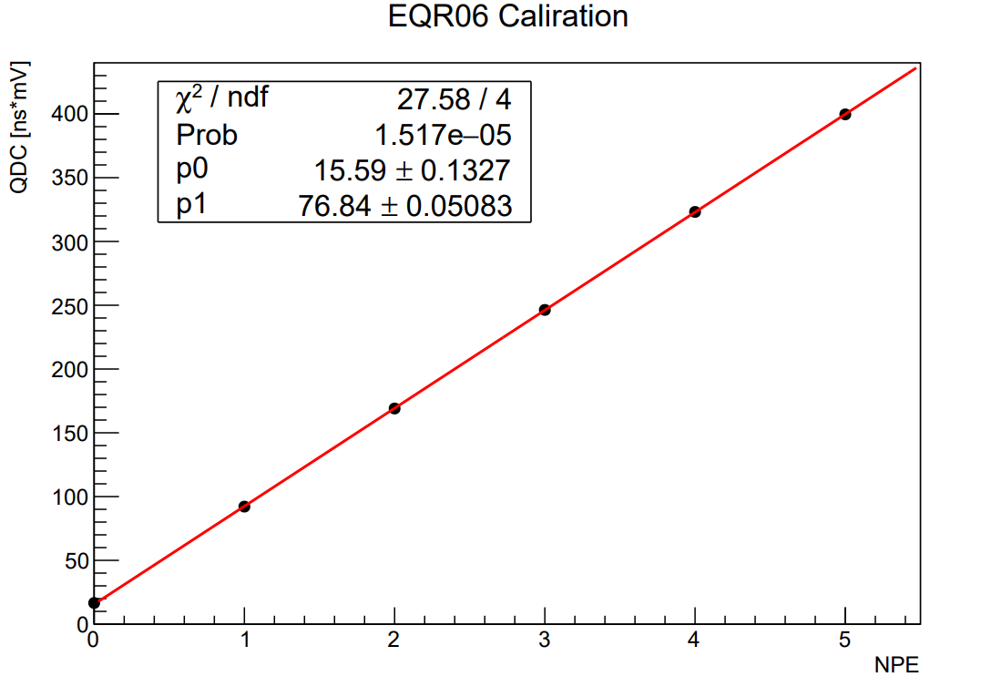
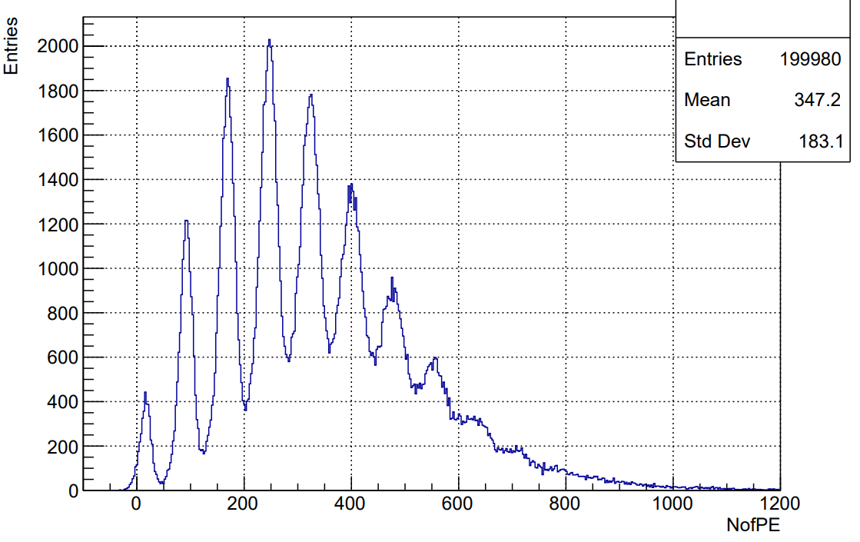
SiPM Calibration
NDL SiPM EQR06, ${3×3mm}^{2}$, 244720 pixels
LED as a light source
NDL 40dB pre-amplifier

Slide 5
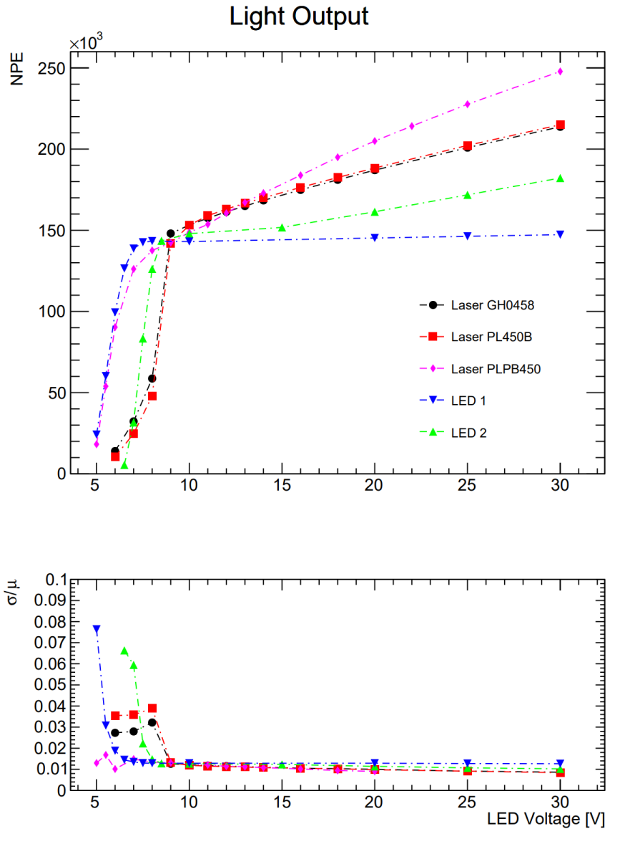
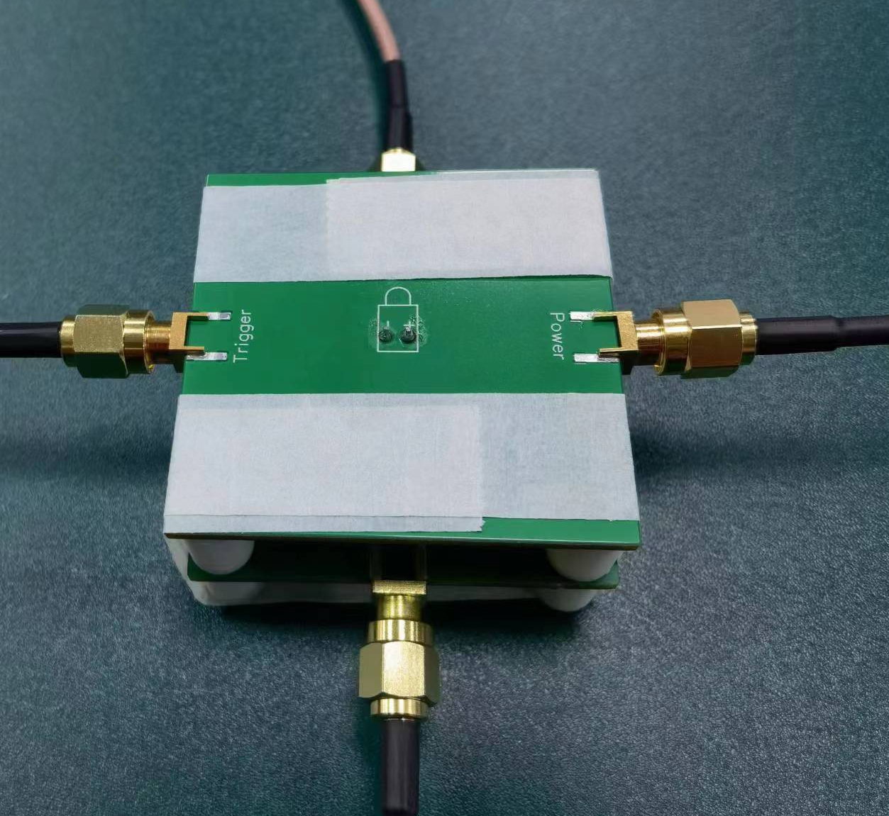
Measurement Results of Different Sources
LED/Laser Diode
The number of photon detected by SiPM is close to 250k, which is beyond its pixels number.
SiPM

Slide 6
Summary & Next
We can use laser diode as light source to measure the response curve of SiPMs with large pixels number.
We also need to measure the response time of laser diode and driver circuit. Because if the pulse width is longer than the recovery time of SiPM, its pixels could be fired more than one time. Then we will not sure if the SiPM is saturated.

Slide 7
Backup

Slide 8
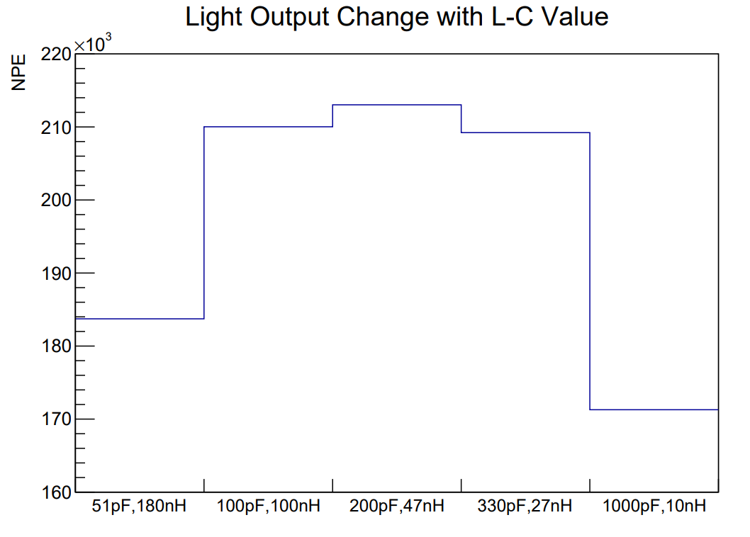
Light Output Change with L-C Values
LD GH0458
The light emission of diode is controlled by a LC oscillation circuit. If we change the values of L and C, the light output will be changed accordingly.

