Slide 1
Study of B meson weak decays
(A.7 & A.8 Precision calculations in hadronic physics and beyond the standard model physics)
Institute of High Energy Physics
Dong-Hao Li (李东浩)
Supervisor: Cai-Dian Lü (吕才典)
Based on:
Si-Hong Zhou, Xin-Xia Hai, Run-Hui Li and Cai-Dian Lü, [arxiv:2305.02811[hep-ph]].
Jian Chai, Shan Cheng, Yao-hui Ju, Da-Cheng Yan, Cai-Dian Lü, Zhen-Jun Xiao, [arxiv:2207.04190[hep-ph]].
7.19-7.22 Rizhao, Shandong, China
Notes:
Representing deliver

Slide 2
Outline
Present and progress in b-flavored hadron decays
Charmless B meson decays in the perturbative QCD approach
Factorization-assisted topological-amplitude approach
Publications
Notes:
Divided into these parts

Slide 3
What can we benefit from B meson physics
Test of Standard Model precisely and search for new physics signals.
Understanding QCD dynamics and hadron structure.
Notes:
b favored hadrons crucial role due to rich decay channel. Allow us to extract fundamental parameters and perform measurements of observables sensitive, deepen

Slide 4
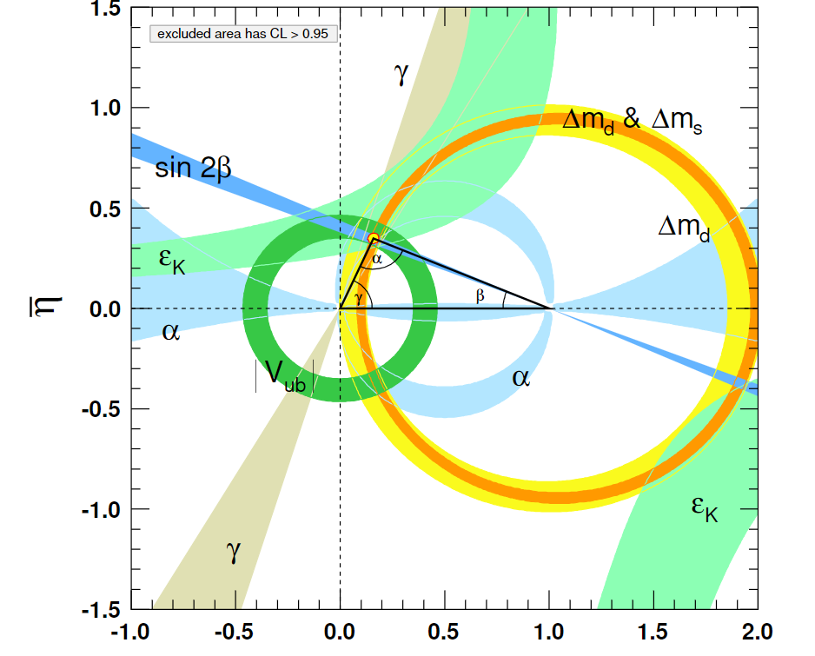
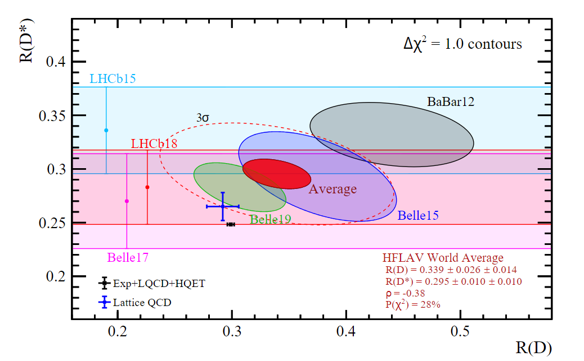
Present and progress
Test of Standard Model precisely and search for new physics signals.
Notes:
$$α={({85.2}_{−4.3}^{+4.8})}^{°}$$

Slide 5
Present and progress
Test of Standard Model precisely and search for new physics signals.
Semileptonic, $b→cℓ\overline{ν}, b→uℓ\overline{ν}$
Ratios of BRs involving tau leptons to involving $e, μ$
${|V}_{ub}|=(3.82±0.20)×{10}^{−3}$ (average)
${|V}_{cb}|=(39.4±0.8)×{10}^{−3}$ (exclusive)
${|V}_{cb}|=(42.2±0.8)×{10}^{−3}$ (inclusive)
$${R(D)}^{LQCD+Exp}=0.299±0.003$$
2.4$σ$
1.4$σ$
$${R(D)}^{means}=0.339±0.014±0.026$$
$${R(D^{∗})}^{LQCD+Exp}=0.2483±0.0016$$
3.3$σ$
$${R(D^{∗})}^{means}=0.295±0.010±0.010$$
[Unbinned angular analysis of $B→D^{∗}ℓν$and the right-handed current, Z.R. Huang, E. Kou, C.D. Lü and R. Y. Tang, PRD, 2022]
[Scrutinizing new physics in semi-leptonic decay $B→J/φτν$, R. Y. Tang, Z. R. Huang, C. D. Lü and R. Zhu, JPG, 2022]
Notes:
Precise determination a high priority allow us to test CKM sector provide essential inputs of CPA show marginal consistency, ratio provide sensitivity to test lepf our perform

Slide 6
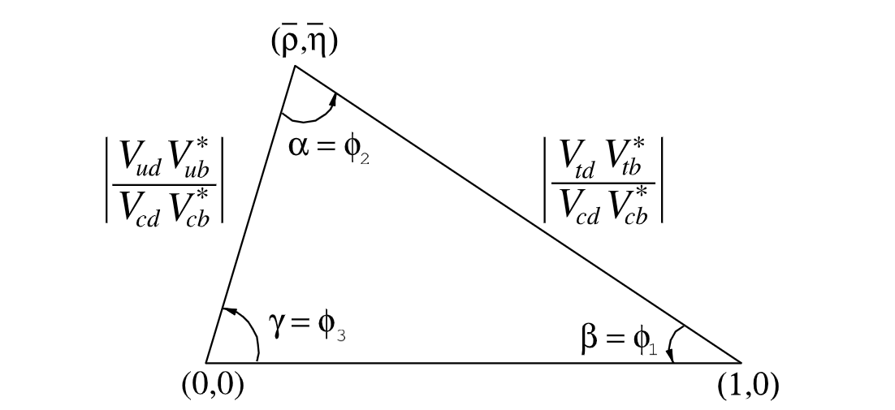
Present and progress
Test of Standard Model precisely and search for new physics signals.
Time-dependent CP asymmetries in Hadronic decay modes
$$B→ππ,πρ,ρρ$$
$$B→J/ψ K_{L/S}$$
$$B→Dπ$$
$$α+β+γ={(173±6)}^{°}$$
Notes:
Consistent with the expectation

Slide 7
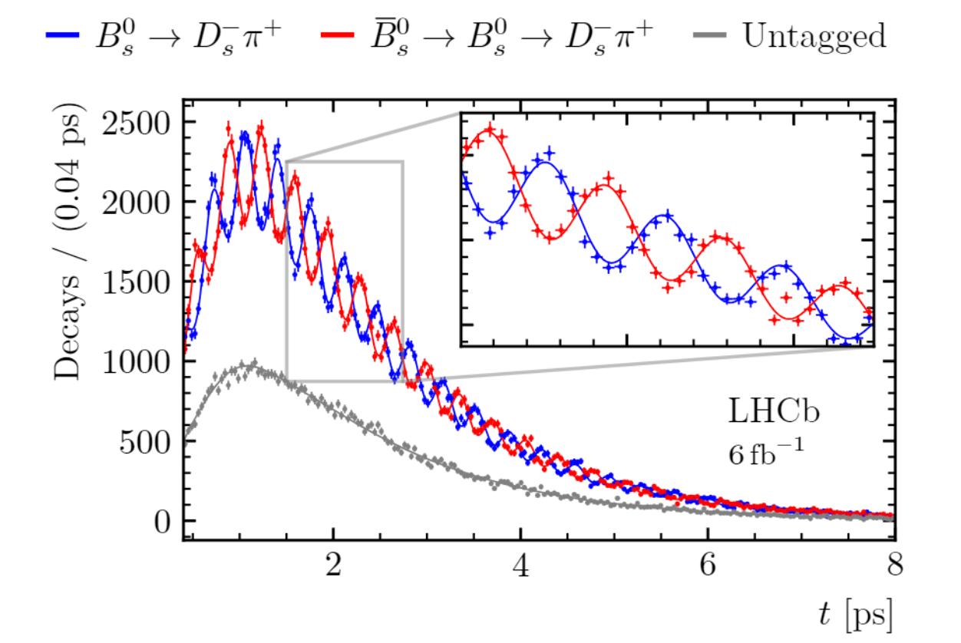
Present and progress
Test of Standard Model precisely and search for new physics signals.
$$ΔM_{s}=17.7656±0.0057 {ps}^{−1}$$
Neutral B mixing
Rare decay modes
$$ΔΓ_{s}=0.084±0.005 {ps}^{−1}$$
$$A_{CP}\left(B^{0}→K^{+}π^{−}\right)=−0.083±0.004$$
$$A_{CP}\left(B^{+}→K^{+}π^{0}\right)=+0.017±0.016$$
FCNC process
$$B→K^{∗}γ$$
$B→Kℓ^{+}ℓ^{−}$ and $P_{5}^{′}$
$$B→K\overline{ν}\overline{ν}$$
$$B→ℓ^{+}ℓ^{−}$$
[See PDG reviews for more details]
Notes:
Charmless b decays offer clean experimental signals as the final sataes have larger momenta compared to charmed decay, they provide opportunities to probe CPv, Direct cpv have been measured in b to kp decays and these asy signif differ from naïve expectations based on isospin sy. Proceed through

Slide 8
Present and progress
Understanding QCD dynamics and hadron structure.
Charmless decays of B meson and precision calculations.
QCD factorization (QCDF) and soft collinear effective theory(SCET)
QCDF for $B→PP,PV$ at leading power. [Beneke, Buchalla, Neubert, Sachrajda, 2000]
[Bell, Beneke, Huber, X-Q Li, 2019,2020]
Two loop SCET computations of A-type hard function. [Bonciani, Ferroglia, 2008; Asatrian, Greub, Pecjak, 2008;Beneke, Huber, Li, 2009; Bell, 2009; Bell, Beneke, Huber, Li, 2011]
One loop SCET computations of B-type hard function. [Becher, Hill, 2004; Hill, Becher, Lee, Neubert, 2004]
Beneke, Yang, 2006]
$$\left\langle M_{1}M_{2} | ℒ_{QCD} | \overline{B}\right\rangle ≅F^{B→M_{1}}T_{i}^{I}⨂φ_{M1}+T_{i}^{II}⨂φ_{B}⨂φ_{M1}⨂φ_{M2}$$
Notes:
Nonleptonic decay involve decay of b to light accompanied by the creation of a color siglet quark pair quickly exit the strong, between , theoretical method have been developed

Slide 9
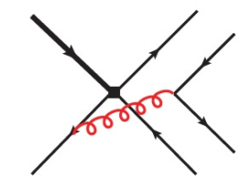
Present and progress
Understanding QCD dynamics and hadron structure.
Charmless decays of B meson and precision calculations.
QCD factorization (QCDF) and soft collinear effective theory(SCET)
Light-cone QCD/SCET sum rules [F. D. Fazio, T. Feldmann, T. Hurth, 2008; A. Khodjamirian, T. Mannel, N. Offen, 2007]
The missing piece: hard-collinear gluon contribution
Now annihilation diagram is calculable, finite, and contains strong phase
[C-D Lü, Y-L S, Chao W, Y-M W, 2202.08073]
$B_{d,s}→π,K$ form factors: one loop corrections, power corrections, higher twist effects, non-vanishing spectator-quark mass effects [B-Y Cui, Y-K Huang, Y-L Shen, Y-M Wang, 2023]
Two loop QCD corrections (in large $β_{0}$ limit) [Y-K Huang, D-H Li, C-D Lü, Y-M Wang, H-X Yu, in preparation]
Notes:
Severely limits the predictive power of QCDF for process involving

Slide 10
Present and progress
$B→PP,PV,VV$ decays in the perturbative QCD factorization approach
An update of hadronic B decay is urgent
To eliminate the end-point singularity emerged in collinear factorization, the PQCD approach is proposed by picking up the $k_{T}$ of valence quarks
1. Leading order $(α_{s})$ results and a global analysis.
[Xiao, 07; Lü 02; Li 05; Li 06;] [Jun Hua, C-D Lü, et al 2021]
2. Partially NLO $(α_{s}^{2})$ results:
Factorizable amplitudes
Effective operators
Hard scattering
TMD wave functions
[Cheng 2021]
[Mishima, 03; Li 05;]
[Li, 2012; Cheng 14;][Li, 13; Cheng 15;][Li, 14; Liu 15;]
[ Li, Wang 2014, 2015]
[J, Chai, S. Cheng, Y-h Ju, D-C, Yan, C-D Lü , Z-J Xiao, 2207.04190]
Notes:
Establish a bridge between

Slide 11
Present and progress
$B→PP,PV,VV$ decays in the perturbative QCD factorization approach
Introduce $k_{T}$ to regularize the end-point singularity
Do the resummation and obtain the final factorization formula

Slide 12
Present and progress
Updated PQCD results for the CP asymmetries of $B→PP$decays (in units of 10^-2)
[J, Chai, S. Cheng, Y-h Ju, D-C, Yan, C-D Lü , Z-J Xiao, 2207.04190]

Slide 13
Present and progress
Updated PQCD results for the CP asymmetries of $B→PV$decays (in units of 10^-2)
[J, Chai, S. Cheng, Y-h Ju, D-C, Yan, C-D Lü , Z-J Xiao, 2207.04190]

Slide 14
Present and progress
Updated PQCD results for the longitudinal polarization fractions of $B→VV$decays
[J, Chai, S. Cheng, Y-h Ju, D-C, Yan, C-D Lü , Z-J Xiao, 2207.04190]

Slide 15
Present and progress
QCD is complicated (non)-perturbatively, It is hard to calculate $B→M_{1}M_{2}$decays precisely.
Non-neglectable nonperturbative contributions or $1/{m_{b}}$ power corrections sometimes.
factorization-assisted topological-amplitude (FAT) approach
[L. L. Chua, H. Y. Cheng, 1986,1987; H.-n. Li, C-D Lü, F.-S. Yu, 2012]
Model independent.
Include the non-perturbative and non-factorization contribution
Make full use of the large amount branching ratios and CP asymmetry parameters already measured.
Analysis of charmless $B→PV→PPP$ decays under the FAT approach
[S. H. Zhou, X. X. Hai, R. H. Li, C-D Lü , 2305.02811]

Slide 16
Present and progress
$B→PV→PPP$ decays in the FAT approach
$$b→u+\overline{u}d/s$$
$$b→d/s+q\overline{q}$$
[S. H. Zhou, X. X. Hai, R. H. Li, C-D Lü , 2305.02811]

Slide 17
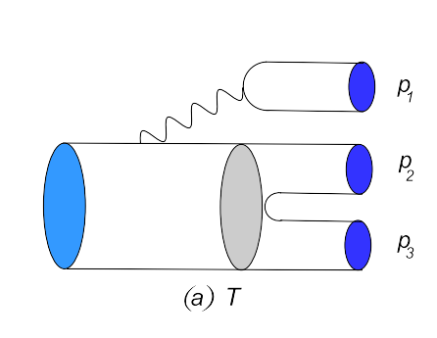
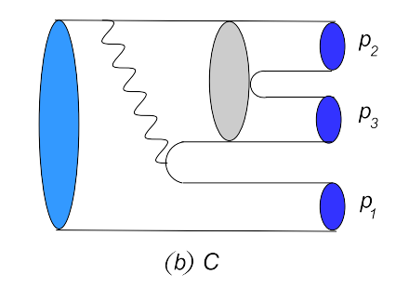
Present and progress
$B→PV→PPP$ decays in the FAT approach
quasi-two-body process
SU(3) symmetry breaking
[S. H. Zhou, X. X. Hai, R. H. Li, C-D Lü , 2305.02811]

Slide 18
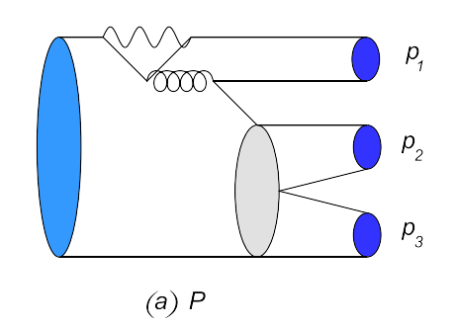
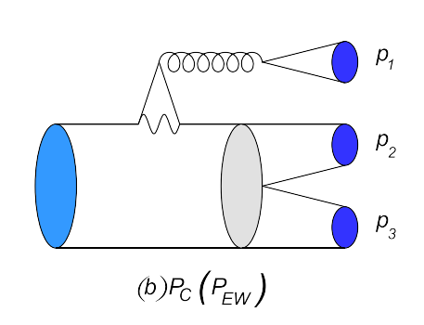
Present and progress
$B→PV→PPP$ decays in the FAT approach
quasi-two-body process
SU(3) symmetry breaking
[S. H. Zhou, X. X. Hai, R. H. Li, C-D Lü , 2305.02811]

Slide 19
Present and progress
$B→PV→PPP$ decays in the FAT approach
quasi-two-body process
[S. H. Zhou, X. X. Hai, R. H. Li, C-D Lü , 2305.02811]

Slide 20
Present and progress
$B→PV→PPP$ decays in the FAT approach, Numerical results
Input parameters: CKM, decay constants, transition form factors, data of $ℬℛ$($B→PV$).
[S. H. Zhou, X. X. Hai, R. H. Li, C-D Lü , 2305.02811]

Slide 21
Present and progress
$B→PV→PPP$ decays in the FAT approach, Numerical results
Input parameters: CKM, decay constants, transition form factors, data of $ℬℛ$($B→PV$).
[S. H. Zhou, X. X. Hai, R. H. Li, C-D Lü , 2305.02811]

Slide 22
Present and progress: Other Highlights
New observables:
New methods:
b-favored baryon decay:
CP violation induced by neutral meson mixing interference
[Qin Qin, et al, 2301.05848]
T-odd correlation induced CP asymmetry $Λ_{b}→N^{∗} K^{∗}$
[Jian-Peng Wang, Qin Qin, Fu-Sheng Yu, 2211.07332]
Polarization induced CPV e.g. $Λ_{b}→Λ ρ^{0}, B→Λ \overline{Λ}$
[Chao-Qiang Geng, et al, 2109.09524, 2206.00348, 2306.14280]
Partial wave CP asymmetry in multi-body decays
[Zhen-Hua Zhang, et al, 2103.11335, 2208.13411, 2209.13196]
Quasi-DA&LCDA from LQCD calculation
[Lattice Parton Collaboration, J. Hua, et al, 2021, 2022]
Inverse Problem of Dispersion relation
[Hsiang-nan Li, 2021-2023]
[Ao-Sheng Xiong, Ting Wei, Fu-Sheng Yu, 2211.13753]
baryonic CPV evidence: $Λ_{b}→p+3π$, 3$σ$
[LHCb, Nature Physics 2017]
$A_{CP}\left(Λ_{b}→pπ\right)=\left(−3.5±1.7±2.0\right)\%$, $A_{CP}\left(Λ_{b}→pK\right)=\left(−2.0±1.3±1.0\right)\%$
[LHCb, PLB 2018]

Slide 23
Present and progress: Other Highlights
Precision calculation:
Exotic states:
A Reappraisal of $B→γℓν$: Factorization and Sudakov Resummation.
[A. M. Galda, M. Neubert, X. Wang, 2203.08202]
Long-distance contribution to $B→γγ$, a noval B meson DA.
[Qin Qin, Y. L. Shen, C. Wang, Y. M. Wang, 2207.02691]
NNLO, NNNLO corrections to $B_{c}$ decay constant.
[W. Tao, et al, 2209.15521;F. Feng, et al, 2208.04302]
[Y. Q. Ma, X. Liu, Z. F. Liu, et al, 17-22]
AMFlow: automatic calculation of Feynman integrals
Strange quark mass effect in $B_{s}→γγ,γℓℓ$ decays.
[D. H. Li, L. Y. Li, C. D. Lü, Y. L. Shen, 2205.05528]
Strange quark mass effect in the $B_{s}$​ meson’s LCDA
[T. Feldmann, et al, 2306.14686]
$Λ_{b}→p, Λ…$ baryonic transition form factors in PQCD, LCSR, SCET
[J. J. Han, et al , 2022;Rui Zhou, et al, 2022; K. S. Huang, et al, 2023; D. H. Li, Z. P. Xing, C. D. Lü, W Wei, in preparation]
$X\left(3872\right) in B^{+}→J/φπ^{−}π^{+}K^{+}$, Belle 2003
[Fu-Sheng Yu, EPJC 2022;Yan-Ke Chen, et al, EPJC 2021; Fei Huang, et al, EPJC 2022;…]
Notes:
Currently, no complete QCD-inspired method for non-leptonic b-baryon decays

Slide 24
Publications
“Analysis of three-body charmed B-meson decays under the factorization-assisted topological-amplitude approach,” S. H. Zhou, R. H. Li, Z. Y. Wei and C. D. Lü, Phys. Rev. D 104 (2021) no.11, 116012
“Global analysis of hadronic two-body B decays in the perturbative QCD approach,” J. Hua, H.n. Li, C. D. Lü, W. Wang and Z.P. Xing, Phys. Rev. D 104 (2021) no.1, 016025
“Study on pure annihilation type B → V γ decays,” H. Deng, J. Gao, L.Y. Li, C.D. Lü, Y.L. Shen and C.X. Yu, Phys. Rev. D103 (2021) no.7, 076004
“First Lattice QCD calculations of semileptonic decays of charmed-strange baryons $Ξ_{c}$,” Q. A. Zhang, J. Hua, F. Huang, R. B. Li, Y. Y. Li, C. D. Lü, P. Sun, W. Sun, W. Wang and Y. B. Yang, Chin. Phys. C46, no.1 (2022)
“Unbinned angular analysis of B → D∗lν_{l} and the right-handed current,” Z.R. Huang, E. Kou, C.D. Lü and R. Y. Tang, Phys. Rev. D105 (2022) no.1, 013010

Slide 25
Publications
“Scrutinizing new physics in semi-leptonic Bc → J/ψ τυ decay,” R. Y. Tang, Z. R. Huang, C. D. Lü and R. Zhu, J. Phys. G 49 (2022) no.11, 115003
“Strange quark mass effect in Bs → γγ, γll decays”, D. H. Li, L. Y. Li, C. D. Lü, Y. L. Shen, Phys. Rev. D 106 (2022) no.9, 094038
“Charmless two-body B meson decays in the perturbative QCD factorization approach”, J. Chai，S. Cheng，Y.-h. Ju，D-C. Yan, C. D. Lü， Z. J. Xiao, Chin. Phys. C46, No. 12 (2022) 123103
“Analysis of three-body charmless B-meson decays under the factorization-assisted topological-amplitude approach”, S. H. Zhou, X. X. Hai, R. H. Li and C. D. Lü, Phys. Rev. D 107 (2023) no.11, 116023
”Shedding new light on weak annihilation B-meson decays,” C. D .Lü, Y. L. Shen, C. Wang and Y. M. Wang, Nucl. Phys. B 990(2023), 116175

Slide 26
Backup

Slide 27
Equivalence of Topological Diagram and Irreducible Representation Amplitudes
Universality and completeness
[1811.03480][1803.04227] Xiao-Gang He, Wang Wei

