Slide 1
Charmed baryon spectrum and their decay patterns
Hua-Xing Chen
Southeast University
Collaborators: Er-Liang Cui, Hui-Min Yang, Wei Chen, Atsushi Hosaka, Xiang Liu, Shi-Lin Zhu.

Slide 2





























































Review of Particle Physics, PTEP 8,083C01(2020)
Ground bottom baryons
Excited bottom baryons
$$Λ_{b}{(5920)}^{0}$$
$$Λ_{b}{(5912)}^{0}$$
$$Ω_{b}{(6350)}^{−}$$
$$Ω_{b}{(6340)}^{−}$$
$$Λ_{b}{(6152)}^{0}$$
$$Ω_{b}{(6330)}^{−}$$
$$Λ_{b}{(6146)}^{0}$$
$$Ω_{b}{(6316)}^{−}$$
$$Ξ_{b}^{∗}(5945)$$
$$Λ_{b}{(5920)}^{0}$$
$$Ξ_{b}{(6333)}^{0}$$
DELPHI
$$Σ_{b}^{∗}(5835)$$
$$Ξ_{b}{(6327)}^{0}$$
$$Ξ_{b}{(5790)}^{−}$$
$$Σ_{b}(5815)$$
$$Ξ_{b}{(6227)}^{−}$$
$$Λ_{b}{(6150)}^{0}$$
CERN R415
$$Σ_{b}{(6097)}^{±}$$
$$Λ_{b}{(6072)}^{0}$$
$$Λ_{b}{(5625)}^{0}$$
$$Ω_{b}(6046)$$
$$Ξ_{b}{(6100)}^{−}$$
$$Ξ_{b}^{′}(5935)$$
1975
1976
1981
1983
1985
1993
1995
1998
1999
2001
2005
2006
2007
2008
2012
2013
2014
2017
2018
2019
2020
2021
2022
$$Λ_{c}{(2286)}^{+}$$
$$Ω_{c}{(2700)}^{0}$$
$$Ξ_{c}^{′}(2570)$$
$$Λ_{c}{(2765)}^{+}$$
$$Ξ_{c}{(3080)}^{0}$$
$$Λ_{c}{(2860)}^{+}$$
BARI
CERN WA62
$$Λ_{c}{(2880)}^{+}$$
$$Ξ_{c}{(2980)}^{+}$$
$$Ω_{c}{(3000)}^{0}$$
$$Ξ_{c}{(2923)}^{0}$$
$$Σ_{c}{(2455)}^{0}$$
$$Λ_{c}{(2625)}^{+}$$
$$Ξ_{c}{(2790)}^{0/+}$$
$$Ω_{c}^{∗}{(2770)}^{0}$$
$$Ξ_{c}{(3123)}^{+}$$
$$Ω_{c}{(3050)}^{0}$$
$$Ξ_{c}{(2939)}^{0}$$
$$Ξ_{c}{(2880)}^{0}$$
BNL
ARGUS
$$Ξ_{c}{(3055)}^{+}$$
$$Ω_{c}{(3066)}^{0}$$
$$Ξ_{c}{(2965)}^{0}$$
$$Ξ_{c}{(2470)}^{0}$$
$$Σ_{c}^{∗}(2520)$$
$$Ξ_{c}^{∗}(2645)$$
$$Ξ_{c}{(2930)}^{0}$$
$$Ω_{c}{(3090)}^{0}$$
SERP
$$Λ_{c}{(2940)}^{+}$$
$$Ω_{c}{(3119)}^{0}$$
CERN WA62
$$Λ_{c}{(2595)}^{+}$$
$$Ξ_{c}{(2815)}^{0/+}$$
$$Σ_{c}{(2800)}^{0}$$
Ground charmed baryons
Excited charmed baryons
Notes:
A lot more were discovered in the following years

Slide 3
Contents
Internal structure of heavy mesons
Internal structure of heavy baryons
QCD sum rule analyses

Slide 4
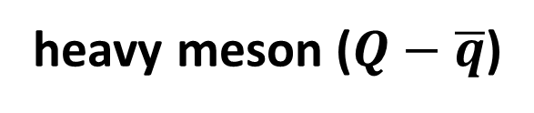




Internal structure of heavy mesons
Q
q
$$L$$
heavy meson ($Q−\overline{q}$)
$$s_{Q}$$
$$s_{\overline{q}}$$
$$J=s_{Q}+s_{\overline{q}}+L$$

Slide 5
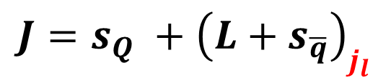
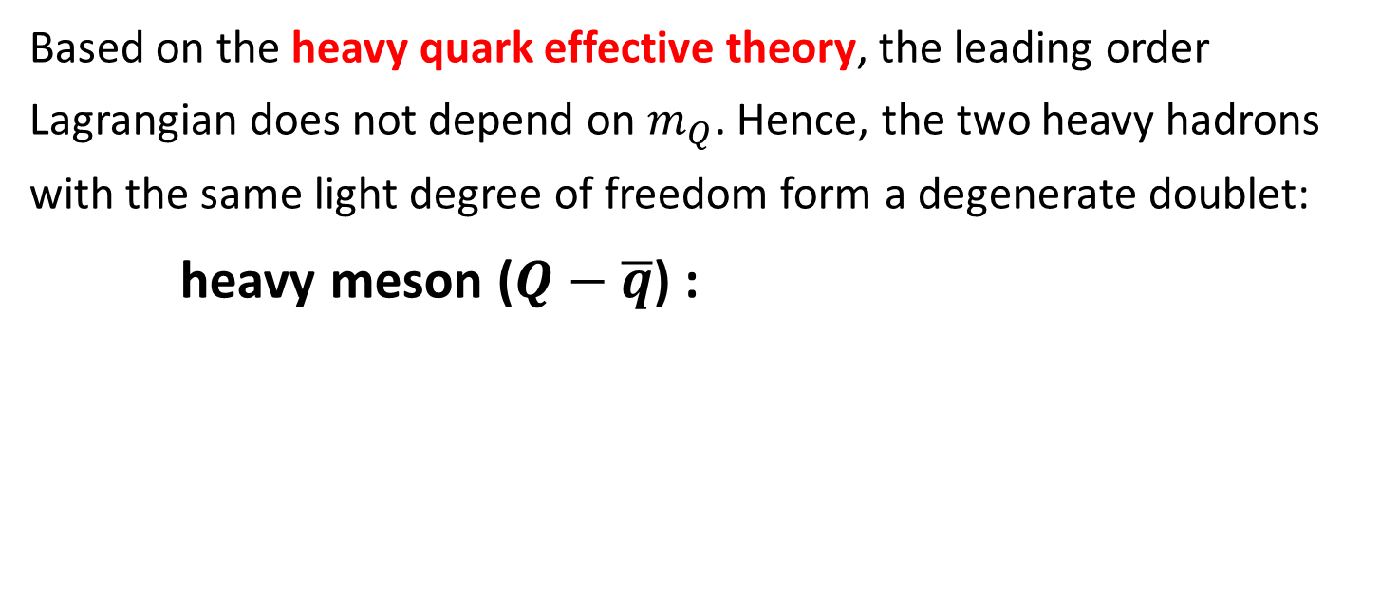
Internal structure of heavy mesons
Based on the heavy quark effective theory, the leading order Lagrangian does not depend on $m_{Q}$. Hence, the two heavy hadrons with the same light degree of freedom form a degenerate doublet:
heavy meson ($Q−\overline{q}$) :
$$J=s_{Q} +{\left(L+s_{\overline{q}}\right)}_{j_{l}}$$
spin of the light degree of freedom

Slide 6


Internal structure of heavy mesons
Based on the heavy quark effective theory, the leading order Lagrangian does not depend on $m_{Q}$. Hence, the two heavy hadrons with the same light degree of freedom form a degenerate doublet:
heavy meson ($Q−\overline{q}$) :
$$J=s_{Q} +{\left(L+s_{\overline{q}}\right)}_{j_{l}}$$
$$=1/2$$
$$=1/2$$

Slide 7
Internal structure of heavy mesons
Based on the heavy quark effective theory, the leading order Lagrangian does not depend on $m_{Q}$. Hence, the two heavy hadrons with the same light degree of freedom form a degenerate doublet:
heavy meson ($Q−\overline{q}$) :
$$J=s_{Q} +{\left(L+s_{\overline{q}}\right)}_{j_{l}}$$
$$=1/2$$
$$=1/2$$
$$L=0 :j_{l}=1/2, J^{P}=\left(0^{−},1^{−}\right)$$

Slide 8
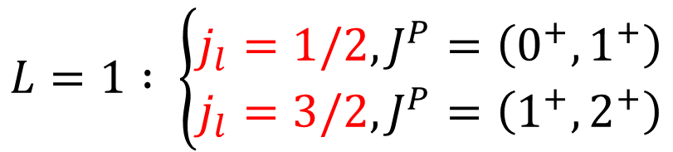
Internal structure of heavy mesons
Based on the heavy quark effective theory, the leading order Lagrangian does not depend on $m_{Q}$. Hence, the two heavy hadrons with the same light degree of freedom form a degenerate doublet:
heavy meson ($Q−\overline{q}$) :
$$J=s_{Q} +{\left(L+s_{\overline{q}}\right)}_{j_{l}}$$
$$=1/2$$
$$=1/2$$
$$L=0 :j_{l}=1/2, J^{P}=\left(0^{−},1^{−}\right)$$
$$L=1 : \left\{\begin{aligned}j_{l}=1/2,J^{P}=\left(0^{+},1^{+}\right) \\ j_{l}=3/2,J^{P}=\left(1^{+},2^{+}\right)\end{aligned}\right.$$

Slide 9
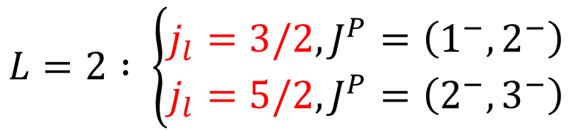
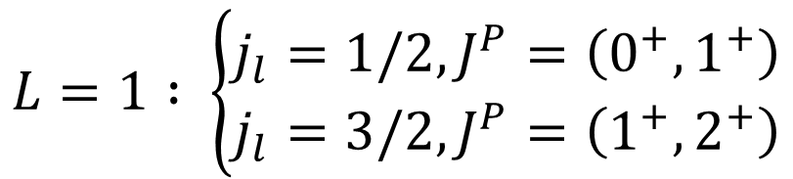
Internal structure of heavy mesons
Based on the heavy quark effective theory, the leading order Lagrangian does not depend on $m_{Q}$. Hence, the two heavy hadrons with the same light degree of freedom form a degenerate doublet:
heavy meson ($Q−\overline{q}$) :
$$J=s_{Q} +{\left(L+s_{\overline{q}}\right)}_{j_{l}}$$
$$=1/2$$
$$=1/2$$
$$L=0 :j_{l}=1/2, J^{P}=\left(0^{−},1^{−}\right)$$
$$L=1 : \left\{\begin{aligned}j_{l}=1/2,J^{P}=\left(0^{+},1^{+}\right) \\ j_{l}=3/2,J^{P}=\left(1^{+},2^{+}\right)\end{aligned}\right.$$
$$L=2 : \left\{\begin{aligned}j_{l}=3/2,J^{P}=\left(1^{−},2^{−}\right) \\ j_{l}=5/2,J^{P}=\left(2^{−},3^{−}\right)\end{aligned}\right.$$

Slide 10
Contents
Internal structure of heavy mesons
Internal structure of heavy baryons
QCD sum rule analyses

Slide 11
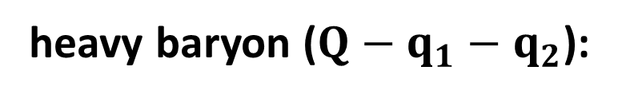
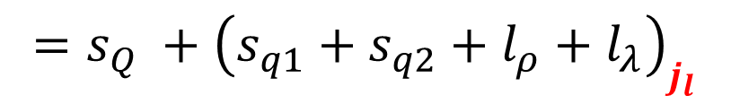

Internal structure of heavy baryons
heavy baryon ($Q−q_{1}−q_{2}$):
λ-excitation and ρ-excitation
$$J=s_{Q}+s_{q1}+s_{q2}+l_{ρ}+l_{λ}$$
$$=s_{Q} +{\left(s_{q1}+s_{q2}+l_{ρ}+l_{λ}\right)}_{j_{l}}$$
spin of the light degree of freedom

Slide 12
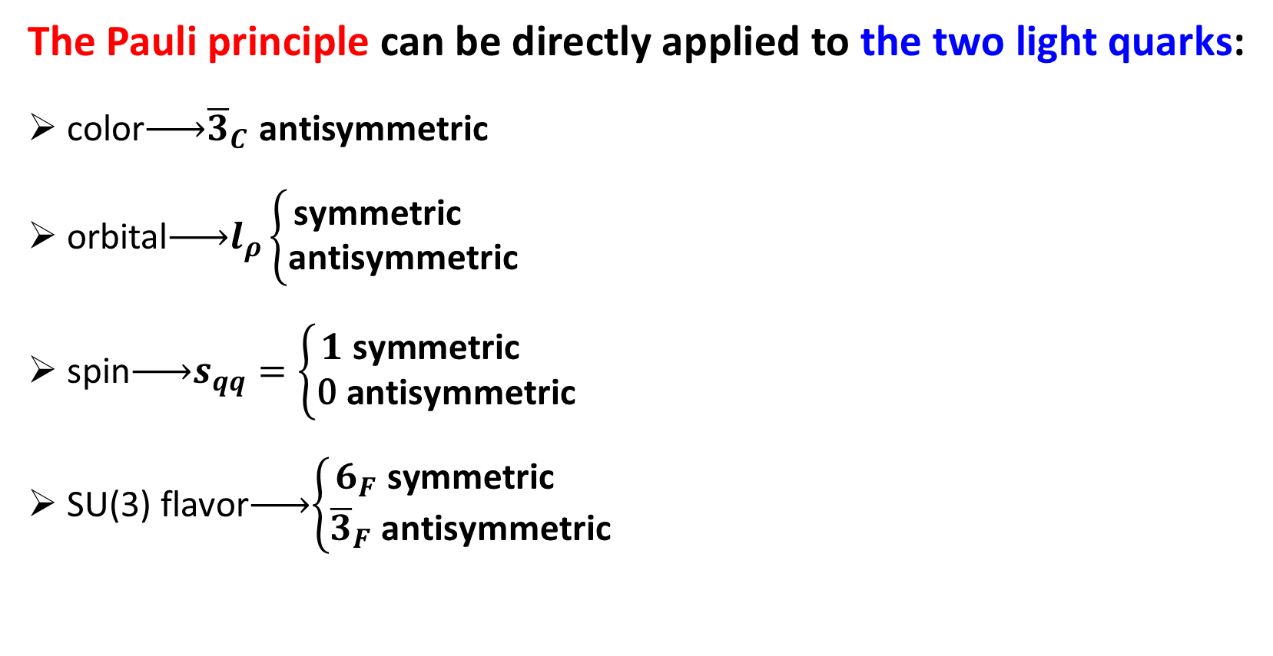
Internal structure of heavy baryons
The Pauli principle can be directly applied to the two light quarks:
color$\underset{→}{ }{\overline{3}}_{C}$ antisymmetric
orbital$\underset{→}{ }l_{ρ}\left\{\begin{aligned}\text{symmetric} \\ \text{antisymmetric}\end{aligned}\right.$
spin$\underset{→}{ }s_{qq}=\left\{\begin{aligned}1 \text{symmetric} \\ \text{0 }\text{antisymmetric}\end{aligned}\right.$
SU(3) flavor$\underset{→}{ }\left\{\begin{aligned}6_{F} \text{symmetric} \\ {\overline{3}}_{F} \text{antisymmetric}\end{aligned}\right.$

Slide 13
Internal structure of heavy baryons
The Pauli principle can be directly applied to the two light quarks:
color$\underset{→}{ }{\overline{3}}_{C}$ antisymmetric
orbital$\underset{→}{ }l_{ρ}\left\{\begin{aligned}\text{symmetric} \\ \text{antisymmetric}\end{aligned}\right.$
spin$\underset{→}{ }s_{qq}=\left\{\begin{aligned}1 \text{symmetric} \\ \text{0 }\text{antisymmetric}\end{aligned}\right.$
SU(3) flavor$\underset{→}{ }\left\{\begin{aligned}6_{F} \text{symmetric} \\ {\overline{3}}_{F} \text{antisymmetric}\end{aligned}\right.$
Totally Antisymmetric

Slide 14

Internal structure of heavy baryons
S-wave heavy baryons:
color$\underset{→}{ }{\overline{3}}_{C}$ antisymmetric
orbital$\underset{→}{ }l_{ρ}=0$ $\text{symmetric}$
spin$\underset{→}{ }s_{qq}=\left\{\begin{aligned}1 \text{symmetric} \\ \text{0 }\text{antisymmetric}\end{aligned}\right.$
SU(3) flavor$\underset{→}{ }\left\{\begin{aligned}6_{F} \text{symmetric} \\ {\overline{3}}_{F} \text{antisymmetric}\end{aligned}\right.$

Slide 15
Internal structure of heavy baryons
S-wave heavy baryons:
color$\underset{→}{ }{\overline{3}}_{C}$ antisymmetric
orbital$\underset{→}{ }l_{ρ}=0$ $\text{symmetric}$
spin$\underset{→}{ }s_{qq}=\left\{\begin{aligned}1 \text{symmetric} \\ \text{0 }\text{antisymmetric}\end{aligned}\right.$
SU(3) flavor$\underset{→}{ }\left\{\begin{aligned}6_{F} \text{symmetric} \\ {\overline{3}}_{F} \text{antisymmetric}\end{aligned}\right.$
Totally Antisymmetric

Slide 16
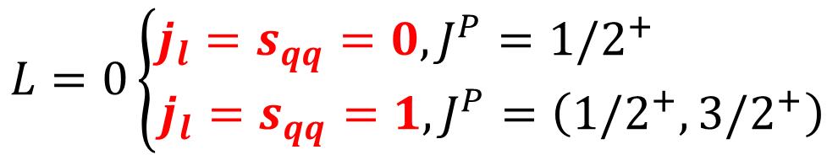


Internal structure of heavy baryons
S-wave heavy baryons:
color$\underset{→}{ }{\overline{3}}_{C}$ antisymmetric
orbital$\underset{→}{ }l_{ρ}=0$ $\text{symmetric}$
spin$\underset{→}{ }s_{qq}=\left\{\begin{aligned}1 \text{symmetric} \\ \text{0 }\text{antisymmetric}\end{aligned}\right.$
SU(3) flavor$\underset{→}{ }\left\{\begin{aligned}6_{F} \text{symmetric} \\ {\overline{3}}_{F} \text{antisymmetric}\end{aligned}\right.$
$$L=0\left\{\begin{aligned}j_{l}=s_{qq}=0,J^{P}={1/2}^{+} \\ j_{l}=s_{qq}=1,J^{P}=\left({1/2}^{+},{3/2}^{+}\right)\end{aligned}\right.$$
$${\overline{3}}_{F}$$
$$6_{F}$$

Slide 17
Internal structure of heavy baryons
S-wave heavy baryons:
color$\underset{→}{ }{\overline{3}}_{C}$ antisymmetric
orbital$\underset{→}{ }l_{ρ}=0$ $\text{symmetric}$
spin$\underset{→}{ }s_{qq}=\left\{\begin{aligned}1 \text{symmetric} \\ \text{0 }\text{antisymmetric}\end{aligned}\right.$
SU(3) flavor$\underset{→}{ }\left\{\begin{aligned}6_{F} \text{symmetric} \\ {\overline{3}}_{F} \text{antisymmetric}\end{aligned}\right.$
$$L=0\left\{\begin{aligned}j_{l}=s_{qq}=0,J^{P}={1/2}^{+} \\ j_{l}=s_{qq}=1,J^{P}=\left({1/2}^{+},{3/2}^{+}\right)\end{aligned}\right.$$
$${\overline{3}}_{F}$$
$$6_{F}$$

Slide 18


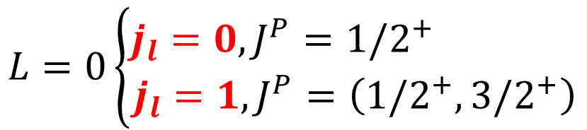


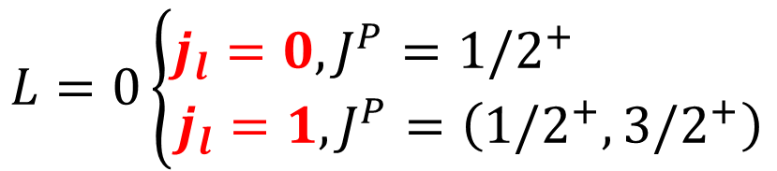


Internal structure of heavy baryons
S-wave charmed baryons
$$L=0\left\{\begin{aligned}j_{l}=0,J^{P}={1/2}^{+} \\ j_{l}=1,J^{P}=\left({1/2}^{+},{3/2}^{+}\right)\end{aligned}\right.$$
$${\overline{3}}_{F}: Λ_{c}, Ξ_{c}$$
$$6_{F}:\left(Σ_{c},Σ_{c}^{∗}\right), \left(Ξ_{c}^{′},Ξ_{c}^{∗}\right), (Ω_{c},Ω_{c}^{∗})$$
$${1/2}^{+}$$
$${3/2}^{+}$$
S-wave bottom baryons
$$L=0\left\{\begin{aligned}j_{l}=0,J^{P}={1/2}^{+} \\ j_{l}=1,J^{P}=\left({1/2}^{+},{3/2}^{+}\right)\end{aligned}\right.$$
$${\overline{3}}_{F}: Λ_{b}, Ξ_{b}$$
$$6_{F}:\left(Σ_{b},Σ_{b}^{∗}\right), \left(Ξ_{b}^{′},Ξ_{b}^{∗}\right), (Ω_{b},Ω_{b}^{∗})$$
$${1/2}^{+}$$
$${3/2}^{+}$$

Slide 19
Internal structure of heavy baryons
S-wave charmed baryons
$$L=0\left\{\begin{aligned}j_{l}=0,J^{P}={1/2}^{+} \\ j_{l}=1,J^{P}=\left({1/2}^{+},{3/2}^{+}\right)\end{aligned}\right.$$
$${\overline{3}}_{F}: Λ_{c}, Ξ_{c}$$
$$6_{F}:\left(Σ_{c},Σ_{c}^{∗}\right), \left(Ξ_{c}^{′},Ξ_{c}^{∗}\right), (Ω_{c},Ω_{c}^{∗})$$
$${1/2}^{+}$$
$${3/2}^{+}$$
S-wave bottom baryons
$$L=0\left\{\begin{aligned}j_{l}=0,J^{P}={1/2}^{+} \\ j_{l}=1,J^{P}=\left({1/2}^{+},{3/2}^{+}\right)\end{aligned}\right.$$
$${\overline{3}}_{F}: Λ_{b}, Ξ_{b}$$
$$6_{F}:\left(Σ_{b},Σ_{b}^{∗}\right), \left(Ξ_{b}^{′},Ξ_{b}^{∗}\right), (Ω_{b},Ω_{b}^{∗})$$
$${1/2}^{+}$$
$${3/2}^{+}$$
missing

Slide 20
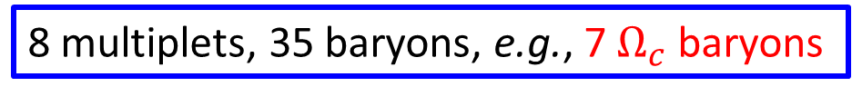
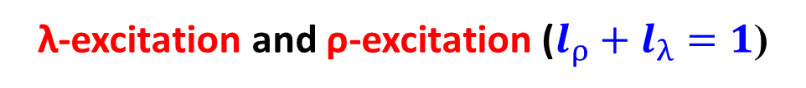
Internal structure of heavy baryons
P-wave charmed baryons
8 multiplets, 35 baryons, e.g., 7 $Ω_{c}$ baryons
λ-excitation and ρ-excitation ($l_{ρ}+l_{λ}=1$)

Slide 21




Currents for P-wave charmed baryons of the flavor $6_{F}$
$$[6_{F}, 1, 0, ρ]$$
$$[6_{F}, 0, 1, λ]$$
$$[6_{F}, 1, 1, λ]$$
$$[6_{F}, 2, 1, λ]$$

Slide 22
General discussions on hadronic currents
Hadronic currents well describe the internal color, flavor, spin, and orbital quantum numbers.
Hadronic currents well describe the internal symmetries of hadrons, e.g,
the Pauli principle is automatically satisfied.

Slide 23
Contents
Internal structure of heavy mesons
Internal structure of heavy baryons
QCD sum rule analyses

Slide 24


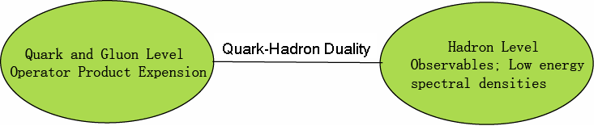
QCD Sum Rules
In sum rule analyses, we consider two-point correlation functions:
where η is the current which can couple to hadronic states.
By using the dispersion relation, we can obtain the spectral density
In QCD sum rule, we can calculate these matrix elements from QCD (OPE) and relate them to observables by using dispersion relation.

Slide 25


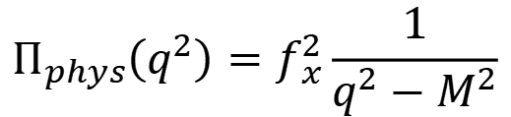
Nielsen et al, Phys. Rept. 497, 41 (2010); Albuquerque et al, JPG46, 093002 (2019).
SVZ sum rule
Quark and Gluon Level
(Convergence of OPE)
dispersion relation
s = -q²
Quark-Hadron Duality
Hadron Level
$$Π_{phys}\left(q^{2}\right)=f_{x}^{2}\frac{1}{q^{2}−M^{2}}$$
(Positivity)
(for boson case)
ρ
(Sufficient amount of Pole contribution)
0
M
s₀
s

Slide 26
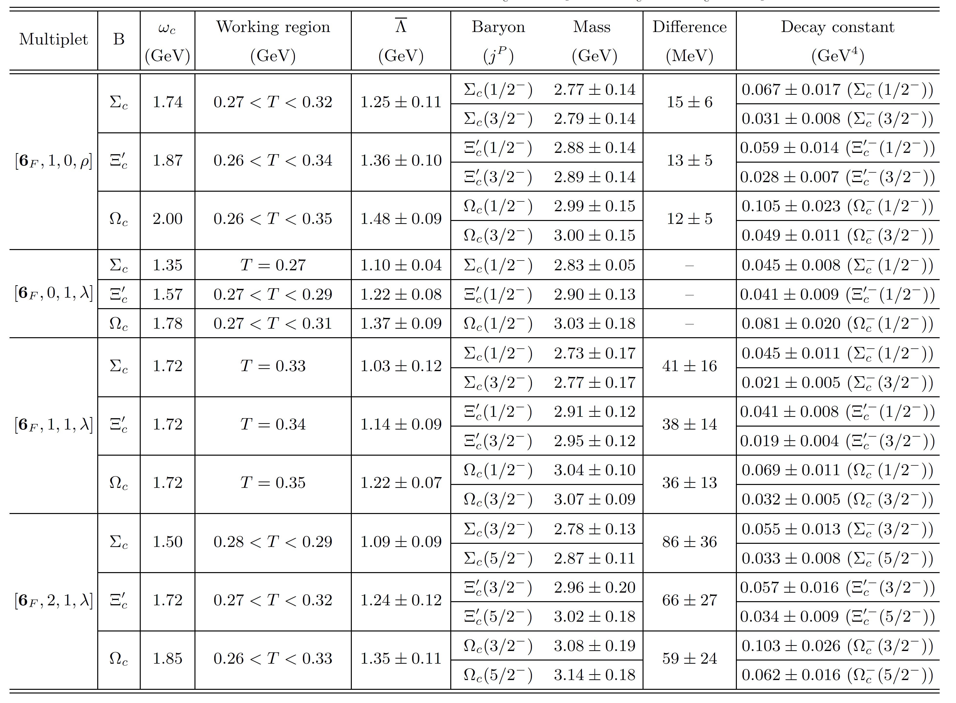
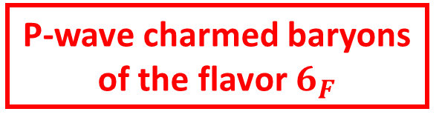
Mass spectrum
P-wave charmed baryons
of the flavor $6_{F}$

Slide 27
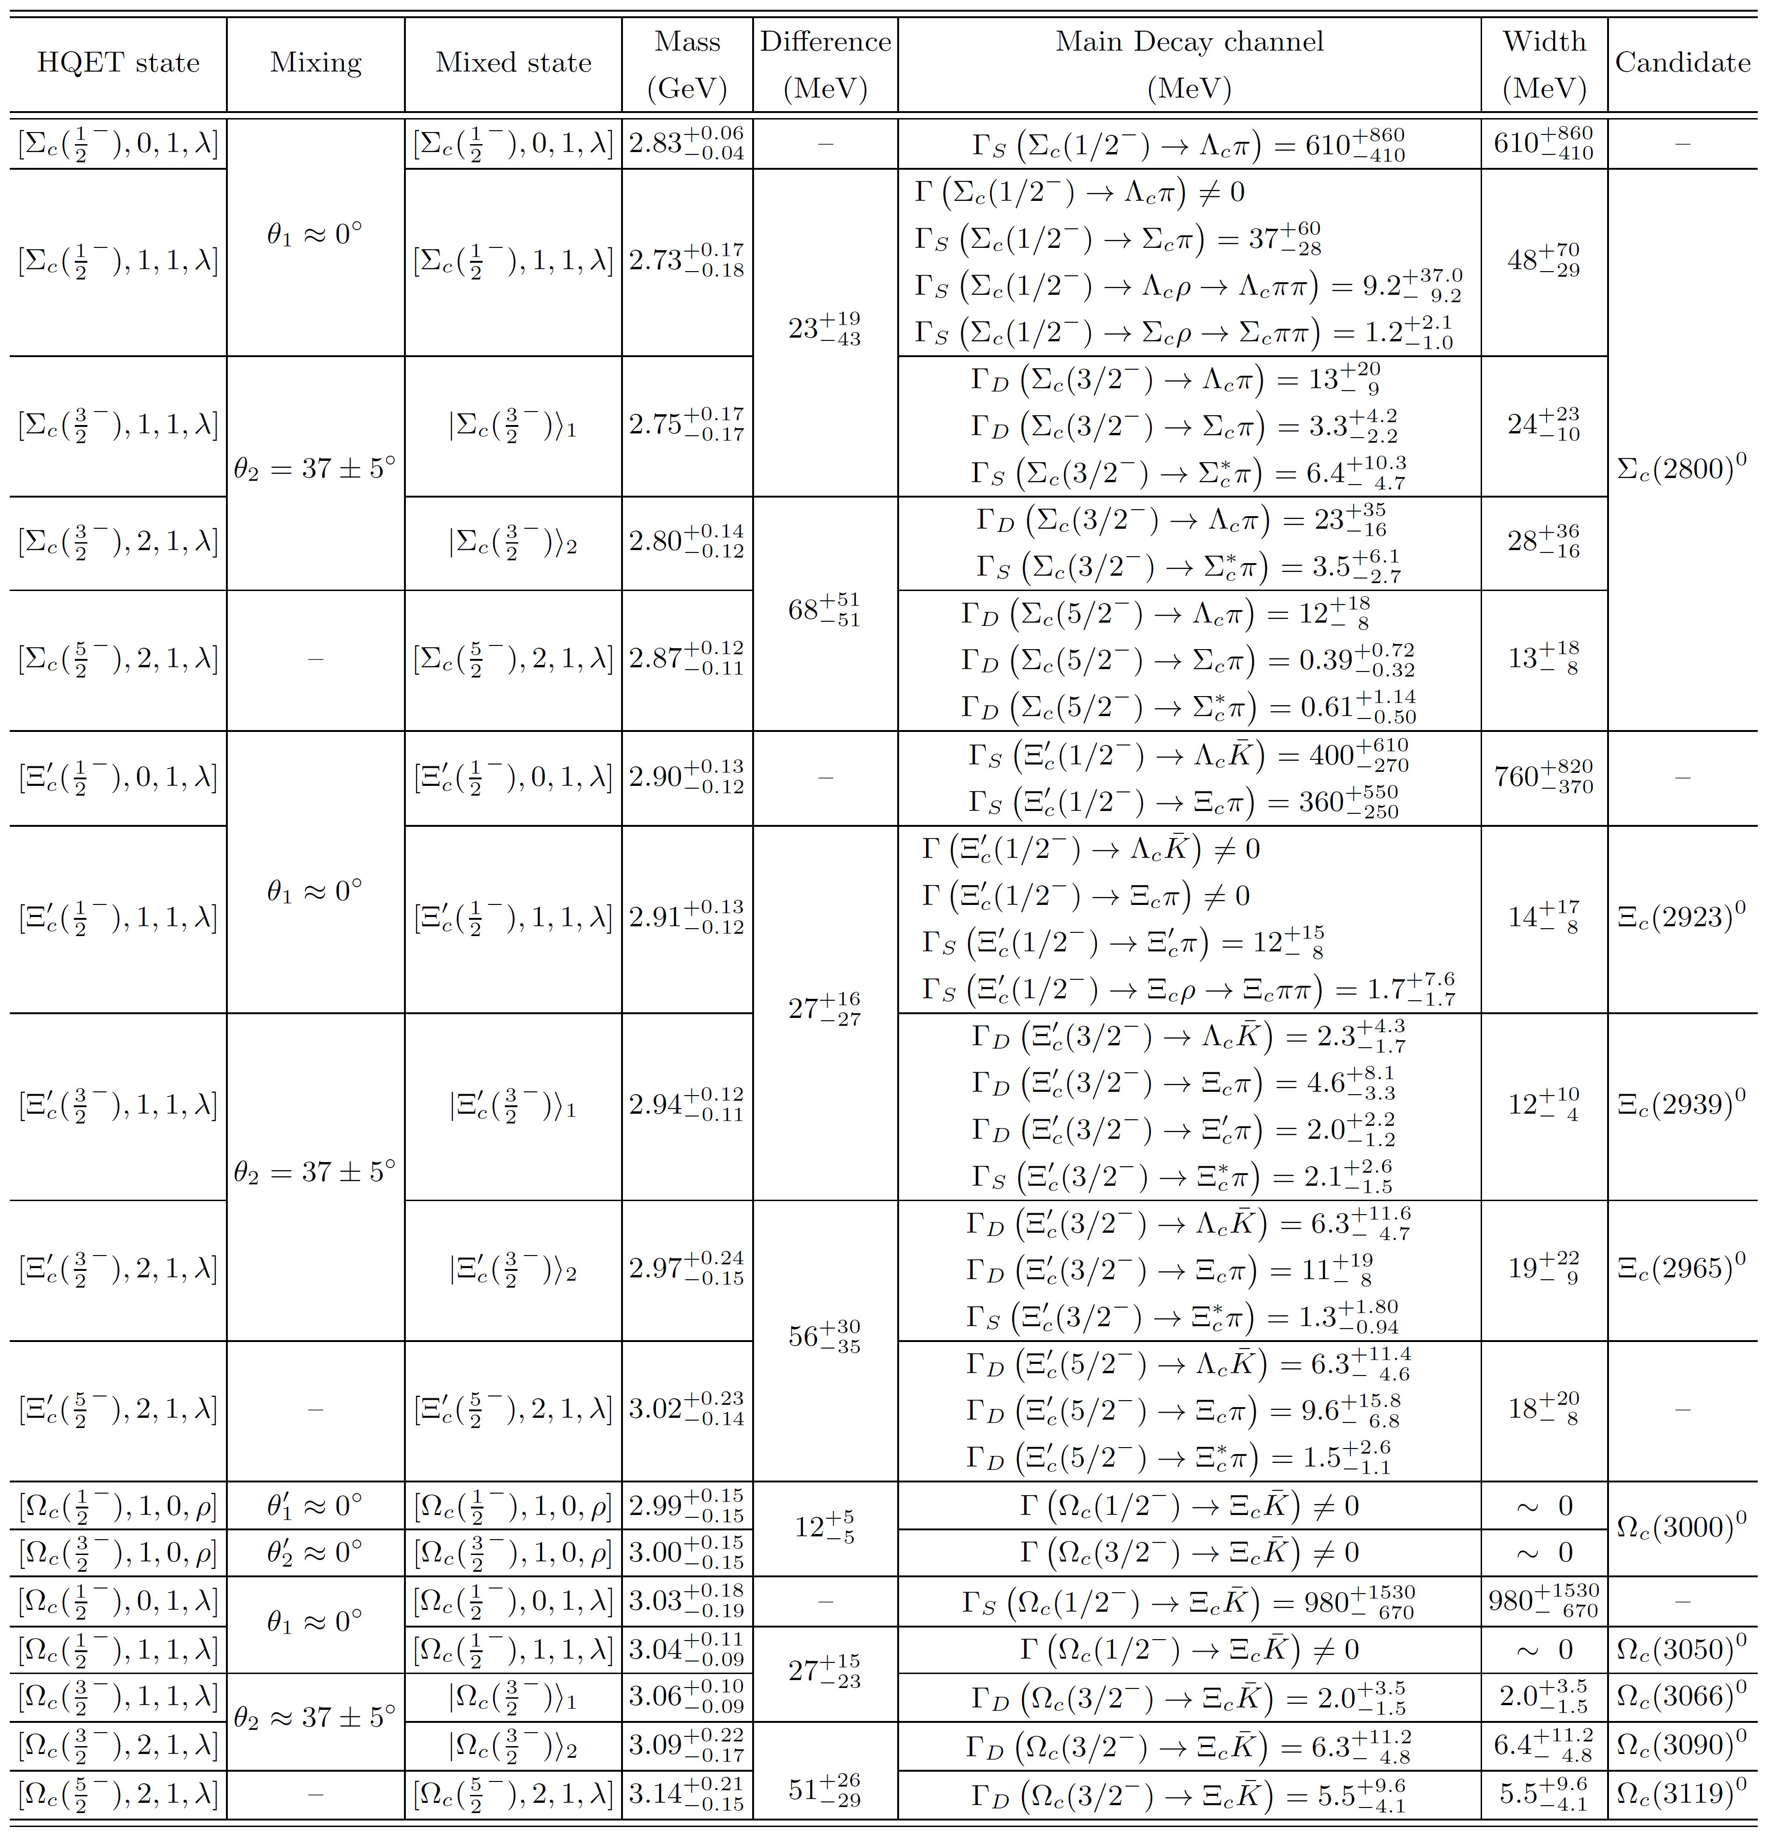



Decay properties
P-wave charmed baryons
of the flavor $6_{F}$
$Ω_{c}^{0}\text{(}{1/2}^{−}\text{)}$ →$Ξ_{c}$+$\overline{K}$ (S-wave)
$Ω_{c}^{0}\text{(}{1/2}^{−}\text{)}$ →$Ξ_{c}$+${\overline{K}}^{∗}$→$Ξ_{c}$+$\overline{K}$+π
$Ω_{c}^{0}\text{(}{1/2}^{−}\text{)}$ →$Ξ_{c}^{∗}$+$\overline{K}$ (D-wave)
… …
Total: 128 decay channels

Slide 28
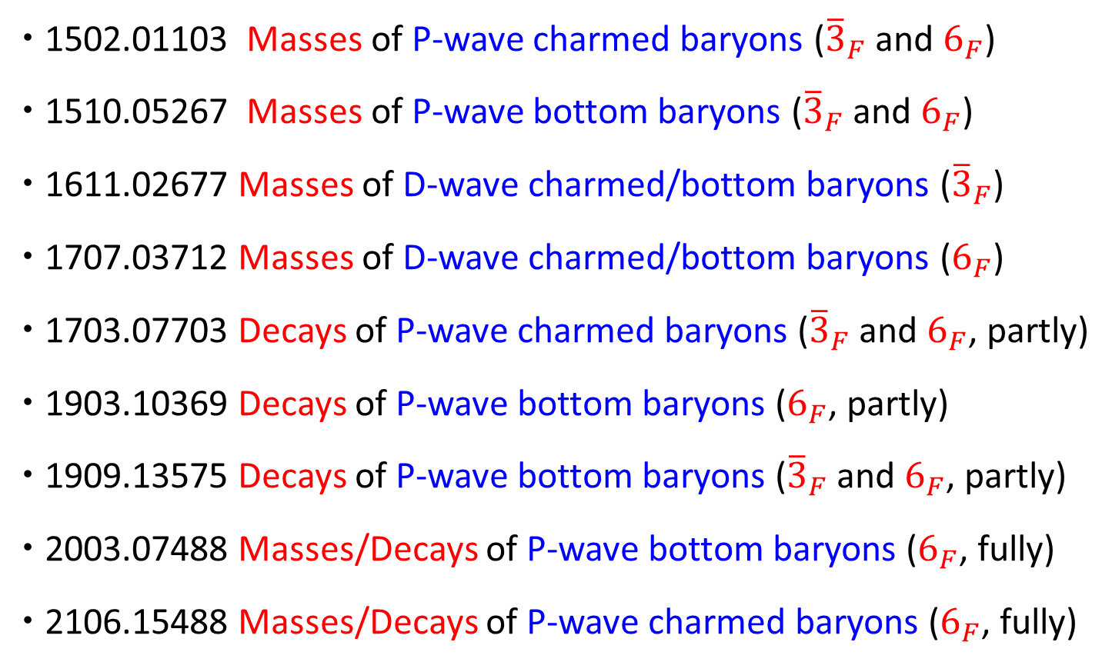
Our QCD sum rule studies
1502.01103 Masses of P-wave charmed baryons (${\overline{3}}_{F}$ and $6_{F}$)
1510.05267 Masses of P-wave bottom baryons (${\overline{3}}_{F}$ and $6_{F}$)
1611.02677 Masses of D-wave charmed/bottom baryons (${\overline{3}}_{F}$)
1707.03712 Masses of D-wave charmed/bottom baryons ($6_{F}$)
1703.07703 Decays of P-wave charmed baryons (${\overline{3}}_{F} \text{and} 6_{F}$, partly)
1903.10369 Decays of P-wave bottom baryons ($6_{F}$, partly)
1909.13575 Decays of P-wave bottom baryons (${\overline{3}}_{F} \text{and} 6_{F}$, partly)
2003.07488 Masses/Decays of P-wave bottom baryons ($6_{F}$, fully)
2106.15488 Masses/Decays of P-wave charmed baryons ($6_{F}$, fully)

Slide 29

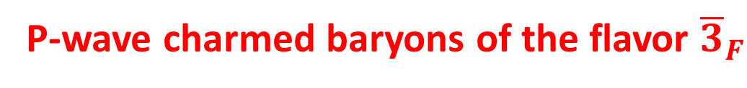
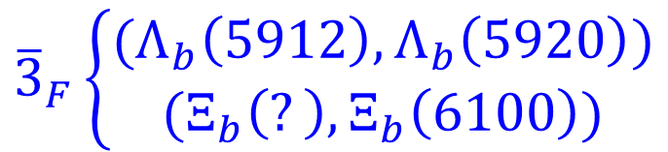

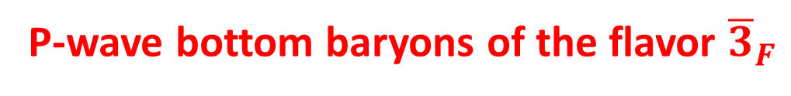

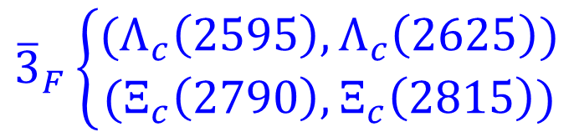

Heavy baryons possibly known
P-wave charmed baryons of the flavor ${\overline{3}}_{F}$
$${\overline{3}}_{F}\left\{\begin{aligned}(Λ_{c}\left(2595\right),Λ_{c}\left(2625\right)) \\ (Ξ_{c}\left(2790\right),Ξ_{c}\left(2815\right))\end{aligned}\right.$$
$$L=1,j_{l}=1,J^{P}=\left({1/2}^{−},{3/2}^{−}\right)$$
$${1/2}^{−}$$
$${3/2}^{−}$$
P-wave bottom baryons of the flavor ${\overline{3}}_{F}$
$${1/2}^{−}$$
$${3/2}^{−}$$
$${\overline{3}}_{F}\left\{\begin{aligned}(Λ_{b}\left(5912\right),Λ_{b}\left(5920\right)) \\ (Ξ_{b}\left(?\right),Ξ_{b}\left(6100\right))\end{aligned}\right.$$
$$L=1,j_{l}=1,J^{P}=\left({1/2}^{−},{3/2}^{−}\right)$$
missing

Slide 30

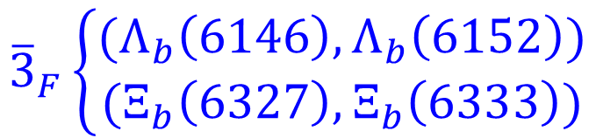
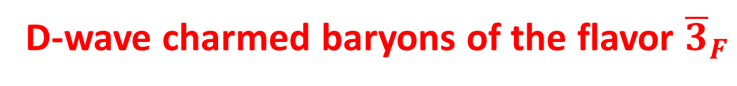

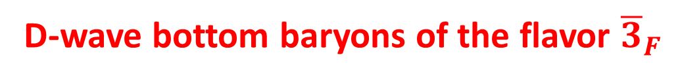

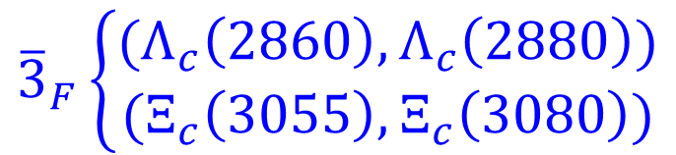

Heavy baryons possibly known
D-wave charmed baryons of the flavor ${\overline{3}}_{F}$
$${\overline{3}}_{F}\left\{\begin{aligned}(Λ_{c}\left(2860\right),Λ_{c}\left(2880\right)) \\ (Ξ_{c}\left(3055\right),Ξ_{c}\left(3080\right))\end{aligned}\right.$$
$$L=2,j_{l}=2,J^{P}=\left({3/2}^{+},{5/2}^{+}\right)$$
$${3/2}^{+}$$
$${5/2}^{+}$$
D-wave bottom baryons of the flavor ${\overline{3}}_{F}$
$${3/2}^{+}$$
$${5/2}^{+}$$
$${\overline{3}}_{F}\left\{\begin{aligned}(Λ_{b}\left(6146\right),Λ_{b}\left(6152\right)) \\ (Ξ_{b}\left(6327\right),Ξ_{b}\left(6333\right))\end{aligned}\right.$$
$$L=2,j_{l}=2,J^{P}=\left({3/2}^{+},{5/2}^{+}\right)$$

Slide 31

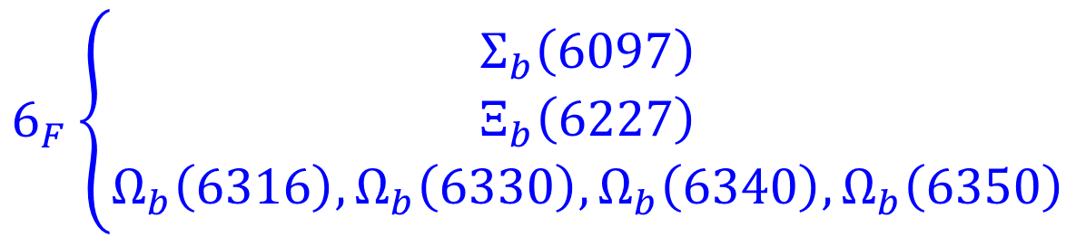
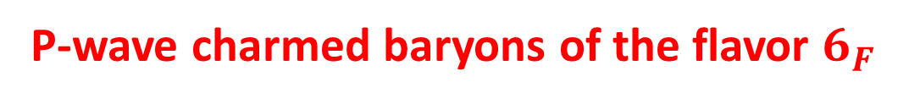

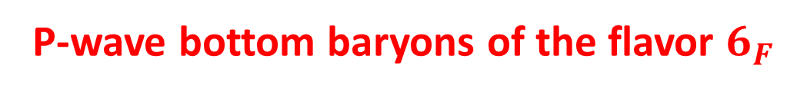
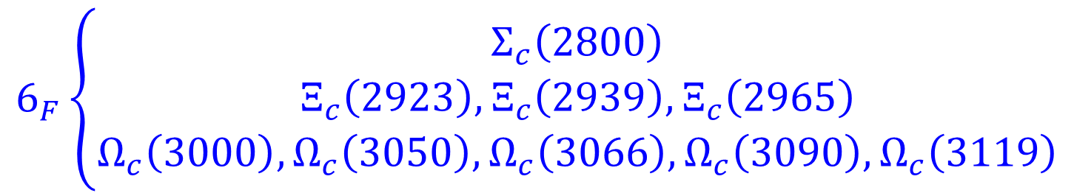
Heavy baryons not well known
P-wave charmed baryons of the flavor $6_{F}$
$$L=1, j_{l}=?,J^{P}=?^{−}$$
$$6_{F}\left\{\begin{aligned}Σ_{c}\left(2800\right) \\ Ξ_{c}\left(2923\right),Ξ_{c}\left(2939\right),Ξ_{c}\left(2965\right) \\ Ω_{c}\left(3000\right),Ω_{c}\left(3050\right),Ω_{c}\left(3066\right),Ω_{c}\left(3090\right),Ω_{c}\left(3119\right)\end{aligned}\right.$$
Many of them are missing
P-wave bottom baryons of the flavor $6_{F}$
$$L=1, j_{l}=?,J^{P}=?^{−}$$
$$6_{F}\left\{\begin{aligned}Σ_{b}\left(6097\right) \\ Ξ_{b}\left(6227\right) \\ Ω_{b}\left(6316\right),Ω_{b}\left(6330\right),Ω_{b}\left(6340\right),Ω_{b}\left(6350\right)\end{aligned}\right.$$
Many of them are missing

Slide 32
Summary
Thanks to the efforts of experimentalists, various signals of heavy baryons and exotic hadrons were observed in recent years, making hadron physics popular once more.
Different from exotic hadrons, we know the internal structure of heavy mesons and heavy baryons much better. Especially, the heavy quark effective theory plays an important role.
All the above assignments are just possible assignments. We propose to search for more excited heavy hadrons in future experiments.
Thank you very much!

