Slide 1
Predictions for the feed-down peaks at the $Λ_{c}\overline{D}$ and $Λ_{c}{\overline{D}}^{∗}$ threshold in $P_{c}→J/ψpπ(π)$
段鸣晓(Ming-Xiao Duan)
In collaboration with 邱林 (Lin Qiu), 凌悉哲(Xi-Zhe Ling), and 赵强 (Qiang Zhao)
July 19, 2023 to July 22, 2023
山东日照
第七届强相互作用量子色动力学对称性及其物质结构学术研讨会

Slide 2
Content
I. A brief introduction to history and status of the P_{c} family.
II. feed-down phenomenon of P_{c} states.
1. Triangle/Box Singularity around the $Λ_{c}\overline{D}$ threshold and feed-down phenomenon.
2. search for the feed-down peak.
III. Summary

Slide 3
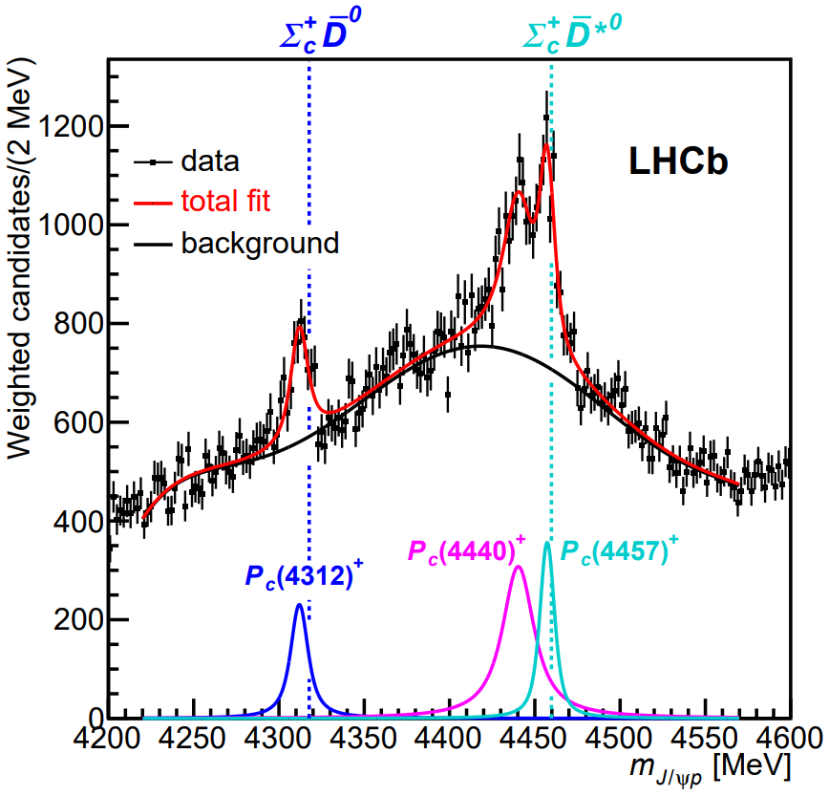
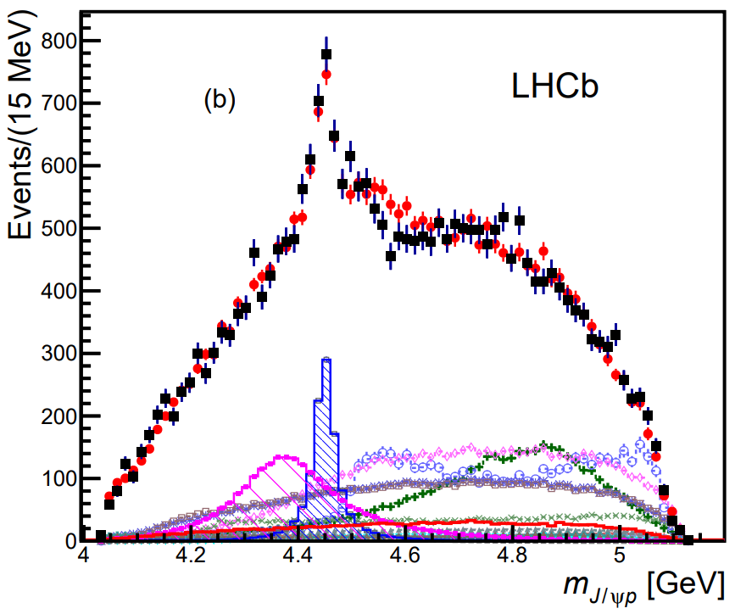
Discovery of P_{c}
2015:
$$Λ_{b}→KJ/ψp$$
2019:
LHCb Phys.Rev.Lett. 122 (2019) 22, 222001
LHCb Phys.Rev.Lett. 115 (2015) 072001
$$P_{c}(4450)$$
$$P_{c}(4380)$$
The $P_{c}$ family was first observed in 2015 by LHCb in $Λ_{b}$ decay processes. In the $J/ψp$ invariant mass spectrum, $P_{c}(4380)$ and $P_{c}(4450)$ were discovered. In 2019, With more precise data in $J/ψp$ spectrum $P_{c}\left(4312\right),$ $P_{c}\left(4440\right), and P_{c}(4457)$ were observed.

Slide 4
Theoretical studies of P_{c}
People employed many different methods to study the $P_{c}$ family, the results indicate the molecular explanation is the most reasonable choice.
u
$$\overline{C}$$
d
c
u
$$\overline{D}$$
No molecular state
Because of the repulsive interaction between $Λ_{c}$ and ${\overline{D}}^{(∗)}$, there is no molecular $Λ_{c}{\overline{D}}^{(∗)}$ state.
$m_{Λ_{c}\overline{D}}=4153$ MeV
$$Λ_{c}$$
repulsive
$${\overline{D}}^{∗}$$
$m_{Λ_{c}{\overline{D}}^{∗}}=4295$ MeV
$$\overline{D}$$
People already predicted the existence of the molecular $Σ_{c}^{(∗)}{\overline{D}}^{(∗)}$ states before P_{c} was observed
$m_{Σ_{c}\overline{D}}=4320$ MeV
$$P_{c}(4312)$$
$$Σ_{c}$$
$${\overline{D}}^{∗}$$
$m_{Σ_{c}{\overline{D}}^{∗}}=4462$ MeV
$$P_{c}(4440)$$
$$P_{c}(4457)$$
attractive
[1] W.L. Wang et al. Phys. Rev. C 84 (2011) 015203,
[2] Zhong-Cheng Yang et al. Chin. Phys. C 36 (2012) 6-13,
[3] Jia-Jun Wu et al. Phys.Rev.C 85 (2012) 044002.
......
$$\overline{D}$$
$m_{Σ_{c}{\overline{D}}^{∗}}=4387$ MeV
$$P_{c}(4380)$$
$$Σ_{c}^{∗}$$
$${\overline{D}}^{∗}$$
???
$m_{Σ_{c}^{∗}{\overline{D}}^{∗}}=4529$ MeV

Slide 5
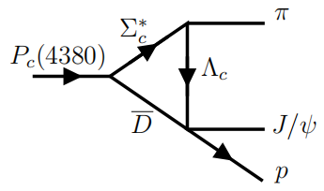
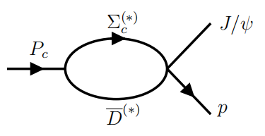
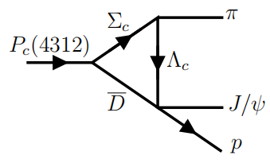
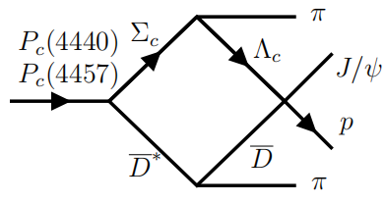
Feed-down phenomenon of P_{c} states
Besides the 2-body decay of $P_{c}$ states, the 3-body and 4-body decay processes show some unique phenomena from molecular $P_{c}$ states and Triangle/Box Singularity.
Triangle Singularity
At $Λ_{c}\overline{D}$ threshold
Nearly on-shell
1->2
[1] L.D. Landau Nucl.Phys. 13 (1959) 1, 181-192,
[2] R.E. Cutkosky J.Math.Phys. 1 (1960) 429-433,
[3] Jia-Jun Wu et al. Phys.Rev.Lett. 108 (2012) 081803.
A molecular $P_{c}$ can only couple to $Σ_{c}^{(∗)}{\overline{D}}^{(∗)}$ which is the component of the $P_{c}$
$Σ_{c}^{∗}→Λ_{c}π$ and $D^{∗}→Dπ$ processes induce a $π$ emission process in $P_{c}$ decay.
Feed-down peak: a TS(BS) peak around $Λ_{c}{\overline{D}}^{(∗)}$ threshold can be observed in the $J/ψp(π)$ invariant mass spectrum.
1->3
the multibody decay of $P_{c}$ was not studied carefully before.
1->4
$Λ_{c}{\overline{D}}^{(∗)}$ cut appears in the $J/ψp(π)$ invariant mass spectrum of $P_{c}→J/ψpπ(π)$

Slide 6
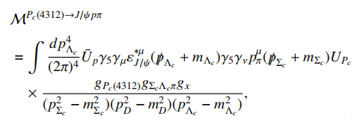
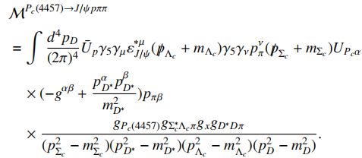
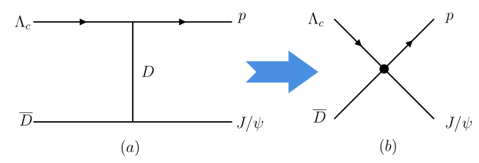
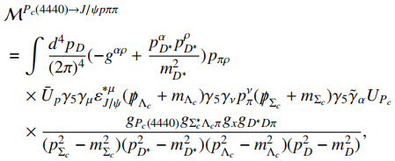
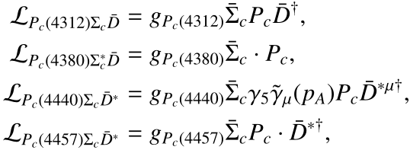
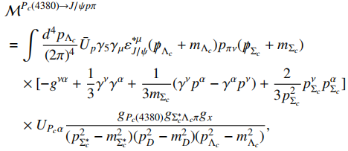
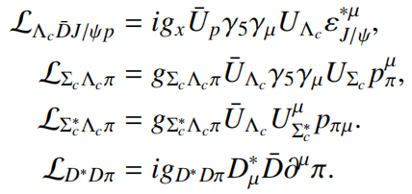
Feed-down phenomenon of P_{c} states
The processes can be calculated concretely by the Lagrangians and amplitudes shown here.
[1] Jia-Ming Xie et al. Eur.Phys.J.C 82 (2022) 11, 1061

Slide 7
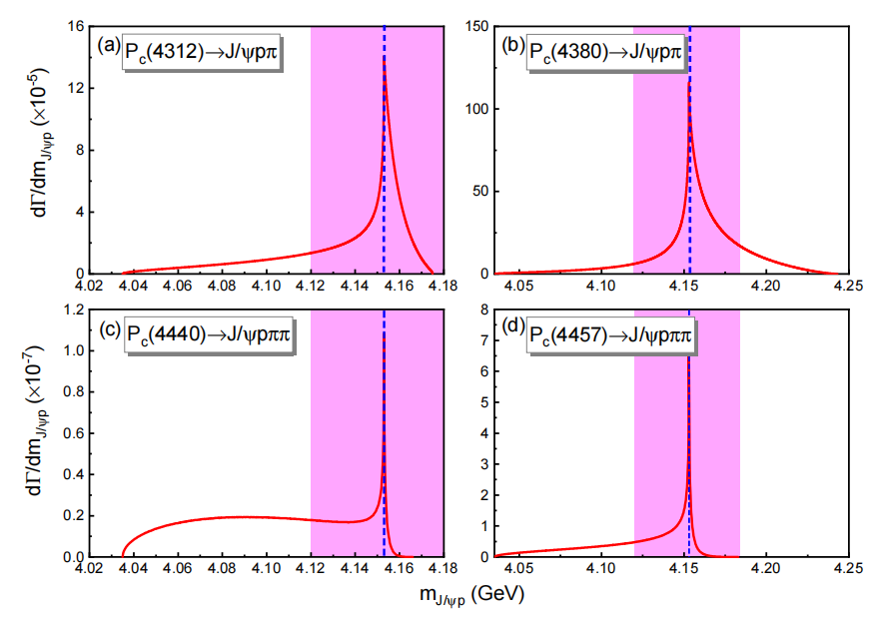
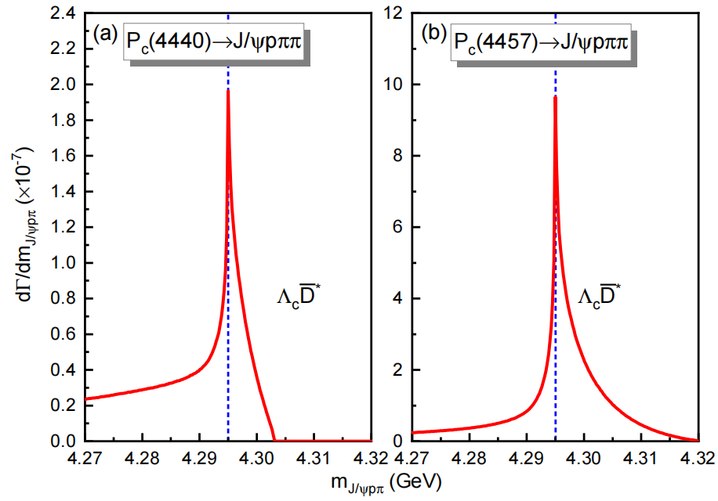
Feed-down phenomenon of P_{c} states
$J/ψp$ invariant mass spectrum:
$J/ψpπ$ invariant mass spectrum:
The different $P_{c}$ initial states feed down to the similar $Λ_{c}\overline{D}(Λ_{c}{\overline{D}}^{∗})$ TS(BS) peak in the $J/ψp(J/ψpπ)$ invariant mass spectrum.
The unique results from molecular nature of $P_{c}$ family.
The feature can be tested by experiments.

Slide 8
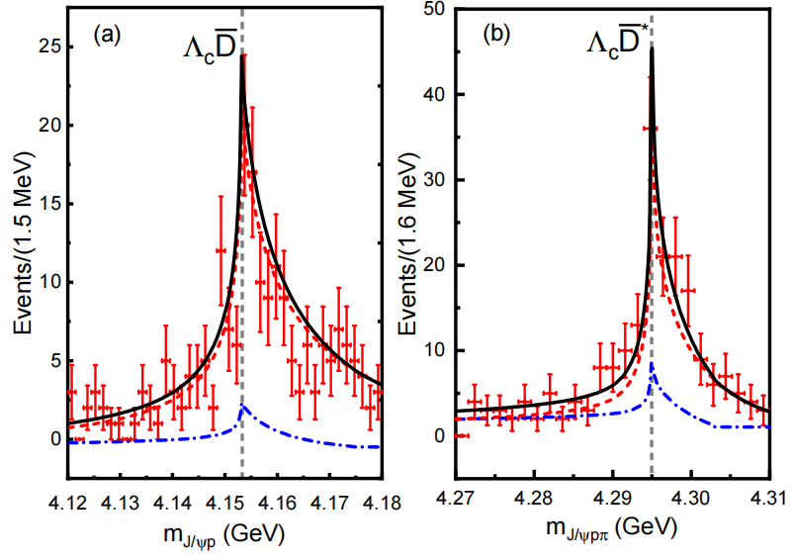
Feed-down phenomenon of P_{c} states
(1). In the semi-inclusive measurement of the $J/ψp(J/ψpπ)$ mass spectrum, the feed-down peak from different $P_{c}$ initial states will accumulate as one TS(BS) peak.
(2). In order to estimate whether the accumulated feed-down peak can be observed in an experiment, we have made a Monte Carlo simulation with 200 events in the discretized energy range, where the efficiency correction is ignored for a perfect detector.
$Λ_{c}\overline{D}$ and $Λ_{c}{\overline{D}}^{∗}$ feed-down spectrum
Blue dashed dot line:
$P_{c}\left(4312\right)+P_{c}\left(4440\right)+P_{c}\left(4457\right)→J/ψpπ$
Red dashed line: $P_{c}(4380)→J/ψpπ$
Black solid line:
Total contribution of $P_{c}$
Blue dashed line: $P_{c}\left(4440\right)→J/ψpππ$
Red dashed line:
$$P_{c}\left(4457\right)→J/ψpππ$$
Black solid line:
Total contribution of $P_{c}$
The multibody decays of molecular $P_{c}$ family provide a special observable theoretical prediction for molecular scheme and triangle/box singularity of $P_{c}$.

Slide 9
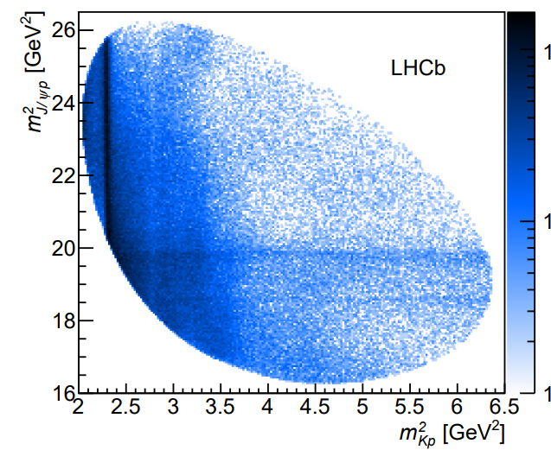
How to search for the feed-down peak
Because ${Λ_{c}\overline{D} and Λ}_{c}{\overline{D}}^{∗}$ internal states appear in the $J/ψpπ(π)$ multibody decay channels, therefore in the $J/ψp$ mass spectrum of the exclusive $P_{c}→J/ψp$, the feed-down peak will not occur.
1. A direct way to find the feed-down peaks is doing a semi-inclusive measurement on $J/ψp$. The feed-down contribution from different $P_{c}$ states will accumulate and appear as one peak.
2. An another way to find the feed-down peak is measuring the $J/ψpπ(π)$ channel and to reconstruct the $P_{c}$ states. In the Dalitz plot of $P_{c}$ decay processes, people can find the signal of the feed-down peak.
For example: $Λ_{b}→J/ψpπK$ $P_{c}→J/ψpπ$
p
p
Pc
$$π$$
$$π$$
J/$Ψ$
$$p$$
$$m_{J/ψp}$$

Slide 10
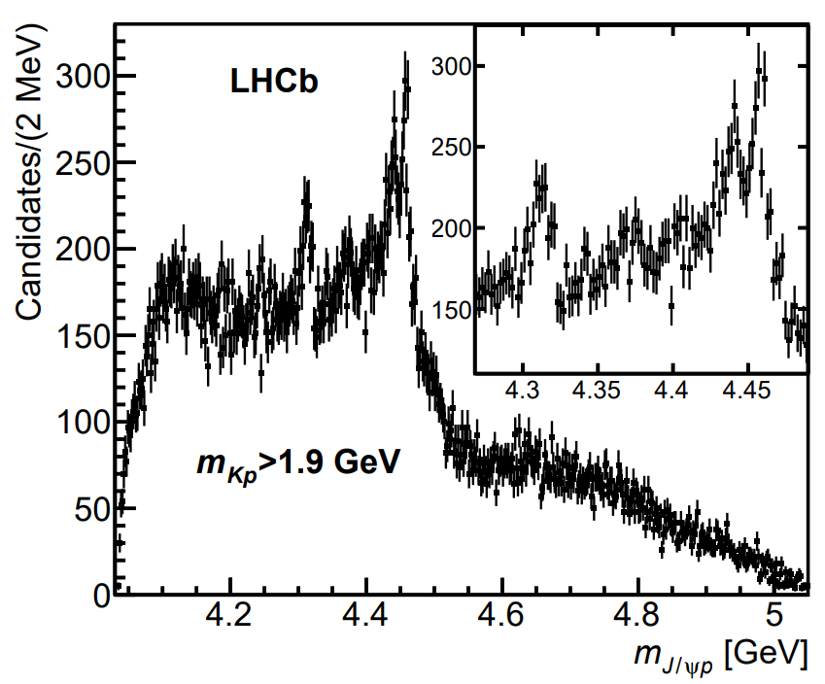
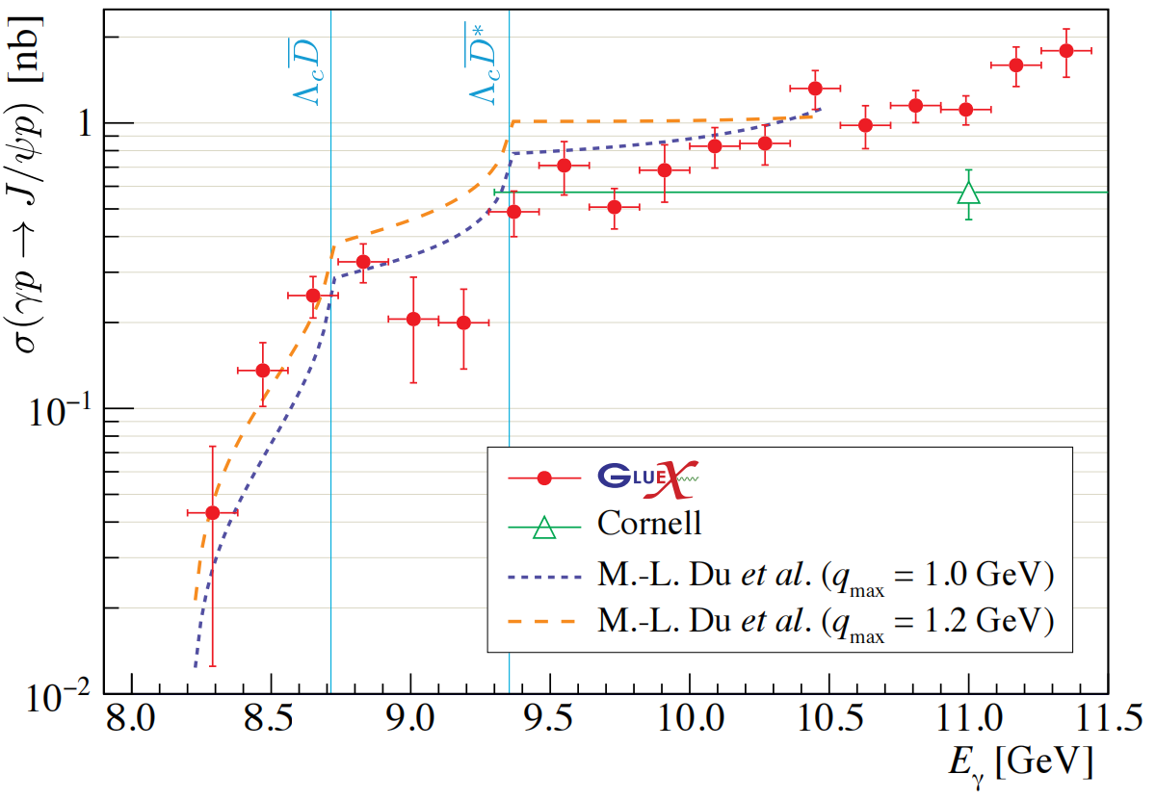
How to search for the feed-down peak
Considering the present data
the $Λ_{b}→J/ψpK$ of LHCb:
LHCb Phys.Rev.Lett. 122 (2019) 22, 222001.
the $γp→J/ψp$ of GlueX: GlueX arXiv:2304.03845v1.
There is no obvious peak at $Λ_{c}\overline{D}$ and $Λ_{c}{\overline{D}}^{∗}$ threshold
There are two CUSPs at $Λ_{c}\overline{D}$ and $Λ_{c}{\overline{D}}^{∗},$ respectively.
I. Until now, there is no resonance peak appear in the available experimental data, which agrees with the result of the repulsive interaction between $Λ_{c} and \overline{D}$.
II. In order to pin down the role of TS/BS in the decay of $P_{c}$, the measurement of the feed-down phenomenon in the multibody decay channel of $P_{c}$ is necessary in the future experiments.

Slide 11
Summary
The study on the multibody decay of $P_{c}$ is necessary.
The feed-down mechanism will make sense in understanding$P_{c}$, which will also induce a unique observable theoretical prediction.
The experimental measurement to the multibody decay of $P_{c}$ will be a crucial step to make clear the role of TS/BS mechanism for the molecular $P_{c}$ states.

Slide 12
Thank You for your attention
谢谢

