Slide 1
Study on Auto-gain-mode files
2022/03/08
Wang Jiaxuan

Slide 2
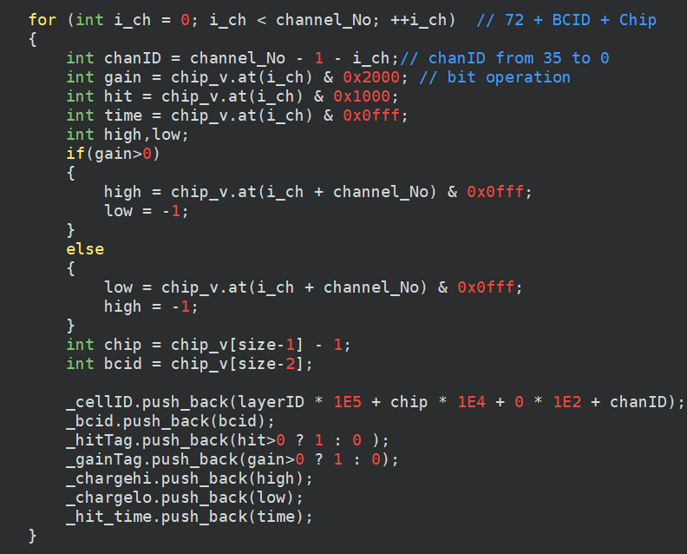
Status of ECAL MIP Calibration
Code written and debug completed
Code for decoding auto-gain mode
Code for MIP Calibration
Some problems about binary data files
High-gain charge and low-gain charge
Time Information

Slide 3
Study on auto-gain-mode files
ECAL Run321~Run341 (auto-gain mode, 108GeV mu+)
No hit message in Run335~Run341
All binary data file are decoded by same code and at the same time in single batch
Problem
High-gain and Low-gain charge
Time information

Slide 4
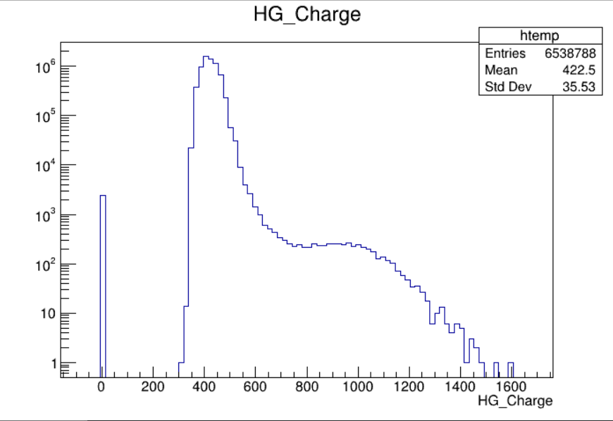
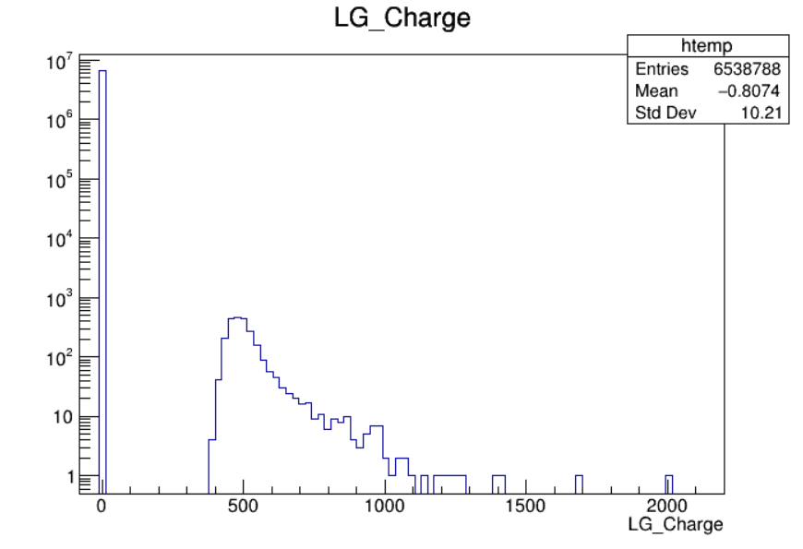
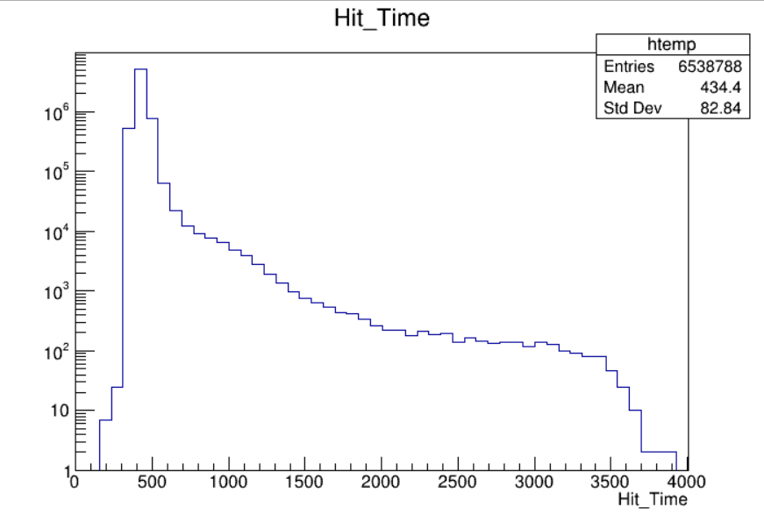
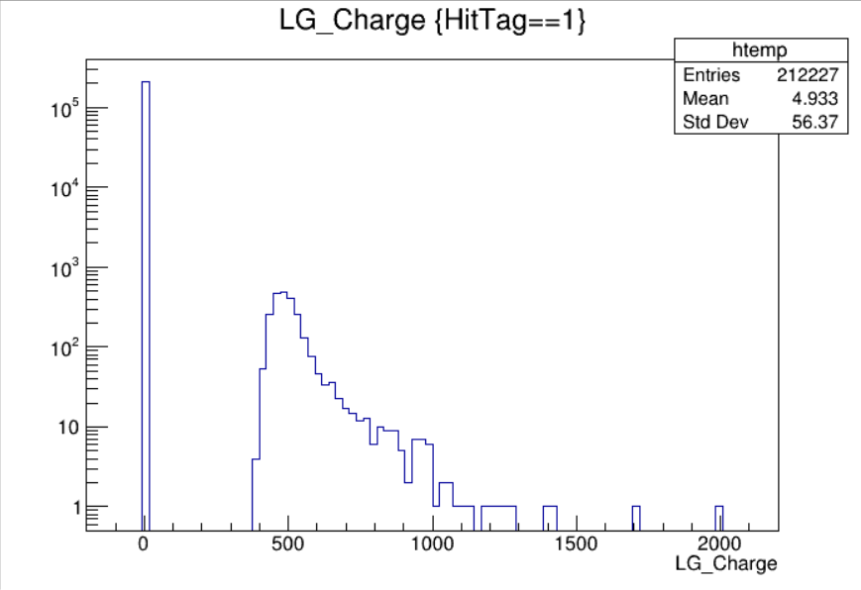
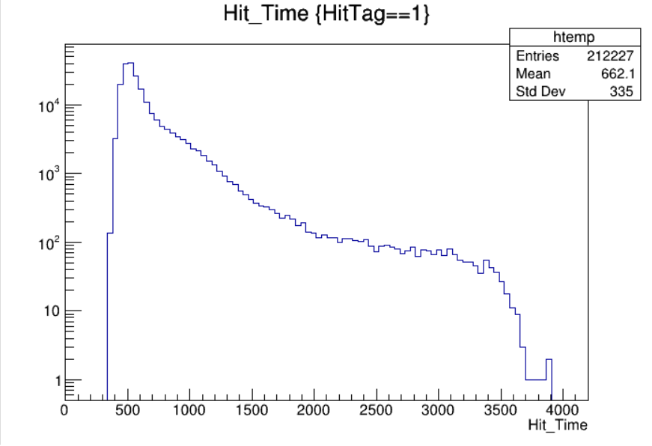
Run321 (auto-gain mode, 108GeV mu+)
No fit data
Not of uniform distrbution
Common issue from Run321 to Run324

Slide 5
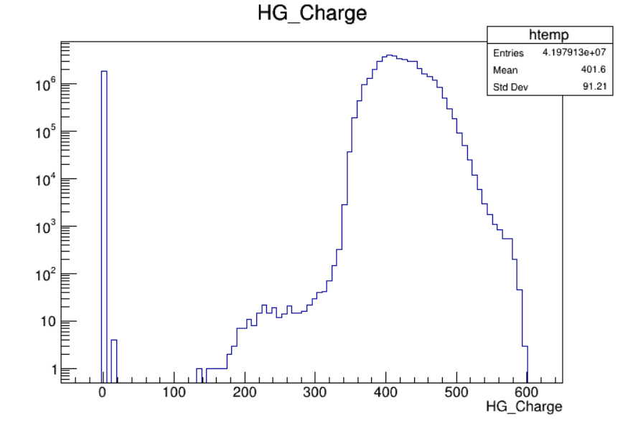
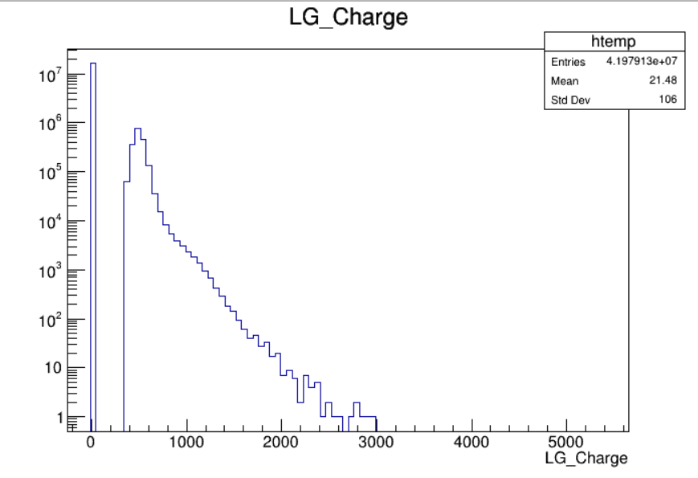
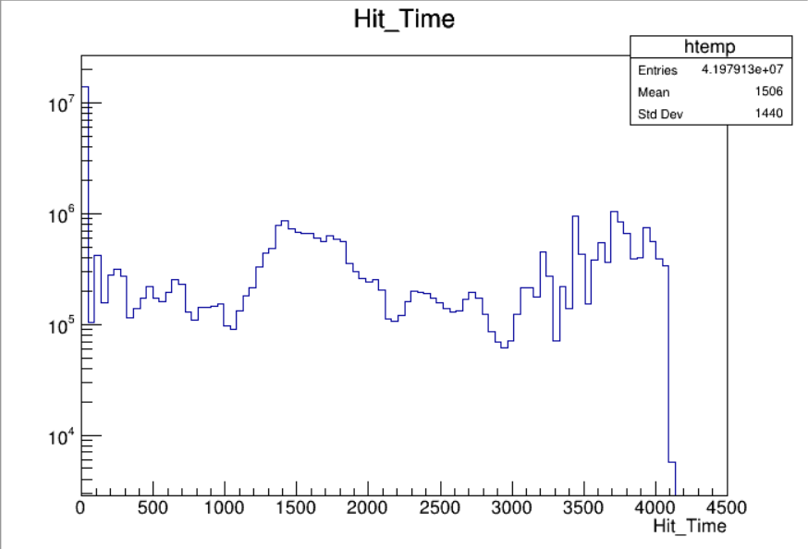
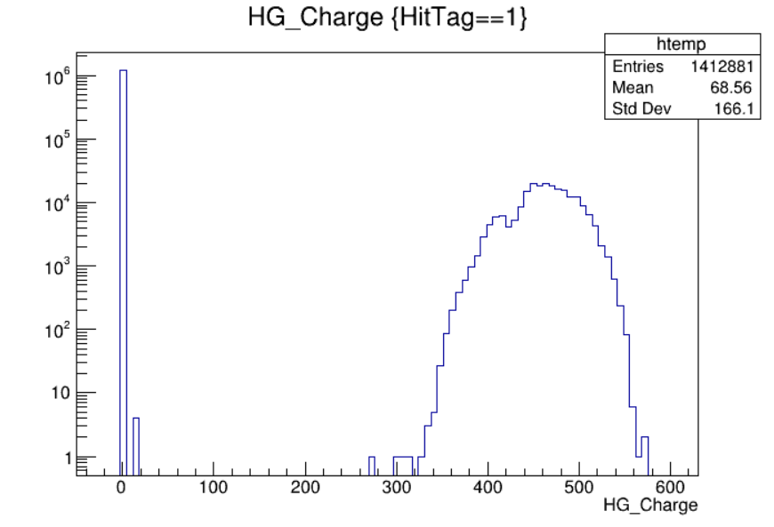
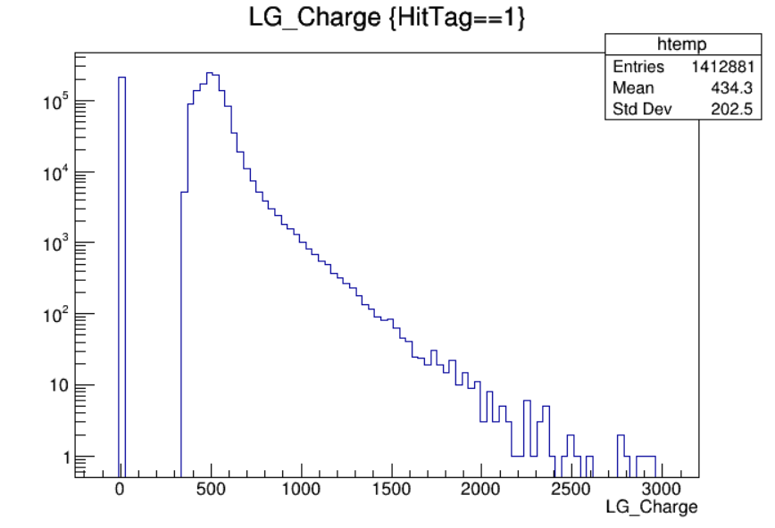
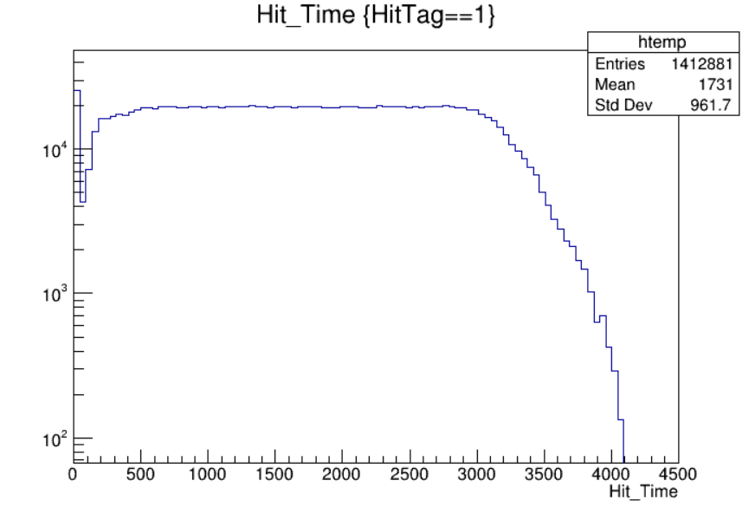
Run326 (auto-gain mode, 108GeV mu+)
No fit data
Common issue from Run325 to Run334

Slide 6
Summary
Unknown reason why auto-gain data behaves quite different
Binary data files (electronics)
Decode code under auto-gain (need crosscheck)
And any possible detailed reason ?

Slide 8
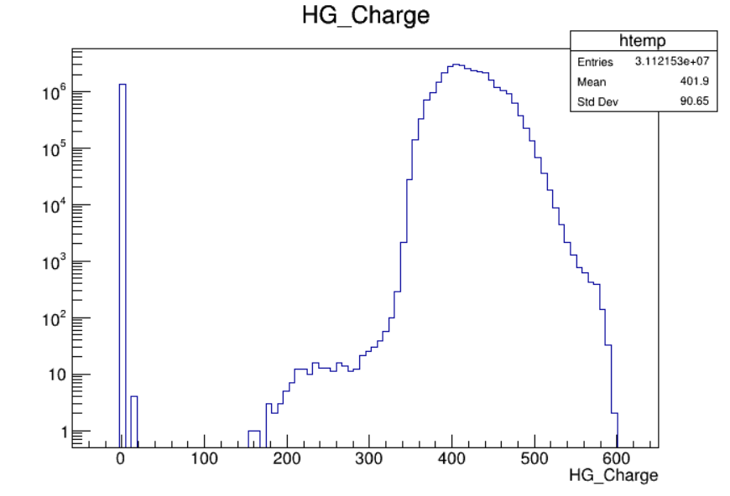
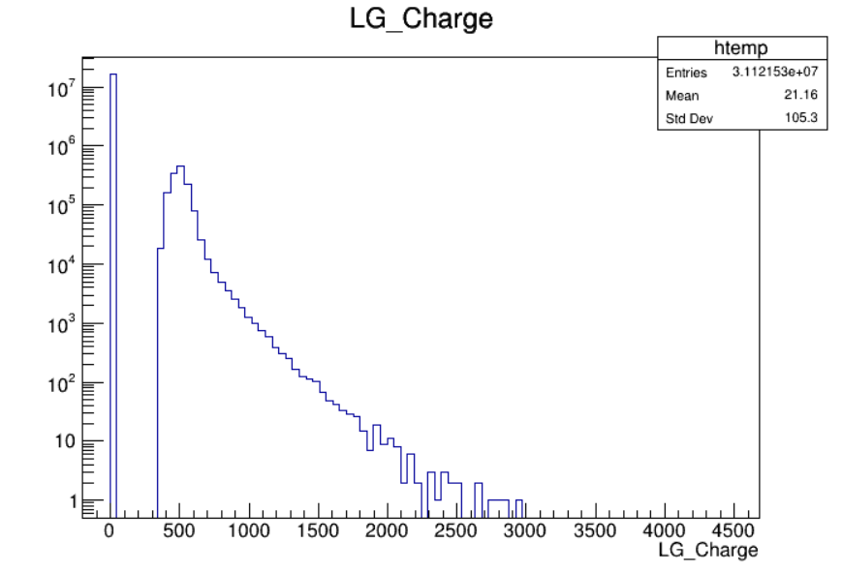
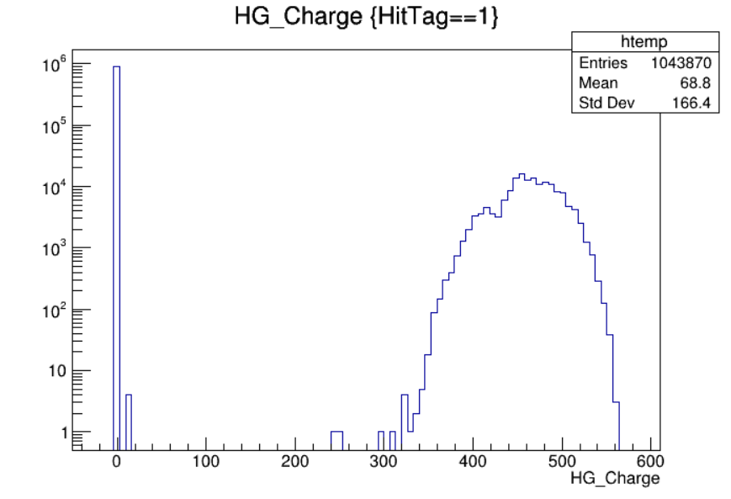
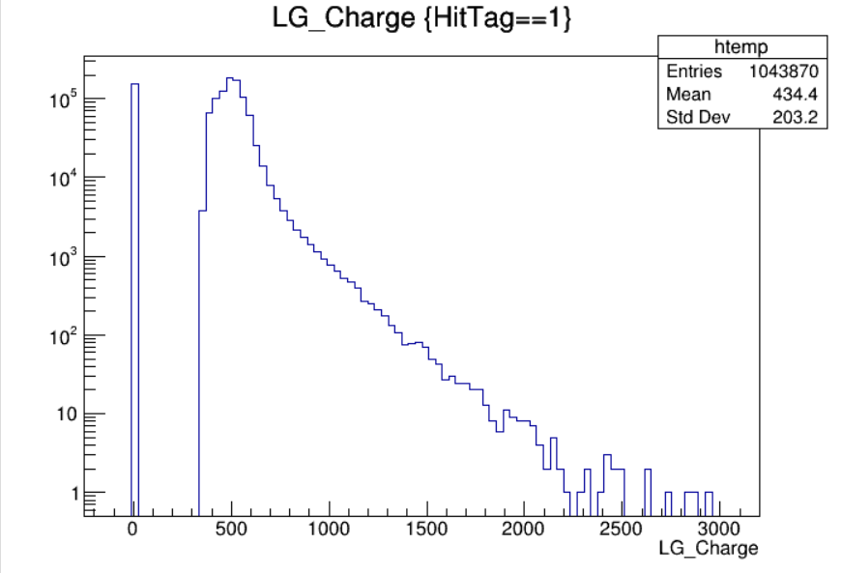
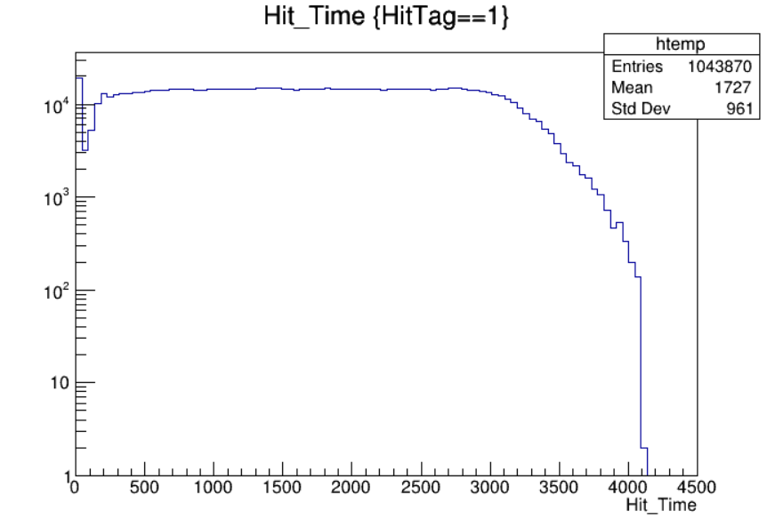
Run327 (auto-gain mode, 108GeV mu+)

