Slide 1






国家重点研发计划
R&D and Verification of Key Technologies for a High Energy Circular Electron-Positron Collider
Zhijun Liang for CEPC MOST2 vertex detector team

Slide 2
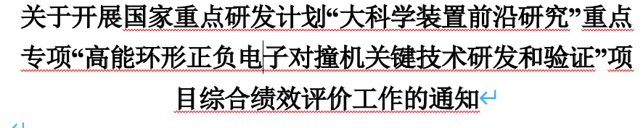
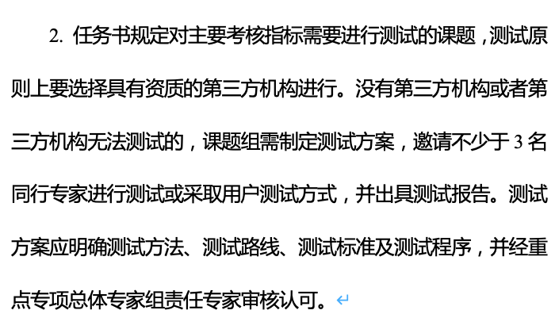
News on MOST2 project
Project timescale （执行期）： up to April 30th ,2023
June 20 –July 21: submission of final reports and review report into MOST2 system
  Reviews on silicon task 2 and reviews on MOST2 project are likely take place in May/June
  Final reports needs to be ready
  Reviews on key parameter (考核指标）

Slide 3
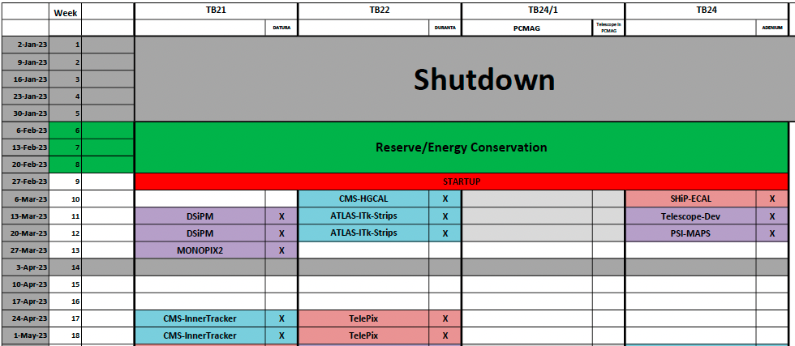
Time line for prototype
Barrel Prototype:
  January : debugging the flex communication
  February: Ladder assembly and testing
  March: Detector assembly
  Middle March: VIP visit, CEPC prototype demonstration (Samuel C.C. Ting)
  Early April: Testbeam at BSRF
  Apr 11- Apr 23: Testbeam at DESY(reserved)

Slide 4
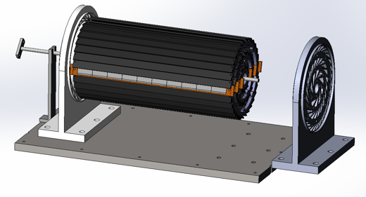
Plan for test beam (Apr 11- Apr 23,2023)
Person power, expertise
  Joao (IHEP, overall)
  Zhijun Liang (IHEP, overall)
  Tianya (IHEP, ASIC)
  Xiaomin WuWei(NWPU, ASIC )?
  Wei Wang(IHEP,ASIC, offline)
  Jia Zhou (IHEP ,DAQ)
  Xinhui Huang (IHEP, mechanism)
  Shuqi Li (IHEP, offline)
  Hao Zeng(IHEP, offline)
  Xuewei Jia(IHEP, offline)
  Yuhang Guo(IHEP, CSNS, testbeam)
  Should Request Invitation letter now

Slide 5
Plan
2nd round of flex production :
  submitted, expected to get ~20 more flex in one month (2 metal layer and 4 metal layer)
2nd round of Taichu chip delivery (expect to arrive in 1 weeks)
  Wafer level testing, thinning to 100um, dicing
Focus on assembly and testing ladder
  Goal: 12 flexes needed for prototype, 6~10 flex needed for flex based telescope
  Aiming to build 10~12 ladder with 4 metal-layer flex (at least 2 chips on each flex )
  Build ~6 ladder with 2 metal layer flex
  Testing for ladder
    Electronics tests
    Laser tests
    Beta tests

Slide 6
Plan
First Ladder prototype ( in 1 week): gluing two flex on carbon fiber support
ladder prototype production ( in 2 weeks, by middle of March )
Assembly ladders in final vertex detector (before April)
Test prototype with beam or beta source (1st week of April)
Ladder based telescope (by 1st week of April)

Slide 7
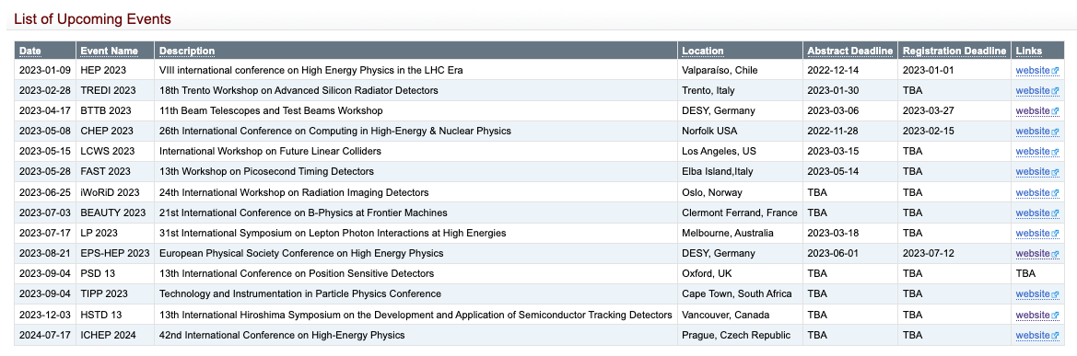
Conference
https://twiki.cern.ch/twiki/bin/view/CLIC/UpcomingConferences

Slide 8
Publication plan
Taichu2 Laser test (NIMA): submitted
DESY Test beam 1st paper: submission date: Early March (!!!)
Paper about prototype testbeam : before May 15th (!!!)
Electronics for ladder and prototype (JINST): (should published before Sep 30th )
Paper about the prototype : (should published before Sep 30th )
Paper of TaichuPix3: (should published before Sep 30th )
Document about irradiation hardness: Before May (!!!)
Final report (结题科技报告）(Before May). (!!!)

