Slide 1
CEPC Collider ring lattice design
Yiwei Wang
for the CEPC Accelerator Physics Group
The Institute of High Energy Physics, Chinese Academy of Sciences
The 2023 CEPC MDI workshop
30 March-1 April 2023, USC, Hengyang

Slide 2
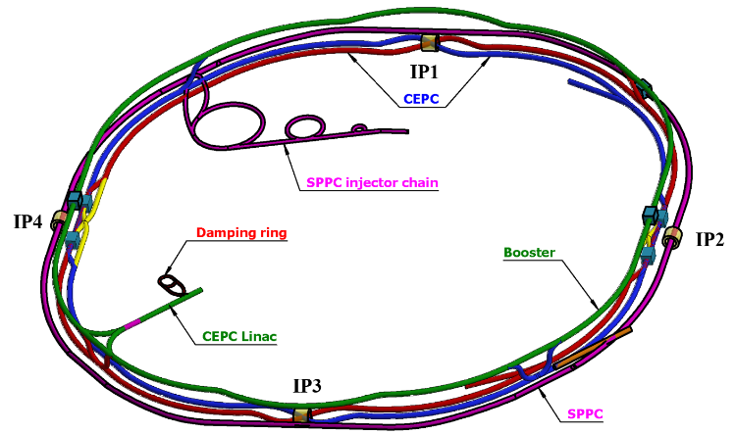
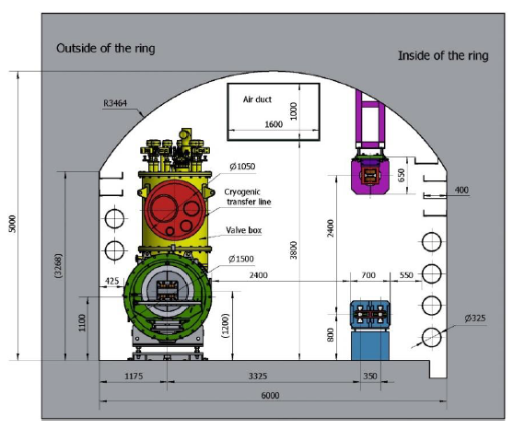
Overall design requirement of the CEPC collider ring
SR power per beam 30 MW (50 MW upgradable), 100 km, 2 interaction points
Compatible modes for H/Z/W/$t\overline{t}$runnig: provide high quality beam energy from 45.5 to 180 GeV
Compatible with SPPC: two machines share the most tunnels except the IP1-IP4
CEPC+SPPC complex
Tunnel in the arc regions
CEPC detectors

Slide 3
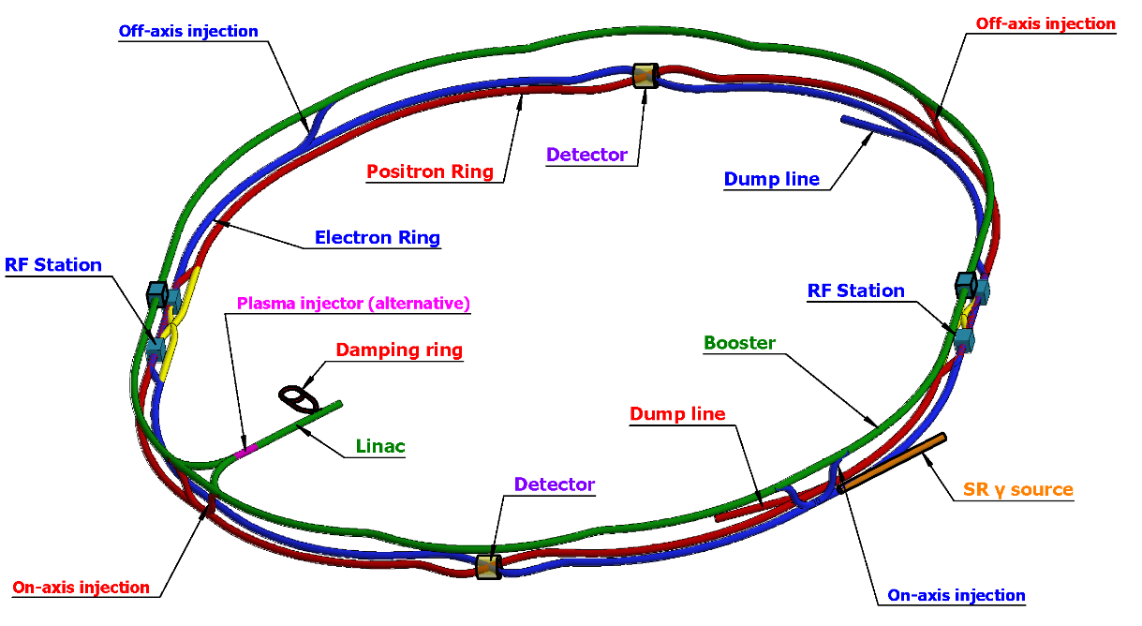
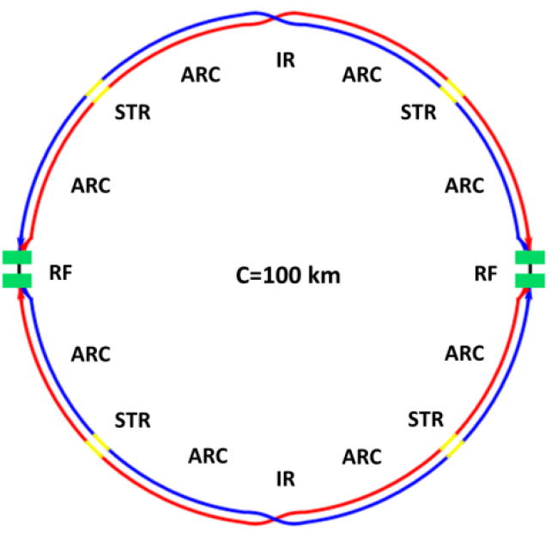
Lattice design of the CEPC collider ring
CEPC complex
Basically 2 folded symmetry
8 arc sections
dual aperture dipole and quadrupole magnets
non-interleaved sextupoles
4 short straight section
on/off axis injection regions for different modes
beam dumping
2 interaction regions
crab waist collision
local chromaticity correction for the interaction region
asymmetric interaction region
2 RF acceleration regions
shared cavities for two beam @ ttbar, Higgs
flexible switching between compatible modes
Correction of sawtooth orbit
CEPC collider layout
*ref: CEPC-CDR; CEPC pre-CDR; K. Oide, arXiv:1610.07170; M. Zobov et al, Phys. Rev. Lett. 104, 174801(2010); A. Milanese, PRAB 19, 112401 (2016);

Slide 4
Machine parameters of CEPC
 | Higgs | Z | W | $$t\overline{t}$$
Number of IPs | 2
Circumference (km) | 100.0
SR power per beam (MW) | 30
Half crossing angle at IP (mrad) | 16.5
Bending radius (km) | 10.7
Energy (GeV) | 120 | 45.5 | 80 | 180
Energy loss per turn (GeV) | 1.8 | 0.037 | 0.357 | 9.1
Damping time τ_{x}/τ_{y}/τ_{z} (ms) | 44.6/44.6/22.3 | 816/816/408 | 150/150/75 | 13.2/13.2/6.6
Piwinski angle | 4.88 | 24.23 | 5.98 | 1.23
Bunch number | 268 | 11934 | 1297 | 35
Bunch spacing (ns) | 591 (53% gap) | 23 (18% gap) | 257 | 4524 (53% gap)
Bunch population (10¹¹) | 1.3 | 1.4 | 1.35 | 2.0
Beam current (mA) | 16.7 | 803.5 | 84.1 | 3.3
Phase advance of arc FODO (°) | 90 | 60 | 60 | 90
Momentum compaction (10⁻⁵) | 0.71 | 1.43 | 1.43 | 0.71
Beta functions at IP β _{x}*/β _{y}* (m/mm) | 0.3/1 | 0.13/0.9 | 0.21/1 | 1.04/2.7
Emittance ε_{x}/ε_{y} (nm/pm) | 0.64/1.3 | 0.27/1.4 | 0.87/1.7 | 1.4/4.7
Betatron tune n_{x}/n_{y} | 445/445 | 266/267 | 266/266 | 445/445
Beam size at IP s_{x} /s_{y} (um/nm) | 14/36 | 6/35 | 13/42 | 39/113
Bunch length (natural/total) (mm) | 2.3/4.1 | 2.5/8.7 | 2.5/4.9 | 2.2/2.9
Energy spread (natural/total) (%) | 0.10/0.17 | 0.04/0.13 | 0.07/0.14 | 0.15/0.20
Energy acceptance (DA/RF) (%) | 1.6/2.2 | 1.3/1.7 | 1.2/2.5 | 2.0/2.6
Beam-beam parameters x_{x} /x_{y} | 0.015/0.11 | 0.004/0.127 | 0.012/0.113 | 0.071/0.1
RF voltage (GV) | 2.2 | 0.12 | 0.7 | 10
RF frequency (MHz) | 650
Longitudinal tune n_{s} | 0.049 | 0.035 | 0.062 | 0.078
Beam lifetime (Bhabha/beamstrahlung) (min) | 39/40 | 80/18000 | 60/700 | 81/23
Beam lifetime (min) | 20 | 80 | 55 | 18
Hourglass Factor | 0.9 | 0.97 | 0.9 | 0.89
Luminosity per IP (10³⁴ cm^{–2} s^{–1}) | 5.0 | 115 | 16 | 0.5
*CEPC AP group, TDR draft ch 4.1

Slide 5
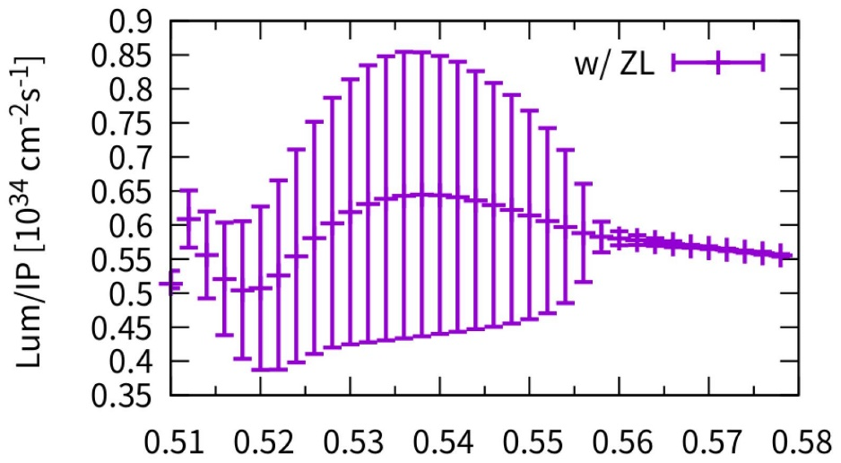
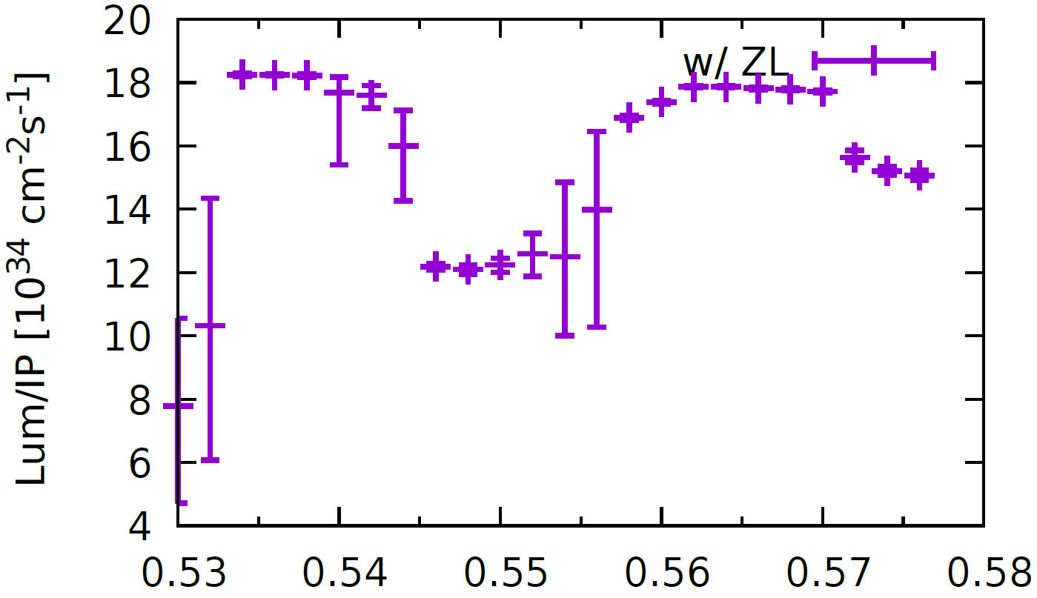
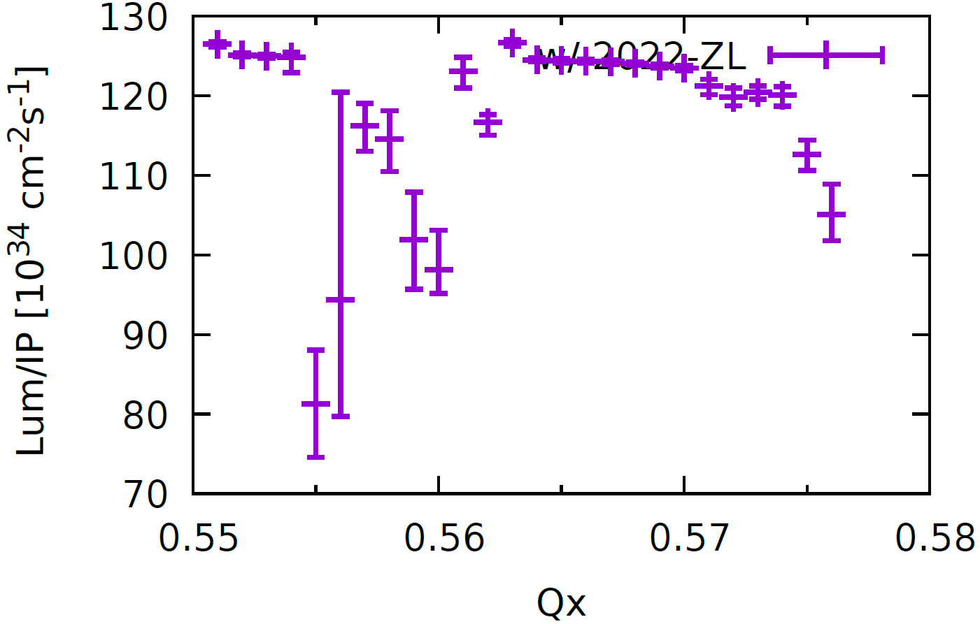
CEPC TDR luminosity checked by
beam-beam simulations
Y. Zhang
ttbar
Higgs
Qx
Qx
ttbar: 0.55* 10^34/cm^2/s (BB Simulation)
0.5*10^34/cm^2/s (Parameter table)
Higgs : 5*10^34/cm^2/s (BB Simulation)
5*10^34/cm^2/s (Parameter table)
W
Z
Qx
Qx
W-pole : 18*10^34/cm^2/s (BB Simulation)
16*10^34/cm^2/s (Parameter table)
Z-pole : 125*10^34/cm^2/s (BB Simulation)
115*10^34/cm^2/s (Parameter table)

Slide 6
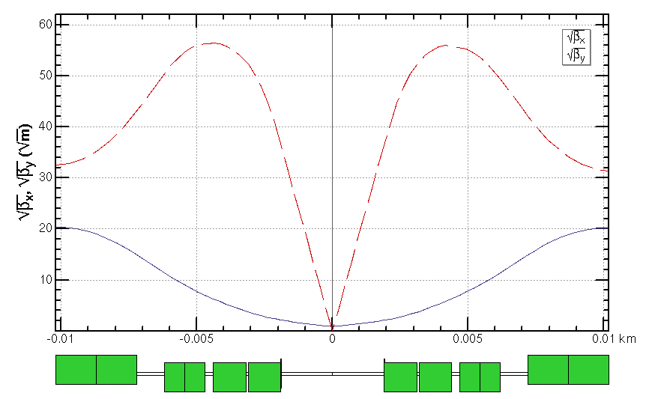
Interaction region for all modes
Crab waist collision, local chromaticity correction, asymmetric interaction region
Quadrupole | L [m] | Distance from IP [m] | Strength [T/m]
 |  |  | $$t\overline{t}$$ | Higgs | W | Z
Q1AIRU | 1.21 | 1.9 | -141 | -141 | -94 | -110
Q1BIRU | 1.21 | 3.19 | -59 | -85 | -56 | +65
Q2IRU | 1.5 | 4.7 | -51 | +95 | +63 | 0
Q3IRU | 3 | 7.2 | +40 | 0 | 0 | +2
Q1AIRD | 1.21 | -1.9 | -142 | -142 | -95 | -110
Q1BIRD | 1.21 | -3.19 | -64 | -85 | -57 | +65
Q2IRD | 1.5 | -4.7 | -47 | +96 | +64 | 0
Q3IRD | 3 | -7.2 | +40 | 0 | 0 | +2
ttbar
Strength of other modes doesn’t exceeded the one of Higgs mode.
Q3BIRU
Q3AIRU
Q2IRU
Q1BIRU
Q1AIRU
Q1AIRD
Q1BIRD
Q2IRD
Q3AIRD
Q3BIRD
 | QD | QF
Z | Q1A | Q1B
W/H | Q1A+Q1B | Q2
ttbar | Q1A+Q1B+Q2 | add quad Q3A and Q3B
 | L* [m] | LQ1 [m] | LQ2 [m] | GQ1 [T/m] | GQ2 [T/m] | d [m]
CDR | 2.2 | 2.0 | 1.5 | -136 | 111 | 0.3
TDR | 1.9 | 1.22/ 1.22 | 1.5 | -141/ -85 | +95 | 0.3
*ref: Y. Cai, IAS2016, HKUST; K. Oide, arXiv:1610.07170;
P. Raimondi, Proc. of the 2nd SuperB Workshop, Frascati, March 2006；M. Zobov et al, Phys. Rev. Lett. 104, 174801(2010);

Slide 7
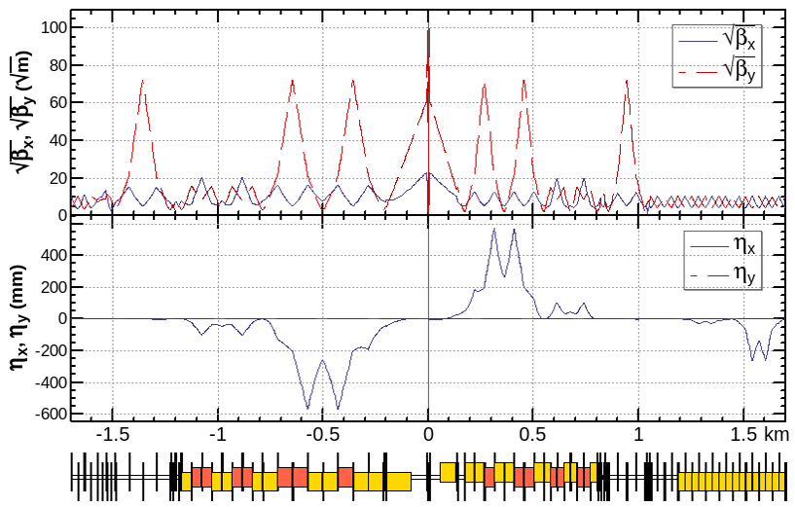
Interaction region for all modes (cont.)
Crab waist collision, local chromaticity correction, asymmetric interaction region
Quadrupole | L [m] | Distance from IP [m] | Strength [T/m]
 |  |  | $$t\overline{t}$$ | Higgs | W | Z
Q1AIRU | 1.21 | 1.9 | -141 | -141 | -94 | -110
Q1BIRU | 1.21 | 3.19 | -59 | -85 | -56 | +65
Q2IRU | 1.5 | 4.7 | -51 | +95 | +63 | 0
Q3IRU | 3 | 7.2 | +40 | 0 | 0 | +2
Q1AIRD | 1.21 | -1.9 | -142 | -142 | -95 | -110
Q1BIRD | 1.21 | -3.19 | -64 | -85 | -57 | +65
Q2IRD | 1.5 | -4.7 | -47 | +96 | +64 | 0
Q3IRD | 3 | -7.2 | +40 | 0 | 0 | +2
CW
CCX
CCY
FT
ttbar
beam
a pair of chromatic sextupoles in CCY
Strength of other modes doesn’t exceeded the one of Higgs mode.
Q3BIRU
Q3AIRU
Q2IRU
Q1BIRU
Q1AIRU
Q1AIRD
Q1BIRD
Q2IRD
Q3AIRD
Q3BIRD
 | QD | QF
Z | Q1A | Q1B
W/H | Q1A+Q1B | Q2
ttbar | Q1A+Q1B+Q2 | add quad Q3A and Q3B
 | L* [m] | LQ1 [m] | LQ2 [m] | GQ1 [T/m] | GQ2 [T/m] | d [m]
CDR | 2.2 | 2.0 | 1.5 | -136 | 111 | 0.3
TDR | 1.9 | 1.22/ 1.22 | 1.5 | -141/ -85 | +95 | 0.3
*ref: Y. Cai, IAS2016, HKUST; K. Oide, arXiv:1610.07170;
P. Raimondi, Proc. of the 2nd SuperB Workshop, Frascati, March 2006；M. Zobov et al, Phys. Rev. Lett. 104, 174801(2010);

Slide 8
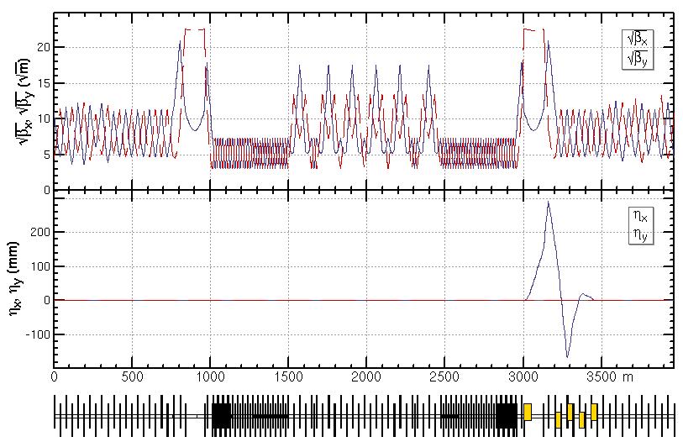
CEPC TDR RF Layout
Jiyuan Zhai, Yiwei Wang
Stage 1
H/W/LL
-
Z (and HL
-
1st priority of the Higgs running and flexible switching
Low cost at early stage
Get high luminosity for all modes
：
H/W upgrade)
Outer Ring
H
H
Inner Ring
Stage 2
HL
-
H/W/Z (HL
-
：
Z upgrade)
Stage 1 (H/W run)
Layout and parameters are same with CDR except longer central part
Medium or low luminosity at Z
Stage 2 (HL-Z upgrade)
Move Higgs cavities to center and add high current Z cavities.
By-pass low current H cavities.
Stage 3(ttbar upgrade)：
Add ttbar cavities (low current, high gradient, high Q)
Nb3Sn@4.2 K or others to significant reducing the cost of cryo-system and AC power.
Outer Ring
Z
H
H
Z
Inner Ring
Stage 3
HL
-
H/W/Z/ttbar (ttbar
-
：
upgrade)
Outer Ring
Z
H
ttbar
H
Z
Inner Ring
H
Z
ttbar
650 MHz 2
-
cell cavity
650 MHz 5
-
650 MHz 1
cell cavity
-
6 cavities in 1 CM
cell cavity
4 cavities in 1 CM
1 cavity in 1 CM
Peak luminosity at different stages with SR power up to 50MW/beam
Lumi/IP[10^34/cm^2/s] | Higgs | Z | W | ttbar
Stage 1 | 8.3 | 38(10MW limit) | 26.7 | -
Stage 2 | 8.3 | 192 | 26.7 | -
Stage 3 | 8.3 | 192 | 26.7 | 0.83

Slide 9
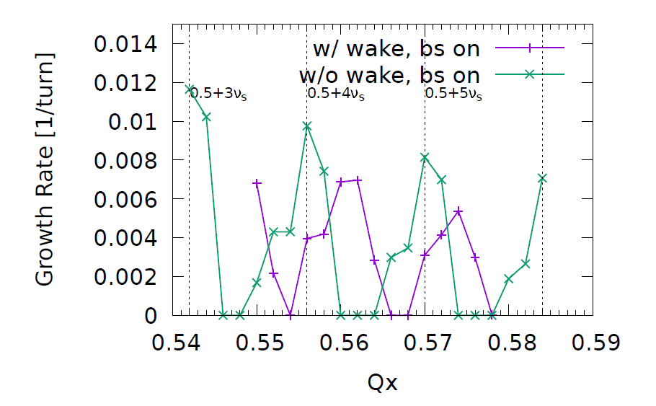
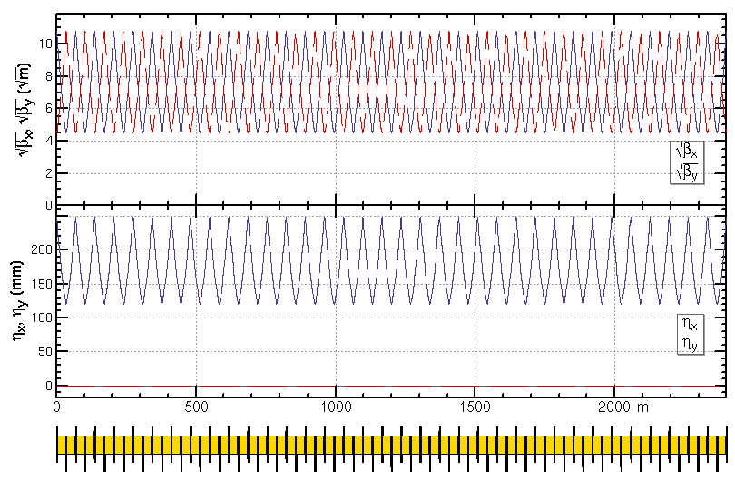
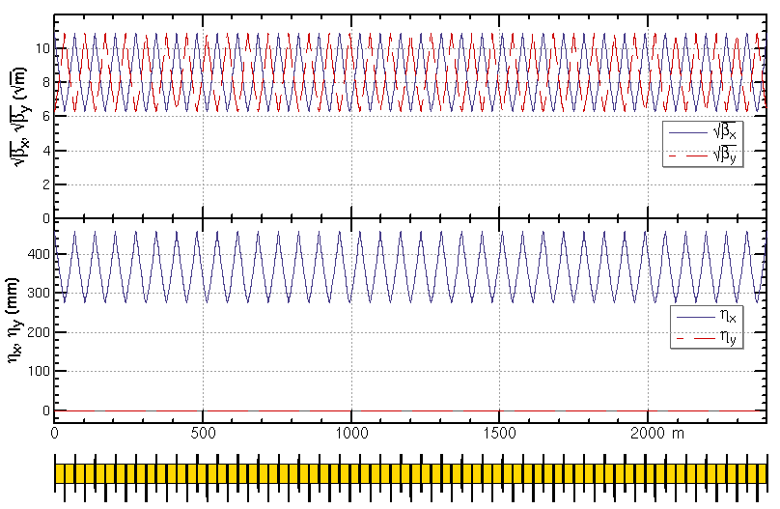
ARC region for all modes
Z and W modes need larger momentum compaction factor αp and thus larger emittance εx, Qs
To suppress the impedance induced instability at Z mode
To increase stable tune area if considering beam-beam effect and impedance consistently at W and Z modes
Microwave instability
stable tune area with both beam-beam and impedance (Z mode 90/90)
Na Wang,
CEPC Day, March 2020
Yuan Zhang
Phase advance reduced from 90° to 60° for W and Z modes
H/ttbar mode 90°/ 90°
W/Z mode 60°/ 60°

Slide 10
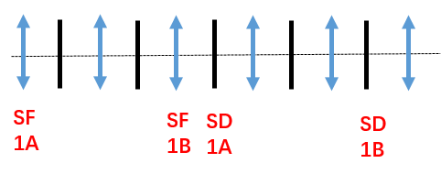
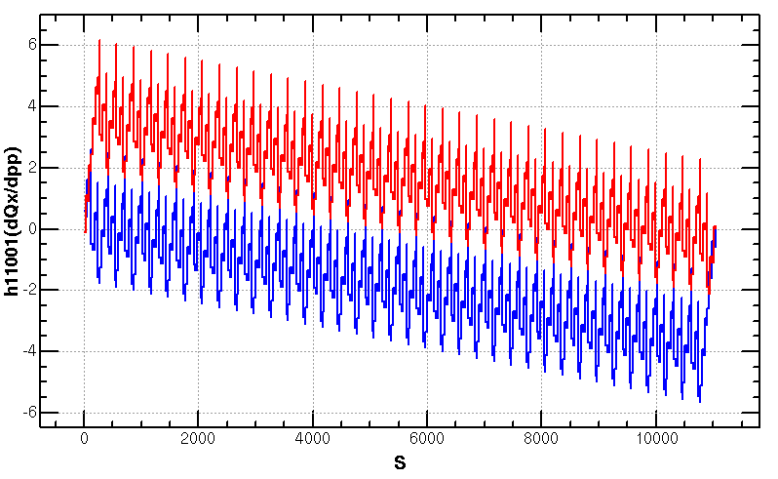
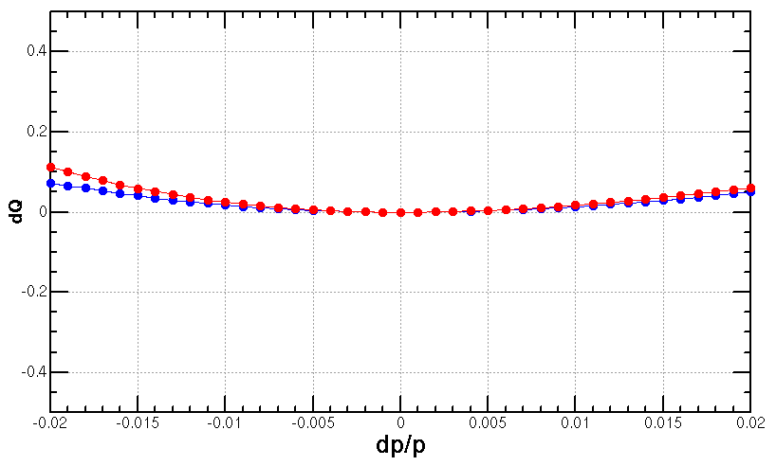
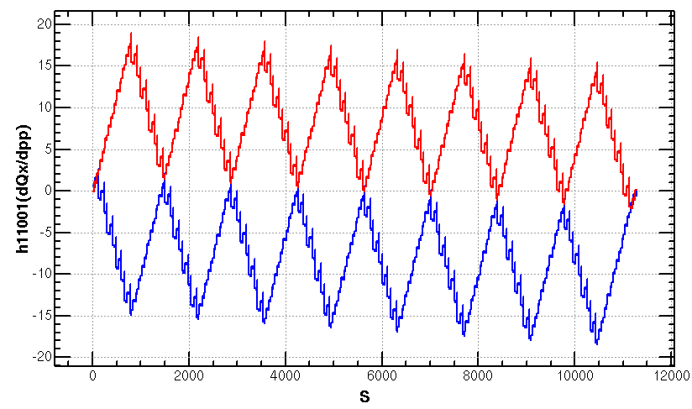
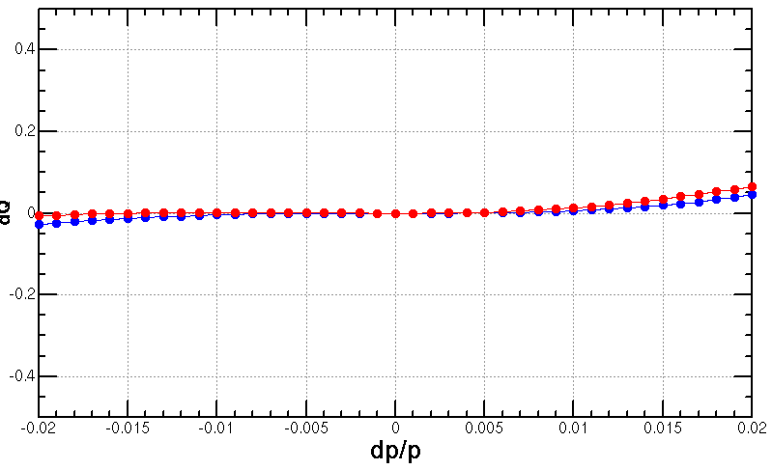
Optimization of ARC aberration for Higgs/ttbar modes
2nd order chromaticity is a main aberration for the optimization of momentum acceptance with one –I sextupole pair scheme.
In previous versions, 2nd order chromaticity generated in the ARC region are corrected with IR knobs (phase advance or K1).
However, the IR knobs will generate distortions at IP (beta, alfa and dispersion) especially for the horizontal plane.
A lattice with four –I sextupole pairs scheme for Higgs & ttbar modes
much less 2nd order chromaticity for the horizontal plane
Scheme with one –I sextupole pair
Proposed by K. Oide
Q’’=313, 410
Q’’=9, 145
Scheme with four –I sextupole pairs
Proposed by Tianjian Bian

Slide 11
Optimization of ARC aberration for
W/Z modes
The distribution of sextupoles for Higgs & ttbar mode allowed to select –I sextupole pairs for W &Z mode.
6*6=36 cases for 23 cells
There are much more combinations if choose different cases in each arc section (184 cells)
SF
1A
SF
1B
SF
2A
SF
2B
SF3A
SF
3B
SF
4A
SF
4B
SD
1A
SD
1B
SD
2A
SD
2B
SD3A
SD
3B
SD
4A
SD
4B
-I
-I
-I
-I
2nd and 3rd order dQ@dp/p=1% in x, y
@ dp/p=1%
1st pair | 2nd pair
(1A, 2A) | (2B,3B) | (3A,4A) | (3B,4B)
(1B, 2B) | - | (3A,4A) | (3B,4B)
(2A, 3A) | - | - | (3B,4B)

Slide 12
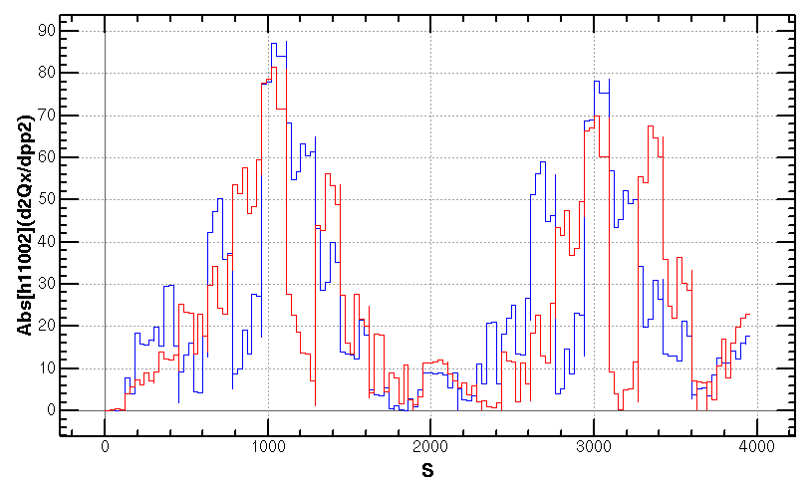
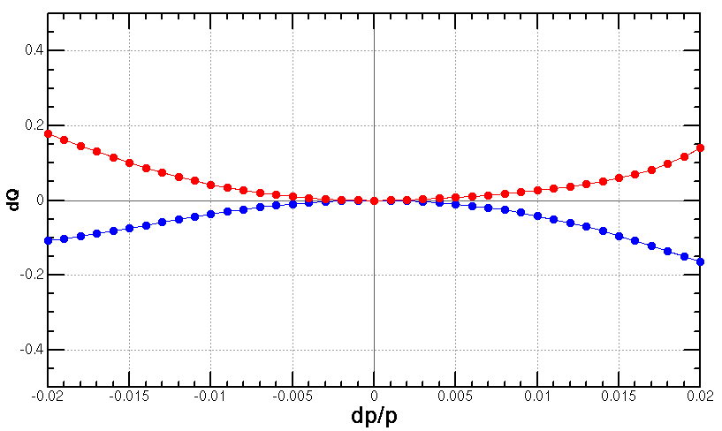
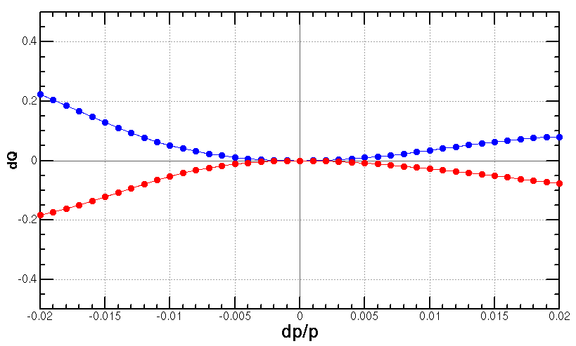
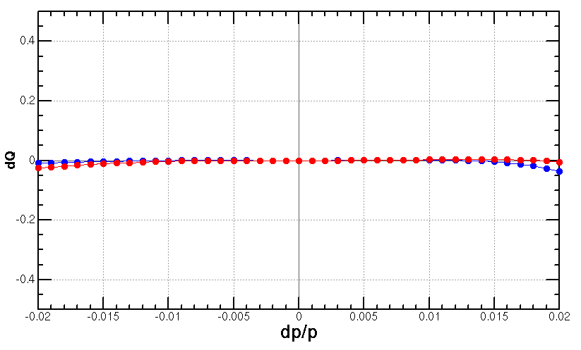
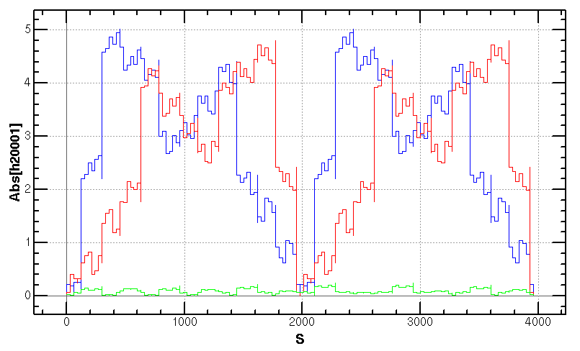
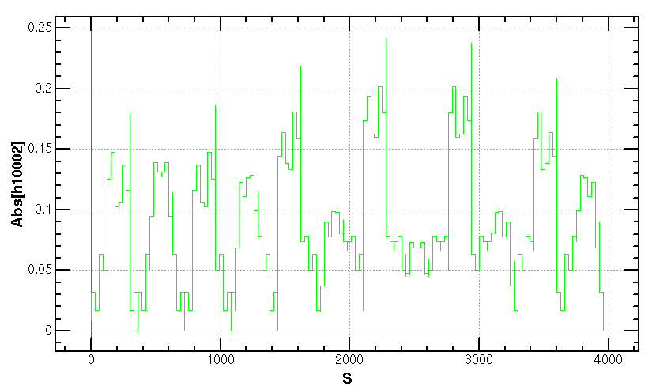
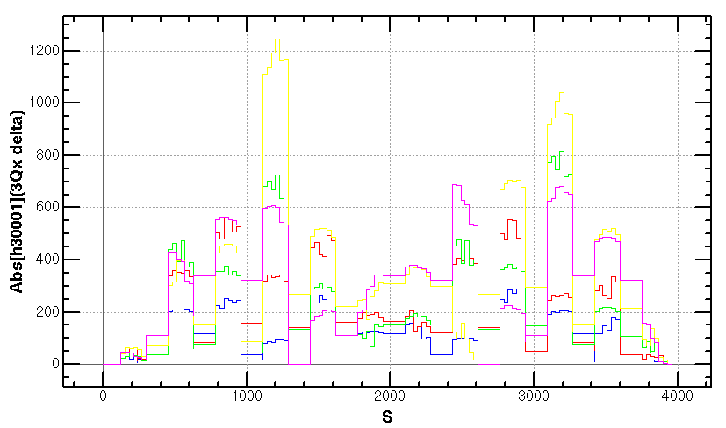
Optimization of ARC aberration for
W/Z modes (cont.)
Cancellation of main aberration has period of 23*3 cells.
case {4,3}
case {3,4}
case {4,3}+{3,4}
+

Slide 13
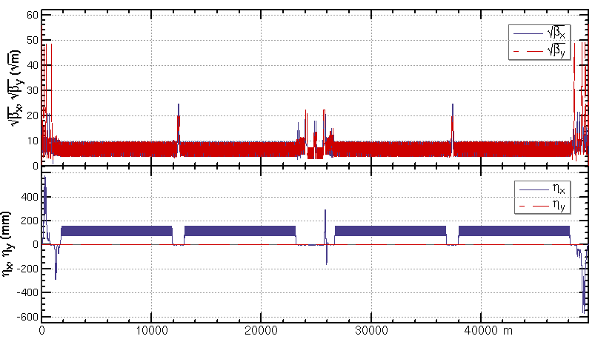
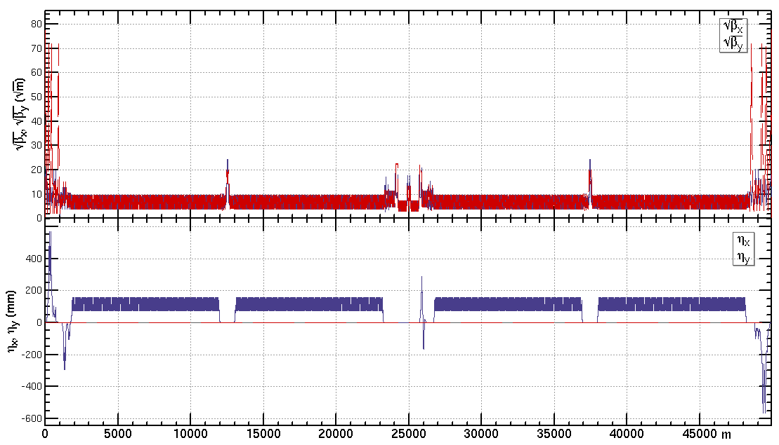
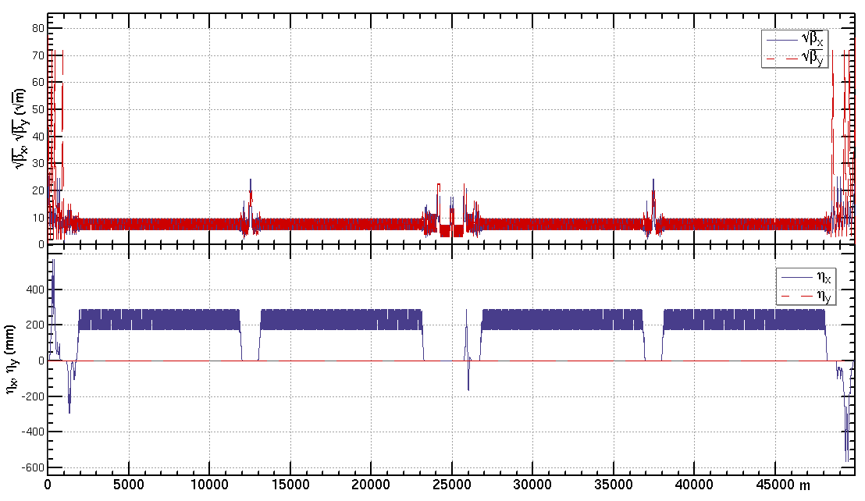
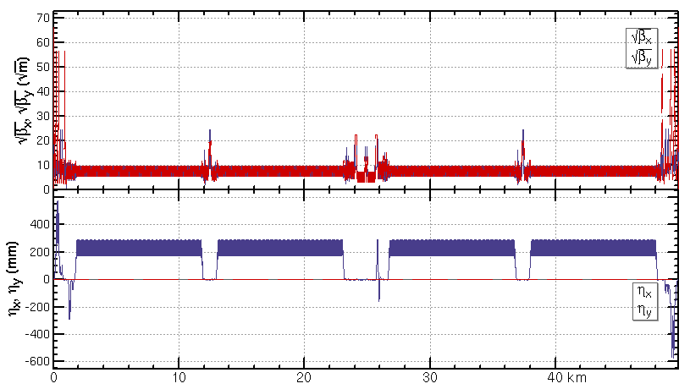
Lattice design of the CEPC half ring
ttbar: εx=1.4nm, β=1.04m/2.7mm
Higgs: εx=0.64nm, β=0.30m/1mm
W: εx=0.87nm, β=0.21m/1mm
Z: εx=0.27nm, β=0.13m/0.9mm

Slide 14
Dynamic aperture requirement
by Y. Zhang, X. H. Cui, Y. W. Wang
 | ttbar | Higgs | W | Z
Horizontal Emittance in collider/booster [nm] | $1.4$ / 2.83 | $0.64$/ 1.26 | $0.87$/ 0.56 | $0.27$ / 0.19
DA requirement from injection | $${\text{13.9} σ}_{x}×7 σ_{y}$$ off axis | $$14.4{ σ}_{x}×7{ σ}_{y}$$ off axis $$7{ σ}_{x}×7 σ_{y}$$ on axis | $${\text{10.5} σ}_{x}×5 σ_{y}$$ off axis | $${\text{11.8} σ}_{x}×5{ σ}_{y}$$ off axis
Beam lifetime (mainly bhabha and beamstrahlung) [min] | 18 | 20 | 55 | 80
Energy acceptance requirement from beam lifetime [%] | 2.0 | 1.6 | 1.2 | 1.3
DA requirement | ttbar | Higgs | W | Z
with on-axis injection | - | ${\text{7}σ}_{x}×15σ_{y}×$1.6% | - | -
with off-axis injection | ${\text{13.9}σ}_{x}×{20σ}_{y}×$2.0% | ${\text{14.4}σ}_{x}×15σ_{y}×$1.6% | ${\text{1}\text{0.5}σ}_{x}×9σ_{y}×$1.2% | ${\text{1}\text{1.8}σ}_{x}×9σ_{y}×$1.3%

Slide 15
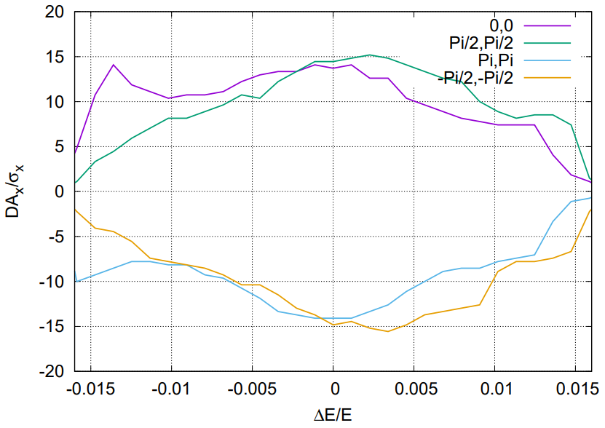
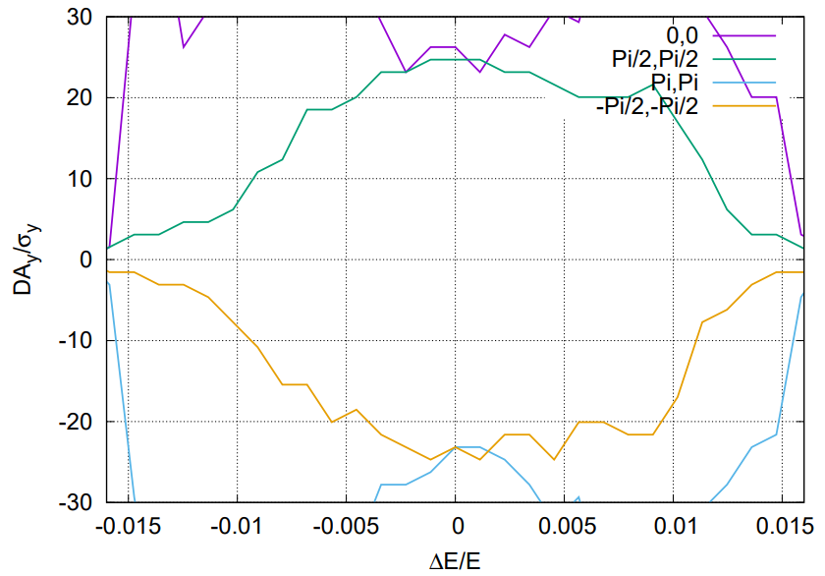
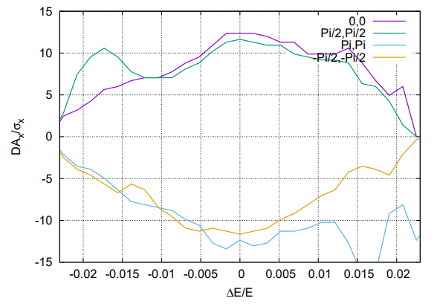
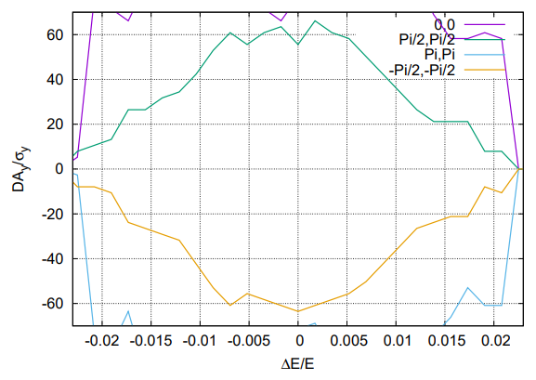
Dynamic aperture @ Higgs and ttbar
Tracking to get DA without errors, with turns for one transvers damping time, with 4 initial phases
DA optimized with 84 variables (64 arc sextupoles + 8 IR sextupoles + 4 multipoles + 8 phase advance)
Effects included in tracking
Synchrotron motion
Radiation loss in all magnets
Tapering
Crab waist sextupole
Maxwellian fringes
Kinematic terms
Finite length of sextupole
Higgs
1.6 %
1.6 %
ttbar
2.3 %
2.3 %

Slide 16
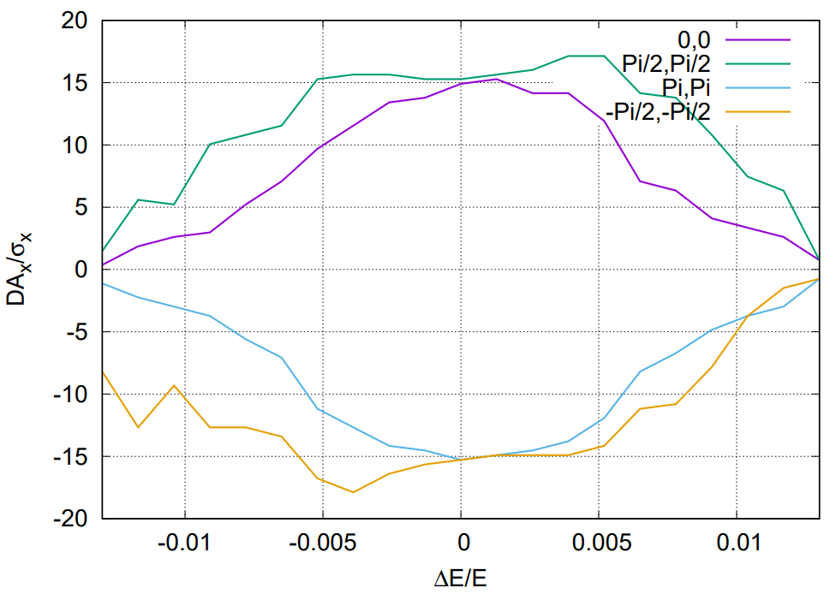
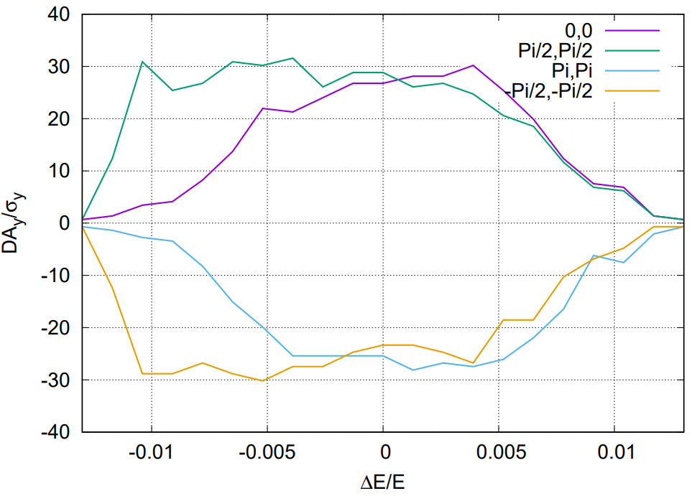
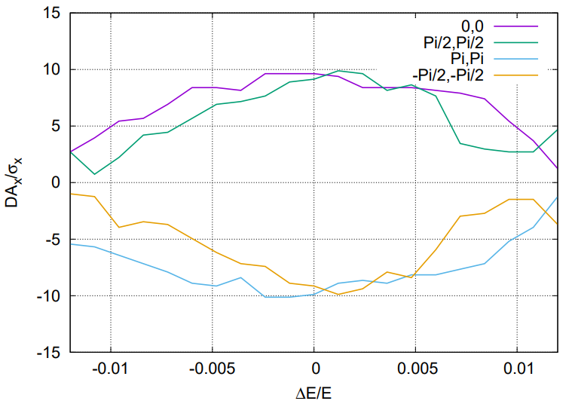
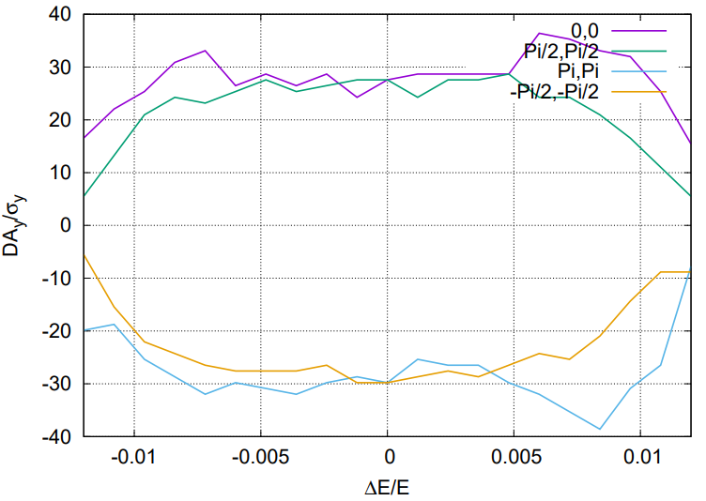
Dynamic aperture @ Z and W
Tracking to get DA without errors, with turns for one transvers damping time, with 4 initial phases
DA optimized with 116 variables (96 arc sextupole families + 8 IR sextupoles + 4 multipoles + 8 phase advance)
Effects included in tracking
Synchrotron motion
Radiation loss in all magnets
Tapering
Crab waist sextupole
Maxwellian fringes
Kinematic terms
Finite length of sextupole
1.3 %
1.3 %
Z
W
1.2 %
1.2 %
Notes:
Though the current injection schemes for W and Z modes are both transverse injection, it’s worthy to further improve the momentum acceptance for exploring the longitudinal injection scheme and leaving more margins for the error effects. The dynamic aperture at the W and Z energies has been optimized with 116 variables (96 arc sextupole families + 8 IR sextupoles + 4 multipoles + 8 phase advance). The current momentum acceptance of W and Z energies achieved 1.2% and 1.3% respectively which fulfill the requirement from the beam-beam effect and injection, shown in the following figure. Further optimization with 160 more arc families is undergoing to increase the on-momentum dynamic aperture.

Slide 17
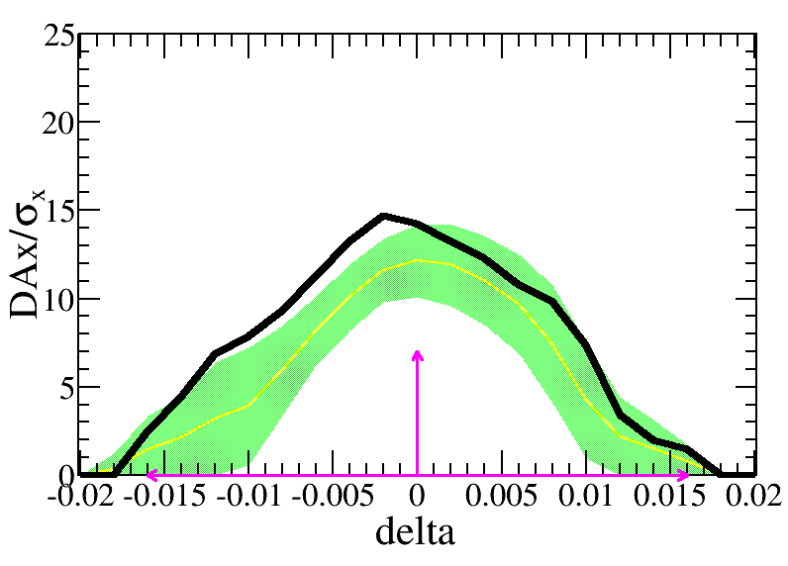
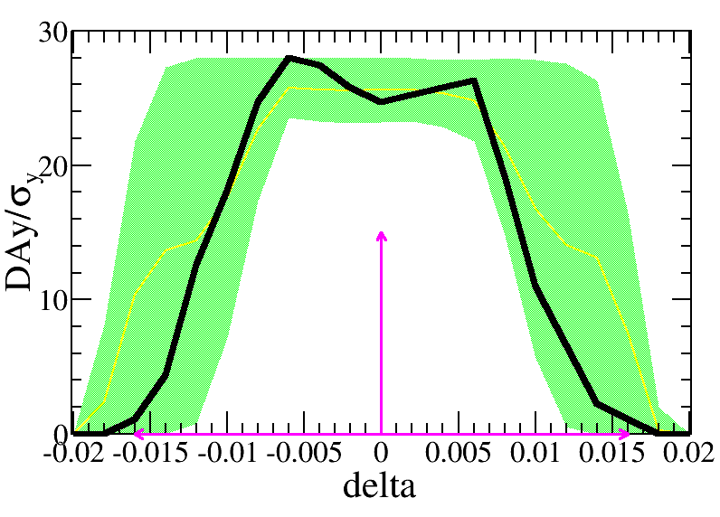
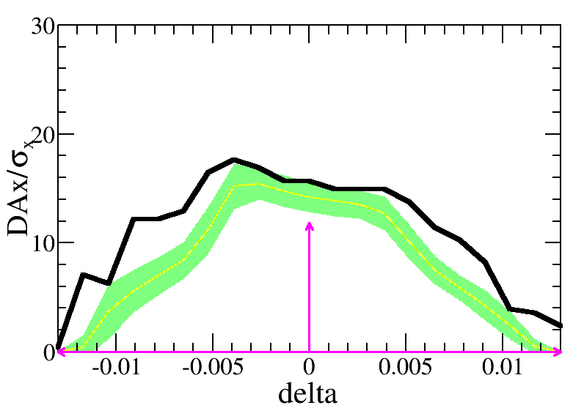
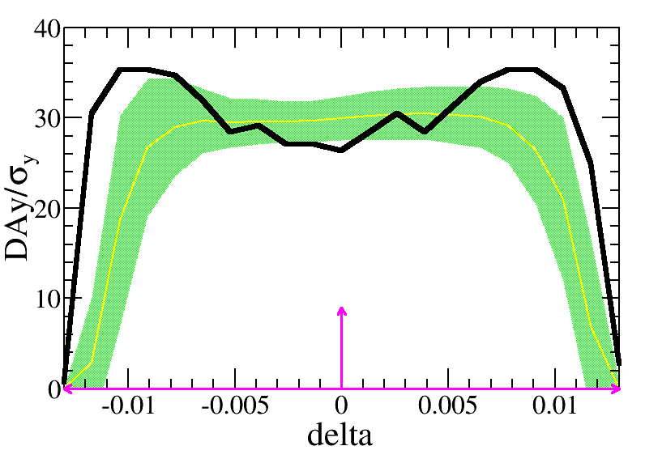
Dynamic aperture with errors @ Higgs
Bin Wang,
Yuanyuan Wei,
Yiwei Wang
Component | Δx (mm) | Δy (mm) | Δθ_{z} (mrad) | Field error
Dipole | 0.10 | 0.10 | 0.10 | 0.01%
Arc Quadrupole | 0.10 | 0.10 | 0.10 | 0.02%
IR Quadrupole | 0.10 | 0.10 | 0.10 | 0.02%
Sextupole | 0.10* | 0.10* | 0.10
*reduced to 10 um by turn on sextupole gradually or movers
w/o misalignment of the girder, main field errors of the sextupole
Effects included in tracking
Synchrotron motion
Radiation loss in all magnets
Tapering
Crab waist sextupole
Maxwellian fringes
Kinematic terms
Finite length of sextupole
—DA w/o error
—mean value
—statistic errors
—requirement
Higgs
Z
1000 and 500 lattices with errors are corrected for Higgs and Z respectively.
The DA with error correction are tracked and satisfy the on-axis injection requirement for Higgs and off-axis injection requirement for Z.

Slide 18
Summary
The lattice of CEPC collider ring was designed with luminosity goal 5e34/cm^2/s/IP @ Higgs with 30 MW/beam.
RF region: 1st priority of the Higgs running and flexible switching
ARC: New aberration correction scheme in ARC region. The distribution of sextupoles for Higgs & ttbar modes (90 deg cell) allowed to select –I sextupole pairs for W &Z modes (60 deg cell) .
IR: Crab waist collision, local chromaticity correction, asymmetric interaction region
Dynamic aperture w/o error for four modes achieve the requirement of energy acceptance.
Dynamic aperture w/ main errors for Higgs and Z modes achieve the requirements.

Slide 19
backup

Slide 20
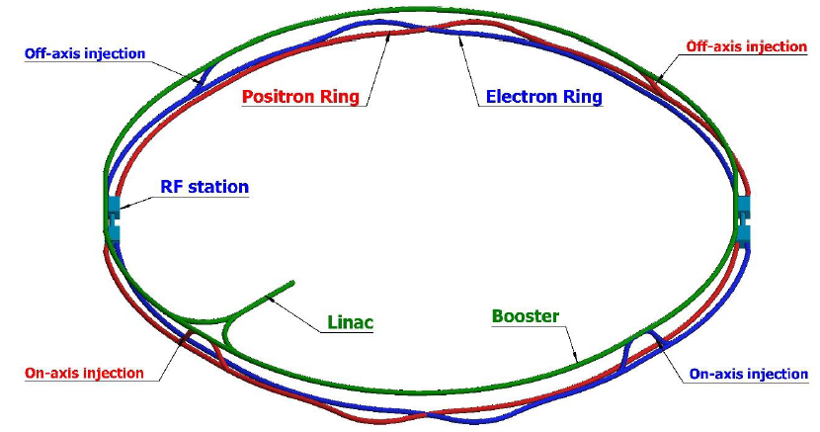
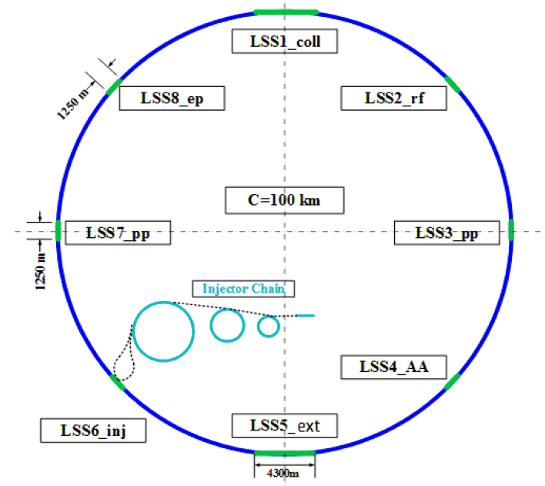
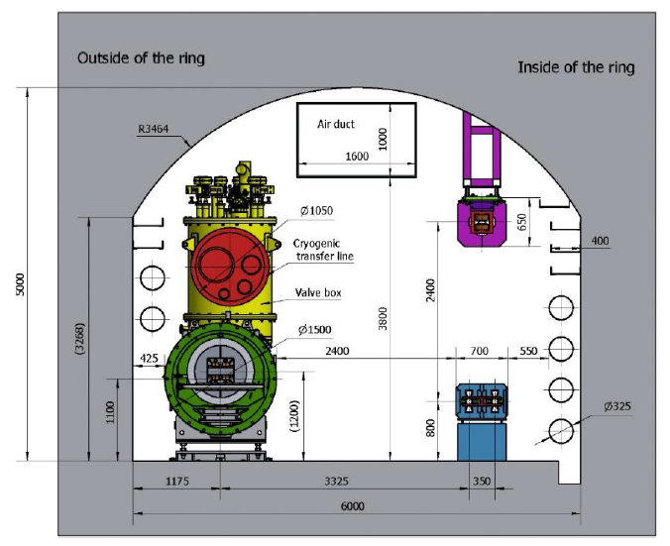
Location of the dumping system
Dumping system for collider ring
Seems not necessary to be close to IP
Active machine protection for the beam loss with time larger than multi turns
Located at STR1 and STR2 or STR2 and STR3
At least one dump for each collider ring
STR4 for future option of ep collision
Inner side of tunnel
SPPC will locates outer side of CEPC
Maintenance of the dump
Dumping system for booster ring
Low charge bunches can be dumped by collimator
Dumping for bunches of on axis injection can share the dump with collider ring
STR4
STR1
STR3
STR2

