Slide 1


CEPC MDI
Sha Bai
On behalf of CEPC MDI group
The 2022 CEPC MDI Workshop
University of South China, Hengyang, Hunan
March 30 ~ April 1, 2023

Slide 2
Outline
Introduction
Map of MDI study
SC magnet
IR beam pipe structure
Background estimation
Mitigation design efforts
  Masks
  Collimators
  Shielding
Thermal Analysis
  HOM heating
  Synchrotron radiation
  Beam loss backgrounds
  Beam pipe thermal analysis
IP BPM
Cryostat and Support
Luminosity monitoring
Summary

Slide 3
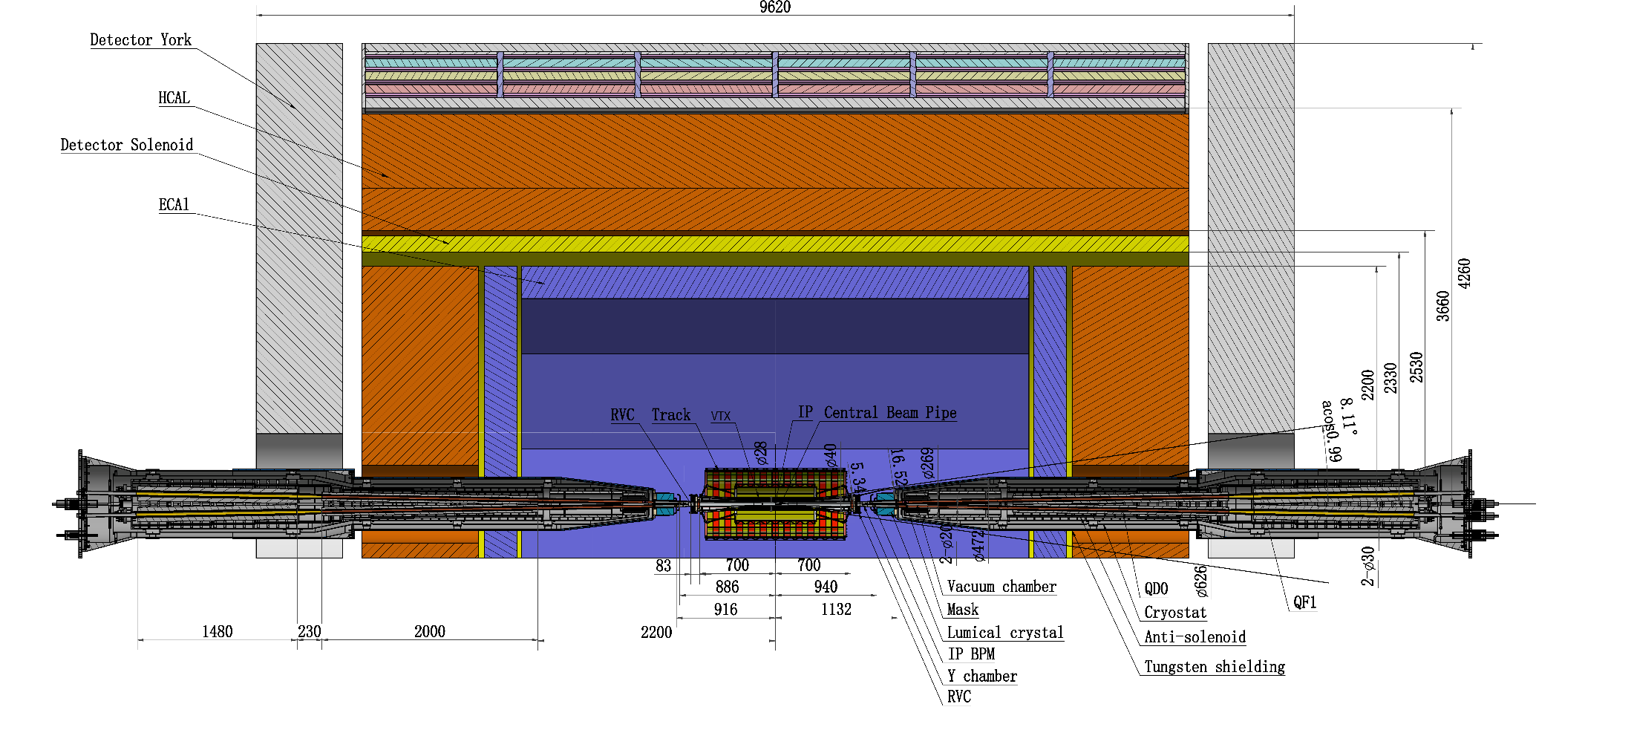
MDI layout and IR design
The Machine Detector Interface (MDI) of CEPC double ring scheme is about ±7m long from the IP.
The CEPC detector superconducting solenoid with 3T magnetic field（2T in Z）and the length of 7.3m.
The accelerator components inside the detector without shielding are within a conical space with an opening angle of cosθ=0.993. Detective angle: acos0.99
The e+e- beams collide at the IP with a horizontal angle of 33mrad and the final focusing length is to 1.9m.

Slide 4
Detector Designs

Slide 5
Map of MDI study
Accelerator
HOM
IR vacuum chamber
SC Magnet
Anti-solenoid
Cryostat
IP BPM
Shielding
Assembly&Supporting
Collimators
SR masks
Luminosity monitoring
IP Feedback
Cooling
Control
Detector
Central Beam Pipe
Vertex Detector
Lumical
Silicon Tracker
TPC
Hcal
Ecal
Solenoid
Yoke
Muon Detector
Hall
BG simulation&Shielding
Cryogenics
Radiation Protection

Slide 6
MDI parameters
 | range | Peak field in coil | Central field gradient | Bending angle | length | Beam stay clear region | Minimal distance between two aperture | Inner diameter of beam pipe | Outer diameter of beam pipe | Critical energy (Horizontal) | Critical energy (Vertical) | SR power (Horizontal) | SR power (Vertical)
L* | 0~1.9m |  |  |  | 1.9m
Crossing angle | 33mrad
MDI length | ±7m
Detector requirement of accelerator components in opening angle | 8.11˚
QDa/QDb |  | 3.5/2.8T | 142/85T/m |  | 1.21m | 14.9/18.2mm | 62.71/105.28mm | 20/23mm | 26/29mm | 724.7/663.1keV | 396.3/263keV | 212.2/239.23W | 99.9/42.8W
QF1 |  | 3.3T | 96.7T/m |  | 1.5m | 24.48mm | 155.11mm | 32mm | 38mm | 675.2keV | 499.4keV | 472.9W | 135.1W
Lumical | 0.95~1.11m |  |  |  | 0.16m
Anti-solenoid before QD0 |  | 6.8T |  |  | 1.1m
Anti-solenoid QD0 |  | 3T |  |  | 2.5m
Anti-solenoid QF1 |  | 3T |  |  | 1.5m
Beryllium pipe |  |  |  |  | ±85mm |  |  | 20mm
Last B upstream | 64.97~153.5m |  |  | 0.77mrad | 88.5m |  |  |  |  | 33.3keV
First B downstream | 44.4~102m |  |  | 1.17mrad | 57.6m |  |  |  |  | 77.9keV
Beampipe within QDa/QDb |  |  |  |  | 1.21m |  |  |  |  |  |  | 1.19/1.31W
Beampipe within QF1 |  |  |  |  | 1.5m |  |  |  |  |  |  | 2.39W
Beampipe between QD0/QF1 |  |  |  |  | 0.3m |  |  |  |  |  |  | 26.5W

Slide 7
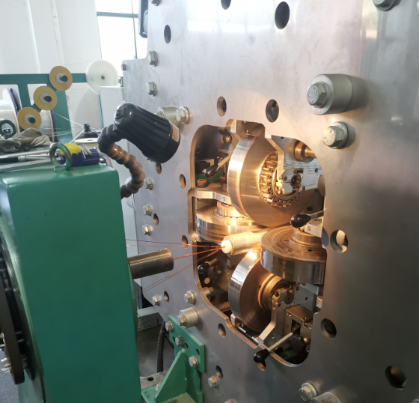
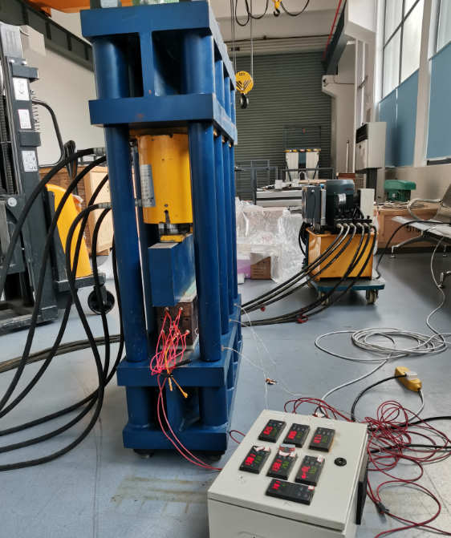
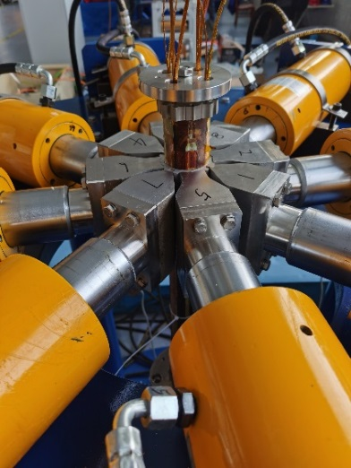
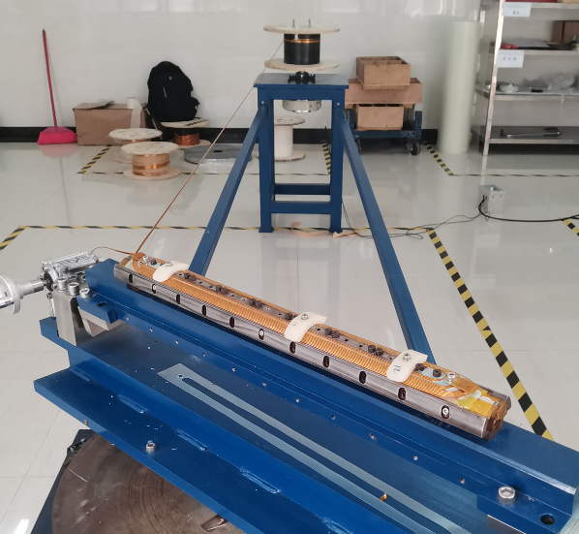
SC Magnet
Refer to Yingshun’s talk
QD locate at 1.9~4.4m from the IP, while QF locate at 4.7~6.2m from the IP.
To greatly squeeze the beam for high luminosity, compact high gradient final focus quadrupole magnets are required on both sides of IP points.
Magnet | Central field gradient (T/m) | Magnetic length (m) | Width of GFR (mm) | Outer diameter of beam pipe (mm) | Dipole field | Minimal distance between two aperture beam lines (mm)
Q1a | 142.3 | 1.21 | 14.92 | 26 or 28 | <30 Gs | 62.71
Q1b | 85.4 | 1.21 | 18.17 | 31 | <30 Gs | 105.28
Q2 | 96.7 | 1.5 | 24.48 | 40 | <30 Gs | 155.11
Research on main key technologies of 0.5m single aperture quadrupole model has started (NbTi, 136T/m), in collaboration with HeFei KEYE Company.
Progress: Manufacture of all hardware is completed.

Slide 8
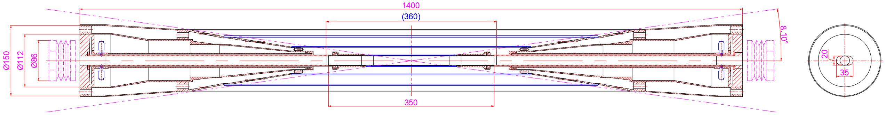
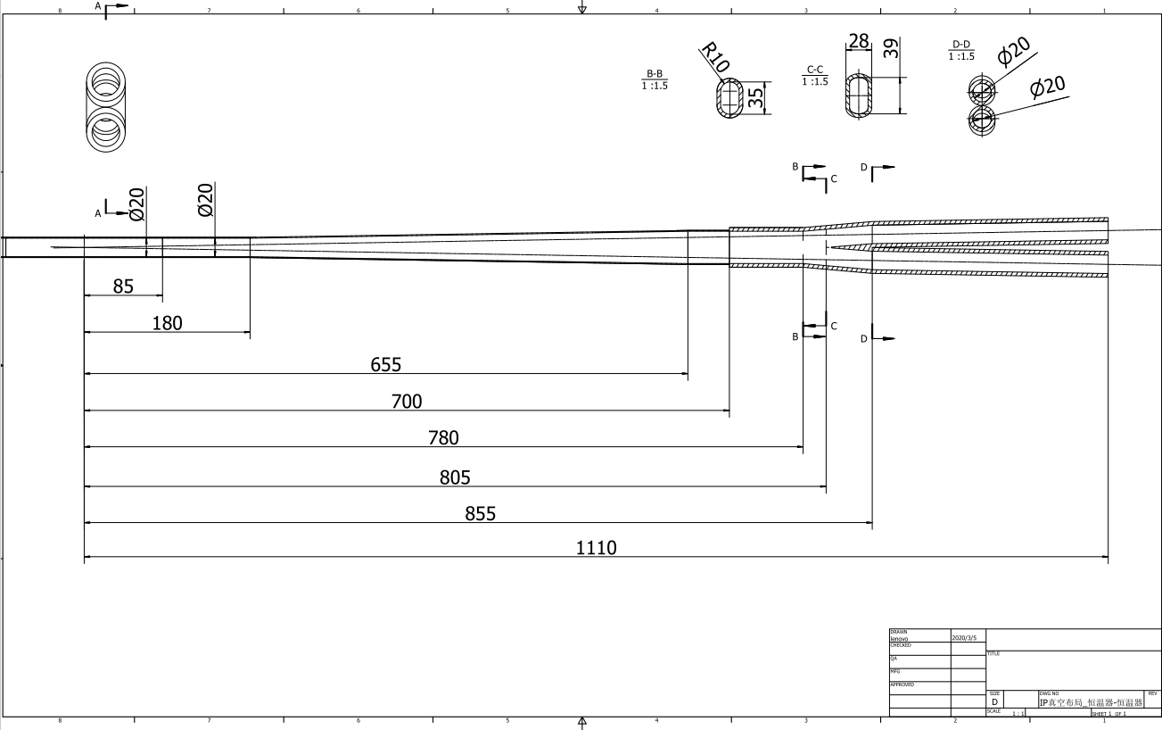
The central beampipe design
From IP(mm) | Shape | Inner diameter(mm) | Material | Marker
0-85 | Circular | 20 | Be
85~180 | Circular | 20 | Al
180~655 | Cone | 20~35 | Al | Taper: 1:70
655~700 | Circular | 35 | Al
700~780 | Circular | 35 | Cu
780~805 | Cone | 35~39 | Cu
805~855 | Race-track | 39~20 double pipe | Cu
Crotch point at 805mm，with slope，breeches pipe starting point at 855mm，cone，interface point at 700mm

Slide 9
Background estimation
Refer to Haoyu’s talk
Background sources
  Photon backgrounds: SR, Pair production
  Beam loss backgrounds
    Radiative Bhabha scattering
    Beam Gas scattering
    Beam Thermal photon scattering
  Injection background
Real beam
  Errors
  Beam-beam effect
  Beam tail
  Solenoid
Multi-turn tracking
  Using built-in LOSSMAP with one step ahead output
  SR emitting on
  RF on
  Radtapper on
A. Natochii
Beam loss BG
A. Natochii
Photon BG
Injection BG

Slide 10
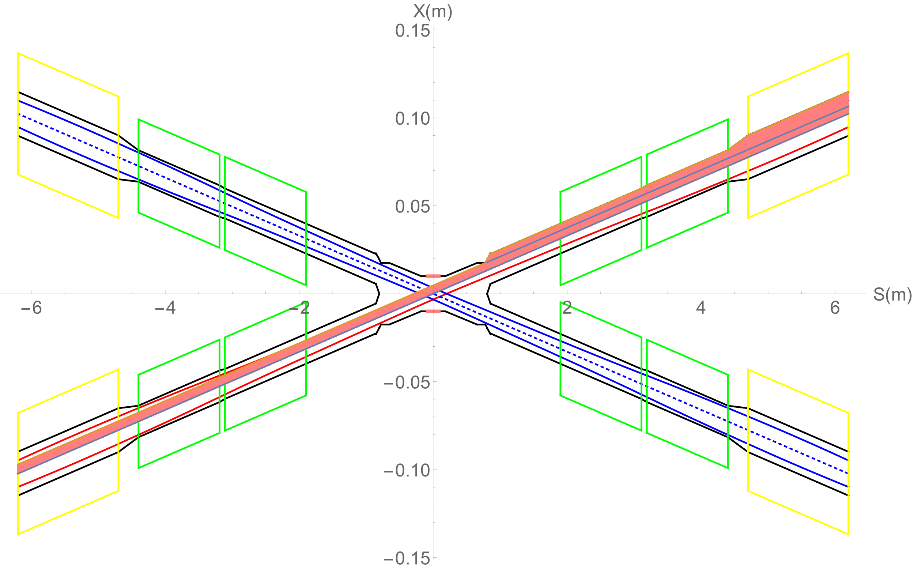
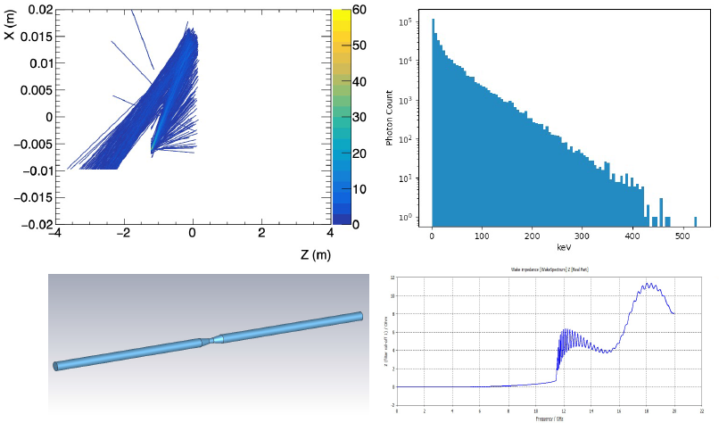
Synchrotron radiation
No SR photons hitting the central beam pipe directly in normal conditions, which is generated from the last bending magnet in the upstream of IP
However, some secondaries generated within the beam pipe of QD would hit the detector beampipe, even the beryllium part. Therefore, the mitigation methods must be studied.
SR photons generated from the FD magnets will hit downstream of the IR beam pipe, and the once-scattering photons will not go into the detector beam pipe but goes to even far away from the IP region.

Slide 11
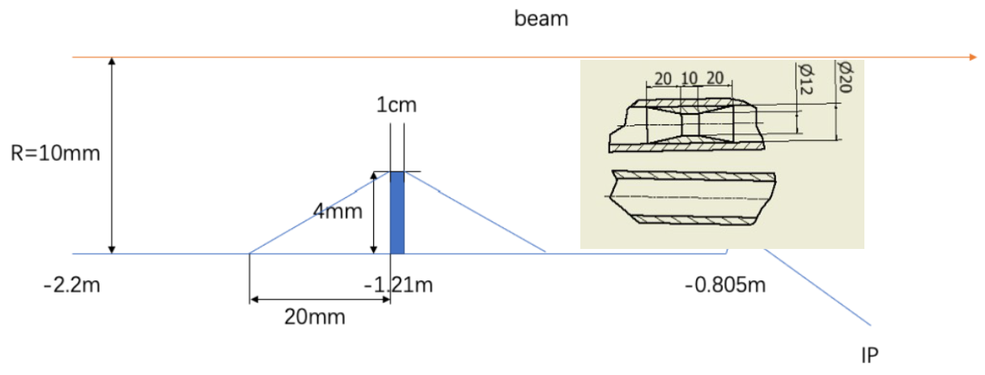
SR mitigation – mask and Au shielding
Methods | Photon hitting number on Be/BX | Deposition power on Be(W)
No mask | 39400.0 | 30.57*e-5
1.21-mask-Cu | 1736.0 | 1.45*e-5
1.21-mask-W | 1698.0 | 1.36*e-5
2.2-mask-Cu | 1147.0 | 0.94*e-5
1.21-mask-Cu-5㎛Au | 216.0 | 0.273*e-5
Masks design(two masks/IP/ring) :
  Tungsten
  One locates at -1.21m with 4mm height and 10mm long
  The other at -4.2m with 0.6mm height
Lots of photons are secondaries, generated within QD0
Photons hitting number on Be/BX reduced by two orders of magnitude
~216 photons/BX could hit Be
  ~2.73x10⁻⁶ W deposition power on Be beampipe

Slide 12
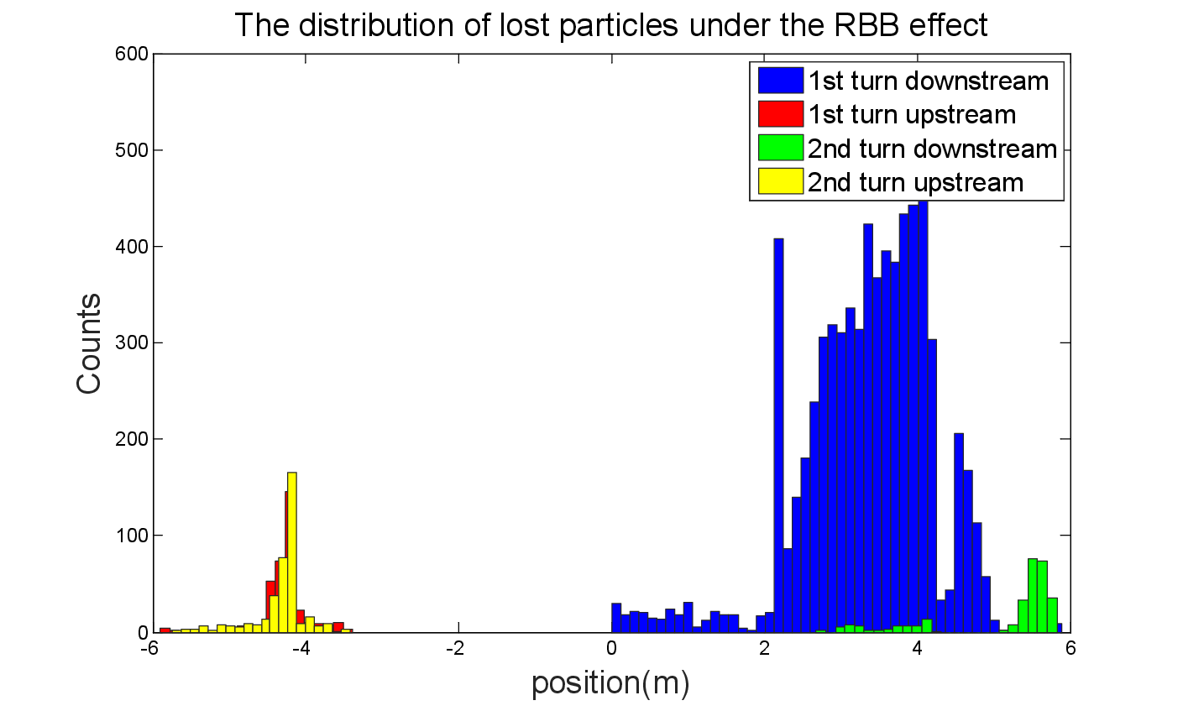
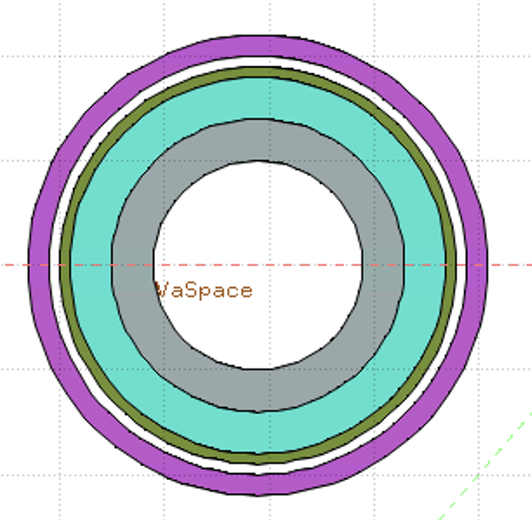
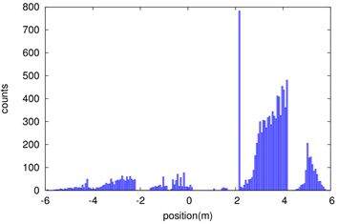
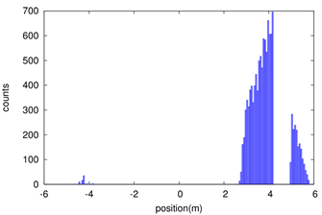
Shielding
Beam loss in the downstream IR with a large amount, due to the process of radiative bhabha scattering, beamstrahlung, beam-gas scattering, beam thermal photon scattering.
Radiation dose may damage the SC magnet coil and the detector.
solution
1. Tungsten IR beam pipe,
2. Combined iron and tungsten yoke of SC magnet
Key Issues on Calculation and Simplification of Beam pipe model
Pure tungsten IR beam pipe with 4mm thickness without cooling taken into account, simulate the Absorbed Dose on Coil (Region)
Only Beam-Gas beam loss is taken into account until now
Take the loss rate calculated by SAD into account:
  ~0.00166 Gy/s(0.166rad/s)
  ~14.35 Gy/day
  ~36662.49 Gy/lifetime(Higgs plans to run 7 years)
  Limit is 100000 Gy/lifetime
White: Vacuum
Gray: Tungsten Pipe
Light Green: Helium
Heavy Green: Stainless Steel Vassel
Pink: Coil

Slide 13
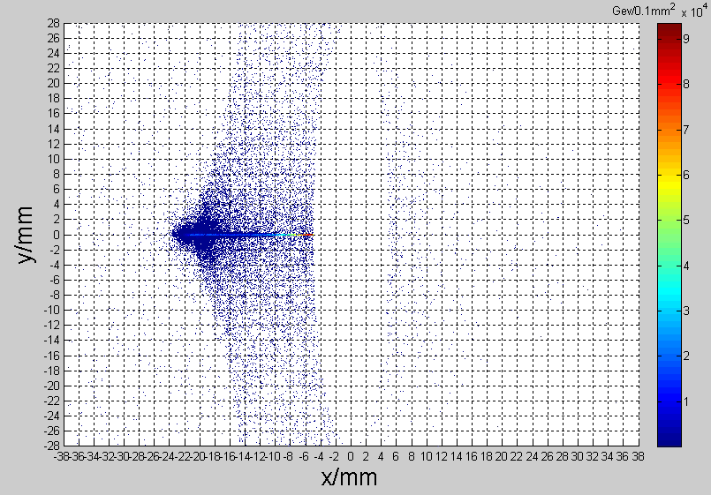
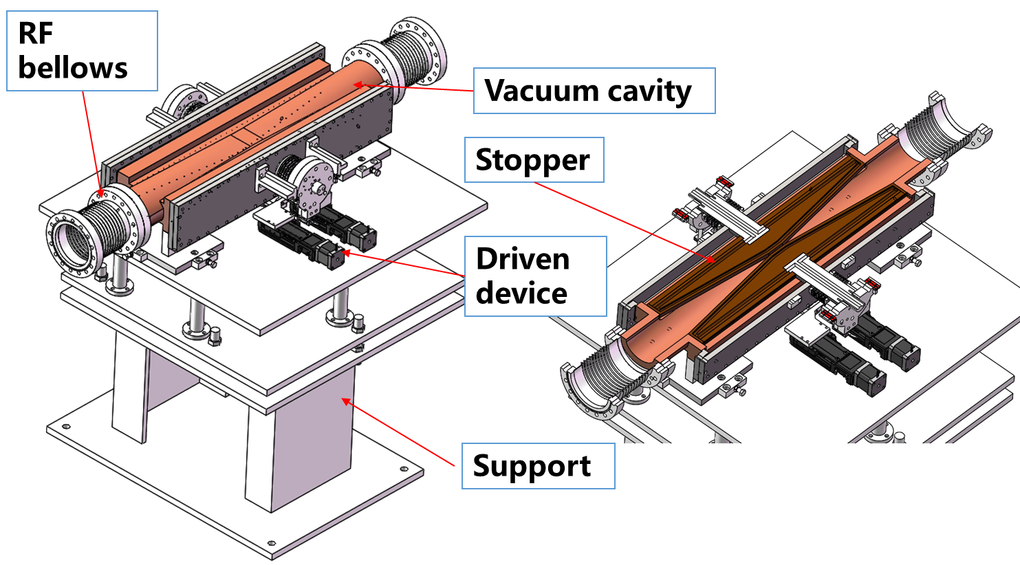
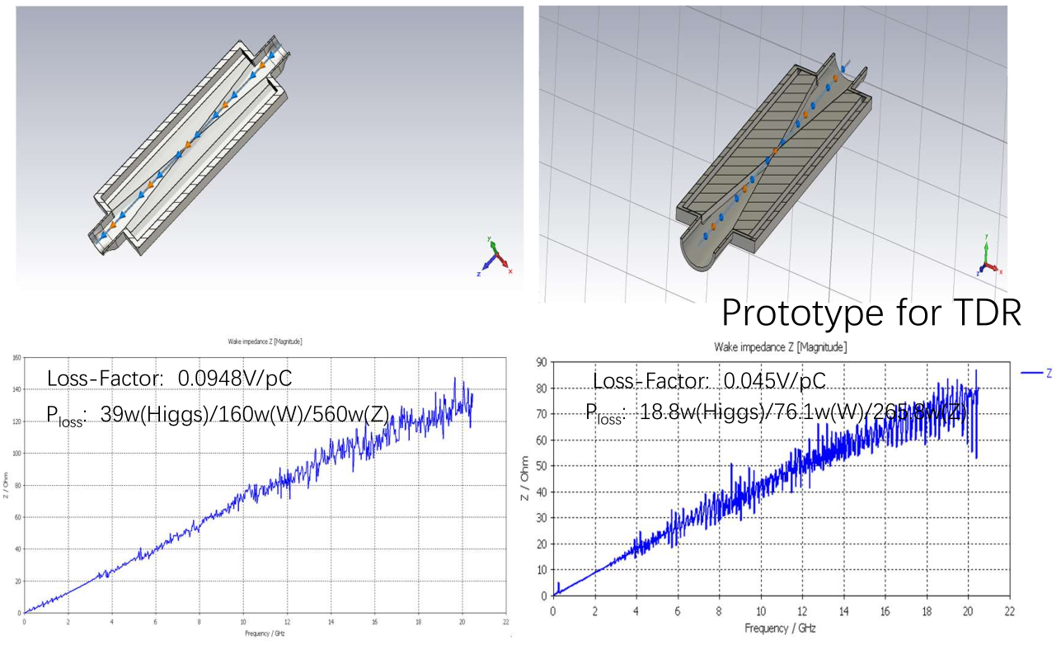
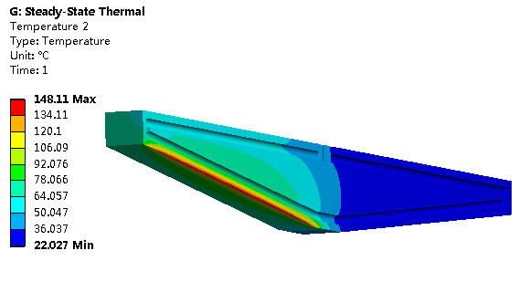
Movable collimators
Refer to Haijing’s talk
Located in straight section between two dipoles, the length is 800 mm.
SR power: 9.3kW @Higgs, 30MW
  Particle deposition:
  Jaw material: Cu
  Total heat generation: 91.6 W
  Maximum temperature raise by particle-material reaction: 2℃
Highest temperature: 148 ℃

Slide 14
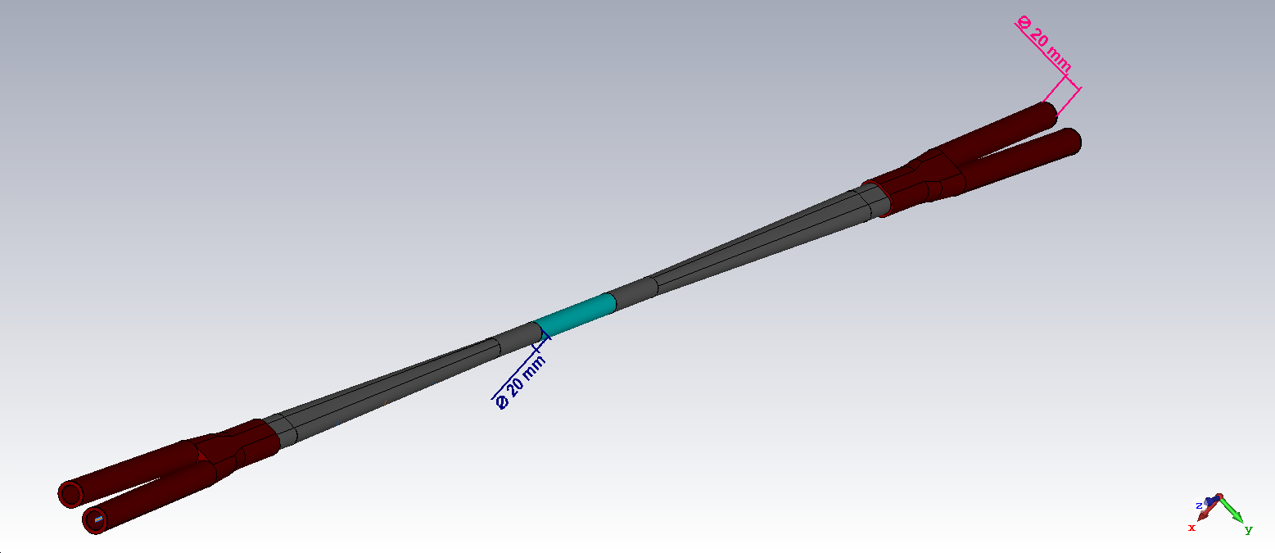
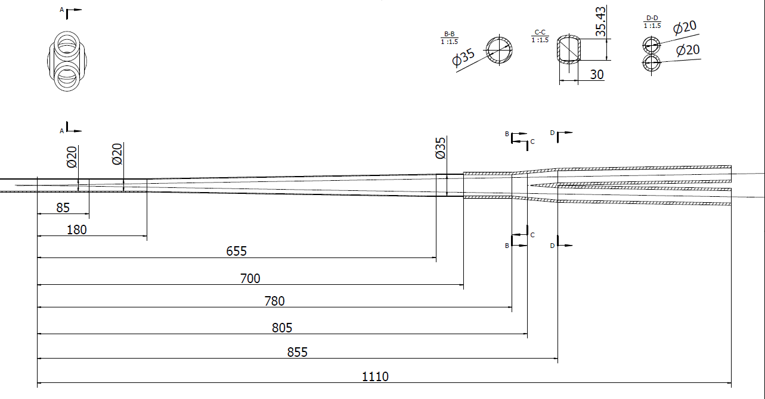
HOM power distribution
results for MDI 20mm-20mm
Transition region: Racetrack (including materials)
σ_{z}=5mm: Two beam in the IR
Loss factor Trap in IR @k_trap: 0.032v/pc
P_{trap}: H/W/Z/tt: 24.0w/117.1w/1160.8w/6.67w
Refer to Yudong’s talk
Position | Position Start-end（mm） | material | Length (mm) | Higgs(w) & (w/cm²) | W (w) & (w/cm²) | Z(w) & (w/cm²) | ttbar（w） & (w/cm²)
Be pipe (w) | 0-85 | Be | 85 | 1.13 & 0.021 | 5.587 & 0.105 | 55.295 & 1.35 | 0.31 & 0.005
Be pipe transition(w) | 85-180 | Al | 95 | 0.61 & 0.01 | 2.950 & 0.049 | 29.280 & 0.491 | 0.172 & 0.007
Transition pipe (w) | 180-655 | Al | 475 | 6.99 & 0.017 | 34.48 & 0.085 | 341.562 & 0.83 | 1.958 & 0.005
Transition （w） | 655-700 | Al | 45 | 0.62 & 0.015 | 2.95 & 0.071 | 29.28 & 0.701 | 0.172 & 0.004
RVC bellow（w） | 700-780 | Cu | 80 | 0.52 & 0.007 | 2.532 & 0.034 | 25.002 & 0.337 | 0.14 & 0.002
Transition on Y-crotch | 780-805 | Cu | 25 | 0.16 & 0.007 | 0.785 & 0.032 | 7.822 & 0.316 | 0.05 & 0.002
Y- crotch (w) | 805-855 | Cu | 50 | 0.33 & 0.005 | 1.572 & 0.024 | 15.626 & 0.241 | 0.091 & 0.002
Quadrupole pipe(w) | 855-1100 | Cu | 245 | 1.58 & 0.005 | 7.735 & 0.024 | 75.594& 0.24 | 0.434 & 0.002
Total | 0-1100 | - | 1100 | 12.0 &0.011 | 58.594 &0.056 | 580.46 & 0.56 | 3.331 & 0.003

Slide 15
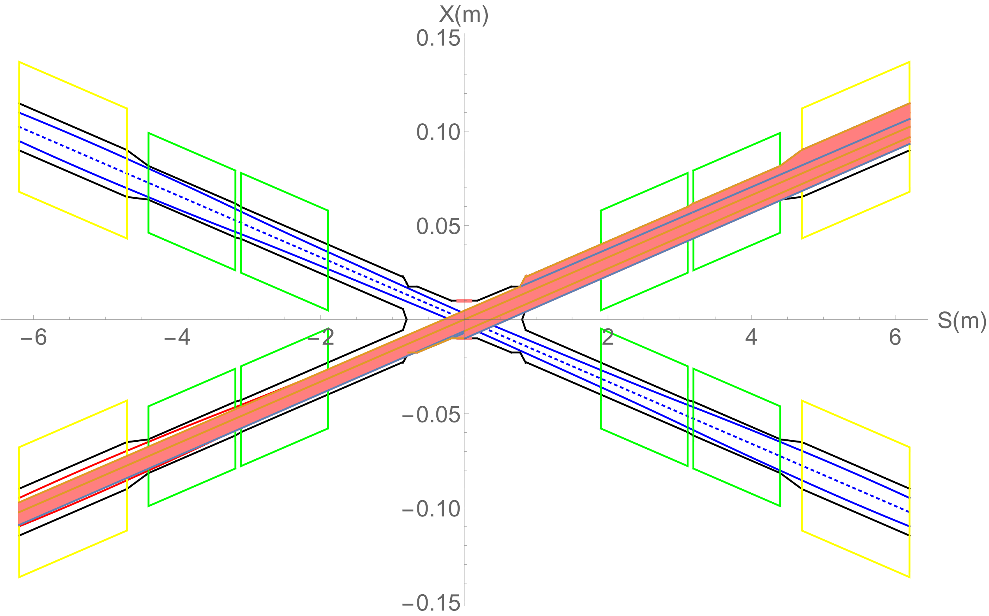
Heat load from SR
In normal conditions, there is no SR photons hitting the central beam pipe.
Single layer beam pipe with water cooling, SR heat load is not a problem.
In abnormal conditions, SR photons hitting the bellows (no cooling) and berrylium pipe under the extreme beam conditions , since it is a transient effect, heat load is not a problem.
Region | SR heat load | SR average power density
0~780mm | 0 | 0
780mm~805mm | 23.04W | 256W/cm²
805mm~855mm | 53.39W | 296.6W/cm²
855mm~1.9m(QDa entrance） | 4.32W | 1.15W/cm²
QDa | 3.28W | 0.75W/cm²
QDa~QDb | 22.92W | 79.58W/cm²
QDb | 3.96W | 0.91W/cm²
QDb~QF1 | 71.04W | 65.8W/cm²
QF1 | 7.26W | 1.34W/cm²
In extreme cases ~ at least 10 times per day. The beam will be stopped within 0.5ms when abnormal.
The background of the detector and radiation dose should be considered under abnormal conditions.

Slide 16
Heat load in IR from beam loss background
Region | RBB | Beamstrahlung | Beam-Gas | BTH
Berryllium pipe | 6.7mW | 0 | 0 | 0
Detector beam pipe | 0.024W | 0 | 4.8uW | 1.2uW
Accelerator beam pipe before QDa | 0.17W | 0 | 4.2uW | 1.2uW
QDa~QDb | 2.13W | 3.8uW | 5.9uW | 1.8uW
QDb~QF1 | 0.01W | 3.8uW | 0.5uW | 0.6uW
QF1 | 0.26mW | 0 | 3.7uW | 0.66uW
Beam loss particles from the process of radiative Bhabha scattering, Beamstrahlung, Beam-Gas scattering, and beam-thermal photon scattering hitting the IR beam pipe
Heat load in IR from beam loss background is so small, compared to synchrotron radiation and HOM.
The photons generated from the process of radiative Bhabha scattering, Beamstrahlung, and Beam-Gas scattering with small angle and large energy, still under analysis.

Slide 17
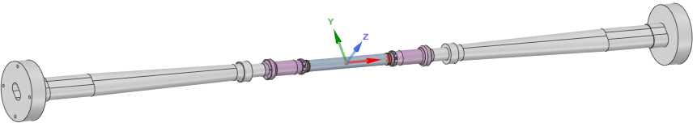
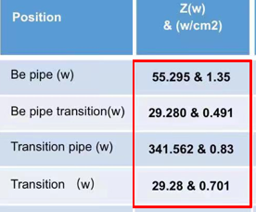
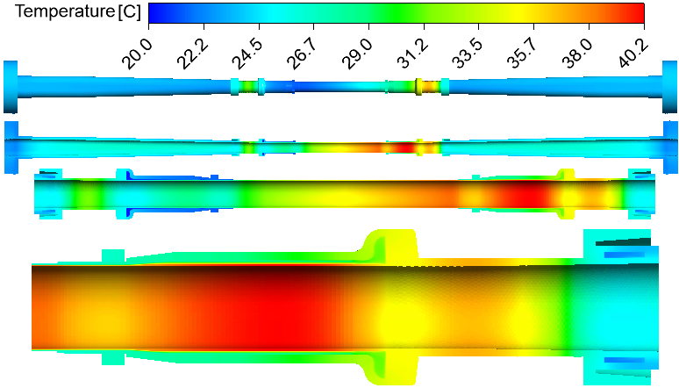
Beam pipe thermal analysis
Calculation model and condition
Refer to several talks in following days
Heat source distribution
Extending pipe:
2 inlet pipe, 2 outlet pipe
Coolant: water
Inlet temperature: 20℃
Inlet velocity: 0.5m/s（1.7L/min）
Be pipe:
4 inlet pipe, 4 outlet pipe
Coolant: paraffin
Inlet temperature: 20℃
Inlet velocity: 0.5m/s（0.8L/min）
Extending pipe:
2 inlet pipe, 2 outlet pipe
Coolant: water
Inlet temperature: 20℃
Inlet velocity: 0.5m/s（1.7L/min）
Calculation results:
Temperature difference ~5.9⁰C between two sides of the first layer detector
Temperature low, temperature difference small, meet the requirement
Δt of detector installation position: 5.9℃
t_{max} : 40.2℃

Slide 18
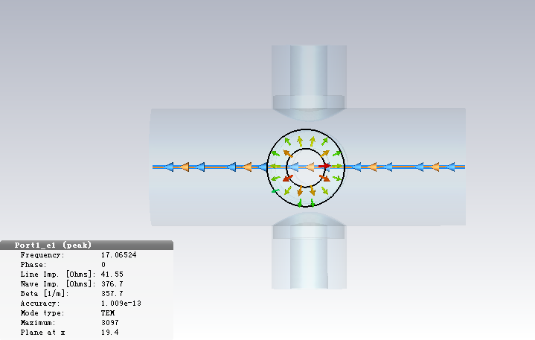
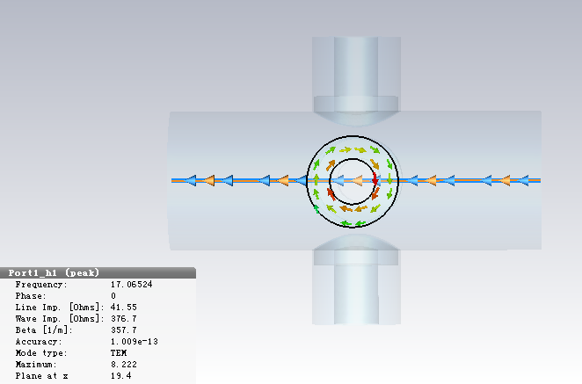
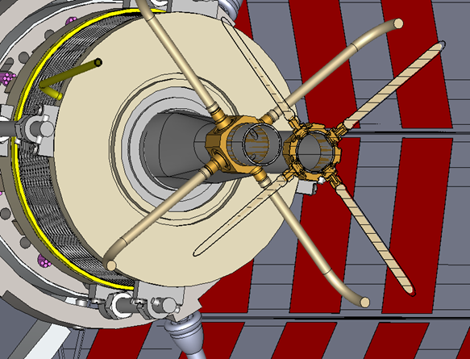
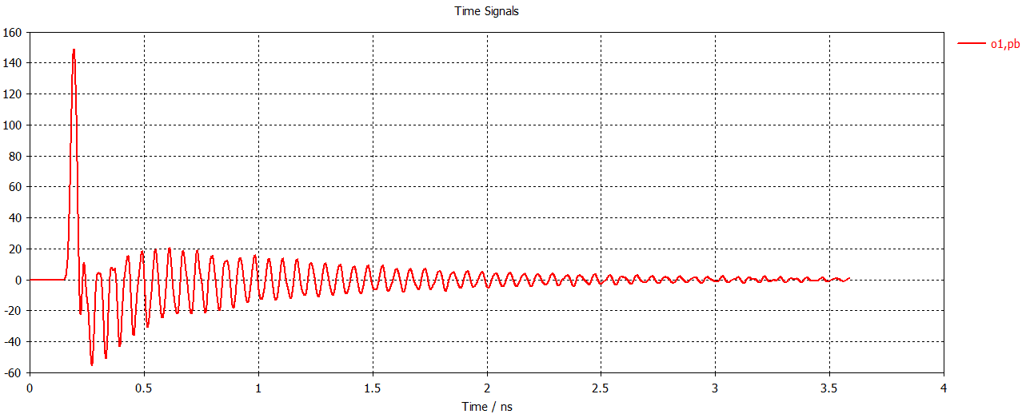
IP BPM
Electromagnetic field at electrodes
Refer to Hejun’s talk
Considering response time and calibration difficulty, two 4 button electrodes BPM at each side of CEPC IR is adopted.
Due to the short bunch length, signal has many resonance hump, signal amplitude proportional to the bunch charge.
Size and signal intensity can be satisfied by CEPC MDI requirement.
Electrodes signal(bunch length 2.68mm)

Slide 19
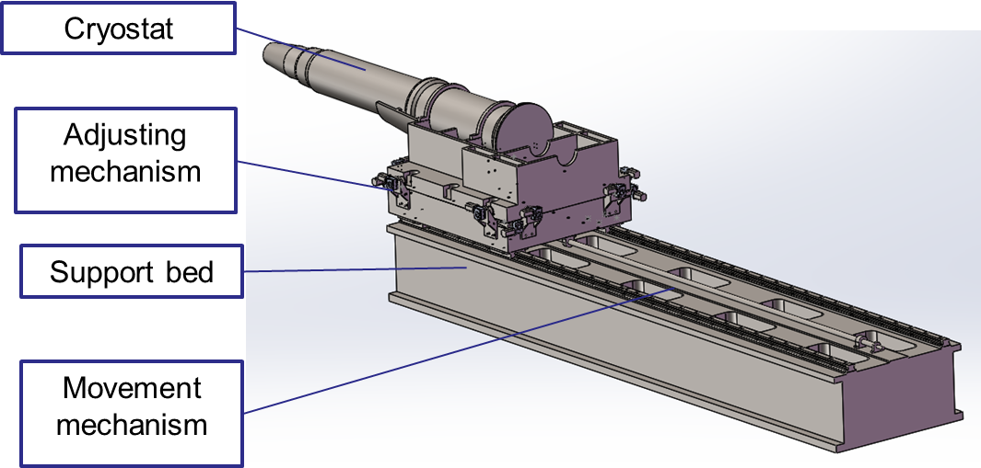
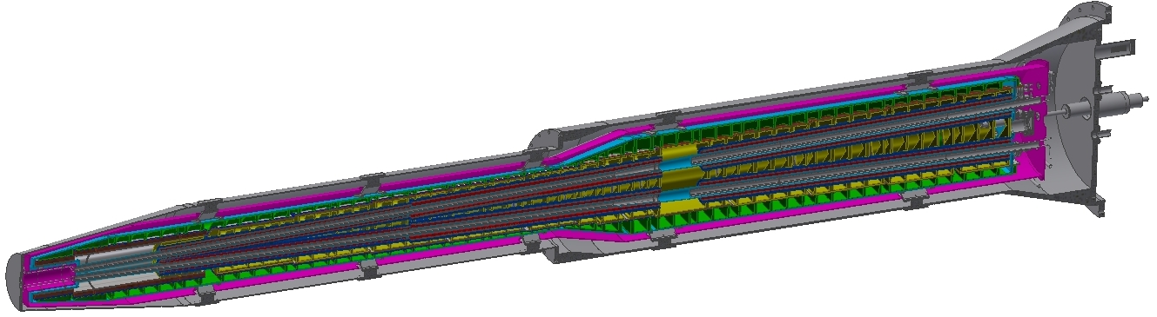
Cryostat and Supporting
Nontrivial to install and support the magnets and its auxiliary components with sufficient accuracy and stability.
Refer to Miaofu & Haijing’s talk
The cryostat is about 5.6m long. The cantilever length is 5283mm.
Thermal shield
Helium vessel
Q2
Vacuum vessel
Q1b
Q1a
Anti-solenoid
Support rods

Slide 20
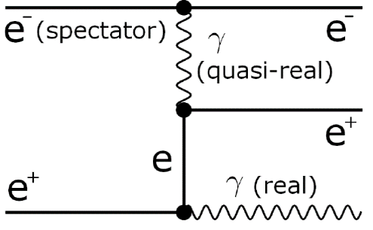
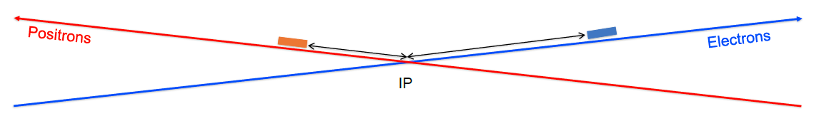
Luminosity monitoring
Relative luminosity monitoring (machine tuning, feedback…)
Fast, precise, realtime
Train-integrated-luminosity
Bunch-integrated-luminosity
Radiative Bhabha process at vanishing photon scattering angle
Proportional to luminosity
Large cross-section
Techniques and experiences
ZDLM at BEPC-II
ZDLM (scintillator & Cherenkov, analog) and LumiBelle2 (diamond, digital) at SuperKEKB
Plans
Figure out the requirement of the luminosity monitoring
Luminosity monitoring system
Search for the best candidate position for the luminosity monitor
Study on the signals / backgrounds

Slide 21
Summary
MDI covers interaction region and beyond. With the MDI map, lots of works are in progressing.
The MDI layout is compatible and no interference for the design.
Φ20mm IR beam pipe is designed as TDR baseline.
The design of CEPC MDI is finishing and optimizing.
The optimization and validation of current design is always needed.

Slide 22
Thanks

