Slide 1
MDI accelerator mechanics
Haijing Wang
On behalf of CEPC mechanics group
The 2022 CEPC MDI Workshop
30th Mar-1st Apr, 2023

Slide 2
Outline
Integration of the MDI devices
Remote vacuum connector
SC magnet support system in cryostat
Movable collimators

Slide 3
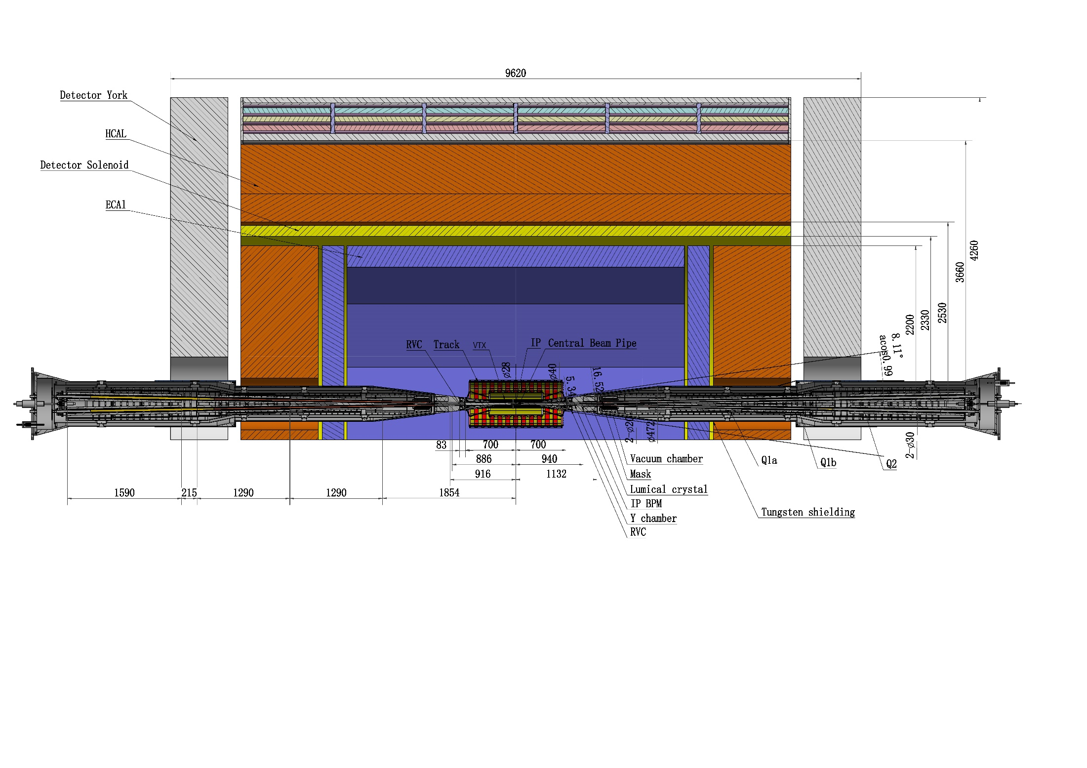
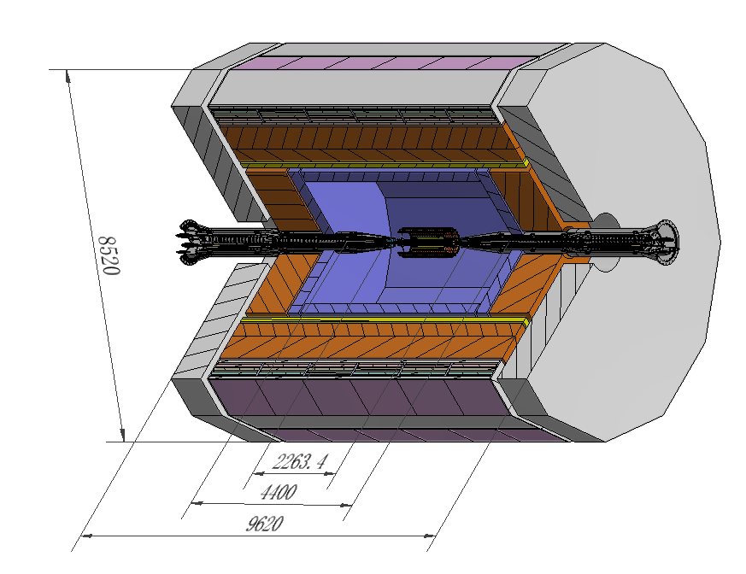
Integration of the MDI devices
The devices at MDI are integrated together.
Detective angle: acos0.99
IP chamber:-700mm~700mm
Detector York length: 9620mm

Slide 4
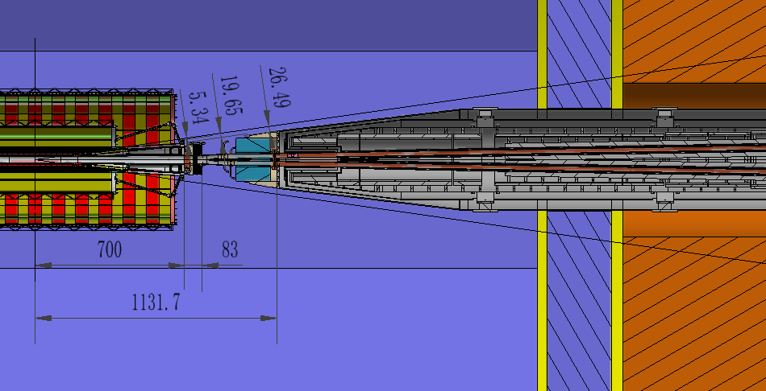
Integration of the MDI devices
IP
Be-Al chamber
Z: -700~700mm
With 1 BPM inside
Remote Vacuum Connector
Z: 700~783mm
Y chamber
Z: 783~855mm
IP BPMs
Z: 855~950mm
Lumical body
Z: 940-1100mm
Q1a Q1b
Z: 1855~4440mm
All the devices are within the detective angle, acos0.99.

Slide 5
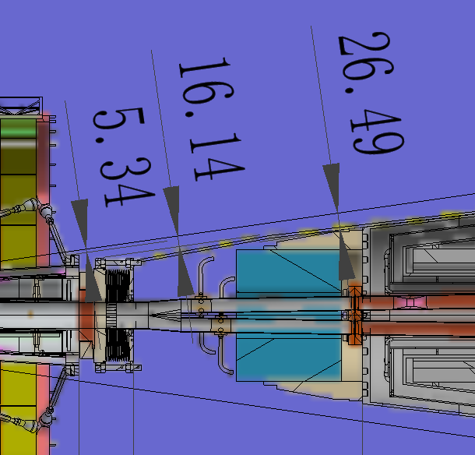
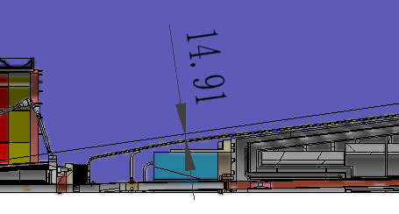
Integration of the MDI devices
IP chamber flange
RVC
BPM & cable
Lumical& support
Distance to detective angle
IP chamber flange: 5.34mm
RVC: 19.65 14.91mm
Cryostat:26.49mm
Cryostat
Pressure tube of RVC
Pressure tube of RVC has been added

Slide 6
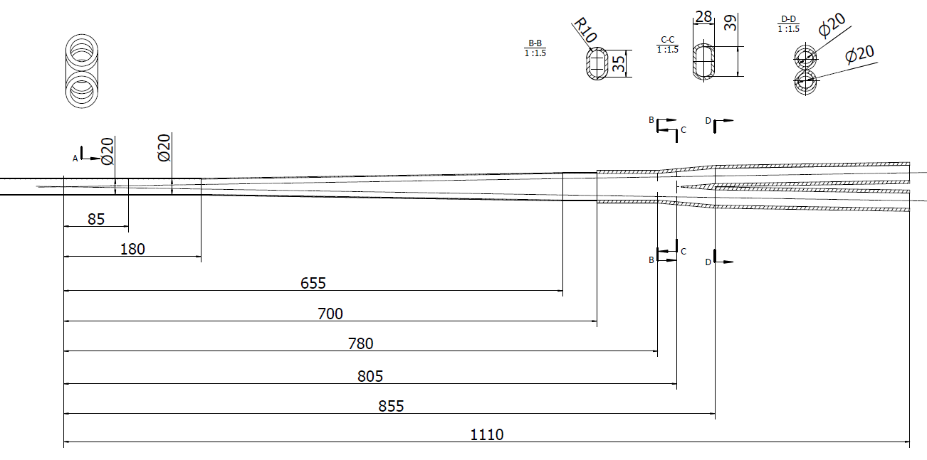
Integration of the MDI devices
Vacuum layout
Inner diameter at IP: 28 mm→20mm
Y-chamber cross section: circle (d40 mm) → racetrack (35mm-20mm)
Cryostat chamber
IP chamber
RVC
Y chamber
Paraffin cooled
Water cooled
No forced cooling
Water cooled
Be
Al
RF bellows
Cu
IP
IP BPM
Lumical

Slide 7
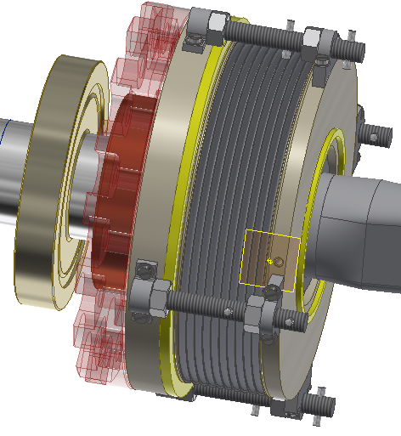
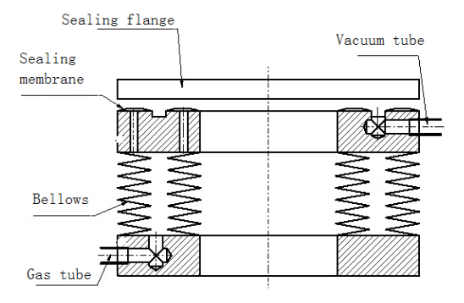
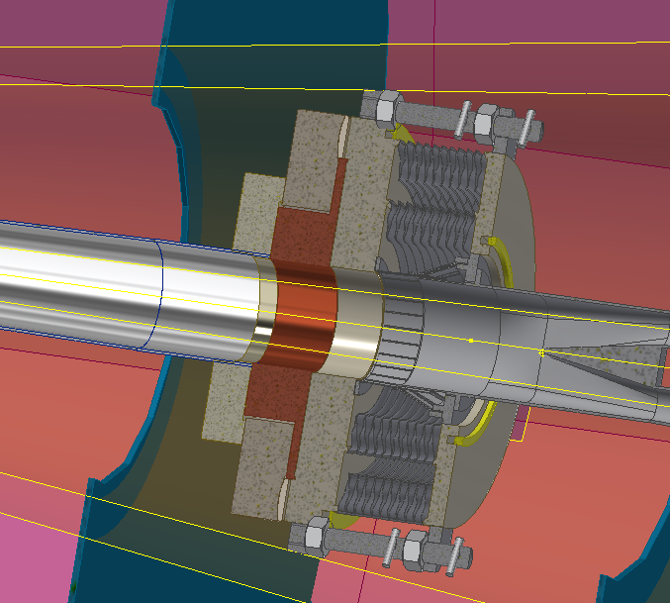
Remote vacuum connector
Improved inflatable seal
Low vacuum
RF finger
Two layers of edge sealing
Dimensions:
Transversal: Max. ϕ174mm
Longitudinal: ~83mm
Replace the sealing membranes by two layers of edge sealing.

Slide 8
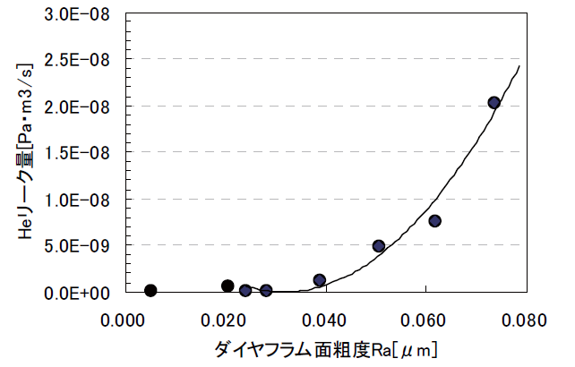
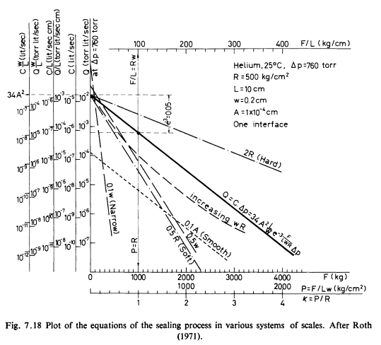
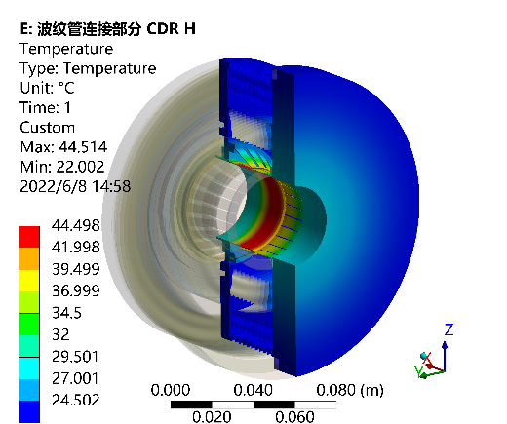
Remote vacuum connector
Difficulties:
Space limitation, leak rate, thermal dissipation…
$$\left.C=34A^{2}（L/w）exp{[}−3F/(LwR)\right]$$
Demonstrated by J-PARC
For sealings with the same F/L
Decrease roughness A
Perimeter L: determined by layout
Decrease gasket hardness $R:$ copper instead of SS
Decrease the seal width $w$: knife-edge seal
Can endure a heat flux of 1 W/cm2, the HOM power is acceptable.
Picture from Roth Alexander, Vacuum technology
The leak rate is estimated in theory in the TDR stage. No prototype has been developed.

Slide 9
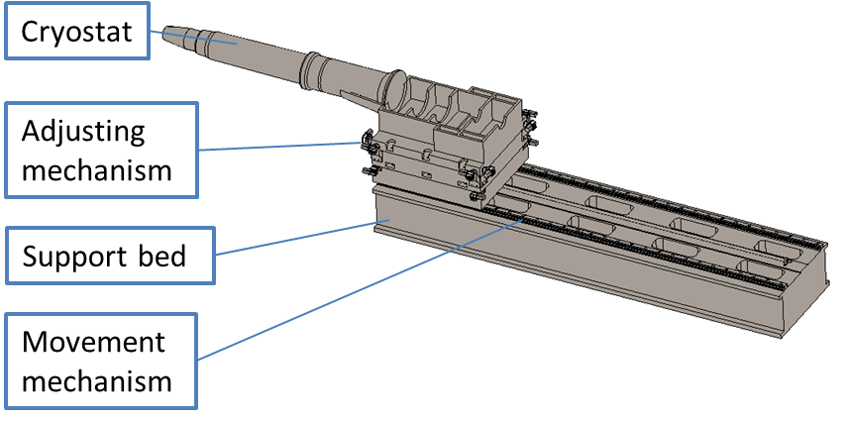
SC magnet support system
The cryostat is about 5.6m long. The cantilever length is 5283mm.
Movement mechanism: has high precision rails, motion range 6 m.
Support bed: steel bed with ribs inside.
Adjusting mechanism: Auto driven wedge jacks for adjusting.
The resolution requirement of the adjusting mechanism < 5 μm.
Key points
Stability (static and modal)
Accuracy
Easy-operating
Dimensions

Slide 10
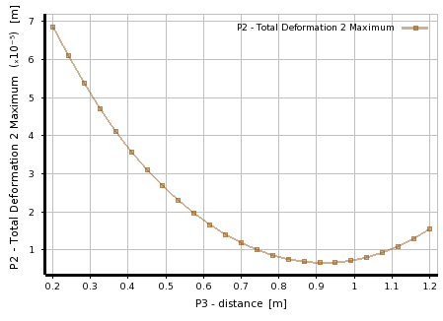
SC magnet support system
Helium vessel
Q2
Vacuum vessel
Q1b
Q1a
Thermal shield
Anti-solenoid
Support rods
$$\left.y_{max}\sim \frac{ρl^{4}}{32EI}(D^{2}−d^{2}+\frac{ρ^{′}}{ρ}d^{2}\right)$$
Candidate materials for supports inside
Material | Density (kg/m3) | Specific stiffness (Nm/kg $×$10³)
Stainless steel | 8000 | 25
Ti-6Al-4V | 4430 | 25.7
A6061 (Al) | 2700 | 25.5
Copper (Cu) | 8960 | 12.3
After the optimization of the supports in the cryostat, the total weight of the cryostat and the devices inside is 2790 Kg.

Slide 11
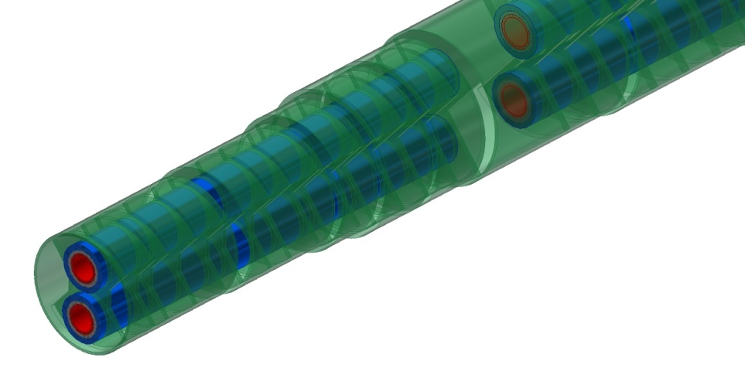
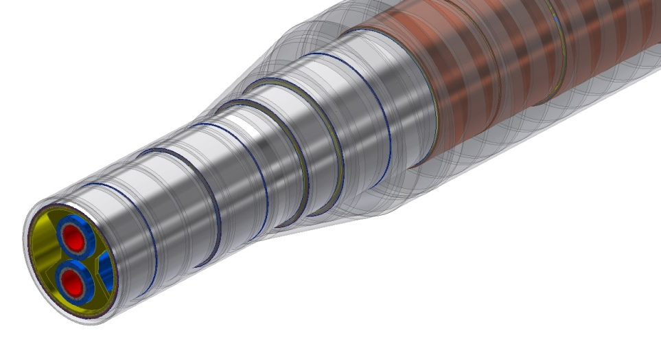
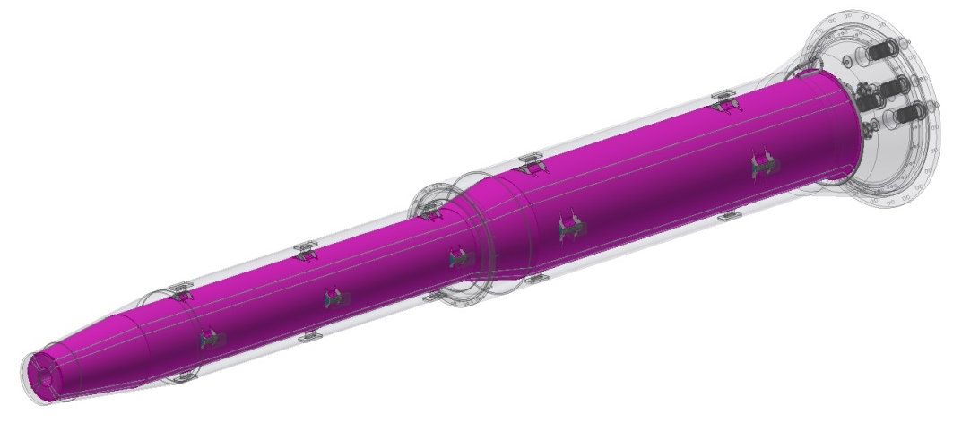
SC magnet support system
Magnets to helium vessels
Skeleton with outer ring support can minimize weight and reducing deformation.
Helium vessel to vacuum vessel
Support blocks, 60mm x 20mm.
Aim: minimize the SC magnets deformation, enhance stability.
Sketch of skeleton support
Models | materials
Q1a/Q1b/Q2 | Nb-Ti alloy+ SS + FeCoV
Anti-solenoid | SS + Cu + AL
Vessels | SS
Magnet supports | SS
Vacuum chamber | SS
Sketch of support blocks

Slide 12
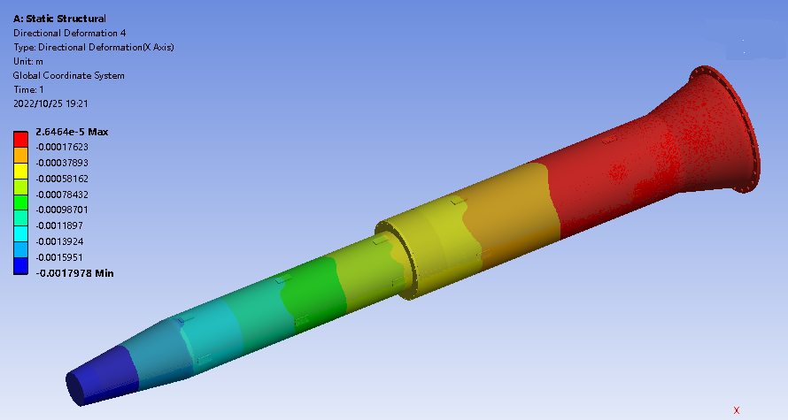
SC magnet support system
Integral FEA
Loads：gravity, Lorentz force Fz with detector solenoid operation
Alignment cannot based on the displacement.
To pre-align the magnet to compensate the absolute displacement.
Fz1
Fz2
Fz3
G

Slide 13
SC magnet support system
Integral FEA
Loads：gravity, Lorentz force Fz with detector solenoid operation
Alignment cannot based on the displacement.
To pre-align the magnet to compensate the absolute displacement.
Requirements:
The alignment accuracy of SC magnets: ≤100 μm.
Magnet support | uneven deformation in Q1a (um) |  | uneven deformation in Q1b (um) |  | uneven deformation in Q2 (um) |  | Max. displacement of cryostat (mm)
 | Vertical | Horizontal | Vertical | Horizontal | Vertical | Horizontal | Vertical | Horizontal
TDR s-o support | 5 | 1.2 | 15 | 3.5 | 14 | 4 | 1.79 | 0.08

Slide 14
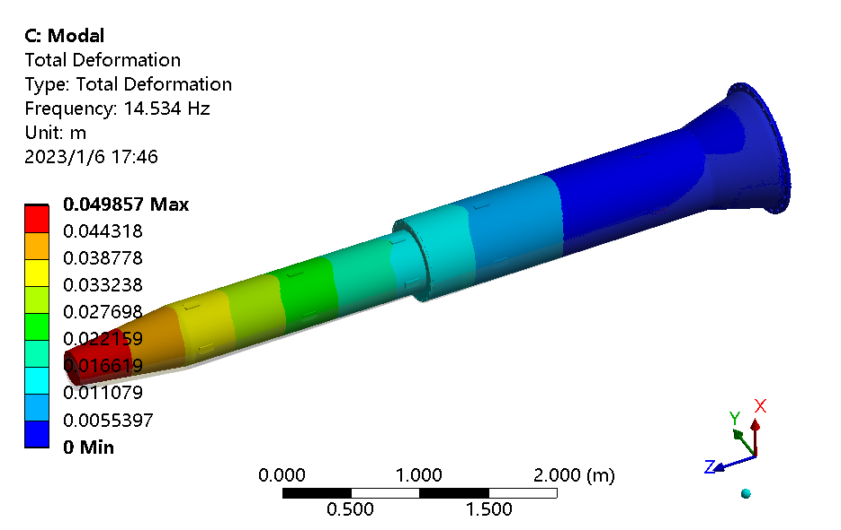
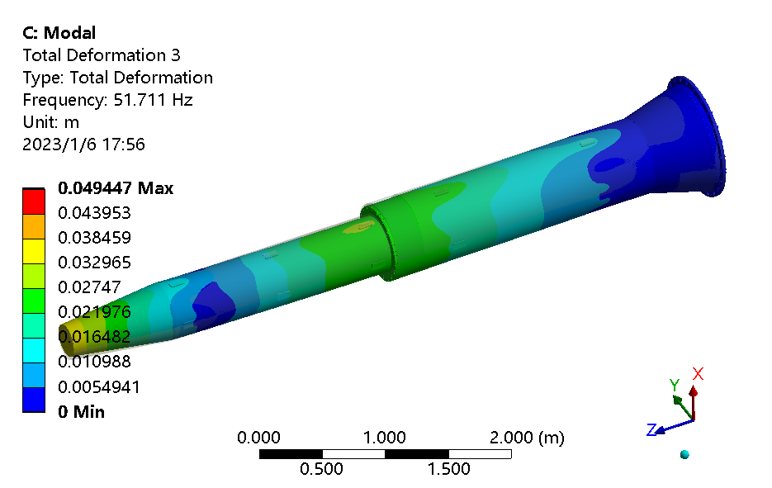
SC magnet support system
No. of order | Frequency (Hz) | Mode
1 | 14.5 | Integral vertical sway
2 | 14.9 | Integral horizontal sway
3 | 51.7 | Integral vertical wave
4 | 53.7 | Integral horizontal wave
5 | 89.7 | Vertical wave of helium vessel
6 | 91.4 | Horizon wave of helium vessel

Slide 15
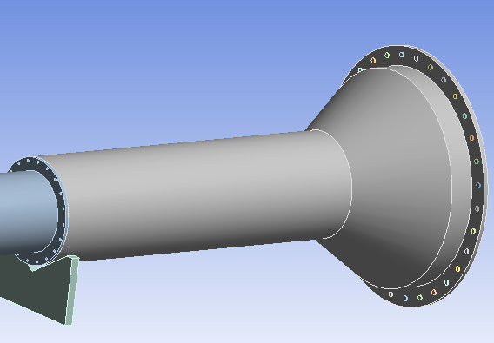
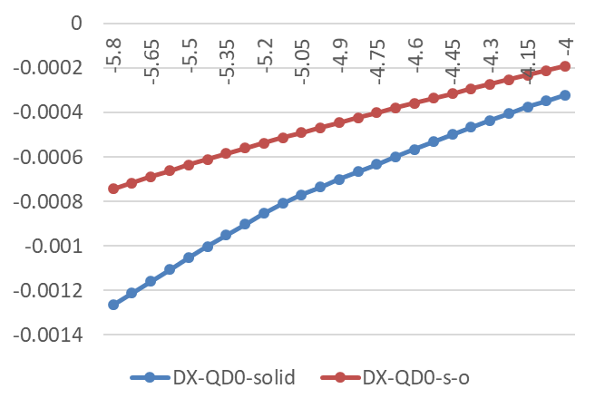
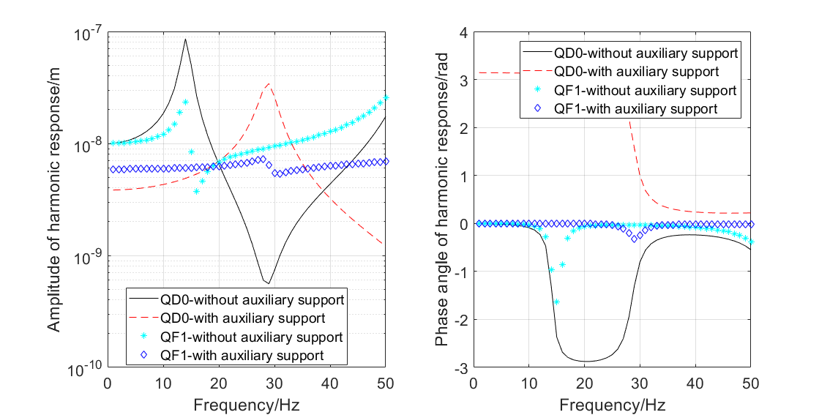
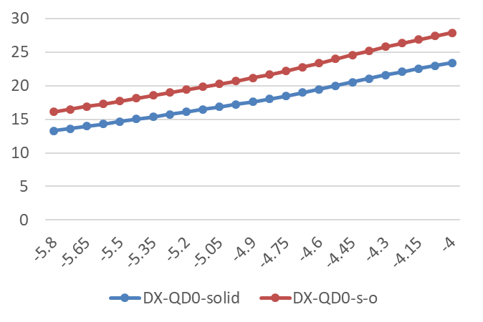
SC magnet support system
Auxiliary support of cryostat
Auxiliary constraint: V groove, translational in beam direction
Range: 4 m to 5.9 m from IP (on inner wall of detector yoke)
Can decrease the uneven deformation as well as enhance natural frequency largely.
* Not for the latest magnet version. Updates are undergoing.
Uneven deformation VS support location
Harmonic response
Frequency 1~50 Hz.
The auxiliary support can reduce the response amplitude largely.
Natural frequency VS support location

Slide 16
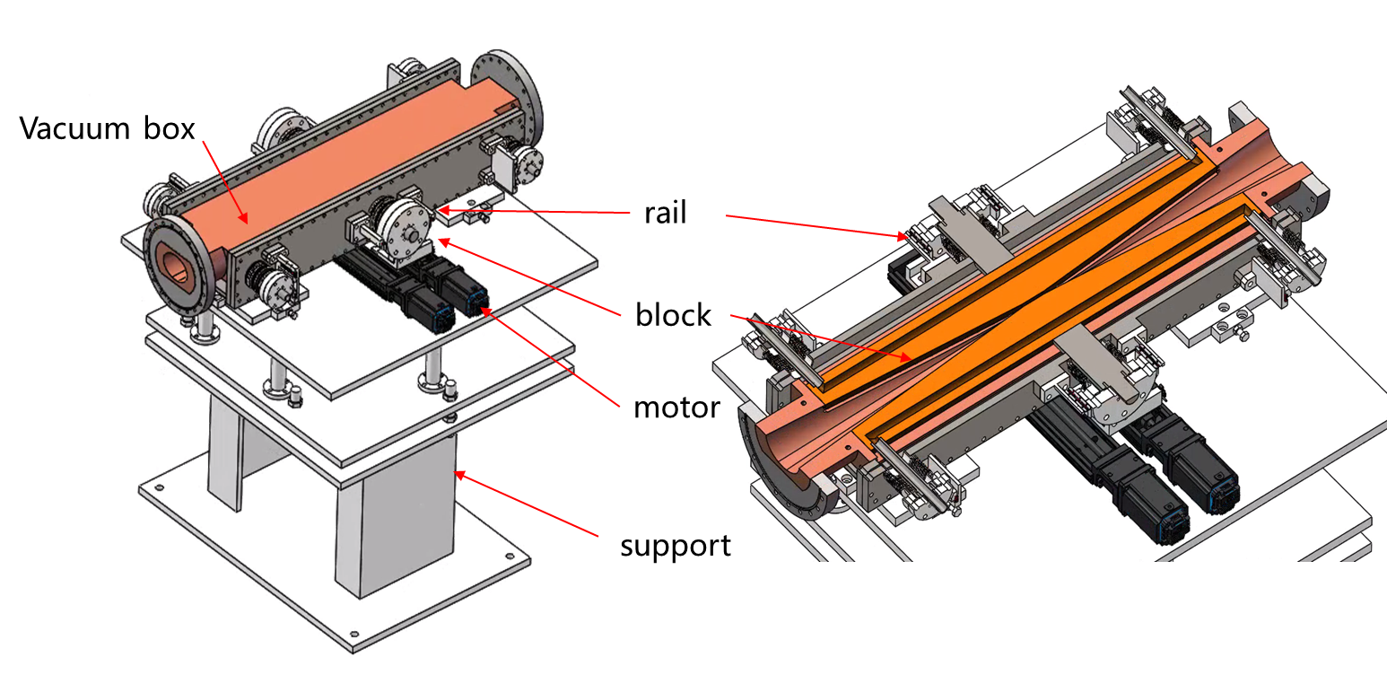
Movable collimators
Collimators for background decreasing
28mm
37.5mm
28mm
28mm
The cross section of the vacuum pipe is changed from ellipse to circle, and the collimator is adjusted accordingly.
The diameter in the X direction smaller
The synchrotron radiation load reduced from 9.3KW to 7.5KW
The thermal power density decreases
reduce the temperature
The inclination of block ramp smaller.
Beam loss reduced
reduce stress
Modification suggestion of vacuum chamber for the collider ring，Liu Yu Dong for CEPC accelerator physical group，2021/3/25

Slide 17
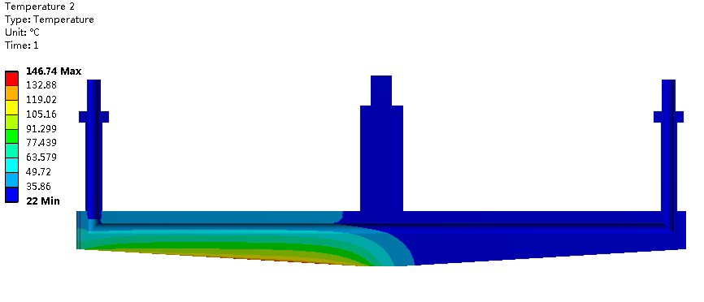
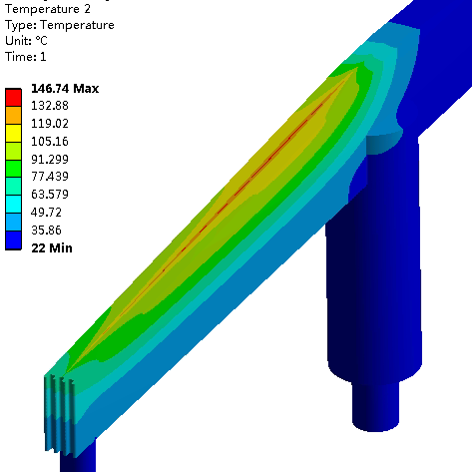
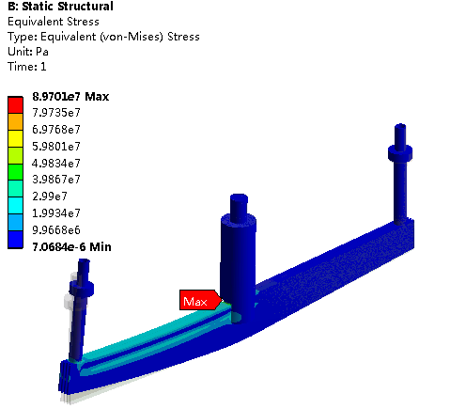
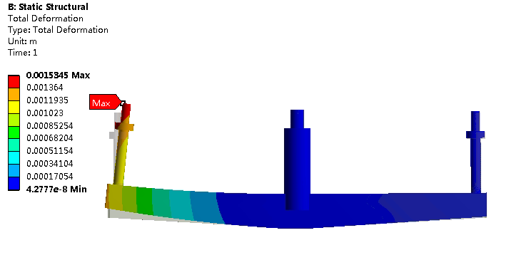
Movable collimators
183℃ （original version, i.e. ellipse vacuum pipe） → 147℃
1.89mm (original version)→ 1.53mm
129.31MPa (original version) → 89.7MPa

Slide 18
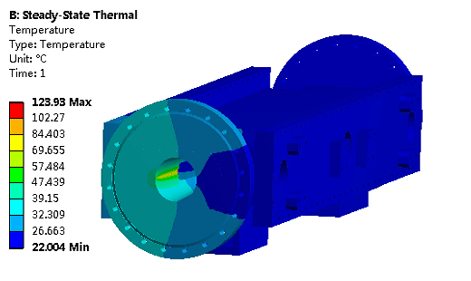
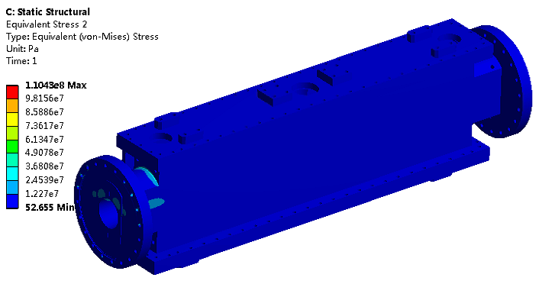
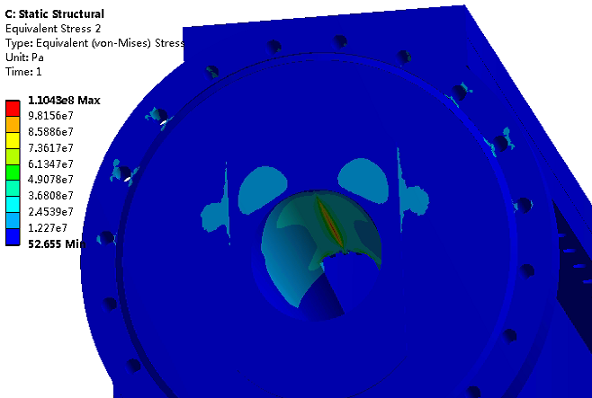
Movable collimators
141℃ (original version) → 124℃
132MPa (original version) → 110MPa

Slide 19
Conclusion
We have updated the cryostat and MDI layout.
The SC magnet supports inside the cryostat are under design and optimization.
The stability of the TDR cryostat is being studied.
Integral FEA with thermal contraction and adjustment components will be studied next step.
Structure design and thermal-mechanics analyses of movable collimators for background decreasing have been done.

Slide 20
Thanks for your attention!

