Slide 1
CEPC IP Beam position monitor
On behalf of beam instrumentation group
March 30- April 1, 2023
Hunan, Hengyang

Slide 2
Contents
1
The function of IP BPM
2
The challenge for IP BPM
3
IP BPM preliminary design
Summary
4

Slide 3
The principle of beam position monitor
V
-
+
-
+
-
-
+
-
+
-
+
-
-
+
-
+
-
+
-
+
-
-
+
-
+
-
+
-
+
-
+
-
+
-
-
-
+
+
-
-
+
+
-
-
-
-
+
-
+
-
+
-
-
+
-
+
-
+
-
-
+
-
-
-
-
-
+
-
+
+
-
+
-
-
+
-
+
-
+
-
+
-
+
+
+
+
-
+
-
-
+
-
+
+
+
+
+
+
+
+
+
+
+
+
+
+
+
+
+
+
+
+
+
+
+
+
+
+
+
+
+
+
+
+
+
+
+
+
+
+
+
+
+
+
+
+
+
+
+
+
+
+
+
+
+
+
+
+
+
+
+
+
+
+
+
+
+
+
+
+
+
+
+
+
+
+
+
+
+
+

Slide 4
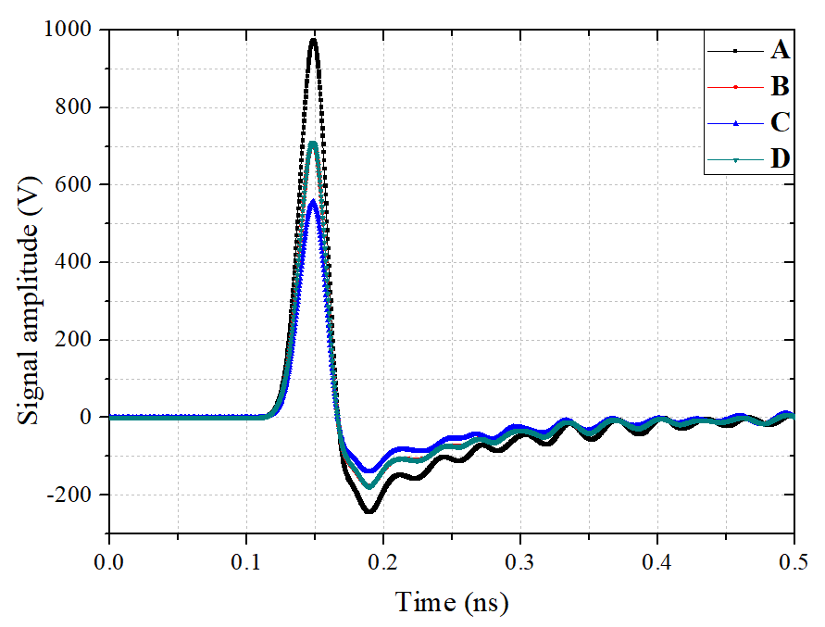
2 / 4 electrodes BPM
Principle of BPM: the closer the beam to the electrode, the stronger the signal, the position is proportional to the difference between electrodes
2 electrodes: x₀= K× (R-L) /(L+R) K: the scale coefficient
B
A
x₀=y₀=1
L
R
Beam
x₀
C
D
4 electrodes: x=K_{h}×U，y=K_{v}×V, $\text{U}\text{ =}\frac{{\text{V}}_{\text{a}}\text{+}{\text{V}}_{\text{d}}\text{−}{\text{V}}_{\text{b}}{\text{−}\text{V}}_{\text{c}}}{{\text{V}}_{\text{a}}\text{+}{\text{V}}_{\text{b}}{\text{+}\text{V}}_{\text{c}}\text{+}{\text{V}}_{\text{d}}}\text{, }\text{V}\text{ =}\frac{{\text{V}}_{\text{a}}\text{+}{\text{V}}_{\text{b}}\text{−}{\text{V}}_{\text{c}}{\text{−}\text{V}}_{\text{d}}}{{\text{V}}_{\text{a}}\text{+}{\text{V}}_{\text{b}}{\text{+}\text{V}}_{\text{c}}\text{+}{\text{V}}_{\text{d}}}$

Slide 5
IP BPM Vs other BPM
The IP Beam Position Monitor can also be used as a beam arrival time detector except position measurement, the beam-beam deflection technique is necessary for luminosity optimumization.
Spatially: The local bumps at the IP created by steering magnets can be used for beam–beam deflection scan. The parameters (position and angle) of electron and position can be set as the ideal state after through several iterations.
Temporally: The relative timing can be adjusted by changing the RF phase between the two rings, the collision point can be shifted.
Phase advance
Phase lag

Slide 6
IP BPM: Temporally coincide
BPM location
t1
L
L
t2
t3
t3 – t1 = Δt = 2×L/c

Slide 7
The challenge for IP BPM
1：~300 nm resolution and ~5μm accuracy
2：Limitation induced by material and installation space
3：Limitation induced by wakefield
4：Limitation induced by interfere for duel-beam
5：Other restrictions such as radiation resistance, beam is at nonlinear region

Slide 8
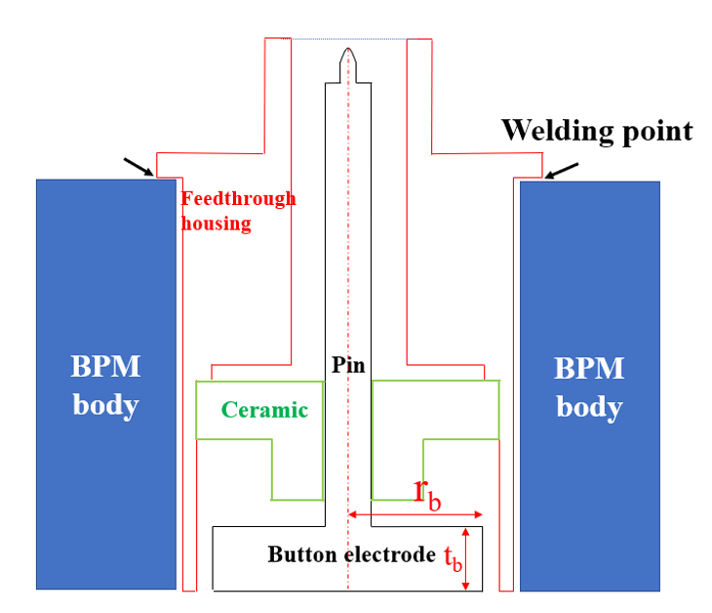
Constraints on space and material
Ceramic metallization
air
Safe distance
Seal contact face
vacuum
beam

Slide 9
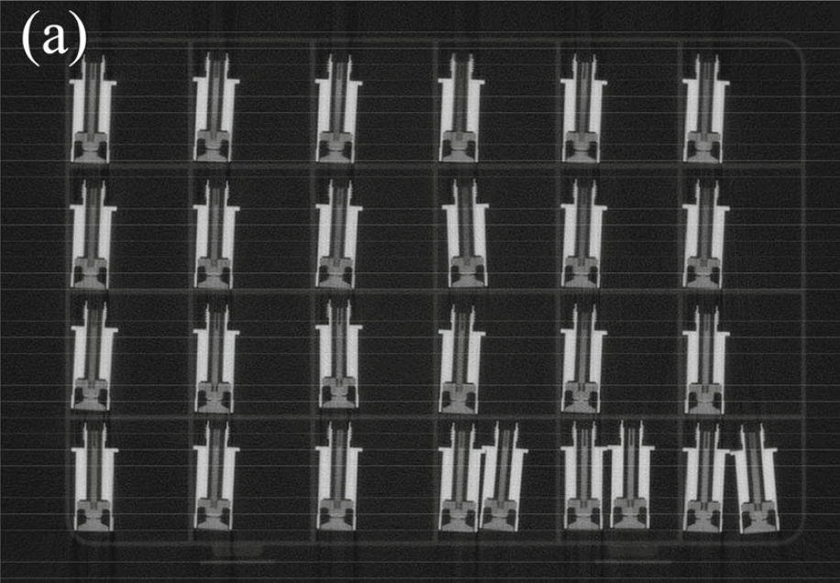
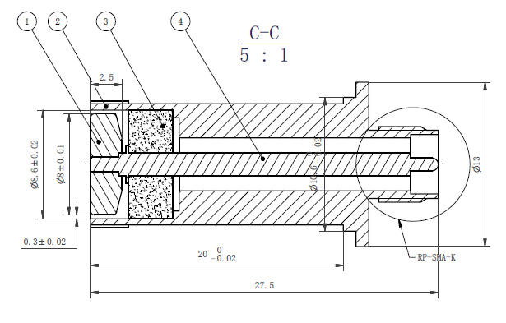
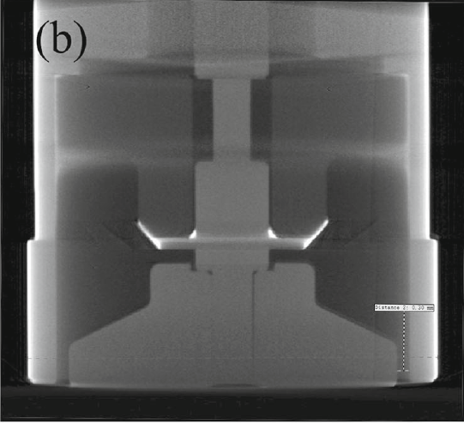
Key components: feedthrough
Machine drawing
Inner structure results of x-ray tomography

Slide 10
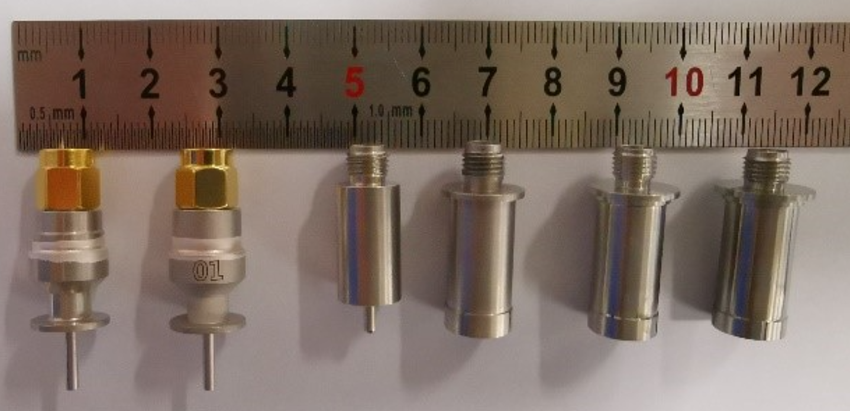
4 Feedthrough + pipe = BPM pickup
Installation space requirement: 10 mm in longitudinal direction, 30 mm in radial direction
Welding between the feedthrough housing and the beam pipe, optional materials for housing: stainless steel, Kovar (nickel cobalt ferrous alloy), titanium, etc

Slide 11
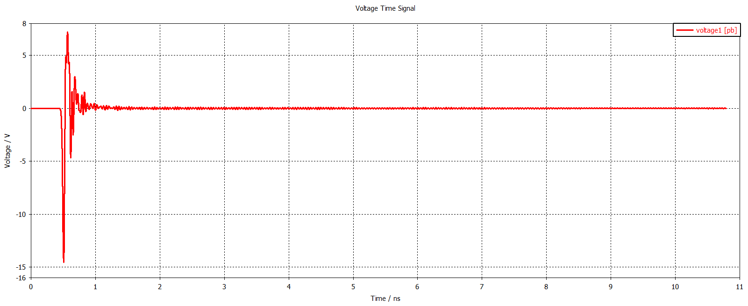
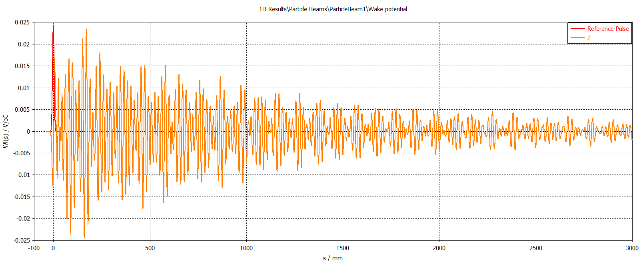
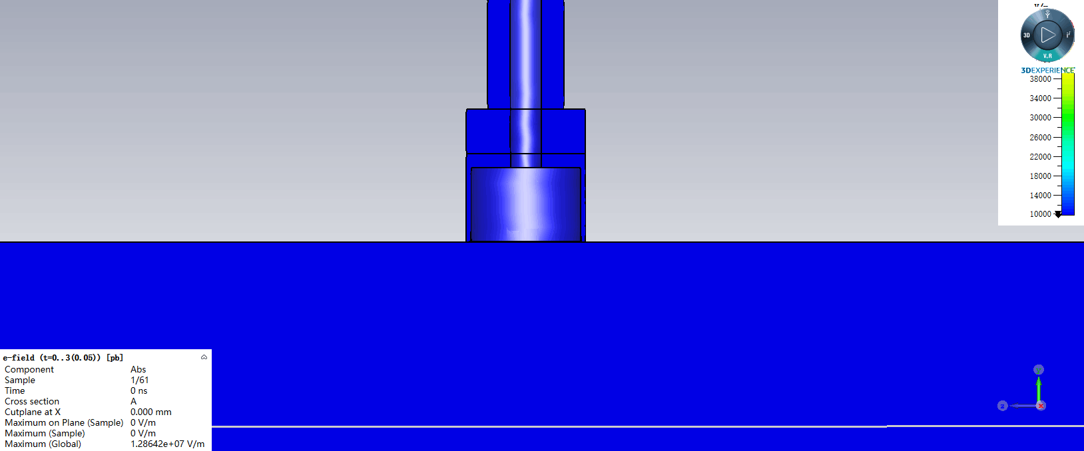
The wakefield of BPM
The signal of BPM electrode outputs
The electric field in bpm during beam passby
The longitudinal wakefield potential of BPM
A high-order mode captured by feedthrough

Slide 12
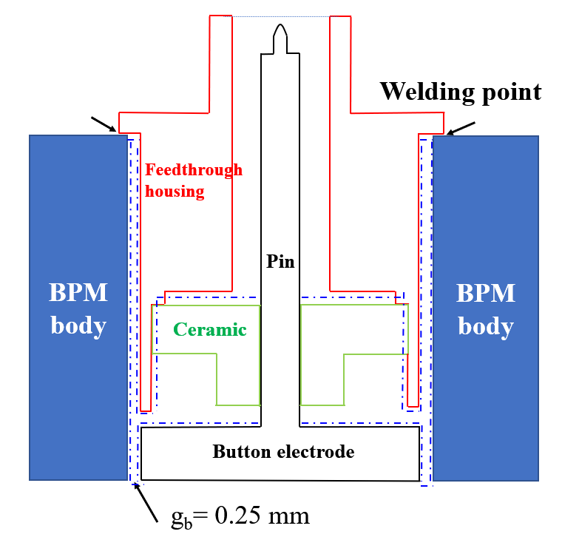
Design of feedthrough
Reduce the volume of the gap and the sealing material
A lower dielectric sealing material, glass instead of ceramics
A asymmetric structure
Transmission structure optimization, a bigger coupling a smaller Q_{ext}
Special structure …
2
1
2
f ∝1/(ε_{r})^{0.5}，ceramics: 9.5 glass: 3~5.
Three main parameters for BPM
Radius and height of button rb，tb，gap gb，a set of typical parameter (rb=3mm, gb=0.25mm, tb=3 mm)，f_{H110} : 5.1 GHz, 7.6 GHz
Smaller the better (Mechanical processing)

Slide 13
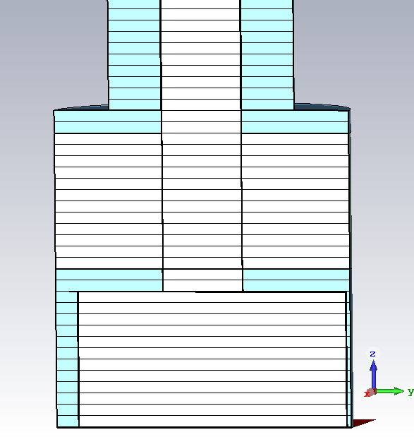
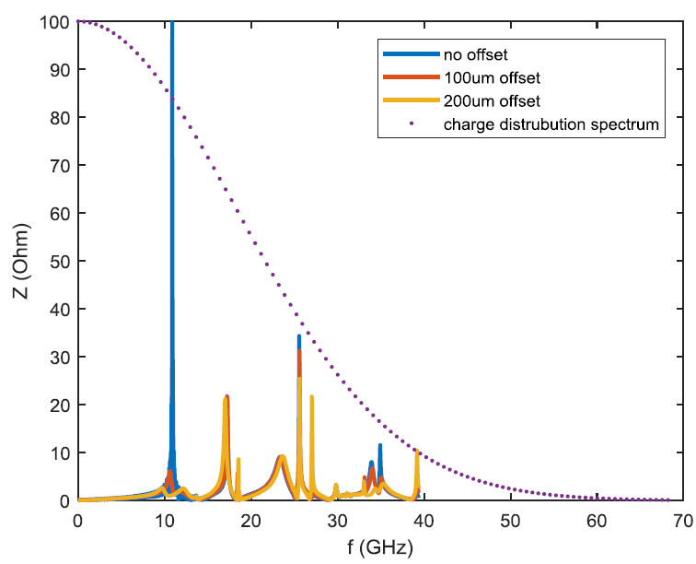
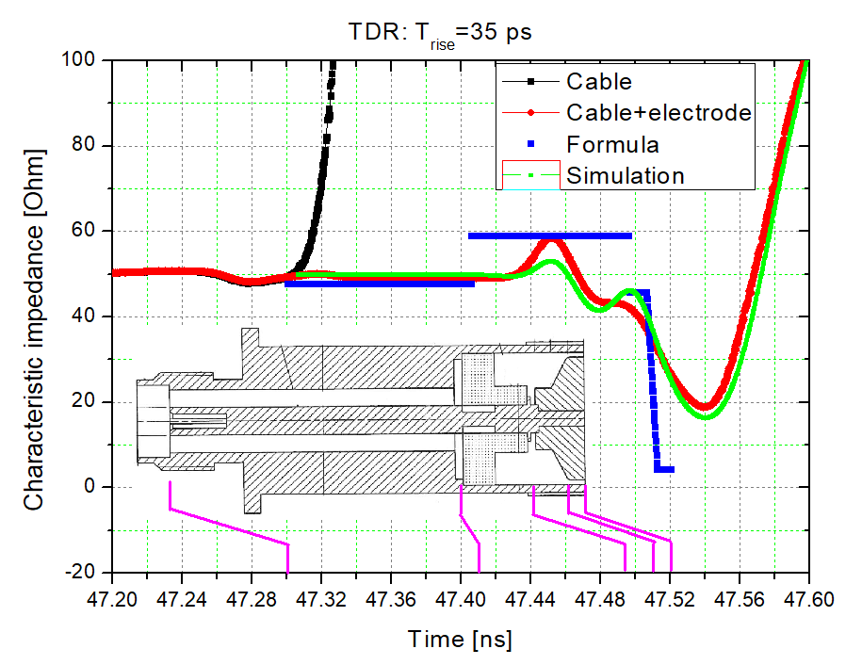
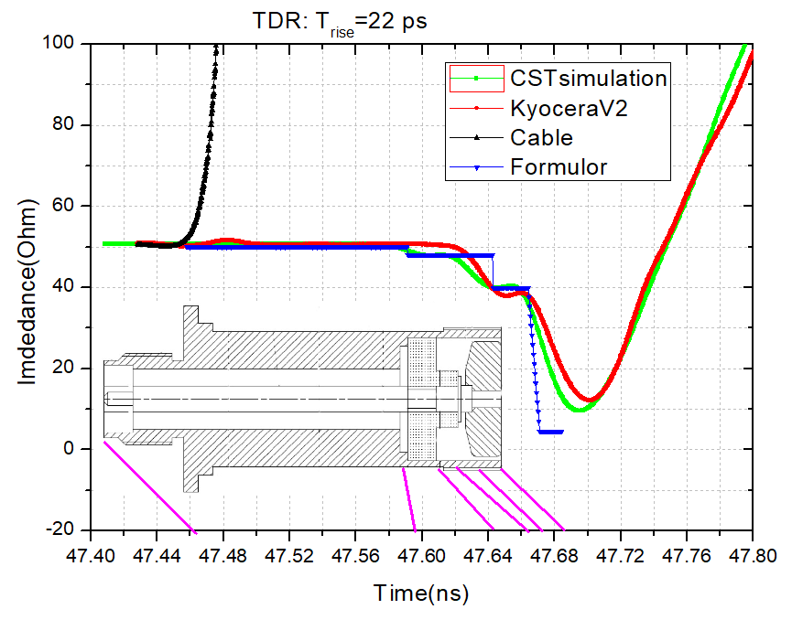
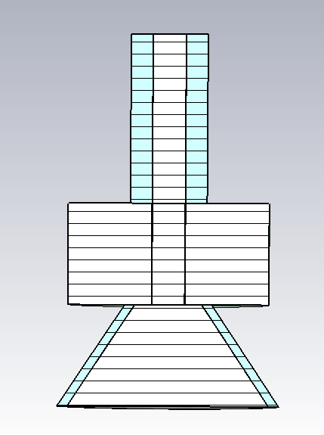
Design of feedthrough
3
3
offset
4
4
5
5

Slide 14
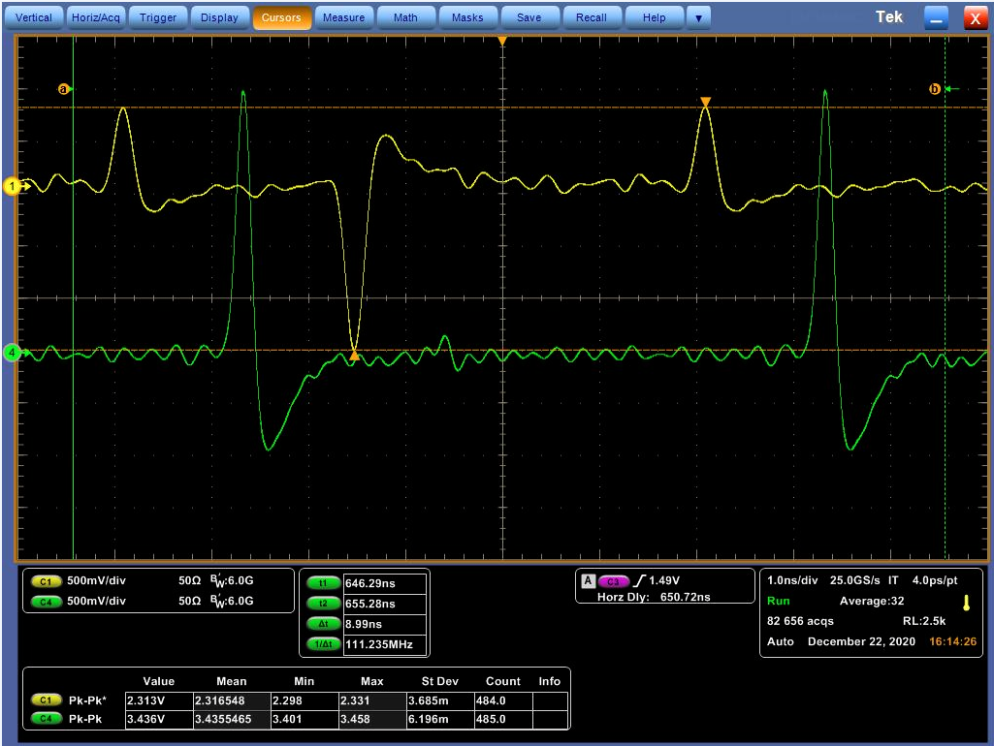
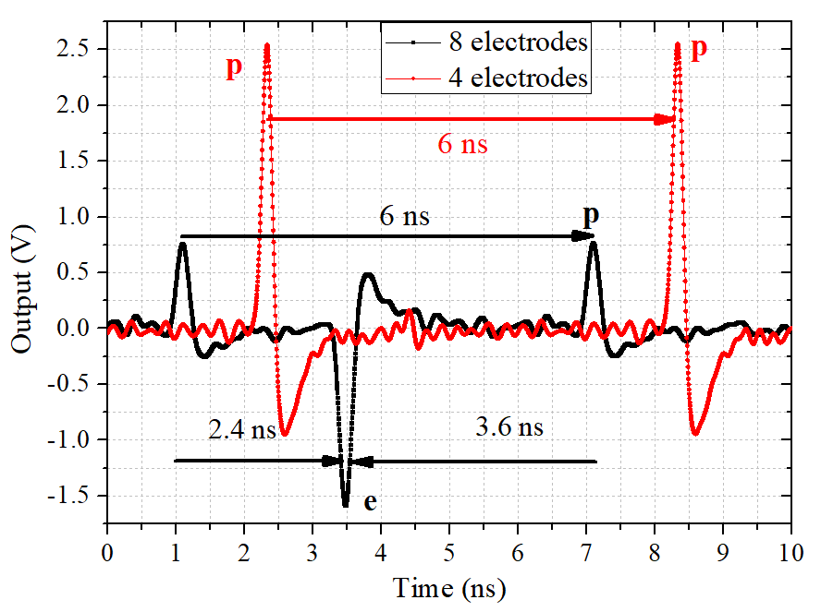
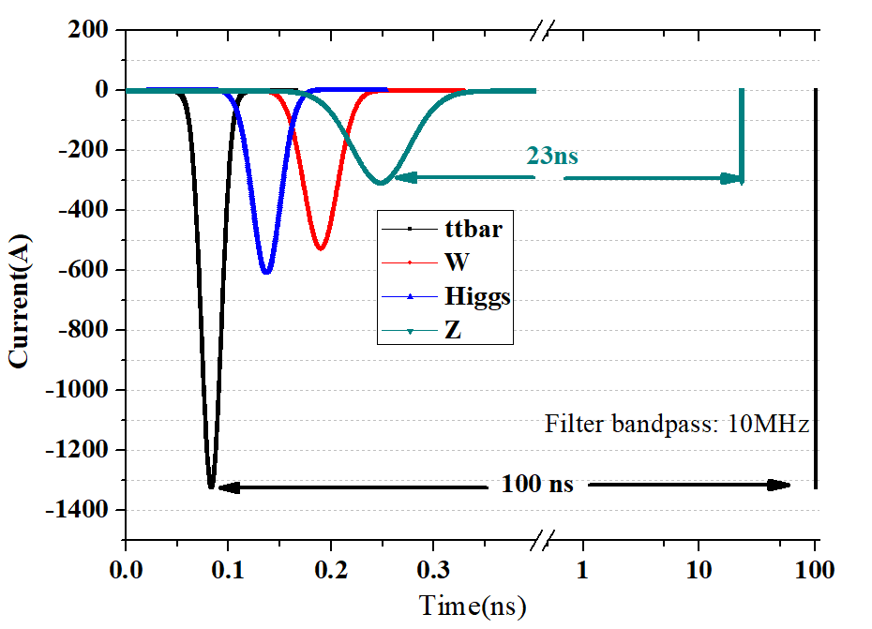
Signal interference
BII 8 electrodes BPM signal
4 electrodes
Time interval between two beam pass through the same BPM ΔT : 2×L/c
CEPC IP BPM （s=640mm）ΔT: 4.26 ns, Signal width after the filter T1>Bunch gap T2>ΔT

Slide 15
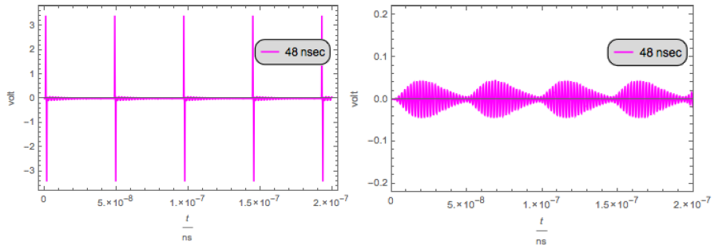
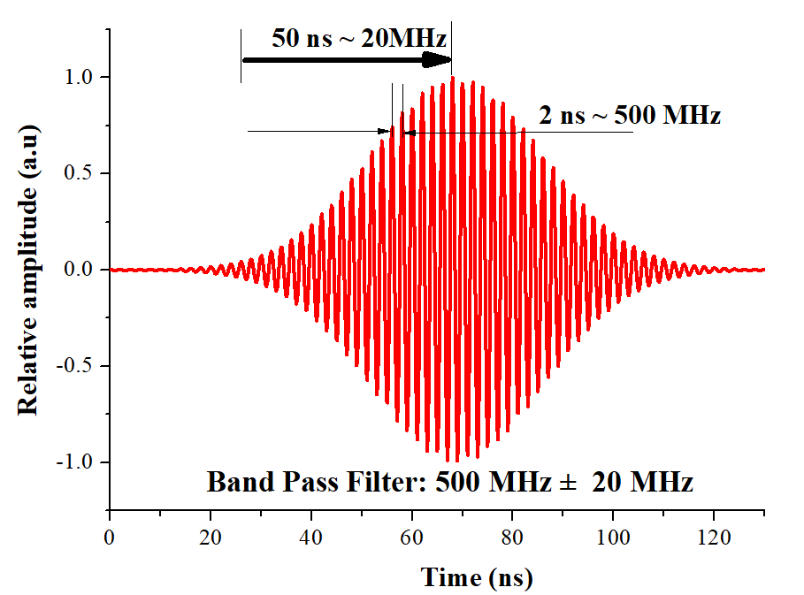
The challenge in a shared pipe
Bunch gap: 48 ns
Bunch gap: 24 ns
Gap: 12 ns
Operation mode of BPM readout electronics: CW mode Sampling rate ~100MHz.（different with scope GHz）
The filter will bring a long tail which make the detection become difficult

Slide 16
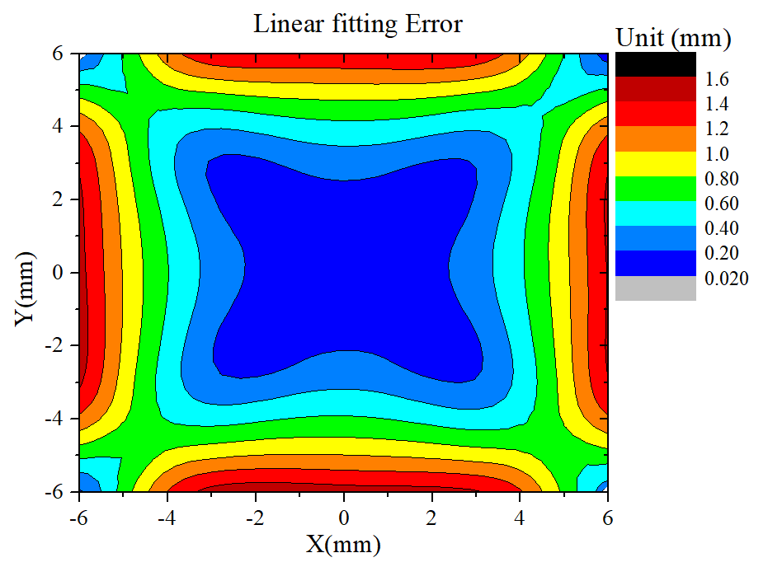
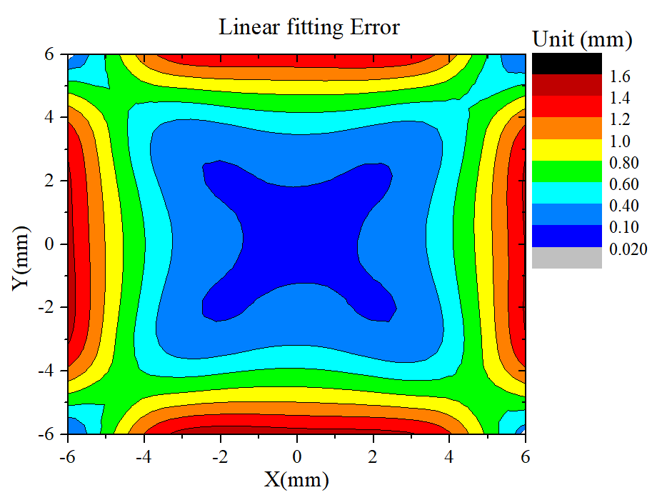
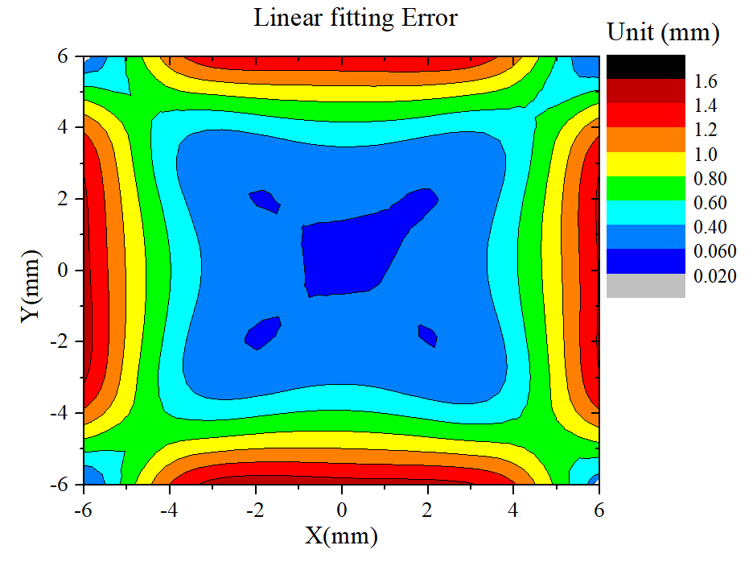
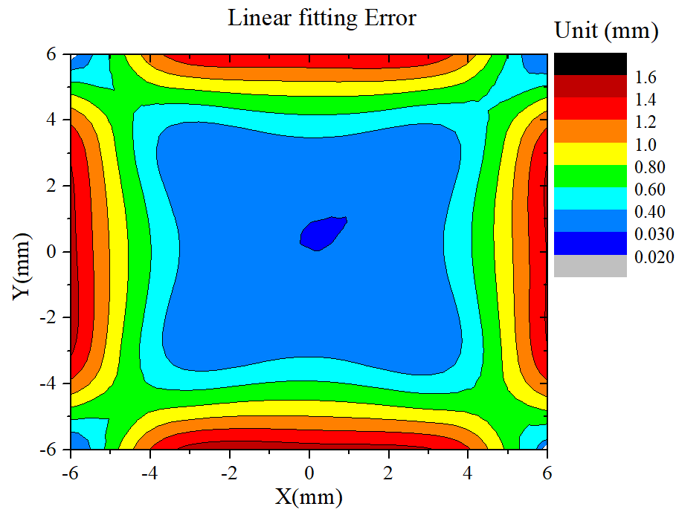
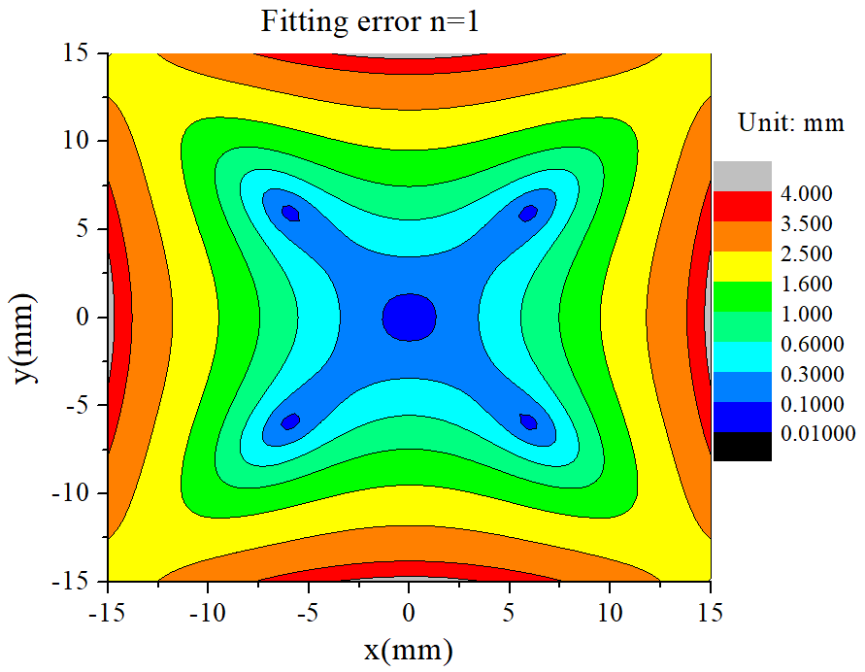
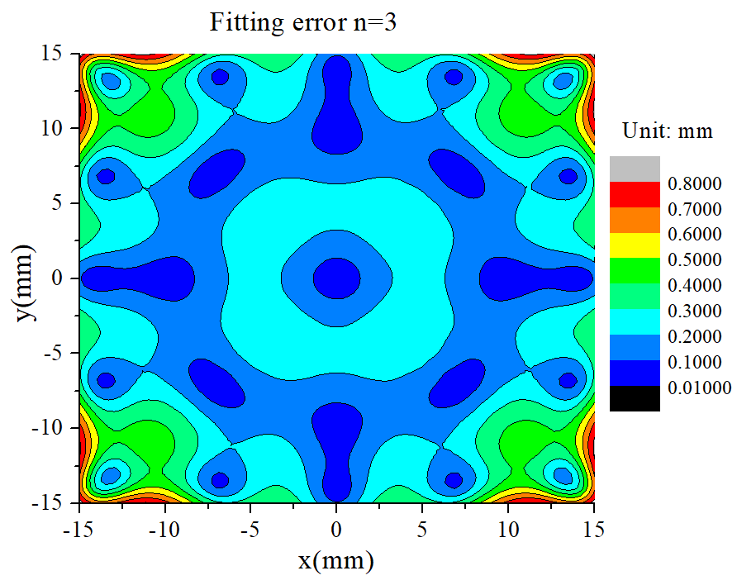
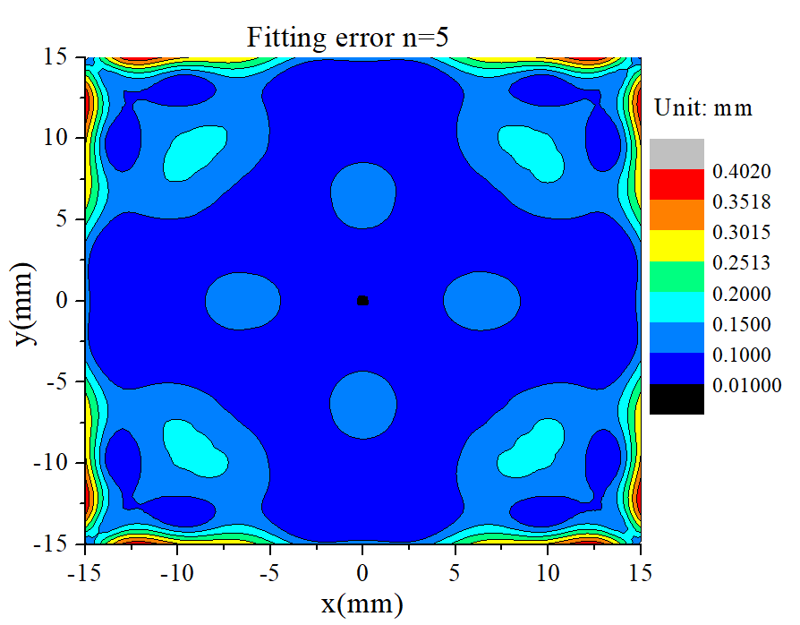
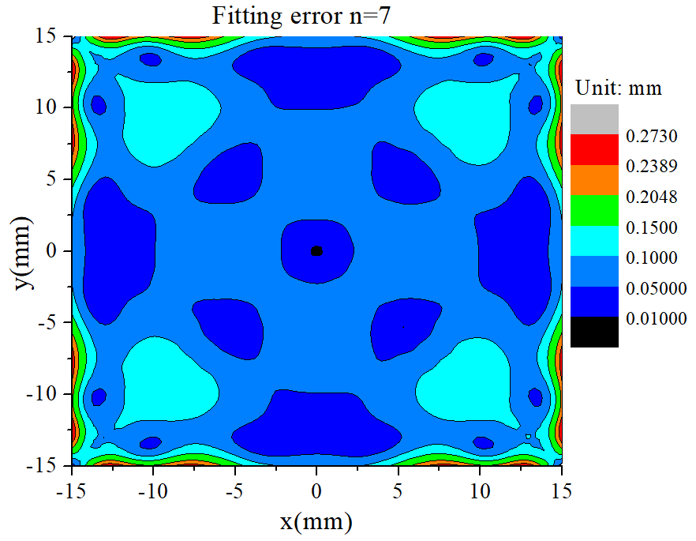
The accurancy for off axis beam
IP BPM b=10 mm
＜200 μm
＜100 μm
＜60 μm
＜30 μm
The error distribution in a round pipe (x = A₀+kU+A₂V n=1)
n=1
n=3
n=5
n=7
BPM b=28 mm
＜100 μm
＜100 μm
＜100 μm
＜50 μm

Slide 17
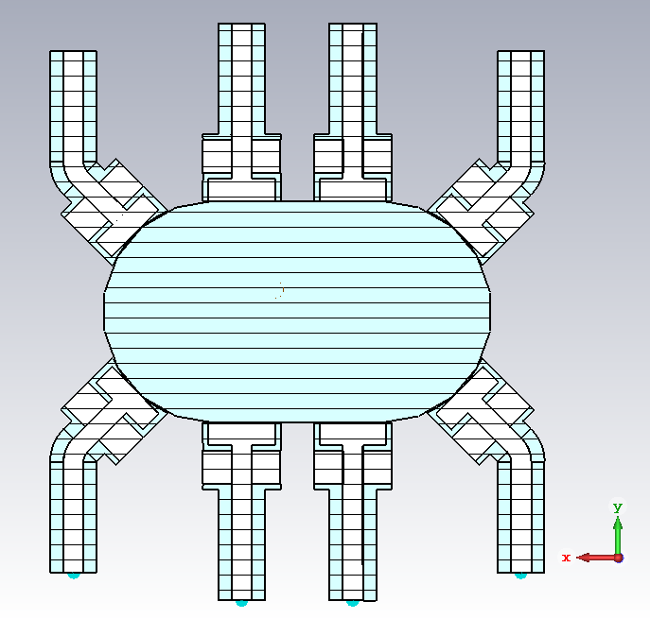
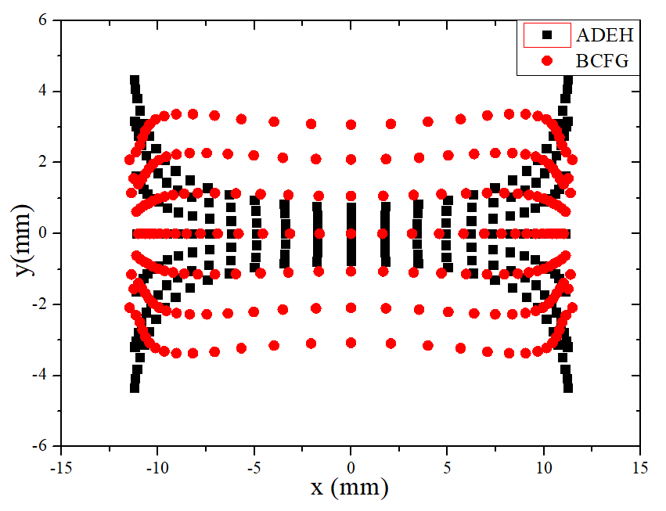
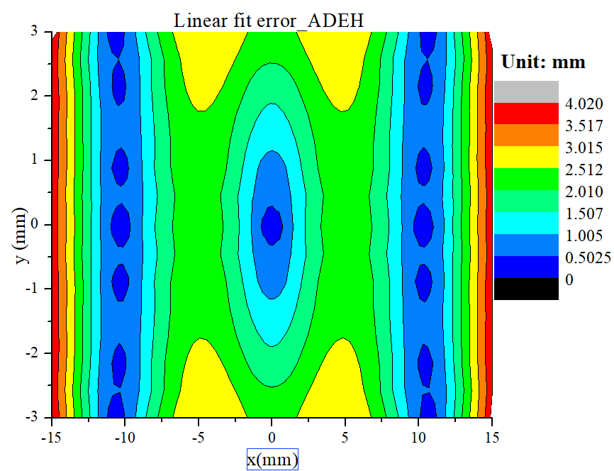
The error distribution
C
B
A
D
e+e-：±10.6 mm
Δt = 4.26 ns
20
E
H
±3mm ×±15 mm
F
G
15

Slide 18
IP BPM distributions
4 electrodes: blue / red in separated pipe for position measurement
8 electrodes: black in shared pipe for position/arrive time measurement
s = 885 mm
s = 630 mm
Improve the position measure accurancy for a single beam but bring difficulty to separate the duel-beam signal
Relativity between the data and the beam at IP became less
s = 915 mm

Slide 19
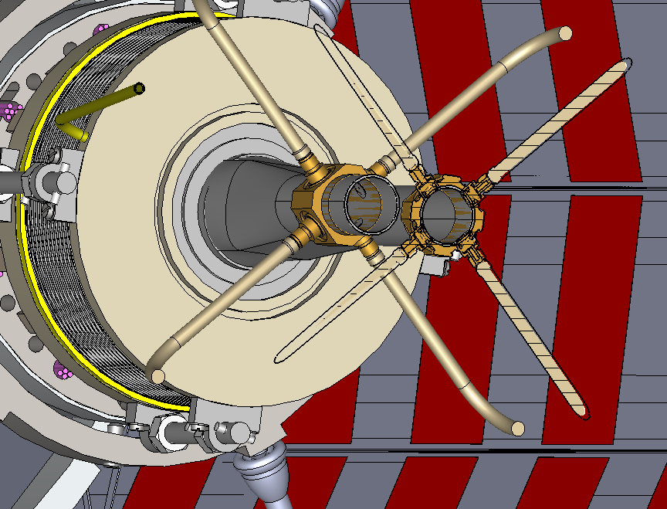
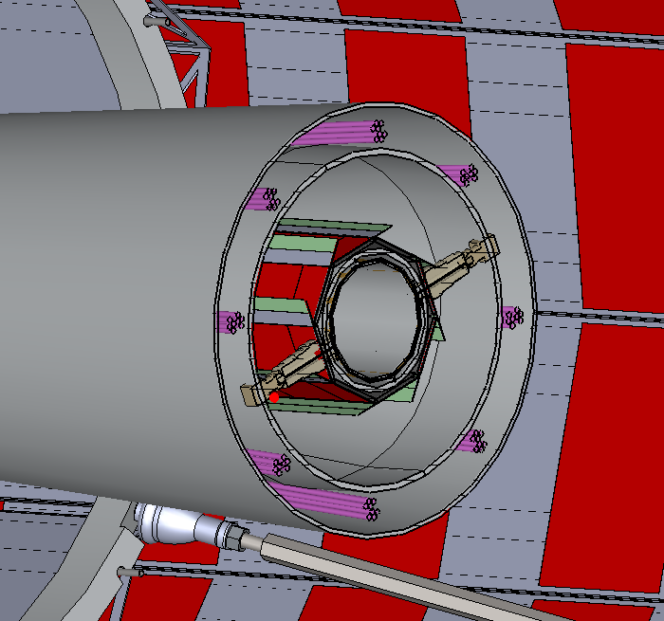
IP BPM
Courtesy of Wang Haijing
A special pipe （thicker），shift 30 mm in Z for two beam.
Preliminary schematic

Slide 20
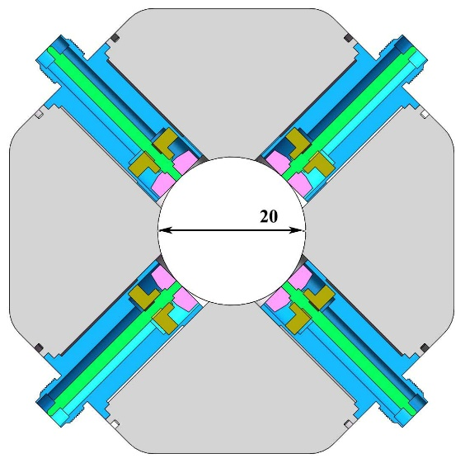
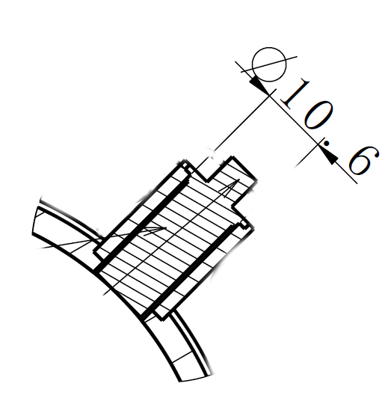
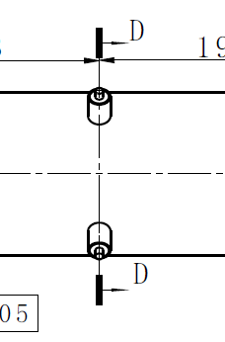
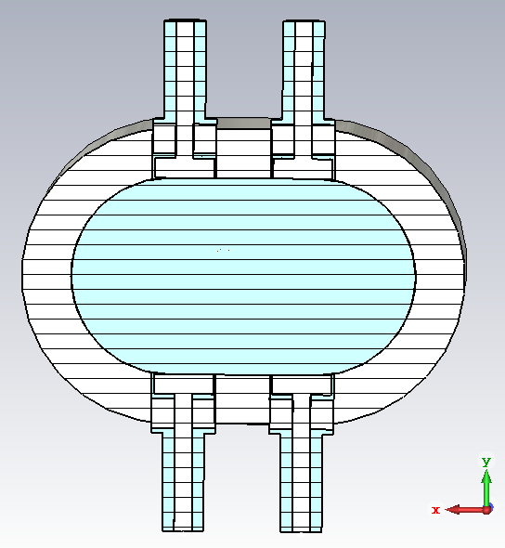
Mechanical parameters
Solution for a thin pipe
Schematic for a track pipe
 |  | Increase | Advantage | Disadvantage
r_{b} | 3 mm | Larger area and C_{b} | Higher signal level | Lower resolution
t_{b} | 2 mm | Larger volume | Lower wake impedance | Lower resolution
g_{b} | 0.25 mm | More trapped modes | Higher resolution | Higher wake impedance
b | 10 (28) mm | Smaller signal | Lower wake impedance | Lower resolution

Slide 21
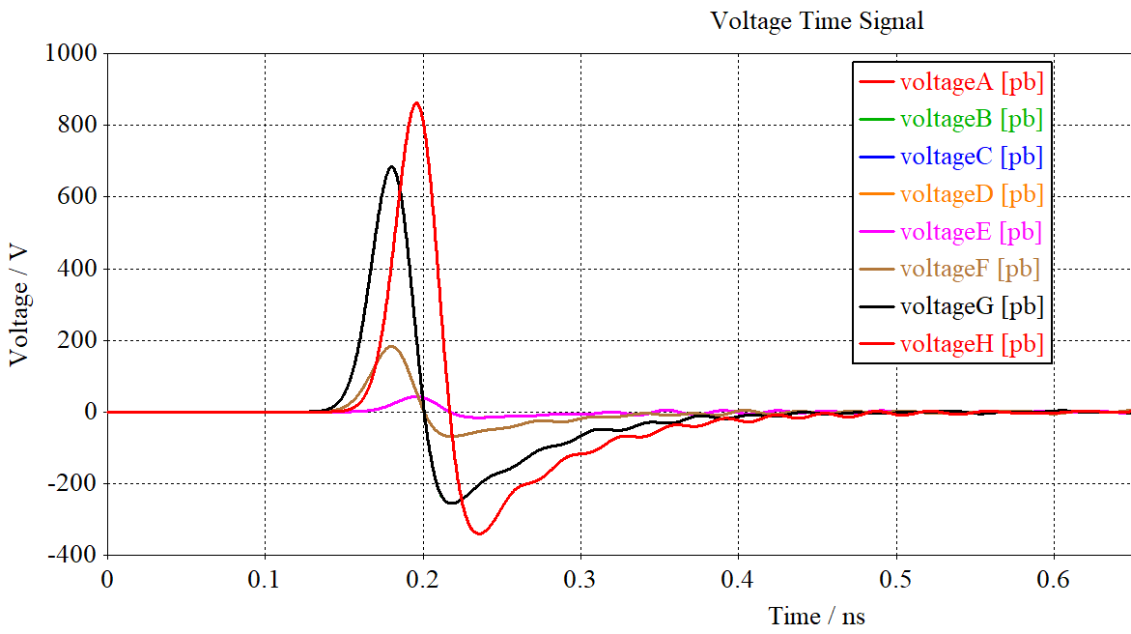
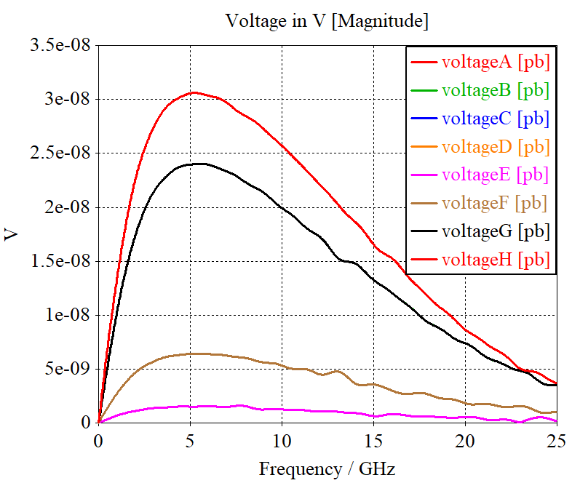
Design parameters
 | Bunch charge | Bunch length | Current peak | Current average | 650MHz | K_{loss}
 | nC | mm | A | A | dBm | mV/pC
Higgs | 20.8 | 4.1 | 607 | 0.208 | -11.9 (-20.2) | 6.76 (0.16)
Z | 22.4 | 8.7 | 308 | 0.974 | 1.5 (-6.8) | 0.30 (0.15)
W | 21.6 | 4.9 | 527 | 0.216 | -11.5 (-19.8) | 3.4 (0.25)
ttbar | 32.0 | 2.9 | 1315 | 0.320 | -20.2 (-16.4) | 15.1 (0.017)

Slide 22
Plan for next step
Signal high-speed switching processing
Algorithm improvement for 8 electrodes（with the help of calibration）
Development of glass sealing feedthrough
Prototype production including feedthrough and BPM
Wakefield Impedance test for a real BPM
….

Slide 23
Summary
The performance of the machine depends on the performance of the measurement system.
The resolution and accuracy of BPM are constantly improving with the progress of mechanical processing and digital signal processing technology.
IP BPM will face a series of special issues, the spatial interference, background noise, algorithm optimization, wakefield heating, and welding process need to be solved and further research is needed.

Slide 24
Thank you for your attention! ☺

Slide 25
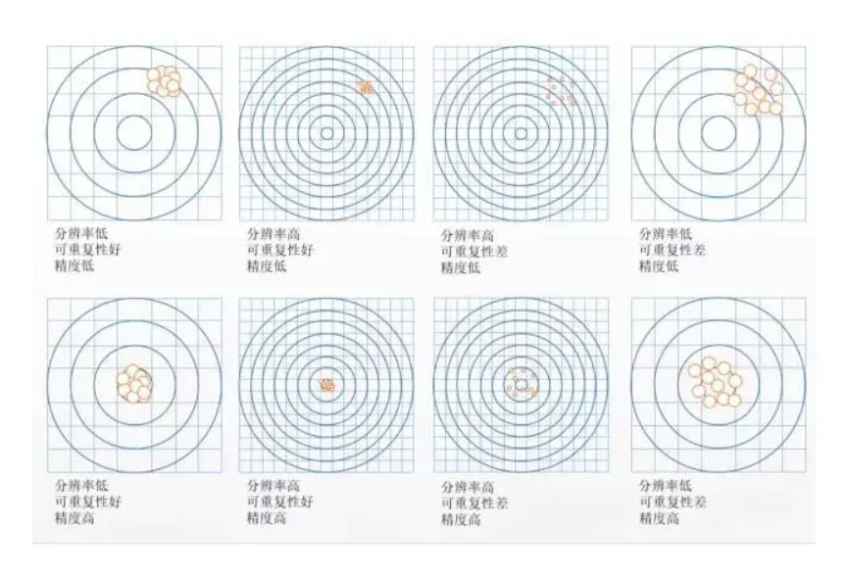
其它测量的分辨率精度、可重复性

Slide 26
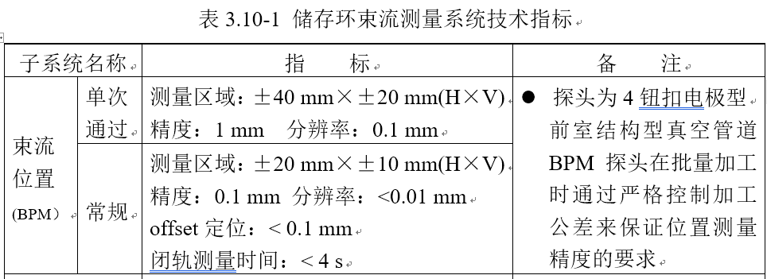
高分辨率、高精度
 | BEPCII (800/200μm) | HEPS (10/1 μm) | CEPC
分辨率 | ＜ 10 μm （2s） | 0.1 μm | 1 μm (4 s)
精度 | 100 μm | /（10 μm） | 10 μm

