Slide 1
Some considerations on the beam loss & machine protection in CEPC
Speaker: Cui Xiaohao
For CEPC Accelerator Physics Group
The Institute of High Energy Physics, Chinese Academy of Sciences

Slide 2
1. Introduction
Continuous beam losses as machine working:
from beam-beam scattering, beamstrahlung, Touschek effect,…
Beam losses as machine failure:
from magnet field failure, beam instabilities, feed-back system,…

Slide 3
1. Introduction
Energy stored in the particle beams
 | Higgs | W | Z | ttbar
Energy (GeV) | 120 | 80 | 45.5 | 180
Bunch Number | 268 | 1297 | 11934 | 35
Bunch Charge (nC) | 22.3 | 21.6 | 22.4 | 31.4
Energy/bunch (kJ) | 2.68 | 1.73 | 1.02 | 5.65
Energy/beam (MJ) | 0.66 | 2.24 | 12.19 | 0.19
The z mode machine has the largest energy storage in the beam, and tt mode machine has the larges energy per bunch.
The energy stored in the machine is very high compared to other lepton colliders.

Slide 4
1. Introduction
A study of the beam loss in CEPC is very important:
1. The particle loss position;
2. Energy deposited at the loss point;
3. bunch distribution at the loss point;
4. machine protection considerations regarding these effects;
……

Slide 5
2. Machine Protection
Active machine protection:
Monitoring of the beam (BPMs, beam loss monitors, charge monitors,…);
Beam dump system;
Interlock system;
……
Passive machine protection:
Shielding;
Collimators;
……

Slide 6
2. Machine Protection
Process of active machine protection
signal
signal
Beam loss detection
Beam interlock
system
Dumping system
Dumping complete
>100 μs
>150 μs
>150 μs
300 μs
~1ms
CEPC active machine protection system can only work for beam failure of time scale larger than 1ms

Slide 7
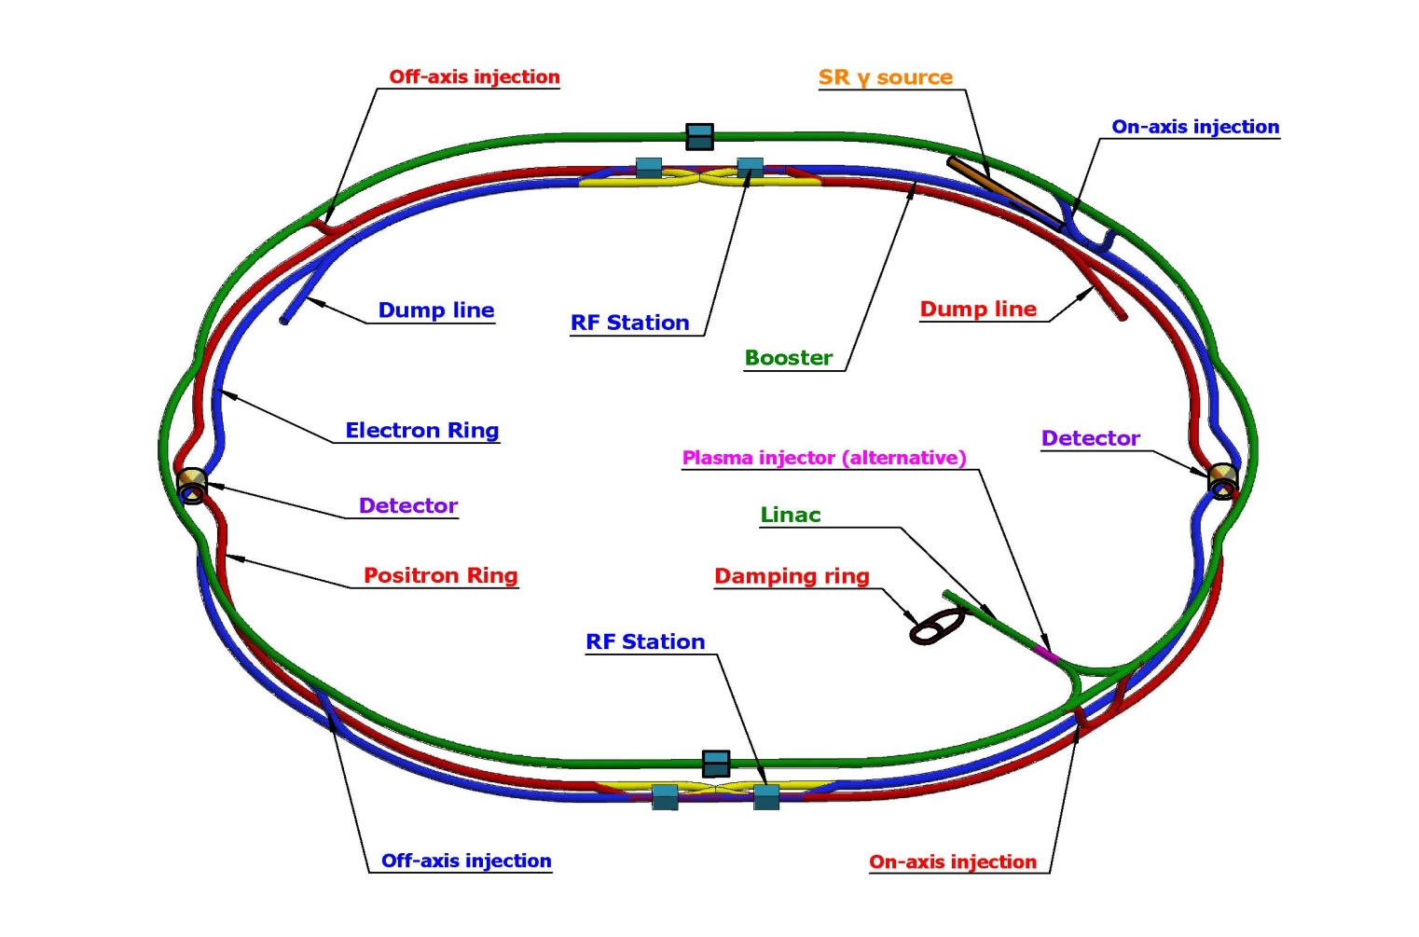
3. Beam dumping system in CEPC
For machine and detector protection;
One beam dump line for each electron/positron ring;
Dumping line go into the inside of the ring to avoid SppC;
Both electron and positron dumping lines are placed in the straight section near IP.

Slide 8
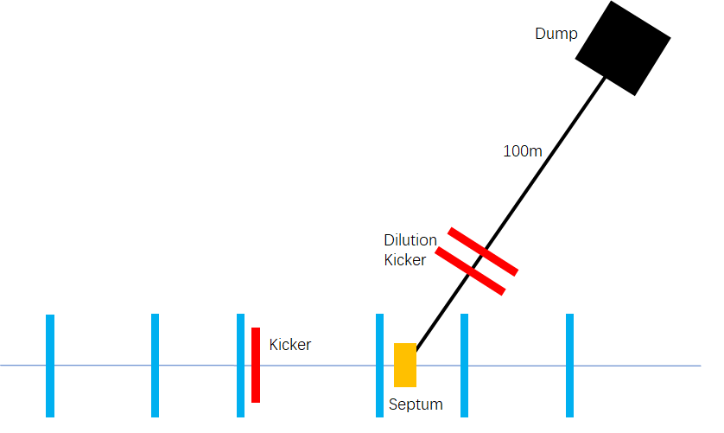
3. Beam dumping system in CEPC
For machine and detector protection;
Use one kicker and one septum to get the beams into the dump line, so all bunches can be dumped in one turn;
Horizontal and vertical dilution kickers are used to change the position of different bunches at the dump, in order to reduce the beam damage to the dump.

Slide 9
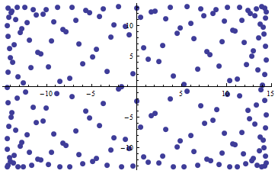
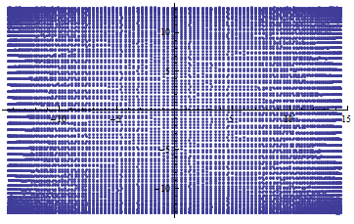
3. Beam dumping system in CEPC
Fast dilution kickers are used to direct different bunches to different positions at the beam dump plane.
Distribution of bunches at the Dump for different bunch pattern

Slide 10
4. Collimators in CEPC
Collimators for detector background (details in MDI report);
Beam lost protection;
Beam halo cleaning;
Momentum collimation;
……

Slide 11
4. Collimators in CEPC
We did some preliminary simulations on the beam loss and collimators;
AT and Sad are used for the simulation;
Considered beam loss induced by machine failure and RF failure;
Bunch time t
Magnet field or RF failure
Other magnets

Slide 12
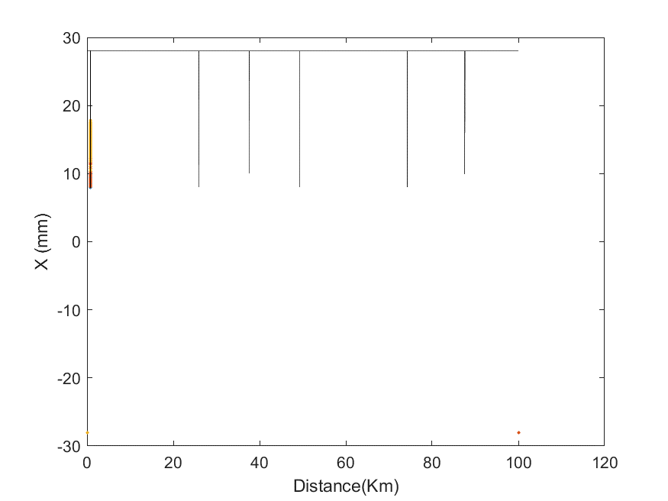
4. Collimators in CEPC
IP1
IP2
Constant pipe radius assumed;
Small aperture near the IP and detector collimators are added;
Collimators with different apertures and positions are inserted;

Slide 13
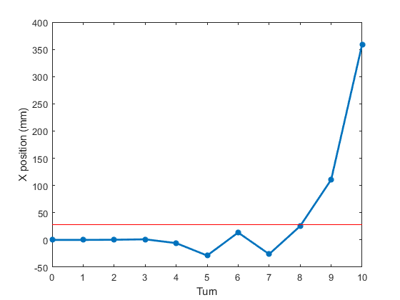
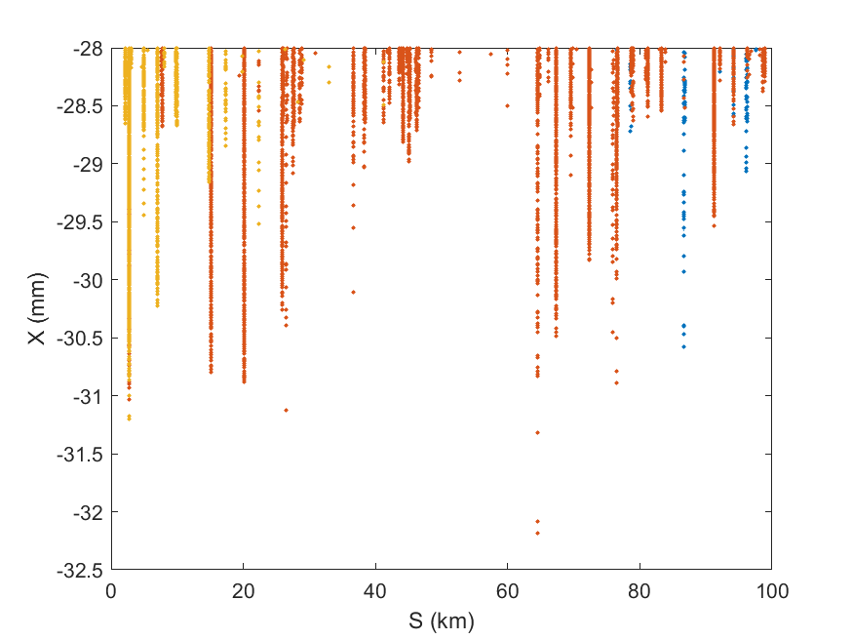
4. Collimators in CEPC
In most cases, when magnet failure occurs, the bunch get lost in several turns time.
Without collimators, particles get loss at all places around the ring.

Slide 14
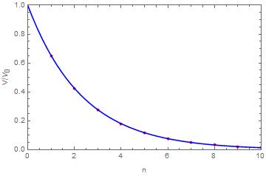
4. Collimators in CEPC
J.Y Zhai
In the condition of critical RF failures, the most serious beam loss occurs.
$$V=V_{0}e^{−t/τ}$$
where $V_{0}=4.01×{10}^{7}$ is the voltage of the RF cavity , $τ≈773 μs$.
Single passage at CEPC ~ 331$μs$
Fig.1 Voltage decays as n varies

Slide 15
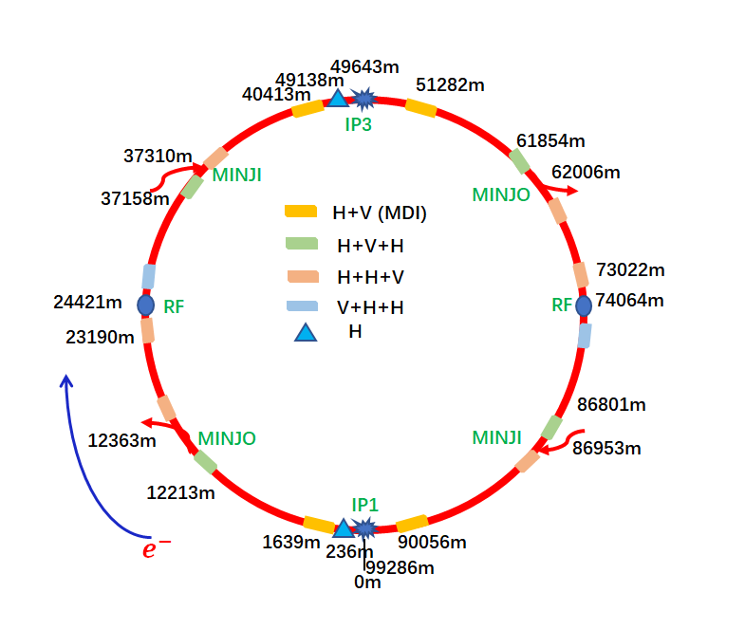
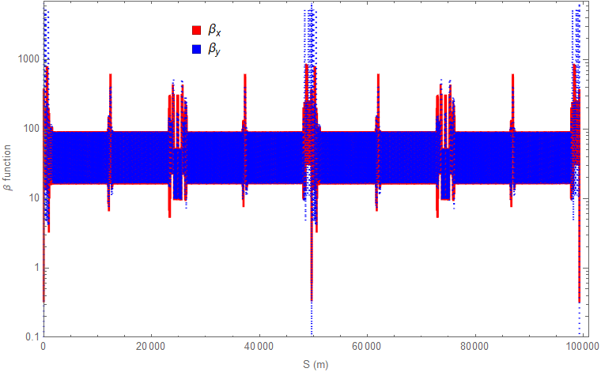
4. Collimators in CEPC
Y.T. Wang
Collimators locate at the regions with large $β$ functions or large dispersion functions
16 collimators for MDI
Total number of collimators: 54
Fig 2: $β$ functions along the collider ring
Fig 1: Layout of the global collimators

Slide 16
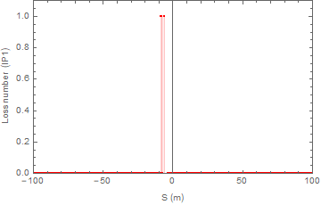
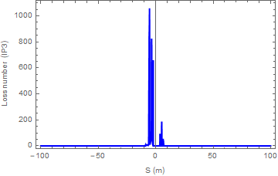
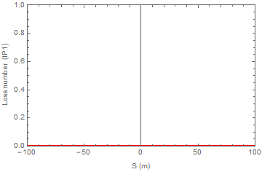
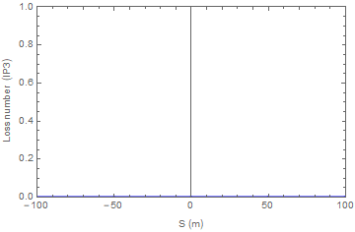
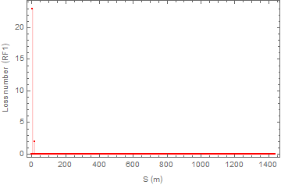
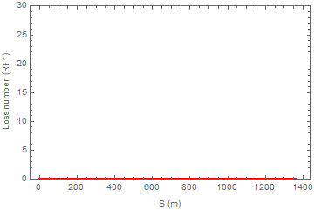
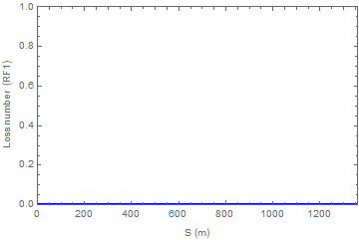
4. Collimators in CEPC
Y.T. Wang
Simulation result suggest:
In condition of MDI collimator, particles will loss near IP region and RF region (20000 particles in simulation)
IP
IP
W/O collimators
W collimators
RF
RF

Slide 17
Summary:
1. A general introduction for the considerations of beam loss and machine protection for CEPC is given;
Some very preliminary studies on the beam dump and beam collimation;
More physical considerations and simulations are needed.

Slide 18
Thank You!

