Slide 1

中国科学院高能物理研究所
Institute of High Energy Physics, CAS
Recent progress of CEPC detector magnet
Ning Feipeng
IHEP, CAS
ningfp@ihep.ac.cn
Hengyang，2023.04.01

Slide 2

目录
Recent progress of LTS plan
Recent progress of HTS plan
Summarize of Superconducting detector Magnet Workshop hosted by CERN and KEK on 12-14 Sep. 2022
Conclusion

Slide 3
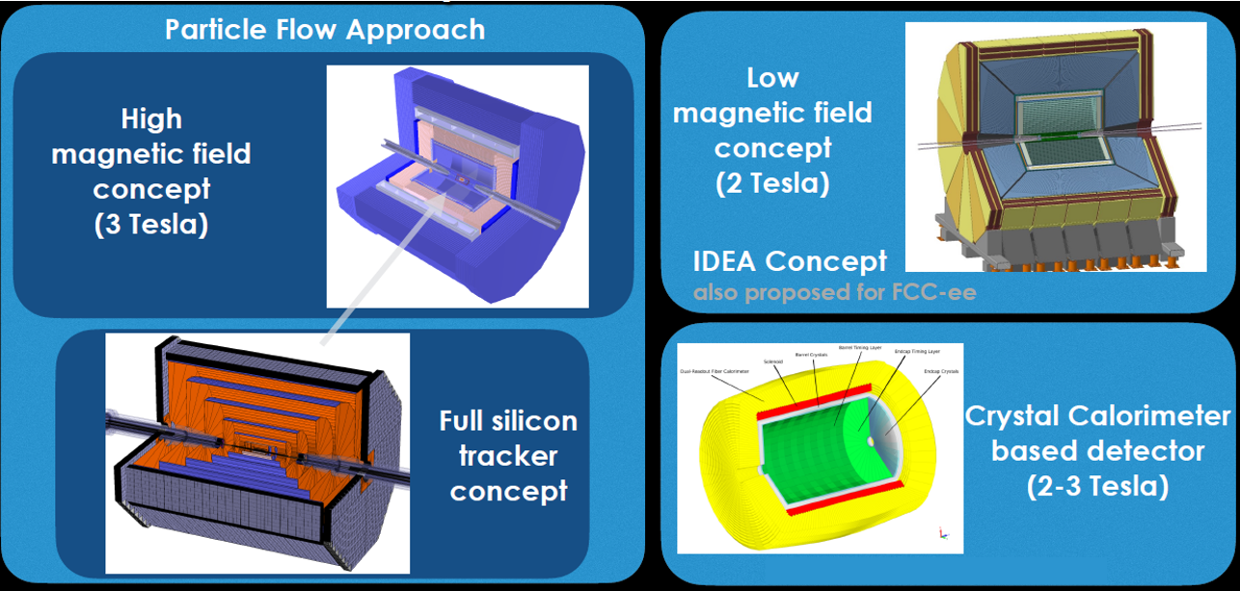
CEPC detector
LTS based
HTS based

Slide 4
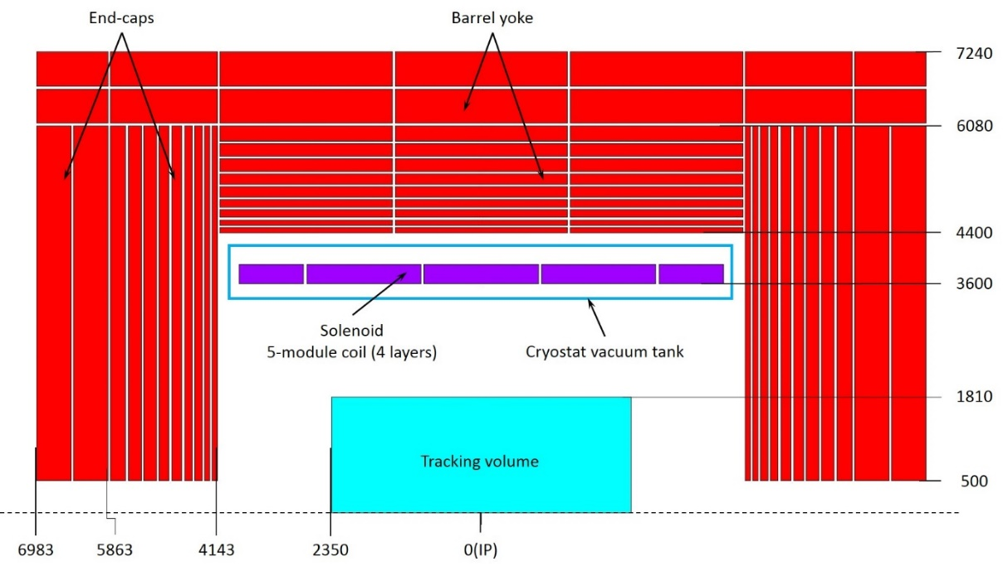
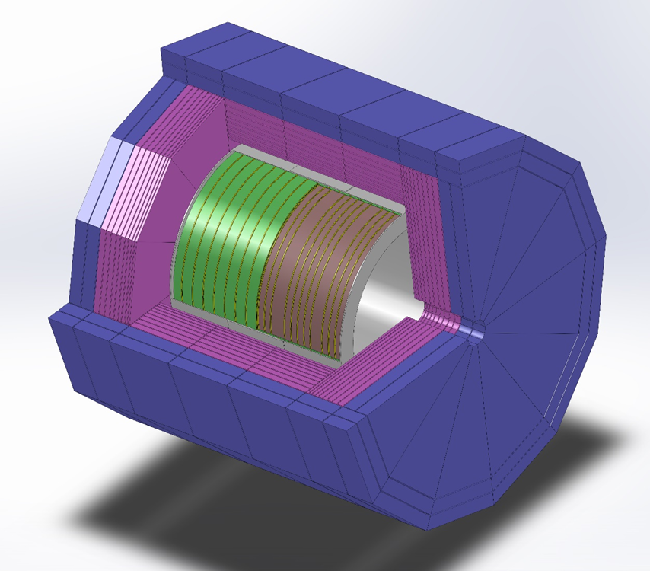
LTS version
The solenoid central field (T) | 3 | Working current (A) | 15779
Maximum field on conductor (T) | 3.485 | Total ampere-turns (MAt) | 20.323
Coil inner radius (mm) | 3600 | Inductance (H) | 10.46
Coil outer radius (mm) | 3900 | Stored energy (GJ) | 1.3
Coil length (mm) | 7600 | Cable length (km) | 30.35
低温恒温器内半径(mm) | 3400 | 桶部轭铁外半径(mm) | 7240
低温恒温器外半径(mm) | 4250 | 外围轭铁总长(mm) | 13966
低温恒温器长度(mm) | 8050 | 桶部轭铁重量(t) | 5775
冷重(t) | 165 | 端部轭铁重量(t) | 6425
桶部轭铁内半径(mm) | 4400 | 轭铁总重(t) | 12200

Slide 5
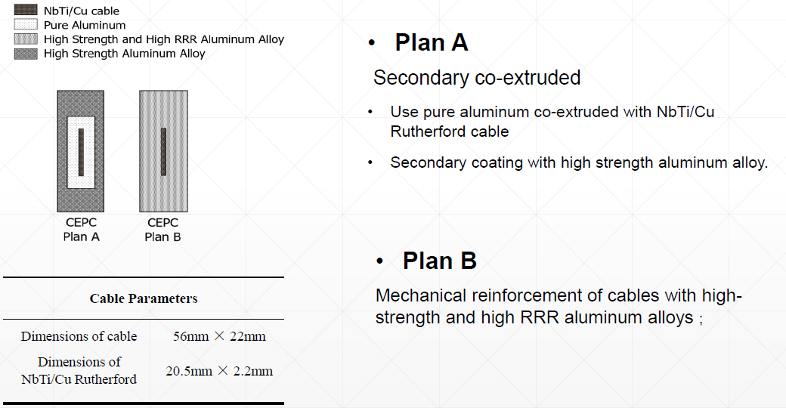
LTS version
Al stabilized NbTi-Cu Rutherford cable

Slide 6
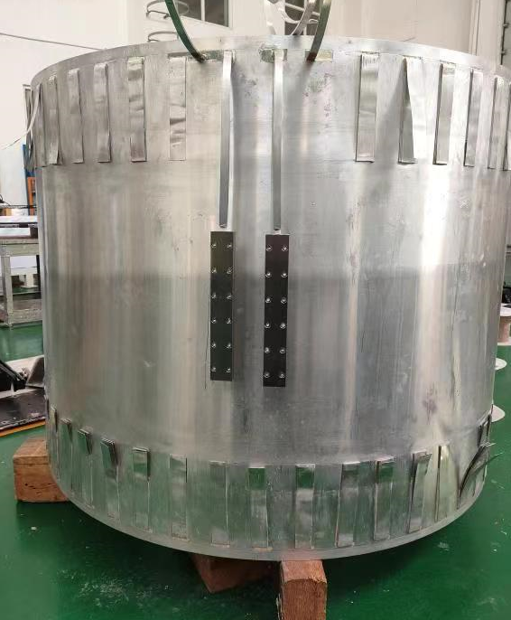
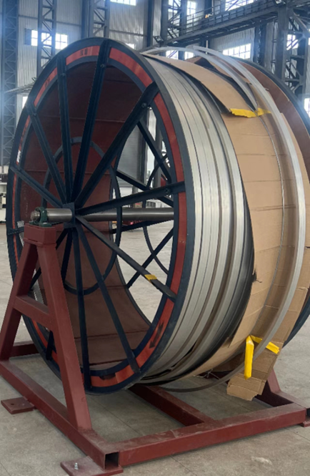

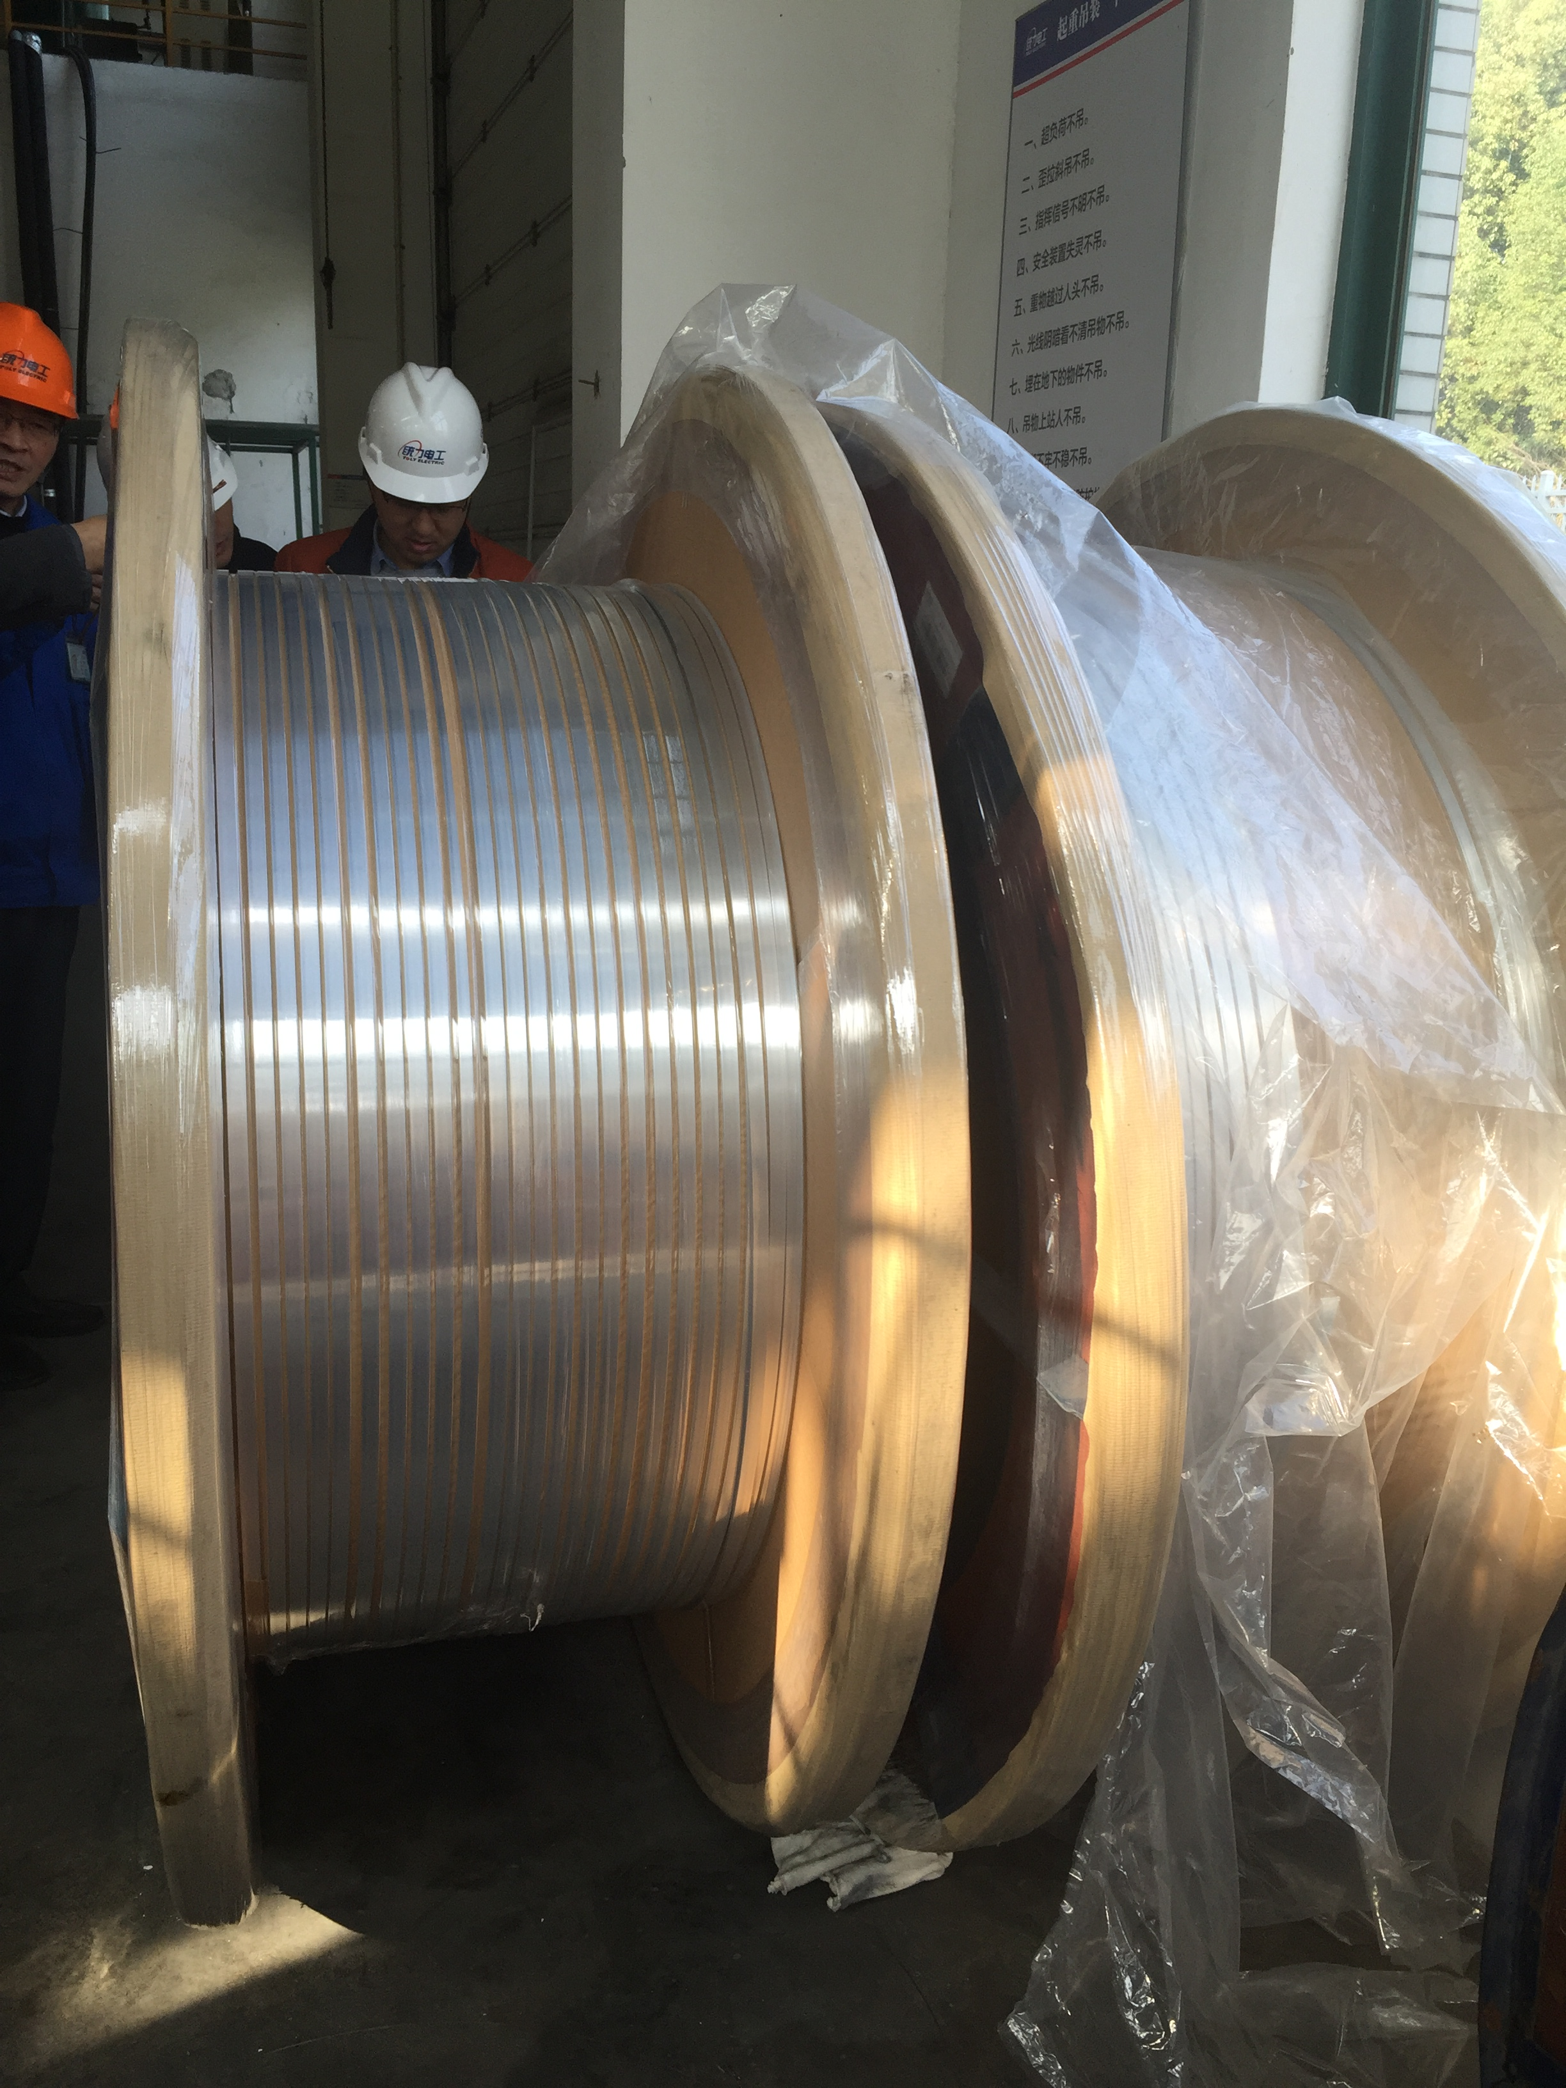
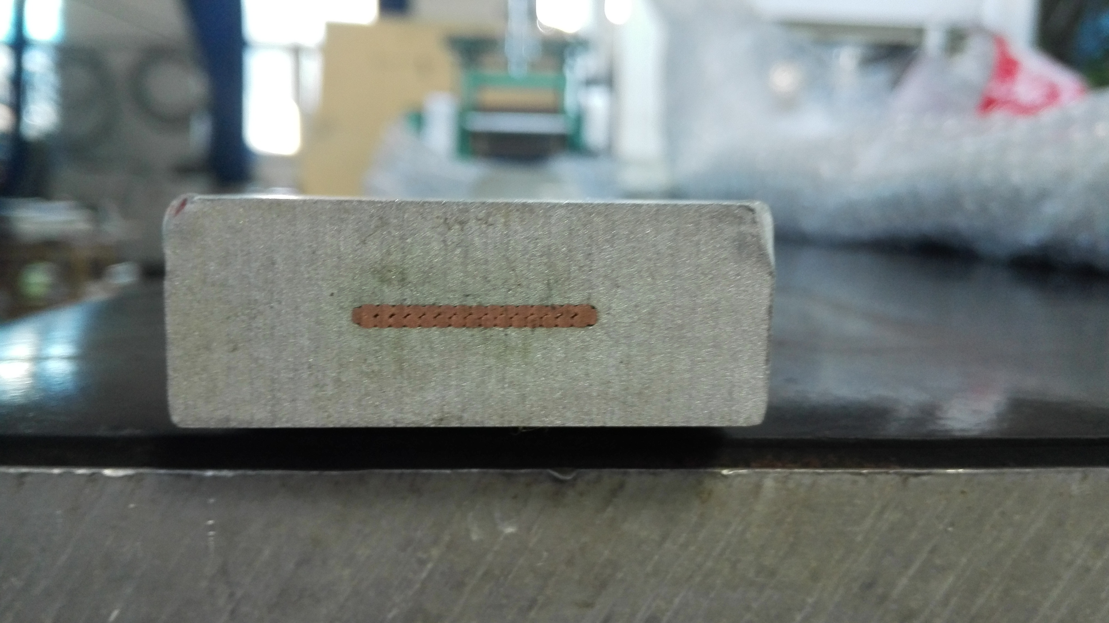
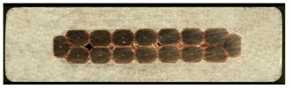
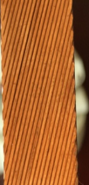
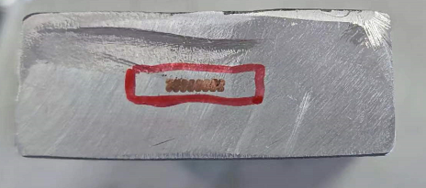
LTS version
32芯和16芯超导卢瑟福电缆的研制，临界电流衰减小于 5%, 铜的RRR值下降小于1/3
1公里长16芯铝基铌钛卢瑟福电缆，铝稳定态与铌钛卢瑟福电缆剪切强度大于 30MPa. 已经用在Emus超导磁体模型线圈上
长的样缆和线圈, 6061 + copper，22*56mm²
继续研究铝合金二次包覆的工艺.
EMuS coil
NbTi Rutherford cable
Small size Al stabilized cable 4.7*15mm²
Long small size cable
Dummy cable 22*56mm²
Long Dummy cable（22*56mm²）

Slide 7
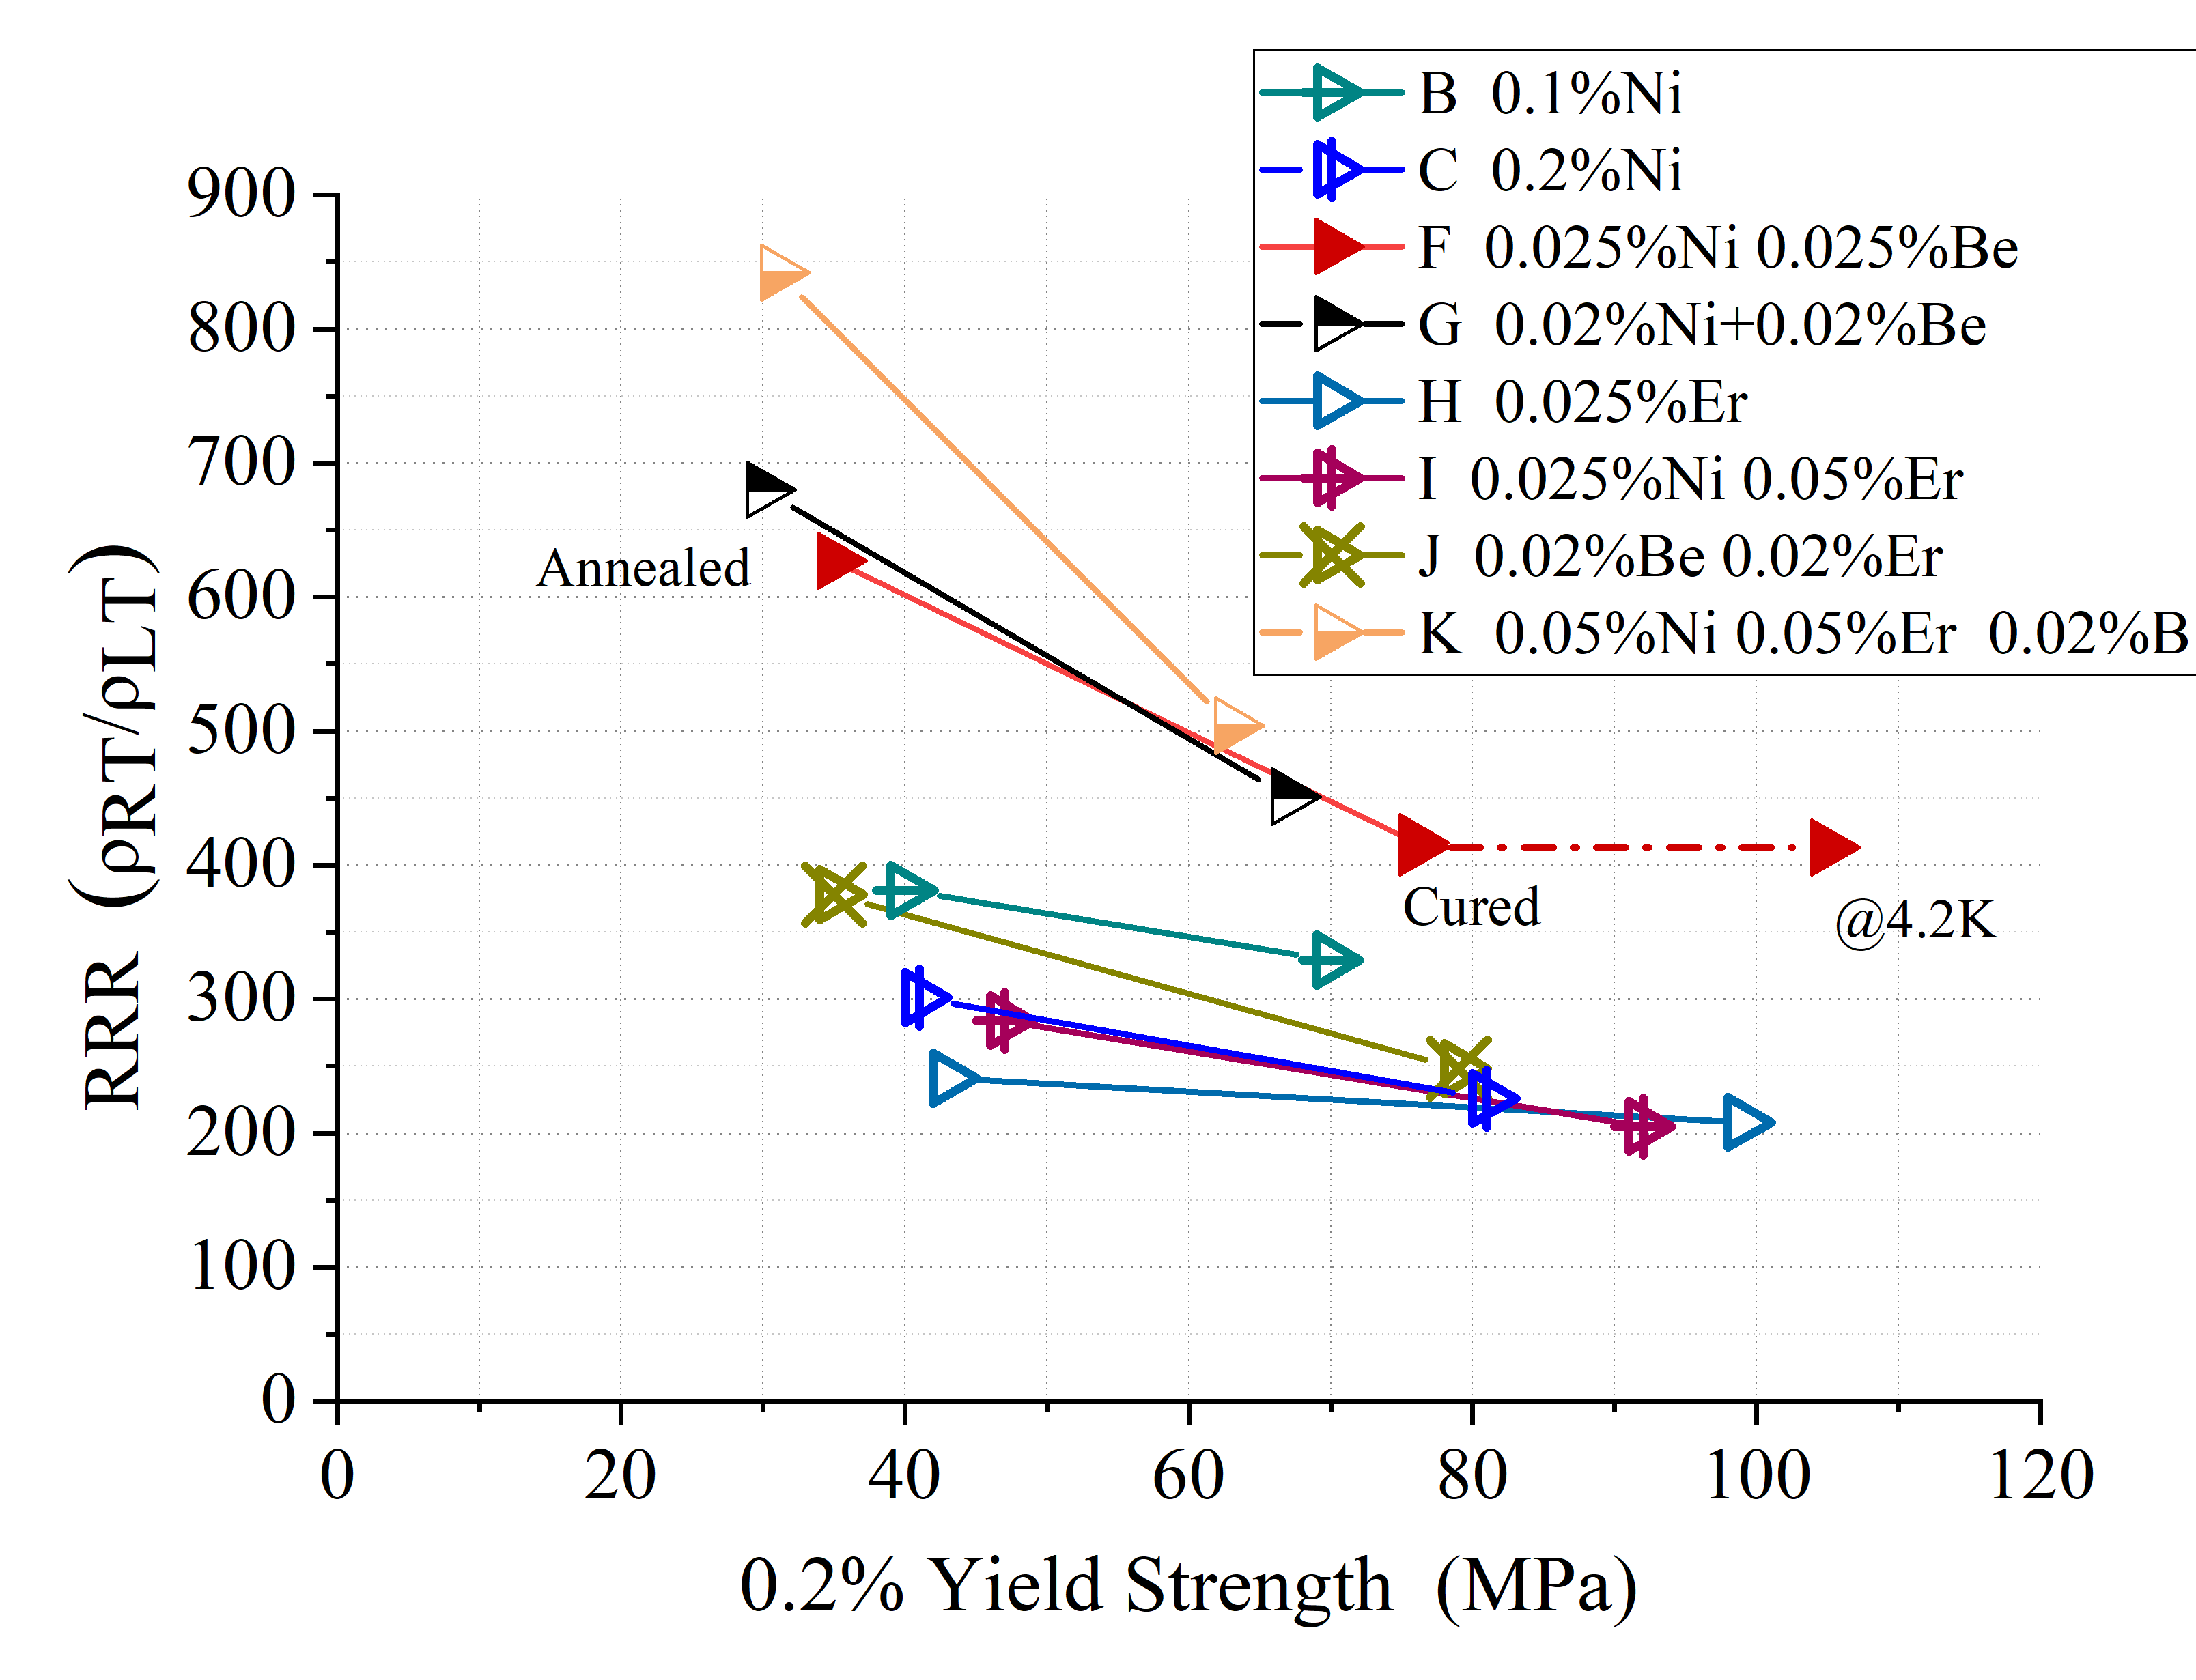
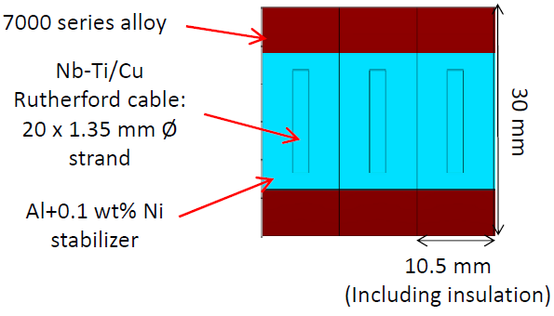
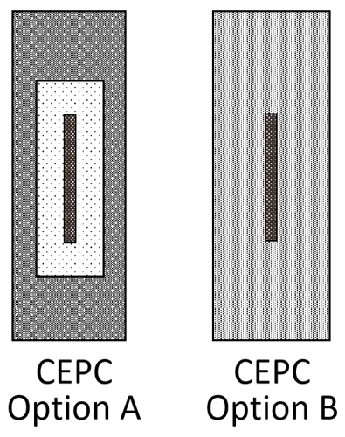
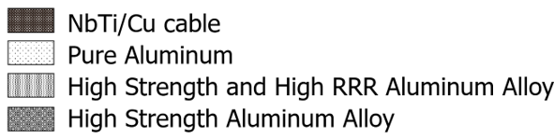
LTS version
R&D of High Strength and High RRR Aluminum- Stabilizer for Superconducting Cable
Yield strength > 100 MPa@4.2K, 74 MPa at room temperature, RRR value > 400
By doping Ni-0.025% Be-0.025%, annealing, cold-working and curing.
The Al-0.025%Ni-0.025%Be alloy prepared from 4N8-aluminum achieved high 0.2% yield strength of 75MPa (R.T.) with RRR of 417 after cold working of 21% and annealing at 130℃ for 15hrs.
IDEA

Slide 8
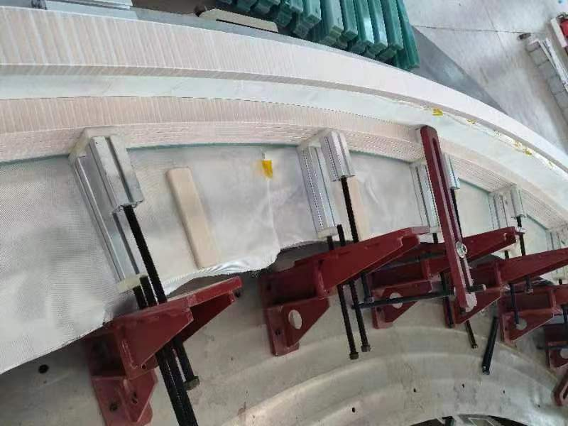
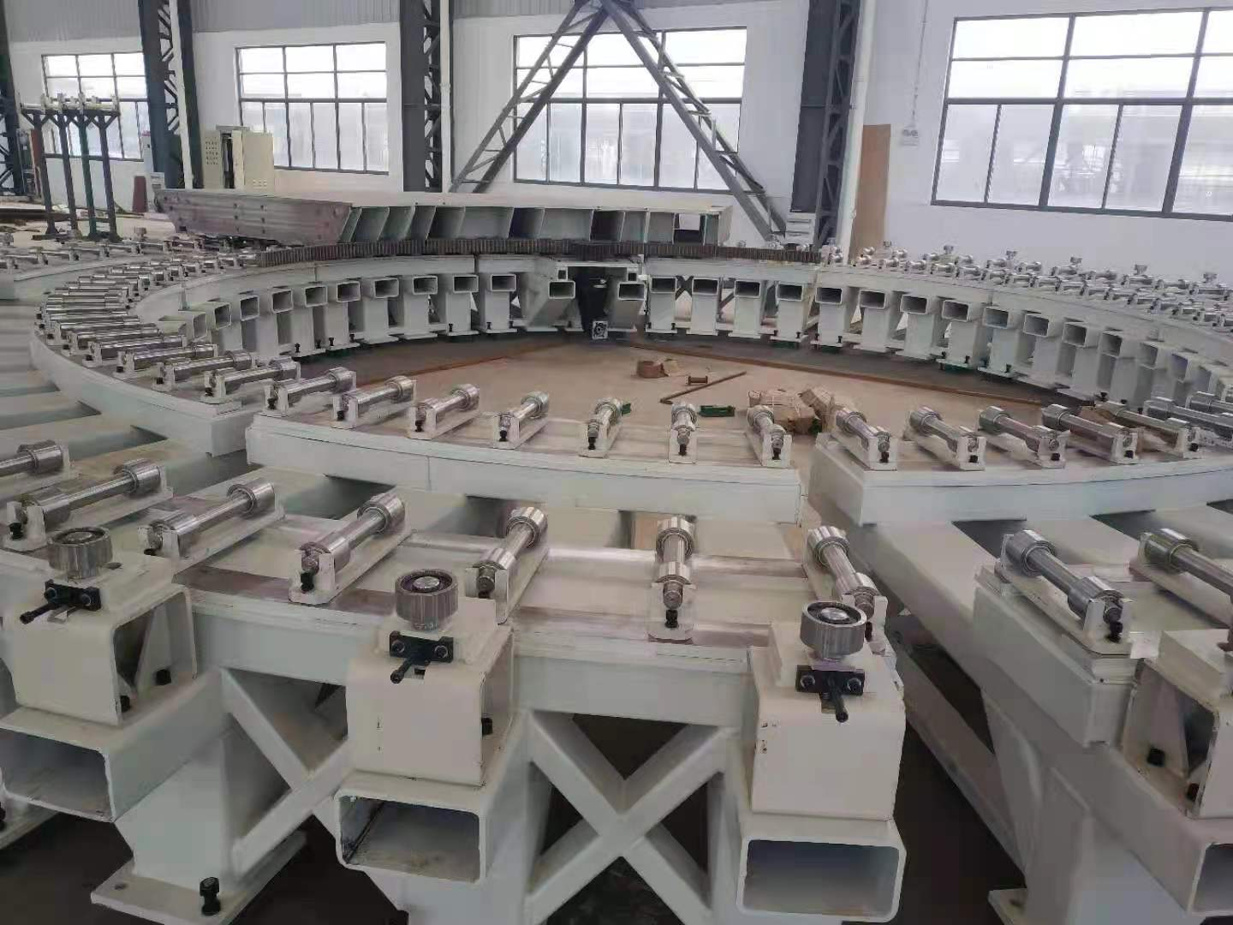
LTS version
CEPC detector magnet winding platform (cooperated with Hefei Keye company)

Slide 9
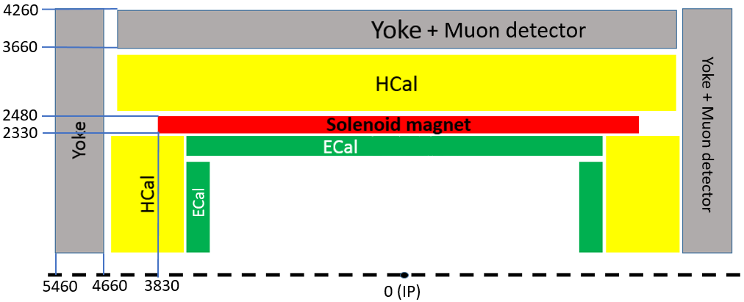
HTS version
The 4th Conceptual Detector Design: The solenoid magnet locates between Hcal and Ecal.
A large ultra-thin & transparent solenoid magnet:
Advantages:
Stable, can work at 20K, with a large temperature margin and stable operation;
Transparent, the main material is hastelloy;
High strength, HTS tape can withstand a tensile force of 400MPa, much higher than 150MPa of LTS NbTi wire;
Supply, three domestic manufacturers with sufficient supply
Disadvantages:
The technology is immature, need to develop all processes from HTS cables to magnet technologies;
The cost of magnets is high.
Magnetic field | 3 T | Current | 29600 A
Inner diameter | 4660 mm | Inductance | 0.53 H
Outer diameter | 4960 mm | Stored energy | 234 MJ
Magnet thickness | 150 mm | Cold mass | 20 ton
Length | 8000 mm | Total weight | 35 ton

Slide 10
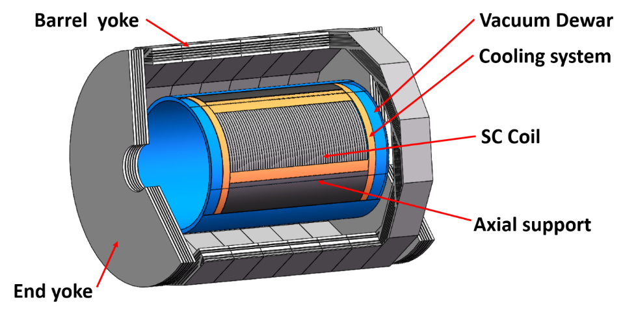
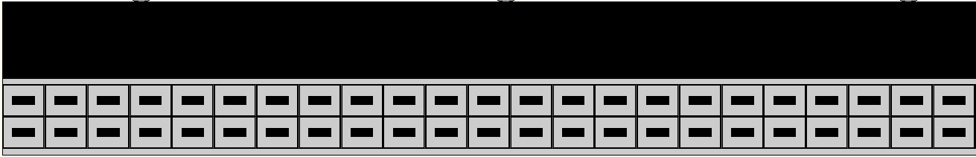

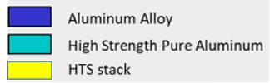
HTS version
HTS coil concept design:
Aluminum alloy support
Turns | 300*2 | HTS cable length (km) | 9
Current | 29700 A | ASTC weight (ton) | 9
Inductance | 0.53 H | Cold mass weight (ton) | 20
Stored energy | 234 MJ | Total weight (ton) (no yoke) | 35
CEPC HTS
HTS cable: ASTC(Al stabilized HTS Stacked Tape Conductor)

Slide 11
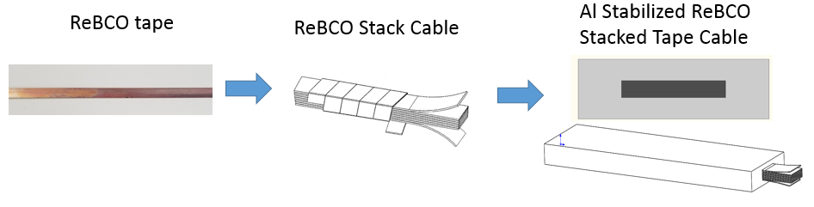
HTS version
铝稳定体高温超导叠型电缆
ASTC(Al stabilized HTS Stacked Tape Conductor) cable development
Advantage: Simple structure, easy to process, has experience and processing equipment;
Disadvantage: uneven current distribution, High dynamic loss, great influence of shielding current, large AC loss, and so on.

Slide 12
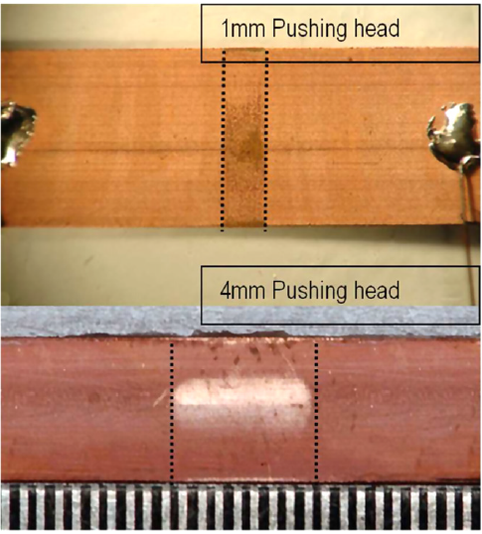
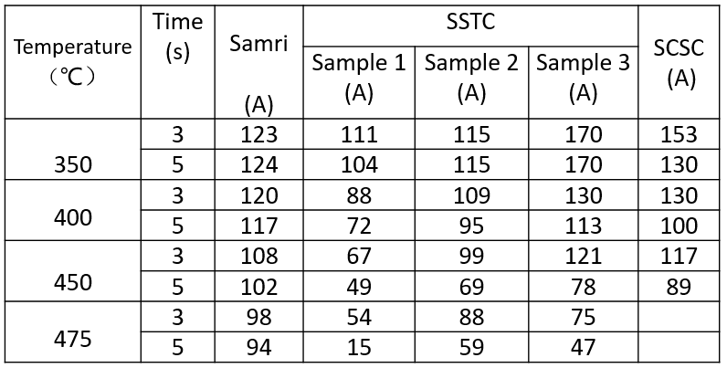
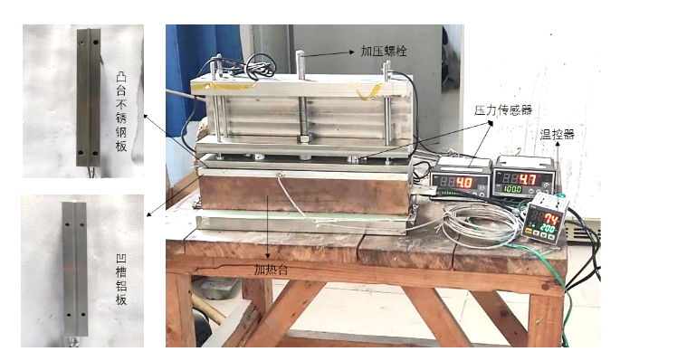
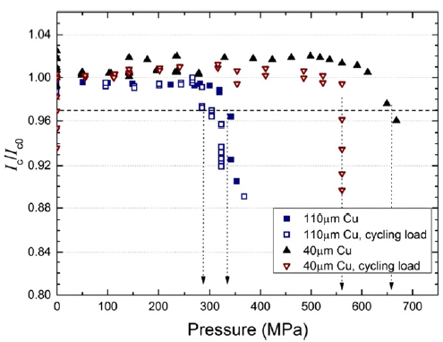
HTS version
ASTC(Al stabilized HTS Stacked Tape Conductor) cable development
During the processing of cables, encountered high temperature(500℃) and high pressures (50~100MPa)
High temperature test：
High pressure test：
50 MPa, 1cm, 200 kg压力
二代高温超导带材耐高温性能研究，核聚变与等离子体物理，2022年5月，第42卷，增刊，150-154
REBCO带材焊接接头电阻研究，低温与超导，第50卷，第7期，21-27
Ilin, SUST 28(2015)055006

Slide 13
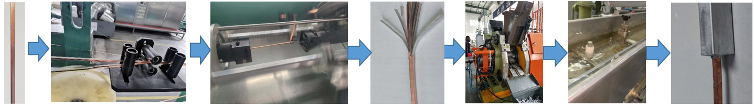
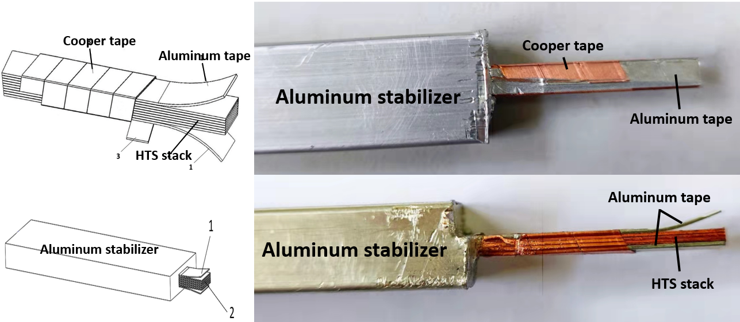
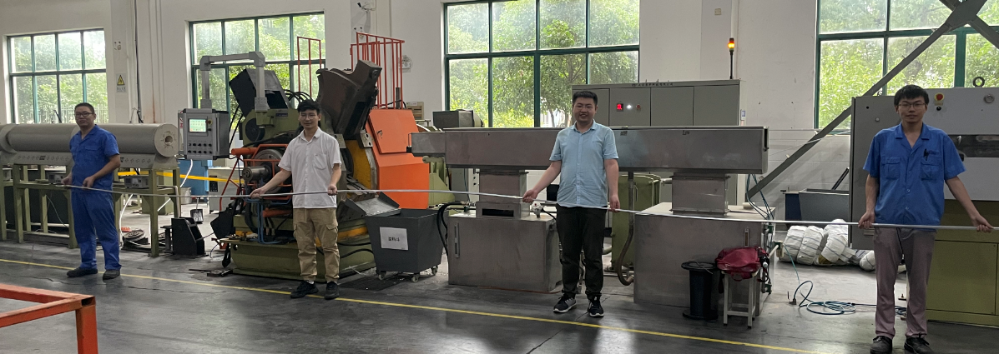
HTS version
铝稳定体高温超导叠型电缆
ASTC(Al stabilized HTS Stacked Tape Conductor) cable development
Small size cable: 15*10mm² , Tape Width: 4 mm, thickness: 80 μm; tape layer ≥14
10 m ASTC prototype cable
2021.09.29

Slide 14
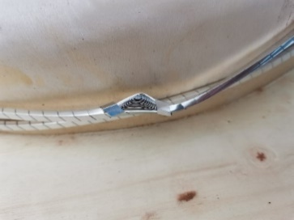
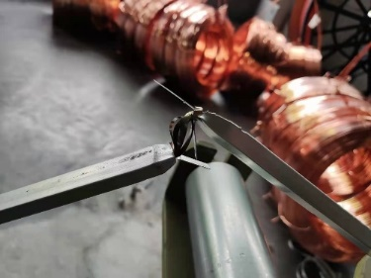
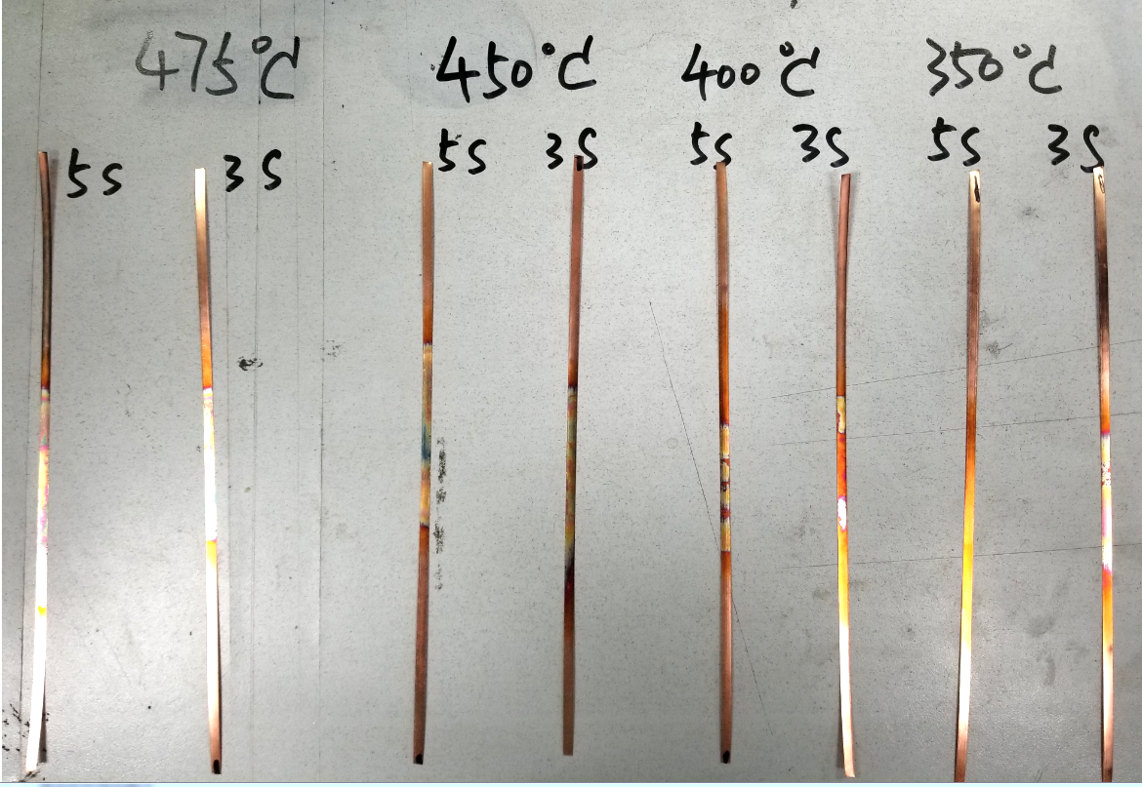
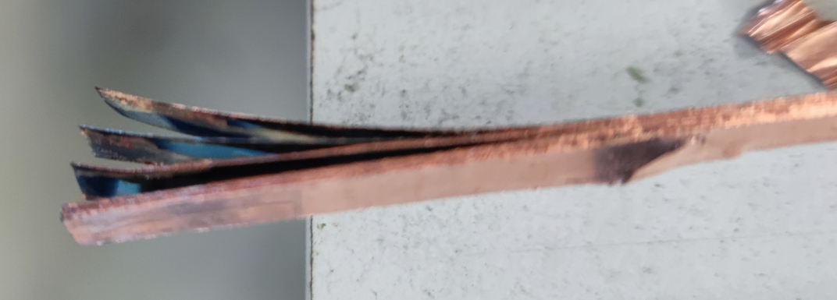
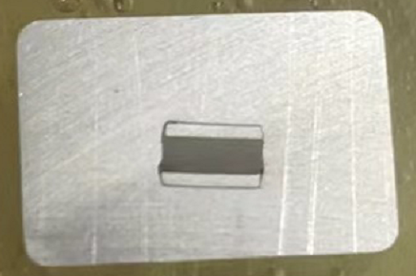
HTS version
Problems in HTS cable development ：
上收线盘绕包带断裂
覆铝时断芯
高温持续时间太长
超导叠粘连
芯线不居中
Continuous cable performance optimization and improvement
调试模具预热温度；
减少高温时间；
覆铝温度监控；
改善超导带的排布方式；
不同绕包带材料和绕包方式；
不同的挤压轮转速；
模具中凸模尺寸的调整；
添加分流模，改善覆铝时压力

Slide 15
HTS version
Target：single tape Ic > 100 A； Consider self-field effects, 16 layers HTS cable Ic > 925 A
Samri
7 layers
SSTC
SSTC
Samri
Samri
Samri
16 layers
16 layers
7 layers
16 layers
15 layers
16 layers
16 layers
20 layers
20 layers

Slide 16
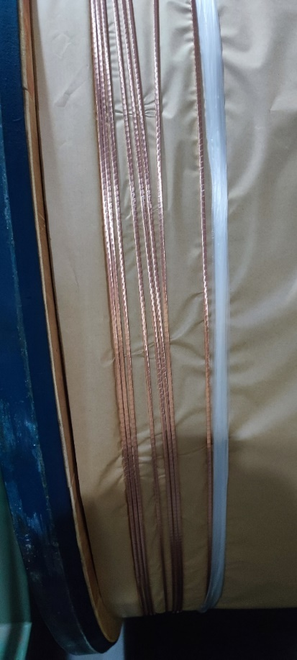
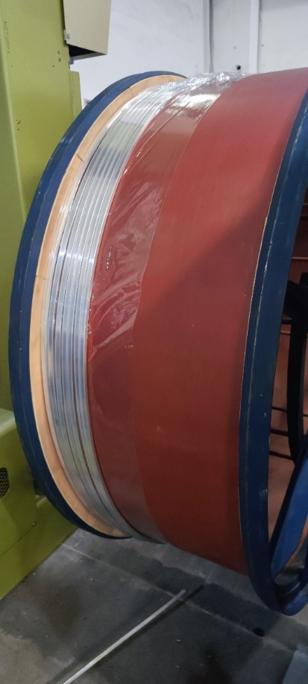
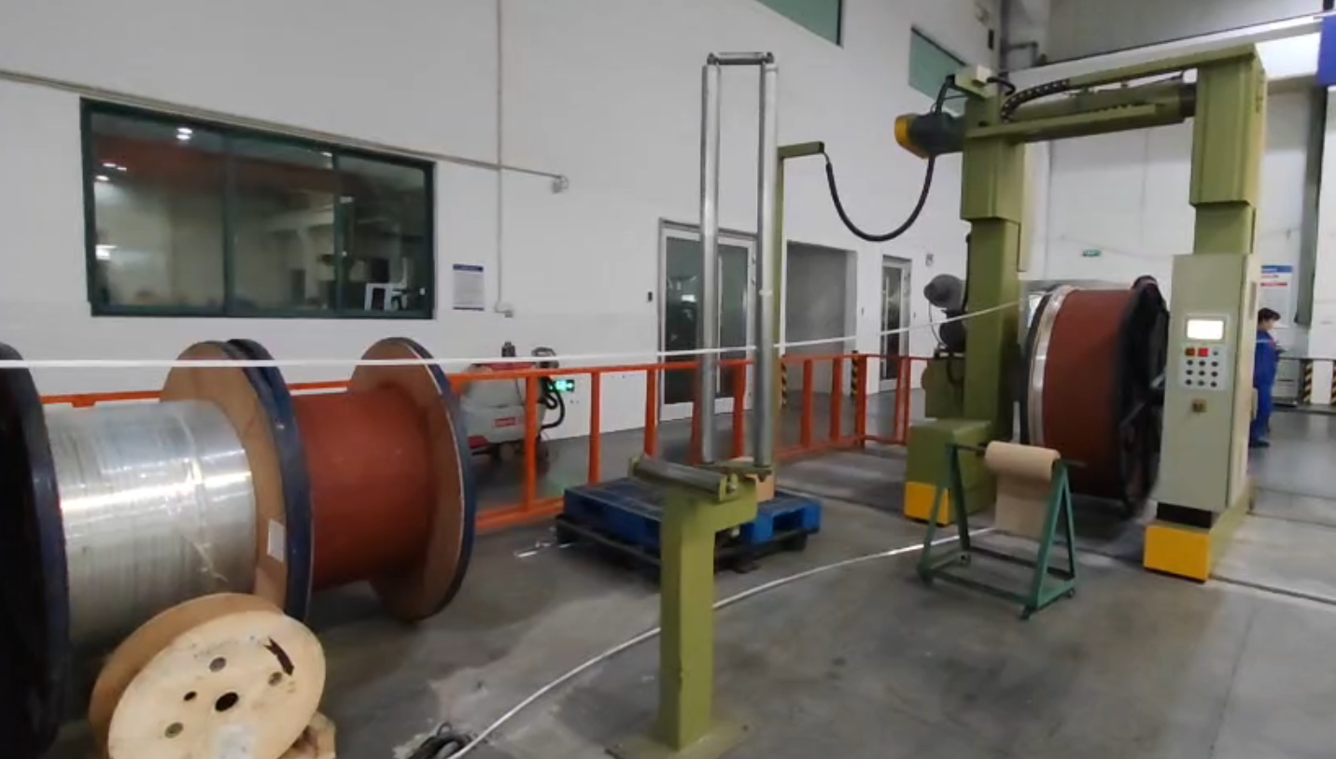
HTS version
Long dummy cable development
50 meter dummy cable successfully fabricated.

Slide 17
HTS version
Work in progress
Mechanical properties
Critical current at 4.2K
Critical current at magnetic field
Bending radius
Torsion intercept
Current distribution
Positive bend
Side bend
Electromagnetic properties
AC loss
Cable joints
Shielding current
Cable-copper joint
Cable-cable joint
Dynamic loss
Cable inner joint
Cable outer joint
Quench properties

Slide 18
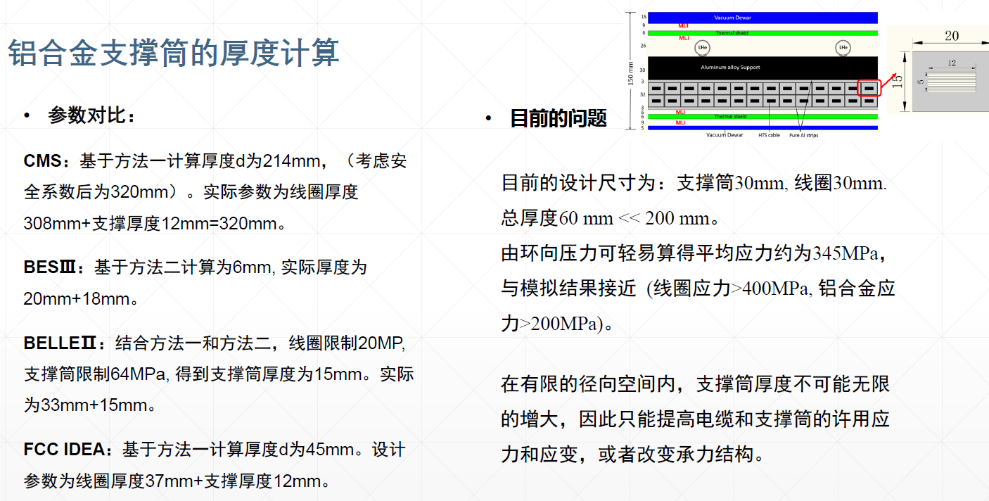
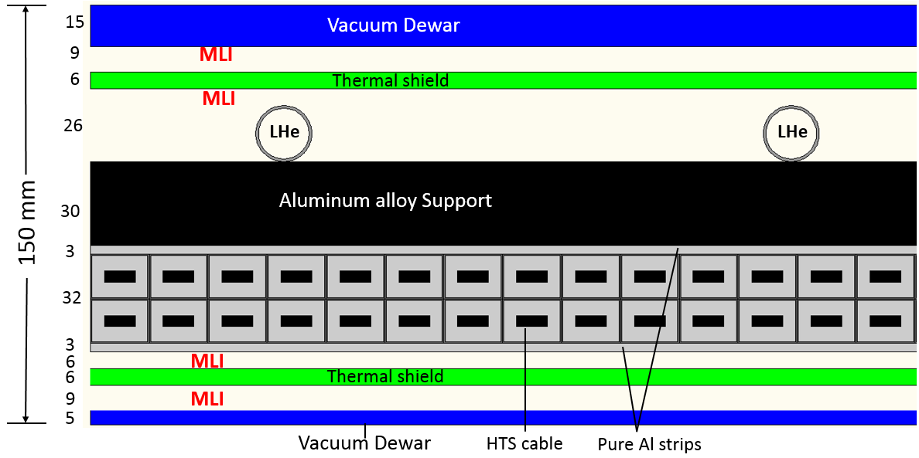
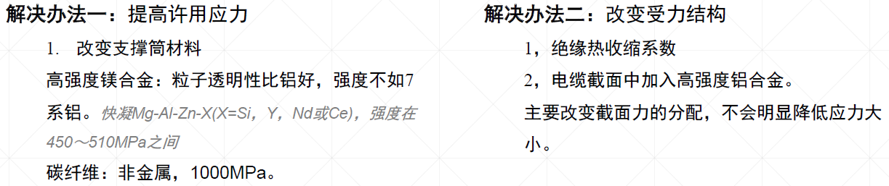
HTS version
Ultra-thin structure
  Thickness of the magnet: 150 mm
Conceptual mechanical design

Slide 19
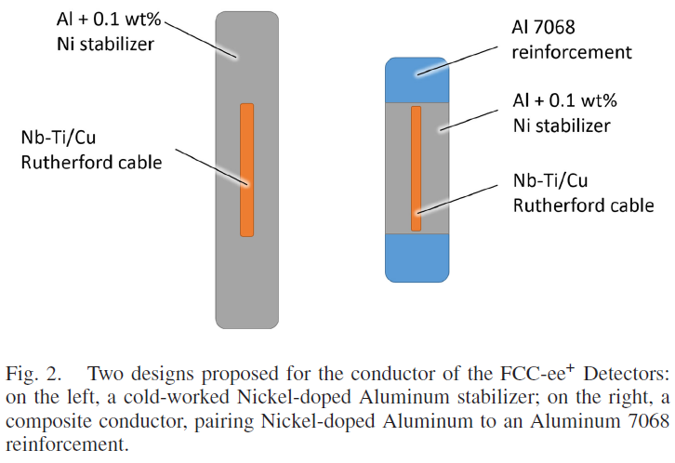
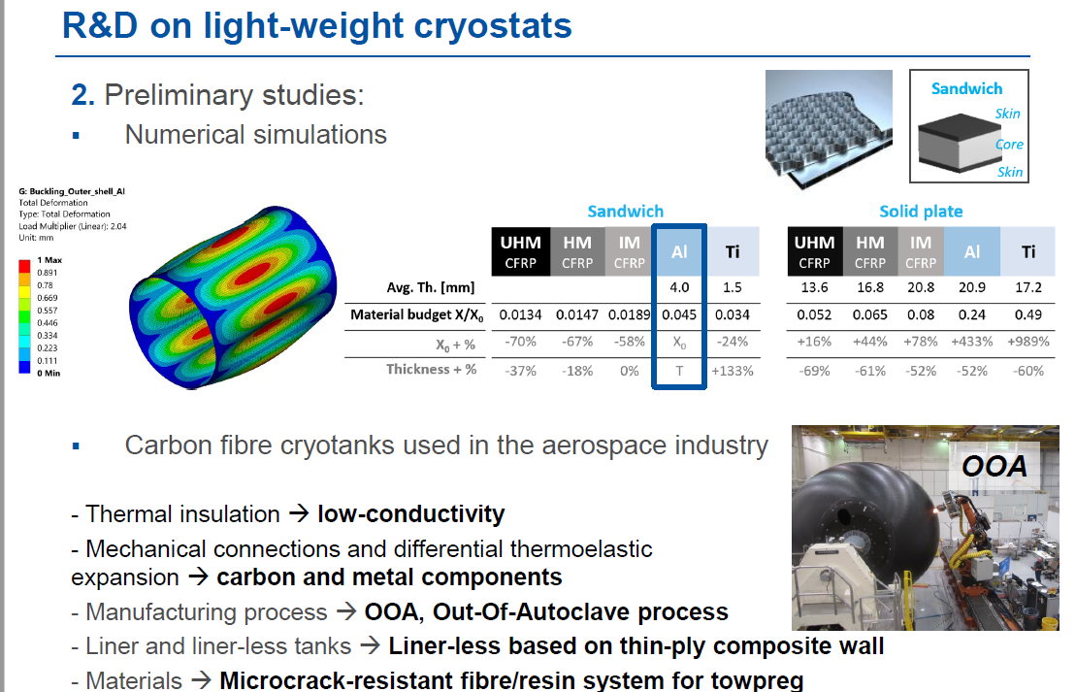
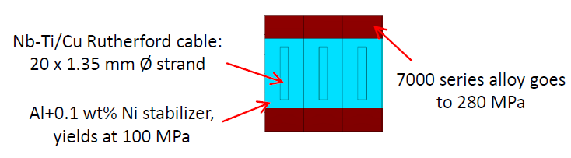
HTS version

Slide 20
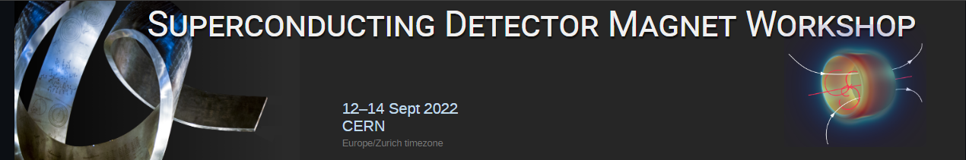
Introduction
Co-chairs : Matthias Mentink (CERN) and Toru Ogitsu (KEK)
Local Organizing Committee: Nikkie Deelen and Connie Potter (CERN)
Program Committee: Benoit Cure (CERN), Lionel Quettier (CEA), Renuka Rajput-Ghoshal (JLab), Vadim Kashikhin (Fermilab), Ken-ichi Sasaki (KEK), Yasuhiro Makida (KEK), and
Akira Yamamoto (Chair, KEK/CERN)
held at CERN, in hybrid format, 12-14 Sept. 2022
https://indico.cern.ch/e/sdmw

Slide 21
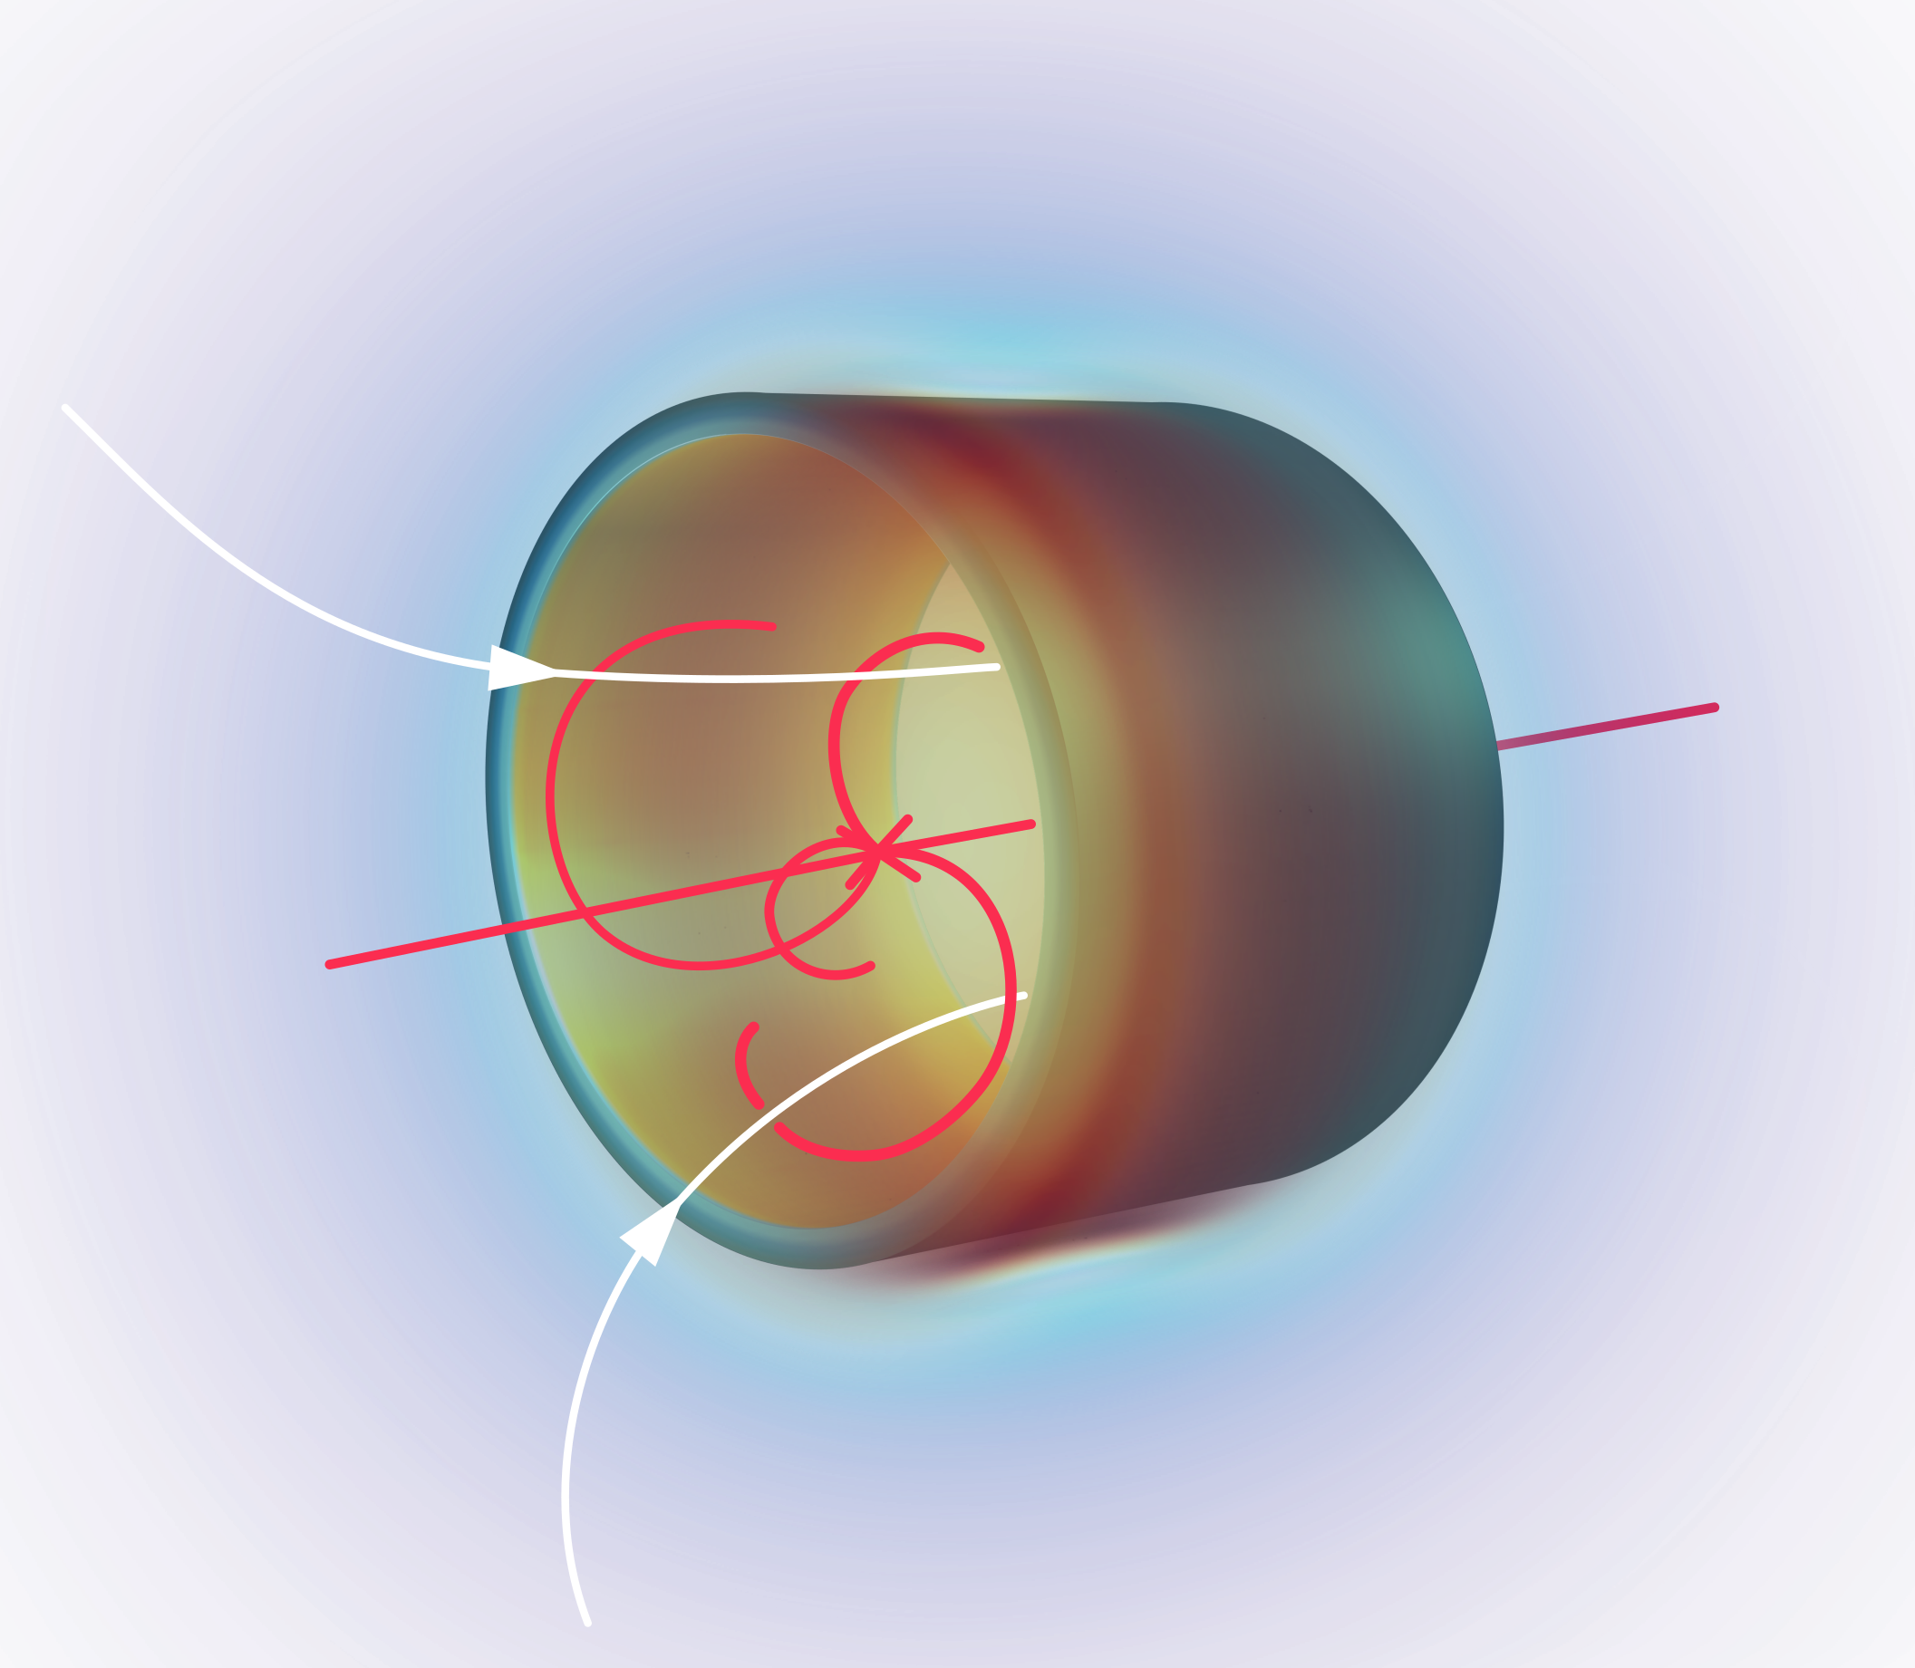
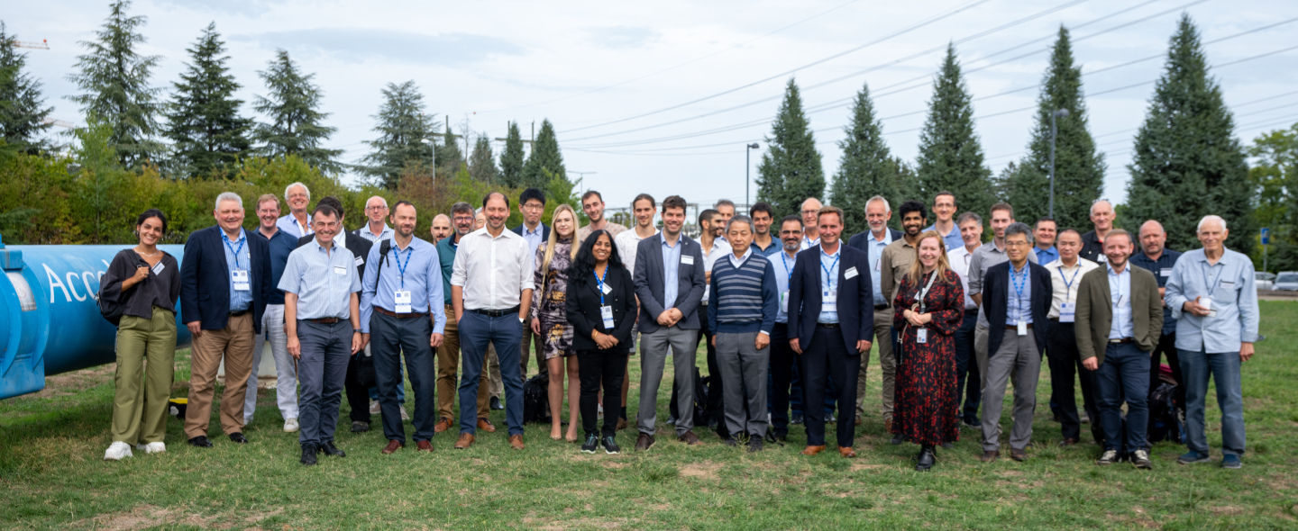
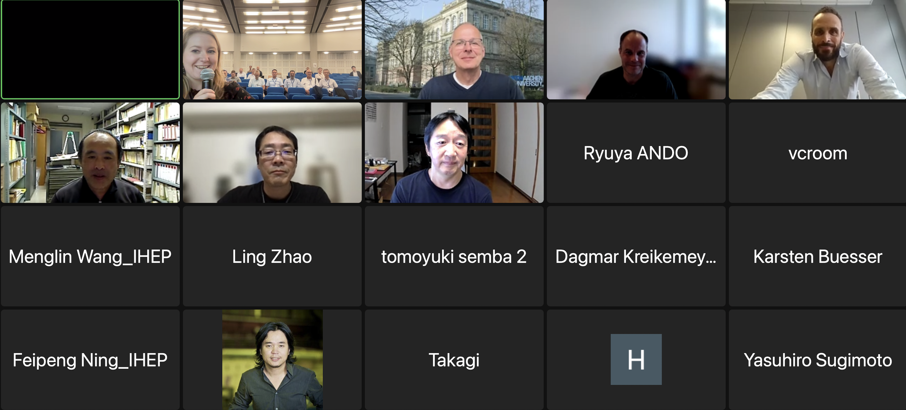
Introduction
Superconducting Detector Magnet Workshop organized by CERN and KEK, hosted at CERN
in hybrid format, with 90 participants (57 on-site, 33 online) from 36 institutes and companies,
opening with the welcome address given by Prof. Joachim Mnich, CERN’s Director of Research and Computing.

Slide 22
Executive Summary (1/2)
The Superconducting Detector Magnet Workshop is aiming at :
  Addressing the issue of commercial availability of Al-stabilized superconductor technology for future superconducting detector magnets,
  Informing the community of on-going and future projects, to exchange ideas, concepts, best practices, and to advance on superconducting detector magnet technology, and fostering collaboration,
  Bringing together the physics community, the magnet designers and the industry to exchange about the future needs and efforts to be achieved in research and development to build the next magnet generations of the Future Colliders and Beyond Collider Physics Experiments developed by collaborative Institutes.
  Understanding the industrial capacities and their availabilities, with the foreseen prospects and plans, with presentations made by invited representatives of industry working on all aspects of superconducting detector magnet.
Agenda:
  Report from Projects (day 1): EIC, ALICE-3, ILC-ILD, -SID, CLIC, FCC-ee, FCC-hh for colliders, and BabyIAXO, MadMax, Mu2e, Comet, AMS100 for beyond collider physics
  Reports from Industry (day 2): Furukawa E., Toly E., Techmeta, Hitachi, Toshiba, Mitsubishi E., Bilfinger-Noel., ASG, Sigma-Phi, SAES RIAL&Group.
  Discussions (day 3): Advanced SC for detector magnets, Al-stabilized SC w/ EBW/Soldering, CICC, HTS

Slide 23
Executive Summary (2/2)
Outlook:
  Al-stabilized superconductor/magnet technology needs to be resumed,
  Industrial cooperation to be anticipated and strongly encouraged, in particular,
    “Co-extrusion technology” of Al-stabilizer and NbTi/Cu-conductor to be resumed and widely available, and
    “Hybrid-structure technology” by using electron beam welding (EBW) or by other approaches, to maximize the performance of Al-stabilized SC (Ni or Cu/Mg doped) combined with ultimately high-strength Al-alloy structure.
  Laboratory’s leading effort will be very important to advance the technology to be openly transferred to the industry.
Remarks:
  It will be also important to investigate/seek for backup solutions such as soldering technology of NbTi/Cu conductor with Cu stabilizer, Cu-coated Al-stabilizer, and/or CICC.
  In long-term future, Al-stabilized HTS will provide important potential in specific detector magnet applications.
  The next workshop will be planned to be held in 1 ~ 2 years, based on the R&D advances expected.

Slide 24

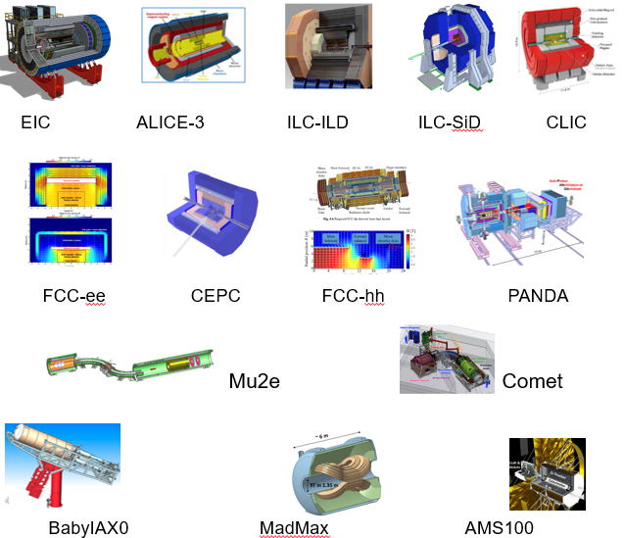
Summarize of Superconducting Detector Magnet Workshop（SDMW）
Aluminum-stabilized Nb-Ti/Cu conductor types
 | Experiments | Site | B [T} | Size, ID x L [m] | Note | Fabrication Expected
Collider | EIC-Detector | BNL | 1.5~3 | 2.5~3.2 x 8.5 | Solenoid | 2025 ~
 | ILC-ILD | Japan | 4 | 6.88 X 7.35 | Solenoid | 2030 ~
 | ILC-SiD | Japan | 5 | 5 X 5 | Solenoid | 2030 ~
 | CLIC-ILD | CERN | 4 | 6.8 X 8.3 | Solenoid | 2035 ~
 | CLIC-SiD | CERN | 5 | 5.4 X 6.5 | Solenoid | 2035 ~
 | CLIC | CERN | 4 | 7 X 8.3 | Solenoid | 2035 ~
 | FCC-ee IDEA | CERN | 2 | 4.2 X 6.0 | Solenoid | 2035 ~
 | FCC-ee CLD | CERN | 2 | 7.4 X 7.4 | Solenoid | 2035 ~
 | FCC-hh | CERN | 4 | 10 X 20 | Solenoid | 2060 ~
 | ALICE-3 | CERN | 2 | 3 x 7.5 | Solenoid | 2027 ~
 | CEPC | IHEP | 3 | 7.2*7.6 | Solenoid
Others | Mu2e | Fermilab | 5 ~ 2.5 | 1.5 X 4 | Production | Under construction
 | Muon-g-2 | Fermilab | 1.473 | 0.09 X 14.22▪2π | Storage solenoid | Reuse after BNL
 | COMET | J-PARC | 5 ~ 3 | 1.3 X 1.6 | Capture Sol. | Under const.
 | Muon-g-2 | J-PARC | 3 | 0.66 X 0.33 | Solenoid | 2025 ~
 | BabyIAXO | DESY | 2 | 0.7 X 10 | D. Racetrack | TBD
 | IAXO | DESY | 5 - 6 | 5 X 25 | Toroid | TBD
 | Panda | GSI | 2 | 1.8 x 3.1 | Solenoid | TBD
 | Madmax | DESY | 9 | 1.35 x 1.2 | Dipole | TBD

Slide 25
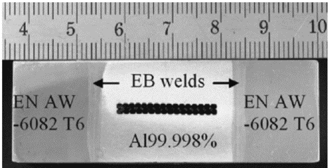
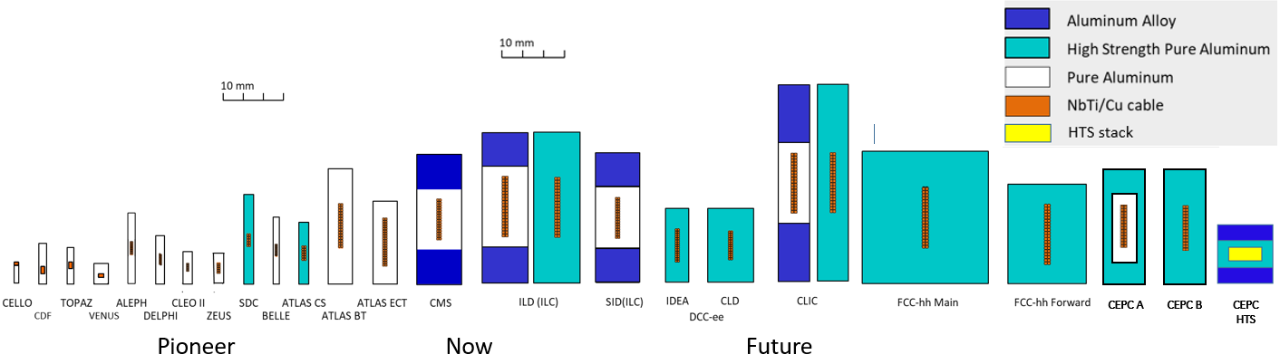
Summarize of SDMW
Aluminum-stabilized LTS/HTS conductor types
CMS

Slide 26




Summarize of SDMW
LTS
HTS
IHEP & Toly

Slide 27


Summarize of SDMW
IDEA detector

Slide 28







Summarize of SDMW
FCC-ee
AMS-100 Alpha Magnetic Spectrometer on the International Space Station
Magnetic Spectrometer to be send to Lagrange Point 2 (1.5 Mkm from earth).
Probing high energy cosmic rays, in particular anti-protons and anti-deuterons.
Geometric acceptance of 100 m² sr.
Main magnet is a 6 m long, 4 m diameter HTS ultra-thin solenoid.
No active cooling, only passive cooling using radiators.
Electrical/thermal/mechanical challenge.
Compensation coil needed to correct magnetic torque during operation.
Comp. coil is a 1.5 m long, 8 m diameter HTS solenoid.

Slide 29



Summarize of SDMW
J-PARC Future Muon Source

Slide 30

Conclusion
The only one in the world that can produce Al-stabilized superconducting cables.
Not only Al-stabilized LTS cables, but also the development of HTS cables are far ahead.
Further improve the performance of the Al-stabilized superconducting cable.

