Slide 1
Recent Oscillation Results and Upgrade of the T2K Experiment
Weijun Li, University of Oxford
SPeCial4Young, SYSU
8th Mar. 2023

Slide 2
Outline
Introduction
The T2K Experiment
Recent Oscillation Results
Future Prospects

Slide 3
Outline
Introduction
The T2K Experiment
Recent Oscillation Results
Future Prospects

Slide 4
What are neutrinos & neutrino oscillation?
Neutral fermions
Only left-handed neutrinos have been experimentally observed
Flavour change during propagation – neutrino oscillation has been observed in various experiments
Hence, neutrinos cannot all be massless -> beyond the current Standard Model.
The PMNS Matrix
$$s_{ij}=sin\left(θ_{ij}\right)$$
$$c_{ij}=cos\left(θ_{ij}\right)$$

Slide 5
Why study neutrino oscillation?
The PMNS Matrix
Precise measurement of the mixing angles, $θ_{ij}$ -> test on the unitarity of the PMNS matrix.
$δ_{CP}$, the CP violation term, analogous to the one in the quark sector, would be crucial in explaining for the observed matter-antimatter asymmetry
& many other implications

Slide 6
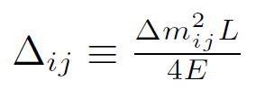
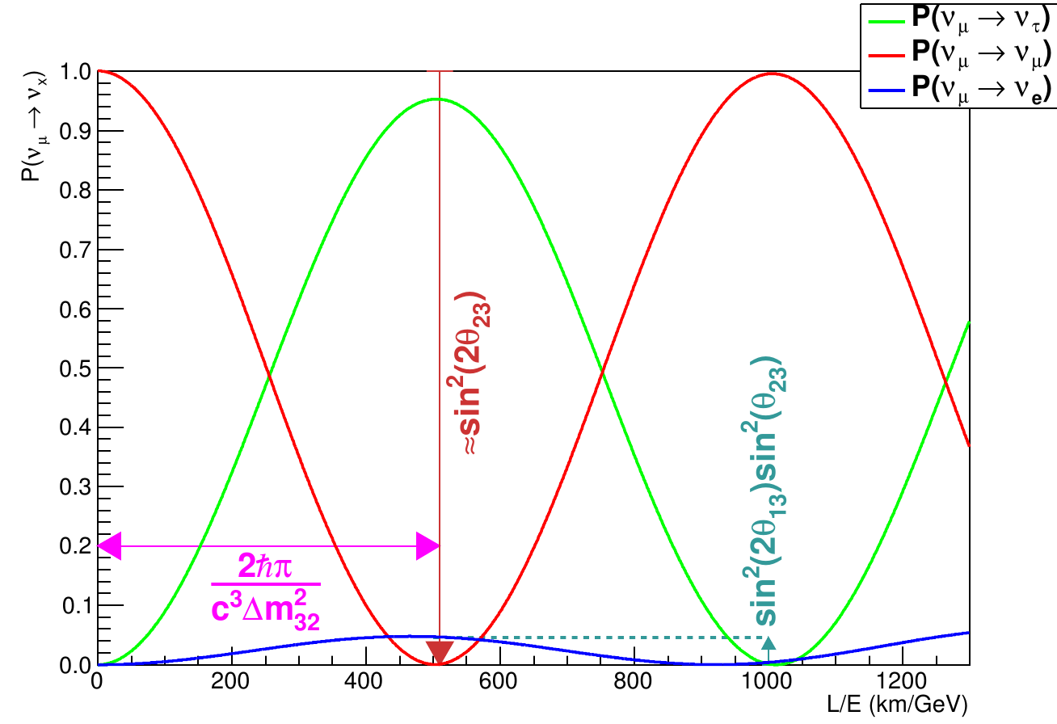
How to measure?
$ν_{μ}$ disappearance and $ν_{e}$ appearance.
But how exactly?
$θ_{12}$ - solar + KamLAND
$θ_{13}$ - reactor, e.g. Daya Bay
Notes:
Theta_12~34o, Theta_23~45o, Theta_13<11

Slide 7
Outline
Introduction
The T2K Experiment
Recent Oscillation Results
Future Prospects

Slide 8
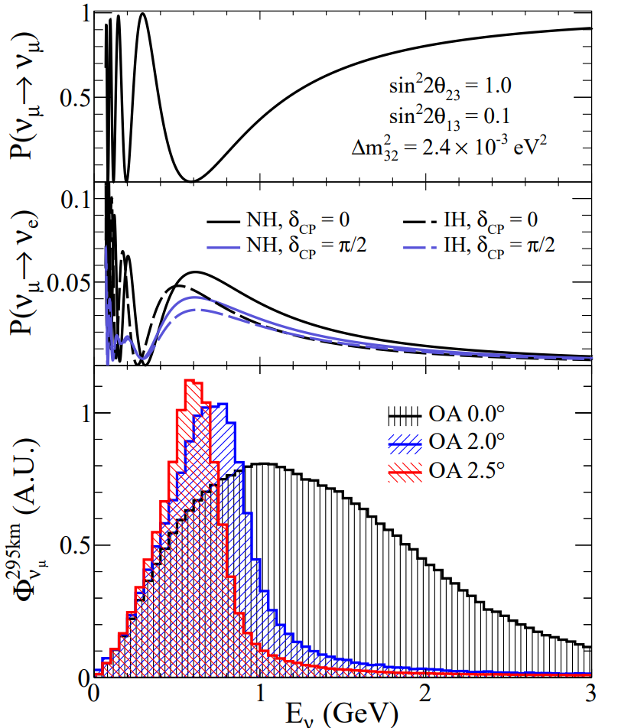
The T2K(Tokai to Kamioka) Experiment
Super-Kamiokande
J-PARC
Near Detectors
Mt. Noguchi-Goro
2,924 m
Mt. Ikeno-Yama
1,360 m
1,700 m below sea level
Kamioka
Neutrino Beam
Tokai
295 km

Slide 9
The T2K Experiment
Super-Kamiokande
J-PARC
Near Detectors
Mt. Noguchi-Goro
2,924 m
Mt. Ikeno-Yama
1,360 m
1,700 m below sea level
Neutrino Beam
295 km
Electroma-gnetic Horn
$$ν_{μ}$$
$$π^{+}$$
$$π^{±}$$
decay
Target(carbon)
P
$$ν_{μ}$$
$$K^{+}$$
$$K^{±}$$

Slide 10
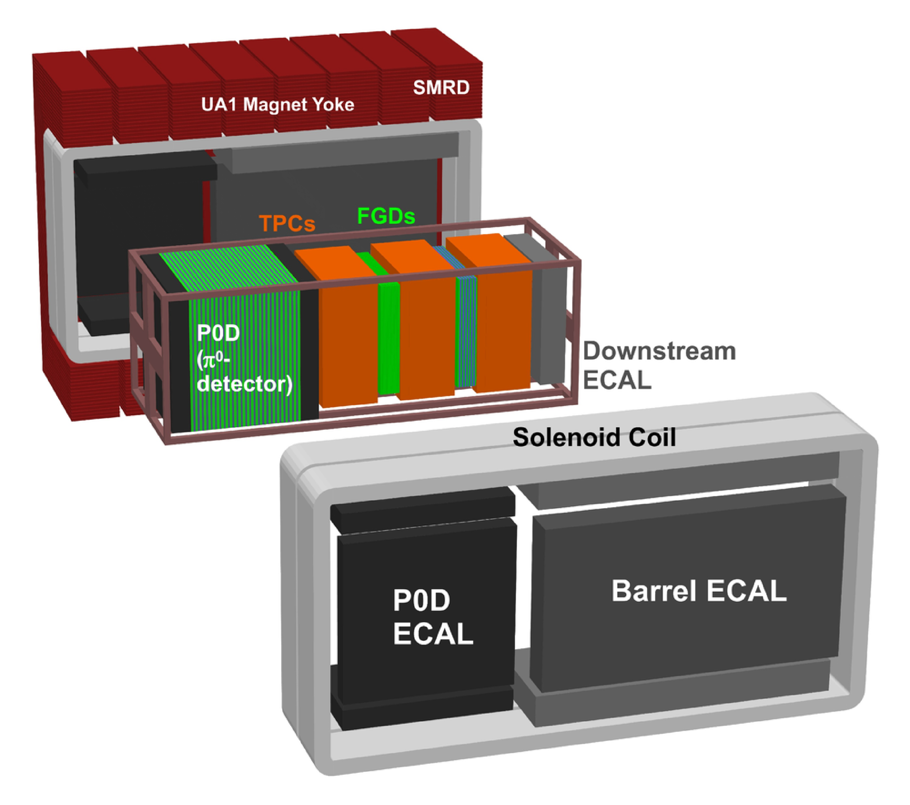
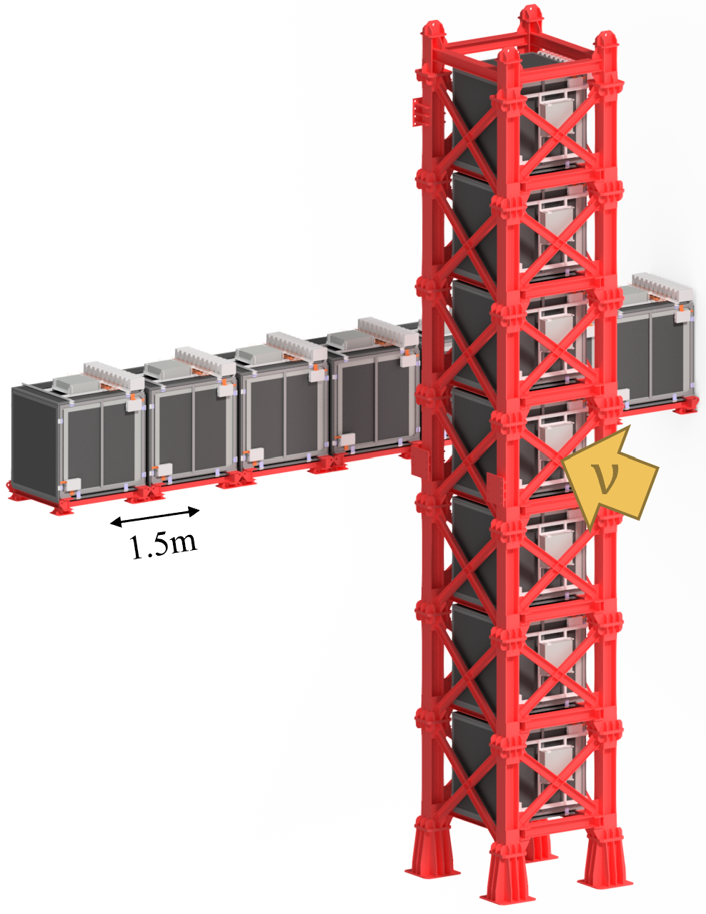
The T2K Experiment
Super-Kamiokande
J-PARC
Near Detectors
Mt. Noguchi-Goro
2,924 m
Mt. Ikeno-Yama
1,360 m
1,700 m below sea level
Neutrino Beam
Off-axis detector:
ND280
295 km
On-axis detector:
INGRID

Slide 11
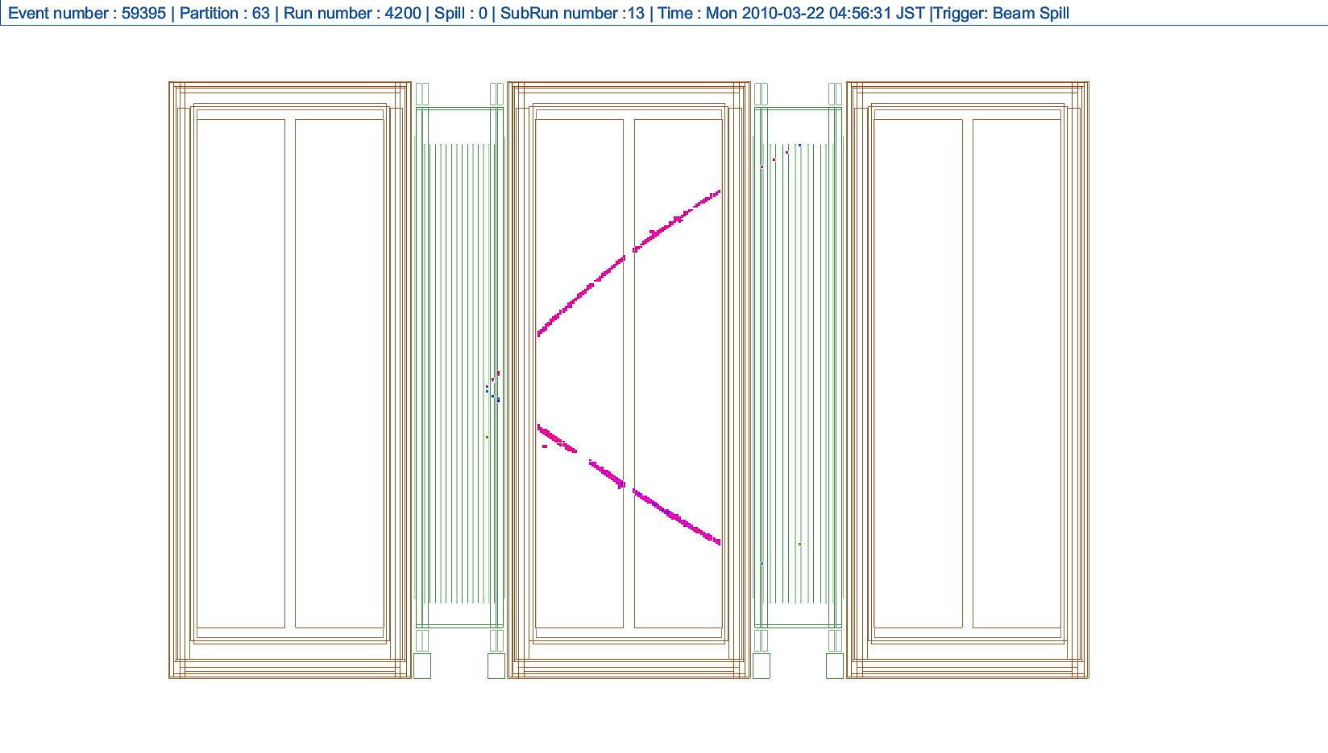
ND280
Event Display Example
Side view of Fine Grain Detector (FGD)
……
Scintillation bars
……
……

Slide 12
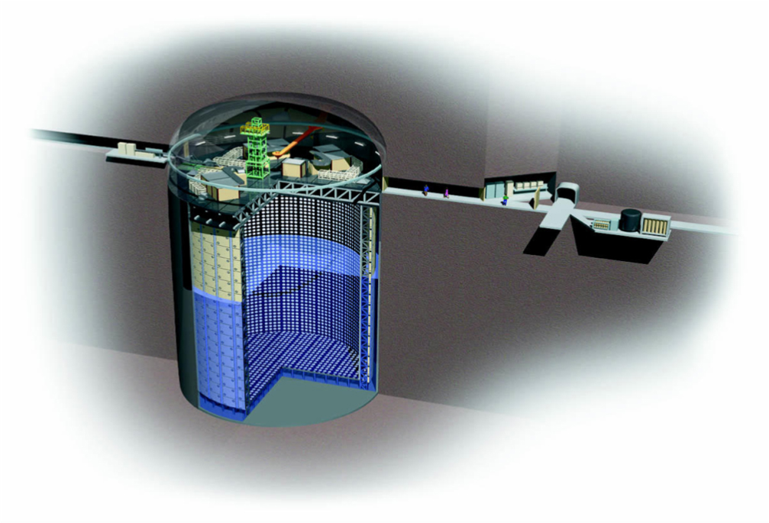
The T2K Experiment
Super-Kamiokande
J-PARC
Near Detectors
Mt. Noguchi-Goro
2,924 m
Mt. Ikeno-Yama
1,360 m
1,700 m below sea level
Neutrino Beam
295 km
Water Cherenkov Detector
~40m*40m
~50kt

Slide 14
Outline
Introduction
The T2K Experiment
Recent Oscillation Results
Future Prospects

Slide 15
Near Detector Fit
Topology:
CC: Charge Current
0pi: 0 pion
0p : 0 proton
Reactions, e.g.
QE: Quasielastic;
Res: Resonance
Model Fitting

Slide 16
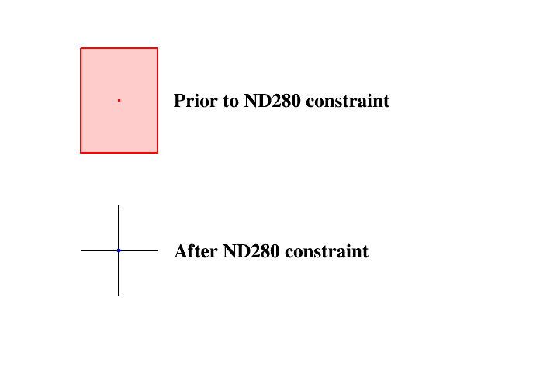
Near Detector Fit
This reduces the uncertainty on the SK prediction from ∼ 13% to ∼ 3% for the parameters constrained by the near detector fit.

Slide 17
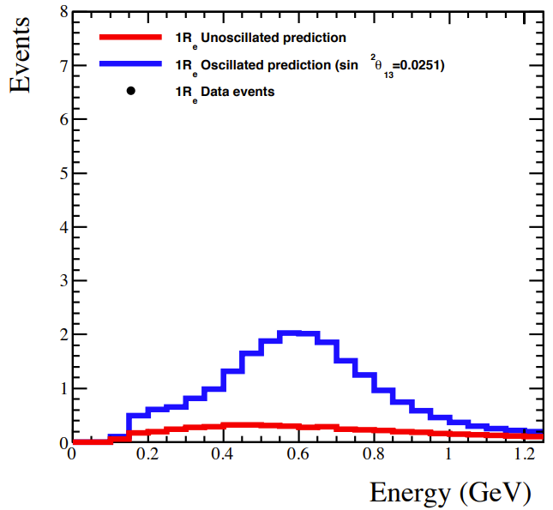
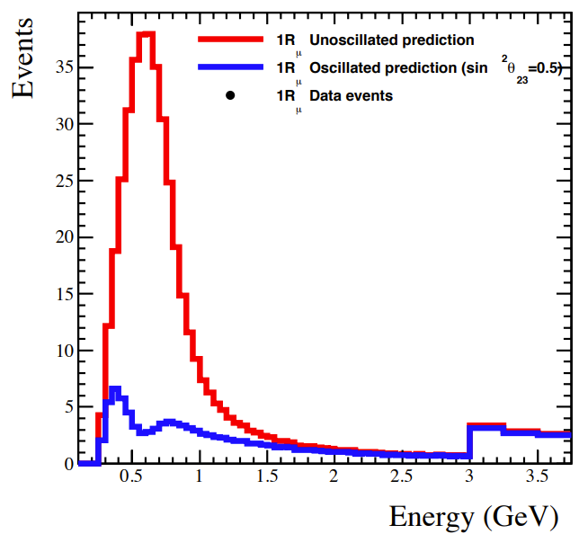
Far Detector Result
Notes:
318 & 94

Slide 18
Far Detector Result
CP conservation excluded at 90% confidence level!
Large CP violation favoured.
What next?
(NO, +reactor)
No
CP violation.
Maximally
CP-violating.

Slide 19
Outline
Introduction
The T2K Experiment
Recent Oscillation Results
Future Prospects

Slide 20
Upgrades
CP conservation excluded at 90% confidence level!
Impressive but not enough – two limitations: statistics and systematics
Increase statistics – Beam upgrade
Reduce systematics – Near Detector Upgrade

Slide 21
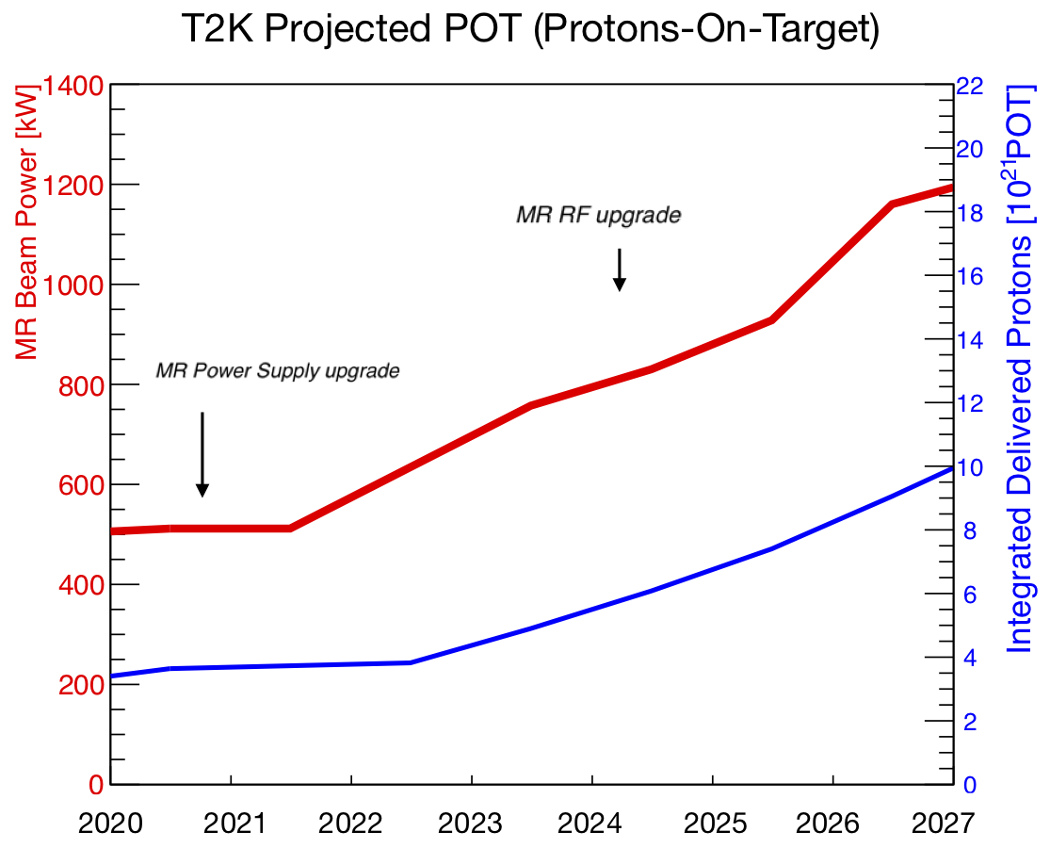
Beam
Power supply upgrade
Radio Frequency cavity systems upgrade
Assuming 4 month/year –
1 x 10^22 POT in JFY2026 (current: 3 x 10^21 POT for 10-year running)

Slide 22
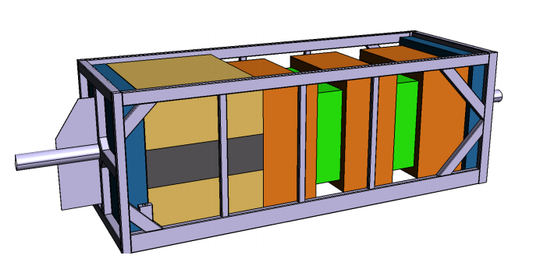
Near Detector Upgrade
(Technical Design Report on arXiv:1901.03750)
High Angle TPC
Super FGD
High Angle TPC

Slide 23
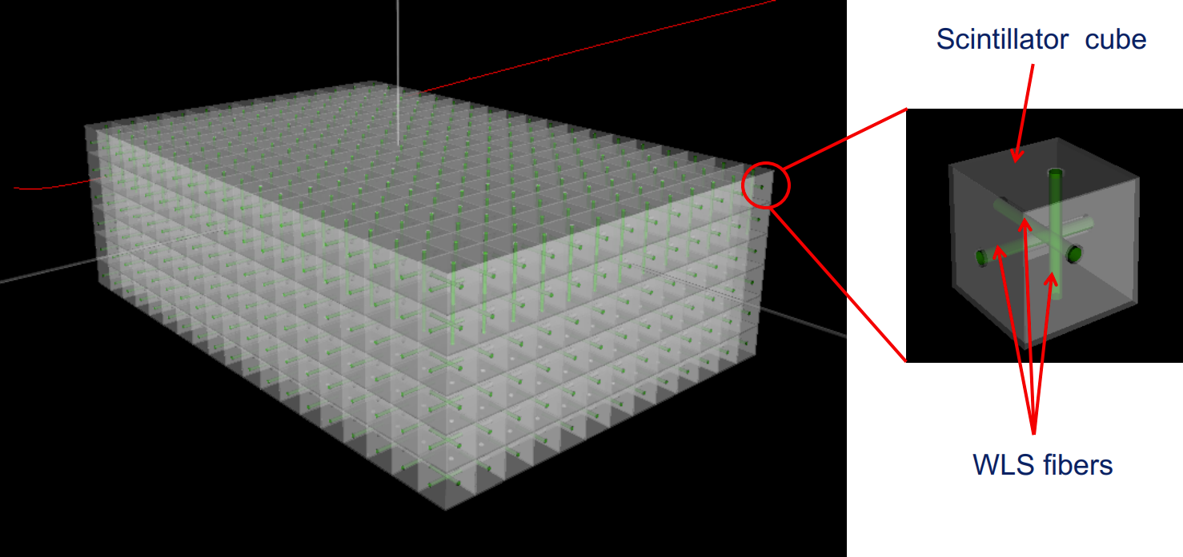
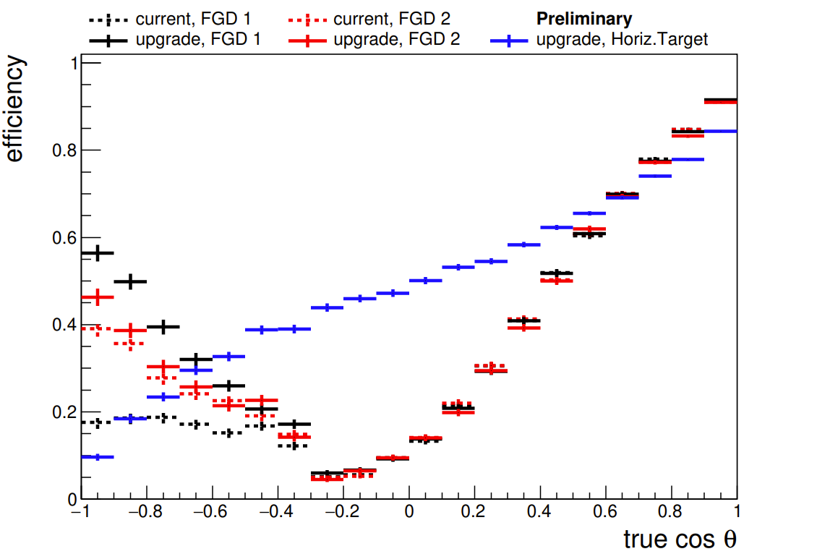
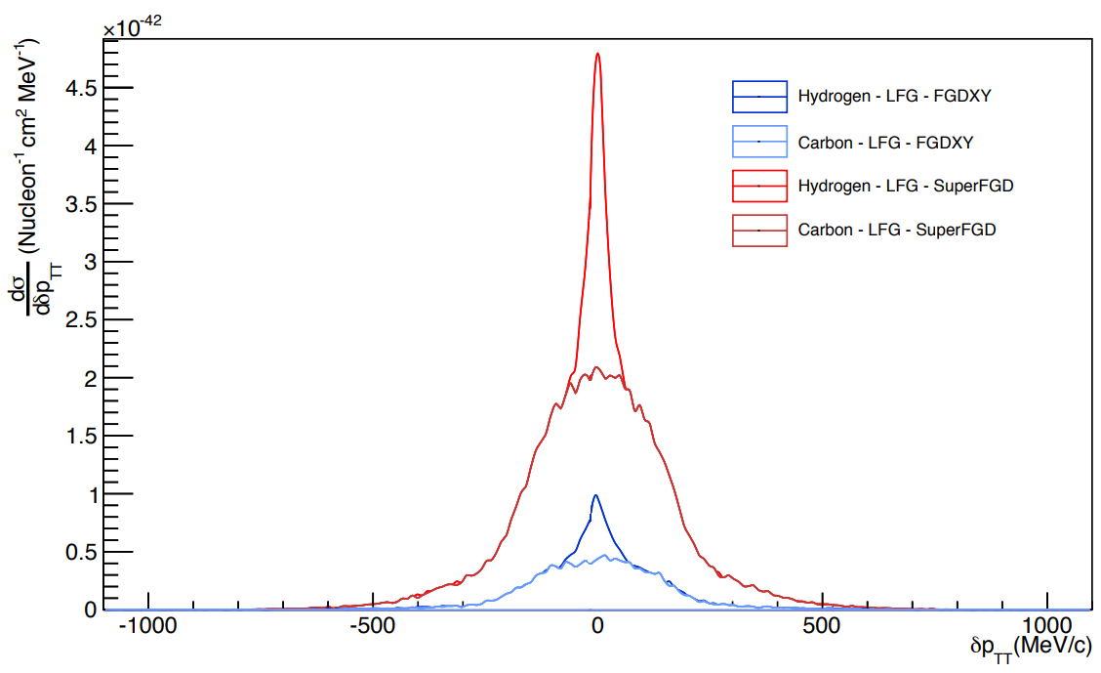
The Super FGD
3D plastic scintillator ~ 2 million 1.0cm^3 cubes
Much better tracking quality and high angle acceptance -> larger phase space
Currently being assembled in Japan

Slide 24
Take-home messages
Neutrino oscillation is one of the most promising probes to new physics beyond the standard model.
T2K is undergoing upgrade and would soon be ready to take new data that would bring exciting results!

Slide 25
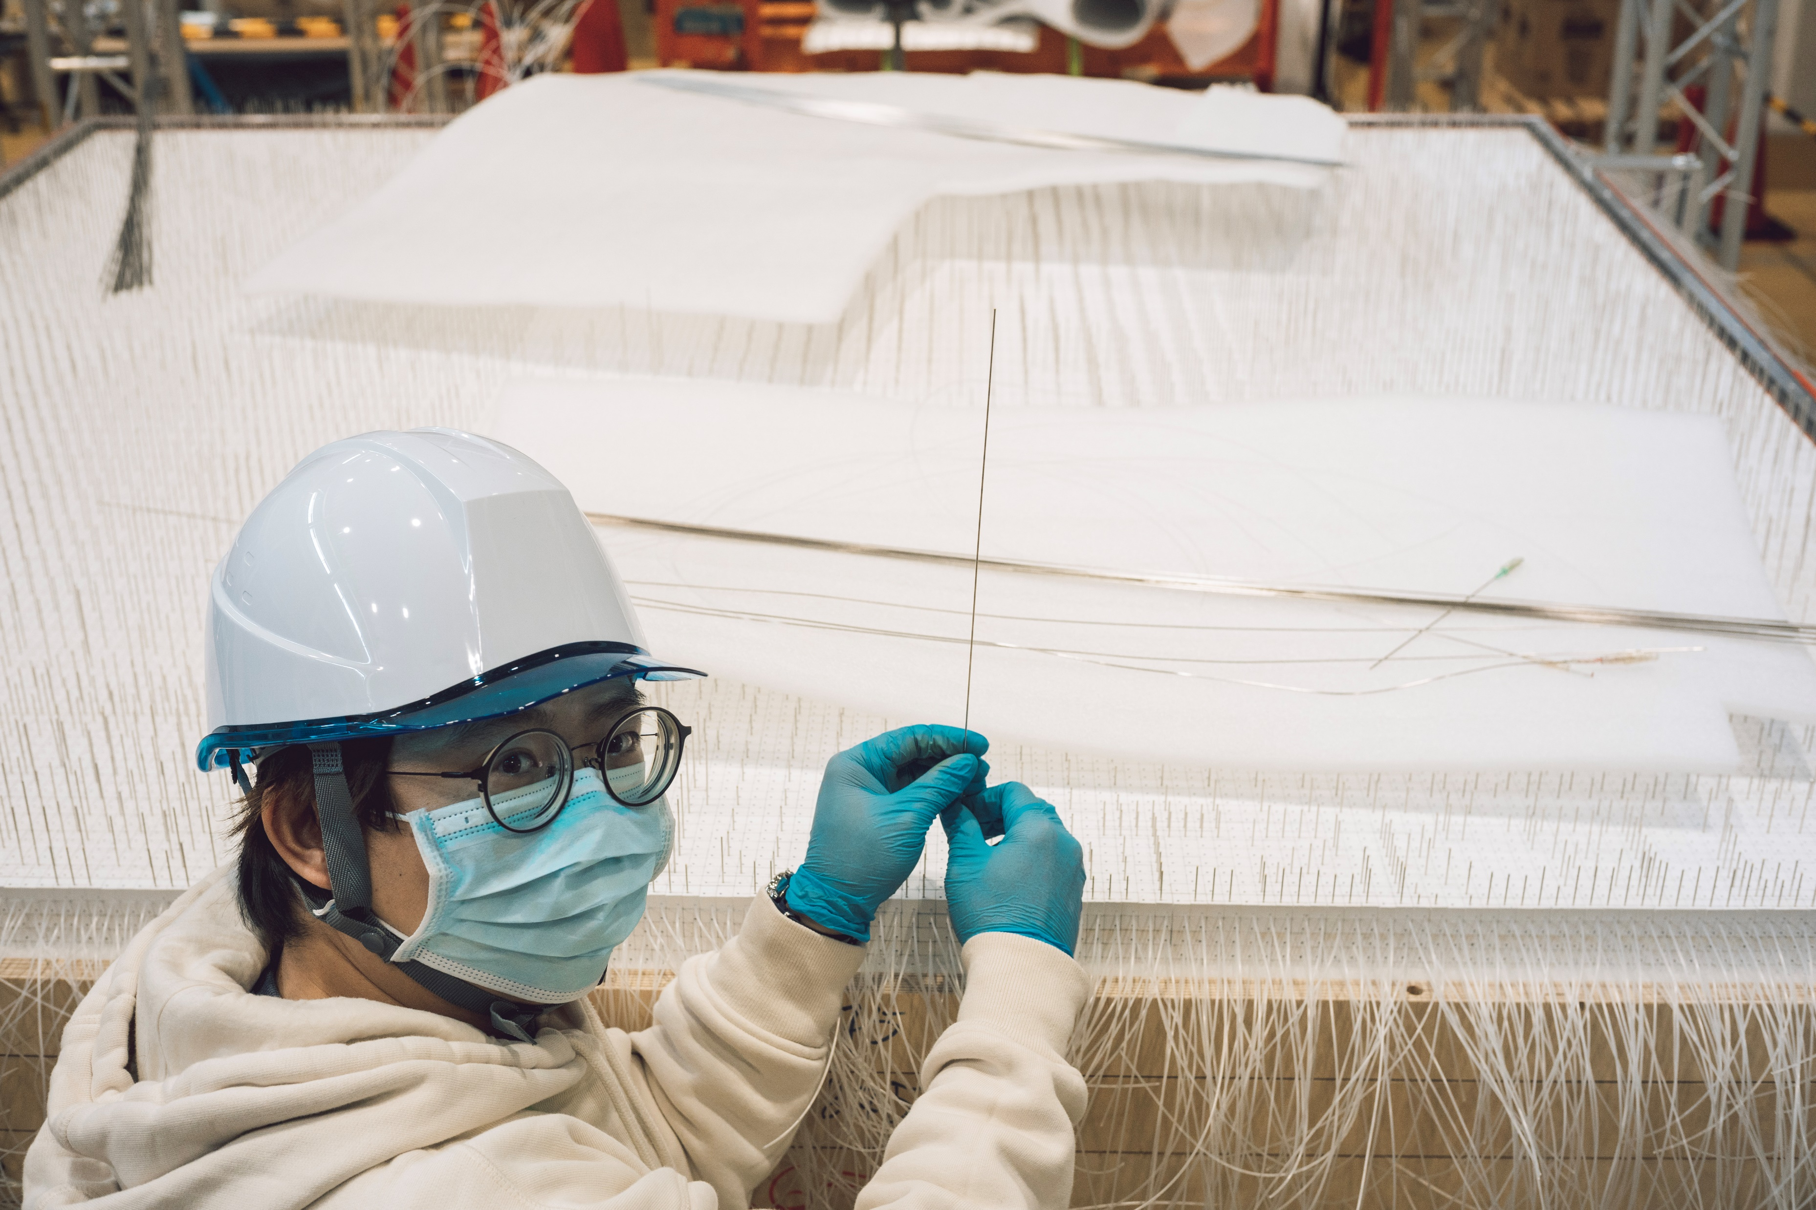
Acknowledgement
I would like to extend my sincere gratitude to the Great Britain Sasakawa Foundation, whose support is vital for my visit to Japan to help with the SuperFGD assembly and has significantly improved my productivity.

Slide 26
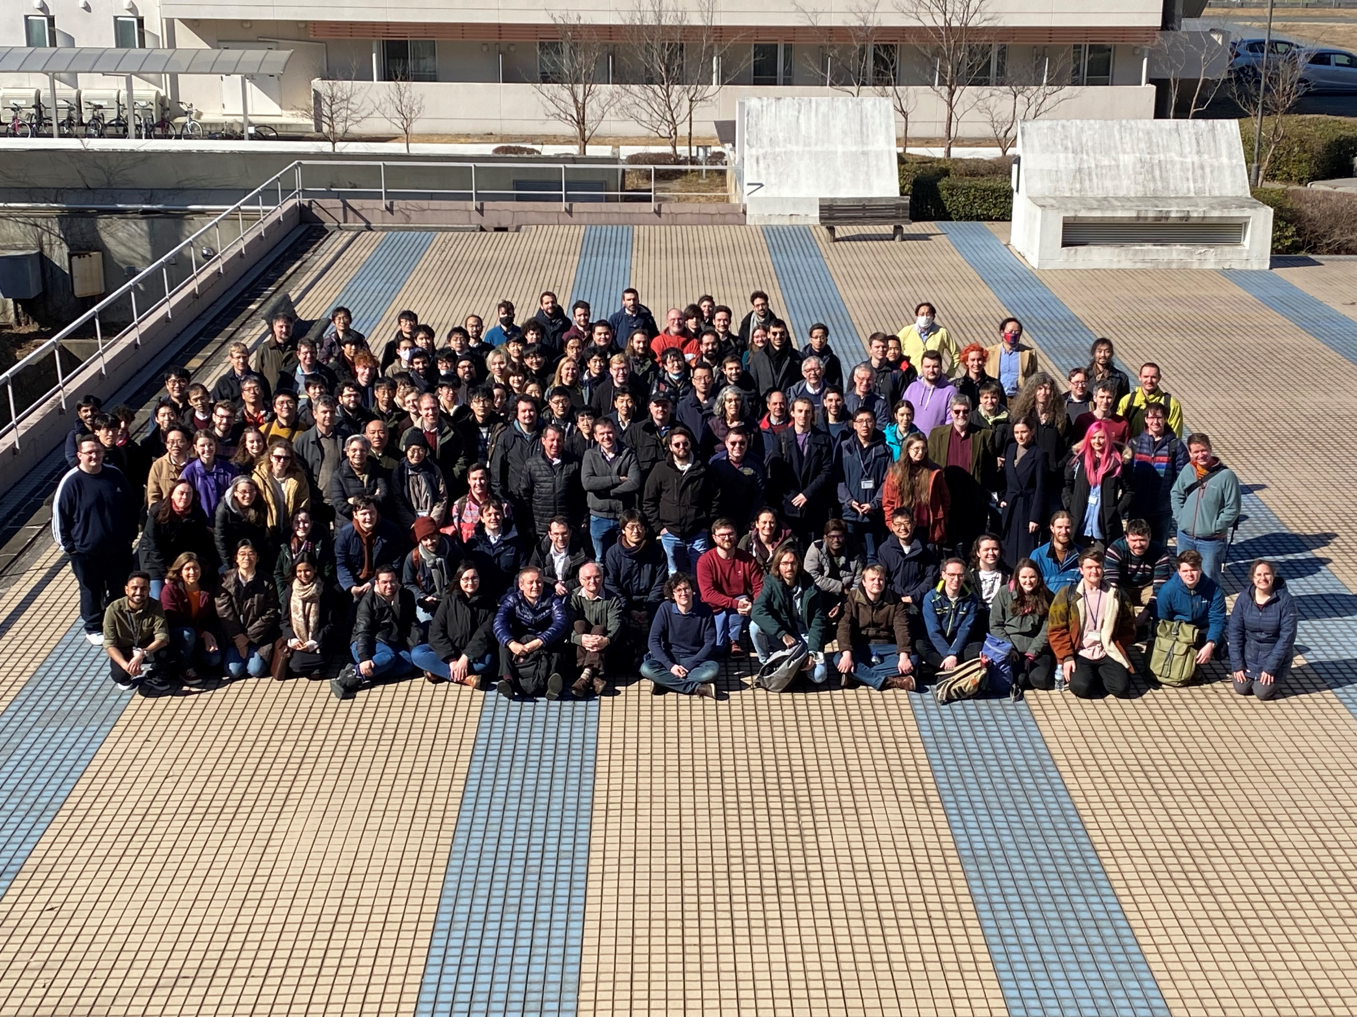
Thank you!

Slide 27
Backup

