Slide 1


QCD与中高能核物理暑期学校@SDU July 2023
Spinodal Enhancement of Light Nuclei Yield Ratio in Relativistic Heavy Ion Collisions
报告人：周文豪
合作者：孙开佳、徐骏、李锋、柯治明、陈列文、王睿
Email: zhouwenhao@xaau.edu.cn
arXiv:2205.11010, Eur. Phys. J. A 57, 313 (2021), Phys. Rev. C 104. 044901 (2021).

Slide 2
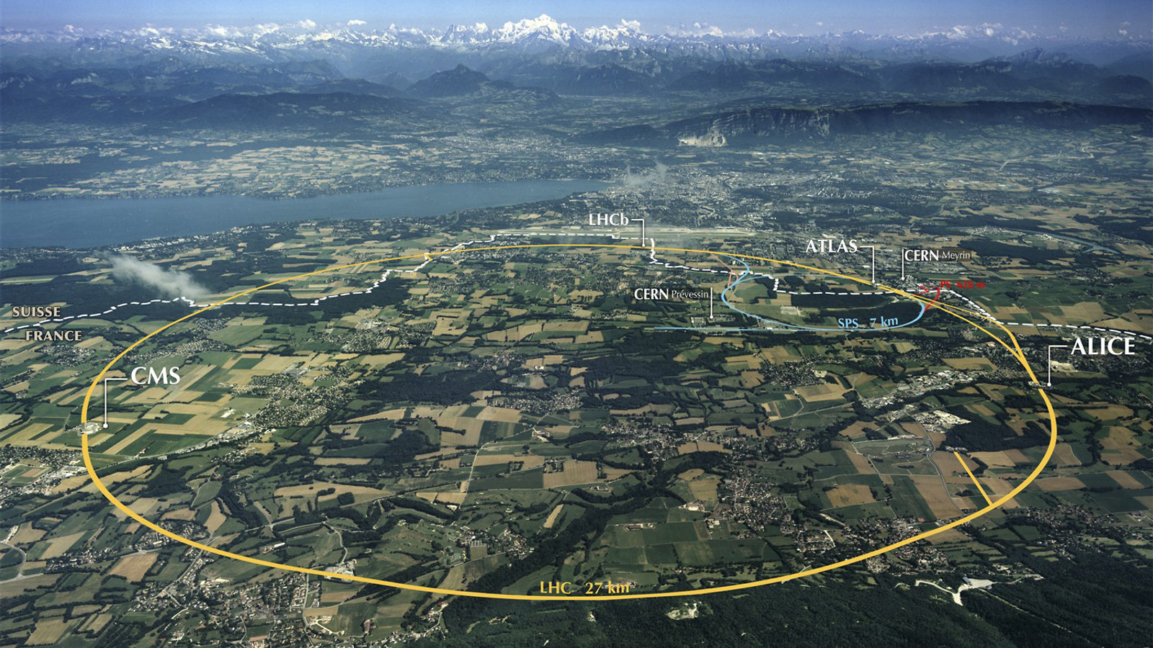
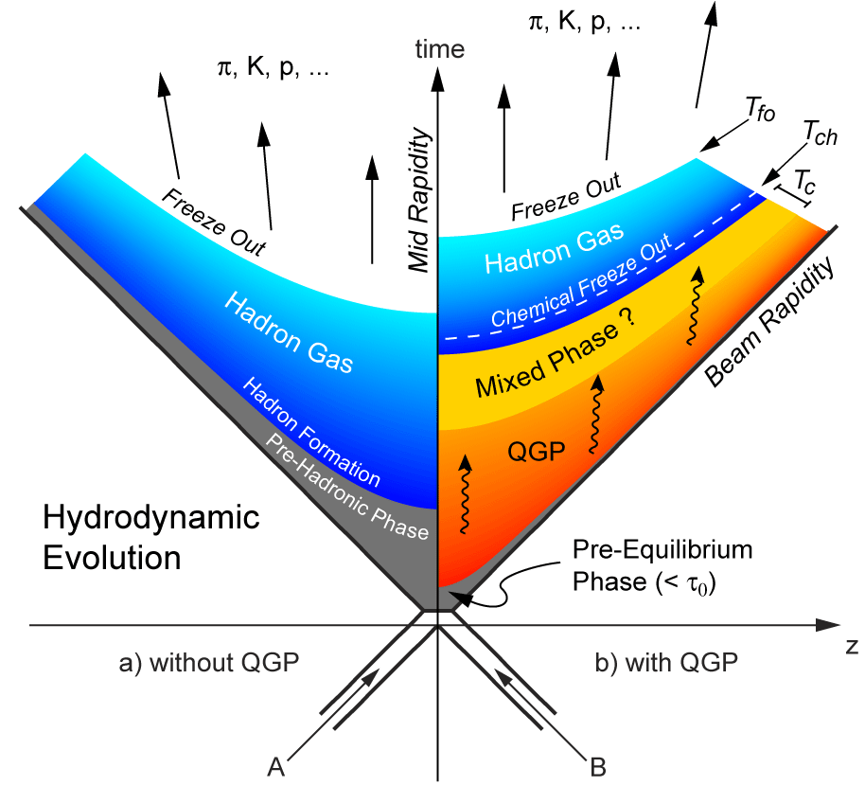
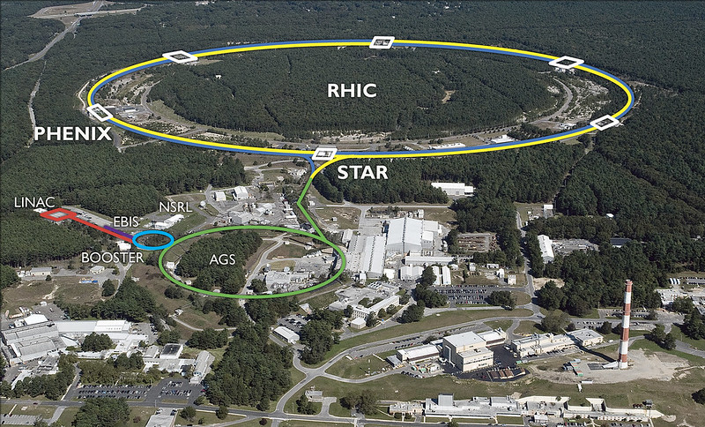
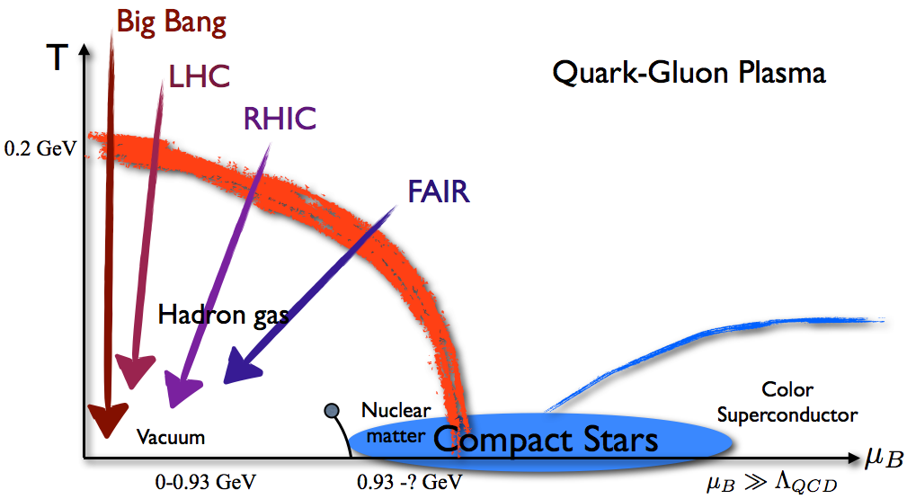
QCD与中高能核物理暑期学校@SDU July 2023
Phase diagram
LHC
RHIC
1

Slide 3
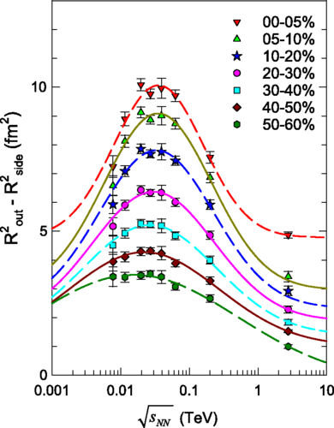
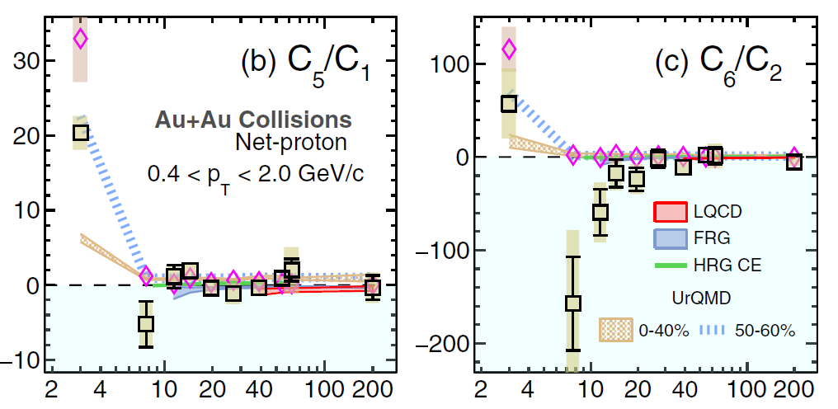
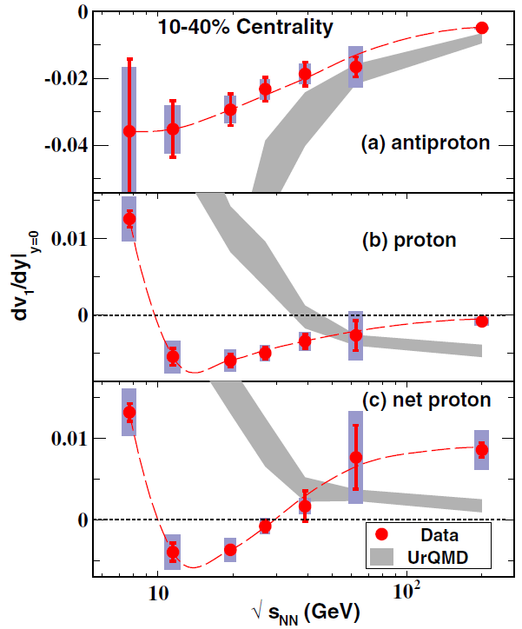

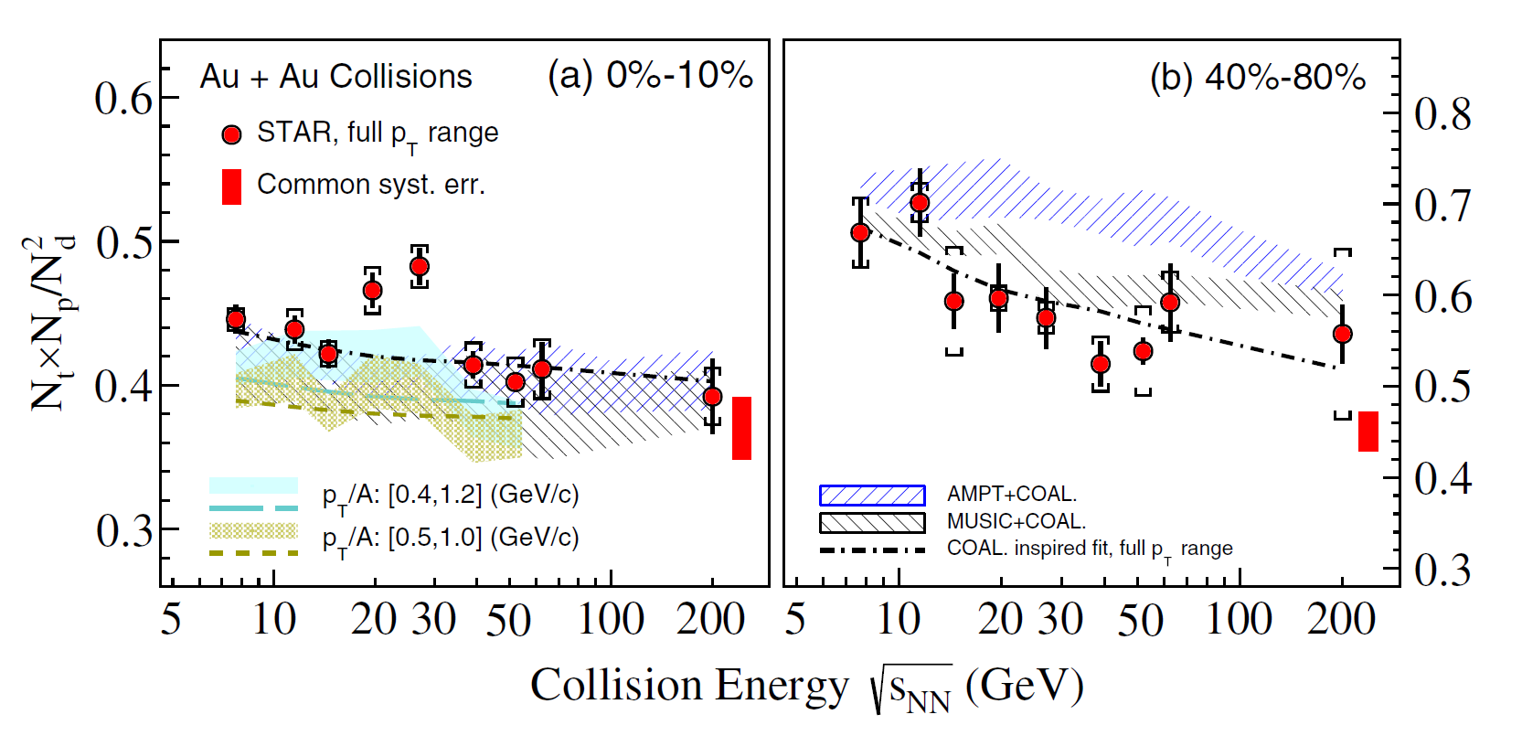
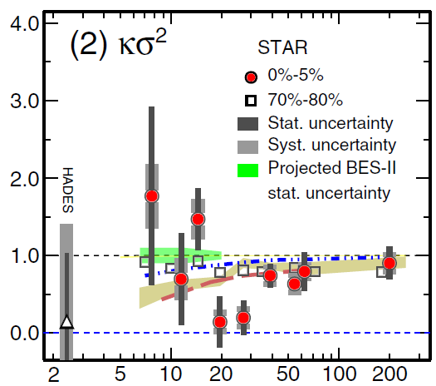
QCD与中高能核物理暑期学校@SDU July 2023
Backgrounds
R. A. Lacey, PRL 114, 142301 (2015).
STAR, PRL 130, 082301 (2023).
STAR, PRL 112, 162301 (2014).
No model can explain
the data well.
STAR, PRL 130, 202301 (2023).
STAR, PRL 126, 092301 (2021).
2

Slide 4
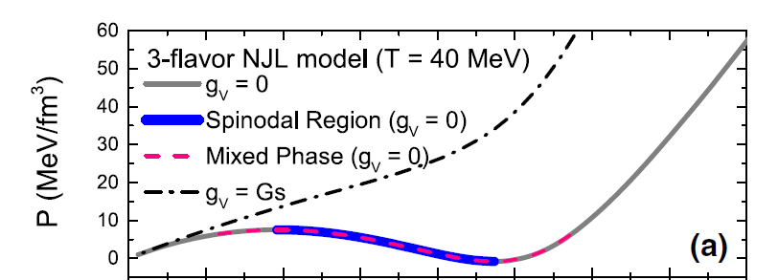
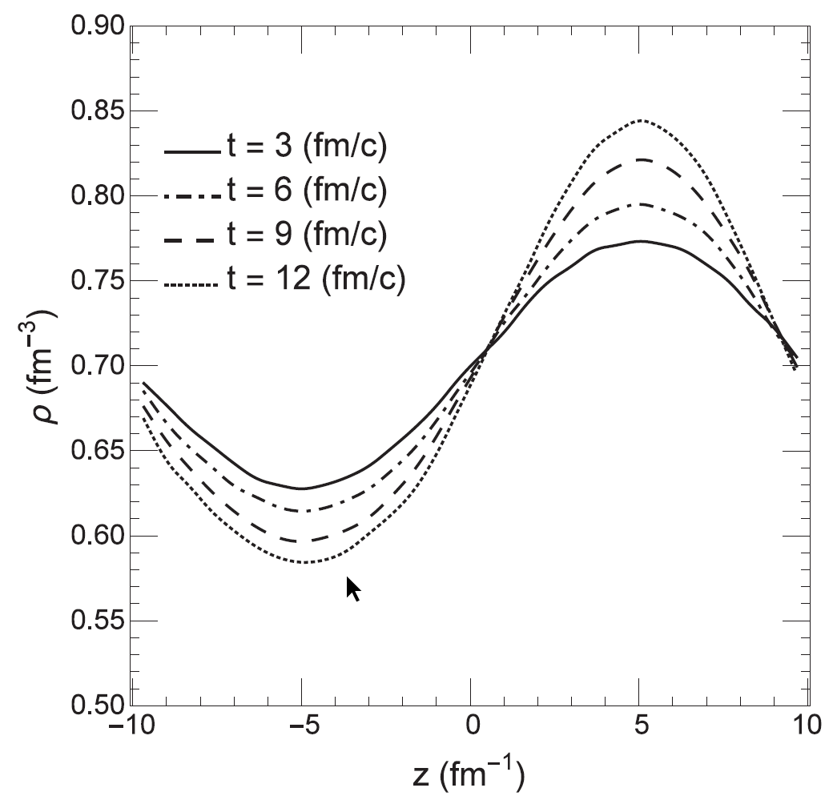
QCD与中高能核物理暑期学校@SDU July 2023
Spinodal instability
In Spinodal
Out of Spinodal
Initial
Low
High
Time evolution of an unstable density.
The phase separation in the phase diagram.
Density fluctuation is enhanced in spinodal region.
K.-J Sun, C. M. Ko, J. Xu, F. Li, C.-L. Chen, Eur. Phys. J. A 57, 313 (2021).
F. Li and C. M. Ko, Phys. Rev. C 95, 055203 (2017).
3

Slide 5
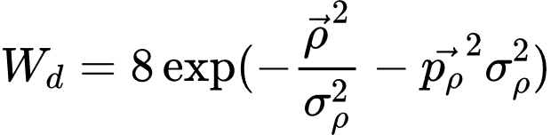
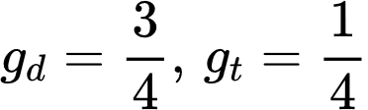
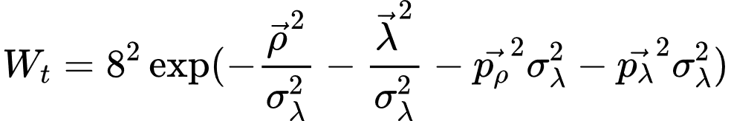
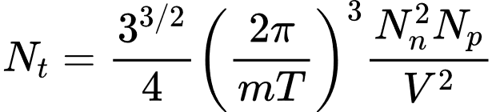
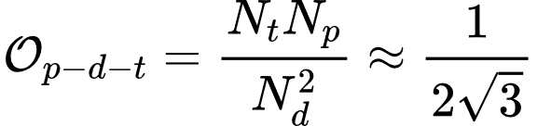
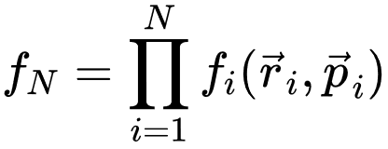
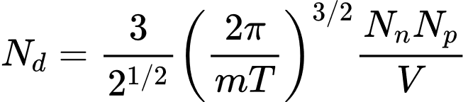
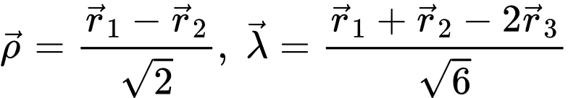
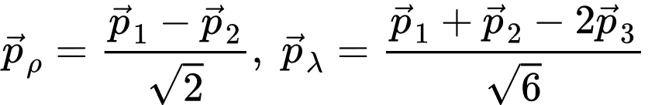
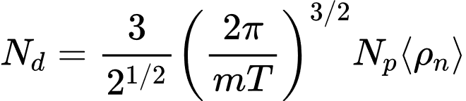
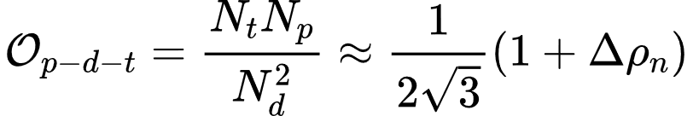
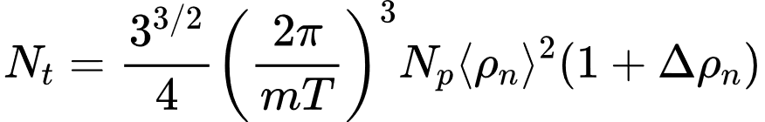
QCD与中高能核物理暑期学校@SDU July 2023
Light nuclei yield ratio
Without density fluctuations
With density fluctuations
K.-J. Sun, L. W. Chen, C. M. Ko, Z, Xu,
Phys. Lett. B 774, 103 (2017).
K.-J. Sun, L. W. Chen, C. M. Ko, J. Pu, Z, Xu,
Phys. Lett. B 781, 499 (2018).
4

Slide 6
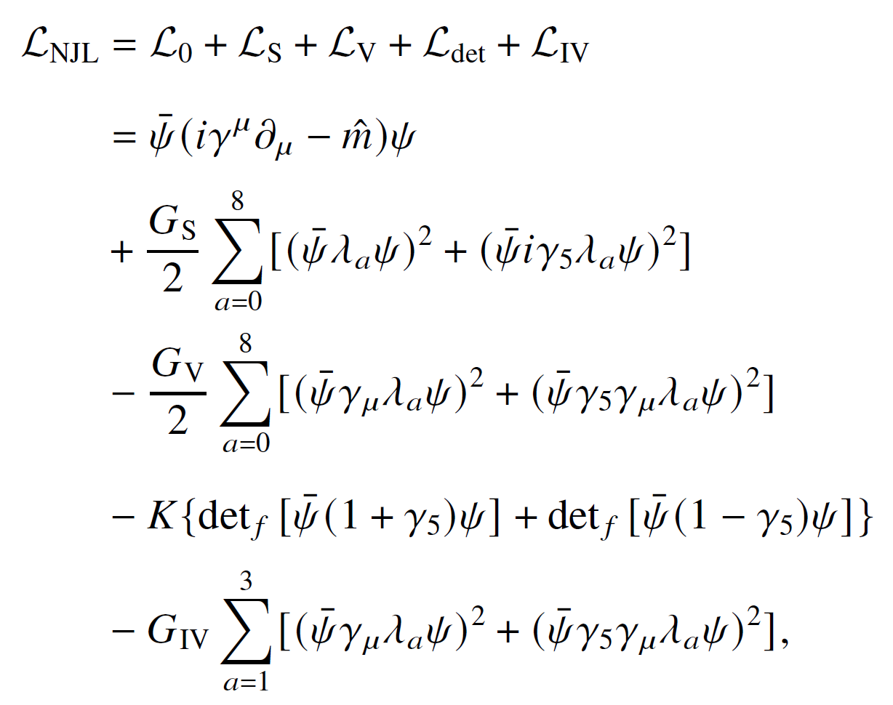
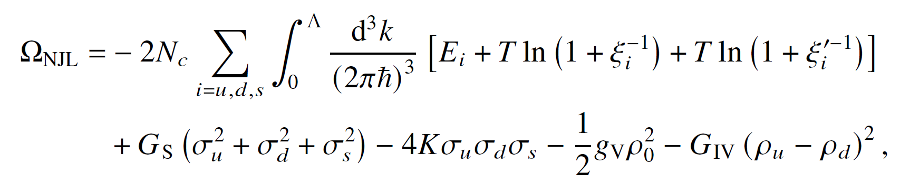
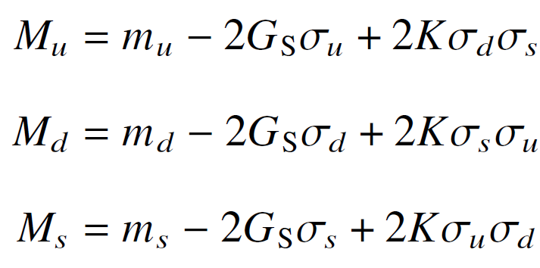
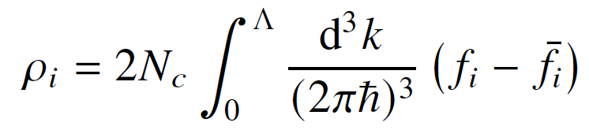
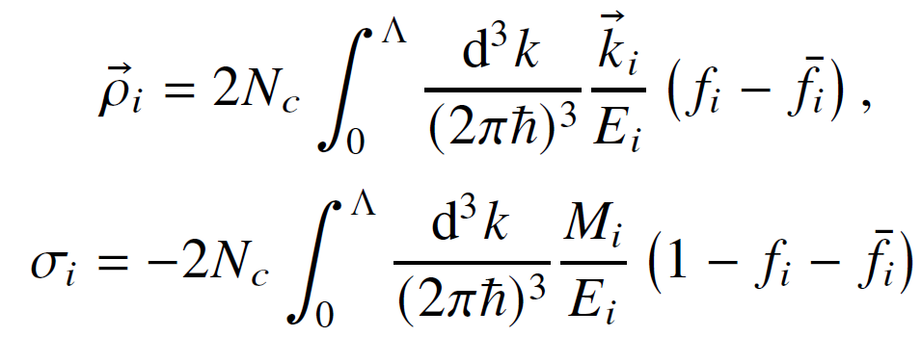
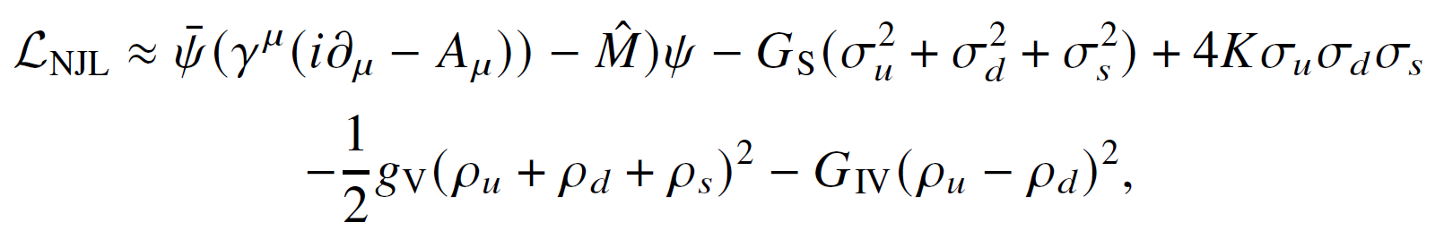
NJL model
scalar
pseudo-scalar
vector
pseudo-vector
FTFT
Gap equations
Quark densities
KMT interaction
Mean field approximation
Current densities
Quark condensates
Y. Nambu and G. Jona-Lasinio, Rhys. Rep. 122, 235 (1961); 124, 246 (1961).
5

Slide 7
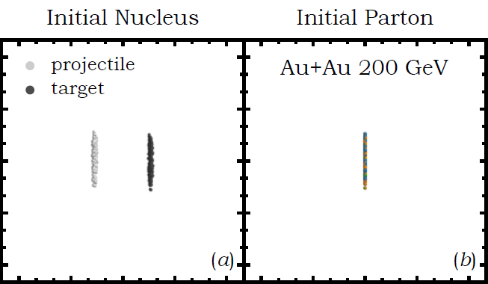
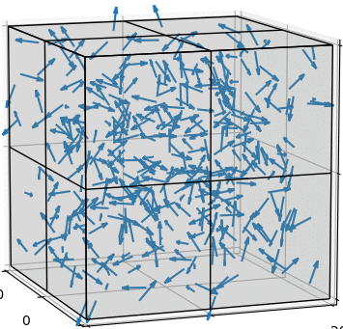
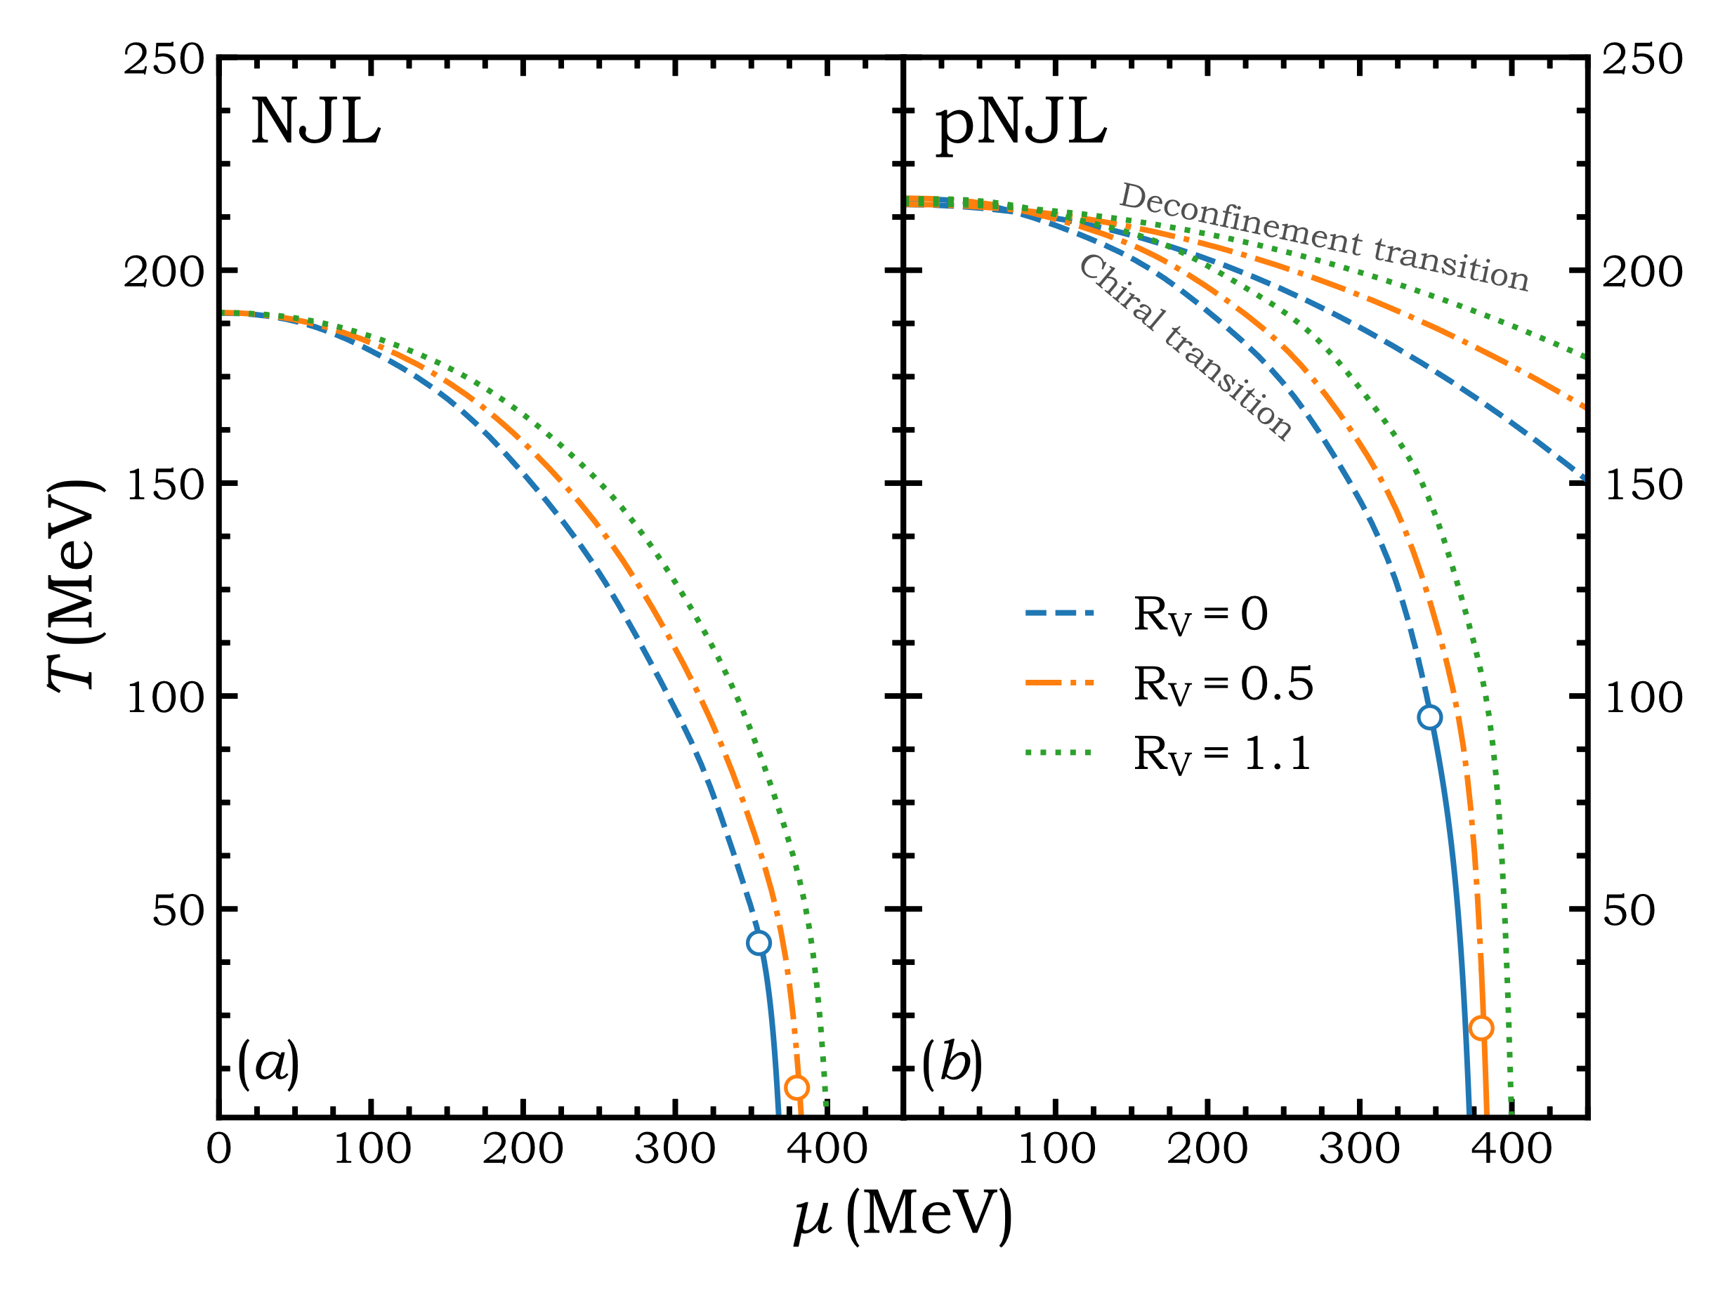
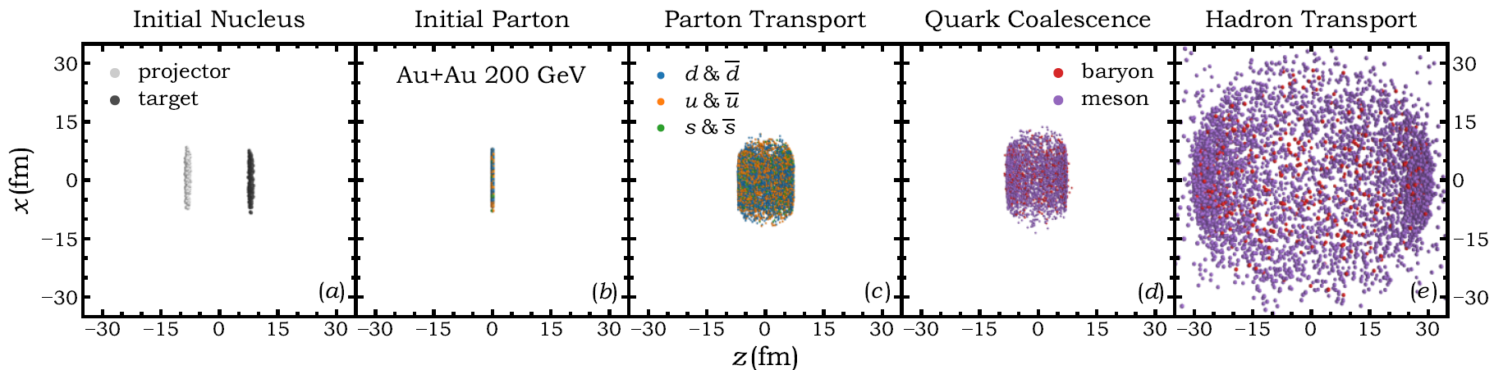
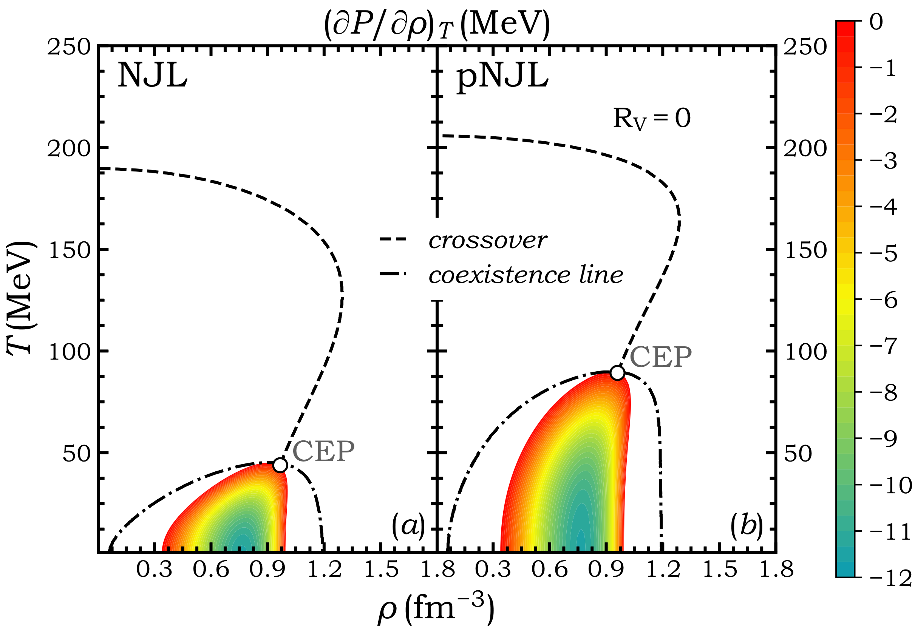
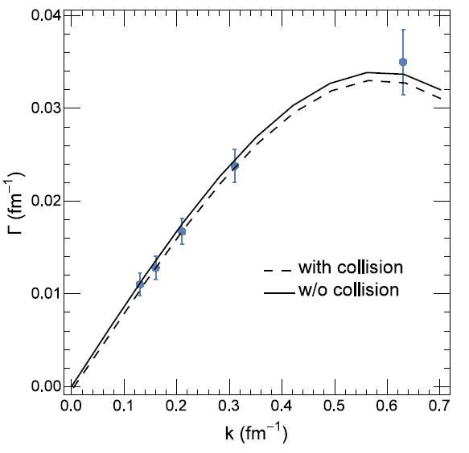

QCD与中高能核物理暑期学校@SDU July 2023
Methods
Transport simulations
Thermodynamics
Box calculations
W.-H Zhou and J. Xu, Phys. Rev. C 104. 044901 (2021).
F. Li and C. M. Ko, Phys. Rev. C 95, 055203 (2017).
6

Slide 8
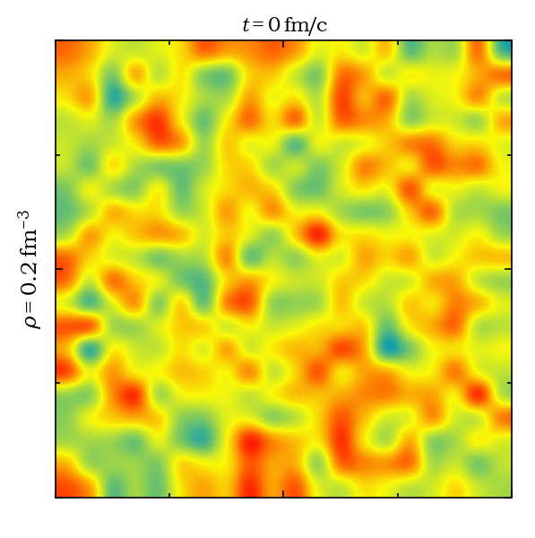
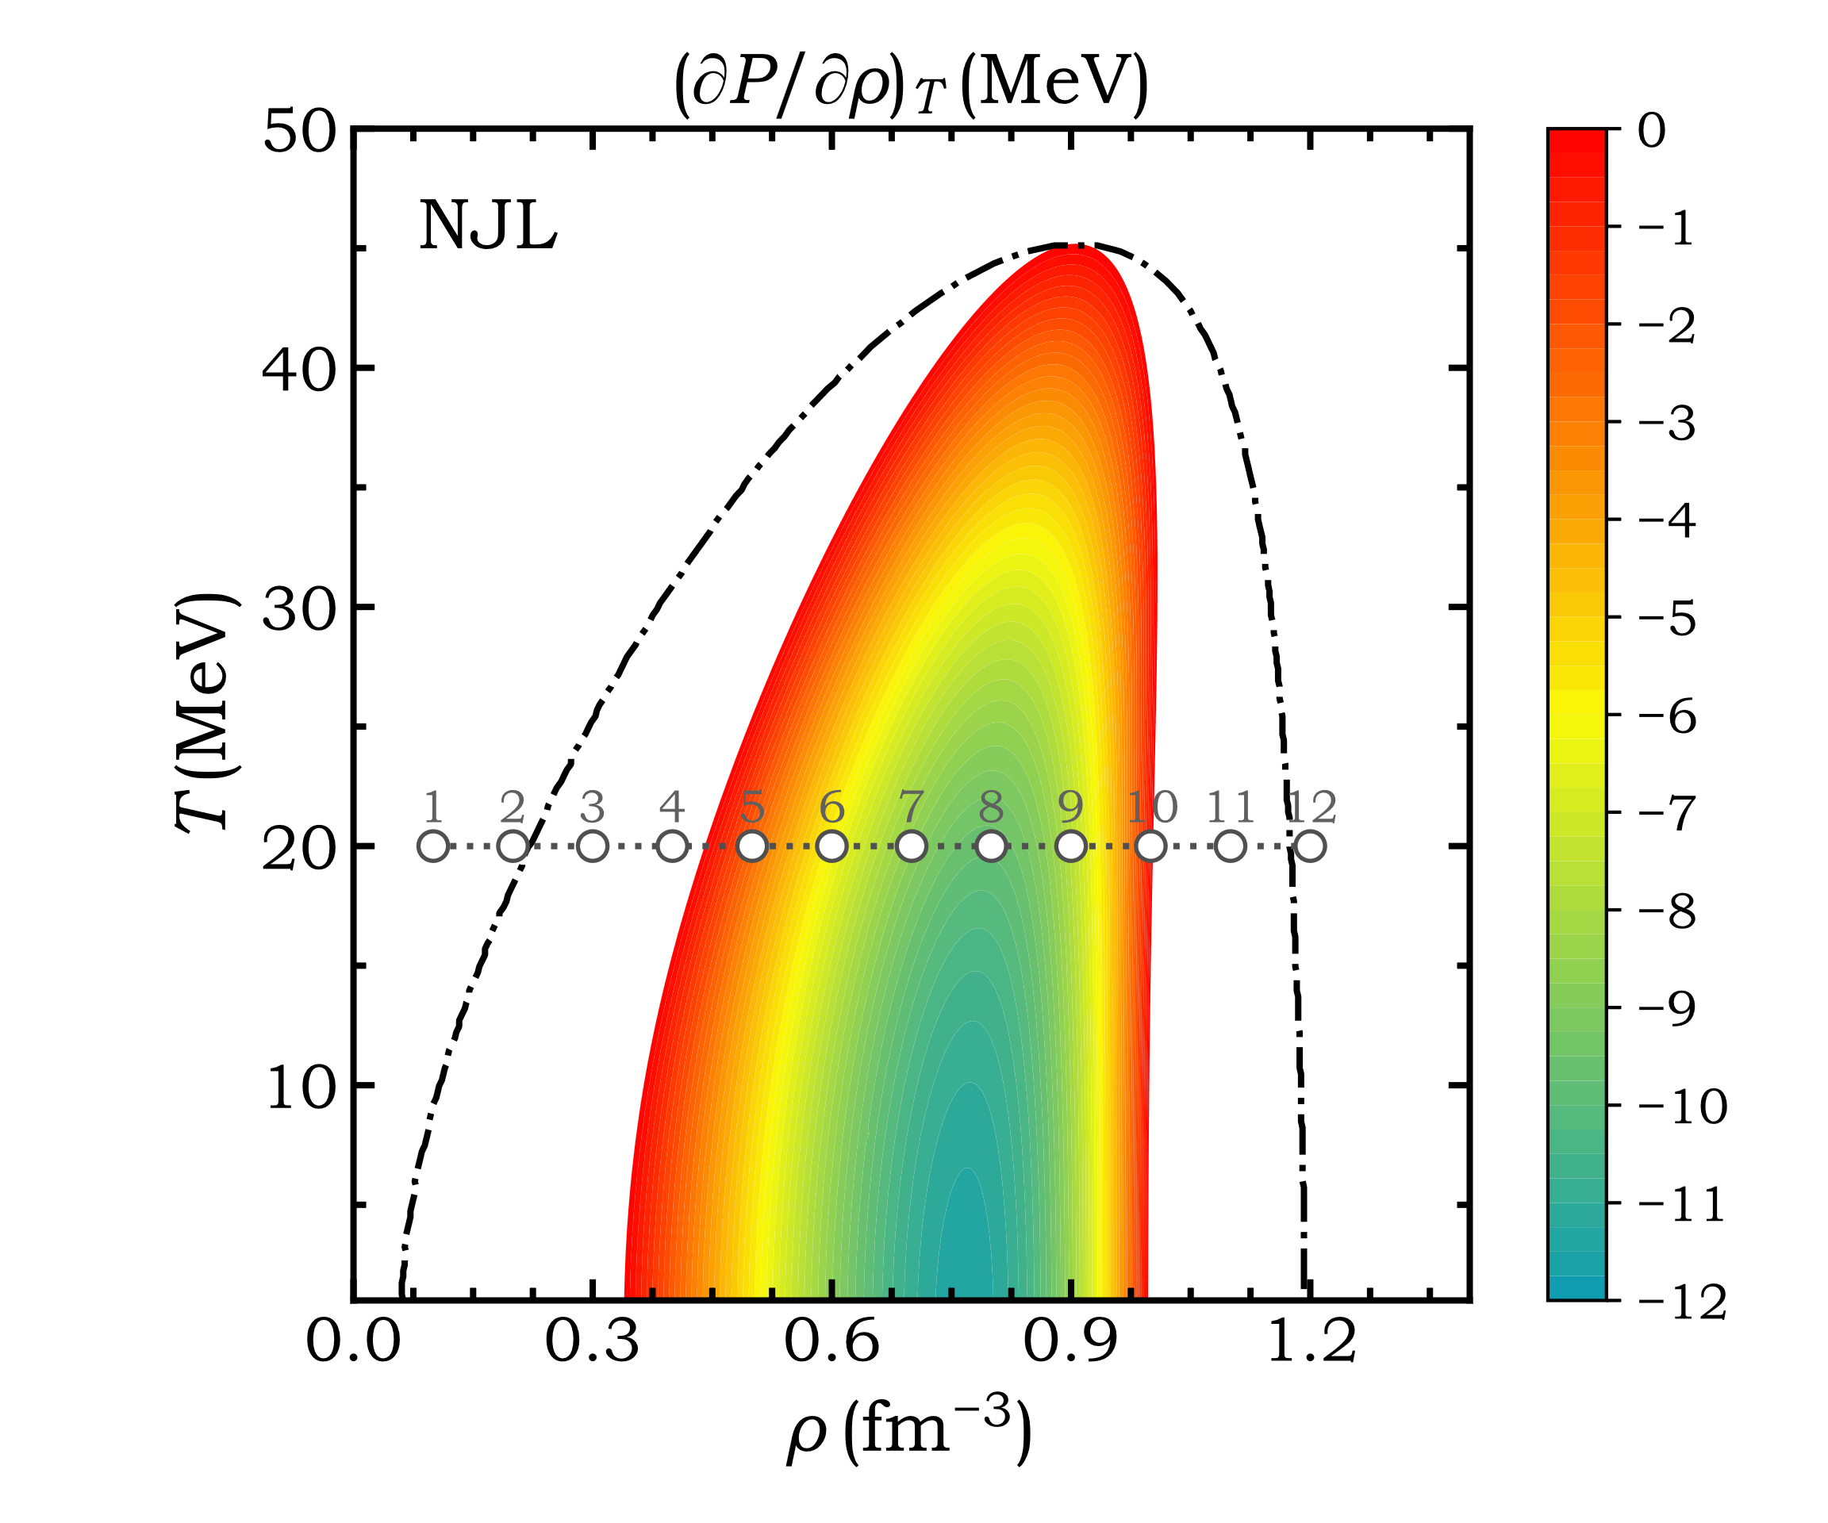
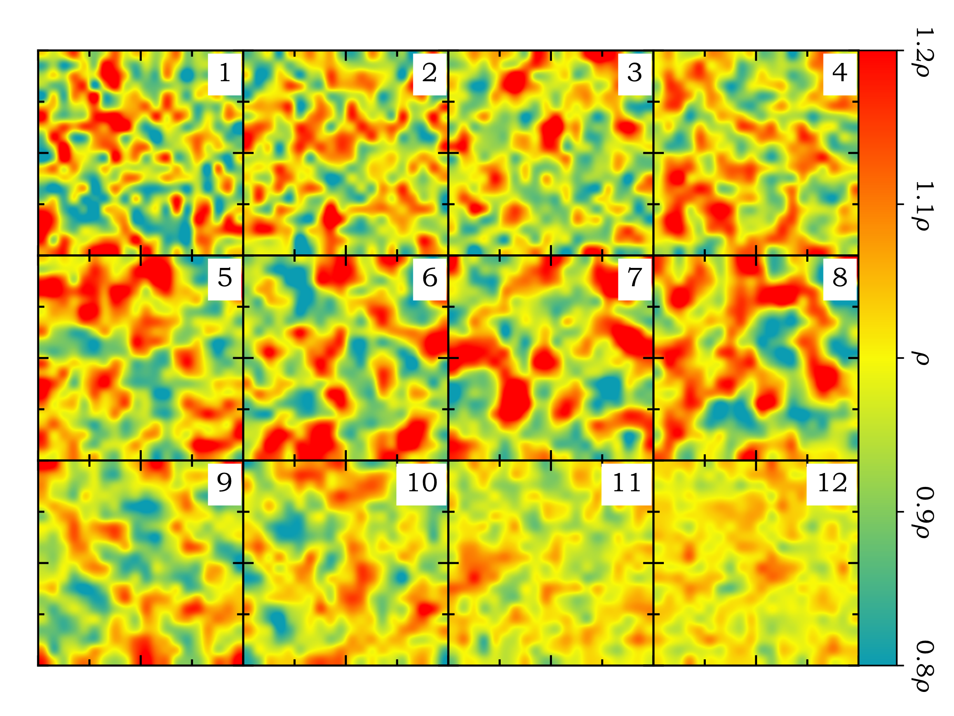
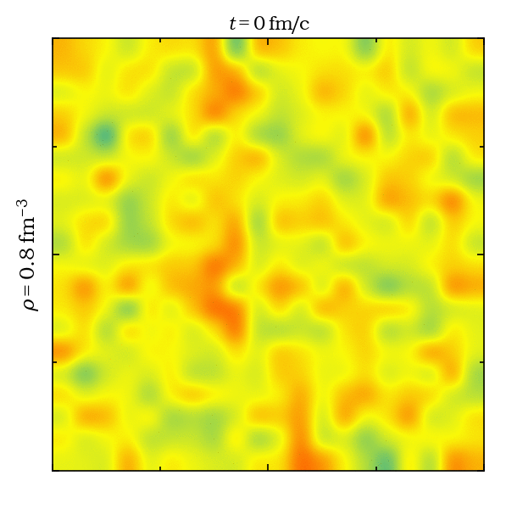

QCD与中高能核物理暑期学校@SDU July 2023
Box calculations
2
8
7

Slide 9
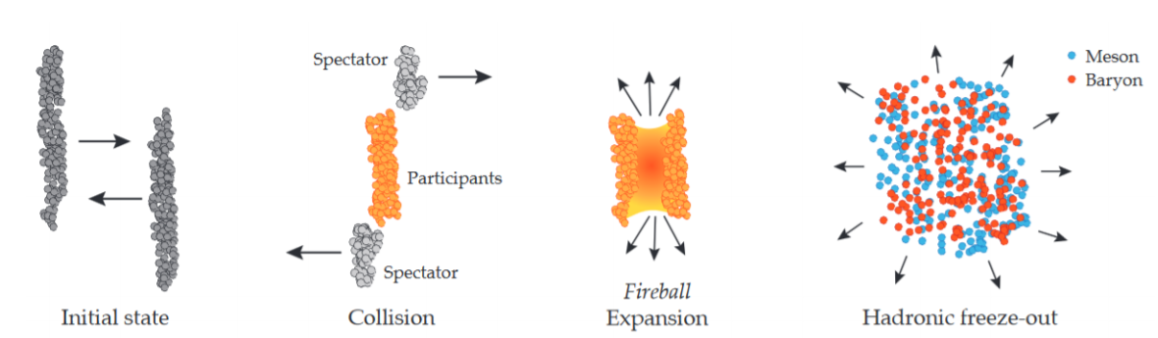
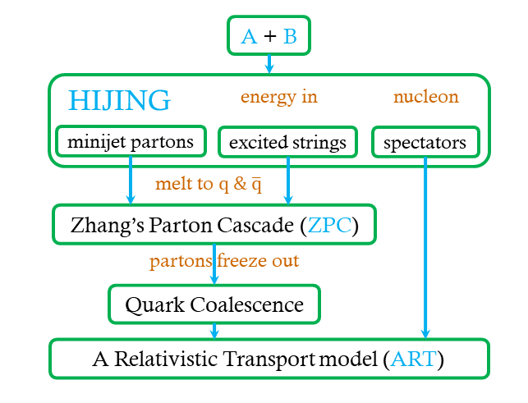
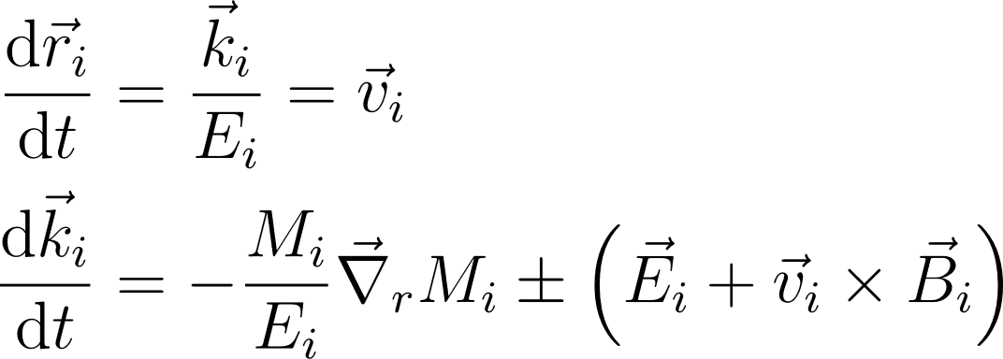
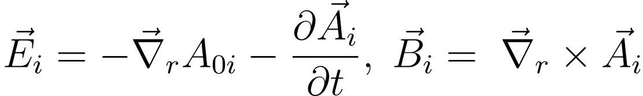
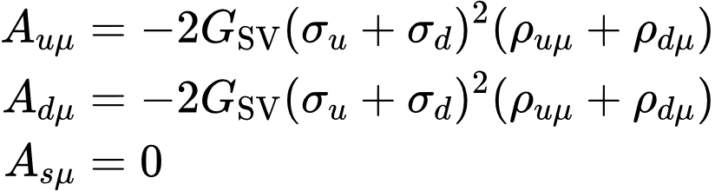
QCD与中高能核物理暑期学校@SDU July 2023
Extended AMPT model
EOMs
Parton Transport with Nambu-Jona-Lasinio (NJL) model
Nucleon Coalescence
String Melting-AMPT
To Replace ZPC model with NJL model.
Z.-W. Lin, C. M. Ko, B.-A. Li, B. Zhang, S. Pal,
Phys. Rev. C 72, 064901 (2005).
8

Slide 10
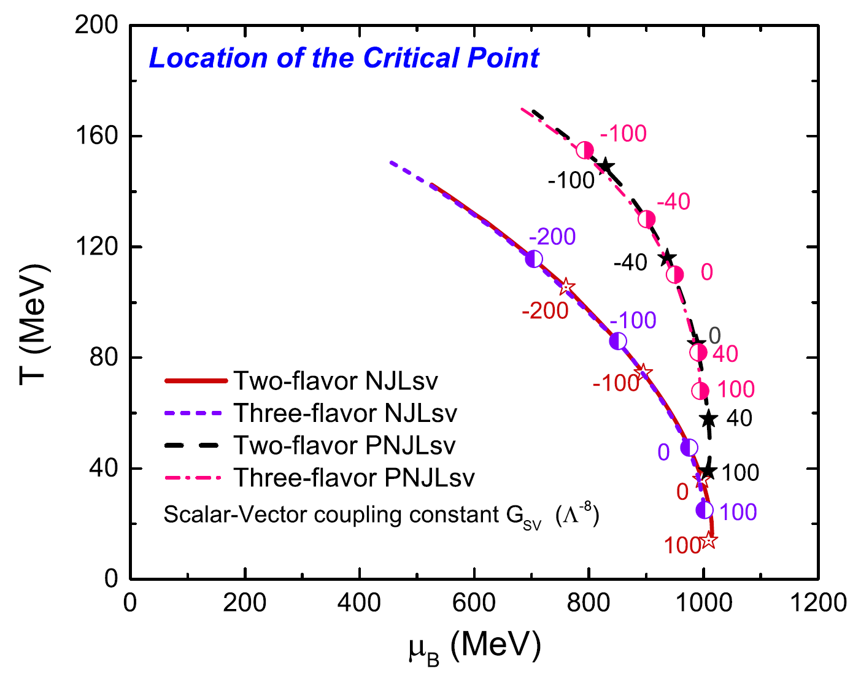
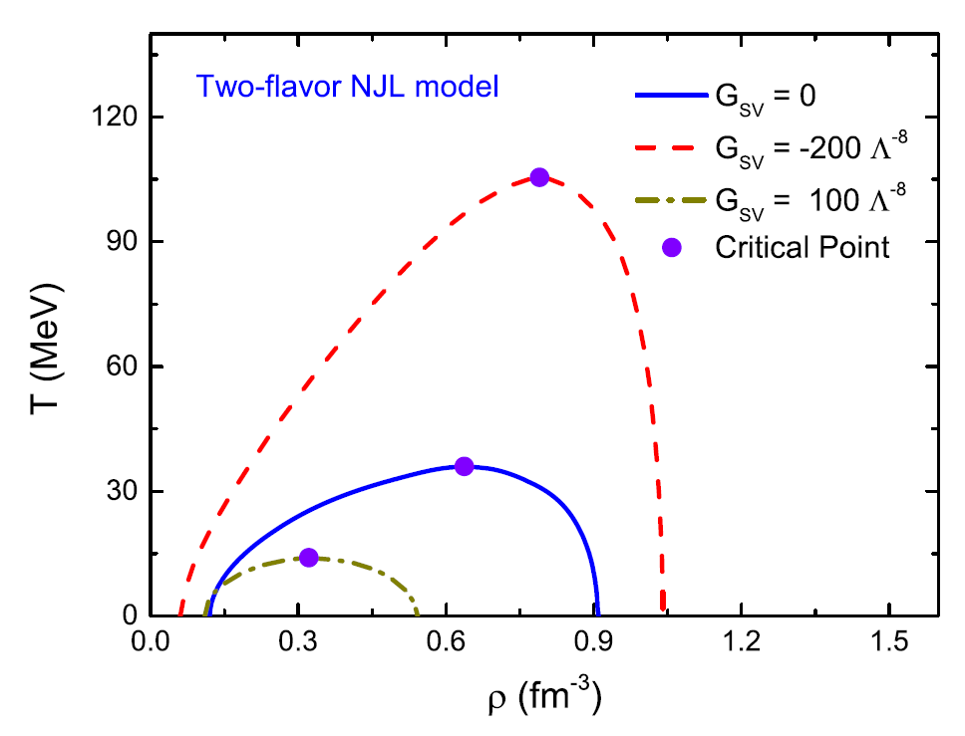
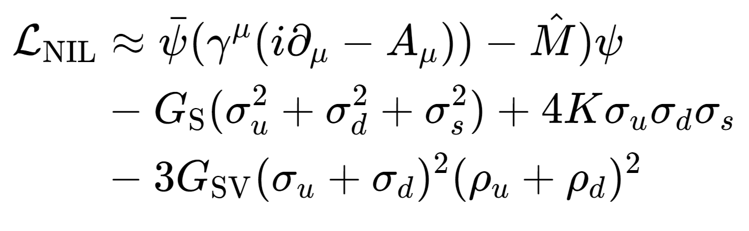
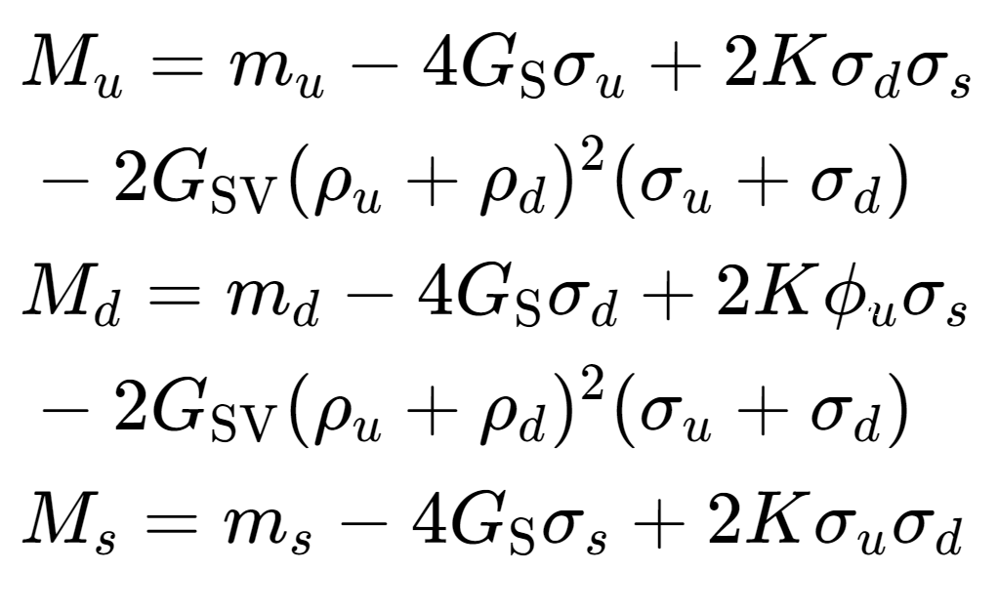
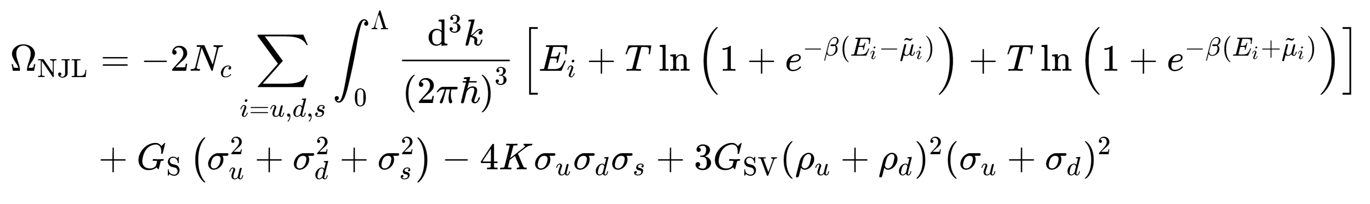
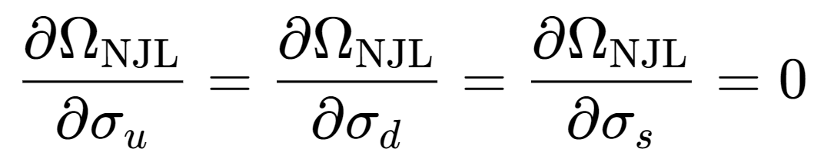
QCD与中高能核物理暑期学校@SDU July 2023
Results
K.-J. Sun, C. M. Ko, S. S. Cao, F. Li, Phys. Rev. D 103, 014006 (2021).
Finite negative $G_{SV}$ term can obtain higher critical point temperature and bigger area of spinodal region.
9

Slide 11






QCD与中高能核物理暑期学校@SDU July 2023
Results
Second-order scaled density moment
$y_{2}=1$if the density is a constant.
Large density inhomogeneity survives to kinetic freezeout.
K.-J Sun, C. M. Ko, J. Xu, F. Li, C.-L. Chen Eur. Phys. J. A 57, 313 (2021).
The longer system stay in spinodal region, the bigger the fluctuations system can get.
The light nuclei yield is enhanced in EoS-I.
arXiv:2205.11010.
10

Slide 12
QCD与中高能核物理暑期学校@SDU July 2023
Thank you for your attention!
11

Slide 13
Backup

Slide 14








Phase diagram
B.1

Slide 15



Mean field approximation
B.2

