Slide 1

自旋极化
Spin Polarization
高建华
山东大学威海校区
QCD与中高能核物理暑期学校，青岛，2023年7月10日-25日

Slide 2
Outline
Introduction to spin
Introduction to polarization
Introduction to spin polarization in heavy-ion collisions

Slide 3
Outline
References:
《Spin in Particle Physics》 E. Leader
《The quantum theory of fields》S. Weinberg
《Particles and Quantum fields》H. Klienert
《Modern quantum mechanics》 J. J. Sakurai
《Relativistic quantum mechanics. D. Bjorken and S. D. Drell
《Strongly interacting matter under rotation》Lecture Notes in Physics

Slide 4
Introduction to spin

Slide 5
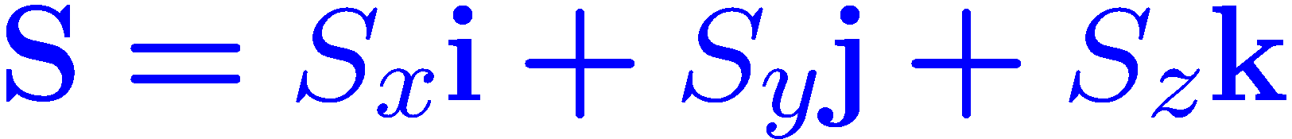
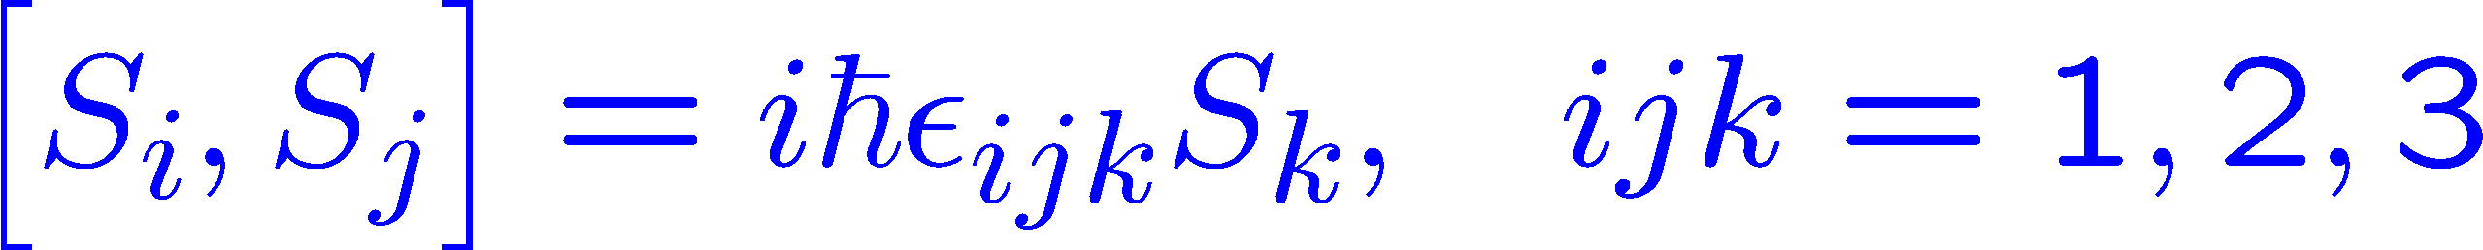
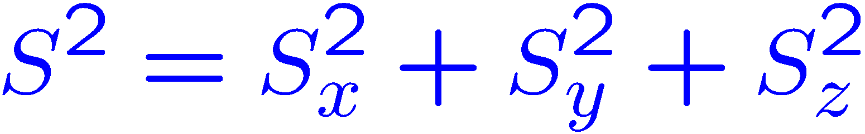
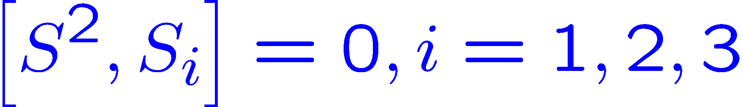
Spin in quantum mechanics
In quantum mechanics, the observable spin is represented by spin operators:
In a more compact form:
The observables $S_{x},S_{y},S_{z}$ are incompatible observables
Define another operator:
Made by Chun Shen
The observables $S^{2},S_{x}$or $S^{2},S_{y}$, or $S^{2},S_{z}$ are compatible observables

Slide 6
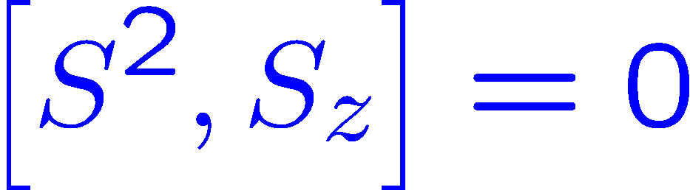
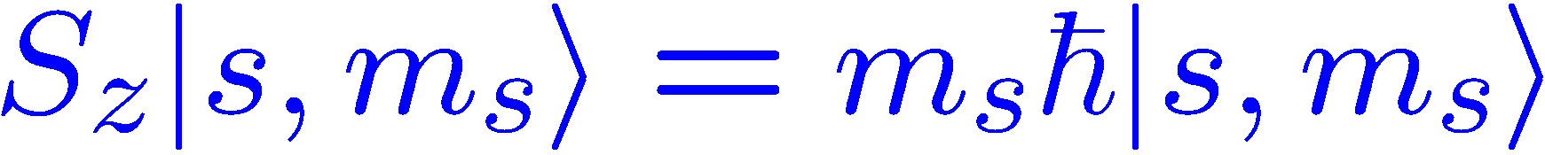



Spin in quantum mechanics
Choose the compatible observables $S^{2},S_{z}$ :
For a certain particle , the quantum number $s$ is fixed, only $m_{s}$ is relevant
In quantum mechanics, the spin observables are compatible with position or momentum:
$$|x′,y′,z′,m〉$$
Made by Chun Shen
$$|p_{x}^{′},p_{y}^{′},p_{z}^{′},m〉$$

Slide 7
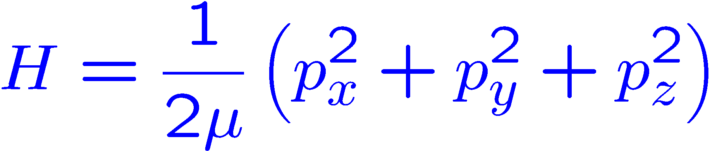


Spin in non-relativistic quantum mechanics
The Hamiltonian for a free non-relativistic particle with arbitrary spin :
The coordinate $x′,y′,z′,$ are not good numbers:
The momentum and spin $p_{x}^{′},p_{y}^{′},p_{z}^{′},m$ are good numbers:
In non-relativistic quantum mechanics, it is convenient to denote a free particle with $p_{x}^{′},p_{y}^{′},p_{z}^{′},m_{s}$!
The orbital angular momentum and total angular momentum are both good numbers for free particles:
Made by Chun Shen
$$|E,l,m,m_{s}〉$$

Slide 8
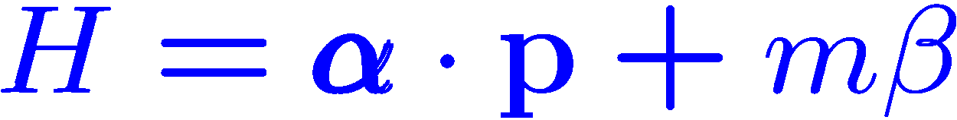
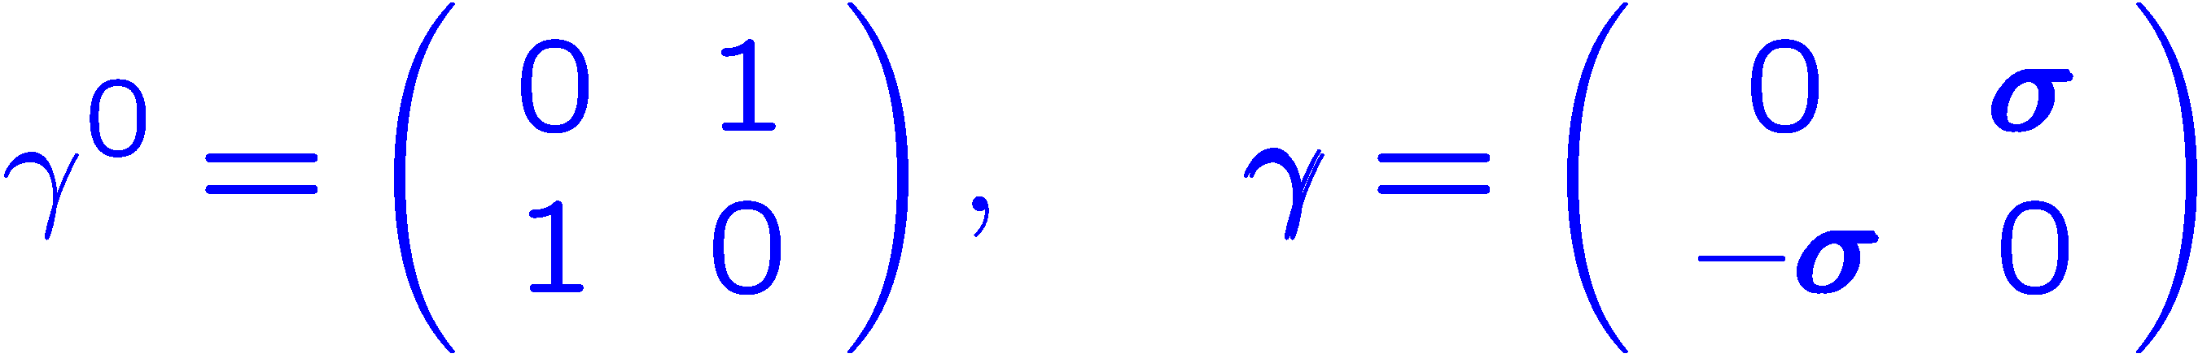
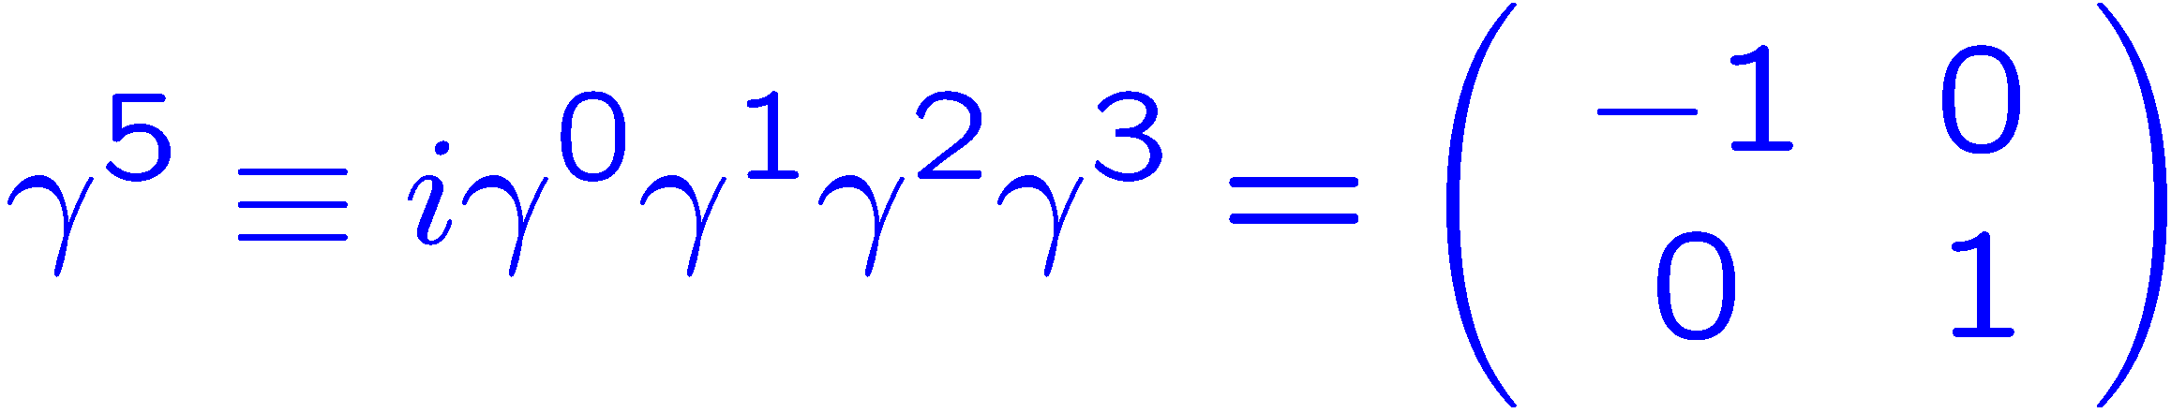
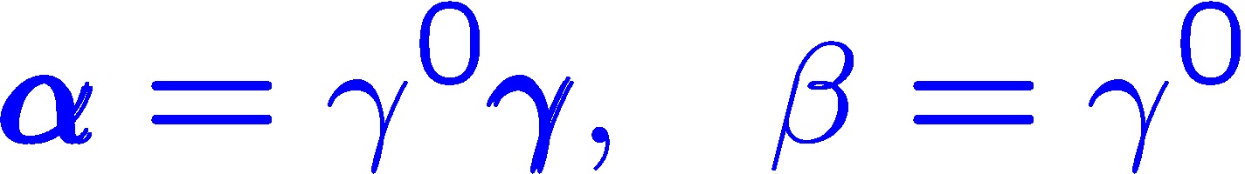
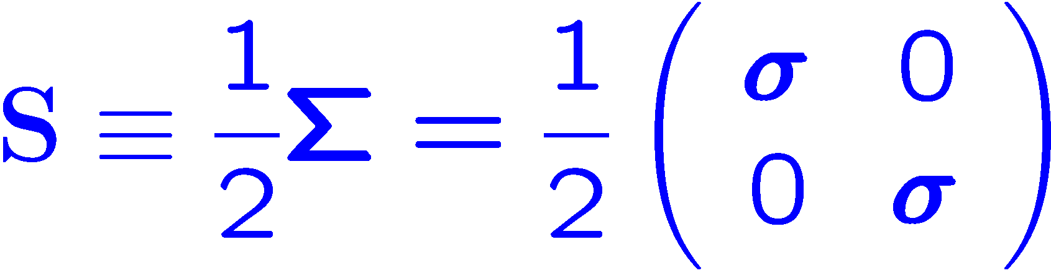


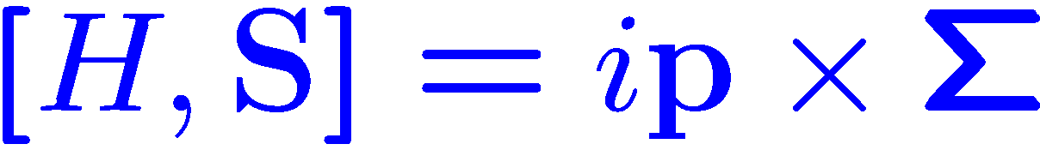

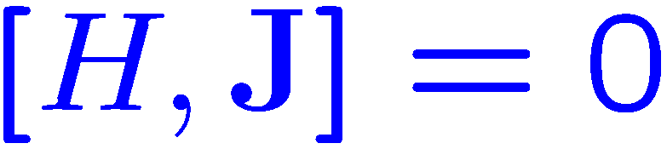
Spin in relativistic quantum mechanics
The Hamiltonian for a free relativistic particle with spin 1/2 :
The spin, orbital and total angular momentum operator:
Made by Chun Shen
Neither spin nor orbital angular momentum is good quantum numbers. But the total angular momentum does!
In relativistic quantum mechanics, $p_{x}^{′},p_{y}^{′},p_{z}^{′},m_{s}$ are not good quantum numbers any more!

Slide 9
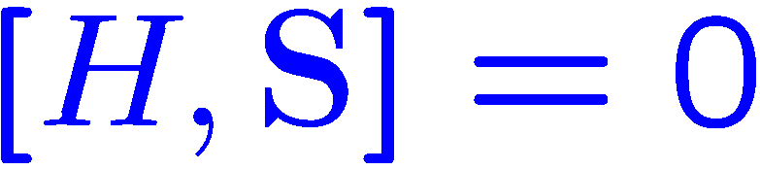
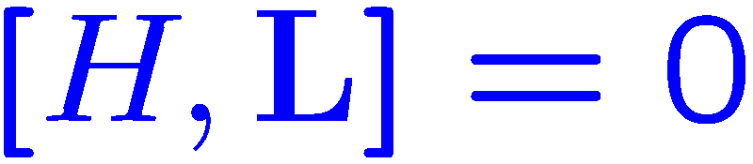


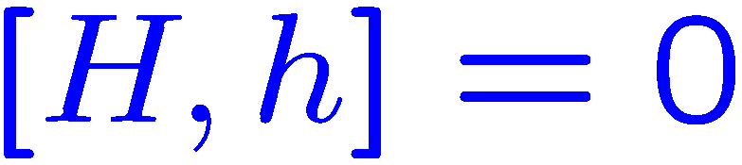
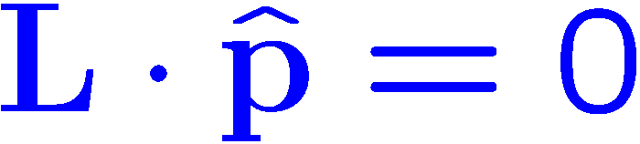
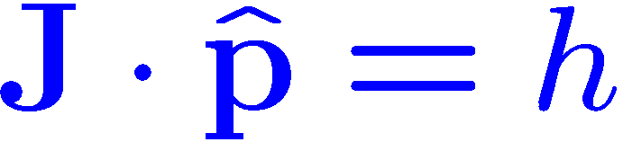


Spin in relativistic quantum mechanics
Method 1:
Set $p=0$
Method 2:
Define the helicity operator $h=S⋅\hat{p}$
Made by Chun Shen
Method 1: valid for the massive particles!
Method 2: valid for both massive and massless particles!

Slide 10
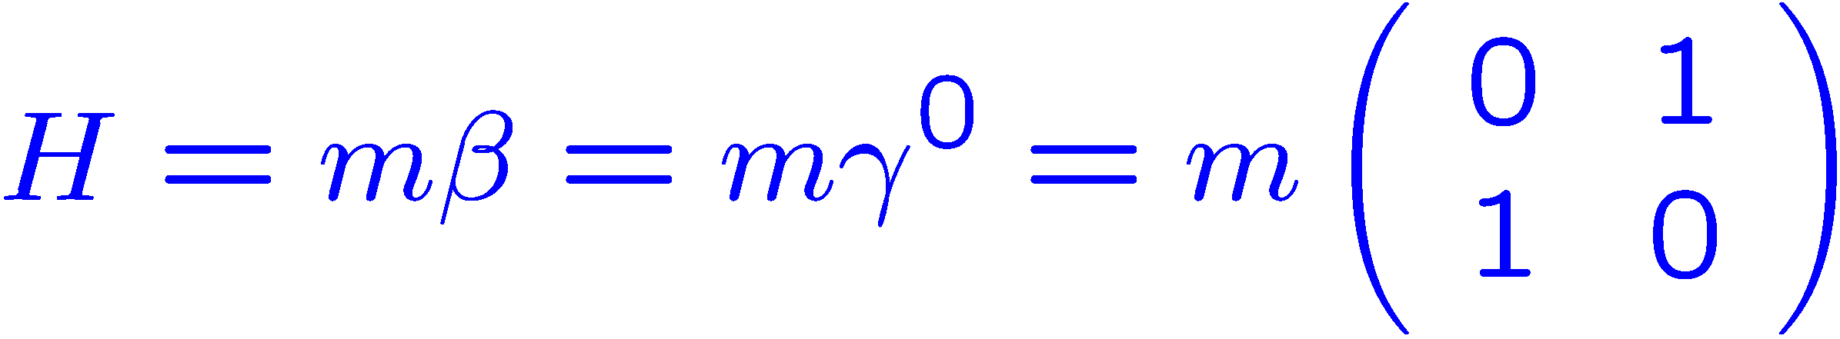
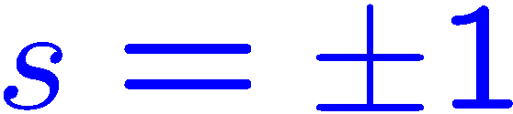
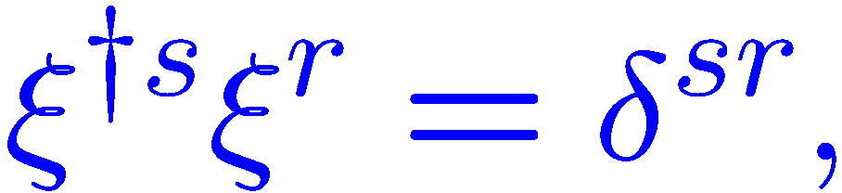
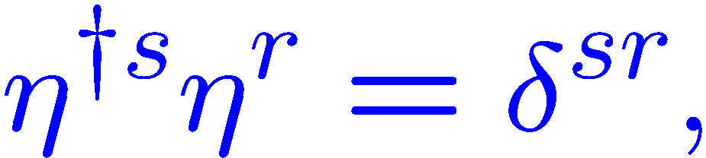
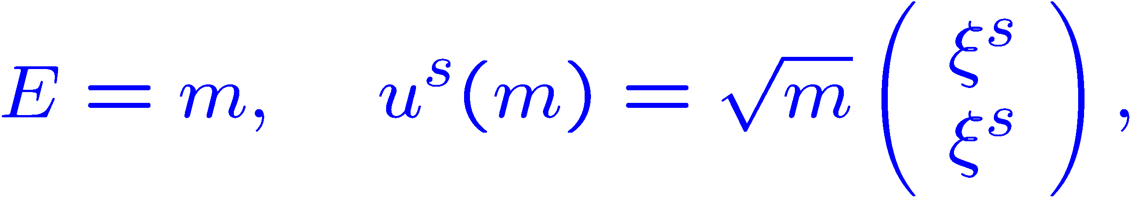
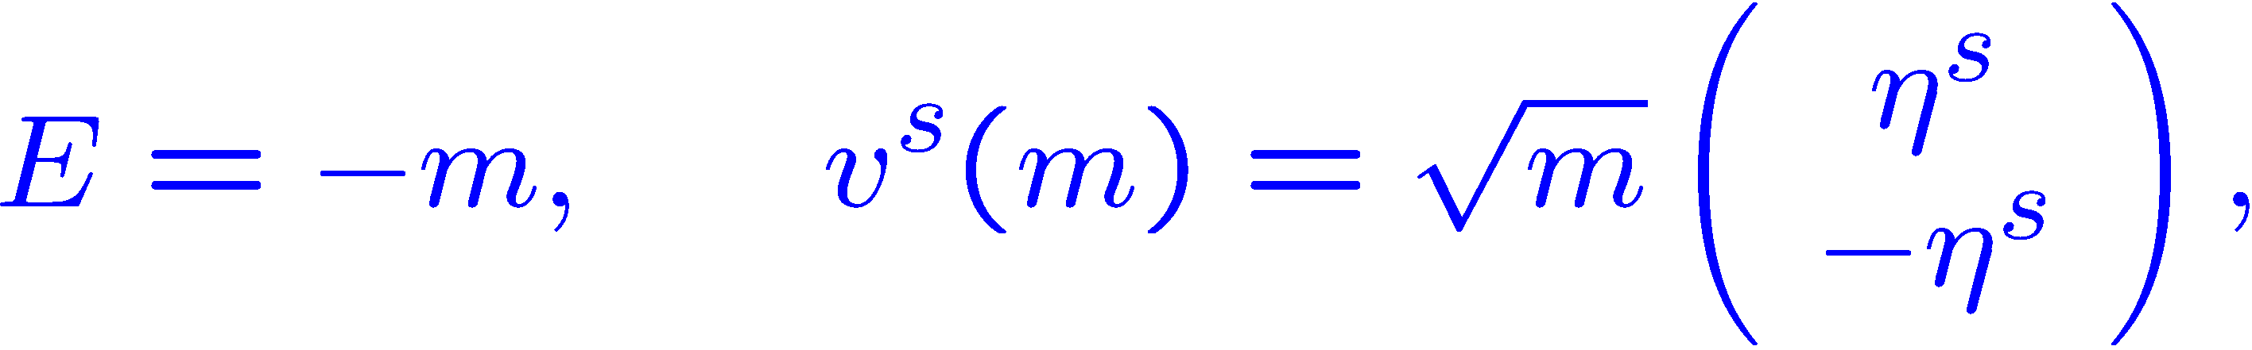
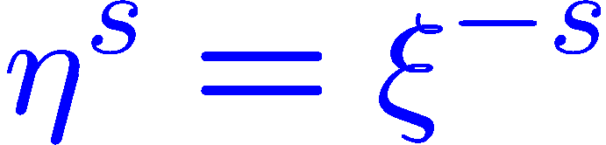
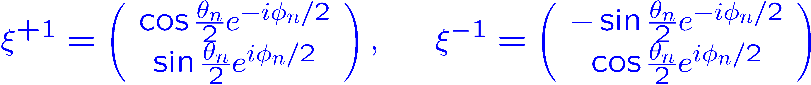
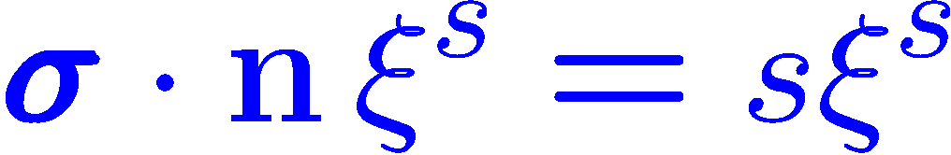
Spinor in the rest frame
Method 1:
In the rest frame:
Four orthogonal eigen-spinors for the Hamiltonian:
Made by Chun Shen
Spin quantization direction $n=(\sin{θ_{n}}\cos{φ_{n}},\sin{θ_{n}}\sin{φ_{n}},\cos{θ_{n}})$:
In rest frame, $p_{x}^{′}=0,p_{y}^{′}=0,p_{z}^{′}=0,s$ are good quantum numbers

Slide 11
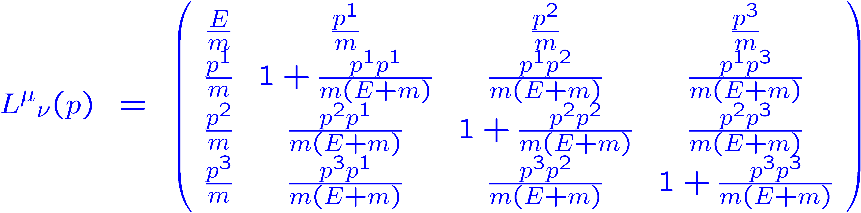
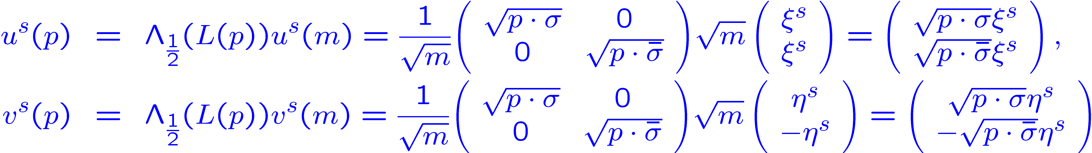

Spinor in any other frame
Choose a standard boost which carries the 4-vector from $(m,0)$ to $(E,p)$ :
$\hat{p}=(\sin{θ}\cos{φ},\sin{θ}\sin{φ},\cos{θ})$:
The spinor in the frame with momentum $p^{μ}=(E,p)$ can be obtained by:
Made by Chun Shen

Slide 12
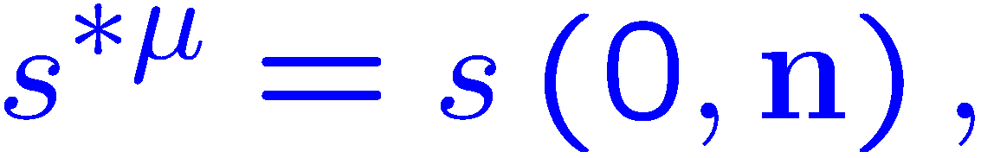
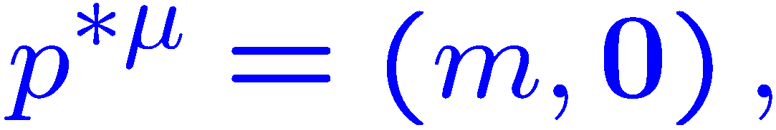
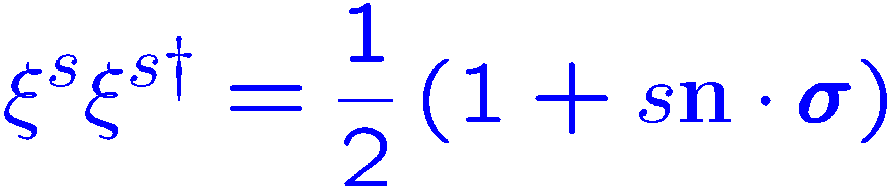
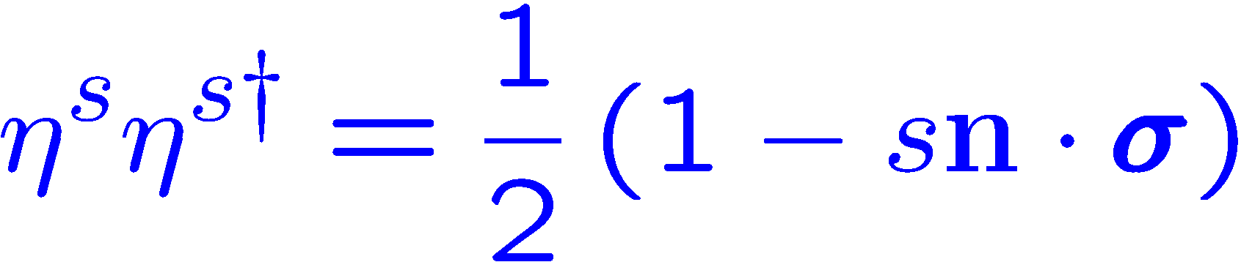
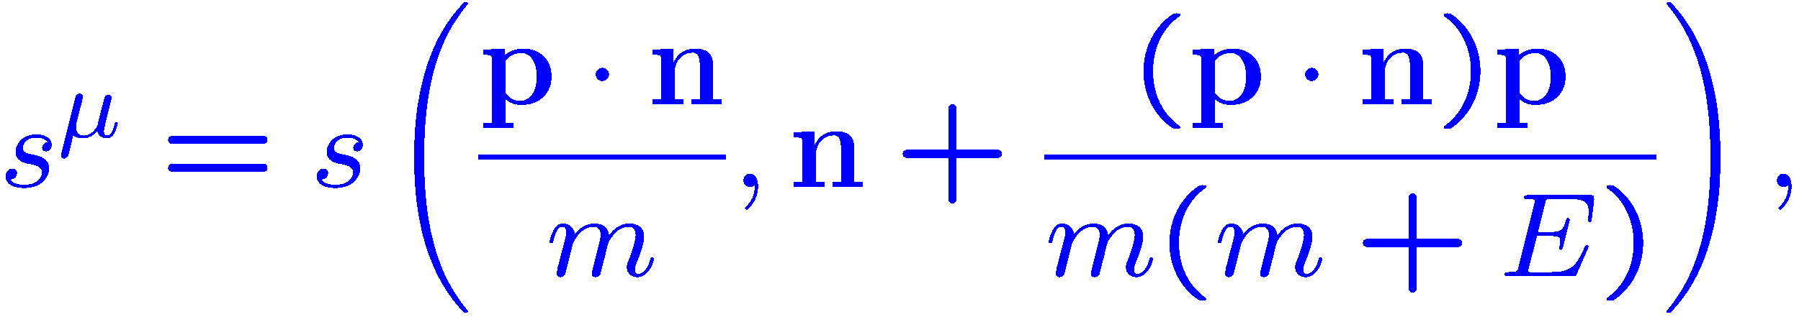
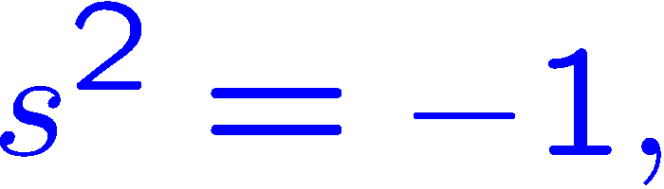
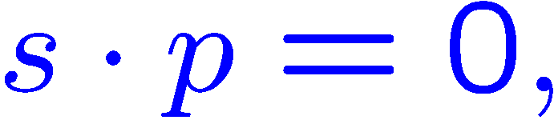
Spinor in any other frame
How to calculate:
In rest frame:
After boosting:
Made by Chun Shen
Spin vector :

Slide 13
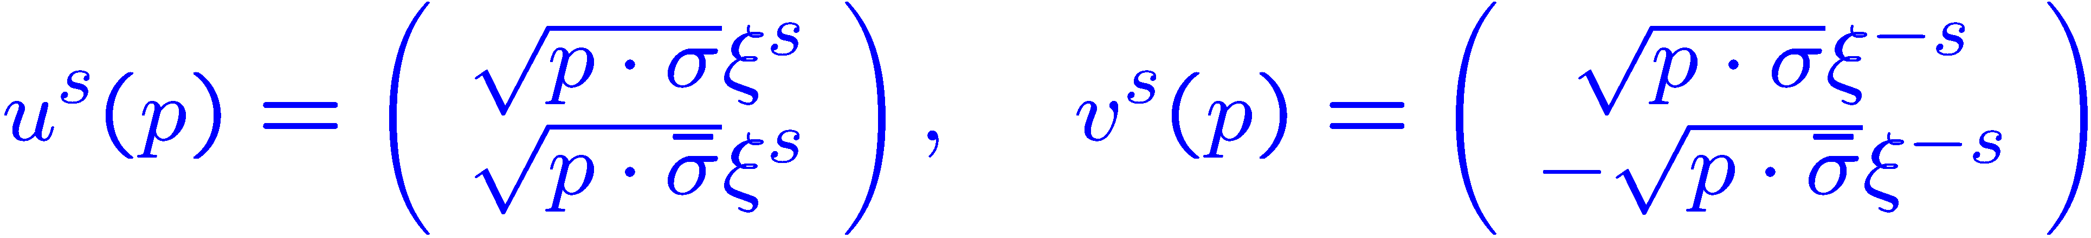
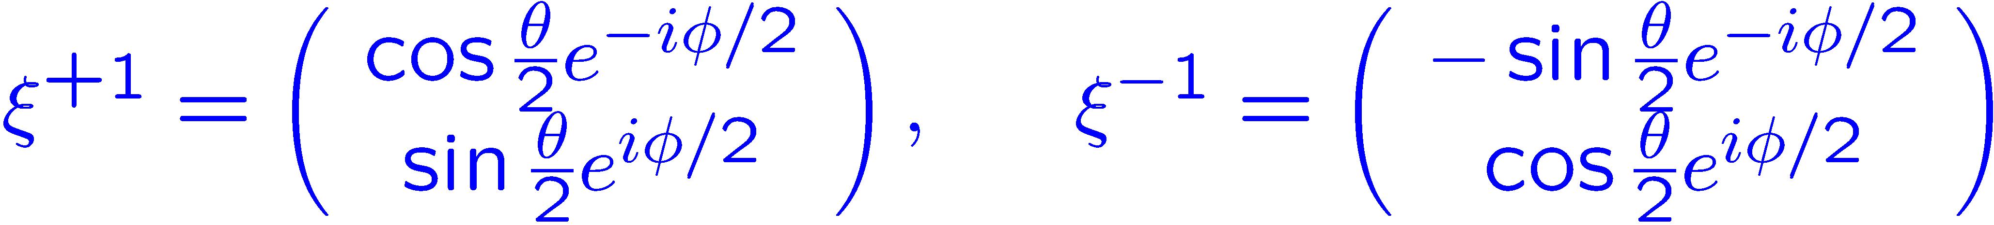
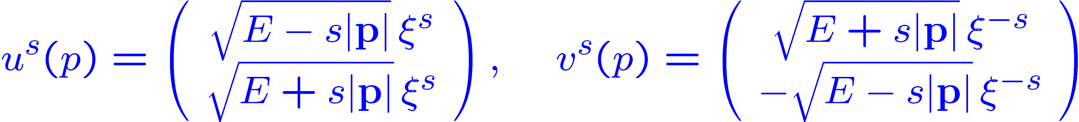
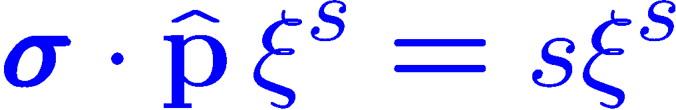
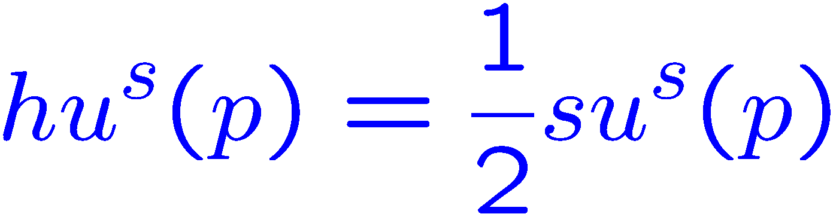
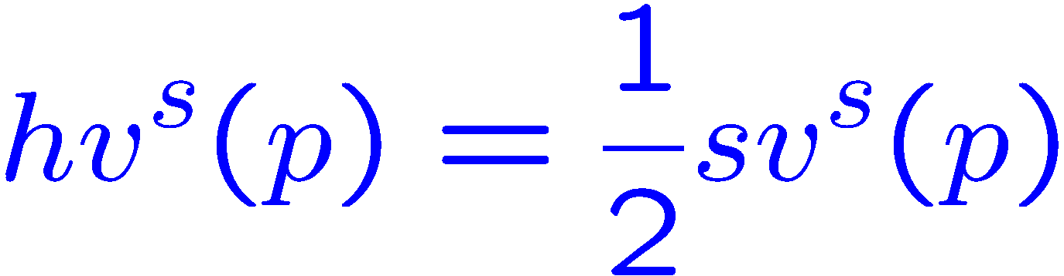
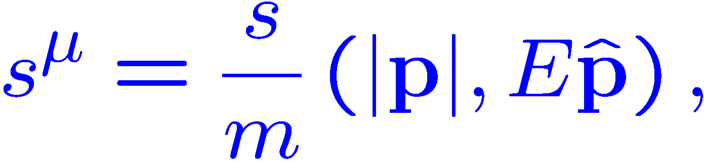
Spinor with the helicity basis
Method 2:
The helicity operator $h=S⋅\hat{p}$ for particle while$h=−S⋅\hat{p}$ for antiparticle
The eigenspinor of helicity operator :
Spin vector:
Made by Chun Shen
Made by Chun Shen
Made by Chun Shen
In any frame, the momentum and helicity $(p_{x},p_{y},p_{z},s)$ are good quantum numbers

Slide 14
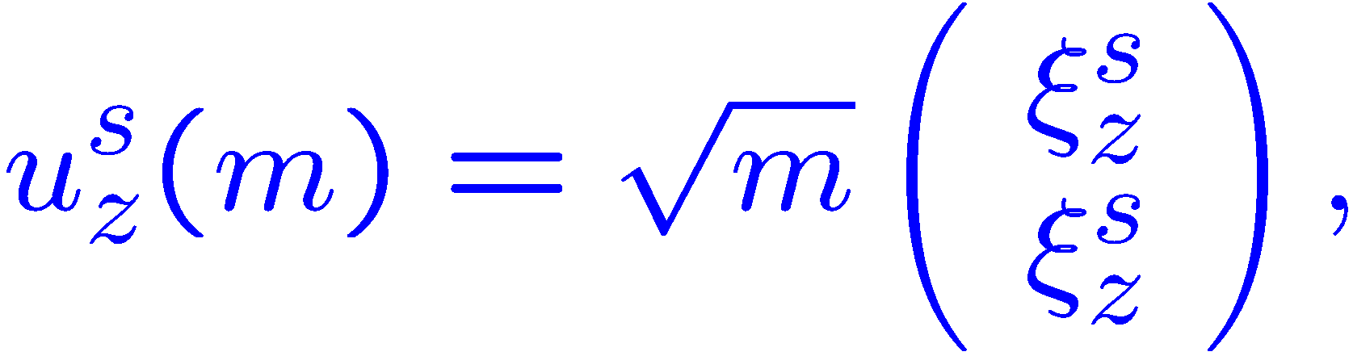
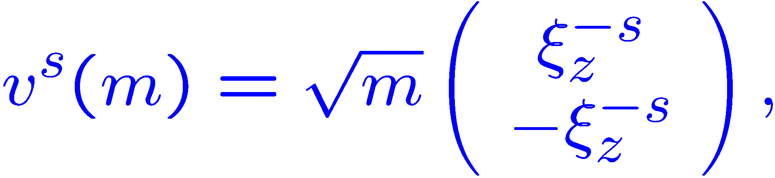
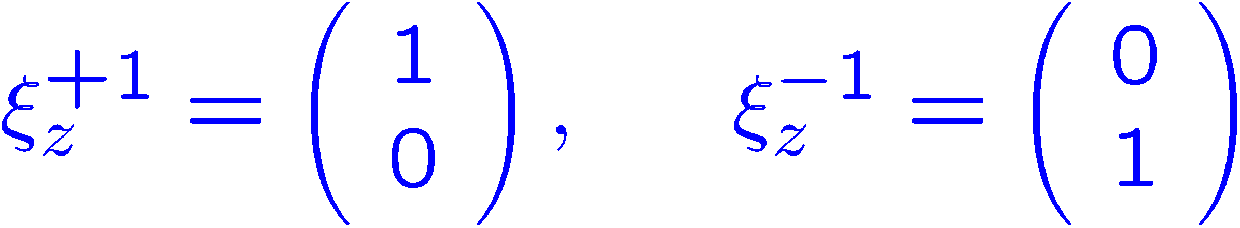

Spinor in any other frame
Recall the standard boost which carries the 4-vector from $(m,0)$ to $(E,p)$ :
$\hat{p}=(\sin{θ}\cos{φ},\sin{θ}\sin{φ},\cos{θ})$:
The spinor in the frame with momentum $p^{μ}=(E,p)$ can be obtained by:
Made by Chun Shen

Slide 15
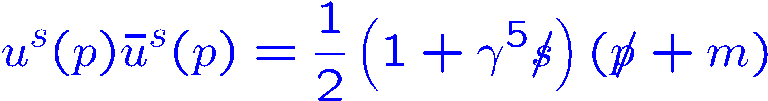
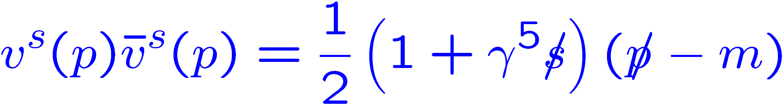
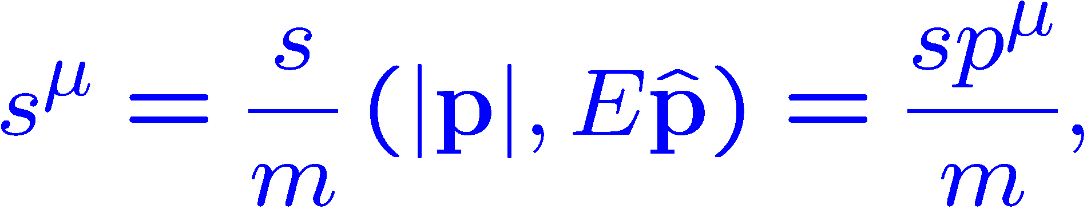


Spinor for the massless particles
The spinor for the massless particles:
Made by Chun Shen
Made by Chun Shen
Made by Chun Shen

Slide 16





Helicity and Chirality
The helicity operator:
particle
antiparticle
The chirality operator:
particle
antiparticle
The commutation with Hamiltonian:
helicity: +1 -1 +1 -1
chirality: +1 -1 -1 +1
Made by Chun Shen
Made by Chun Shen

Slide 17
















Projection operators
The projection operator for energy:
The projection operator for spin:
Made by Chun Shen
Made by Chun Shen

Slide 18










Projection operators
The projection operator for chirality:
Massless particle:
Chirality: Right-handed
Left-handed:
Helicity:
Right-handed for particle
Right-handed for particle
Right-handed for antiparticle
Right-handed for particle
Made by Chun Shen
Made by Chun Shen

Slide 19



Spin ½ in quantum field theory
Quantized Dirac field:
Fundamental anti-commutation rules:
Charge and energy-momentum :
Total angular momentum:
Made by Chun Shen
Made by Chun Shen

Slide 20











Spin 1 in quantum field theory
Proca equations:
Constraint condition:
The general solution:
Fundamental commutation rules:
In the rest frame $p^{μ}=(m,0)$ :
Orthonormal linear polarization vectors： $ε^{(1)},ε^{(2)},ε^{(3)}$ with $ε^{(1)}×ε^{(2)}=ε^{(3)}=n$
$η^{(1)},η^{(2)},η^{(3)}$ with $η^{(1)}×η^{(2)}=η^{(3)}=n$

Slide 21







Spin 1 in quantum field theory
Using the standard boost which carries the 4-vector from $(m,0)$ to $(E,p)$ :
$\hat{p}=(\sin{θ}\cos{φ},\sin{θ}\sin{φ},\cos{θ})$:
The polarization vector in the frame with momentum $p^{μ}=(E,p)$ can be obtained by:
Made by Chun Shen
The sum rule:

Slide 22


Spin 1 in quantum field theory
Charge and energy-momentum :
Total angular momentum:
Spin for the particle in the rest frame with linear polarization:
Orthonormal circular polarization vector :
Spin for the particle in the rest frame with circular polarization:
Made by Chun Shen

Slide 23





Spin and Symmetry
Poincare group: Lorentz group with translations:
Poincare algebra:
Angular momentum and boost three-vector:

Slide 24





Casimir operators
The first Casimir invariant operator:
The second Casimir invariant operator:
Pauli-Lubanski pseudovector:

Slide 25







Casimir operators
For $p^{2}=m^{2}>0$, in the particle rest-frame $k^{μ}=(m,0,0,0)$:
Little group for massive particle in the standard frame with $k^{μ}=(m,0,0,0)$ :

Slide 26





Spin and Symmetry
Space inversion:
Intrinsic parity:
Time reversal:
Made by Chun Shen

Slide 27








Spin and Symmetry
Little group for massless particle in the standard frame with $k^{μ}=(1,0,0,1)$ :
Helicity:
Made by Chun Shen

Slide 28







Spin and Symmetry
Space inversion:
Time reversal:
Made by Chun Shen

Slide 29
Introduction to polarization

Slide 30







Density matrix
In a pure ensemble:
In a mixed ensemble:
Density matrix:
Density operator:
Ensemble average can be written as:

Slide 31












Density matrix
Density matrix:
Density operator:
(1):
(2):
(3):
(4):
(5):
For a pure state $|ψ〉$ :
Made by Chun Shen
Made by Chun Shen
Time evolution of density operator:

Slide 32










Spin ½ density matrix
Spin ½ density matrix:
Degree of polarization:
A completely polarized ensemble:
Made by Chun Shen
Made by Chun Shen
Made by Chun Shen
$n=(\sin{θ_{n}}\cos{φ_{n}},\sin{θ_{n}}\sin{φ_{n}},\cos{θ_{n}})$:

Slide 33










Spin ½ density matrix
An unpolarized ensemble:
Made by Chun Shen
An partially polarized ensemble:

Slide 34




Spin ½ density matrix
An partially polarized ensemble:

Slide 35











Spin 1 density matrix
Spin 1 density matrix:
The degrees of the vector polarization and tensor polarization:

Slide 36











Spin 1 density matrix
For a pure ensemble:

Slide 37












Spin 1 density matrix
For a mixed ensemble:

Slide 38

Hyperon decay
$$θ^{∗}$$
P
H

Slide 39






Hyperon decay

Slide 40

Vector meson decay
$$θ^{∗}$$
M
V

Slide 41


Vector meson decay

Slide 42



Density matrix in global equilibrium
Define a quantity:
For a completely random ensemble:
For a pure ensemble:
Entropy in quantum statistical mechanics:

Slide 43










Density matrix in global equilibrium
The ensemble in global equilibrium:
Subject to the constraints:
Using Lagrange multipliers:

Slide 44
Spin density matrix in global equilibrium
Spin density matrix:
Bake-Hausdorff lemma:

Slide 45



Spin density matrix in global equilibrium

Slide 46
Introduction to spin polarization
in heavy-ion collisions

Slide 47








Nuclear shell model
M. G. Mayer
J. H. D. Jensen
1963
Spin-orbital interaction
$$\vec{l}$$
$$\vec{s}$$
$$H=−\frac{ℏ^{2}}{2m}∇^{2}+\frac{1}{2}mω^{2}r^{2}+f\left(r\right)\vec{l}⋅\vec{s}$$

Slide 48








Collective rotation at low energy
Heavy ion fusion evaporation reaction
A. N. Bohr
B. R. Mottelson
High spin state
L. J. Rainwater
1975
Barnett effect in a nucleus
Angular-momentum alignment:
S. J. Barnett Rev.Mod.Phys.1935
$$H_{ω}=H_{0}−\vec{ω}⋅\vec{j}$$
F.S.Stephens Rev.Mod.Phys.1975

Slide 49






Global and local o.a.m. in relativistic heavy ion collisions
Local o.a.m
Spin polarization
?
$$Δp_{z}$$
$$Δx$$
$$\vec{l}⋅\vec{s}$$
Liang-Wang PRL 2005
Landau fireball model
Bjorken senario
Vorticity
JHG-Chen-Deng-Liang-Wang-Wang PRC 2008

Slide 50










Polarization after single scattering
Single scattering at fixed impact parameter
JHG-Chen-Deng-Liang-Wang-Wang PRC 2008
$$s,\vec{n}$$
1
unpolarized
$$\vec{p}$$
$${\vec{x}}_{T}$$
2
unpolarized
$\frac{dσ_{s}}{d^{2}{\vec{x}}_{T}}=$ $\frac{dσ}{d^{2}{\vec{x}}_{T}}+s\frac{dΔσ}{d^{2}{\vec{x}}_{T}}$
$$\frac{dΔσ}{d^{2}{\vec{x}}_{T}} ∝ \vec{n}⋅\left({\vec{x}}_{T}×\hat{\vec{p}}\right)=\vec{n}⋅\hat{\vec{L}}$$
$T:$ Temperature of QGP
$\sqrt{\hat{s}}:$ CM energy of qq
200GeV:
${\sqrt{\hat{s}}}/T\sim 0.4$ (Landau)
$\sim 0.0025$ (Bjorken)
Intuitive method displaying how o.a.m leads to spin polarization

Slide 51



Evolution of the global polarization
Huang-Huovinen-Wang PRC 2011

Slide 52



Evolution of the global polarization
Li-Jiang-Cao-Deng EPJC 2023

Slide 53


Polarization from microscopic transport theory
Microscopic description for polarization in particle scattering
Zhang-Fang-Wang-Wang PRC 2019
Wave packets collision
Non-local collision

Slide 54


Introduction
Quantum Kinetic Theory for massless particles:
Quantum Kinetic Theory for massive particles:
Stephanov, Yin PRL2012;
Chen, Pu, Q. Wang , X. Wang PRL2013,
Hidaka,Pu, Yang PRD 2017;
Huang, Shi, Jiang, Liao, Zhuang PRD2018;
Gao, Liang, Q.Wang, X.Wang PRD2018;
Liu, Gao, Mameda, Huang PRD2019;
Lin, Yang PRD2020
Luo, Gao JHEP2021
… … … …
Weickgenannt, Sheng, Speranza , Wang PRD2019;
Gao, Liang PRD2019;
Hattori, Hidaka, Yang PRD2019;
Wang, Guo, Shi , Zhuang PRD2019
Liu, Mameda, Huang CPC2021
Sheng, Wang, Rischke PRD2022
Weickgenannt, Speranza, Sheng, Wang PRD2019
Lin, PRD2022
… … … …
Generating spin polarization from vorticity through nonlocal collisions
$$p⋅∂\tilde{f}\left(x,p,s\right)=∫dΓ_{1}dΓ_{2}dΓ^{′}\tilde{W}$$
$$[\tilde{f}\left(x+Δ_{1},p_{1},s_{1}\right)\tilde{f}\left(x+Δ_{2},p_{2},s_{2}\right)−\tilde{f}\left(x+Δ,p,s \right)\tilde{f}\left(x+Δ^{′},p^{′},s^{′}\right)]$$
$$+∫dΓ_{2}dS_{1}\left(p\right)M\tilde{f}\left(x+Δ_{1},p_{1},s_{1}\right)\tilde{f}\left(x+Δ_{2},p_{2},s_{2}\right)$$
$Δ_{1},Δ_{2},Δ,Δ^{′}:$Non-local collision
Weickgenannt-Speranza-Sheng-Wang-Rischke 2005.01506; 2103.04896
Notes:
54
54

Slide 55






Polarization in equilibrium
Density operator at global equilibrium with given $J^{μν}$
$$\hat{ρ}=\frac{1}{Z}exp\left[−β_{μ}{\hat{P}}^{μ}+\frac{1}{2}π_{μν}{\hat{J}}^{μν}+ζ\hat{Q}\right]$$
Thermal vorticity: $π_{μν}=−\frac{1}{2}\left(∂_{μ}β_{ν}−∂_{ν}β_{μ}\right)$,
$$β_{μ}=u_{μ}/T$$
Becattini-Chandra-Del Zanna-Grossi Annals Phys. 2013
Spin polarization vector in phase space for spin ½ particles
$$S^{μ}\left(x,p\right)=−\frac{1}{8m}\left(1−f\right)ε^{μνρσ}p_{ν}π_{ρσ}$$
$f:$Fermi-Dirac distribution
Also: Fang-Pang-Wang-Wang PRC 2016
Valid at global equilibrium $⟹$ Dominant at local equilibrium
Spin polarization vector at freezeout hypersurface in heavy ion collisions:
$$S^{μ}\left(p\right)=−\frac{1}{8m}ε^{μνρσ}p_{ν}\frac{∫dΣ_{λ}p^{λ}π_{ρσ}f (1−f)}{∫dΣ_{λ}p^{λ}π_{ρσ}f}$$

Slide 56






Global vorticity in heavy ion collisions
Deng-Huang PRC 2016
Deng-Huang-Ma-Zhang PRC 2020
Xie-Chen-Csernai EPJC 2021
Energy:
Jiang-Lin-Liao PRC 2016
Wei-Deng-Huang PRC 2019
Shi-Li-Liao PLB 2019
Time:
Becattini-Csernai-Wang PRC 2013, Karpenko-Becattini EPJC 2017, Ivanov-Soldatov PRC 2017, Kolomeitsev-Toneev-Voronyuk PRC 2018 ……

Slide 57









Global polarization in heavy ion collisions
Karpenko-Becattini EPJC 2017
Xie-Wang-Csernai PRC 2017
Li-Pang-Wang-Xia PRC 2017
Sun-Ko PRC 2019
Shi-Li-Liao PLB 2019
Wei-Deng-Huang PRC 2019
$$\sqrt{s_{NN}}(GeV)$$
Quantitatively consistent !

Slide 58











Local polarization in heavy ion collisions
Transverse
vorticity
$$⇒$$
$$⇎$$
Xia-Li-Tang-Wang PRC 2018
Becattini-Karpenko PRL 2018
y
Longitudinal
vorticity
⊙
⊕
$$ω_{z}$$
$$⇒$$
$$⇎$$
⊕
⊙
x
Qualitatively inconsistent!
Feed down effects can not solve it: Xia-Li-Huang-Huang PRC 2019; Becattini-Cao-Speranza EPJC2019

Slide 59









Spatial vorticity gives right sign
Blast wave model
$$P_{z}≈\frac{ω_{z}}{2T}≈0.1\sin{nφ_{s}}[b_{n}−a_{n}]$$
$$ω_{z}≈\frac{1}{2}{\left(\vec{∇}×\vec{v}\right)}_{z}$$
Voloshin, EPJ Web Conf. 2018
Spatial thermal vorticity
$$ω_{μν}=Δ_{μα}Δ_{νβ}π^{αβ}$$
Florkowski-Kumar-Mazeliauskas-Ryblewski PRC 2019
Temperature vorticity
$$Ω_{μν}=∂_{μ}\left(Tu_{ν}\right)−∂_{ν}(Tu_{μ})$$
Wu-Pang-Huang-Wang PRR 2019
$u^{μ}Ω_{μν}=0$, ideal uncharged hydro
Spatial part $ω_{μν}$gives right sign, acceleration part gives wrong sign!
$u^{μ}π_{μν}$

Slide 60







Polarization from shear tensor
Shear-induced spin polarization (SIP)
Isothermal local equilibrium (ILE)
From chiral kinetic theory/ linear response theory
From stationary non-equilibrium density operator
$$A_{SIP}^{μ}=n_{F}^{′}{\left(\frac{p_{⊥}}{ε_{0}}\right)}^{2}ε^{μναρ}u_{ν}Q_{α}^{ λ}σ_{ρλ }^{ }$$
$$S_{ILE}^{μ}=\frac{ε^{μρστ}p_{τ}}{4mT_{dec}}\frac{\int_{Σ}{dΣ⋅p {n′}_{F}{\hat{t}}_{ρ}Ξ_{λσ}}}{\int_{Σ}{dΣ⋅p} n_{F}}+…$$
$$σ_{ρλ}=\frac{1}{2}\left(∂_{ρ}^{⊥}u_{λ}+∂_{λ}^{⊥}u_{ρ}+\frac{2}{3}∂⋅u Δ_{ρλ}\right)$$
$$Ξ_{λσ}=\frac{1}{2}\left(∂_{λ}u_{σ}+∂_{λ}u_{σ}\right)$$
Liu-Yin 2103.09200,
Fu-Liu-Pang-Song-Yin 2103.10403
Becattini-Buzzegoli-Palermo 2103.10917,
Becattini-Buzzegoli-Palermo-Inghirami-Karpenko 2103.14621
Could be very sensitive to the EOS, the ratio $η/s$ and freezeout temperature $T_{f}$!
Yi-Pu-Yang 2106.00238

Slide 61












Spin hydrodynamics
Anomalous hydrodynamics
Son-Surowka PRL. 2009, Pu-Gao-Wangl PRD 2011, ……
$∂_{μ}T^{μν}=F^{νλ}j_{λ}$,
$$∂_{μ}j^{μ}=0,$$
$$∂_{μ}j_{5}^{μ}=CE⋅B$$
$$j_{5}^{μ}=n_{5}u^{μ}+ξ_{5}ω^{μ}+ξ_{B5}B^{μ}$$
Chiral current = Spin vector
Ideal spin hydrodynamics --- spin chemical potential $ω^{μν}$
From effective field theory
Montenegro-Tinti-Torrieri PRD2017……
$∂_{μ}T^{μν}=0$,
$y^{μν}=χ\left(b,ω^{2}\right)ω^{μν}$,
$∂_{μ}J_{I}^{μ}=0$,
Require non-dissipative dynamics at higher order than second order
From classical kinetic theory
Florkowski-Friman-Jaiswal-Speranzal PRC. 2018……
Background equation:
$∂_{μ}T^{μν}=0$,
$$∂_{μ}(nu^{μ})=0,$$
$$∂_{μ}(wu^{μ})=0,$$
Spin conservation law:
$$u^{λ}∂_{λ}{\overline{ω}}^{μν}=0,$$
$$S^{λ,μν}=wu^{λ}{\overline{ω}}^{μν}/2,$$

Slide 62





Spin hydrodynamics
Viscous spin hydrodynamics
From entropy-current analysis
K. Hattori-Hongo-Huang-Matsuo-Tayal PLB. 2019
Angular momentum conservation:
$$∂_{μ}{(u^{μ}s}^{αβ})=−2T_{A}^{αβ}=T^{βα}−T^{αβ}$$
$$T_{A}^{μν}=−2λ\left(−Du^{[μ}+β∂_{⊥}^{[μ}β^{−1}+4u_{ρ}ω^{ρ[μ}\right)u^{ν]}−2γ\left(∂_{⊥}^{[μ}u^{ν]}−2Δ_{ρ}^{μ}Δ_{σ}^{ν}ω^{ρσ}\right)$$
From classical RTA kinetic equation
Bhadury-Florkowski-Jaiswal et al PRD. 2021
$$p^{μ}∂_{μ}f_{s}^{±}=p⋅u(f_{s, eq}^{±}−f_{s}^{±})/τ_{eq}$$
${\dot{ω}}^{μν}=D_{Π}^{μν}θ+\left(∇^{α}ξ\right){D_{n}^{\left[μν\right]}}_{α}+$ ${D_{π}^{[ν}}_{λ}σ^{λμ]}+D_{Σ1}^{α}∇^{[μ}ω_{ α}^{ν]}+D_{Σ1}^{α}∇^{[μ}ω_{ α}^{ν]}$
From chiral kinetic theory with collision terms
Shi-Gale-Jeon, PRC. 2021
$$\left[p^{μ}±{ℏε^{μνρσ}p_{ν}∂_{ρ}u_{σ}}/{\left(4u⋅p\right)}\right]∂_{μ}f_{±}=C_{±}[f_{+},f_{−}]$$
$$Δ_{ρσ}^{μν}{\dot{π}}^{ρσ}≡\int_{p}{Δ_{ρσ}^{μν}}p^{α}p^{β}\left(\dot{δf_{+}}+\dot{δf_{−}}\right),$$
$$Δ^{μν}{\dot{ν}}_{±,ν}≡\int_{p}{Δ_{α}^{μ}}p^{α}\dot{δf_{±}}$$

Slide 63








Spin alignment of vector mesons
$$\frac{dN}{d\cos{θ^{∗}}}=\frac{3}{4}\left[1+ρ_{00}+(3ρ_{00}−1) \cos^{2}{θ^{∗}}\right]$$
Spin alignment:
$$ρ_{00}≠\frac{1}{3}$$
Recombination:
$$ρ_{00}−\frac{1}{3}\sim P_{q}^{2}<0$$
Naïve estimation:
$$ρ_{00}−\frac{1}{3}\sim P_{H}^{2} \sim {10}^{−4}$$
Experimental result:
$$ρ_{00}−\frac{1}{3} \sim {10}^{−1}$$
$$2.76TeV$$
STAR Nature 2023

Slide 64










Spin alignment of vector mesons
Spin alignment from a meson field of $φ$?
$$ρ_{00}^{φ}≈\frac{1}{3}+c_{Λ}+c_{ε}+c_{E}+c_{φ}$$
$$c_{φ}∝{\left\langle p^{2}\right\rangle }_{φ}\left\langle {\tilde{E}}_{φ,z}^{2}+{\tilde{E}}_{φ,x}^{2}\right\rangle$$
Sheng-Oliva-Liang-Wang-Wang arXiv2205.15689
Sheng-Oliva-Wang PRD 2020； Sheng-Wang-Wang PRD 2020
Spin alignment from locally polarized $q\overline{q}$ ?
$$\left\langle ρ_{00}\right\rangle =\frac{1}{2π}\int_{0}^{2π}{ρ_{00}\left(Δψ\right)d(Δψ)}≈\frac{1}{3}−\frac{F_{⊥}^{2}}{9}$$
Even $\left\langle P_{x}\right\rangle =\left\langle P_{y}\right\rangle =0$
Xia-Li-Huang-Huang PLB 2021
Recombination:
$$P_{hyperon} ∝\left\langle P_{q}\right\rangle$$
$$ρ_{00}−\frac{1}{3}∝\left\langle P_{q}^{2}\right\rangle$$
$$not {\left\langle P_{q}\right\rangle }^{2}$$
JHG PRD 2021

Slide 65


Summary and outlook
?
?
?
Low energy nuclear physics
HIAF J-PARK FAIR NICA
BES-RHIC
RHIC
LHC
Spin provides a new avenue to probe QGP at high energy.
Spin physics in heavy-ion collisions are in hot debate.
A big picture of spin in nuclear physics is coming!

Slide 66
Thanks for your attention !

