Slide 1
Cluster Timing Analysis for Beam Test data
Shuaiyi Liu, Yaxin Shen, Guang Zhao, Linghui Wu, Mingyi Dong

Slide 2
Content
Event Selection
Timing Analysis
First Cluster Time Distribution
First Cluster Time & Difference between First and Last Cluster Time 2D Histogram

Slide 3
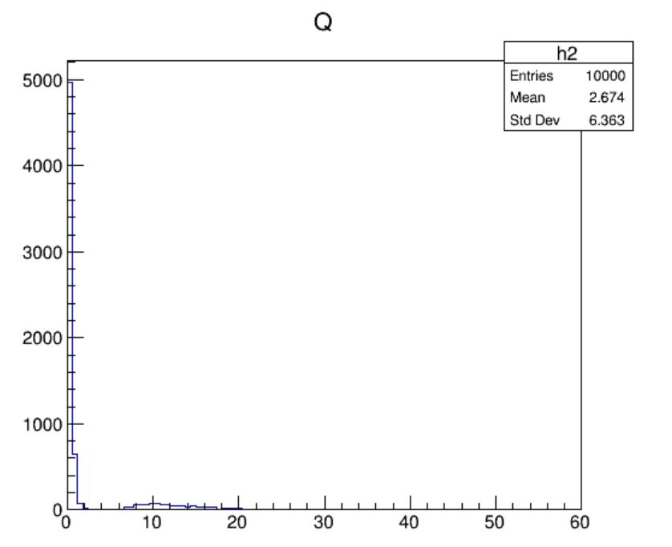
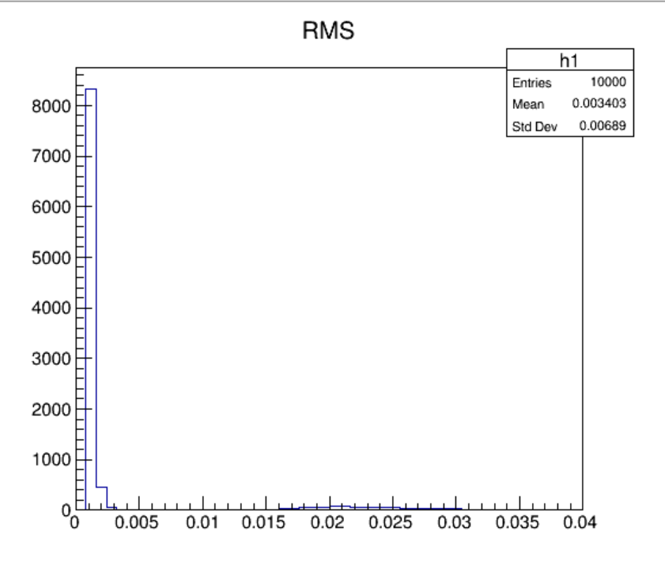
Definition of Q and RMS
Q=$\sum{a[i]}$,
a[i] means the amplitude of i-th bin
The first and last several bins are removed due to abnormal values
RMS= $\sqrt{\frac{\sum_{i=0}^{n}{{a[i]}^{2}}}{n}}$
Run10, Ch5, gas90/10, 45°
Q distribution
RMS distribution

Slide 4
Event Selection Via RMS&Q 2D Histogram
Run10, Ch5, gas90/10, 45°
RMS vs Q
(events with RMS<0.004 removed)
RMS vs Q
Q>2.5 can be used to remove noise
Almost noises
Validated event by event
Almost signals
Validated event by event

Slide 5
Event Selection with Q
Run10, Ch5, gas 90/10, 45°
n_{count} distribution of noises
(Q<2.5)
n_{count} distribution of signals
(Q>2.5)

Slide 6
Timing Analysis: First Cluster Time ,0°
Run11, Ch5, gas90/10, 0°
Time distribution of the first peak (T_{First})
Blue arrow: track
Brown square: tube
$$t_{0}=40ns$$
Peaks with t<t₀ could be recognized as noises

Slide 7
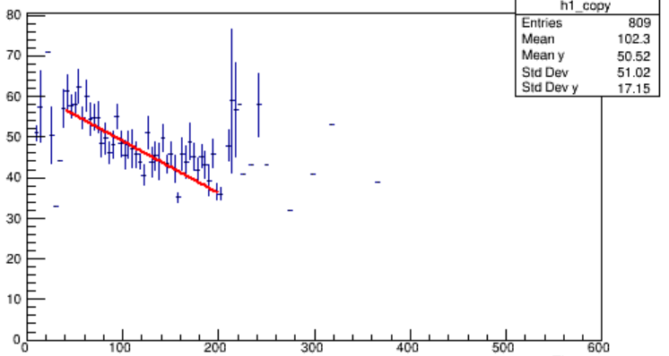
Timing Analysis: N_{count} vs T_{First}, angle=0
Run11, Ch5, gas90/10, 0°, 2.0G, low statistics
N_{count} vs T_{First}
Profile of N_{count} vs T_{First}
N_{count}
N_{count}
Slope: -0.128
T_{First} (ns)
T_{First} (ns)

Slide 8
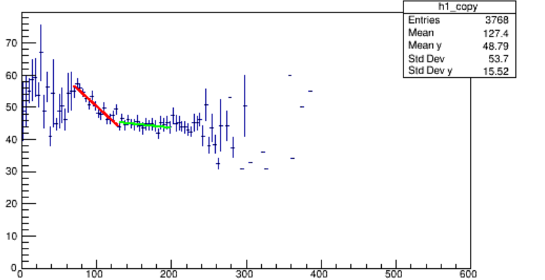
Timing Analysis: N_{count} vs T_{First}, angle=0
Run13 Ch5 gas90/10 0°, 1.5G, low statistics
N_{count} vs T_{First}
Profile of N_{count} vs T_{First}
N_{count}
N_{count}
T_{First} (ns)
T_{First} (ns)
Might be related with cluster density (next page)

Slide 9
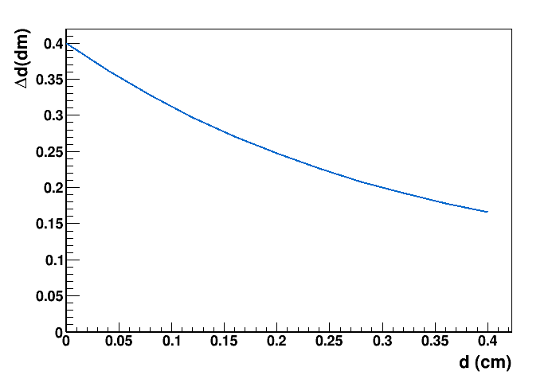
Timing Analysis: T_{Last}-T_{First} vs T_{First}, angle=0
Run11, Ch5, gas90/10, 0°
For the track with drift distance = d
The drift distance of the first cluster: d_{F} = d
The drift distance of the first cluster: d_{L} = sqrt(d²+R²)
Cluster density in time is related with Δd (=d_{L}-d_{F})
Δd gets smaller as d increases, i.e. cluster density increases as d increases
ΔT vs T_{First} (ΔT = T_{Last} – T_{First})
ΔT (ns)
Δd vs d
$$d$$
ΔT (ns)
R
$$dL=\sqrt{d^{2}+R^{2}}$$
T_{First} (ns)

Slide 10
T_{First} distribution with angle=45
Run10, Ch5, gas90/10, 45°
Distribution of T_{First}
Blue arrow: track
Brown square: tube
$$t_{0}=40ns$$

Slide 11
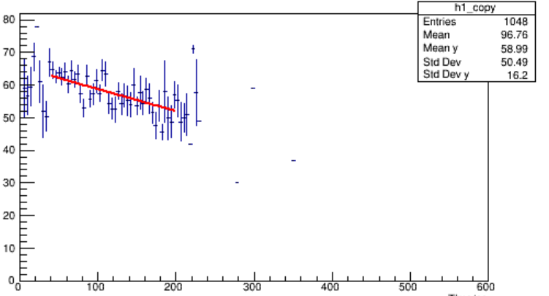
N_{count} vs T_{First} with angle=45
Run10, Ch5, gas90/10, 45°
N_{count} vs T_{First}
Profile of N_{count} vs T_{First}
N_{count}
N_{count}
Slope: -0.068
T_{First} (ns)
T_{First} (ns)

Slide 12
Timing Analysis: T_{Last}-T_{First} vs T_{First}, angle=45
Run10 Ch5 gas90/10 45°
ΔT vs T_{First} (ΔT = T_{Last} – T_{First})

Slide 13
Summary
Event Selection with Q>2.5 can be used to select good signals
Timing Analysis:
Variation in Ncount over time of 1st cluster observed
For angle=0, possible related with cluster density and need further study
For angle=45, the correction on track length should be taken into account
Next
Correction on track length and drift distance in the analysis
Discussion
Calibration on drift distance and incident angle is important to improve the dN/dx performance. Tracking information is helpful
A multi-layer DC prototype would benefit the data analysis in the test

Slide 14
Backup

Slide 15
BackUp: Run10 Ch5 TimePlot 0

Slide 16
High Event Timeplot
Run13 Ch5 gas90/10 0° 1cm sampling rate=1.5
Blue arrow: track
Brown square: tube

Slide 17
High Event Timeplot
Run13 Ch5 gas90/10 0° 1cm

