Slide 1
Theory Overview On Heavy Flavor Physics
A personal perspective
Yue-Long Shen
Ocean University of China
HFPCP-2023 15-18 Dec. 2023, Shanghai

Slide 2
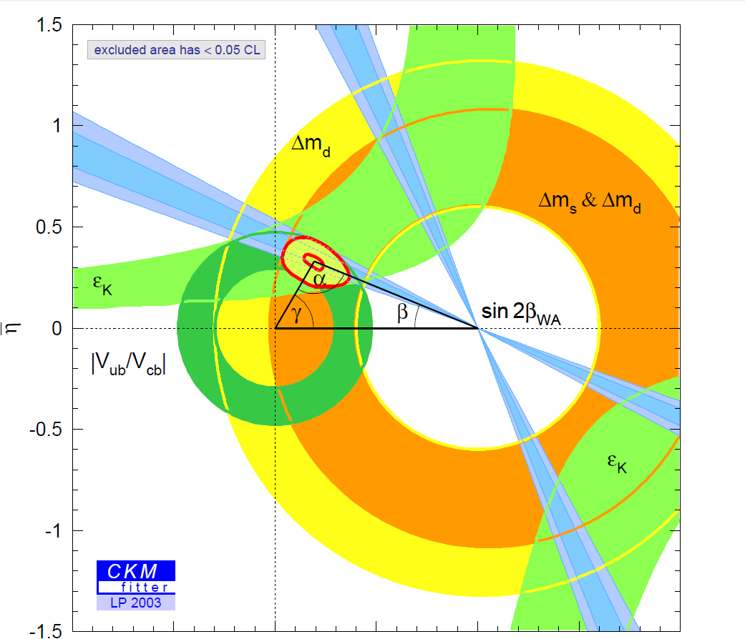
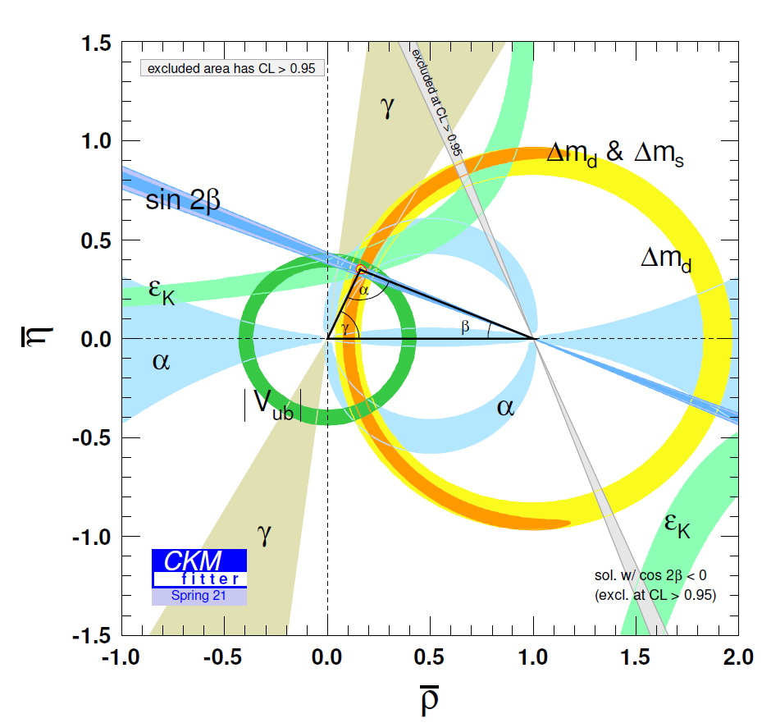
The main tasks of heavy flavor physics
Time-dependent CP violation in B meson decays, [Babar& Belle 2001]
Direct CP violation in B meson decays, [Babar& Belle 2004]
Direct CP violation in D meson decays, [LHCb 2019]
Study on CP violation
Precisely testing the standard model
Indirect searching for new physics signals

Slide 3
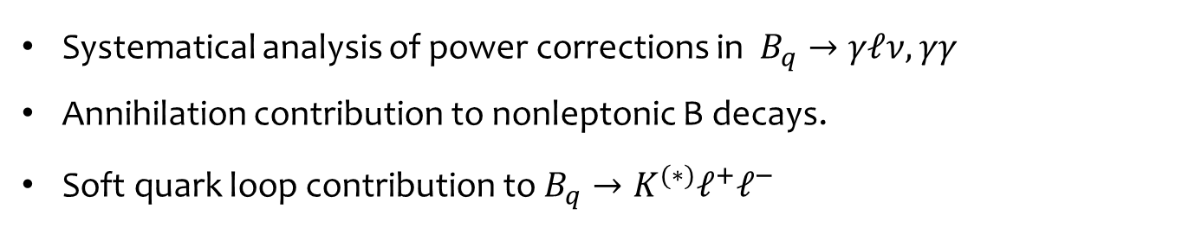
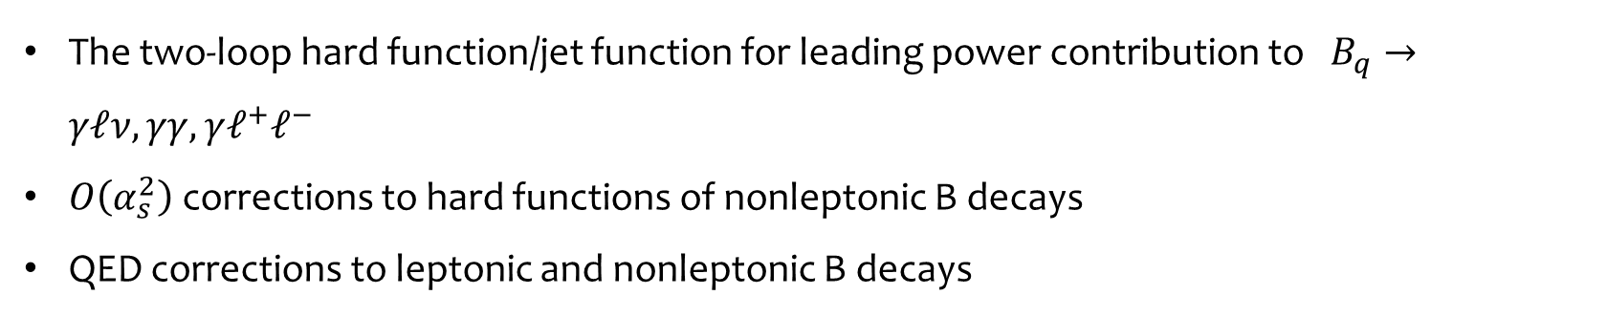
Era of precision calculation
The accuracy of experimental data is far beyond theoretical predictions for most heavy flavor processes
(Multi-)loop corrections for perturbation functions at leading power of HQE:
The two-loop hard function/jet function for leading power contribution to $B_{q}→γℓν, γγ, γℓ^{+}ℓ^{−}$
$O\left(α_{s}^{2}\right)$ corrections to hard functions of nonleptonic B decays
QED corrections to leptonic and nonleptonic B decays
Beyond leading power
Systematical analysis of power corrections in $B_{q}→γℓν, γγ$
Annihilation contribution to nonleptonic B decays.
Soft quark loop contribution to $B_{q}→K^{(∗)}ℓ^{+}ℓ^{−}$

Slide 4





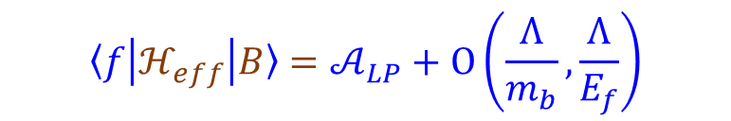


B decays: The multi-scale problem
NP scale
EW scale
Heavy quark scale
Intermediate scale
Hadronization scale
TeV or beyond
$$m_{W}$$
$m_{b}(m_{c})$
$\sqrt{m_{b}Λ}$, $m_{c}$
$$Λ$$
$ℋ_{eff}=\frac{G_{F}}{\sqrt{2}}\sum_{i}{C_{i}O_{i}}$+ $\sum_{i}{C_{i}^{′}O_{i}^{′}}$
Low energy QCD
HQET, SCET-II
$$ℒ_{NP}$$
$ℒ_{SM}$+ $ℒ_{D>4}$
SCET-I
$${〈f\left|ℋ_{eff}\right|B〉=𝒜}_{LP}+O\left(\frac{Λ}{m_{b}},\frac{Λ}{E_{f}}\right)$$
Perturbation：matching, resummation, evolution
Nonperturbation：Lattice simulation, sum rules…

Slide 5
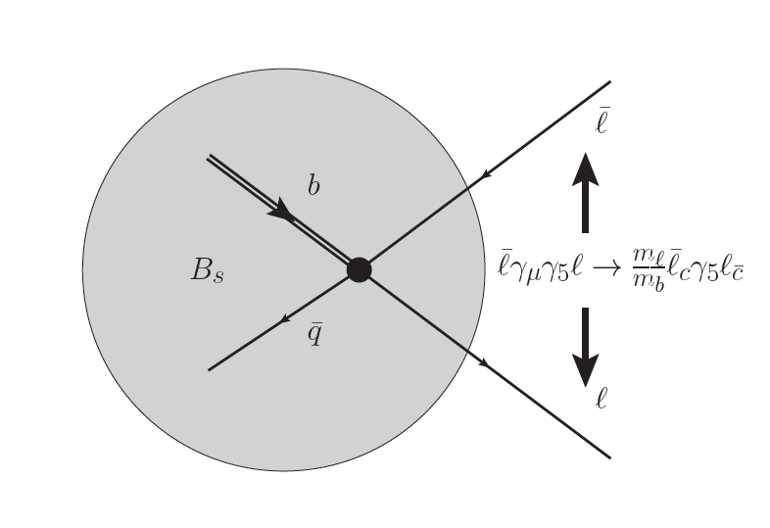



Leptonic B decays
$Γ\sim m_{l}^{2}$ $f_{B}^{2}|V_{ub}|^{2}$
$Γ\sim m_{l}^{2}$ $f_{B}^{2}|V_{tb}{V_{ts}|}^{2}$
Determination of | $V_{ub}$| and |$V_{tb}V_{ts}^{∗}$| largely unaffected by hadronic uncertainties
Helicity suppression: test of new scalar interactions
QCD matrix element is known with <1% accuracy
$f_{B}=\text{(}\text{189.4 ± 1.4}\text{)}$MeV
Structure dependent QED corrections are not negligible

Slide 6
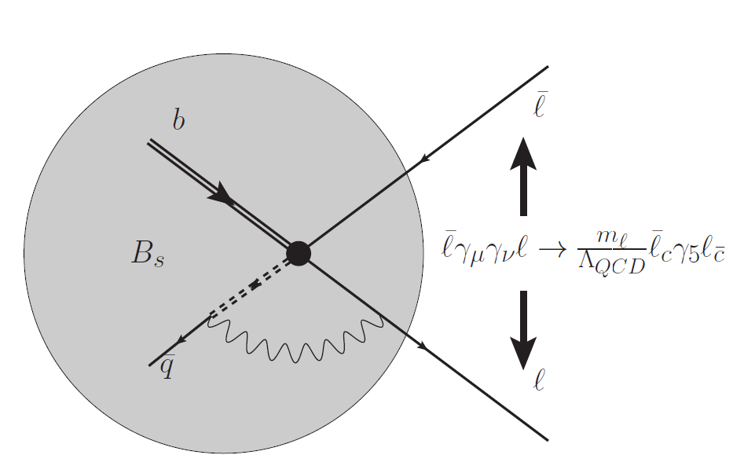
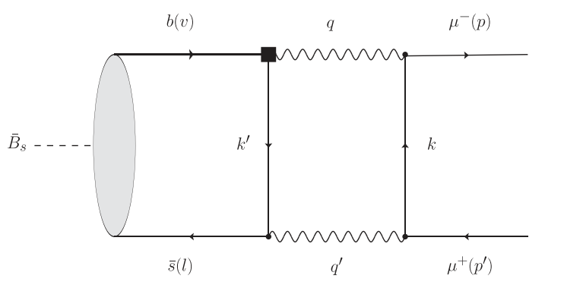

QED corrections in leptonic B decays
$$B_{(s)}→μ^{+} μ^{−}$$
[Beneke et al 2018]
Power enhancement +double Logarithmic enhancement in
Endpoint divergence in the contribution from $O_{7γ}$
[Beneke et al, 2018; Feldmann et al, 2023]
After resummation, the contribution is about 0.3%- 1.1%
[Beneke et al, 2019]
No power enhancement in $B→lν$ due to (V-A) structure of the current

Slide 7

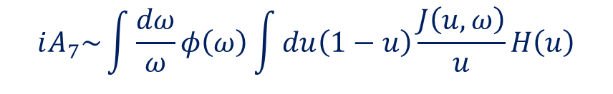

QED corrections in leptonic B decays
$B_{q}→τ^{+}$ $τ^{−}$
[Huang, YLS, Zhao, Zhou, 2023]
Si-Hong Zhou’s Talk
Endpoint divergence disappears due to large tauon mass takes place in the jet function: A more rigorous factorization theorem
$$iA_{7}\sim \int{\frac{dω}{ω}φ\left(ω\right)\int{du\left(1−u\right)}\frac{J\left(u,ω\right)}{u}H\left(u\right)}$$
$$J\left(u,ω\right)=N\frac{1−u}{ω}ln \left(1+\frac{ωn_{+}p_{l}}{m_{τ}^{2}}\frac{u}{1−u}\right)$$
No logarithmic enhancement: about 0.04% reduction of LO

Slide 8
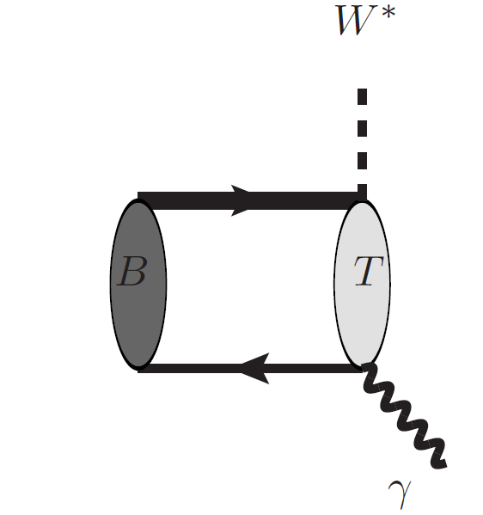



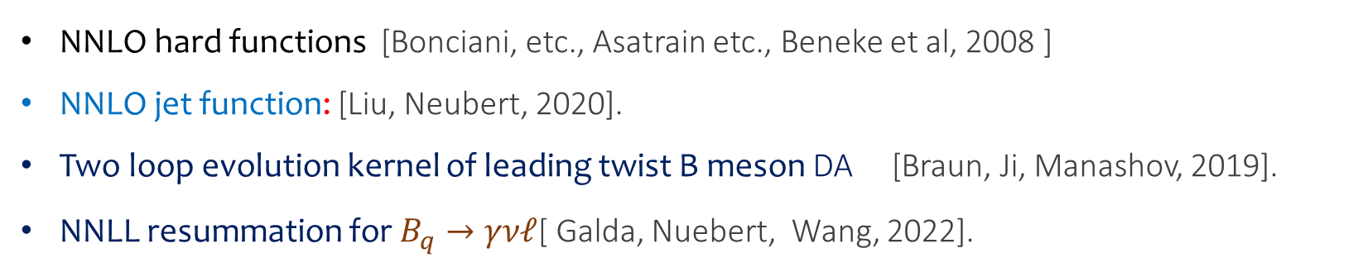
Radiative leptonic/double radiative B decays
,$γ,γ^{∗}$
$B_{q}→γνℓ, γγ,{γℓ^{+}ℓ^{−},γ}^{∗}γ^{∗}$
$$𝒜_{LP}∼{\frac{G_{F}}{\sqrt{2}}λ_{CKM}f}_{B}m_{B}C(m_{b},μ)\int_{0}^{∞}{\frac{dω}{ω}J\left(\sqrt{Eω},μ\right)}φ^{+}(ω,μ)$$
$$,γ^{∗}$$
NNLO hard functions [Bonciani, etc., Asatrain etc., Beneke et al, 2008 ]
NNLO jet function: [Liu, Neubert, 2020].
Two loop evolution kernel of leading twist B meson DA [Braun, Ji, Manashov, 2019].
NNLL resummation for $B_{q}→γνℓ$[ Galda, Nuebert, Wang, 2022].

Slide 9
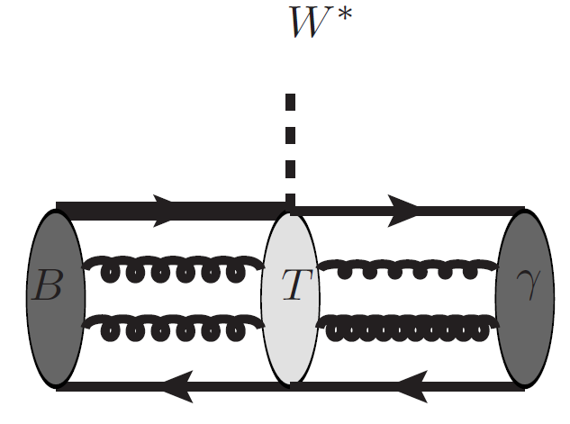

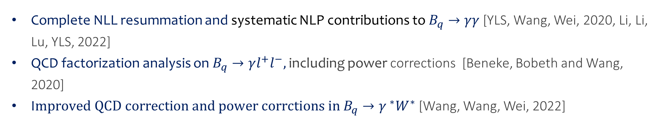
Radiative leptonic/double radiative B decays
Power corrections in
$$B_{q}→γνℓ$$
Subleading power corrections from the dispersion technique:
[Braun, Khodjamirian, 2013； Wang, 2016；Beneke et al, 2018]
Hadronic photon corrections up to the twist-4 accuracy
[Khodjamirian et al, 1995; Ali et al, 1995; Eilam et al, 1995 ；Ball et al, 2003; Wang, YLS, 2018].
Recent improvement: combined updated LP result and NLP corrections
[YLS, Wei, Zhao, Zhou, 2020; Cui, YLS, Wang, Wei, 2023].
Other processes
Complete NLL resummation and systematic NLP contributions to $B_{q}→γγ$ [YLS, Wang, Wei, 2020, Li, Li, Lu, YLS, 2022]
QCD factorization analysis on $B_{q}→γl^{+}l^{−},$including power corrections [Beneke, Bobeth and Wang, 2020]
I$mproved QCD correction and power corrctions in B_{q}→γ^{ ∗}W^{∗}$[Wang, Wang, Wei, 2022]

Slide 10
The Distribution amplitudes of B meson
The definition of leading twist B meson DA
[Grozin, Nuebert, 1997]
$$\left\langle 0\left|{\overline{q}}_{β}\left(z\right)\left[z,0\right]h_{vα}\left(0\right)\right|\overline{B}\left(v\right)\right\rangle =−\frac{i}{4}F_{B}m_{B}{\left[\frac{1+v⋅γ}{2}\left\{2{\tilde{φ}}^{+}\left(t,μ\right)+\frac{{\tilde{φ}}^{−}\left(t,μ\right)−{\tilde{φ}}^{+}\left(t,μ\right)}{2}z⋅γ\right\}γ_{5}\right]}_{αβ}$$
The Evolution: Lange-Neubert equation
[Lange, Nuebert, 2003]
$μ\frac{d}{dμ}φ^{+}(ω,μ)=−\left[Γ_{cusp}\left(α_{s}\right)ln\frac{ω}{μ}+γ_{+}(α_{s})\right]$ $φ^{+}\left(ω,μ\right)−ω\int_{0}^{∞}{dηΓ_{+}(ω, η, α_{s})φ^{+}\left(η,μ\right)}$
The evolution equation at two loops: [Braun, Ji, Manashov, 2019]
Solution to the LN equation: dual space: [Bell, Feldmann, YMW, Yip, 2013]:
Solution to the evolution equation @ two loop level [Galda, Neubert, 2020]
The higher twist DAs of B meson [Braun et al, 2017]
Modelling the B meson LCDA: Expernential [Grozin, Nuebert, 1997], Free parton[KKQT 2001], Local duality[Braun etc. 2003]
Shan Cheng’s Talk

Slide 11
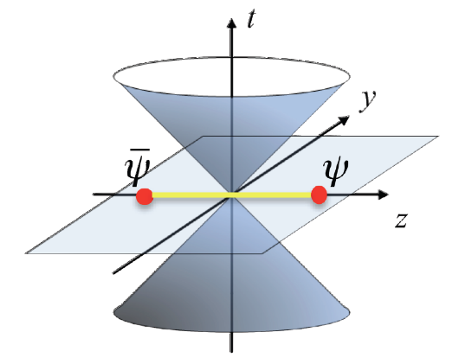
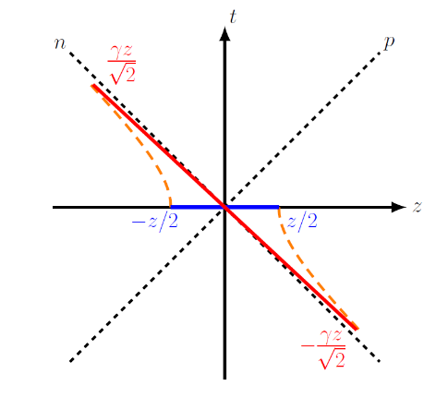
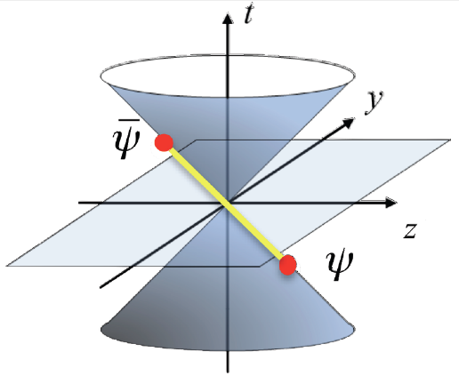
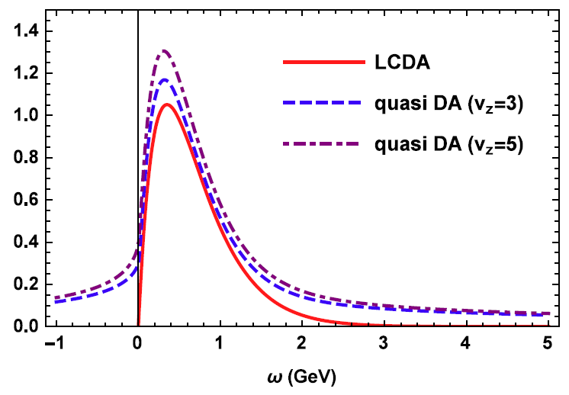
The Quasi-DA of B meson
The Large momentum effective theory [Ji, 2013]
Boost
match
The Quasi-DA of leading twist B meson
[Wang, Wang, Xu, Zhao 2019]
$$iF_{B}m_{B} φ_{B}^{+}\left(ξ,μ\right)=\int_{−∞}^{+∞}{\frac{dτ}{2π}}e^{in_{z}⋅vξτ}\left\langle 0\left|{(\overline{q}}_{s}Y_{s})\left(τn_{z}\right)n_{z}⋅ γγ_{5}{(Y}_{s}^{†} {h)}_{v}\left(0\right)\right|\overline{B}\left(v\right)\right\rangle$$
The matching
$$φ_{B}^{+}\left(ξ,μ\right)=\int_{0}^{+∞}{dωH(ξ,ω,n_{z}⋅v,μ)}φ_{B}^{+}\left(ω,μ\right)+O\left(\frac{Λ}{n_{z}⋅vξ}\right)$$
The inverse moment of Quasi-DA of leading twist B meson
[Xu, Zhang, Zhao 2023]
The Quasi-DA of subleading twist B meson
Ji Xu’s Talk
[Hu, Wang, Xu, Zhao 2023]
Problem: Calculation of Quasi-DA of B meson on Lattice

Slide 12
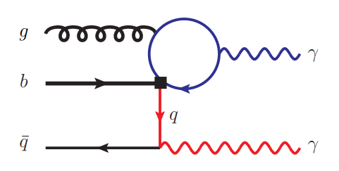
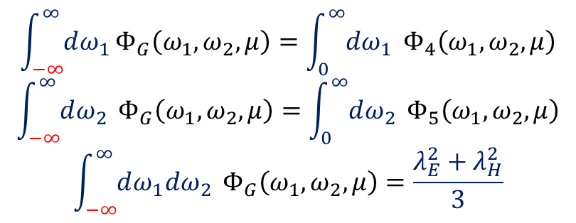
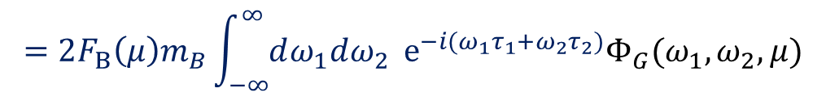

The novel soft function
Integrate out hard-collinear fields: nonlocal operator
[Qin, YLS, Wang, Wang, 2023]
${m_{c}^{2}≈m}_{b}Λ_{QCD}$:
Hard-collinear
A novel soft function with different light-cone direction
$$〈0|{(\overline{q}}_{s}S_{n})\left(τ_{1}n\right)S_{n}^{†}S_{\overline{n}}\left(0\right)S_{\overline{n}}^{†}{g_{s}G_{μν}S}_{\overline{n}}\left(τ_{2}\overline{n}\right){\overline{n}}^{ν}n⋅γγ_{⊥}^{μ}γ_{5}S_{\overline{n}}^{†}h_{v}(0)|{\overline{B}}_{v}〉$$
$$=2F_{B}\left(μ\right)m_{B}\int_{−∞}^{∞}{dω_{1}dω_{2} }e^{−i{(ω}_{1}τ_{1}+ω_{2}τ_{2})}Φ_{G}(ω_{1},ω_{2},μ)$$
Normalization
$$\int_{−∞}^{∞}{dω_{1}}Φ_{G}\left(ω_{1},ω_{2},μ\right)=\int_{0}^{∞}{dω_{1} }Φ_{4}\left(ω_{1},ω_{2},μ\right)$$
$$\int_{−∞}^{∞}{dω_{2} }Φ_{G}\left(ω_{1},ω_{2},μ\right)=\int_{0}^{∞}{dω_{2} }Φ_{5}\left(ω_{1},ω_{2},μ\right)$$
$$\int_{−∞}^{∞}{dω_{1}dω_{2} }Φ_{G}\left(ω_{1},ω_{2},μ\right)=\frac{{λ_{E}^{2}+λ}_{H}^{2}}{3}$$

Slide 13
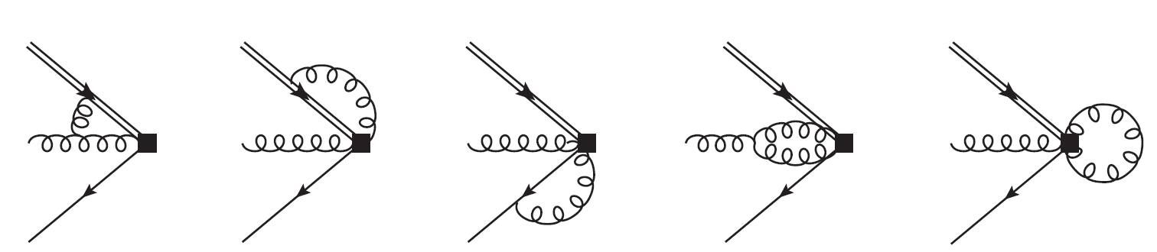
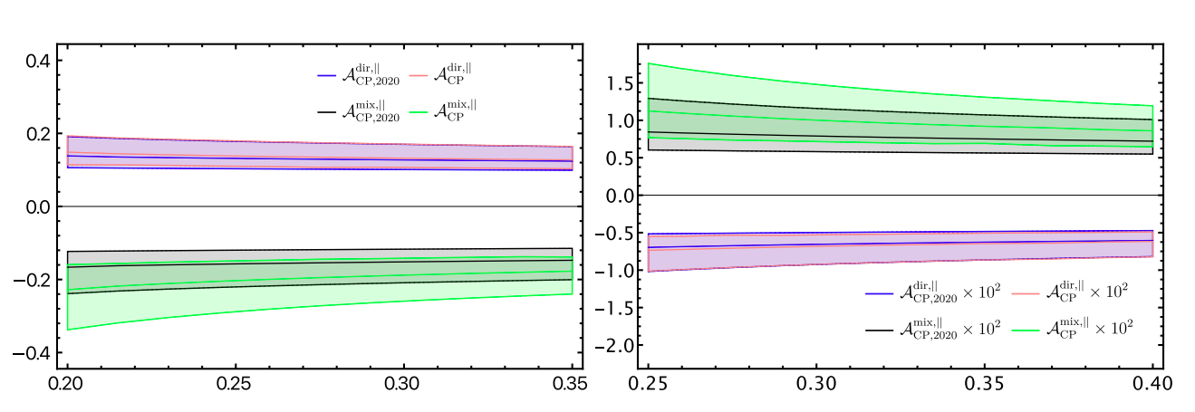
The novel soft function
Renormalization and evolution [Huang, Ji, YLS, Wang, Wang, Zhao,2023]
The arguments are not constrained
Asymptotic behavior
$$Φ_{G}\left(ω_{1}→0,ω_{2}→0,μ\right)∝\frac{{λ_{E}^{2}+λ}_{H}^{2}}{6ω_{0}^{2} }e^{V+2γ_{E}\left(a_{1}+a_{2}\right)}{\left(\frac{μ_{0}}{ω_{0}}\right)}^{a_{1}+a_{2}}\frac{1−e^{−iπa_{2}}}{4π^{2}}Γ\left(1+a_{1}\right)Γ(1+a_{2})$$
$$Φ_{G}\left(ω_{1}→±∞,ω_{2}→±∞,μ\right)∝\frac{{λ_{E}^{2}+λ}_{H}^{2}}{6ω_{0}^{2} }e^{V+2γ_{E}\left(a_{1}+a_{2}\right)}{\left(\frac{μ_{0}}{ω_{0}}\right)}^{a_{1}+a_{2}}{\left(\frac{μ_{0}}{±ω_{1}}\right)}^{1+a_{1}}{\left(\frac{μ_{0}}{±ω_{2}}\right)}^{1+a_{2}}$$
Phenomenological impact
Qin Qin’s Talk

Slide 14
Heavy-to-light form factors
Semileptonic decays play an essential role in the determination of the CKM matrix elements
$$\frac{dΓ(B→πlν)}{dq^{2}}=\frac{G_{F}^{2}|{\left.​V_{ub}\right|}^{2}m_{B}^{3}}{256π^{3}}λ^{\frac{3}{2}}{\left(1−\frac{m_{l}^{2}}{q^{2}}\right)}^{2}\left[\left(1+\frac{{2m}_{l}^{2}}{q^{2}}\right)|{f^{+}\left(q^{2}\right)\left.​\right|}^{2}+\frac{{3m}_{l}^{2}}{{2λq}^{2}}{\left(1−\frac{m_{M}^{2}}{q^{2}}\right)}^{2}|{f^{0}\left(q^{2}\right)\left.​\right|}^{2}\right]$$
QCD/SCET factorization formulae for mesonic form factor[BBNS, BPRS, and many others].
$$F_{i,LP}^{B→M}\left(E\right)=C_{i}^{\left(A0\right)}\left(E\right)ζ_{a}\left(E\right)+\int_{0}^{∞}{\frac{dω}{ω}\int_{0}^{1}{du C_{i}^{\left(B1\right)}\left(E,u\right)J_{i}\left(E,ω\right)φ_{B}^{+}(ω)φ_{M}(u)}}$$
QCD/SCET factorization formulae for baryonic form factor [Wang, 2011].
$$F_{LP}^{Λ_{b}→Λ}\left(E\right)=\int_{0}^{∞}{dω_{1}dω_{2}\int_{0}^{1}{du {dvC}_{i}^{\left(A0\right)}\left(E,u,v\right)J_{i}\left(E,ω_{i}\right)ψ_{Λ_{b}}^{(2)}(ω_{1},ω_{2})ψ_{Λ }^{(3)}(u, v)}}$$
Leading power contribution; but numerically suppressed: dominated by NLP
Lattice simulation: direct calculation of the QCD form factors
Works well at small recoil region, and needs to be extrapolated to the whole physical region

Slide 15
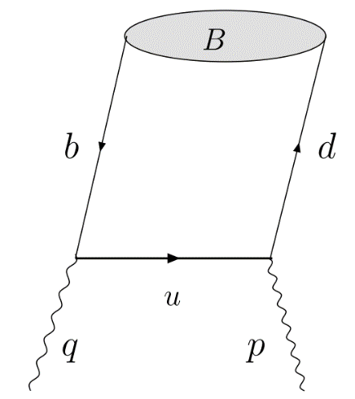




LCSR for the heavy-to-light form factors
LCSR is a QCD inspired method for the large recoil region of the heavy-to-light form factors.
$$(M)$$
The correlation function
($q)$
$$〈0\left|T\left\{J_{weak} \left(0\right), J_{B}\left(x\right)\right\}\right|\overline{B}\left(P\right)〉$$
B-meson LCSR(SCET sum rules).
or
$$〈\overline{M}\left(P\right)\left|T\left\{J_{weak} \left(0\right), J_{M}\left(x\right)\right\}\right|0〉$$
Light meson LCSR
Quark level OPE
Quark hadron duality
Hardon level: parameterization
The correlation function can be calculated with standard QCD factorization technique.
$B→πK$ form factors [Cui, Huang, YLS, Wang, Wang, 2022]
A recent review:
A guide to the QCD light-cone sum rule for b-quark decays
Khodjamirian, Melić, Wang,2023
$B→D$ form factors [Gao, Huber, Ji, Wang, Wang, Wei, 2022]
$B→D(D^{∗})$ form factors [Cui, huang, Wang, Zhao, 2023]
Combine Lattice data and LCSR results: reduce uncertainty

Slide 16
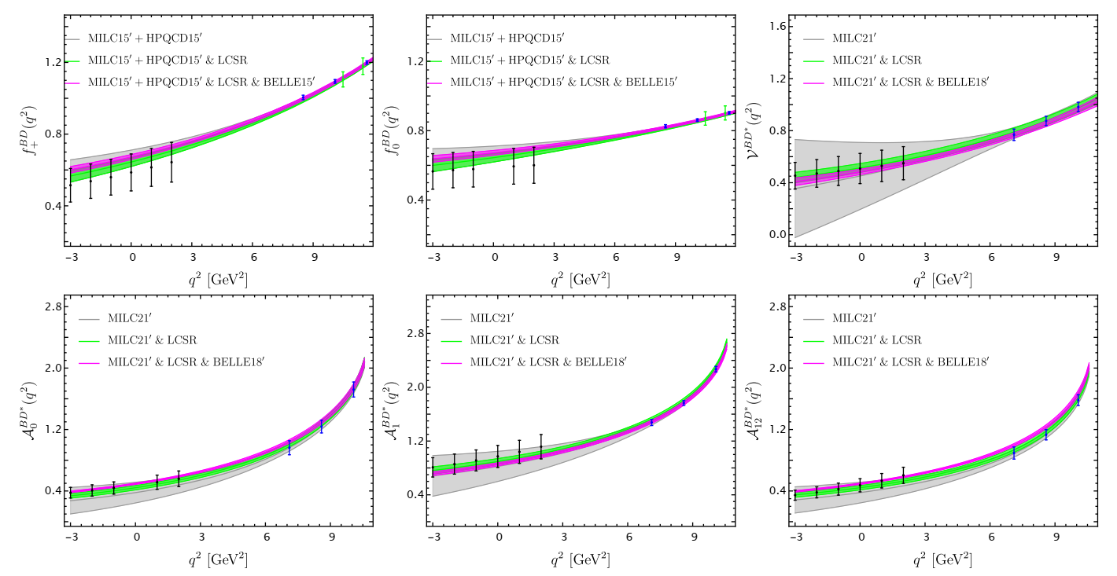
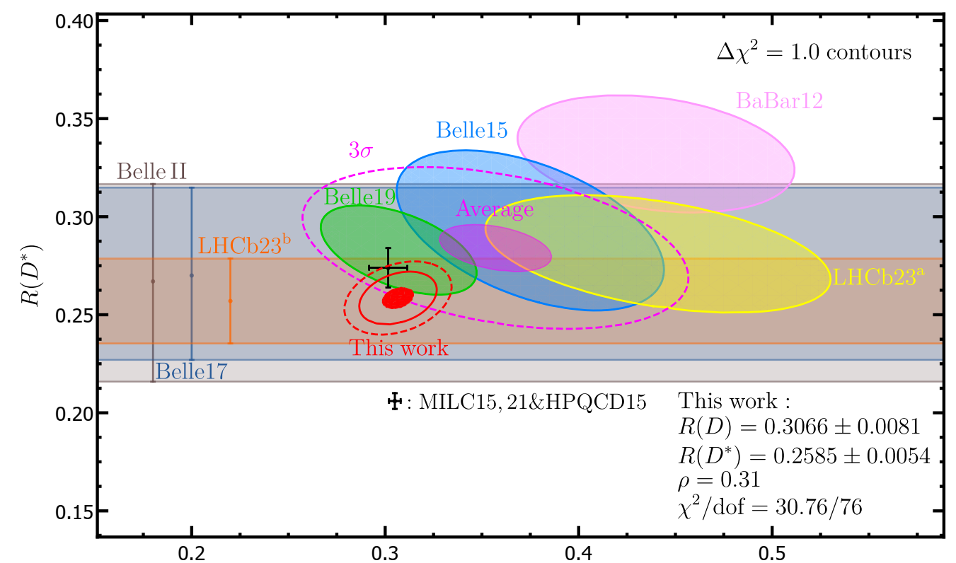

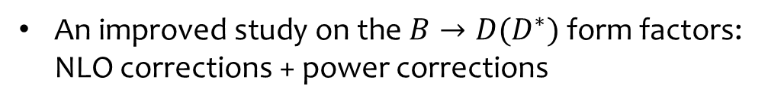
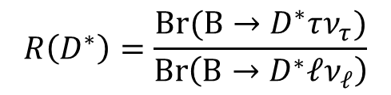
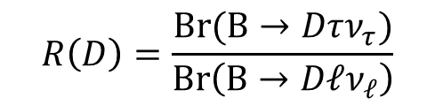

The ${B→D(D}^{∗})$ form factors
$R\left(D\right)/R\left(D^{∗}\right)$ Anormals：about 3.3 $σ$
$$R\left(D\right)=\frac{Br(B→Dτν_{τ})}{Br\left(B→Dℓν_{ℓ}\right)}$$
$$R\left(D^{∗}\right)=\frac{Br(B→D^{∗}τν_{τ})}{Br\left(B→D^{∗}ℓν_{ℓ}\right)}$$
An improved study on the ${B→D(D}^{∗})$ form factors: NLO corrections + power corrections
[Cui, huang, Wang, Zhao, 2023]
Combined analysis of Lattice simulation and LCSR
The updated prediction on $R\left(D\right)/R\left(D^{∗}\right)$

Slide 17
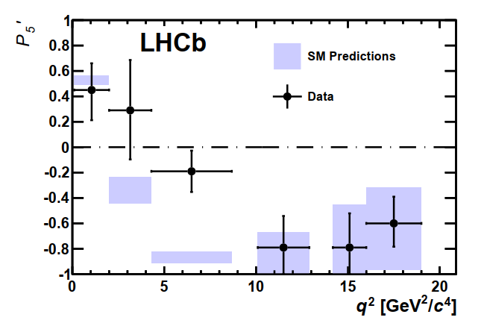
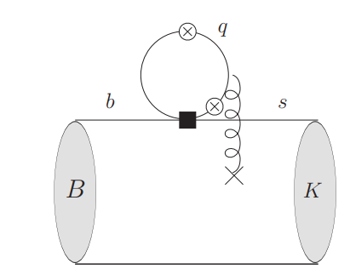
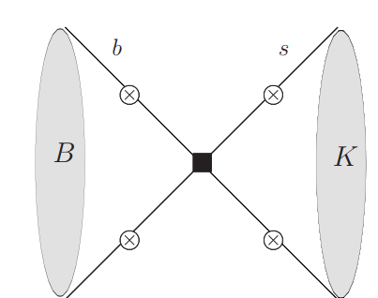


The ${B→{K(K^{ ∗})ℓ}^{+}ℓ}^{−}$ decays
Very interesting processes for its sensitivity to new physics signals
The decay amplitudes
The clean observables from angular distribution analysis
$P_{5}^{′}=S_{5}/\sqrt{F_{L}(1−F_{L})}$
The long distance charm loop and annihilation diagrams
The NLO corrections to the annihilation diagrams: the last piece of the complete LP contribution at one-loop level [YLS, Wang, Wang, in preparation]

Slide 18
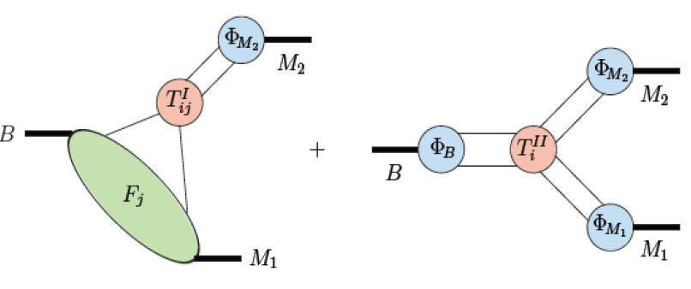
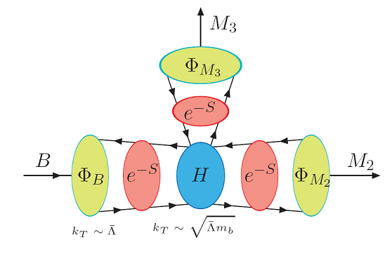
Two-body nonleptonic B decays
Factorization approach
Naïve factorization[BSW1985] and Generalized factorization[Cheng etc. , Ali, Kramer, Lü1998]
$$\left\langle M_{1}M_{2} | O_{i}|\overline{B}\right\rangle ={C_{1}F}^{B→M_{1}}f_{M_{2}}+{C_{2}F}^{B→M_{2}}f_{M_{1}}$$
QCD factorization [BBNS1999] SCET [Bauer et al2001]
$\left\langle M_{1}M_{2} | O_{i}|\overline{B}\right\rangle =F^{B→M_{1}}T_{i}^{I}⊗φ_{M_{2}}+T_{i}^{II}⊗φ_{B}$ $⊗φ_{M_{1}}$ $⊗φ_{M_{2}}$
For recently progress, see Xin Qiang Li’s Talk
PQCD approach (Li, Lü, Xiao etc.)
$\left\langle M_{1}M_{2} | O_{i}|\overline{B}\right\rangle =H⊗φ_{B}$ $⊗φ_{M_{1}}$ $⊗φ_{M_{2}}⊗e^{−∑S_{i}}$
Phenomenological approach
SU(3) analysis; topological diagram analysis…(He, Wang etc.)

Slide 19

Recent progress in PQCD approach
(Partial)NLO corrections
[Chai, Cheng, Ju, Yan, Lv, Xiao,2022]
NLO: vertex corrections, quark loops, NLO FFs, Glauber gluons
NLO have significant impact on the CP violation
$A_{CP}\left(B^{+}→K^{+}π^{0}\right)−A_{CP}\left({\overline{B}}^{0}→K^{+}π^{−}\right)={(7.71}_{−2.92}^{+2.74})\%(data:(12.0±2.4)\%$)
Modified PQCD and $π$ $π$ puzzle
[Lv, Yang, 2023]
Including soft factors below the soft momentum cutoff and the color octet contribution
Multi-body B decays
Three body B decays
Zhi-Tian Zou’s Talk
Four body B decays
[Zhou, Li etc. ]

Slide 20
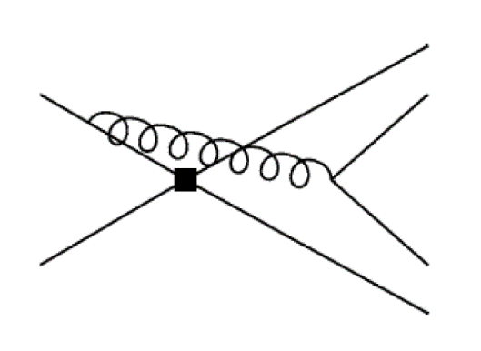
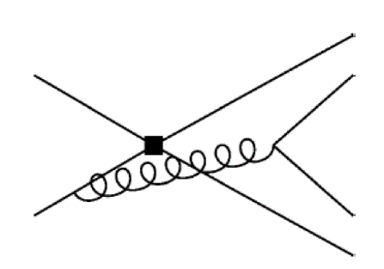

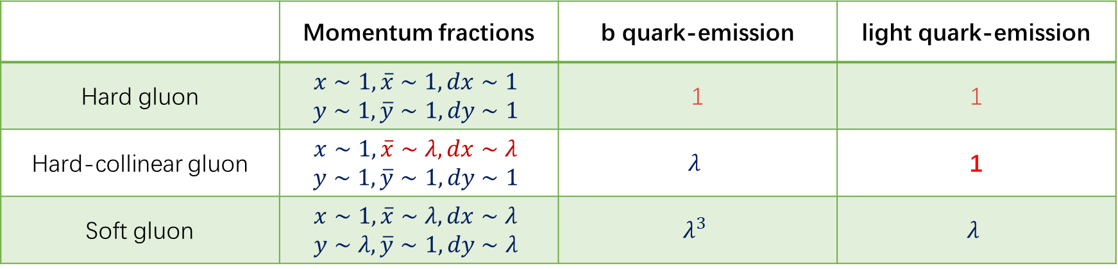
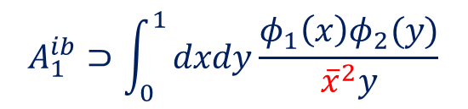
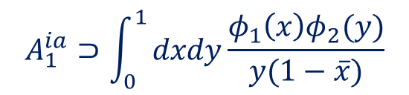
The annihilation diagrams
The factorization amplitude(leading twist)
$$A_{1}^{ia}⊃\int_{0}^{1}{dxdy\frac{φ_{1}\left(x\right)φ_{2}(y)}{y(1−\overline{x})}}$$
$$A_{1}^{ib}⊃\int_{0}^{1}{dxdy\frac{φ_{1}\left(x\right)φ_{2}(y)}{{\overline{x}}^{2}y}}$$
Asymptotic form
$$φ_{1}\left(x\right)∼6x(1−x)$$
 | Momentum fractions | b quark-emission | light quark-emission
Hard gluon | $$x∼1,\overline{x}∼1,dx∼1$$ $$y∼1,\overline{y}∼1,dy∼1$$ | 1 | 1
Hard-collinear gluon | $$x∼1,\overline{x}∼λ,dx∼λ$$ $$y∼1,\overline{y}∼1,dy∼1$$ | $$λ$$ | 1
Soft gluon | $$x∼1,\overline{x}∼λ,dx∼λ$$ $$y∼λ,\overline{y}∼1,dy∼λ$$ | $$λ^{3}$$ | $$λ$$

Slide 21
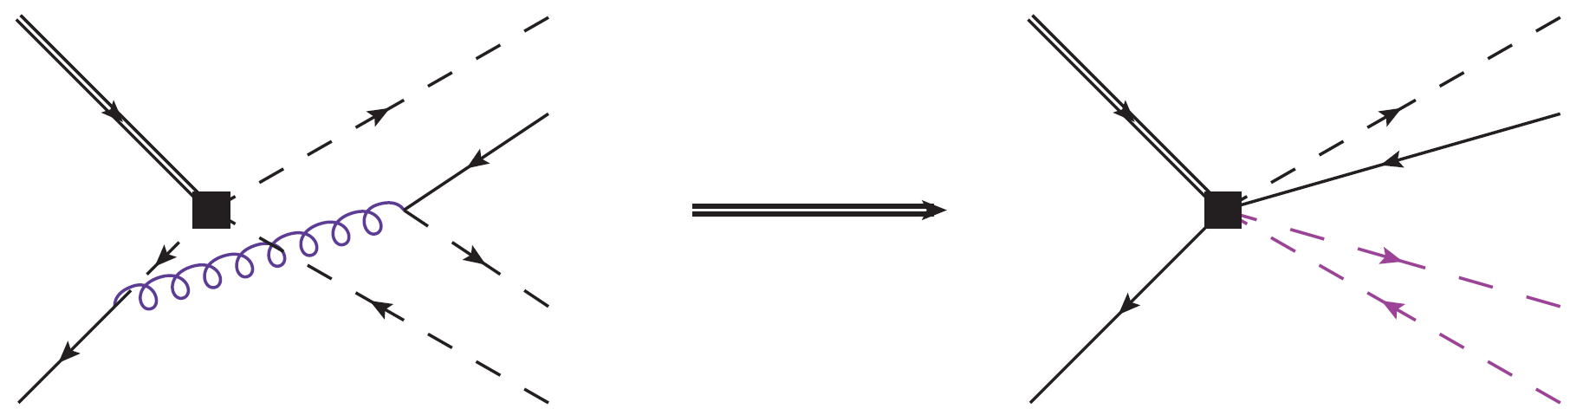
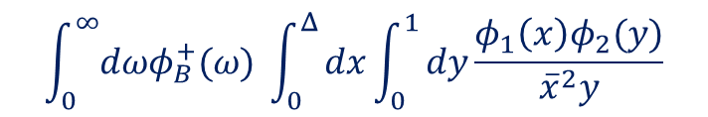
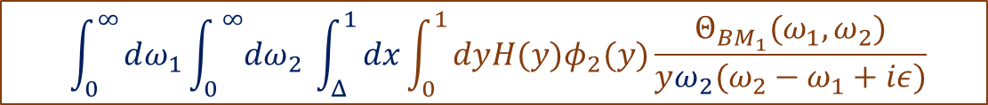
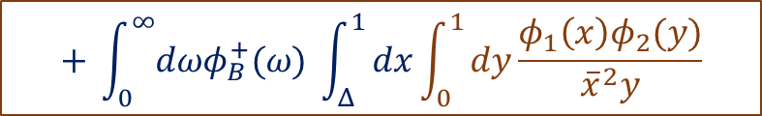
The annihilation diagrams
Separation of hard and hard collinear region
[Lü, YLS, Wang, Wang, 2023]
$$\int_{0}^{∞}{dωφ_{B}^{+}(ω)} \int_{0}^{Δ}{dx\int_{0}^{1}{dy\frac{φ_{1}\left(x\right)φ_{2}(y)}{{\overline{x}}^{2}y}}}$$
$$+ \int_{0}^{∞}{dωφ_{B}^{+}(ω)} \int_{Δ}^{1}{dx\int_{0}^{1}{dy\frac{φ_{1}\left(x\right)φ_{2}(y)}{{\overline{x}}^{2}y}}}$$
$$\int_{0}^{∞}{dω_{1}\int_{0}^{ ∞}{dω_{2}}} \int_{Δ}^{1}{dx\int_{0}^{1}{dy{H(y)φ}_{2}(y)\frac{Θ_{BM_{1}}(ω_{1},ω_{2})}{yω_{2}(ω_{2}−ω_{1}+iε)}}}$$
The soft-collinear function
$$Θ_{BM}\left(ω_{1},ω_{2}\right)=∫dt∫dse^{i\left(ω_{1}t−ω_{2}s\right)}⟨M\left(p\right)\left|\left[{\overline{q}}_{s}\left(tn\right)Γ_{1}h_{v}\left(0\right)\right]\left[{\overline{ξ}}_{\overline{c}}\left(0\right)Γ_{2}q_{\overline{sc}}\left(sn\right)\right]\right|{\overline{B}}_{q}\left(P\right)⟩$$
Factorization is yet to be proved

Slide 22
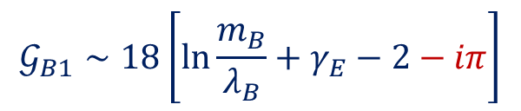

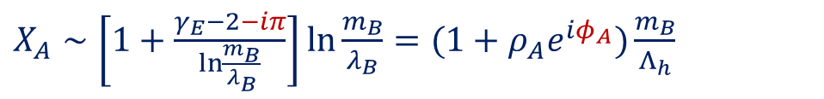
The annihilation diagrams
The tree level approximation of the soft factor
$$Θ_{BM}\left(ω_{1},ω_{2}\right){\left.​\right|}_{fac}=φ_{B}^{+}\left(ω_{1}\right)φ_{M}\left(1−\frac{ω_{2}}{m_{B}}\right)θ\left(1−\frac{ω_{2}}{m_{B}}\right)$$
The factorization formula
$$𝒢_{B1}=\int_{0}^{∞}{dωφ_{B}^{+}(ω)}\int_{0}^{1}{dxdy\frac{φ_{1}\left(x\right)φ_{2}(y)}{\overline{x}y(\overline{x}−\frac{ω}{m_{B}}+iε)}}$$
Approximation result: asymptotic light meson DA, Exponential model for B meson
$$𝒢_{B1}∼18\left[\ln{\frac{m_{B}}{λ_{B}}}+γ_{E}−2−iπ\right]$$
Compared with QCDF
$X_{A}∼\left[1+\frac{γ_{E}−2−iπ}{\ln{\frac{m_{B}}{λ_{B}}}}\right]$ $\ln{\frac{m_{B}}{λ_{B}}=(1+ρ_{A}e^{iφ_{A}})\frac{m_{B}}{Λ_{h}}}$

Slide 23
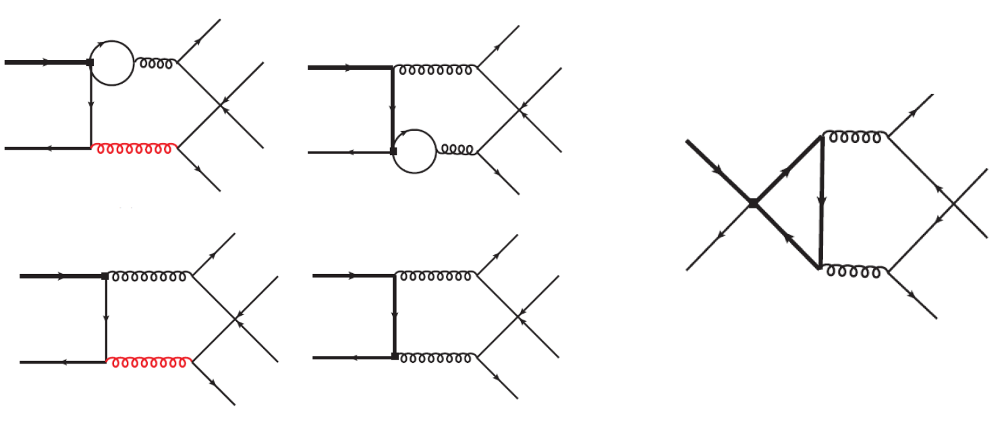
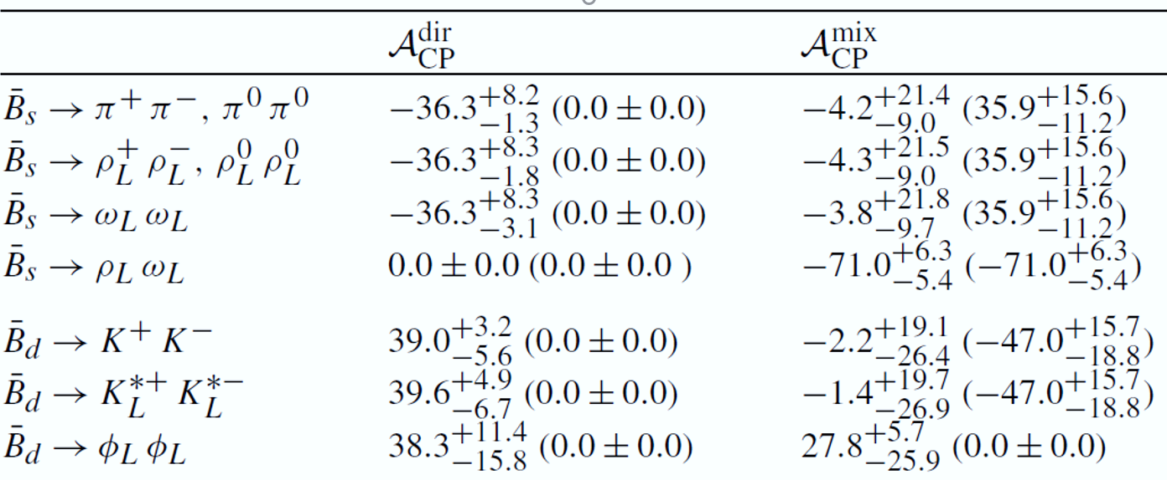
The enhanced NLO contributions to pure annihilation B decays
Contributions from tree operators at NLO can enhance the penguin dominated processes
[Lü, YLS, Wang, Wang, 2023]
The prediction on CP violation is significantly modified.

Slide 24


Heavy baryon decays
Possible large CP violation in $Λ_{b}$ decays
[Shen, Wang, Qin 2023]
$$Λ_{b}→D\left(→K^{+}π^{−}\right)N(→pπ^{−})$$
Angular distribution analysis $Λ_{b}$ decays
Fei Huang’s Talk
Semileptonic $Λ_{b}$ decays in PQCD
[Han, Li, Li, Shen, Yu, Hsiao]
Power suppressed contribution dominates
Nonleptonic B decays[factorization approach: Geng, Hsiao; PQCD, Han, Yu, Zhou etc.]
Jia-Jie Han’s Talk

Slide 25
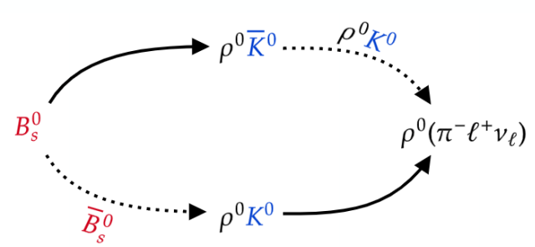
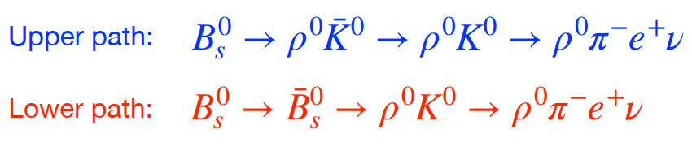
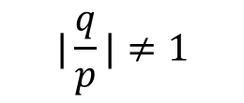


Progress on mixing induced CP violation
Common mixing induced CP violation
Indirect CP violation
$$|\frac{q}{p}|≠1$$
CPV in interference between a decay without and with initial mixing
$$\left(M→f\right)+(M→\overline{M}→f)$$
CPV in interference between a decay without and with final mixing
$$\left(M→f\right)+(M→\overline{f}→f)$$
[Wang， Li, Yu, 2017]
Double mixing CP violation
[Shen， Song, Qin, 2023]
Advantage: nonzero strong phase is not required, the weak phase can be extracted without strong interaction pollution

Slide 26
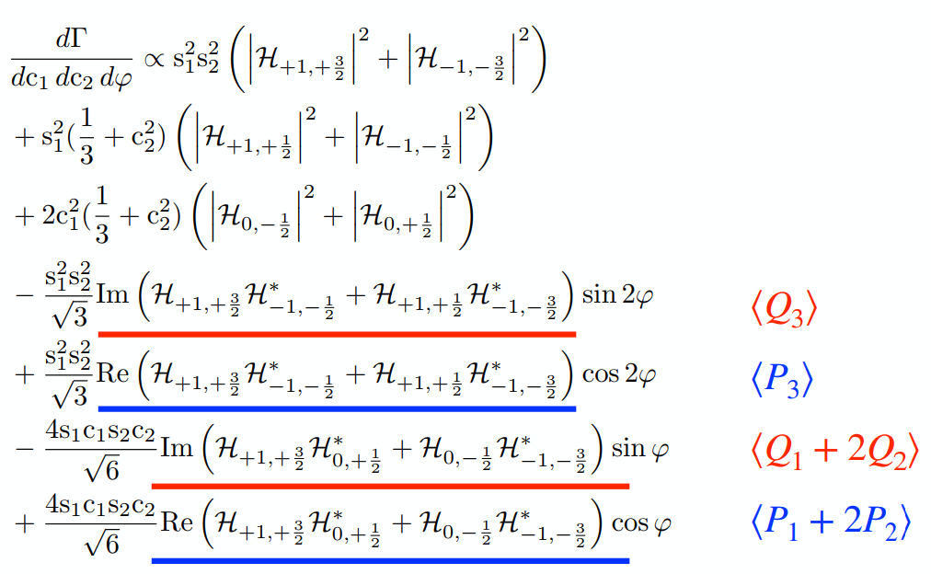






T-odd induced CP asymmetry
Strong phase dependences of CPVs
$\sin{δ_{s}}$ Vs $\cos{δ_{s}}$
T odd correlation induced CPV have cosine dependence on strong phases
$$A_{CP}^{Q^{−}}=\frac{〈Q^{−}〉−〈{ \overline{Q}}^{−}〉}{〈Q^{−}〉+〈{ \overline{Q}}^{−}〉}∝\cos{δ_{s}}$$
$$\left\{T, Q^{−}\right\}=0$$
[Wang, Qin, Yu, 2022]
if there is a unitary transform U
$$UK|ψ〉=e^{−iα}|ψ〉$$
$$UQ_{−}U^{†}=Q_{−}$$
The triple product in P $→P_{1}P_{2}$
$$Q_{1}=\left({\vec{s}}_{1}×{\vec{s}}_{2}\right)⋅\vec{p}$$
These observables can be found in the angular distribution of
$$Λ_{b}→N^{∗}\left(1520\right)K^{∗}$$

Slide 27
Topics not included
Heavy hadron spectroscopy
The charm physics
The inverse problem method for nonperturbative QCD
Hsiang-nan Li’s Talk
The exclusive production of heavy meson
Yan-Bing Wei’s Talk
Inclusive decays of heavy hadrons
Application of new physics models beyond the SM in heavy flavor physics
Xing-Bo Yuan’s Talk

Slide 28
Summary
More precise theoretical predictions on the observables in heavy hadron decays are required to accurately test of the SM and search for new physics signals
The perturbative QCD corrections have been performed to high order, and the power corrections are to be investigated
The determination of the nonperbuative input is essential to improve the theoretical accuracy.

