Slide 1



How to understand the charmed strange tetraquarks near 2.9 GeV？
Bo Wang(王波)
Hebei University
2023年12月18日@上海

Slide 2

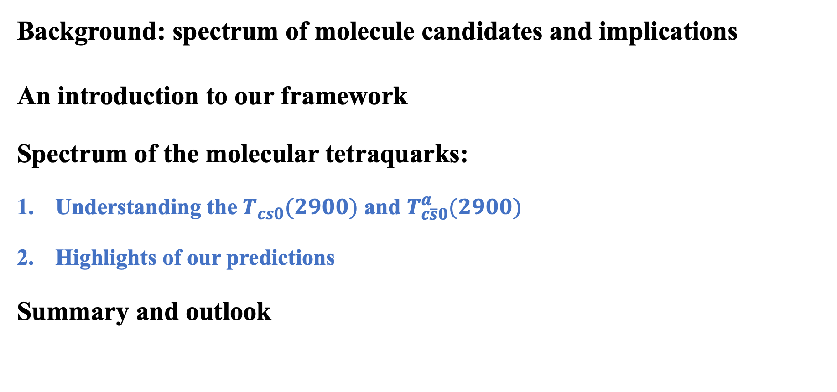
Outline
Background: spectrum of molecule candidates and implications
An introduction to our framework
Spectrum of the molecular tetraquarks:
Understanding the $T_{cs0}(2900)$ and $T_{c\overline{s}0}^{a}(2900)$
Highlights of our predictions
Summary and outlook

Slide 3
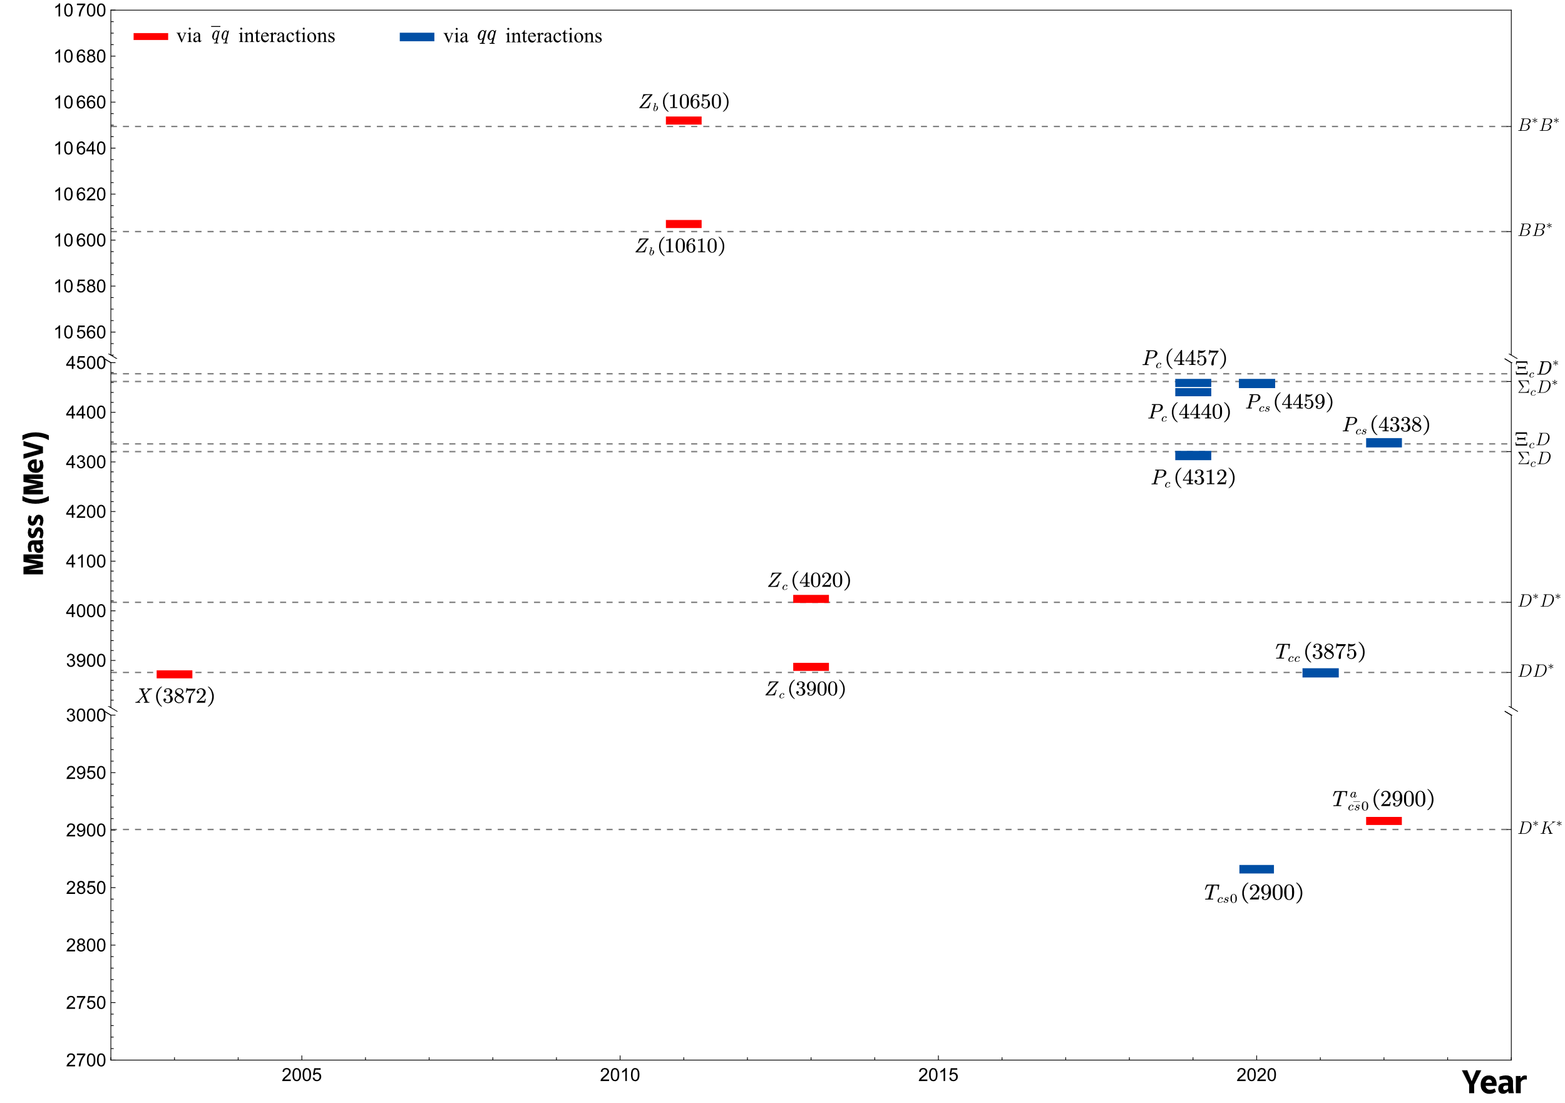

Background: spectrum of molecule candidates and implications
Two salient features:
1. Near-threshold
2. Strong isospin tropism
Are these states independent
or correlated entities?
Recent reviews:
H.-X. Chen et al, Phys. Rept. 639, 1 (2016) | F.-K. Guo et al, Rev. Mod. Phys. 90, 015004 (2018)
Y.-R. Liu et al, Prog. Part. Nucl. Phys. 107, 237 (2019) | N. Brambilla et al, Phys. Rept. 873, 1 (2020)
H.-X. Chen et al, Rept. Prog. Phys. 86, 026201 (2023) | L. Meng et al, Phys. Rept. 1019, 1 (2023)
Our focus in this talk

Slide 4
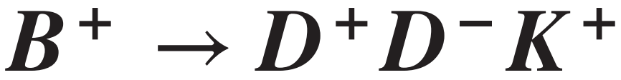
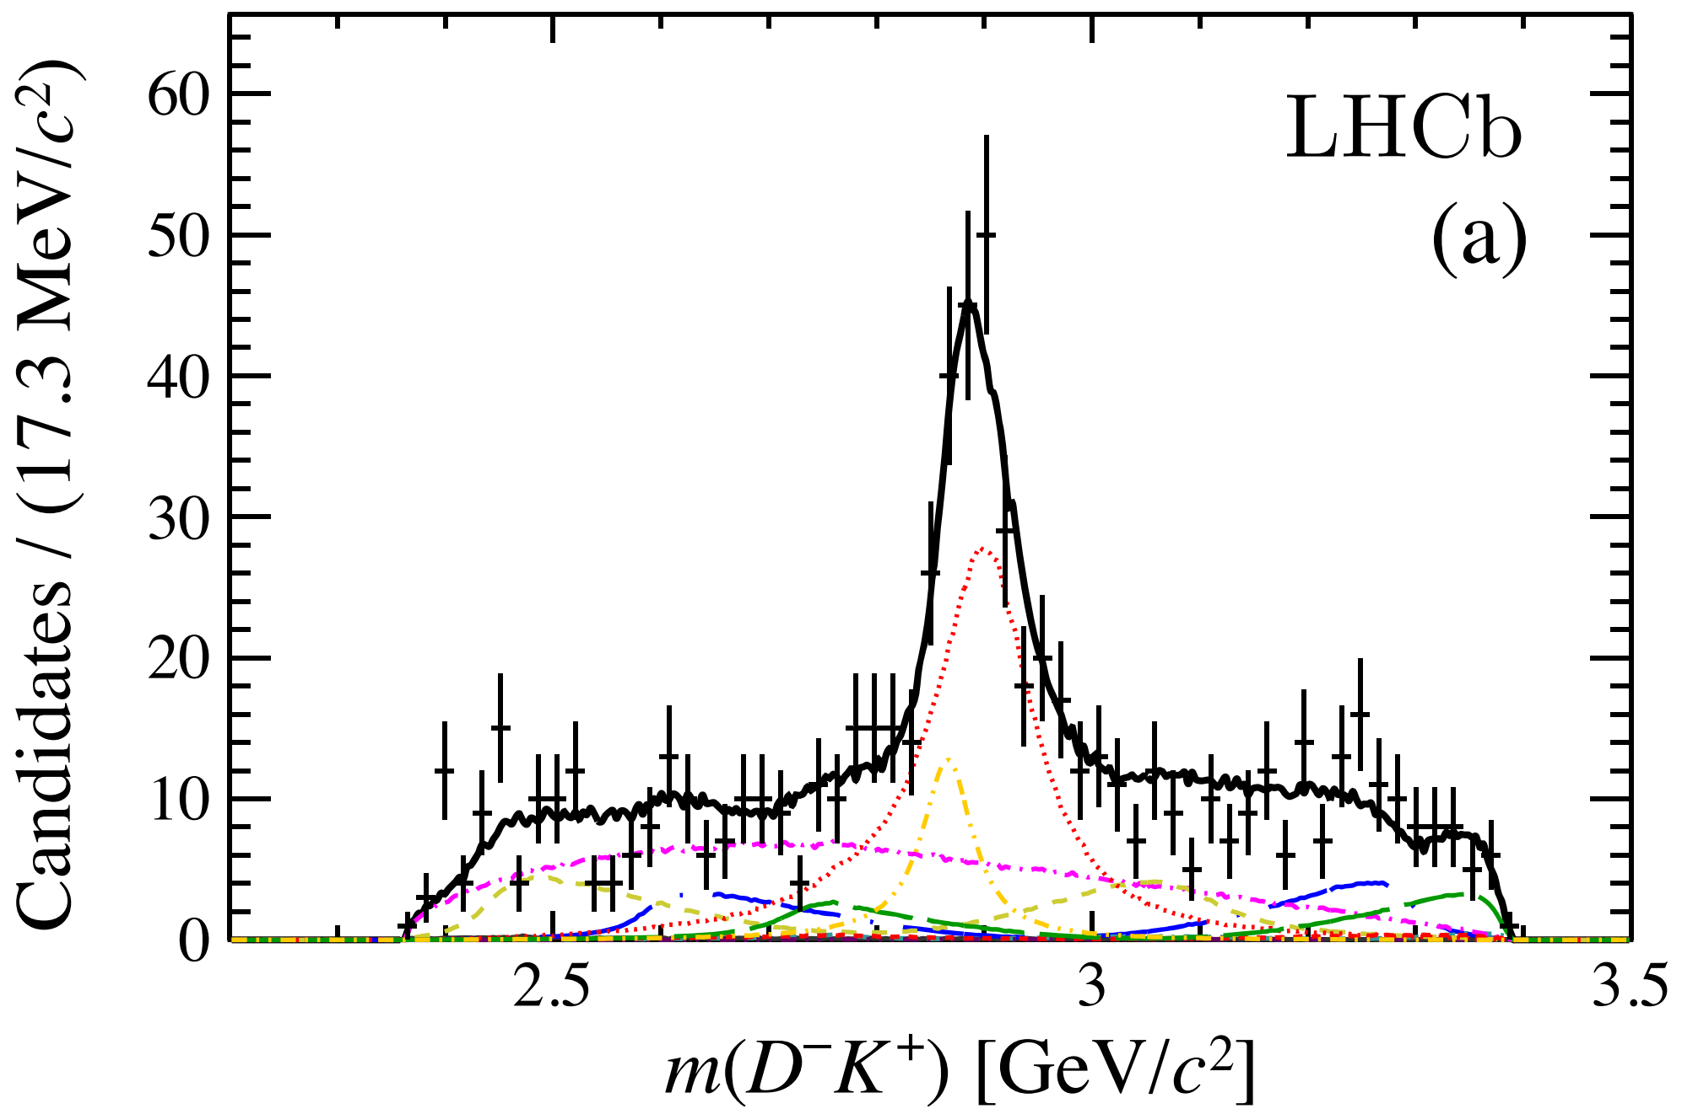
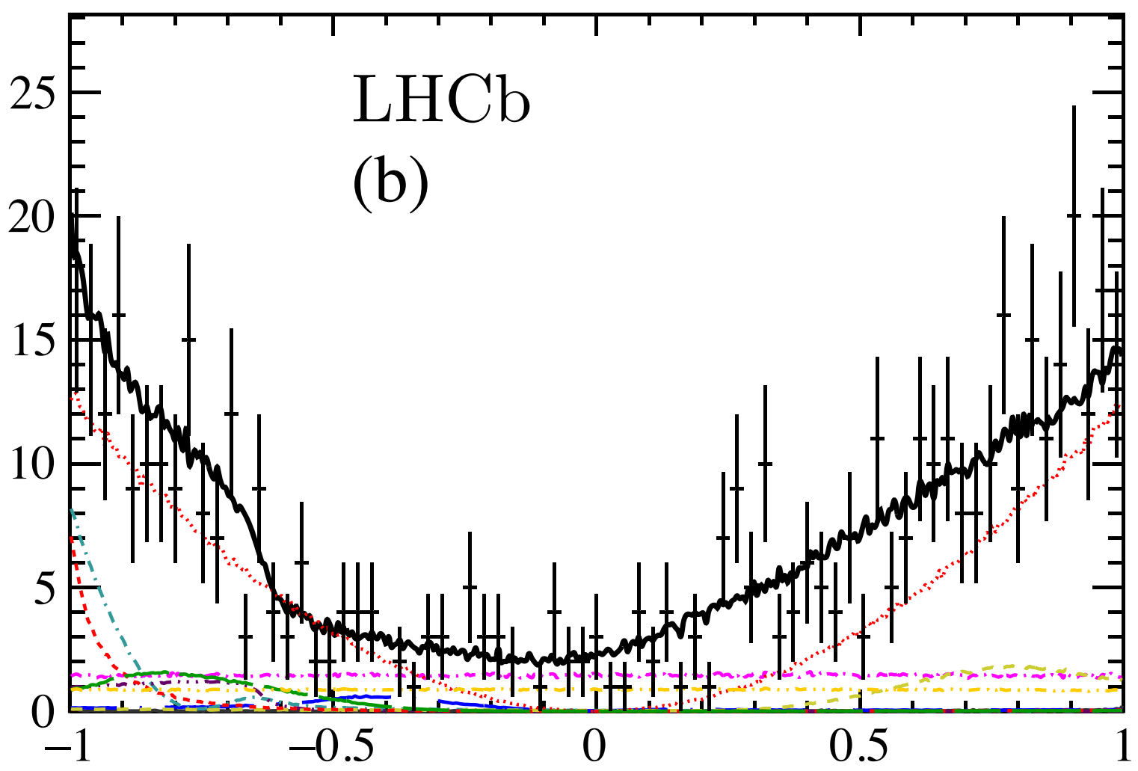
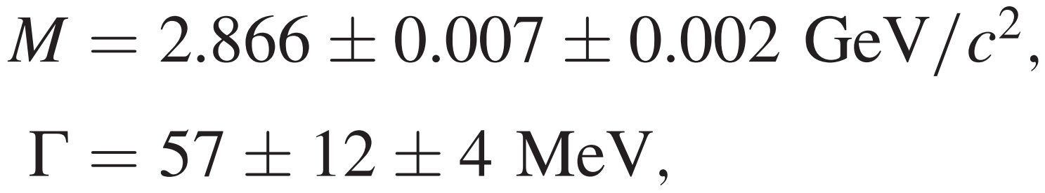





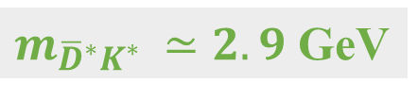
Background: status of the $T_{cs0}(2900)$
:Phys. Rev. D 102, 112003 (2020)
Explanations for $T_{cs}(2900)$
$$T_{cs0,1}(2900)$$
 |  | Kinematic effect
Chen et al., Chin. Phys. Lett. 37, 101201 (2020) | Karliner et al., Phys. Rev. D 102, 094016(2020) | Liu et al., Eur. Phys. J. C 80, 1178 (2020)
He et al., Chin. Phys. C 45, 063102 (2021) | He et al., Eur. Phys. J. C 80, 1026 (2020) | Burns et al., Phys. Lett. B 813, 136057 (2021)
Liu et al., Phys. Rev. D 102, 091502 (2020) | Wang et al., Int. J. Mod. Phys. A 35, 2050187 (2020)
Hu et al., Chin. Phys. C 45, 021003 (2021) | Zhang et al., Phys. Rev. D 103, 054019 (2021)
B. Wang et al., Eur. Phys. J. C 82, 419 (2022) | Wang et al., Eur. Phys. J. C 81, 188 (2021)
 | Lü et al., Phys. Rev. D 102, 074021 (2020),
 | Tan et al., Chin. Phys. C 45, 093104 (2021)
${\overline{D}}^{∗}K^{∗}$molecule
$\overline{c}\overline{s}ud$ tetraquark
P-wave behavior
$T_{cs0}(2900)$, aka $X_{0}(2900)$
The calculations from quark model showed that
Compact tetraquark explanation appears incompatible with the current experimental data!
$m_{{\overline{D}}^{∗}K^{∗} }≃2.9$ GeV

Slide 5
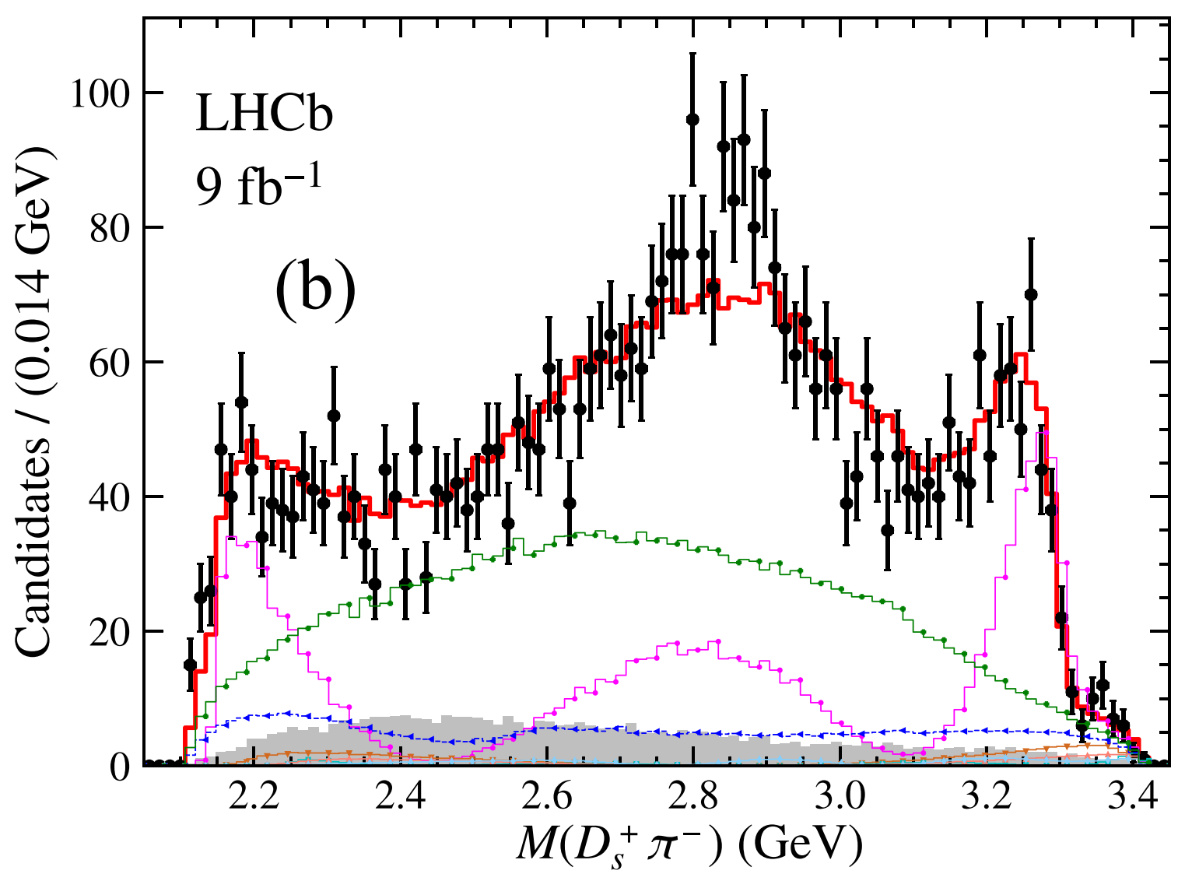
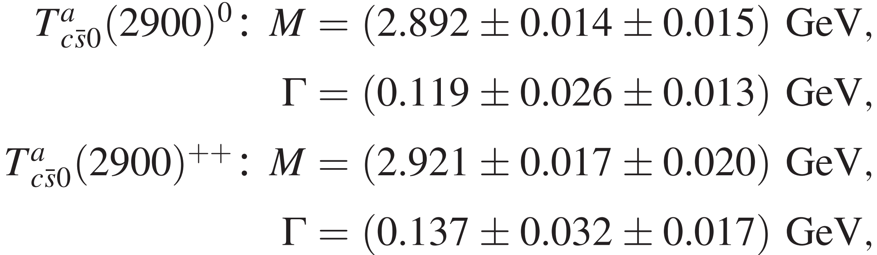
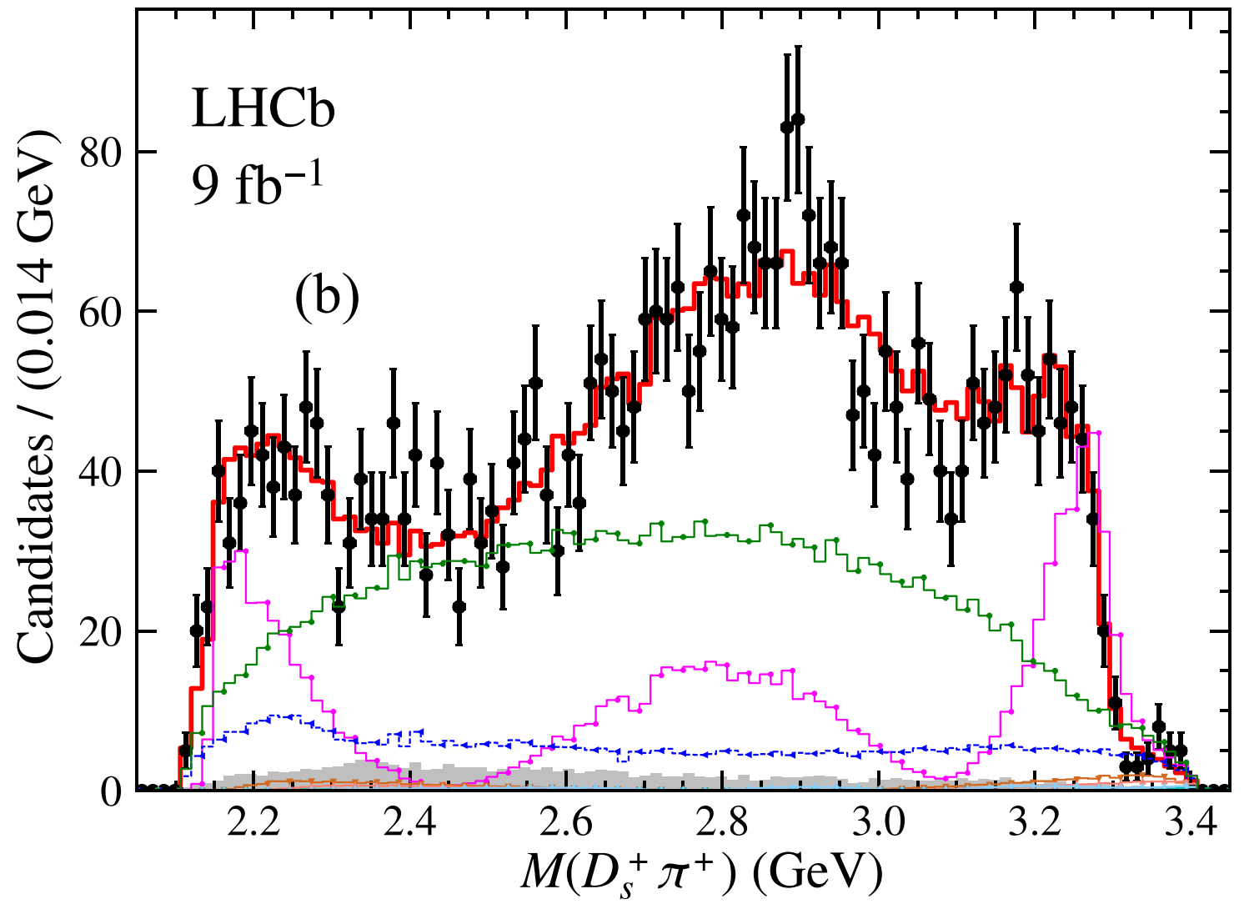

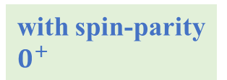
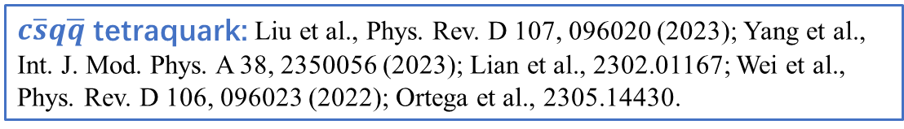
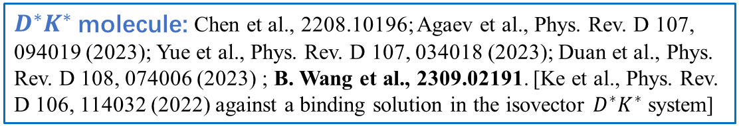
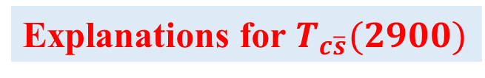
Background: status of the $T_{c\overline{s}0}^{a}(2900)$
:Phys. Rev. D 108, 012017 (2023)
$m_{D^{∗}K^{∗} }≃2.9$ GeV
belong to an isospin triplet
with spin-parity $0^{+}$
Explanations for $T_{c\overline{s}}(2900)$
$D^{∗}K^{∗}$ molecule: Chen et al., 2208.10196; Agaev et al., Phys. Rev. D 107, 094019 (2023); Yue et al., Phys. Rev. D 107, 034018 (2023); Duan et al., Phys. Rev. D 108, 074006 (2023) ; B. Wang et al., 2309.02191. [Ke et al., Phys. Rev. D 106, 114032 (2022) against a binding solution in the isovector $D^{∗}K^{∗}$system]
$c\overline{s}q\overline{q}$ tetraquark: Liu et al., Phys. Rev. D 107, 096020 (2023); Yang et al., Int. J. Mod. Phys. A 38, 2350056 (2023); Lian et al., 2302.01167; Wei et al., Phys. Rev. D 106, 096023 (2022); Ortega et al., 2305.14430.
For other related works, see 2309.02191 and the references therein

Slide 6
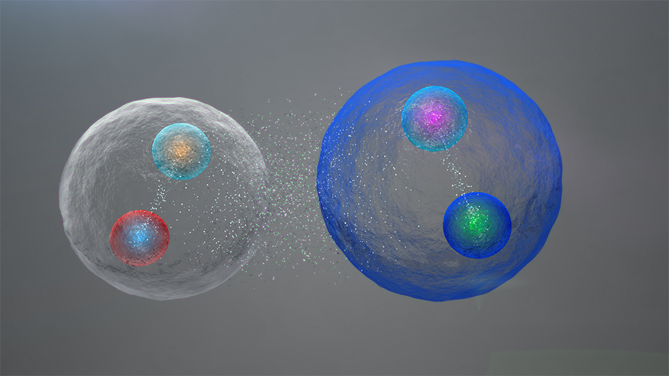






Implications from the spectrum
Are these states independent or correlated entities?
light quark pair correlations
$$\overline{u}$$
$$\overline{d}$$
2. Strong isospin tropism
$$c$$
$$c$$
1. Near-threshold
Highly plausible molecule candidates
Their existence is reliant on the light quark pair correlations
3. Flavor symmetry
These exotic states do not exist as independent entities
Occam's Razor

Slide 7
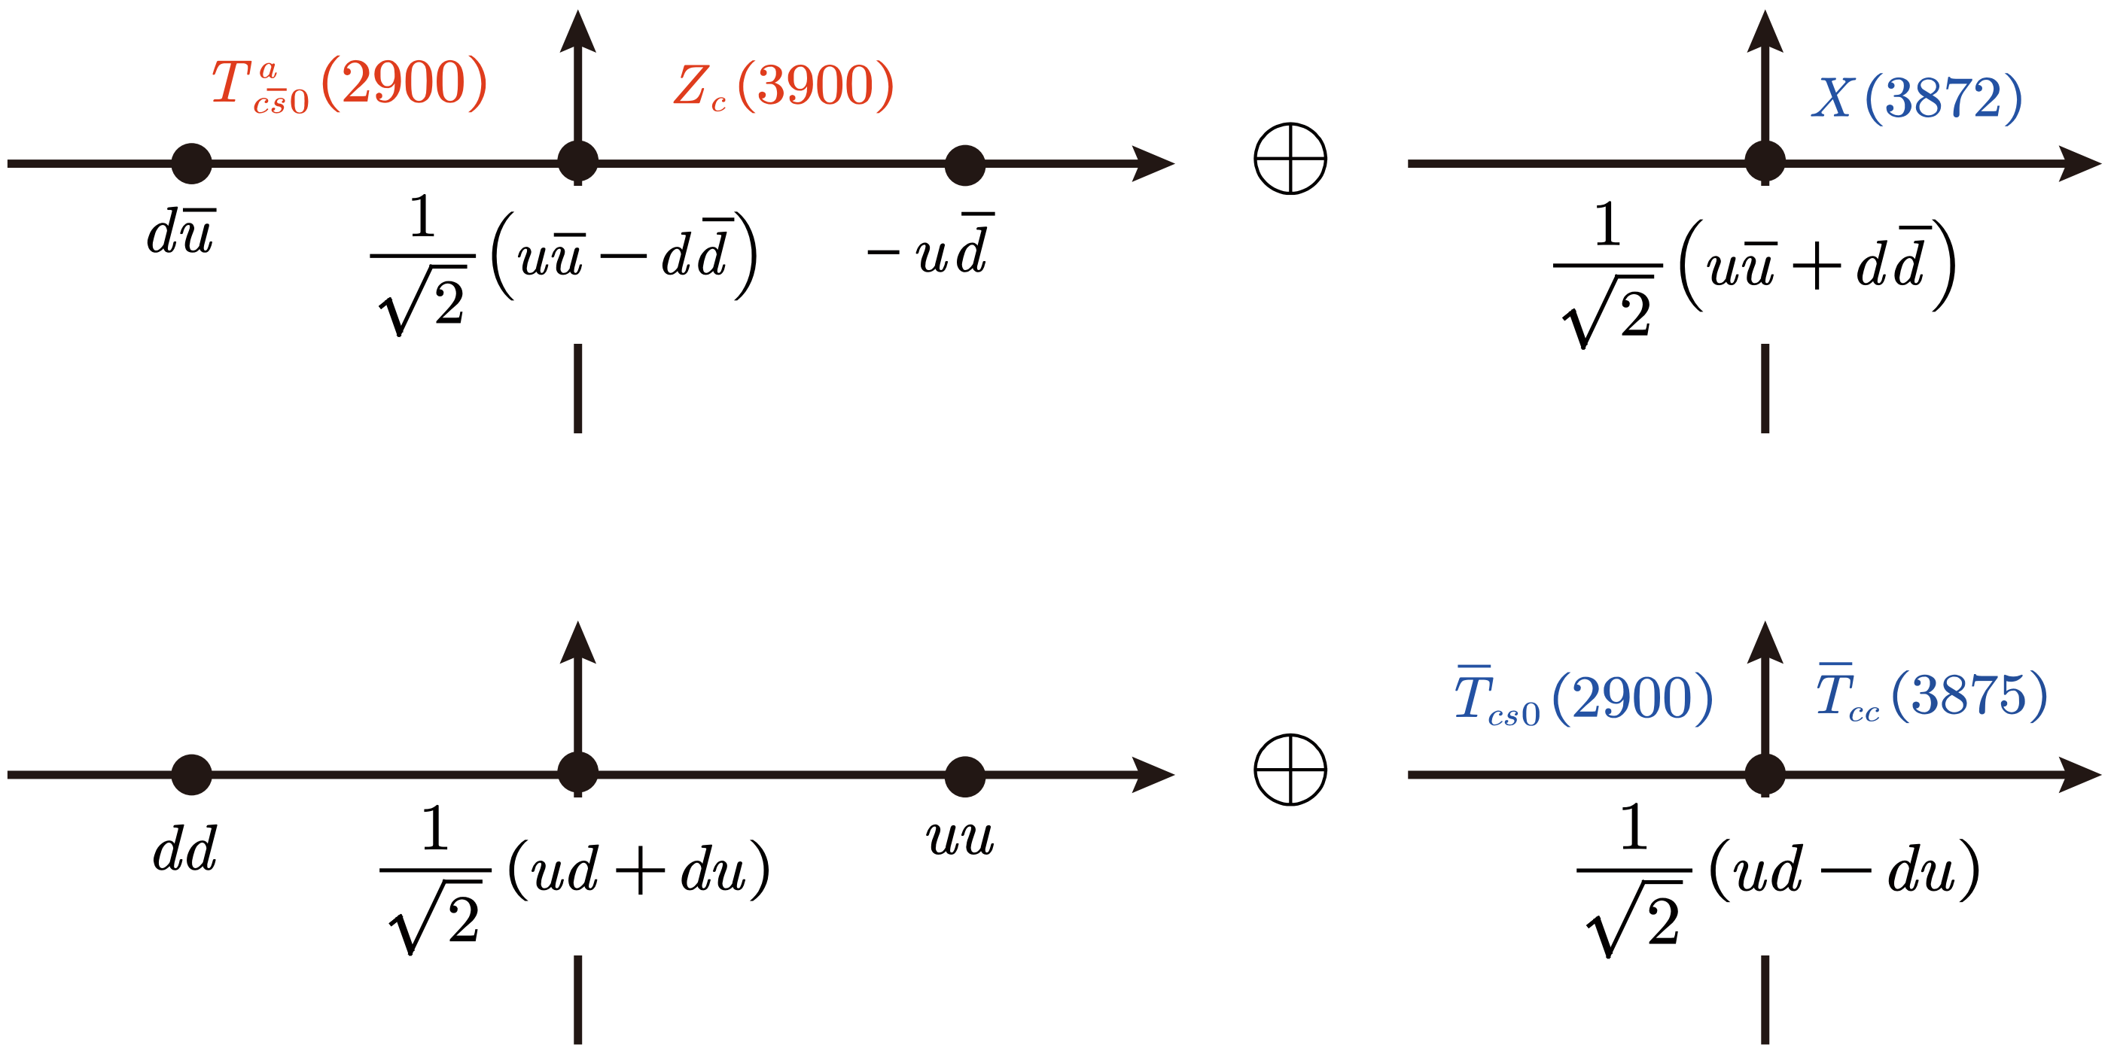


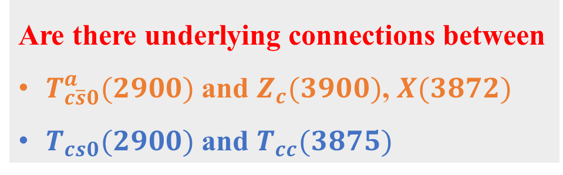

Light flavor wave functions
$$q\overline{q}$$
$$qq$$
B. Wang et al., 2309.02191
Are there underlying connections between
$T_{c\overline{s}0}^{a}(2900)$ and $Z_{c}(3900)$, $X(3872)$
$T_{cs0}(2900)$ and $T_{cc}(3875)$

Slide 8
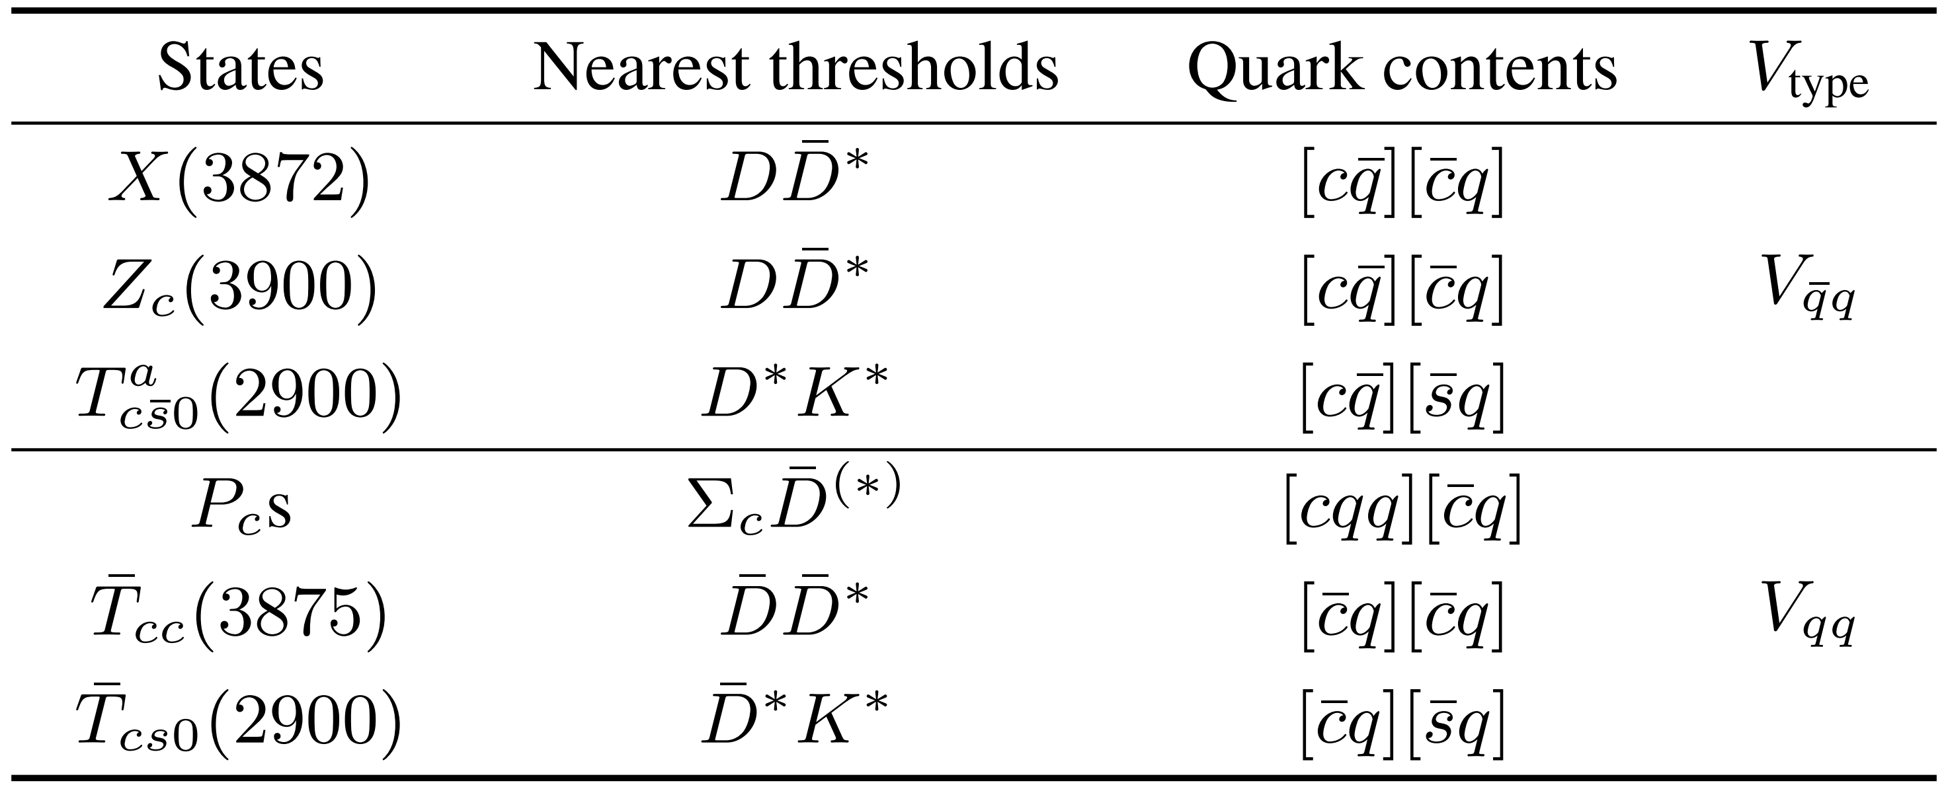
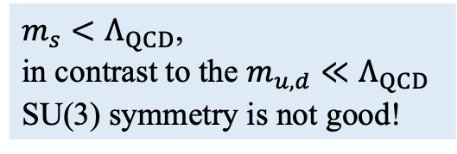
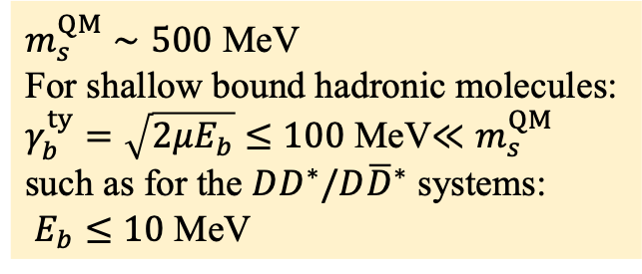
An introduction to our framework
Strange quark: light or heavy?
$m_{s}<Λ_{QCD}$,
in contrast to the $m_{u,d}≪Λ_{QCD}$
SU(3) symmetry is not good!
$m_{s}^{QM}∼500$ MeV
For shallow bound hadronic molecules:
$γ_{b}^{ty}=\sqrt{2μE_{b}}≤100$ MeV$≪m_{s}^{QM}$
such as for the $DD^{∗}/D{\overline{D}}^{∗}$ systems:
$E_{b}≤10$ MeV
B. Wang et al., 2309.02191
residual strong interaction
The near-threshold interactions are too weak to excite the strange quarks inside the heavy hadrons.
The strange quark will behave like an inert source (heavy quark) from the view of the residual strong interactions at the near-threshold energy scale.

Slide 9
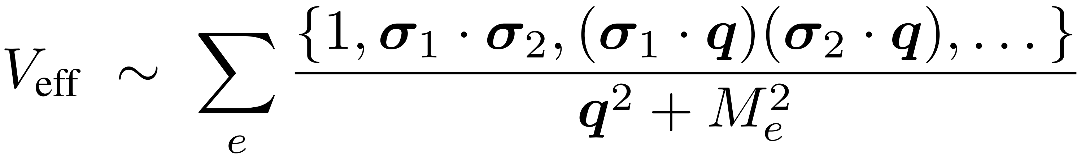
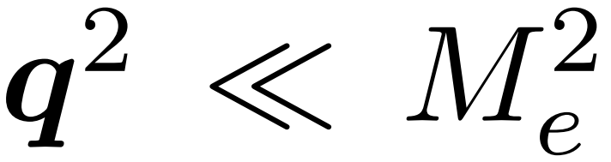

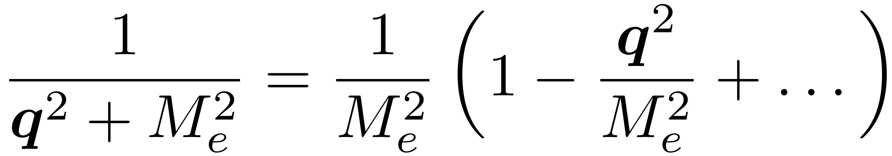
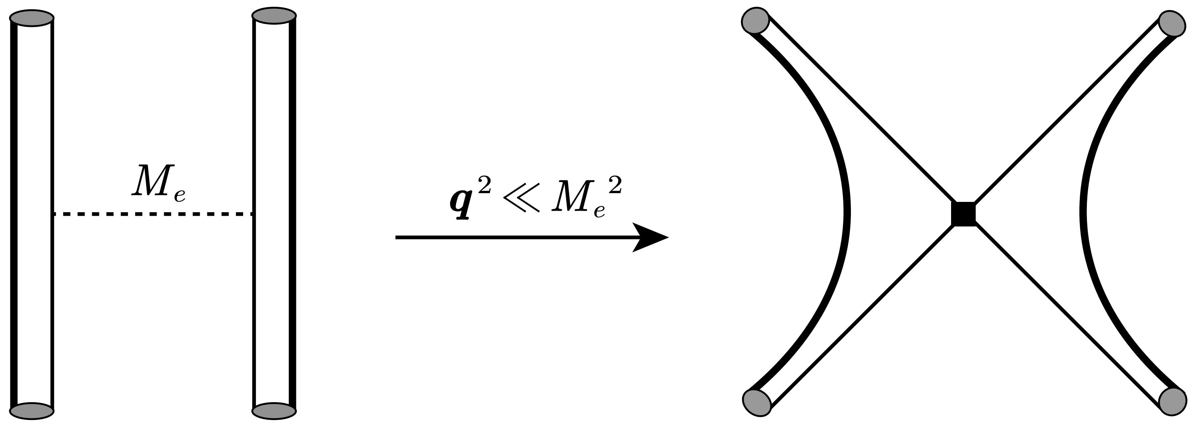





An introduction to our framework
Constructing the effective potentials from a quark-level perspective
$$Q$$
$$Q$$
$$\overline{q}$$
$$\overline{q}$$
For the near-threshold interactions:
e: scalar, pseudoscalar,
vector, axial-vector, tensor,…
From “H” to a “butterfly”
Keep the leading order ($q^{0}$) of the expansion
B. Wang et al., 2309.02191

Slide 10
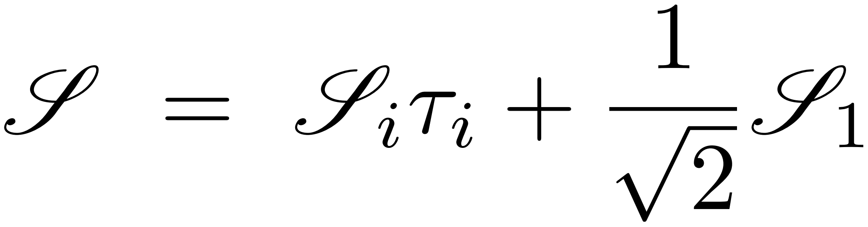
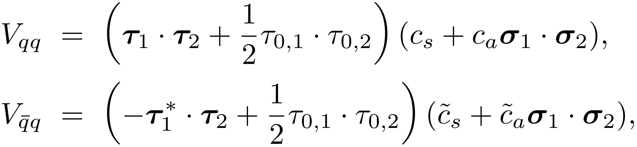
An introduction to our framework
Each exchanged meson fields contain both the isospin triplet and singlet:
The net contributions from the exchanged particles will give rise to the non-relativistic effective potentials for the light $qq$ and $q\overline{q}$with the following forms, respectively,
Pauli matrix
in isospin space
Pauli matrix
in spin space
B. Wang et al., 2309.02191

Slide 11
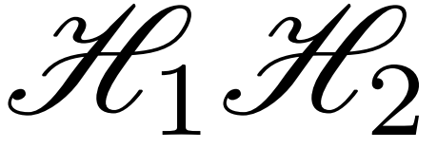
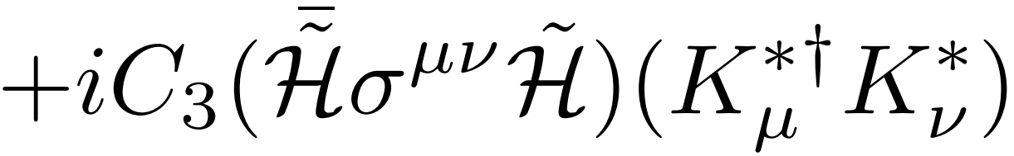
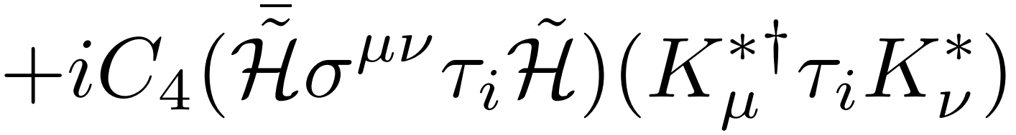
An introduction to our framework
Translating the quark-level potential to the hadron-level:
spin-flavor wave function of
di-hadron systems
Equivalent to using a hadron-level contact Lagrangians:
B. Wang et al., 2309.02191

Slide 12
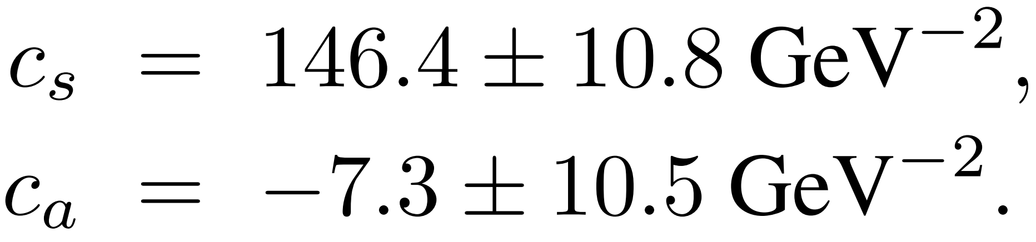
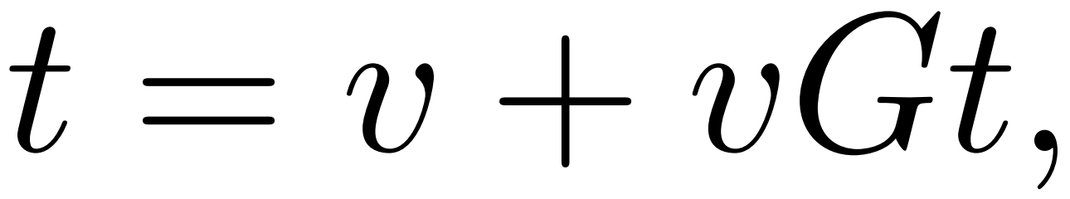
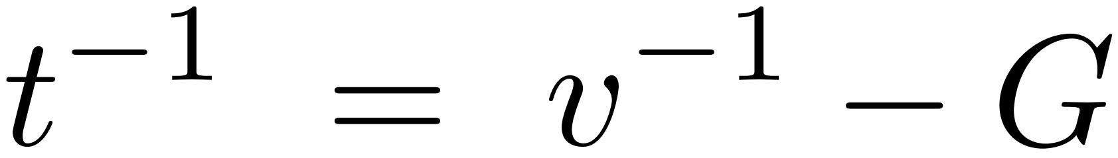
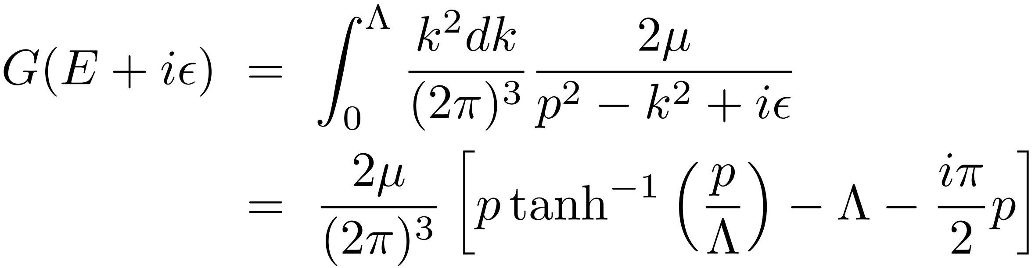
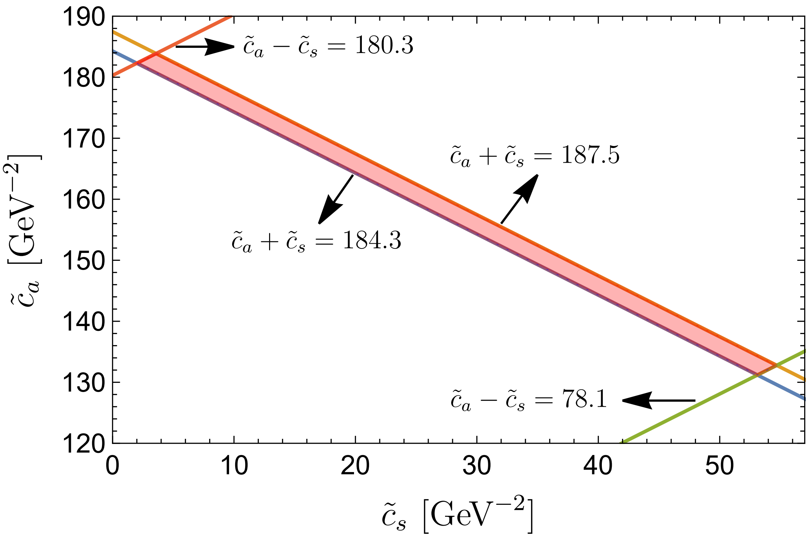
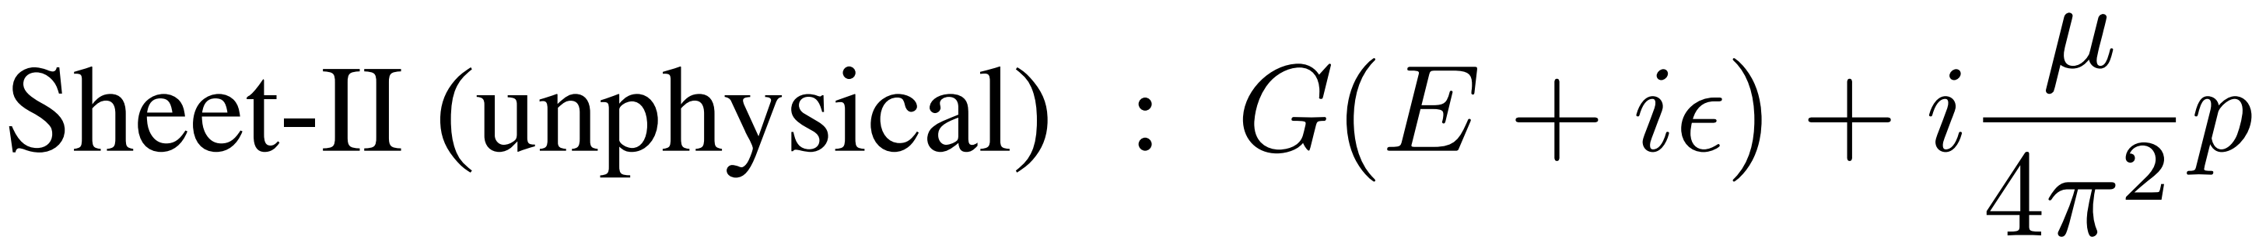


An introduction to our framework
To search for the bound/virtual state poles,
$P_{c}$ and $T_{cc}$ as inputs
$X(3872)$ and $Z_{c}(3900)$ as inputs
Bound state pole in
Virtual state pole in

Slide 13
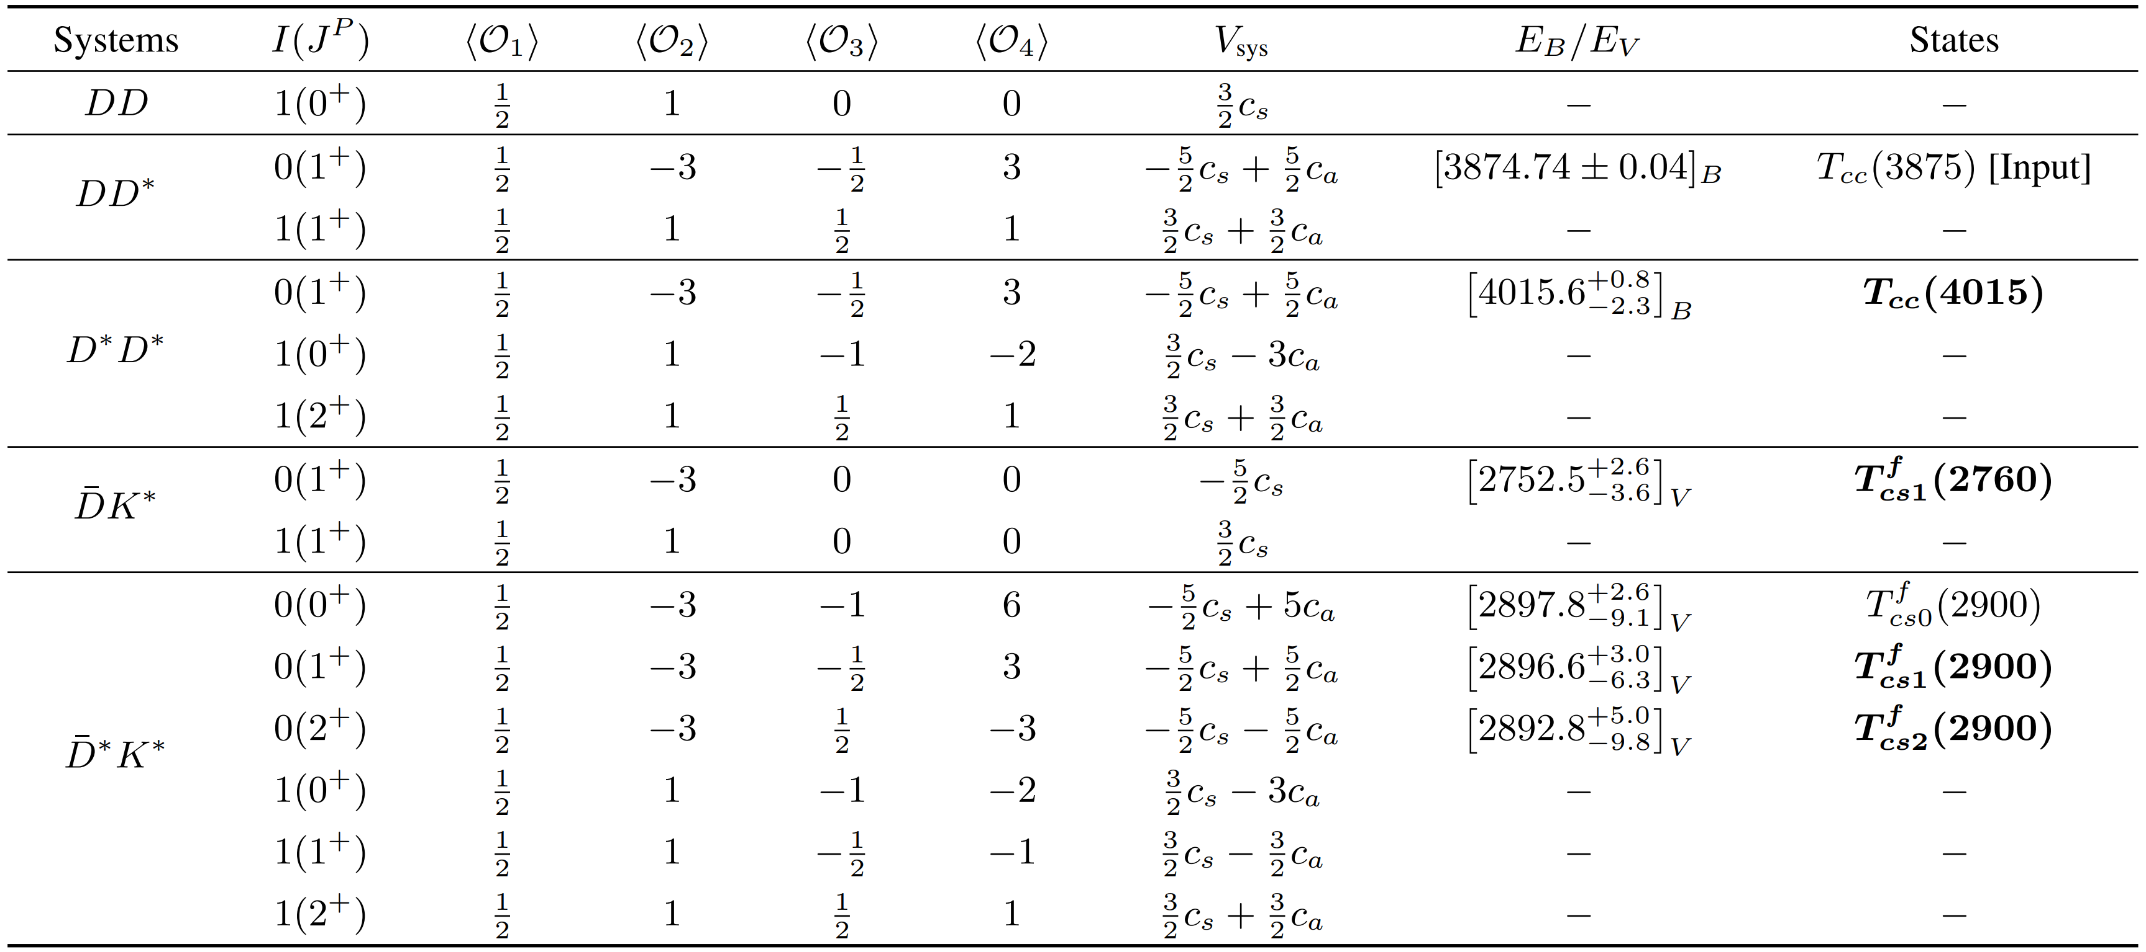
Spectrum of the molecular tetraquarks: understanding the $T_{cs0}(2900)$
B. Wang et al., 2309.02191

Slide 14
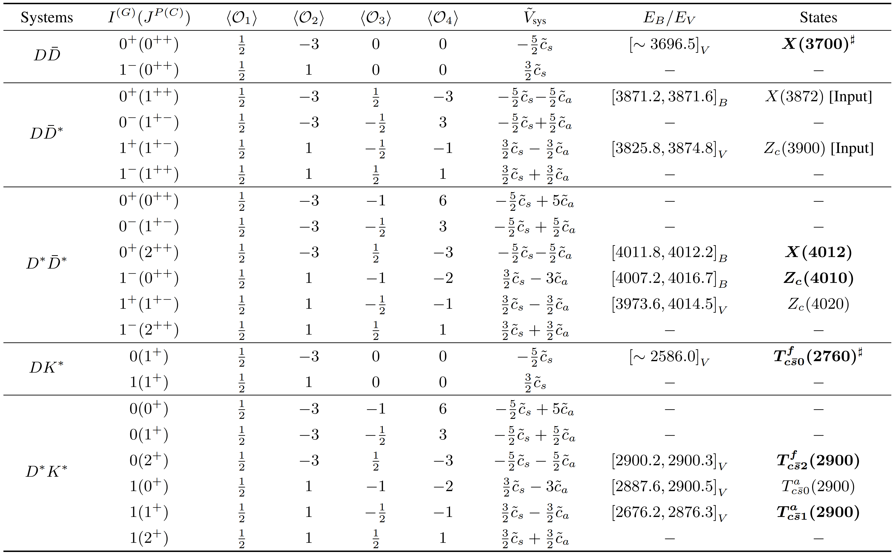
Spectrum of the molecular tetraquarks: understanding the $T_{c\overline{s}0}^{a}(2900)$

Slide 15
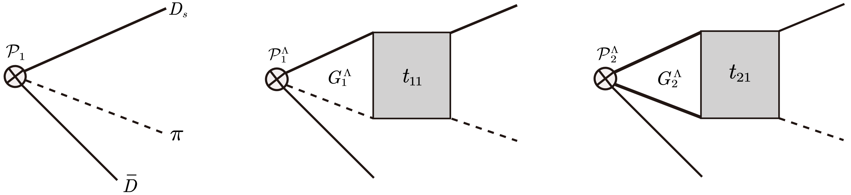
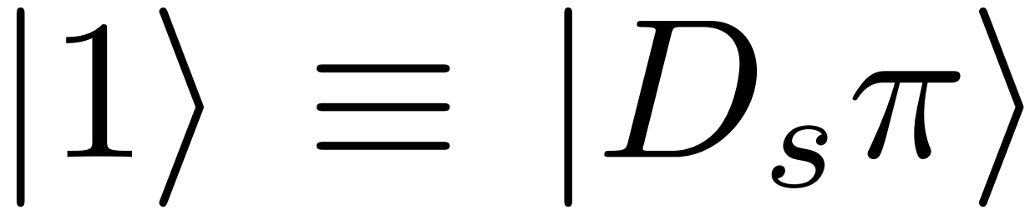
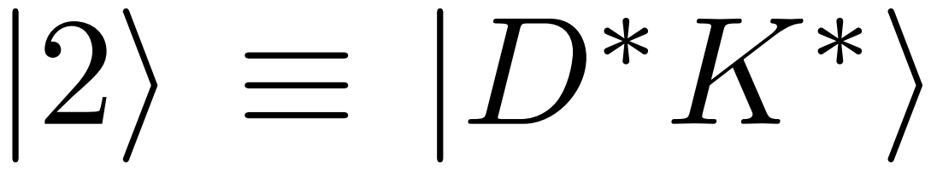
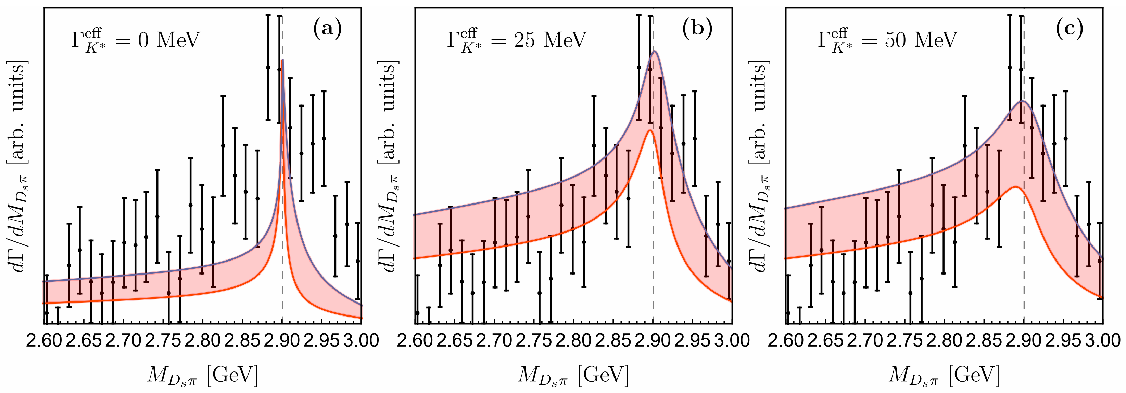
Spectrum of the molecular tetraquarks: understanding the $T_{c\overline{s}0}^{a}(2900)$
Line-shapes of $T_{c\overline{s}0}^{a}(2900)$ in the molecular scenario
B. Wang et al., 2309.02191

Slide 16




















Unraveling the $T_{cs0}(2900)$ and $T_{c\overline{s}0}^{a}(2900)$
In our calculations, the recently discovered $T_{cs0}(2900)$ and $T_{c\overline{s}0}^{a}(2900)$ can be confidently identified as the charm-strange counterparts of $T_{cc}(3875)$and $Z_{c}(3900)$, respectively.
$$c$$
$$c$$
$$c$$
$$s$$
$$\overline{u}$$
$$\overline{d}$$
$$\overline{u}$$
$$\overline{d}$$
Phys. Rev. Lett. 112, 022001 (2014)
$$T_{cc}(3875)$$
$T_{cs0}(2900)$
$$c$$
$$\overline{c}$$
$$c$$
$$\overline{s}$$
Conservative estimation
$$\overline{u}$$
$$d$$
$$\overline{u}$$
$$d$$
$$Z_{c}(3900)$$
$$T_{c\overline{s}0}^{a}(2900)$$

Slide 17

Highlights of our predictions

Slide 18
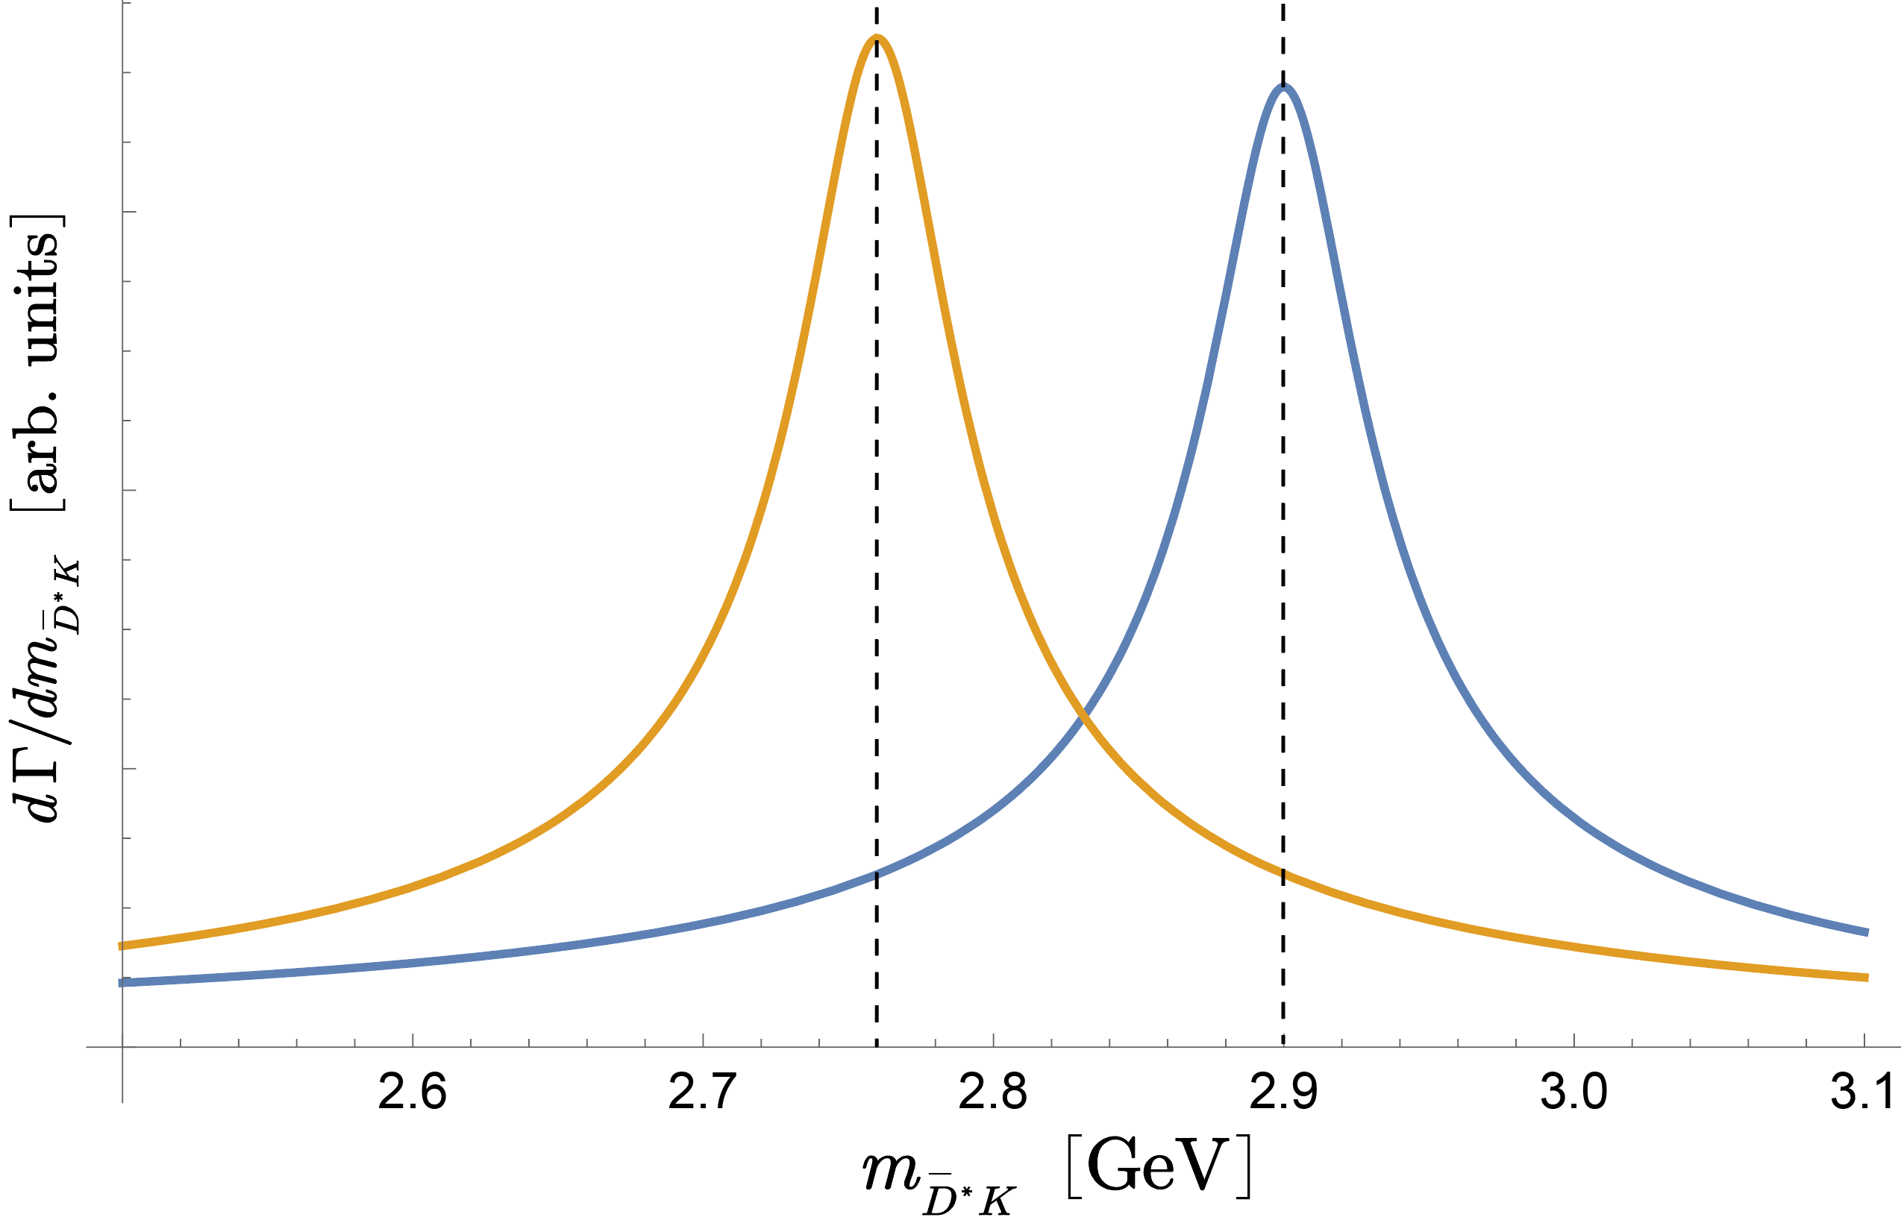
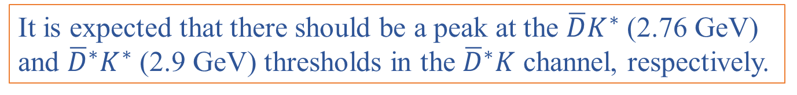



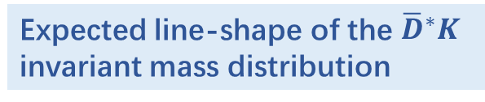





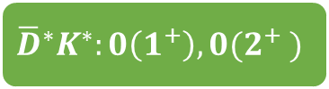

Highlights of our predictions
also expected in many works, such as Chen et al,. Eur. Phys. J. C 82, 581 (2022); Li et al., Phys. Rev. D 88,
114008 (2013); Liu et al., Phys. Rev. D 99, 094018 (2019); Ding et al., Eur. Phys. J. C 80, 1179 (2020); Dong et al., Commun. Theor. Phys. 73, 125201 (2021).
$$D^{∗}D^{∗}:0(1^{+})$$
$$\overline{D}K^{∗}:0(1^{+})$$
It is expected that there should be a peak at the $\overline{D}K^{∗}$ (2.76 GeV) and ${\overline{D}}^{∗}K^{∗}$ (2.9 GeV) thresholds in the ${\overline{D}}^{∗}K$ channel, respectively.
$${\overline{D}}^{∗}K$$
$${\overline{D}}^{∗}K^{∗}:0\left(1^{+}\right), 0(2^{+} )$$
$$0(1^{+})$$
$$0(1^{+})$$
Expected line-shape of the ${\overline{D}}^{∗}K$
invariant mass distribution
D-wave
D-wave
$$\overline{D}K$$
$${\overline{D}}^{∗}K$$
$$\overline{D}K^{∗}$$
${\overline{D}}^{∗}K^{∗}$

Slide 19
Highlights of our predictions

Slide 20
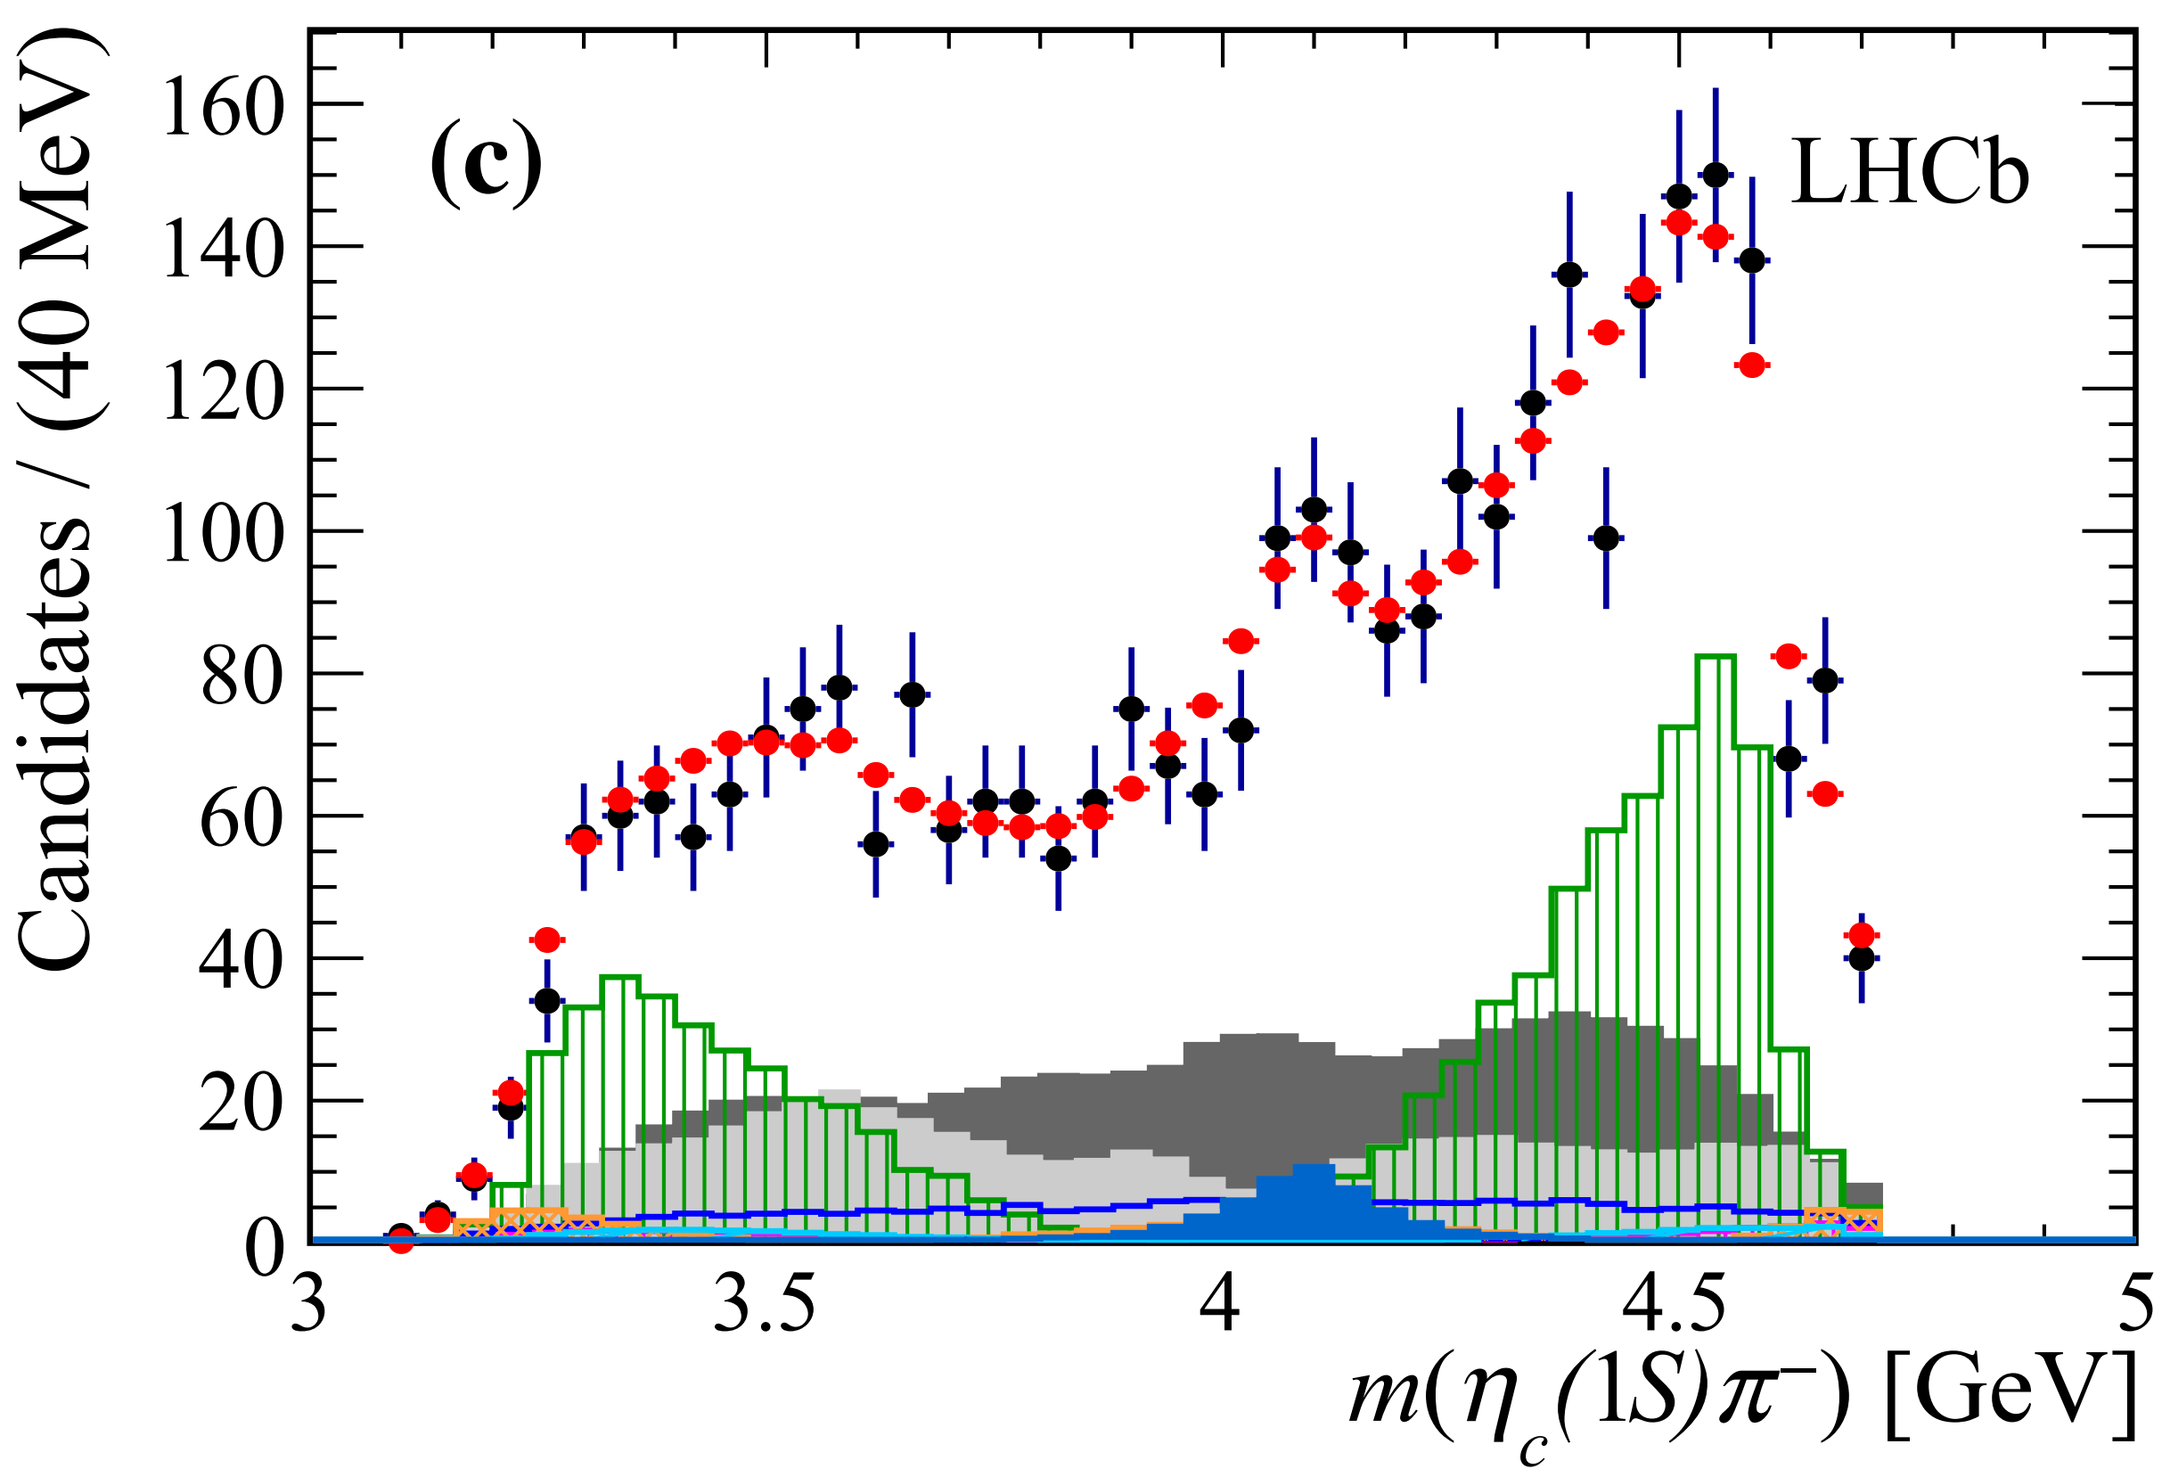

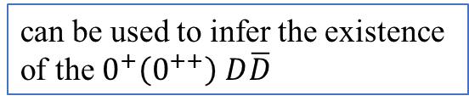

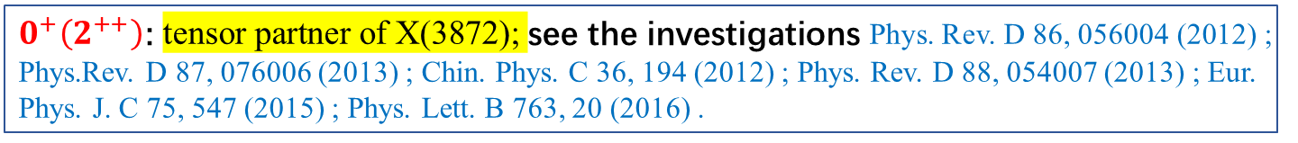






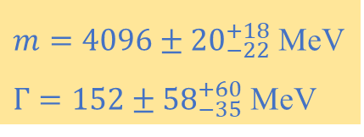


Highlights of our predictions
$$D\overline{D}:0^{+}\left(0^{++}\right)$$
virtual state/nonexistent
investigated in Phys. Rev. D 86, 056004 (2012); Phys. Rev. D 87, 076006 (2013) ; Phys. Rev. D 74, 014013 (2006) ; Phys. Rev. D 76, 074016 (2007); JHEP 06, 035 (2021).
$0^{+}\left(2^{++}\right)$: tensor partner of X(3872); see the investigations Phys. Rev. D 86, 056004 (2012) ; Phys.Rev. D 87, 076006 (2013) ; Chin. Phys. C 36, 194 (2012) ; Phys. Rev. D 88, 054007 (2013) ; Eur. Phys. J. C 75, 547 (2015) ; Phys. Lett. B 763, 20 (2016) .
$$D^{∗}{\overline{D}}^{∗}:0^{+}\left(2^{++}\right), 1^{−}(0^{++})$$
Eur. Phys. J. C 78,1019 (2018)
$1^{−}\left(0^{++}\right)$: $η_{c}π, D\overline{D}, J/ψρ,$ $χ_{c1}π (P wave)$
$$DK^{∗}:0\left(1^{+}\right)$$
can be used to infer the existence
of the $0^{+}\left(0^{++}\right)$ $D\overline{D}$
virtual state/nonexistent
$$D^{∗}K^{∗}:0\left(2^{+}\right), 1(1^{+})$$
Conservative estimation
$$Z_{c}(4100)$$
$m=4096±{20}_{−22}^{+18}$ MeV
$Γ=152±{58}_{−35}^{+60}$ MeV
D-wave
$$\frac{Γ[T_{c\overline{s}1}^{a}\left(2900\right)→D^{∗}K]}{Γ[T_{c\overline{s}1}^{a}\left(2900\right)→D_{s}^{∗}π]}∼10$$
$$DK$$
$$D^{∗}K$$
$$D_{s}^{∗}π$$

Slide 21

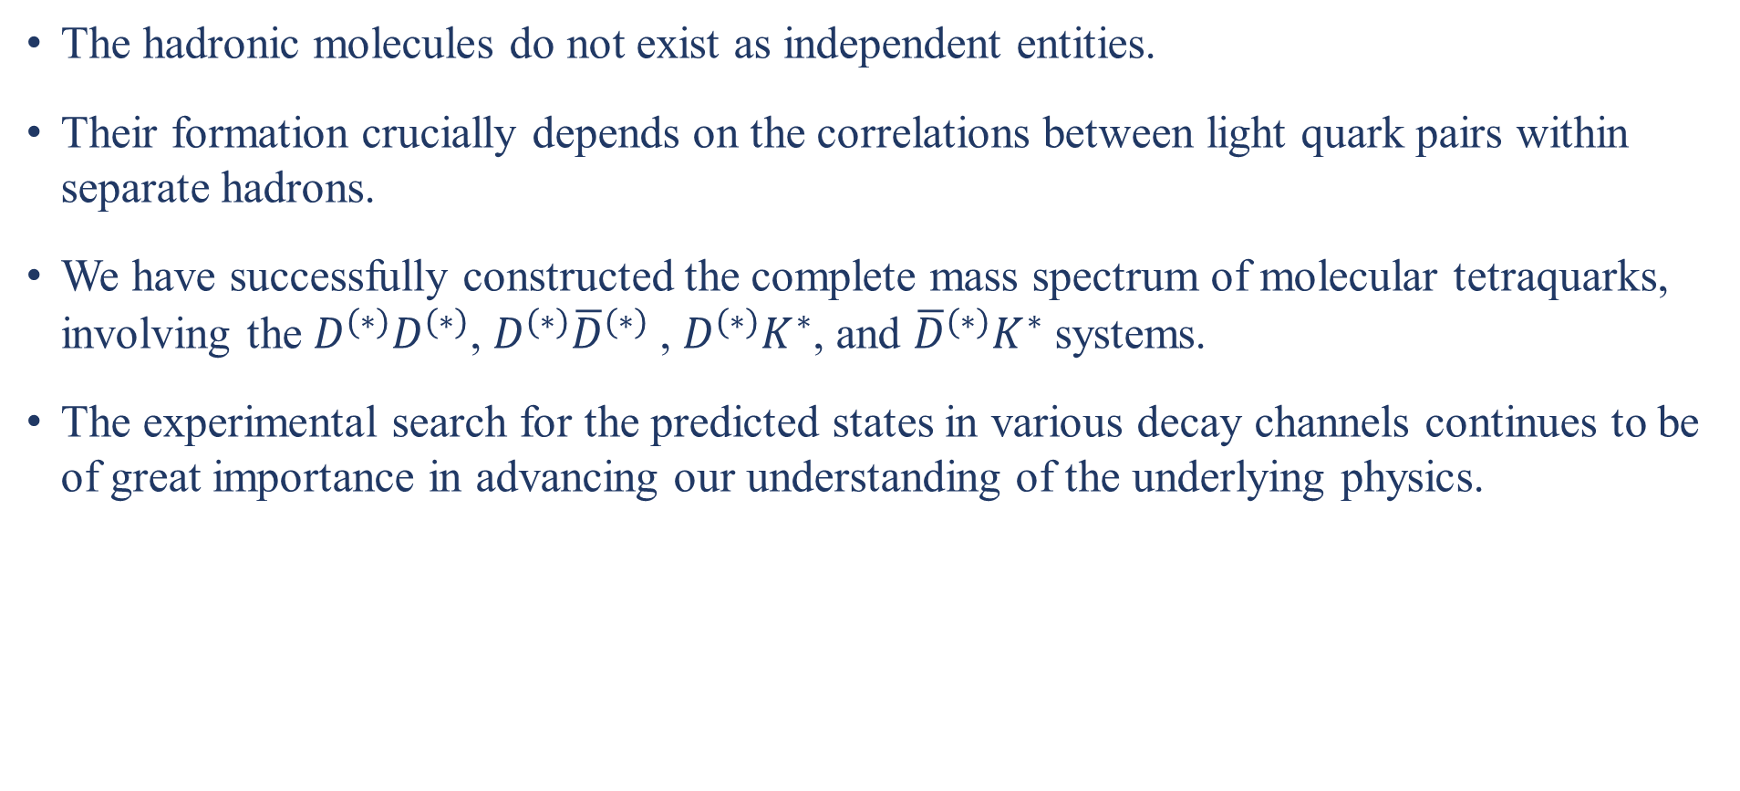
Summary and outlook
The hadronic molecules do not exist as independent entities.
Their formation crucially depends on the correlations between light quark pairs within separate hadrons.
We have successfully constructed the complete mass spectrum of molecular tetraquarks, involving the $D^{(∗)}D^{(∗)}$, $D^{(∗)}{\overline{D}}^{(∗)}$, $D^{(∗)}K^{∗}$, and ${\overline{D}}^{(∗)}K^{∗}$ systems.
The experimental search for the predicted states in various decay channels continues to be of great importance in advancing our understanding of the underlying physics.
Thanks!

