Slide 1
e+/e- Backgrounds at BEPCII/BESIII
JIN Dapeng
Aug. 22, 2011

Slide 2
Outline
What, where from and how generated?
Study of the e+/e- backgrounds at BEPCII/BESIII
Summary

Slide 3
What? Where? How?
BEPC: Beijing Electron Positron Collider; BES: BEijing Spectrometer;
Charm-Tau Physics experiment, e+ && e- collision;

Slide 4
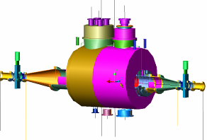
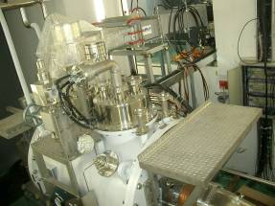
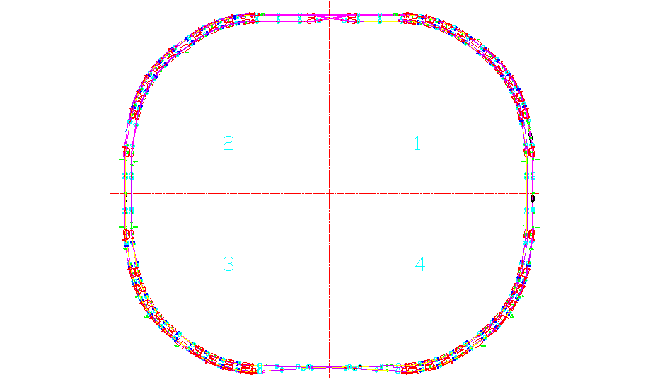
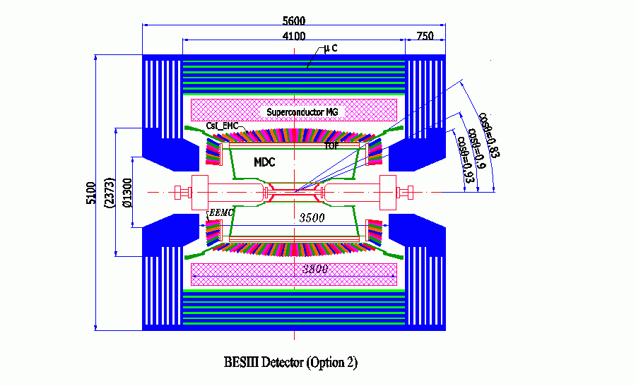
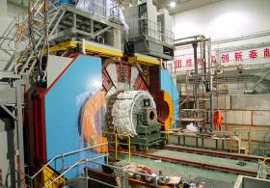
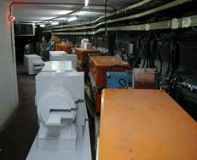
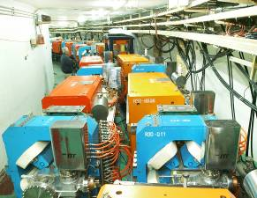
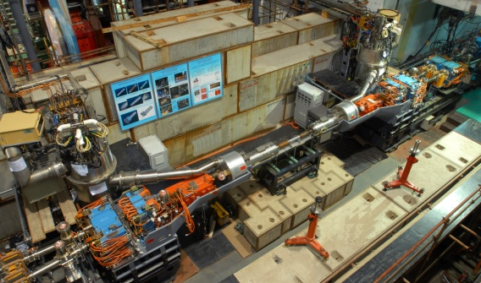
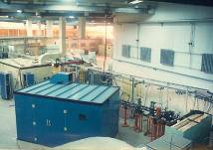
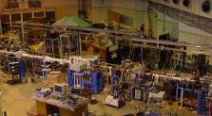
BEPCII: 双环结构高亮度正负电子对撞机

Slide 5
What? Where? How?
Backgrounds are not noise, they are “real interactions” with real energy deposition and generate real responses;
For BES, backgrounds are cosmic rays, showers into the detectors by beam-related lost particles, synchrotron radiation photons, …
e+/e- backgrounds: showers into the detectors by beam-related lost particles and SR photons;
How particles lost? Interactions with residual gas molecules, scattering between the particles in the same bunch(Touschek effect), bunch-crossing and Bhabha scattering.
Safety and performance of the detectors and electronics, unwanted events to trigger system …

Slide 6
Beam-gas interactions
Interactions between the e+/e- with the residual gas molecules in the storage ring;
Mainly, bremsstrahlung and Coulomb scatterings;
Small mass of e => Interact mainly with the electrons of the molecules;
Inelastic Bremsstrahlung: (mostly one photon generated)
e e(molecule) e(molecole) e photon
E0 = E1 + E2, the final e and photon go along the direction of the incident e.
E0
E1
E2

Slide 7
Cross section:
,photon energy normalized to the incident e;
Z: atomic number of the target atom;
Normalized factor:
P: pressure of the residual gas in Torr;
Lrad: radiation length in cm under 1 atm. of the residual gas;
C: circumference of the storage ring.

Slide 8
E1
Elastic Coulomb scattering:
Cross section:
, scattering angle;
, correction factor for screening effect;
m_{e}, mass of electron;
Normalized factor:
N_{A}, Avogadro constant.
E0

Slide 9
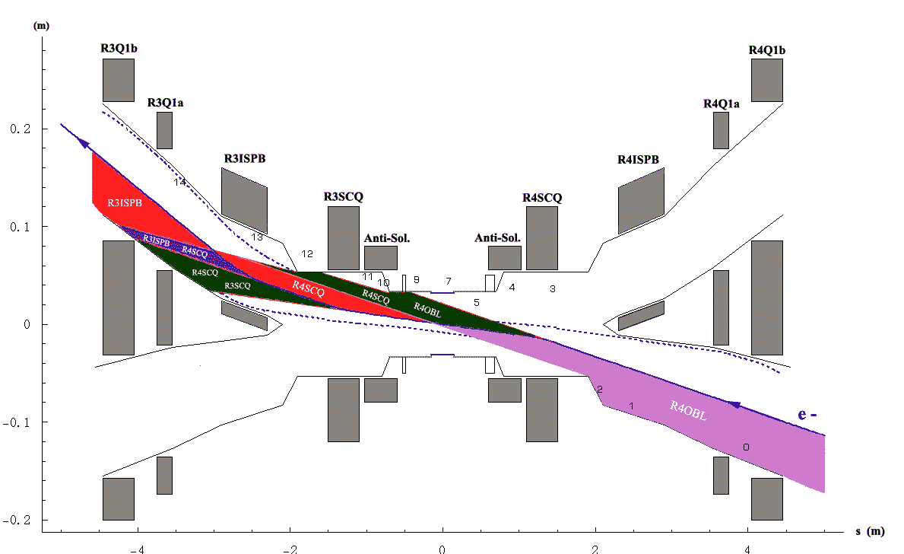
Synchrotron radiations
Photons emitted out when e+/e- undergo acceleration. Along the tangent of the instantaneous trajectory.

Slide 10
Total power:
ρ , local radius of curvature;
dφ, the deflecting angle;
I, beam current;
E_{beam}, beam energy.
Critical energy:
Some of the SR photons avoidably hit the vacuum chamber near the detectors and go into the detectors, especially the inner most Main Drift Chamber (gas detector).

Slide 11
Study of the backgrounds
Two ways: simulation and experiment.
Simulation of lost particles
Set up simulation models according to the theories and then coding the models into the accelerator transport program;
Sampling interactions along the storage ring and recording the lost particles’ type, positions lost, angles, momentum, source…
Set up detector models with the detector simulation toolkit – GEANT3/GEANT4 by CERN;
Sending the lost particles into the detector model and get the detector responses.
beam-gas simulation codes from SLAC (W. Kozanecki etc.)
Touschek effect simulation codes self-developed.

Slide 12
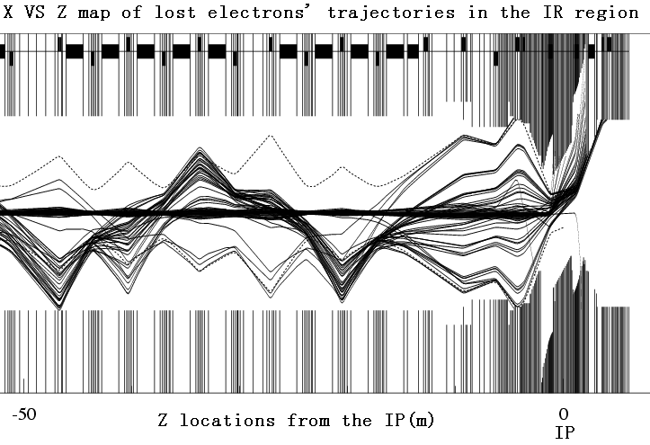
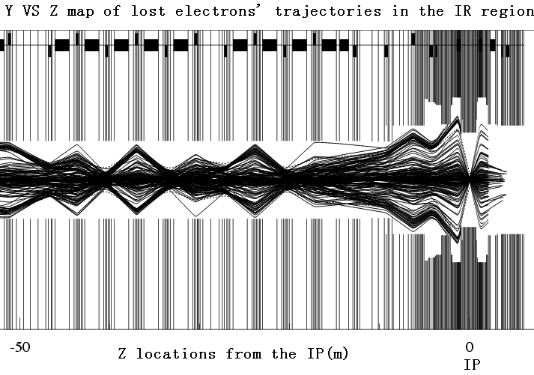
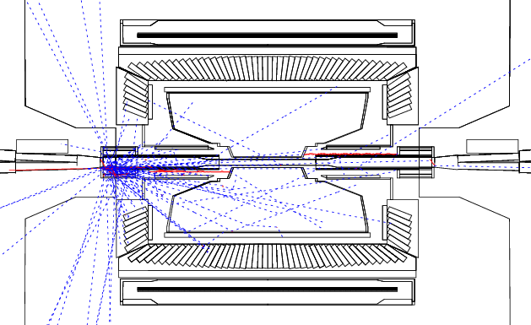
Typical trajectories of the e+/e- lost in the interaction region of BEPCII.
Bremsstrahlung Coulomb scattering
Showers in the IR.

Slide 13
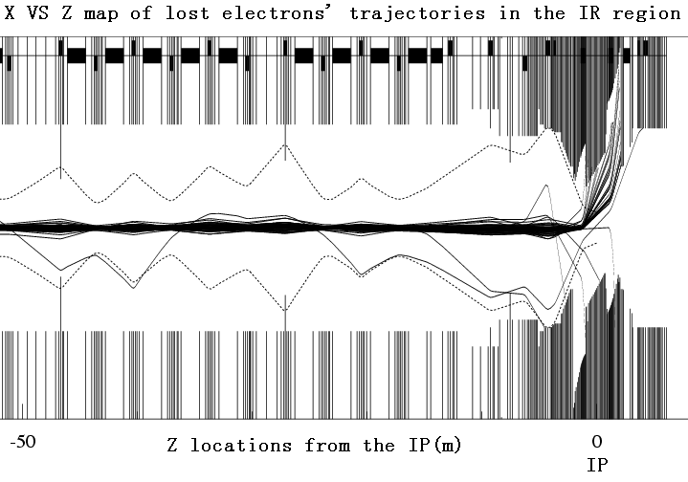
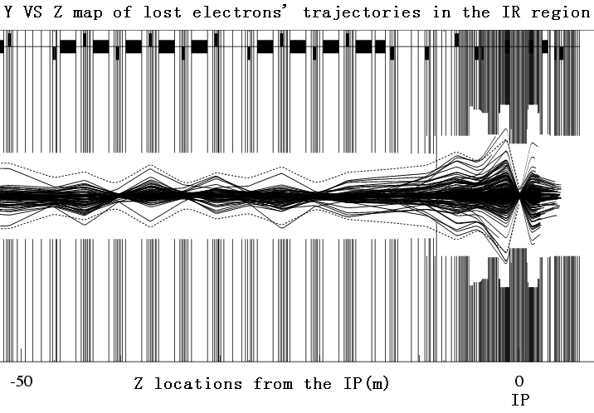
Design collimators on the storage ring.
Bremsstrahlung Coulomb scattering

Slide 14
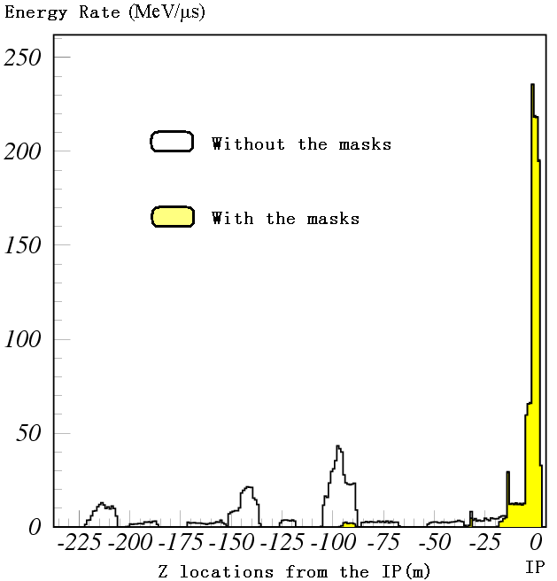
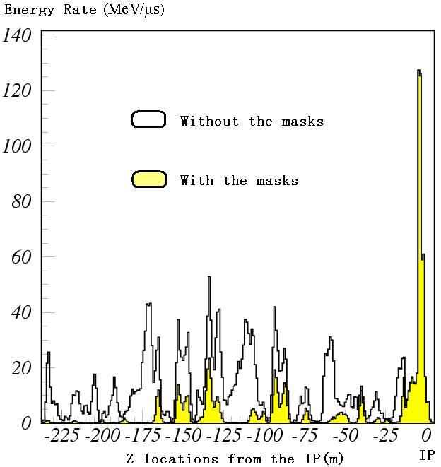
Energy lost in the IR from different positions along the storage ring with and without collimators.
Bremsstrahlung Coulomb scattering

Slide 15
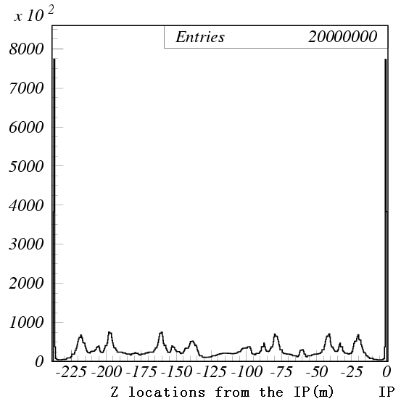
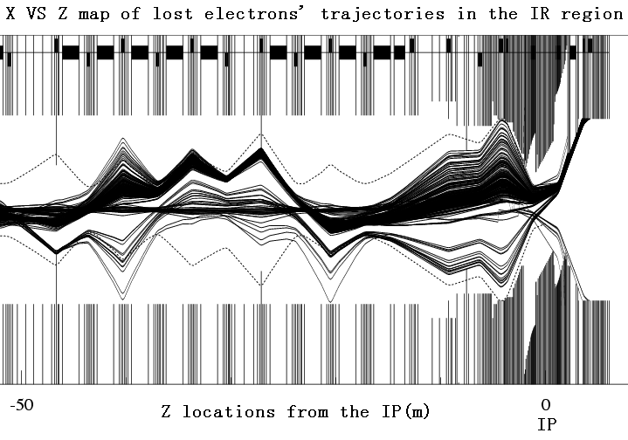
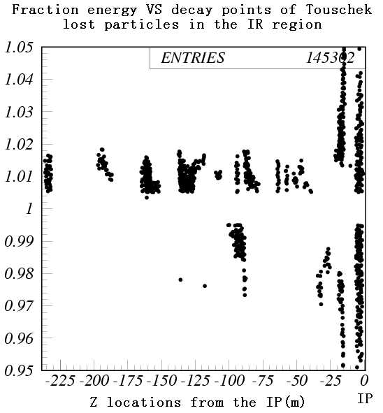
Touschek effect
Typical trajectories of Interaction times versus positions
particles lost in the IR along the storage ring
Normalized energy versus interaction
positions of lost particles in the IR

Slide 16
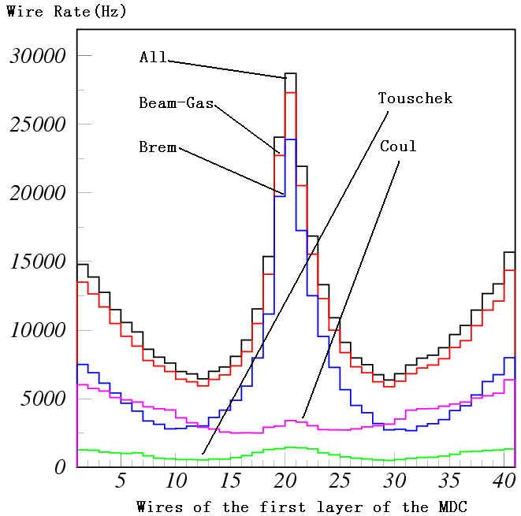
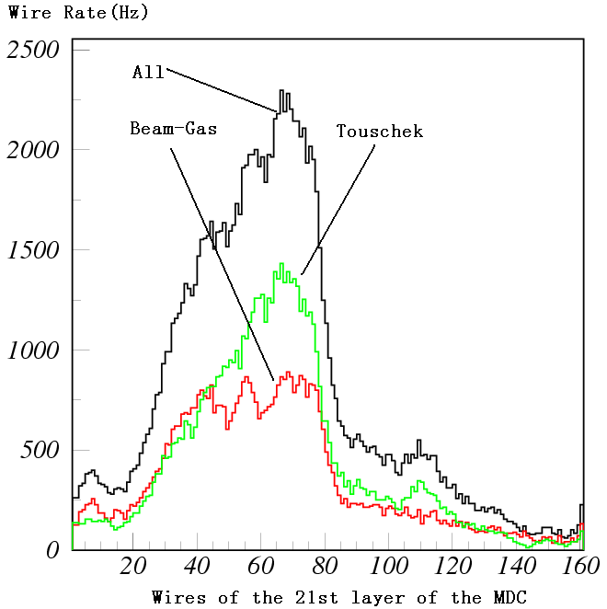
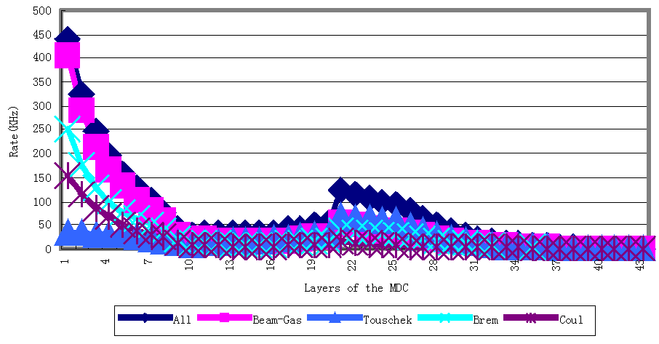
Wire rate of the 1st and 21st layers and layer rate of the MDC

Slide 17
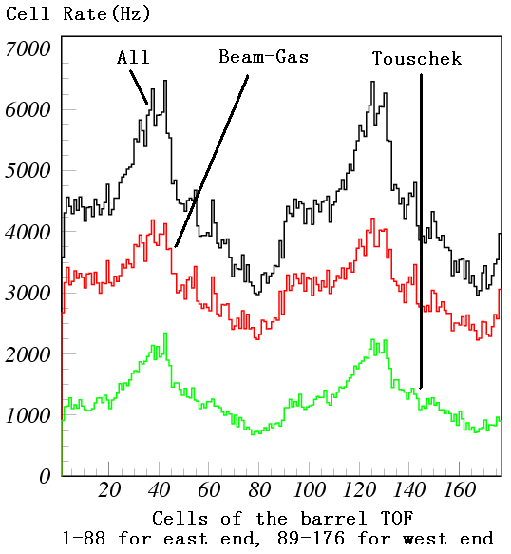
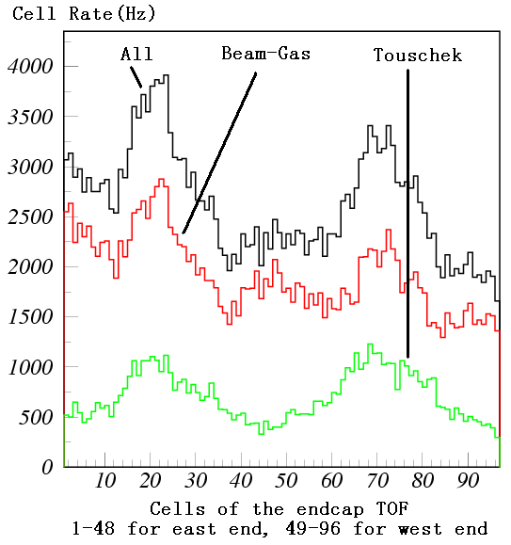
Cell rate of the Time Of Flight

Slide 18
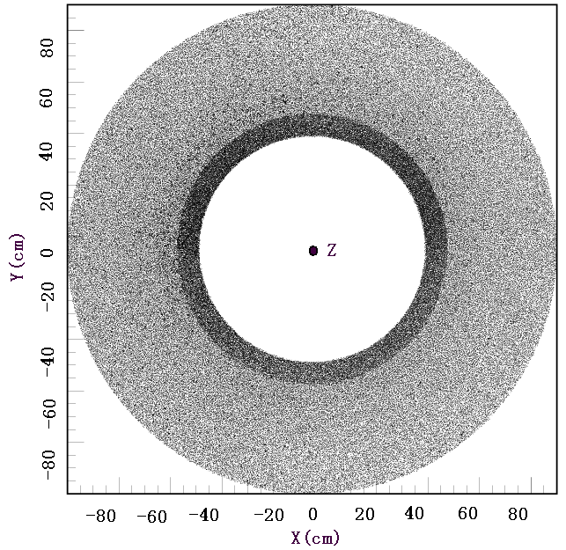
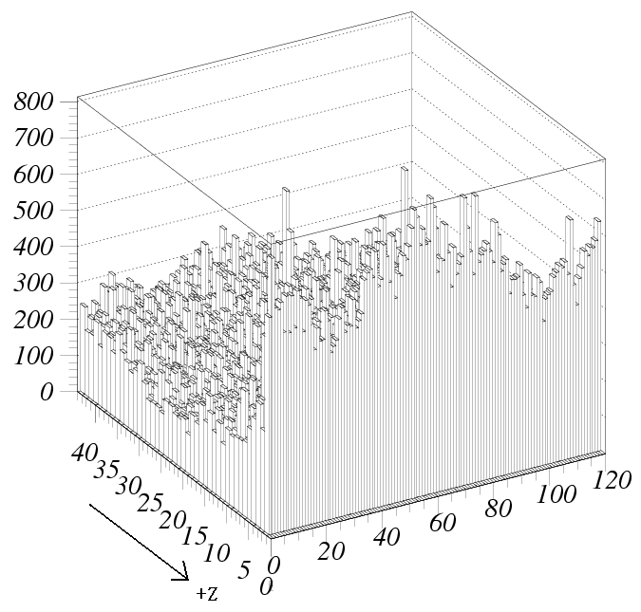
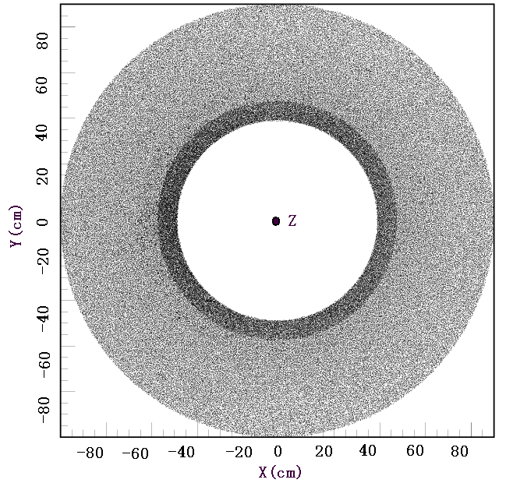
Relative energy deposition in the ElectroMagnetic Calorimeter
Barrel East (upper) and west (lower) endcaps

Slide 19
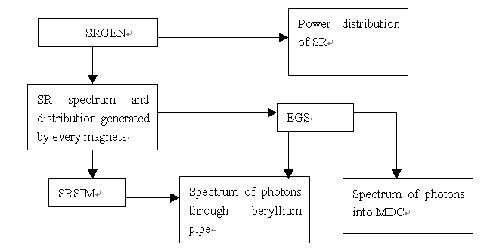
Simulation of SR photons
(By ZHOU Nengfeng and YU Chenghui)
Modeling the beam and mangnets;
Defining the vacuum chambers;
=>Starting simulation

Slide 20
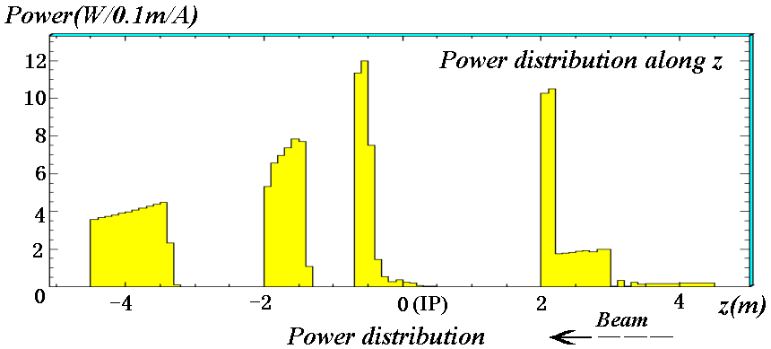
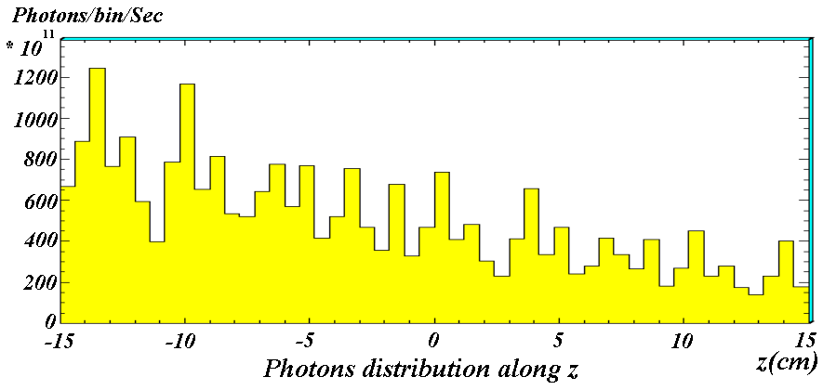

Slide 21
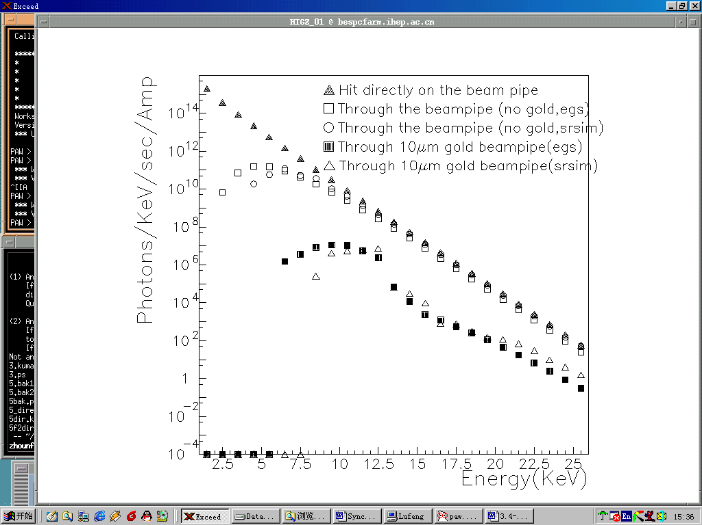
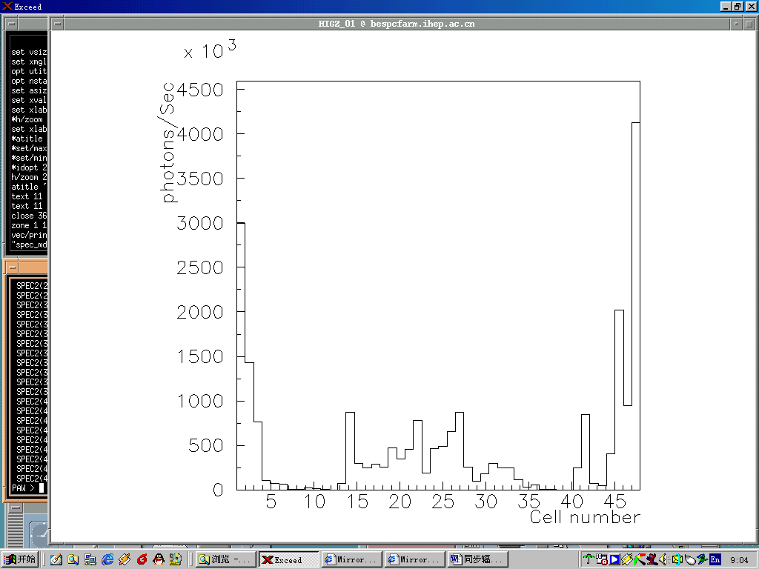
Photons on the Beryllium beampipe;
Photons through the beam-pipe with different coatings
Cell rate of the 1st layer of MDC

Slide 22
Influence of the backgrounds
Beam-lost particles:
Safety of the detectors and electronics due to high radiation and dark current(gas detectors); No serious damage to the beam-pipe since lower showers with lower energy deposition;
Performance of the detectors and physics analysis due to unwanted hits and energy deposition; False tracking, lower energy resolution, lower efficiency due to lower high voltage on the wires…
SR photons:
Safety of the beryllium beam-pipe due to focused power density;
Performance of the inner most detectors due to unwanted hits.

Slide 23
Background experiment
Distinguishing the beam-gas and Touschek backgrounds;
Beam-gas: nearly proportional to total beam current;
Touschek: Proportional to square of number of particles in a bunch and number of bunches;
Theoretically, more particles in a bunch, higher luminosity, also higher Touschek backgrounds;
Effectiveness of movable collimators. “Application of movable collimators to BEPCII”.
Movable collimators about 8m upstream of the IP in horizontal direction. Collimator open: half aperture 42mm, close: 26mm.

Slide 24
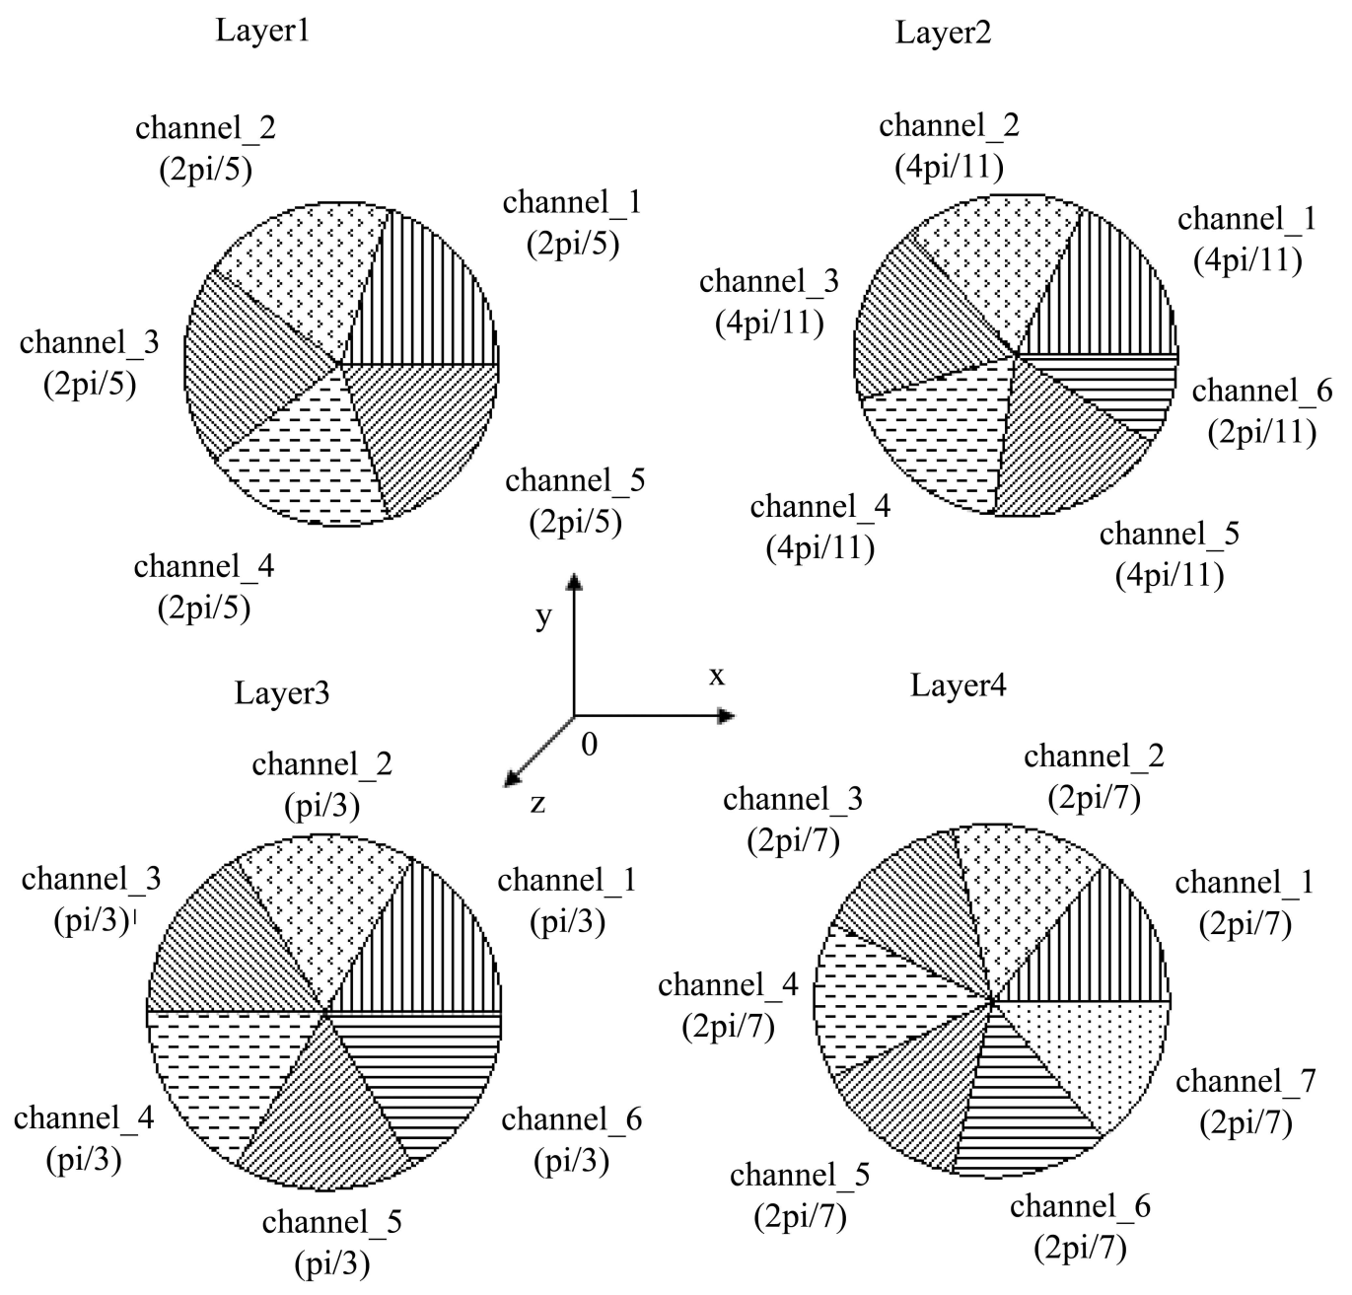
Sectional application of high voltage to the inner most several layers of MDC

Slide 25
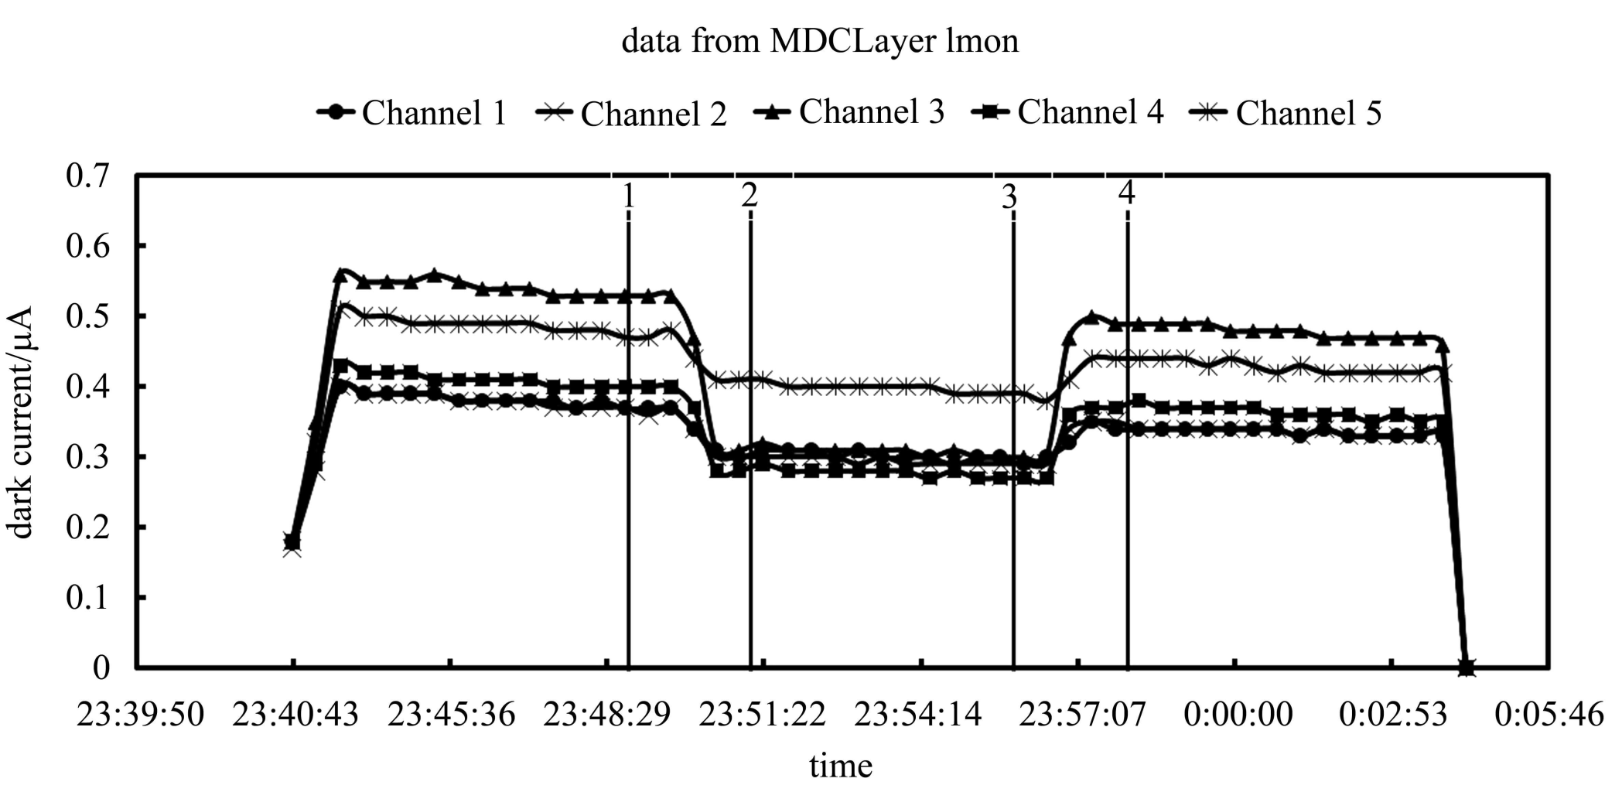
Dark current change with movable collimator open and close(1&&4 open, 2&&3 close)
e+ beam, bunch current 1mA, beam current 150mA

Slide 26
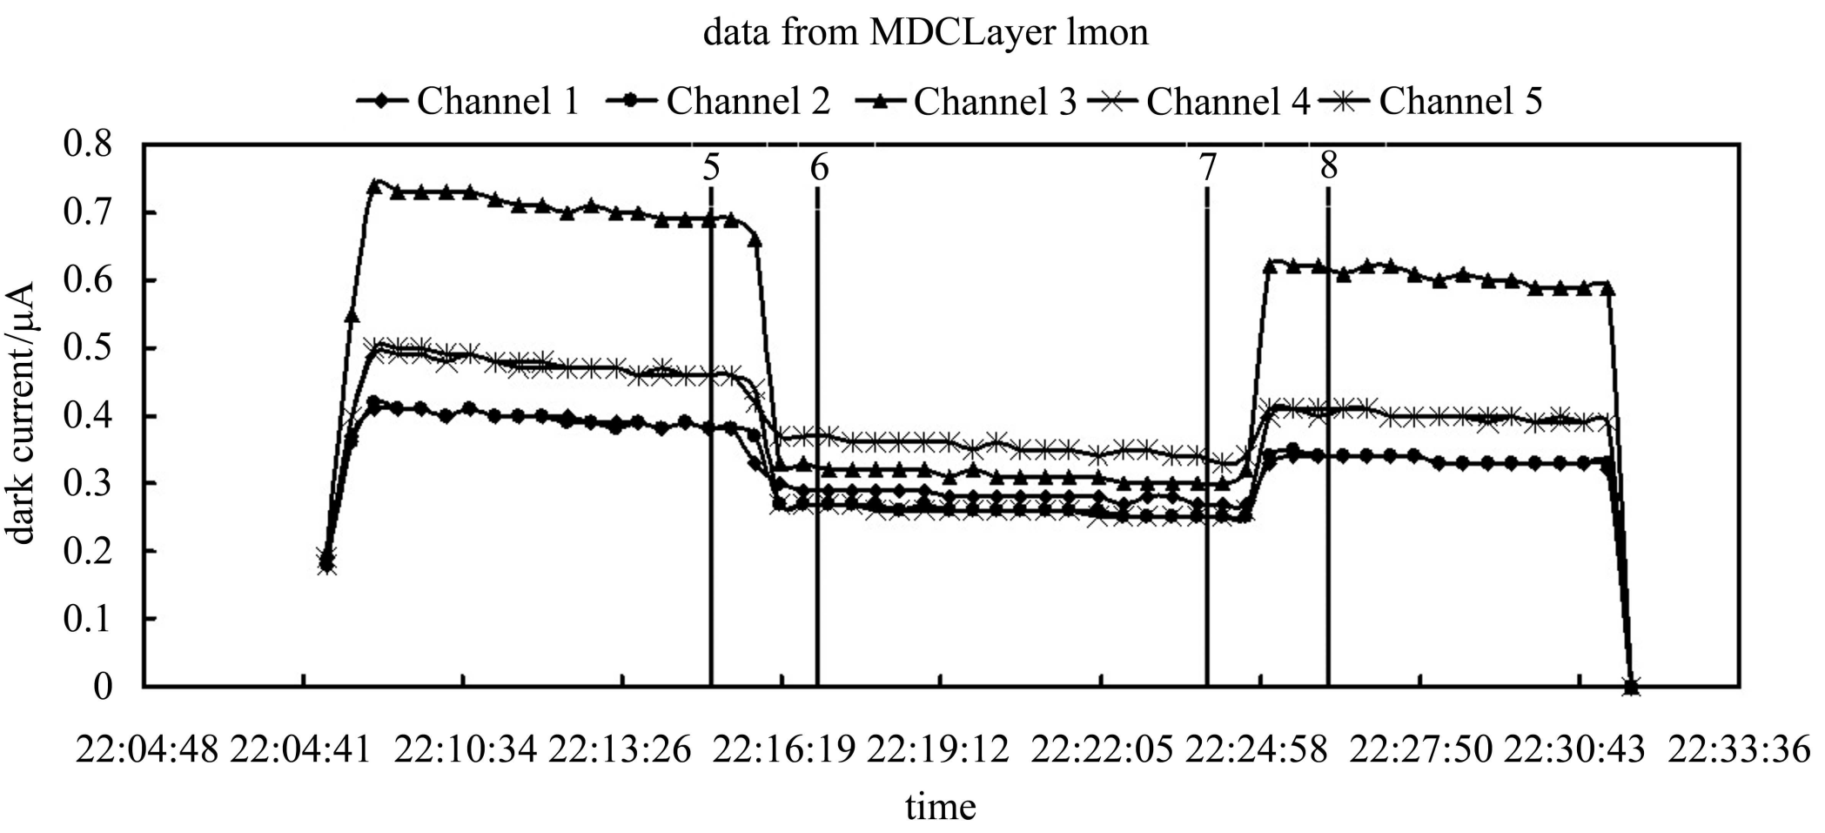
Dark current change with movable collimator open and close(1&&4 open, 2&&3 close)
e+ beam, bunch current 6mA, beam current 150mA

Slide 27
Summary
Backgrounds is very important an issue for physics project with large beam current (collision or fixed target);
Thorough study with both simulations and experiments is necessary;
Different beams(electron, proton?), different mechanisms, different modeling, different tools;
Close cooperation with experts in different fields is must.
Thanks!

