Slide 1
Extremely low background detectors
Andreas Piepke
University of Alabama
August 2011
Beijing

Slide 2
What will I be talking about and what not?
Let’s start with what this will not be:
I will not give a summary of low background detectors
I will not focus of the science covered by these devices
I will talk about what creates low energy detector background
What causes it
How avoid or at least minimize its impact
This talk is about enabling interesting science by better understanding what interferes with it.

Slide 3
Let’s first define the terms.
Detector:
In experimental particle and nuclear physics, a particle
detector, sometime called radiation detector, is a device used to detect, track, and/or identify high-energy particles, such as those produced by nuclear decay, cosmic radiation, or reactions in a particle accelerator. Modern detectors are often used as calorimeters to measure the energy of the detected radiation. They may also be used to measure other attributes such as momentum, spin, charge, type etc. of the particles.

Slide 4
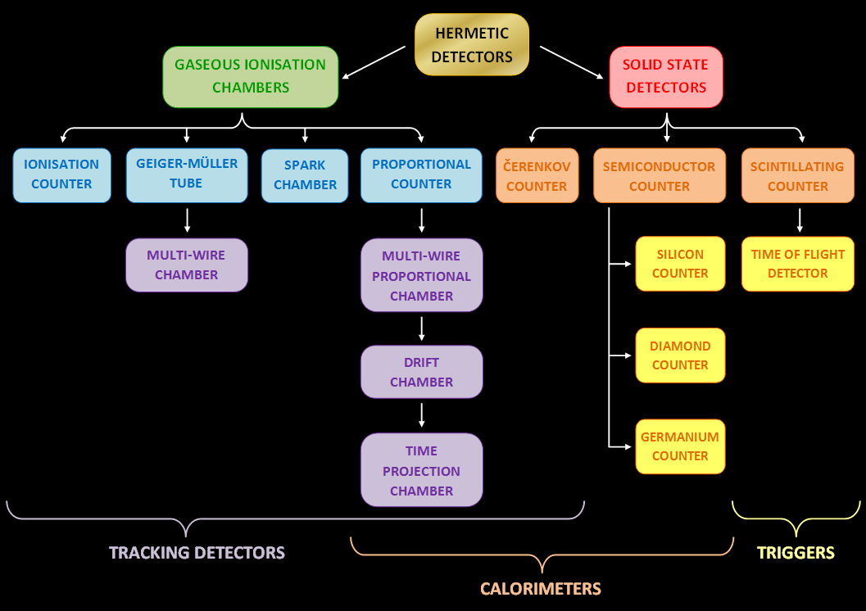

Slide 5
Background:
This term means different things in various contexts. In
particle and nuclear physics we are concerned with:
background radiation that is constantly present in the
natural environment of the earth, which is emitted by
natural and artificial sources. Background is a signal
present even in the absence of the effect we are interested in.
In cases of a low rate signal this background can partially
or totally mask the physics we are interested in. Measured
signal yields may be wrong because of un-accounted for
backgrounds and un-identified.

Slide 6
The understanding, quantification, and ultimately reduction
or elimination of background is thus a central theme of
many rare event experiments/searches.
Examples:
Low energy neutrino physics, such as neutrino oscillation or solar neutrino experiments.
Dark matter searches.
Double beta decay experiments.
Many more subjects and can’t think of right now!

Slide 7
Backgrounds, or effects which presence is disturbing your
measurement but you are not interested in, are a common
problem in physics.
To make this subject more manageable I interpret my
charge for these lectures to mean “Extremely low
background detectors at an energy scale of a few MeV”.
This talk will, thus, focus on low energies and thus all kinds
of radioactivity.
Some reading material:
G. Heusser, Annual Review of Particle Science 45 (1995) 543-590.
A. Piepke, Review of Particle Physics, Journal of Physics G 37 (2010) 338-340.
D.S. Leonard et al., Nuclear Instruments and Methods A 591 (2008) 490-509.
G.F. Knoll, “Radiation Detection and Measurement”, John Wiley and Sons.

Slide 8
Sources of low energy background. (the problem)
Construction of a figure of merit via Monte Carlo simulation. (how to find what’s important and what not)
Methods for sensitive detection of trace radioactivity. (what do you have in your detector)
Background prevention and reduction (general rules and what you can do if your materials are not good enough)
Cosmogenic backgrounds, underground laboratories, active muon detection. (a murky area, the reason why this science usually takes place in dark places, passive versus active cosmic ray rejection)
Applications and examples.

Slide 9
Radioactivity in its various forms plays an important role
for this subject.
This is a summer school so I am assuming that the audience
is mainly students. I will first give a brief introduction:
Types of radioactivity
Measurement units for radioactivity
I can skip this part if everybody is familiar with these two subjects.
Skip radioactivity
Skip both

Slide 10
Types of Radioactivity

Slide 11
Types of Radioactivity
Radioactive decay is the process by which an atomic
nucleus of an unstable atom loses energy by emitting
ionizing particles (ionizing radiation). The emission is
spontaneous, in that the atom decays without any
interaction with another particle from outside the atom
(i.e., without a nuclear reaction). Usually, radioactive
decay happens due to a process confined to the nucleus
of the unstable atom, but, on occasion (as with the different
processes of electron capture and internal conversion), an
inner electron of the radioactive atom is also necessary to
the process.

Slide 12
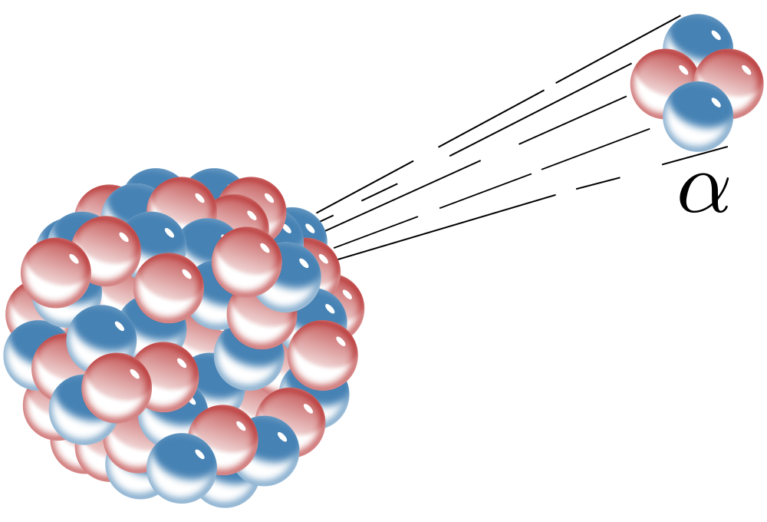

Slide 13
α−decay:
This is the disintegration of a parent nucleus to a daughter
through the emission of the nucleus of a helium atom:
The Q-value defines the disintegration energy.
T: kinetic energy
m: rest mass
The nuclear recoil energy is a few percent of the Q-value
(typically 4-8 MeV) and thus a few hundred keV.

Slide 14
α-decay can be modeled as quantum tunneling of the He
nucleus through the Coulomb barrier (Gamow model):
U(r)
E_{α}
Coulomb potential ~1/r
r
R
nuclear
radius
r₁
width of
barrier
Use the WKB approximation to get the
tunnel probability and with it the half life,
T_{1/2}. As typical for tunneling problems,
the decay rate depends exponentially on
the Q-value. Consequently α-decays
span a huge range of half lives.
−U₀
nuclear
binding
energy

Slide 15
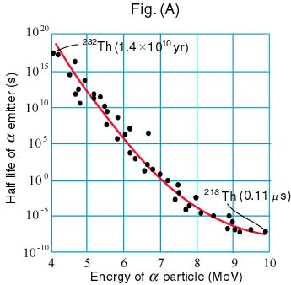
A factor 2 variation in
decay energy results in
25 orders of magnitude
variation of the half life!
Such is the power of
quantum tunneling.

Slide 16
Alpha decays into an excited state of the daughter nucleus
are possible but not the norm.
For this reason alpha decays, often, don’t go along with the emission of γ-radiation. γ-radiation detectors are therefore not well suited to test for alpha radioactivity.
α-decay is a two body decay, α energies are therefore
discrete.
The range of alpha particles in matter is very short. Rule
of thump: 1 cm / MeV in air. They are readily screened by
even thin absorbers and therefore easily lost in analysis.
As far is background is concerned: alpha decays usually
only matter if the activity is inside the active medium.

Slide 17
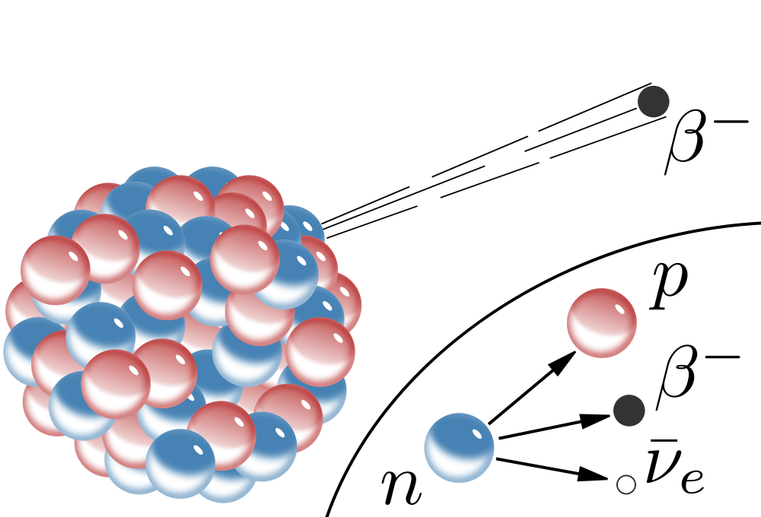

Slide 18
β−decay:
Nuclei with an abundance of neutrons (protons) can
transform to a more stable (meaning lighter) nucleus by
emitting an electron (positron) and an anti-neutrino
(neutrino). The transformation can be denoted as:
β⁻:
The basic transformation happening inside the nucleus is
a spontaneous transformation of a neutron into a
proton, with the simultaneous emission of an electron
and anti-neutrino:
neutrons are heavier than protons so this
decay can happen for free neutrons, it is
the reason why they are unstable.

Slide 19
The nuclear recoil energy is VERY small compared to that
of the electron(positron) and anti-(neutrino), T_{Y}≈0.
T: kinetic energy
For β-decays the Q-value is tabulated in terms of atomic
mass differences.
β-decay is a three body decay, electron and anti-neutrino
energies are therefore continuous.

Slide 20
β⁺:
This process is observed in proton rich nuclei. Here a proton
spontaneously transforms into a positron and a neutrino.
Protons are lighter than neutrons so this
decay cannot happen for free protons. Only
for protons bound inside an atomic nucleus with empty
neutron states available at lower energy (due to binding)
can this decay occur.
Electron capture:
is a sub-variety of β⁺-decay. One electron mass is
gained.

Slide 21
Also here the tabulated Q-value corresponds to the
atomic mass difference. The maximal positron kinetic energy
is by 2 electron masses smaller than the Q-value.
A detail one has to pay attention to, caused by the fact
tabulated quantities are always relative to atomic masses.
Q-value
You further see that β⁺ decay is energetically only possible
if the Q-value is at least 1.022 MeV or 2 electron masses!

Slide 22
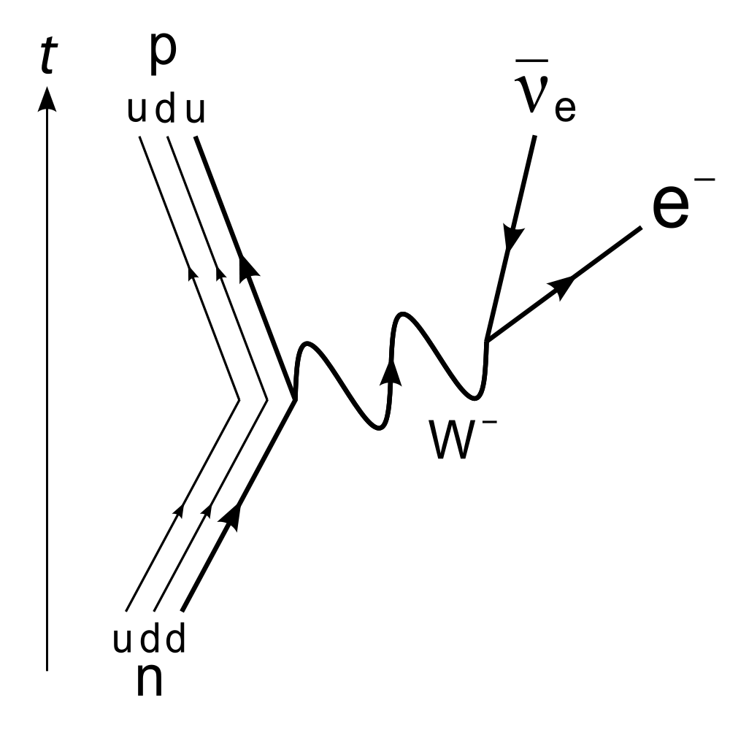
Beta decay is mediated by
the weak force, a force of
change.
Decay half lives vary between
ms to 1.3∙10⁹ y (⁴⁰K),
4∙10¹⁴ y (¹¹⁵In).
In nuclei this transition rate can be determined
by means of time dependent perturbation
theory. The transition rate (into the continuum)
is given by Fermi’s golden rule.

Slide 23
The weak force is considered a small perturbation of the
forces responsible for keeping the initial and final stationary
states. The decay rates can thus be calculated using
perturbation theory.
In units of total electron energy E_{e}
the phase space is:
Matrix
element
Phase
space
Fermi’s golden rule. Gives the
decay rate into continuous
states.
Fermi function,
accounts for Coulomb
interaction between
Lepton and nucleus.

Slide 24
Statistical sharing of the energy
The neutrino and the electron share the available energy
statistically. The atomic nucleus carries recoil momentum,
but because its so much heavier than the electron and
neutrino the associated kinetic energy is negligible.
The number of states for an electron with momentum
p_{e} in the range dp_{e} is: proportional
to the momentum range.
A similar relation holds for neutrinos:
Let stand for the fraction of decays for which electron
and neutrino momenta are within above range.

Slide 25
This ratio is:
The denominator represents the whole of the available
momentum space consistent with the energy restriction.
We express above relation in terms of the momentum
into the solid angle element dΩ into which the momenta
are directed . The cartesian momentum element is
transformed into its spherical coordinate equivalent:

Slide 26
We know that the neutrino mass is very small:
Integral in the denominator
is a number, f₀. It does not
depend on the electron or
neutrino momenta.
The energy dependence of the decay rate, dR/dE_{e} is, thus,
entirely determined by the numerator.
To get the decay rate into all electron and neutrino
directions. The integrations over the solid angle elements
give a constant factor.

Slide 27
We further know that the nuclear recoil energy is negligible.
This allows us to relate the total energy release E₀ to
electron and neutrino energies E_{e} and E_{ν}:
Therefore: these two quantities depend
on each other. There change is related.
If you pick a particular electron energy E_{e} its variation
dE_{e}=0. The neutrino energy element is therefore restricted
to zero dE_{ν}≈0 by the energy constraint (small but not
exactly zero as the nuclear recoil energy is small but not
exactly zero).

Slide 28
We have just shown that dE_{ν} is kinematically restricted
to be approximately zero.
In:
this term appears in both
the numerator and the
denominator. It thus
cancels.

Slide 29
What is the number of electrons emitted with energy E_{e}
or dR/dE_{e}?

Slide 30
I have discussed the electron energy dependence of the
phase space factor. How does the nuclear matrix
element depend on the electron energy?
It turns out it doesn't!
At the energy scales of nuclear beta decays (≤20 MeV)
the wave lengths of the electron and neutrino are
MUCH longer than the nuclear diameter. The leptonic
wave functions, entering into the calculation of the nuclear
matrix element, are to very good approximation constant
over the nuclear volume. This make the nuclear matrix
element Lepton energy independent. This approximation
goes back to Enrico Fermi.

Slide 31
The total decay rate is proportional to the integral over
all possible energies:
For reasonably high energies E_{e} >> m_{e} and neglecting the
energy dependence of the Fermi function F:
Beta decay half lives roughly depend in the fifth power on
the decay Q-value.
The electrons emitted in β-decays are a source of
background. Due to their charge they have short range. As
in case of α-alpha decays: β-decays contribute to detector
background if the activity is contained in the active medium.

Slide 32
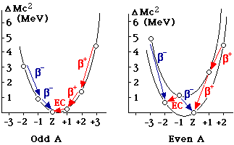
Beta decay and nuclear mass:

Slide 33
γ−decay:
This is not a real nuclear decay at all. This term refers to
the very energetic electromagnetic radiation emitted
in the decay of excited quantum states of the nucleus.
Many times radioactive α− or β−decays leave the daughter
nucleus in an excited state which then quickly (10⁻¹² s)
decays via emission of a photon into the ground state or
some lower lying state. So gamma radiation many times
comes along with radioactive decay.
Depending on the nuclide one finds more or less compli-
cated patterns. Due to its high penetrating power, γ-radiation
it is one of the principal sources of detector background.
Radioactivity in the active medium and in passive compo-
nents (even far away) can contribute to detector background.

Slide 34
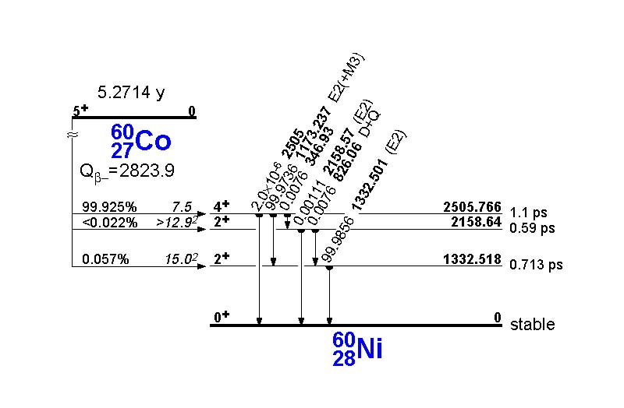

Slide 35
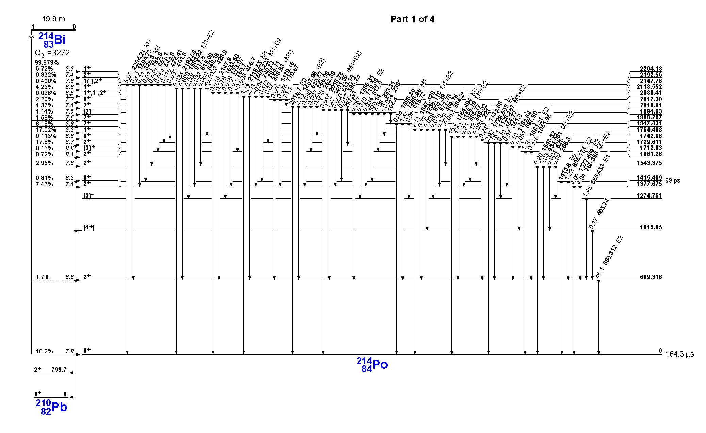

Slide 36
Units of measurement

Slide 37
Units of measurement
There is a multitude of units measuring different things.
Activity is the expectation value of the number of
nuclear decays occurring in a given quantity of material
per unit time. The unite is Becquerel: 1 Bq = 1 / s.
For very long-lived radioactivity the activity is sometimes
expressed as a mass concentration in a host material.
Let N atoms of a radioactive species with life time τ,
molar mass M, total mass m, and isotope abundance a be distributed within the mass m_{H} of some host substance (called matrix). The disintegration rate R is given as:

Slide 38
The disintegration rate per unit mass of host substance,
measured in Bq/kg, is then:
Element and isotope
dependent conversion
factor.
Mass concentration of radioactive
species in host material in g/g.
Often given in ppm, ppb, or ppt.
Some examples:
⁴⁰K: 1 ppmK = 0.031 Bq/kg
1 Bq/kg = 32.2 ppmK
²³²Th: 1 ppm = 4.06 Bq/kg
1 Bq/kg = 0.246 ppm
²³⁸U: 1 ppm = 12.35 Bq/kg
1 Bq/kg = 0.081 ppm

Slide 39
Outdated unit of activity: Curie.
1 Curie is defined as the equivalent activity of one gram
of ²²⁶Ra.
This non-SI unit isn’t really good for anything but
conversion into Becquerel: 1 Ci = 3.7∙10¹⁰ Bq!

Slide 40
Absorbed dose is the energy imparted by ionizing radiation
in a volume element of a specific material divided by the
mass of the volume element. The unit is Gray:
1 Gy = 1 J / kg. An outdated unit, still in frequent use, is
1 rad =1 0.01 J / kg.
Another depreciated unit for the absorbed dose is the
Roentgen: 1 R is the amount of radiation required to
liberate positive and negative charges of one electrostatic
unit of charge (esu, 1 esu = 3.33∙10⁻¹⁰ C) in 1 cm³ of dry
air at standard temperature and pressure (STP). This
corresponds to the generation of approximately 2.0819×10⁹
ion pairs. This unit is strictly only defined for interaction of
radiation with air.
The absorbed dose measures the effect radiation has on
matter. For most physics applications it is irrelevant.

Slide 41
Nonetheless…
A whole-body exposure to 5 or more gray of high-energy
radiation at one time usually leads to death within 14 days.
This dosage represents 375 joules for a 75 kg adult
(equivalent to the chemical energy in 20 mg of sugar).
Local dose exceeding 45 Gy will result in permanent hair
loss.
Biological effects: the biological effects of ionizing
radiation (as opposed to the physical aspects which are
characterized by the absorbed dose) is measured in Gray.
The unit sievert measures the equivalent dose of radiation
supposed to have a damaging effect equivalent to the
same dose of gamma rays.

Slide 42
Both Gy and Sv are SI derived units, defined as a unit of
energy per unit of mass:1 Gy = 1 Sv = 1 J / kg.
The equivalent dose, H, to a tissue is found by multiplying
the absorbed dose, D, in gray, by a weighting factor W_{R}
for radiation of type R.
Radiation type | W_{R}
electrons, muons, photons | 1
protons, charged pions | 2
alphas, fission fragments | 20
neutrons L linear energy transfer [keV/μm] | 1 – 300/√L

Slide 43
In many countries the limit for the equivalent dose for the
general public for any man made facility is: 1 mSv/y.
Average individual background radiation dose: 1.5 mSv/y
(Australia), 3.0 mSv/y (USA).
Dose from background radiation in parts of Iran, India and
Europe: 50 mSv/year
Dental radiography: 0.005 mSv
Mammogram, single exposure, equipment mean: 2 mSv
Brain CT scan: 0.8–5 mSv
Chest CT scan: 6–18 mSv
Highest reported level during Fukushima accident: 266 Sv/h
for gas/steam inside primary containment, reactor 1 7/3/11

Slide 44
Dose received within one day [mSv] | Symptoms
0 - 250 | None
250 - 1000 | Some people feel nausea and loss of appetite; bone marrow, lymph nodes, spleen damage.
1000 - 3000 | Mild to severe nausea, loss of appetite, infection; more severe bone marrow, lymph node, spleen damage; recovery probable, not assured.
3000 - 6000 | Severe nausea, loss of appetite; hemorrhaging, infection, diarrhea, peeling of skin, sterility; death if untreated
6000 - 10000 | Above symptoms plus central nervous system impairment; death expected.
Above 10000 | Incapacitation and death.

Slide 45
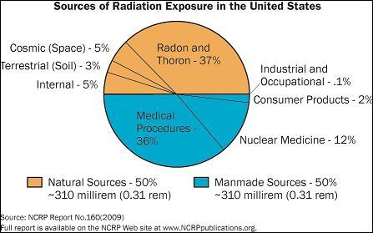

Slide 46
The Problem
Natural radioactivity
Airborne radioactivity
Man made radioactivity
Cosmogenic radioactivity, cosmic radiation

Slide 47
Natural radioactivity

Slide 48
Natural radioactivity is, as the name suggests, a natural
phenomenon.
The extremely long lived nuclides ⁴⁰K (T_{1/2}=1.28∙10⁹ y),
²³²Th (T_{1/2}=1.41∙10¹⁰ y), and ²³⁸U (T_{1/2}=4.47∙10⁹ y) are
called natural radioactivity or primordial radioactivity. They
can be found everywhere and essentially in any material.
Some materials contain more natural radioactivity some less.
The radiation emitted can interfere with low energy, low
rate experiments to an extent where it may totally mask
the signal of interest.
How much of this natural radioactivity is around?

Slide 49
Rock type | K [ppm] | ⁴⁰K [Bq/kg] | Th [ppm] | ²³²Th [Bq/kg] | U [ppm] | ²³⁸U [Bq/kg]
Basalt¹ | 8000 | 250 | 3-4 | 12-16 | 0.5-1 | 6-12
Granite¹ | 40000 | 1200 | 17 | 70 | 3 | 40
Marble² | 1500 | 47 | 0.75 | 3 | 0.6 | 7
Olivine² | 730 | 23 | 0.5 | 2 | 0.2 | 2.5
Sedimentary rocks¹ | 3000 | 93 | 2 | 8 | 2 | 25
Continental crust¹ (average) | 28000 | 870 | 11 | 45 | 2.8 | 35
There is a good deal of natural radioactivity all around us.
A typical human body contains about 1.5 g of K per kg of
body mass or 1500 ppm of K. This corresponds to a
specific ⁴⁰K activity of 47 Bq/kg. The body of an 80 kg
man thus contains about 3700 Bq of ⁴⁰K.
1: NCRP Report 94, 1987
2: My measurements

Slide 50
As far as background contributors are concerned (solid),
natural radioactivity can find its way into detectors in
several ways:
Left over from material processing (intrinsic)
Surface contamination due to un-clean handling
That’s the reason why many low rate low activity
experiments screen all used materials for their content
of radioactivity.
To address surface contamination detectors are often
assembled in clean rooms. Surfaces can be cleaned
with appropriate solvents and acids.

Slide 51
Airborne radioactivity

Slide 52
The air contains the radioactive noble gas ²²²Rn.
It is a ²³⁸U decay product, released from the soil,
construction materials and so on. Because of its 3.8 d
half life ²²²Rn can travel over great distances horizontally,
driven by the wind. Upward motion by diffusion of
turbulence tends to dilute the effect of distant sources.
The Rn concentration in the air varies with location,
time of the day, ventilation… Some measured level of
Rn in outdoor air in north America.
Location | ²²²Rn specific activity [Bq/m³]
Colorado Springs (CO)¹ | 44
Cincinnati (OH)¹ | 18
New York City (NY)¹ | 4
St. Lawrence (Canada)¹ | 200
Tuscaloosa (AL)² | 11±1
1: NCRP Report 94, 1987
2: My measurements

Slide 53
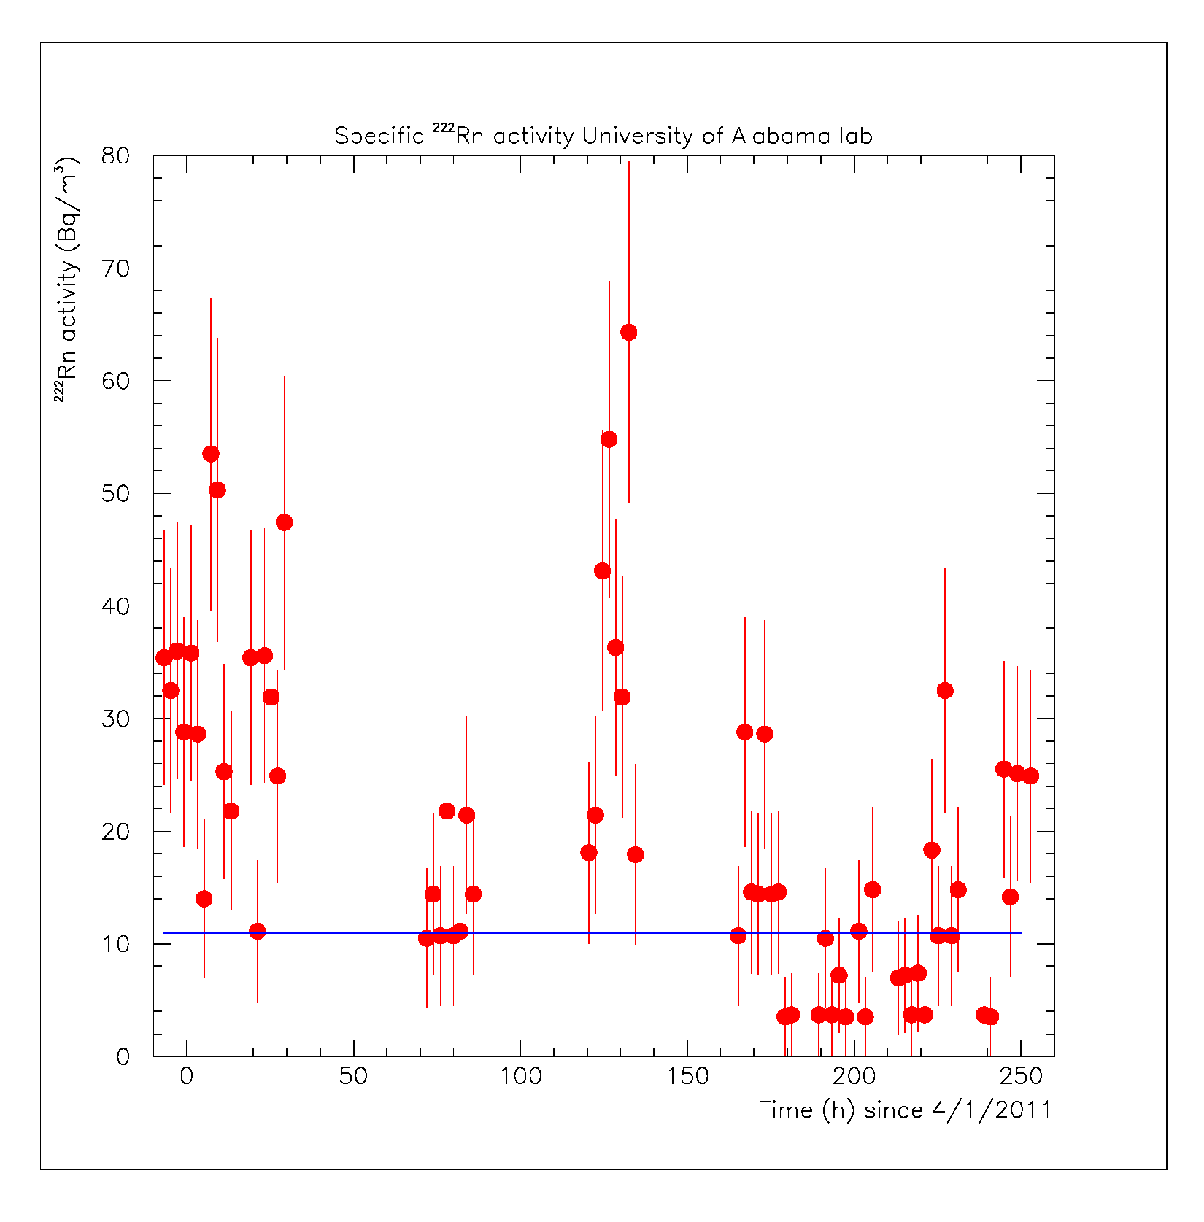
Measured in a well
ventilated lab in
Alabama. Indoor
Rn levels can reach 1000 Bq/m³ and more with
insufficient ventil-
ation, especially
underground.

Slide 54
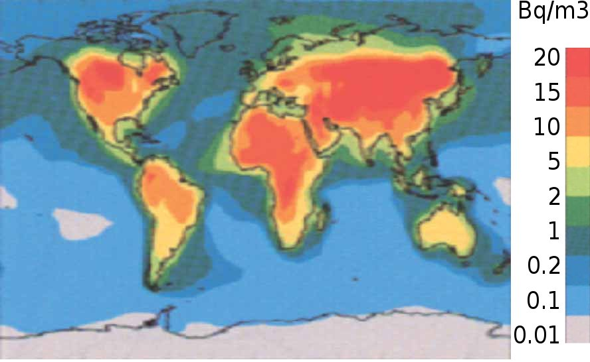

Slide 55
The ²²²Rn half life is 3.8 d. The activity decays away
on a time scale of weeks.
However, Rn is a gas, mixed into the air. If there is some
gas exchange, resulting in a steady re-feeding, then there
will be a constant steady state activity in that gas.
This is a concern for example for passive lead shields
where air, and with it Rn, is in the inner voids. Through
γ-radiation it can contribute to the background and
does not die out. I will show the math for that later.

Slide 56
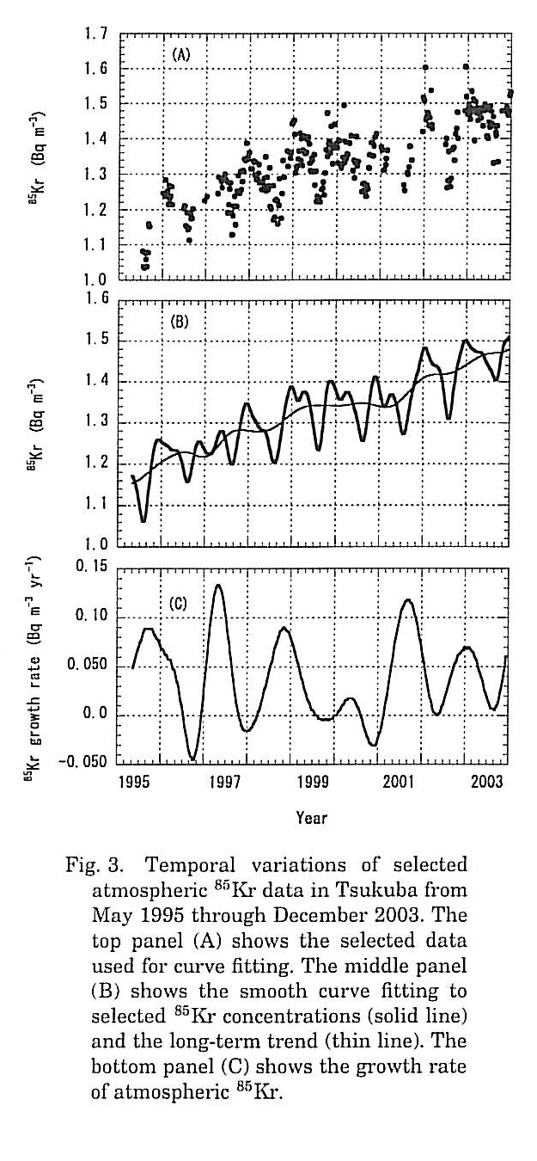
There are other airborne activities:
⁸⁵Kr (pure beta decay Q=687 keV,
T_{1/2}=10.76 y, very little γ
radiation) from nuclear fission
and fuel reprocessing: ~1 Bq/m³
H. Inoue et al., J. Meteorological Soc. Japan
84 (2006) 959.

Slide 57
³⁹Ar (Q=565 keV, T_{1/2}=269 y, pure β-decay, no γ’s) is
produced in the atmosphere by interaction of the cosmic
radiation with natural Ar: ⁴⁰Ar(n,2n)³⁹Ar.
0.94% of the atmosphere is ⁴⁰Ar.
Ar is obtained by freezing it out of the atmosphere. It
contains about 1 Bq/m³ of ³⁹Ar¹.
The ³⁹Ar activity of air is about 0.01 Bq/m³.
Airborne activities (²²²Rn, ⁸⁵Kr, ³⁹Ar) can become a
real problem when handling detector media in the open
if there is good solubility of noble gases e.g. in case of
organic liquid scintillators. Noble gas detectors using
Ar or Xe as detection medium are vulnerable to these
background sources.
1: C. Galbiati et al., J. of Phys.: Conf. Series 120 (2008) 042015.

Slide 58
⁷Be (EC-decay, T1/2=53.3 d, 478 keV γ-radiation with
10% branching ratio). Is continuously produced in the
atmosphere by interaction of secondary neutrons from
galactic cosmic rays (GCR) with N and O.
The flux of energetic GCR protons is known to vary
with the solar cycle (due to changes of the solar magnetic
field).
The specific ⁷Be activity in the air is about 3 mBq/m³.

Slide 59
The ²³²Th and ²³⁸U decays feed so-called decay series,
comprising of many unstable radio nuclides.
Different members of these series contribute to detector
background differently.
The question naturally arises: if you measure the decay
rate of one member (that you can measure) what does
this tell you about the decay rate of another (that may
create your background)? Are these rates necessarily the
same?
I will do a little math to illuminate this problem.

Slide 60
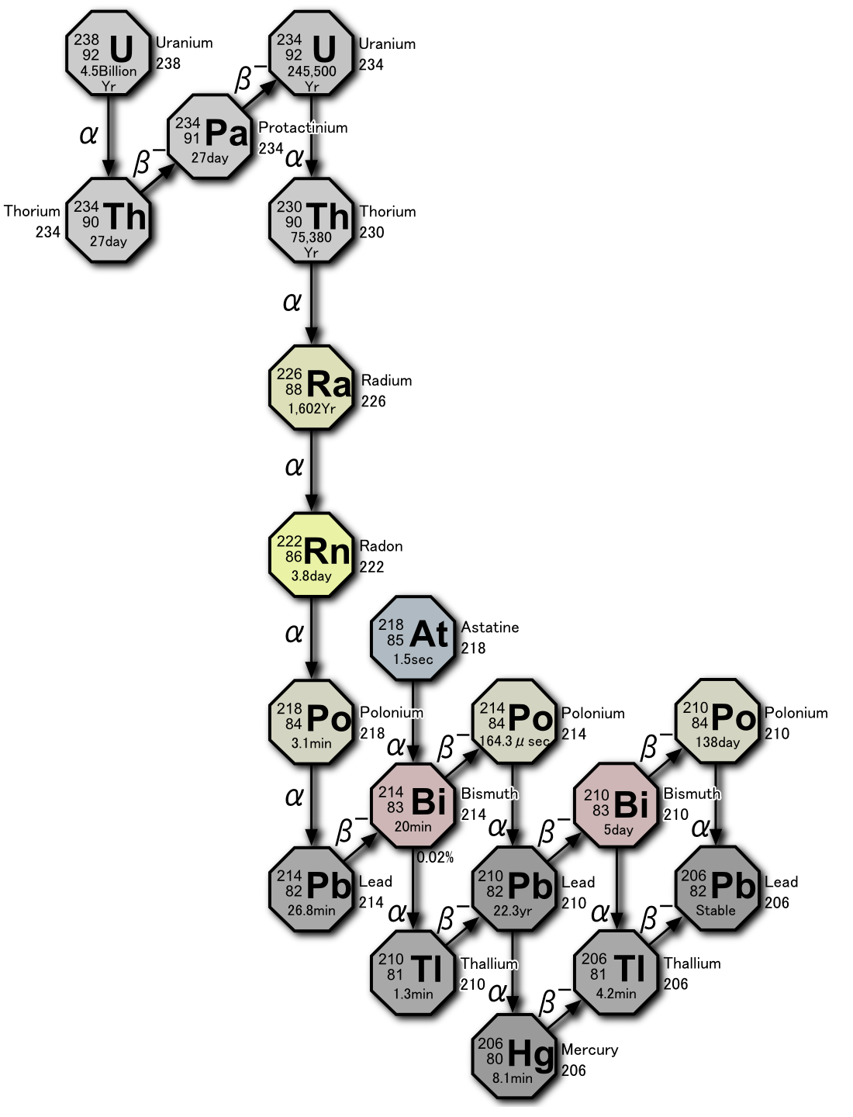
A noble
gas that
may escape.

Slide 61
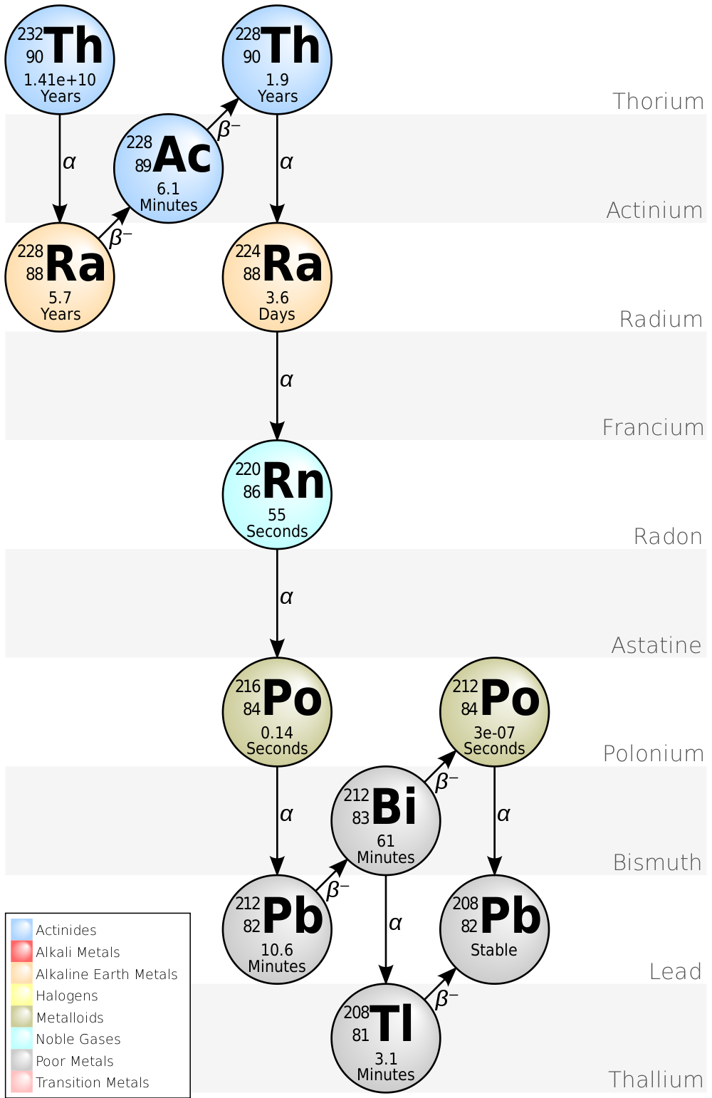

Slide 62
Radioactive equilibria

Slide 63
What is the time dependent activity of any member
of such a decay chain?
The solution is obtained by assuming that radioactive decays are random. Every nucleus has the same probability
to decay within some time interval t to t+dt, all the time.
Differential equation governing the above sequence:
we solve this with:
substitute solution for N_{A}
substitute solution for N_{B} …

Slide 64
How do we solve this equation?
A linear differential equation of first order of the type:
is called Leibnitz-equation. It
has a closed analytic solution.
Choose:

Slide 65
To get:
We get the integration constant C from the boundary
condition: at time zero (t=0) none of the element B was
present in the sample N_{B}(t=0)=0.

Slide 66
Transient equilibrium
The lifetime of the parent nuclide is longer but comparable
to that of the daughter τ_{A}>τ_{B}. The ratio of activities will
converge towards a stable value: transient equilibrium.
in the difference of the exp.
functions the term with τ_{B} is
negligible.
For t>>τ_{Β}:
For large t the activity ratio thus converges to:
a stable, time independent
(equilibrium) value.

Slide 67
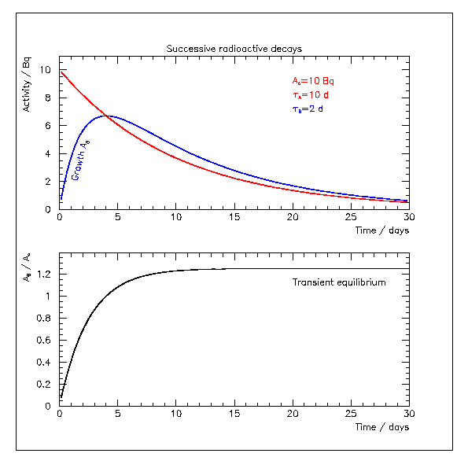

Slide 68
No equilibrium:
The lifetime of the parent nuclide is shorter than that of the
daughter τ_{A}<τ_{B}.
For t>>τ_{Α}:
Never independent of time, never in
equilibrium.

Slide 69
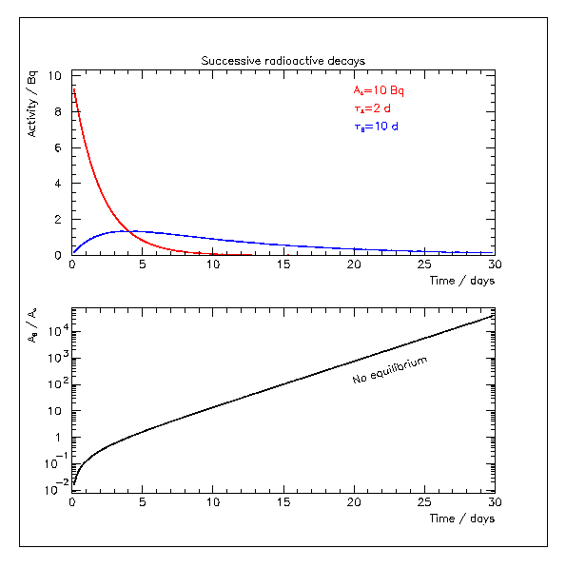
No stable activity
ratio is reached.

Slide 70
Secular equilibrium:
This is the situation that applies to natural radioactivity:
τ_{A}>>τ_{B}: secular equilibrium
As shown before for large t:
The activities are the same. The daughters can only decay
at a rate consistent with what trickles down from above.
In the natural decay series the Th and U half lives are
MUCH longer than those of the daughters. The decay
rate of any member of the series is given by that of the
long lived parent. This situation is called secular equilibrium.

Slide 71
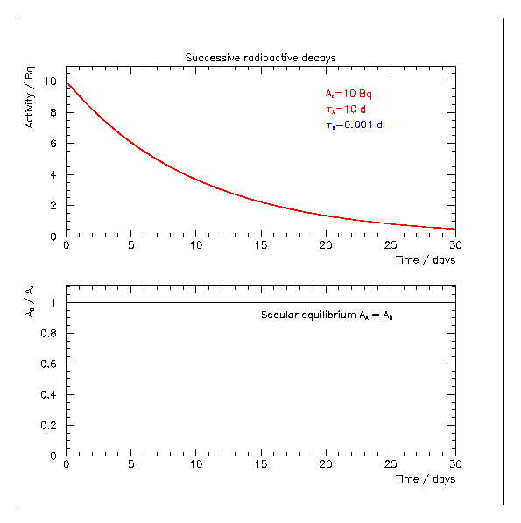
This is what we
see many times
or the natural radioactive decay series.

Slide 72
As long as the natural balance of the decay series is
not disturbed the measurement of one member’s rate
determines that of any other.
However, the different members of the decay sequences
have different chemical properties. Chemical processing
can, thus, disturb this balance. This situation is called
“broken equilibrium” and difficult to detect.
This is like the small print in a contract and easily
overlooked. If you have a sensitive method to detect
Th or U (we will talk about those) but your background
is caused by the energetic decays of ²¹⁴Bi or ²⁰⁸Tl
then even a material with low content of “natural
radioactivity” may still be a significant contributor to
the detector background.

Slide 73
Radon decay

Slide 74
In case of a constant population of ²²²Rn atoms, not in
contact with air, you expect to see its activity A_{Rn} to die out
exponentially with T_{1/2}=3.82 d (τ_{Rn}=5.51 d).
For an infinitesimally short time dt,
over which the number of atoms N_{Rn}
can be considered constant, the number
of decays is proportional to the number
of atoms and the observation time dt.
1/τ_{Rn} is the constant of proportionality.
This equation is solved by integration to yield:
Activity dies out exponentially. You achieve an activity as
low as you wish by simply waiting long enough!

Slide 75
Now assume that the initial population of Rn atoms
is in contact with the air. Assume that we are feeding
fresh atoms at a rate of n_{Rn} (in units of atoms per unit time)
for example by diffusion or air movement. The number
of decays per infinitesimal time interval dt is now:
The loss term is unchanged
but now we also gain atoms
at the rate n_{Rn}.
This again has the general form of the Leibniz equation
and can be solved analytically (apply solution of page 64):
As boundary condition I assumed
that initially there were 0 Rn atoms.
For infinite waiting time the decay rate equals the influx.
There is some equilibrium decay rate. Waiting does not
solve the radon problem in the presence of an air leak.

Slide 76
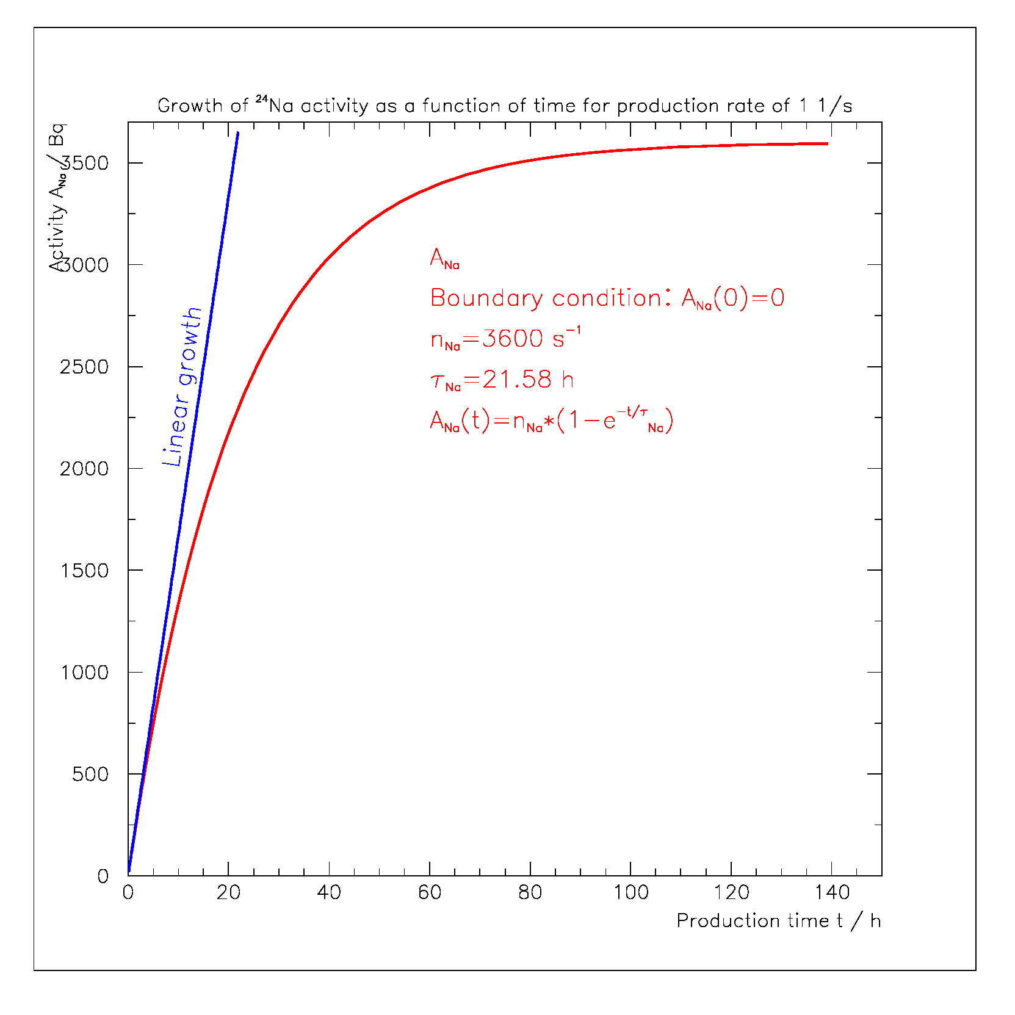
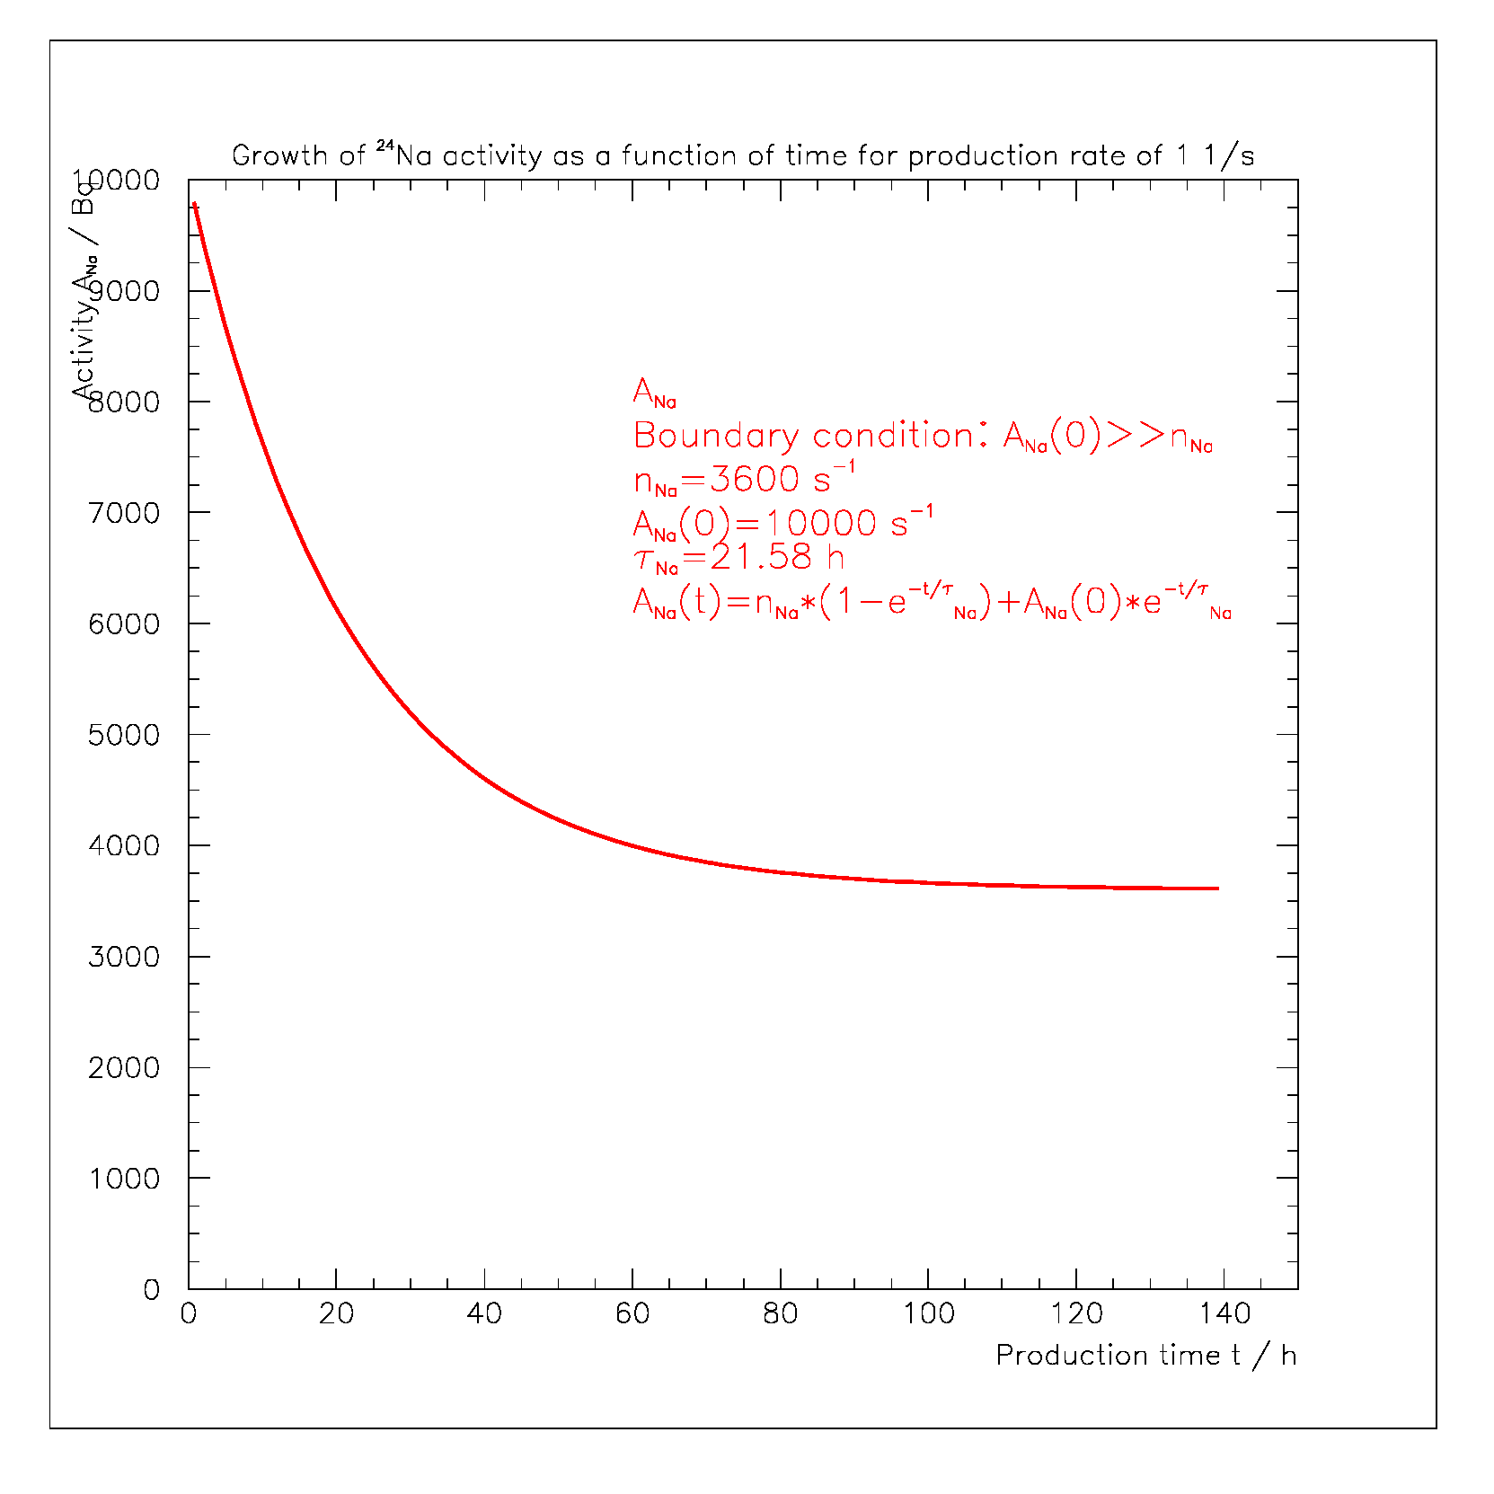
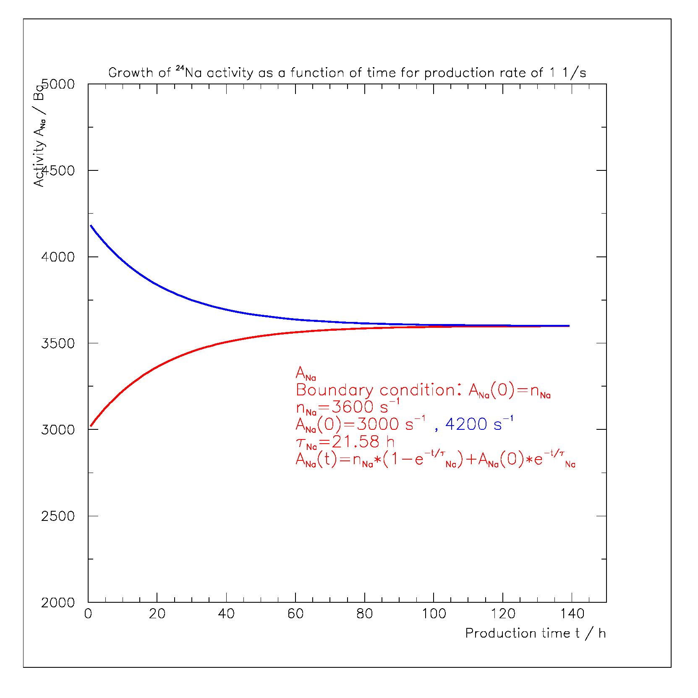
Even this simplest exponential decay has
a rich phenomenology when adding a production
term to the decay. One can be easily fooled by
the decay argument.

Slide 77
For a “state of the art” low energy experiment
what reduction factors to we need
compared to typical activities found all around us?

Slide 78
What impact does all this this now have on low energy
detector background?
As an example let’s use a new low background Ge
detector that we are currently setting up at the University
of Alabama.
This detector has an active Ge mass of m_{Ge}=2.16 kg.

Slide 79
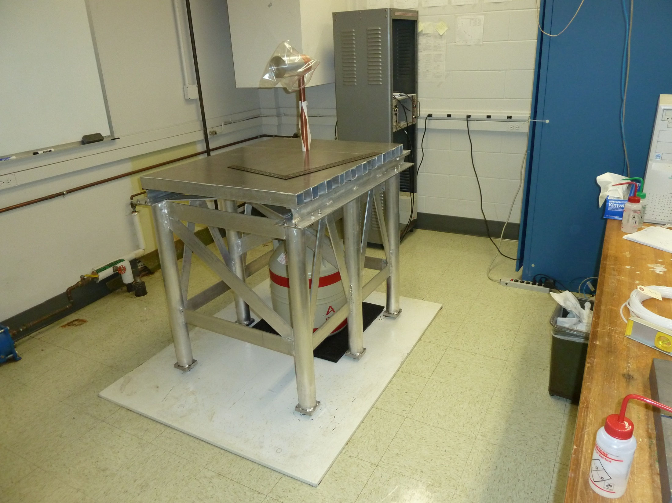
Low background
Ge detector
University of Alabama
May 2011

Slide 80
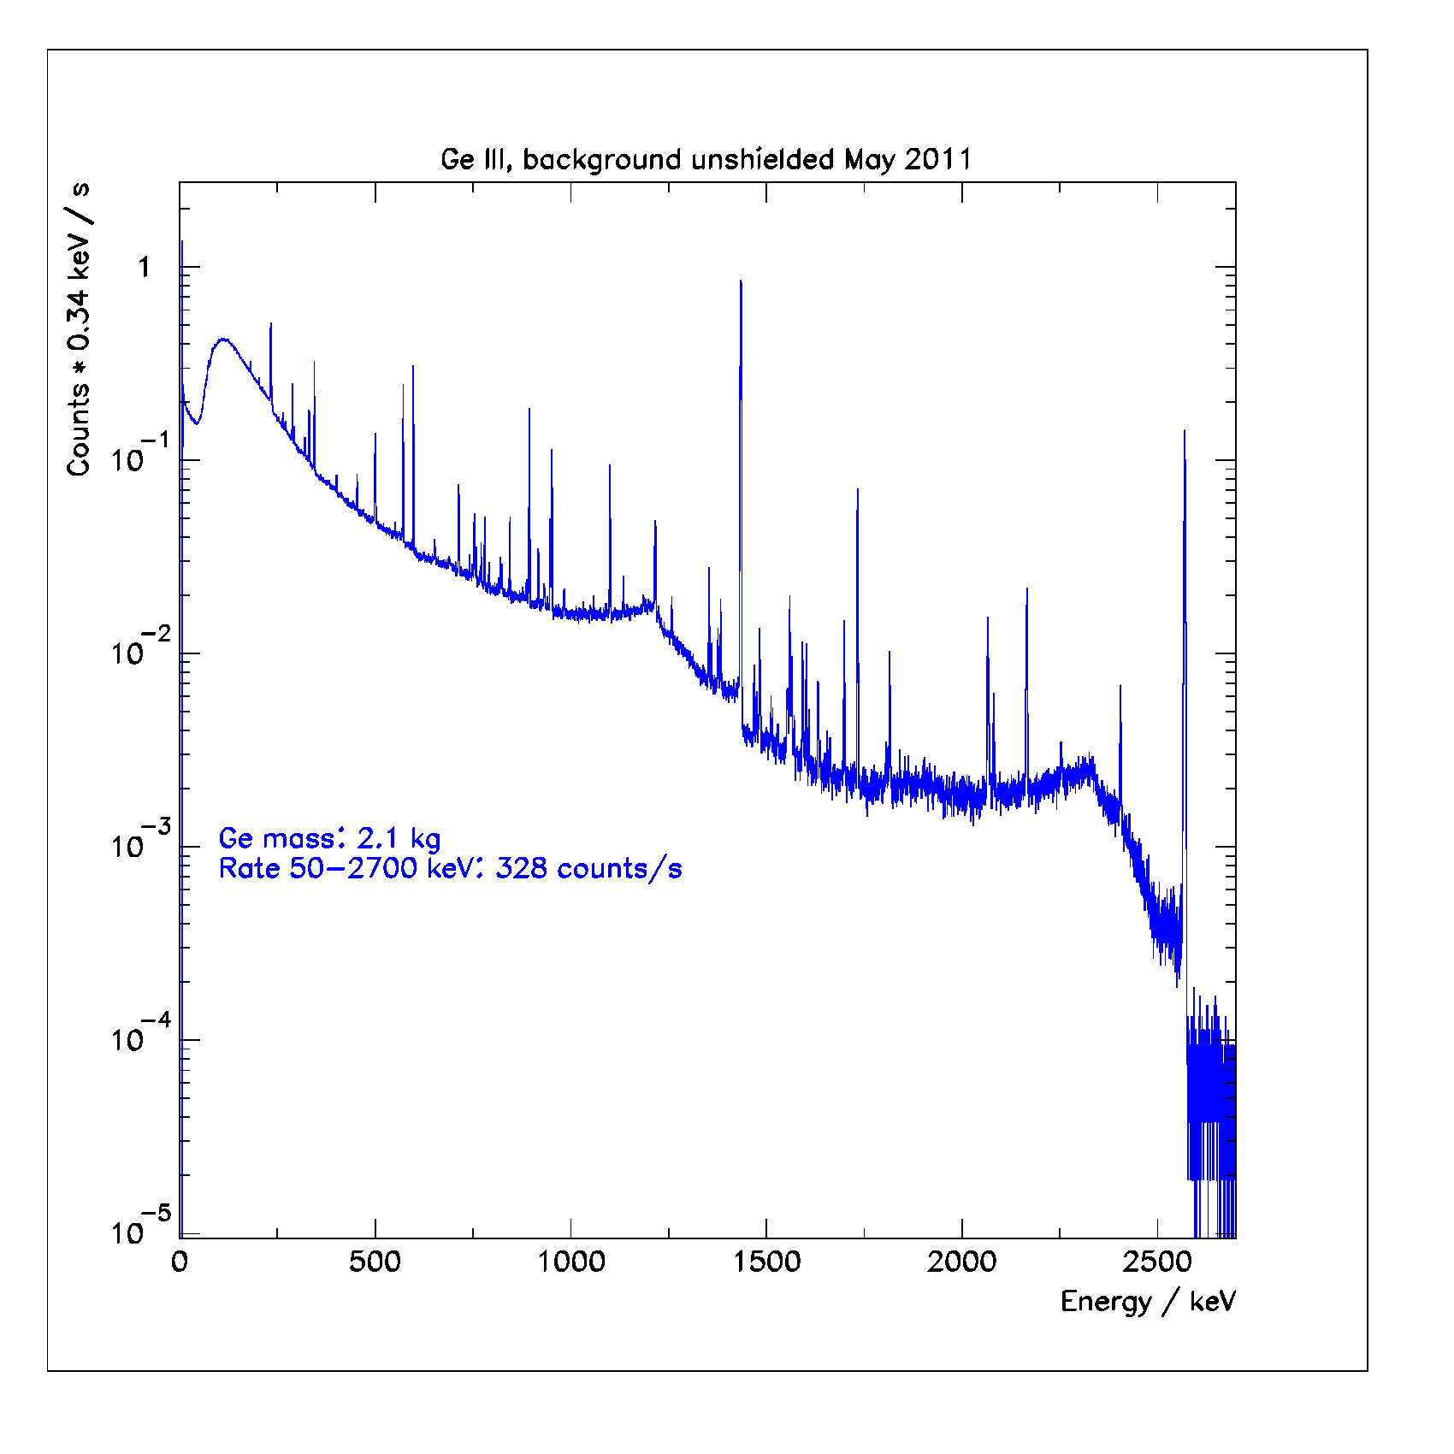
The background of the
unshielded detector is
dominated by γ-radiation.
Photons interact mainly
with electrons. The total
interaction cross section
(and with it the event rate)
is proportional to the number
of electrons contained in the
detector and so is the mass.
It therefore makes sense to
state the rate per mass.
The event rate just due to
the environment is thus:
160 counts/(kg s).

Slide 81
By how much do we need to reduce this rate?
To answer this needs to define some process of interest
for which we will have to estimate typical rates.
I will do so for two low energy process:
Double beta decay
Solar neutrino electron scattering

Slide 82
Example: double beta decay

Slide 83
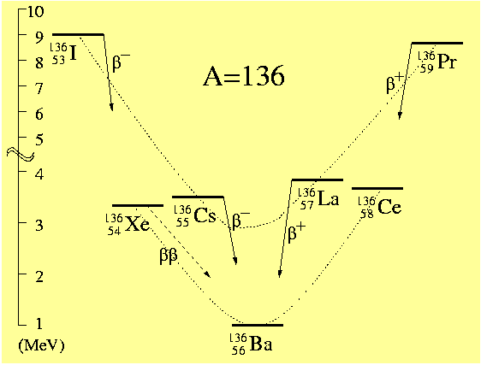
Double beta decay
Extremely rare second order
weak decay converting two
neutrons simultaneously into
two protons. Becomes
observable were single
β-decay is energetically
forbidden.
ββ2ν:
Q=2458 keV
ββ0ν:

Slide 84
Candidate nuclei with Q>2 MeV
Candidate Q Abund.
(MeV) (%)
⁴⁸Ca→⁴⁸Ti | 4.271 | 0.187
⁷⁶Ge→⁷⁶Se | 2.040 | 7.8
⁸²Se→⁸²Kr | 2.995 | 9.2
⁹⁶Zr→⁹⁶Mo | 3.350 | 2.8
¹⁰⁰Mo→¹⁰⁰Ru | 3.034 | 9.6
¹¹⁰Pd→¹¹⁰Cd | 2.013 | 11.8
¹¹⁶Cd→¹¹⁶Sn | 2.802 | 7.5
¹²⁴Sn→¹²⁴Te | 2.228 | 5.64
¹³⁰Te→¹³⁰Xe | 2.533 | 34.5
¹³⁶Xe→¹³⁶Ba | 2.458 | 8.9
¹⁵⁰Nd→¹⁵⁰Sm | 3.367 | 5.6

Slide 85
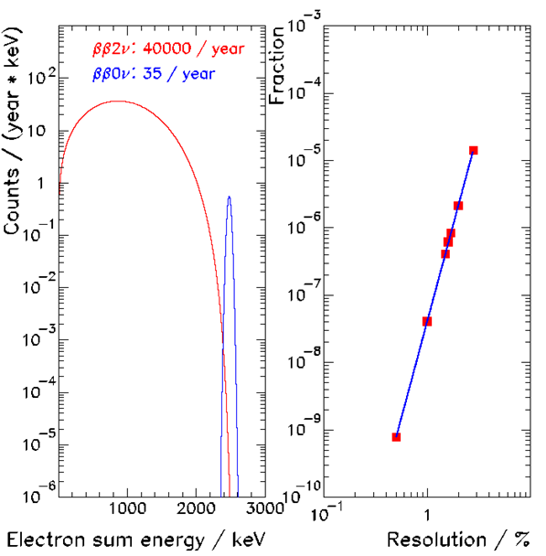
Decay modes distinguished by sum energy of electrons.
Left: expected spectra
for 200 kg ¹³⁶Xe in
one year.
Right: leakage of
ββ2ν-events into
ββ0ν−analysis interval.
5.8th power!

Slide 86
ββ-decay happen in different ways. Here two popular cases.
B L
1/3 0
1/3 0
u
ν_{e}
e⁻
e⁻
ν_{e}
u
ΔB=0
Observed for ~10 nuclides.
Half life 10¹⁸−10²¹ y
Measured rates used to test nuclear models.
ΔL=0
ββ2ν
W
W
Δ(B−L)=0
d
d
e⁻
e⁻
B L
1/3 2
1/3 0
u
u
ΔB=0
Need non-zero neutrino mass because
of helicity mismatch of emitted and
absorbed Majorana neutrinos.
ν_{e}
ΔL=2
ββ0ν
W
W
Δ(B−L)=−2
d
d
B: Baryon Number
L: Lepton Number
Notes:
Tree level: A simply connected Feynman diagram, i.e., a Feynman diagram that that can be divided into two disconnected parts by cutting any line.

Slide 87
Vertex factor U_{ei}: flavor state couples to interaction, is
linear combination of mass states. We cannot know
which mass state has been exchanged: needs coherent sum.
e⁻
e⁻
u
u
ν_{e}
ββ0ν
W
W
d
d
Right handed neutrino component emitted, right handed
absorbed:
Notes:
Tree level: A simply connected Feynman diagram, i.e., a Feynman diagram that that can be divided into two disconnected parts by cutting any line.

Slide 88
Focus on light neutrino exchange mode
Decay rate is given by the golden rule and depends on
an effective Majorana mass. It requires knowledge
of nuclear physics quantities.
Phase space
Matrix element
CP-phases: ±1
CP-phases can lead to cancellation.
But how much? Replace masses by
two possible choices of minimal mass
m₁ or m₃ and add knowledge of mixing
and mass splitting from oscillations.
Elements upper
row of MNS-matrix
Neutrino masses

Slide 89
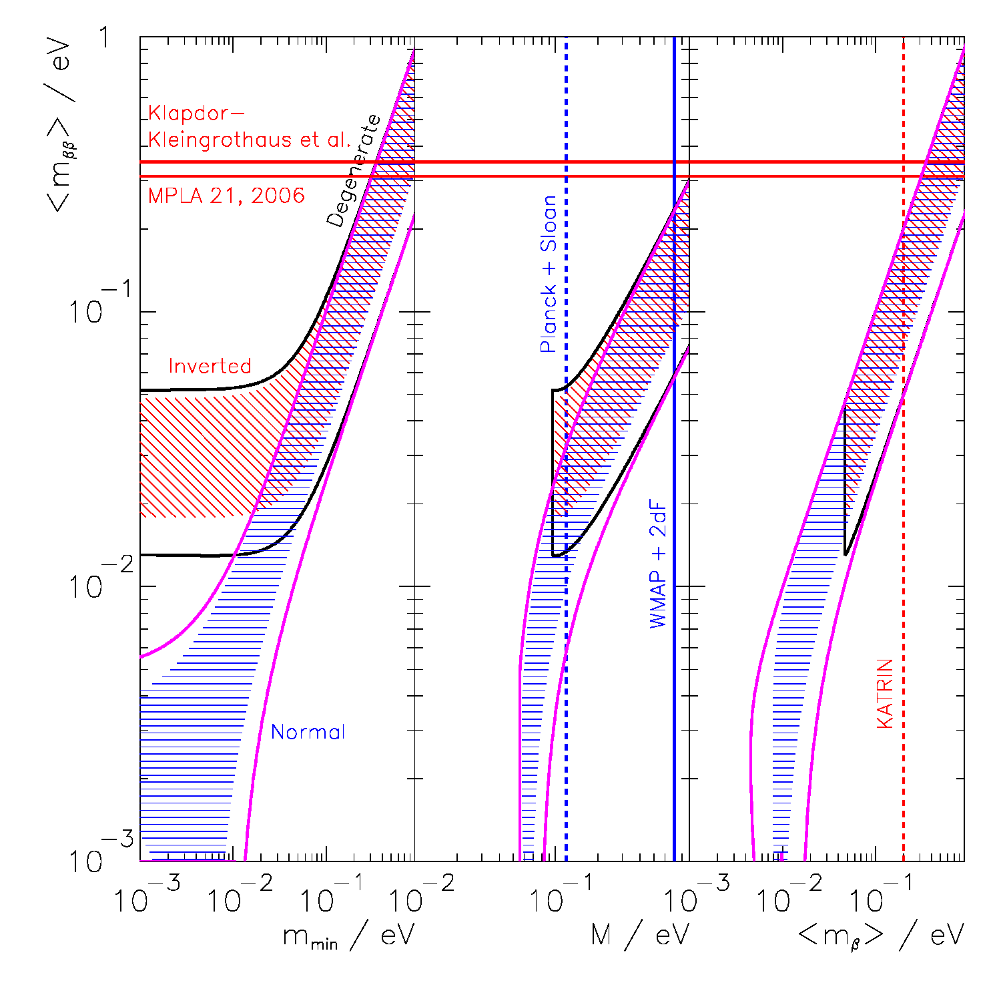
The problem to be solved:
A new generation
of experiments is
being built to test
Majorana neutrino
masses in the
degenerate and
inverted domains.
⁷⁶Ge : 2.2×10²⁸ y
¹⁰⁰Mo: 5.9×10²⁷ y
¹³⁶Xe : 1.1×10²⁸ y
Rodin et al. PRC68 (2003)

Slide 90
Let’s pick ¹³⁶Xe as an example. I am involved in studying
this nuclide with an experiment called EXO.
Neutrino oscillation data indicate that T_{1/2}=6∙10²⁵ y is a
scale of interest (m_{ν}=0.1 eV). How many decays would one
expect when using m_{Xe}=100 kg of Xe containing a=80% of
the isotope ¹³⁶Xe (9 times isotopical enrichment)?
I use the same equation as derived on page 37.
About four decays per year!

Slide 91
Now we have a scale.
My example with the bare Ge detector set up above ground
in Alabama showed a typical counting rate of about
150 counts / (kg s) (total) and 0.28 counts / (kg s) in the
appropriate energy window taking into account that
ββ0ν-decay has a discrete energy spectrum.
A 100 kg detector would register:
5∙10¹¹ counts / y (all energies)
9∙10⁶ counts / y (at ββ0ν-peak)
ββ0ν-expectation:
4.1 counts / y
One needs to find a factor 10⁶ improvement over natural
materials as far as their radioactivity content is concerned.
Typical concentrations of natural radioactivity are ppm,
this science needs ppt purities.

Slide 92
Example: solar neutrinos

Slide 93
Low energy solar neutrino detection
The flux of low energy ⁷Be solar neutrinos on the earth
surface is 4.6∙10⁹ cm⁻² s⁻¹. This is a substantial flux.
Using the large liquid scintillation detector KamLAND
(Japan), containing about 1000 tons of scintillator,
on can measure these solar neutrinos by means of elastic
scattering on electrons. The recoil energy given to the
electrons is detected.

Slide 94
The interaction cross section σ can be calculated and
is usually given as a function of the electron recoil
energy T:
+: electron neutrinos
−: mu, tau neutrinos
For anti-neutrinos g_{L}↔g_{R}
θ_{W}: Weinberg angle
E_{ν}: neutrino energy
G_{F}: Fermi constant
In case the scattering angle cannot be measured the
detector response to mono-energetic neutrinos is a
continuous T-distribution.

Slide 95
The cross section, averaged over the neutrino spectrum
Φ(E_{ν}) is:
Neutrino survival
probability
The total cross section for detecting a recoil electron
between the recoil energies T₁ and T₂ is:

Slide 96
Kinematically the maximal recoil energy, T_{max}, is
constrain (as in the case of Compton scattering of
photons) to:
For ⁷Be neutrinos E_{ν}=862 keV (mono-energetic line,
90% branching ratio) we expect a sharp edge at
T_{max}=665 keV.

Slide 97
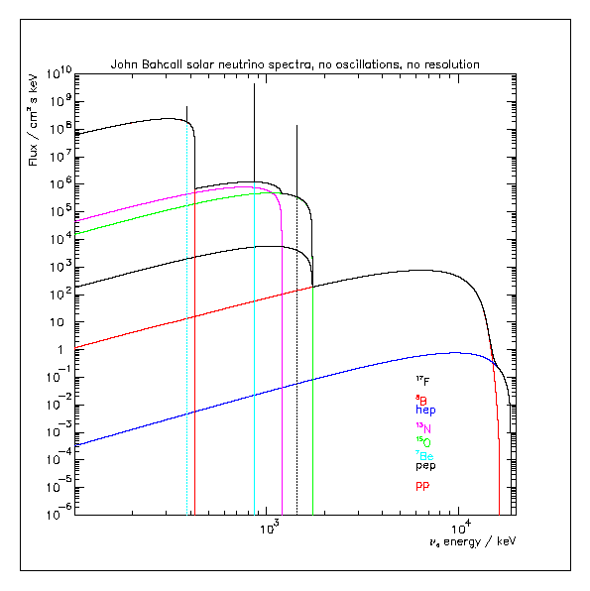
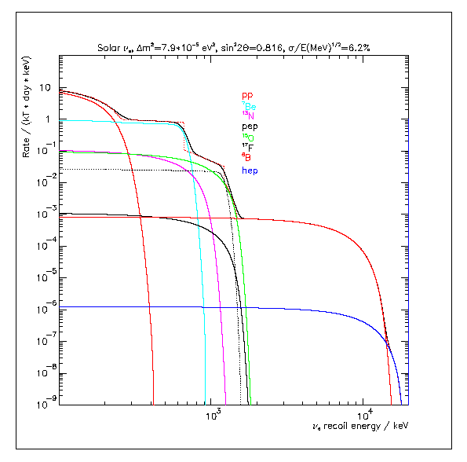
Yield
(kt∙day)⁻¹ for
energy inte-
gration:
280 – 800 keV
pp : 1.6
⁷Be : 272
pep : 12.6
CNO: 55.6
⁸B : 0.4
hep : 0

Slide 98
Compare this to the example rate of the un-shielded
Ge detector: 280-800 keV: 41.6 counts / (kg s).
Scaled up to 1 kton target mass the expected rate would
be: 3.6∙10¹² counts / (kt d).
Compared to the expected ν_{e} yield of 272 counts / (kt d)
one needs to find a factor 10¹⁰ rate reduction compared
to natural abundances of radioactivity.
For a natural abundance scale of ppm → 10⁻⁶ g/g we
need to go to 10⁻¹⁶ g/g.
A more sophisticated Monte Carlo estimate actually
yields a similar result.

Slide 99
How does such a detector look like?

Slide 100
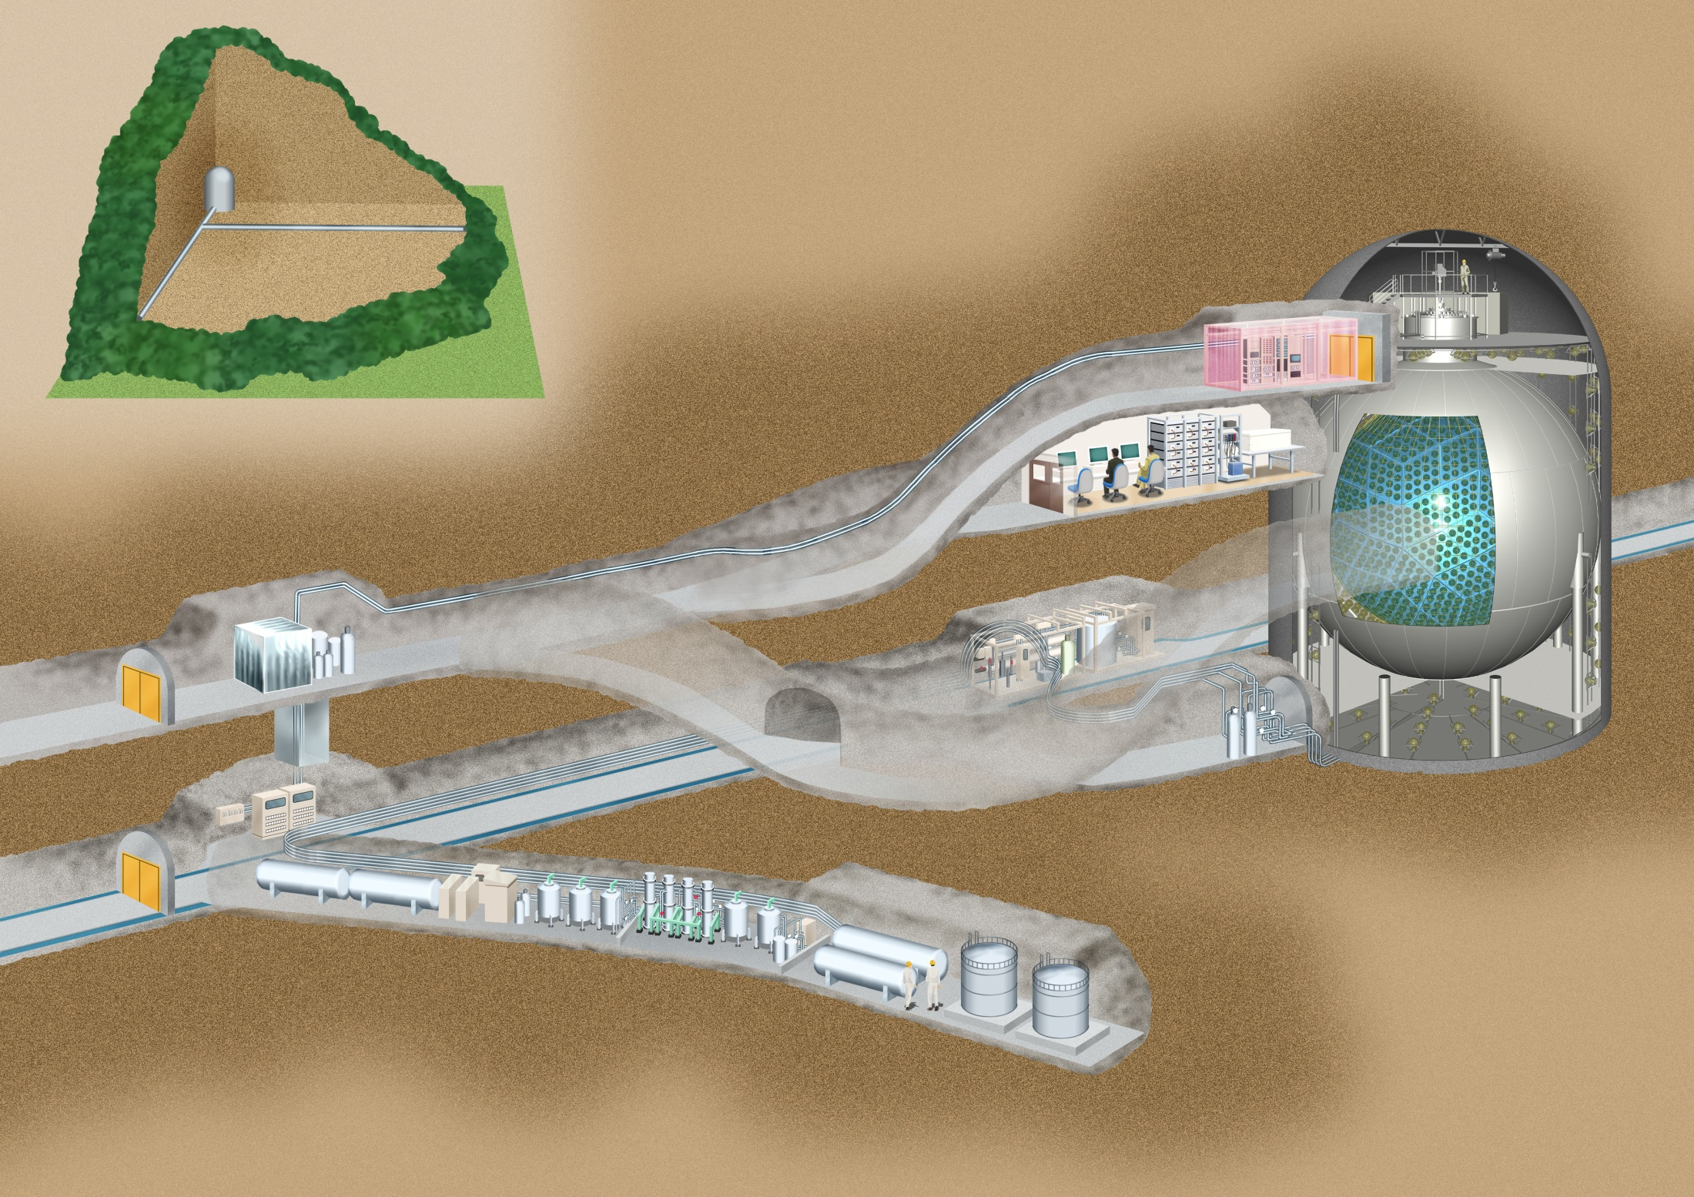
2700 m w.e.

Slide 102
What did KamLAND observe when
looking at low energy data?

Slide 103
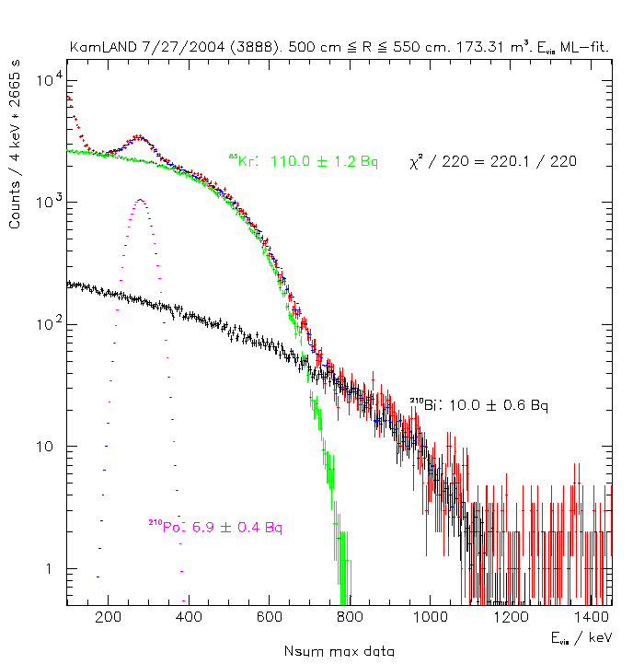
About 10⁵ more rate than tolerable.
Backgrounds were found to be
dominated by ⁸⁵Kr, ²¹⁰Po, and ²¹⁰Bi.
All airborne activities (Po and Bi are
Rn daughters)!
This shows how important even the
details of the handling can be.
I will talk more about this example
later.

Slide 104
Next class we will discuss the different background
components, talk about measurement techniques
for trace radioactivity and talk some about reduction
techniques.

