Slide 1
Advancement on Semiconductor Radiation Detectors
Zhong He
Department of Nuclear Engineering and Radiological Sciences
The University of Michigan, Ann Arbor, Michigan

Slide 2
How can we record radiation?
Detector
Radiation
Electrical Sensing
(1) The detector must interact with the radiation
(2) Record an electrical signal from the event
Therefore, charged particles can be “directly” measured.
Such as electrons, heavy charged particles (protons + bare nuclei)
(B) Un-charged particles cannot be “sensed” directly. They can
only be recorded indirectly after interaction with matter
Gamma rays → electrons neutrons → heavy charged particles

Slide 3
Three Major Types of Radiation Detectors
V-
Electric field
V+
(1) Gas-filled detectors
←ion e- →
Gas
Q
Light
Q
(2) Scintillation detectors
Light to charge converter
V-
Electric field
V+
(3) Semiconductor detectors
←hole e- →
Q

Slide 4
Part 1: Basics of Semiconductor Radiation Detectors
Advantages of Semiconductor Detectors:
Superior energy resolution (theoretically achievable)
Position sensing (localized charge collection)
High stopping power (solid state detector)
Brief overview on:
Properties of semiconductors
(2) Impurities and doping
(3) Diode junctions
(4) Advancement on Si detectors

Slide 5
Semiconductor Band Structure
Conduction band
Electron
Energy
E_{g} > 5 eV
Conduction band
E_{g} ≈ 1 eV
Valence Band
Insulators
Semiconductors
The probability per unit time that an electron-hole pair is thermally generated
kT = 0.0253 eV at 20°C, E_{g}= 1 eV → exp(−1eV/0.0506eV) ≈ 2.6×10⁻⁹
E_{g}= 5 eV → (2.6×10⁻⁹ )⁵ =1.2×10⁻⁴³

Slide 6
Influence of Bandgap
Silicon
Germanium
At room
temperature
E_{g} = 1.1 eV
E_{g} = 0.7 eV
Valence Band
Intrinsic carrier density
1.5×10¹⁰
2.4×10¹³ cm⁻³
A “small” increase in band-gap energy leads to significant decrease in carrier density
Influence of Temperature
Germanium E_{g} = 0.7 eV
T = 293 K
T = 77 K
Intrinsic carrier density
2.4×10¹³ cm⁻³
< 10⁻⁵
Lower temperature leads to significant decrease in carrier density

Slide 7
Charge Migration in an Electric Field
Low to moderate electric field E:
Electrons: v_{e} = μ_{e}Ε
Holes: v_{h} = μ_{h}Ε
In Silicon | 77 K | 300K
μ_{e} (cm²/V⋅s) | 21000 | 1350
μ_{h} (cm²/V⋅s) | 11000 | 480
Charge carrier drift velocity saturates in high electric field (when drift speed →10⁷ cm/s)

Slide 8
Intrinsic (Ideal) Semiconductors
Define:
  n = concentration of (negative charge) electrons in conduction band
  p = concentration of (positive) holes in valence band
For intrinsic materials: n_{i} = p_{i}
Relationship between bulk resistivity ρ and n_{i}: If all thermal generated electrons and holes can be swept out by the electric field, the bulk leakage current I of an intrinsic semiconductor is:
Note: Current = Charge / Time, and t is thickness
Actual semiconductors always have impurities

Slide 9
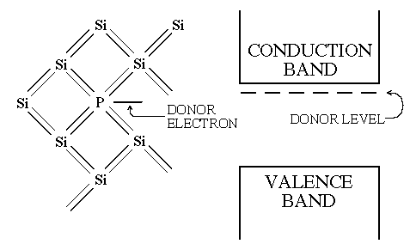
Donor Impurity
Phosphorus
Since the “extra” electron is “almost free” (slightly bounded), its energy level
should be “slightly” below that of free electrons in the conduction band.

Slide 10
Effect of Donors on Charge Concentrations
Because of the small energy gap between donor electrons and
the conduction band (equivalent to a very small E_{g}), nearly all
donor electrons are thermally excited to the conduction band.
n-Type Semiconductors
Add donor impurity N_{D} >> n_{i}
Conduction electron density n ≈ N_{D}
To maintain equilibrium
n⋅p = constant = n_{i}⋅p_{i}
Conduction
band
Donor levels
E_{g}
Valence
band
Note: Donor ions (positively charged
and fixed in lattice) neutralize the total
charge (with e- in conduction band and
holes in valence band.)
n >> n_{i}: Electrons are majority carriers; p << p_{i}: Holes are minority carriers

Slide 11
Memo on the Law of Mass-Action
The recombination rate of e-h pairs must be proportional to the product of electron and hole concentrations (n⋅p). The generation rate of e-h pairs depends only on the band-gap energy E_{g} and the temperature T .
Equilibrium means that the recombination rate = generation rate, thus we have
(at T)
In addition, the proportional constants k₁ and k₃ should be independent of the value
of (n⋅p). If you double n and keep the same p, the recombination rate should also
double. This means that k₁ and k₃ must be constants. So when n⋅p = n_{i}⋅p_{i}, k₁ = k₃
This means: The generation rate of e-h pairs depends only on the band-gap energy E_{g} and the temperature T. The recombination rate depends on the product of n & p. Therefore, does not matter whether it is an intrinsic or doped semiconductor, n⋅p must be the same (having the same recombination rate) to reach equilibrium.
Note: The assumption here is that E_{g} has the same value for actual and intrinsic
semiconductors, which is true.
Notes:
Memo: In n-type semiconductors, electrons in conduction band recombine with holes in valance band, not likely to recombine with holes at donor sites since ionized donor atoms are fixed in the lattice. Donor ions cannot move and they are very few in number compared with Si atoms.

Slide 12
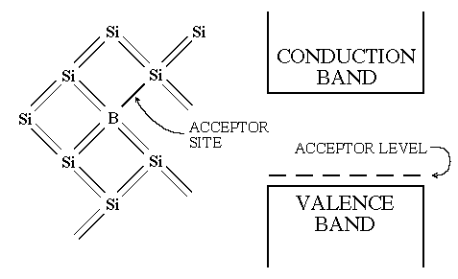
Acceptor Impurity
Since the forming of four pairs of covalent bonds is energetically favorable
(from quantum mechanics), an electron (from Si) is easily captured near Boron
(at the acceptor site), creates a hole in the valence band.

Slide 13
Effects of Acceptors on Carrier Concentrations
Because of small energy difference between acceptor energy levels and the valence band, nearly all acceptor sites are filled with electrons, leaving holes in valence band.
p-Type Semiconductors
Add acceptor impurity N_{A} >> p_{i}
Hole density (in valence band)
p ≈ N_{A}
To maintain equilibrium
n⋅p = constant = n_{i}⋅p_{i}
Conduction
band
E_{g}
Acceptor
levels
Valence
band
Note: Negatively charged acceptor
ions neutralize total charge (with e-
in the conduction band and holes in
valence band.)
p >> p_{i}: Holes are majority carriers; n << n_{i}: Electrons are minority carriers

Slide 14
Compensated Semiconductors
N_{A} ≈ N_{D} → n ≈ n_{i} p ≈ p_{i}
Can be produced through lithium ion drifting in Si
Heavily Doped Semiconductors
High electrical conductivity, often denoted as n⁺ or p⁺
Summary on p & n-Types
P-type
N-type
Increasing
conductivity
Increasing
resistivity
π ν
10¹⁵
10¹¹
10¹¹
10¹⁵/cm³
←N_{A}
N_{D}→

Slide 15
Action of Ionizing Radiation
Fast charged
particle
Electrons
Holes
Temp. | w of Si | w of Ge
77 K | 3.76 eV | 2.96 eV
300 K | 3.62 eV
Equal number of e- & holes are produced
Trapping & recombination
Deep impurities (larger ΔE → longer trapping times, not desired) :
Can trap carriers and remove them from collected charge
May promote recombination with carriers of opposite polarity
Lattice defects can also trap charges, thus not desired.
Charge transport properties are important for radiation detectors:
(1) Carrier lifetime τ; (2) Mean free drift length λ = μ⋅E⋅τ

Slide 16
Would a simple Si planar detector work?
Radiation
Si detector: 1 cm² area and 1 mm thickness
Bias voltage = 500 V
V_{bias}
Si
ΔQ
ΔV
We must reduce leakage current
Charge carrier densities n & p

Slide 17
Effect of Electrical Contacts
Ohmic electrodes
Blocking electrodes
Injection
+
+
n-Type
e-
e-
Thermal +
radiation
Si
E
E
Si
h+
−
h+
−
p-Type
Injection
Ohmic contact: Charges can flow freely between electrode and semiconductor, thus equilibrium charge carrier densities n & p will be maintained. If an electron or hole is collected by one electrode, an identical charge carrier is injected into the semiconductor at the opposite electrode, to keep n & p constant. The bulk resistivity is determined by n & p.
Blocking contact: Collected charge carriers cannot be replaced, thus charge carrier concentrations n′ & p′ under an electric field are much lower than n & p. The leakage current can be minimized to the thermal generation rate which is much smaller compared to that without blocking contacts.

Slide 18
Sources of Free Carriers
Leakage current injected from contacts (can be avoided by using blocking contacts)
Thermally-generated carriers (can be reduced by cooling (Ge) or using wider band-gap materials)
Minority carriers in blocking contacts (very low due to depleted population)
Radiation-induced carriers (signal to be collected)

Slide 19
n-p Junction
n-type
E
p-type
e- →
← h+
Effect of Diffusion
Majority electrons in conduction band in n-type material (left) moves to the right
Majority holes in valence band in p-type material (right) moves to the left
↓
Generate an electric field E which has a higher potential on the left
“pushing” holes back to the right, and electrons to the left
↓
An equilibrium condition will be reached

Slide 20
An idealized p-n Junction
No electric field to
collect charge in
un-depleted regions
(“Dead layers”)
Depletion region
n-region
Electric field
p-type region
ρ(x)
Un-depleted regions
act as electrodes (or
conductor) due to
high conductivity
e₀N_{D}
Assume uniform charge distributions
0
b
x
Note: Since free electrons
and holes are swept out of
the depletion region quickly
by the electric field, we can
approximate that charge
densities are just impurity
concentrations in depleted
region.
-a
e₀N_{A}

Slide 21
Derivation of Junction Properties
The electric field Ε :
Poisson’s Equation:

Slide 22
Solution for the electric field
First integration with boundary
conditions:
E = − dϕ / dx = 0 at –a and +b
( Note: E = 0 inside conductors)
E(x)
Maximum E at x = 0 (at the interface)
−a
0
b

Slide 23
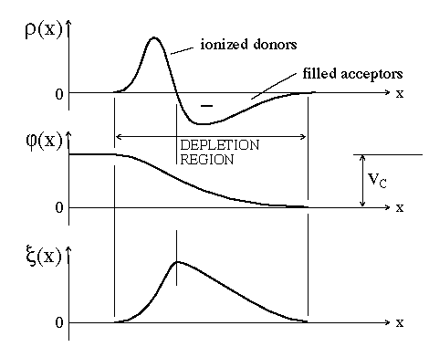
The Electric Field of a p-n Junction
Slop dE/dx ∝ ρ
Area ∝ V

Slide 24
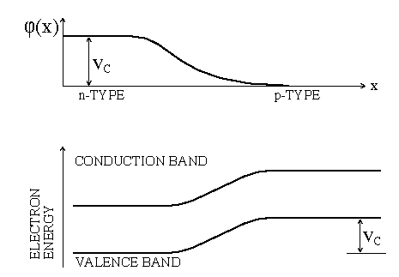
e-
The electric field makes electrons to drift towards n-region (to lower energy)
The diffusion process makes electrons to drift towards p-region

Slide 25
Reverse Biasing
e- minority carrier
h+ minority carrier

Slide 26
The Depletion Depth (Width)
(N_{A}: The one with (original) lower carrier concentration)
Memo on derivation

Slide 27
Lower dopant
concentration
Desire smaller
capacitance for
radiation detector
(can reach 10⁶ – 10⁷ V/cm
for small d ↔ high N)

Slide 28
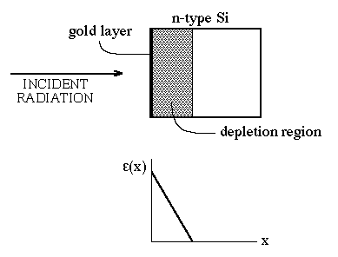
Various Detector Configurations
Diffused Junction Detectors
Surface Barrier Detectors
(A thin layer having high density electron traps (p-type) is formed
between gold and Si, such as an oxidation layer)

Slide 29
Ion Implanted Detectors
Low-energy (10 – 100 keV)
ions from accelerator
N or P-type
wafer
Use different ions, can produce either n⁺ or p⁺ layers (using arsenic or boron, for example)
Mono-energetic ions have well-defined range – can closely control thickness and concentration profile of implanted layer

Slide 30
Fully Depleted Detectors
Increasing bias voltage
E
Slop dE/dx ∝ ρ
E
E
Area ∝ V
x
x
x

Slide 31
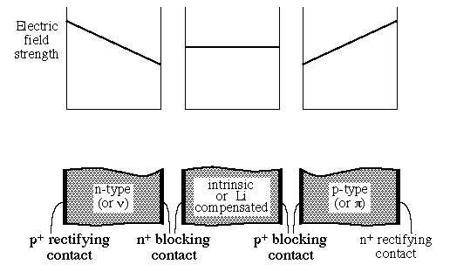
Fully depleted p-i-n planar detectors
Since the minority carrier concentration is still high in near intrinsic materials, blocking contacts are used to reduce leakage currents.
P-N Junction
No junction
P-N Junction

Slide 32
Silicon Detectors
General properties:
Low-Z (atomic number), solid state & thin (< 1mm)
Applications:
Charge particle detection
Vertex & tracking (high energy physics)
Photon detection
X-ray detectors

Slide 33
Charged Particle Spectroscopy with p-n Junction Semiconductor Detectors
Require depletion depth > particle range
Detector response function is typically a simple full-energy peak
Si has been the detector of choice – room temperature operation
Counts
Signal amplitude or particle energy

Slide 34
Particle Identification
Δt
Δt
Thick E detector
E
For Δt << Particle range R
E
ΔE Detector to measure dE/dx
Particle Identifier Telescope

Slide 35
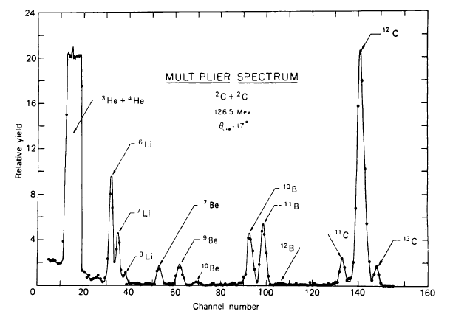
E⋅ΔE Spectrum for Different Ions
Figure 11.19 (ΔE⋅E) in Glenn Knoll′s 4th Edition

Slide 36
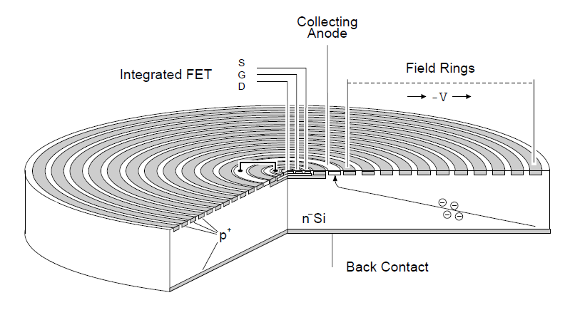
Si drift detectors
(to reduce input capacitance → reduce noise)
Proposed by E. Gatti & P. Rehak
NIM 225(1984)608-614
Advantages: Very low noise (small output capacitance); higher count rate

Slide 37
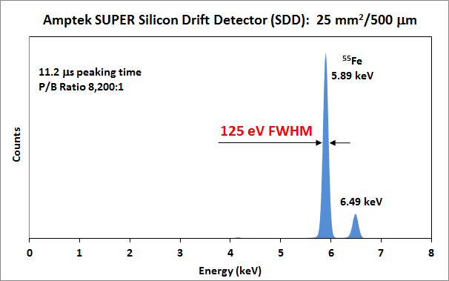
An example performance of Si drift detector
Cooled to −55°C
http://www.amptek.com/drift.html

Slide 38
Avalanche Si diode detectors
(To provide internal gain – multiplication)
p
p⁺
n⁺
π
dE/dx
(drift)
region
V⁻
V⁺
Example application
TOF PET
High field region
for avalanche
Advantages: (1) Internal multiplication (several hundred times);
(2) Better timing resolution (due to faster response): could reach < 0.1 ns
Challenges: (1) Uniform multiplication across entrance area
(2) stability (sensitive to temperature and applied voltage)

Slide 39
Si Photomultipliers
(to count the number of photons received)
(1) SiPM is an avalanche photodiode (APD) array on common Si substrate.
The dimension of each APD cell can vary from 20 to 100 μm with a density up to ~1000 per square millimeter.
(2) All APD cells operate in Geiger-mode. The digital (and also analogue) outputs of triggered cells are summed together, giving the total number of triggered cells, thus the total number of photons received.
(3) SiPMs work well from a single photon to ~1000 photons.
(4) Typical supply voltage is tens of volts, much lower than the voltage required for a photomultiplier tubes (PMTs) .
Proposed in 2003 by Russian scientists
P. Buzhan et al., NIM A504 (2003) 48-52 and Z. Sadygov et al., NIM A504 (2003) 301-303

Slide 40
2-D position-sensitive detectors for particle tracking or X-ray (photon) imaging
2-D Si tracking detectors
(cross-strip or pixellated)
Particle collider
Imaging detector
(Si pixel detectors
or CCD camera)
X rays
Grazing incidence X-ray mirror
or an X-ray image forming device

Slide 41
An illustrated example of 2-D position-sensitive (cross-strip) readout
x
Detector
y
Total number of readout channels = 2N versus pixellated readout = N²

Slide 42
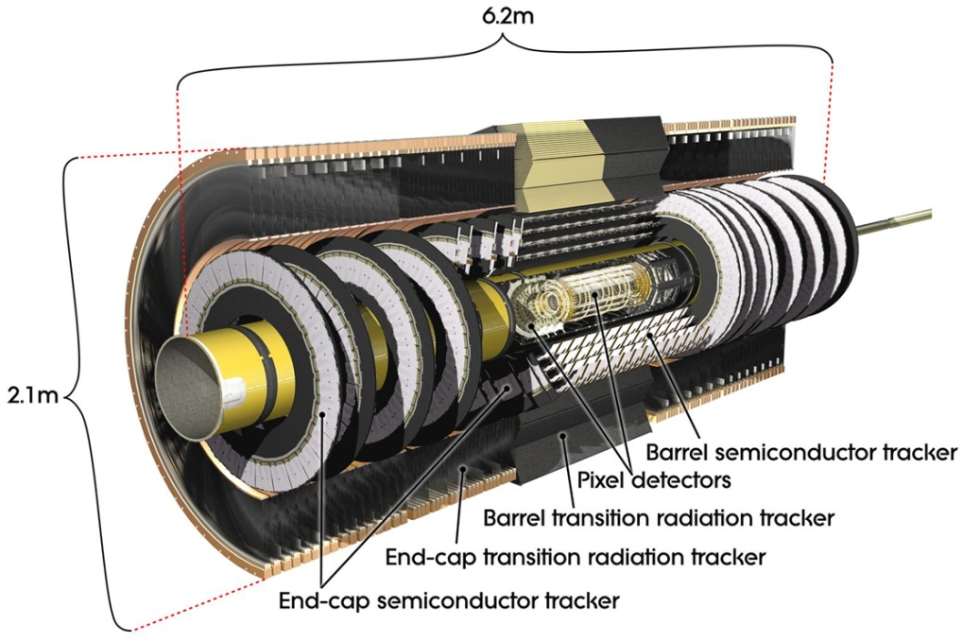
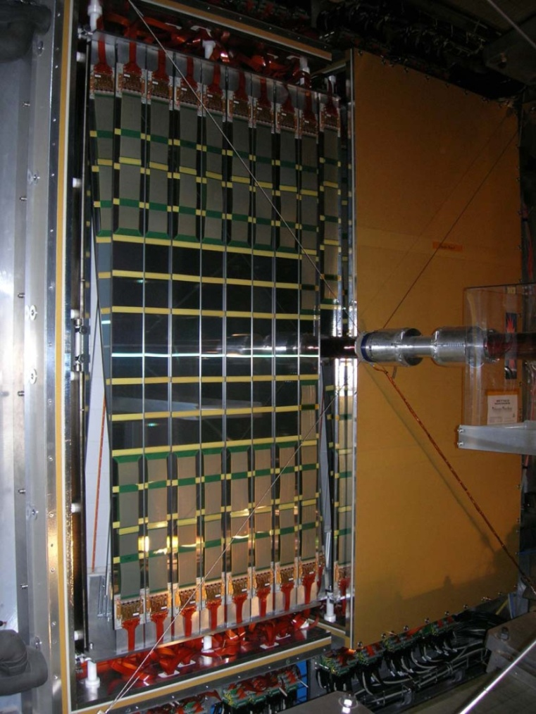
High Energy Physics Experiments
Silicon vertex & tracking detectors
The inner detector of ATLAS
(Excellent Res. on momentum & vertex (~10μm)
The inner most detectors have pixel readout.
The Semiconductor (micro-strip) Tracker: 61 m²,
~80 μm pitch 6.3 million channels
LHCb Si (micro-strip) Tracker
(12m², 183μm pitch)
Peter Vankov 2010 IEEE NSS Conf. record (#N32-7) DESY, Germany
M. Tobin 2010 IEEE NSS Conf. record (#N32-6)

Slide 43
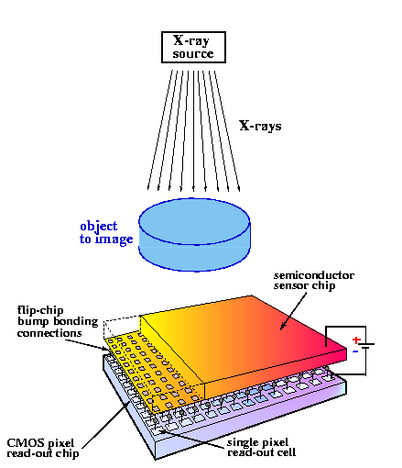
Silicon pixel detectors
Medipix2 ASIC based detectors (~50 μm pitch)

Slide 44
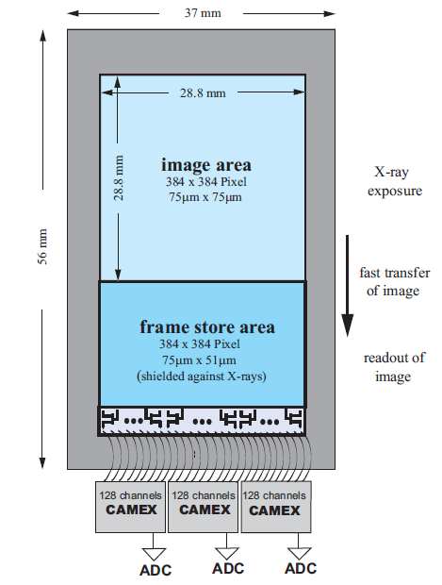
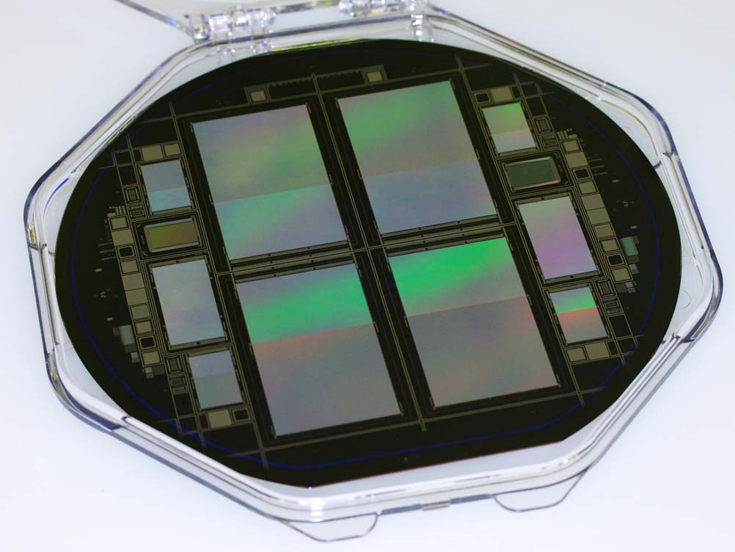
Astrophysics Applications
The pnCCD Detector
for the eROSITA X-ray Space Telescope
Area = 3× 3 cm² , thickness = 450 μm, fully depleted pnCCDs Energy range ~ 0.3 keV − 10 keV. Read noise ~ 2 electrons rms
Energy resolution = 135 eV FWHM at 5.9 keV (measured 52 eV FWHM at 280 eV)
Norbert Meidinger, et al. 2010 IEEE NSS Conf. record.
(Paper #N02-1) Max-Planck-Institute, Germany)

Slide 45
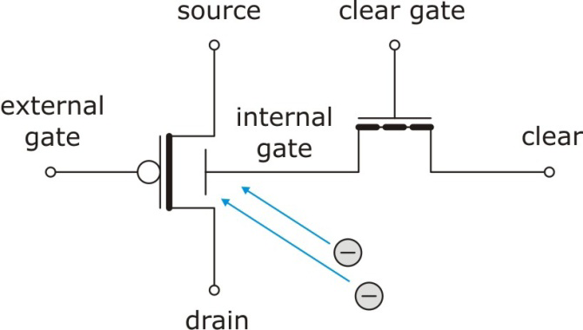
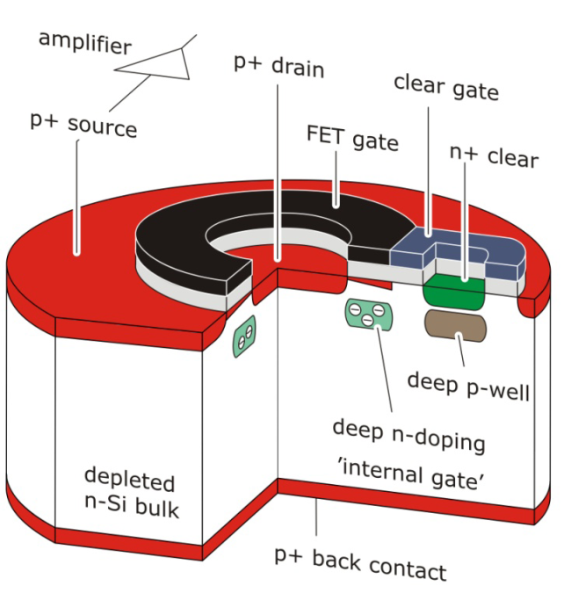
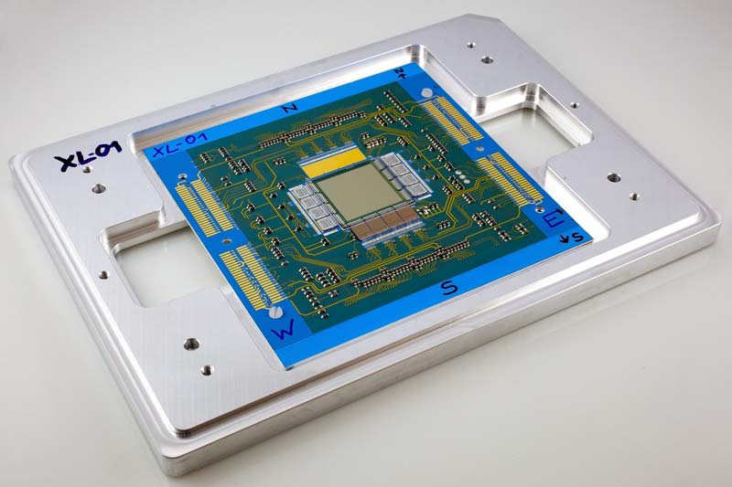
Astrophysics Applications
Si active pixel sensors for X-ray imaging
spectroscopy (X-ray astronomy)
Depleted P-channel Field Effect Transistor (DEPFET) pixel detector = 256×256 pixels, Pitch = 75 μm; Energy resolution = 129 eV FWHM at 5.9 keV (cooled at −20°C)
Its equivalent circuit
Aline Meuris, et al. 2010 IEEE NSS Conf. record.
(Paper #N02-3) Max-Planck-Institute, Germany)
256×256 pixel sensor

Slide 46
Part 2: High Purity Germanium (HPGe) Detectors

Slide 47
HPGe detectors for searching neutrino-less double-beta decay (⁷⁶Ge) & coherent neutrino scattering
Small anode electrode
HPGe
For lower noise & faster rise time to identify “single-site”
radiation events from multiple-site interaction events
See publications of Professor Juan I. Collar, Department of Physics and
Enrico Fermi Institute, University of Chicago

Slide 48
Compton Imaging with Position-
Sensitive Si and Ge Detectors
Gamma
Si (Li drifted)
cross-strip (~2mm)
scatter detectors
with depth
sensing
Thickness ~ 10mm
HPGe
cross-strip (~2mm)
detector with depth
sensing
Thickness ~ 10mm
Kai Vetter et al. UC Berkeley & Lawrence Livermore National Laboratory
NIMA 579 (2007) 363 – 366

