Slide 1
Double beta decay and the nature of the neutrino
Andreas Piepke
University of Alabama

Slide 2
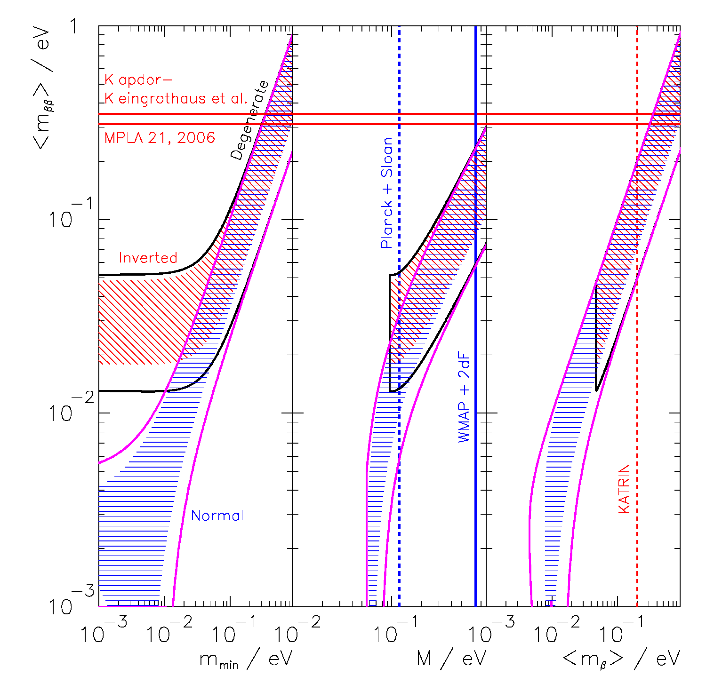
The problem to be solved:
A new generation
of experiments is
being built to test
Majorana neutrino
masses in the
degenerate and
inverted domains.
⁷⁶Ge : 2.2×10²⁸ y
¹⁰⁰Mo: 5.9×10²⁷ y
¹³⁶Xe : 1.1×10²⁸ y
Rodin et al. PRC68 (2003)

Slide 3
In order to test interesting neutrino physics with a double beta decay experiment one has to plan for sensitivities of order 10²⁵ to 10²⁸y.
Decay rate to be expected at these ultra long half lives are of order few per year per 100 kg of source material or even few per few tons.

Slide 4
How to attack this problem experimentally?
Find a candidate nuclide with reasonably high decay energy
and isotopic abundance to maximize decay rate.
Most popular approach: pick a substance that decays and
serves as the detector. But there are exceptions.
Build the largest high resolution detector you can afford.
To gain rate and reduce background, enrich the decaying
isotope, removing non-decaying but sensitive ‘ballast’.
Build this detector such that its background is few events
per year at 2-3 MeV! This is THE technological challenge.
Requires use of exotic low activity materials with sometimes
undesirable mechanical properties.
Employ active background suppression.

Slide 5
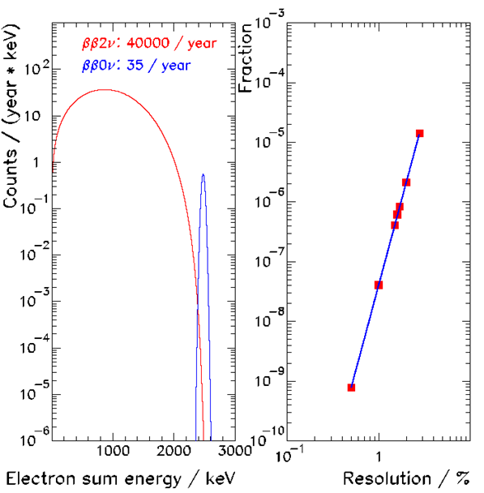
Decay modes distinguished by measurement of electron sum energy.
Left: expected spectra
for 200 kg ¹³⁶Xe in
one year.
Right: leakage of
ββ2ν-events into
ββ0ν−analysis interval.
5.8th power!

Slide 6
State of the art and beyond…
There is a number of projects world wide that plans to take
advantage of this physics opportunity.
For background limited null result the experiment sensitivity
has the following general form (for small detectors):
Constant depending on CL, integration of peak, mol mass
Detector mass
Counting time
Energy resolution
Isotope abundance
Efficiency
Background rate per
unit mass and energy

Slide 7
For a background free experiment the sensitivity is:
Detector mass and time enter in via the square instead of
the fourth root.
In the following I will discuss some of the coming double
beta decay experiments. Because of lack of time I will
not discuss the two leading current projects:
Cuoricino
NEMO III

Slide 8
 | Nuclide | Q [MeV] | Principle | Det mass [kg] | Decay mass [kg] | Site
CANDLES | ⁴⁸Ca (0.19%) | 4.271 | CaF₂ scint. | 305 | 0.3 | Kamioka
Cobra | ¹¹⁶Cd (90%) | 2.802 | CdZnTe semicond. | 420 | 142 | Gran Sasso
CUORE | ¹³⁰Te (34%) | 2.527 | Bolometer | 740 | 200 | Gran Sasso
EXO-200 | ¹³⁶Xe (80%) | 2.458 | Liquid TPC | 120 | 96 | WIPP
EXO | ¹³⁶Xe (80%) | 2.458 | Liquid/gas TPC final state tag | 10³−10⁴ | 800-8000 | DUSEL/SNOLab
GERDA | ⁷⁶Ge (86%) | 2.039 | Ge semicond. | 40 | 34 | Gran Sasso
KamLAND | ¹³⁶Xe (90%) | 2.458 | Liquid. scint. | 400 | 360 | Kamioka
MAJORANA | ⁷⁶Ge (86%) | 2.039 | Ge semicond. | 60-1000 | 52-860 | DUSEL
MOON | ¹⁰⁰Mo (90%) | 3.034 | Source foil plastic scint. | 480 | 430 | Oto
SNO+ | ¹⁵⁰Nd (5.6%) | 3.367 | Liquid. scint. | 780 | 44 | SNOLab
Super NEMO | ⁸²Se | 2.995 | Source foil tracking & scint | 100+ |  | Frejus
Under construction
In blue: passive source
The rest has substantial R&D funding

Slide 9
 | Nuc-lide | Backgr [1/keV∙y∙kg] | Res. σ [keV] | Active b tag | ‹m_{ββ}› [meV] | Data
CANDLES | ⁴⁸Ca | 4∙10⁻⁶ | 170 | Active LS shield
Cobra | ¹¹⁶Cd | 10⁻³ − 5∙10⁻⁴ | 4.8 | Fine pixelation | 50 (3-4 y) | ?
CUORE | ¹³⁰Te | 10⁻² − 10⁻³ | 2.0 | Heat/light, anti-coinc | 20-80 (5 y) | 2013
EXO-200 | ¹³⁶Xe | 10⁻³ | 37 | 3d tracking, ion/scint | 130–190 (2 y) | 2010
EXO | ¹³⁶Xe | 2∙10⁻⁷ | 25 | 3d tracking, Ba tag | 5 (10 y) | ?
GERDA | ⁷⁶Ge | 10⁻³ − 10⁻⁴ | 1.5 | Pulse shape, anti-coinc | 75–130 (3 y) | 2010
KamLAND | ¹³⁶Xe | 6∙10⁻⁵ | 107 | BiPo, anti-coinc | 50 (3 y) | 2011
MAJORANA | ⁷⁶Ge | 10⁻³ | 1.5 | Pulse shape, anti-coinc | 140 (3 y) | 2014
MOON | ¹⁰⁰Mo | 5∙10⁻⁵ | 67 | Tracking, 1e/2e discrim | 30−45 (4 y) | ?
SNO+ | ¹⁵⁰Nd |  | 216 | BiPo, anti-coinc | 150 (1 y) | 2012
Super NEMO | ⁸²Se |  | 51 | Tracking, 1e/2e discrim | 40-110

Slide 10
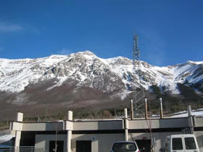
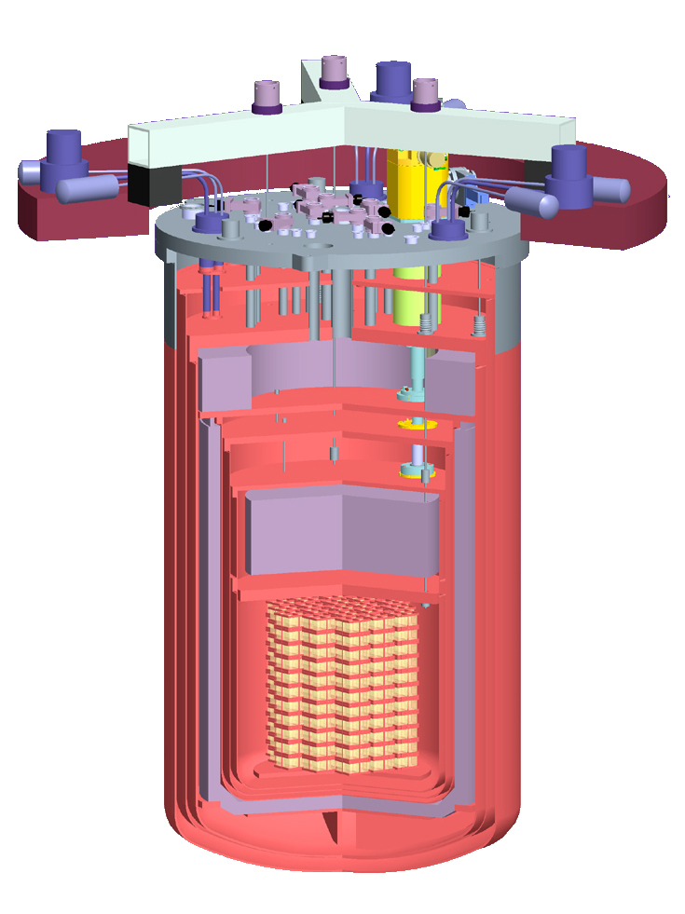
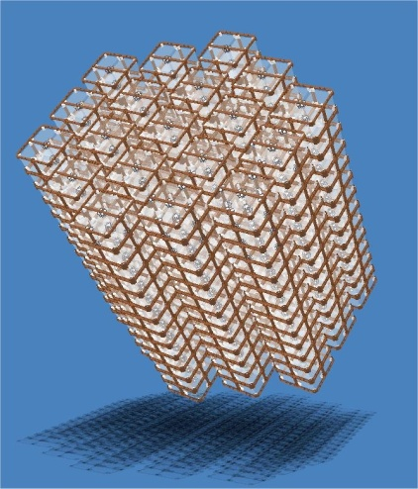
CUORE Experiment
Cryogenic Underground
Observatory for Rare Events
LNGS
located in Hall A of Gran Sasso National Lab (LNGS)
overburden of ~3100 m.w.e. (relative to flat overburden) Phys.Rev. D73 053004
cryogen-free dilution refrigerator
array of 988 bolometers
19 towers, 13 planes
4 bolometers /plane /tower
300 K
40 K
total detector mass 741kg
M(¹³⁰Te) ~200 kg (¹³⁰Te: 0νββ candidate isotope)
4 K
lead shield
0.7 K
it is all about reducing background:
70 mK
Borated polyethylene
neutron shield
10 mK
3m
lead shield
at least 36cm lead shields
only radiopure material
copper, teflon
goal: reach a flat bkg of
0.01 cts/(keV kg y) in ROI
80cm
+ external lead shield
(not shown)
demonstrated within factor 2 - 4
From C. Heeger
3

Slide 11
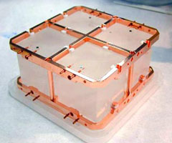
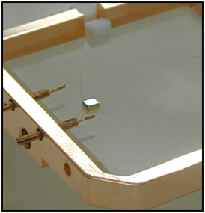
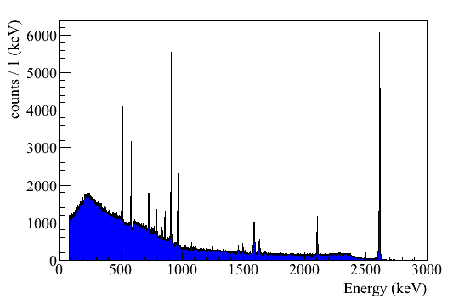
CUORE Bolometers
large bolometers 5 x 5 x 5 cm
made from natural Te0₂
¹³⁰Te abundance ~34 % (no enrichment)
Q-value (¹³⁰Te) = 2528 keV
Phys. Rev. C 80 025501
Phys. Rev. Lett. 102, 212502
Temperature sensor:
high purity copper & Teflon holder structure
NTD Ge thermistor
911 keV
²²⁸Ac
2615 keV
²⁰⁸Tl
511 keV
e⁺e⁻
resistance change converted into voltage pulse
965 + 969 keV
²²⁸Ac
2528 keV
0νββ
583 keV
²⁰⁸Tl
non-linear energy response
1588
²²⁸Ac
+ 1593 keV
DEP
Resolution:
2104 keV
SEP
FWHM ~ 5 keV @2528 keV
+ external lead shield
(not shown)
From C. Heeger

Slide 12
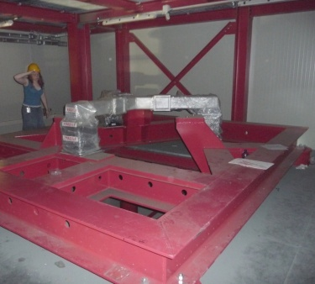
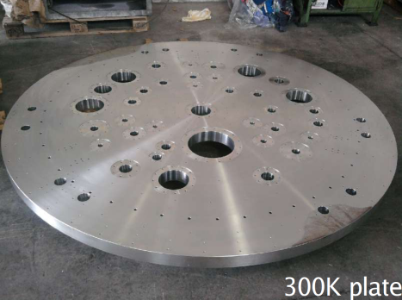
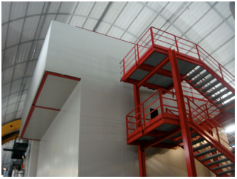
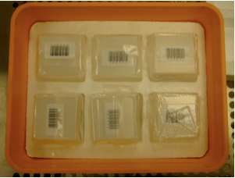
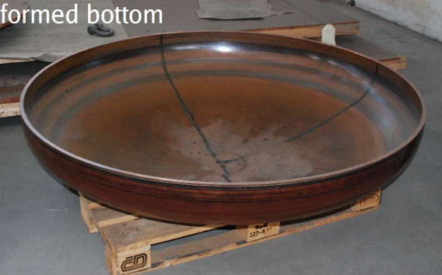
CUORE Experiment - Status
CUORE hut
bolometers
packaged
cryostat
main support
now:
CUORE experimental hut finished
12/2010 outer cryostat vessels delivery
cryostat main support in place
12/2010 partial calibration system delivery
450 bolometers ready and stored
underground at LNGS; tests ongoing
early 2011 cryostat 4K tests
mid 2011 delivery dilution unit
US bolometer production started
fall 2011 CUORE-0 data taking
2013 CUORE data taking
From C. Heeger

Slide 13
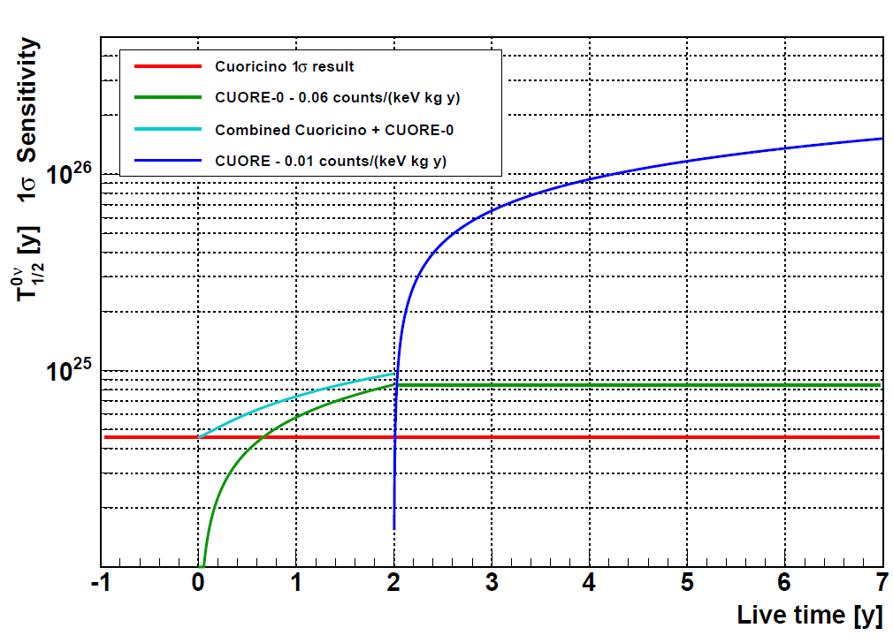
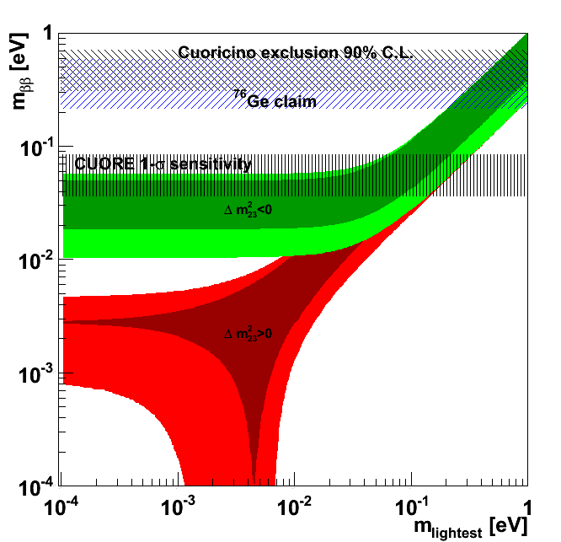
Projected Sensitivity
5 years live time and bkg of b = 0.01 cts/ (keV kg y)
CUORE Sensitivity at 1σ:
m_{ββ} = 41 – 96 meV
(depending on NME)
T^{0ν}_{1/2} = 1.5 x 10²⁶ y at 1σ
start probing inverted hierarchy
From C. Heeger

Slide 14
 | Nuc-lide | Backgr [1/keV∙y∙kg] | Res. σ [keV] | Active b tag | ‹m_{ββ}› [meV] | Data
CANDLES | ⁴⁸Ca | 4∙10⁻⁶ | 170 | Active LS shield
Cobra | ¹¹⁶Cd | 10⁻³ − 5∙10⁻⁴ | 4.8 | Fine pixelation | 50 (3-4 y) | ?
CUORE | ¹³⁰Te | 10⁻² − 10⁻³ | 2.0 | Heat/light, anti-coinc | 20-80 (5 y) | 2013
EXO-200 | ¹³⁶Xe | 10⁻³ | 37 | 3d tracking, ion/scint | 130–190 (2 y) | 2010
EXO | ¹³⁶Xe | 2∙10⁻⁷ | 25 | 3d tracking Ba tag | 3−5 (10 y) | ?
GERDA | ⁷⁶Ge | 10⁻³ − 10⁻⁴ | 1.5 | Pulse shape, anti-coinc | 75–130 (3 y) | 2010
KamLAND | ¹³⁶Xe | 6∙10⁻⁵ | 107 | BiPo, anti-coinc | 50 (3 y) | 2011
MAJORANA | ⁷⁶Ge | 10⁻³ | 1.5 | Pulse shape, anti-coinc | 140 (3 y) | 2014
MOON | ¹⁰⁰Mo | 5∙10⁻⁵ | 67 | Tracking, 1e/2e discrim | 30−45 (4 y) | ?
SNO+ | ¹⁵⁰Nd |  | 216 | BiPo, anti-coinc | 150 (1 y) | 2012
Super NEMO | ⁸²Se |  | 51 | Tracking, 1e/2e discrim | 40-110

Slide 16
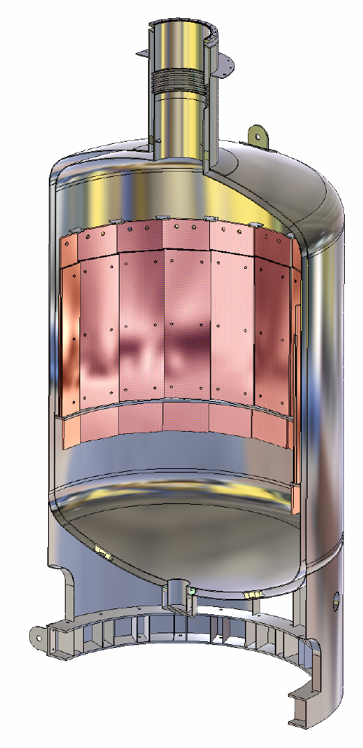
GERDA design
Additional inner copper shield
Germanium-detector array
Liquid argon
Vacuum-insulated double wall stainless steel cryostat
From H. Simgen

Slide 19
Recent progress and status
December 2009: Liquid argon fill
January 2010: Commissioning of the cryogenic system
April/May 2010: Installation of the (commissioning-) lock
May 2010: 1st deployment of FE electronics & detector mock-up (27 pF)
pulser resolution 1.4 keV (FWHM)
June 2010: First deployment of ^{nat}Ge detectors
Since July 2010: Commissioning run with ^{nat}Ge detector string (3 diodes):
1st data show more ⁴²Ar than expected → requires dedicated analysis
Afterwards: Start phase I physics data taking
From H. Simgen

Slide 20
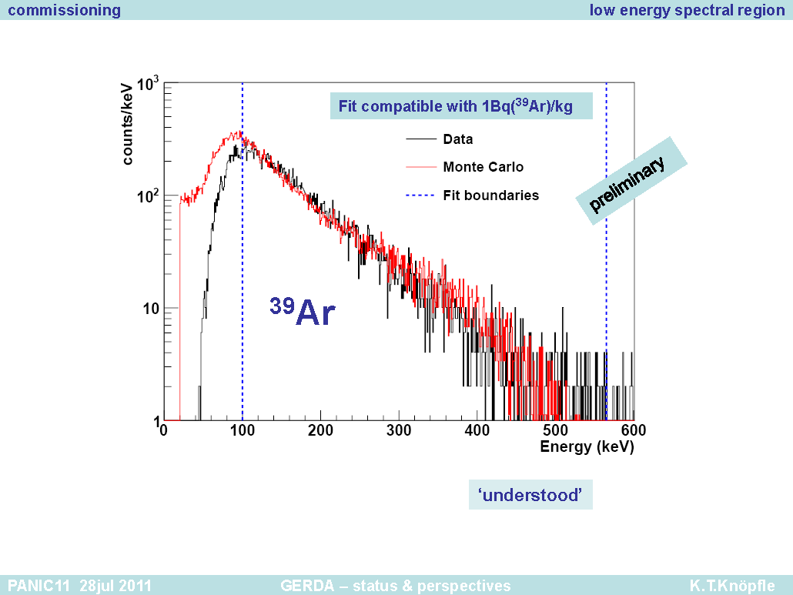

Slide 23
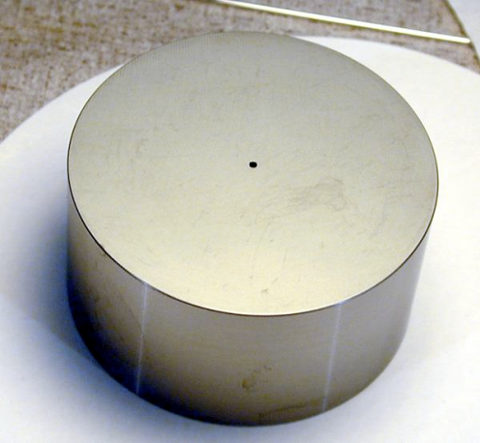
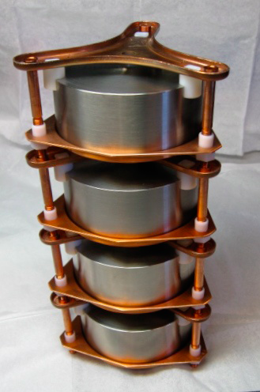
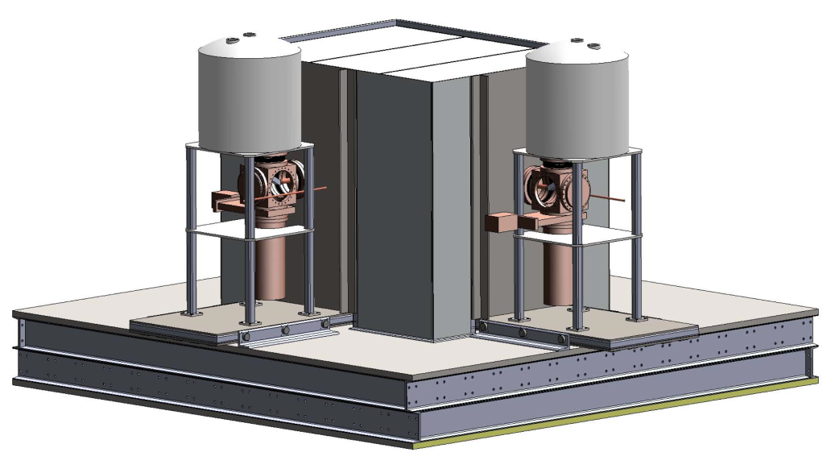
Toward a tonne-scale Ge experiment: the MAJORANA DEMONSTRATOR
Steve Elliott
From S. Elliott

Slide 24
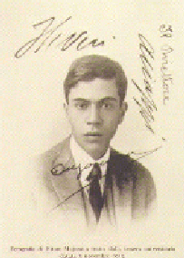
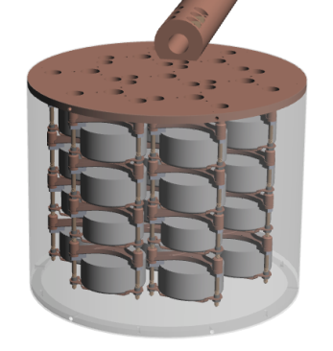
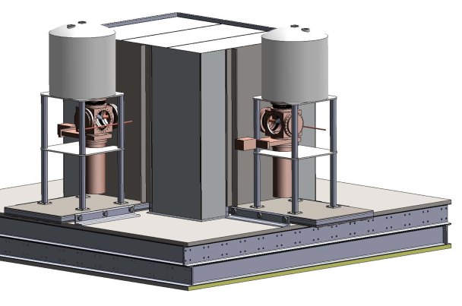
The MAJORANA Demonstrator Module
⁷⁶Ge offers an excellent combination of capabilities & sensitivities.
(Excellent energy resolution, intrinsically clean detectors, commercial technologies, best 0νββ sensitivity to date)
40-kg of Ge detectors
Up to 30-kg of 86% enriched ⁷⁶Ge crystals required for science and background goals
Examine detector technology options focus on point-contact detectors for DEMONSTRATOR
Low-background Cryostats & Shield
ultra-clean, electroformed Cu
naturally scalable
Compact low-background passive Cu and Pb shield with active muon veto
Agreement to locate at 4850’ level at Sanford Lab
Background Goal in the 0νββ peak ROI(4 keV at 2039 keV)
~ 4 count/ROI/t-y (after analysis cuts)
From S. Elliott

Slide 26
 | Nuc-lide | Backgr [1/keV∙y∙kg] | Res. σ [keV] | Active b tag | ‹m_{ββ}› [meV] | Data
CANDLES | ⁴⁸Ca | 4∙10⁻⁶ | 170 | Active LS shield
Cobra | ¹¹⁶Cd | 10⁻³ − 5∙10⁻⁴ | 4.8 | Fine pixelation | 50 (3-4 y) | ?
CUORE | ¹³⁰Te | 10⁻² − 10⁻³ | 2.0 | Heat/light, anti-coinc | 20-80 (5 y) | 2013
EXO-200 | ¹³⁶Xe | 10⁻³ | 37 | 3d tracking, ion/scint | 130–190 (2 y) | 2010
EXO | ¹³⁶Xe | 2∙10⁻⁷ | 25 | 3d tracking, Ba tag | 3−5 (10 y) | ?
GERDA | ⁷⁶Ge | 10⁻³ − 10⁻⁴ | 1.5 | Pulse shape, anti-coinc | 75–130 (3 y) | 2010
KamLAND | ¹³⁶Xe | 6∙10⁻⁵ | 107 | BiPo, anti-coinc | 50 (3 y) | 2011
MAJORANA | ⁷⁶Ge | 10⁻³ | 1.5 | Pulse shape, anti-coinc | 140 (3 y) | 2014
MOON | ¹⁰⁰Mo | 5∙10⁻⁵ | 67 | Tracking, 1e/2e discrim | 30−45 (4 y) | ?
SNO+ | ¹⁵⁰Nd |  | 216 | BiPo, anti-coinc | 150 (1 y) | 2012
Super NEMO | ⁸²Se |  | 51 | Tracking, 1e/2e discrim | 40-110

Slide 27
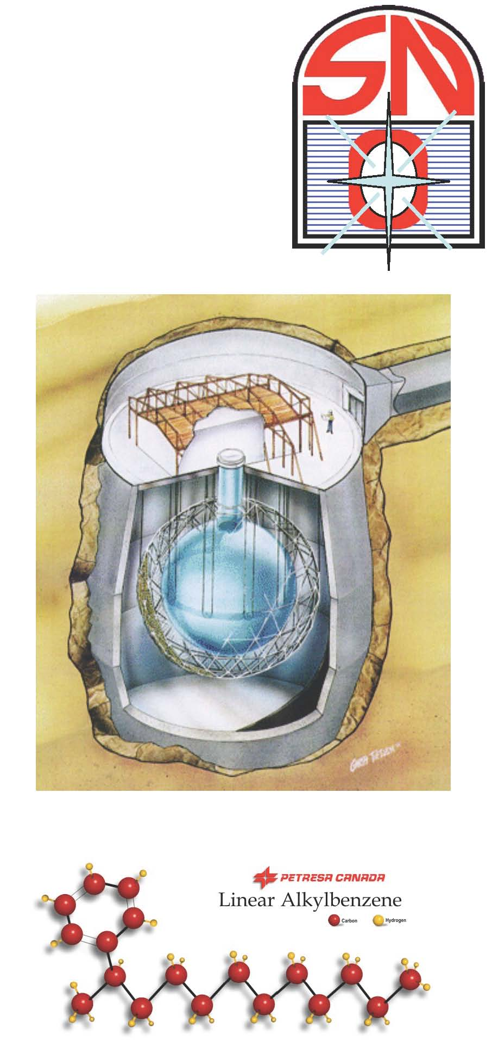
SNO+
Based on the same idea as KamLAND:
dissolve ββ-emitter in ultra pure organic
liquid scintillator. The emphasis is on low
background and not resolution.
The now empty SNO detector will be
filled with liquid scintillator. Because of its
large size other physics can be addressed:
solar pep, CNO neutrinos geo-neutrinos and
more.
Natural Nd is dissiloved at 0.1% concentration in linear
alcylbenze based scintillator. These experiements search
for a shoulder and not a ββ-peak.

Slide 28
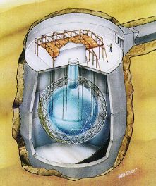
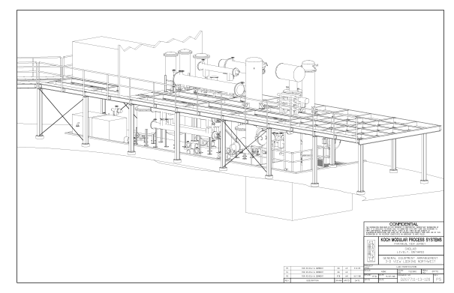
The SNO+ Experiment
860 tonnes scintillator
(LAB + 2g/L PPO)
1000 tonnes D₂O
Support Structure for 9500 PMTs
12 m Diameter Acrylic Vessel
Scintillator purification
1700 tonnes Inner
Shielding H₂O
Rope net anchored to the cavity floor
5300 tonnes Outer
Shield H₂O
Urylon Liner and
Radon Seal

Slide 29
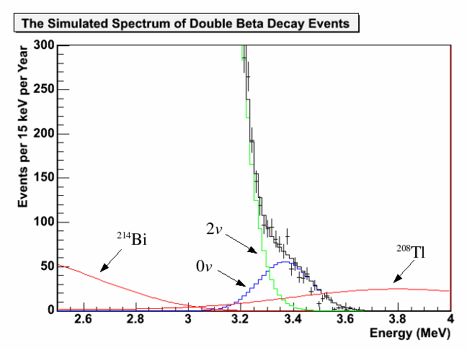
SNO+ Double Beta Decay Concept
energy resolution in a liquid scintillator is relatively poor
search for endpoint shape distortion at high Q-value above the gamma lines from natural radioactivity
¹⁵⁰Nd has highest phase space factor and NME, thus highest predicted rate
simulation:
one year of data
1% NdLS
m_{eff} = 0.15 eV
From M. Chen

Slide 31
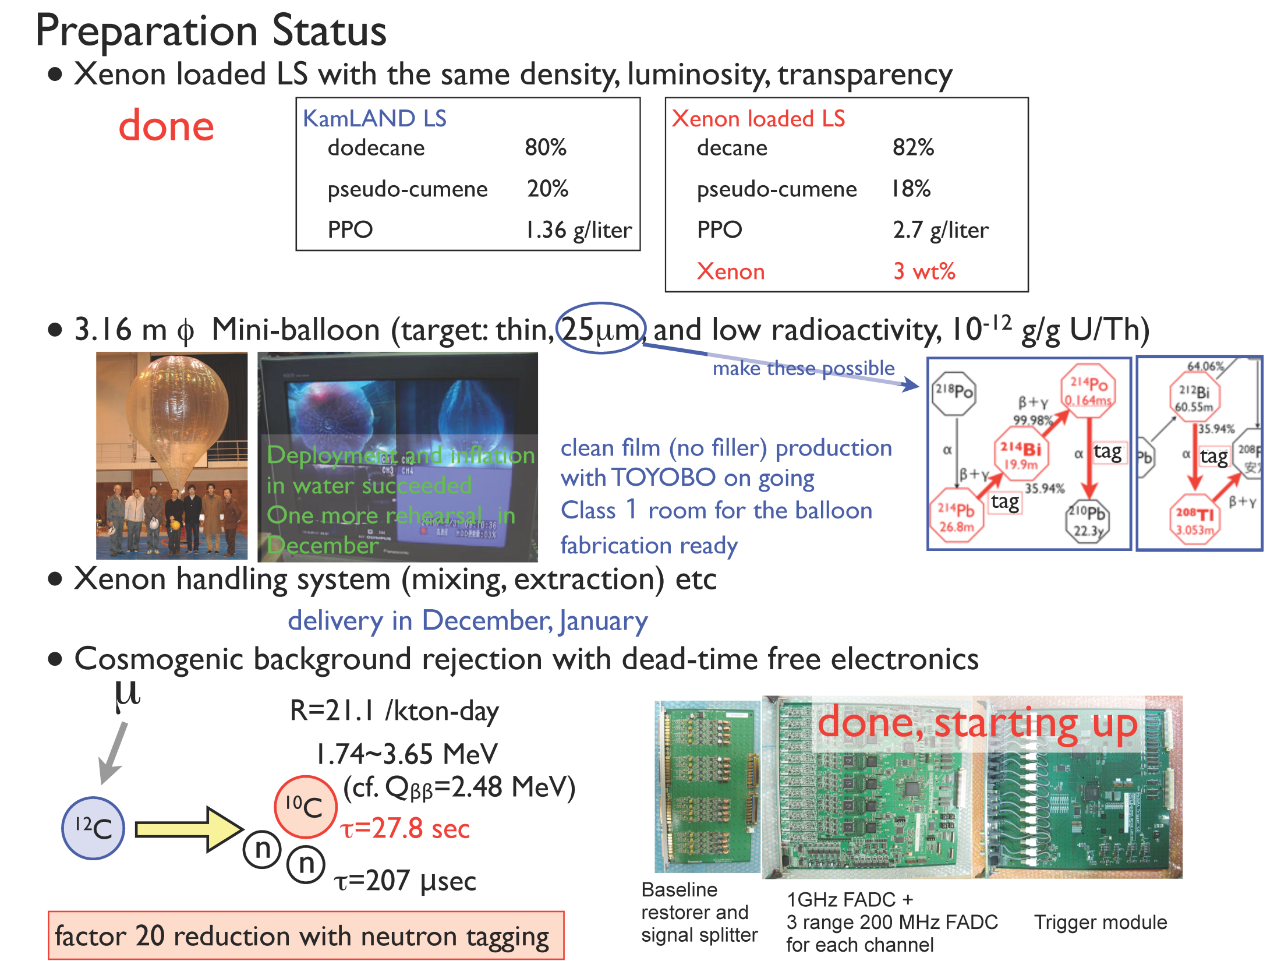
From K. Inoue

Slide 32
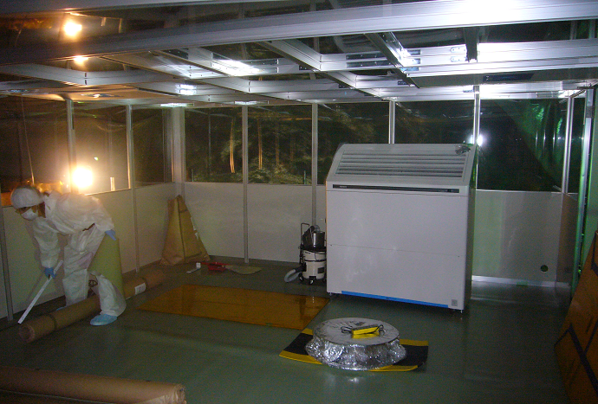
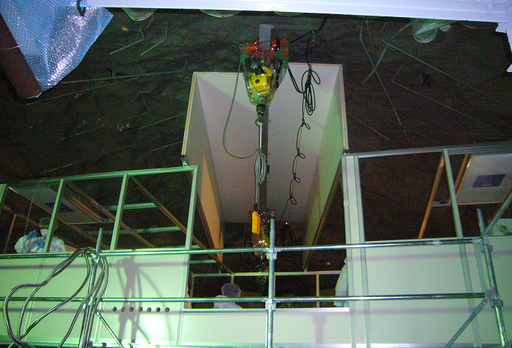
July 2011: Construction of clean tent on top of detector is under way
Inside the clean tent ->

Slide 33
From K. Nakamura

Slide 34
 | Nuc-lide | Backgr [1/keV∙y∙kg] | Res. σ [keV] | Active b tag | ‹m_{ββ}› [meV] | Data
CANDLES | ⁴⁸Ca | 4∙10⁻⁶ | 170 | Active LS shield
Cobra | ¹¹⁶Cd | 10⁻³ − 5∙10⁻⁴ | 4.8 | Fine pixelation | 50 (3-4 y) | ?
CUORE | ¹³⁰Te | 10⁻² − 10⁻³ | 2.0 | Heat/light, anti-coinc | 20-80 (5 y) | 2013
EXO-200 | ¹³⁶Xe | 10⁻³ | 37 | 3d tracking, ion/scint | 130–190 (2 y) | 2010
EXO | ¹³⁶Xe | 2∙10⁻⁷ | 25 | 3d tracking, Ba tag | 3−5 (10 y) | ?
GERDA | ⁷⁶Ge | 10⁻³ − 10⁻⁴ | 1.5 | Pulse shape, anti-coinc | 75–130 (3 y) | 2010
KamLAND | ¹³⁶Xe | 6∙10⁻⁵ | 107 | BiPo, anti-coinc | 50 (3 y) | 2011
MAJORANA | ⁷⁶Ge | 10⁻³ | 1.5 | Pulse shape, anti-coinc | 140 (3 y) | 2014
MOON | ¹⁰⁰Mo | 5∙10⁻⁵ | 67 | Tracking, 1e/2e discrim | 30−45 (4 y) | ?
SNO+ | ¹⁵⁰Nd |  | 216 | BiPo, anti-coinc | 150 (1 y) | 2012
Super NEMO | ⁸²Se |  | 51 | Tracking, 1e/2e discrim | 40-110

Slide 35
EXO detection strategy
Xe TPC
detect the 2 electrons
(ionization + scintillation in xenon detector)
e-
e-
e-
e-
e-
¹³⁶Xe → ¹³⁶Ba⁺⁺ + 2e⁻ (+ 2νe)
positively identify daughter via
optical spectroscopy of Ba⁺
ion “tip”
[M. Moe, Phys. Rev. C 44 (1991) R931]
other Ba⁺ identification strategies are also being investigated within the EXO collaboration
CCD
observe single ion

Slide 36
EXO-200
Make use of the fact that Xenon is relatively cheap to enrich,
allows drifting of charges, scintillates and may admit
identification of the Ba final state in a later phase.
Use a TPC for 3d reconstruction of charge tracks, discriminate
single site e-events from multi site γ events. No Ba tag.
To achieve a compact experiment use liquid Xenon (3 g/cm³).
Read out both ionization and scintillation to optimize energy
resolution and obtain particle ID. Resolution at Q_{ββ}: 1.4% or
37 keV (σ).
Build the detector exclusively from radio-screened materials
and components to achieve low background. More than 450
material analyses by ICPMS, NAA, counting, Rn emanation.
Develop Ba removal and tagging in parallel in the lab.

Slide 38
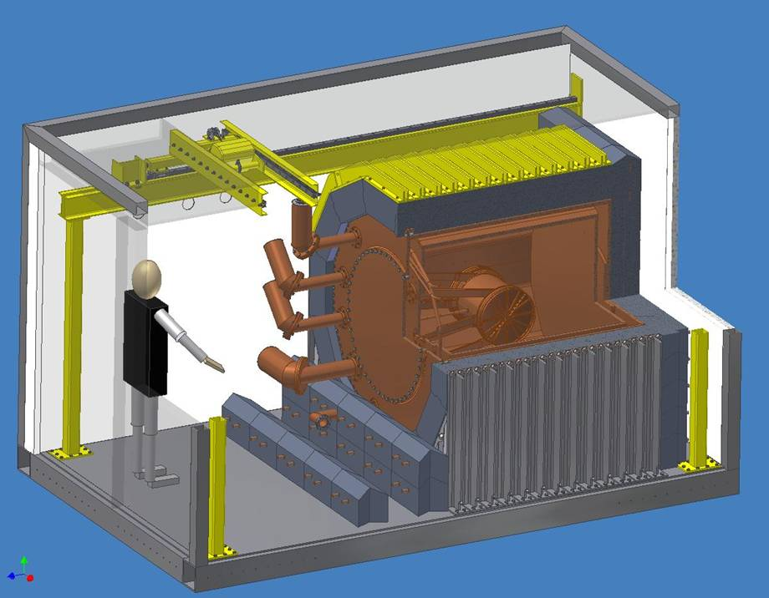
5 cm Cu cryostat
50 cm cryogenic
fluid HFE-7000
25 cm Pb
EXO-200
Thin walled Cu
TPC

Slide 43
Status now:
Xenon gas (first at room temp. later at -90 C) has been
circulated since May 2010 through TPC to remove
electronegatives. Our GPMs show improving purity.
Summer 2010 liquid Xe filling was put on hold to wait for
improvements of the line power and installation of faster fiber
connection. This was done out of an abundance of caution.
Detector is now cold and filled with enr. Xe. We have
several months of low background data.
Next steps: finish Rn trap, Rn enclosure.

Slide 44
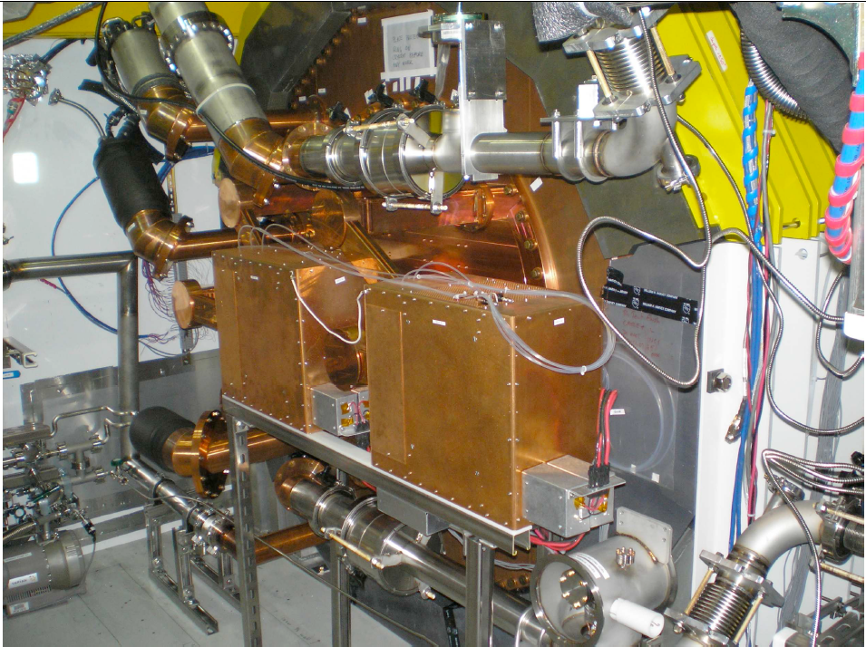
EXO-200 engineering run Dec 2010
Check stability of all LXe/GXe systems
Check Xe purity
Check electronics
Generally test detector performance
Test Xe emergency recovery
No front shielding
No Rn enclosure
No Rn trap in Xe system
No veto counter

Slide 45
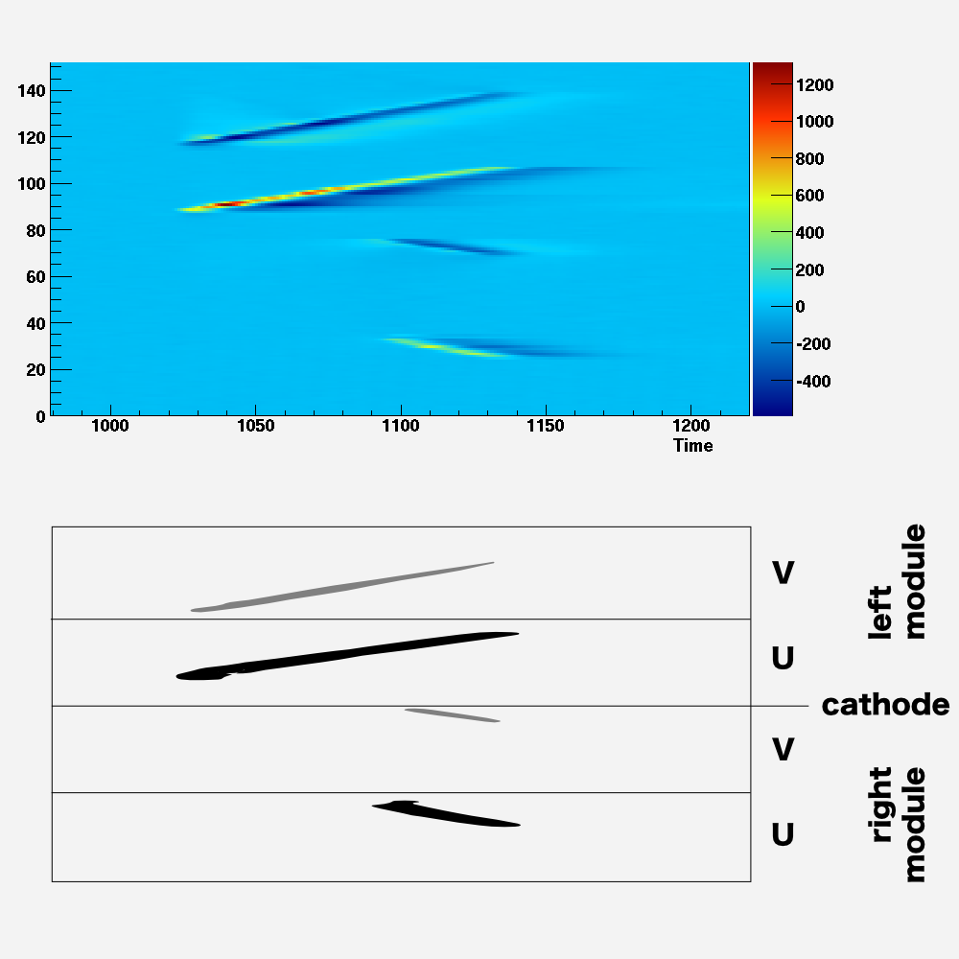
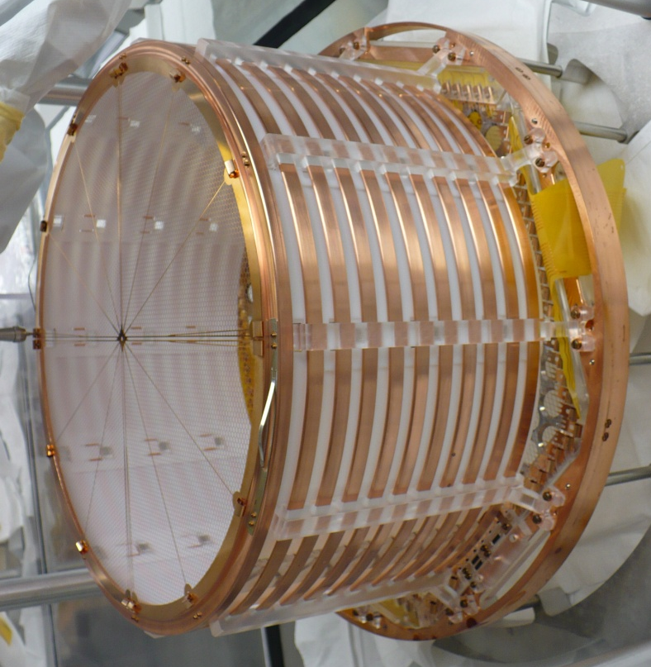
Muon track in EXO-200 (Dec 2010)
One of the two TPC modules
Cathode
U and V wires
A track from a cosmic-ray muon in EXO-200. The horizontal axis represents time (uncalibrated
for now) while the vertical is the wire position (see sketch). V-wires, in front of the charge-
collecting U-wires report a smaller inductive signal. The two sets of wires cross at 60º angle.
The muon in the present event traverses the cathode grid, leaving a long track in one TPC
module and a shorter one in the other.

Slide 46
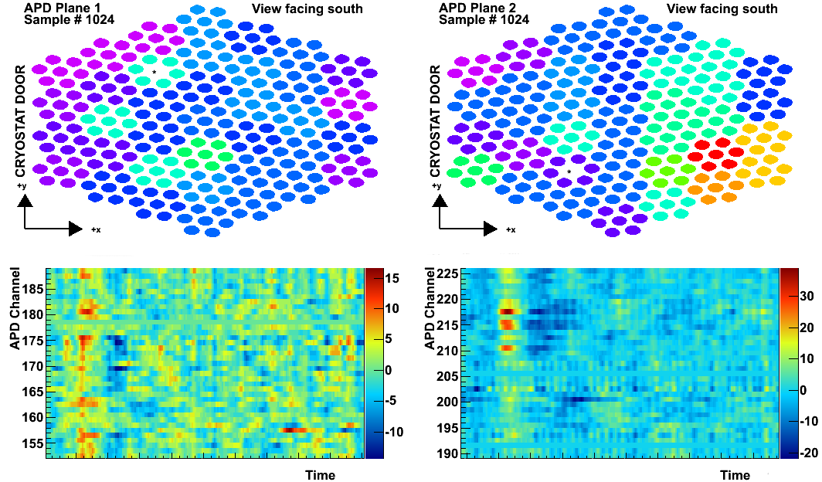
V
U
V
U
Side 1 Side 2
A single-site energy
deposition in EXO-200.
Top display is charge readout (V are
induction wires and U are collection wires).
Left display is light readout. APD map
Refers to the sample with max signal.
Scintillation light is seen from both sides,
although more intense and localized on
side 2, where the event occurred.
Small depositions produce induction
signals on more than one V wires
but are collected by a single U wire.
V signal always comes before U.
Light signals precede in time the charge
ones

Slide 47
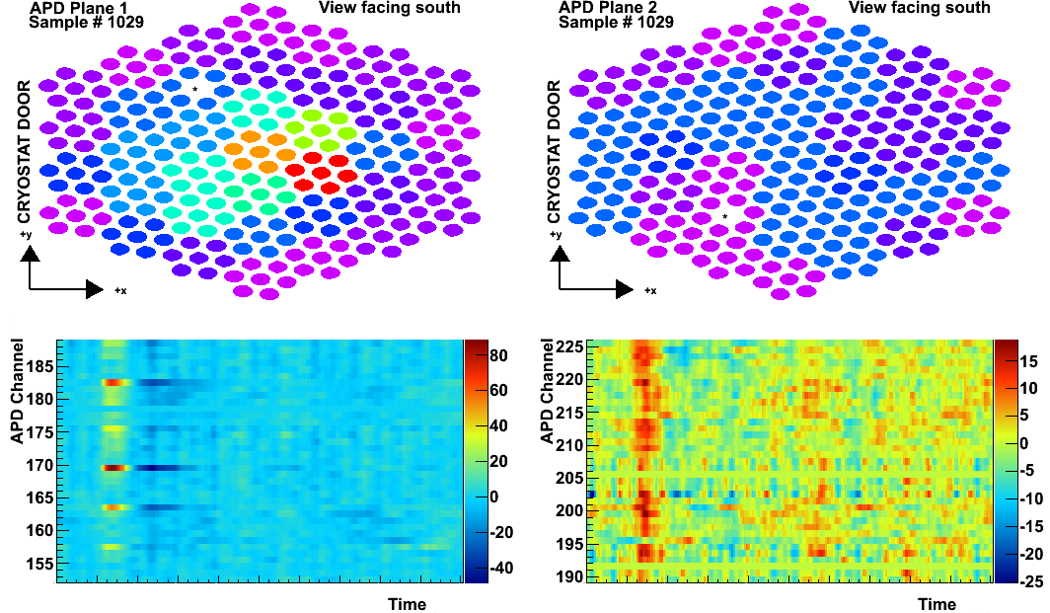
V
U
V
U
Side 1 Side 2
A two-site Compton
scattering event.
All scintillation light arrives at
the same time, indicating that
the two energy depositions
are simultaneous.
The scintillation light is brighter
and more localized on Side 1
where the scattering occurs

Slide 48
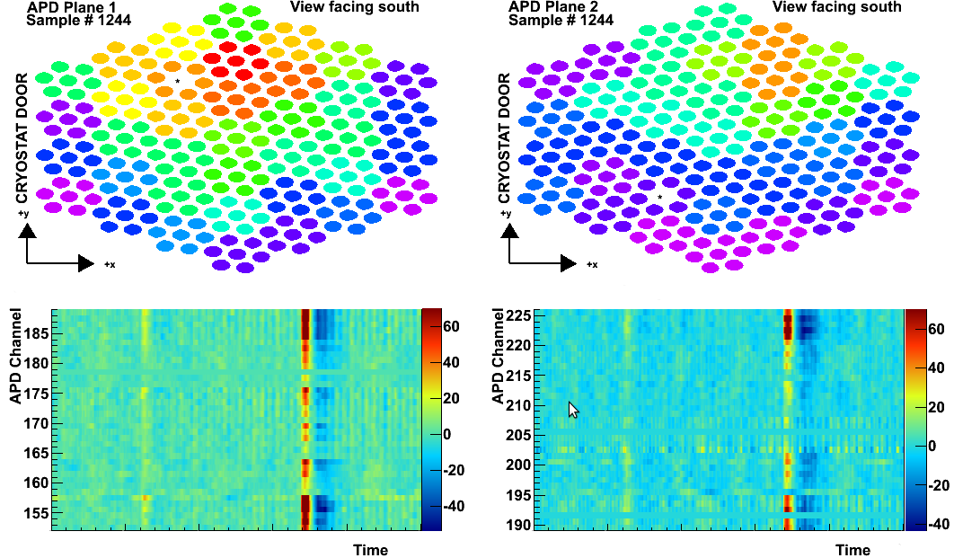
V
U
V
U
Side 1 Side 2
A possible ²¹⁴Bi - ²¹⁴Po
correlated event
There are two scintillation flashes but only
one event of charge collection.
Since light always comes first, the charge
site is related to the first scintillation flash.
This is consistent with the β from the
²¹⁴Bi→²¹⁴Po+β+ν decay in the ²³⁸U chain.
The second scintillation flash without a
charge counterpart is consistent with the
detection of the α from ²¹⁴Po→²¹⁰Pb+α
The time between the two scintillation flashes
is consistent with the T_{1/2} of ²¹⁴Po (164µs).
The timing is also consistent with the ²¹⁴Bi
being very close to the cathode grid.

Slide 49
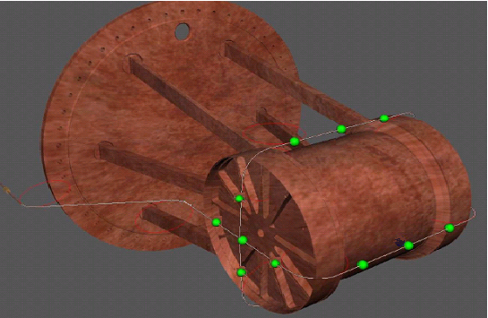
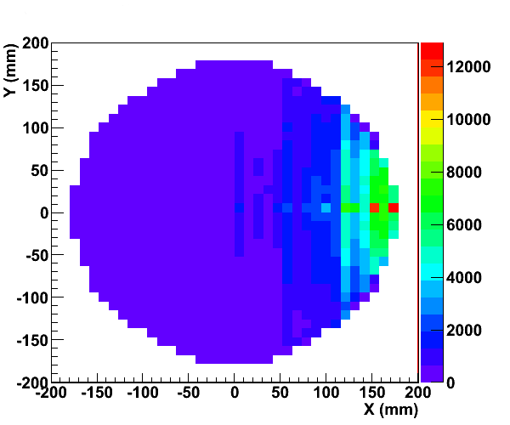
Early calibration source run
Various calibration sources
can be brought to several
positions just outside
the detector
⁶ ⁰Co
source
y
z
x
x-y distribution of events
clearly shows excess near
the source location

Slide 50
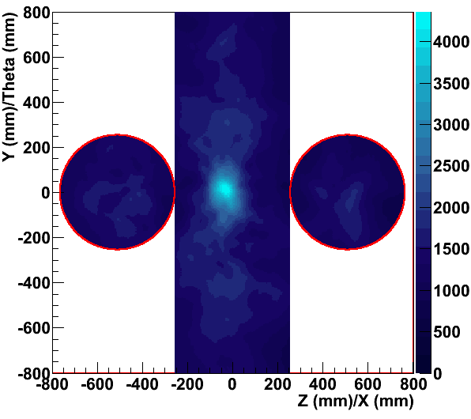
Can point to source using a
Compton telescope technique
500
events
Detector measures E, x, y, z
for each site
Use scattering formula
From each site a cone is
drawn and adding up
these cones produces
the image to the right

Slide 51
The NatlXe used for the EXO-200 engineering run contains Kr
The total Kr concentration in the ^{nat}Xe was measured
to be, using a special technique involving mass-spec*,
(42.6±5.7)∙10⁻⁹ g/g
*A.Dobi et al., arXiv:1103.2714v1

Slide 52
The ⁸⁵Kr fraction of the Kr in the detector can be seen in the
low energy spectrum (for the time being only use charge readout,
light-charge correlation analysis still in progress)
Energy scale set by ⁶⁰Co calibration
χ²/ndf=46.2/39
Adjust ⁸⁵Kr simulation to match the data in the integral from 450keV to the Q value (687keV)
Consistent with Mass Spec result assuming
standard ⁸⁵Kr/Kr concentration of ~10⁻¹¹

Slide 53
A first look at the ⁸⁵Kr endpoint
Q=(668±22^{stat}±18^{syst})keV
χ²/ndf=26.5/29
Near end point other backgrounds start to emerge:
- Fit Kurie plot excluding data above 635keV
- Vary fit range to
Measured Q value in good agreement with expectation (687keV)

Slide 54
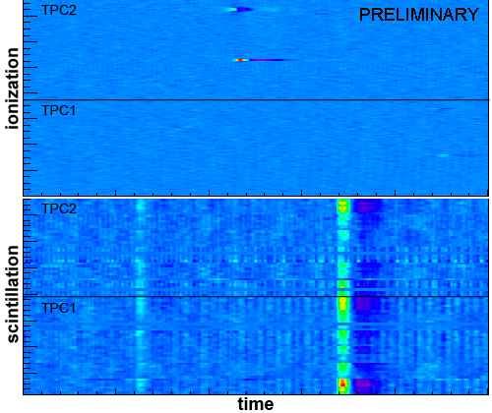
²¹⁴Bi – ²¹⁴Po correlations in the EXO-200 detector
²¹⁴Po
164 μs
²¹⁰Pb
22.3 y
β
²¹⁴Bi undergoes β-decay
into ²¹⁴Po which then
undergoes α-decay with a
half life of 164 μs.
α
²¹⁴Bi
20 m
²²²Rn
3.8 d
²³⁸U
4.8 Gy
…
²¹⁸Po
3.1 m
²¹⁴Pb
26.8 m
β-decay
α-decay
Bi-Po events are identified by their
characteristic event topology which has
a high probability to be detected in a
single trigger window.
α: strong light signal, weak charge signal
β: weak light signal, strong charge signal
Scintillation Ionization

Slide 55
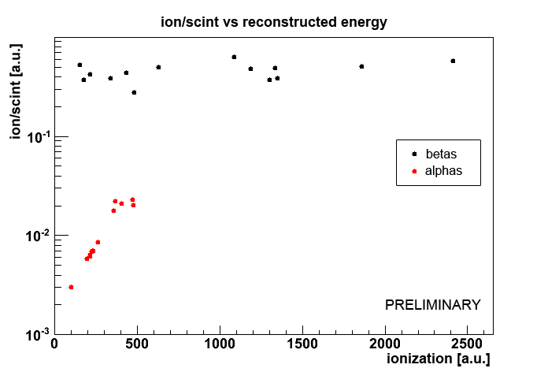
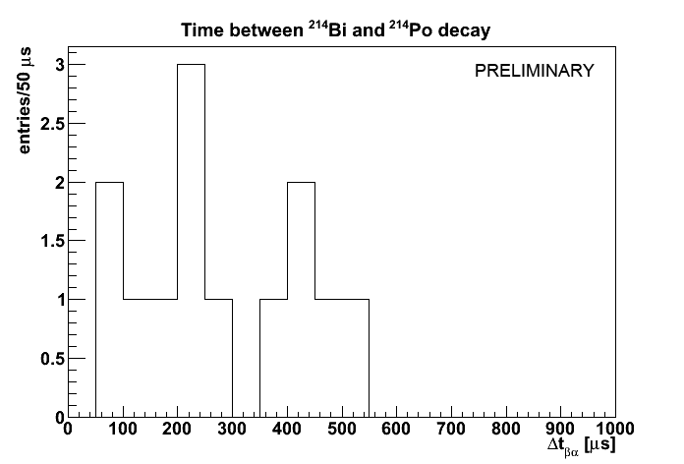
²¹⁴Bi – ²¹⁴Po correlations in the EXO-200 detector
α and β particles can be identified by their
ionization/scintillation ratio (right plot).
15 Bi-Po events were found in a
commissioning run.
6 of them occurred on or near the
cathode whereas the others are
located in the bulk of detector.
The average time between the β and α decay
(left plot) is 242 μs which corresponds to
τ = 271 μs.
Considering the low statistics, this is in good agreement with the true value of τ=237 μs.
Accurate detection efficiency still under study
but the 214Bi decay rate is consistent with
expectation before the Rn trap is commissioned.

Slide 56
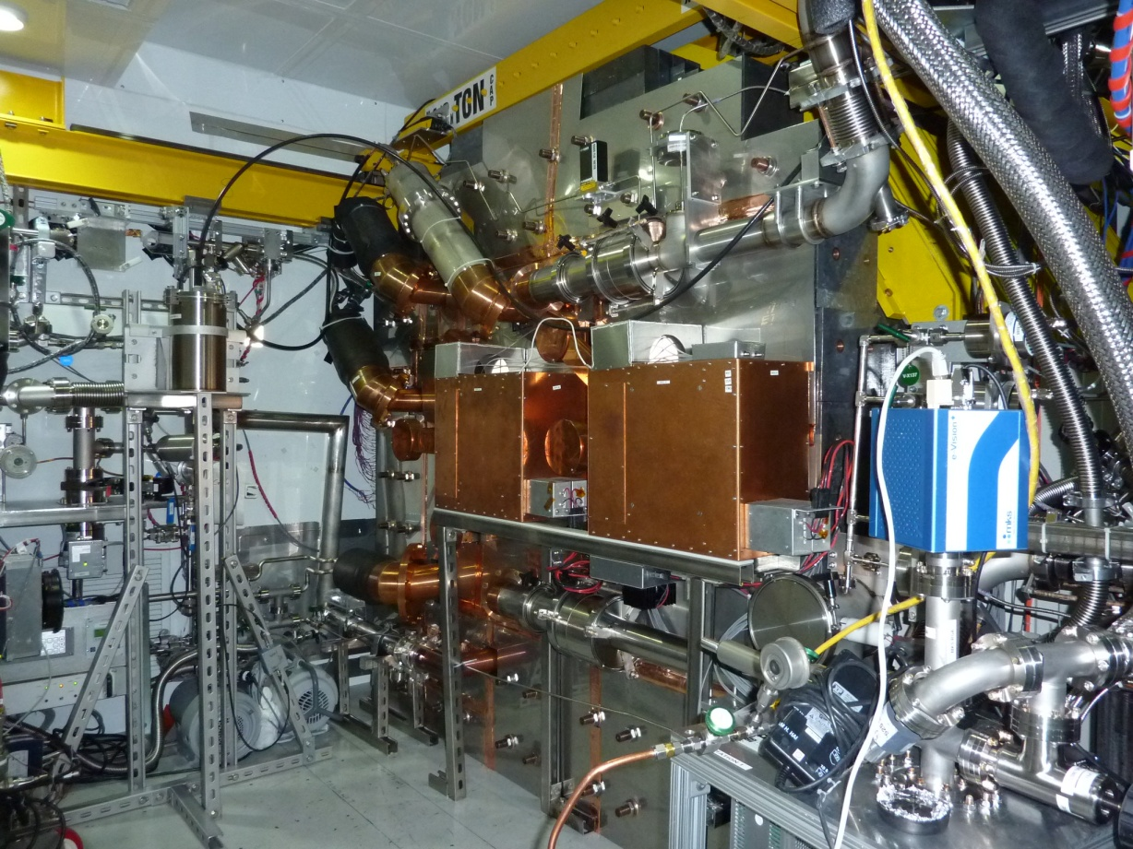
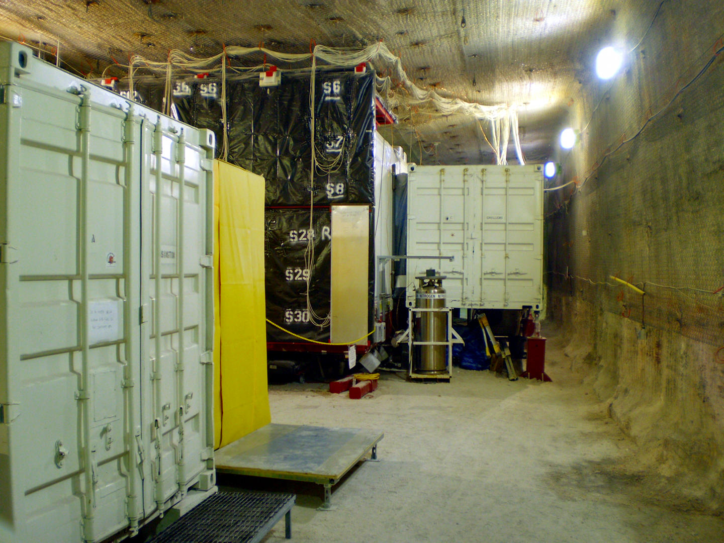
Front shield
& Rn enclosure
Veto counter installed
and commissioned

Slide 57
EXO-200 Majorana mass sensitivity
Assumptions:
200kg of Xe enriched to 80% in 136
σ(E)/E = 1.4% obtained in EXO R&D, Conti et al Phys Rev B 68 (2003) 054201
Low but finite radioactive background:
20 events/year in the ±2σ interval centered around the 2.46MeV endpoint
4) Negligible background from 2νββ (T_{1/2}>1·10²²yr R.Bernabei et al. measurement)
Case | Mass (ton) | Eff. (%) | Run Time (yr) | σ_{E}/E @ 2.5MeV (%) | Radioactive Background (events) | T_{1/2}^{0ν} (yr, 90%CL) | Majorana mass (meV) QRPA¹ NSM²
EXO-200 | 0.2 | 70 | 2 | 1.6* | 40 | 6.4×10²⁵ | 109 | 135
Simkovic et al. Phys. Rev. C79, 055501(2009) [use RQRPA and
g_{A}= 1.25]
2) Menendez et al., Nucl. Phys. A818, 139(2009), use UCOM results

Slide 58
What if the signal reported by Klapdor-Kleingrothaus is due
ββ-decay?
T_{1/2}(Ge)=2.23^{+0.44}_{-0.41}∙10²⁵ (±1σ) [MPLA 21 (2006) 1547]
In 200 kg EXO, after 2 yrs of life time:
Worst case (RQRPA, 1 σ upper half life, a=0.5):
51 events on top of 40 events bkgd → 5.4 σ
Best case (NSM, 1 σ lower half life, a=0.39):
91 events on top of 40 bkgd → 8.0 σ

Slide 59
Ba single ion detection
Out of time?
Skip to end.

Slide 60
Xe offers a qualitatively new tool against background:
¹³⁶Xe ¹³⁶Ba⁺⁺ e⁻ e⁻ final state can be identified
using optical spectroscopy (M.Moe PRC44 (1991) 931)
Ba⁺ system best studied
(Neuhauser, Hohenstatt,
Toshek, Dehmelt 1980)
Very specific signature
“shelving”
Single ions can be detected
from a photon rate of 10⁷/s
²P_{1/2}
650nm
493nm
metastable 47s
⁴D_{3/2}
Important additional
constraint
Drastic background
reduction
²S_{1/2}

Slide 61
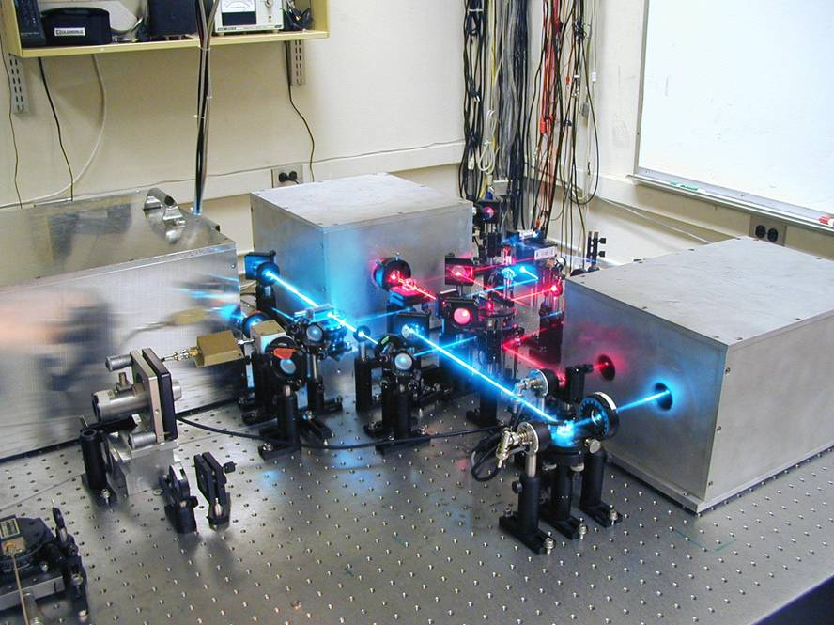
Stable laser tagging system
Red Laser
Reference
Cavities
Blue Laser

Slide 62
Ba⁺ Linear Ion Trap
U
CCD
Ba oven
Scope
Spectroscopy lasers
Vcos(Ωt) + U
0 Volts
e- gun
DC potential [V]
Ba
Buffer gas
-5 Volts
High ion loading efficiency observed.
Ions loaded at one end will travel to the other.
Ions can be manipulated by changing DC potential configuration.

Slide 66
The next generation

Slide 67
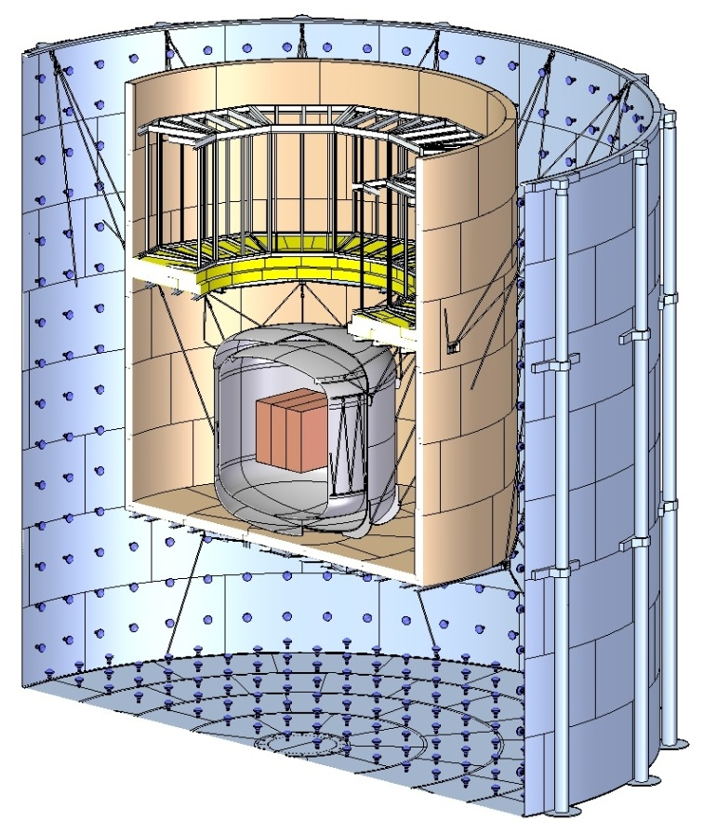
10 Tonne EXO Basics
LXe core
LXe core
Liquid Xenon (¹³⁶Xe)
Fiducial Mass = 10 Tonnes
Volume = 3,400 liters
Temperature = 165K
Cu vessel for LXe
Single vessel, 170cm x 160cm x 170cm
3 equally sized internal chambers
TPC – Time Projection Chamber
Central Cathode in each chamber
Max drift distance = 25cm
Ionization and scintillation readout
Coincidence measurement by identifying Ba⁺⁺ Daughter
TPC
From M. Breidenbach

Slide 68
10 Tonne EXO Basics
TPC – Time Projection Chamber
Central Cathode in each chamber
Max drift distance = 25cm
Central Cathode
25cm drift
150cm
25cm
drift
160cm
50cm
From M. Breidenbach

Slide 69
10 Tonne EXO Basics
TPC – Time Projection Chamber
Central Cathode in each chamber
Max drift distance = 25cm
LAAPDs and Anode planes
Ionization and scintillation readout
LAAPD &
Anode planes
150cm
160cm
50cm
From M. Breidenbach

Slide 70
10 Tonne EXO Basics
TPC – Time Projection Chamber
Central Cathode in each chamber
Max drift distance = 25cm
LAAPDs and Anode planes
Ionization and scintillation readout
Ba++ grabber
Coincidence measurement by identifying Ba⁺⁺ Daughter
Ba⁺ Grabber
Gimbaled, telescoping
150cm
160cm
50cm
From M. Breidenbach

Slide 71
EXO neutrino effective mass sensitivity
Assumptions:
80% enrichment in 136
Intrinsic low background + Ba tagging eliminate all radioactive background
Energy res only used to separate the 0ν from 2ν modes:
Select 0ν events in a ±2σ interval centered around the 2.46 MeV endpoint
4) Use for 2νββ T_{1/2} > 1·10²² yr (Bernabei et al. measurement)
Case
Mass
(ton)
Eff.
(%)
Run Time
(yr)
σ_{E}/E @ 2.5MeV
(%)
2νββ
Background
(events)
T_{1/2}^{0ν}
(yr, 90%CL)
Majorana mass
(meV)
QRPA¹ NSM²
Conservative
1
70
5
1.6*
0.5 (use 1)
2*10²⁷
24
33
Aggressive
10
70
10
1†
0.7 (use 1)
4.1*10²⁸
5.3
7.3
* s(E)/E = 1.4% obtained in EXO R&D, Conti et al Phys Rev B 68 (2003) 054201
† s(E)/E = 1.0% considered as an aggressive but realistic guess with large light
collection area
¹⁾ Rodin, et. al., Nucl. Phys. A 793 (2007) 213-215
²⁾ Caurier, et. al., arXiv:0709.2137v2

Slide 72
Conclusion
Many thanks to all colleagues who supplied the material for
this talk! All mistakes or misrepresentations are entirely my
fault.
My sincere apology to all projects not covered: I couldn’t
possibly squeeze anything else in.
The End!

