Slide 1
AHCAL MIP Calibration
Yukun Shi

Slide 2
Motivation and strategy
Use MIP data and Simulation information to do energy calibration
Analyse HCAL and ECAL+HCAL muon data separately
HCAL: muon beam position fixed
ECAL+HCAL: muon beam position scanned
First do fit on chip level
for channels with adequate counts, do fit on channel level
for channels without enough statistics, use chip results as itself parameter

Slide 3
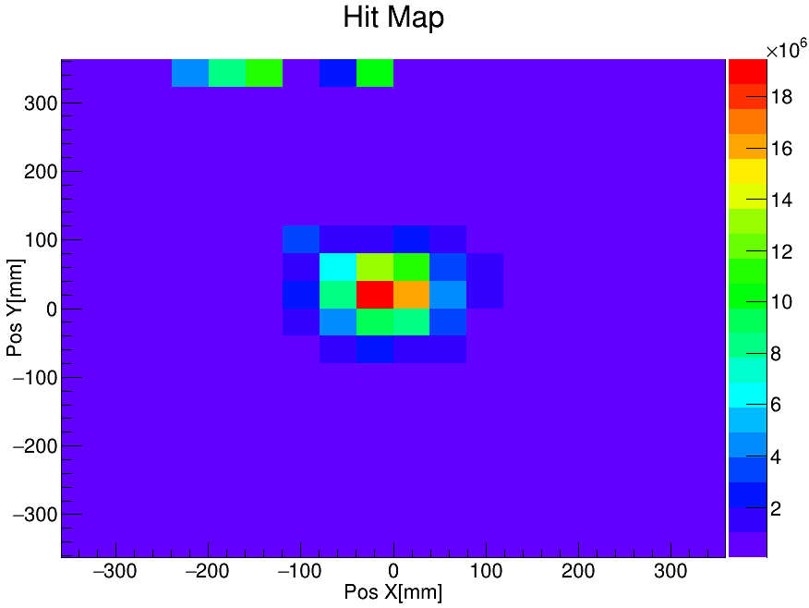
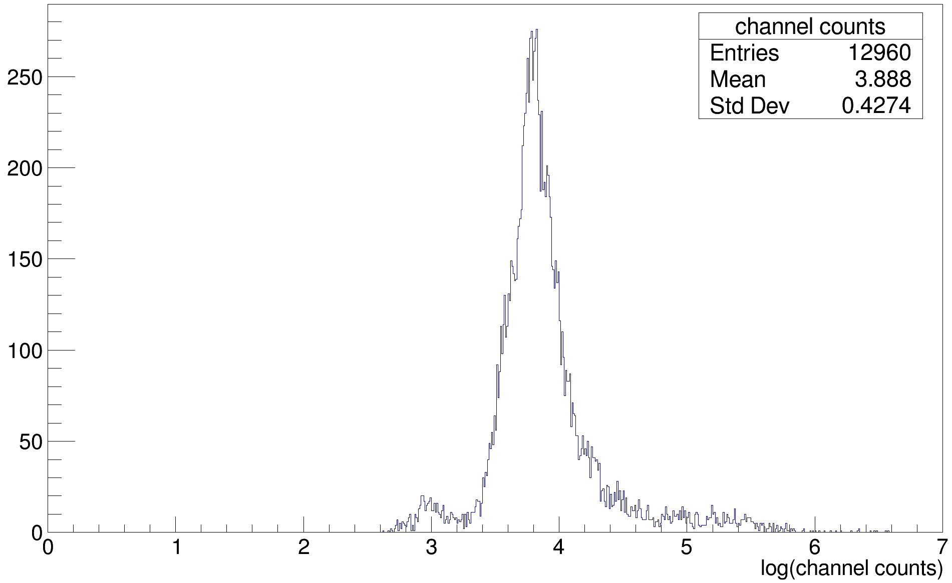
Statistics overview
HCAL alone statistics
There are channels with light leakage
Most of the channel’s statistics are around ${10}^{4}$

Slide 4
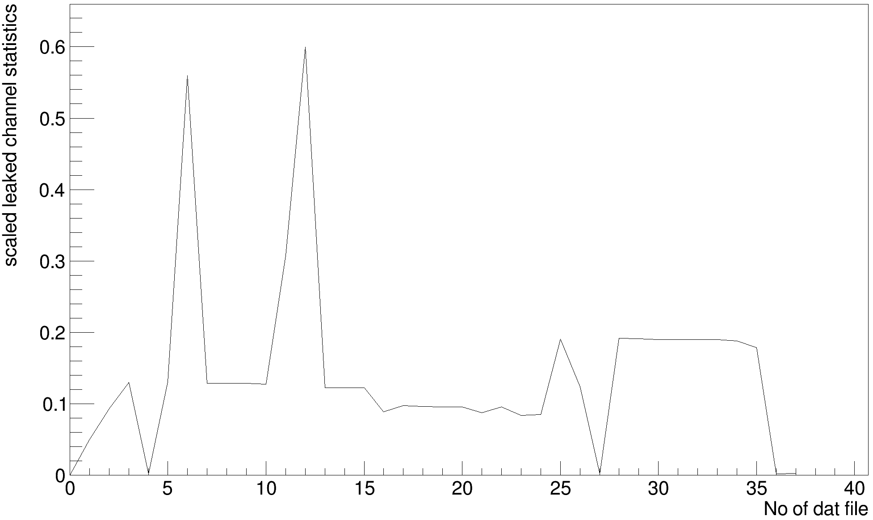
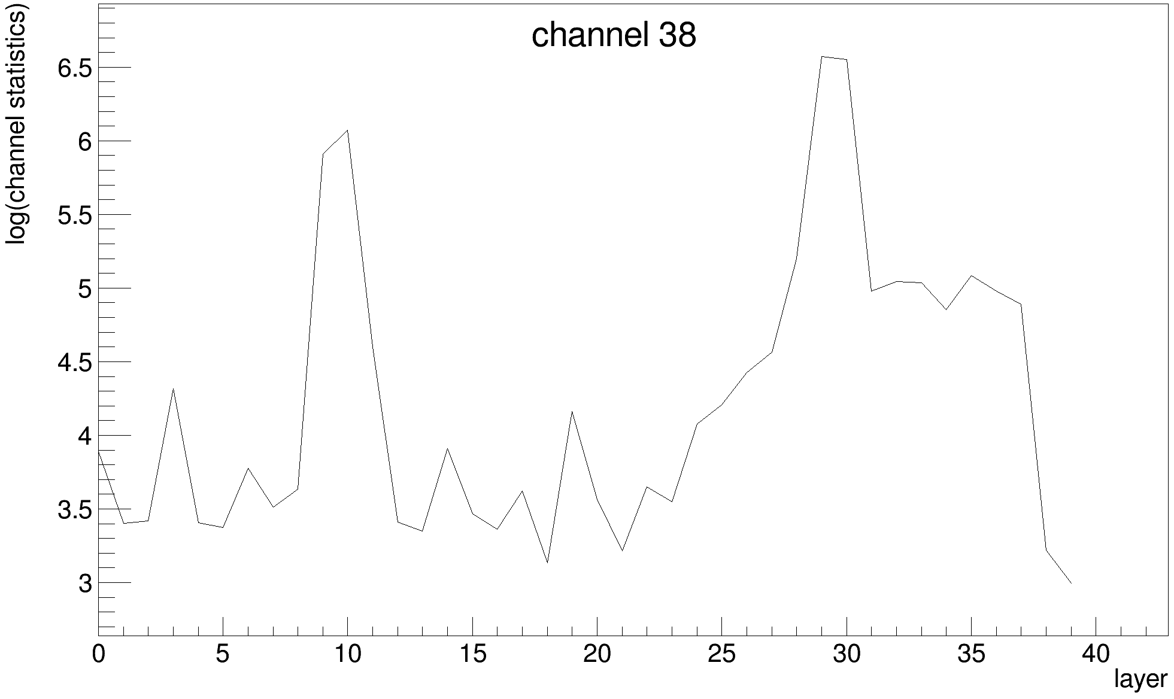
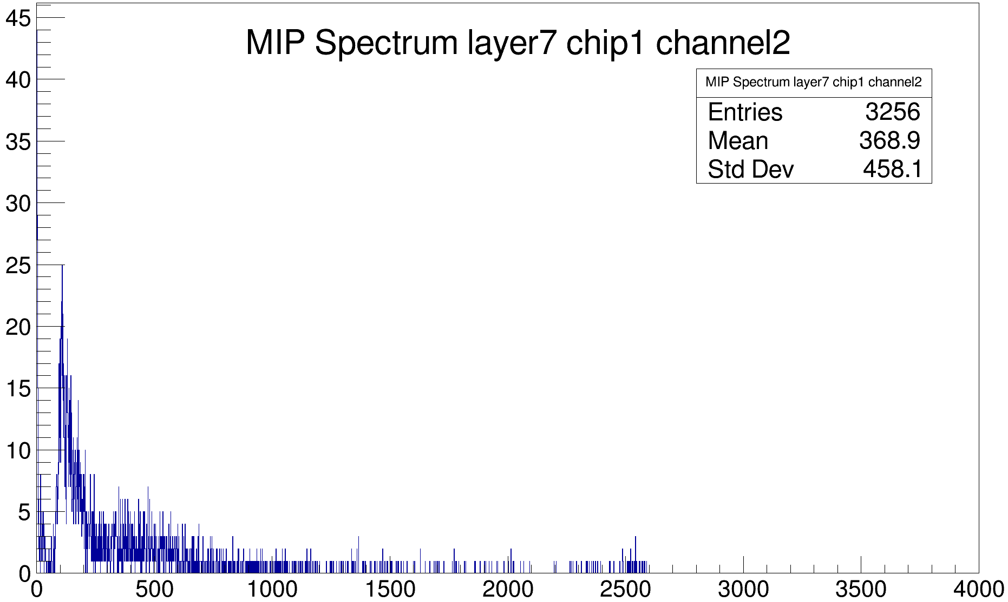
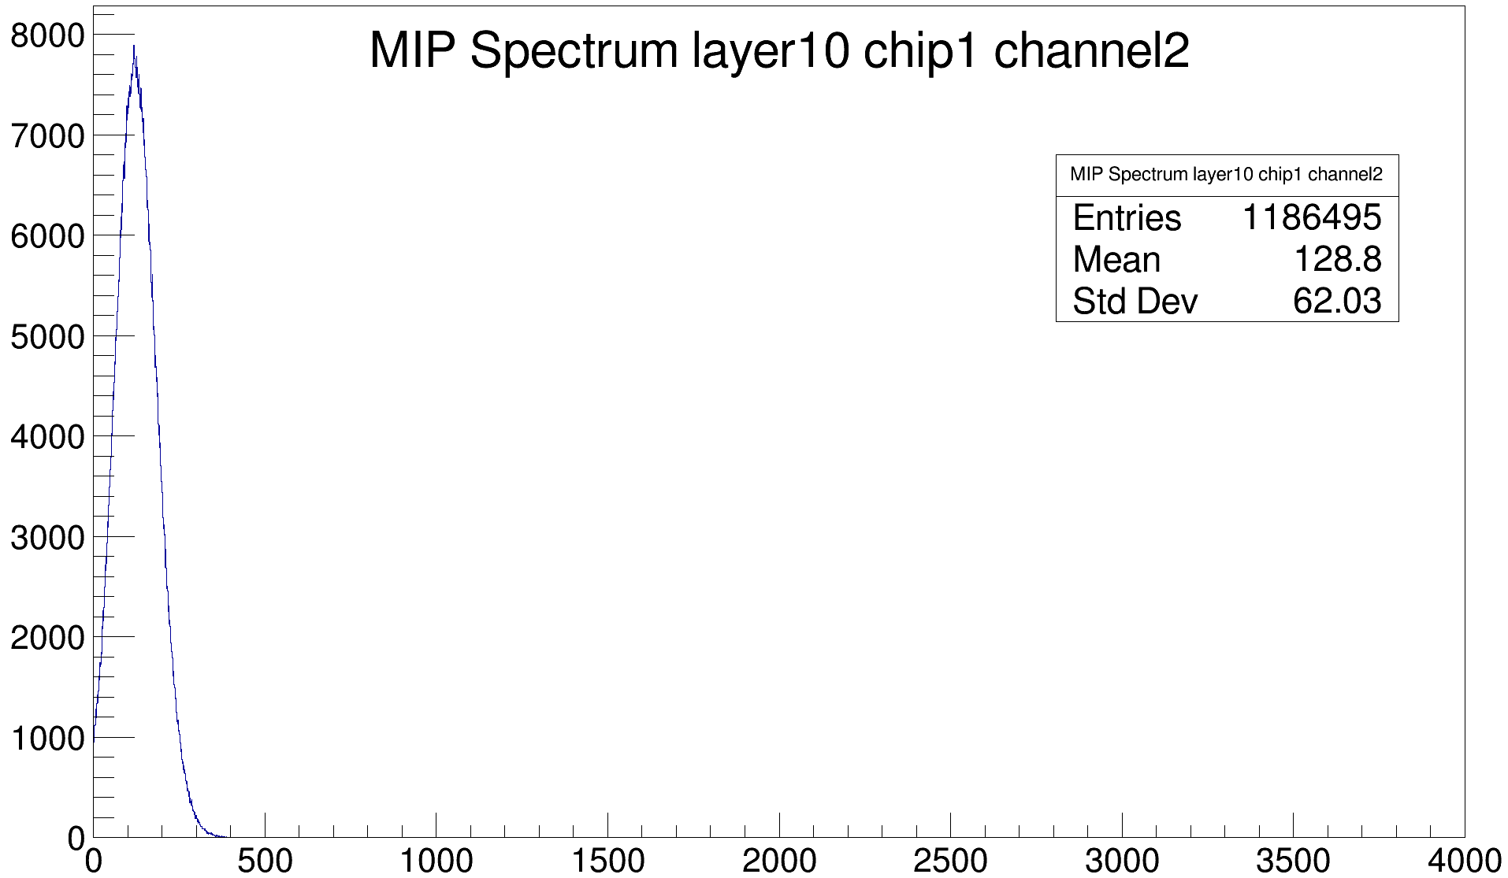
Statistics overview
HCAL alone leaked channels
No obvious time dependence
Abandon channels with > ${10}^{4}$ counts
abandoned

Slide 5
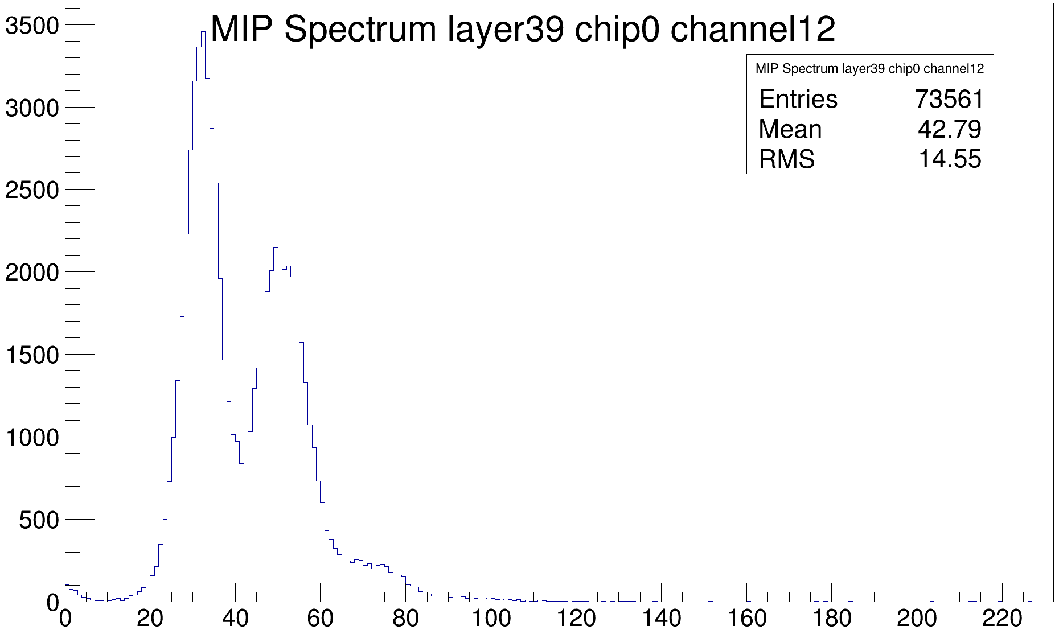
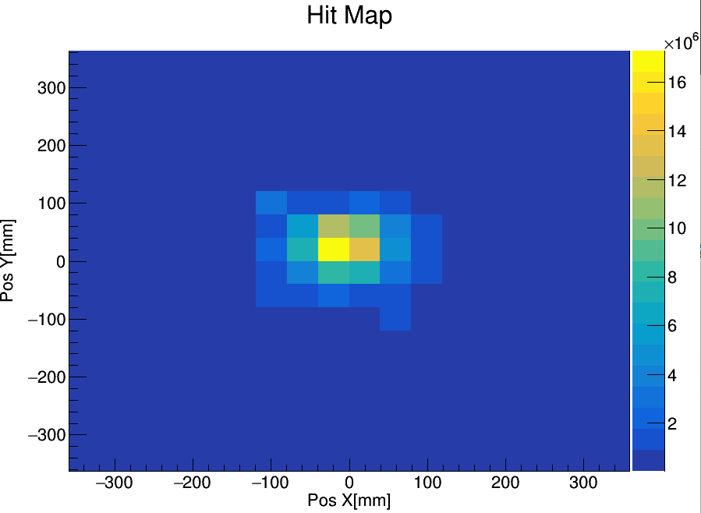
Statistics overview
Some abnormal NDL channels
Selection criteria:
More than ${10}^{4}$ counts & Mean value < 250
90 channels(0.4%) are abandoned
Abnormal NDL channel
Hit Map after selection

Slide 6
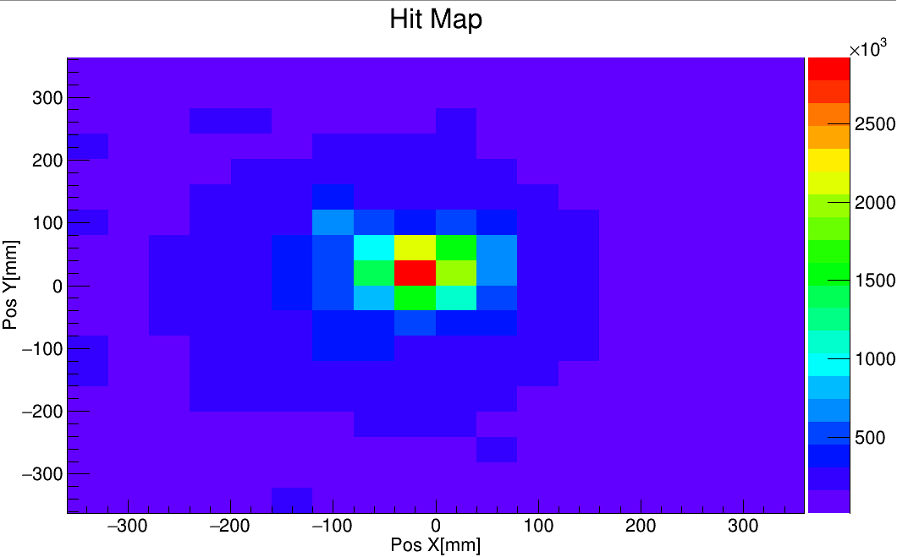
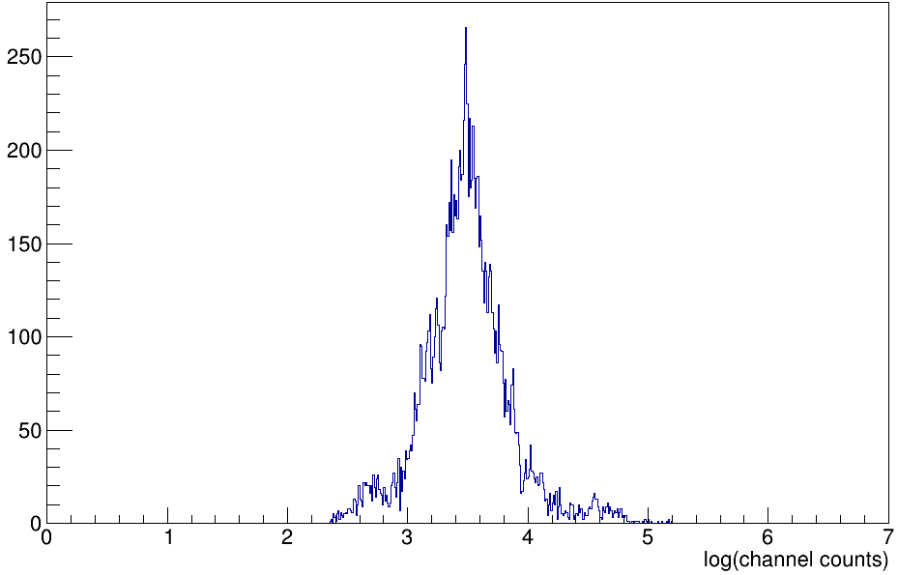
Statistics overview
Data in the ECAL+HCAL run
The light leakage has been fixed
NDL layers still have abnormal channels
The statistics is not enough for fittng at channel level

Slide 7
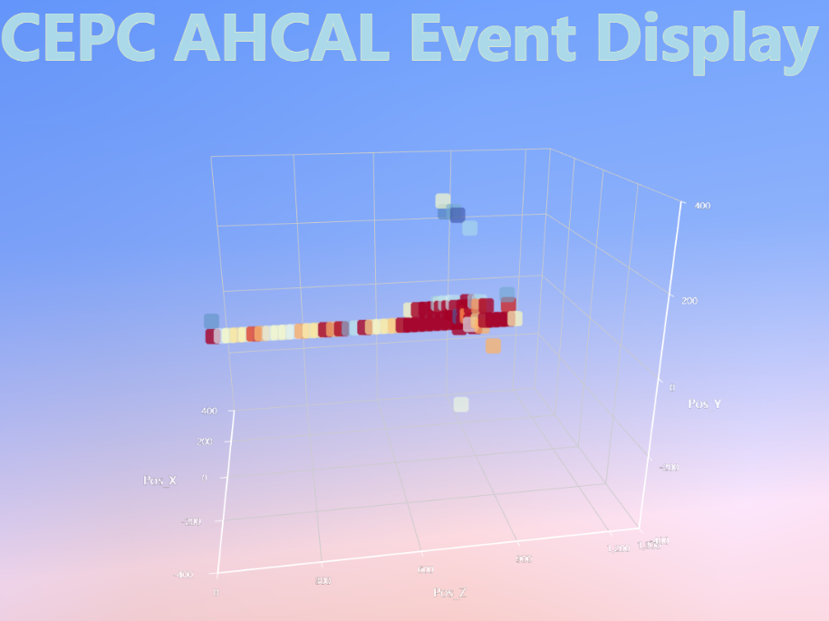
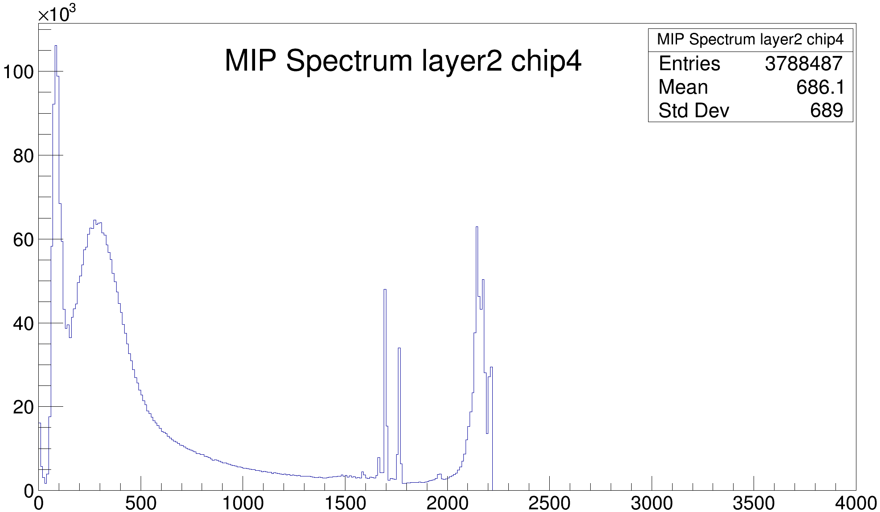
MIP Selection
Some events have showers
Saturation has also been observed

Slide 8
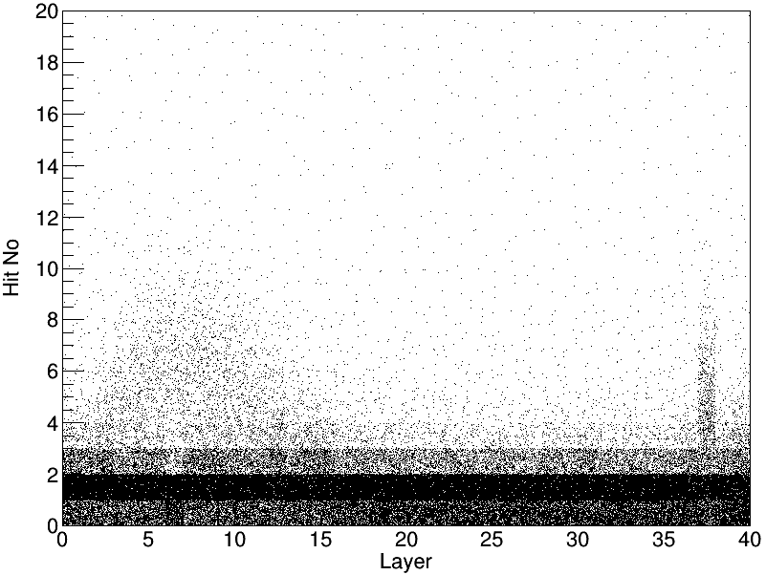
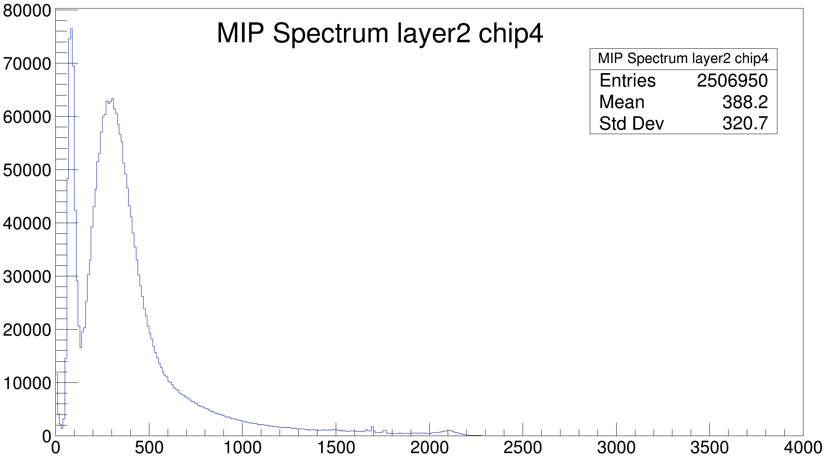
MIP Selection
Shower rejection
Max layer hits < 4
4292515 of 6453816(67%) passed
Fit in chip level is finished

Slide 9
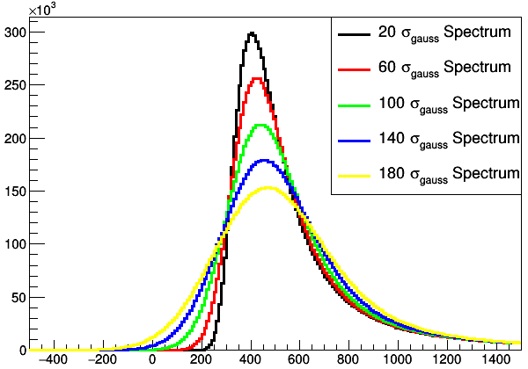
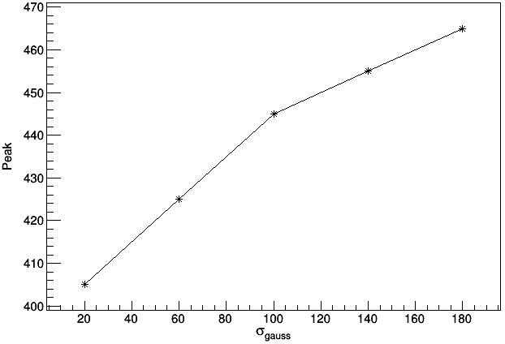
Scan of the $σ_{gauss}$
$σ_{gauss}$ increased from 20 to 180 by 40
$MPV=400$
$σ_{landau}=60$
The peak value has an obvious increase

Slide 10
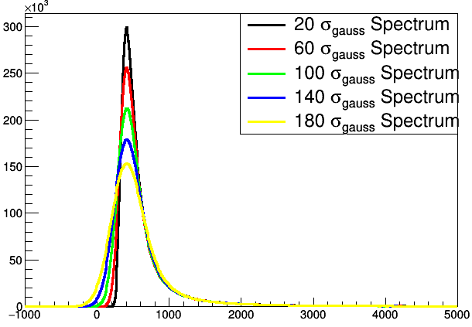
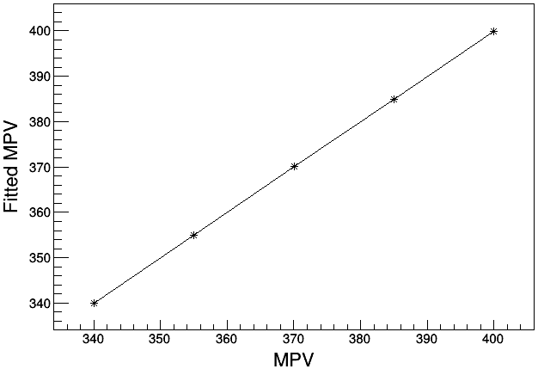
Fit method test
$σ_{gauss}$ increased from 20 to 180 by 40
$MPV$ decreased from 400 to 340 by 15
$σ_{landau}=60$
The fitted MPV is correct as if the fit is good

Slide 11
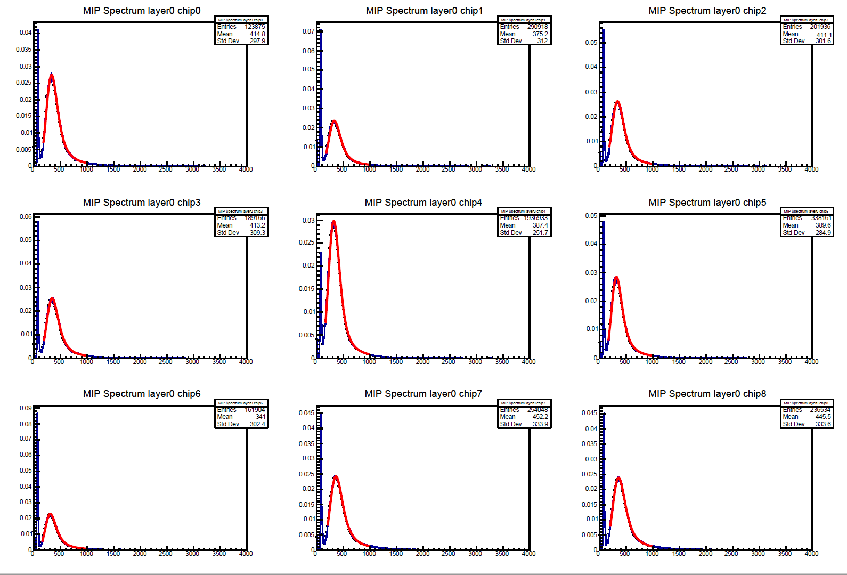
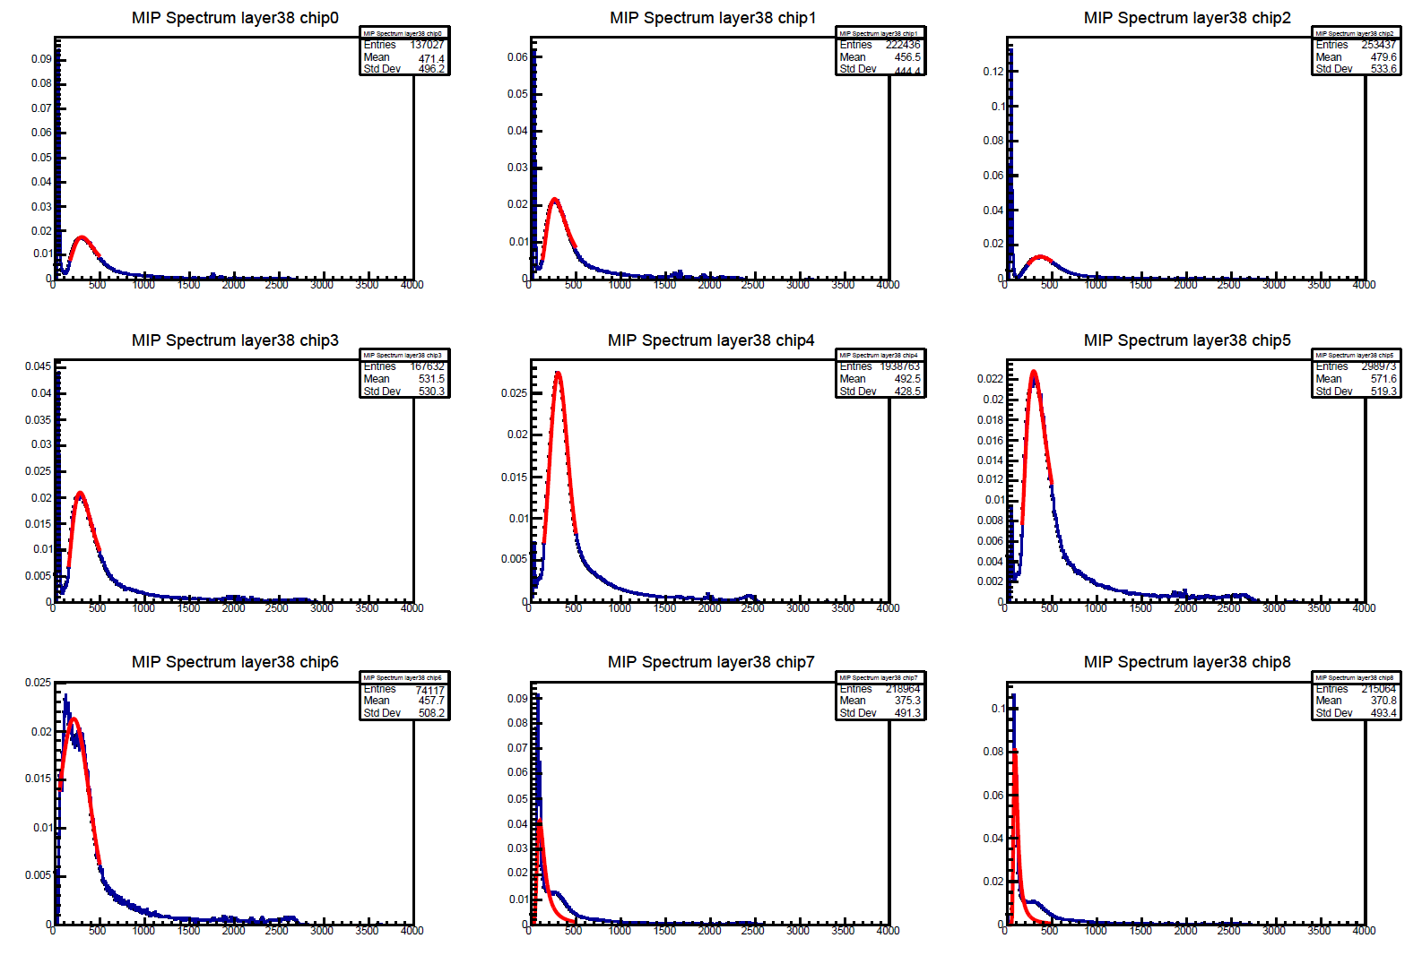
Chip fitting results
3 chips in NDL layers fail the fitting
They will use layer $MPV_{avg}$

Slide 12
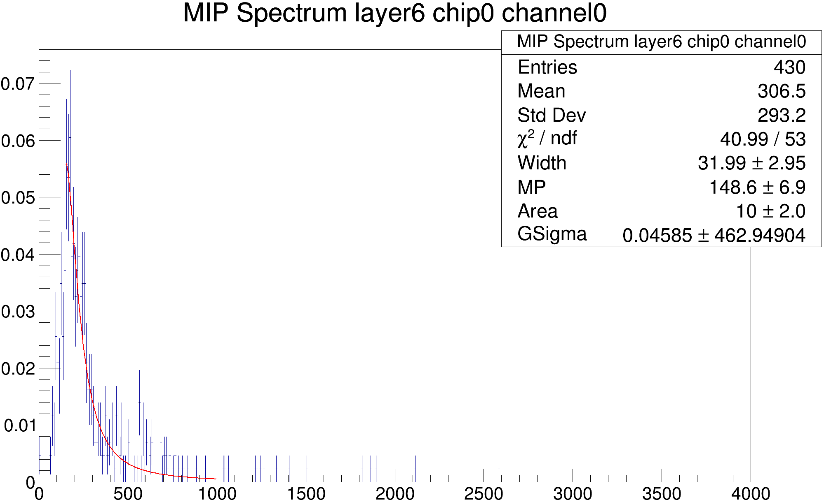
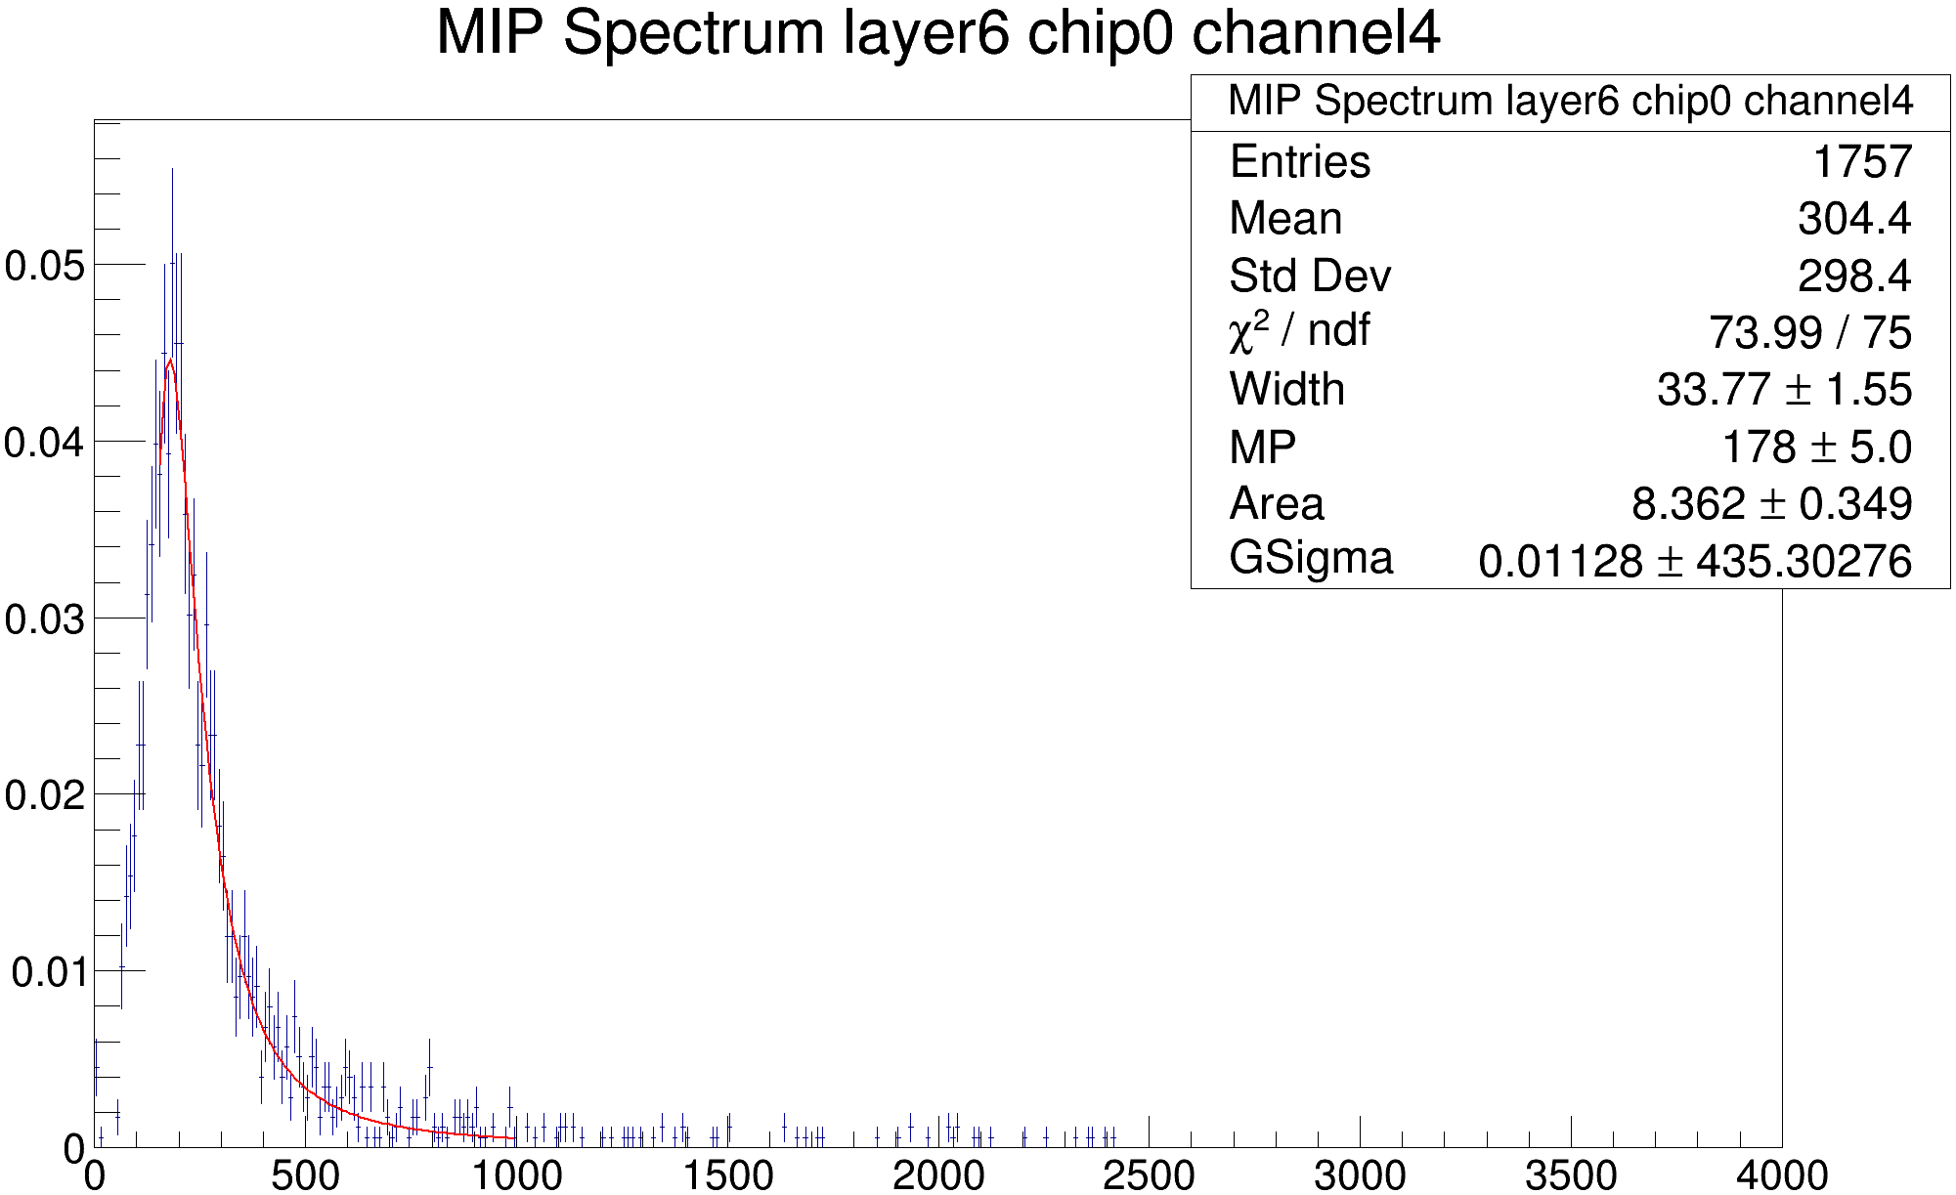
Channel overview
Inadequate statistics usually will cause abnormal fitting result
Small MPV means the MIP peak is not well distinguished from pedestal which is not so reliable
Abnormal MPV are usually accompanied with other abnormal parameters
Inadequate statistics
Small MPV

Slide 13
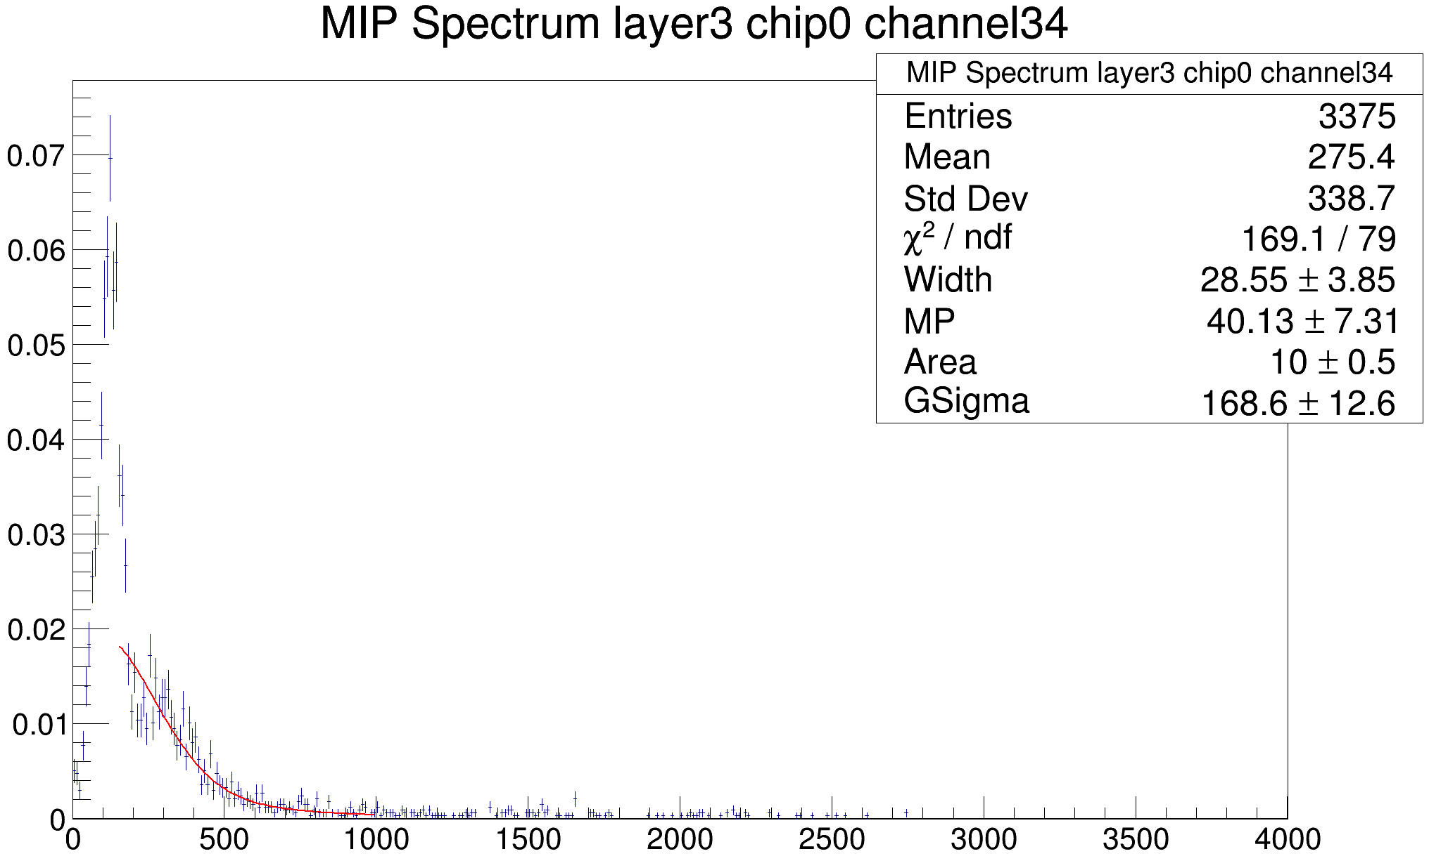
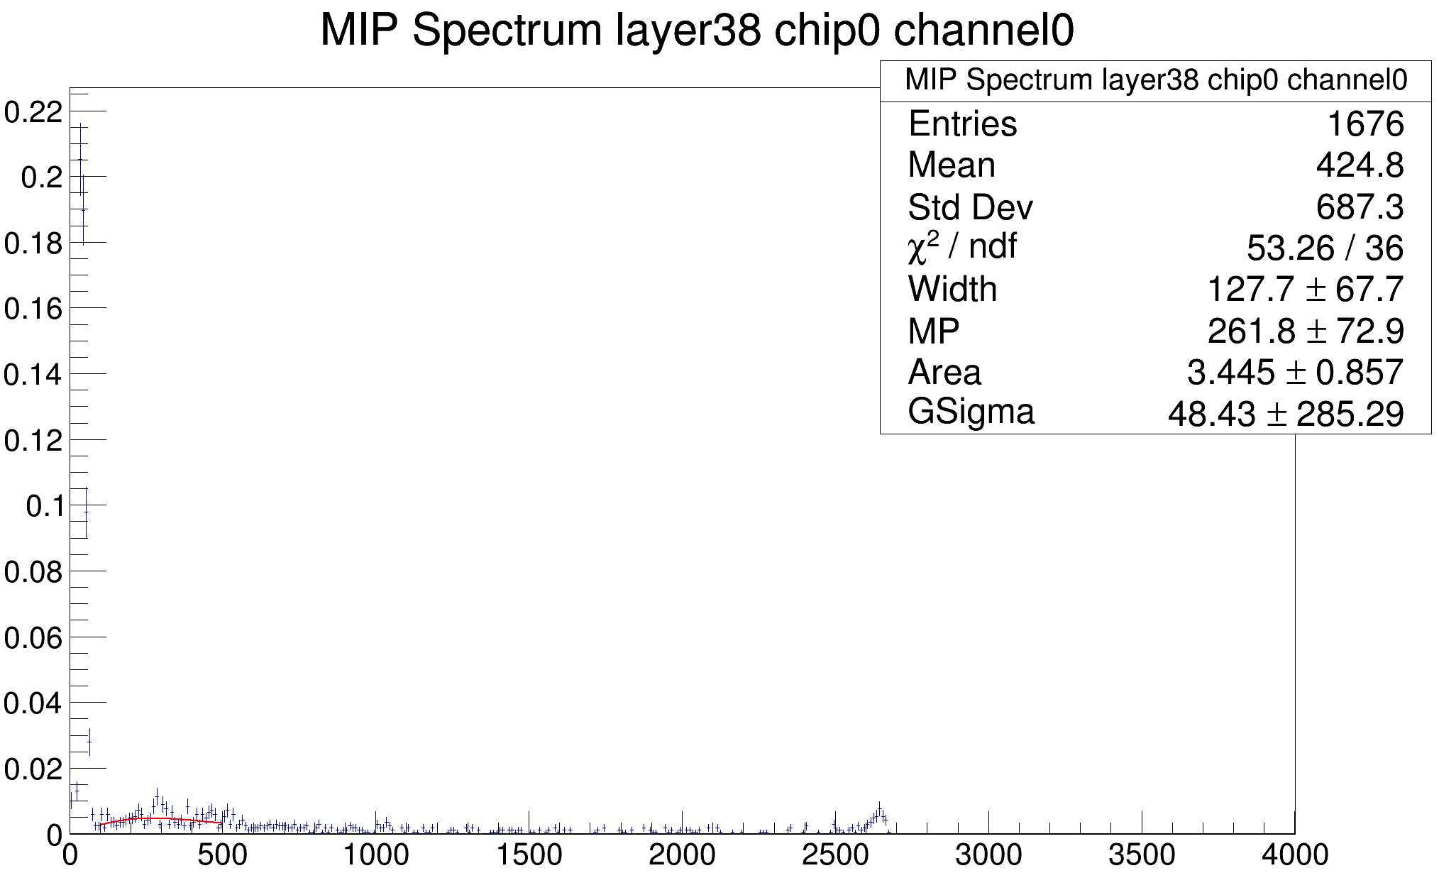
Channel overview
Large Gauss Sigma means the whole fitting is wrong even if other parameters seems normal
Abnormal landau sigmas gather up in NDL layers, mostly caused by inappropriate detector setup
Large gauss sigma
Abnormal landau width

Slide 14
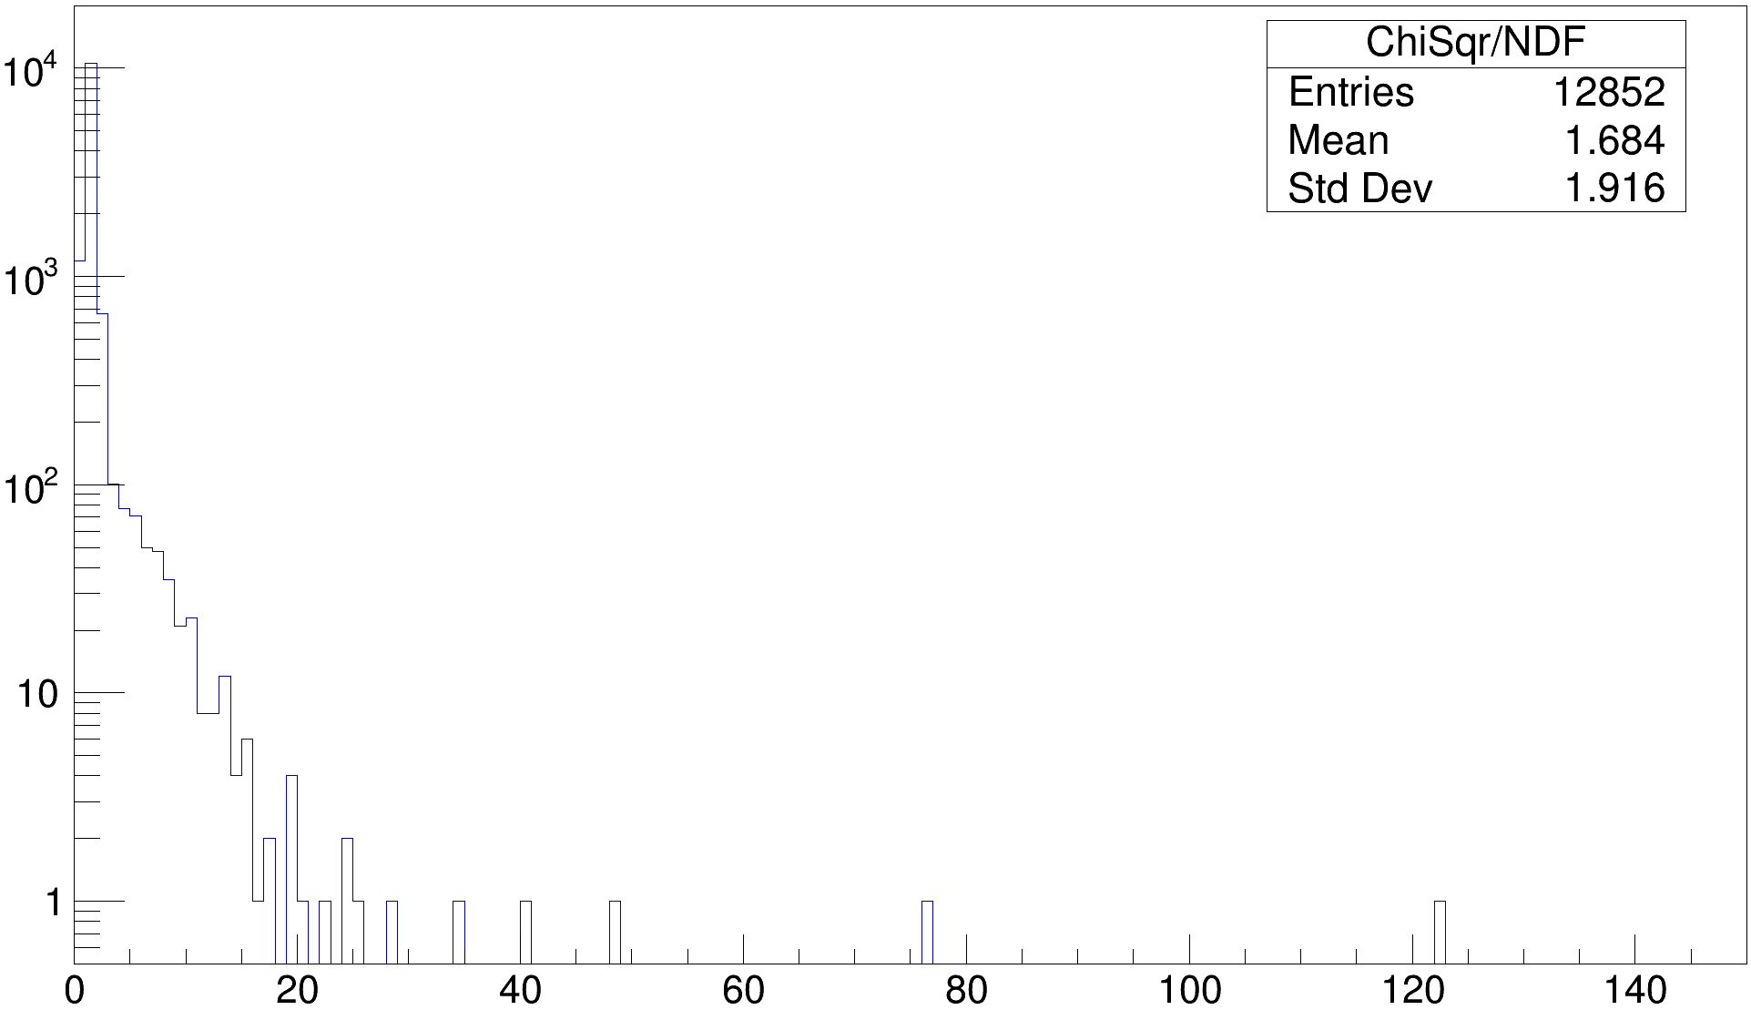
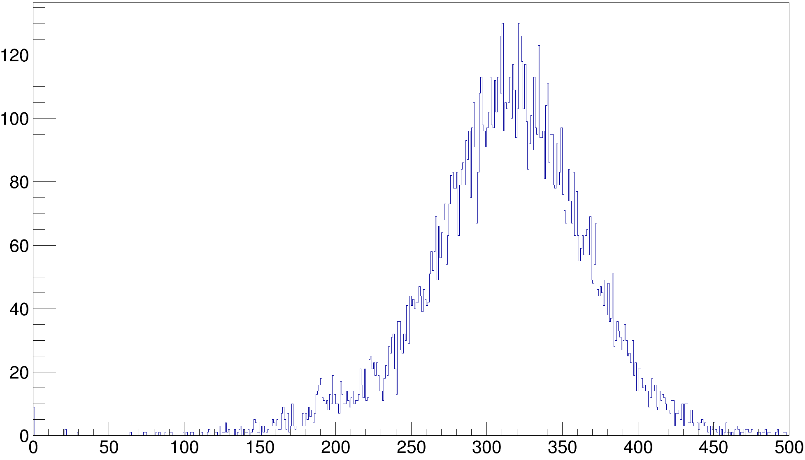
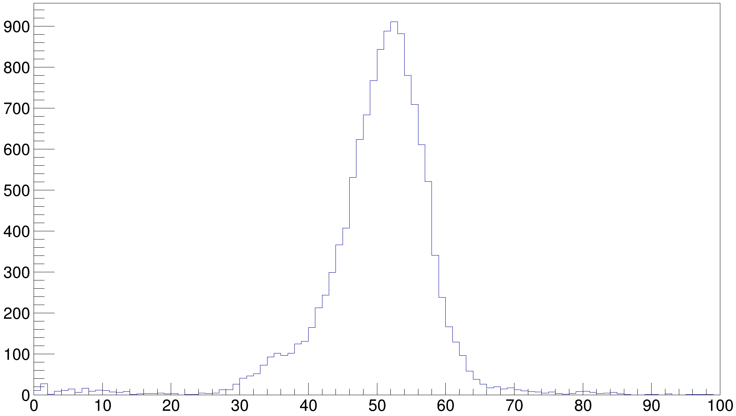
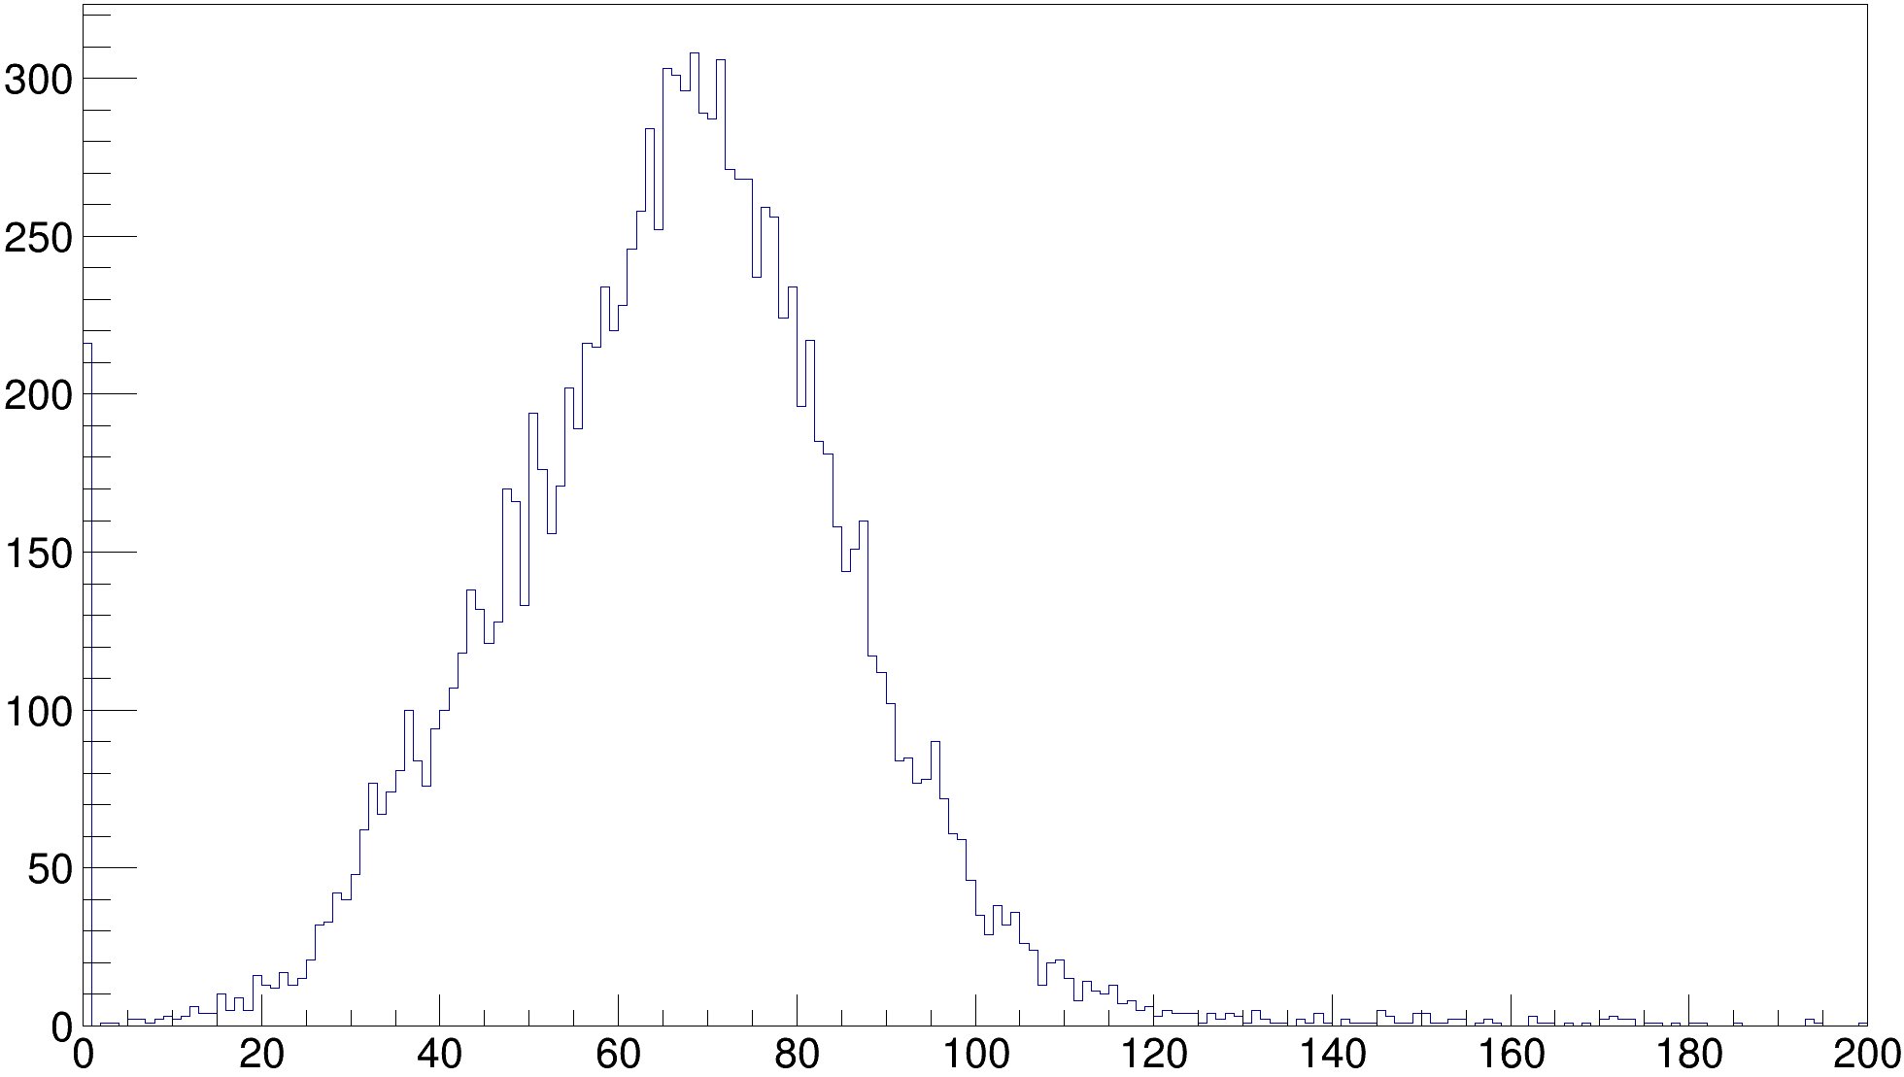
Channel overview
$$χ^{2}/NDF$$
$$MPV$$
$$Landau Width$$
$$Gauss Sigma$$

Slide 15
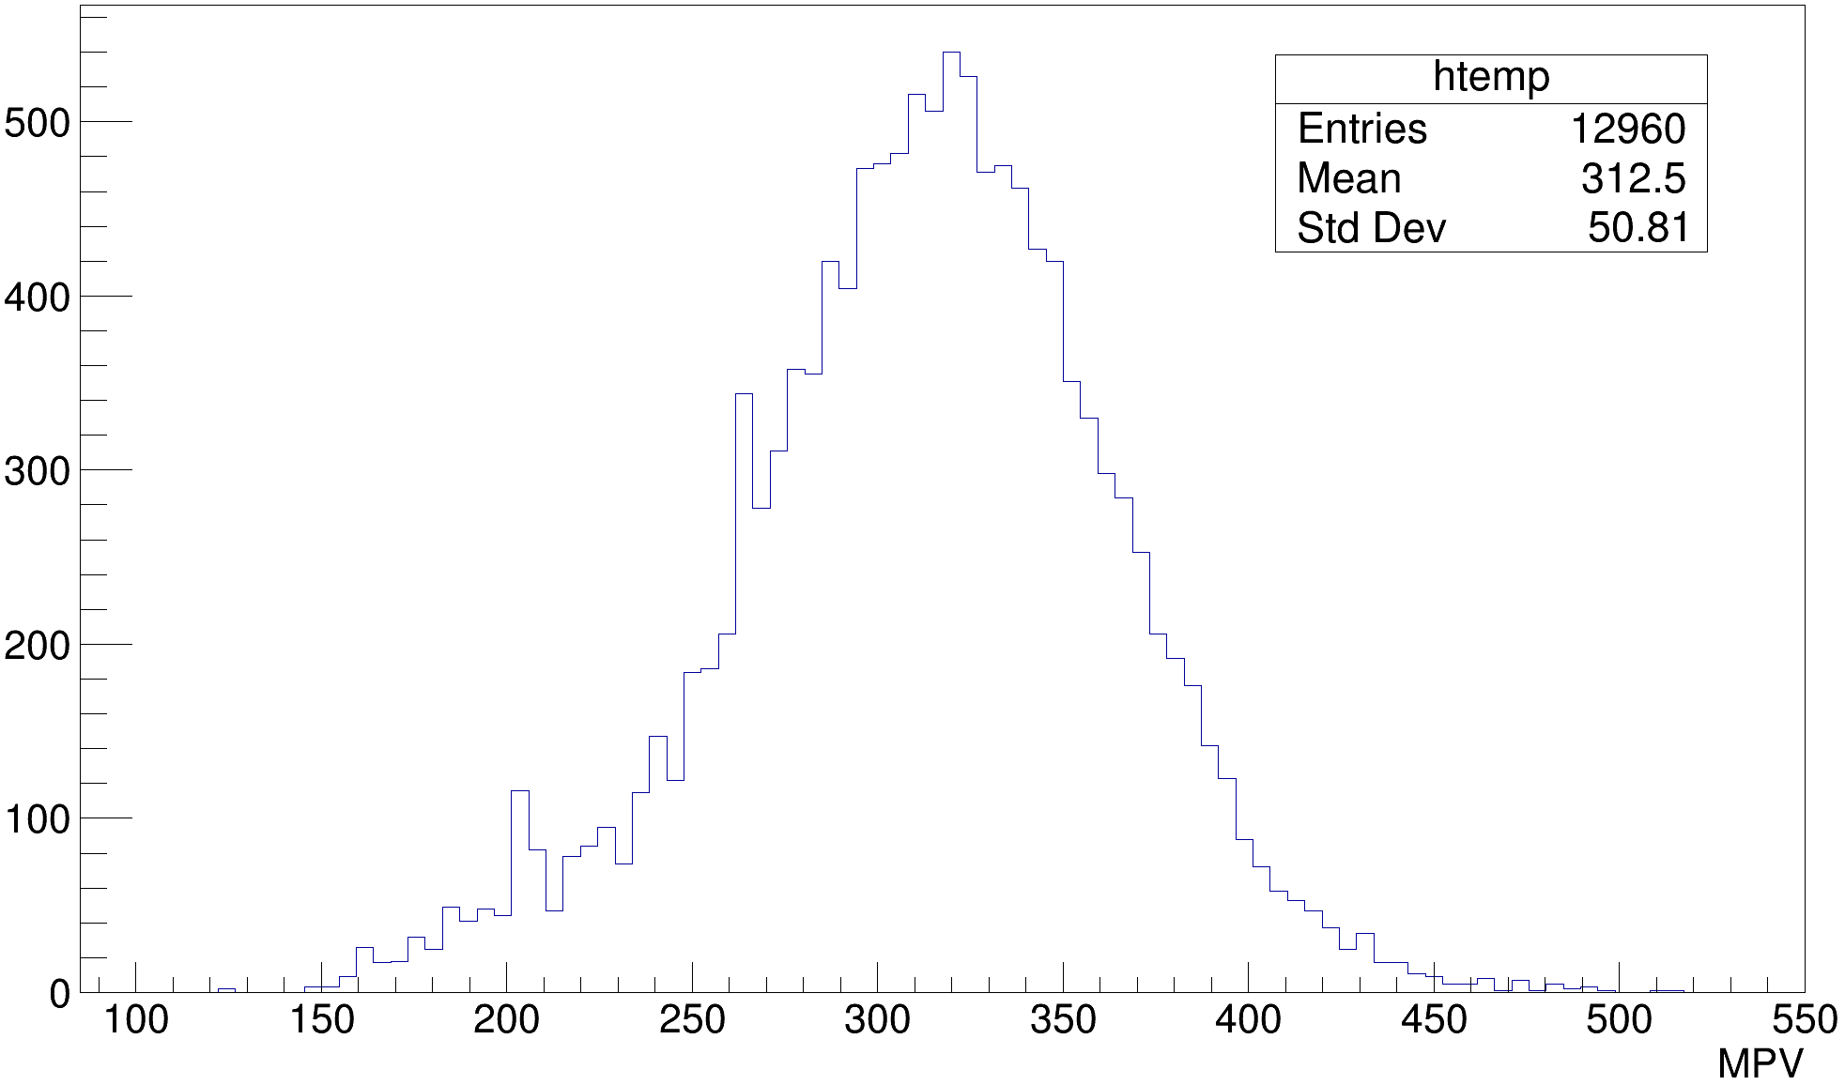
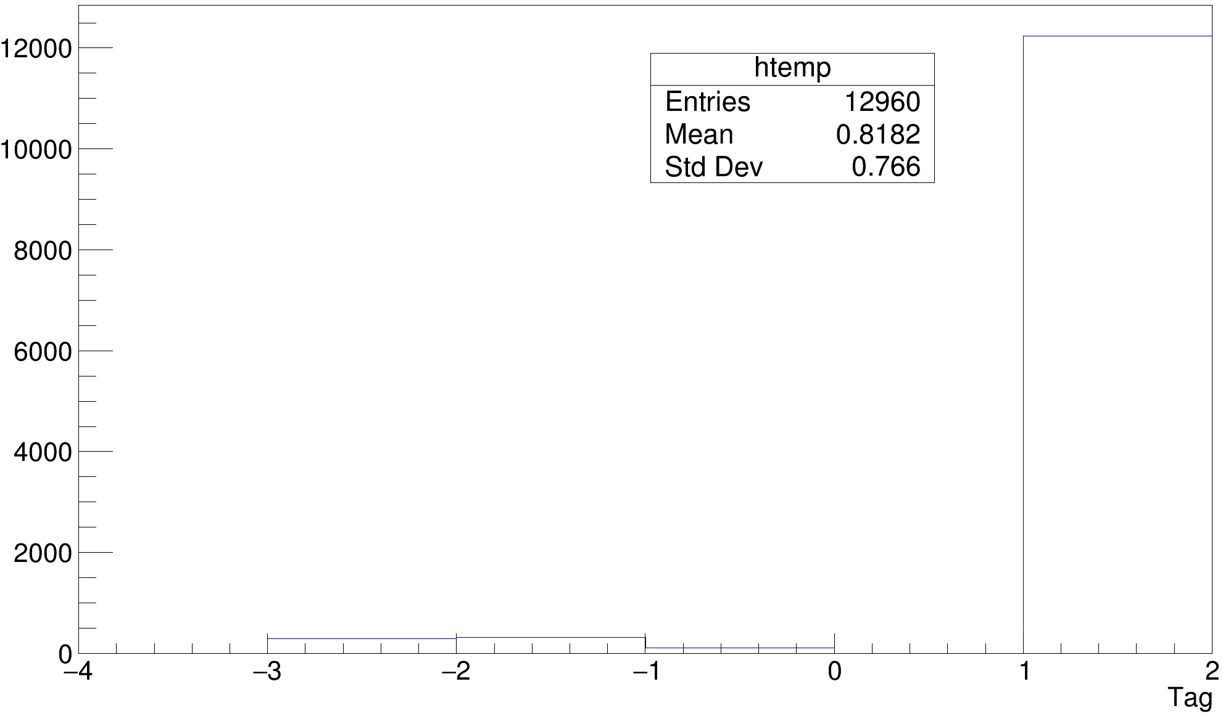
Channel selection
Selection Criteria
Entries>700
$χ^{2}/NDF$ < 20
200<MPV<400 || |$MPV_{channel}−MPV_{chip}$|<80
20<Landau Width<100
10<Gauss Sigma<150
Channels fail the selection will use chip MPV
Tag: 1 for normal; -1 for abnormal chips; -2 for inadequate statistics; -3 for abnormal fitting
$$MPV$$
$$Tag$$

Slide 16
Summary
Event Selection has been studied to extract the light leakage events and shower events
The study of Landau gauss function and pre-fit on chip level guarantee the stability of the fitting
The MIP parameters for all channel is calibrated after the final selection on channels

Slide 17
backup

Slide 18
Energy Calibration
$Hit E=\left(Readout ADC −pedestal\right)×GainRatio÷MIP ADC×MIP Energy$
Calibration File V1
Pedestal: cosmic_pedestal_beam.root
GainRatio: Mu_Calib.root
MIP: MIP_Xu.root
Planned V2
Pedestal: DAC.root
GainRatio: Pion_Calib.root
MIP: Combined Xu,Hu,Shi result

Slide 19
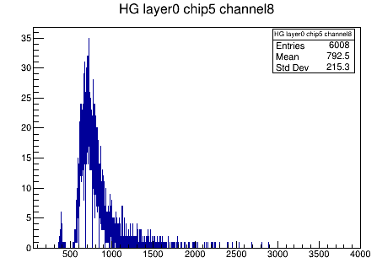
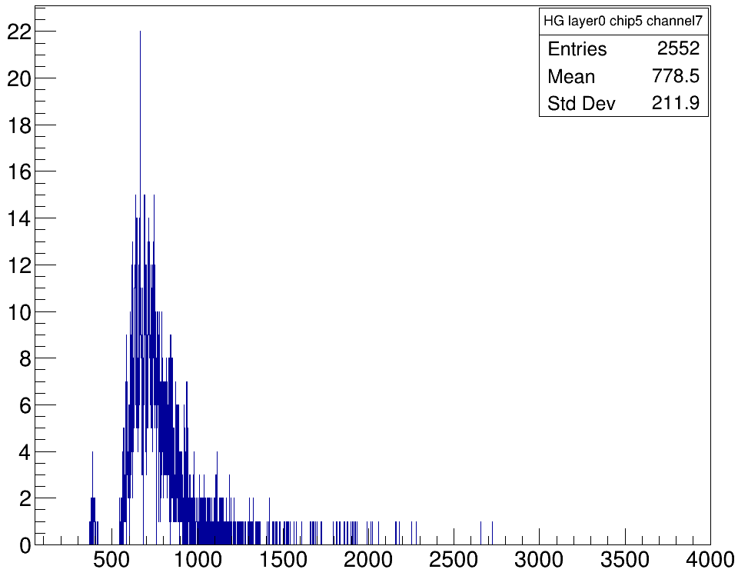
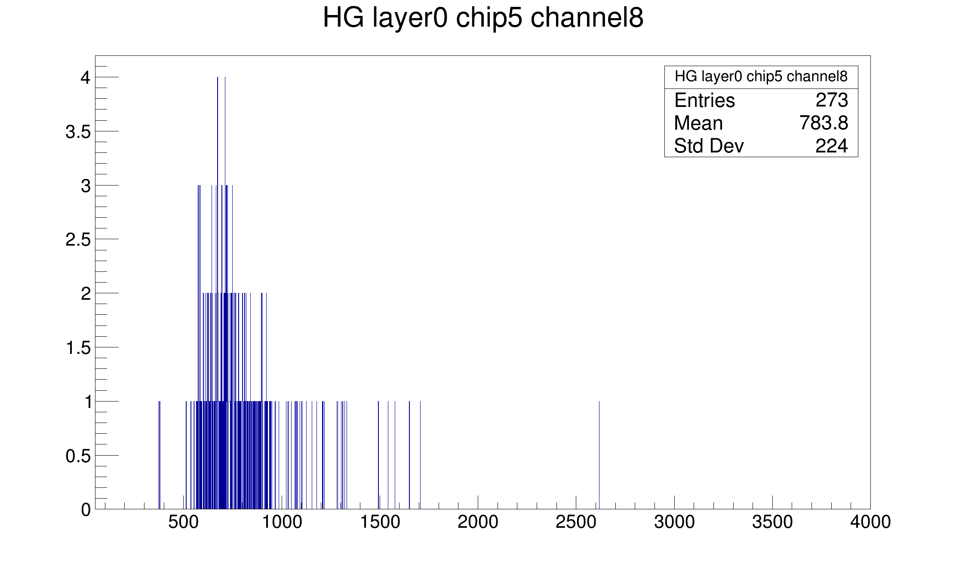
Different threshold
Muon beam
330 DAC
Peak 700
320 DAC
310 DAC

Slide 20
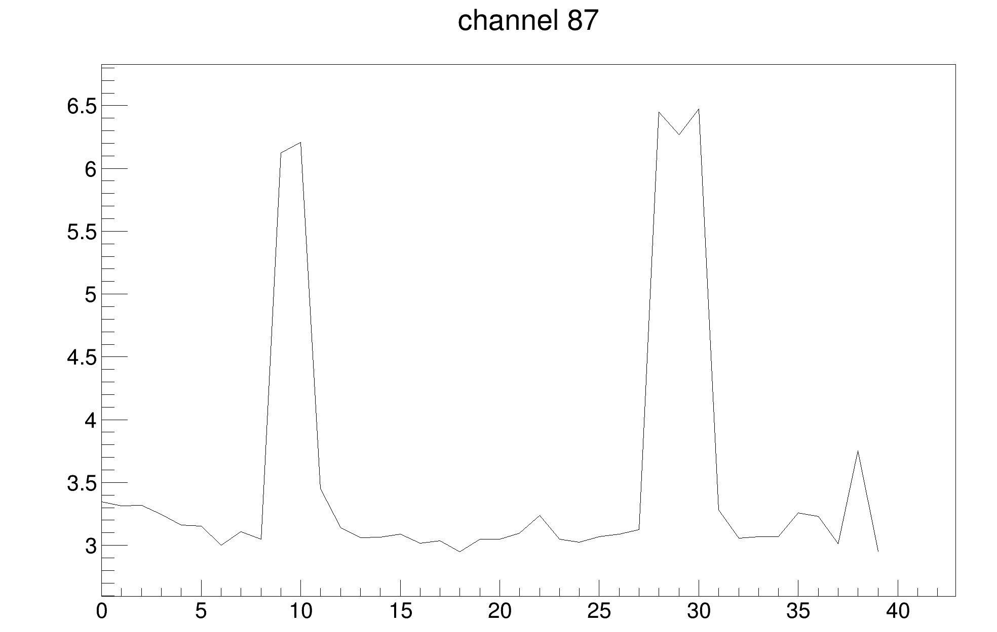
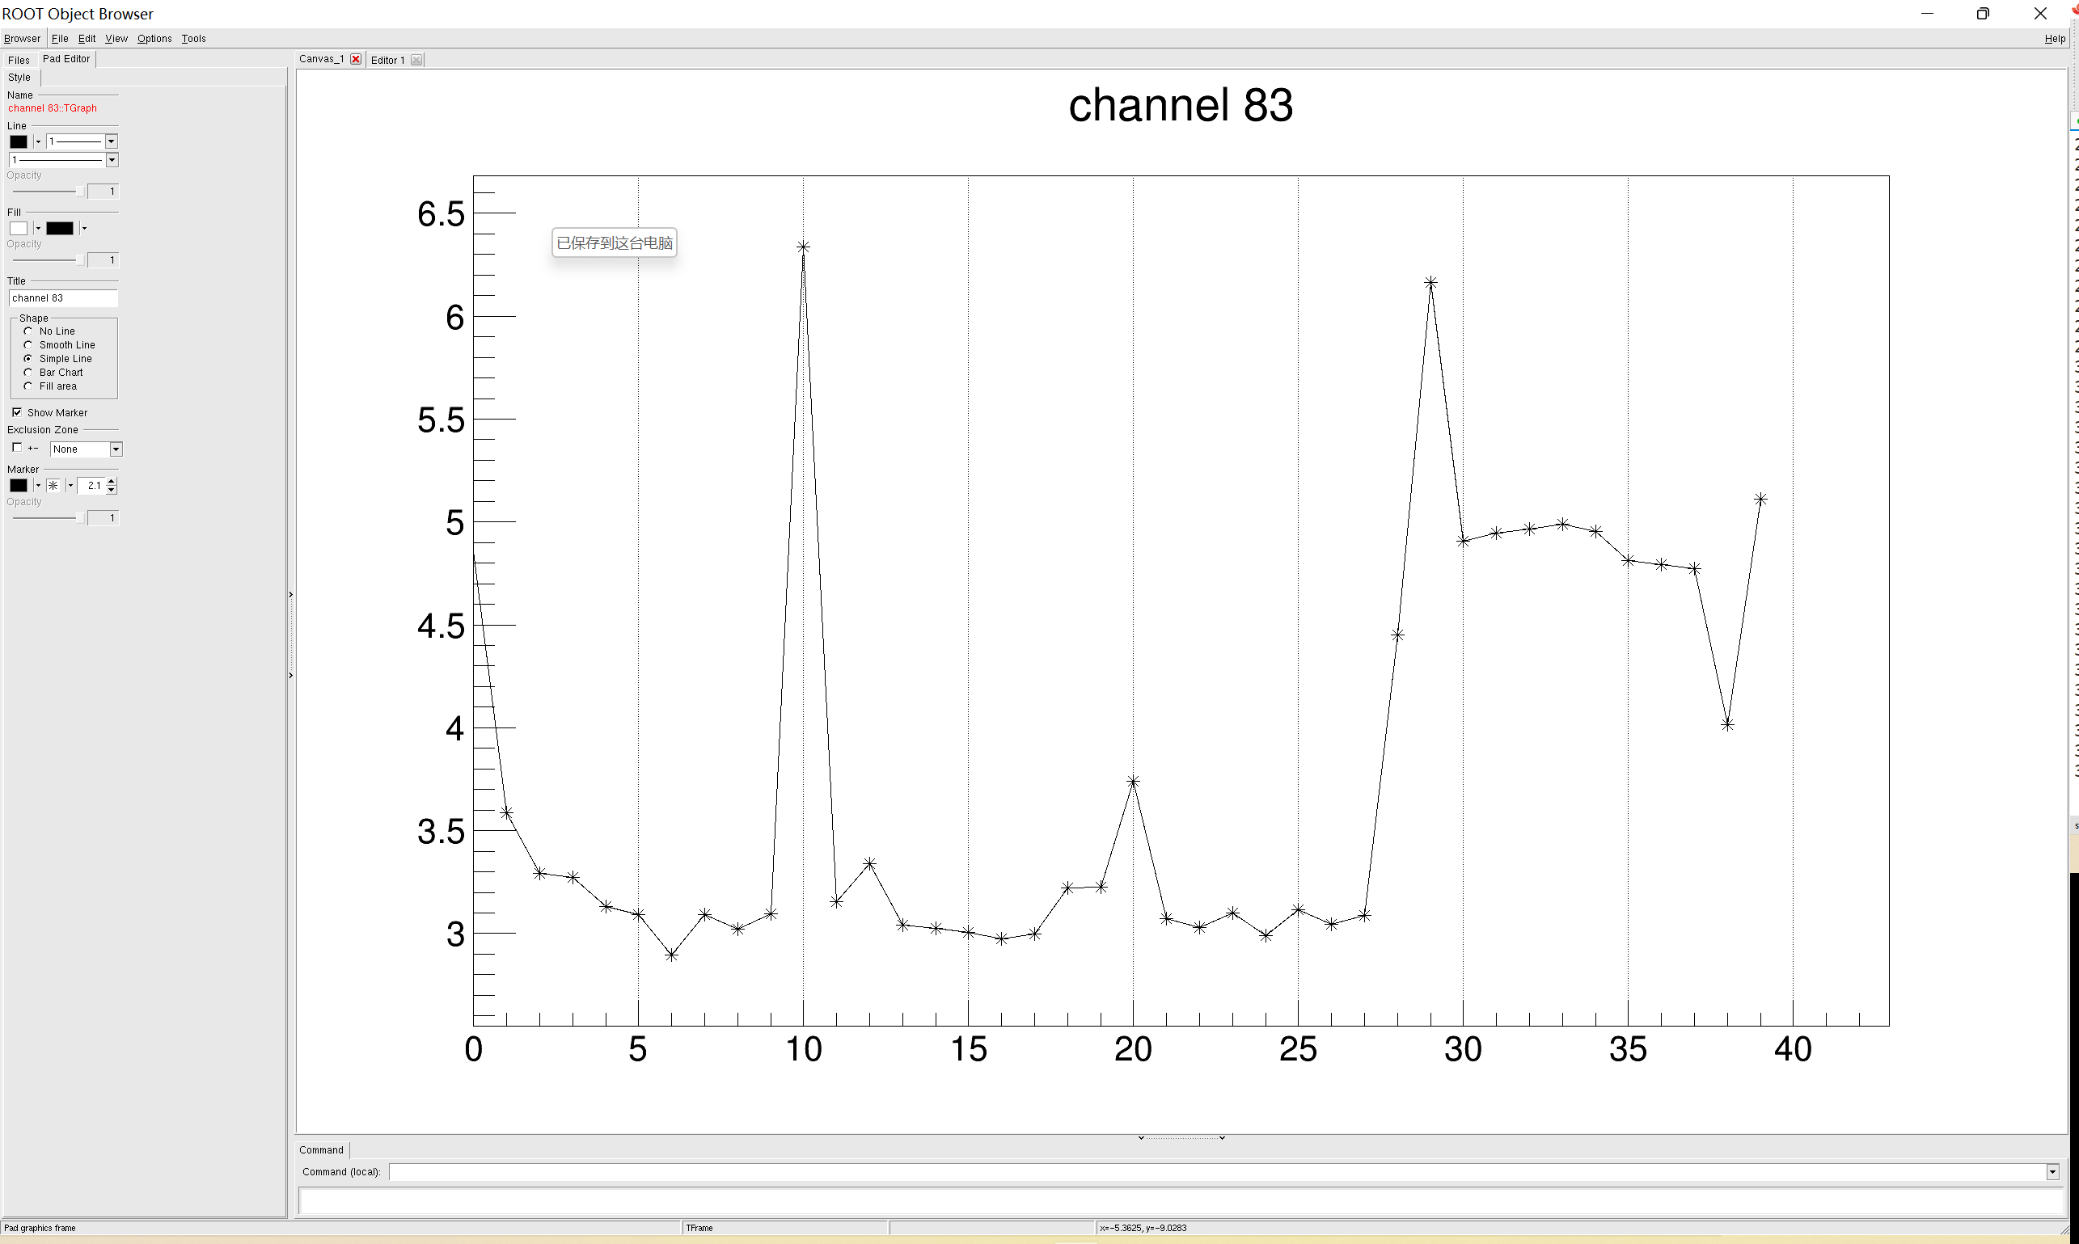

Slide 21
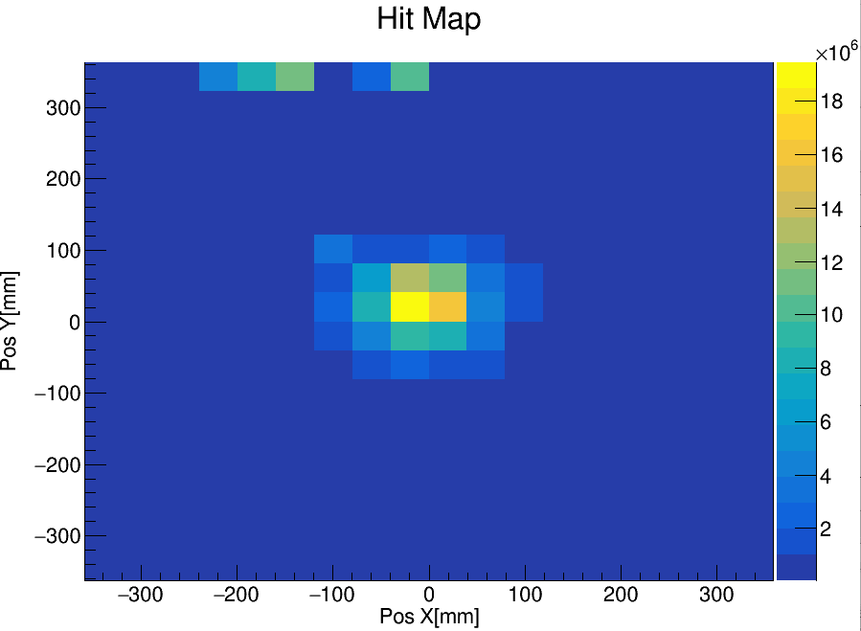
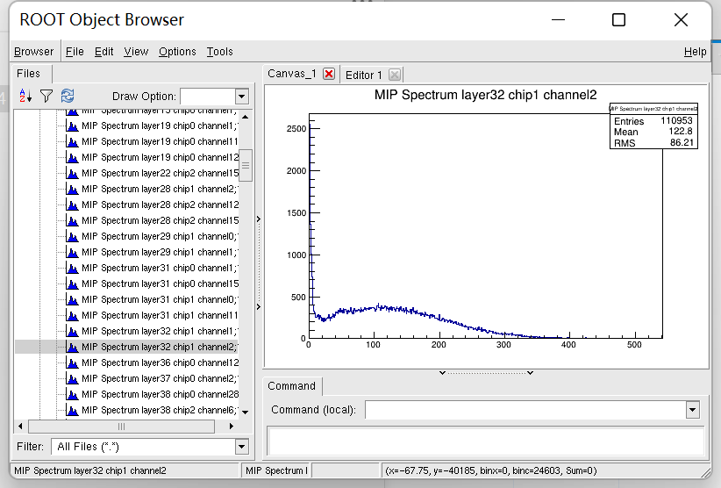
83 84 87 36 37 38

Slide 22
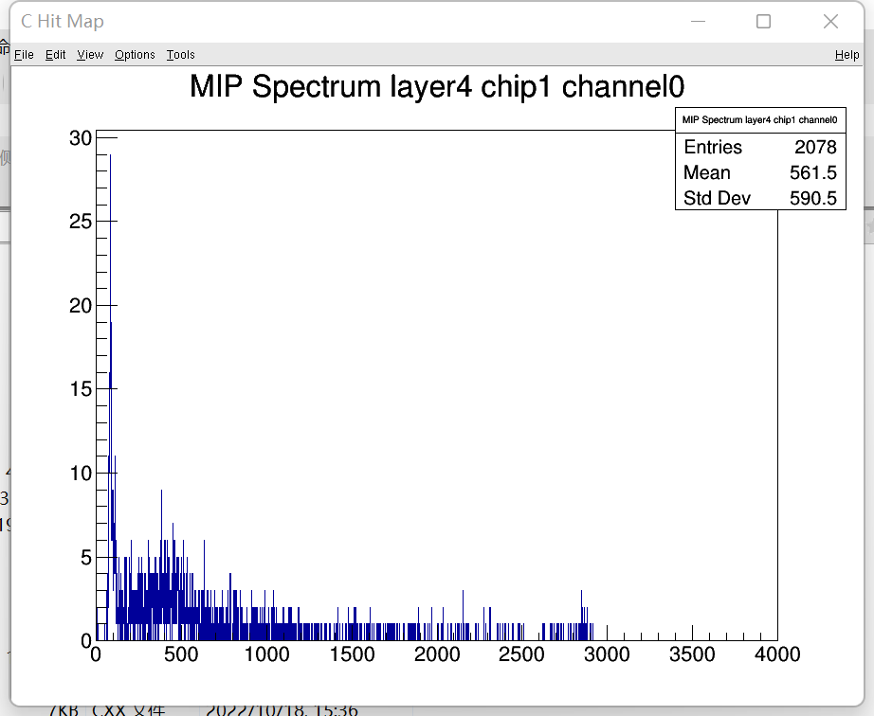
漏光通道

Slide 23
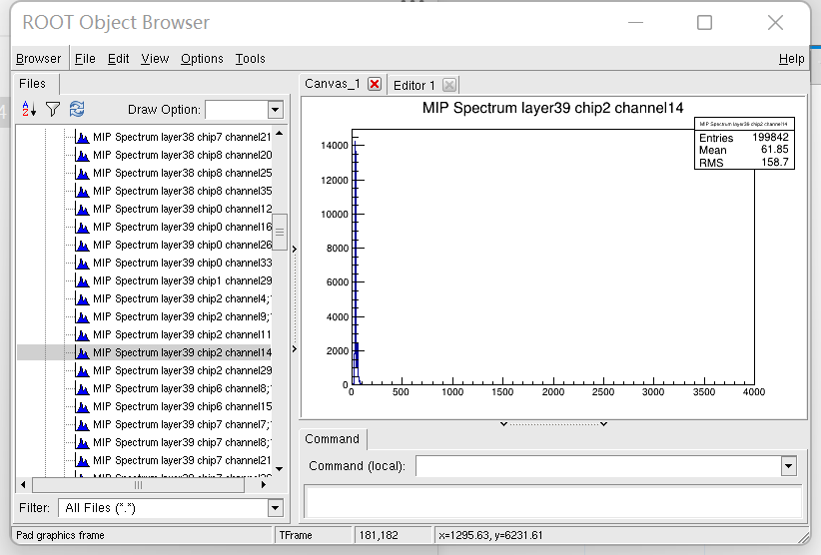
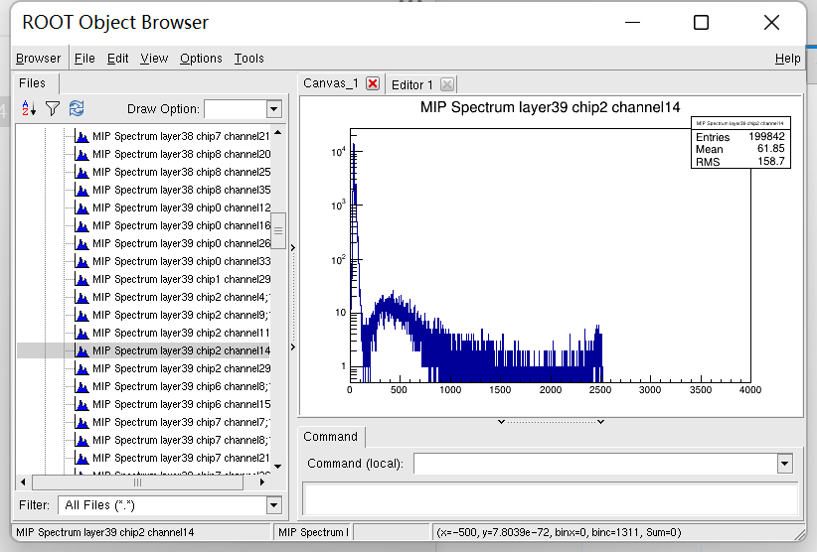
39 38 layer被误去除一部分

Slide 24
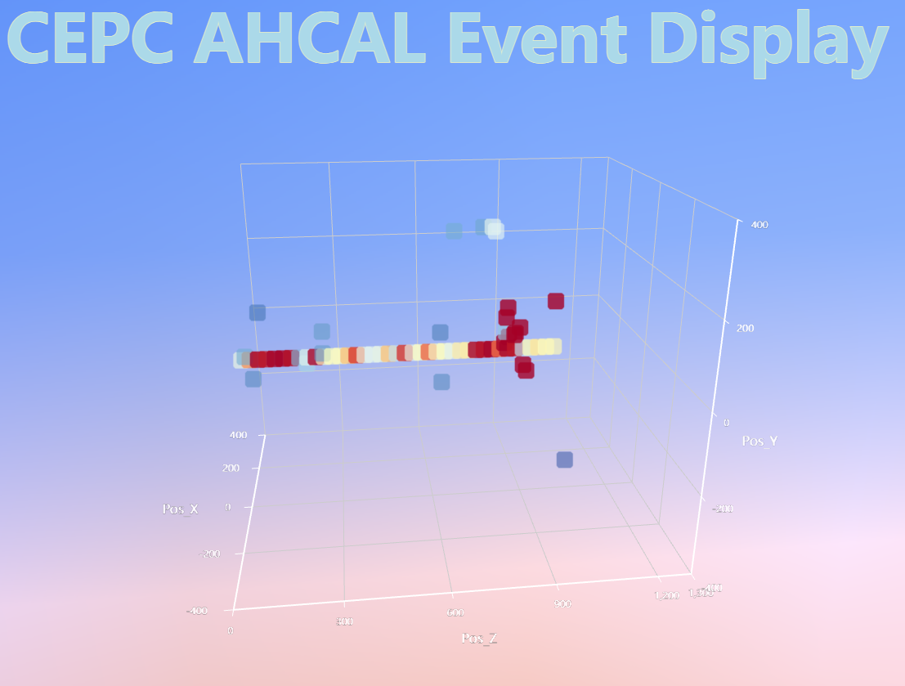
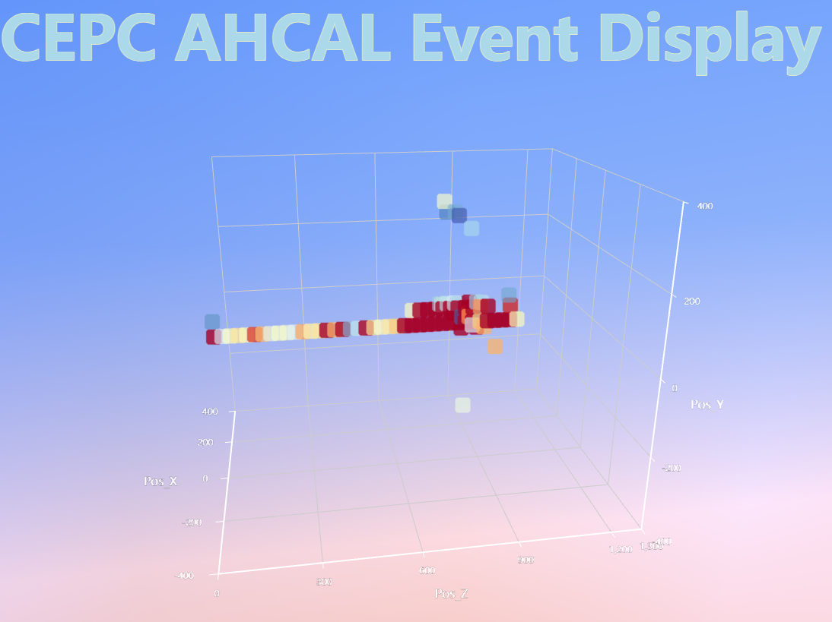
MIP Selection
Some muon shower

Slide 25
Statistics overview
Some abnormal NDL channels
Selection criteria:
More than ${10}^{4}$ counts & Mean value < 150
57 channels(0.4%) are abandoned
Abnormal NDL channel

Slide 26
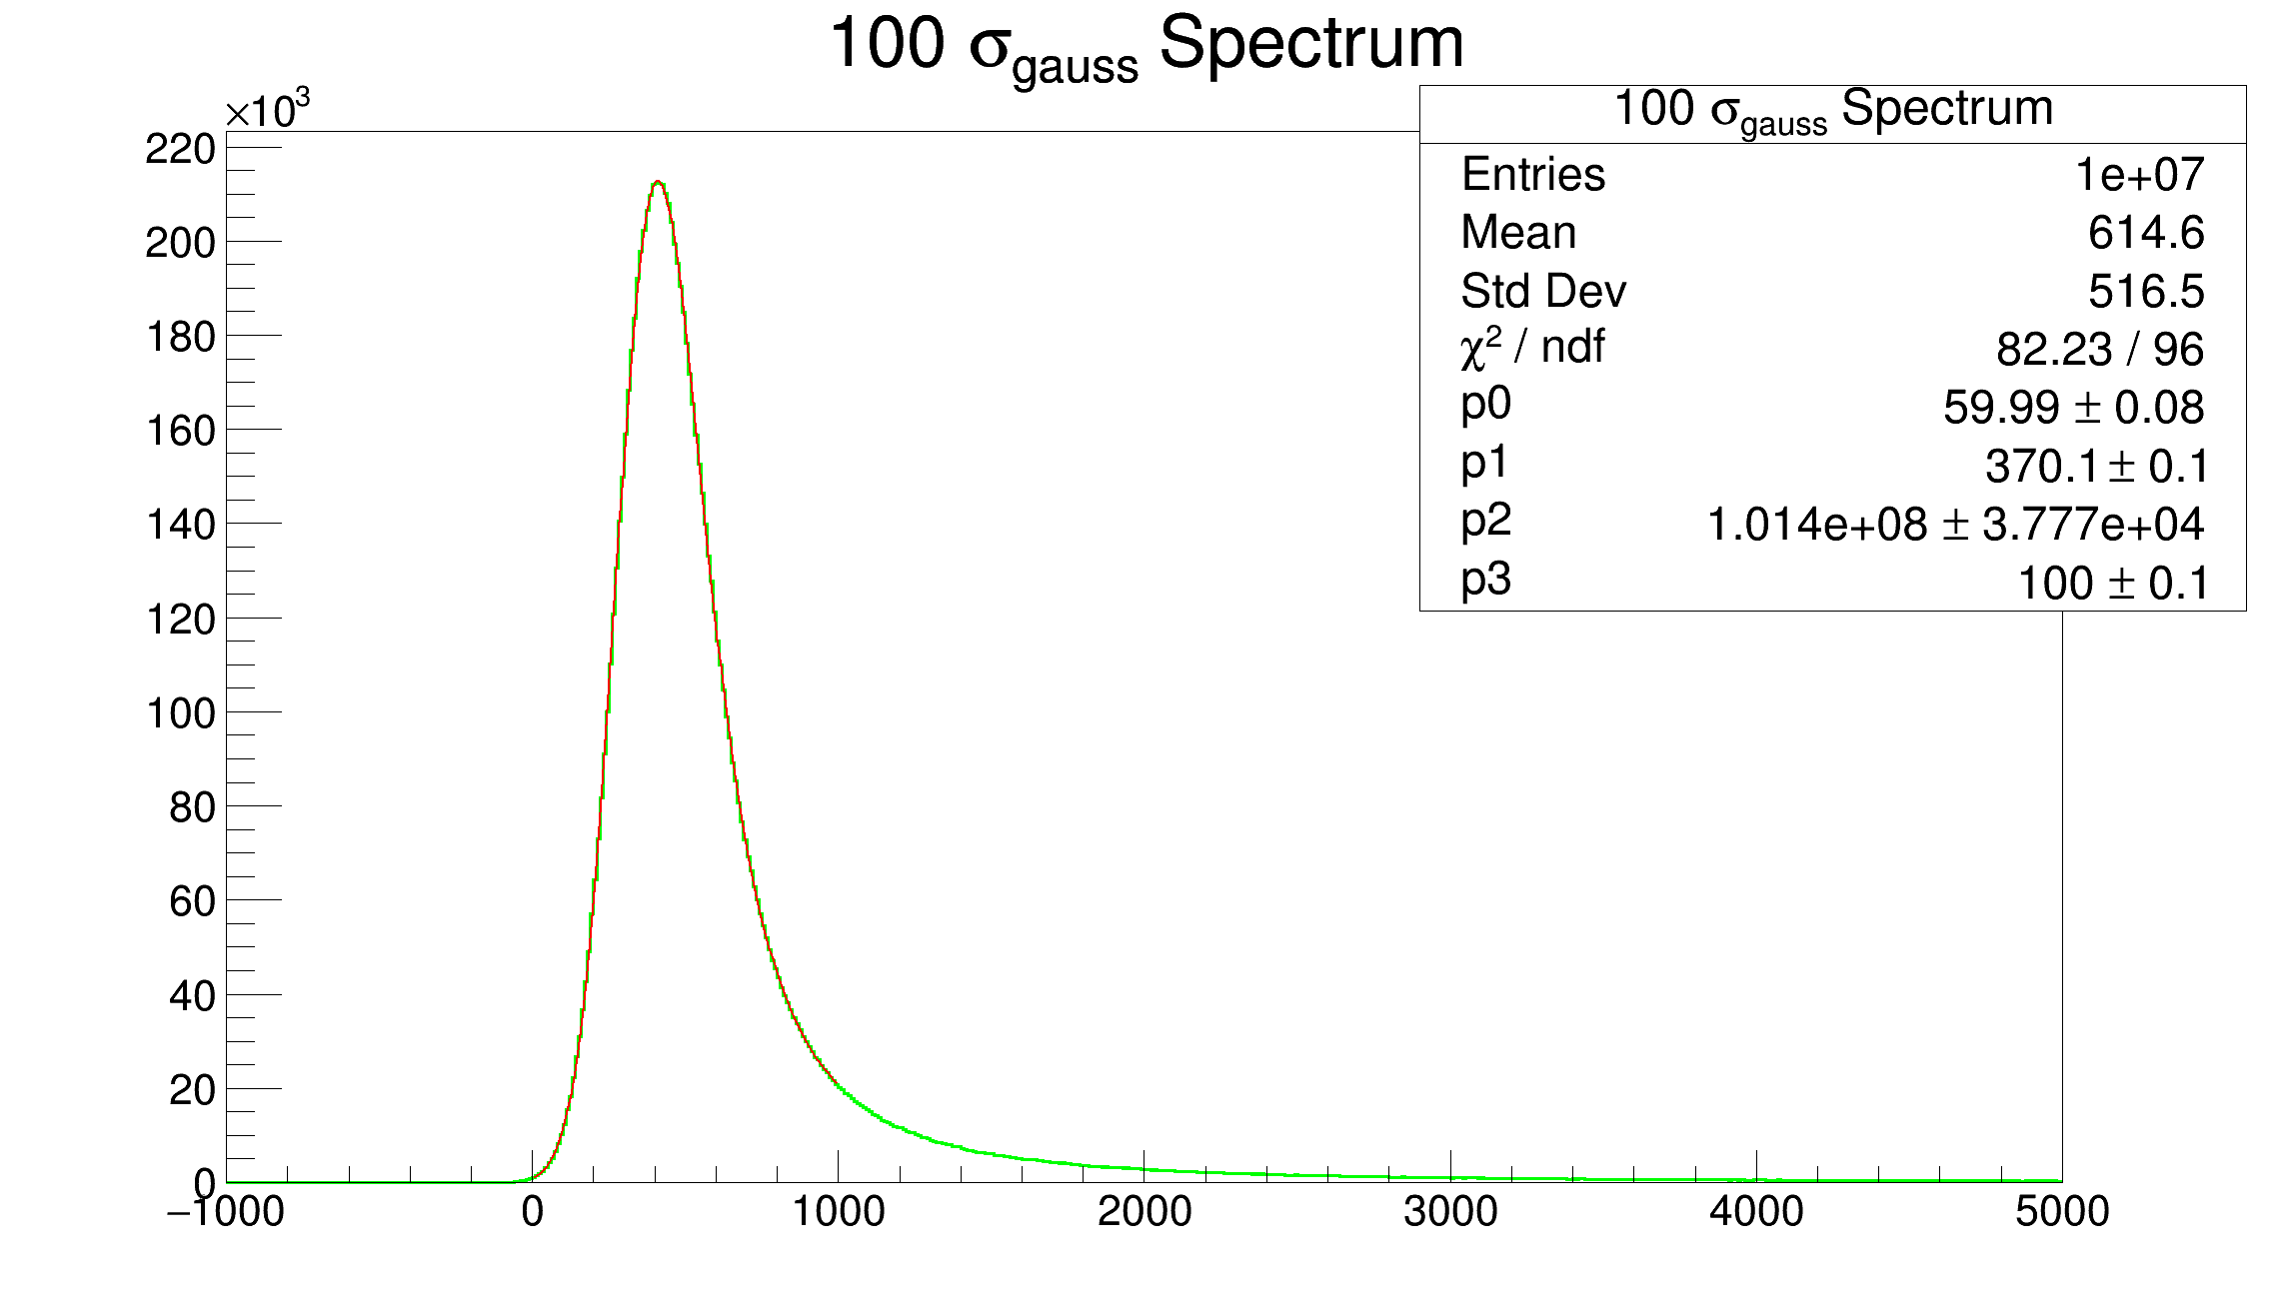

Slide 27
