Slide 1
国家重点研发计划
R&D and Verification of Key Technologies for a High Energy Circular Electron-Positron Collider
Zhijun Liang for CEPC MOST2 vertex detector team

Slide 2
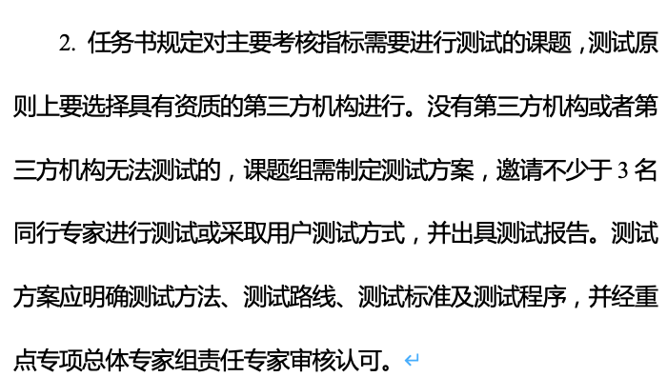
News on MOST2 project
Project timescale （执行期）： up to April 30th ,2023
June 20 –July 21: submission of final reports and review report into MOST2 system
Reviews on silicon task 2 and reviews on MOST2 project are likely take place in May/June
Final reports needs to be ready
Reviews on key parameter (考核指标）

Slide 3
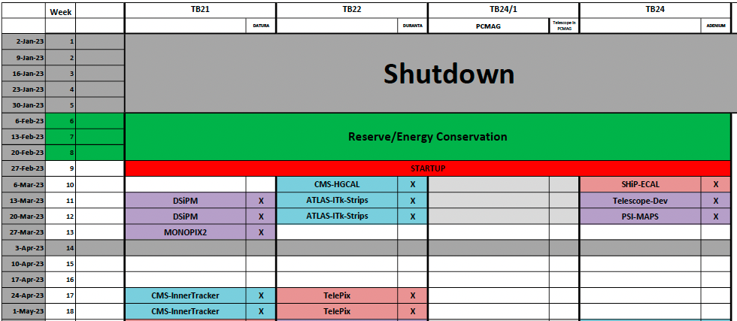
Time line for prototype
Barrel Prototype:
January : debugging the flex communication
February: Ladder assembly and testing
March: Detector assembly
Early April: Testbeam at BSRF
Apr 11- Apr 23: Testbeam at DESY(reserved)

Slide 4
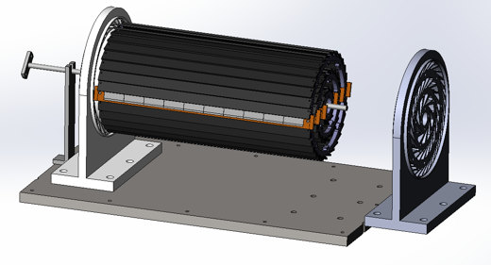
Plan
2nd round of flex production :
submitted, expected to got ~20 more flex early next week
2nd round of Taichu chip delivery
Wafer level testing （doing now）
,thinning to 100um, dicing (in 1～2 weeks)
Focus on assembly and testing ladder
Goal: 12 flexes needed for prototype, 6~10 flex needed for flex based telescope
Aiming to build 10~12 ladder with 4 metal-layer flex (at least 2 chips on each flex )
Build ~6 ladder with 2 metal layer flex
Testing for ladder
Electronics tests
Laser tests
Beta tests

Slide 5
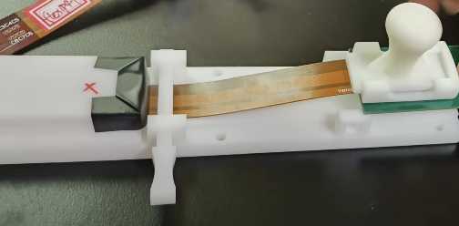
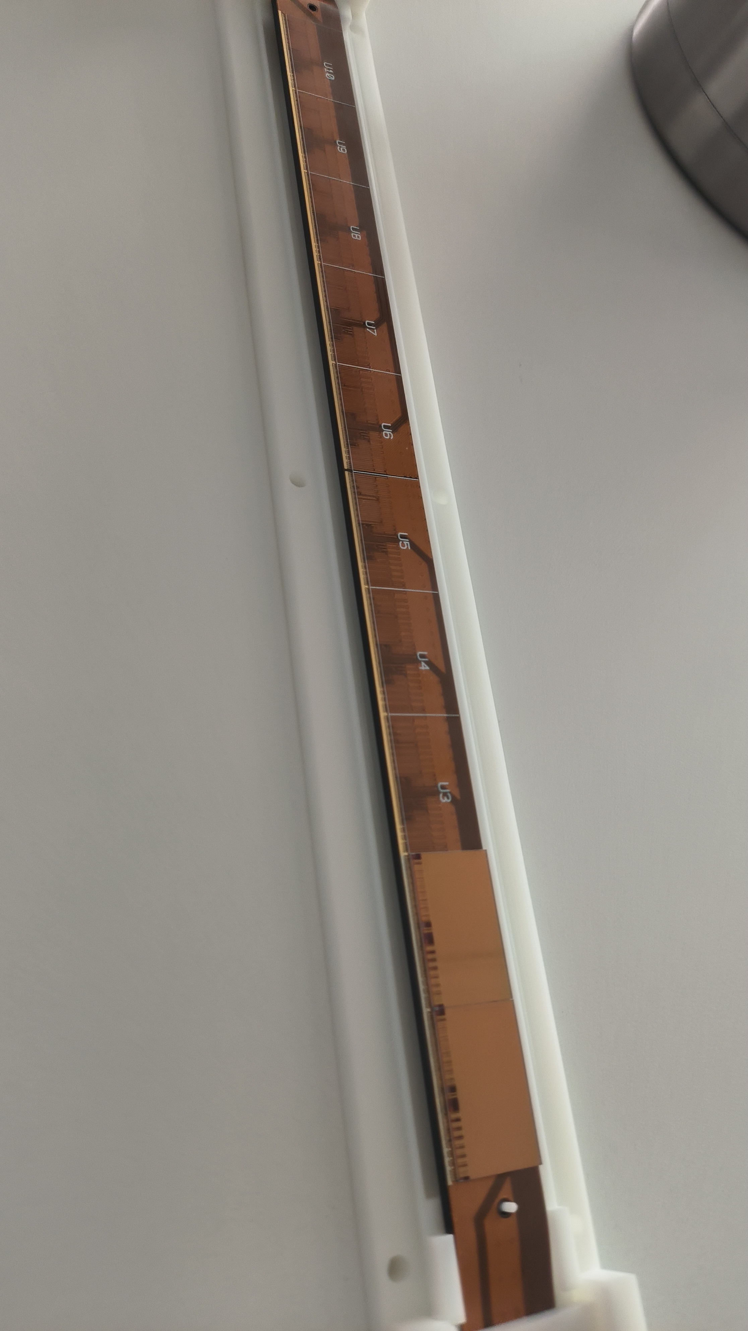
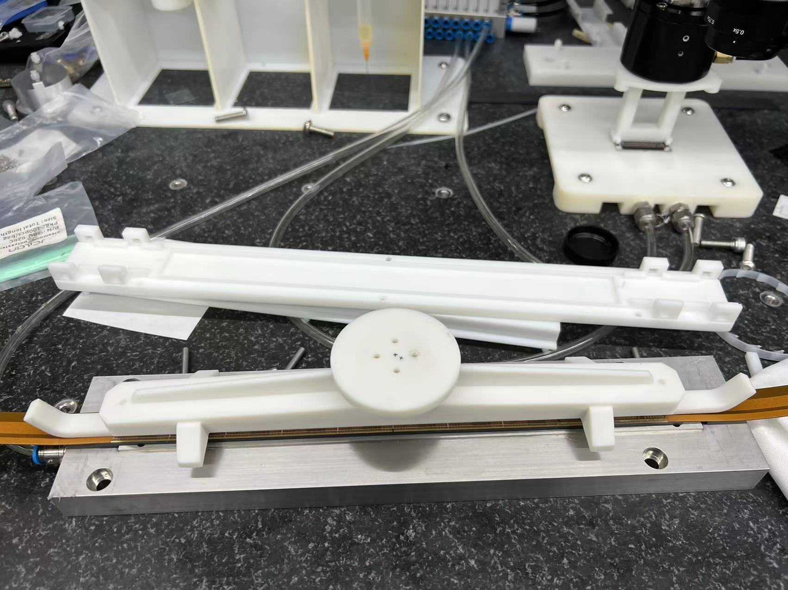
Plan
Investigation on ladder stability issue (2 weeks)
Connector issue --》 Tooling for connecting the flex
ESD → try to be very careful about ESD issue
First Ladder prototype gluing two flex on carbon fiber support
ladder prototype production ( next week) → ~ 4 ladders
Assembly ladders in final vertex detector (before April)
Test prototype with BSRF beam or beta source (1st week of April)
Ladder based telescope (by 1st week of April)

Slide 6
Publication plan
Taichu2 Laser test (NIMA): submitted
DESY Test beam 1st paper: submission date: Early March (!!!)
Paper about vertex prototype testbeam : before May 15th (!!!)
Need to decide on modified process result
Electronics for ladder and prototype (JINST): (should published before Sep 30th )
Paper about the prototype : (should published before Sep 30th )
Paper of TaichuPix3: (should published before Sep 30th )
Document about irradiation hardness: Before May (!!!)
Final report (结题科技报告）(Before May). (!!!)

Slide 7
Plan for test beam (Apr 11- Apr 23,2023)
Person power, expertise
Joao (IHEP, overall)
Zhijun Liang (IHEP, overall)
Tianya (IHEP, ASIC)
Xiaomin WuWei(NWPU, ASIC )?
Wei Wang(IHEP,ASIC, offline)
Jia Zhou (IHEP ,DAQ)
Xinhui Huang (IHEP, mechanism)
Shuqi Li (IHEP, offline)
Hao Zeng(IHEP, offline)
Xuewei Jia(IHEP, offline)
Yuhang Guo(IHEP, CSNS, testbeam)

Slide 8
Conference
https://twiki.cern.ch/twiki/bin/view/CLIC/UpcomingConferences

