Slide 1



CEPC Accelerator Overview
Technical Design Report
Yuhui Li
On behalf of the CEPC accelerator research team
12-16. June. 2023, Hongkong, CEPC Accelerator TDR International Review

Slide 2
Content
General Status of the CEPC Accelerator
  Introduction
  Evolution from CDR to TDR
  CEPC Layout and upgradability
  The CEPC operational plan
  Machine design and key technology R&D
Overview of TDR content
  Introduction to the TDR document

Slide 3
Introduction
This is an overview of the CEPC accelerator status
This talk mostly relates to
chapters 1-3 of the TDR document;
the objectives and feasibility of the physics design; and
the readiness of key technologies.
This talk also describes the organization of the presentations in this review

Slide 4
The Evolution: from CDR to TDR
Main Parameters (30MW)
CDR（2018）
TDR（2023）
 | Higgs | W | Z（3T） | Z（2T）
Number of IPs | 2
Circumference (km) | 100
Bunch number | 242 | 1524 | 12000
β function at IP β_{x}* / β_{y}* (m/mm) | 0.36/1.5 | 0.36/1.5 | 0.2/1.5 | 0.2/1.0
Emittance e_{x}/e_{y} (nm/pm) | 1.21/3.1 | 0.54/1.6 | 0.18/4.0 | 0.18/1.6
Energy acceptance (%) | 1.35 | 0.4 | 0.23
Luminosity per IP (10³⁴cm⁻²s⁻¹) | 2.93 | 10.1 | 16.6 | 32.1
 | Higgs | W | Z (2T) | ttbar
Number of IPs | 2
Circumference (km) | 100.0
Bunch number | 268 | 1297 | 11934 | 35
Beta functions at IP β _{x}*/β _{y}* (m/mm) | 0.3/1 | 0.21/1 | 0.13/0.9 | 1.04/2.7
Emittance ε_{x}/ε_{y} (nm/pm) | 0.64/1.3 | 0.87/1.7 | 0.27/1.4 | 1.4/4.7
Energy acceptance (%) | 1.6 | 1.0 | 1.0 | 2.0
Luminosity per IP (10³⁴cm⁻²s⁻¹) | 5.0 | 16 | 115 | 0.5
Key technology R&D
RF power supply and high efficiency klystron
SRF cavities & modules (1.3G & 650MHz)
Key components of the positron source
High performance accelerator (S&C-band)
Novel magnets: Weak field dipole, dual aperture magnets
Injection/extraction
Electrostatic deflector
Vacuum chamber with NEG coating
Instrumentation, Feedback system
Cryogenic system
Magnet power supply

Slide 5
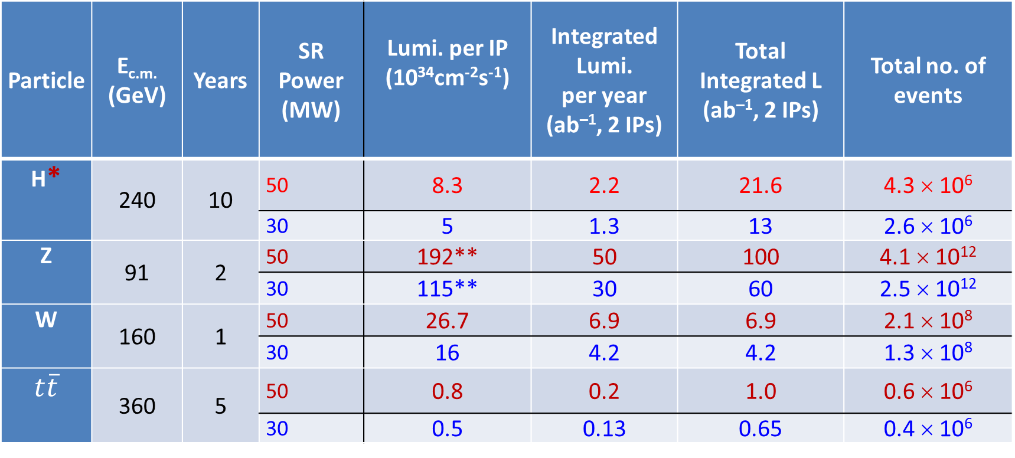
Operational plan
Particle | E_{c.m.} (GeV) | Years | SR Power (MW) | Lumi. per IP (10³⁴cm⁻²s⁻¹) | Integrated Lumi. per year (ab^{–1}, 2 IPs) | Total Integrated L (ab^{–1}, 2 IPs) | Total no. of events
H* | 240 | 10 | 50 | 8.3 | 2.2 | 21.6 | 4.3 × 10⁶
 |  |  | 30 | 5 | 1.3 | 13 | 2.6 × 10⁶
Z | 91 | 2 | 50 | 192** | 50 | 100 | 4.1 × 10¹²
 |  |  | 30 | 115** | 30 | 60 | 2.5 × 10¹²
W | 160 | 1 | 50 | 26.7 | 6.9 | 6.9 | 2.1 × 10⁸
 |  |  | 30 | 16 | 4.2 | 4.2 | 1.3 × 10⁸
$$t\overline{t}$$ | 360 | 5 | 50 | 0.8 | 0.2 | 1.0 | 0.6 × 10⁶
 |  |  | 30 | 0.5 | 0.13 | 0.65 | 0.4 × 10⁶
* Higgs is the top priority. The CEPC will commence its operation with a focus on Higgs.
** Detector solenoid field is 2 Tesla during Z operation, 3Tesla for all other energies.
*** Calculated using 3,600 hours per year for data collection.

Slide 6
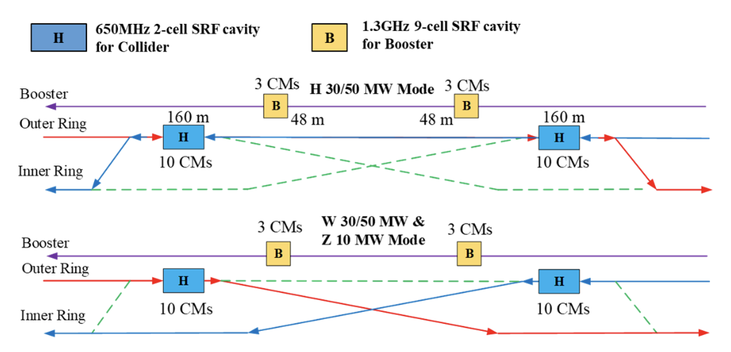
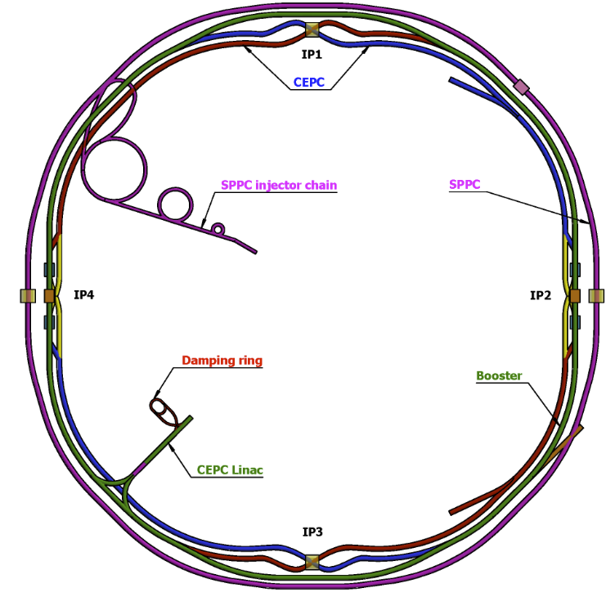
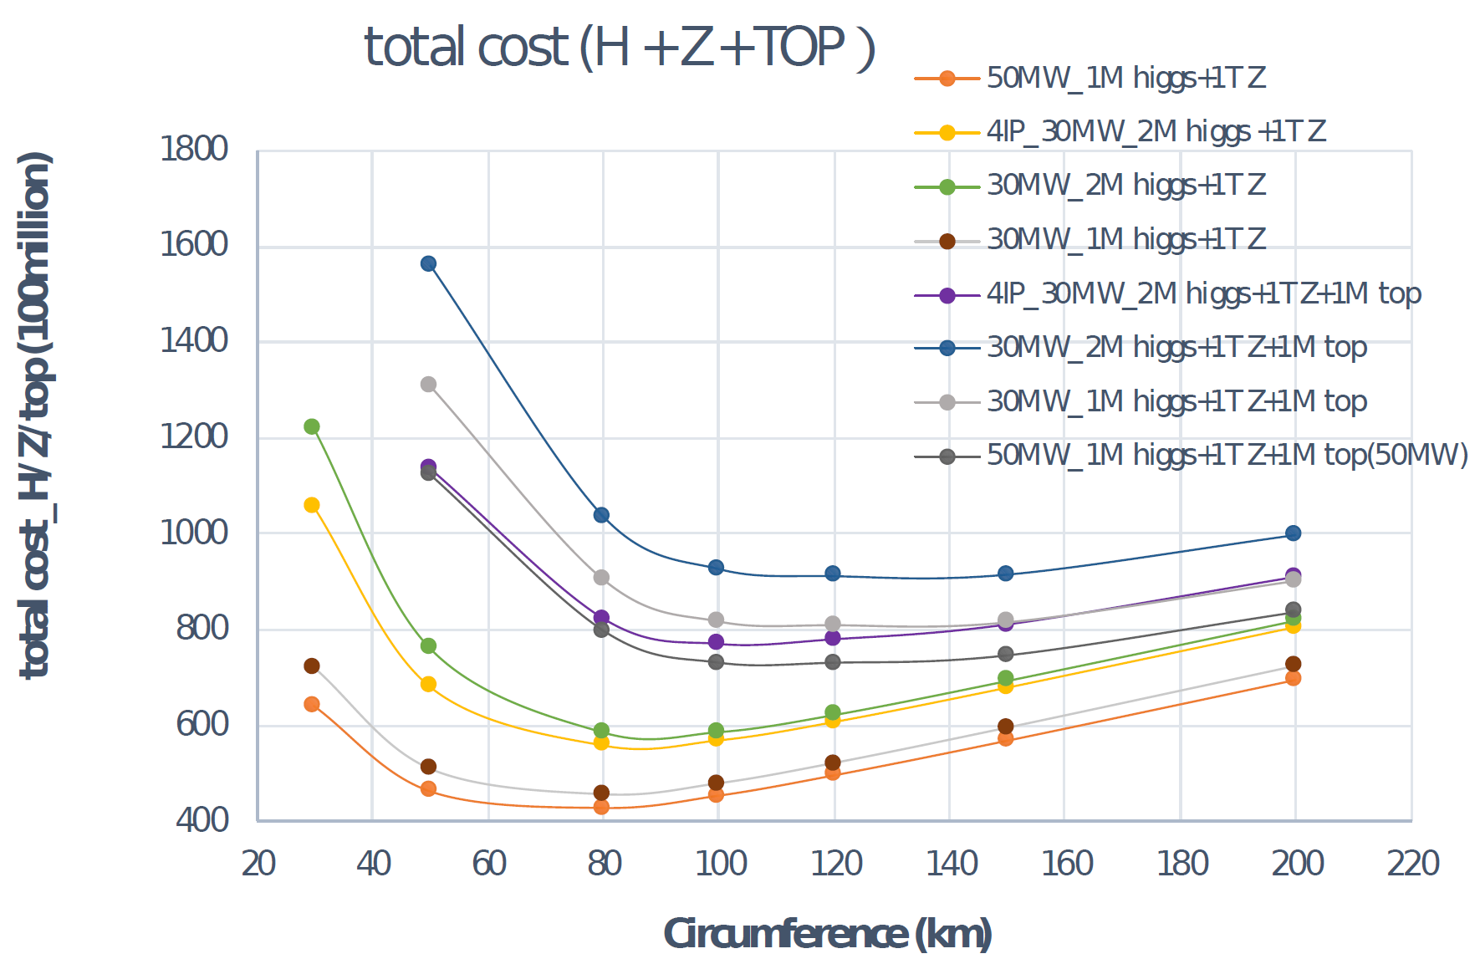
CEPC layout and design essentials
Cost optimization v.s. circumference
Switchable operation for Higgs W and Z
D. Wang et al 2022 JINST 17 P10018
Circular collider: Higher luminosity than a linear collider
100km circumference: Optimum total cost
Shared tunnel: Compatible design for CEPC and SppC
Switchable operation: Higgs, W/Z, top
Common tunnel for booster/collider & SppC

Slide 7
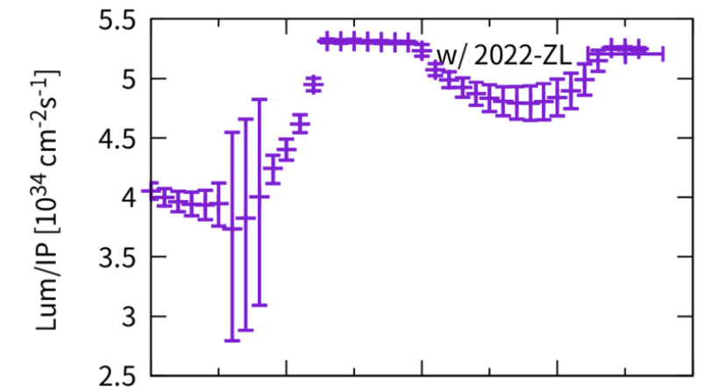
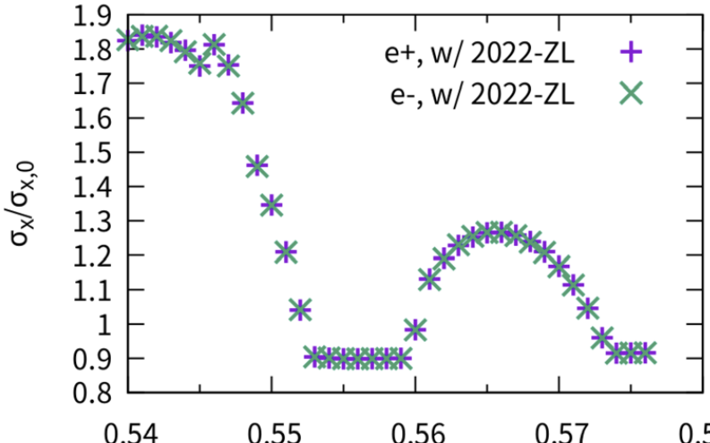
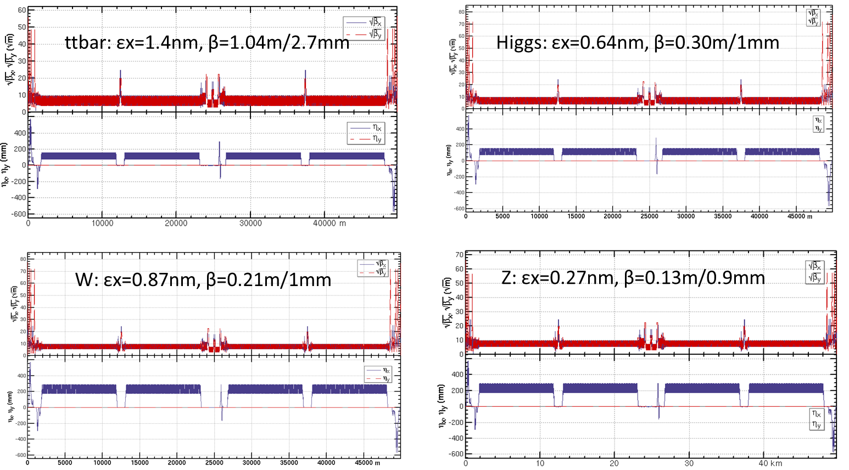
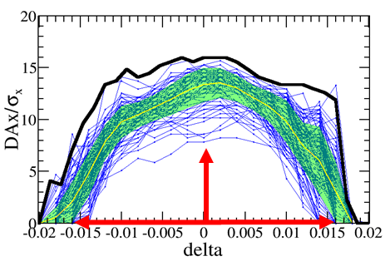
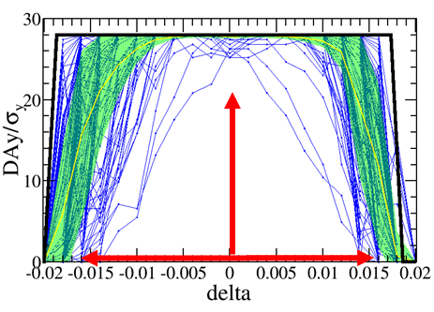

Feasible design for all operational modes
GOAL
Design
e+e- circular collider as a high lumi. Higgs factory
Accelerator complex comprised of Linac, 100 km booster and collider ring
Lattice optimization for all energies
Sufficient DA for all energies
Beam-beam & collective instability
Crab waist scheme with large cross angle and sextuples
Beam-beam effect study
Compatible operation for Higgs, W, Z and Top runs
Increasing Luminosity
The comprehensive design will be presented in the following specific talks
Lattice for all energies
Dynamic Aperture (DA) optimization
Requirement met Higgs (w/error):
$7σ_{x}×16σ_{y}×1.6\%$

Slide 8

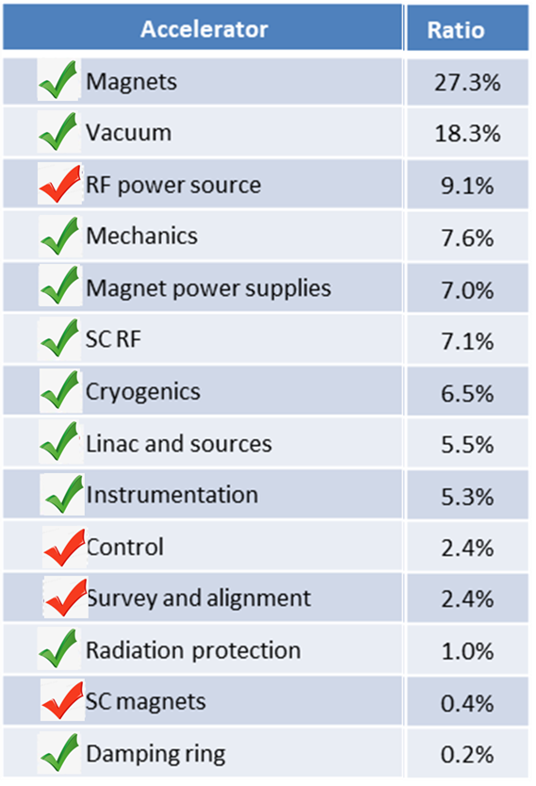

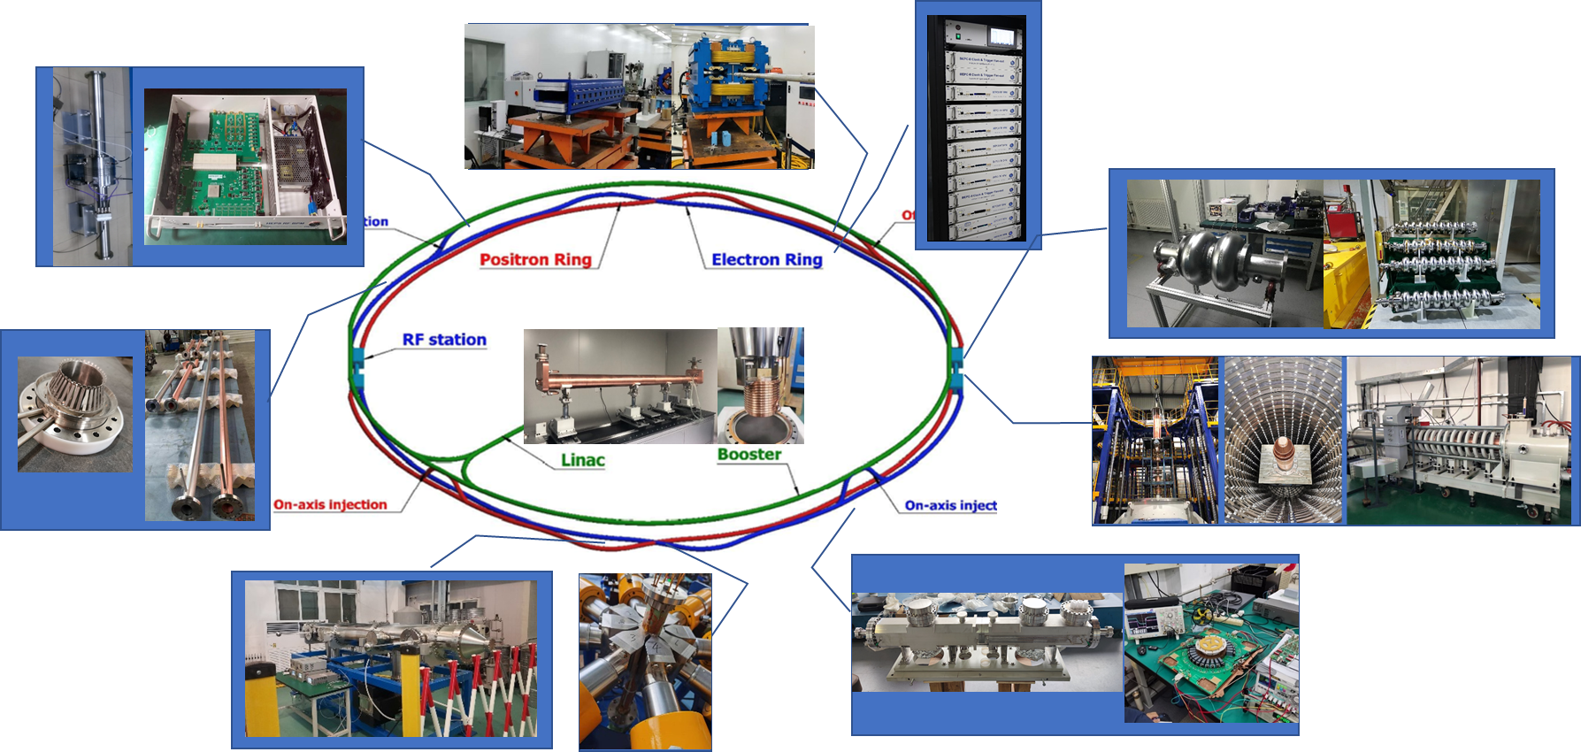
Key technology R&D
Represented Key Technologies for the CEPC
Specification Met
Fraction
Prototype Manufactured
CEPC R&D
~ 30% cost of acc. components
  Key technology R&D spans all component lists in CEPC CDR

Slide 9
Key technology readiness
  CEPC received ~ 260 Million CNY from MOST, CAS, NSFC, etc for the key technology R&D
  Large amount of key technology validated in other project by IHEP: BEPCII, HEPS, …
Novel magnets: Weak field dipole, dual aperture magnets
Extremely fast injection/extraction
Electrostatic deflector
MDI
High efficiency klystron
SRF cavities
Positron source
High performance accelerator
CEPC R&D
~ 30% cost of acc. components
Comprehensive key technology R&D results will be reported in the following specific talks
High precision magnet
Stable magnet power source
Vacuum chamber with NEG coating
Instrumentation, Feedback system
Survey & Alignment
Ultra stable mechanics
Radiation protection
Cryogenic system
MDI
BEPCII / HEPS
~ 60% cost of acc. components
~10% remaining (the machine integration, commissioning etc.) and is anticipated to be completed by 2026, and the international contribution/collaboration may be needed.

Slide 10
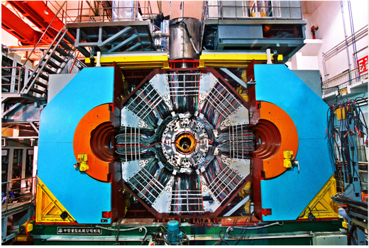
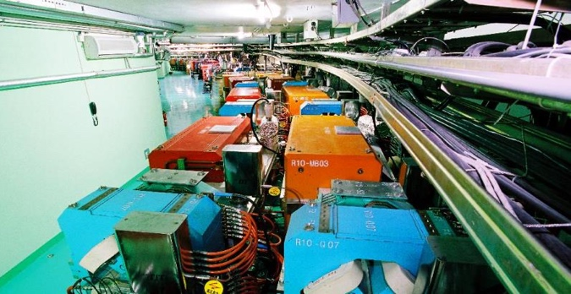
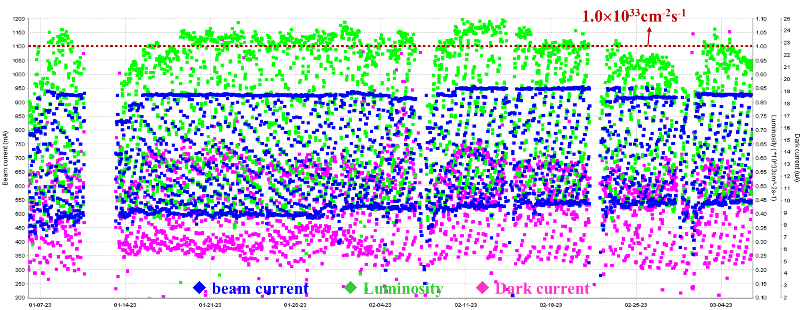
Experience in e-e+ collider operation
  BEPCII is in stable operation, and the beam current exceeds 900mA with the peak luminosity of 1.1×10³³cm⁻²s⁻¹;
  In the last operation year, the accumulated luminosity reached as high as 8.1 fb⁻¹;
  Rich experiences in achieving high luminosity have been accumulated;
BES III
BEPC II

Slide 11
TDR Document Overview

Slide 12
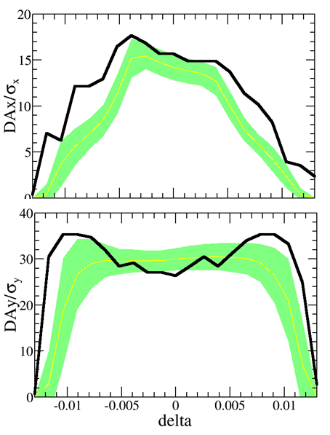
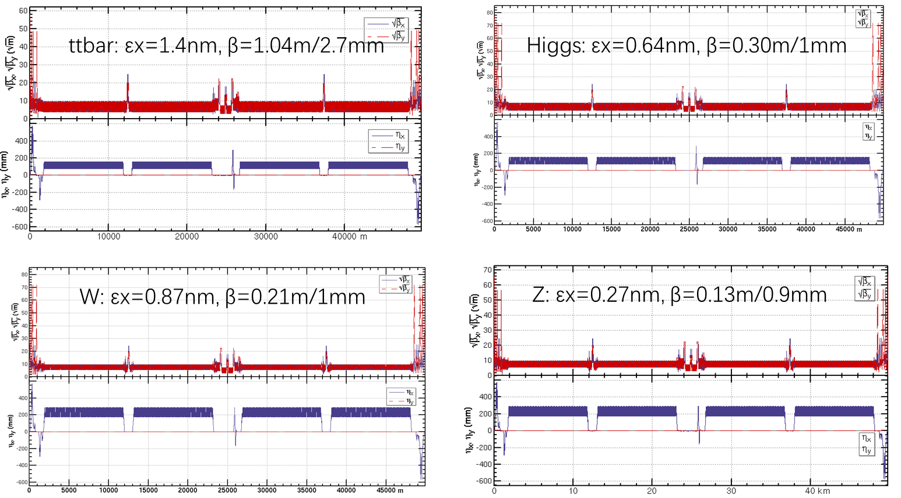


Collider design
Yiwei Wang
Session M1-2: #3
Lattice design for MDI, Arc, straight line for all modes
Emittance & DA with errors
Higgs (w/error): $7σ_{x}×16σ_{y}×1.6\%$
Z (w/error): $11σ_{x}×9σ_{y}×1.0\%$
The global lattice design for the regions of MDI, Arc, straight line, was conducted for all energies;
Emittance and DA for all modes were optimized. Errors were included and mitigation measures were carried out;
Based on the physics design, the CEPC main parameters, including luminosities, are calculated

Slide 13
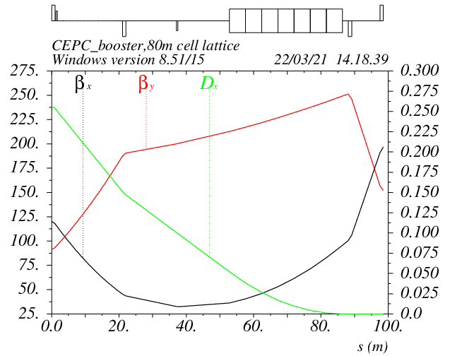
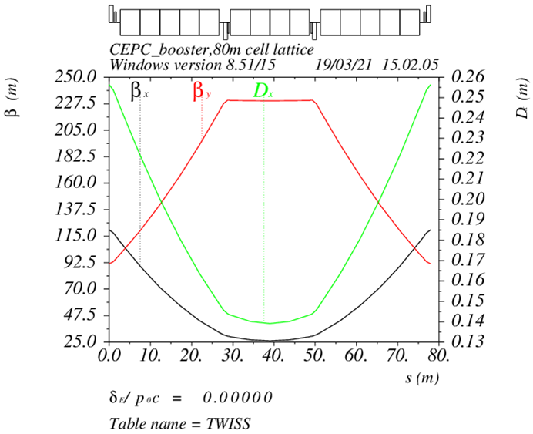
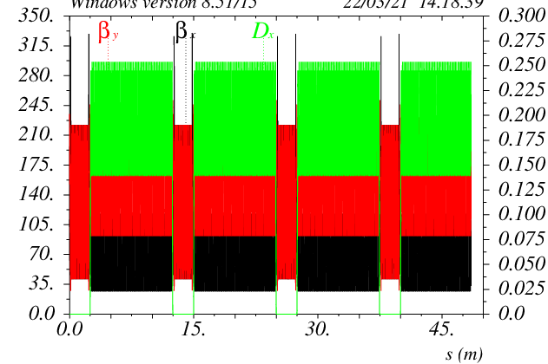
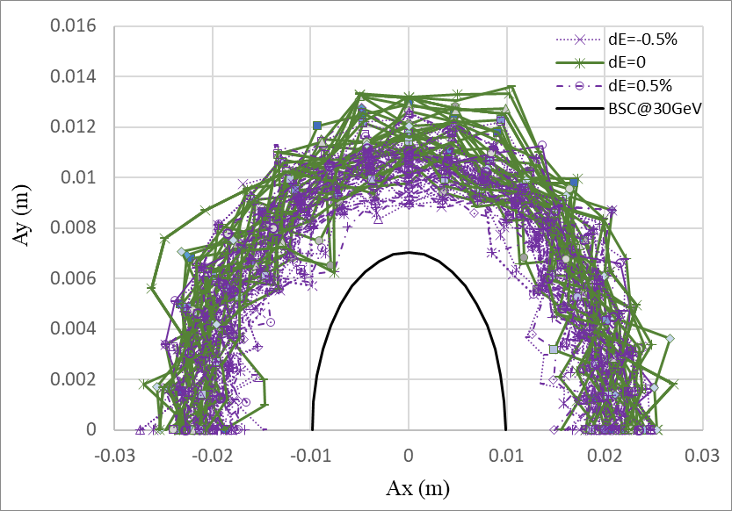
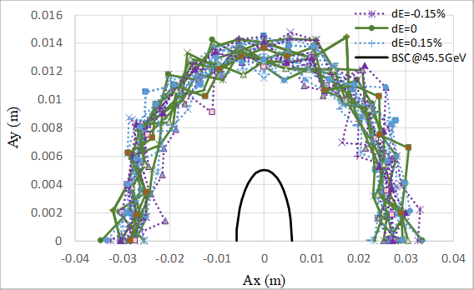
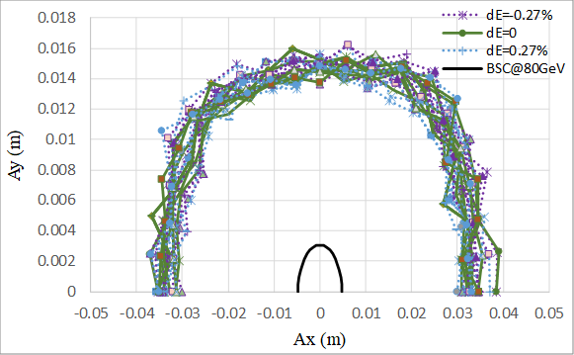
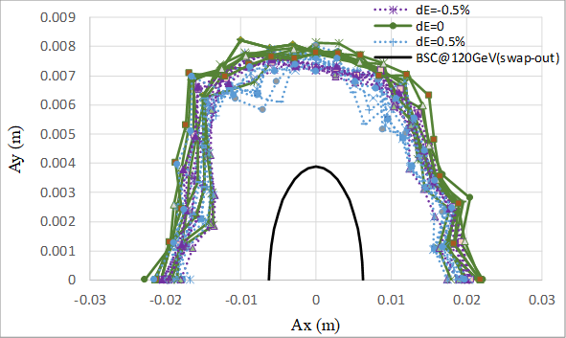
Booster design
30→180GeV
Dou Wang
Session A1-1: #1
30GeV
TME like structure (cell length=78m)
Interleave sextupole scheme
Emittance@120GeV=1.26nm
Dispersion sup.
DA@30GeV
DA@45GeV
Arc cell
Half ring
DA@80GeV
DA@120GeV
30 GeV injection energy, Maximum extraction energy @ 180GeV
Lattice design with TME structure, lower emittance than CDR
Sufficient Dynamic Aperture for all energies with errors

Slide 14
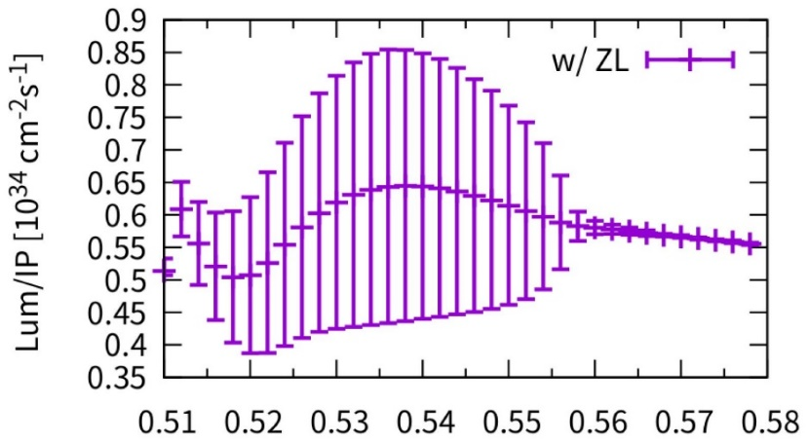
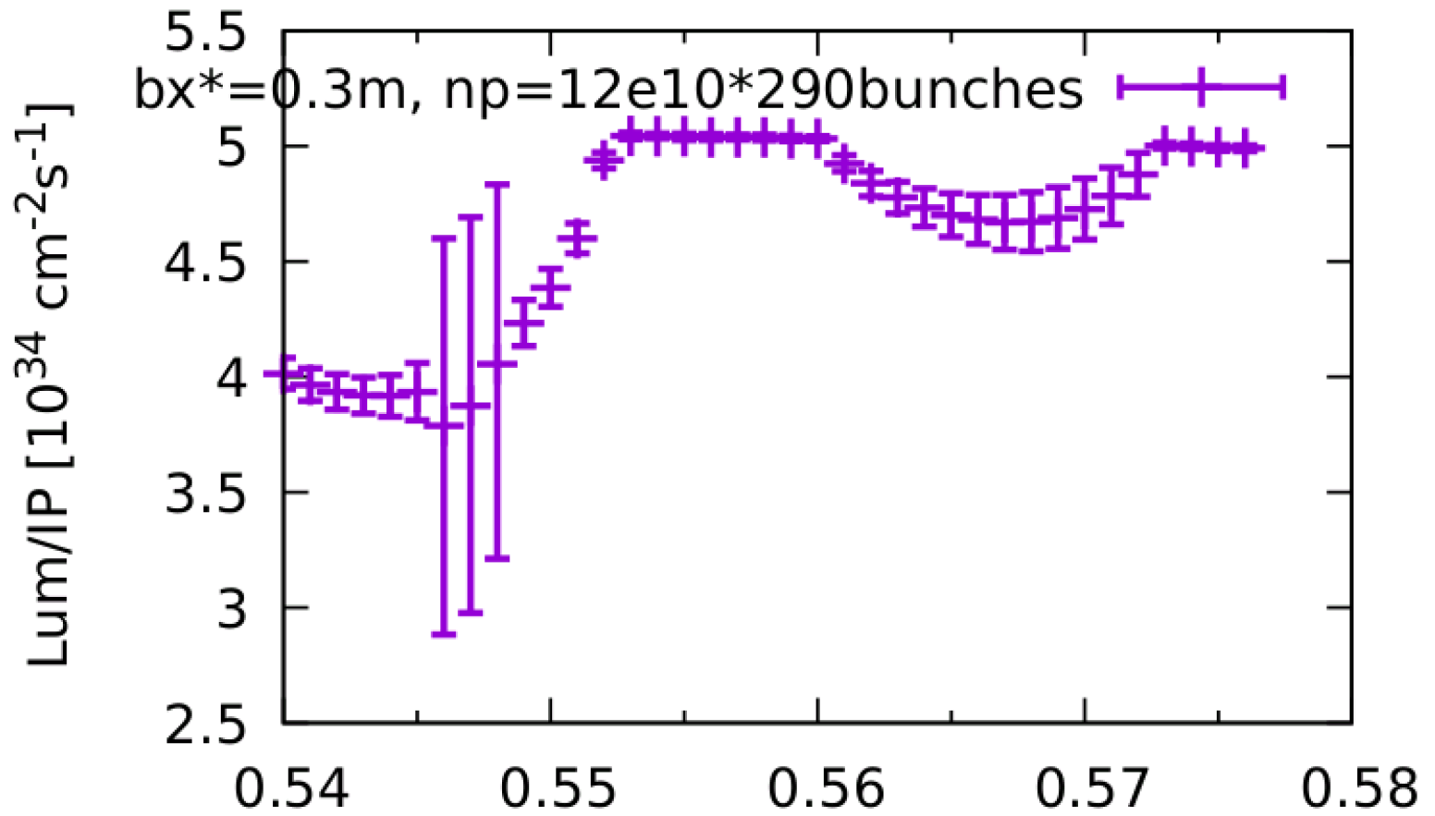
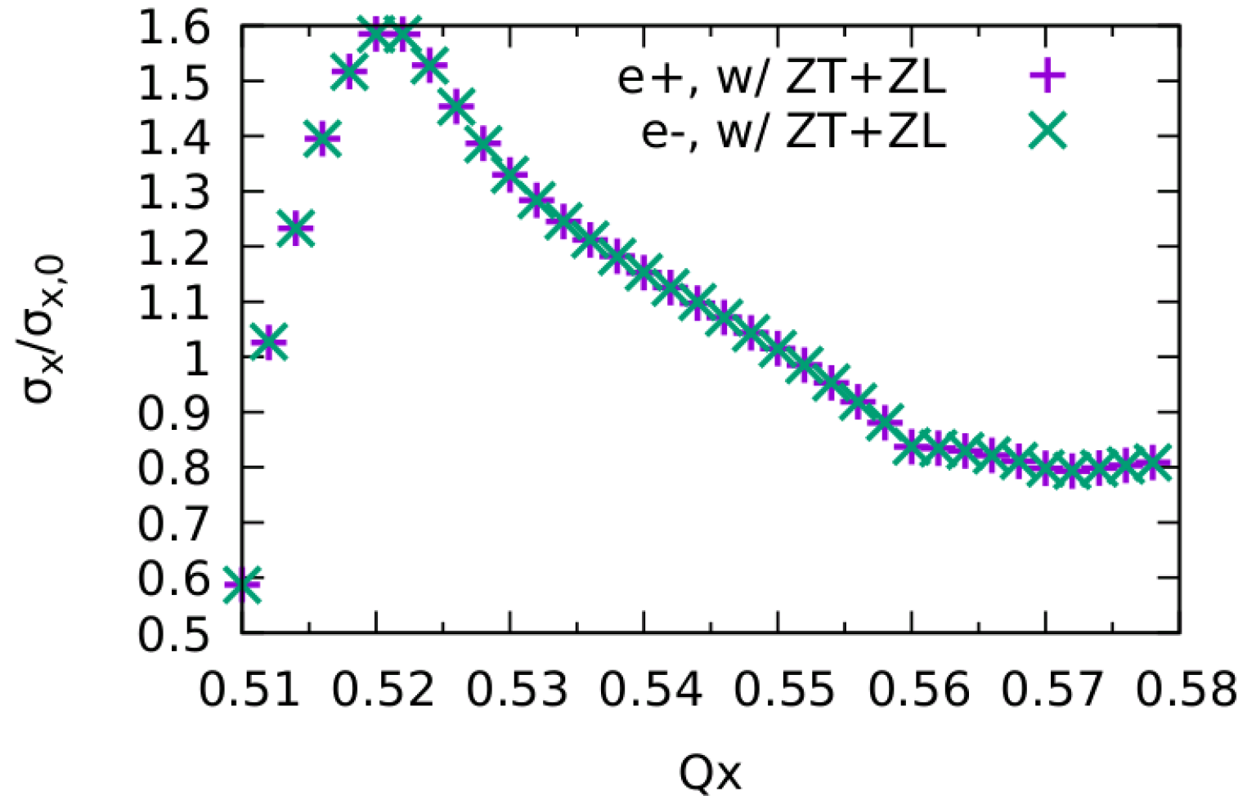
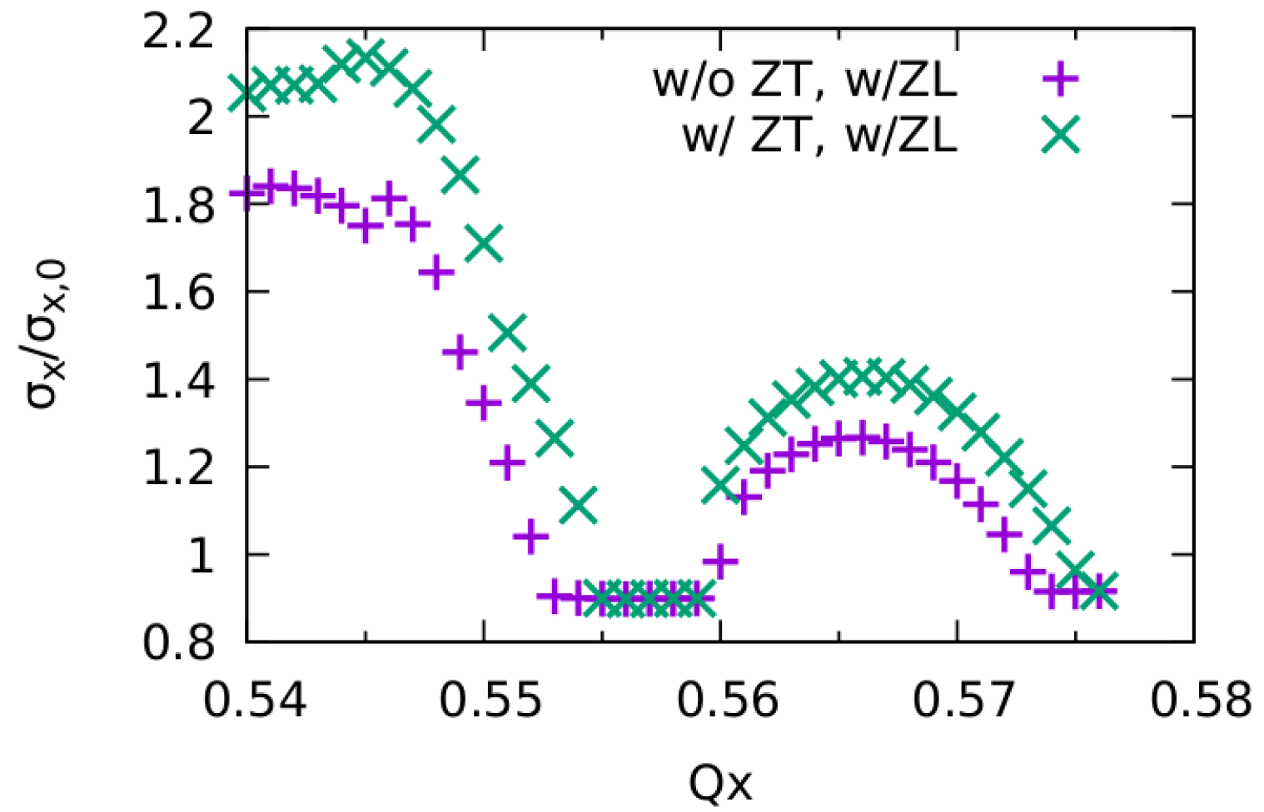
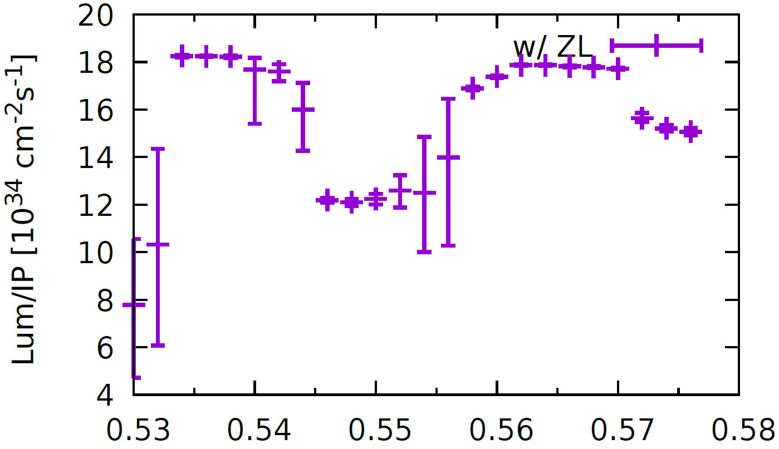
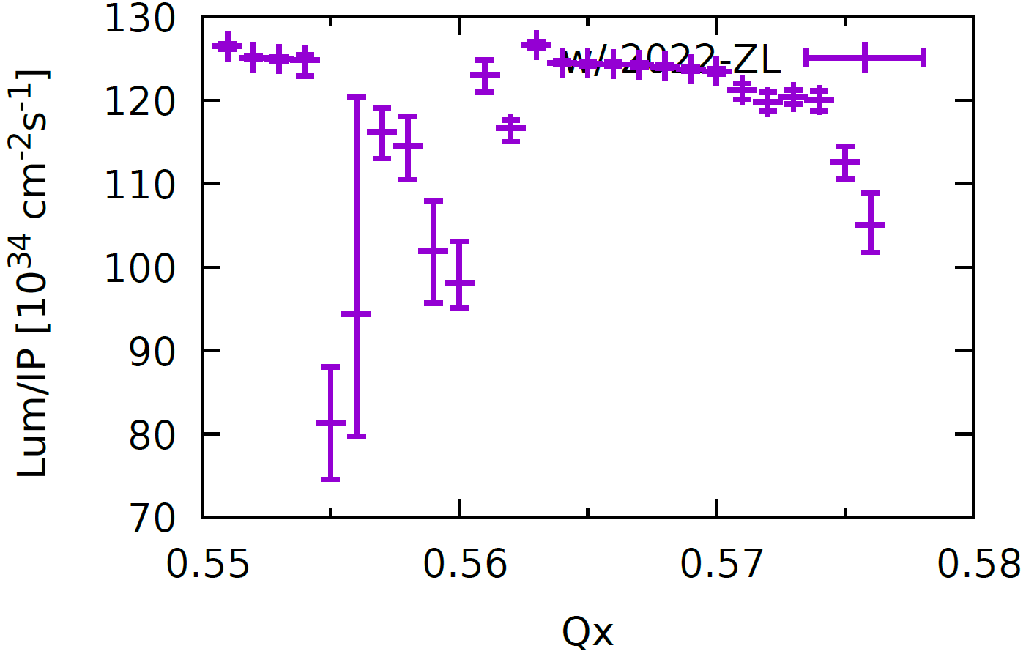
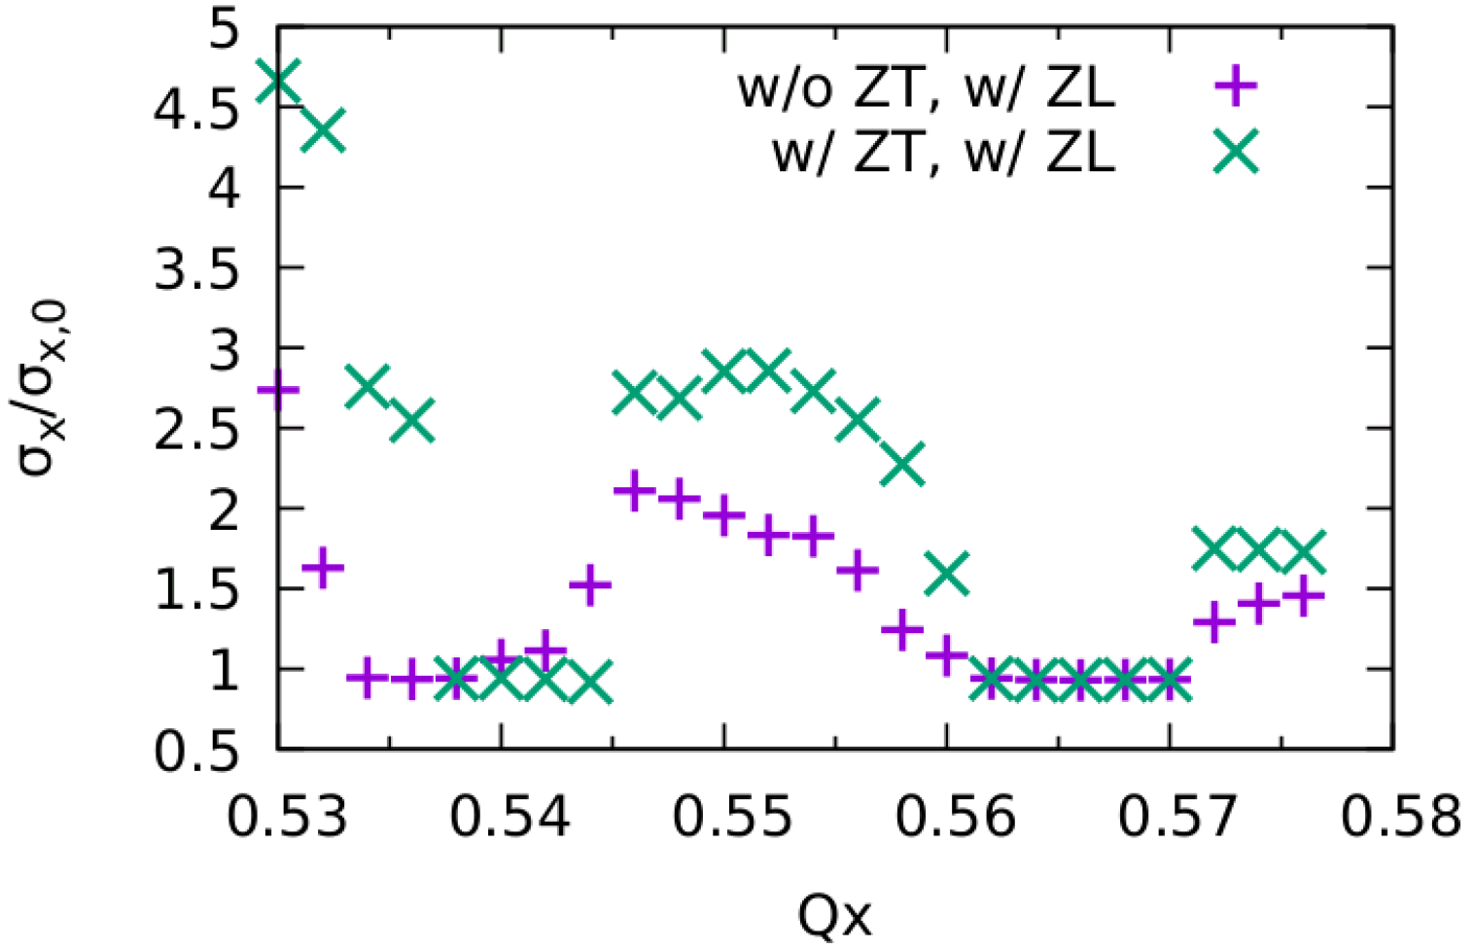
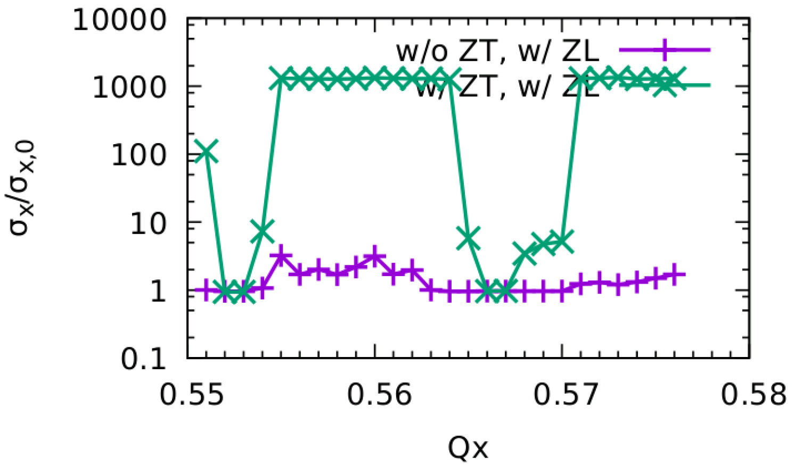
Study of beam-beam effects
Yuanzhang
Session A1-1: #2
Luminosity simulations w/ZL
Transverse size simulations
ttbar
Higgs
ttbar
Higgs
W
Z
W
Z
Beam-beam simulation results are consistent with the main parameter table
Luminosity & Lifetime is evaluated by strong-strong simulation
X-Z instability is well suppressed even considering Potential Well Distortion
Lifetime optimization with both beam-beam\lattice nonlinearity is done

Slide 15
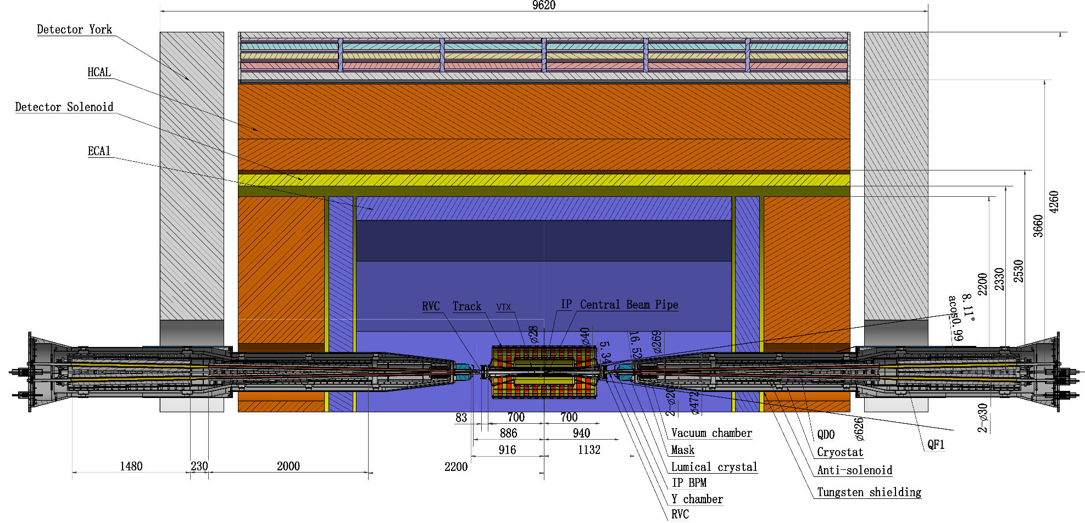
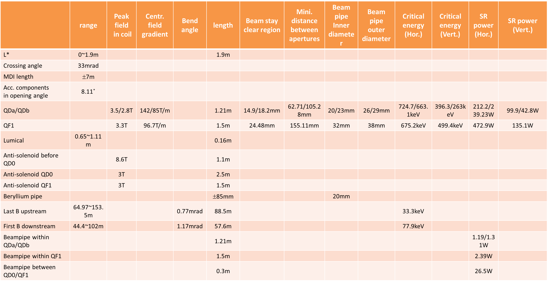
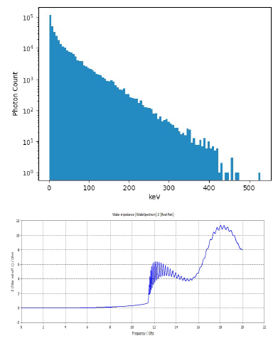
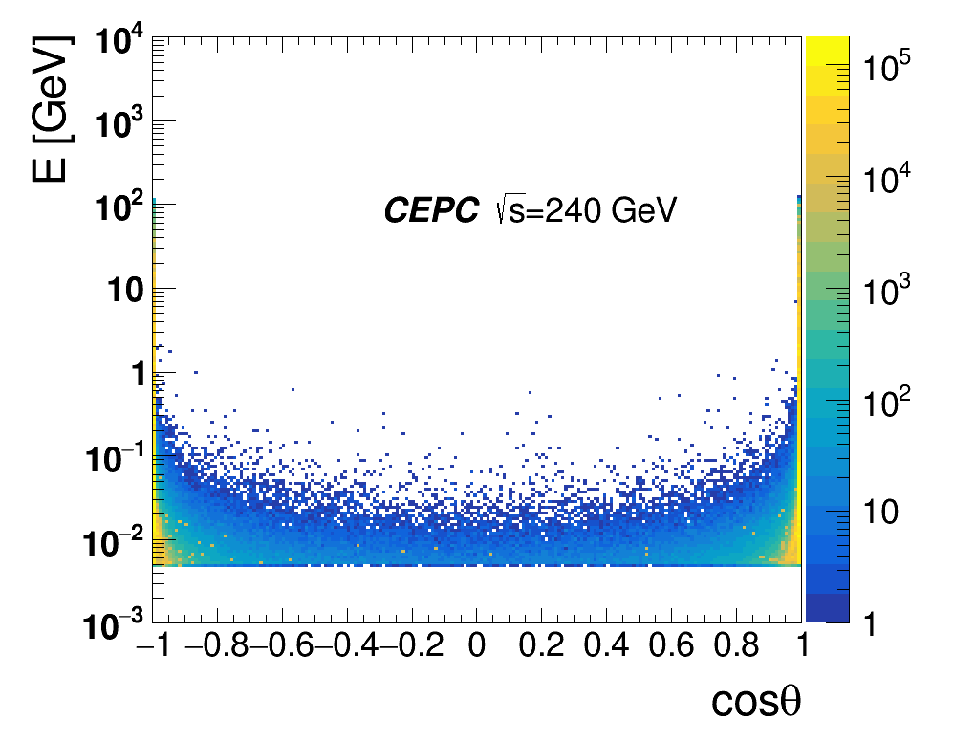
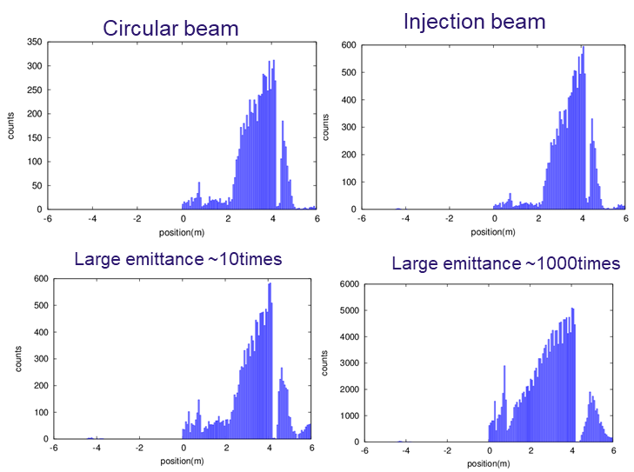
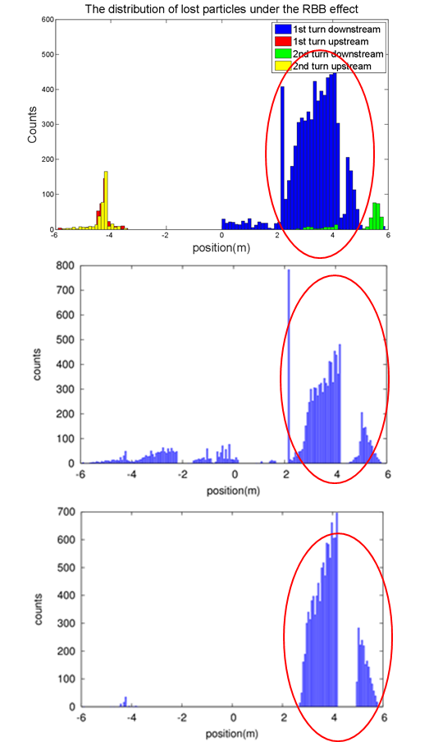
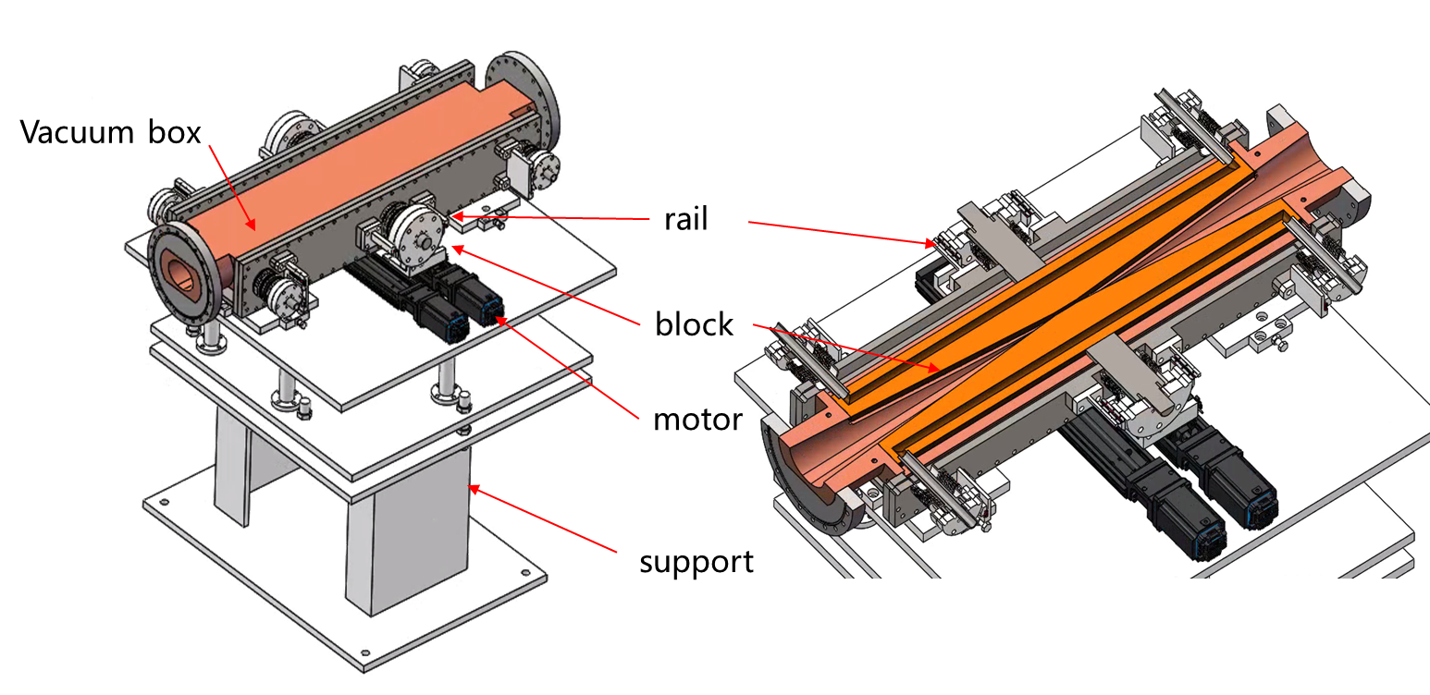
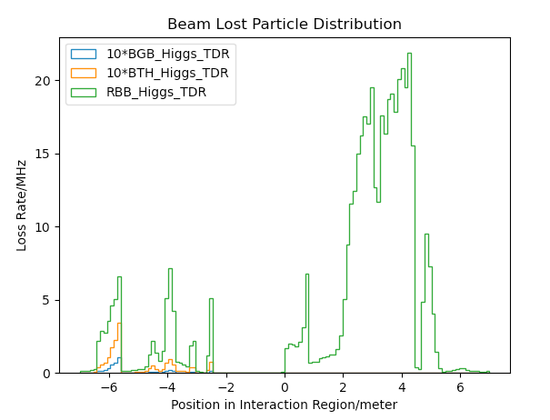
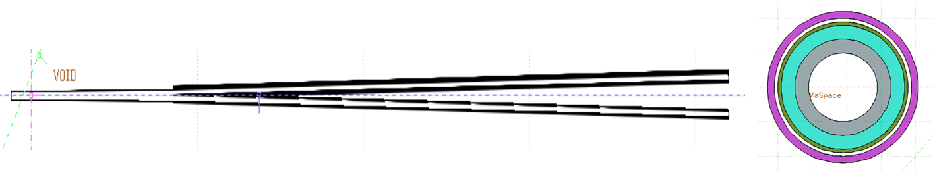
MDI design
Sha Bai
Session A1-1: #3
MDI Layout
General Parameters
A comprehensive design for MDI was made;
The general parameters, including the superconducting magnet geometries, pipes sizes, masks, etc., were determined;
Various radiation background was calculated and analyzed, and the mitigation measures were studied. The results demonstrate that the design fulfills the requirements;
SR Calculation
Radiation background
Radiative barbar, Beam-Gas, beam thermal photon scattering
Injection background
Radiation Mitigation
Masks, collimators, shielding

Slide 16
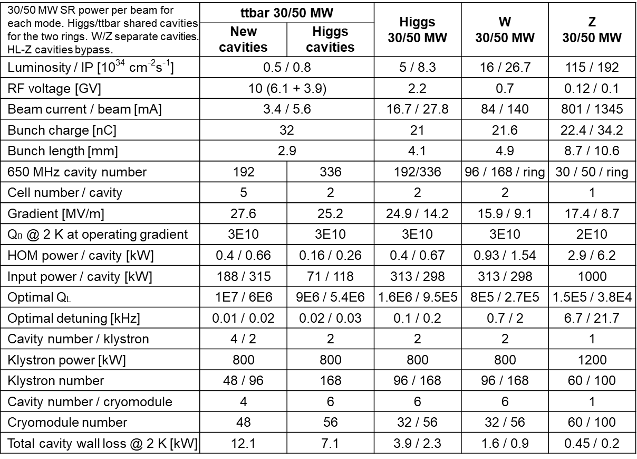
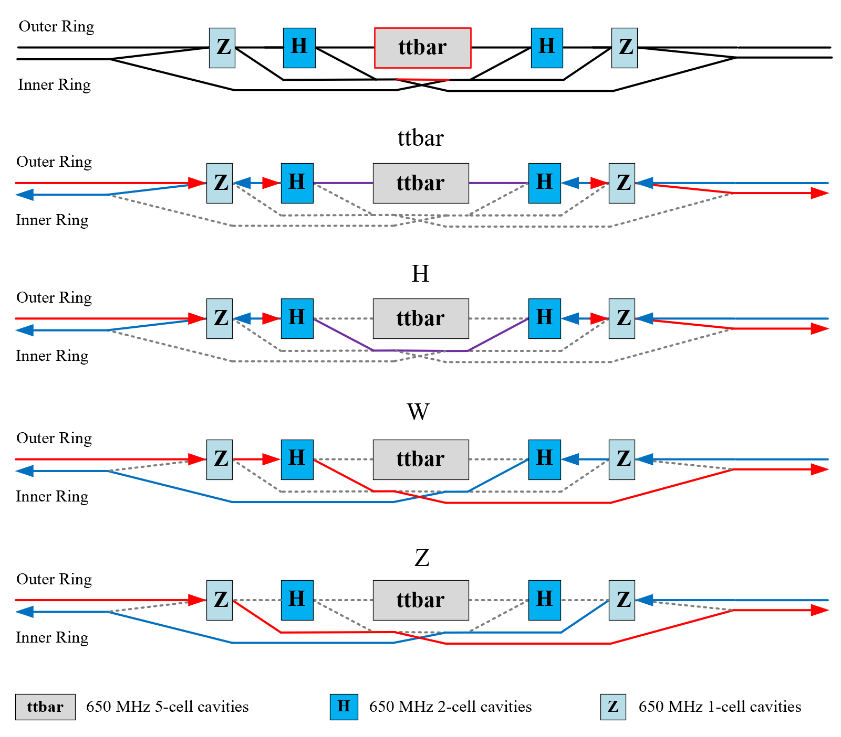
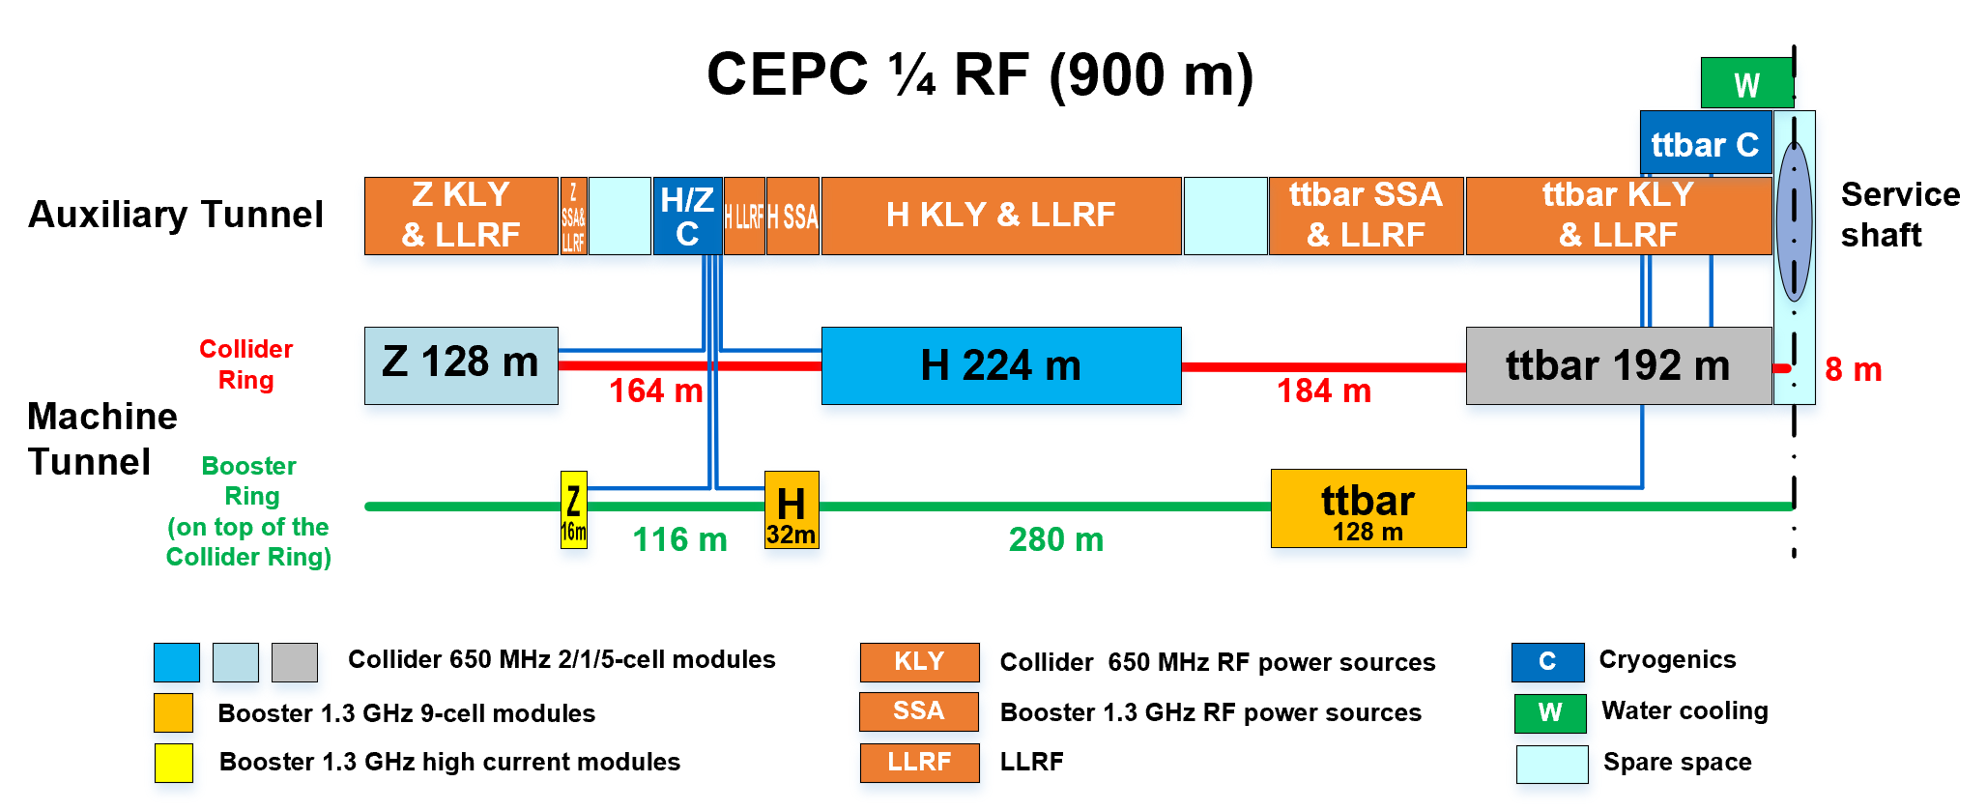
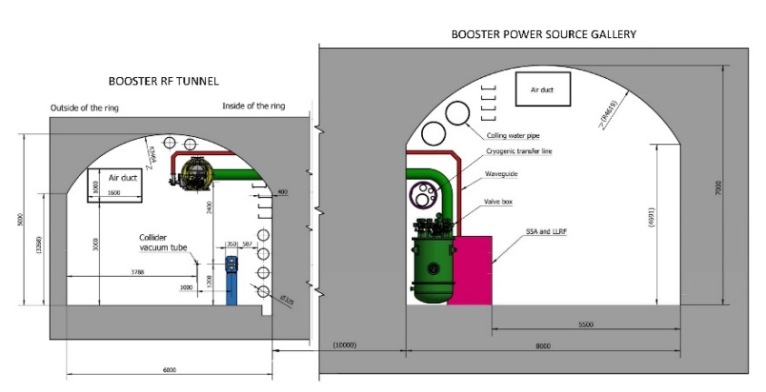
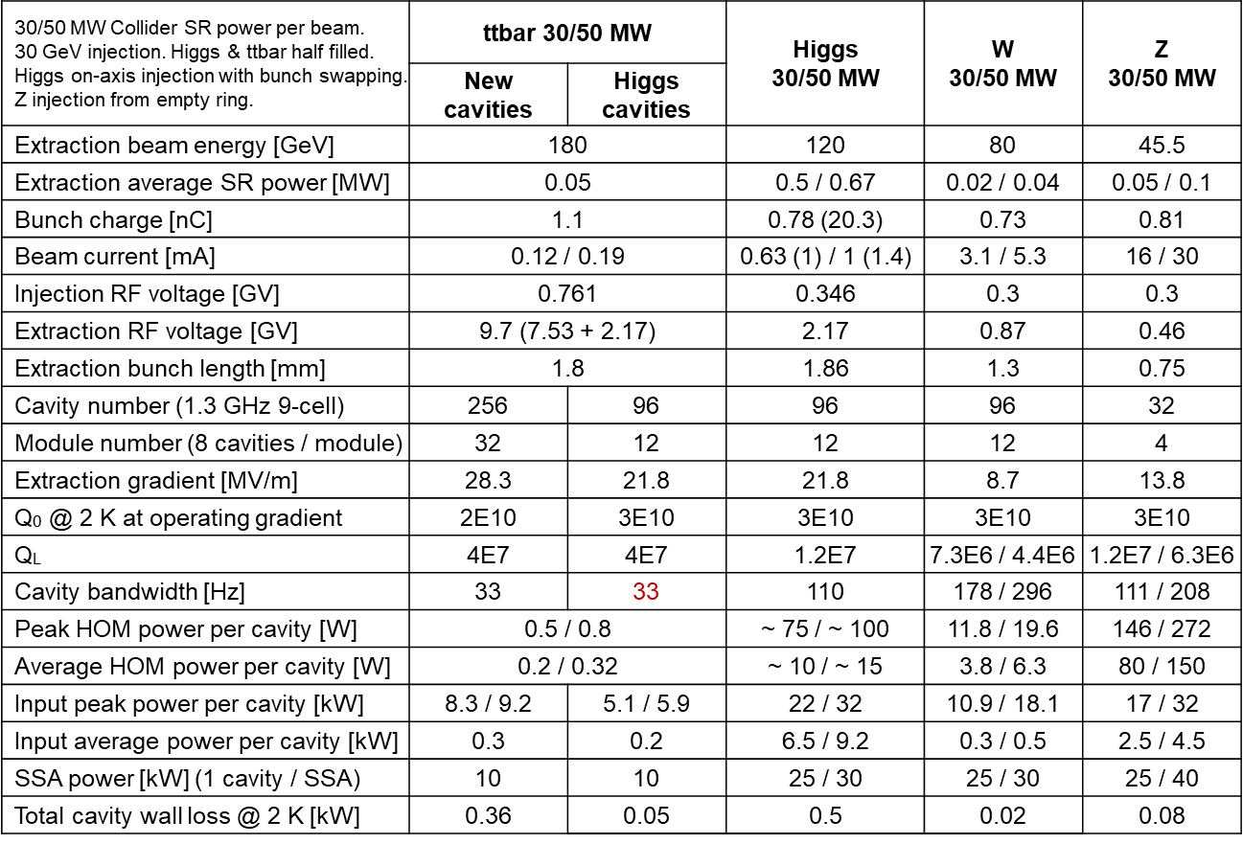
SRF system design and upgrade plan
Jiyuan Zhai
Session A1-2: #1
650MHz Parameters
H/W/Z/ttbar bypass scheme
SRF power supply auxiliary tunnel
1.3GHz Parameters
CEPC TDR SRF layout and parameters are designed to meet physics requirements;
RF system design optimized for Higgs 30/50 MW. Power and energy upgrade by adding cavities, RF power sources and cryogenic plants and other systems are compatible;
Use dedicated high current 1-cell cavity for 10-50 MW Z. Solve the FM & HOM CBI problems.

Slide 17
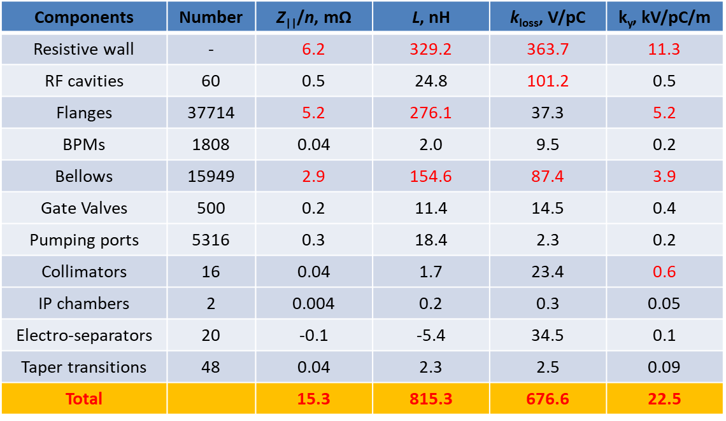
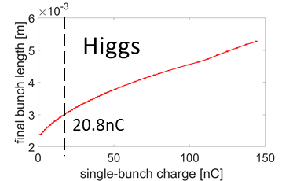
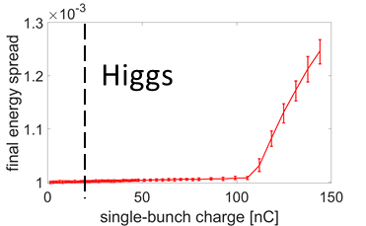
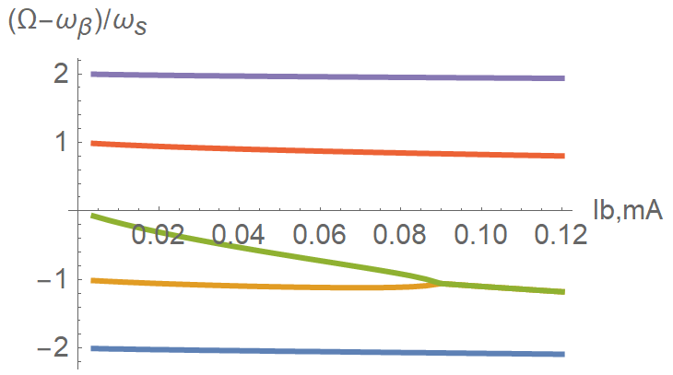
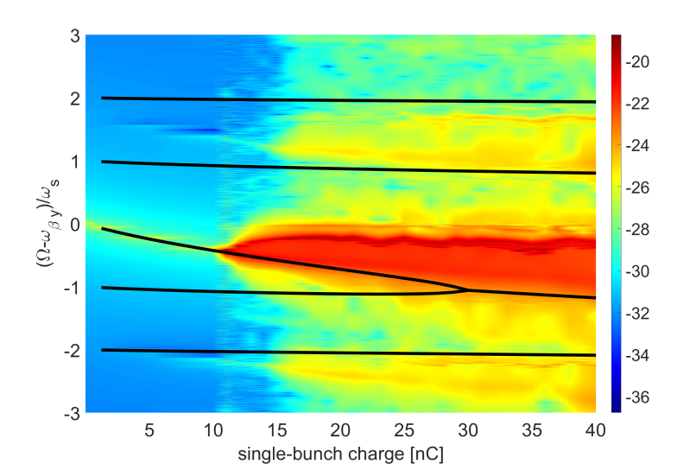
Collective instabilities
Na Wang
Session A1-2: #2
Impedance budget @ σ_{z}=3mm
Bunch lengthening and microwave instability
TMCI w/ZL
No show stoppers exist for Higgs, W and ttbar;
Main constraints from the beam collective effects are at the Z;
The Booster show no constraints from single bunch and CSR effect, however, bunch-by-bunch feedback is required to damp the TRWI;
No constraints observed from the Damping ring, and the impedance will lengthen the bunch by ~2%, which still meet the requirement from injections
Design
67μA (22.4nC)

Slide 18




Electron and positron injection linac designs
Cai Meng
Session A1-2: #3
Parameter | Symbol | Unit | Design value
Energy | E | GeV | 30
Repetition rate | f_{rep} | Hz | 100
Number of bunches per pulse |  |  | 1 or 2
Bunch charge |  | nC | 1.5
Energy spread | σ_{E} |  | 1.5×10^{–3}
Emittance | ε_{r} | nm | 6.5
Electron energy at target |  | GeV | 4
Electron bunch charge at target |  | nC | 10
Tunnel length | L | m | 1800
e- in linac
e+ in linac
Phase space @ SAS exit
Linac energy increases to 30 GeV, with S+C band Accelerator;
Start-to-end simulations were conducted for both electron/positron beams, with quality satisfying requirements.

Slide 19







Transport line and timing
Xiaohao Cui
Session M2-1: #1
Linac to DR
Booster to collider
Lamberson
26 mrad
60m
26m
66m
68m
Injection to Booster
H injection timing
pulse
100Hz single bunch for H/W/tt
10ms
Higgs/ttbar
W/ Z
There are a number of transport lines in the CEPC accelerator complex.
All transport lines are designed;
Injection/ramping timing was given for different energies
t
100Hz double bunch for Z

Slide 20



Collider ring magnets development
Mei Yang
Session M2-1: #2
Full-length Dual aperture dipole
Dual aperture QUAD
E(GeV) | Ap1 ByL(T.mm) | Ap2 ByL(T.mm) | Differ
45 | 15.3972 | 15.3765 | -0.13%
80 | 27.3358 | 27.3199 | -0.06%
120 | 41.2001 | 41.1810 | -0.05%
E(GeV） | GL(T)-A | GL(T)-B | difference
45 | -3.36 | 3.35 | 0.40%
80 | -5.91 | 5.88 | 0.59%
120 | -8.89 | 8.85 | 0.49%
148 | -10.93 | 10.89 | 0.40%
175 | -12.77 | 12.73 | 0.30%
182.5 | -13.27 | 13.21 | 0.40%
 | Dipole | Quad. | Sext. | Corr. | Total
Dual aperture | 3008 | 3008 | - | - | 17562
Single aperture | 162 | 1120 | 3176 | 3544*2
Total length [km] | 68.71 | 9.95 | 2.17 | 3.1 | 83.9
Power[MW]@120GeV | 6 | 17.5 | 8.91 | 0.28 | 32.7
Large quantities of dual-aperture dipoles (69km) and quad. (10km) are required;
Full length dual-aperture dipole and dual aperture QUAD (short length) have been fabricated;
Dipole/QUAD prototypes meet the requirements.

Slide 21


Weak field dipole for booster
Wen Kang
Session M2-2: #1
The integral field uniformity at all field levels is better than ±1×10^{–3}
Booster requires ~15k pieces of magnets (68km);
Booster dipoles are required to work at the low field of 95 Gs (30GeV) with an error smaller than 1×10^{–3} ;
Full length (4.7m) dipole was developed, and it meets the field specification;

Slide 22





Final focus superconducting quadrupoles
Yingshun Zhu
Session M2-2: #2
SCQ Specifications
 | Q1a | Q1b | Q2
Field gradient | 142.3 | 85.4 | 96.7 | T/m
Magnetic length | 1210 | 1210 | 1500 | mm
Reference radius | 7.46 | 9.085 | 12.24 | mm
Mini. distance between aperture center | 62.71 | 105.28 | 155.11 | mm
High order field harmonics | ≤5×10⁻⁴ | ≤5×10⁻⁴ | ≤5×10⁻⁴
Dipole field | ≤3 | ≤3 | ≤3 | mT
Q1a
Q1b
Q2
CCT and Cos2θ type SCQs were modeled, and their fields were calculated; the CEPC specifications have been met;
A 0.5-m single aperture SCQ using Cos2θ technology has been developed. The electro-magnet excitation test showed the highest current reached 2500A (176 T/m), which exceeds the CEPC requirement (142T/m)

Slide 23





Magnet power supply system
Bin Chen
Session M2-2: #3
    Counting the power supplies for the collider, booster, linac, DR, Transport line, the total magnet quantity ：38435
Digital Power Supply Control Module (DPSCM)
Collider | Dipole |  | Quadrupole |  | Sextupole | Corrector | Magnet quantity
 | D-aperture | S-aperture | D-aperture | S-aperture
 | 3008 | 162 | 3016 | 1116 | 3144 | 7088 | 17534
Booster | Dipole |  | Quadrupole |  | Sextupole | Corrector
 | 14866 |  | 3458 |  | 100 | 1200 | 19624
Linac | Dipole |  | Quadrupole |  | Solenoids | Corrector
 | 15 |  | 364 |  | 37 | 275 | 691
Damping Ring | Dipole |  | Quadrupole |  | Sextupole | Corrector
 | 86 |  | 130 |  | 72 | 60 | 348
Transport Line | Dipole |  | Quadrupole |  | Sextupole | Corrector
 | 64 |  | 120 |  | 0 | 54 | 238
Total | 38435
Current Transducer
Stability test
  Both high and low voltage power suppliers for different magnets were designed, with satisfactory stability
  Key components, such as the DPSCM and Current Transducer were developed, which are applied at HEPS

Slide 24








Injection & extraction system
Jinhui Chen
Session A2-1: #1
Various kickers and septums are required
In-vacuum/half in-vacuum Septum
Slotted-pipe kicker
The same team is in charge of both HEPS and CEPC inj. & ext. system
Experience gained in HEPS applies for CEPC
HEPS has developed various types of devices including Septum, Fast Kick, and Pulse Generator, which are compatible with the CEPC.
Fast kicker pulser

Slide 25




Vacuum system
Yongsheng Ma
Session A2-1: #2
Vacuum chamber prototypes, copper & aluminum, with different shape/length were fabricated;
NEG coating technology were developed;
RF shielding bellow manufactured
Vacuum technology applied and was tested at HEPS

Slide 26




SRF cavities and modules
Peng Sha
Session A2-1: #3
6.4E10@30MV/m, 2.3E10@41.6MV/m
Mid-T baking applied to 1.3GHz/650MHz cavities, resulting in High Q SRF cavity that meets the CEPC specification;
Completed SRF modules for both 1.3GHz and 650MHz cavities were assembled;

Slide 27


Cryogenic system
Rui Ge
Session A2-2: #1
Booster SRF
Collider SRF
Cryogenic system was optimized for the most economic operation
Heat load at different operation modes were calculated, accordingly the cooling capacity was designed: 4×15kW@4.5K

Slide 28







Electron & positron linacs
Jingru Zhang
Session A2-2: #2
Flux concentrator for positron source
S band pulse compressor
High perform. S/C-band Acc. Struc.
pulsed magnetic field of 6 T to 0.5 T
15kA/15kV/50Hz solid state pulse source
28

Slide 29




RF power sources and distribution
Zusheng Zhou
Session A2-2: #3
Klystron R&D
Power Step Module
RF distribution plan
Three prototypes of the 650MHz klystron are developed. The efficiency reaches 70%
PSM is developed with the industrial collaboration
RF tunnel distribution was planed

Slide 30






Beam instrumentation
Yanfeng Sui
Session M3-1: #1
Feedthrough
CEPC R&D Funding
FB system
Various types of beam instrumentation were developed with funding from HEPS, BEPCII and CEPC
The CEPC requirements are met
BPM sensor & electronics

Slide 31

Mechanical supports and installation tools
Haijing Wang
Session M3-1: #2

Slide 32








Installation and alignment plan
Xiaolong Wang
Session A3-2: #2
Alignment accuracy requirement
Component Pre-alignment
*implement beam-based alignment
Wall Control Point
Ground Control Point
Backbone Control network (short line:300m; long line 600m)
Tunnel Control network (interval of 6 meters)
Surface Control network (14Points)

Slide 33
Remaining systems
The following presentations will cover the remaining systems
Control system Gang Li
Radiation protection study Guangyi Tang
Site selections & civil engineering designs Yu Xiao
Auxiliary facility and power consumptions Jinshu Huang
SPPC compatible design Jingyu Tang
Superconducting high field magnet Qingjin Xu
CEPC applications as an advanced photon source Yuhui Li
Polarization application at CEPC Zhe Duan
e-/e+ plasma injector design (alternative) Dazhang Li
Industrialization preparation and Deep-C documentation system Song Jin

Slide 34
Summary
The CEPC parameters optimization for high luminosity and 30MW and 50MW operations, for all energies are studied. The results demonstrate that the physics design satisfies the goals required by the scientific objectives.
A comprehensive key technology R&D program has been carried out, and the CEPC accelerator will be ready for construction in “15th five-year-plan” (2026-2030)
The TDR design of the CEPC is compatible with a future SppC

Slide 35
Acknowledgements
Thanks go to CEPC-SppC accelerator team’s hard works,
international and CIPC collaborations
Special thanks to CEPC IAC, IARC and TDR review committee’s critical comments,
suggestions and encouragement

