Slide 1
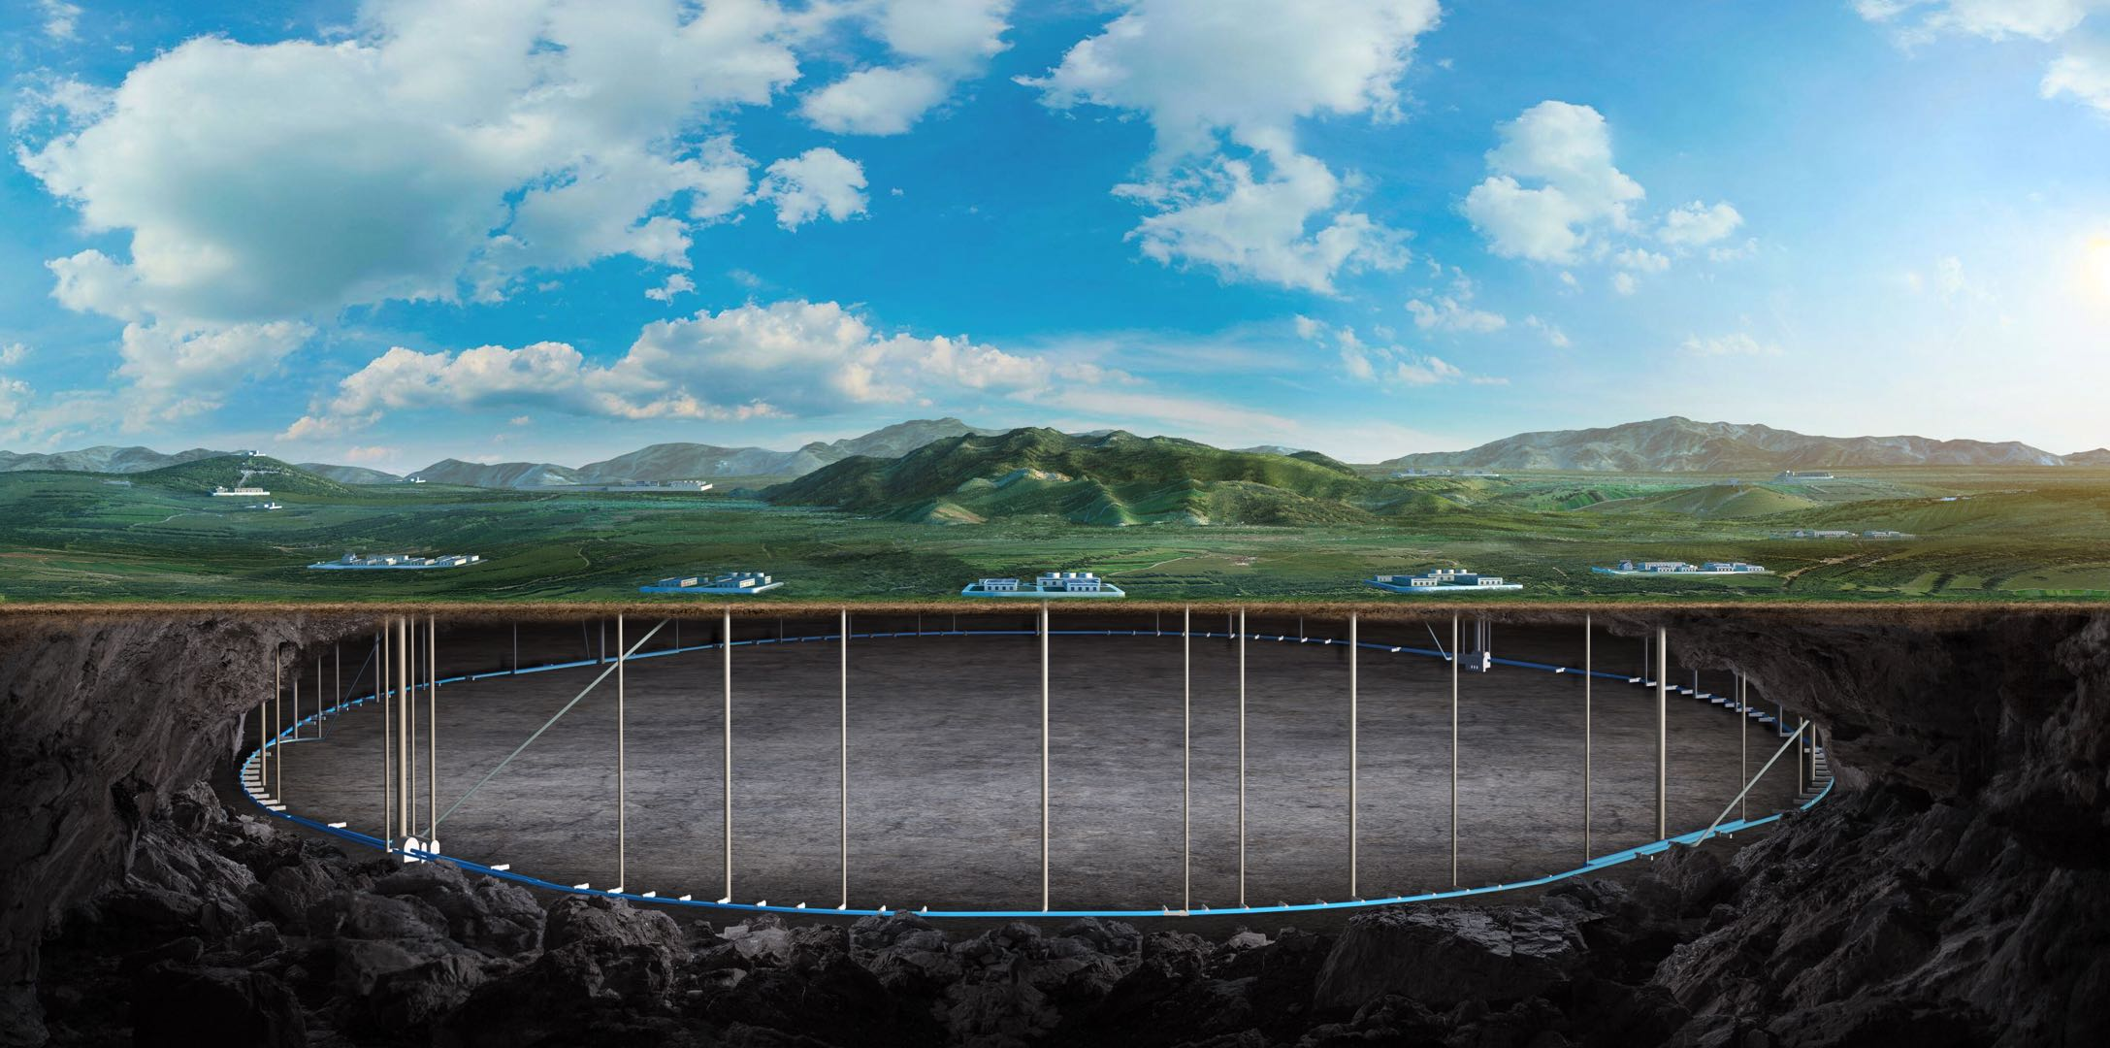
Beam-Beam Effects in CEPC
Yuan Zhang
Contributors:
Na Wang, Yiwei Wang, Dou Wang, Huiping Geng, Zhiyuan Li (IHEP)
Kazuhito Ohmi(KEK), Chuntao Lin (IASF), Demin Zhou(KEK)
M. Zobov(INFN/LNF)
Thanks:
D. Shatilov, K. Oide, M. Migliorati
12-16. June. 2023, Hongkong, CEPC Accelerator TDR International Review

Slide 2
Content
Introduction
Pure Beam-Beam Interaction
Combined effect with Impedance
Combined effect with Lattice
Summary

Slide 3
Introduction
This talk is about Beam-Beam Interaction (sec4.2.2)
This talk relates to the TDR sec4.1, sec4.2.1, sec4.2.3
The content relates to the “charge letter” item
Are the accelerator system design goals well defined? Have the goals been reached in the TDR?
Are the accelerator physics issues adequately addressed?

Slide 4
Design Parameters
2 IPs, 2x16.5 mrad
100 km
 | Higgs | Z | W | ttbar
Beam Energy [GeV] | 120 | 45.5 | 80 | 180
Damping Decrement (x/y/z, SR) | 0.75/0.75/1.5 [${10}^{−2}$] | 4/4/8 [${10}^{−4}$] | 2.2/2.2/4.4 [${10}^{−3}$] | 2.5/2.5/5 [${10}^{−2}$]
$β_{x}^{∗}/β_{y}^{∗}$ [m/mm] | 0.3/1 | 0.13/0.9 | 0.21/1 | 1.04/2.7
$ε_{x}/ε_{y}$ [nm/pm] | 0.64/1.3 | 0.27/1.4 | 0.87/1.7 | 1.4/4.7
$σ_{z}$ (SR/BS) [mm] | 2.3/4.1 | 2.5/8.7 | 2.5/4.9 | 2.2/2.9
$σ_{p}$ (SR/BS) [%] | 0.1/0.17 | 0.04/0.13 | 0.07/0.14 | 0.15/0.2
$β_{y}^{∗}θ/σ_{x}$ | 1.2 | 2.5 | 1.2 | 1.2
Piwinski Angle | 4.88 | 24.23 | 5.98 | 1.23
$ν_{s}$ | 0.0049 | 0.035 | 0.062 | 0.078
Bunch Population [${10}^{10}$] | 13 | 14 | 13.5 | 20
$ξ_{x}/ξ_{y}$ | 0.015/0.11 | 0.004/0.127 | 0.012/0.113 | 0.071/0.1
Bunch Number | 268 | 11934 | 1297 | 35
Luminosity/IP [${10}^{34}cm^{−2}s^{−1}$] | 5 | 115 | 16 | 0.5

Slide 5
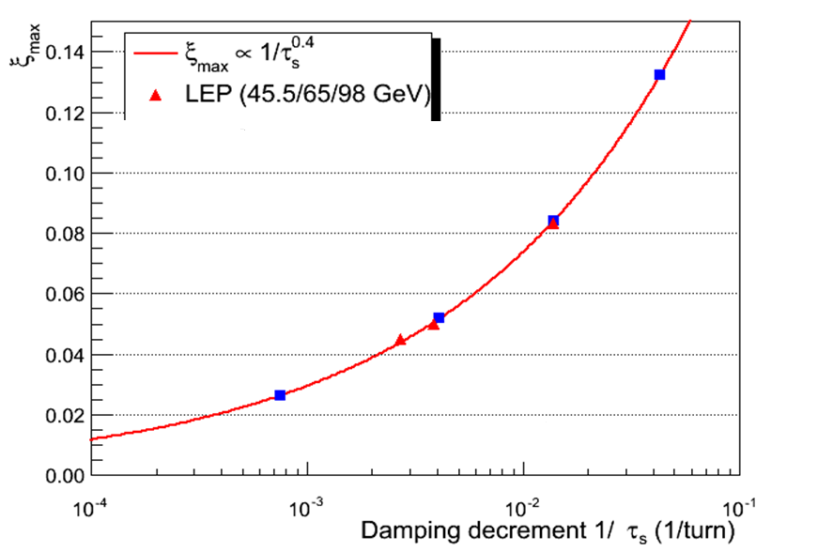
R. Assmann and K. Cornelis, EPAC’00
CEPC-Z
CEPC-H
CEPC-W
CEPC-ttbar

Slide 6
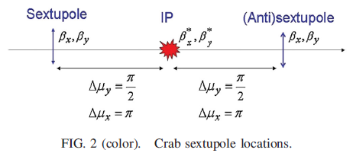
Crab-waist collision
P. Raimondi , 2nd SuperB Workshop, March 2006
M. Zobov et al., PRL 104, 174801 (2010)

Slide 7
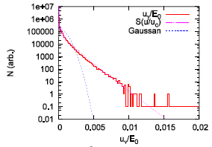
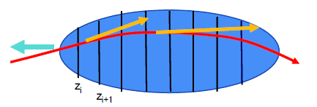
Beamstrahlung Effect & 3D flip-flop
V. I. Telnov, PRL 110, 114801 (2013)
A. Bogomyagkov et al., Phys. Rev. ST Accel. Beams 17, 041004 (2014)
D. Shatilov, ICFA Beam Dyn. Newslett. 72, 30 (2017).
Synchrotron radiation during beam-beam interaction
High energy photon -> Momentum acceptance -> Lifetime
Longer bunch length and Higher energy spread
Asymmetrical beam blowup: 3D flip-flop

Slide 8
Simulation Tool
IBB
K. Hirata et al., PA 40, 205-228 (1993)
K. Hirata, PRL, 74, 2228 (1995)
Y. Zhang et al., PRST-AB, 8, 074402 (2005)
Y. Seimiya et al., PTP 127, 1099 (2012)
K. Ohmi, IPAC16
Y. Zhang et al., PRAB 23, 104402, (2020)
Linear Arc Map with SR radiation
One turn map including general chromaticity
Horizontal crossing angle: Lorentz boost map
Bunch slice number is about 10 times Piwinski angle
Slice-Slice collision: Synchro-beam mapping method (or PIC)
Synchrotron radiation during collision
Longitudinal wakefield
Transverse wakefield

Slide 9
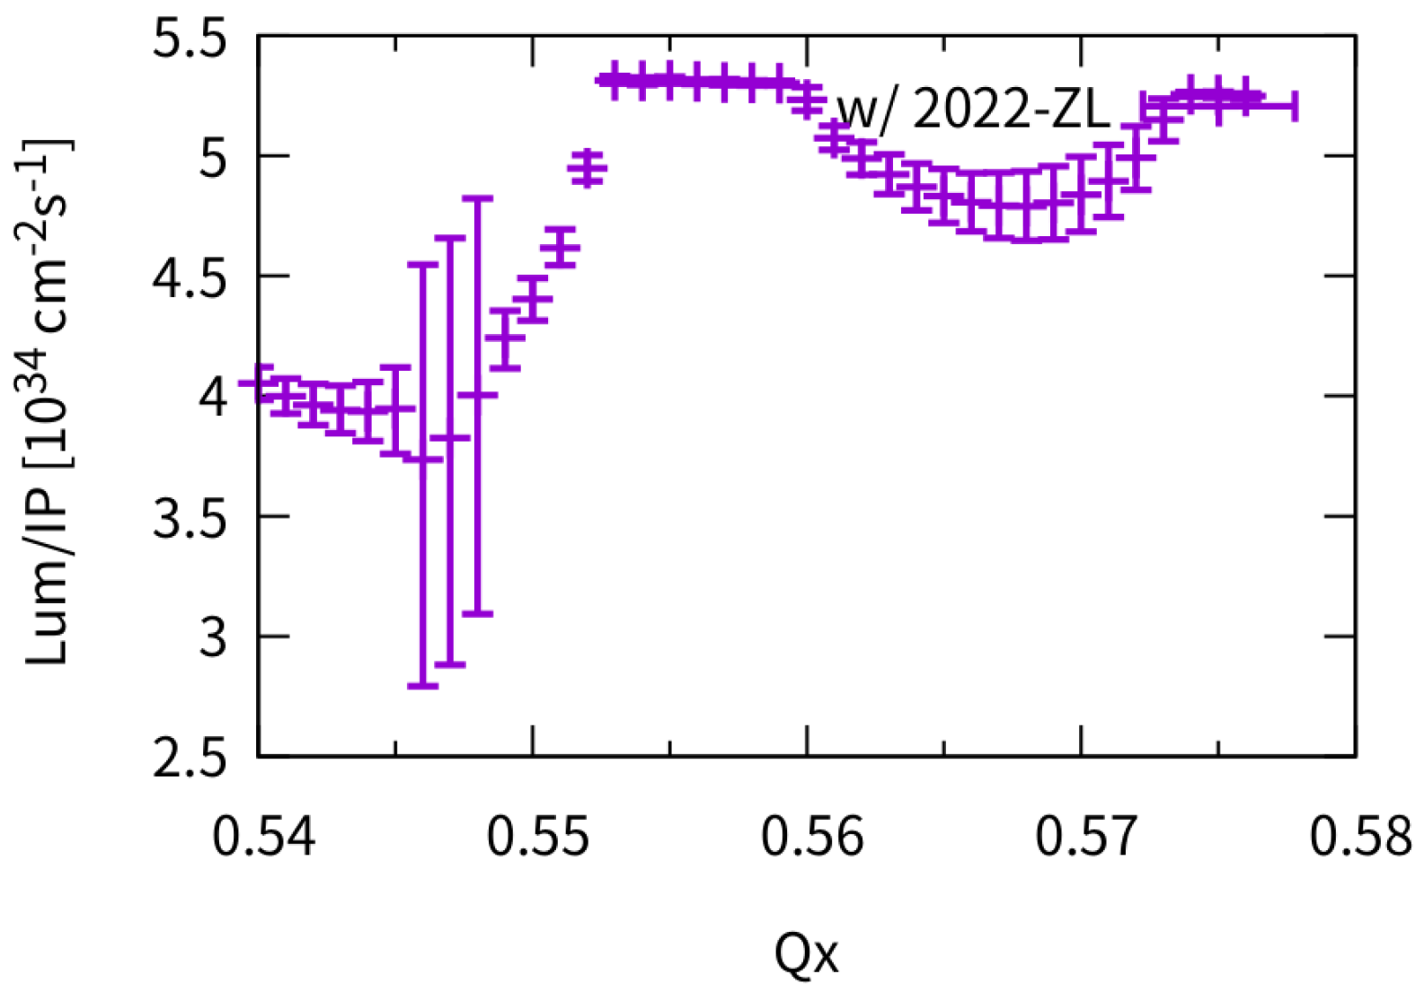
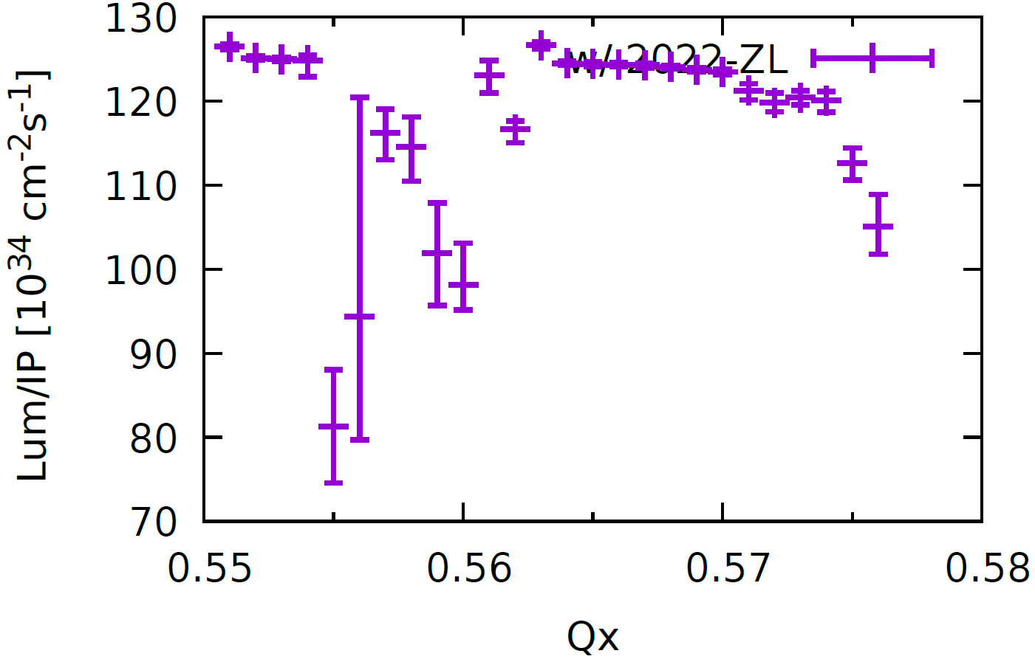
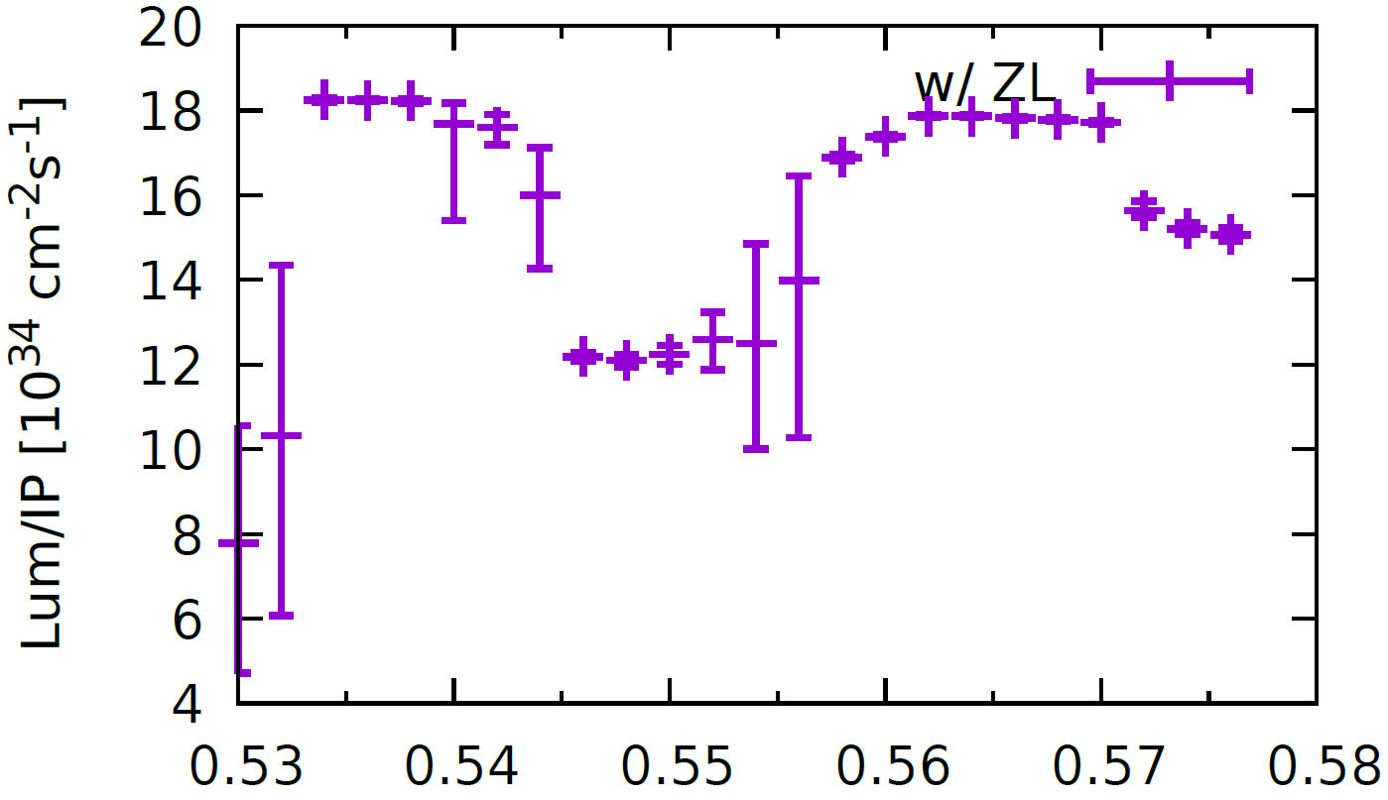
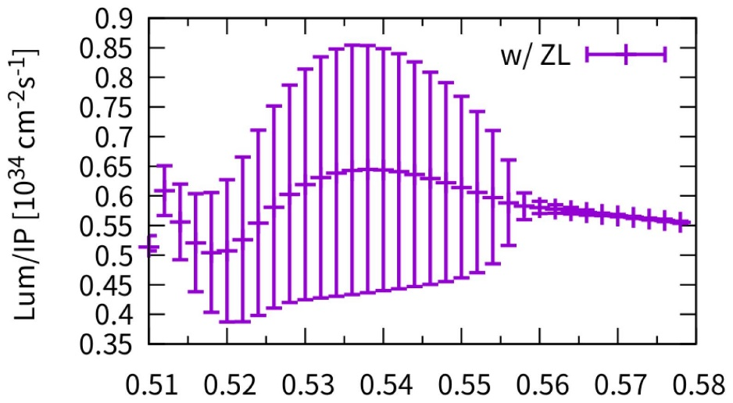
Luminosity versus horizontal tune
The design luminosity could be achieved in the pure beam-beam simulation.
Higgs
Z
W
ttbar

Slide 10
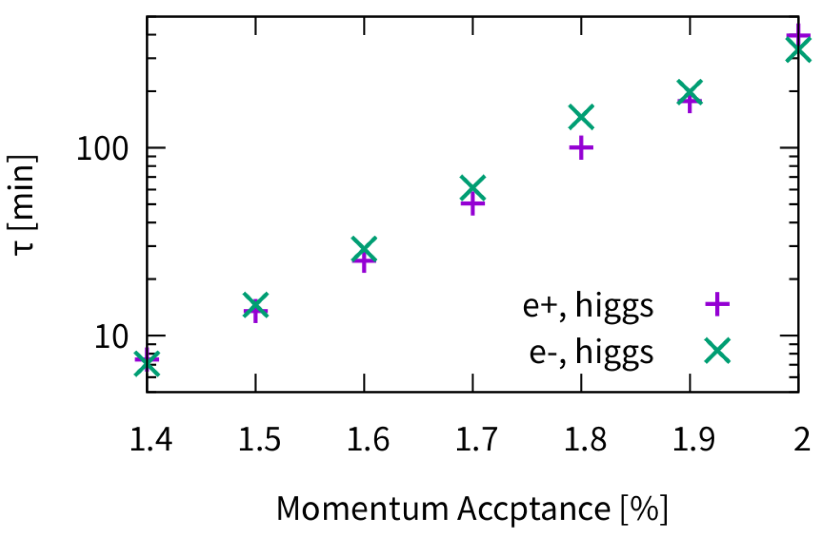
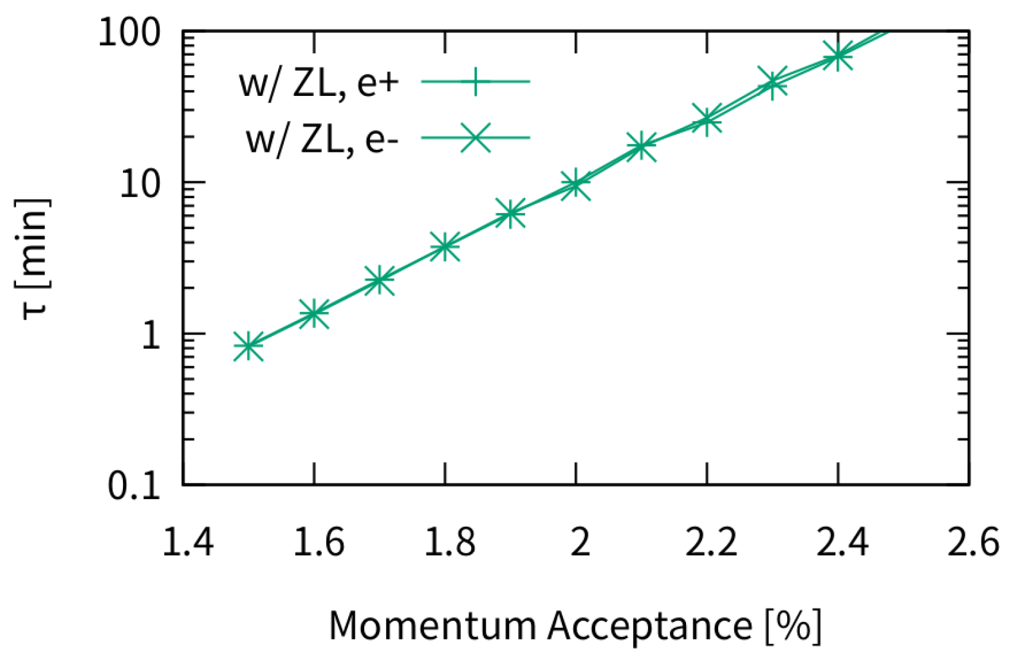
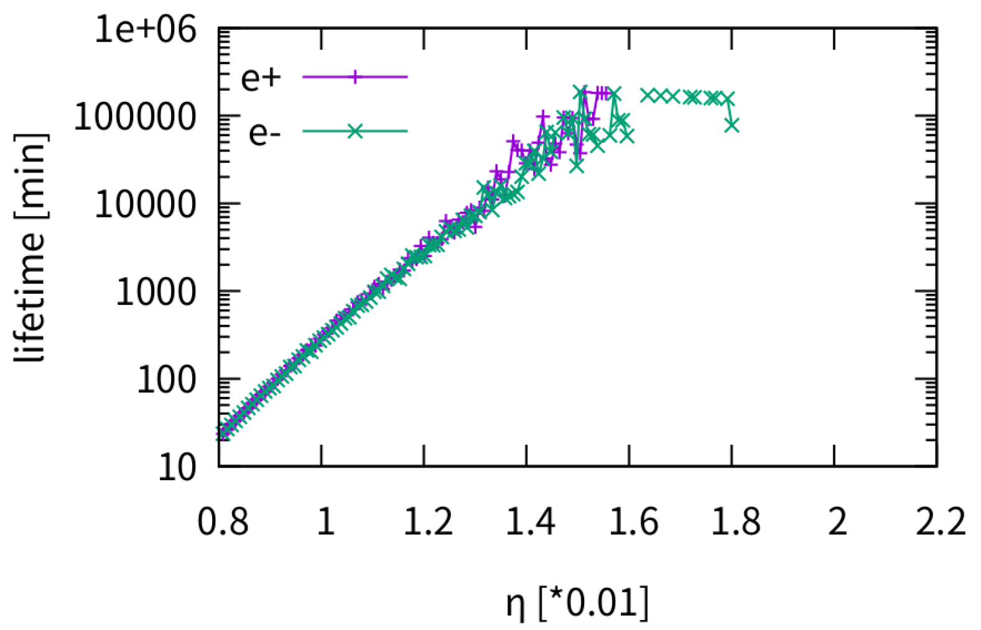
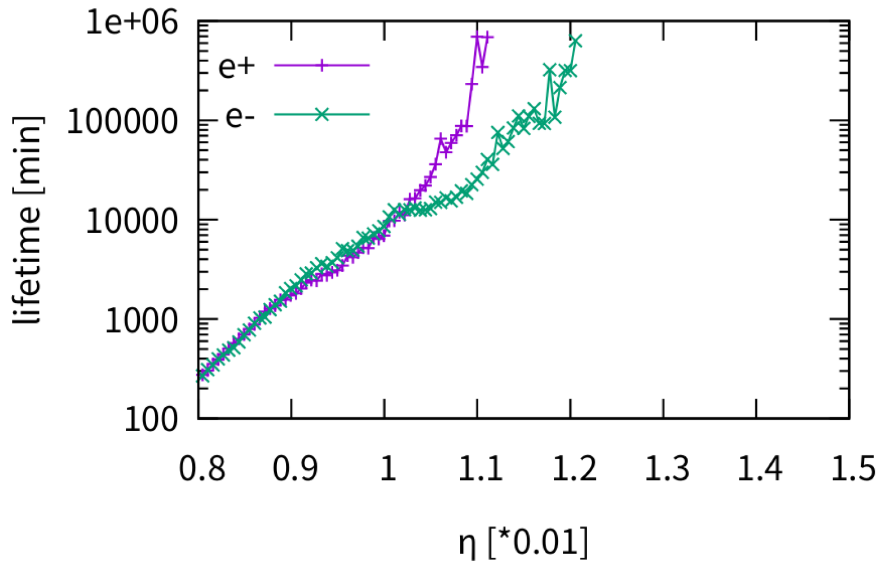
Beamstrahlung Lifetime vs Momentum Acceptance
K. Ohmi, etal., IPAC 14
The pure beam-beam simulation presents a goal value for Lattice optimization.
higgs
ttbar
Z
W
* If particles exceed the momentum acceptance are checked just after collision.

Slide 11
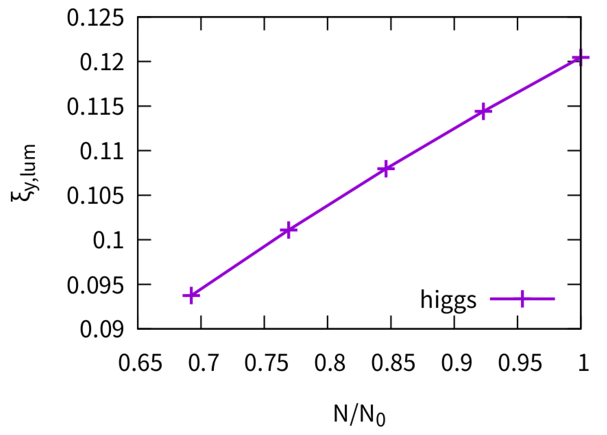
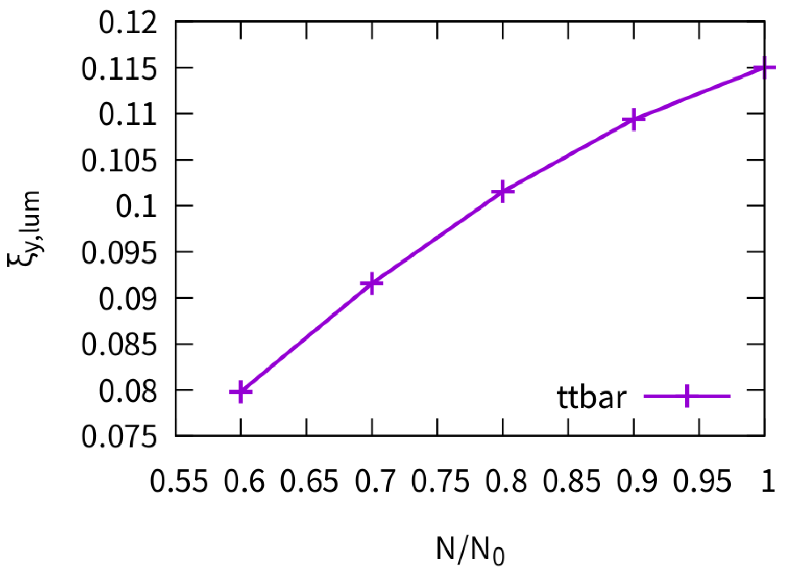
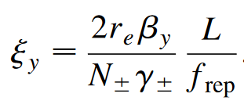
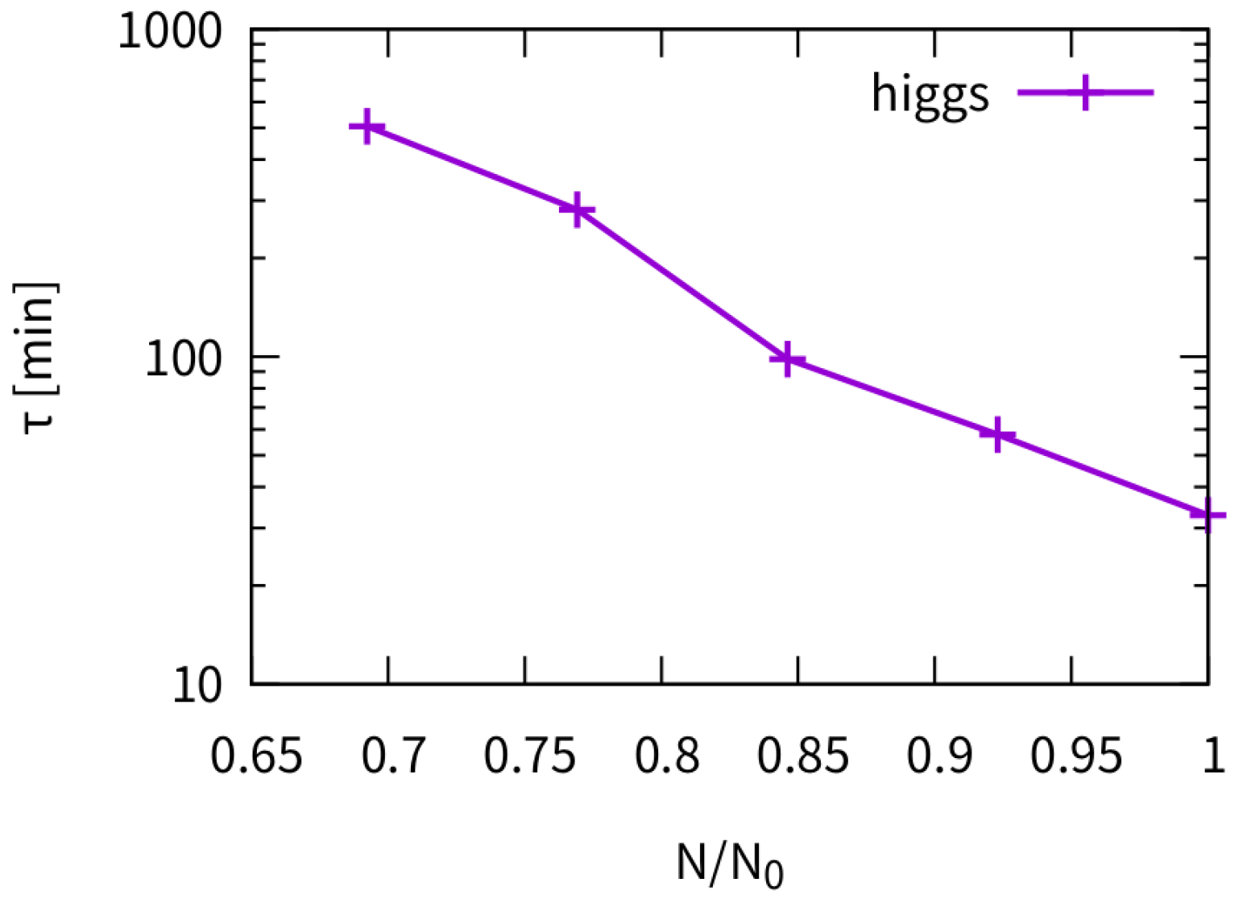
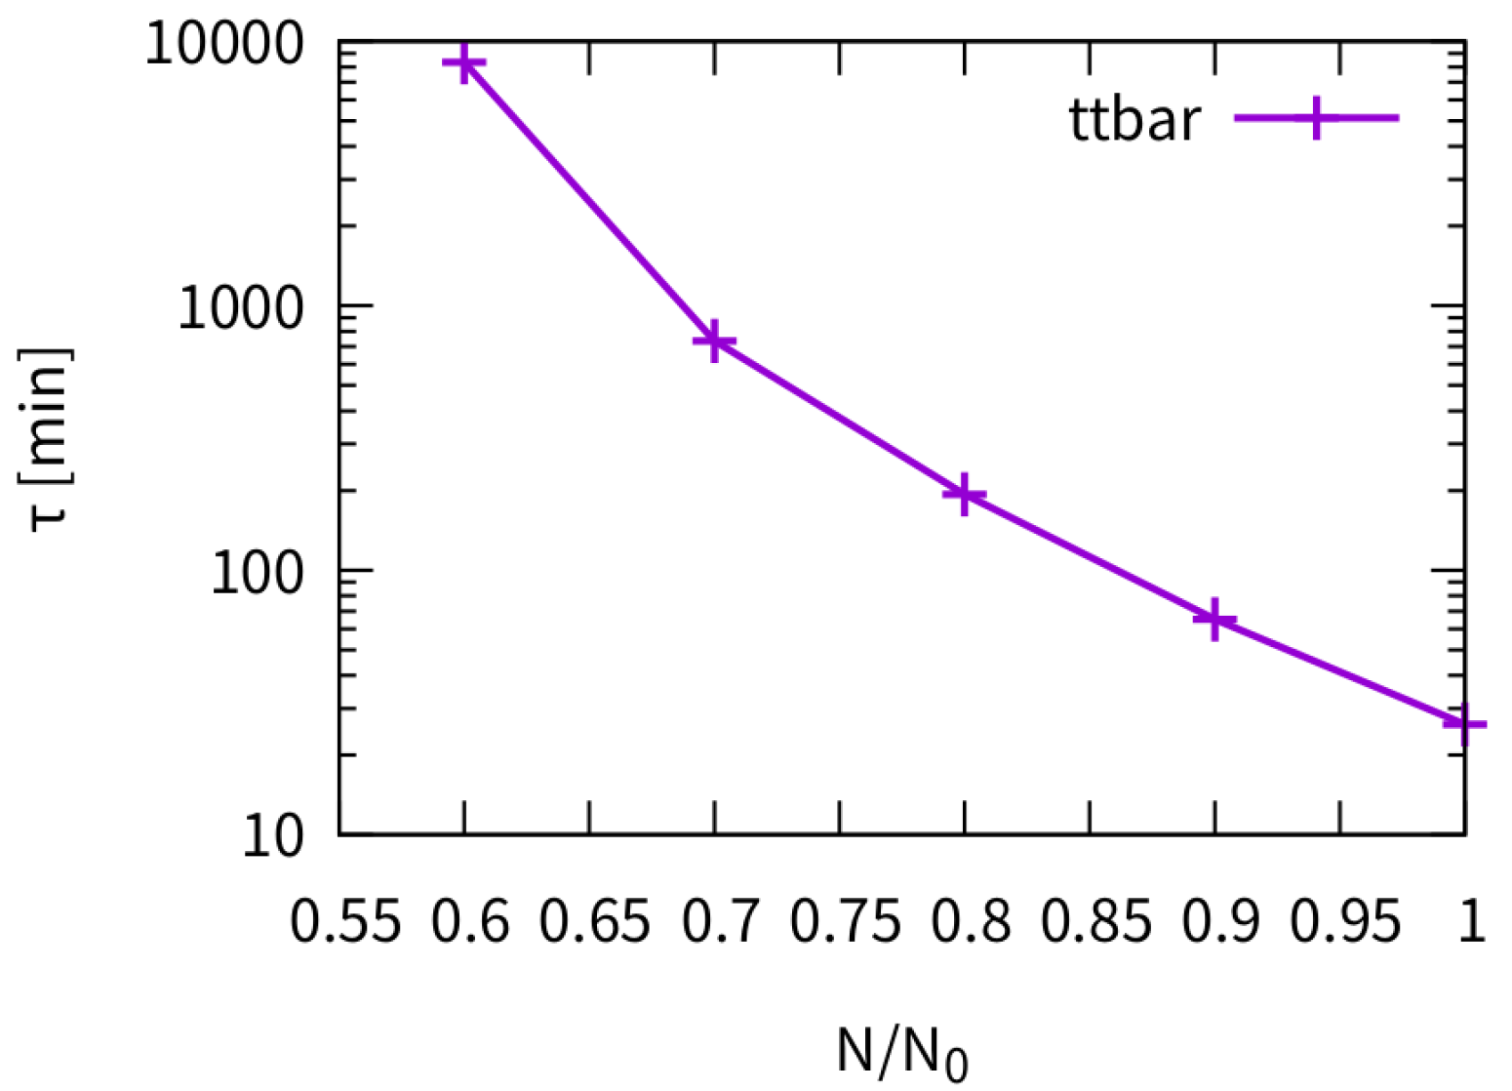
Beam-Beam Performance & Beamstrahlung lifetime vs bunch population (higgs/ttbar)
The beam-beam parameter does not stature at design bunch population
The beamstrahlung lifetime evaluation shows that it is very sensitive to the bunch population
* If particles exceed the momentum acceptance are checked just after collsion.

Slide 12
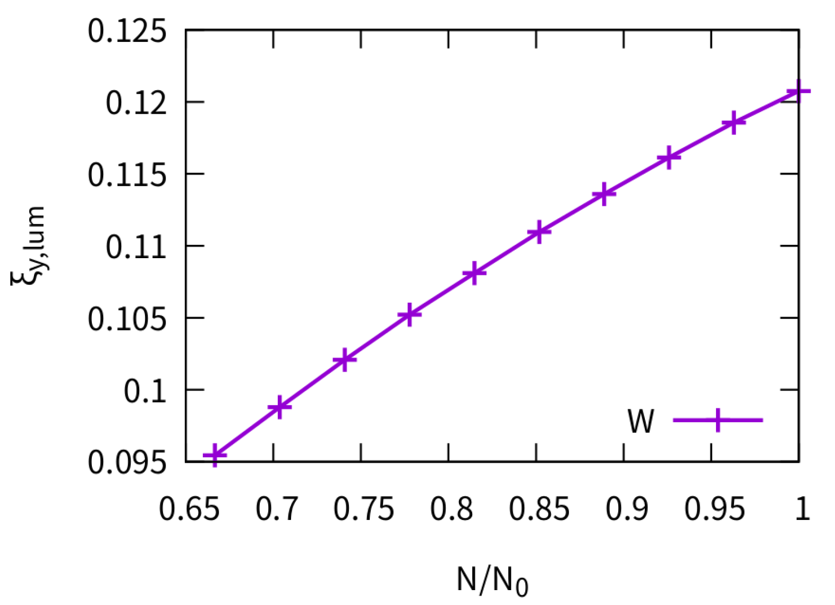
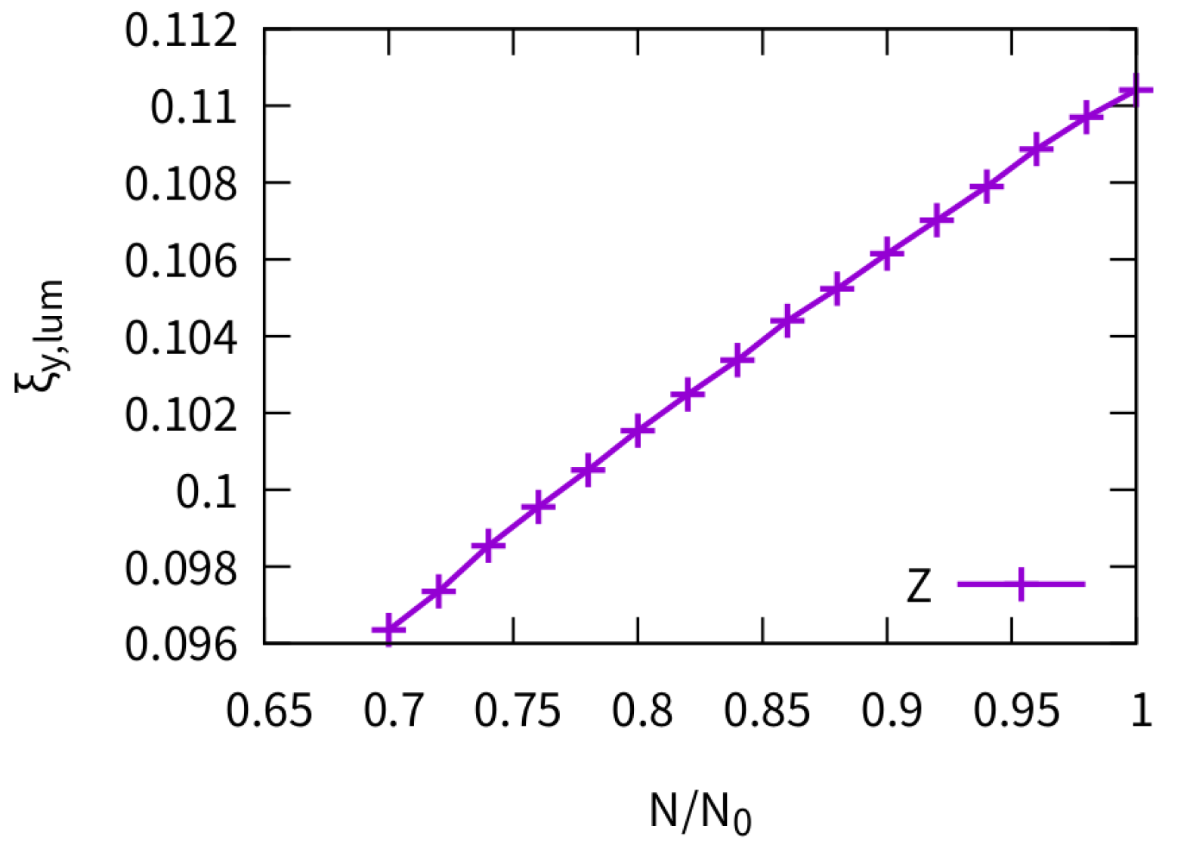
Beam-Beam Performance vs bunch population （W/Z）
The beam-beam parameter does not stature at design bunch population

Slide 13
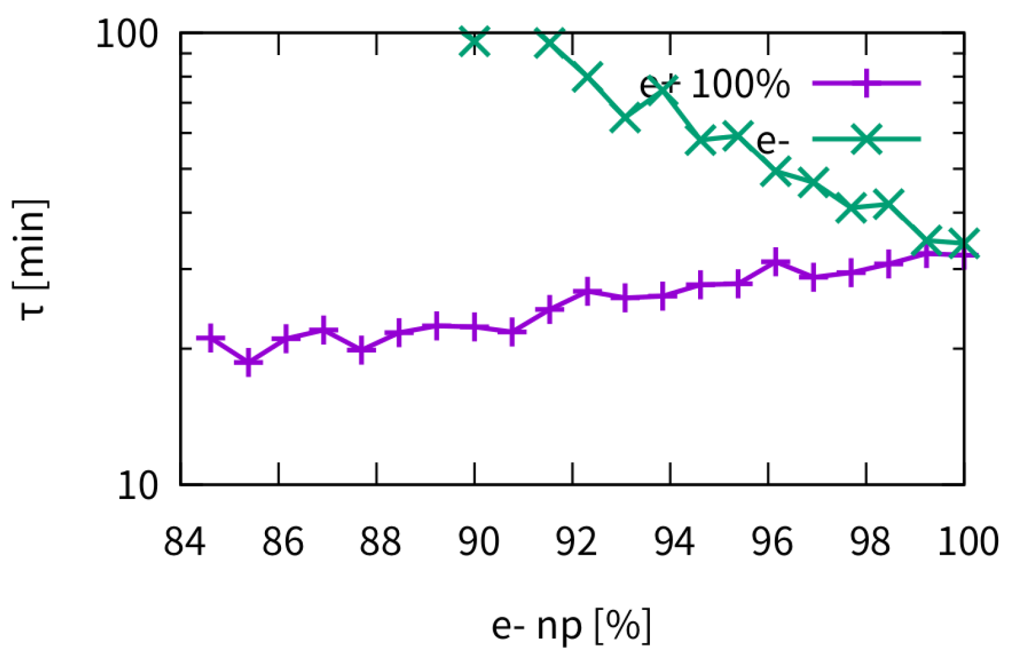
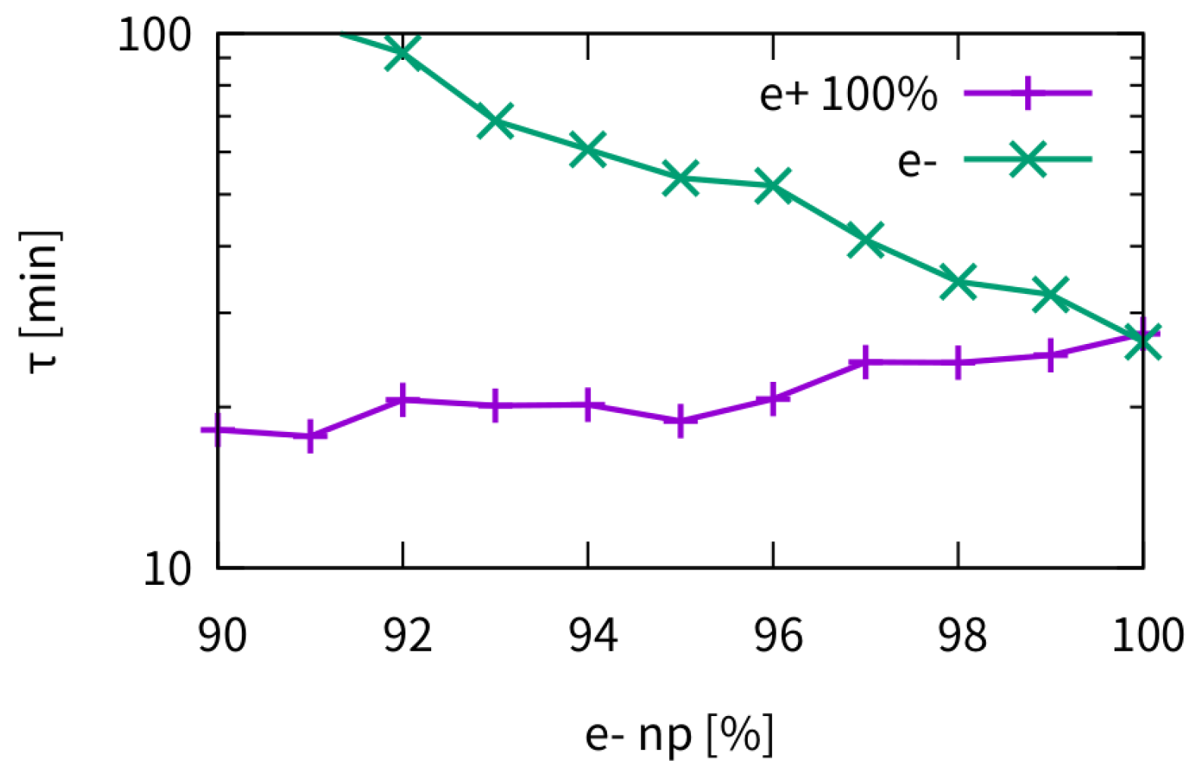
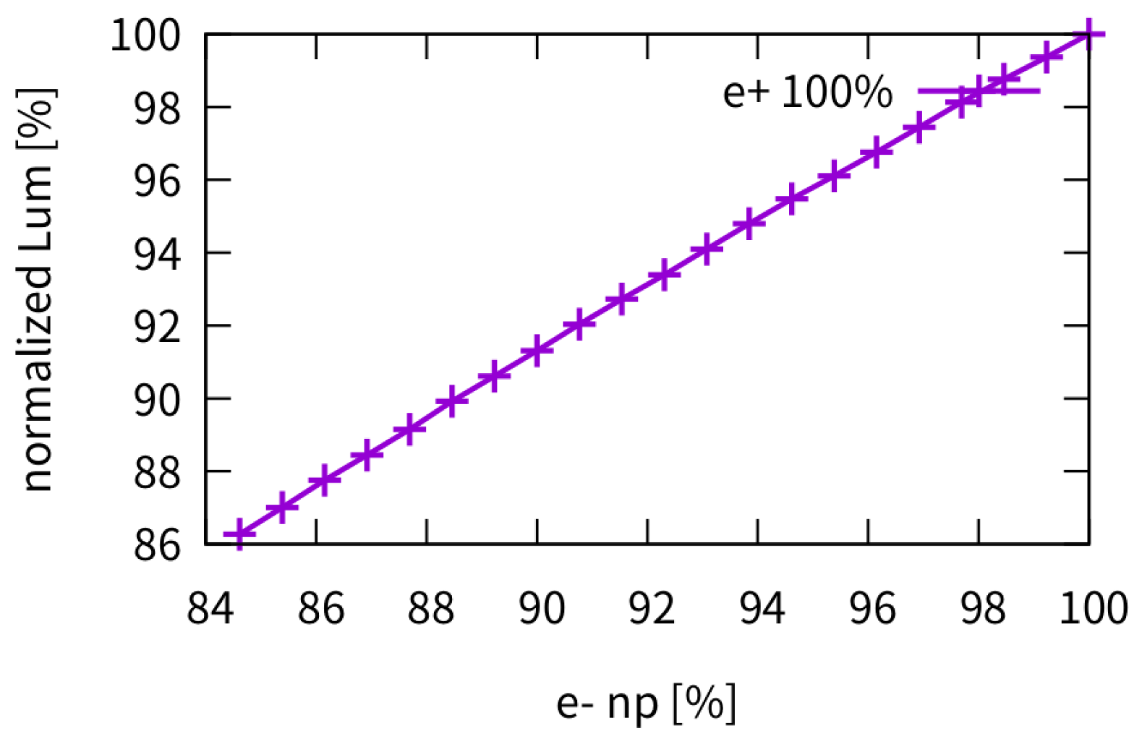
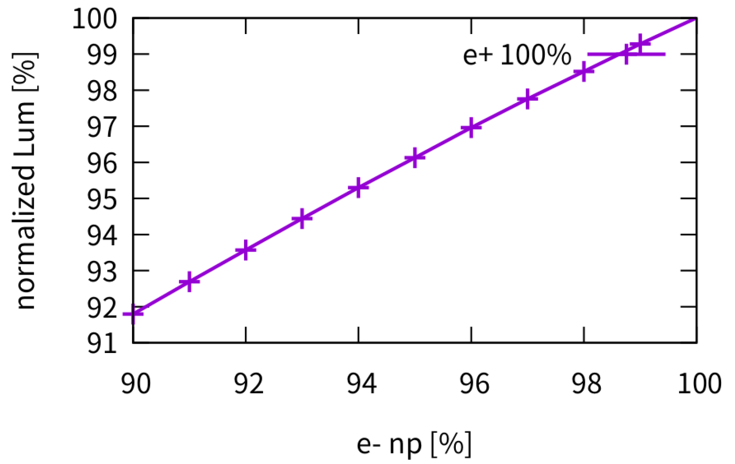
Asymmetric Collision: Higgs/ttbar
The weak beam’s lifetime would be about only half with collision between 100% vs 90% bunch population. (design 100% vs 97%: ~20% lifetime reduction)
The luminosity scale linearly with the weak beam’s bunch population
Lifetime
Higgs
ttbar
Higgs
ttbar
Luminosity
* If particles exceed the momentum acceptance are checked just after collision.

Slide 14
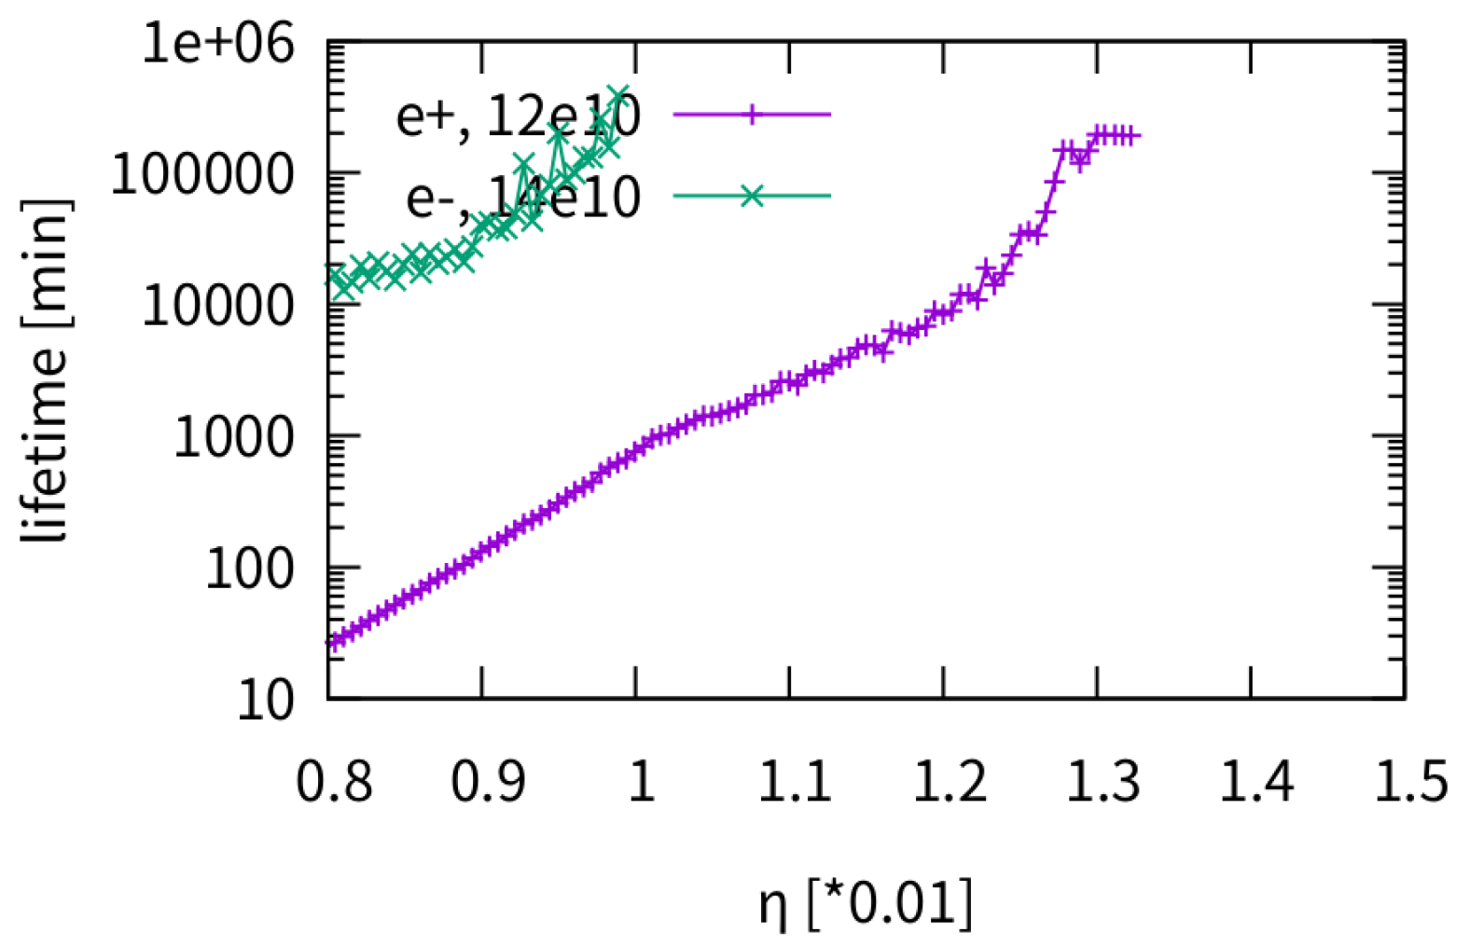
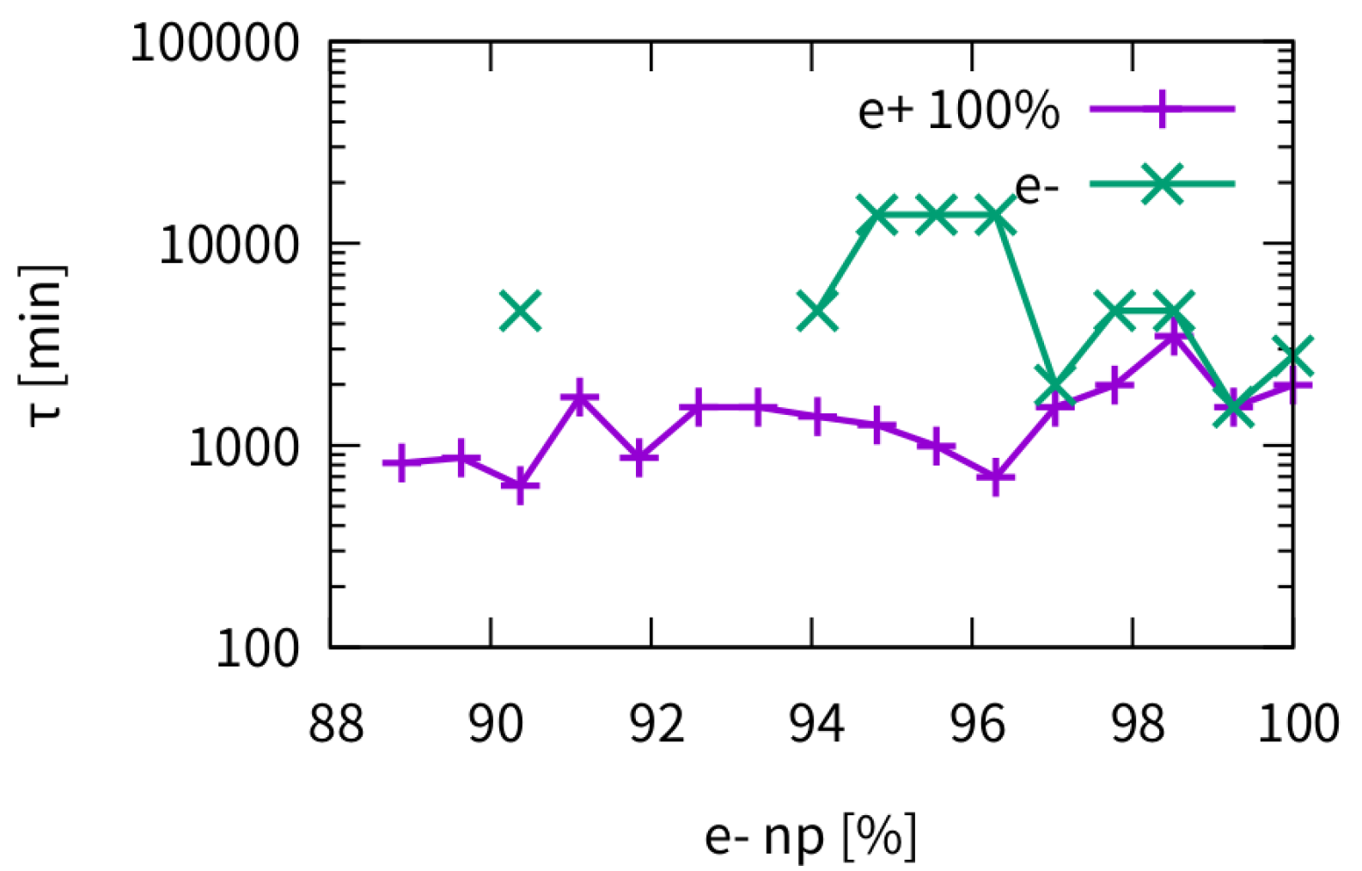
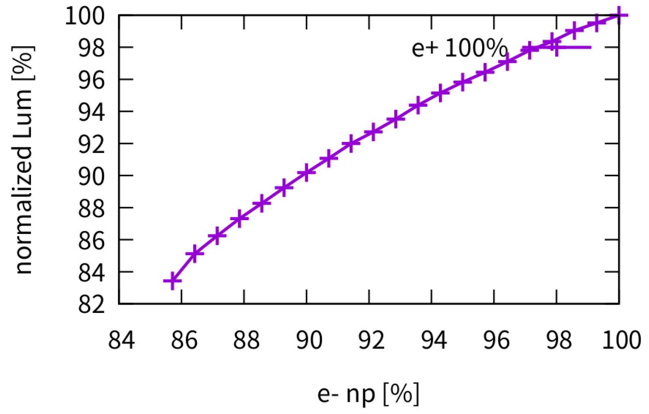
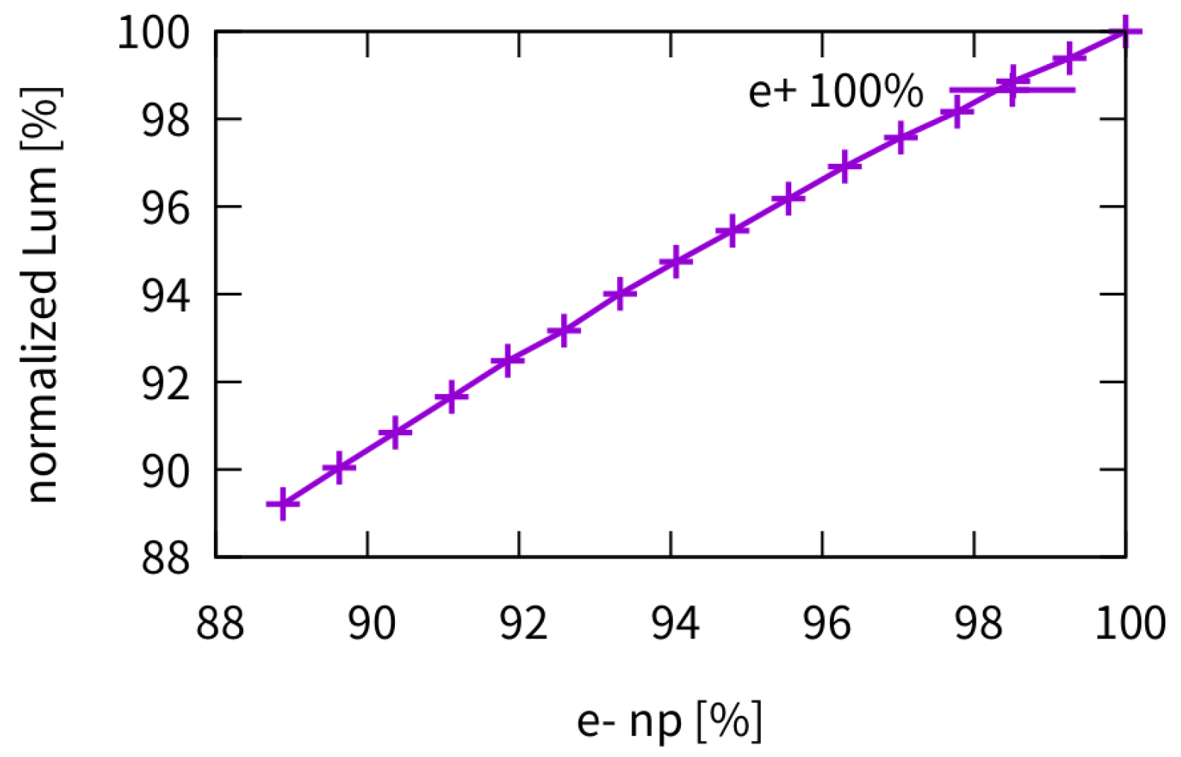
Asymmetric Collision: Z/W
The beamstrahlung lifetime induced by pure beam-beam interaction would not be a serious issue.
The luminosity scale linearly with the weak beam’s bunch population
Lifetime
Z
W
Luminosity
Z
W

Slide 15
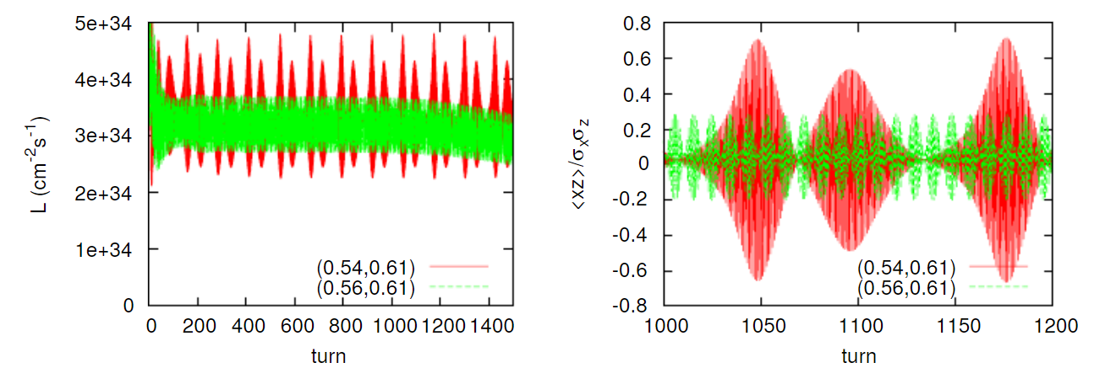
Horizontal Coherent Beam-Beam Instability (X-Z instability)
K. Ohmi, Int. J. Mod. Phys. A, 31, 1644014 (2016).
K. Ohmi and et al., PRL 119, 134801 (2017)
N. Kuroo et al, PHYS. REV. ACCEL. BEAMS 21, 031002 (2018)
K. Ohmi, eeFACT 2018
1. In the collision scheme with Crab Waist and Large Piwinski Angle the luminosity and tune shifts strongly depend on the bunch length
2. For the future circular colliders with extreme beam parameters in collision several new effects become important such as beamstrahlung, coherent X-Z instability and 3D flip-flop. The longitudinal beam dynamics plays an essential role for these effects

Slide 16
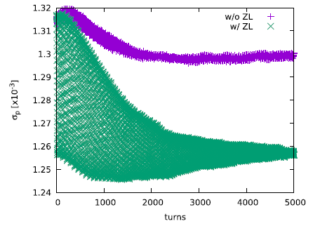
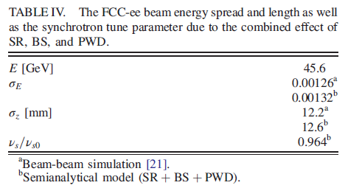
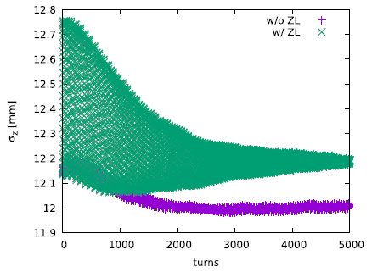
Combined effect of beamstrahlung and longitudinal impedance in stable tune areas
D.Leshenok and et al. PRAB 23, 101003 (2020)
Y. Zhang et al., PRAB 23, 104402, (2020)
Semi-analytical calculations are in reasonable
agreement with numerical modeling
Energy spread
Bunch length
Longitudinal Impedance induces
Longer bunch length
Lower energy spread
Lower incoherent synchrotron tune

Slide 17
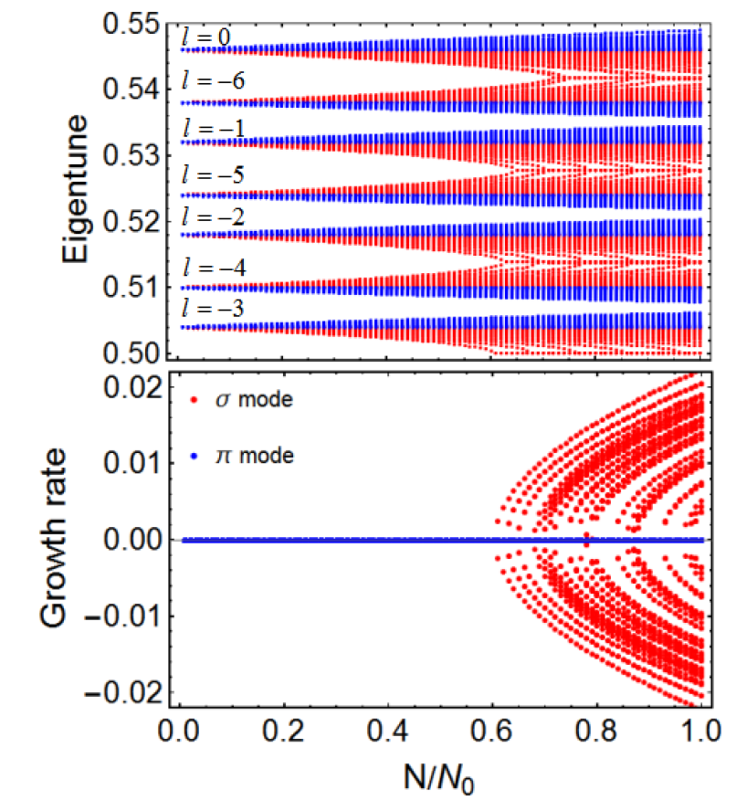
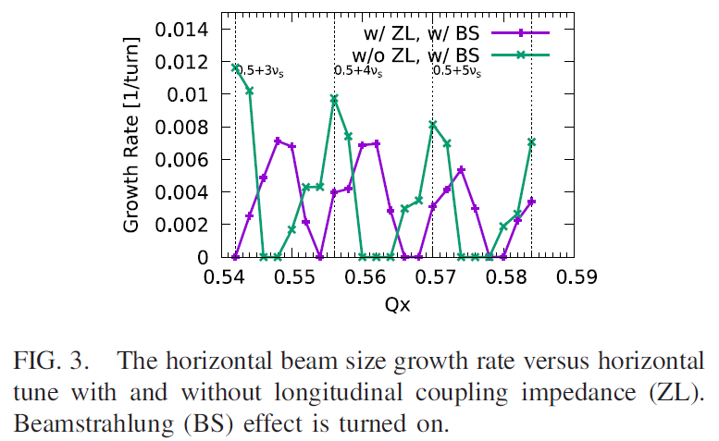
X-Z instability with and without beam coupling impedance
Y. Zhang etal., PRAB 23, 104402, (2020)
C. Lin etal.,, PRAB 25, 011001 (2022)
By including the impedance stable areas become narrower and are shifted
w/o ZL
(CEPC-CDR-Z)
w/ ZL, $σ$ mode
After the horizontal beta function reduction from 0.2 m down to 0.15 m
17

Slide 18
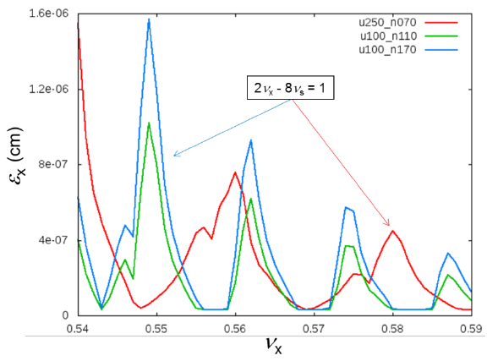
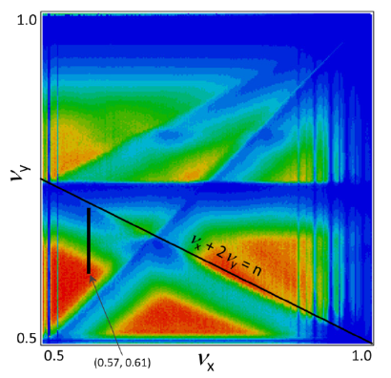
Parameter Optimization for X-Z instability
K. Oide， IPAC2017
D. Shatilov, ICFA Beam Dyn.Newslett. 72 (2017) 30-41
Y. Zhang et al., PRAB 23, 104402, (2020)
Larger $ν_{s}/ξ_{x}$ is preferred
Courtesy of D. Shatilov
Courtesy of D. Shatilov
Different modes of CEPC has been well optimized to mitigate the X-Z instability

Slide 19
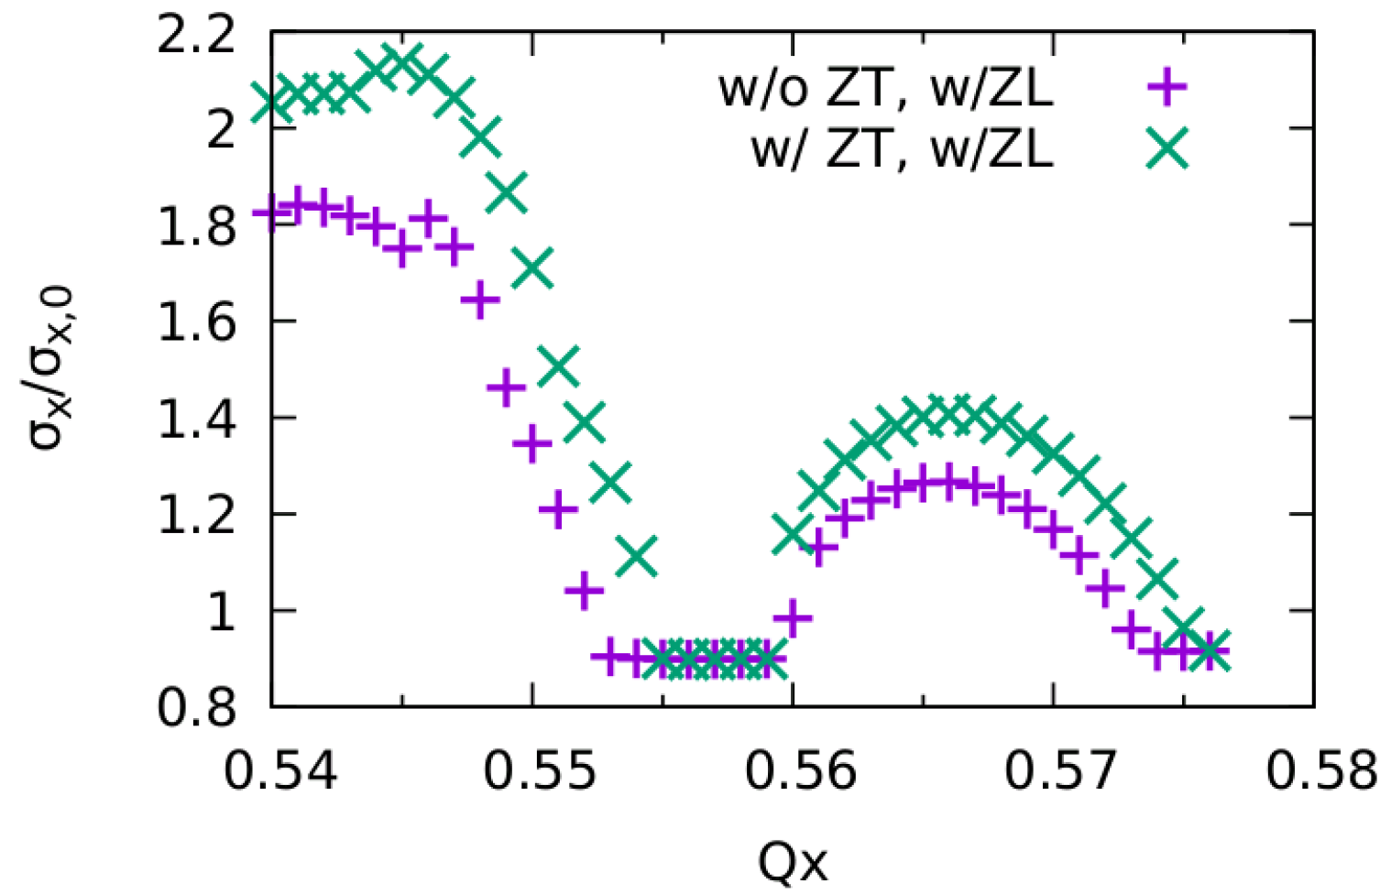
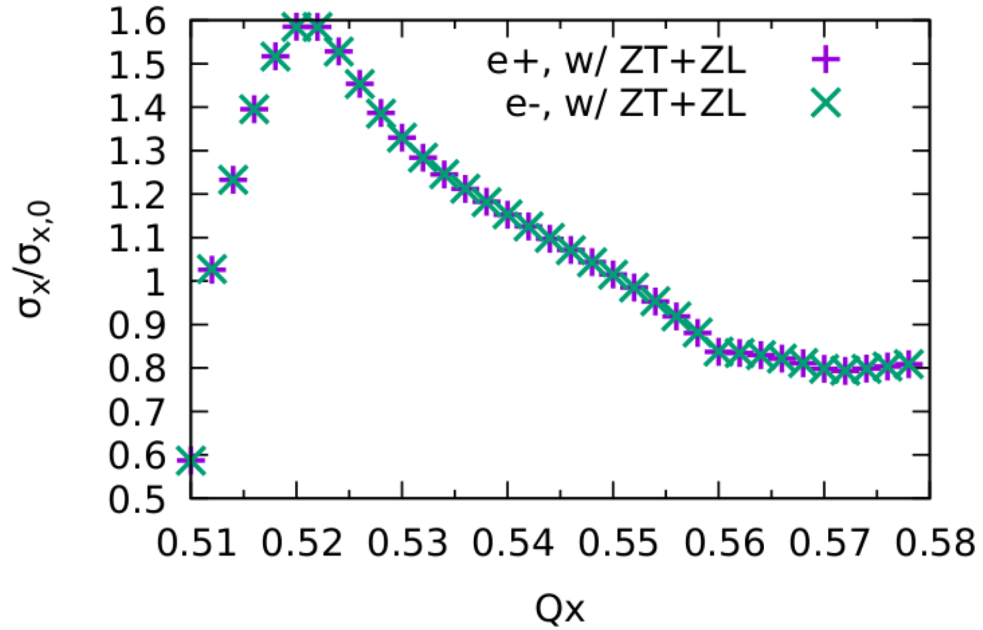
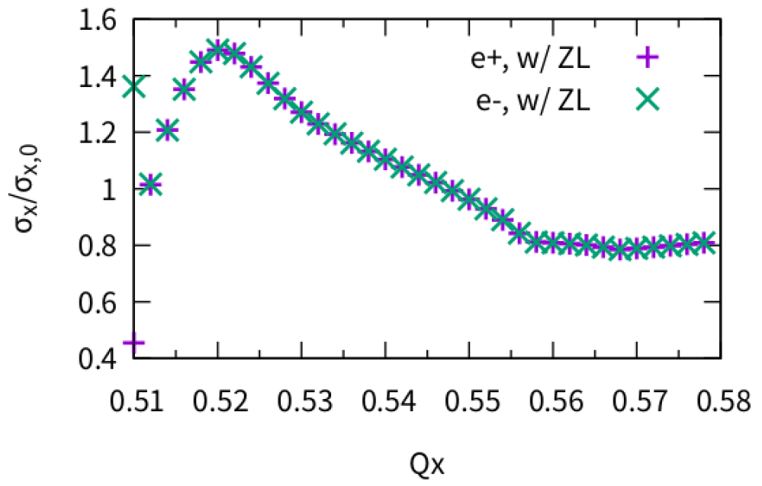
w/ transverse impedance (ZT): Higgs/ttbar
Higgs:
Only X-Z instability
Stable area width is reduced a little (ZT only applied 1 kick)
ttbar:
No clear effect from transverse impedance.

Slide 20
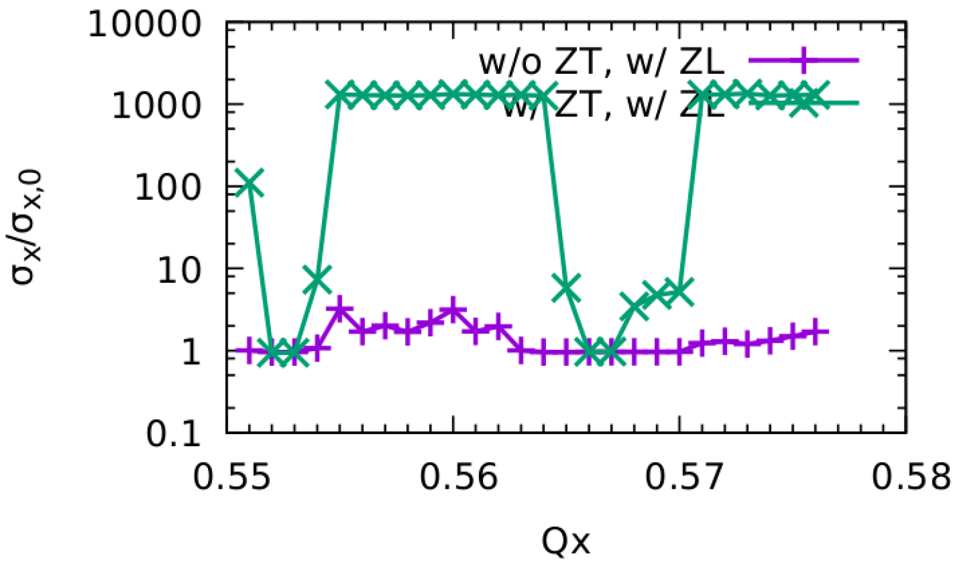
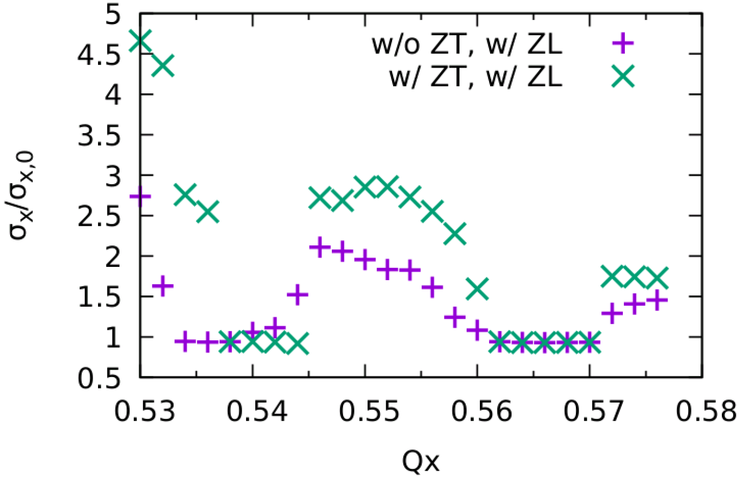
w/ transverse impedance (ZT): Z/W
Z:
No stable working points.
There exist very strong blowup in both X/Y direction
W:
Only X-Z instability
stable area is large enough

Slide 21
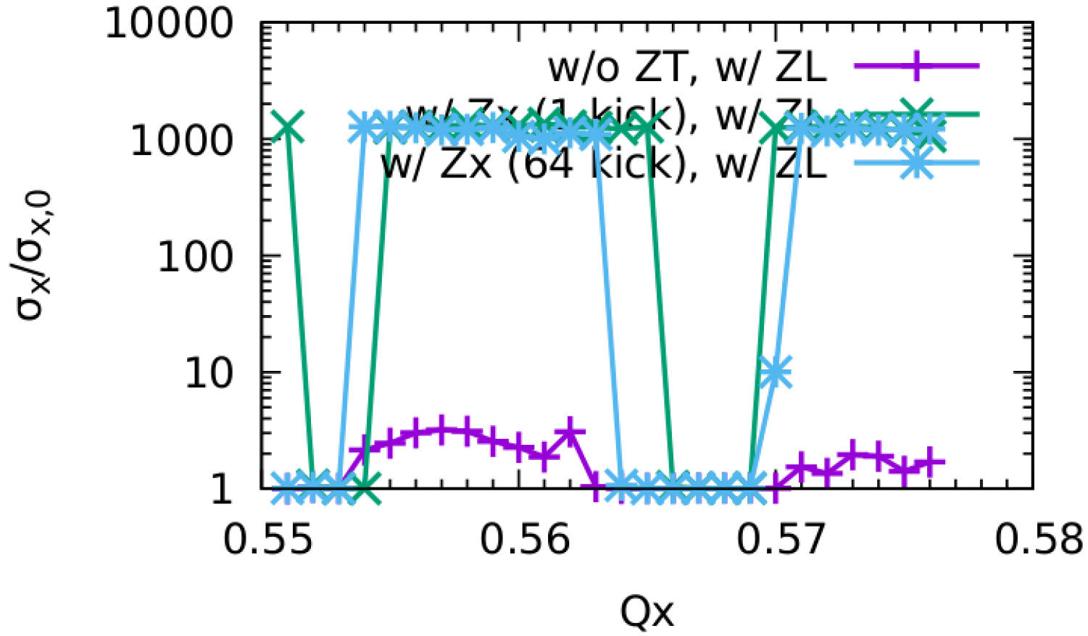
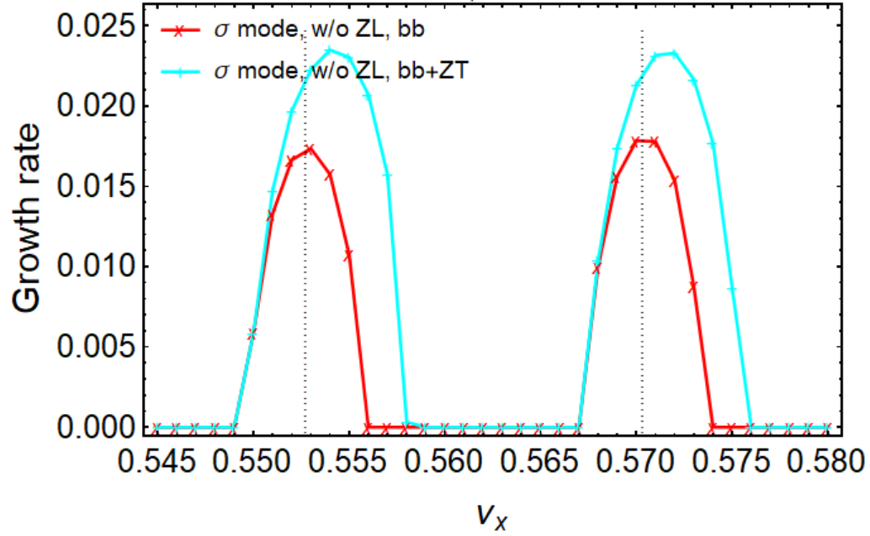
Z: Only horizontal impedance (+ZL)
Stable tune area is large enough (w/ZX)
Simulation and analysis agree well.
Courtesy of Chuntao Lin and Na Wang
Simulation
Analysis, ZT kick applied at IP
Kick number of wake field affect the result
In horizontal direction, smooth distributed impedance nearly does not squeeze the stable tune area serious
A very local impedance may squeeze the stable area.
In horizontal direction, considering ZX
the instability growth rate is faster,
unstable tune area increases

Slide 22
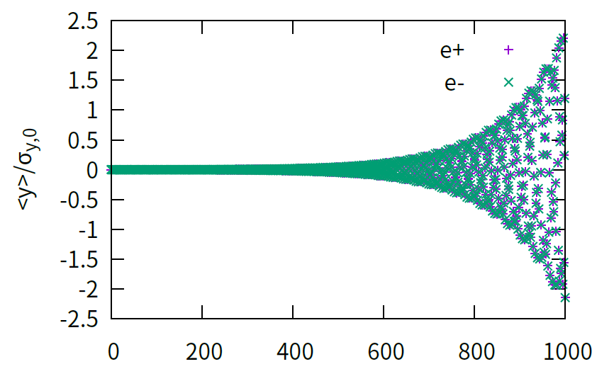
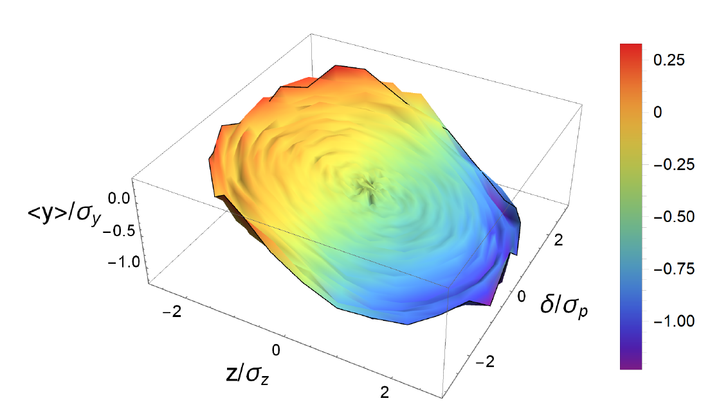
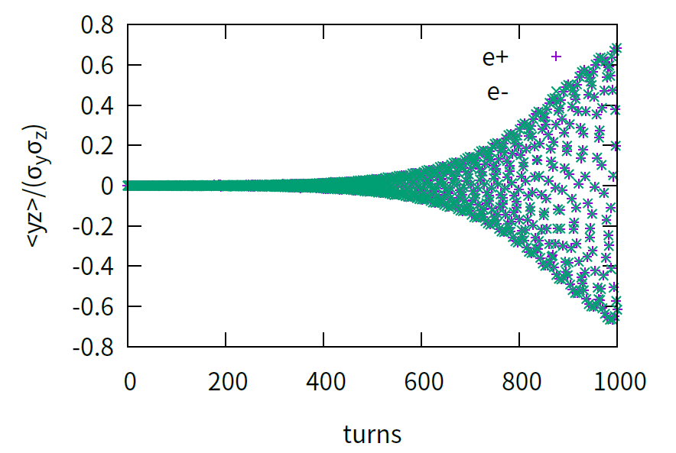
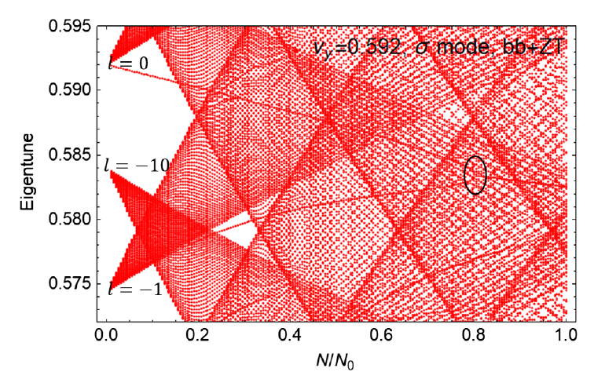
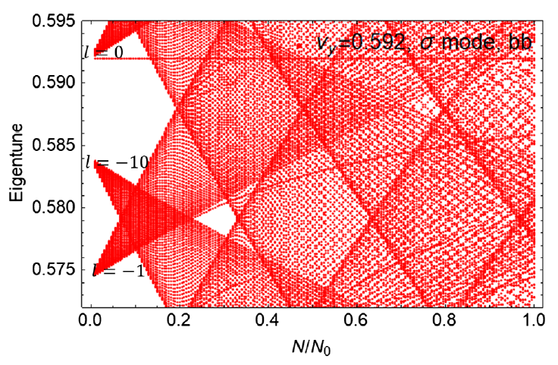
Vertical mode coupling with ZT($σ$-mode)
Accepted by PRAB
TMCI threshold is reduced from about 21e10 to 11e10

Slide 23
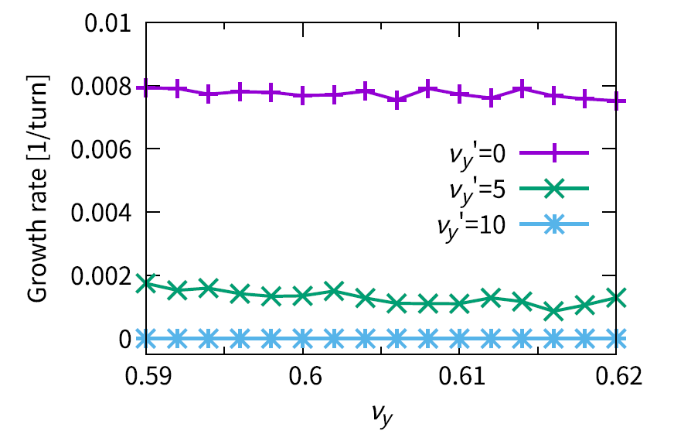
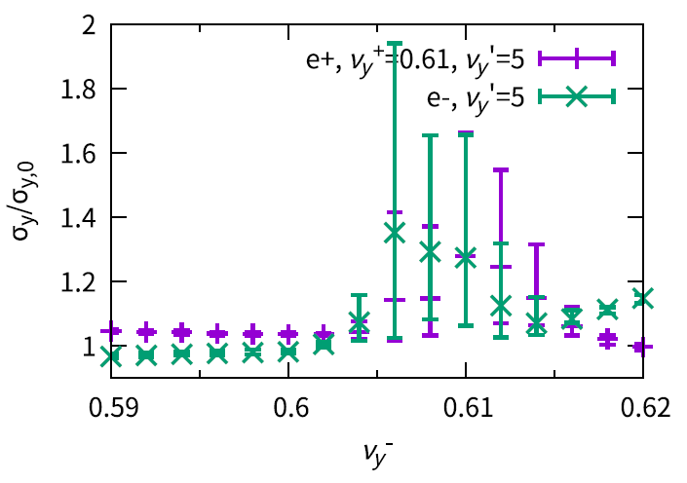
Mitigation of Vertical TMCI (BB+ZT)
Accepted by PRAB
Chromaticity
Asymmetrical Tunes + Chromaticity
Growth rate of vertical centroid versus tune with different vertical chromaticity. Both transverse and longitudinal
impedance are considered.
vertical beam size versus asymmetric vertical tunes with different vertical chromaticity. Both transverse and longitudinal impedance are considered. One beam’s vertical working point is fixed at 0.610.

Slide 24
More measures to suppress vertical TMCI
Y. Zhang, HK-IAS, 2023
K. Ohmi et al., submitted to PRAB
Feedback + Chromaticity
Resistive feedback, damp rate=0.05 + Qy’=10
np=21e10 is stable with 1.5 times higher transverse impedance
Hourglass effect
$β_{y}^{∗}<σ_{x}/θ$ (K. Ohmi)
Courtesy of K. Ohmi

Slide 25
Combined effect considering realistic lattice
J. Wu et al., NIMA 959 (2020) 163517
Case (a) has a larger DA but a shorter beam lifetime,
while case (b) is opposite.
lattice nonlinearity
strong synchrotron radiation
Beam-beam interaction
beamstrahlung effect
Diffussion Map Analysis of Four Cases
Diffussion Map:
Better Lifetime
Better Lifetime

Slide 26
A lifetime optimization sample
Huiping Geng, Yiwei Wang
50k turns, 1k macro-particles @injection point
w/ BB and BS
32 families of sextupoles in Arc
Optimization of diffusion
w/o BB and BS
w/ BB and BS
Survival particles:
1000
Survival particles:
861
Survival particles:
962

Slide 27
Code development for future work
Zhiyuan Li, K. Ohmi and Demin Zhou
Tracking with realistic lattice + Strong Beam-Beam
Based on SAD,
Supports element: DRIFT, BEND, QUAD, SEXT, MULT, SOL, CAVIT, APERT
Support lattice generated by SAD
Lattice error could be included
CPU and GPU.
MPI or CUDA to parallelize multi-particle tracking
Collective effects (MPI) could be included
GPU:NVIDIA A100 FP64：9.746 TFLOPS (1:2)
CPU: Intel(R) Xeon(R) Gold 6348 CPU @ 2.60GHz
SuperKEKB lattice was used:
The acceleration ratio for particle tracking：
GPU /CPU(single core) ≈ 250
Some initial benchmark comparing with SAD has been done
SKEKB LER/HER lattice + Strong-Strong Collision

Slide 28
Summary
Machine parameters are evaluated by strong-strong simulation
X-Z instability is well suppressed even considering longitudinal impedance
Strong vertical instability exist at Z with transverse impedance. Simulation and analysis has helped understanding the physics. Mitigation schemes have been studied.
Disagreement between dynamic aperture and lifetime have been found. Diffusion analysis method is presented to optimize the lifetime. (lattice+beambeam+beamstrahlung)
More self-consistent simulation code is being developed for future study
Error effects and necessary luminosity tuning knob are still not yet studied.

Slide 29
BACKUP

Slide 30
Main Parameters

Slide 31
Lifetime evaluation (pure beam-beam interaction)
Watch Point before vs after IP

Slide 32
Crab Waist strength
ttbar
Higgs

Slide 33
Different Horizontal tune
Asymmetric
Symmetric
Qx+=0.567

Slide 34
CEPC Only Zx(+ZL) @ Qx=0.562
Behavior at unstable working point
It has been simulated that w/o BS (but keep same bunch length), the TMCI-like instability would not appear.
X-Z instability is first excited
Bunch length is shorter
X-TMCI-like instability is then excited
Y is blowup due to stronger beam-beam interaction

Slide 35
CEPC Only Zy(+ZL) Qx=0.567
Behavior at unstable working point
$σ$ mode
It has been simulated that w/o BS (but keep same bunch length), the X-Z instability would not appear.
Y-TMCI-like instability is first excited
Bunch length is shorter
X-Z instability is excited
Stronger Y blowup due to strong beam-beam

