Slide 1



CEPC MDI Design
Sha Bai
On behalf of CEPC MDI group
12-16. June. 2023, Hongkong, CEPC Accelerator TDR International Review

Slide 2
Content
Introduction
IR beam pipe structure
Background estimation
Mitigation design efforts
  Masks
  Collimators
  Shielding
Thermal Analysis
  HOM heating
  Synchrotron radiation
  Beam loss backgrounds
  Beam pipe thermal analysis
IP BPM
SC magnet supporting system
Detector simulation
Luminosity Calorimeter
Summary

Slide 3
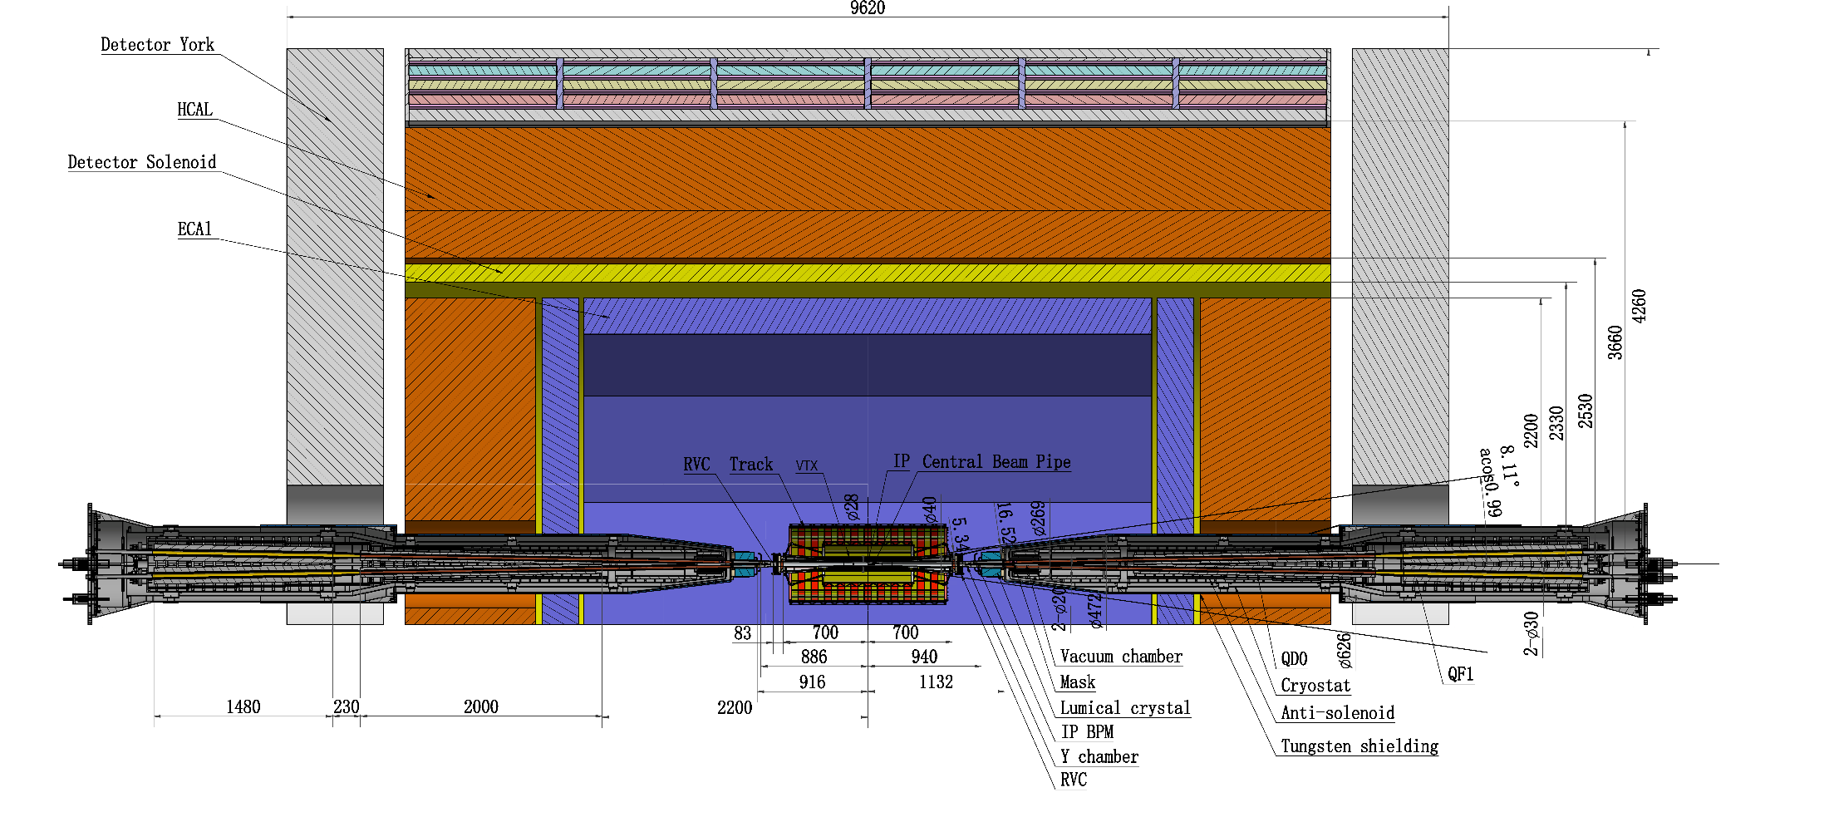
MDI layout and IR design
The Machine Detector Interface (MDI) of CEPC double ring scheme is about ±7m long from the IP.
The CEPC detector superconducting solenoid with 3T magnetic field（2T in Z）and the length of 7.3m.
The accelerator components inside the detector with shielding are within the conical space of detector opending angle: acos0.99.
The e+e- beams collide at the IP with a horizontal angle of 33mrad and the final focusing length is to 1.9m.

Slide 4
MDI parameters
 | range | Peak field in coil | Central field gradient | Bending angle | length | Beam stay clear region | Minimal distance between two aperture | Inner diameter of beam pipe | Outer diameter of beam pipe | Critical energy (Horizontal) | Critical energy (Vertical) | SR power (Horizontal) | SR power (Vertical)
L* | 0~1.9m |  |  |  | 1.9m
Crossing angle | 33mrad
MDI length | ±7m
Detector requirement of accelerator components in opening angle | 8.11˚
QDa/QDb |  | 3.5/2.7T | 142/85T/m |  | 1.21m | 14.9/18.2mm | 62.71/105.28mm | 20/23mm | 26/29mm | 724.7/663.1keV | 396.3/263keV | 212.2/239.23W | 99.9/42.8W
QF1 |  | 3.7T | 96.7T/m |  | 1.5m | 24.48mm | 155.11mm | 32mm | 38mm | 675.2keV | 499.4keV | 472.9W | 135.1W
Lumical | 0.94~1.11m |  |  |  | 0.16m
Anti-solenoid before QD0 |  | 8.8T |  |  | 1.1m
Anti-solenoid QD0 |  | 3T |  |  | 2.5m
Anti-solenoid QF1 |  | 3T |  |  | 1.5m
Beryllium pipe |  |  |  |  | ±85mm |  |  | 20mm
Last B upstream | 64.97~153.5m |  |  | 0.77mrad | 88.5m |  |  |  |  | 33.3keV
First B downstream | 44.4~102m |  |  | 1.17mrad | 57.6m |  |  |  |  | 77.9keV
Beampipe within QDa/QDb |  |  |  |  | 1.21m |  |  |  |  |  |  | 1.19/1.31W
Beampipe within QF1 |  |  |  |  | 1.5m |  |  |  |  |  |  | 2.39W
Beampipe between QD0/QF1 |  |  |  |  | 0.3m |  |  |  |  |  |  | 26.5W

Slide 5
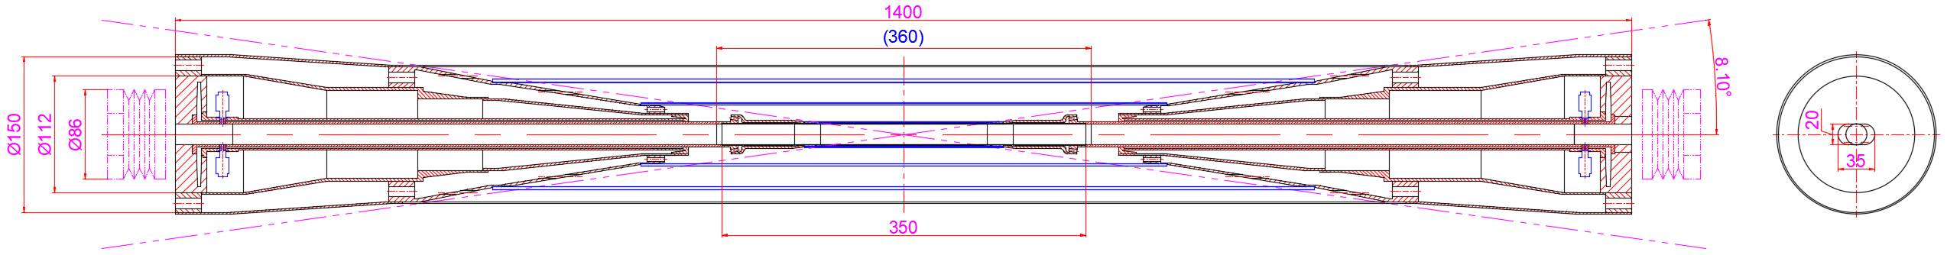
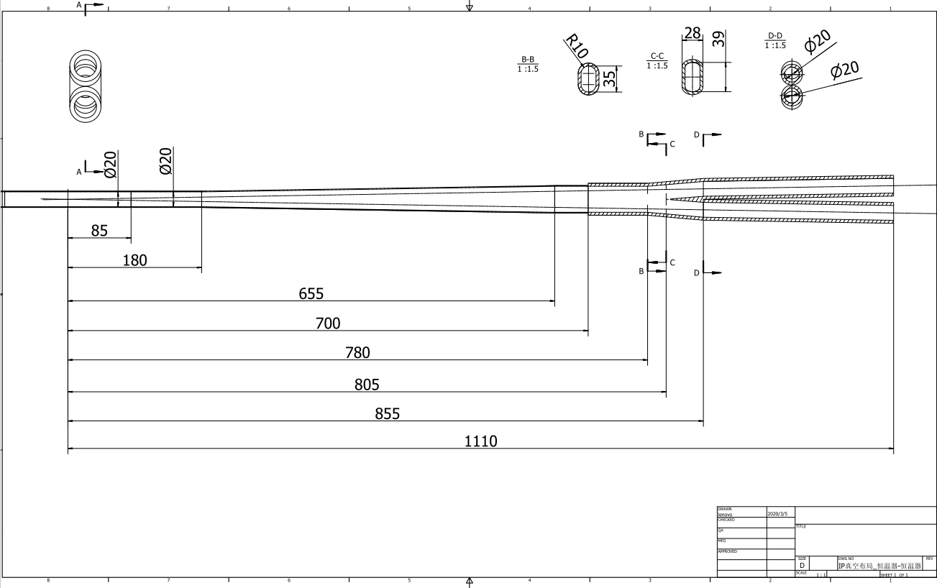
The central beampipe design
From IP(mm) | Shape | Inner diameter(mm) | Material | Marker
0-85 | Circular | 20 | Be
85~180 | Circular | 20 | Al
180~655 | Cone | 20~35 | Al | Taper: 1:70
655~700 | Circular | 35 | Al
700~780 | Circular | 35 | Cu
780~805 | Cone | 35~39 | Cu
805~855 | Race-track | 39~20 double pipe | Cu
Crotch point at 805mm，with slope，breeches pipe starting point at 855mm，cone，interface point at 700mm

Slide 6
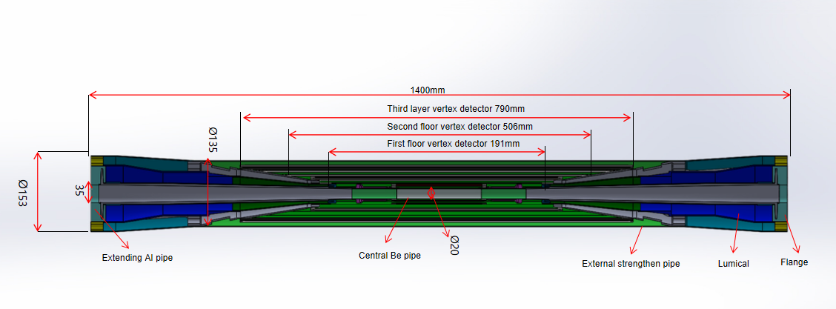
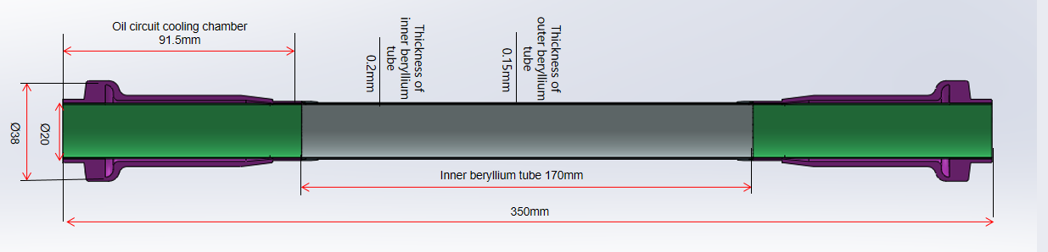
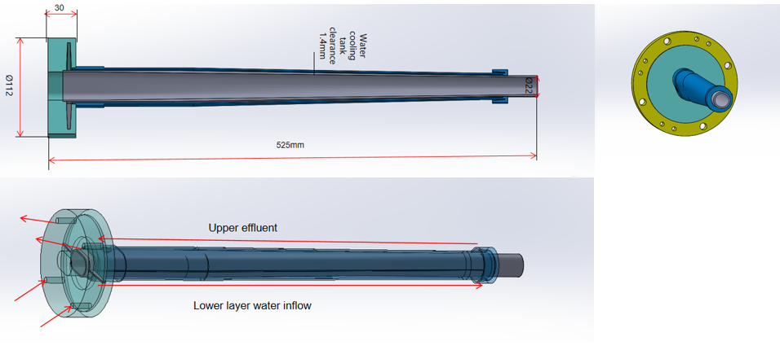
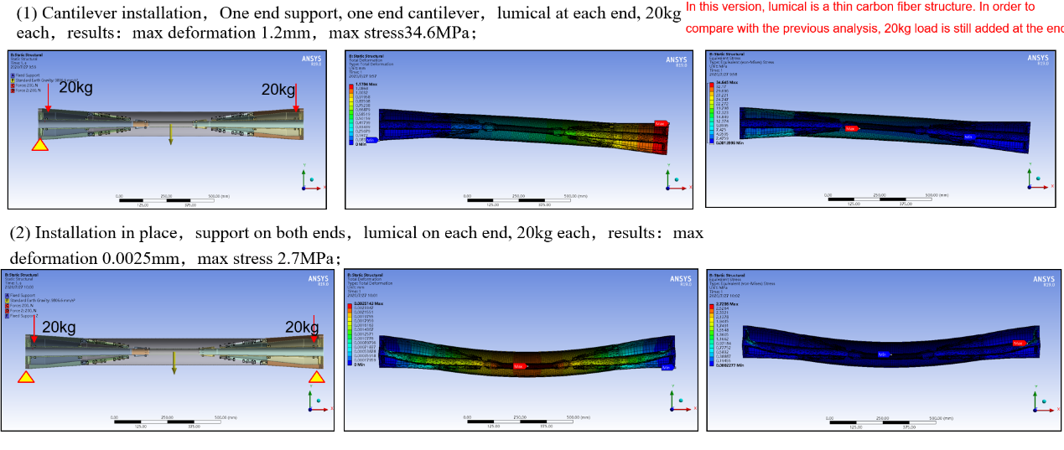
IR beam pipe structure
The central beam pipe adopts a double-layer beryllium pipe structure, with an overall length of 350mm.
The thickness of the inner beryllium pipe is 0.2mm, and the outer beryllium pipe is 0.15mm.
A 0.5mm cooling gap between the double layer beryllium pipes, which is filled with coolant.
The coolant enters through the left amplification chamber, passes through the gap between the double layer beryllium pipes, and finally is discharged through the right amplification chamber, taking away the HOM heat from the inner wall through cooling.
when both ends of the beam pipe are supported, the maximum sink at the center during the simulated installation is 0.0025 mm, and the maximum stress is 2.7 MPa, which meets the requirements and ensures the overall structural safety.
Central beryllium pipe
Epitaxial aluminum tube structure

Slide 7
Background estimation
Background sources
  Photon backgrounds: SR, Pair production
  Beam loss backgrounds
    Radiative Bhabha scattering
    Beam Gas scattering
    Beam Thermal photon scattering
  Injection background
Real beam
  Errors
  Beam-beam effect
  Beam tail
  Solenoid
Multi-turn tracking
  Using built-in LOSSMAP with one step ahead output
  SR emitting on
  RF on
  Radtapper on
Beam loss BG
Photon BG
Injection BG

Slide 8
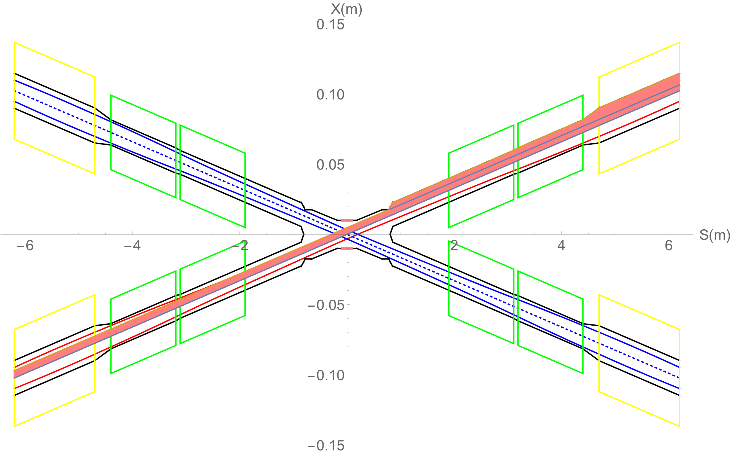
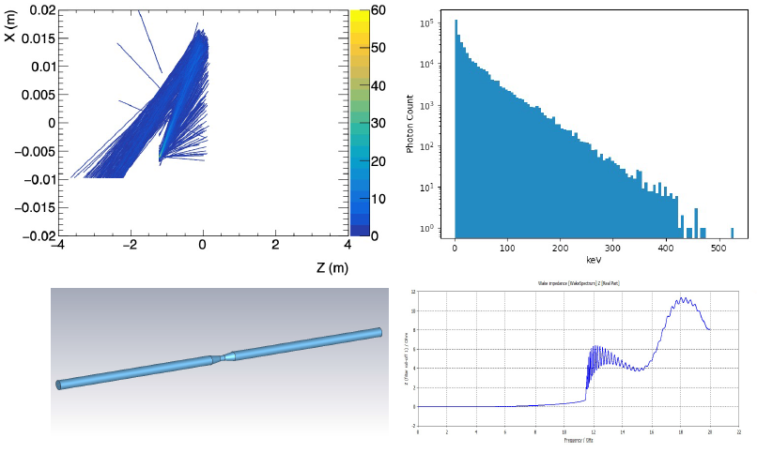
Synchrotron radiation
No SR photons hitting the central beam pipe directly in normal conditions, which is generated from the last bending magnet in the upstream of IP.
However, some secondaries generated within the beam pipe of QD would hit the detector beampipe, even the beryllium part. Therefore, the mitigation methods are studied.
SR photons generated from the FD magnets will hit downstream of the IR beam pipe, and the once-scattering photons will not go into the detector beam pipe but goes to even far away from the IP region.

Slide 9
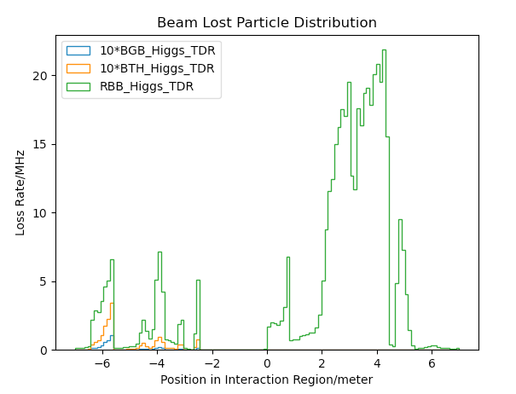
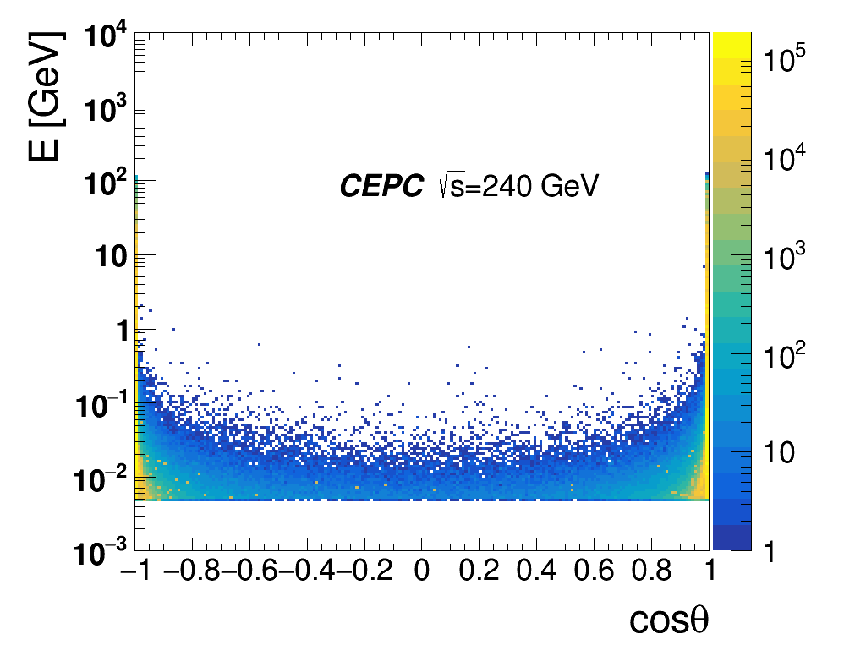
Radiation background
Including Radiative Bhabha scattering, Beam-Gas scattering, Beam Thermal Photon scattering.
Beam loss background from Beamstrahlung almost no in upstream IP, but mainly from pair-production distribution.
name | Position | Distance to IP/m | Beta function/m | Horizontal Dispersion/m | Phase | BSC/2/m | Range of half width allowed/mm
APTX1 | D1I.785 | 44611 | 20.7 | 0.12 | 164.00 | 0.006 | 1~6
APTX2 | D1I.788 | 44680 | 20.7 | 0.12 | 164.25 | 0.006 | 1~6
APTY1 | D1I.791 | 44745 | 105.37 | 0.12 | 165.18 | 0.0036 | 0.156~3.6
APTY2 | D1I.794 | 44817 | 113.83 | 0.12 | 165.43 | 0.0036 | 0.156~3.6
APTX3 | D1O.5 | 1729.66 | 20.7 | 0.06 | 6.85 | 0.00182 | 1~6
APTX4 | D1O.8 | 1798.24 | 20.7 | 0.12 | 7.10 | 0.00182 | 1~6
APTY3 | D1O.10 | 1832.52 | 20.7 | 0.25 | 7.22 | 0.00182 | 0.069~3.3
APTY4 | D1O.14 | 1901.1 | 20.7 | 0.25 | 7.47 | 0.00182 | 0.069~3.3
APTX5 | DMBV01IRU0 | 56.3 | 196.59 | 0 | 362.86 | 0.01178 | 2.9~11.78
Pair-Production Distribution
Beam loss particle distribution with collimator design.
Collimator design meet requirements of beam-stay-clear region, impedance, phase etc on.
4 sets of collimators were implemented per IP per Ring(16 in total)
  2 sets are horizontal(4mm radius), 2 sets are vertical(3mm radius).
One more upstream horizontal collimator sets were implemented to mitigate the Beam-Gas background

Slide 10
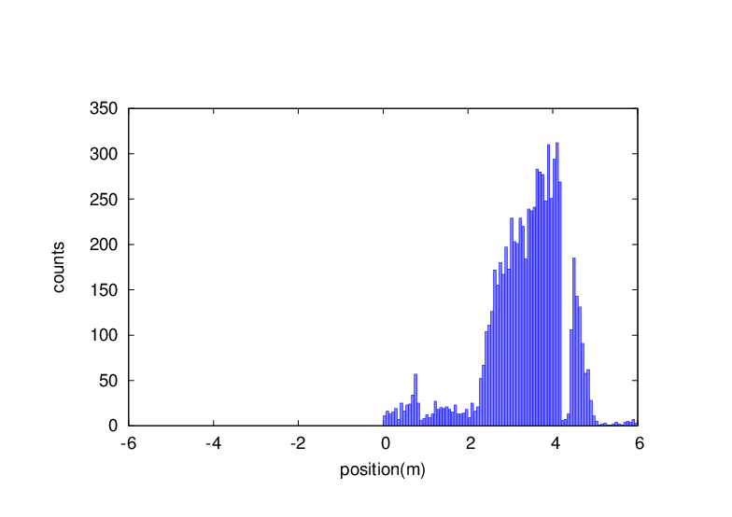
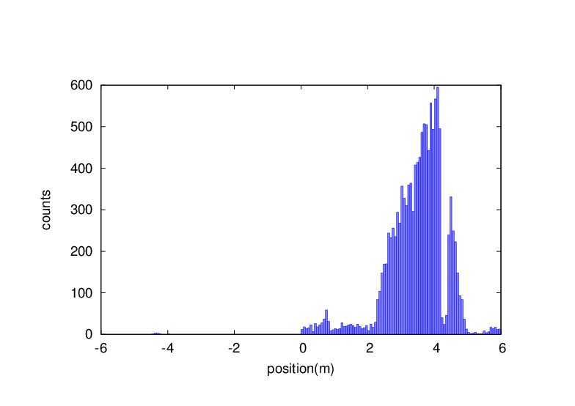
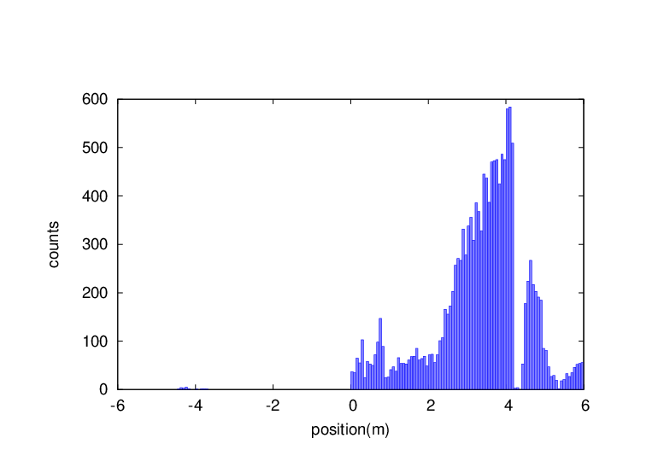
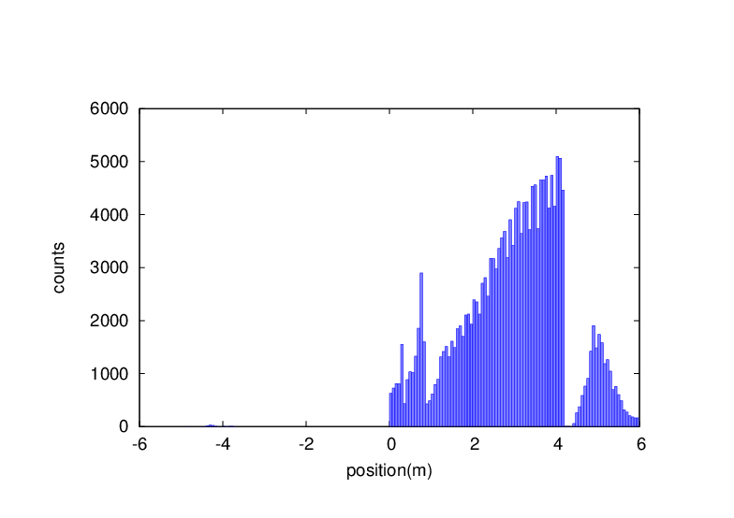

Injection background
RBB is taken into account in all cases
A simplified model of top-up injection beam
Tails from imperfectly corrected X-Y coupling after the injection point
some tolerances to imperfect beams from the booster (e.g. too large emittances)
non-Gaussian distributions existing/building up in the booster and being injected into the main rings
Injection beam parameters
Mode | tt | Higgs | W | Z
Bunch Number | 37 | 240 | 1230 | 3840
Bunch Charge | 0.96 nC | 0.7 nC | 0.73 nC | 0.8 nC
Beam Current(mA) | 0.11 mA | 0.51 mA | 2.69mA | 9.2 mA
Beta_func (x/y) | 200/55 | 200/55 | 200/55 | 200/55
Emittance (nm) | 2.83 | 1.26 | 0.56 | 0.19
Bunch Length (mm) | 2.0 | 2.0 | 1.7 | 0.96
Circular beam
Injection beam
Gaussian beam with 3sigma
Gaussian beam with 40sigma
Almost no beam loss background in the upstream of the IP, while significantly increased downstream
The existed collimation system can well cope
No effect on the inner layer detector but may damage the outer layer or the endcap detector
BG downstream may damage the SC magnet coils and cause quench.
Tungsten shielding demanded in the IR.
Since the very tight space in the IP region, a tungsten-alloy beam pipe is needed.
Large emittance ~10times
Large emittance ~1000times
Double Gaussian beam
Uniform beam

Slide 11
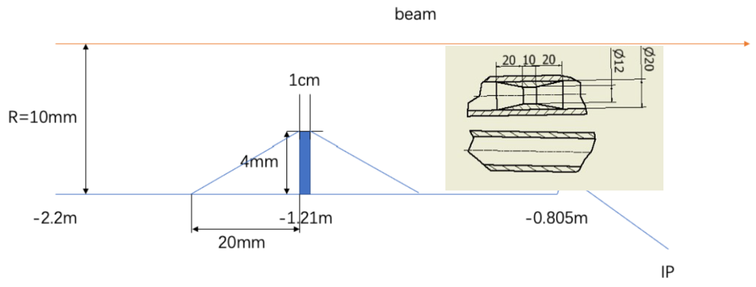
SR mitigation – mask and Au shielding
Methods | Photon hitting number on Be/BX | Deposition power on Be(W)
No mask | 39400.0 | 30.57*e-5
1.21-mask-Cu | 1736.0 | 1.45*e-5
1.21-mask-W | 1698.0 | 1.36*e-5
2.2-mask-Cu | 1147.0 | 0.94*e-5
1.21-mask-Cu-5㎛Au | 216.0 | 0.273*e-5
Masks design(two masks/IP/ring) :
  Tungsten
  One locates at -1.21m with 4mm height and 10mm long
  The other at -4.2m with 0.6mm height
Lots of photons are secondaries, generated within QD0
Photons hitting number on Be/BX reduced by two orders of magnitude
~216 photons/BX could hit Be
  ~2.73x10⁻⁶ W deposition power on Be beampipe

Slide 12
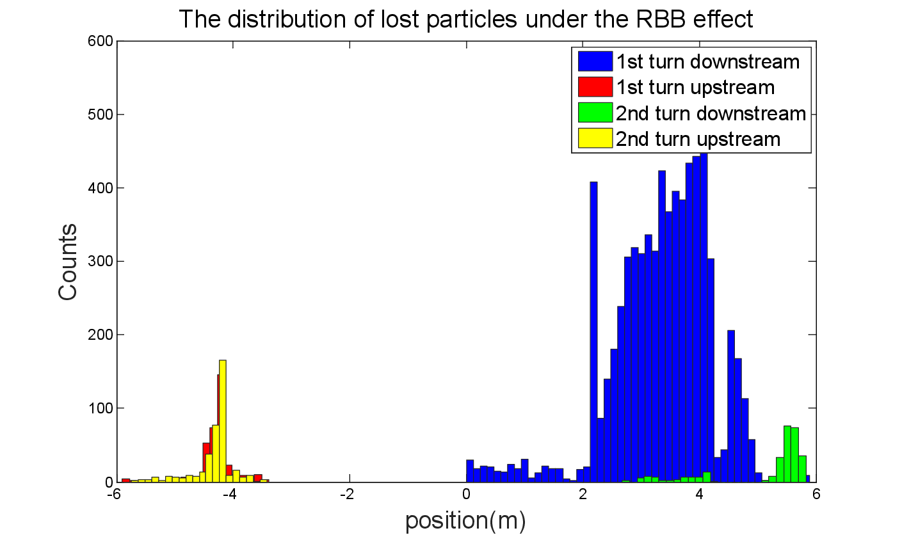
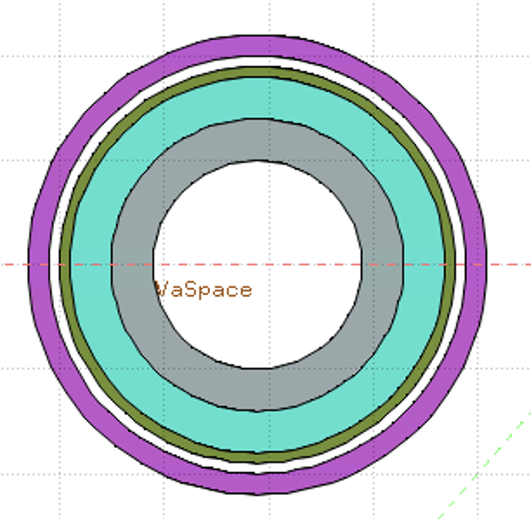
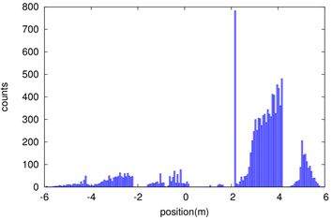
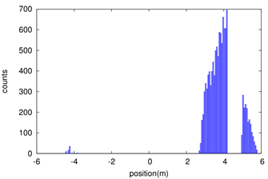
Shielding
Beam loss in the downstream IR with a large amount, due to the process of radiative bhabha scattering, beamstrahlung, beam-gas scattering, beam thermal photon scattering.
Radiation dose may damage the SC magnet coil and the detector.
solution
1. Tungsten IR beam pipe,
2. Combined iron and tungsten yoke of SC magnet
Key Issues on Calculation and Simplification of Beam pipe model
Pure tungsten IR beam pipe with 4mm thickness taken into account, simulate the Absorbed Dose on Coil (Region)
Beam-Gas beam loss is taken into account.
Take the loss rate calculated by SAD into account:
  ~0.00166 Gy/s(0.166rad/s)
  ~14.35 Gy/day
  ~36662.49 Gy/lifetime(Higgs plans to run 10 years)
  Limit is 100000 Gy/lifetime
White: Vacuum
Gray: Tungsten Pipe
Light Green: Helium
Heavy Green: Stainless Steel Vassel
Pink: Coil

Slide 13
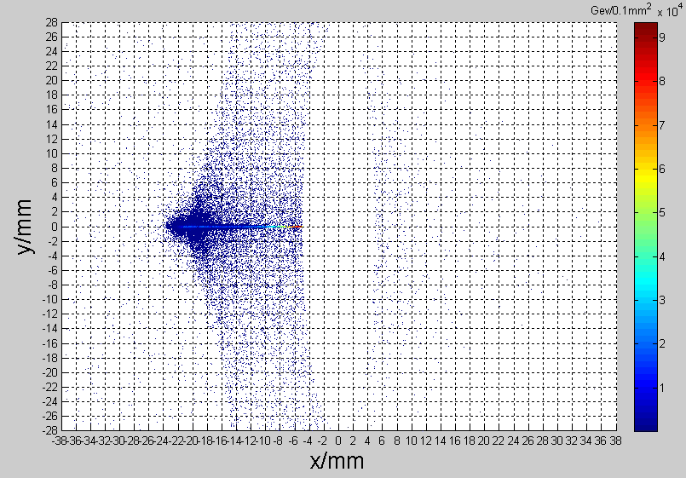
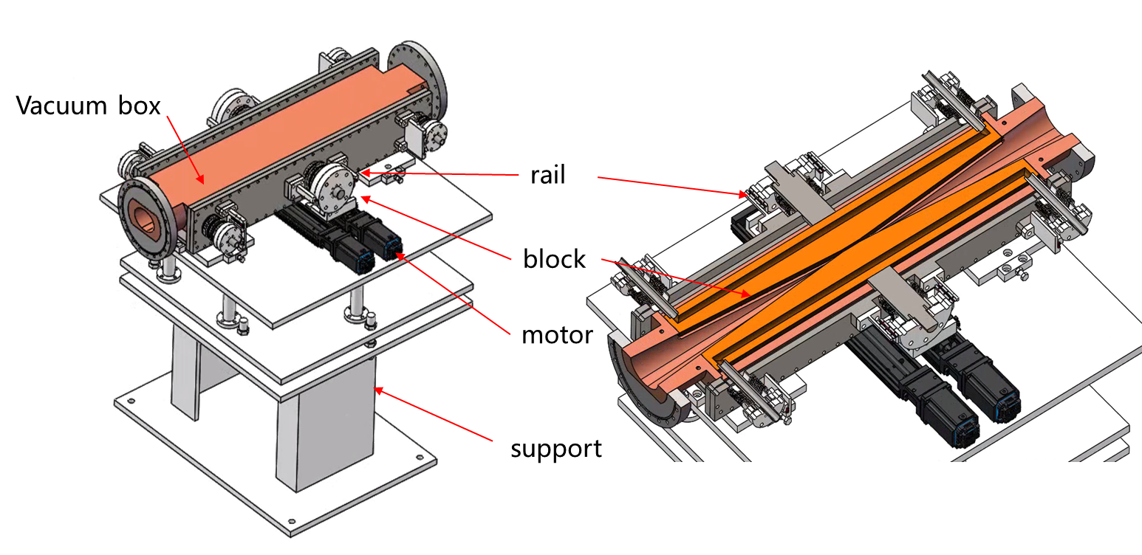
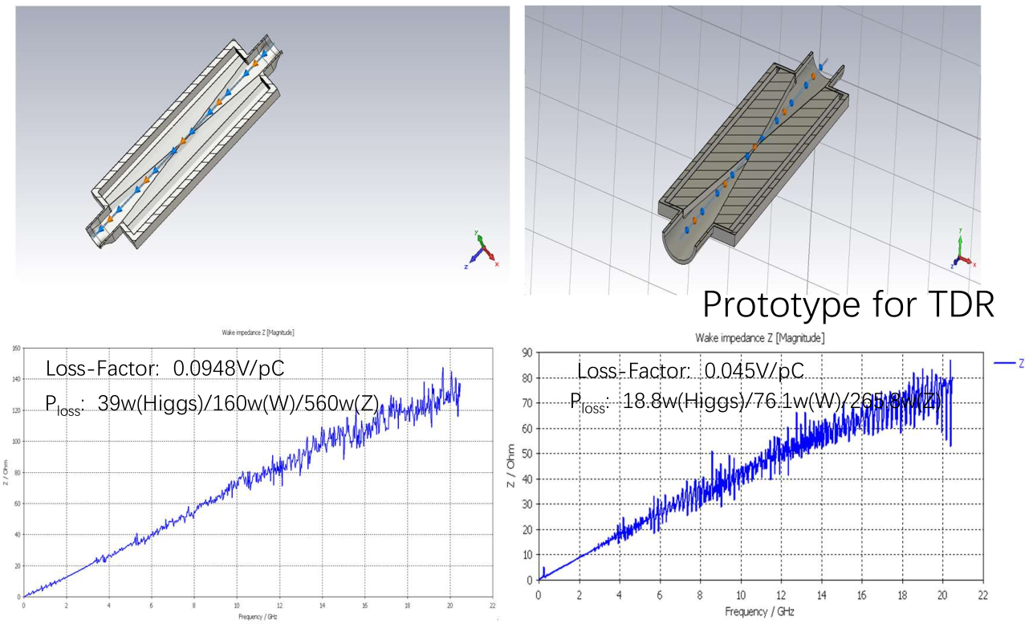
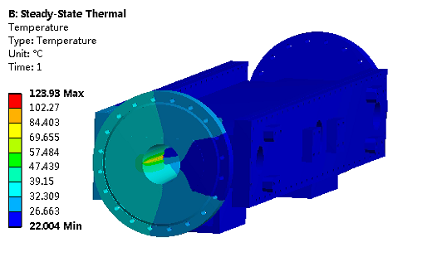
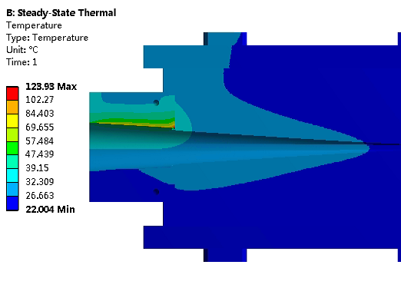
Movable collimators
Located in straight section between two dipoles, the length is 800 mm.
SR power: 7.5kW @Higgs, 30MW
  Particle deposition:
  Jaw material: Cu
  Total heat generation: 21.2W
  Maximum temperature raise by particle-material reaction: 1.3℃
Highest temperature: 124 ℃

Slide 14
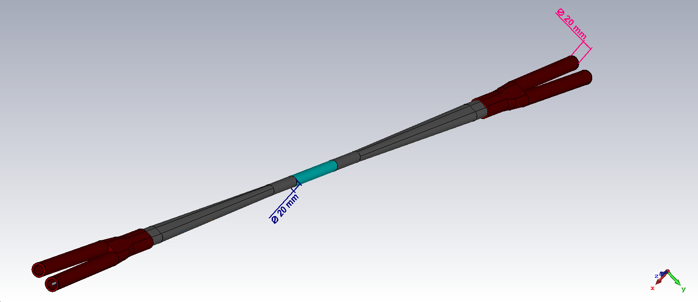
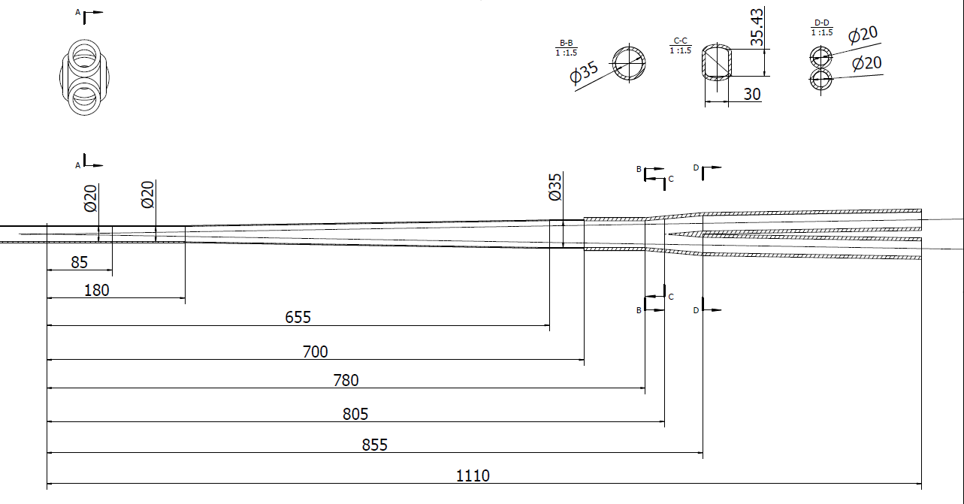
HOM power distribution
results for MDI 20mm-20mm
Transition region: Racetrack (including materials)
σ_{z}=5mm: Two beam in the IR
Loss factor Trap in IR @k_trap: 0.032v/pc
P_{trap}: H/W/Z/tt: 24.0w/117.1w/1160.8w/6.67w
Position | Position Start-end（mm） | material | Length (mm) | Higgs(w) & (w/cm²) | W (w) & (w/cm²) | Z(w) & (w/cm²) | ttbar（w） & (w/cm²)
Be pipe (w) | 0-85 | Be | 85 | 1.13 & 0.021 | 5.587 & 0.105 | 55.295 & 1.35 | 0.31 & 0.005
Be pipe transition(w) | 85-180 | Al | 95 | 0.61 & 0.01 | 2.950 & 0.049 | 29.280 & 0.491 | 0.172 & 0.007
Transition pipe (w) | 180-655 | Al | 475 | 6.99 & 0.017 | 34.48 & 0.085 | 341.562 & 0.83 | 1.958 & 0.005
Transition （w） | 655-700 | Al | 45 | 0.62 & 0.015 | 2.95 & 0.071 | 29.28 & 0.701 | 0.172 & 0.004
RVC bellow（w） | 700-780 | Cu | 80 | 0.52 & 0.007 | 2.532 & 0.034 | 25.002 & 0.337 | 0.14 & 0.002
Transition on Y-crotch | 780-805 | Cu | 25 | 0.16 & 0.007 | 0.785 & 0.032 | 7.822 & 0.316 | 0.05 & 0.002
Y- crotch (w) | 805-855 | Cu | 50 | 0.33 & 0.005 | 1.572 & 0.024 | 15.626 & 0.241 | 0.091 & 0.002
Quadrupole pipe(w) | 855-1100 | Cu | 245 | 1.58 & 0.005 | 7.735 & 0.024 | 75.594& 0.24 | 0.434 & 0.002
Total | 0-1100 | - | 1100 | 12.0 &0.011 | 58.594 &0.056 | 580.46 & 0.56 | 3.331 & 0.003

Slide 15
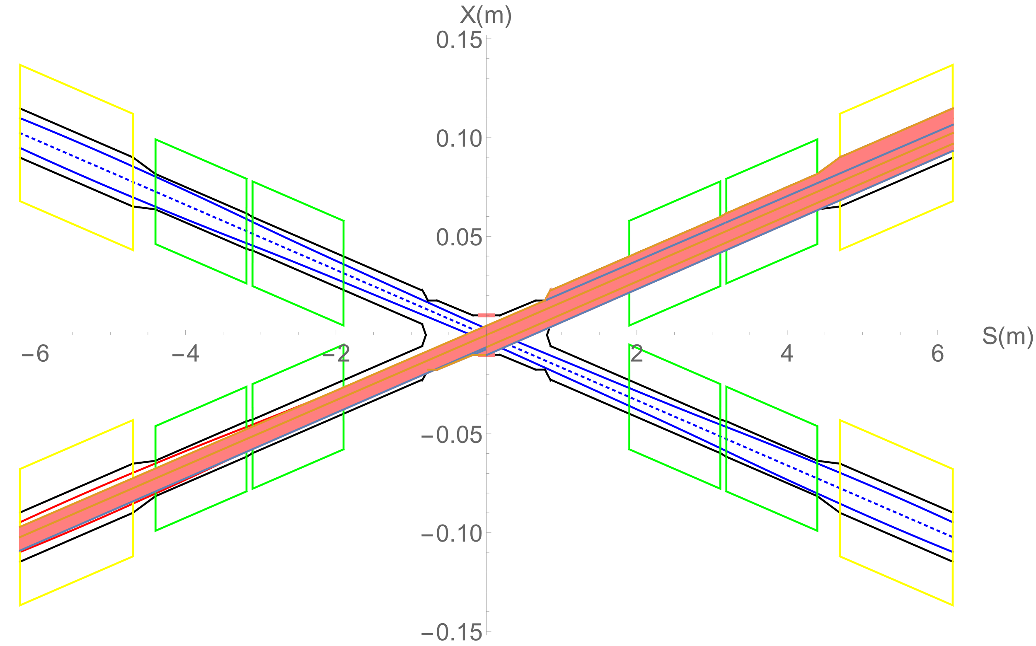
Heat load from SR
In normal conditions, there is no SR photons hitting the central beam pipe.
Single layer beam pipe with water cooling, SR heat load can be accepted.
In abnormal conditions, SR photons hitting the bellows (no cooling) and berrylium pipe under the extreme beam conditions , since it is a transient effect, heat load can be accepted.
Region | SR heat load | SR average power density
0~780mm | 0 | 0
780mm~805mm | 23.04W | 256W/cm²
805mm~855mm | 53.39W | 296.6W/cm²
855mm~1.9m(QDa entrance） | 4.32W | 1.15W/cm²
QDa | 3.28W | 0.75W/cm²
QDa~QDb | 22.92W | 79.58W/cm²
QDb | 3.96W | 0.91W/cm²
QDb~QF1 | 71.04W | 65.8W/cm²
QF1 | 7.26W | 1.34W/cm²
In extreme cases ~ at least 10 times per day. The beam will be stopped within 0.5ms when abnormal.
The background of the detector and radiation dose are in consideration under abnormal conditions.

Slide 16
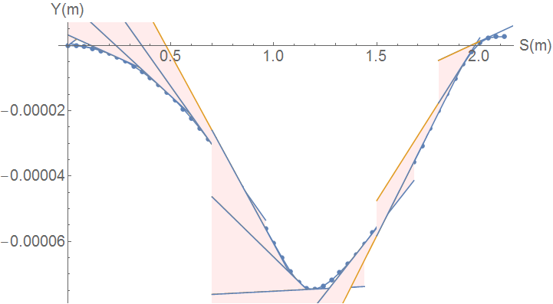
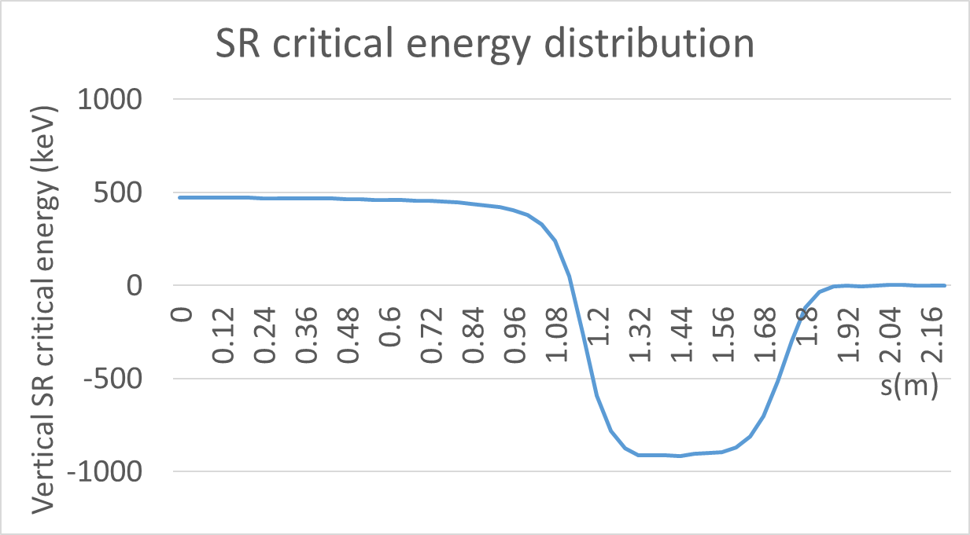
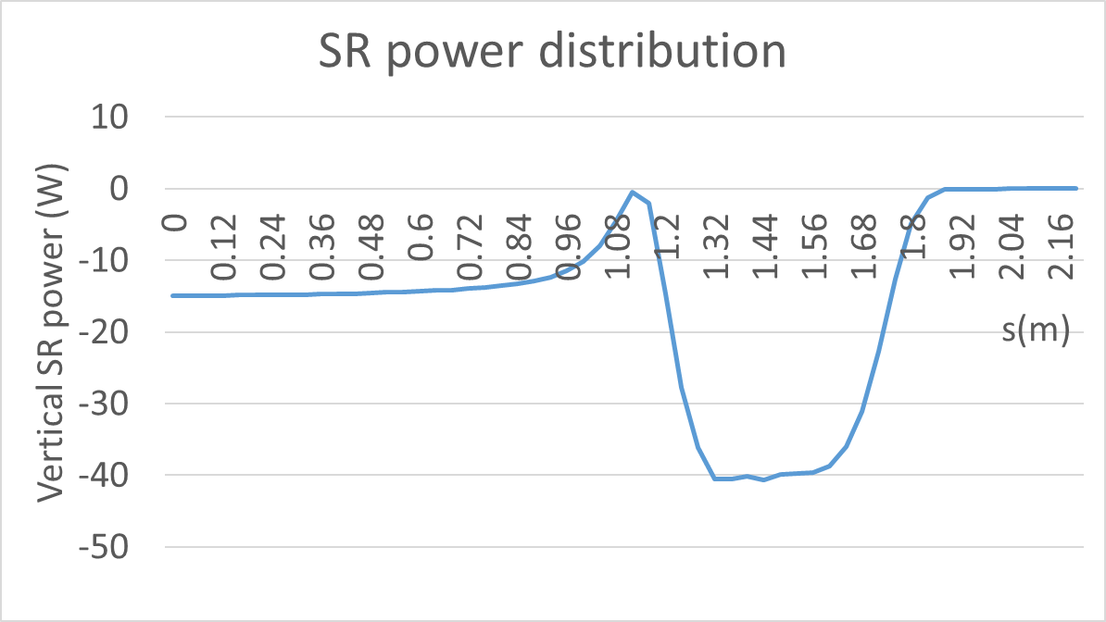
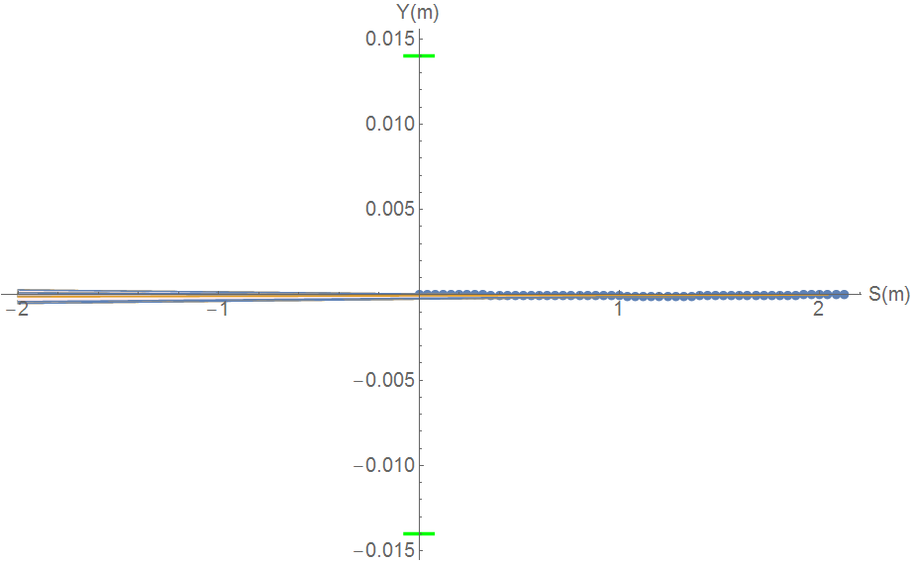
SR from solenoid combined field
Horizontal trajectory will couple to the vertical
Due to the sol+anti-sol field strength quite high, maximum~5.81T, transverse magnetic field component is quite high.
SR from vertical trajectory in sol+anti-sol combined field should be taken into account.
SR fan is focused in a very narrow angle from
-116urad to 131urad
SR will not hit Berryllium pipe, and no background to detector.
SR will hit the beam pipe ~213.5m downstream from IP
Water cooling is needed.
Maximum: 918keV
Maximum: 40.6W

Slide 17
Heat load in IR from beam loss background
Region | RBB | Beamstrahlung | Beam-Gas | BTH
Berryllium pipe | 6.7mW | 0 | 0 | 0
Detector beam pipe | 0.024W | 0 | 4.8uW | 1.2uW
Accelerator beam pipe before QDa | 0.17W | 0 | 4.2uW | 1.2uW
QDa~QDb | 2.13W | 3.8uW | 5.9uW | 1.8uW
QDb~QF1 | 0.01W | 3.8uW | 0.5uW | 0.6uW
QF1 | 0.26mW | 0 | 3.7uW | 0.66uW
Beam loss particles from the process of radiative Bhabha scattering, Beamstrahlung, Beam-Gas scattering, and beam-thermal photon scattering hitting the IR beam pipe.
Heat load in IR from beam loss background is so small, compared to synchrotron radiation and HOM.
The photons generated from the process of radiative Bhabha scattering, Beamstrahlung, and Beam-Gas scattering with small angle and large energy, are in consideration.

Slide 18
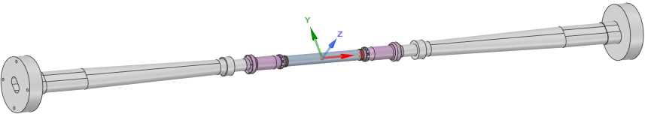
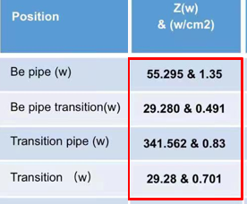
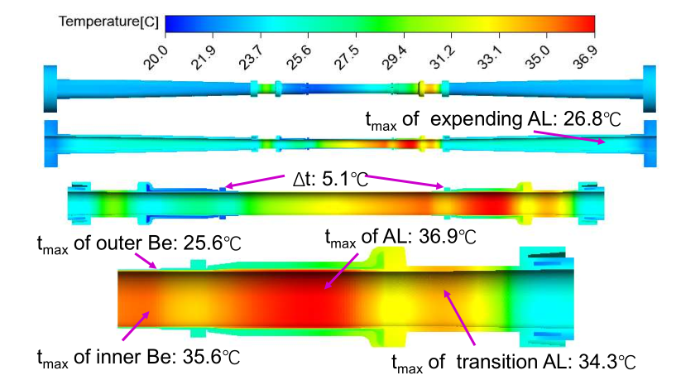
Beam pipe thermal analysis
Calculation model and condition
Heat source distribution
Extending pipe:
2 inlet pipe, 2 outlet pipe
Coolant: water
Inlet temperature: 20℃
Inlet velocity: 0.5m/s（1.7L/min）
Be pipe:
4 inlet pipe, 4 outlet pipe
Coolant: water
Inlet temperature: 20℃
Inlet velocity: 0.5m/s（0.8L/min）
Extending pipe:
2 inlet pipe, 2 outlet pipe
Coolant: water
Inlet temperature: 20℃
Inlet velocity: 0.5m/s（1.7L/min）
Calculation results:
Temperature difference ~5.1⁰C between two sides of the first layer detector
Temperature low, temperature difference small, meet the requirement

Slide 19
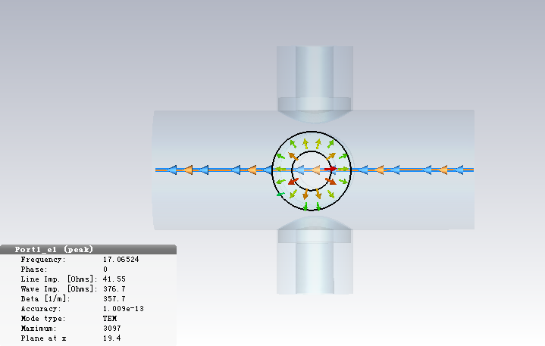
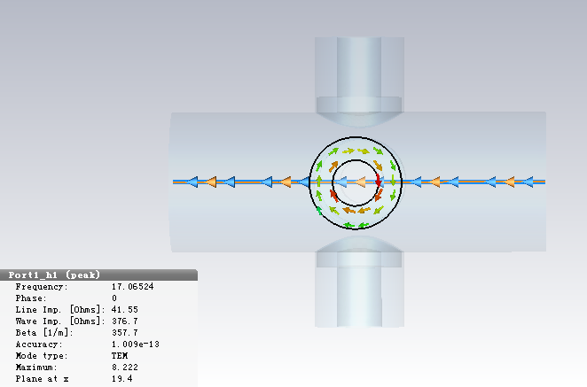
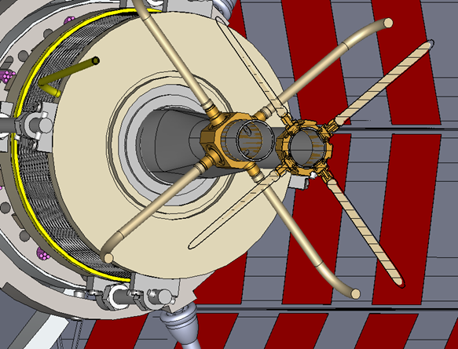
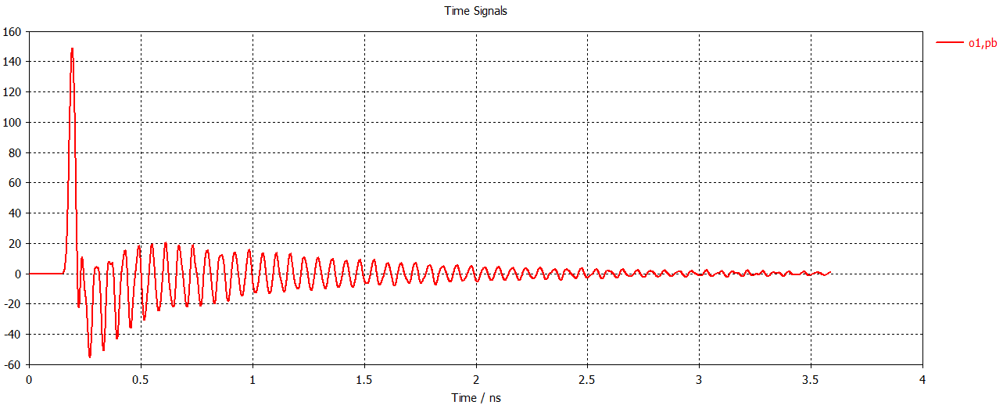
IP BPM
Electromagnetic field at electrodes
Considering response time and calibration difficulty, two 4 button electrodes BPM at each side of CEPC IR are adopted.
Due to the short bunch length, signal has many resonance hump, signal amplitude proportional to the bunch charge.
Size and signal intensity can be satisfied by CEPC MDI requirement.
Electrodes signal

Slide 20
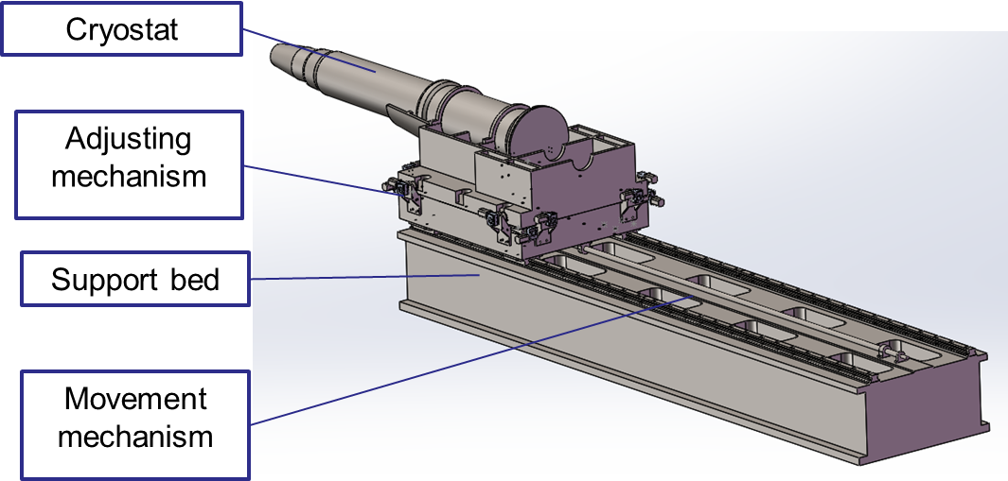
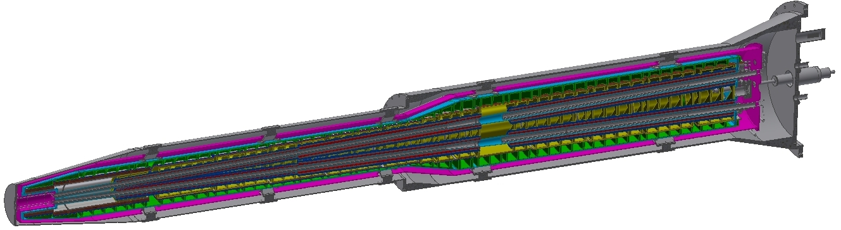
SC magnet support system
After the optimization of the supports in the cryostat, the total weight of the cryostat and the devices inside is 2790 Kg.
The cryostat is about 5.6m long. The cantilever length is 5283mm.
The resolution requirement of the adjusting mechanism < 5 μm.
Thermal shield
Helium vessel
Q2
Vacuum vessel
Q1b
Q1a
Anti-solenoid
Support rods

Slide 21
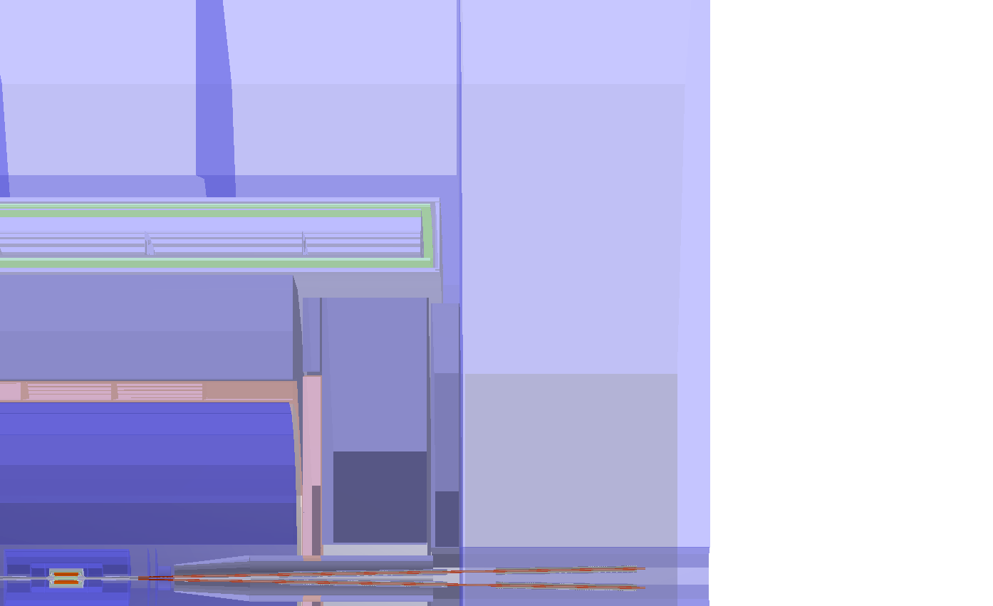
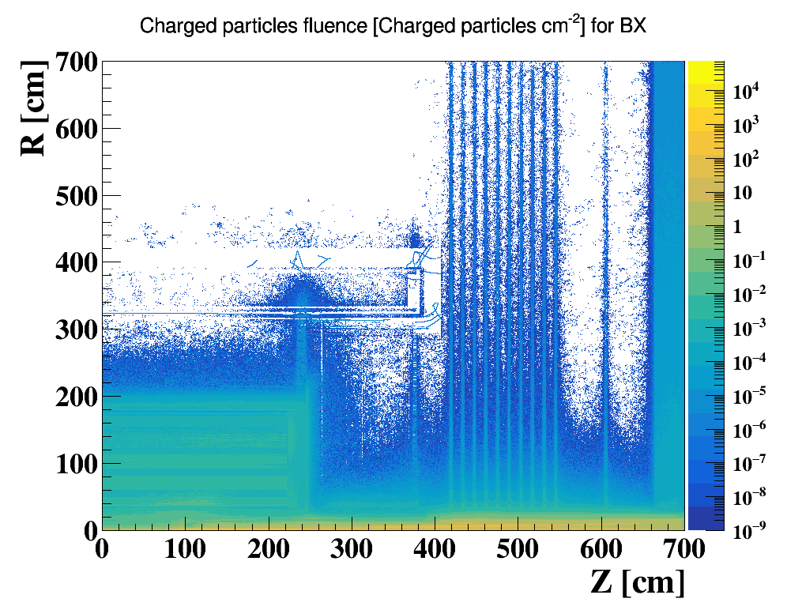
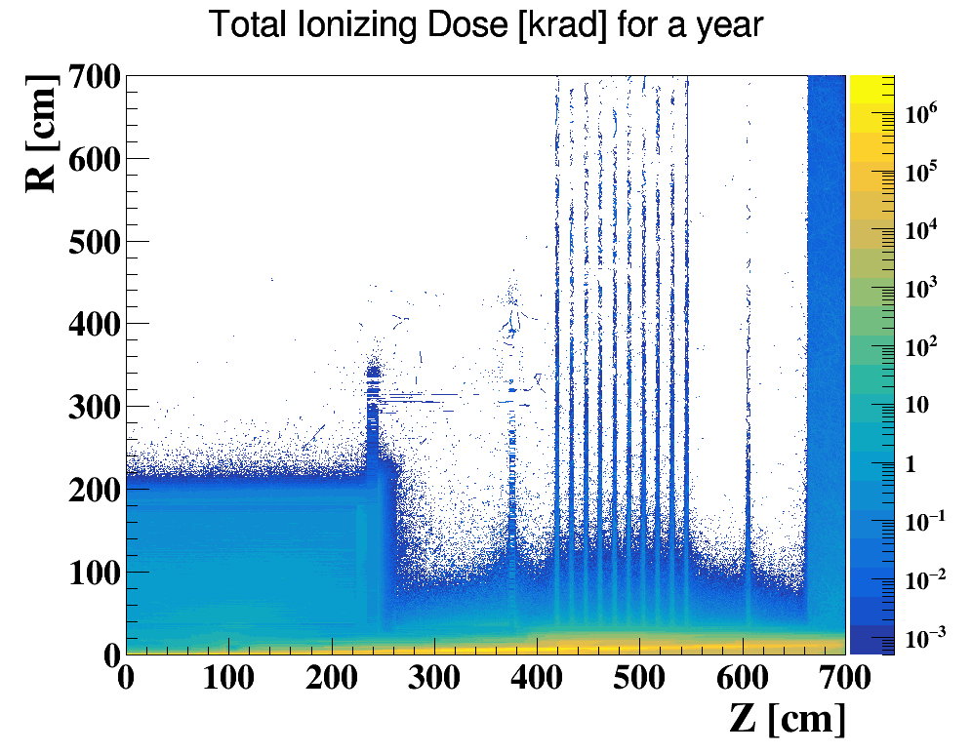
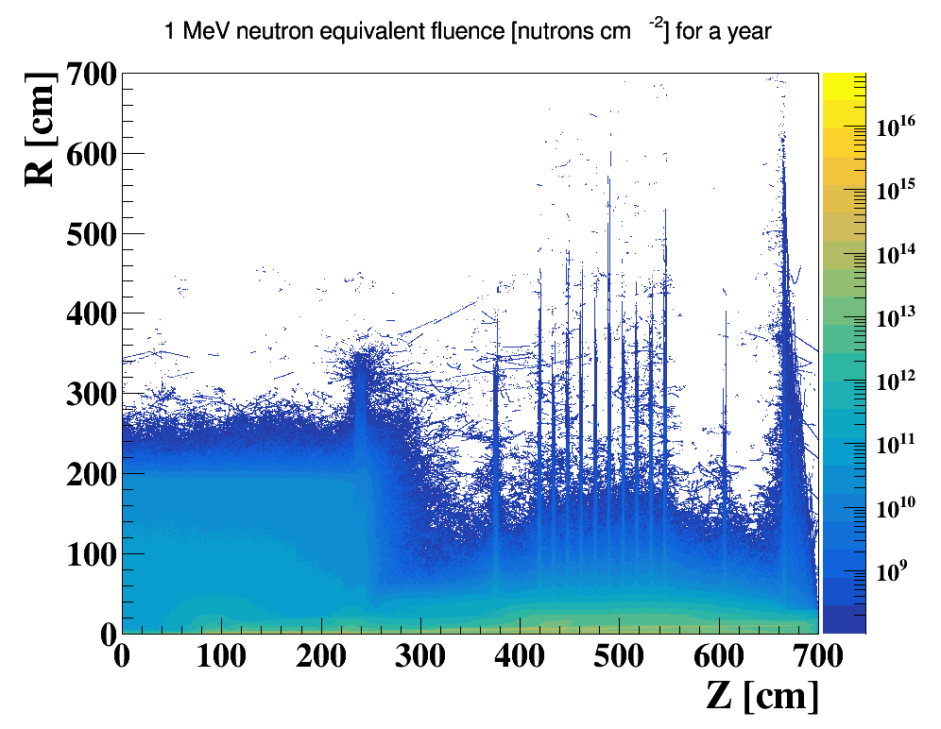
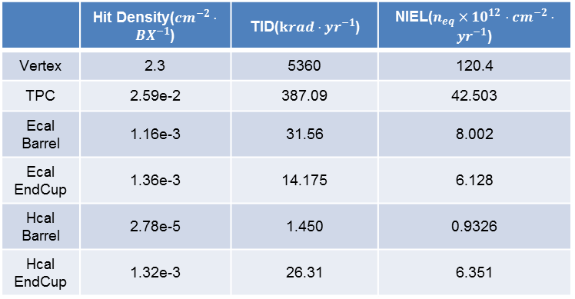
Full Detector Simulation
Two Main Concern has been taken for detector impacts:
    Detecting Efficiency(Occupancy): The ratio of Data/Noise
    Detector Safety: Radiation Tolerance/Cooling Issues
Three quantities has been scored:
    Charged Particle Fluence(Hit Density)
    Total Ionizing Dose(TID)
    1 MeV Silicon Equivalent Fluence(NIEL)
    A Safety of 10 is always applied to all results
Yoke(barrel)
300cm
Solenoid
Yoke(Endcap)
HCal
200cm
HCal
TPC
The impact on detector due to background could reach EMC or more
Pair Production contributes most, BTH and BG are at same level, lower than pair production
Characterized by Hit Density, TID and NIEL
End cap ring
400 cm
EMC
Yoke plugin
Higgs ~ 50MW
 | Hit Density($cm^{−2}⋅BX^{−1}$) | TID($krad⋅yr^{−1}$) | NIEL($n_{eq}×{10}^{12}⋅cm^{−2}⋅yr^{−1}$)
Vertex | 2.3 | 5360 | 120.4
TPC | 2.59e-2 | 387.09 | 42.503
Ecal Barrel | 1.16e-3 | 31.56 | 8.002
Ecal EndCup | 1.36e-3 | 14.175 | 6.128
Hcal Barrel | 2.78e-5 | 1.450 | 0.9326
Hcal EndCup | 1.32e-3 | 26.31 | 6.351

Slide 22
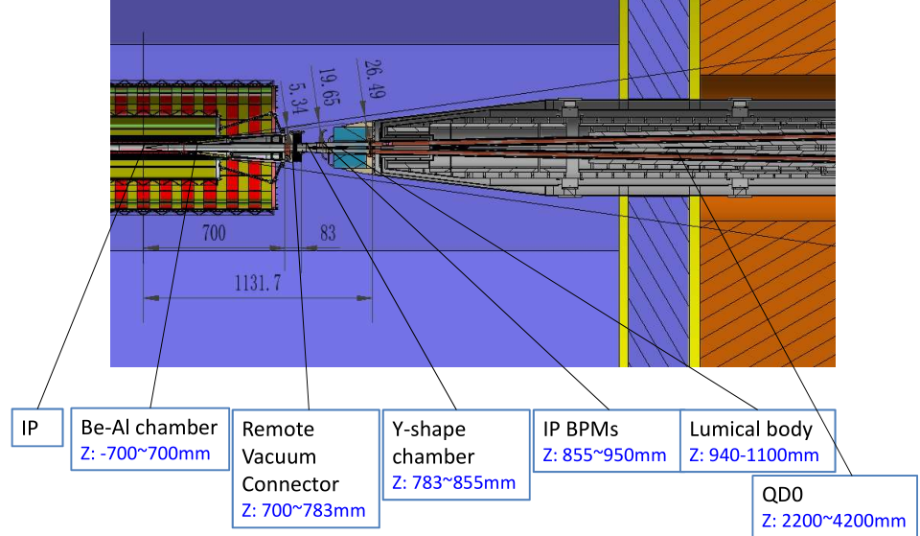
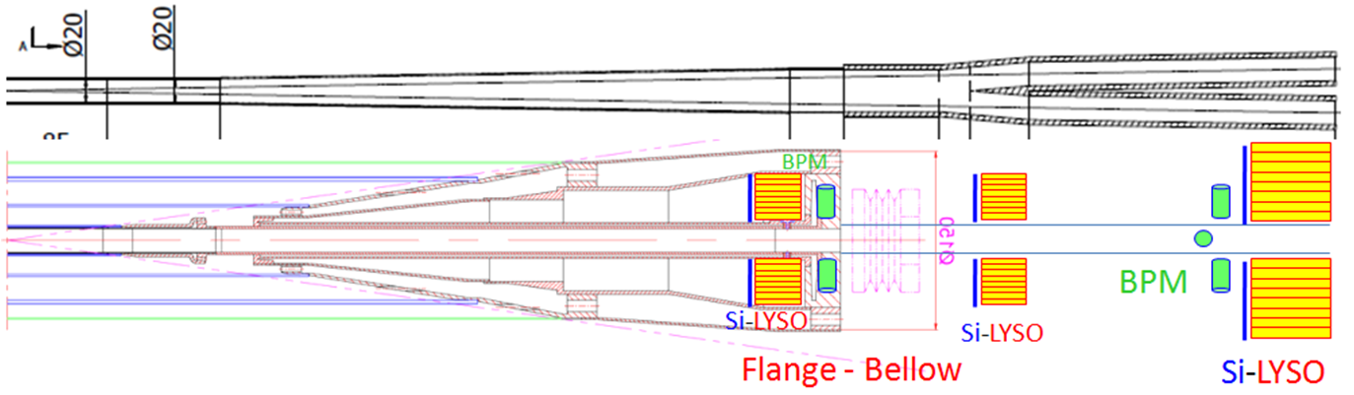
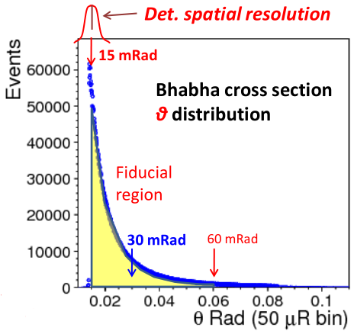
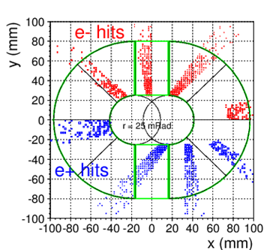
Luminosity Calorimeter
Lumical has 3 parts:
Si-LYSO detector at flange~700mm in vertical
Si-LYSO detector at crotch section in horizontal and vertical
Lumical body at Z 0.94m~1.11m
Race-track beam pipe design limiting the LumiCal's theta coverage to 25-80 mRad.
Bhabha cross section nessitating < 1 μrad tolerance on the lower theta edge for 10⁻⁴ precision on integrated luminosity.
Lumical construction and monitoring requires mean errors of < 1 μm to the beam center and 30 μm in the z-axis to the e⁺e⁻ interaction point.

Slide 23
Summary
The MDI layout is compatible and no interference for the design.
Φ20mm~ Φ20mm IR beam pipe is well designed.
The estimation of the radiative background from photon background, beam loss background and injection background has been estimated with real beam.
The mitigation efforts of every kinds of background dedicated to the mask, collimator and shielding has been designed.
The thermal analysis including HOM heating, synchrotron radiation, beam loss background and beam pipe thermal analysis meet the requirement.
Considering response time and calibration difficulty, two 4 button electrodes BPM at each side of CEPC IR are adopted.
The SC magnet supports inside the cryostat are designed and optimized.
The full detector simulation shows the impact on detector due to background could reach EMC or more. Pair Production contributes most; BTH and BG are at same level, lower than pair production.
Detector impacts small enough. Higgs in 50MW can well accepted by vertex and also for Z in 30MW.
The updated design of the LumiCal could satisfy the requirement. The detail design of the detector itself is started.

Slide 24
Thanks

