Slide 1
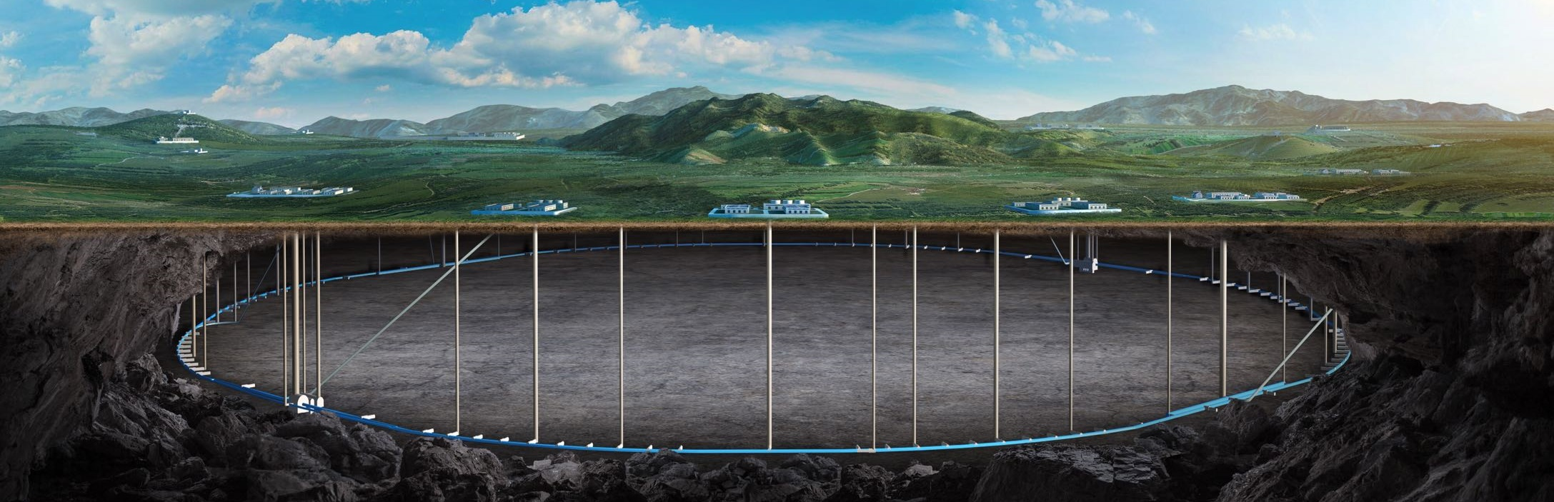
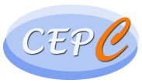

CEPC SRF System Design
and Upgrade Plan
Jiyuan Zhai
12-16 June 2023, Hongkong, CEPC Accelerator TDR International Review

Slide 2
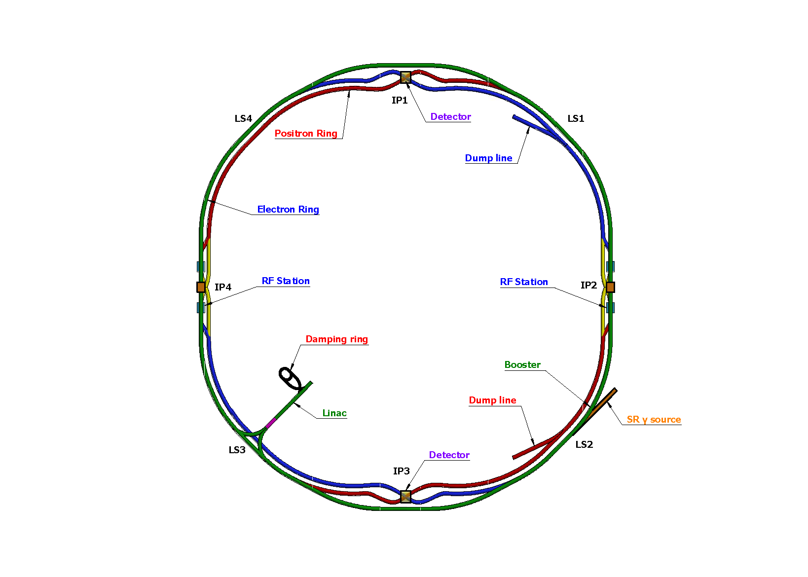
Content
SRF system overview and layout
Collider SRF system design
Booster SRF system design
Power and energy upgrade plan
Summary

Slide 3
Introduction
This talk is about Superconducting RF System Design of CEPC, including RF parameters, RF region layout, cavities and cryomodules types, beam-cavity interaction issues … for the Collider and Booster, not including SRF technology R&D, RF power sources, RF distribution and LLRF.
This talk relates to the TDR chapter 4.3.1, 5.3.1 and 4.4.
The content relates to the “charge letter” items:
  Item 1. System design goals
  Item 2. Accelerator physics issues
  Item 3. Design and key technologies for the performance goals
  Item 4. Operation modes and upgrade plans
  Item 7. Technical risks, potential impacts, mitigation measures
  Item 6. Critical technologies and components ready or will be ready before 2026 through R&D
  Item 8. Ready for construction, after R&D program, and industrial and engineering preparation

Slide 4
Design Requirement and Challenges of SRF System
Higgs priority (10y H + 2y Z + 1y W + 5y ttbar)
- timeline and performance priority for a Higgs factory.
Upgradable
- power (luminosity) and energy upgrade.
Low cost (especially first stage)
- staged cost and in-kind contribution.
Max luminosity for each mode (new for Z/ttbar)
- up to 50 MW SR power per beam.
Seamless mode switch (new)
- switch among H/W/Z/(ttbar), no hardware movement.
CEPC collider 50 MW | Energy (GeV) | Current (mA) | RF voltage (GV)
Z | 45.5 | 1345 | 0.1
W | 80 | 140 | 0.7
H | 120 | 27.8 | 2.2
ttbar | 180 | 5.6 | 10
45.5-180 GeV double-ring collider with a full energy booster, RF system cost and reliability
6.6/30 GV total RF voltage, cavity G & Q, heat load
1.3 A beam current, 100 km large ring, low cavity RF voltage, beam-cavity interaction
60/100 MW SR power, coupler capacity and match
6 kW HOM power / cell, HOM damper, #CAV in CM
Unprecedented challenges on RF system design

Slide 5
Design Features of SRF System
Share cavities for the two rings for H and ttbar (low cost)
  Shared cavities for H/ttbar, separate cavities for W/Z
  Save 2.2/10 GV, reduce by half cavities, klystrons, cryogenics construction and operation cost
  Cons: double coupler power, half filling of both collider and booster
RF system optimized for Higgs (Higgs priority)
  Coupler power, cavity and cell number, cavity gradient, HOM power, Qin match, beam-cavity interactions (FM/HOM CBI, RF transient), cavity material, operating temperature, Q₀, number of cavities in a module, module heat load, HOM damper, cavities per klystron, power overhead for LLRF... Balance all the parameters with technology maturity, reliability, performance degradation, operational margins, cost, risk and maintenance.
RF system for W, Z and ttbar (mode switch and max luminosity)
  Due to the wide range of machine parameters, it is impossible to have a single common SRF system for the highest possible luminosity in each mode. A staged SRF complex with bypass lines for both collider and booster is inevitable.
  W: fully share and use half of the Higgs cavities per ring due to similar beam parameters
  Z: only low power Z can use Higgs cavities (half parking cavities). 1-cell cavity for > 10 MW to 30 / 50 MW.
  ttbar: reuse Higgs (& Z) cavities, add new 5-cell cavities. Add more 9-cell cavities for the booster.
  Add new RF power sources for Z and ttbar
  Bypass the low current cavities for both collider and booster

Slide 6
CEPC Collider Ring 650 MHz RF Parameters
30/50 MW SR power per beam for each mode. Higgs/ttbar shared cavities for the two rings. W/Z separate cavities. HL-Z cavities bypass. | ttbar 30/50 MW |  | Higgs 30/50 MW | W 30/50 MW | Z 10 MW | Z 30/50 MW
 | New cavities | Higgs cavities
Luminosity / IP [10³⁴ cm⁻²s⁻¹] | 0.5 / 0.8 |  | 5 / 8.3 | 16 / 26.7 | 38 | 115 / 192
RF voltage [GV] | 10 (6.1 + 3.9) |  | 2.2 | 0.7 | 0.12 | 0.12 / 0.1
Beam current / beam [mA] | 3.4 / 5.6 |  | 16.7 / 27.8 | 84 / 140 | 267 | 801 / 1345
Bunch charge [nC] | 32 |  | 21 | 21.6 | 22.4 | 22.4 / 34.2
Bunch length [mm] | 2.9 |  | 4.1 | 4.9 | 8.7 | 8.7 / 10.6
650 MHz cavity number | 192 | 336 | 192/336 | 96 / 168 / ring | 48 / ring | 30 / 50 / ring
Cell number / cavity | 5 | 2 | 2 | 2 | 2 | 1
Gradient [MV/m] | 27.6 | 25.2 | 24.9 / 14.2 | 15.9 / 9.1 | 5.4 | 17.4 / 8.7
Q₀ @ 2 K at operating gradient | 3E10 | 3E10 | 3E10 | 3E10 | 3E10 | 2E10
HOM power / cavity [kW] | 0.4 / 0.66 | 0.16 / 0.26 | 0.4 / 0.67 | 0.93 / 1.54 | 1.9 | 2.9 / 6.2
Input power / cavity [kW] | 188 / 315 | 71 / 118 | 313 / 298 | 313 / 298 | 206 | 1000
Optimal Q_{L} | 1E7 / 6E6 | 9E6 / 5.4E6 | 1.6E6 / 9.5E5 | 8E5 / 2.7E5 | 1.4E5 | 1.5E5 / 3.8E4
Optimal detuning [kHz] | 0.01 / 0.02 | 0.02 / 0.03 | 0.1 / 0.2 | 0.7 / 2 | 7 | 6.7 / 21.7
Cavity number / klystron | 4 / 2 | 2 | 2 | 2 | 2 | 1
Klystron power [kW] | 800 | 800 | 800 | 800 | 800 | 1200
Klystron number | 48 / 96 | 168 | 96 / 168 | 96 / 168 | 48 | 60 / 100
Cavity number / cryomodule | 4 | 6 | 6 | 6 | 6 | 1
Cryomodule number | 48 | 56 | 32 / 56 | 32 / 56 | 16 | 60 / 100
Total cavity wall loss @ 2 K [kW] | 12.1 | 7.1 | 3.9 / 2.3 | 1.6 / 0.9 | 0.1 | 0.45 / 0.2
ttbar and Higgs half filled with common cavities for two rings, W and Z with separate cavities for two rings.
High luminosity Z upgrade use high current 1-cell cavity with RF bypass.
Add more 2-cell cavities for Higgs 50 MW upgrade.
Add 5-cell cavities for ttbar while using the original 2-cell Higgs cavities.
Fundamental mode instability of Z-mode due to large detuning will be suppressed by RF & beam feedback.
No beam feedback needed for HL-Z because of deep damping 1-cell cavities.

Slide 7
CEPC Booster Ring 1.3 GHz RF Parameters
30/50 MW Collider SR power per beam. 30 GeV injection. Higgs & ttbar half filled. Higgs on-axis injection with bunch swapping. Z injection from empty ring. | ttbar 30/50 MW |  | Higgs 30/50 MW on-axis | W 30/50 MW | Z 30/50 MW
 | New cavities | Higgs cavities
Extraction beam energy [GeV] | 180 |  | 120 | 80 | 45.5
Extraction average SR power [MW] | 0.05 |  | 0.5 / 0.67 | 0.02 / 0.04 | 0.05 / 0.1
Bunch charge [nC] | 1.1 |  | 0.78 (20.3)* | 0.73 | 0.81
Beam current [mA] | 0.12 / 0.19 |  | 1 / 1.4 | 3.1 / 5.3 | 16 / 30
Injection RF voltage [GV] | 0.761 |  | 0.346 | 0.3 | 0.3
Extraction RF voltage [GV] | 9.7 (7.53 + 2.17) |  | 2.17 | 0.87 | 0.46
Extraction bunch length [mm] | 1.8 |  | 1.86 | 1.3 | 0.75
Cavity number (1.3 GHz 9-cell) | 256 | 96 | 96 | 96 | 32
Module number (8 cavities / module) | 32 | 12 | 12 | 12 | 4
Extraction gradient [MV/m] | 28.3 | 21.8 | 21.8 | 8.7 | 13.8
Q₀ @ 2 K at operating gradient | 2E10 | 3E10 | 3E10 | 3E10 | 3E10
Q_{L} | 4E7 | 4E7 | 1.2E7 | 7.3E6 / 4.4E6 | 1.2E7 / 6.3E6
Cavity bandwidth [Hz] | 33 | 33 | 110 | 178 / 296 | 111 / 208
Peak HOM power per cavity [W] | 0.5 / 0.8 |  | ~ 75 / ~ 100 | 11.8 / 19.6 | 146 / 272
Average HOM power per cavity [W] | 0.2 / 0.32 |  | ~ 10 / ~ 15 | 3.8 / 6.3 | 80 / 150
Input peak power per cavity [kW] | 8.3 / 9.2 | 5.1 / 5.9 | 22 / 32 | 10.9 / 18.1 | 17 / 32
Input average power per cavity [kW] | 0.3 | 0.2 | 6.5 / 9.2 | 0.3 / 0.5 | 2.5 / 4.5
SSA power [kW] (1 cavity / SSA) | 10 | 10 | 25 / 30 | 25 / 30 | 25 / 40
Total cavity wall loss @ 2 K [kW] | 0.36 | 0.05 | 0.5 | 0.02 | 0.08
1.3 GHz 9-cell cavities
Higgs and ttbar booster are half filled for the injection timing with Collider ring.
Transient beam loading for Higgs on-axis injection tolerable (both at injection and extraction).
Increased average HOM power of HL-Z requires ERL-type 1.3 GHz cryomodule (HOM absorber at low temperature between cavities). Four cryomodules for Z with RF bypass, also to reduce impedance and increase current limit.
High gradient high Q 9-cell cavities for ttbar.
Narrow bandwidth high gradient cavity voltage ramping through the multipacting region to be studied. Counter-phasing ramp.
* The small bunch charge number before the parenthesis is for the bunches injected from the linac. The large bunch charge number in the parenthesis is for the bunches injected back from the Collider ring during the swap-out injection at Higgs energy.

Slide 8
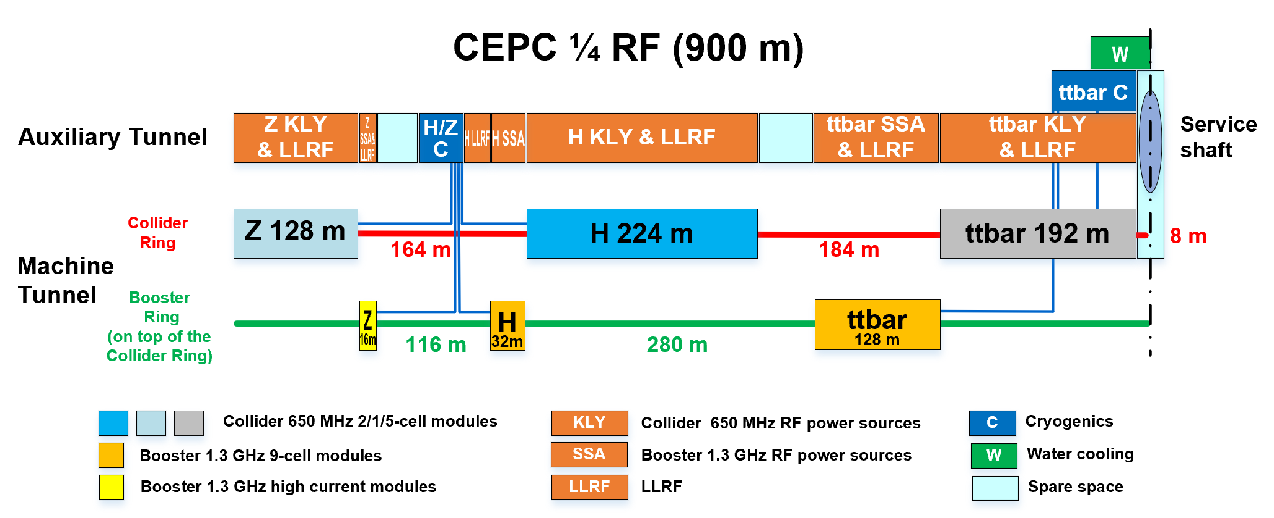
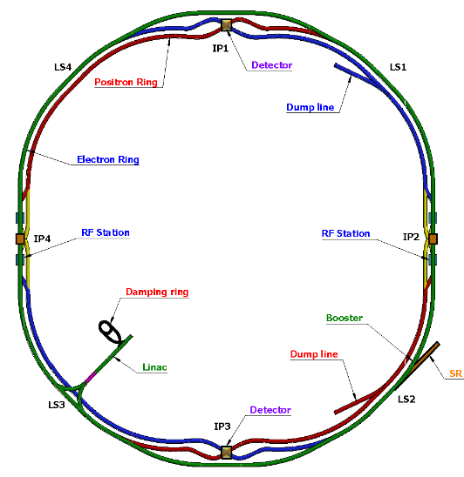
RF Section Layout
2x3.7 km long straight section
2x1.8 km RF section
3 km RF module footprint
2 km RF module
528 650 MHz cavities, 384 1.3 GHz cav, total 912 cav, 5188 cells
Major changes to CDR: move ttbar cavities to the center (shaft and tunnel transportation, bypass). Add dedicated high current Z cavities in the two ends. More realistic layout than CDR.
H/Z cryogenics near cavity for less transfer line heat loss. Challenge: large cold box transportation for maintenance .
Even if no ttbar mode switch and bypass, booster module will occupy the length. Longer tunnel necessary.

Slide 9
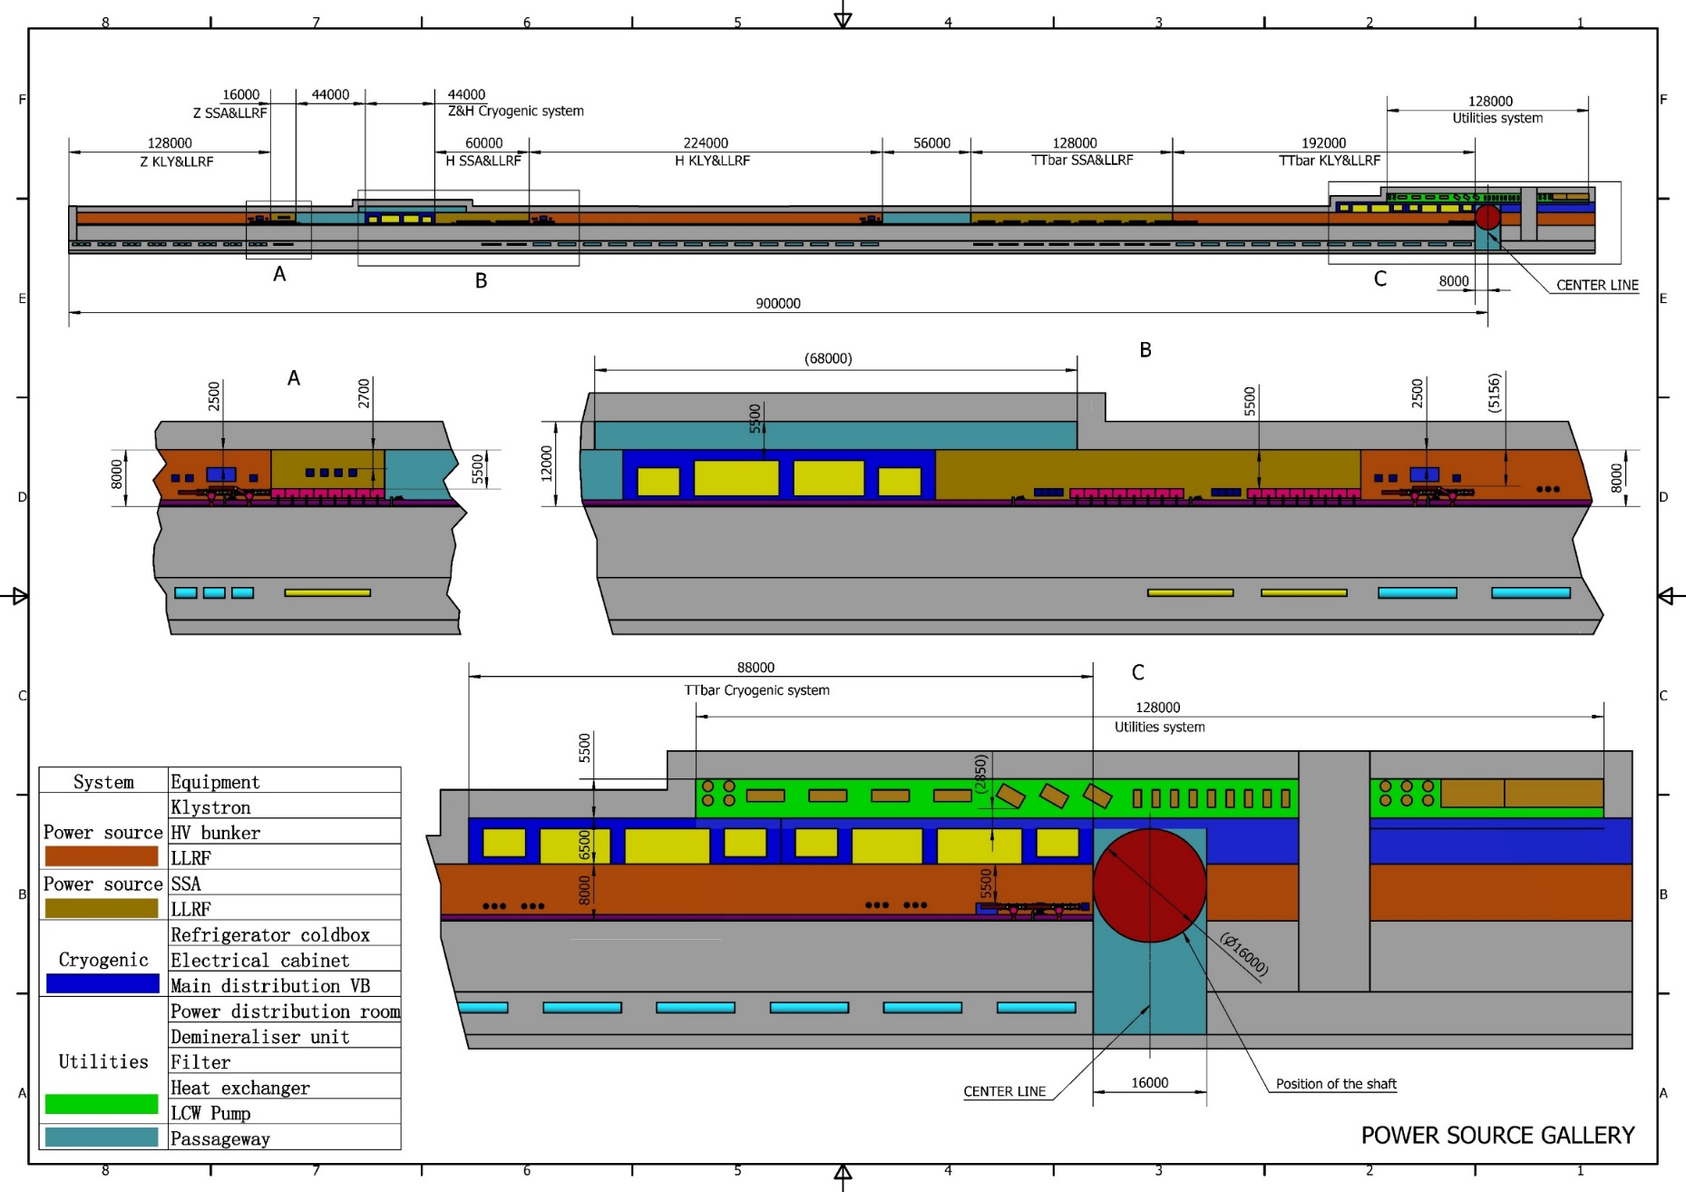
RF Section Layout

Slide 10
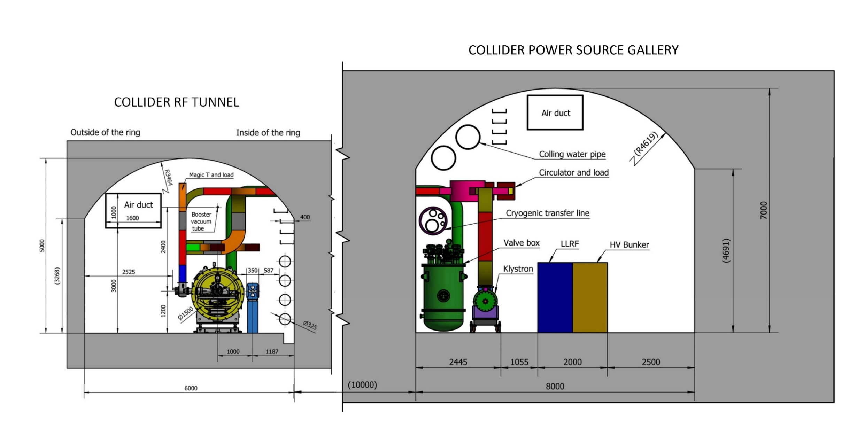
Collider RF Tunnel Cross Section
650 MHz cryomodules mounted on tunnel floor. Cavities operate in CW mode.

Slide 11
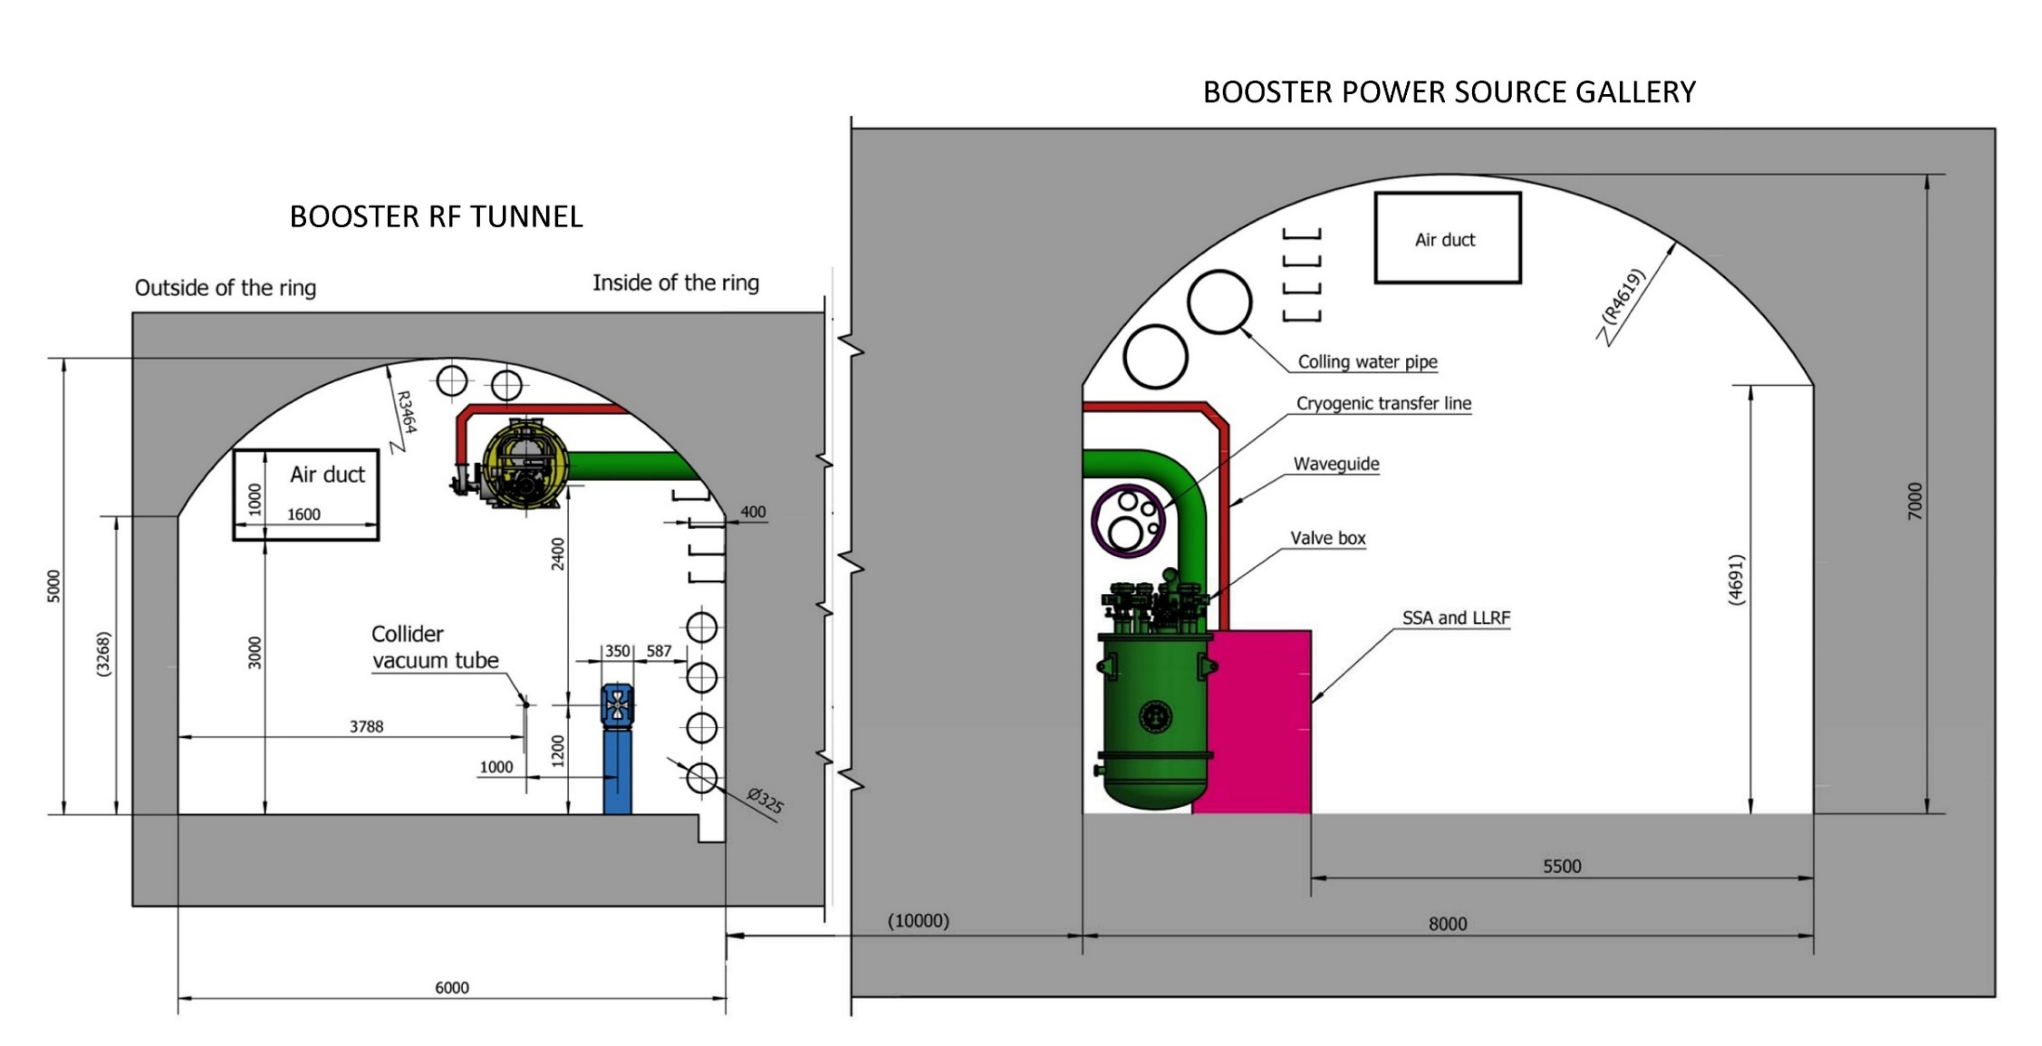
Booster RF Tunnel Cross Section
1.3 GHz cryomodules hung from ceiling at a different beamline height and in between collider cryomodule sections. Cavities operate in fast voltage ramp mode.

Slide 12
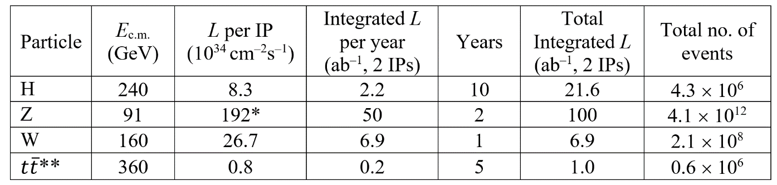
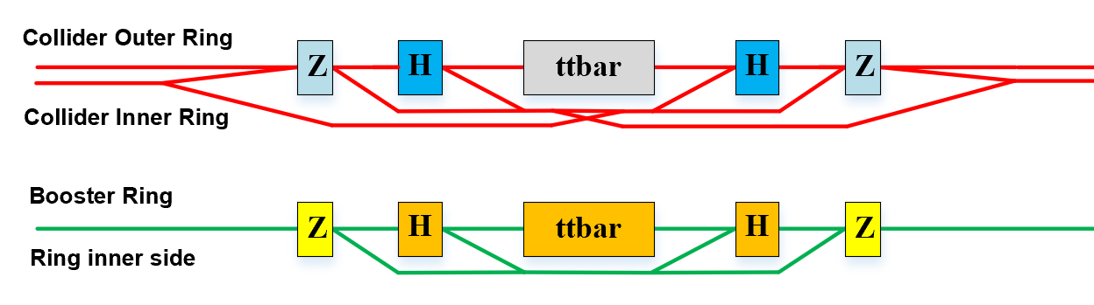
RF Bypass Scheme
Lower current cavities in the centre of an RF section, higher current cavities on the two sides.
Higher current beam can bypass the lower current cavities without causing HOM power and beam instability issues, and the lower current beam can go through cavities of the two rings for the collider and use the RF voltage of higher current cavities.
Bypass lines are in the inner side of cryomodules. Note the collider is a single ring in the RF section.
Avoid SR shining towards the RF cavities. Always deflect the outgoing beam. Need additional SR light shielding: collider ttbar cavities bypass for H operation in ttbar stage, booster H cavities bypass for Z operation, ttbar cavities bypass for H operation.

Slide 13
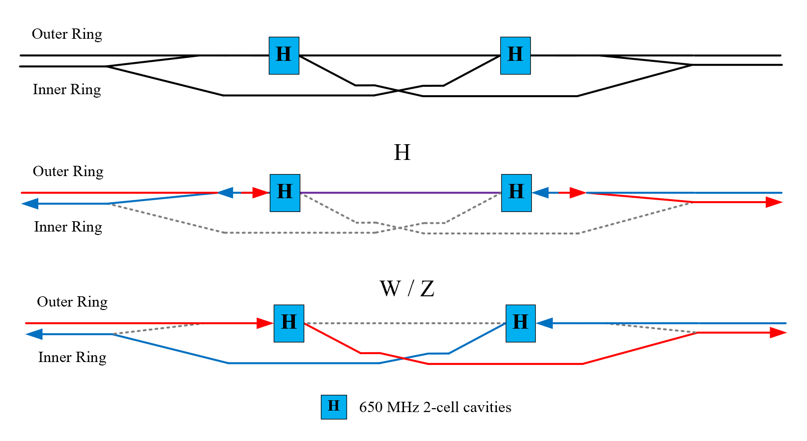
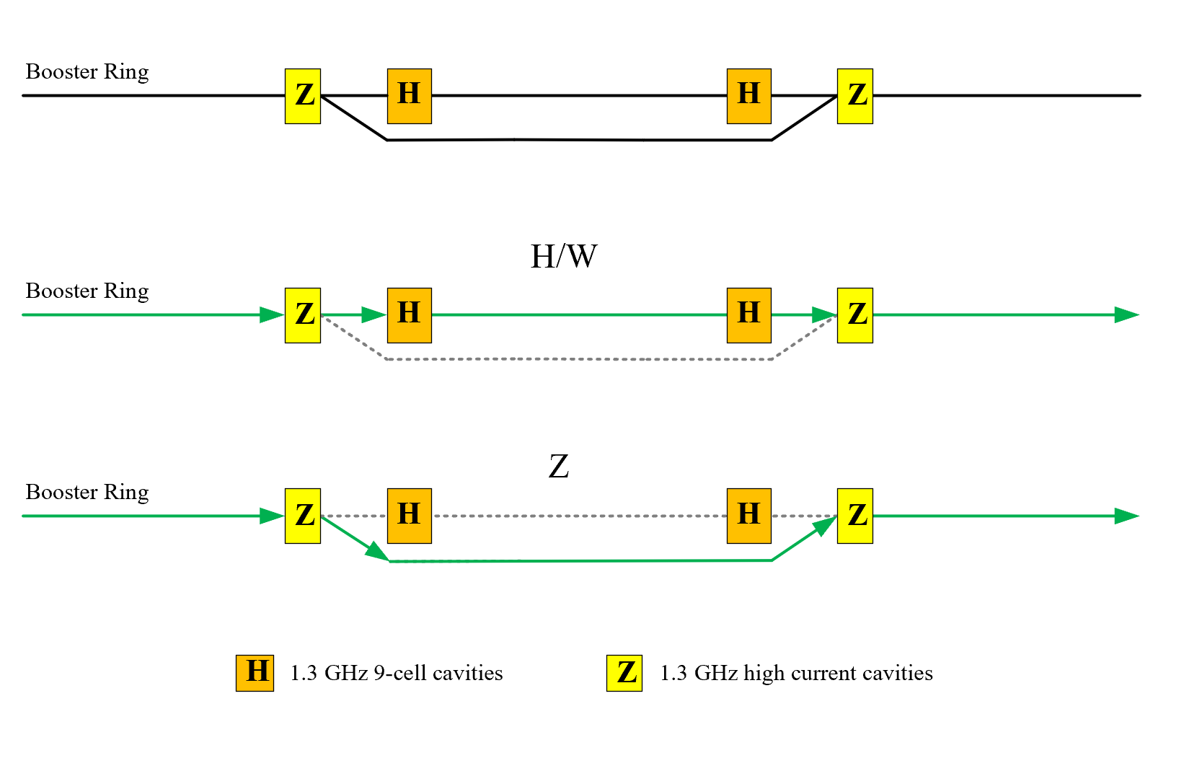
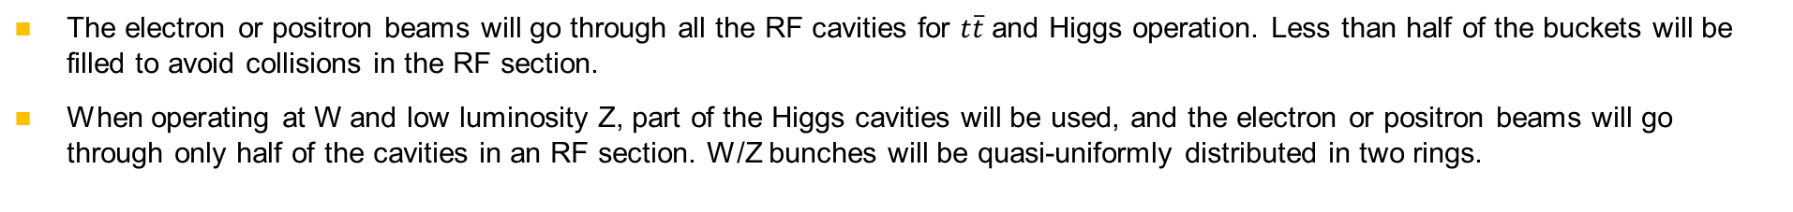
RF Bypass Scheme
Stage 1: 30/50 MW H/W, ~ 10 MW Z
The electron or positron beams will go through all the RF cavities for $t\overline{t}$ and Higgs operation. Less than half of the buckets will be filled to avoid collisions in the RF section.
When operating at W and low luminosity Z, part of the Higgs cavities will be used, and the electron or positron beams will go through only half of the cavities in an RF section. W/Z bunches will be quasi-uniformly distributed in two rings.

Slide 14
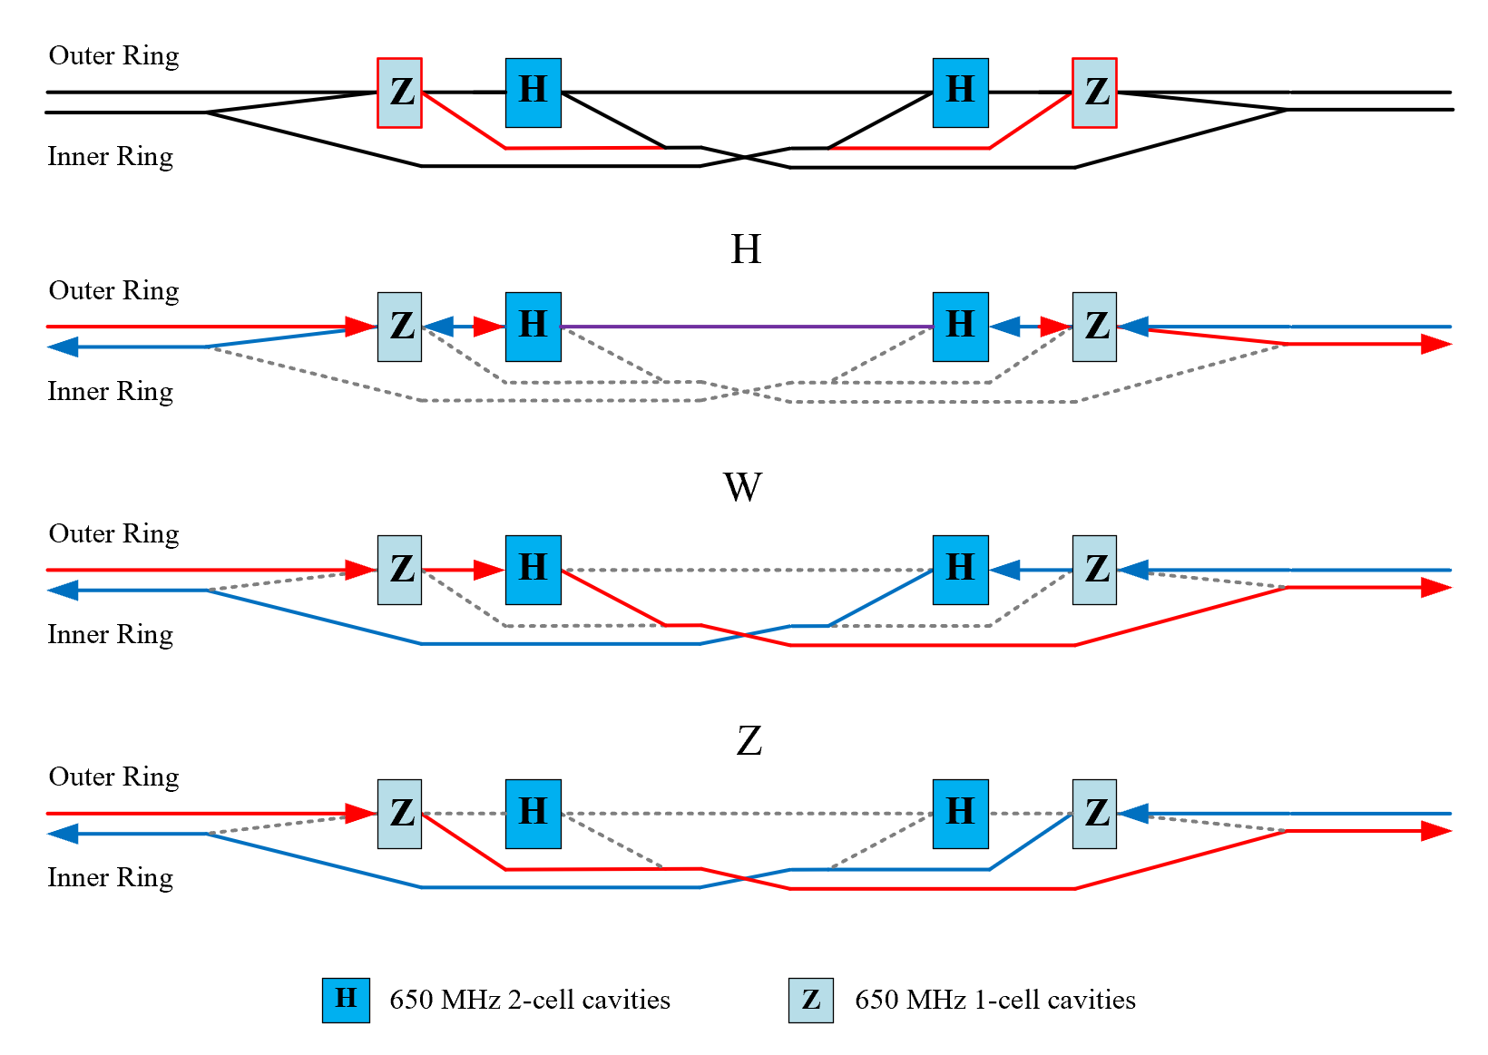
RF Bypass Scheme
Stage 2: 30/50 MW H/W/Z

Slide 15
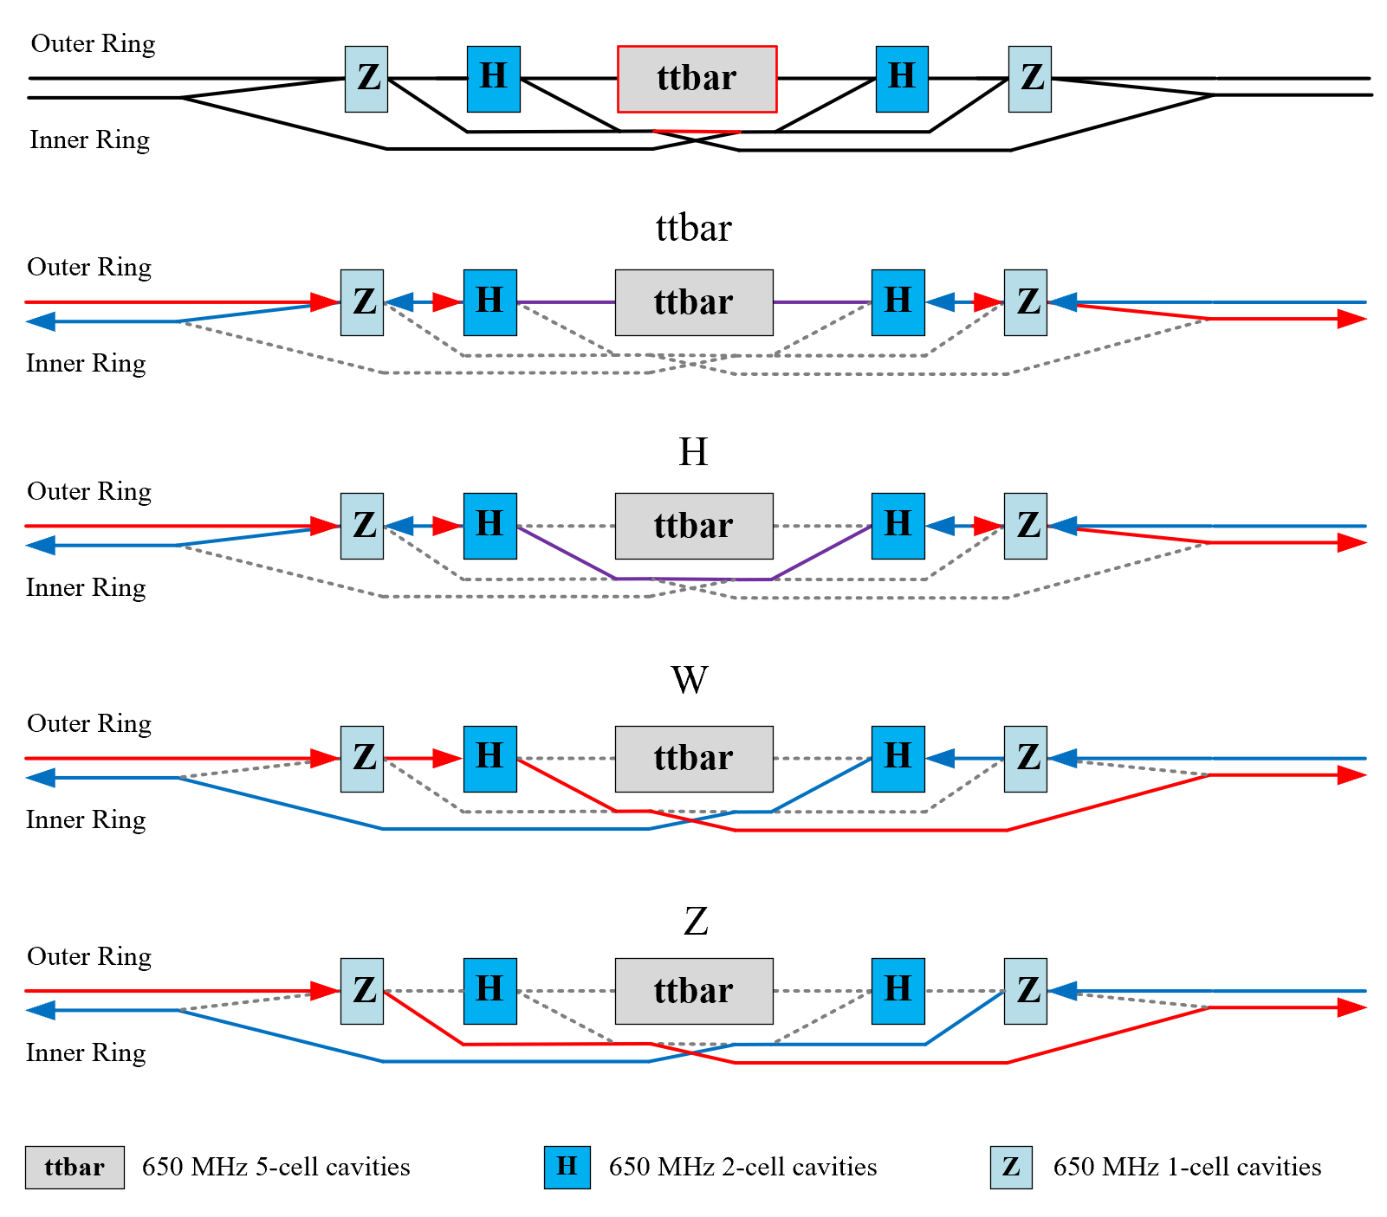
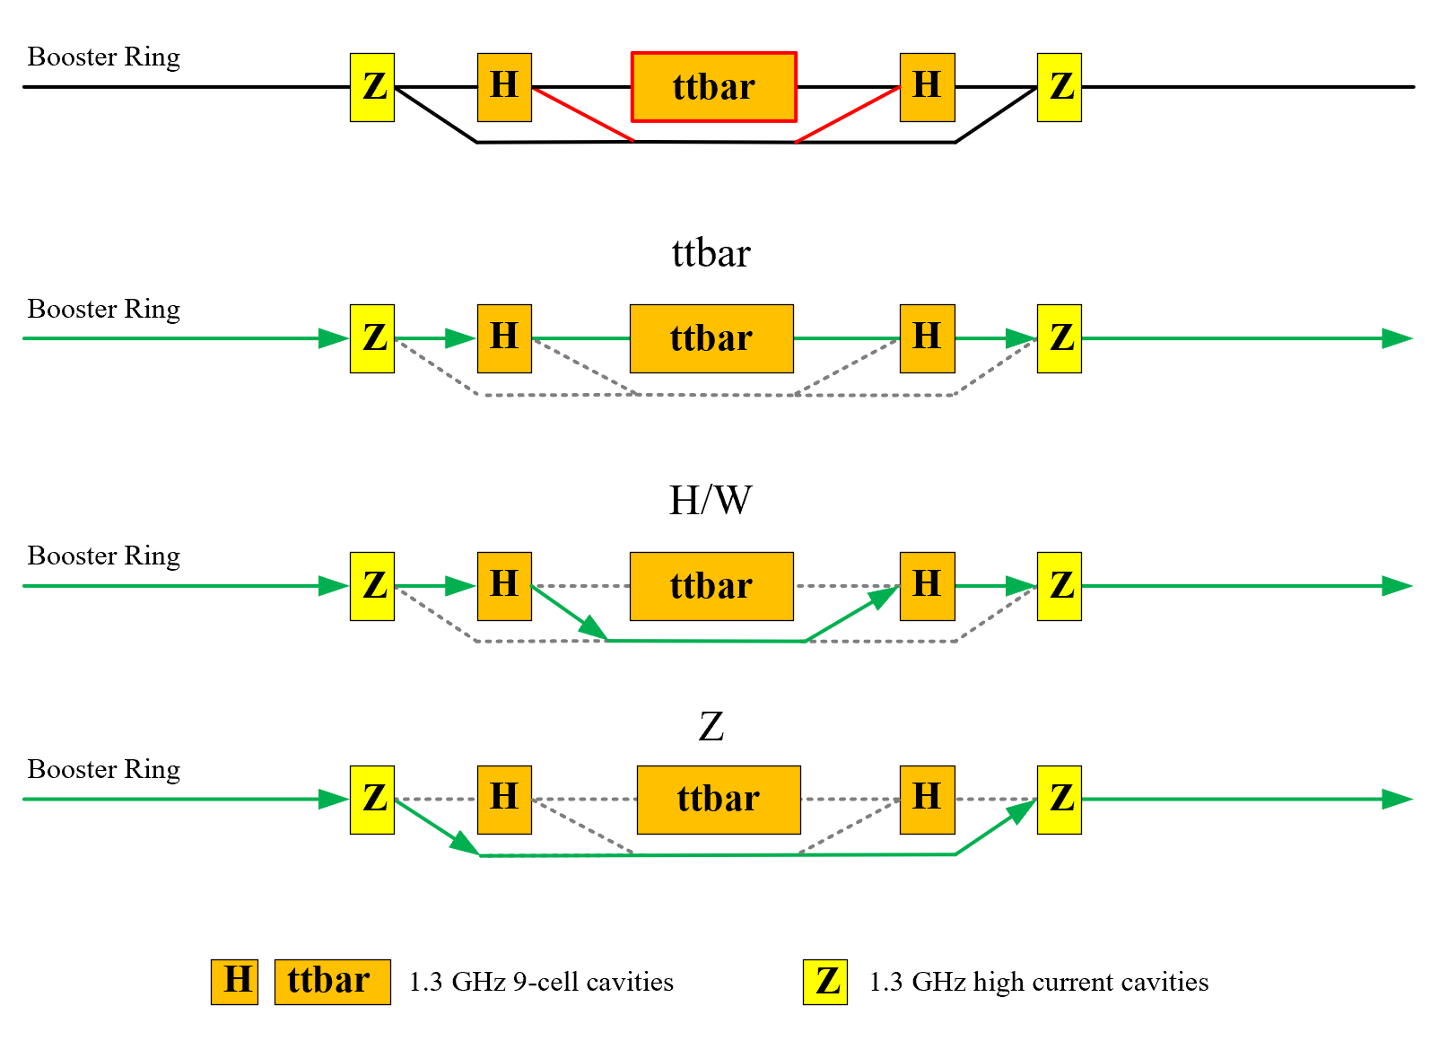
RF Bypass Scheme
Stage 3: 30/50 MW ttbar/H/W/Z

Slide 16
Content
SRF system overview and layout
Collider SRF system design
Booster SRF system design
Power and energy upgrade plan
Summary

Slide 17
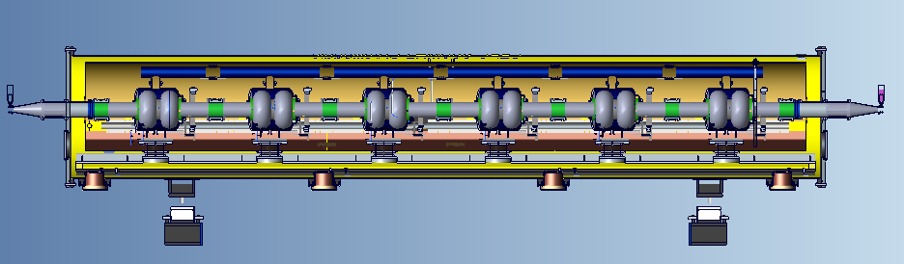
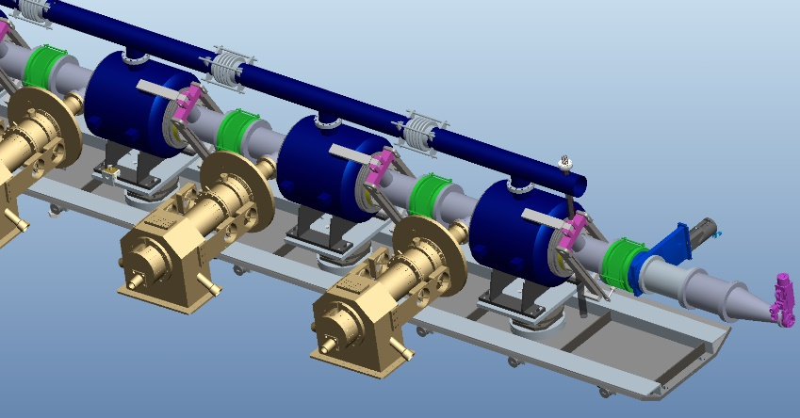
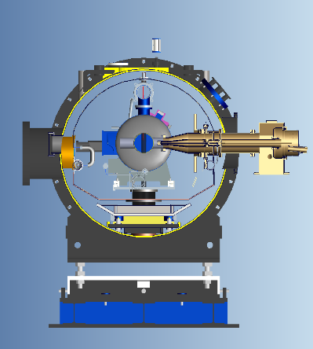
Collider 650 MHz SRF System Design
The collider Higgs mode will require 30 MW SR power per beam and will use a 650 MHz RF system with 192 2-cell cavities.
Each of the 11 m-long collider cryomodules will contain six 650 MHz 2-cell cavities.
Each cavity will have two detachable coaxial HOM couplers mounted on the cavity beam pipe with a HOM power handling capacity of 1 kW. Additionally, each cryomodule will have two beamline HOM absorbers at room temperature outside the vacuum vessel with a HOM power handling capacity of 5 kW each.

Slide 18
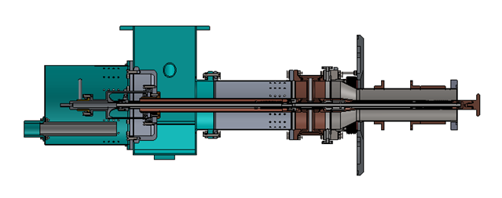
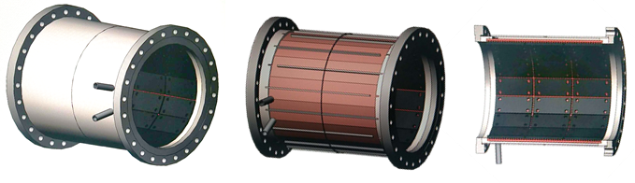
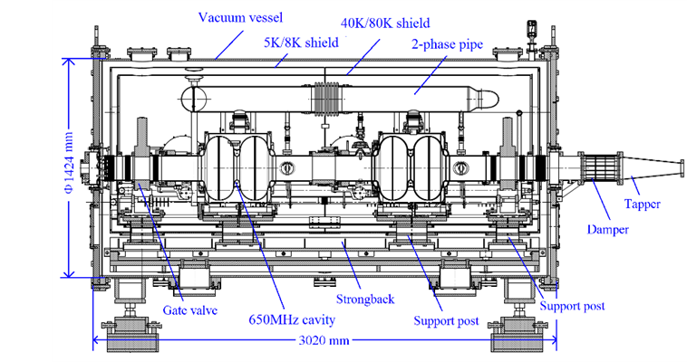
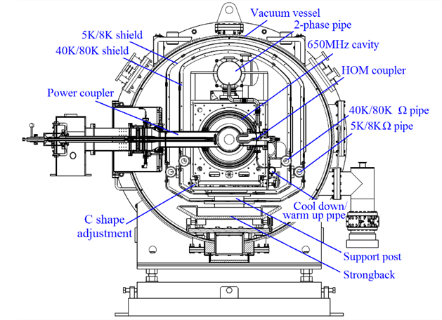
Collider 650 MHz SRF System Design
Design of the prototype 650 MHz test cryomodule with two 2-cell cavities.

Slide 19
Z-pole Operation with Higgs 2-cell Cavities
The HOM power limit per cavity and the fast-growing coupled-bunch instabilities (CBI) driven by both fundamental modes (FM) and higher-order modes (HOM) impedance of the RF cavities will determine to a large extent the highest beam current and luminosity obtainable in the Z mode.
Using Higgs 2-cell cavities, Z mode can only operate at low luminosity and low power (up to about 10 MW SR power per beam).
The low luminosity Z mode will use 48 cavities per ring and park the other 48 cavities in the ring.
However, the beam will go through all the 96 cavities and interact with the cavity impedance. Therefore, the parking cavities will be kept at 2 K to extract the HOM power.
They will be symmetrically detuned to cancel FM impedance and adjust the variable input coupler to high loaded Q with a narrow bandwidth to avoid FM CBI.

Slide 20
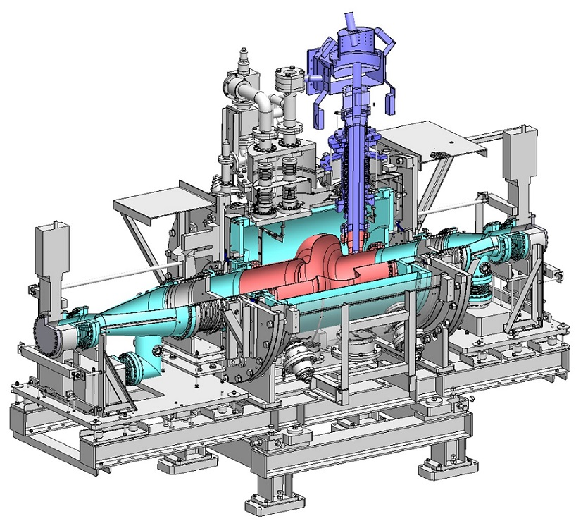
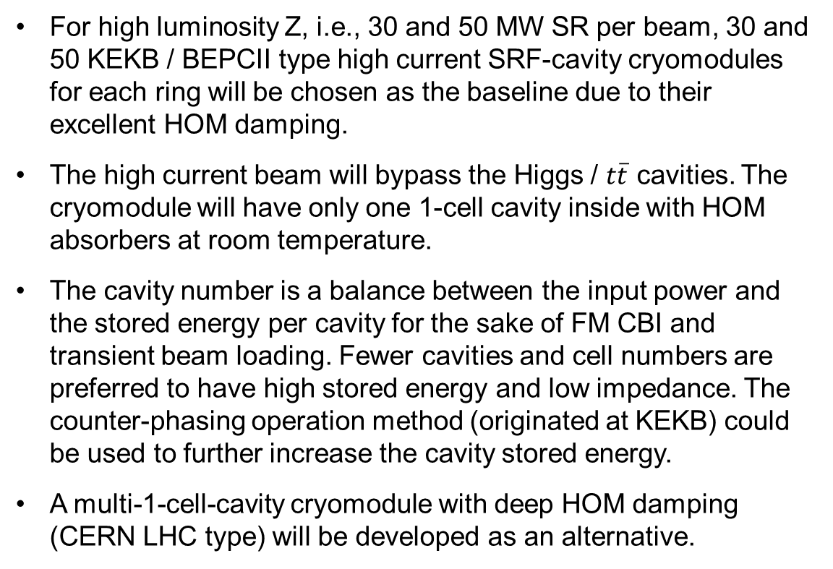
High Current 650 MHz Cavity for HL-Z mode
For high luminosity Z, i.e., 30 and 50 MW SR per beam, 30 and 50 KEKB / BEPCII type high current SRF-cavity cryomodules for each ring will be chosen as the baseline due to their excellent HOM damping.
The high current beam will bypass the Higgs / $t\overline{t}$ cavities. The cryomodule will have only one 1-cell cavity inside with HOM absorbers at room temperature.
The cavity number is a balance between the input power and the stored energy per cavity for the sake of FM CBI and transient beam loading. Fewer cavities and cell numbers are preferred to have high stored energy and low impedance. The counter-phasing operation method (originated at KEKB) could be used to further increase the cavity stored energy.
A multi-1-cell-cavity cryomodule with deep HOM damping (CERN LHC type) will be developed as an alternative.

Slide 21
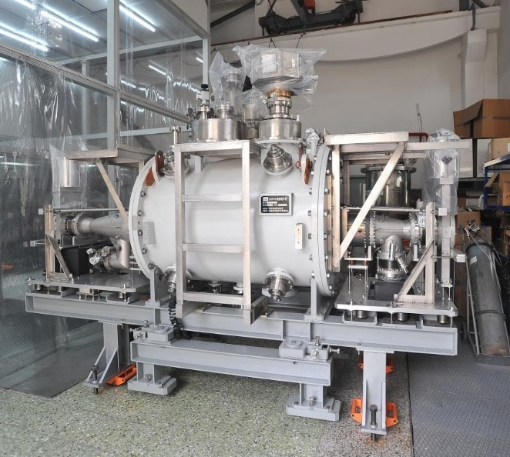
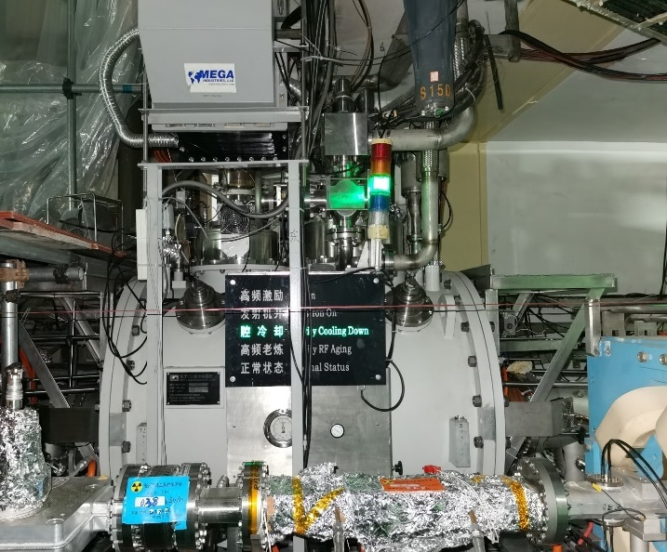
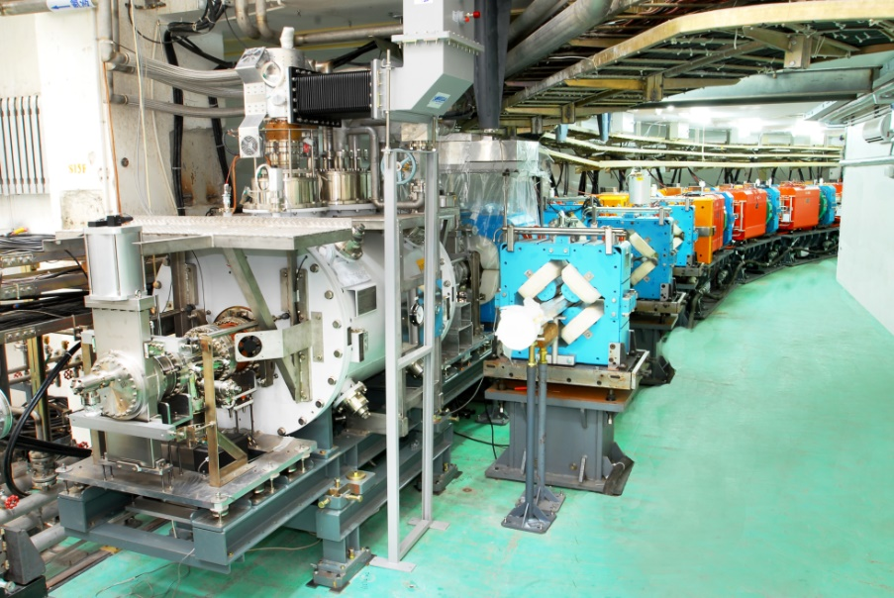
High Current 650 MHz Cavity for HL-Z mode
Based on the successful construction and stable operation of BEPCII 500 MHz cavity system. Small batch production for HEPS and BEPCII-U (~ 5).
Higher gradient (x3, 18 MV/m) and Q (x20, 2E10), 2 K operation
Higher input power (x10, 1 MW per cavity, two couplers and two 600 kW klystrons as alternative).
Deep HOM damping.

Slide 22
Beam Cavity Interaction
CEPC large ring features:
  Large circumference and small revolution frequency (3 kHz, dense beam spectrum)
  W and Z low energy and small radiation damping
  Low injection energy of Booster
Beam cavity interaction issues:
  Transient beam loading of beam gaps for beam abort, ion-clearing or in bunch trains
  Fundamental mode (FM) induced coupled bunch instabilities (CBI), due to large cavity detuning (low RF voltage and high current) and the parked cavities
  Higher-order-modes (HOM) induced coupled bunch instabilities
Less cavities and cells are preferred to have high stored energy and low impedance.

Slide 23

Transient Beam Loading
Transient beam loading is a major concern in large rings with uneven fill patterns. Result in bunch phase shift, smaller energy acceptance, possible lifetime and luminosity degradation.
In CEPC Z mode, even a 1% beam gap to mitigate ion-trapping and fast beam ion
instability (FBII) can create a significant bunch phase shift.
To minimize these effects, the fill pattern should consist of many small gaps and short bunch trains, rather than one long gap.
$$Δθ_{g}≈\frac{−2kI_{0}T_{g}}{V_{c0}\sin{φ_{0}}}$$
 | H | W | Z
Beam gap in number of buckets | 3091 | 550 | 24832
Beam gap length [us] | 4.76 | 0.85 | 38.20
Max relative voltage drop | 0.5% | 0.7% | 460%
Max bunch train phase shift [deg] | 0.5 | 0.6 | /
48 trains of 250 bunches located symmetrically in the ring. Bunch spacing is 24.6 ns (16 RF buckets), gaps are 820 ns (533 buckets).

Slide 24
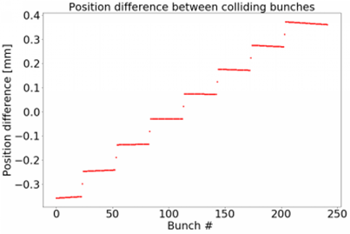
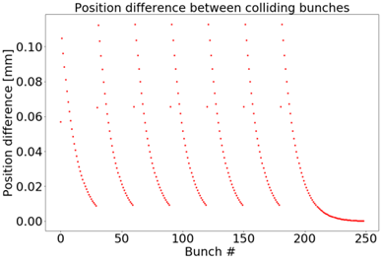
Transient Beam Loading
In the on-axis injection process of the Higgs mode, transient beam loading can cause a significant asymmetric phase shift between the colliding bunches in the two beams, negatively impacting the luminosity of the machine.
However, by carefully choosing the bunches to extract, it is possible to mitigate the phase mismatching and recover a major portion of the integrated luminosity.
With the help of a strong direct feedback loop, it is possible to further reduce the mismatching without putting too much stress on the generator.

Slide 25
Cavity Fundamental Mode Instability
The detune of the cavities in CEPC's W and Z modes is significant due to the low cavity voltage and relatively high beam loading compared to the revolution frequency in the collider ring.
This, combined with a low matched quality factor Q_{L}, can result in more than 10 unstable coupled-bunch modes in some operation modes.
To reduce the growth rate of these dangerous modes to a manageable level (100 ms) for the longitudinal bunch-by-bunch feedback system to work, we require a direct feedback loop and one-turn-delay feedback with a comb filter to reduce the effective impedance seen by the beam. A loop delay of around 300 ns is assumed, which is reasonable for a state-of-the-art system.
D. Gong, J. Gao, J. Zhai, Dou Wang. Cavity fundamental mode and beam interaction in CEPC main ring. Radiation Detection Technology and Methods, 2 (2018) 17
H. Zhu, T. Xin, J. Zhai, J. Dai. Suppression of longitudinal coupled-bunch instabilities with RF feedback systems in CEPC main ring. Radiation Detection Technology and Methods, (2023)

Slide 26
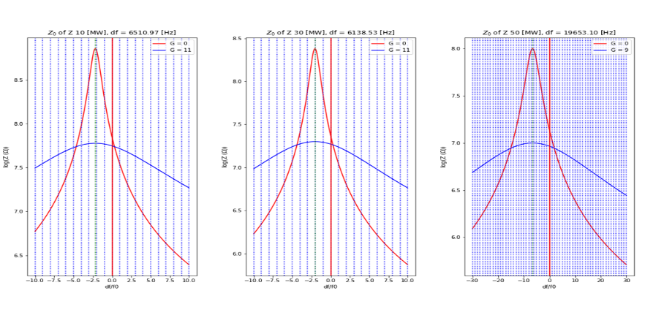
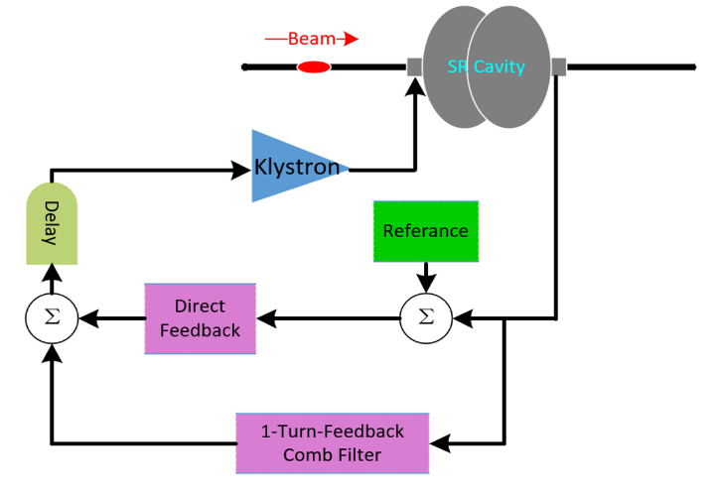
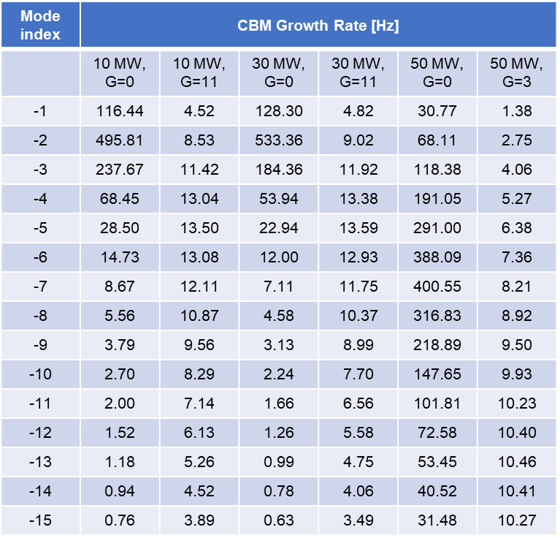
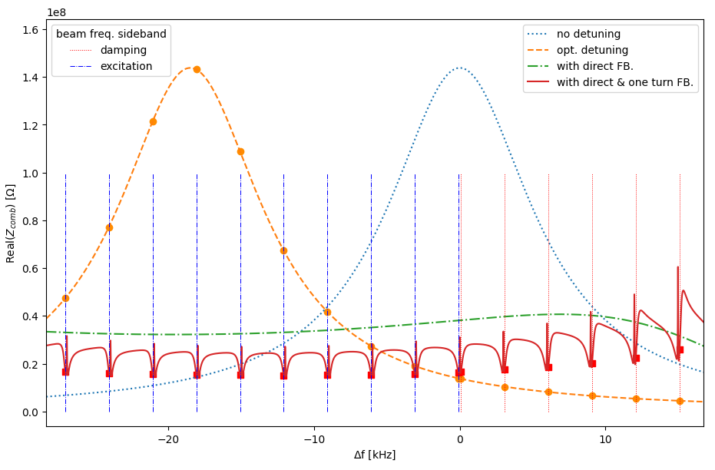
RF and Beam Feedback for Fundamental Mode CBI
Z 10/30/50 MW, damping rate 2.45 Hz.
Bunch by bunch feedback time 10 Hz.
With the help of direct feedback loop, it is possible to reduce the growth rate of the dangerous coupled bunch modes in all cases to the levels which are manageable by the bunch by bunch feedback system.
To reduce FM impedance of parking 2-cell cavities of 10 MW Z, will try narrow BW (up to Qe 7E6) and symmetric detune methods.

Slide 27
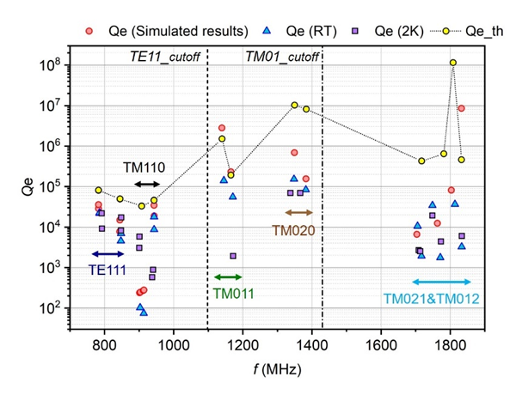
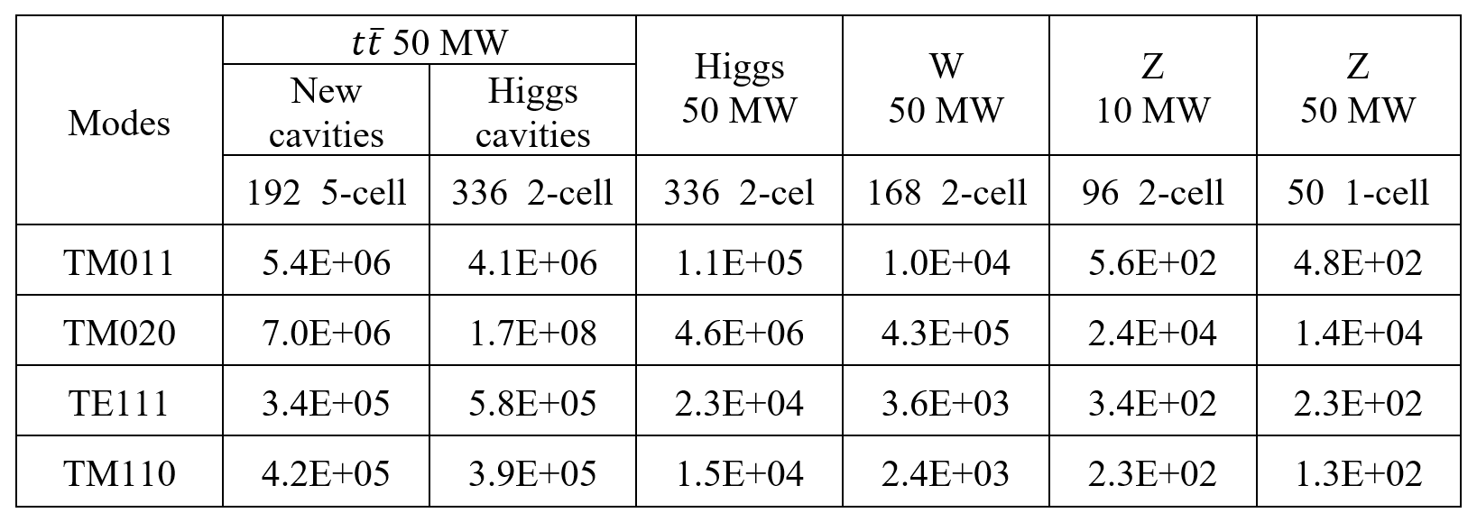
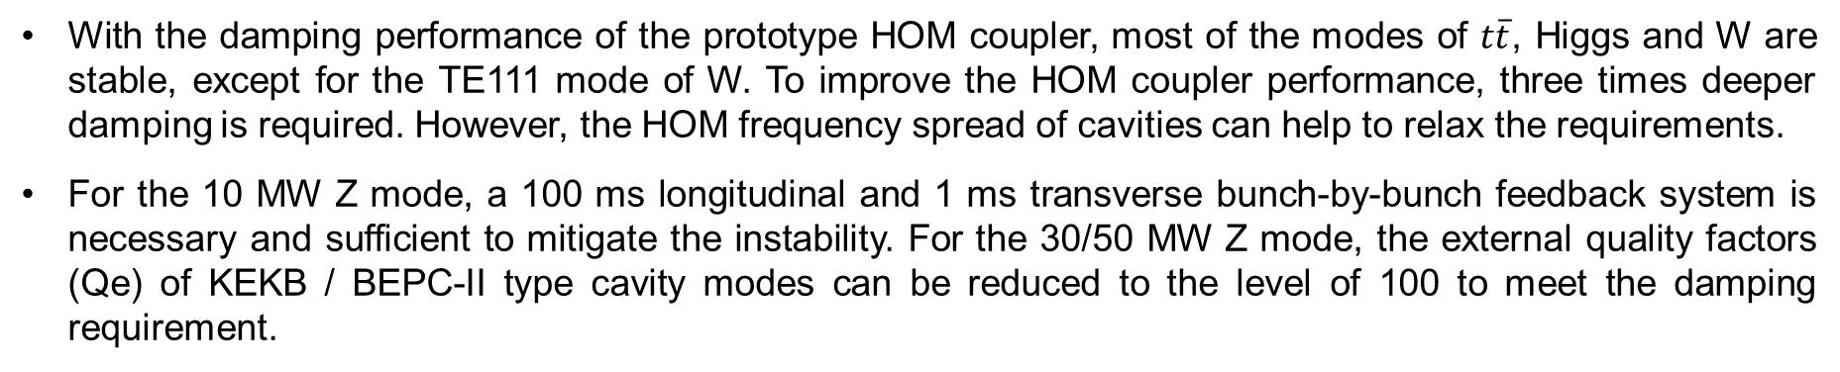
Cavity HOM CBI and Damping
With the damping performance of the prototype HOM coupler, most of the modes of $t\overline{t}$, Higgs and W are stable, except for the TE111 mode of W. To improve the HOM coupler performance, three times deeper damping is required. However, the HOM frequency spread of cavities can help to relax the requirements.
For the 10 MW Z mode, a 100 ms longitudinal and 1 ms transverse bunch-by-bunch feedback system is necessary and sufficient to mitigate the instability. For the 30/50 MW Z mode, the external quality factors (Qe) of KEKB / BEPC-II type cavity modes can be reduced to the level of 100 to meet the damping requirement.
Damping Qe requirements of prominent HOMs of the Collider cavity

Slide 28
Content
SRF system overview and layout
Collider SRF system design
Booster SRF system design
Power and energy upgrade plan
Summary

Slide 29
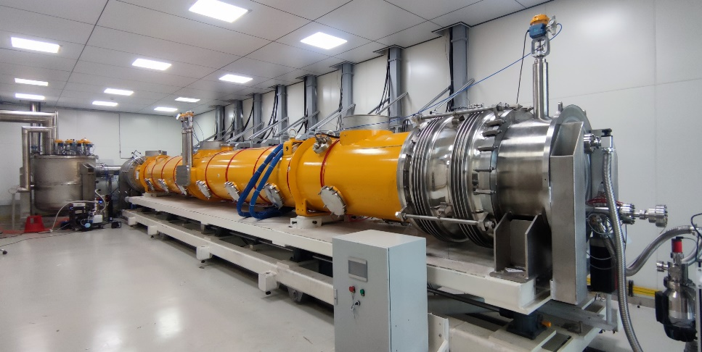
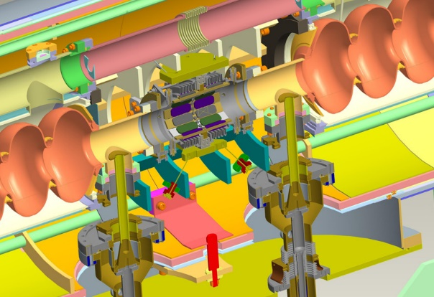
Booster RF Cavity and Cryomodule
TESLA/TTF/Euro-XFEL/ILC/LCLS-II/SHINE/S3FEL type 1.3 GHz cryomodule will be used for the Booster. Each of the 12-meter-long cryomodules contains eight 1.3 GHz 9-cell cavities, with each cavity having two welded HOM couplers on the cavity beam pipe. No superconducting magnet in the module.
For the distinct advantages of mid-T baking over N-doping, IHEP made the world's first mid-T high Q 1.3 GHz 8x9-cell cryomodule and demonstrated excellent performance.
Due to the high beam current and high HOM power per cavity in the high luminosity Z mode (up to 30 mA for injection into the empty Collider ring), an ERL-type 1.3 GHz cryomodule with a HOM absorber at 100 K between cavities will be used instead of the low current TESLA cavities for Higgs, W and tt̄ mode. To reduce the impedance, the Z-mode beams will only go through Z-cavities and bypass the Higgs and tt̄ cavities.

Slide 30
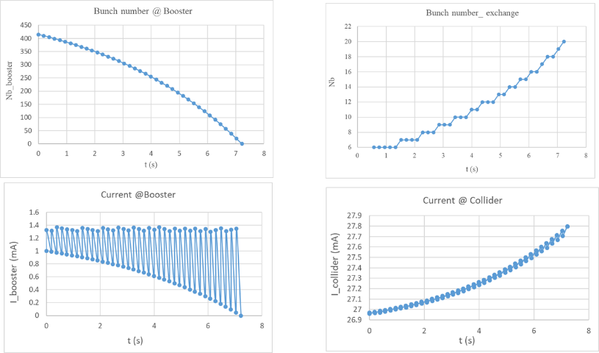
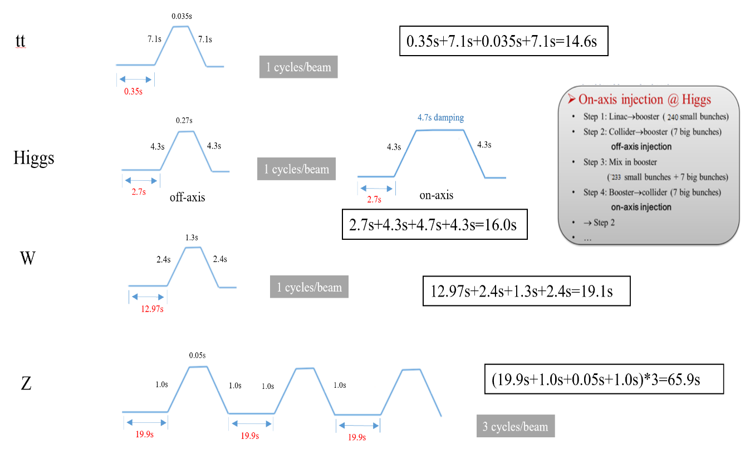
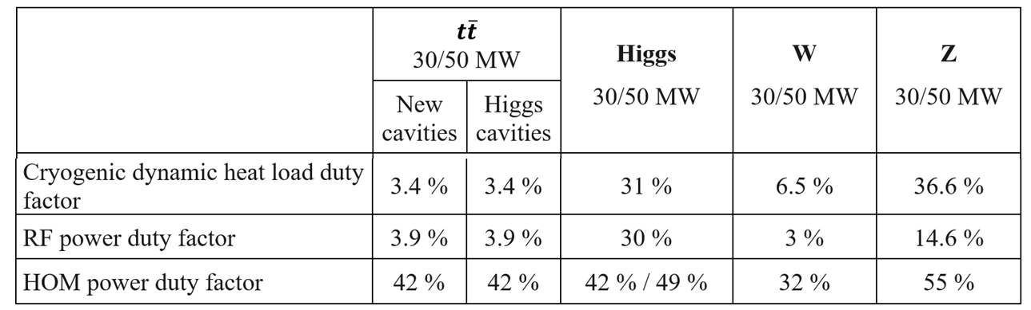
Booster Ramp and Duty Factors
Booster cavities operate in fast ramp mode, and the beam energy increases almost linearly with time. The total RF voltage must be increased during the energy ramp to keep the synchrotron tune constant.
Cryogenic, RF power and HOM power duty factor change with the cavity voltage, Q0, ramp time, circulating and swapping bunch charge, bunch length, beam current, etc. Big impact on Higgs on-axis injection.

Slide 31
Booster HOM CBI and Damping
Collider 10/50 MW SR power per beam. Higgs/ttbar shared cavities for the two rings. W/Z separate cavities. Z 50 MW cavities bypass. Average beta x/y in RF 30 m. | 50 MW SR power per beam for each mode. Higgs/ttbar shared cavities for the two rings. W/Z separate cavities. HL-Z cavities bypass. | Measured HOM Qe of TESLA cavity | ttbar 50 MW |  | Higgs 50 MW | W 50 MW | Z 50 MW |  | Z 50 MW Required Qe w/o FB
 |  |  | New cavities | Higgs cavities
Online 1.3 GHz 9-cell cavities |  |  | 256 | 96 | 96 | 96 | 96 | 32 | 32
Extraction Required feedback time ms. (τ_{s} = 7/24/81/446 ms) | TM011 | 5.9E+04 | - | - | - | - | 76.2 | 228.5 | 8.8E+03
 | TE111 | 3.4E+03 | - | - | - | - | 166.4 | 499.2 | 5.5E+02
 | TM110 | 5.0E+04 | - | - | - | 61 | 21.1 | 63.4 | 1.0E+03
Injection Required feedback time ms. (τ_{s} = 1.5 s) | TM011 | 5.9E+04 | 994.8 |  | 333.8 | 82.1 | 14.5 | 43.5 | 1.7E+03
 | TE111 | 3.4E+03 | 1370 |  | 681.7 | 180.1 | 31.8 | 95.4 | 1.1E+02
 | TM110 | 5.0E+04 | 174 |  | 86.6 | 22.9 | 4.0 | 12.1 | 2.0E+02
Due to the 30 GeV low energy injection to the Booster, all the higher order modes' coupled bunch instability growth time is much shorter than the radiation damping time during injection and while the Booster is in the low energy region.
With the assumed bunch-by-bunch transverse feedback time of 10 ms and longitudinal feedback time of 200 ms, almost all modes are safe with enough margin for Higgs, W, and tt̄ injection.
The HOM absorbers between cavities in the Z-mode high current 1.3 GHz cryomodule will have deeper HOM damping to suppress CBI. Including the HOM frequency spreads among the cavities will provide more margin. Usually more than one to two orders of magnitude. TM011 and TM110 HOM frequency spread of cavities will relax the requirements by 20 times assuming 1 MHz spread. The real spread is more than 5 MHz of the XFEL cavity mass production.

Slide 32
Content
SRF system overview and layout
Collider SRF system design
Booster SRF system design
Power and energy upgrade plan
Summary

Slide 33
CEPC Power and Energy Upgrade Plan
 | Baseline |  |  | Power Upgrade |  |  | Energy Upgrade
 | Higgs | W | Z | Higgs | W | Z | tt̄
Collider SR power / beam [MW] | 30 |  |  | 50 |  |  | 30 |  | 50
Beam energy [GeV] | 120 | 80 | 45.5 | 120 | 80 | 45.5 | 180
Luminosity / IP [10³⁴ cm⁻²s⁻¹] | 5 | 16 | 115 | 8.3 | 26.7 | 192 | 0.5 |  | 0.8
Collider 650 MHz cavities | 2-cell |  | 1-cell | 2-cell |  | 1-cell | Add 5-cell | Existing 2-cell | Add 5-cell | Existing 2-cell
RF voltage [GV] | 2.2 | 0.7 | 0.12 | 2.2 | 0.7 | 0.1 | 10 (6.1 + 3.9) |  | 10 (6.1 + 3.9)
Beam current / ring [mA] | 16.7 | 84 | 801 | 27.8 | 140 | 1345 | 3.4 |  | 5.6
Cavity number | 192 | 96×2 | 30×2 | 336 | 168×2 | 50×2 | 192 | 336 | 192 | 336
Cryomodule number | 32 | 32 | 60 | 56 | 56 | 100 | 48 | 56 | 48 | 56
Klystron number | 96 | 96 | 60 | 168 | 168 | 100 | 48 | 168 | 96 | 168
Klystron power [kW] | 800 | 800 | 1200 | 800 | 800 | 1200 | 800 | 800 | 800 | 800
Collider 4.5 K equiv. heat load [kW] | 44.4 | 28.1 | 15.2 | 41.9 | 20 | 20.1 | 128.3 |  | 128.3
Booster 1.3 GHz cavities | 9-cell |  |  |  |  |  | Add 9-cell | Existing 9-cell | Add 9-cell | Existing 9-cell
Extraction RF voltage [GV] | 2.17 | 0.87 | 0.46 | 2.17 | 0.87 | 0.46 | 9.7 (7.53 + 2.17) |  | 9.7 (7.53 + 2.17)
Beam current [mA] | 1 | 3.1 | 16 | 1.4 | 5.3 | 30 | 0.12 |  | 0.19
Cavity number | 96 | 96 | 32 | 96 | 96 | 32 | 256 | 96 | 256 | 96
Cryomodule number | 12 | 12 | 4 | 12 | 12 | 4 | 32 | 12 | 32 | 12
SSA number | 96 | 96 | 32 | 96 | 96 | 32 | 256 | 96 | 256 | 96
SSA power [kW] | 25 | 25 | 25 | 30 | 30 | 40 | 10 | 10 | 10 | 10
Booster 4.5 K equiv. heat load [kW] | 7.8 | 3.1 | 3.5 | 8.1 | 3.2 | 3.7 | 11.4 |  | 11.4
Total RF length [m] | 704 | 704 | 384 | 1088 | 1088 | 608 | 2368 |  | 2368
Total 4.5 K equiv. heat load [kW] | 52.2 | 31.2 | 18.7 | 50.0 | 23.2 | 23.8 | 139.7 |  | 139.7

Slide 34
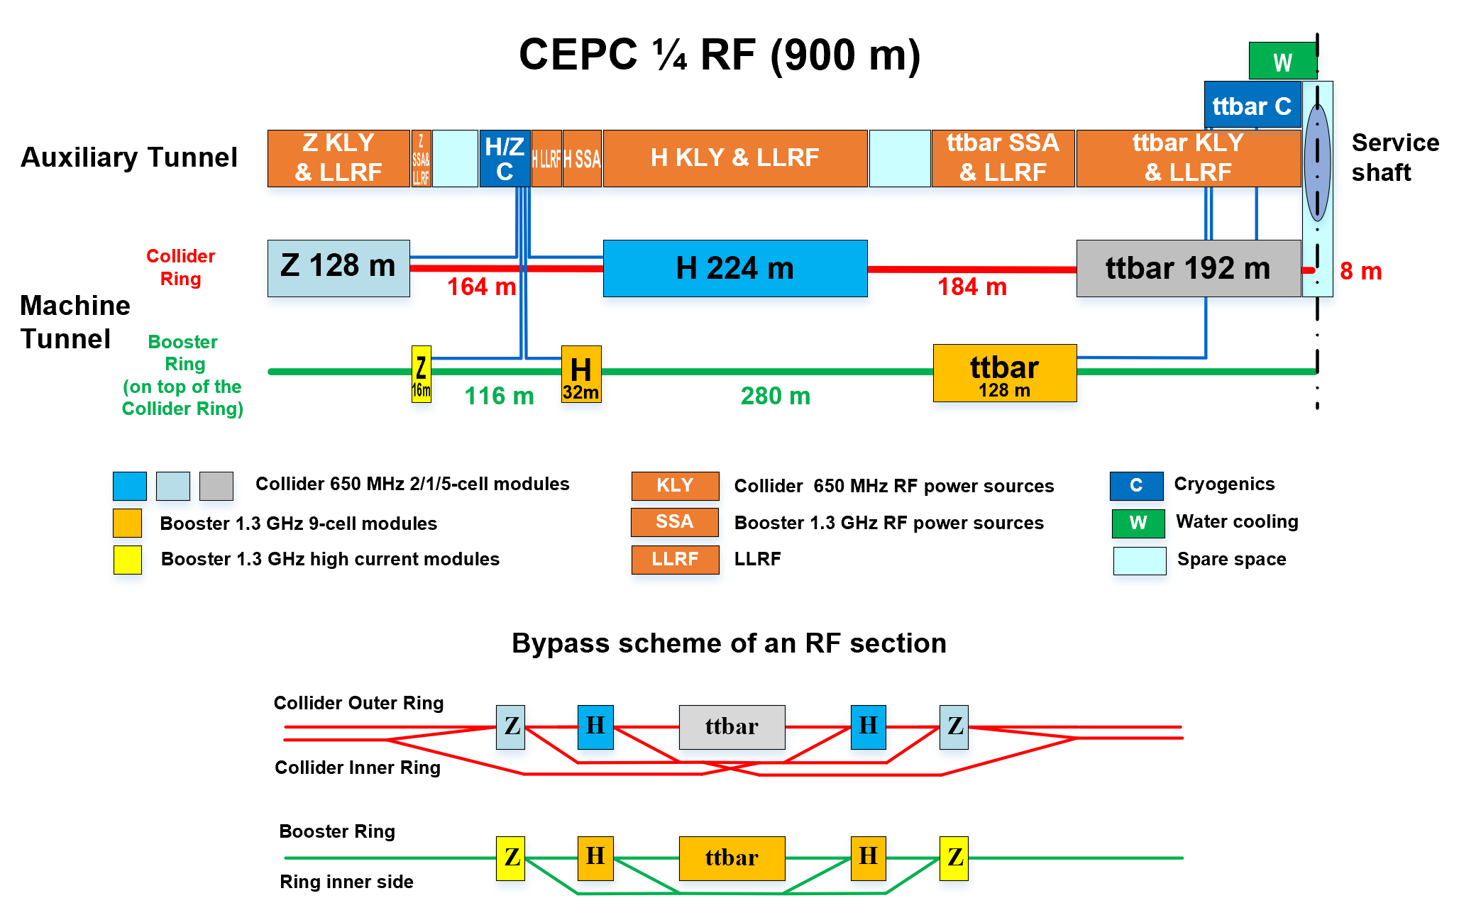
CEPC Power and Energy Upgrade Plan

Slide 35
Power Upgrade
To upgrade to the Higgs 50 MW SR power per beam, the input coupler power per cavity will be kept at a 300 kW level and additional 144 2-cell cavities will be added, resulting in a total of 336 2-cell cavities for 50 MW Higgs operation.
During W 30 MW and 50 MW modes, only half of the Higgs cavities per ring will be utilized, and Higgs 2-cell cavities are generally compatible with W mode operation.
The klystron output power will be kept at 800 kW level and 72 more 800 kW klystrons will be added, thus 168 650 MHz 800 kW klystrons in total are needed for 50 MW Higgs operation.
For high luminosity Z (50 MW), 20 KEKB / BEPCII type high current SRF-cavity modules and 1.2 MW klystron will be added for each ring. The high current beam will bypass Higgs/tt̄ cavities.
The booster cavity number will not change for the collider power upgrade, only the input power per cavity will increase by adding the output RF power of the solid state amplifiers (SSA).

Slide 36
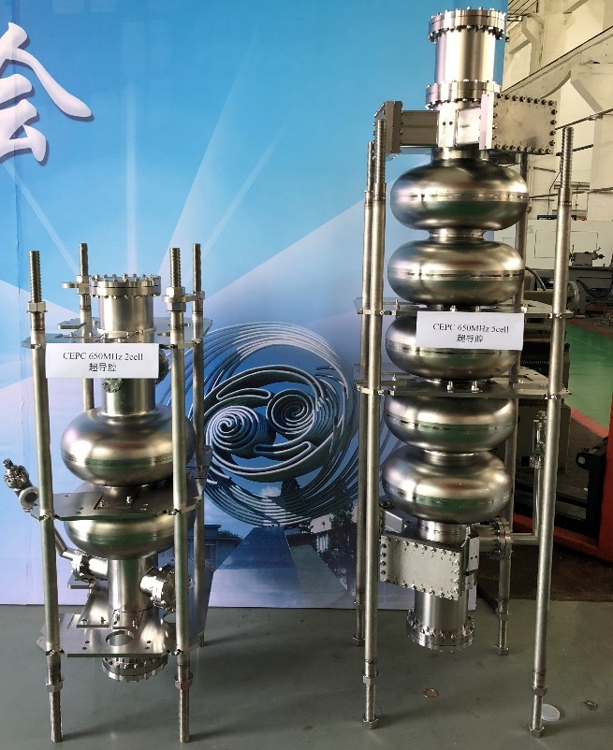
Energy Upgrade
tt̄ 30 MW mode, 240 5-cell 650 MHz cavities and 48 sets of 800 kW klystrons will be added in addition to the 336 Higgs 2-cell cavities, increasing the RF voltage from 2.2 GV to 10 GV.
Each cryomodule will contain four 5-cell cavities with HOM couplers on the beam pipe.
For tt̄ 50 MW, klystron numbers doubled to increase the input power. 256 high-gradient 9-cell cavities each with a 10 kW SSA will be added to raise the booster RF voltage from 2.17 GV to 9.7 GV.
tt̄ needs a cryogenic plant capacity of 140 kW at 4.5 K. Eight 15 kW cryogenic plants will be added for tt̄ in addition to the four 15 kW cryogenic plants for Higgs, W and Z. A large cavern beside the service shaft of the RF region is reserved for the installation of the new cryogenic plants.

Slide 37
Summary
CEPC TDR SRF system layout and parameters are designed to meet physics run requirement (Higgs first, upgradable, low cost for first-stage, mode-switching).
RF system design optimized for Higgs 30/50 MW. Power (luminosity) and energy upgrade by adding cavities, RF power sources and cryogenic plants.
To maximize Z luminosity, we use dedicated high current 1-cell cavity for 10-50 MW Z to solve the HOM power, FM & HOM CBI problems. Bypass scheme designed for both the collider and booster.
CEPC 650 MHz and 1.3 GHz SRF technology R&D in Sha Peng’s talk. RF power sources and LLRF systems in Zhou Zusheng’s talk.

Slide 38

Thank you !

Slide 39
SRF System Risks and other Issues
Input coupler:
Matching and coupling adjusting range: key issue of a green accelerator, same as klystron efficiency.
Most critical RF part: high power, low heat load, high reliability, long lifetime. If fails, input power reduction, cavity number and cost increases, extra RF power, cavity contamination, RF trips...
RF voltage operation margin, standby cavities and power sources
Q0 degradation
Multi-cavity high current cryomodule, HOM coupler and mode propagation
RF power transfer from H to Z to have less klystrons?
New material (thin film e.g. Nb3Sn) for ttbar
Add 1.3 GHz 9-cell cavities for ttbar collider ring? Double-frequency operation
Power overhead for Z LLRF control
Control of multi-cavity fed by one klystron

