Slide 1



CEPC collective instabilities in collider ring, booster and damping ring
Contributors:
Yuan Zhang, Yudong Liu, Haisheng Xu, Saike Tian, Yuting Wang, Sen Yue, Jintao Li (IHEP)
Chuntao Lin (IASF)
Na Wang
12-16. June. 2023, Hongkong, CEPC Accelerator TDR International Review

Slide 2
Introduction
This talk is about impedance and collective effects evaluations in the accelerator physics design.
This talk relates to the TDR chapters:
  Ch 4.2.3 Beam Instability and Beam Lifetime
  Ch 5.2.2 Beam Instability
  Ch 6.2.2.4 Impedance and Beam Instability
The content relates to the “charge letter” item:
  2. Are the accelerator physics issues adequately addressed?

Slide 3
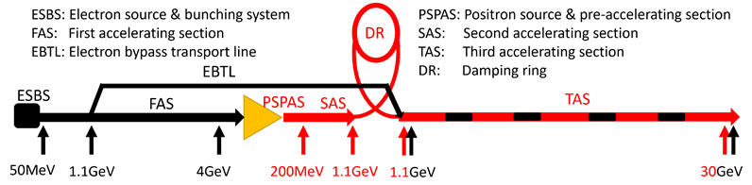
Accelerator Complex
Booster
Circ: 100km
E_{k}: 30 → 180GeV
I₀: 10.5 → 0.1mA
N_{p}: 4.9 → 127×10⁹
Collider rings
Circ: 100km
E_{k}: 45.5 → 180GeV
I₀: 804→ 3.3mA
N_{p}: 13 → 20×10¹⁰
Damping ring
Circ: 147m
E_{k}: 1.1GeV
I₀: 12.4 mA
N_{p}: 0.95×10¹⁰
Motivations:
Beam stable reach the design bunch population and beam current.
Beam quality degradation acceptable for the design luminosity.
Avoid hardware damage due to parasitic heat loss from the beam.

Slide 4
Content
Collider Ring
  Impedance modeling
    Resistive wall, geometrical impedance
  Collective instabilities
    Bunch lengthening, MWI, TMCI, Coupled bunch instabilities, Beam ion, Electron cloud
Booster Ring
  Impedance modeling
    Resistive wall, geometrical impedance
  Collective instabilities
    Single/Coupled bunch instabilities, CSR
Damping Ring
  Impedance modeling
    Resistive wall, geometrical impedance
  Single bunch instabilities

Slide 5
Content
Collider Ring
  Impedance modeling
    Resistive wall, geometrical impedance
  Collective instabilities
    Bunch lengthening, MWI, TMCI, Coupled bunch instabilities, Beam ion, Electron cloud
Booster Ring
  Impedance modeling
    Resistive wall, geometrical impedance
  Collective instabilities
    Single/Coupled bunch instabilities, CSR
Damping Ring
  Impedance modeling
    Resistive wall, geometrical impedance
  Single bunch instabilities

Slide 6
Main beam parameters (30MW)
Parameter [unit] | Higgs | Z | W | tt
Beam energy E_{k} [GeV] | 120 | 45.5 | 80 | 180
L_{max}/IP (10³⁴cm⁻²s⁻¹) | 5 | 115 | 16 | 0.5
Emittance (H/V) [nm/pm] | 0.64/1.3 | 0.27/1.4 | 0.87/1.7 | 1.4/4.7
Beam current [mA] | 16.7 | 803.5 | 84.1 | 3.3
Bunch number | 268 | 11934 | 1297 | 35
Bunch Population [10¹⁰] | 13 | 14 | 13.5 | 20
Momentum compaction α_{p} [10⁻⁵] | 0.71 | 1.43 | 1.43 | 0.71
Bunch length σ_{z} (natural/total) [mm] | 2.3/4.1 | 2.5/8.7 | 2.5/4.9 | 2.2/2.9
Energy spread (natural/total) [10⁻⁴] | 10/17 | 4/13 | 7/14 | 15/20
Betatron tune ν_{x}/ν_{y} | 445.10/445.22 | 317.10/317.22 | 317.10/317.22 | 445.10/445.22
Synchrotron tune | 0.049 | 0.035 | 0.062 | 0.078
Radiation damping [ms] | 44/44/22 | 816/816/408 | 150/150/75 | 14/14/7
Design queries
Small α_{p}
Short natural σ_{z}
Slow damping at low E_{k}

Slide 7
Impedance modeling
Impedance modeling of the key vacuum components has been performed since the beginning of the project.
Resistive wall impedance
  Generated from finite conductivity of the vacuum chambers
  Calculated with theoretical formulas considering the NEG coating
Geometrical impedance
  Generated by the discontinuity of the vacuum chambers
  Calculated individually with 2D/3D simulation codes

Slide 8
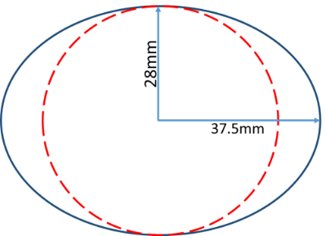
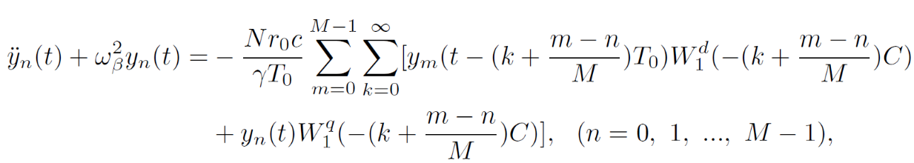
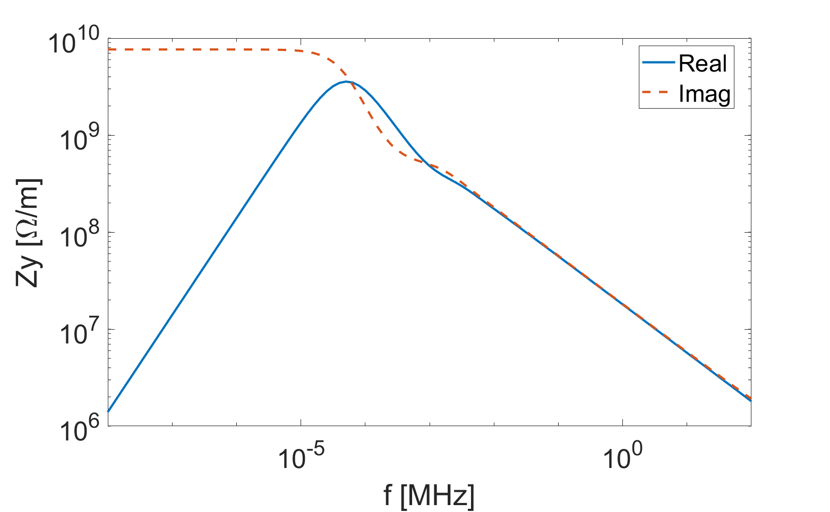
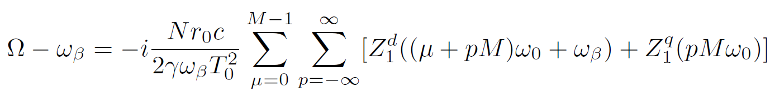
Impedance updates since release of CDR
Impedance model is updated regarding the change of the chamber cross section
elliptical → circular
Multilayer elliptical RW impedance model is derived to study influence of NEG coating [Y.T. Wang, NIM-A 1037, 166928 (2022)]
Incoherent tune shift due to the quadrupolar impedance is derived from beam oscillation equations [Y.T. Wang, NIM-A 1029, 166414 (2022)]
Incoherent tune shift ~0.2 @Z
0.1Hz
[ν_{y}]⋅f_{rev}
DC value of the quadrupolar impedance dominates

Slide 9
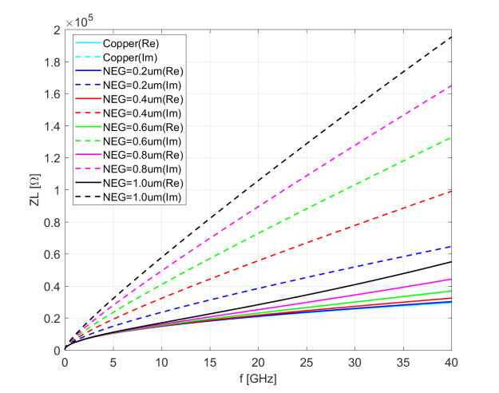
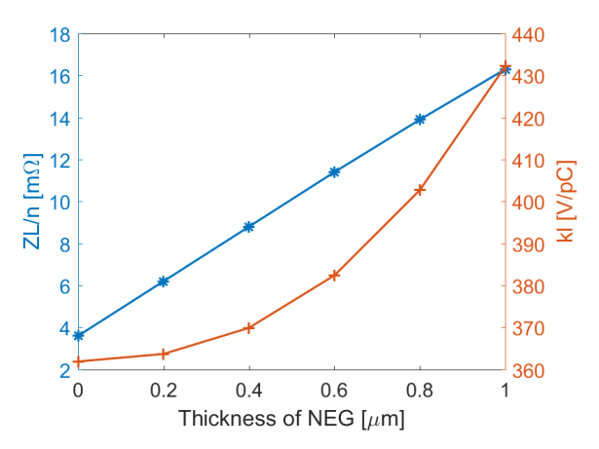
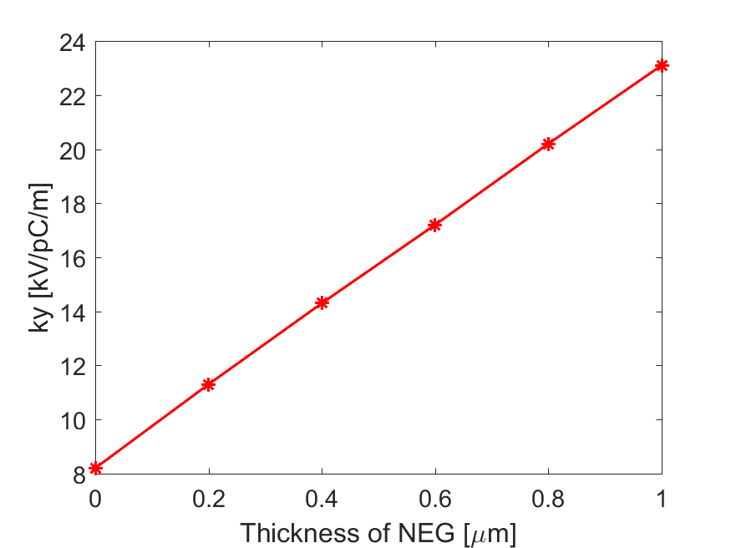
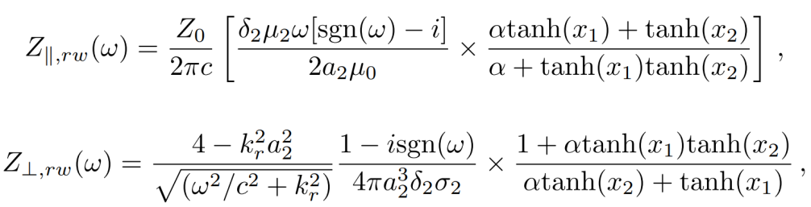
Resistive wall impedance
Typical vacuum chamber: Cylindrical copper beam pipe with radius of 28mm and NEG (Non-Evaporable Getter) coating on its inner surface.
Multi-layer analytical formula is used [N. Wang, PRST-AB 10, 111003 (2007)].
Multilayer formula from field matching:
Simplified formulas are derived for coated metallic chamber:
NEG coating thickness of 0.2 μm has been chosen to control their impedance contributions.

Slide 10
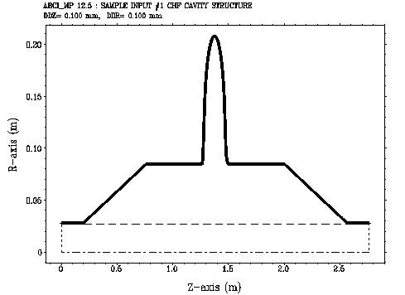
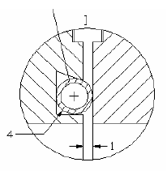
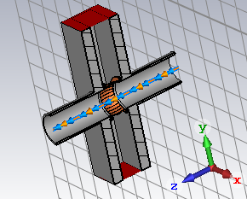
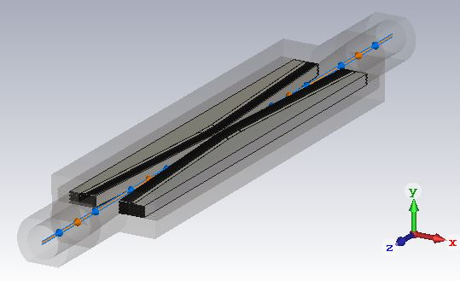
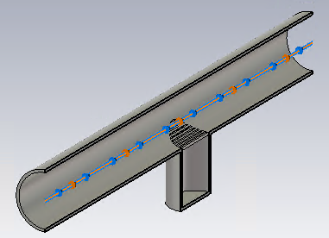
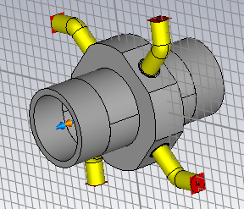
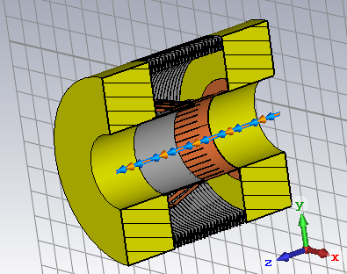
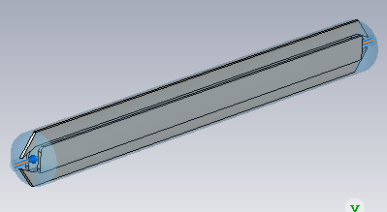
Geometrical impedance
Main vacuum components considered in the impedance model.
Flange
Gate Valve
Collimator
RF cavity
BPM
Bellows
Electro separator
Pumping port

Slide 11
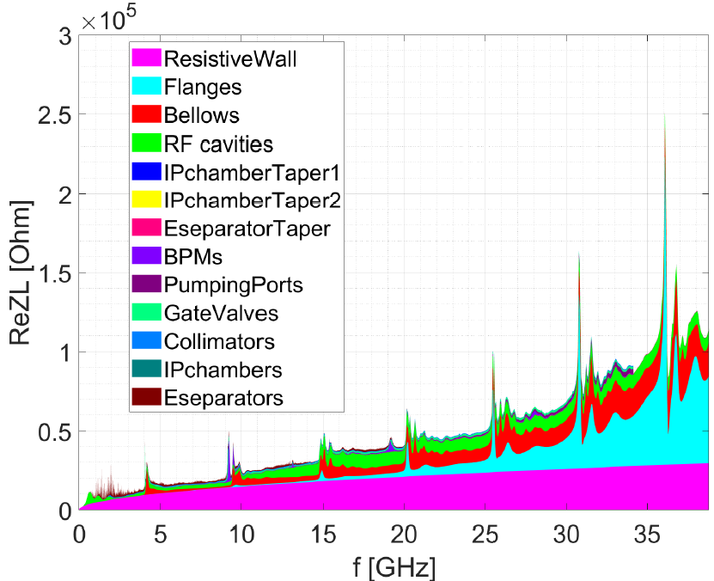
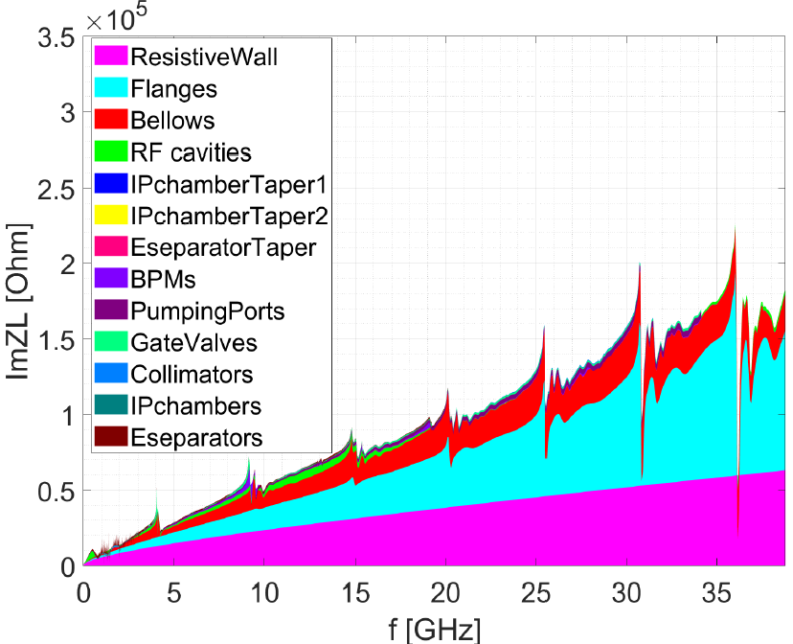
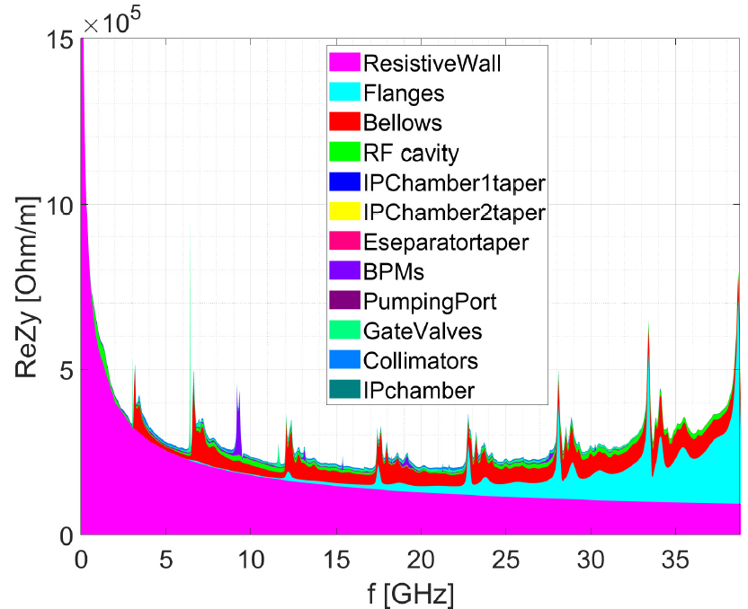
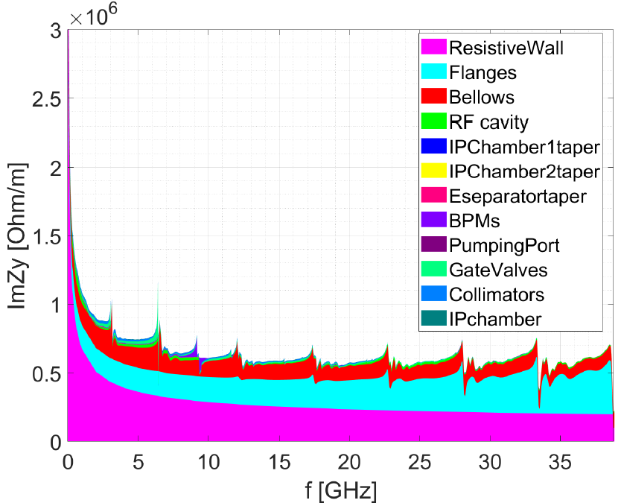
Impedance model
The longitudinal broadband impedance is dominated by the RW, flanges and bellows.
The transverse impedance is dominated by the RW, flanges, bellows and collimators.
The impedance contributed by Inj./ext. elements, feedback kickers, absorbers, masks and collimators outside the IR region are not included.
ReZL
ImZL
ReZy
ImZy

Slide 12
Impedance budget @σ_{z}=3mm
Components | Number | Z||/n, mΩ | L, nH | k_{loss}, V/pC | k_{y}, kV/pC/m
Resistive wall | - | 6.2 | 329.2 | 363.7 | 11.3
RF cavities | 60 | 0.5 | 24.8 | 101.2 | 0.5
Flanges | 37714 | 5.2 | 276.1 | 37.3 | 5.2
BPMs | 1808 | 0.04 | 2.0 | 9.5 | 0.2
Bellows | 15949 | 2.9 | 154.6 | 87.4 | 3.9
Gate Valves | 500 | 0.2 | 11.4 | 14.5 | 0.4
Pumping ports | 5316 | 0.3 | 18.4 | 2.3 | 0.2
Collimators | 16 | 0.04 | 1.7 | 23.4 | 0.6
IP chambers | 2 | 0.004 | 0.2 | 0.3 | 0.05
Electro-separators | 20 | -0.1 | -5.4 | 34.5 | 0.1
Taper transitions | 48 | 0.04 | 2.3 | 2.5 | 0.09
Total |  | 15.3 | 815.3 | 676.6 | 22.5

Slide 13
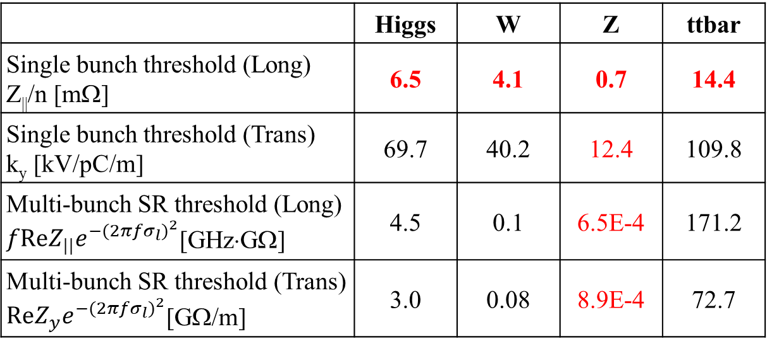
Collective instabilities in the collider rings
Rough estimations of the instability threshold based on analytical criterions.
 | Higgs | W | Z | ttbar
Single bunch threshold (Long) Z||/n [mΩ] | 6.5 | 4.1 | 0.7 | 14.4
Single bunch threshold (Trans) k_{y} [kV/pC/m] | 69.7 | 40.2 | 12.4 | 109.8
Multi-bunch SR threshold (Long) $fReZ_{||}e^{−{(2πfσ_{l})}^{2}}$[GHz⋅GΩ] | 4.5 | 0.1 | 6.5E-4 | 171.2
Multi-bunch SR threshold (Trans) $ReZ_{y}e^{−{(2πfσ_{l})}^{2}}$[GΩ/m] | 3.0 | 0.08 | 8.9E-4 | 72.7
Although the criterion usually underestimates the threshold, we do observed its influence on the beam-beam interaction
^{[PRAB 23, 104402 (2020);} ^{PRAB 25, 011001 (2022)]}.
TMCI unstable
Impedance budget
Z||/n, mΩ | 15.3
k_{y}, kV/pC/m | 22.5
Tight narrowband impedance requirements for Z (at least ~two orders higher for the other energies)

Slide 14
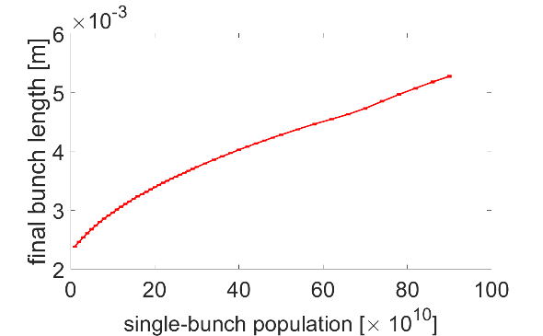
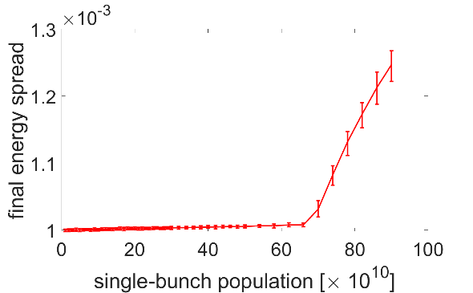
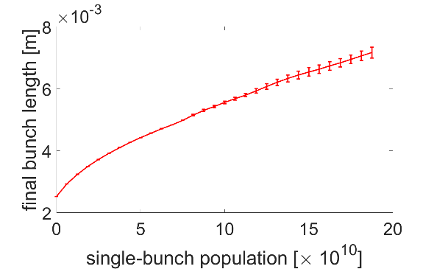
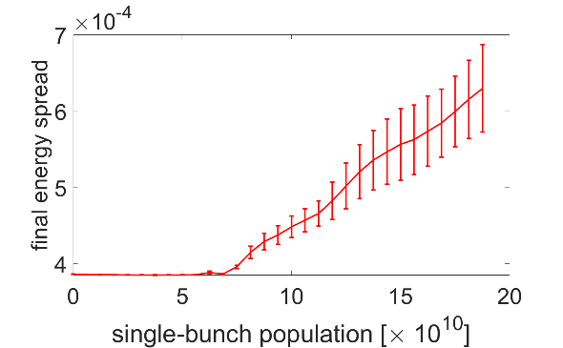
Bunch lengthening and microwave instability
Considering single beam, variations of bunch length and beam energy spread with bunch intensity are calculated by particle tracking simulations.
Higgs
Higgs
Z
Z
13×10¹⁰
13×10¹⁰
14×10¹⁰
14×10¹⁰
Higgs:
Instability threshold is around 70×10¹⁰⇒ far above the design bunch current.
At the design bunch intensity, the bunch will be lengthened by ~30% due to the impedance.
Z:
Instability threshold is about half of the design bunch intensity.
At the design bunch current, the bunch length and the beam energy spread are increased by ~140% and ~35%, respectively.

Slide 15
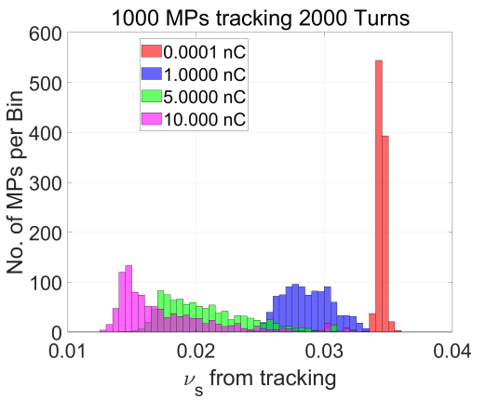
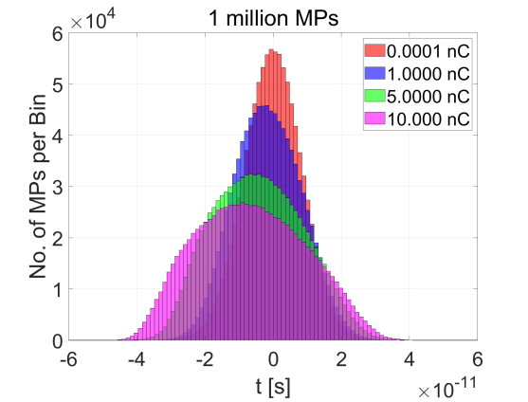
Other influences of longitudinal impedance
Longitudinal impedance (ZL) will induce incoherent synchrotron tune spread and bunch distortion.
Influence transverse single beam dynamics
Cross talk with beam-beam
Beamstrahlung significantly lengthen the bunch ⇒ mitigate the effect of the ZL on beam dynamics.
ZL shrinks and shifts the stable beam-beam interaction region⇒ More details discussed in Yuan Zhang’s talk (the design luminosity can be reached with careful parameter tuning).

Slide 16
Transverse mode coupling instability (TMCI)
Transverse impedance (ZT) can induce fast instability through mode coupling, usually resulting in beam losses ⇒ Main constraint on single bunch current.
The instability @Z is investigated in three different ways
  Analytical estimation with classical Vlasov solver
    Mode analysis with and without impedance induced bunch lengthening
  Macro particle simulations and mitigations
    Study the transverse beam dynamics more consistently including the longitudinal impedance
  Analytical estimation considering the longitudinal perturbations
    Mode analysis with perturbations from ZL, as well as lengthened bunch from beamstrahlung.
 | Higgs | W | Z | tt
Single bunch threshold (Trans) k_{y} [kV/pC/m] | 69.7 | 40.2 | 12.4 | 109.8
Impedance budget
k_{y}, kV/pC/m | 22.5

Slide 17
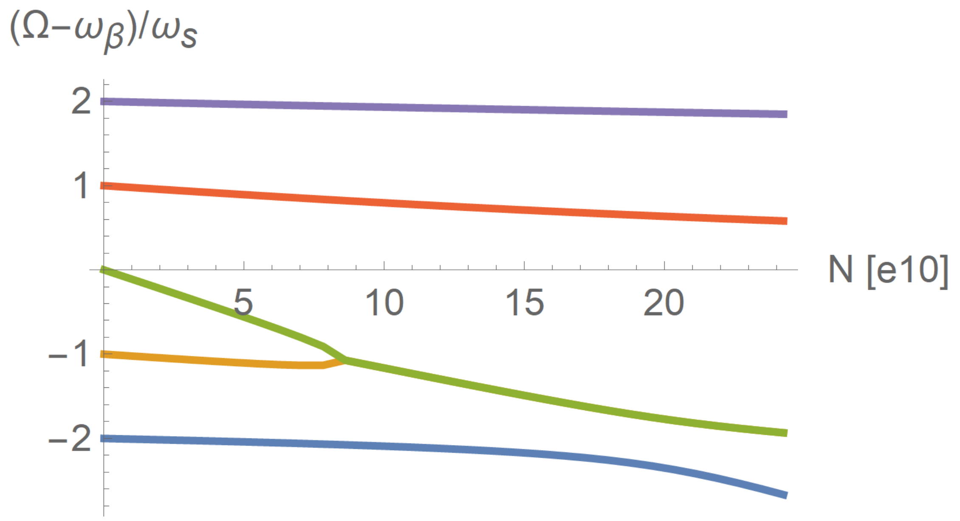
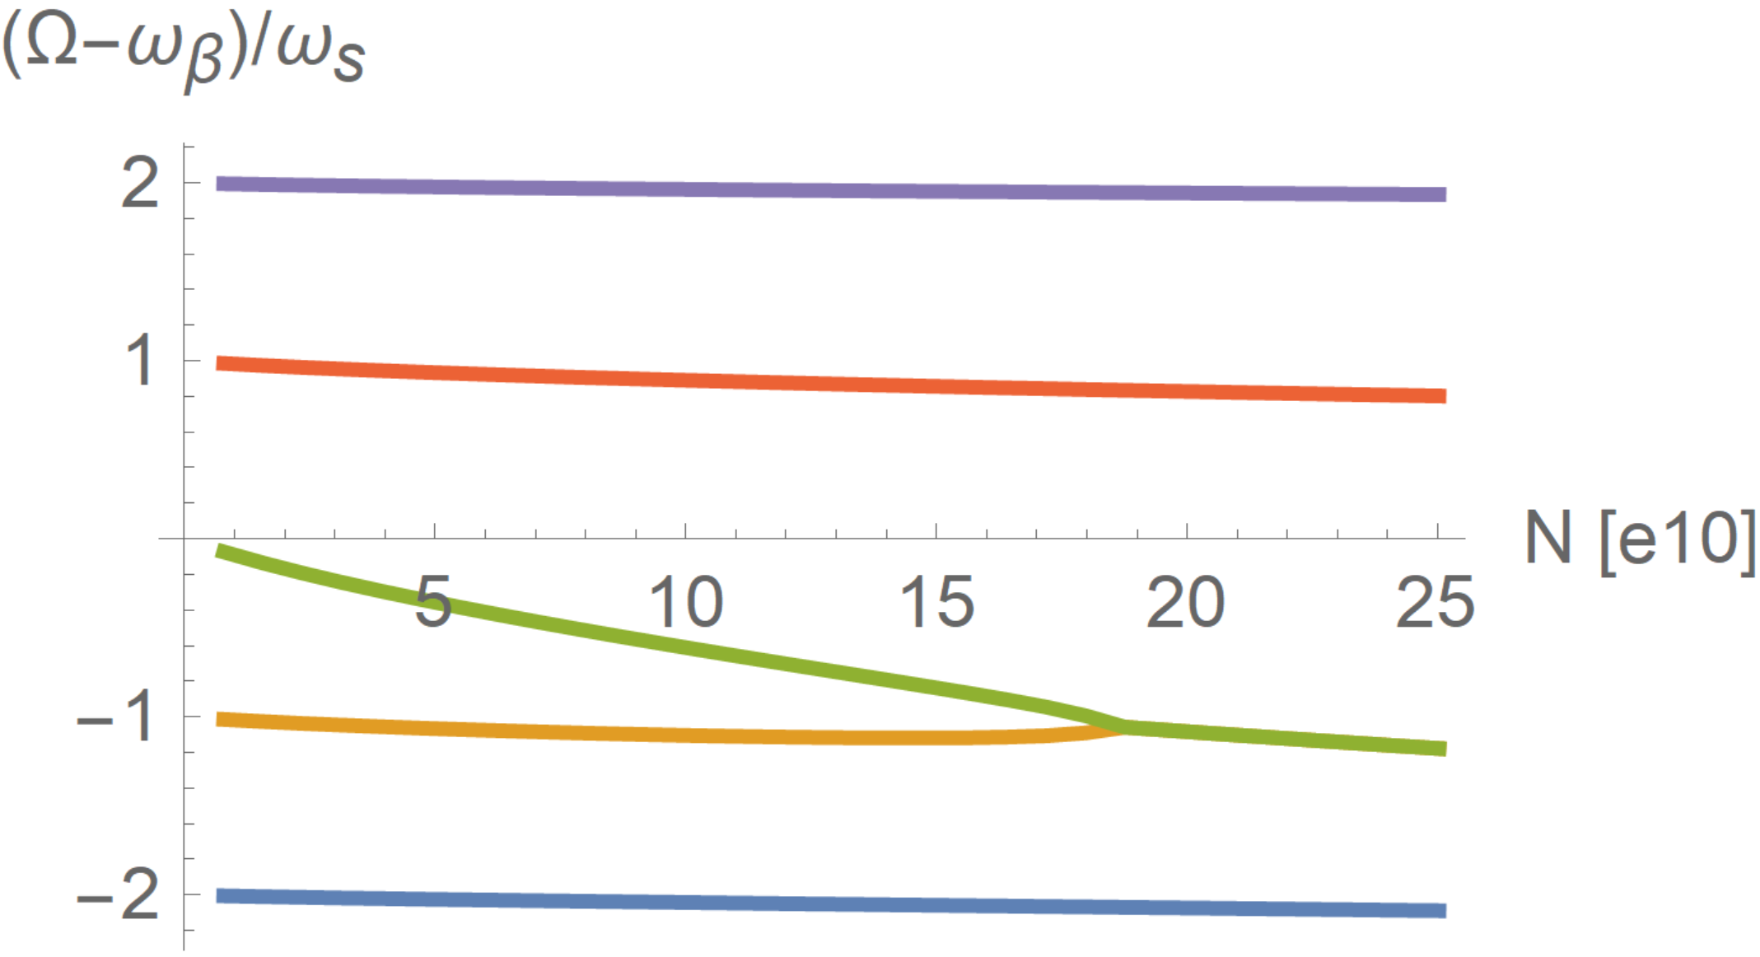
TMCI – Classical Vlasov solver
Analytical estimations show that threshold current will increase when consider impedance bunch lengthening. The instability is supposed to be further detuned if consider further bunch lengthening due to the beamstrahlung. However ….
W/O ZL bunch lengthening
W/ ZL bunch lengthening
Design
14×10¹⁰
Design
14×10¹⁰

Slide 18
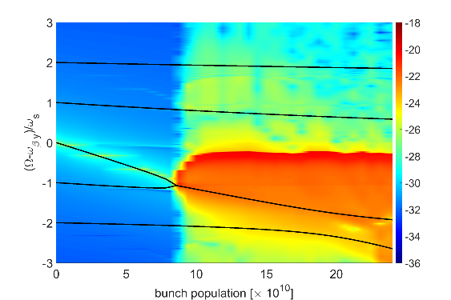
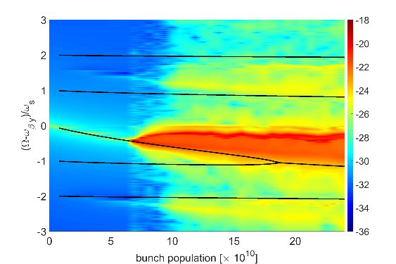
TMCI – Consistent macroparticle simulations
Particle tracking simulations performed with Elegant shows that the TMCI get more unstable when including the longitudinal impedance
  Without ZL: TMCI threshold→9×10¹⁰ (consistent between simulation and theory)
  With ZL: TMCI threshold → 6×10¹⁰ (much lower than the theoretical estimation only with bunch lengthening: 19×10¹⁰, shift of the mode 0 below the threshold still consistent)
W/O ZL
W/ ZL

Slide 19
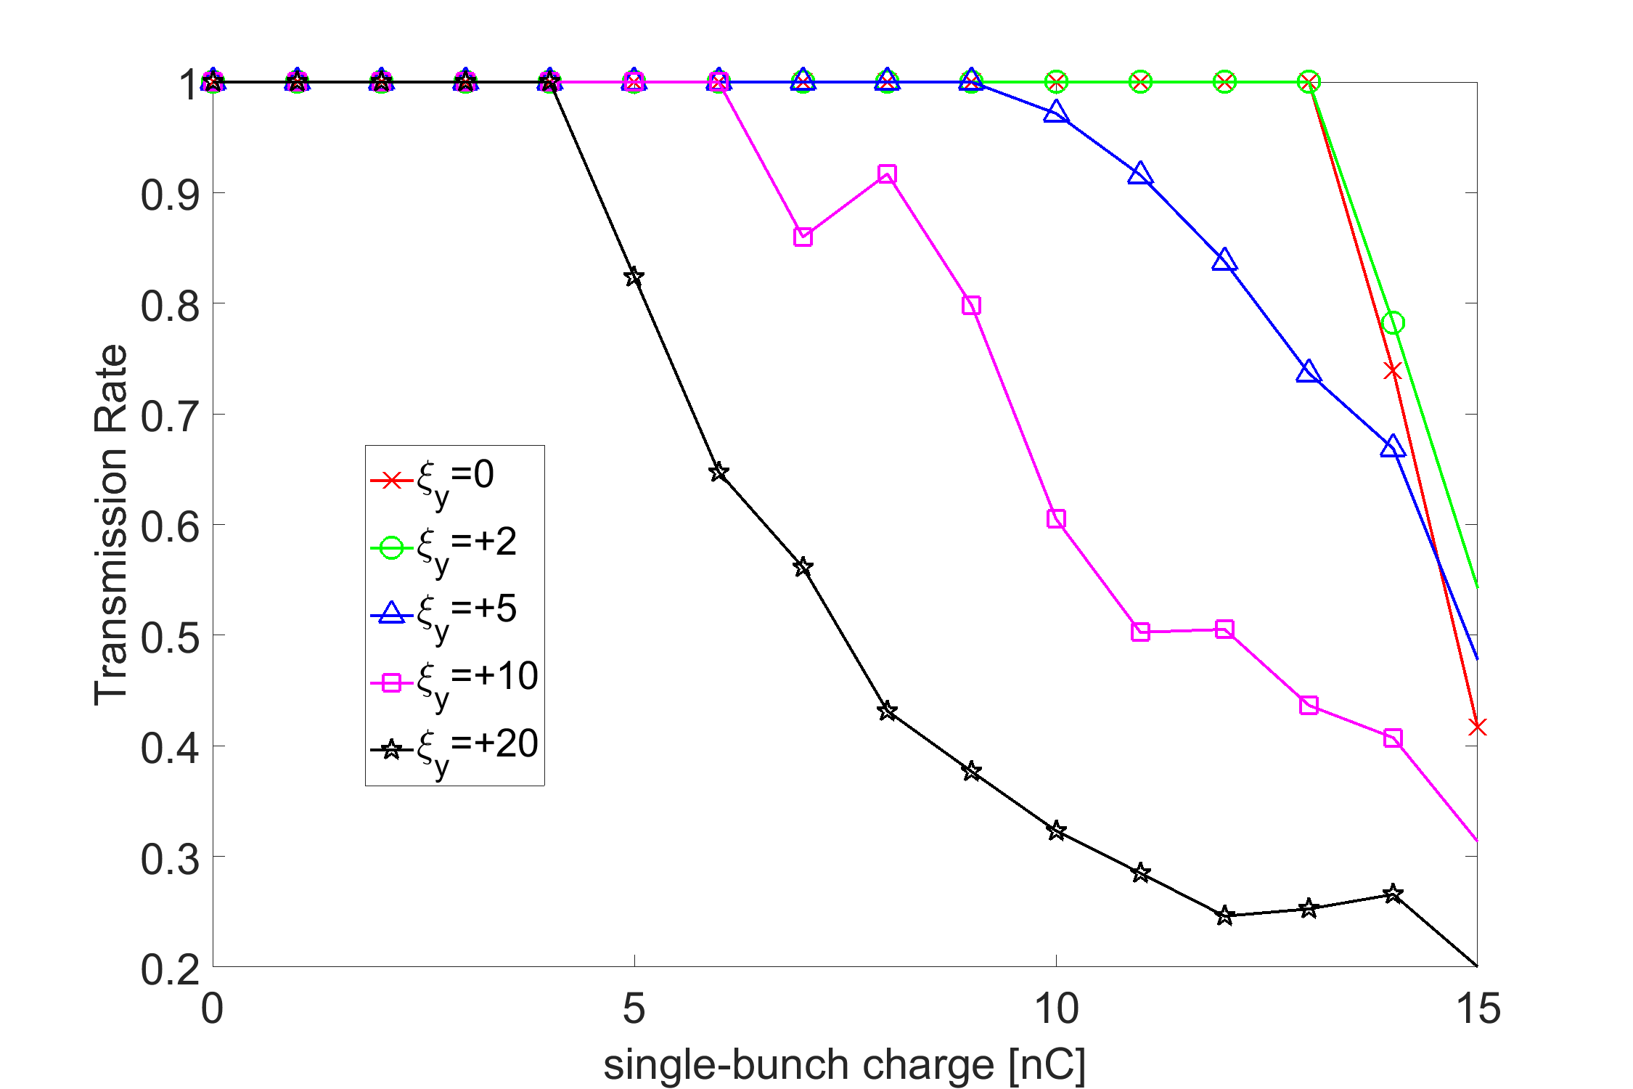
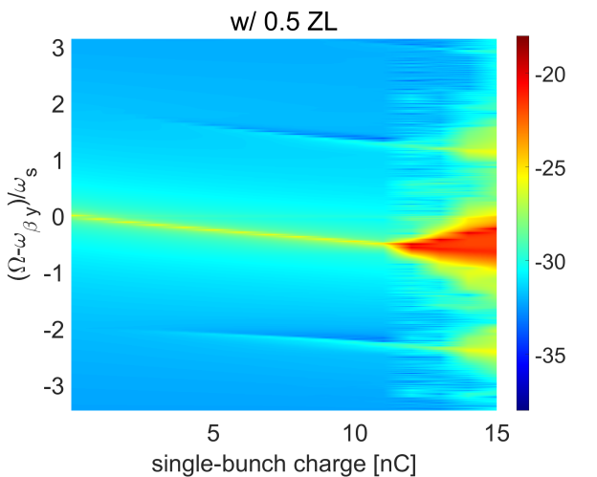
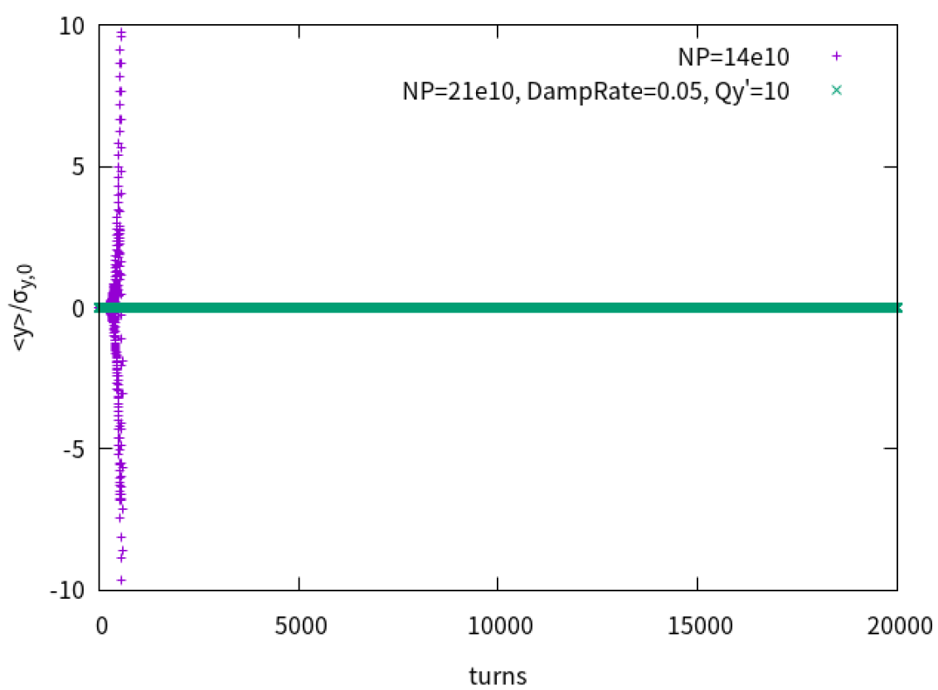
TMCI – Possible mitigations
Positive chromaticity ξ – negative effect
  Head-tail phase shift over the bunch <1, high order TMCI modes could be excited with large ξ
Lower longitudinal perturbations – limited increase of the threshold
  With only RW or ZL/2, the TMCI threshold is increased from 10nC to 11.5nC
Transverse bunch-by-bunch feedback – effective
Beamsstrahlung bunch lengthening – effective
I_{th}: 10nC->11.5nC
Threshold beam current decreases with increase of chromaticity
Longitudinal impedance reduced by a factor of 2, and transverse impedance unchanged
Feedback kick=-dp/2p=0.05, ξ=10
Np=21e10 is stable with 1.5 ZT

Slide 20
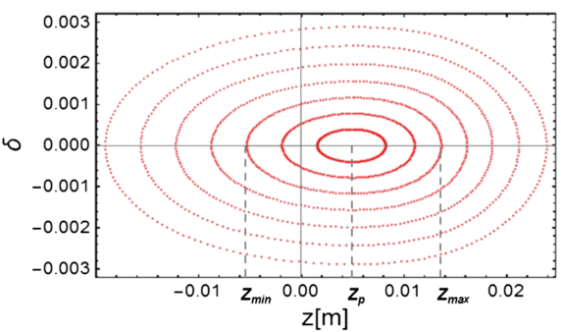
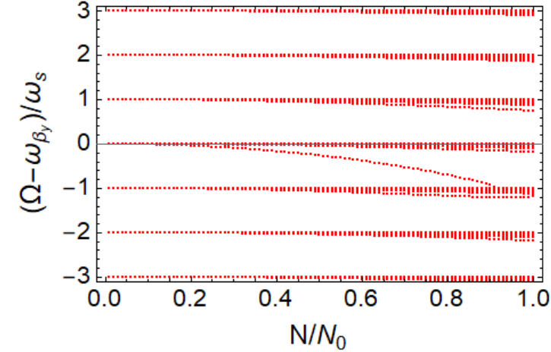
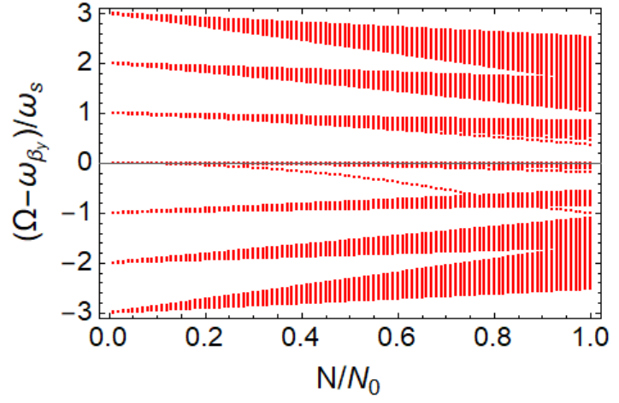
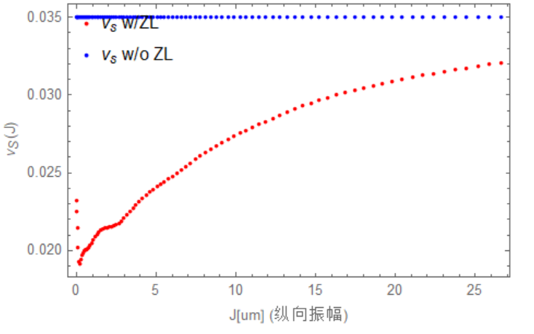
TMCI – Mode analysis with long. perturbations
Considering longer bunch with beamstrahlung
  TMCI threshold without ZL is increased to 22×10¹⁰ due to lengthened bunch;
  Including ZL, the higher order modes shift to mode 0 with wider bandwidth, and TMCI threshold is decreased to 19×10¹⁰ ⇒ TMCI stable with beamstrahlung (Consistent study of ZT and beam-beam was discussed in Yuan Zhang’s talk)
[C.T. Lin, PRAB 25, 011001 (2022)]
W/O ZL
W/ ZL
N₀=25×10¹⁰

Slide 21
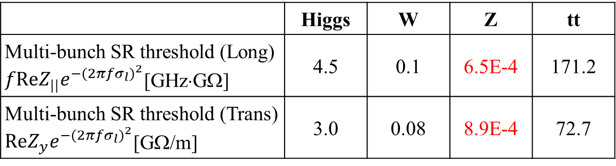
Coupled bunch instabilities
Transverse resistive wall instability
⇒ Dominant due to large circumference
Other narrowband impedances
⇒ High order modes of the RF cavities
⇒ Impedances of flanges, bellows, gate valves, and BPMs are well below the SR threshold
⇒ Impedance of the electro separators and the IP chambers requires further investigations
 | Higgs | W | Z | tt
Multi-bunch SR threshold (Long) $fReZ_{||}e^{−{(2πfσ_{l})}^{2}}$[GHz⋅GΩ] | 4.5 | 0.1 | 6.5E-4 | 171.2
Multi-bunch SR threshold (Trans) $ReZ_{y}e^{−{(2πfσ_{l})}^{2}}$[GΩ/m] | 3.0 | 0.08 | 8.9E-4 | 72.7

Slide 22
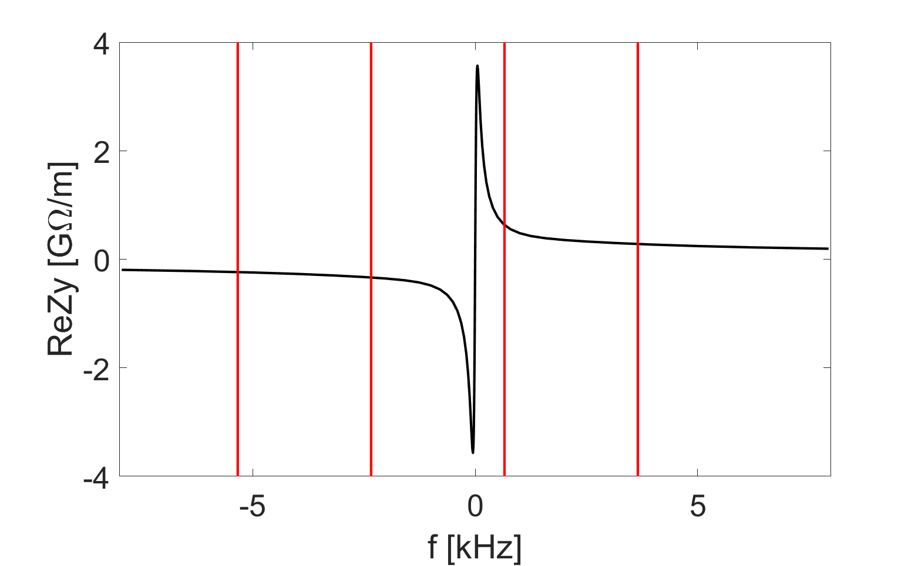
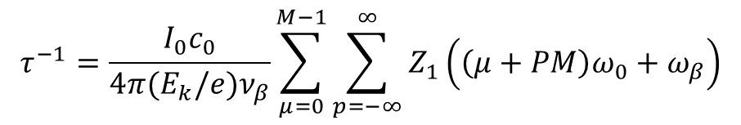
Transverse resistive wall instability
Mainly determined by the zero-frequency resonance of the transverse RW impedance
$$τ^{−1}=\frac{I_{0}c_{0}}{4π(E_{k}/e)ν_{β}}\sum_{μ=0}^{M−1}{\sum_{p=−∞}^{∞}{Z_{1}\left(\left(μ+PM\right)ω_{0}+ω_{β}\right)}}$$
τ [ms] | Higgs | Z | W | tt
instability growth time | 400 | 2 | 38 | 3060
SR damping time | 44 | 816 | 150 | 14
n=11615
n=11616
n=11617
n=11618
First few unstable modes for Z:
f [kHz] | Mode index | Growth t [ms]
-2.338 | 11616 | 2.2 (7 turns)
-5.335 | 11615 | 3.2 (10 turns)
-8.332 | 11614 | 4.0 (12 turns)
-11.330 | 11613 | 4.6 (14 turns)
Tough requirement on feedback damping (broadband feedback + mode feedback)

Slide 23
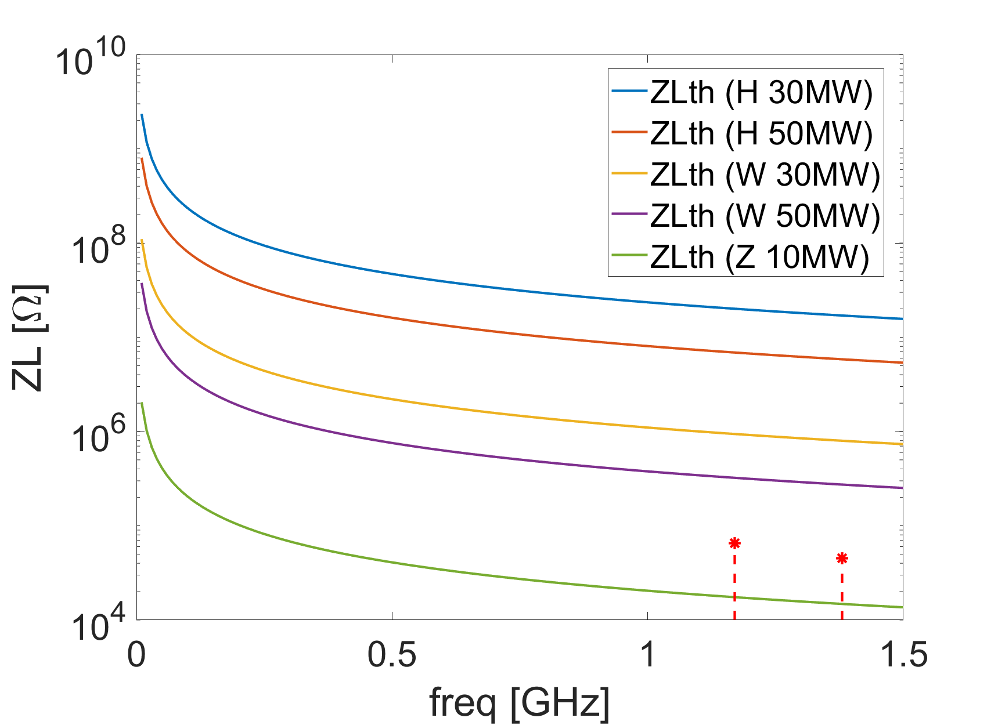
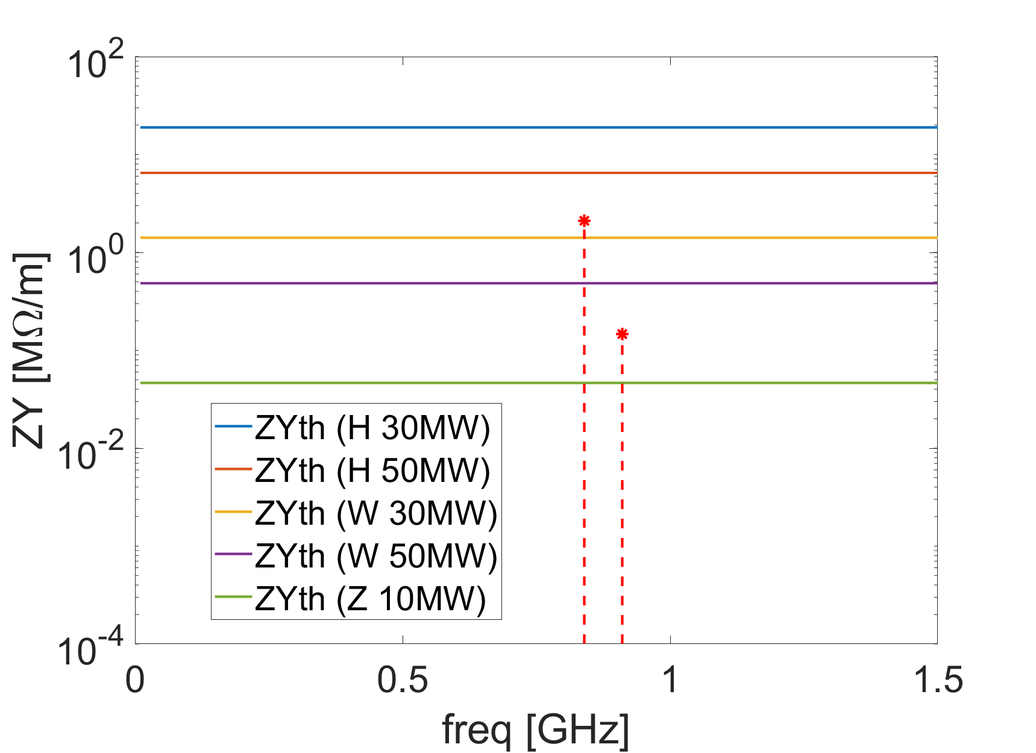
RF HOMs
For the operation modes of Higgs, W and low luminosity Z (with total beam power of 10 MW), the 2-cell 650MHz RF cavities will be adopted.
  The Q_{e} of the longitudinal and transverse HOMs below the cutoff frequency are measured.
  The impedance is above the SR threshold for Z in both longitudinal and transverse planes. In the resonant case, the instability has a growth rate of 114 ms and 19 ms, respectively.
  The W operation mode will also be unstable in transverse when consider only SR damping. In the resonant case, the instability has a growth rate of 105 ms.

Slide 24
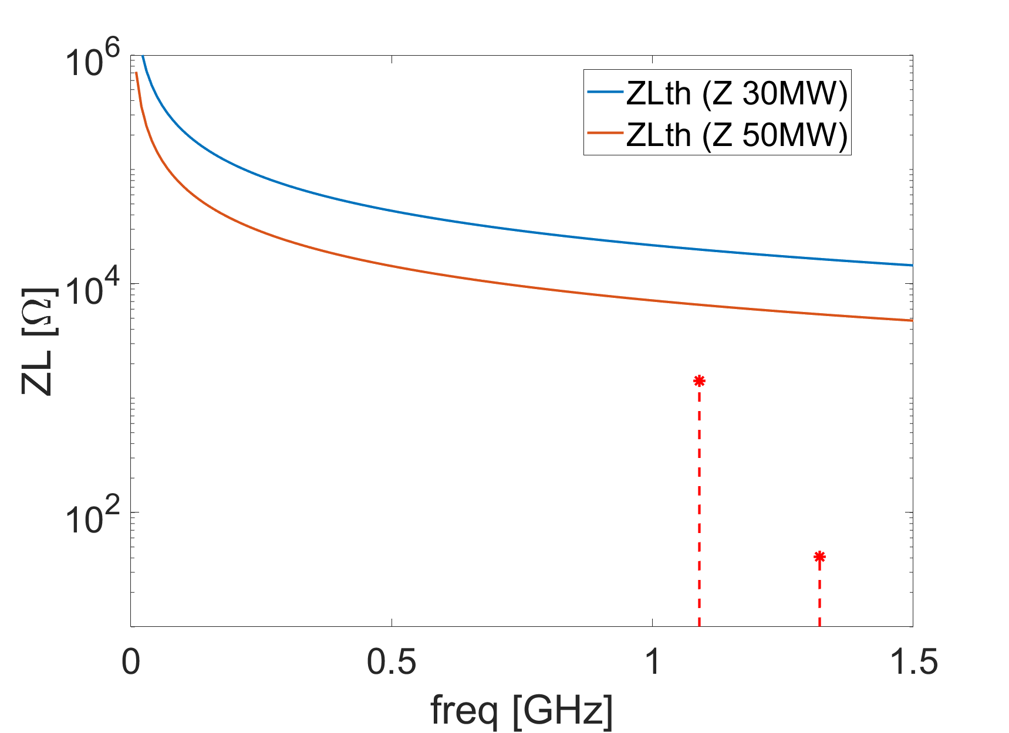
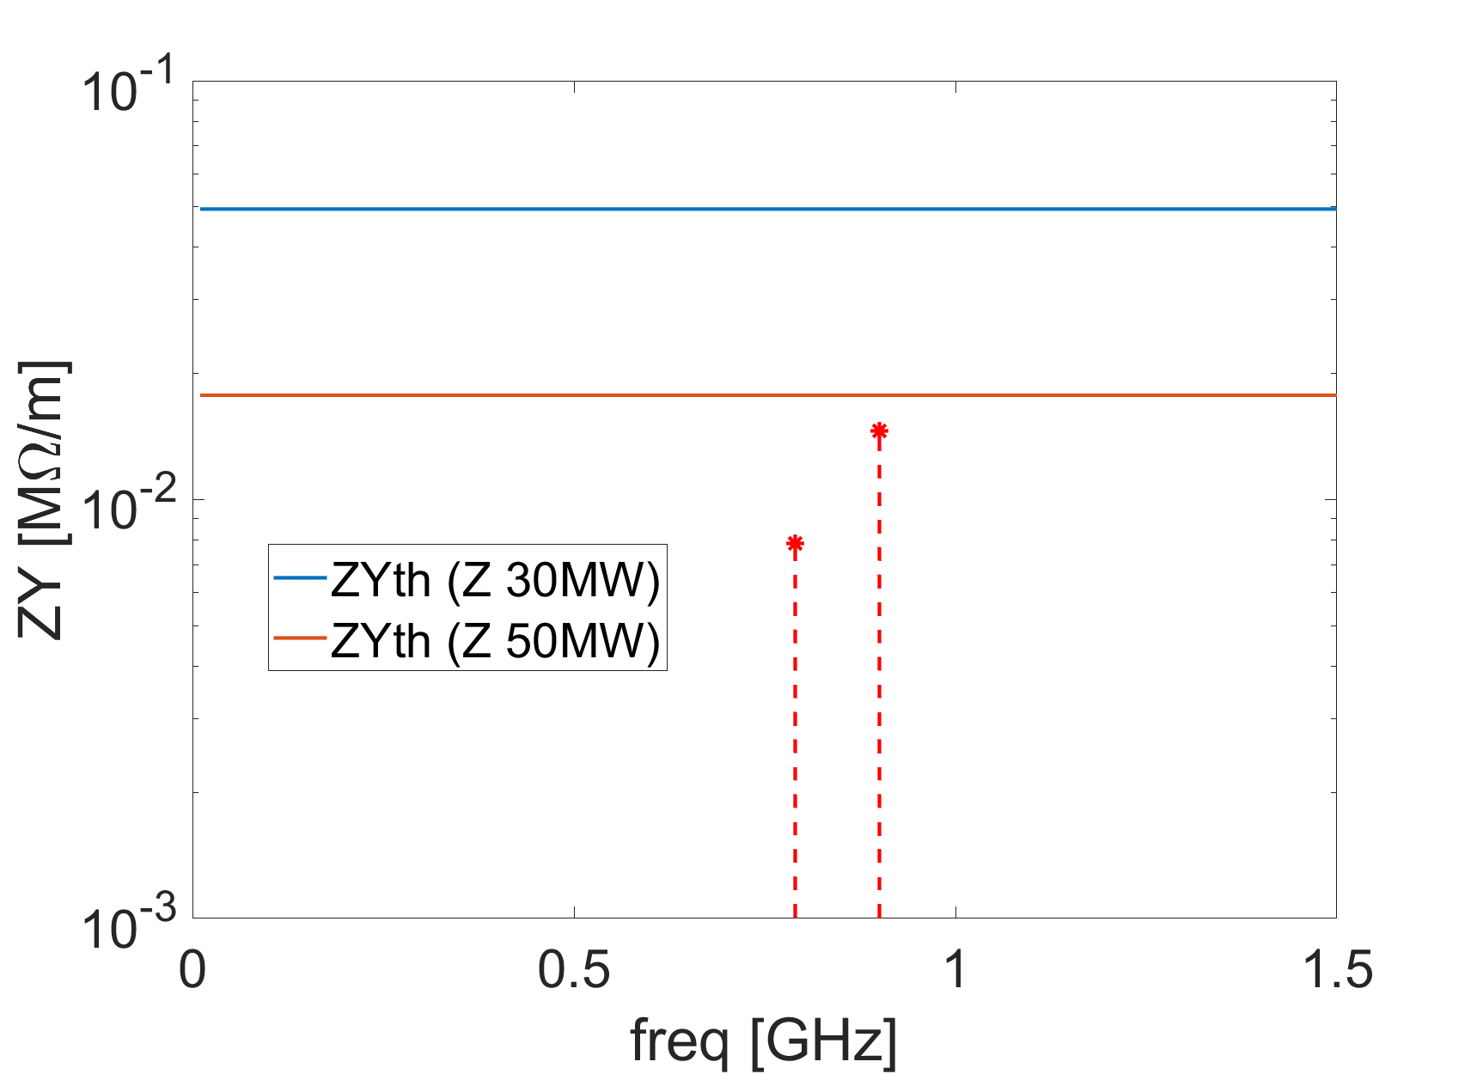
RF HOMs (cont.)
For the high luminosity Z, the RF cavities will be replaced by the 1-cell cavities.
  HOMs can be well damped (loaded Q of 100 has been considered) below the threshold that determined by the SR damping.

Slide 25
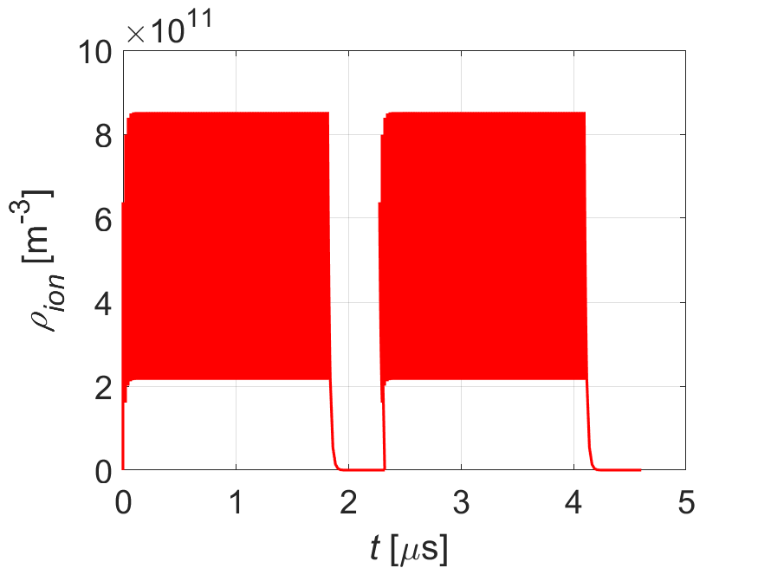
Beam ion effects
Trapped ions can induce bunch centroid oscillation and emittance growth.
The possibility of ion trapping and fast beam ion instability are investigated.
With vacuum pressure of 1nTorr, and CO⁺ has been considered as the only ion species
Consider multi bunch train filling pattern, the instability growth calculated by the analytical theory for W and Z are faster than SR damping
Parameters | Higgs | Z | W | tt
L_{sep}ω_{ion}/c₀ | 6.2 | 0.7 | 2.4 | 14.7
ρ_{ion, ave}[e¹¹ m⁻³] | 0.6 | 4.1 | 0.8 | 0.1
τ_{e} [ms] | 7.9 | 0.1 | 1.9 | 105.4
τ_{H} [ms] | 44.1 | 4.3 | 24.3 | 220.5
SR damping [ms] | 44 | 850 | 156 | 14
FB damping [ms] | 1.0
Δν_{y} | 0.0006 | 0.02 | 0.002 | 0.0001
Build-up of ions along the bunch train

Slide 26
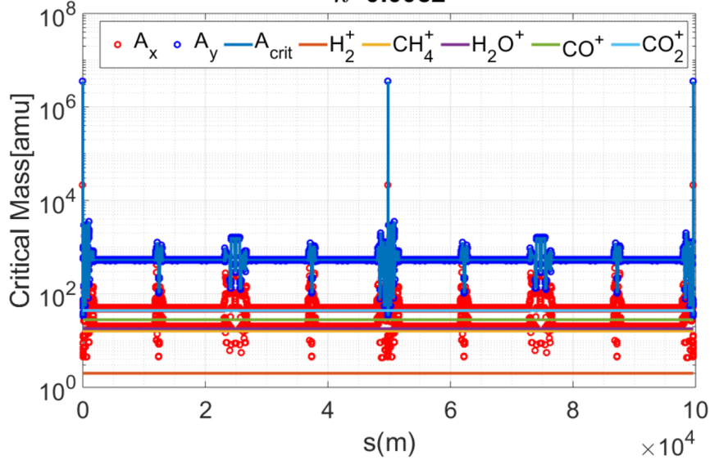
Ion trapping for Z
Linear theory indicates that ions with relative molecular mass larger than the critical mass A_{x,y} will be trapped.
With vacuum pressure of 1 nTorr and uniform bunch filling:
  Only CO₂⁺ will be trapped at the locations around IP with large beta function β_{y}.
  The total percentage of the region with trapped ions is less than 0.1%.

Slide 27
Macro-particle simulations for Z
With uniform filling pattern, ion instability is checked at different locations.
  Both H and V beam centroid oscillation amplitude increased to larger than 0.1σ in few turns, then saturate at around the scale of beam size.
β_{x}/β_{y}=69/96m
β_{x}/β_{y}=0.13/9E-4m
β_{x}/β_{y}=151/4.4km
Horizontal
Horizontal
Horizontal
Vertical
Vertical
Vertical

Slide 28
Macro-particle simulations for Z (cont.)
Filling pattern: 144 bunch trains, each train contains 83 bunches with spacing of 23ns
Multi-train filling is effective in mitigating the beam ion instability. Transverse beam size is almost unchanged, but with some small oscillations ⇒ bunch by bunch feedback could suppress the betatron oscillations if needed.
Beam centroid oscillation amplitude
Transverse beam size
Horizontal
Vertical
β_{x}/β_{y}=69/96m

Slide 29


Electron cloud effects
Influence on the machine performance
  Single bunch fast head-tail instability – coherent motion of a bunch and local electrons
  Coupled bunch instabilities – Coherent motion of bunch train and electron cloud
Parameters |  | Higgs | Z | W | tt
Beam line density | λ_{beam} [10¹³ m⁻¹] | 2.3 | 2.2 | 2.2 | 3.6
Beam size | σ_{x}/σ_{y} [μm] | 151/6.8 | 116/8.3 | 209/9.2 | 224/13.0
RMs bunch length | σ_{z} [mm] | 2.3 | 2.5 | 2.5 | 2.2
Synchrotron tune | ν_{s} | 0.049 | 0.035 | 0.062 | 0.078
Electron osc. period | ω_{e}σ_{z}/c | 17.7 | 19.4 | 13.7 | 12.7
Threshold electron density | ρ_{e, th} [10¹¹ m⁻³] | 7.3 | 1.4 | 4.4 | 17.4
Coupled bunch instability growth time (SEY=1.2) | τ [ms] | >300 | 3 | / | /
$$ρ_{e, th}=\frac{2γν_{s}}{\sqrt{3}Qr_{e}β_{y}C}$$
$$=\frac{γω_{β}ρ_{e}}{2πr_{p}c^{2}}$$
[K. Ohmi, PRE 65, 016502 (2001)]
[F. Zimmerman, IPAC 2001]

Slide 30
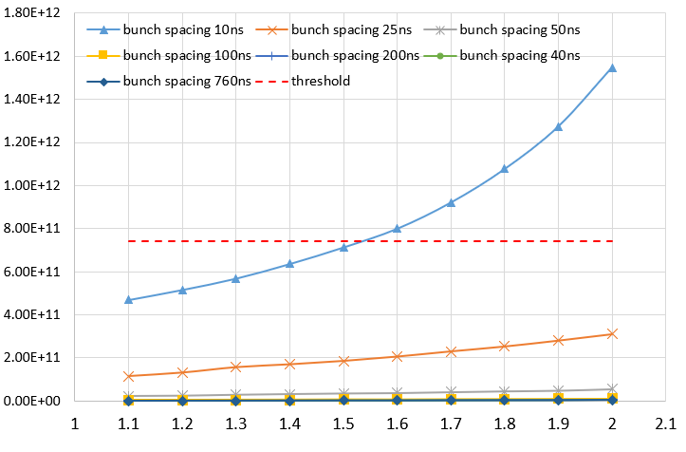



Electron cloud build-up
Higgs mode: Lsep=591ns
Z mode: Lsep=23ns
Higgs mode ()
Density
Secondary electron yield
The coating to SEY<1.3 is necessary for the restriction on ECI

Slide 31



Measurements on SEY with NEG coating
Y.D. Liu, talk in ECLOUD2022
Experimental apparatus
  applicable for both normal or cryogenic environment
The SEY of NEG coating (thickness: 200~400nm) can be decreased to 1.2 by backing treatments at 300℃ for an hour.
Cu with TiZrV coating
Cu with TiZrHfV coating

Slide 32

Summary on the Collider
Impedance model has been developed for the collective effects studies.
Potential restrictions from the collective effects and their mitigations are investigated → no apparent show stoppers for Higgs, W and tt
→ Important restriction for Z – performance can be reached with the mitigations
:
Instability mechanism | Status and mitigation strategies
Microwave instability | $N_{b, th}≈$ 7×10¹⁰ <$N_{b, design}$=14×10¹⁰, ZL is coupled with beam-beam ⇒ brightness degradation for some working point → mitigations: careful parameter tuning.
Transverse mode coupling instability | $N_{b, th}≈$ 6×10¹⁰ <$N_{b, design}$=14×10¹⁰, ZY is coupled with beam-beam ⇒ Restrict bunch current and beam-beam unstable → mitigations: Bootstrapping injection, bunch-by-bunch feedback with positive ξ, larger emittance.
Transverse resistive wall instability | τ⊥ = 2ms << SR damping ⇒ Restrict total beam current → mitigations: bunch-by-bunch feedback (damping time ~1ms)
CBI due to the RF HOMs | τ⊥ = 19ms, τ|| = 114ms, << SR damping ⇒ Restrict total beam current → mitigations: bunch-by-bunch feedback, HOM damper, 1-cell cavities for high luminosity Z
Beam ion effects | τ⊥ = 4ms ⇒ Beam size blow-up, transverse tune shift → mitigations: multi-bunch train filling pattern, bunch-by-bunch feedback
Electron cloud | τ⊥ = 3ms << SR damping ⇒ Beam size blow-up, transverse tune shift, restrict beam current → mitigations: bunch-by-bunch feedback, low SEY with NEG coating

Slide 33

Discussions – Impedance evolving
The impedance model will be continuously updated along with the development of the hardware designs ⇒ impedance increase is expected with more contributors included.
Main constraints from impedance are focused on Z, enough safety margin is reserved for other energies.
Considering the elements been missing, a larger increment is expected in the transverse plane, while less influence in longitudinal.
Limited influence on the transverse resistive wall instability
⇒ Instability growth time from 2.2ms→1.7ms with more detailed chamber material, collimators have little contribution
n=11615
n=11618
n=11616
n=11617
TMCI restriction could be met
Better understanding of the physics and further mitigations: bunch-by-bunch feedback, positive ξ, larger emittance

Slide 34
Content
Collider Ring
  Impedance modeling
    Resistive wall, geometrical impedance
  Collective instabilities
    Bunch lengthening, MWI, TMCI, Coupled bunch instabilities, Beam ion, Electron cloud
Booster Ring
  Impedance modeling
    Resistive wall, geometrical impedance
  Collective instabilities
    Single/Coupled bunch instabilities, CSR
Damping Ring
  Impedance modeling
    Resistive wall, geometrical impedance
  Single bunch instabilities

Slide 35




Impedance modeling
Resistive wall impedance
  radius=28mm, thick=2mm, Aluminum
Geometrical impedance
  Same as in the collider ring, excluding the components related to collision
ReZL
ImZL
ReZy
ImZy
Longitudinal impedance
Transverse impedance

Slide 36
Collective instabilities in Booster
Instabilities are checked for both injection and extraction energies.
Single bunch effects
  Injection: E_{k}=30GeV, Max bunch population of 6.9×10⁹ @tt
  Extraction: E_{k} depends on operation mode, Max bunch population of 1.3 ×10¹¹ @Higgs
Impedance budget @σ_{z}=0.5mm/1.8mm
Impedance threshold
Components | Z||/n [mΩ] | k_{loss} [kV/pC] | k_{y} [kV/pC/m]
Resistive wall | 1.9/3.6 | 6.8/1.0 | 27.0/14.4
Geometrical | 0.1/8.1 | 12.2/1.0 | 28.2/16.0
Total | 2.0/11.7 | 19.0/2.0 | 55.2/30.4
Threshold value | Injection @σ_{z}=0.5mm | Extraction @σ_{z}=1.8mm
Single bunch (longitudinal) Z||/n [mΩ] | >14 | >3.4
Single bunch (transverse) k_{y} [kV/pC/m] | >190 | >36
RW and dominant geometrical impedance (bellows and flanges) extends to 200 GHz
  Some safety margin is reserved for TMCI
  Bunch lengthening is expected

Slide 37

Coupled bunch instabilities
Transverse resistive wall instability
HOMs
  Much more relaxed compare to the collider ring at Z mode
Growth time [ms] | Higgs | Z | W | tt
Injection | 1060 | 62 | 211 | 5865
Extraction | 2685 | 105 | 614 | 38397
SR damping at injection | 3100
SR damping at extraction | 47.6 | 879 | 160 | 14.2
Bunch-by-bunch feedback system is required.
 | Injection | Extraction | Collider-Z
Multi-bunch SR (longitudinal) $fReZ_{||}e^{−{(2πfσ_{l})}^{2}}$[GHz⋅MΩ] | >5.7 | >113 | 0.7
Multi-bunch SR (transverse) $ReZ_{y}e^{−{(2πfσ_{l})}^{2}}$[MΩ/m] | >0.9 | >18 | 0.9

Slide 38

CSR effect
CSR impedance and its induced MWI threshold are calculated, considering the quite short bunch length of ~0.5mm.
CSR impedance << resistive wall impedance.
MWI threshold due to the CSR effect are estimated analytically.
  K. Bane et al. (PRST-AB 13, 104402 (2010))
 | Inj. (linac beam: σ_{z0}=0.4mm, σ_{δ}=1.5E-3) | Inj. (equilibrium: σ_{z0}=0.3mm, σ_{δ}=2.5E-4) | Extraction
Threshold value | >7I_{b, design} | >0.8I_{b, design} | >9I_{b, design}
Extraction → enough safety margin is reserved concerning CSR effect
Injection
  With injection beam parameters → threshold >> design current
  With equivalent beam parameters → the lowest threshold is comparable to the design current (only degrade beam quality during energy ramping + MWI is self-limiting ⇒ less critical)

Slide 39
Content
Collider Ring
  Impedance modeling
    Resistive wall, geometrical impedance
  Collective instabilities
    Bunch lengthening, MWI, TMCI, Coupled bunch instabilities, Beam ion, Electron cloud
Booster Ring
  Impedance modeling
    Resistive wall, geometrical impedance
  Collective instabilities
    Single/Coupled bunch instabilities, CSR
Damping Ring
  Impedance modeling
    Resistive wall, geometrical impedance
  Single bunch instabilities

Slide 40




Impedance modeling
Resistive wall impedance
  radius=15mm, thick=2mm, Aluminum
Geometrical impedance
  Scaled from the collider ring (excluding the components related to collision)
  ZL*(28mm/15mm)*147m/100km, ZY *(28mm/15mm)³*147m/100km
ReZL
ImZL
ReZy
ImZy
Longitudinal impedance
Transverse impedance

Slide 41

Single bunch effects
Impedance budget
Single bunch instabilities
  Enough safety margin reserved for TMCI
  Bunch lengthen is increased by 2%
Components | Z||/n, mΩ | k_{loss}, V/pC | k_{y}, kV/pC/m
Resistive wall | 10.2 | 0.7 | 0.2
Geometrical | 17.3 | 0.3 | 0.1
Total | 27.5 | 1.0 | 0.3
@σ_{z}=4.4mm
Threshold on Z||/n [mΩ] | 680
Threshold on k_{y} [kV/pC/m] | 90
⇒Meet the Requirements on the beam quality
  Increase on the bunch length, beam energy spread and emittance should be less than 20%

Slide 42
Summary on Booster and Damping ring
Impedance model, including a rough geometrical impedance, has been developed and used for the instability studies in both booster and damping ring.
The Booster show no apparent constraints from single bunch effects, as well as CSR, however, bunch-by-bunch feedback is required to damp the transverse resistive wall instability.
No constraints observed from the Damping ring, and the impedance will lengthen the bunch by ~2%, which still meet the requirement from injections.

Slide 43
Thank you!

Slide 44
Backup slides

Slide 45
Booster main beam parameters-Injection
Parameter [unit] | Higgs | Z | W | tt
Beam energy E_{k} [GeV] | 30 | 30 | 30 | 30
Beam current [mA] | 0.62 | 10.5 | 3.1 | 0.12
Bunch number | 268 | 3978 | 1297 | 35
Bunch Population [10⁹] | 4.9 | 5.4 | 5.1 | 6.9
Momentum compaction α_{p} [10⁻⁵] | 1.12 | 1.12 | 1.12 | 1.12
Bunch length σ_{z} (from Linac) [mm] | 0.4 | 0.4 | 0.4 | 0.4
Energy spread (from Linac) [10⁻⁴] | 15 | 15 | 15 | 15
Bunch length σ_{z} (equilibrium) [mm] | 0.5 | 0.5 | 0.5 | 0.3
Energy spread (equilibrium) [10⁻⁴] | 2.5
Betatron tune ν_{x}/ν_{y} | 321.23/117.18
Synchrotron tune | 0.0943 | 0.0879 | 0.0879 | 0.14
Radiation damping x/y/z [s] | 3.1/3.1/1.5

Slide 46
Booster main beam parameters-Extraction
Parameter [unit] | Higgs | Z | W | tt
Beam energy E_{k} [GeV] | 120 | 45.5 | 80 | 180
Beam current [mA] | 0.56/0.98 | 9.5 | 2.85 | 0.11
Bunch number | 268 | 3978 | 1297 | 35
Bunch Population [10⁹] | 4.4/127 | 5.0 | 4.6 | 6.2
Momentum compaction α_{p} [10⁻⁵] | 1.12 | 1.12 | 1.12 | 1.12
Bunch length σ_{z} [mm] | 1.85 | 0.75 | 1.3 | 1.8
Energy spread [10⁻⁴] | 9.9 | 3.7 | 6.6 | 15
Betatron tune ν_{x}/ν_{y} | 321.27/117.19 | 321.27/117.19 | 321.27/117.19 | 321.27/117.19
Synchrotron tune | 0.0943 | 0.0879 | 0.0879 | 0.14
Radiation damping x/y/z [ms] | 47.6/47.6/23.8 | 879/879/440 | 160/160/80 | 14.2/14.2/7.1

Slide 47
Damping ring main beam parameters
Parameter [unit] | Value
Beam energy E_{k} [GeV] | 1.1
Circumference [m] | 147
Beam current [mA] | 12.4 (24.8)
Bunch number | 4 (8)
Bunch Population [10⁹] | 9.5
Momentum compaction α_{p} | 0.013
Bunch length σ_{z} [mm] | 4.4
Energy spread [10⁻⁴] | 5.6
Betatron tune ν_{x}/ν_{y} | 7.70/8.54
Synchrotron tune | 0.0387
Radiation damping x/y/z [ms] | 11.4/11.4/5.7

