Slide 1



Magnet Power Supply System Design
for CEPC TDR
Bin Chen ( On Behalf of Power Supply Group, IHEP )
12-16. June. 2023, Hong kong, CEPC Accelerator TDR International Review

Slide 2
Introduction
This talk is about magnet power supply system
This talk relates to the TDR ch4.3.5, ch4.3.11, ch5.3.4, ch6.3.6 and ch6.4.4
The content relates to the “charge letter” item 3 and 6
    3. Are the accelerator complex design, the key technologies adopted, and the conventional facilities effective for achieving the performance goals?
    6. Regarding the key technology research and development, are critical technologies and components of the CEPC accelerator ready or will they be ready before 2026, through the R&D program being carried out, or achieved with the Light Source project undertaken by IHEP, for the eventual realization of the CEPC?

Slide 3
Content
A Magnet Power supply R&D
B Electro-magnetic Separator R&D
C Summary

Slide 4
Magnet Power supply R&D
  Magnet loads of the power supplies for CEPC
    Including the Collider ring, the Booster ring, the Transport Line, the Linac and the Damping ring
    Total magnet quantity ：38435
Collider | Dipole |  | Quadrupole |  | Sextupole | Corrector | Magnet quantity
 | D-aperture | S-aperture | D-aperture | S-aperture
 | 3008 | 162 | 3016 | 1116 | 3144 | 7088 | 17534
Booster | Dipole |  | Quadrupole |  | Sextupole | Corrector
 | 14866 |  | 3458 |  | 100 | 1200 | 19624
Linac | Dipole |  | Quadrupole |  | Solenoids | Corrector
 | 15 |  | 364 |  | 37 | 275 | 691
Damping Ring | Dipole |  | Quadrupole |  | Sextupole | Corrector
 | 86 |  | 130 |  | 72 | 60 | 348
Transport Line | Dipole |  | Quadrupole |  | Sextupole | Corrector
 | 64 |  | 120 |  | 0 | 54 | 238
Total | 38435

Slide 5
Magnet Power supply R&D
  Design Principles of Power Supply System
    Meet the requirement of the accelerator physics design
    Communicate with magnet system to select optimum magnet parameters, and connection modes to reduce power loss
    Switch mode power supply as the main topology, to reduce the volume, improve the efficiency, and easy to achieve digital control
    Adopt modular design to achieve high current and high voltage output for high-power power supply
    Utilize digital control technology for convenient commissioning and maintenance

Slide 6
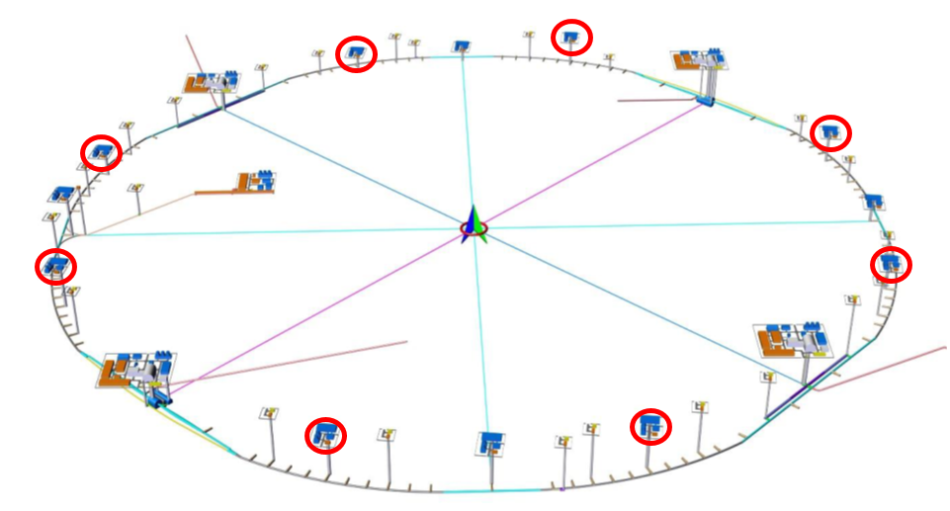
Magnet Power supply R&D
  Design Principles of Power Supply System
    Main power supplies number selection, One or more converters per arc section ( for main B&Q magnet in Collider and Booster）
    The power supply output voltage rating is limited to 1kV
    Main power supplies location
    8 equipment halls above ground located close to the access shafts
    96 auxiliary tunnels around the main tunnel below ground
    Installation on the ground is the priority selection
    Reduced space requirements in tunnel
    Easier and more efficient maintenance
    Higher cost & transmission losses on low voltage line

Slide 7
Magnet Power supply R&D
  Requirement of the power supplies for CEPC
    Collider
    The dual-aperture dipoles ( 2944 B0 and 64 B1 ) within a half-arc are connected in series and powered by a single power supply.
    The dual-aperture quadrupoles ( 3008 Q ) are arranged into 160 families, each comprising 18 or 19 series-connected magnets that is powered by an individual power supply.
    each of the dual-aperture magnets ( B0 and Q ) has 2 trim coils, which need to be powered independently.
Collider | Quantity | Stability /8hours | Output Rating
Dipole-D-aperture | 32 | 50ppm | 1300A/500V *16 150A/50V *16
Dipole-S-aperture | 38 | 100ppm | 40A～250A
Quadrupole-D-aperture | 168 | 100ppm | 120A/850V *160 120A/50V *8
Quadrupole-S-aperture | 600 | 100ppm | 40A～180A
Sextupole | 1608 | 100ppm | 100A～200A
Corrector-H & V | 7088 | 500ppm | ±20A/20V
Trim | 11904 | 500ppm | ±6A/±12V *5888 ±15A/±10V *6016
Superconducting magnets | 88 | 50ppm | 120A～2200A
Total | 21526

Slide 8
Magnet Power supply R&D
  Requirement of the power supplies for CEPC
    Booster
    For Dipole-Arc ( 10192 ) , all dipoles in half arc are connected in series and powered by a single power supply.
    For Dipole-Arc-SF ( 2017 ) & SD ( 2017 ), all dipoles in a arc are connected in series and powered by a single power supply.
    The Quadrupoles-Arc ( 3034 ) are arranged into 80 focusing families and 80 defocusing families, each is powered by an individual power supply.
Booster | Quantity | Stability/tracking | Output Rating
Dipole-Arc | 16 | 500ppm / 0.1% | 560A /780V
Dipole-Arc-SF & SD | 8 | 500ppm / 0.1% | 560A /960V
Dipole-IR | 4 | 500ppm / 0.1% | 560A /140V
Quadrupoles-Arc | 160 | 500ppm / 0.1% | 180A/360V *80 180A/280V *80
Quadrupoles | 176 | 500ppm / 0.1% | 200A～270A
Sextupole | 100 | 500ppm / 0.1% | 140A /35V
Corrector | 1200 | 500ppm / 0.1% | ±25A /±20V
Total | 1664

Slide 9
Magnet Power supply R&D
  Requirement of the power supplies for CEPC
    Linac, Damping Ring and Transport Line
Linac | Quantity | Stability | Output Rating
Dipole | 8 | 500ppm | 220A～330A
Quadrupole | 241 | 500ppm | 150A～250A
Solenoid | 37 | 500ppm | 11A～350A
Corrector | 276 | 500ppm | ±3A～±33A
Total | 562
Damping Ring | Quantity | Stability | Output Rating
Dipole | 10 | 500ppm | 300A～460A
Quadrupole | 130 | 500ppm | 160A～180A
Sextupole | 2 | 500ppm | 11A/23V
Corrector | 60 | 500ppm | ±11A/±3V
Total | 202

Slide 10
Magnet Power supply R&D
  Requirement of the power supplies for CEPC
    Linac, Damping Ring and Transport Line
  Total power supply quantity ：24150
Transport Line | Quantity | Stability | Output Rating
Dipole1 | 12 | 500ppm | 520A/790V
Dipole2 | 8 | 500ppm | 210A/290V
Dipole3 | 2 | 500ppm | 370A/380V
Quadrupole | 120 | 500ppm | 30A/30V
Corrector | 54 | 500ppm | ±30A/±20V
Total | 196

Slide 11
Magnet Power supply R&D
  Power consumption for CEPC in H mode : 57.41MW
    Magnet power consumption is about 72% of the total loss.
    Cables are copper, cable current density is less than 2A/mm² and cable loss is about 18% of the total loss.
Location | Magnet (MW) | PS (MW) | Cable (MW) | Total (MW)
Collider | 30.21 | 4.21 | 7.69 | 42.12
Booster | 5.12 | 0.83 | 2.34 | 8.29
Transport Line | 4.03 | 0.46 | 0.08 | 4.57
Linac | 1.49 | 0.18 | 0.11 | 1.78
Damping Ring | 0.55 | 0.07 | 0.04 | 0.65
Total | 41.40 | 5.75 | 10.26 | 57.41

Slide 12
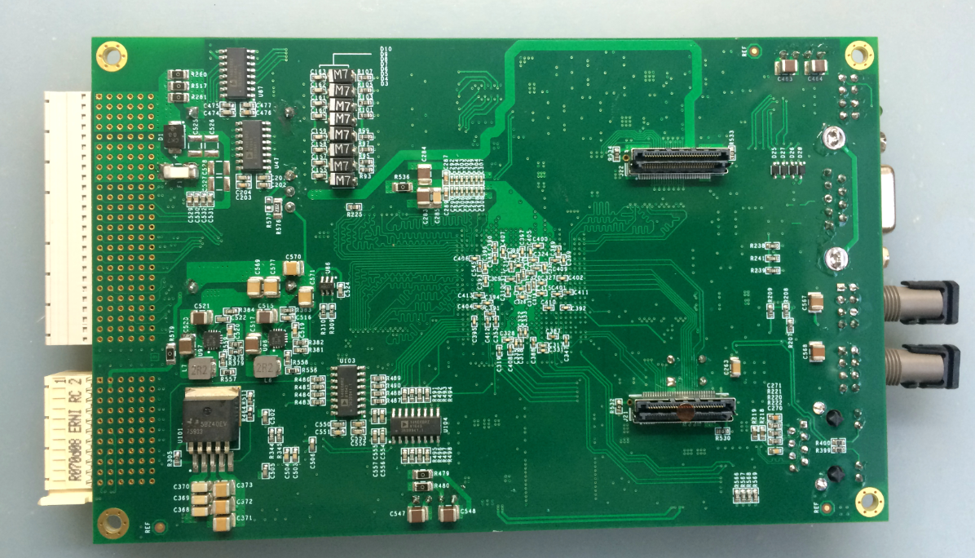
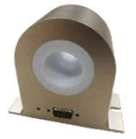
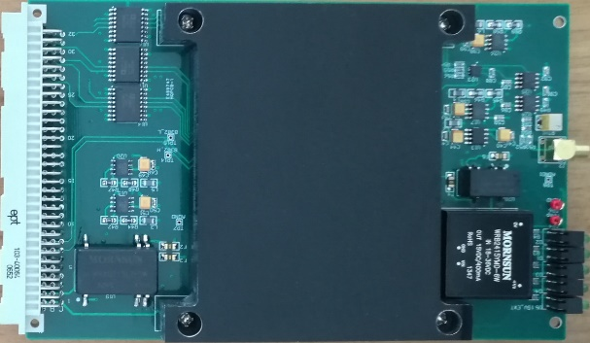
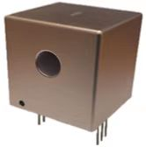
Magnet Power supply R&D
  The digital control power supplies are split in three independent parts
    A power part acting as a voltage source or a current source, which is suitable for industrial design and production
    Current transducers, DCCT（ Commercial Product or Self-design )
    Digital electronics control module, which performs the current regulation, diagnostics, monitoring and local/remote service. It’s standardized for all types of power supply
    Key components that affect the current performance of power supply: DPSCM and DCCT
Functional diagram
DPSCM- Main board and ADC board
Self-design DCCT

Slide 13
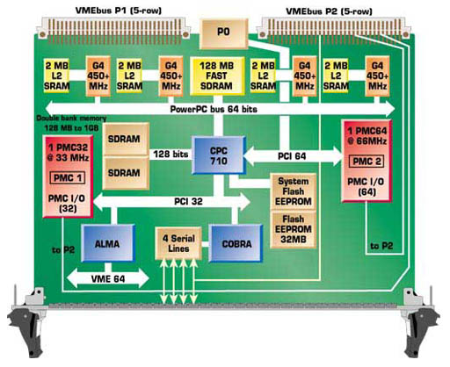
Magnet Power supply R&D
  Digital Power Supply Control Module ( DPSCM )
    SOPC FPGA : System On a Programmable Chip
    All algorithms and peripherals control entirely implemented in one FPGA
I/O
CPU
Flash
I/O
SDRAM
I/O
I/O
I/O
DSP
I/O
FPGA
FPGA
CPU
DSP
Solution: Replace External Devices
with Programmable Logic

Slide 14
Magnet Power supply R&D
  Digital Power Supply Control Module ( DPSCM )
    DPSCM-MB: PID + modern
  control theory
    high precision ADC board
  DPSCM-AD: temp control
    the voltage source
  interfacing board DPSC-DA
    the diagnostic board
    DPSCM_MDA

Slide 15
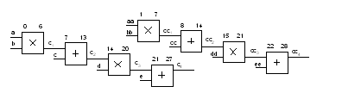
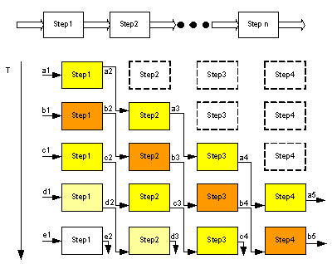
Magnet Power supply R&D
  Digital Power Supply Control Module ( DPSCM )
    Software
Modular time-sharing multiplexing
Pipeline design

Slide 16
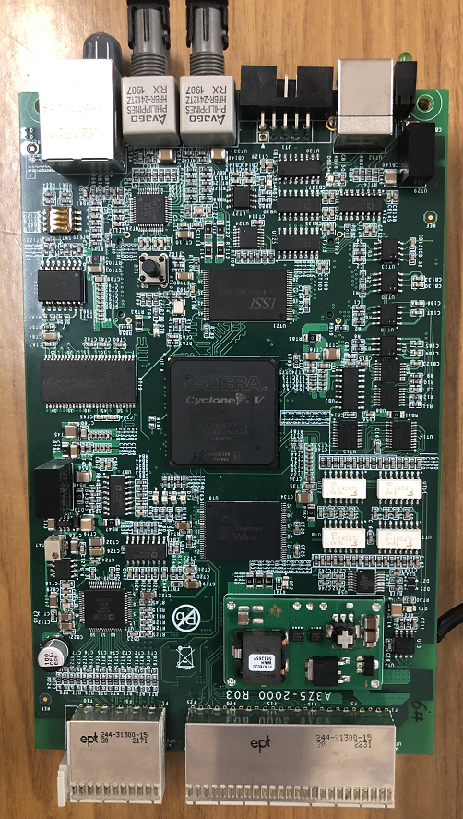
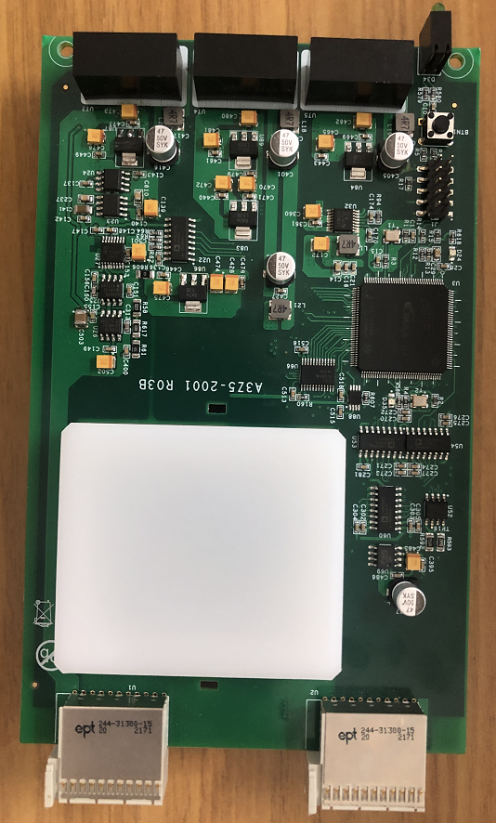
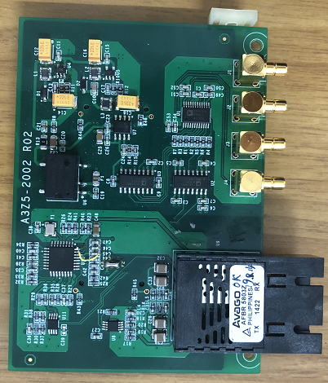
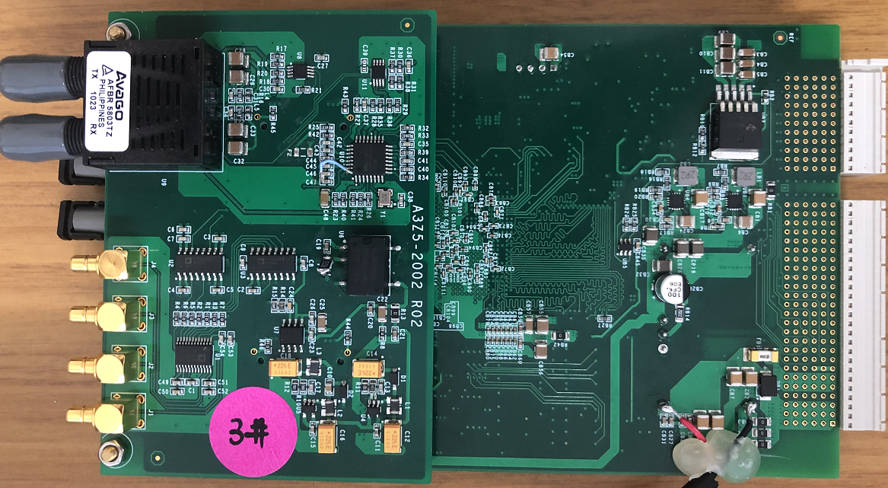
Magnet Power supply R&D
  Digital Power Supply Control Module ( DPSCM )
    Hardware ( used in HEPS )

Slide 17
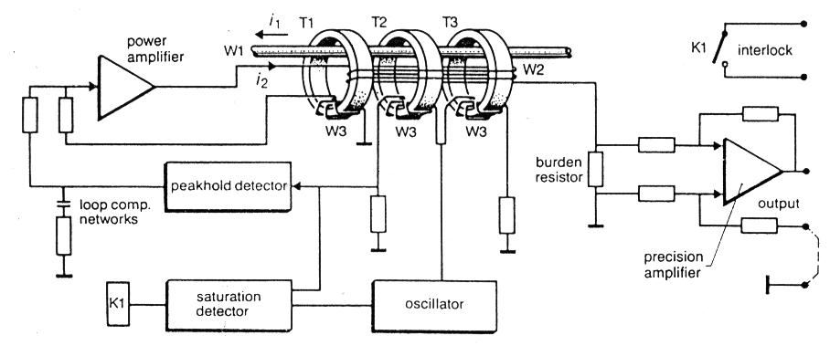
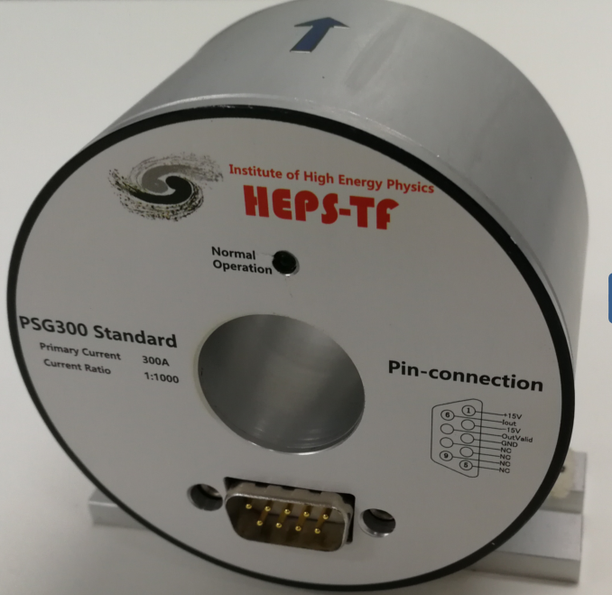
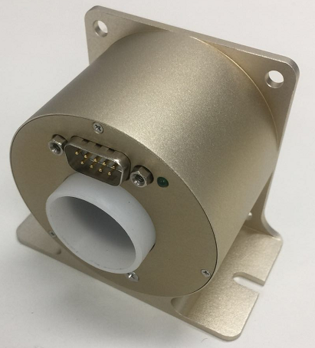
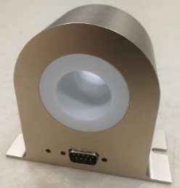
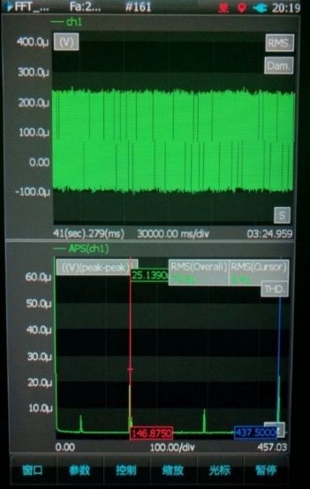
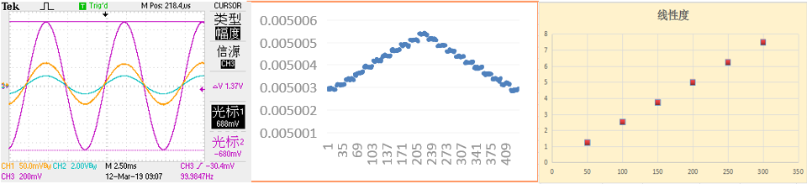
Magnet Power supply R&D
  Current transducers – 300A prototype
    Used at accelerators for magnet current measurement
    High stability, high linearity, high resolution and low temperature drift.
    Capable of performance required for stable, ppm accuracy
    Self-designed 300A and 20A DCCT, based on zero-flux principle.
Reliability, anti-interference, stability have been greatly improved
Version I （HEPS-TF）
Version II
Version III（HEPS）
 | bandwidth (Hz) | Resolution (ppm) | linearity (ppm) | noise (ppm)
Version III | 380 | 0.1 | 1.2 | 1.3
Version III | 350 | 0.15 | 1.2 | 1.5
Version III | 350 | 0.15 | 1.2 | 2
HETIC | 275 | 0.2 | 2.5 | 1
DANYSENSE | 995 | 0.5 | 2 | 1.5
bandwidth
Resolution
linearity
noise

Slide 18
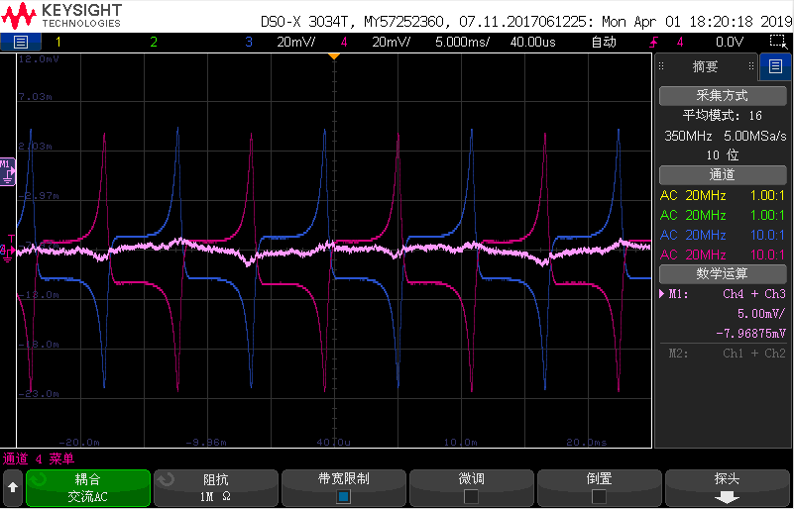
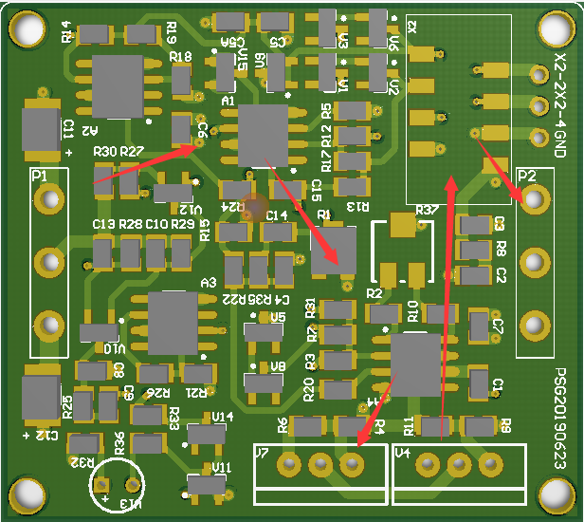
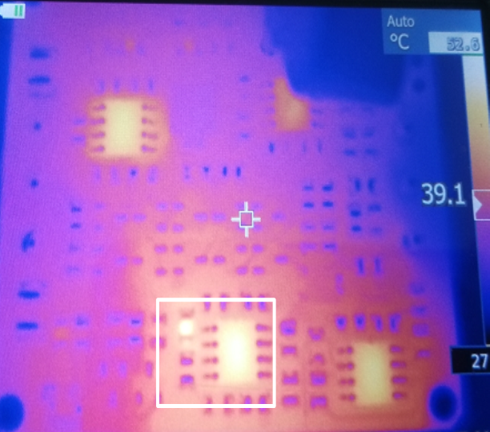
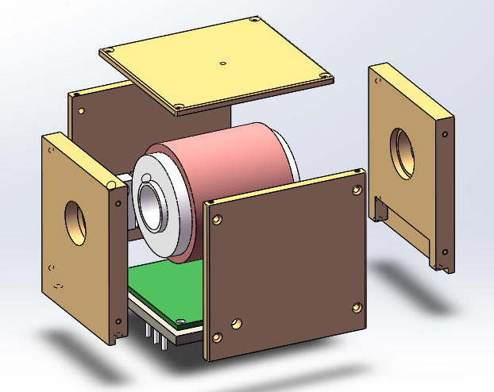
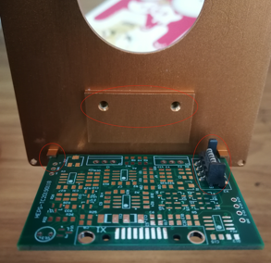
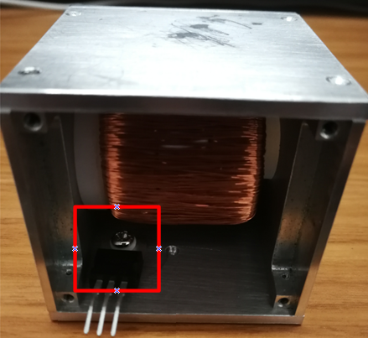
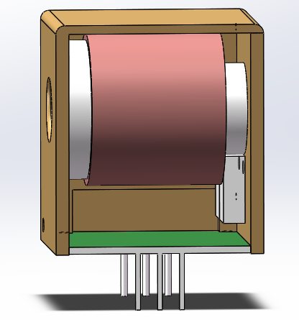
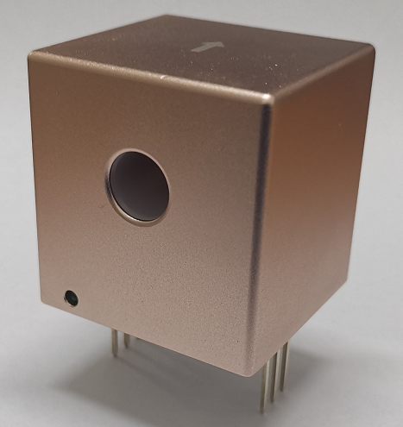
Magnet Power supply R&D
  Current transducers – 20A prototype
    On the basis of the 300A-DCCT: calculation of magnetic circuit parameters, control of circulation noise, structure design.
    20A-DCCT : resolution ≤0.5ppm (10uA), linearity ≤1.5ppm, noise ≤1ppm (maximum noise point)

Slide 19
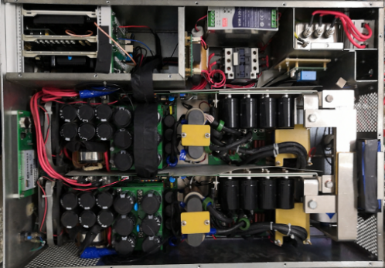
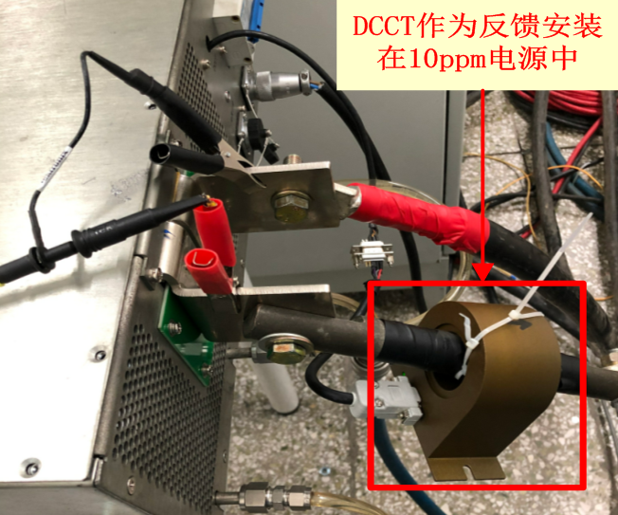
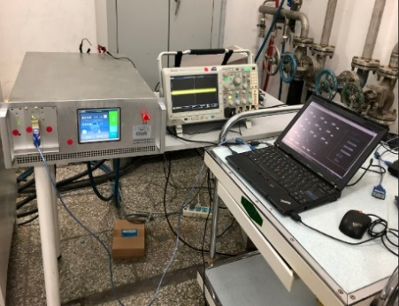
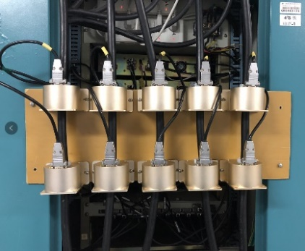
Magnet Power supply R&D
  Current transducers – prototype test
    In order to ensure the reliability and stability of the Self-designed current transducer, long-term performance tests have been carried out in different HEPS power sources
    HEPS high precision power supply, stability is better than 8ppm
Temperature drift effect
Stability 7.912ppm

Slide 20
Magnet Power supply R&D
  Low-power power supply - topology
    Single power supply
    DC source + full bridge inverter
    bipolar power supply
    Single-phase uncontrolled rectifier + phase shift full bridge inverter
Magnet
DC Source
DCCT
H-bridge driver
DPSCM
DCCT
Magnet
DPSCM

Slide 21
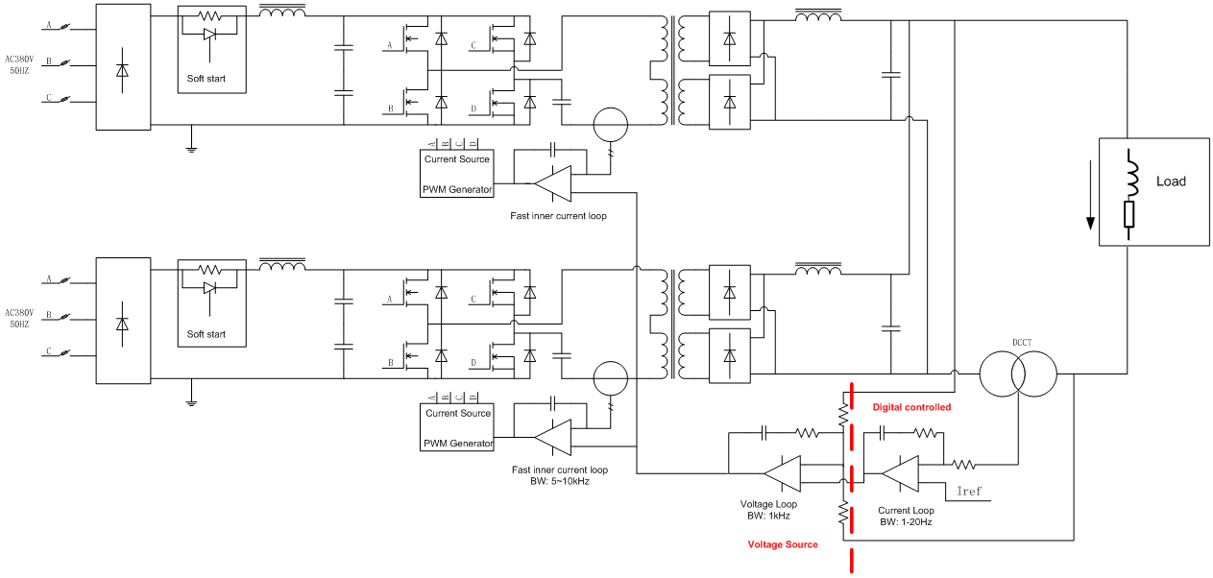
Magnet Power supply R&D
  Medium-power power supply - topology
    Three-phase uncontrolled rectifier + single H-bridge inverter
    The type of the H-bridge switch tube: IGBT or MOSFET

Slide 22
Magnet Power supply R&D
  High-power power supply - topology
    Adopt modular design to achieve high current and high voltage output
    Module: three-phase uncontrolled rectifier + H-bridge high-frequency inverter+high-frequency rectifier
PWM
Load
PWM
PWM

Slide 23
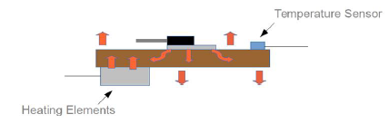
Magnet Power supply R&D
  Power supply – performance improved
    It is recommended to adopt three-loop control structure
    Outer loop: digital current loop, promise current with high precision
    Middle loop: voltage loop, ensuring low voltage ripple
    Inner loop: peak current loop of primary side of high-frequency transformer
    The peak current loop is used to improve the dynamic response of power supply and restrain the fluctuation of the grid
    Improve the stability of output current
    Current type DCCT: Special Considerations for burden resistance
    Digital controller ADC circuit local constant temperature

Slide 24
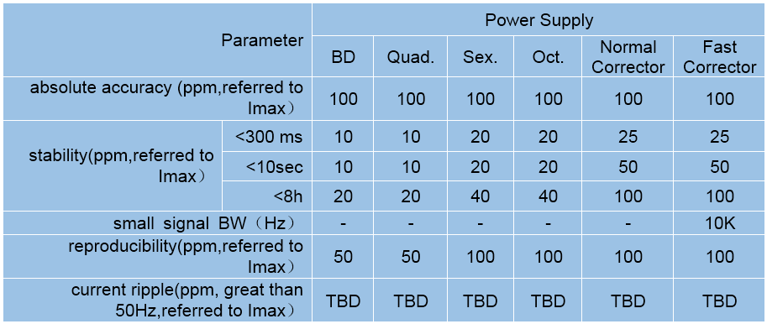
Magnet Power supply R&D
  Power supply – prototype
    With the HEPS project, various types of power supply are developed
    Requirements of HEPS SR PS:
    longitudinal gradient dipole, based on permanent magnets, no High-power PS needed.

Slide 25
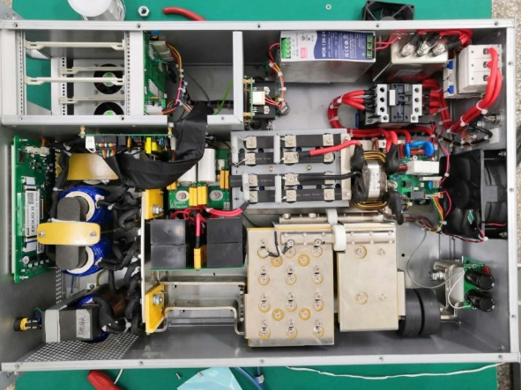
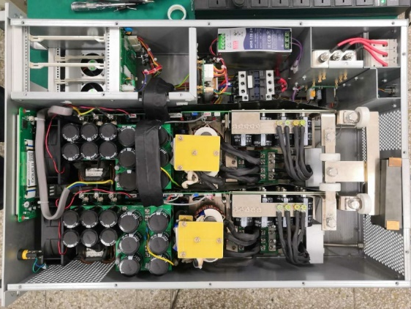
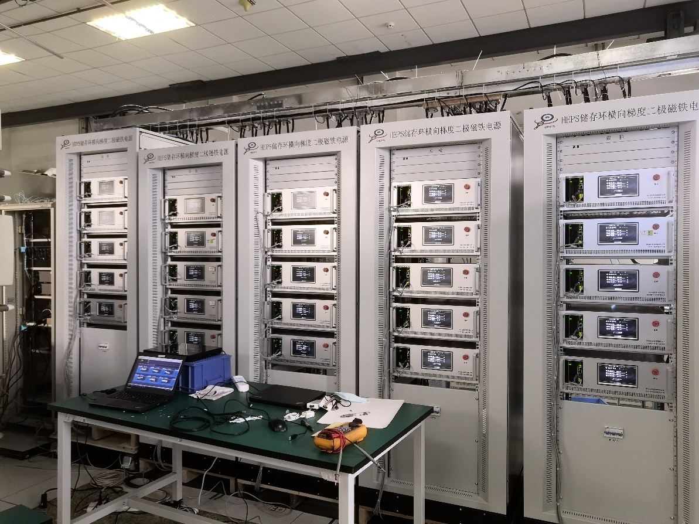
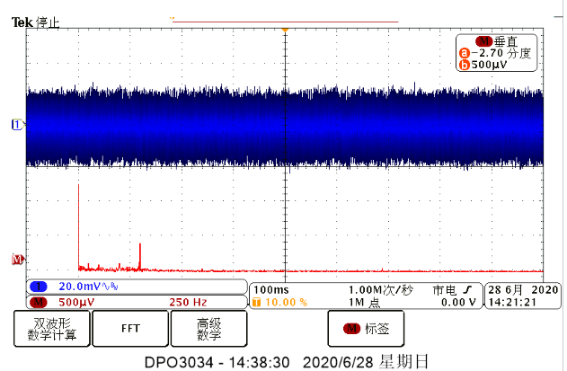
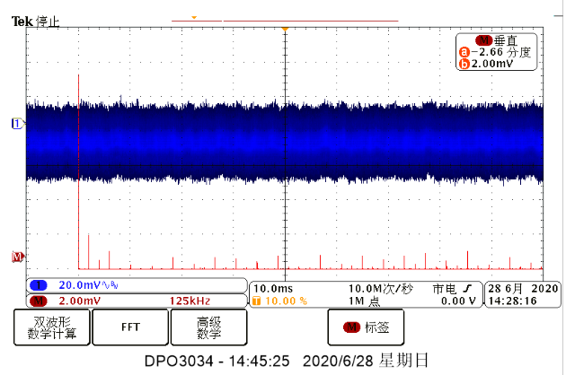
Magnet Power supply R&D
  Medium-power power supply - prototype
IGBT scheme
Dual-module MOSFET scheme

Slide 26
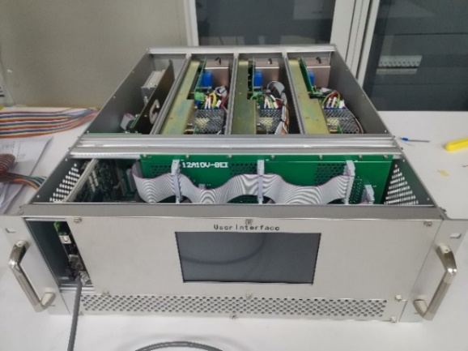
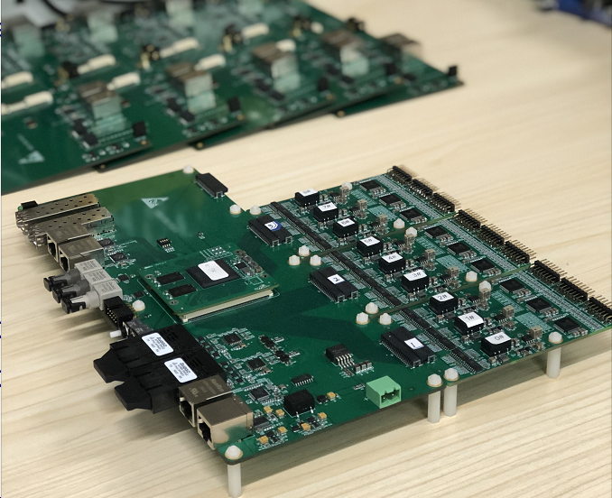
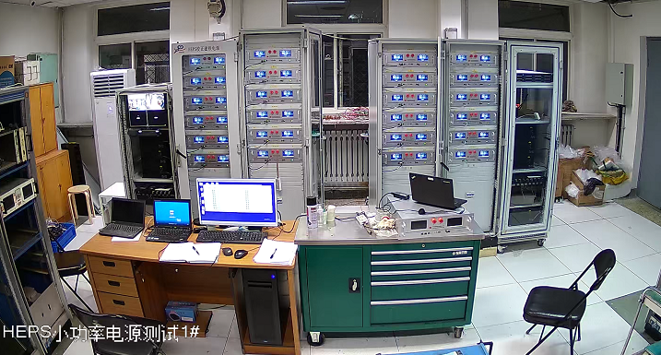
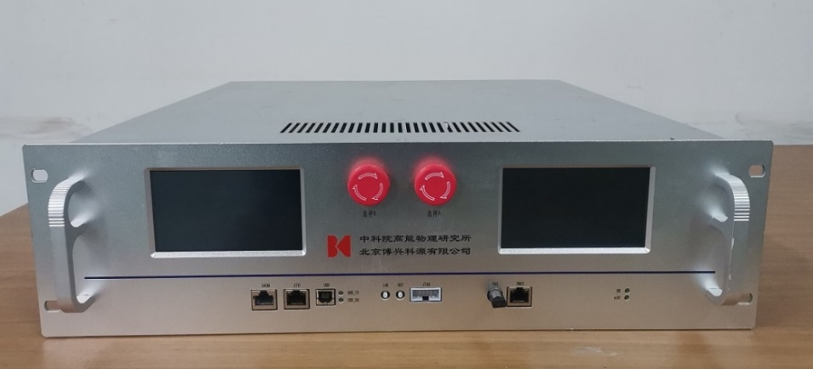
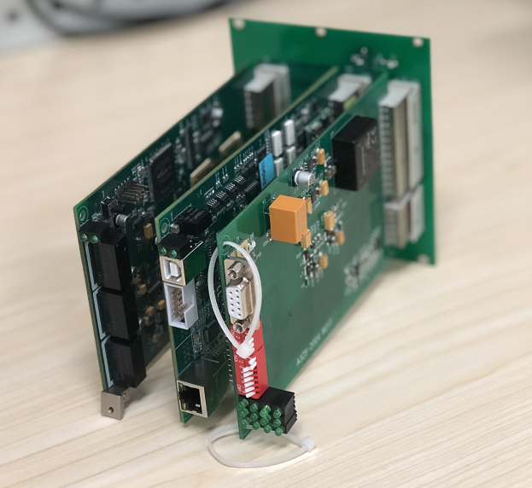
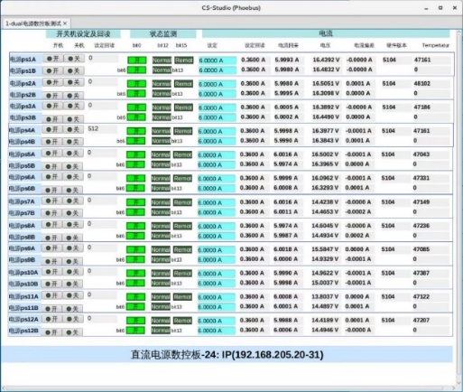
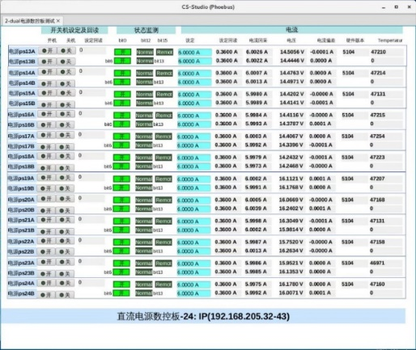
Magnet Power supply R&D
  Low-power power supply - prototype
    Multi power supplies share one chassis - space savings
    Power supplies in one chassis share one digital controller - cost effective
    Power supplies for Trim coil should be installed near the magnet to reduce the cable loss.

Slide 27
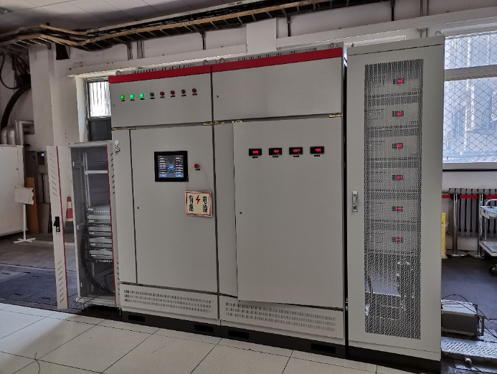
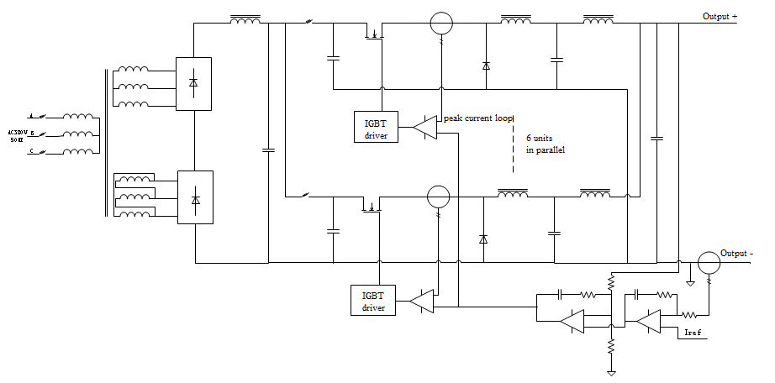
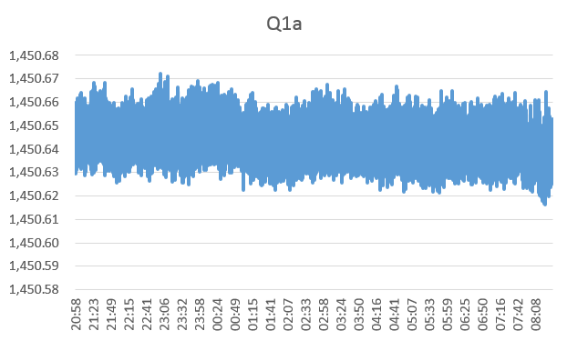
Magnet Power supply R&D
  High-power power supply - prototype
    The front dc source of power supply consists of two 12-phase diode rectifier circuits connected in series to form an equivalent 24 - phase power rectifier circuit. In the output part of the power supply, 6 groups of BUCK circuits are used in parallel to form stable current output
1700A/110V High-power supply for BEPCII

Slide 28

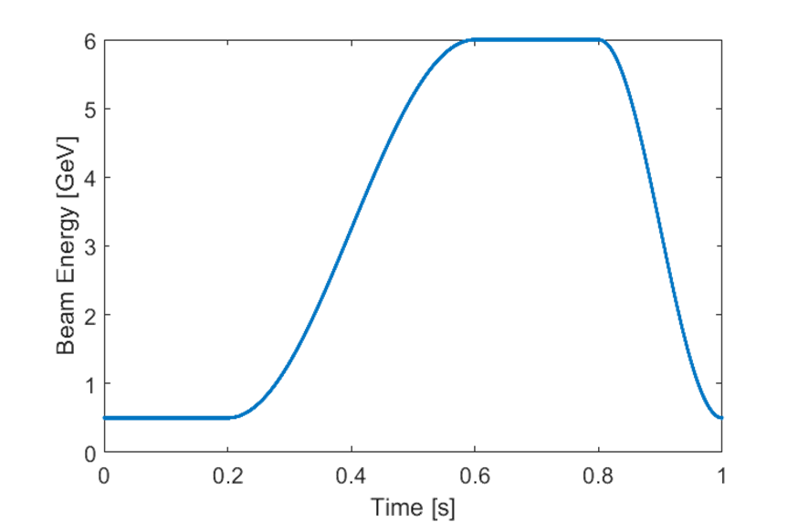
Magnet Power supply R&D
  Booster power supply
    Repetition frequency above 10Hz: White type resonant power system. energy fluctuations in the process of operation is stored by the resonant network.
    Repetition frequency below 10Hz: forced oscillation power supply.
    The booster power supply belongs to the two quadrant regulation current source, it has huge power fluctuations during operation. So it must have energy storage capacity to reduce the impact on the grid. .
    Key technical issue: dynamic tracking accuracy.
4.7s damping
Higgs
4.3s
4.3s
2.7s
on-axis
The magnetic field cycle waveform for CEPC booster
 | CEPC | HEPS
Out Rating | 520A/890V | 900A/900V
Stability | 500ppm | 300ppm
Repetitive frequency | 0.08Hz | 1Hz
Accuracy | 500ppm | 300ppm
Tracking error | 0.1% | 0.09%
The magnetic field cycle waveform for HEPS booster

Slide 29
Magnet Power supply R&D
  Booster power supply - topology
    Mature Multi – module series technology is adopted for high voltage output
    AC-DC-AC structure
    A power control circuit is used to reduce the fluctuation of input power
    Using multi phase-shifting technology to increase the equivalent frequency of power supply
Digital Current loop
Voltage loop
PWM
DPSCM
Frequency division

Slide 30
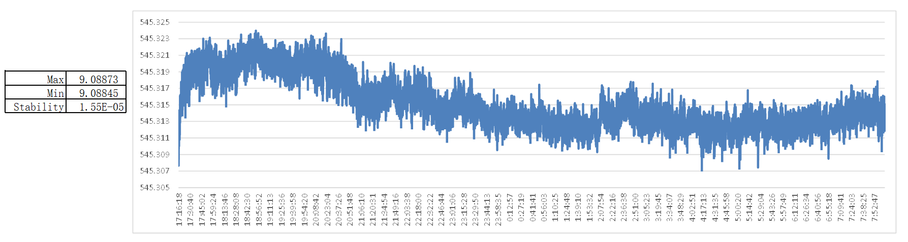


Magnet Power supply R&D
  Booster power supply
the stability meets the requirements
the formal power supply of HEPS booster magnet
Current tracking waveform

Slide 31


Electro-magnetic Separator R&D
  Introduction
    In the RF region, A set of electrostatic separator combined with dipole magnet (Electro-Magnetic Separator ) are installed downstream of the RF cavities.
    They are used to avoid bending of incoming beam and deflect the outgoing beam in H mode. After the Separators, the positive and negative electron beams of the outer ring passing through the RF cavities are deflected to their respective inner rings.
Layout of RF region
Layout of the CEPC accelerator complex
  Optics of the RF region for Higgs (left), W and Z (right) modes

Slide 32



Electro-magnetic Separator R&D
  Introduction
    The Electro-Magnetic Separator is a device consisting of perpendicular electric and magnetic fields.
    One set of Electro-Magnetic Separators including 8 units, total 32 units will be need for CEPC.
 | Filed | Effective Length | Good field region | Stability
Electrostatic separator | 2.0MV/m | 4m | 46mm×11mm | 5×10⁻⁴
Dipole | 66.7Gauss | 4m | 46mm×11mm | 5×10⁻⁴
Schematic of Electrostatic-Magnetic Separator
Metal-ceramic support
High voltage feedthrough
UHV tank
Support
Magnet
Coil
Electrode
  Structure drawing of Electrostatic-Magnetic Separator

Slide 33


Electro-magnetic Separator R&D
  Design of dipole magnet
    The magnet yoke is H-type, because of the higher field integrals uniformity and installation consideration of the electro-static system.
Magnet Name | ESM
Center field [Guass] | 75.5
Magnet Length [m] | 4.4
Current [A/turn] | 10.8
Turns [H×V] | 12×17
Field Clamp Size [H×V, mm] | 830×610
Field Clamp Wall Thickness [mm] | 10
Field Clamp Number | 2
Coil Number | 2
Conductor Size [H×V, mm] | 3×3
Current Density [A/mm^2] | 1.2
Magnet Resistance [Ω] | 7.82
Magnet Voltage [V] | 84.4
Magnet Power [W] | 660
Magnet Inductance [H] | 2.42
Cooling Method | Air
Yoke Weight [Ton] | 11
Coil Weight [Ton] | 0.328
Magnet Weight [Ton] | 11.328
Field Distribution
Magnetic flux density distribution in 3D Model
Parameters of the magnet

Slide 34



Electro-magnetic Separator R&D
  Design of dipole magnet
    The prototype of the magnet has been developed.
    The field measurement of the prototype will be made.

Slide 35

Electro-magnetic Separator R&D
  Design of electrostatic separator
    An electrostatic separator comprise a pair of electrodes, UHV tank, metal-ceramic supports, high voltage feedthrough, High voltage circuit and vacuum system, etc.
Separator length | 4.5m
Inner diameter of separator tank | 380mm
Electrode length | 4.0m
Electrode width | 180mm
Nominal gap | 75mm
Maximum operating field strength | 2MV/m
Maximum operating voltage | ±75kV
Maximum conditioning voltage | ±135kV
Good field region (0.5‰ limit) | 46mm×11mm
Nominal vacuum pressure | 2.7×10⁻⁸ Pa
  Structure drawing of Electrostatic Separator
  Parameters of electrostatic separator

Slide 36





Electro-magnetic Separator R&D
  Design of electrostatic separator
    Electrode ( a pair of metal flat plate )
    Dimension : 4m long and 180mm wide
    Material : Pure Titanium
    Field strength : 2MV/m
    UHV tank
    4.5m long and 38cm inner diameter
Field homogeneity：7.5cm*5cm 0.5‰
Calculated integrated electrical field uniformity ：4.6cm*3cm 0.5‰
Length：400cm
With：18cm
Thickness：2cm
Radius：1.5cm
Density：4.54g/cm³
Weight：≈65kg
18cm
400cm
25cm
400cm
ID：9.5cm
ED：7.5cm
thickness：1cm

Slide 37




Electro-magnetic Separator R&D
  Design of electrostatic separator
    The electrostatic separators are large contributors to the overall impedance. There are two methods implemented in the design of the separator which reduce the loss factor.
    Ground electrodes
    Tapered ends
σ_{z}=5mm: Loss factor @k_trap: 0.032v/pc
Separator tank length | 4000mm
Inner diameter of separator tank | 380mm
Electrode height | 180mm
Electrode gap | 75mm
Electrode thickness | 15mm
Taper length | 231mm
Taper end diameter | 98mm
Ground plate length | 4462mm
Ground plate height | 100mm
Ground plate thickness | 20mm
Ground electrodes
 | Higgs(w) | W (kw) | Z(w) | ttbar（w）
HOM power(30MW) | 385 | 1.87 | 18.6 | 107
HOM power(50MW) | 643 | 3.13 | 31.0 | 178
Tapered ends

Slide 38






Electro-magnetic Separator R&D
  Design of electrostatic separator
    In this fringe ﬁeld region, the ratio of E/B differs from that inside the separator, and this can result in a synchrotron radiation from the Separation Region, which will affect the downstream RF cavities.
    Magnet: addition of ﬁeld clamps, along with the mirror plates.
    Separator: ﬂaring open the electrode ends progressively.
No optimization
Clamp
Mirror plate + clamp
ﬁeld clamp
mirror plate
The normalized longitudinal E and B field profiles before optimization
The normalized longitudinal E and B field profiles after optimization

Slide 39






Electro-magnetic Separator R&D
  Prototype of electrostatic separator
    the prototype of electrostatic separator was commissioning.
    Electrode plate vacuum leak detection and installation.

Slide 40





Electro-magnetic Separator R&D
  Prototype of electrostatic separator
    the prototype of electrostatic separator was commissioning.
    Molecular pump unit for crude pumping.
    Vacuum baking.

Slide 41





Electro-magnetic Separator R&D
  Prototype of electrostatic separator
    Test result
    Electric field uniformity (0.5‰) 46×30 mm² (simulation result) ;
    Vacuum degree ≤ 2.6×10⁻⁸Pa ;
    Electric field intensity 3.15MV/m@±118kV .

Slide 42
Summary
  According to the latest physical parameters, about 24,150 power supplies are needed to power the magnets.
  Based on the optimized design, the power demand is estimated.
  The design of the digital controller and current transducer are introduced, the two key components are independently developed and applied in HEPS.
  The design of the power supply with different power levels is introduced. All types of power supplies have been developed on HEPS and BEPCII.
  The prototype of the magnet has been developed. The field measurement will be made later.
  The prototype of the separator has been fabricated and tested. the vacuum and voltage reached the target.
  Next the Electro-magnetic Separator will be tested when the electrostatic separator and magnet are assembled together.

Slide 43
Thank You!

