Slide 1



CEPC Cryogenic System and Technology Development
Rui Ge
12-16 June 2023, Hongkong, CEPC Accelerator TDR International Review

Slide 2
Content
CEPC Cryogenic System Brief Introduction
Cryogenic system for the SRF
Cooling Scheme Optimization and Process Calculation
Development of key equipment and technology
Platform of Advanced Photon Source Technology （PAPS）
Cryogenic system for SC magnets
Summary

Slide 3
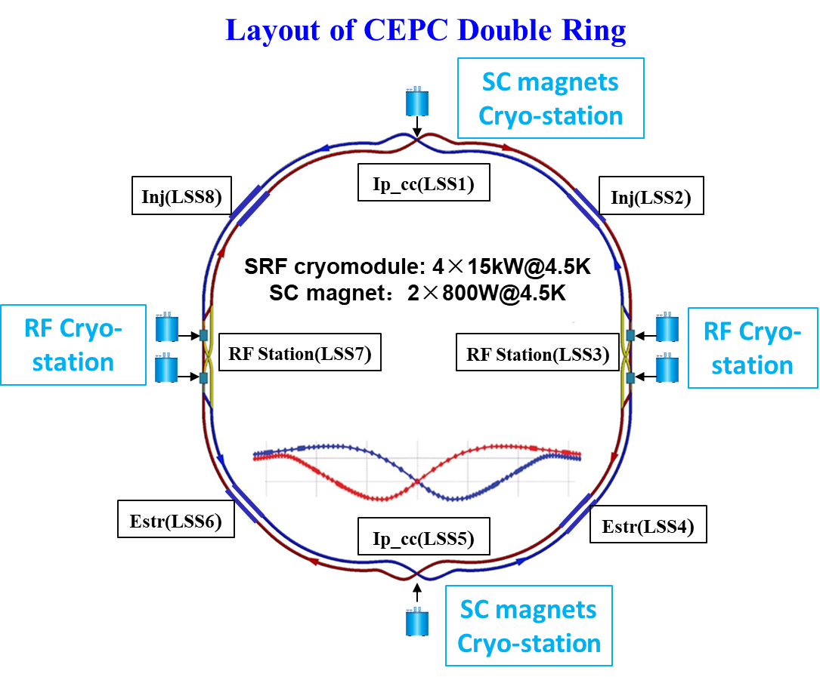
CEPC Cryogenic System Brief Introduction
  Booster ring:
1.3 GHz 9-cell cavities, 96 cavities
12 cryomodules
3 cryomodules/each station
Temperature: 2K
  Collider ring:
650MHz 2-cell cavities, 336 cavities
56 cryomodules
14 cryomodules/each station
Temperature: 2K
  IR magnets:
4 IR magnets,
Temperature: 4.5K
Detectors:
2 detector magnets
Thermosiphon cooling

Slide 4
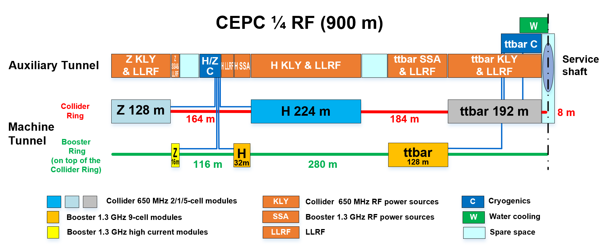
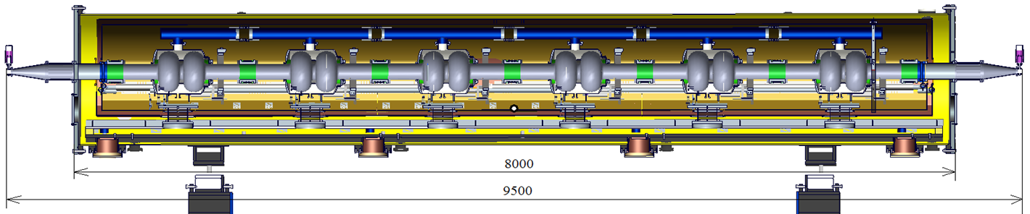
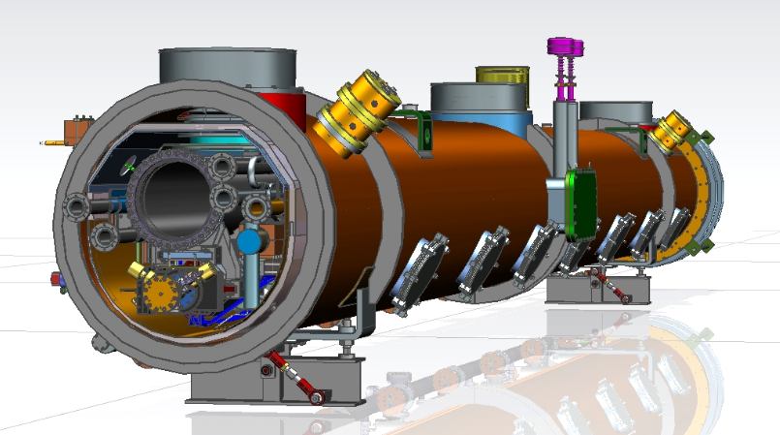
CEPC Cryogenic System Brief Introduction
Cryomodules for Higgs 30 / 50 MW
  30 MW Higgs:
Collider: 192 650 MHz 2-cell cavities in 32 modules (6 cav / CM)
Booster: 96 1.3 GHz 9-cell cavities in 12 modules (8 cav / CM)
  50 MW Higgs:
Collider: add 24 modules, in total 56 650 MHz modules
Booster: 96 1.3 GHz 9-cell cavities in 12 modules (8 cav / CM)

Slide 5
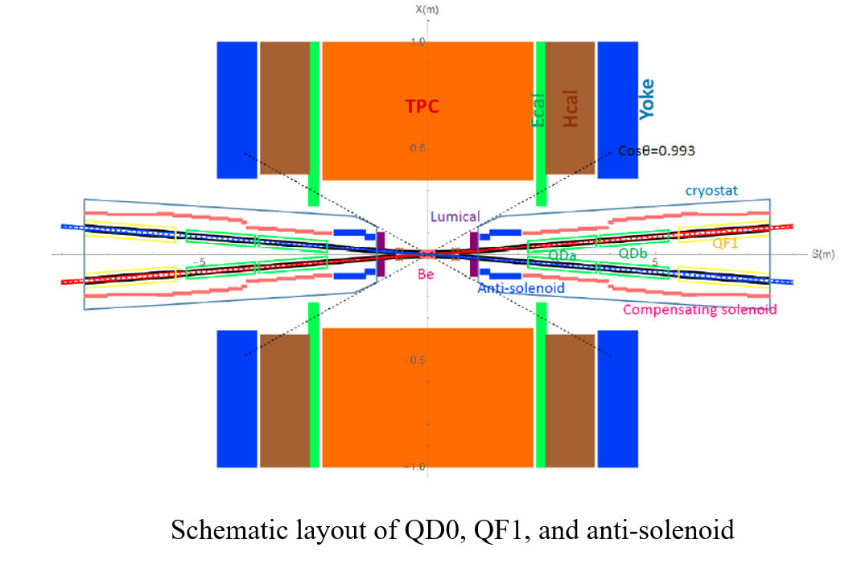
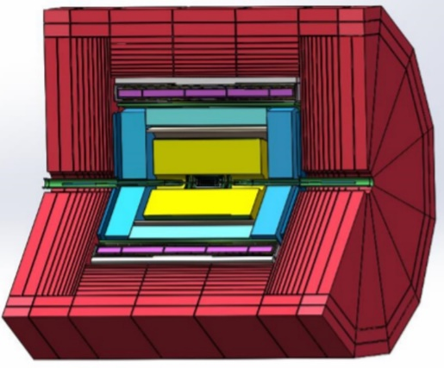
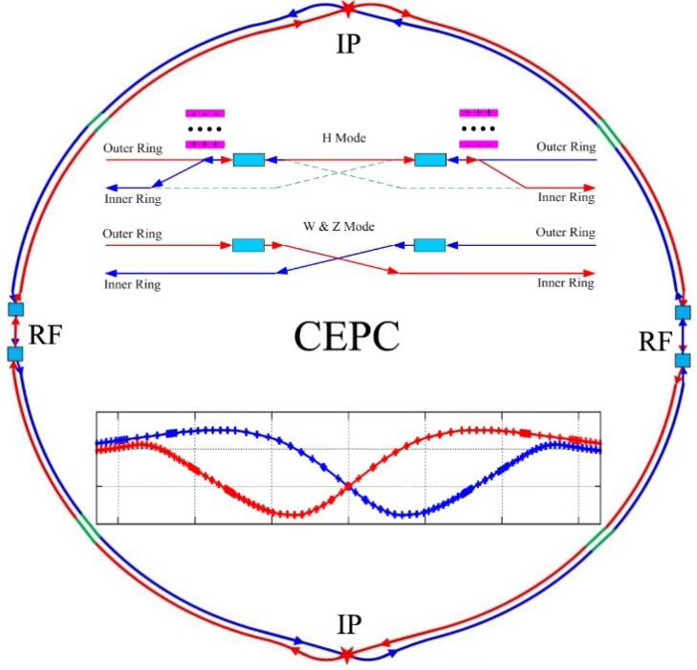
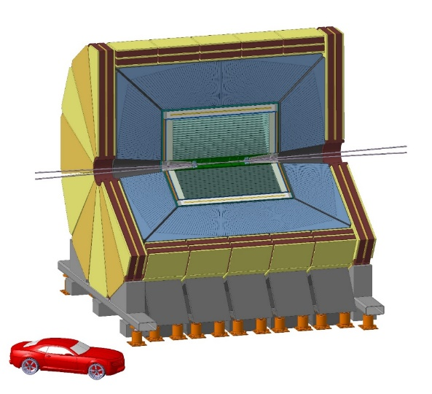
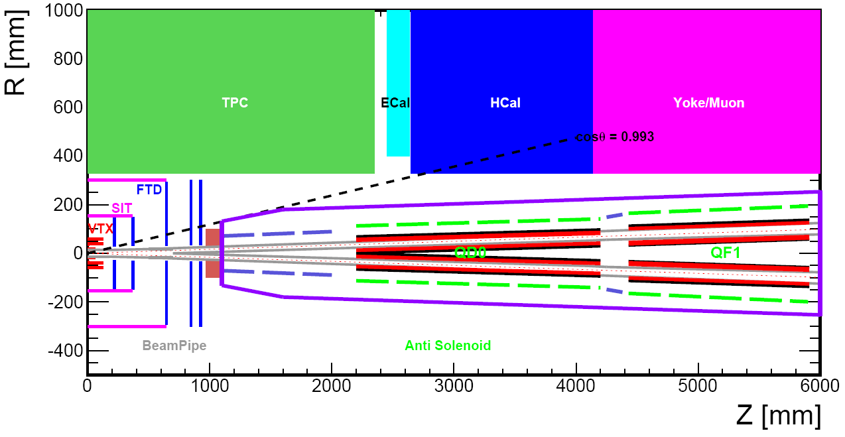
CEPC Cryogenic System Brief Introduction
SC magnets cryogenic system overview
LTS Solenoid
LTS Solenoid ：
Solenoid located outside calorimeter
Inner diameter 7.2 m, length 7.4 m
Central field：3 T
Superconductor：NbTi
Operation temperature：4.2 K
HTS Solenoid
IDEA detector
HTS Solenoid ：
Solenoid located inside calorimeter/less material
Inner diameter 4 m, length 6 m
Central field：2 T
Superconductor：YBCO
Operation temperature：20 K
From Zhu Ying-shun
Zhu Zian，Wang Meifen

Slide 6
Content
CEPC Cryogenic System Brief Introduction
Cryogenic system for the SRF
Cooling Scheme Optimization and Process Calculation
Development of key equipment and technology
Platform of Advanced Photon Source Technology R&D（PAPS）
Cryogenic system for SC magnets
Summary

Slide 7
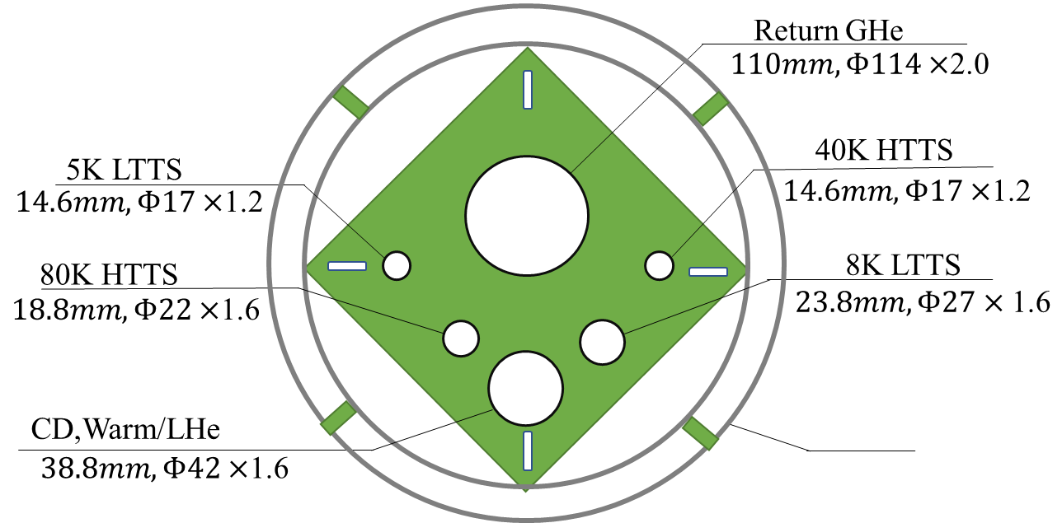
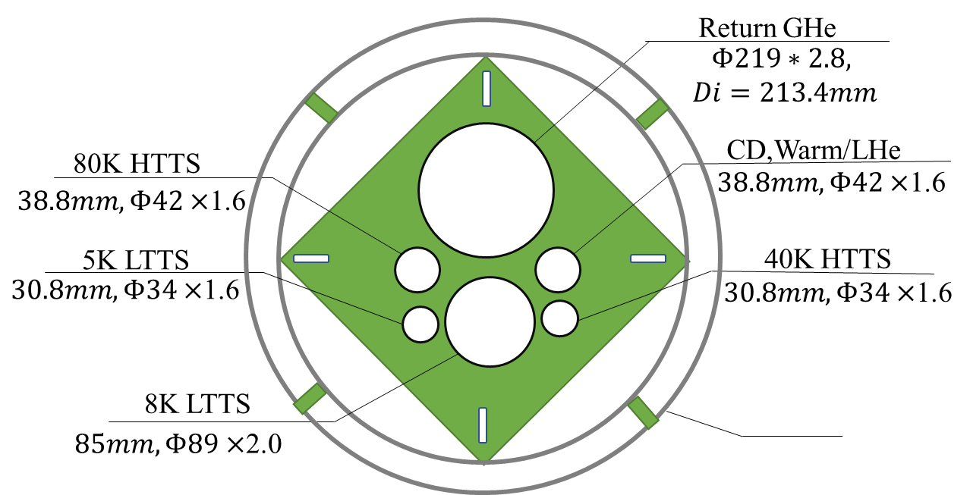
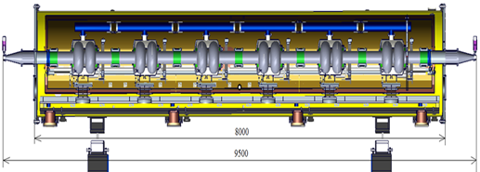
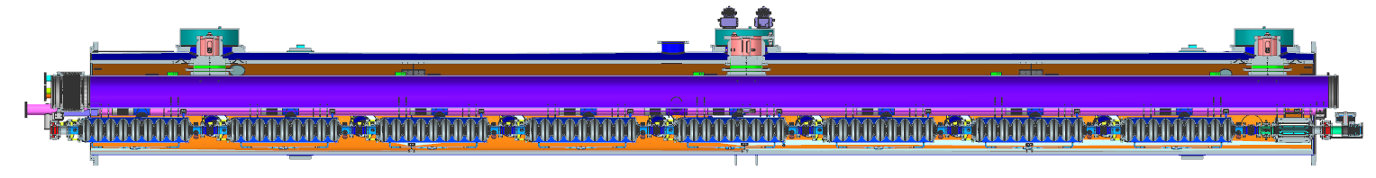
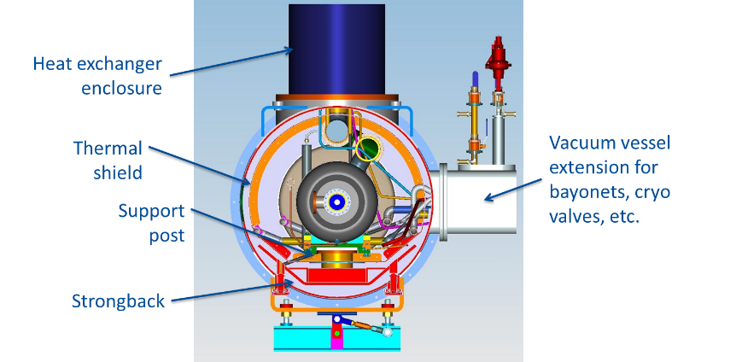

Flow chart of SRF CDR Scheme
24000
50MW
117000
Compressor group
Cold Box
Dewar
Main Distribution
Valve Box
Auxiliary-tunnel
2K valve boxes
224000
80000
14 cryomodules, 6×650MHZ 2-cell cavities each
Collider Ring
3 cryomodules, 8×1.3GHZ 9-cell cavities each
Booster Ring
10
Cryomodules
8000
11000
5000
11000
5000
11000
11000
11000
11000
11000
5000
5000
加速器中心低温组

Slide 8
Estimated heat loads for SC cavities-CDR Scheme
Higgs Mode 50MW | Unit | Collider |  |  | Booster
 |  | 40-80K | 5-8K | 2K | 40-80K | 5-8K | 2K
Predicted static heat load per cryomodule | W | 300 | 60 | 12 | 140 | 20 | 3
Cavity dynamic heat load per cryomodule | W | 0 | 0 | 153.59 | 0 | 0 | 13.98
HOM dynamic heat load per cryomodule | W | 20 | 12 | 2 | 2 | 1 | 1
Input coupler dynamic heat load per cryomodule | W | 60 | 40 | 6 | 40 | 3 | 0.4
Module dynamic heat load | W | 80 | 52 | 161.59 | 42 | 4 | 15.38
Each Module total heat load | W | 380 | 112 | 173.59 | 182 | 24 | 18.38
Cryomodule number | - | 56 | 56 | 56 | 12 | 12 | 12
EVB heat loss | W | 50 | 10 | 10 | 50 | 10 | 10
EVB number | - | 40 | 40 | 40 | 12 | 12 | 12
MDVB heat loss | W | 50 | 30 | 30 | 50 | 30 | 5
MDVB number | - | 4 | 4 | 4 | 4 | 4 | 4
Total cryogenic transfer line length | m | 1924 | 1924 | 1924 | 536 | 536 | 536
cryogenic transfer line heat loss per meter | W/m | 2 | 0.5 | 0.3 | 2 | 0.5 | 0.3
Total cryogenic transfer line heat loss | W | 3848 | 962 | 577.2 | 1072 | 268 | 160.8
Total heat load | kW | 27.328 | 7.754 | 10.81824 | 4.056 | 0.796 | 0.52136
Total predicted mass flow | g/s | 82.42 | 152.26 | 373.72 | 13.34 | 12.73 | 18.324
Overall net cryogenic capacity multiplier |  | 1.54 | 1.54 | 1.54 | 1.54 | 1.54 | 1.54
4.5K equiv. heat load with multiplier | kW | 3.16 | 10.80 | 53.32 | 0.47 | 1.11 | 2.58
4.5K equiv. heat load with multiplier | kW | 67.29 |  |  | 4.15
Total 4.5K equiv. heat load with multiplier | kW | 71.44

Slide 9
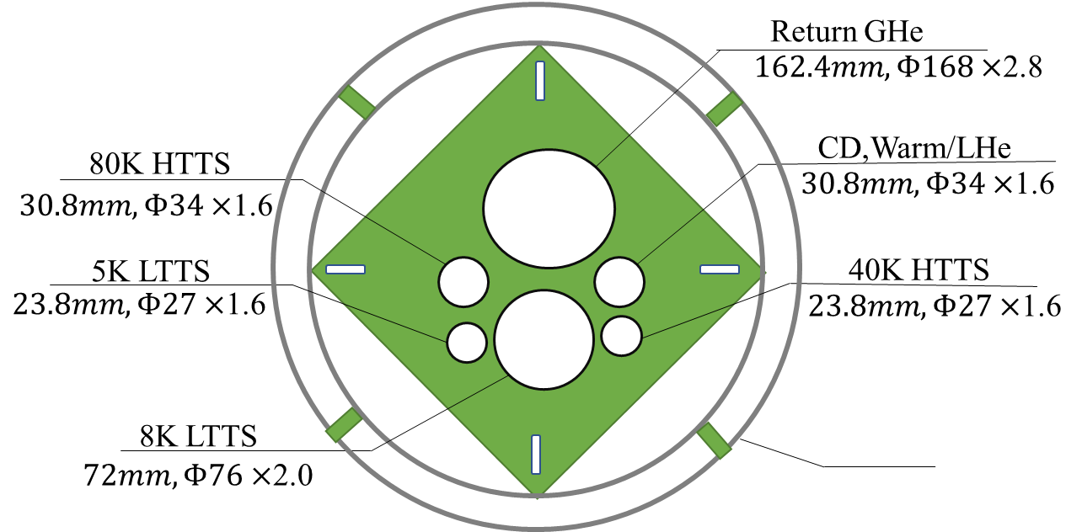
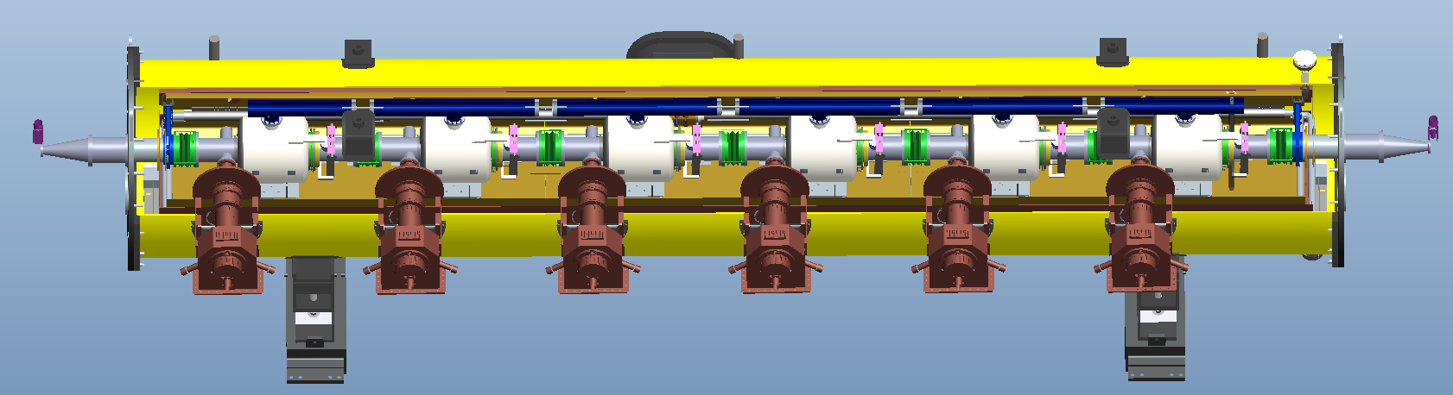
Flow chart of SRF TDR Scheme
24000
117000
Smaller diameter
Compressor group
Cold Box
Dewar
Main Distribution
Valve Box
14 cryomodules, 6×650MHZ 2-cell cavities each
Collider Ring
3 cryomodules, 8×1.3GHZ 9-cell cavities each
Booster Ring
2K valve boxes
2K valve boxes
10
Cryomodules
11000
5000
11000
5000
11000
11000
11000
8000
11000
11000
5000
5000

Slide 10
Estimated heat loads for SRF TDR Scheme
Higgs Mode 50MW | Unit | Collider |  |  | Booster
 |  | 40-80K | 5-8K | 2K | 40-80K | 5-8K | 2K
Predicted static heat load per cryomodule | W | 300 | 60 | 12 | 140 | 20 | 3
Cavity dynamic heat load per cryomodule | W | 300 | 60 | 118.2 | 0 | 0 | 44.8
HOM dynamic heat load per cryomodule | W | 20 | 12 | 2 | 20 | 6 | 1
Input coupler dynamic heat load per cryomodule | W | 60 | 40 | 6 | 40 | 3 | 0.4
Module dynamic heat load | W | 380 | 112 | 126.2 | 60 | 9 | 46.2
Each Module total heat load | W | 680 | 172 | 138.2 | 200 | 29 | 49.2
Cryomodule number | - | 40 | 40 | 40 | 12 | 12 | 12
EVB heat loss | W | 50 | 10 | 10 | 50 | 10 | 10
EVB number | - | 40 | 40 | 40 | 12 | 12 | 12
MDVB heat loss | W | 50 | 30 | 30 | 50 | 30 | 5
MDVB number | - | 4 | 4 | 4 | 4 | 4 | 4
Total cryogenic transfer line length | m | 1000 | 1000 | 1000 | 300 | 300 | 300
cryogenic transfer line heat loss per meter | W/m | 2 | 0.5 | 0.3 | 2 | 0.5 | 0.3
Total cryogenic transfer line heat loss | W | 2000 | 500 | 300 | 600 | 150 | 90
Total heat load | kW | 31.4 | 7.9 | 6.348 | 3.8 | 0.738 | 0.8204
Total predicted mass flow | g/s | 82.42 | 152.26 | 373.72 | 13.34 | 12.73 | 18.324
Overall net cryogenic capacity multiplier |  | 1.54 | 1.54 | 1.54 | 1.54 | 1.54 | 1.54
4.5K equiv. heat load with multiplier | kW | 3.63 | 11.01 | 31.29 | 0.44 | 1.03 | 4.05
4.5K equiv. heat load with multiplier | kW | 45.93 |  |  | 5.52
Total 4.5K equiv. heat load with multiplier | kW | 51.45
Four individual refrigerators (4 × 15kW@4.5K) will be employed for the CEPC cavity cryogenic system.

Slide 11
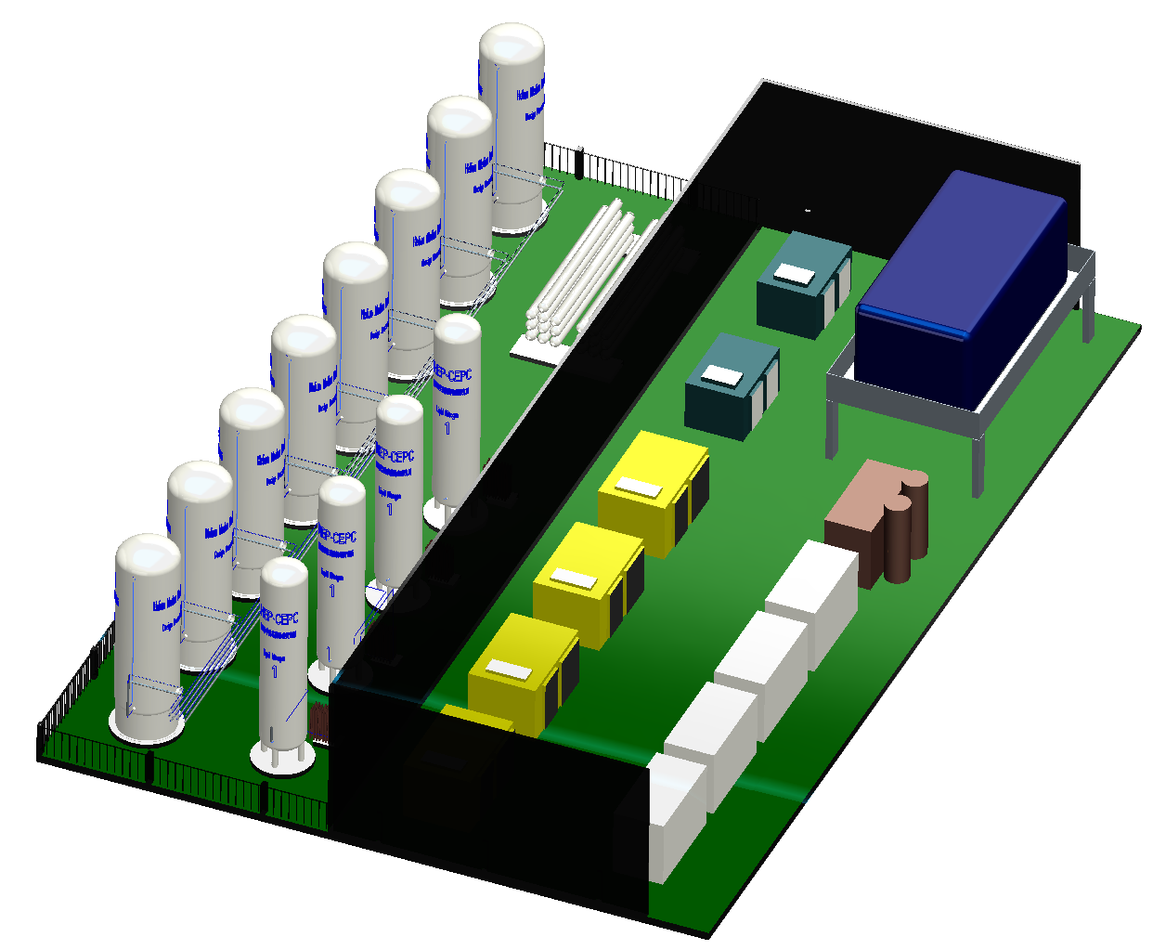
Layout of CEPC cryogenic hall
High pressure helium cylinders
Piston compressors
10*100m³ helium gas
Pressure vessels
Helium gas bag
Helium purifier
Electrical control system
4*50m³ LN₂ Storage Tanks
Recycle screw compressors

Slide 12
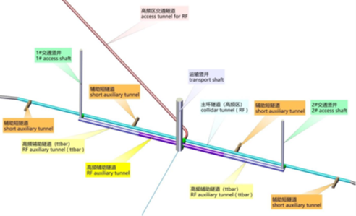
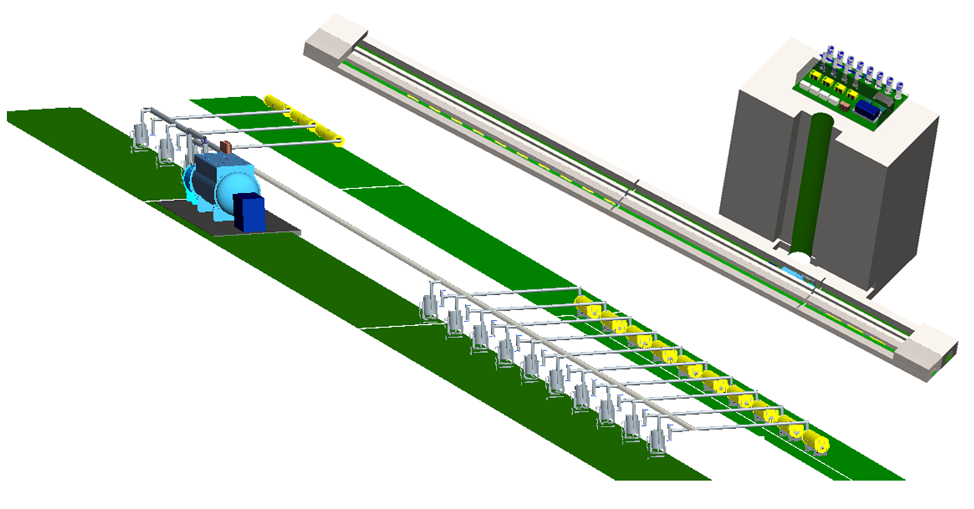
Layout of CEPC cryogenic system for SRF
Warm equipment on the ground:
compressor hall, helium gas tanks
Beam tunnel
Gallery tunnel
Shaft
Refrigerator
Cryogenic transfer line
Cold equipment under the ground
2K valve boxes
cryomodules

Slide 13
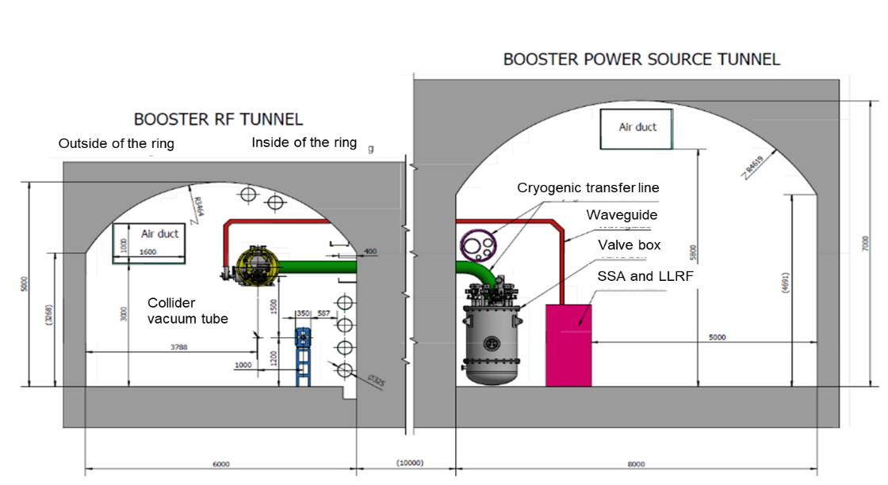
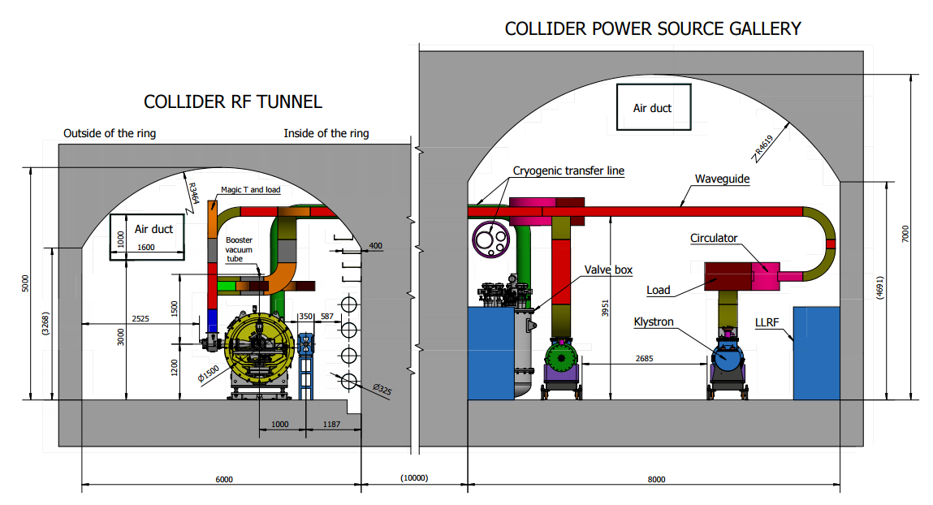
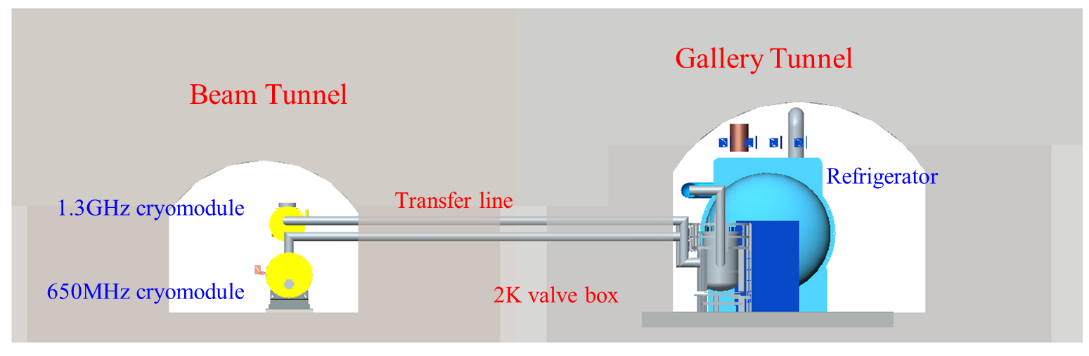
Tunnel cross section

Slide 14
cryogenic system process flow diagram in the SRF system
5K@3bara supercritical helium subcooled to 4.5K, and then through 2K JT heat exchanger reduced to 2.2K@3bara.
2.2K@3bara helium throttled by JT valve to produce the 2K super flow helium.
40-80K loop to cool down the cryomoduls’ thermal shield.
5-8K loop to cool down the coupler.

Slide 15
Booster cryomodules for String

Slide 16
Collider cryomodules for String

Slide 17
Process calculation
0.15W/m single loop transfer line heat loss
Scheme1
Scheme2
Collider: after modified, Smaller diameter

Slide 18
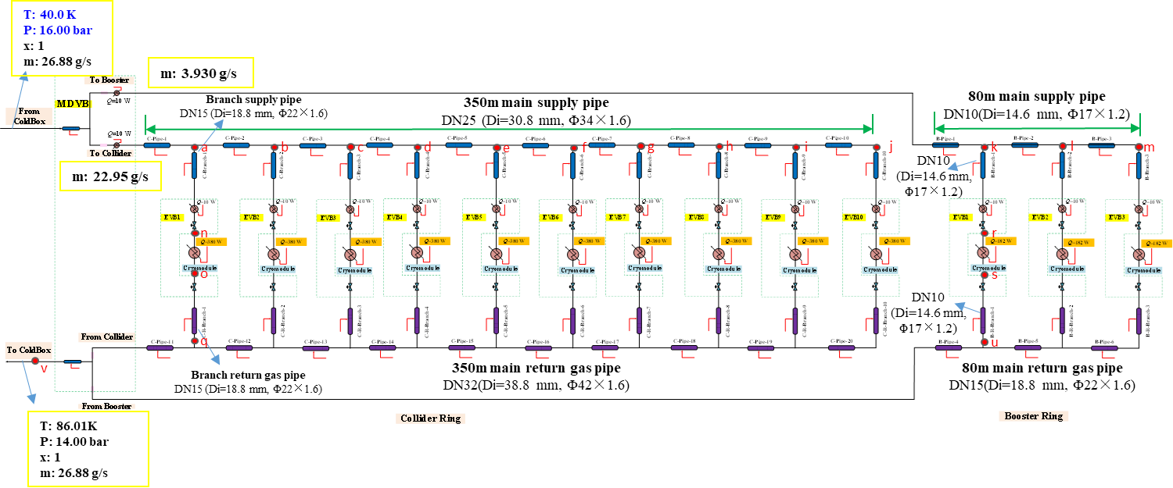
40K~80K TS calculation
Total main supply pipe length is 430 meters, and the heat loss per meter is 2.0 W.
The mass flow of liquid helium needs to be provided by the refrigerator is no less than 26.88 g/s .
Main supply pipe sizes: collider- Di=30.8 mm, Booster-Di=14.6 mm.
Main return gas pipe sizes: collider- Di=38.8 mm, Booster-Di=18.8 mm.
Branch supply pipe sizes: collider- Di=18.8 mm, Booster-Di=14.6 mm.
Branch return gas pipe sizes: collider- Di=18.8 mm, Booster-Di=14.6 mm.

Slide 19
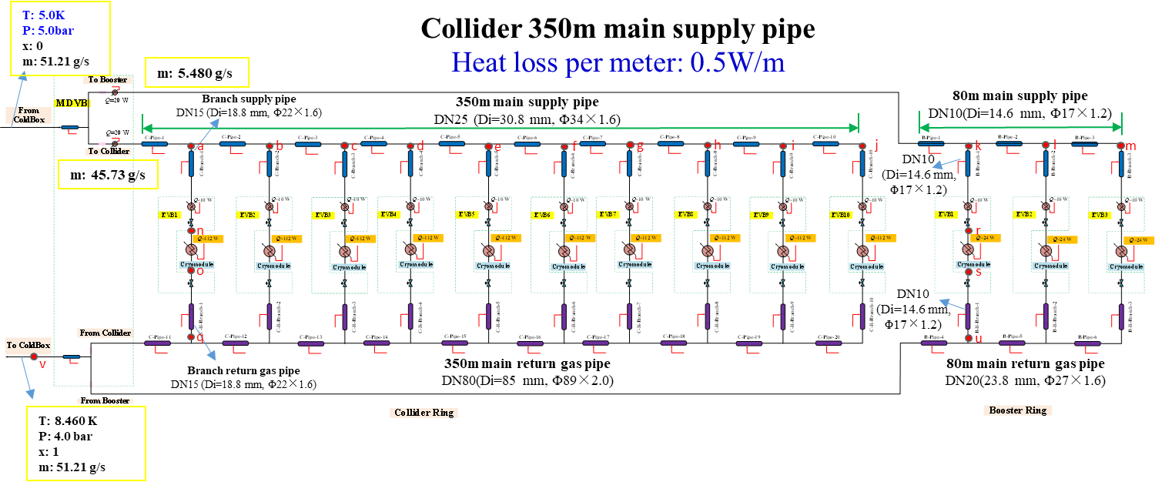
5K~8K TS calculation
Total main supply pipe length is 430 meters, and the heat loss per meter is 0.5 W.
The mass flow of liquid helium needs to be provided by the refrigerator is no less than 51.21 g/s .
Main supply pipe sizes: collider- Di=30.8 mm, Booster-Di=14.6 mm.
Main return gas pipe sizes: collider- Di=85 mm, Booster-Di=23.8 mm.
Branch supply pipe sizes: collider- Di=18.8 mm, Booster-Di=14.6 mm.
Branch return gas pipe sizes: collider- Di=18.8 mm, Booster-Di=14.6 mm.

Slide 20
Development of the key equipment and technology
Large refrigerator
1.3GHz cavity cryomodule
650MHz cavity cryomodule
KW JT heat exchanger
Advanced control strategy

Slide 21
Key equipment and technology
Large refrigerator
Technical supported by FULL CRYO Company and TIPC, CAS
2.5 kW @4.5K or 500W @2K refrigerator have passed test and will be installed in CIADS campus for the long time running to verify the stability.
The CAS pilot project for the 10 kW @4.5K or 15 kW @4.5K (required for CEPC) has been approved, and it is expected to be developed and fully prepared for CEPC in the next few years.

Slide 22
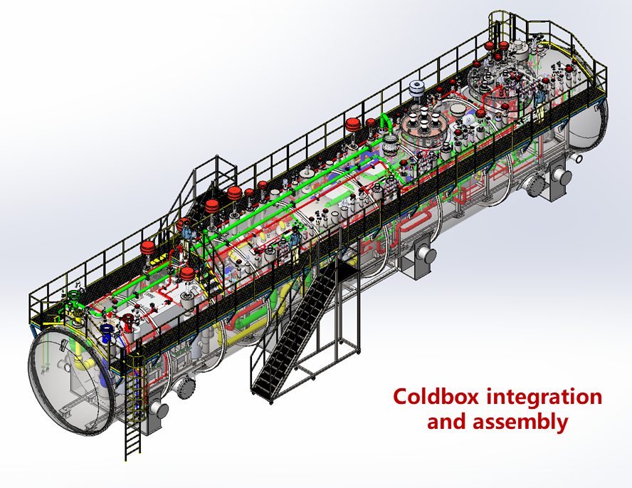
Key equipment and technology
Parameters of the refrigerator
Large refrigerator
Other parameters | Precooled by Turbin expanders | Precooled by liquid nitrogen
The consumption of the Liquid Nitrogen | 0g/s (0L/h) | 428.7g/s(2043L/h)
Gas flow for precooling | 100g/s | 0g/s
Gas flow（g/s） | 1668g/s | 1551g/s
Power Consumption（KW） | 3935.13 | 3721.3
Parameters of the cold compressor
Parameters | The high pressure compressor | The medium pressure compressor | The low pressure compressor
Gas flow (g/s)* | 1668.00 | 862.80 | 230.7
Pressure of the inlet (bara) | 4.05 | 1.05 | 0.40
Pressure of the outlet (bara) | 18.54 | 4.05 | 1.05
Adiabatic efficiency （%） | 85 | 85 | 85
Power consumption (kW) | 2568 | 1155 | 196.3

Slide 23

1.3GHz cavity Cryomodule

Slide 24
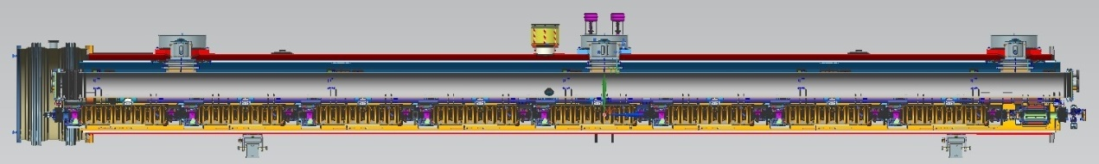
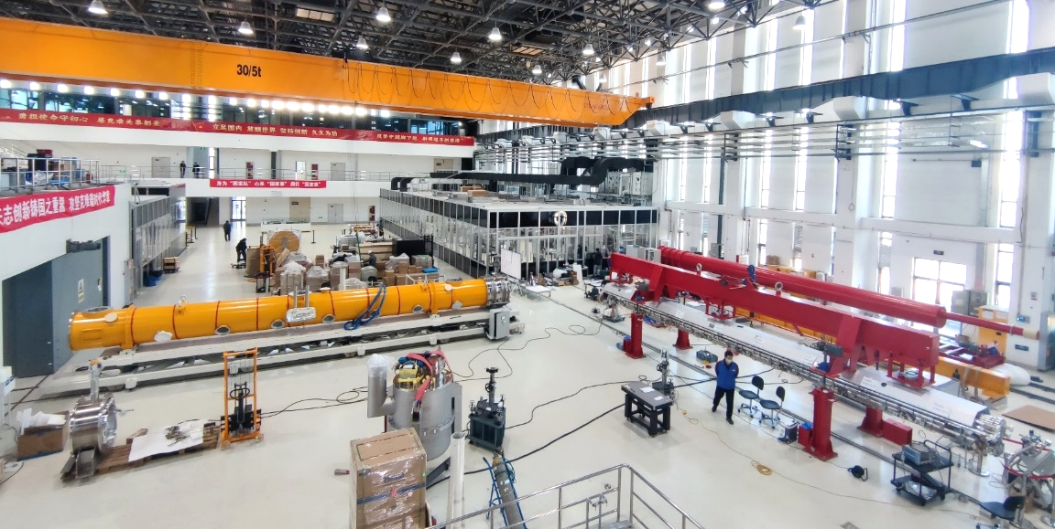
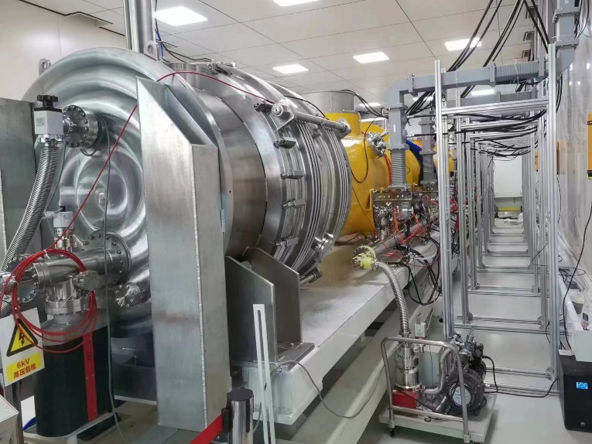
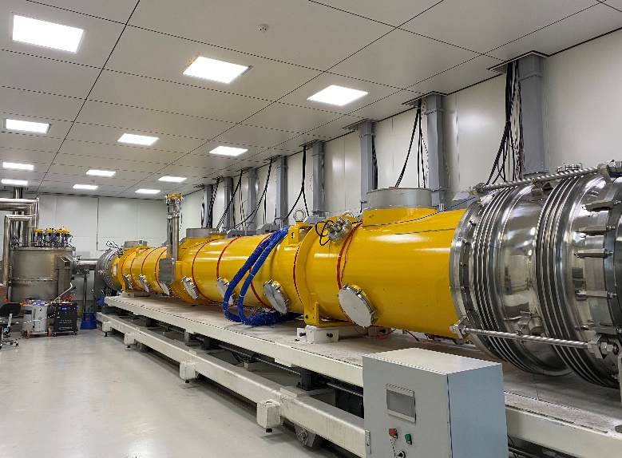

1.3GHz cavity Cryomodule

Slide 25
1.3GHz cavity Cryomodule
Endcap
超导腔模组
Feedcap
2K测试阀箱

Slide 26
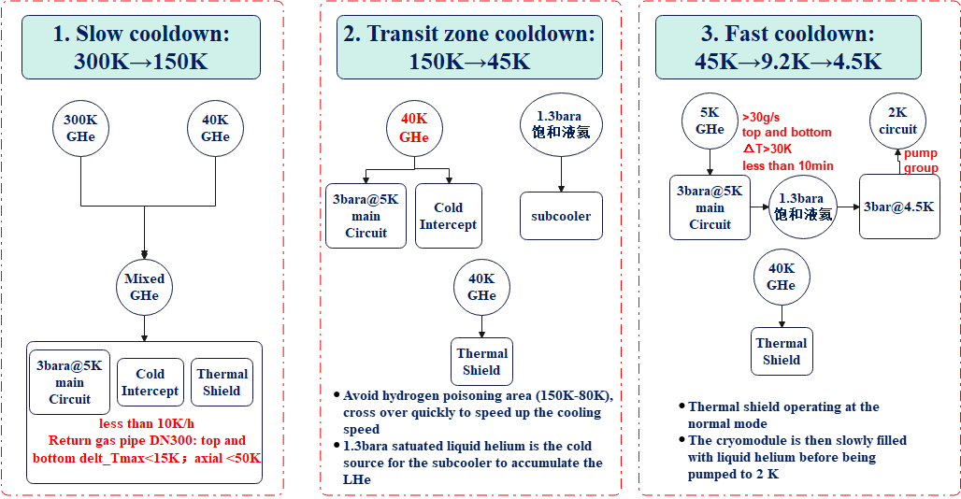
1.3GHz cavity Cryomodule
Cooling scheme for the 1.3 GHz 9-cell SRF cavity module

Slide 27
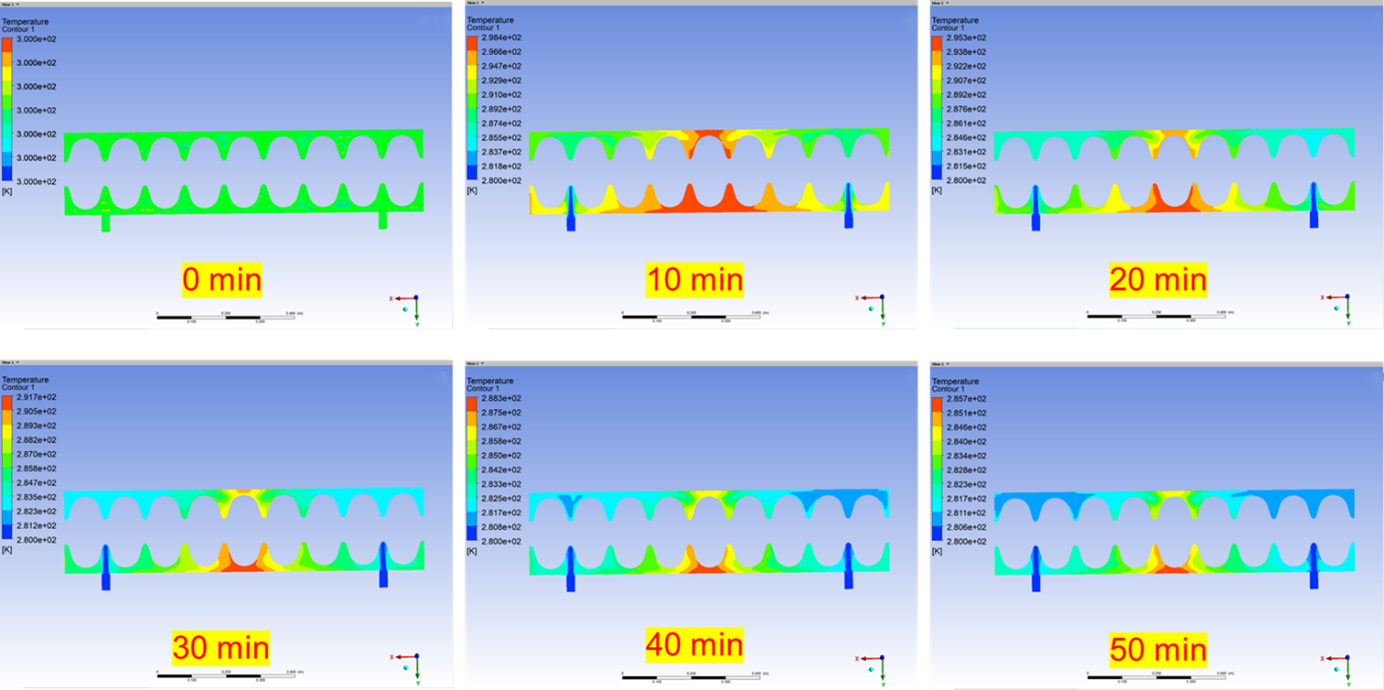
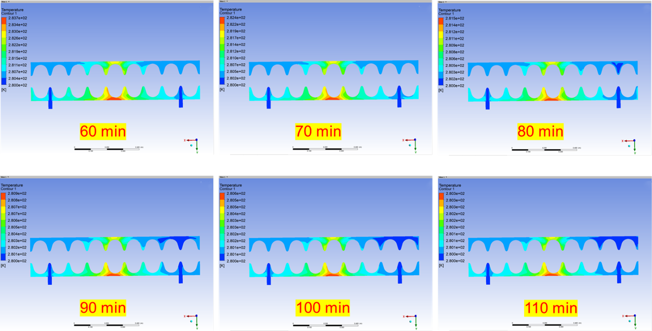
1.3GHz cavity Cryomodule
Unsteady-state simulation for the 1.3GHz cryomodule cooldown process

Slide 28
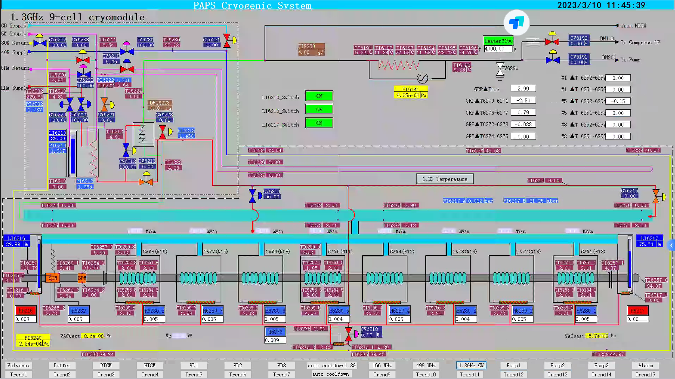
1.3GHz cavity Cryomodule

Slide 29
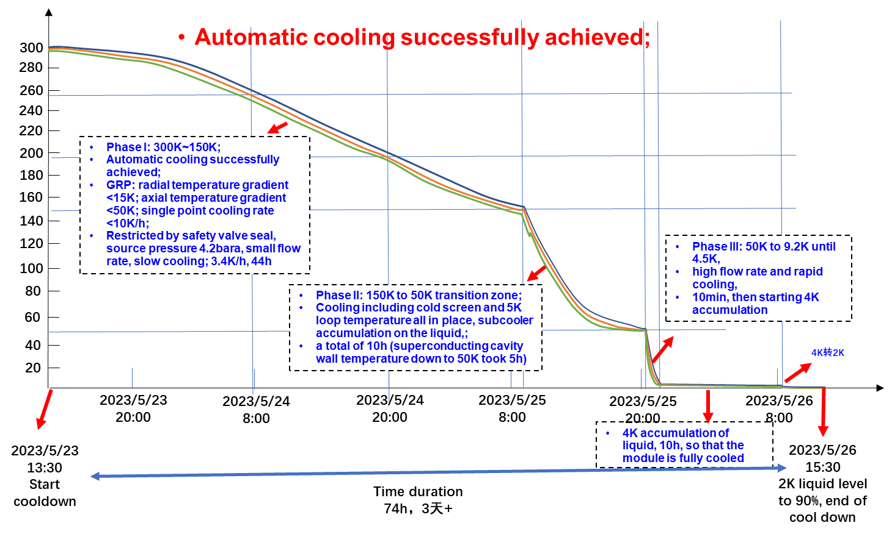
1.3GHz cavity Cryomodule

Slide 30
650MHz cavity Cryomodule
Including six 2-cell 650 MHz superconducting cavities, six high power couplers, six mechanical tuners and two HOM absorbers
Six 2-cell Cavities Cryomodule
Overall length(flange to flange, m) | 8.0
Diameter of Vacuum vessel ,m | 1.3
Beamline height from floor, m | 1.5
Cryo-system working temperature, K | 2
Number of 200-POST | 6
Cryomodule performance |  | Specification
Number of leakage | He →insulation | 0
 | He →beam pipe | 0
 | Insulation →coupler | 0
 | Insulation →beam pipe | 0
 | Coupler →beam pipe | 0
Alignment x/y inside (Cavities) |  | ±0.5mm
Alignment z inside |  | within 2 mm
Coupler antenna design z |  | within 2 mm

Slide 31
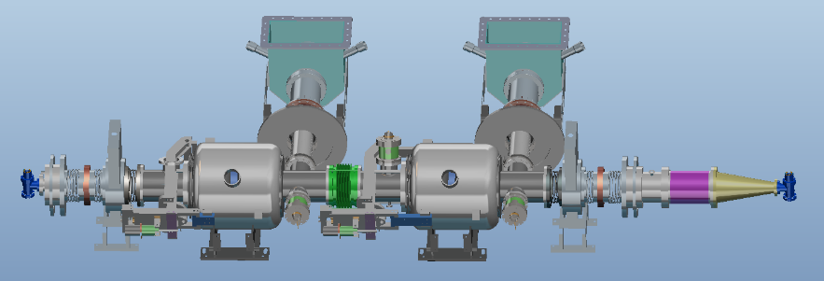
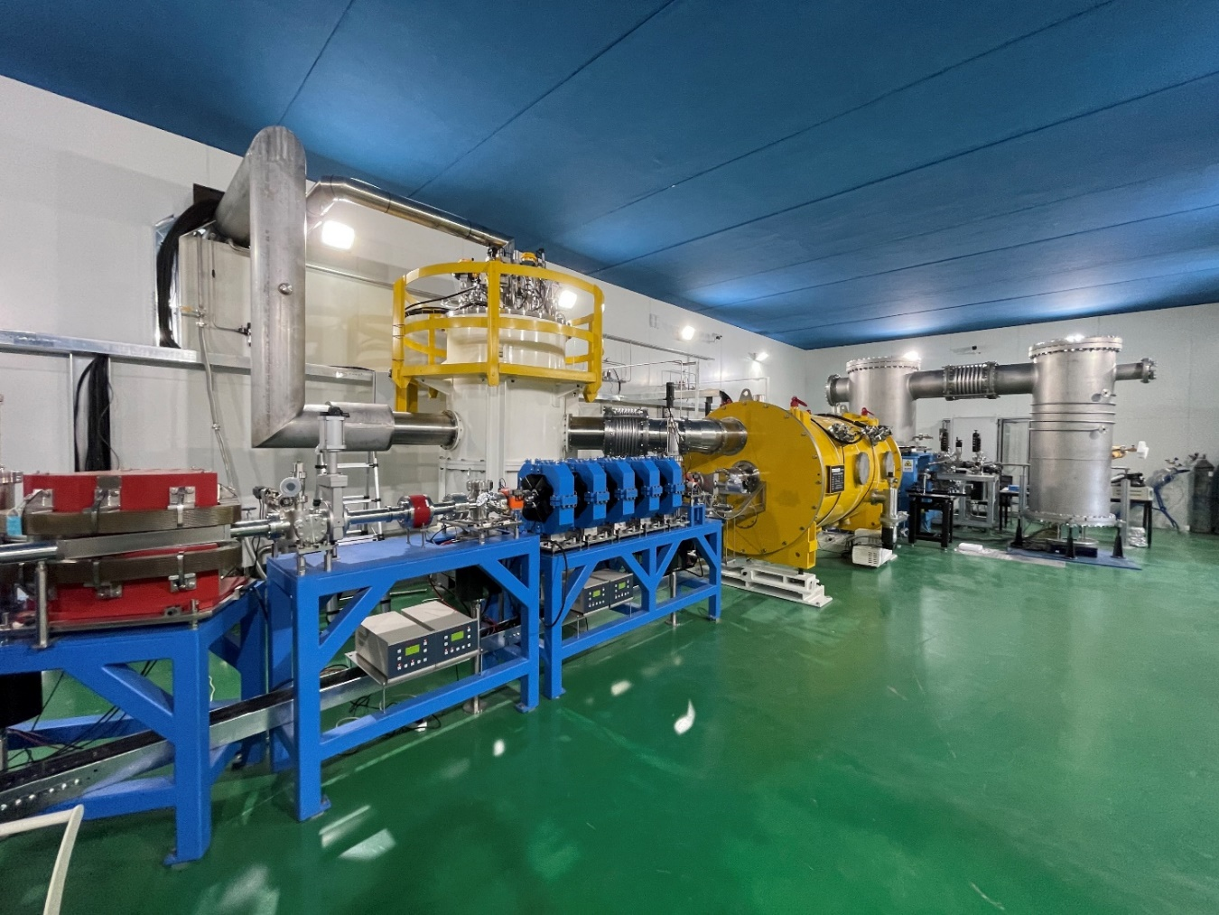
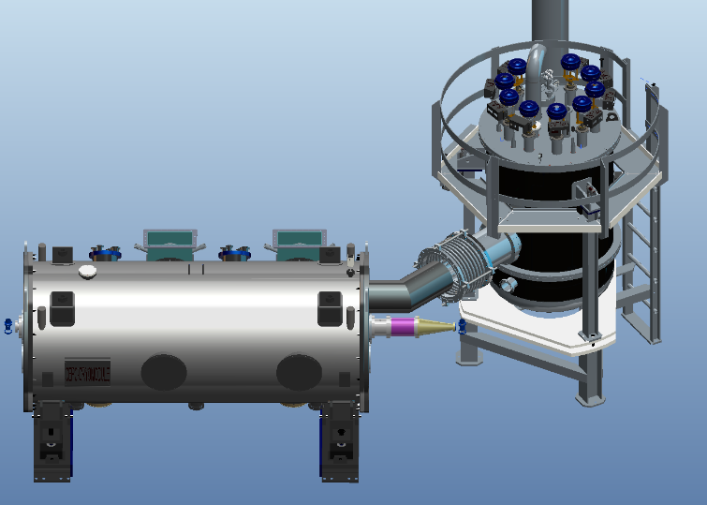
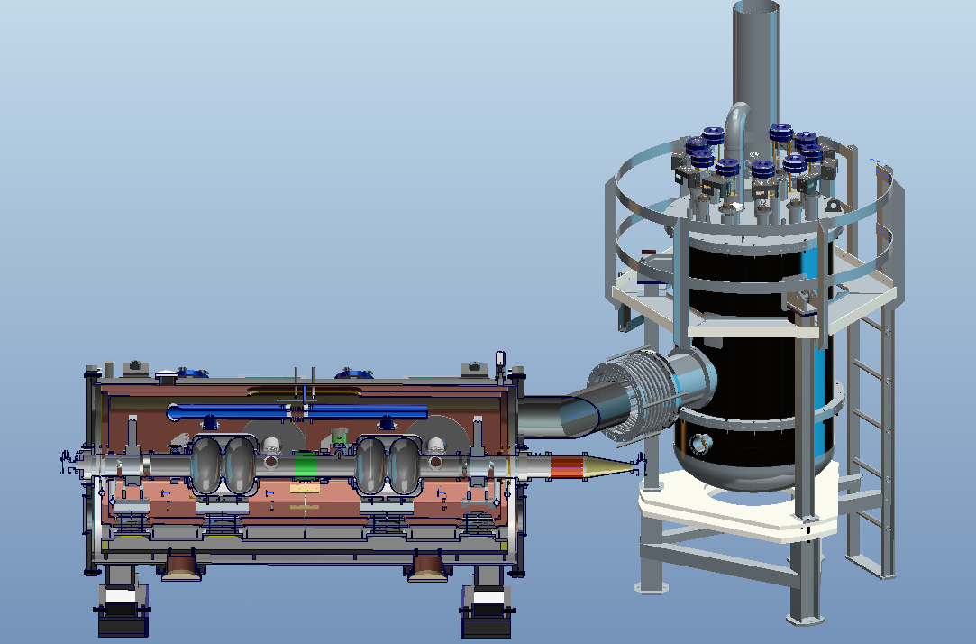
650MHz cavity Cryomodule
Prototype of 650MHz cryomodule with 2* 2cell cavities have been installed in PAPS tunnel and past the cryogenic test.

Slide 32
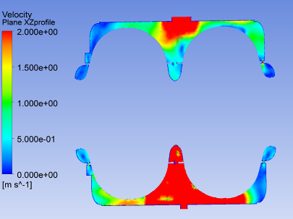
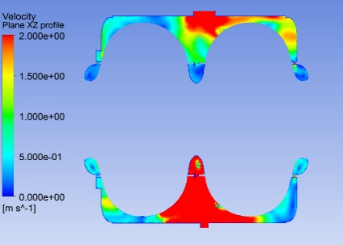
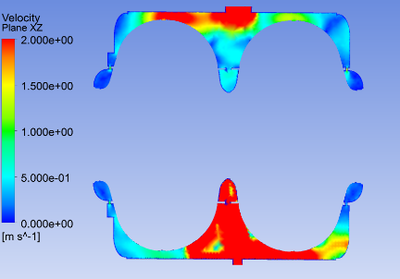
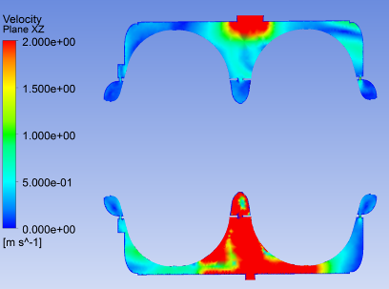
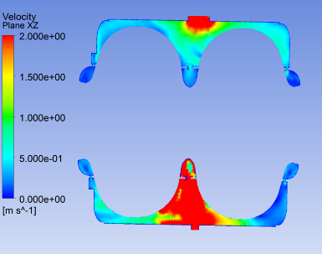
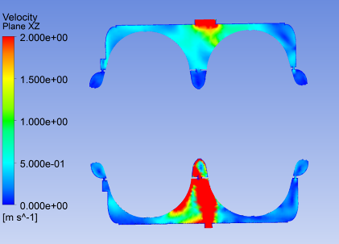
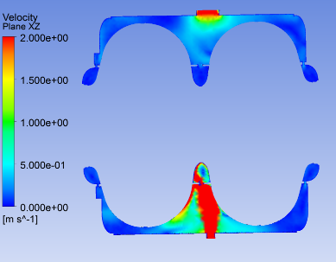
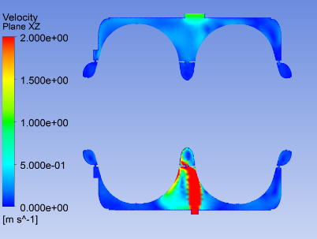
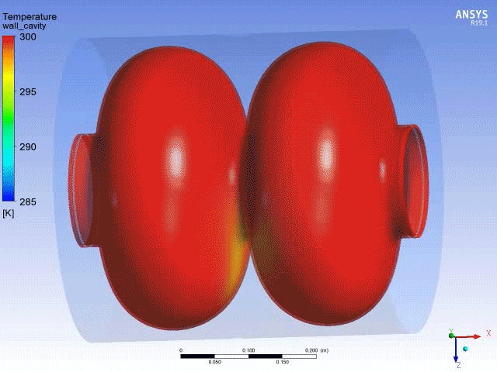
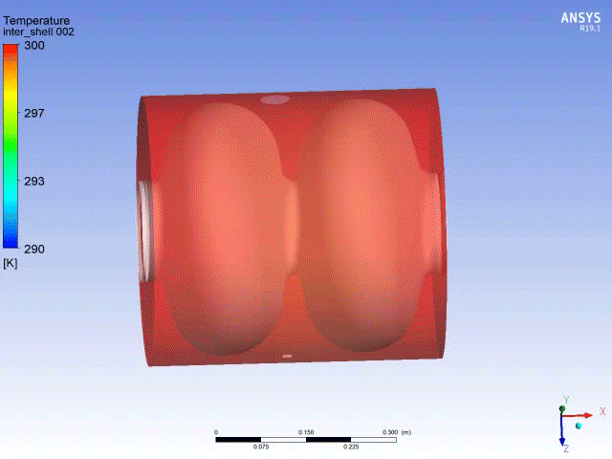
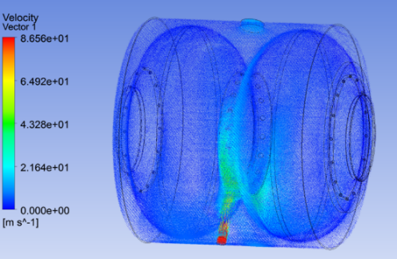

650MHz cavity Cryomodule
The cooling rate of the superconducting cavity needs to be strictly controlled, and a three-dimensional flow field non-stationary numerical simulation of the cooling process of the 650 2-cell superconducting cavity is performed.
A certain simulation basis is laid for the subsequent automatic cooling.
a) 260K b) 220K c) 180K
d) 140K e) 100K f) 60K
g) 40K h) 20K
Non-stationary analysis of superconducting cavity cooling process
Global velocity distribution

Slide 33
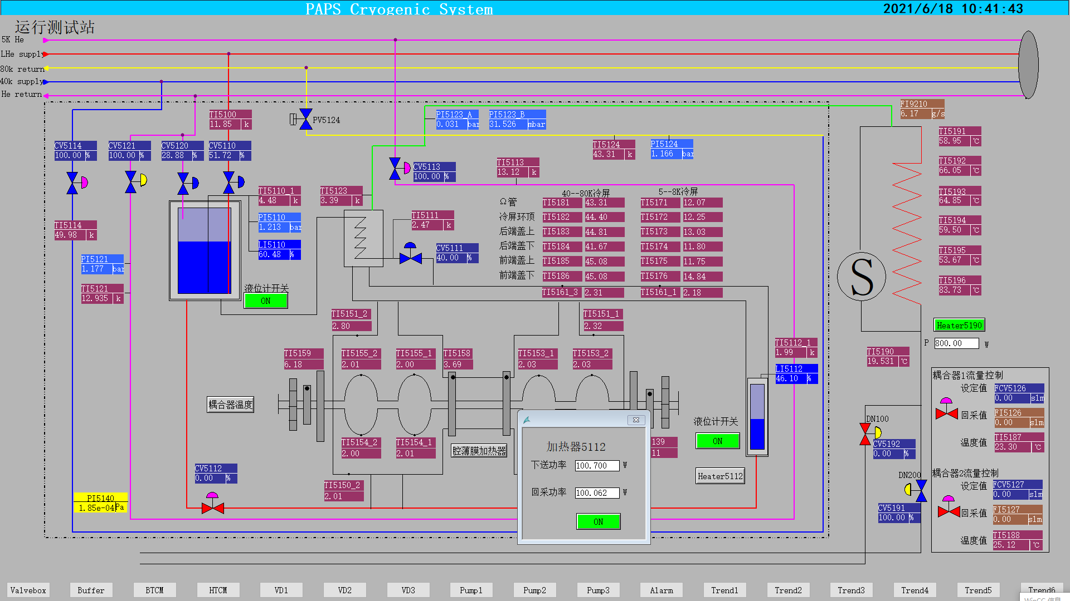



650MHz cavity Cryomodule
BTCM cooldown
BTCM: 100.7W@2K
Level
Temperature
Pressure
Mass flow
Pressure 31mbar±10Pa
Temperature 2K±0.02K
BTCM 2K stable operation
Cryogenic capacity test, 300W@2K return gas flow rate

Slide 34
















KW JT heat exchanger
For CEPC 2kW@2K cryogenic system, the kilo-watt scale heat exchanger project began in 2022.
2022.05-2022.10 Basic Design and Optimization.
Designing & Verification
NSGA-II Optimization
CFD Designing Reslut

Slide 35






KW JT heat exchanger
2022.10-2023.05 Manufacturing and Quality Detection.
Checking Thickness
Before Brazing
Build Up
Leakage Detection
After Product

Slide 36



KW JT heat exchanger
2023.01-2023.06 Cryogenic experiment design and similarity experimentdesign.
The similarity experiment will hold in 2023.7
and cryogenic experiment will hold in 2023.12
Similarity Experiment Dewar
and Inner structure

Slide 37


Platform of Advanced Photon Source Technology R&D （PAPS）
超导高频系统 RF system
加速器分平台
Accelerator platform
低温系统 Cryogenic system
“Platform of Advanced Photon Source Technology R&D”, The goal of the PAPS project is to provide a good foundation and condition for R&D, engineering testing and verification for the high energy phone source (HEPS) project to be completed on schedule and to achieve the expected design target.
Budget: 500M CNY funded by Beijing Gov.
Construction: 2017.5-2021.6
先进光源技术研发与测试平台
Platform of Advanced Photon Source Technology R&D (PAPS)
精密磁铁系统 Magnet technology
束流测试系统 Beam test
X射线分平台
X-Ray platform
X射线光学系统 X-ray optics
X射线探测系统 X-ray detection
X射线应用系统 X-ray application

Slide 38

Magnet building
Beam test building
X-ray building
SRF building
Cryogenic building

Slide 39
Process Flow Diagram of PAPS Cryogenic System
Pump Group
Helium Refrigerator
MDVB
Vertical Test 3
Vertical Test 2
Vertical Test 1
Single Cavity Cryomodule HT
Horizontal Test Stand
Beam Test Stand

Slide 40


Slide 41

PAPS cryogenic hall

Slide 42

PAPS RF hall-cold box

Slide 43

PAPS RF hall-vertical test stand

Slide 44


PAPS RF hall-single cavity horizontal test stand
Length: 3800
Height: 3200
Diameter:1400
Fast cooling down test
Test two cavities at a time
Test cavity performance at 2K
Test and check key equipment of SC cavity such as tuner, power coupler, HOM coupler etc.

Slide 45

PAPS RF hall-cryomodule horizontal test stand

Slide 46

Beam test facility

Slide 47
Content
CEPC Cryogenic System Brief Introduction
Cryogenic system for the SRF
Cooling Scheme Optimization and Process Calculation
Development of key equipment and technology
Platform of Advanced Photon Source Technology R&D（PAPS）
Cryogenic system for SC magnets
Summary

Slide 48

Detailed flow chart for the IR Cryostat
Compressor
Cold box
Dewar
Main Distribution Valve Box
Helium circulating system 1
Helium circulating system 2
Cryostat 1
IP collision point
Cryostat 2

Slide 49
Estimated heat loads for SC IR magnets-updated
 |  | 4.5K main loop |  |  | Thermal Shielding 40~80K
Name | Unit | No. | Heat load for each | Heat load | No. | Heat load for each | Heat load
IR SC magnet | W | 4 | 30 | 120
Valve Box of IR SC magnet | W | 4 | 30 | 120
Current lead of IR SC magnet | g/s | 4 | 0.8 | 3.2
Main distribution valve box | W | 4 | 50 | 100
Cryogenic transfer-line | W | 100 | 0.3 | 30 | 100 | 1.5 | 150
Total heat load @4.5K | W |  |  | 370 |  |  | 150
Total heat load @4.5K including current lead | W |  |  | 370W+3.2g/s |  |  | 150
Total heat load @4.5K | W |  |  | 432 |  |  | 150
Coefficient |  |  |  | 1 |  |  | 0.05
Total heat load @4.5K | W |  |  | 432 |  |  | 7.5
Total equiv. heat load @4.5K | W | 439
Total equiv. heat load @4.5K with multiplier 1.5 | W | 659

Slide 50


Mechanical structure of IR Cryostat

Slide 51


Thermal dynamics simulation
Research on the flow and heat transfer of helium in the narrow channels.
Choose the appropriate cooling method.

Slide 52
summary
Previous CDR and TDR works have laid a good foundation for the further design.
For the CEPC cryogenic system TDR design, relevant aspects have been considered , including process scheme, layout, and key equipment design.
For the RF side, scheme 2 can reduce construction expenses, and has the advantage of low heat loss and easier transfer line construction and flexible maintenance.
For the IR magnets, the preliminary process calculation has been completed. Further detailed design is ongoing.
Several key technologies (JT heat exchanger platform/cryo-circulating pump/multi-channel Transfer line test platform/Virtual system establishment and automatic control strategy research) are considered.

Slide 53
Thanks for Your Attention！

