Slide 1
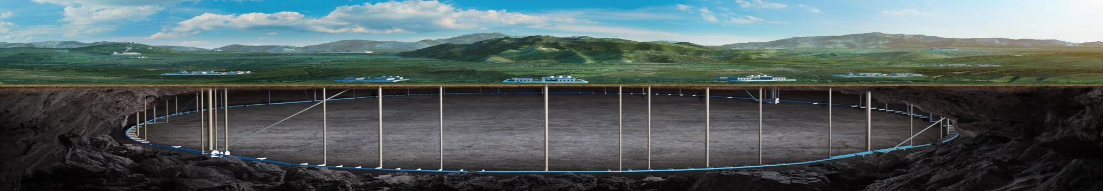


CEPC electron and positron injector linac key technology development
Jingru Zhang
12-16. June. 2023, Hongkong, CEPC Accelerator TDR International Review

Slide 2
Content
Introductuin
Design Parameters / Requirement List
Key technology R&D
  Electron gun
  Positron source
  S-band RF system
  C-band RF system
  5 cell cavity for DR
  LLRF and phase reference line for linac
Summary

Slide 3
Introduction
This talk is about HEPS injector linac source, RF system and Damping ring RF system
This talk relates to the TDR ch6.3.1, ch6.3.2, ch6.3.3, ch6.4.1
The content relates to the “charge letter” item 1, 3, 6, 7, 8

Slide 4
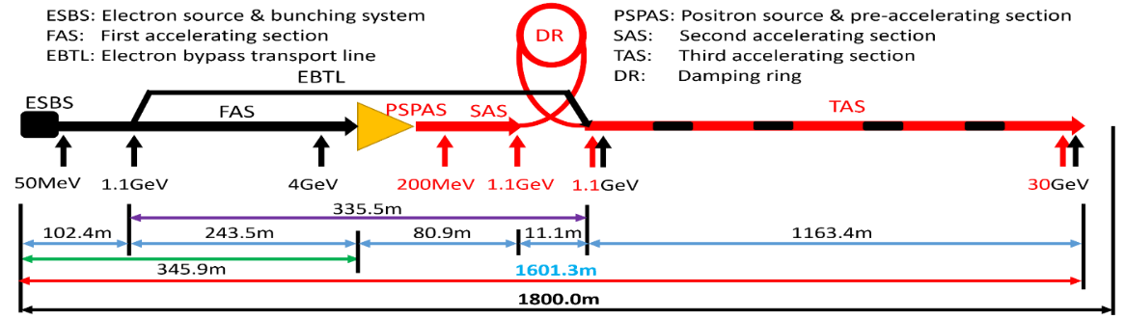
Design Parameters / Requirement List
C. Meng et al
30 GeV linac provides electron and positron beams for booster with 1.1GeV damping ring
  Electron gun: thermal cathode
  Positron source: Conventional scheme (fixed target)
  30 GeV normal conducting accelerating structures including bunching system
    S-band Linac: FAS: 4GeV + PSPAS: 200MeV + SAS: 1.1GeV
    C-band Linac: TAS：1.1GeV→30GeV
  1.1GeV damping ring with two 5 cell normal conducting cavities
The linac tunnel length is 1.8km
    Linac is about 1.6 km
    200 m as reserved space
Parameter | Symbol | Unit | Baseline
Energy | E_{e-}/E_{e+} | GeV | 30
Repetition rate | f_{rep} | Hz | 100
Bunch charge |  | nC | 1.5 (3)
Energy spread | σ_{E} |  | 1.5×10⁻³
Emittance | ε_{r} | nm | 6.5

Slide 5
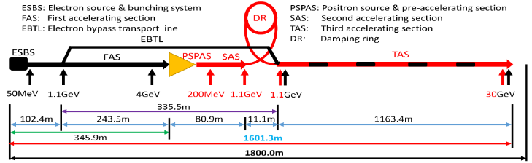
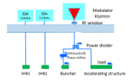
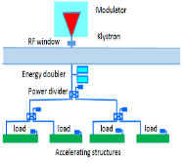
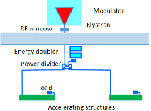
Design Parameters / Requirement List
RF distribution of the 30 GeV linac
  S-band, 80 MW klystron, the number of S-band Acc. Structure is 93, big hole s-band structure after the positron source is 16. the number of pulse compressor is 33
    1-1(ESBS), 1 accelerating structure, 22MV/m
    1-4 (FAS), 21 sets, 84 standard accelerating structures, with pulse compressor, 22MV/m
    1-2(PSPAS), 8 sets, 16 big hole accelerating structures, 22MV/m, with pulse compressor
    1-2(SAS), 4 sets, 8 accelerating structures, 27MV/m , with pulse compressor
  C-band, 50 MW klystron, C-band structures: 470, with 235 pulse compressors
    1.1GeV-30GeV, 1-2(TAS), 235 sets, 470 accelerating structures, ~40MV/m,
Parameter | Unit | S-band |  | C-band
Frequency | MHz | 2860 |  | 5720
Length | m | 3.1 | 2.0 | 1.8
Cavity mode |  | 2π/3 |  | 3π/4
Aperture | mm | 19~26 | 25 | 12~16
Gradient | MV/m | 22/27 | 22 | 40~45
Cells (include coupler cells) |  | 86 | 55 | 89
Number of Acc. Stru. |  | 93 | 16 | 470
Number of Klystron |  | 33 |  | 236
Klystron Power | MW | 80 |  | 50
S-band
C-band

Slide 6
Design Parameters / Requirement List
The main components list for RF system requirement
Name | Number
Gun | 1
Positron source | 1
SHBs | 2
Buncher | 1
S-band structure | 109
S-band pulse compressor | 33
S-band load | 188
C-band structure | 370
C-band pulse compressor | 235
C-band load | 706
5 cell cavity for DR | 2
LLRF&SSA | 270
Linac phase reference line | 1

Slide 7
Design Parameters / Requirement List
The requirement to the power source
  In order to meet requirement of the booster, the pulse repetition rate of the linac is 100Hz
  For Z mode, double bunch per pulse is needed
  For pulse compressor is needed, the pulse duration is 4 us and 2.5us for S-band and C-band respectively
  To ensure the energy doubler factor, the pulse flatness is ±1%
Power Source | S-band | C-band)
Frequency(MHz) | 2860 | 5720
Power(MW) | 80 | 50
Pulse repetition rate(Hz) | 100 | 100
Pulse duration(us) | 4 | 2.5
Pulse repetition stability | ±0.05% | ±0.05%
Pulse flatness | ±1% | ±1%
 | tt(180GeV) | Higs(120GeV) | W(80GeV) | Z(45.5GeV)
Pulse repetition rate(Hz) | 100 | 100 | 100 | 100
Bunch number per pulse | 1 | 1 | 1 | 2

Slide 8
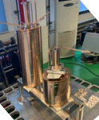
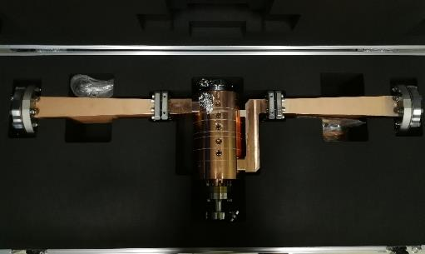
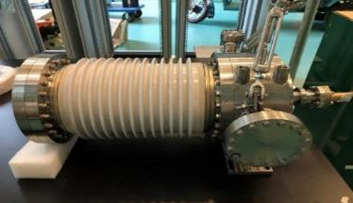
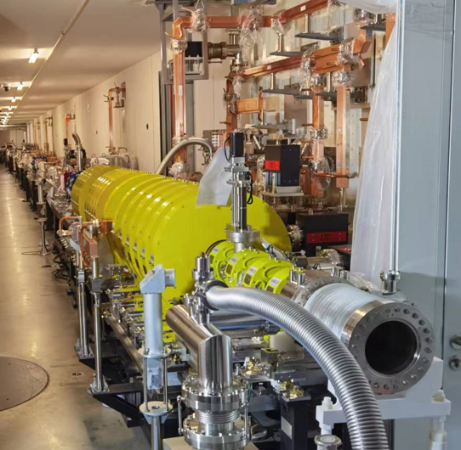
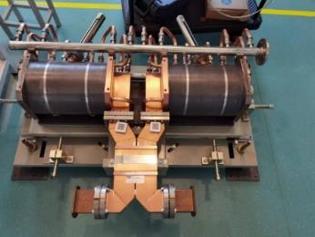
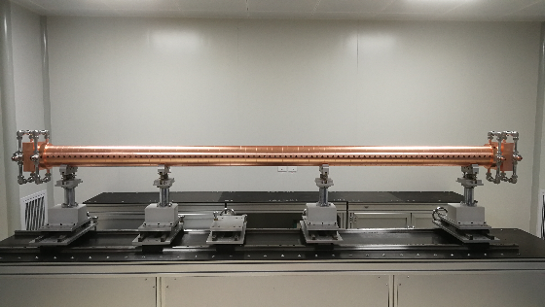
Successful key technology for HEPS (S-band)
The HEPS linac is a 500MeV S-band normal conducting RF system
It has been successfully operated recently
Electron gun
SHBs
Buncher
HEPS linac tunnel
SLAC type pulse compressor
S-band accelerating structure

Slide 9
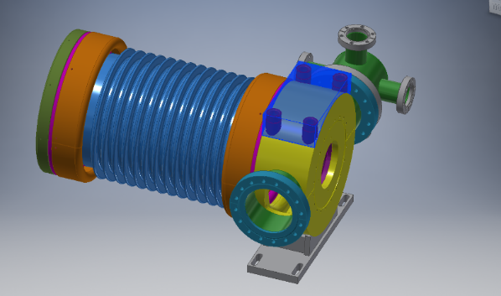
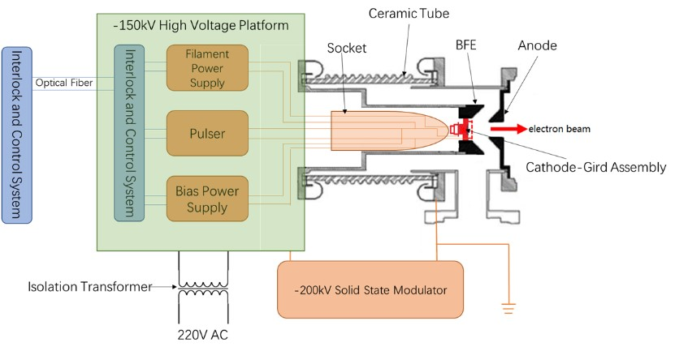
Electron gun
Traditional thermionic triode gun
A 1.5 nC bunch charge for electron injection, and a 10 nC bunch charge for positron production
The parameters is similar to HEPS and BEPCII electron gun at IHEP
Parameter | Unit | Value
Type | - | Thermionic Triode Gun
Cathode | - | Dispenser cathode
Beam current | A | > 10
High voltage of anode | kV | 150
Bunch charge 1 | nC | 3.3 (e– injection)
Bunch charge 2 | nC | 11 (e⁺ production)
Repetition rate | Hz | 100
Pulse duration | ns | 1
The parameters and design of the electron gun

Slide 10
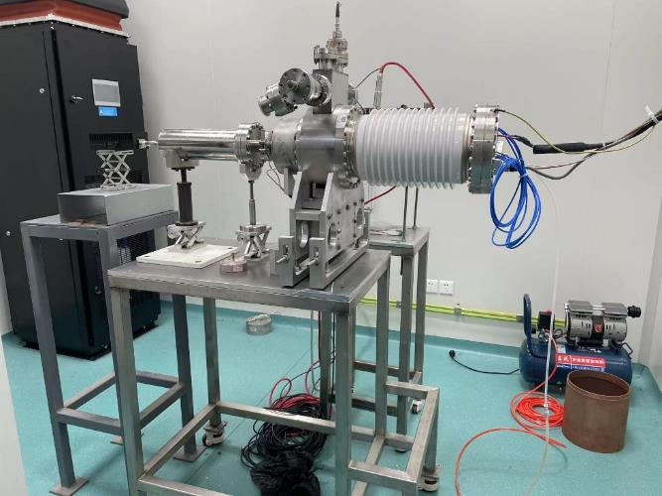
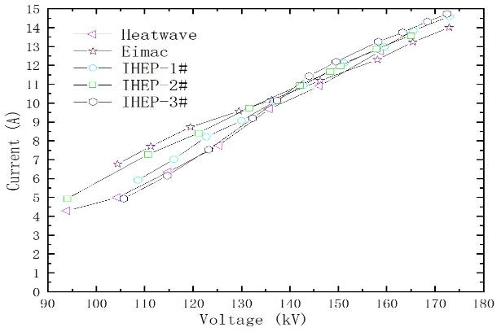
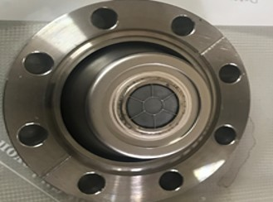
Electron gun
It successfully used in HEPS
The peak emission current is 14A with 1ns FWHM when grid bias is 100V and pulser voltage is 950V
Electron gun for HEPS
The electron gun test platform and beam current measurement

Slide 11
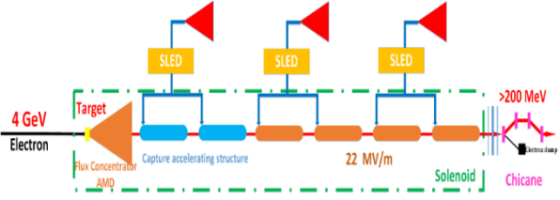
Positron Source
Incident electron beam:4GeV/10nC/100Hz
Fixed Target (Conventional, tungsten,15mm thickness)
FLUX concentrator
  Length: 100mm
  Aperture: 7mm→52mm
  Magnetic field: 6.0T → 0.5T
Solenoid
FLUX Concentrator
Target
e-
Vacuum chamber
Positron source and pre-acceleration layout
Design of positron converter device

Slide 12
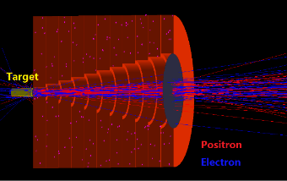
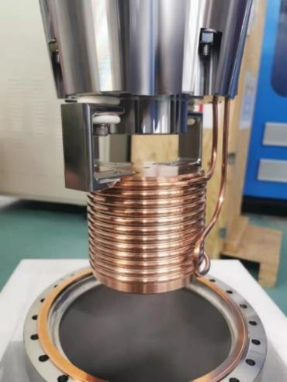
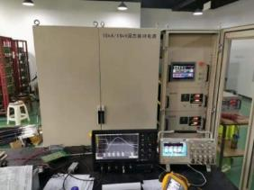
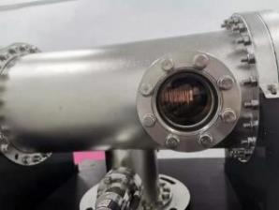
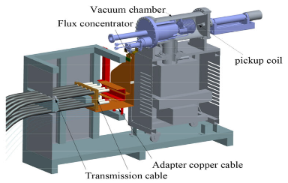
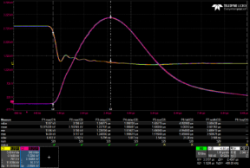
Positron Source
FLUX Concentrator R&D
  A flux concentrator prototype had been successfully developed
  A 15 kA solid-state modulator had also been developed for driving FC
  A peak magnetic field of 6.2 T had been obtained inside the FC at a 15kA driving current
The FLUX conentrator
The 15kA solid-state modulator
Test of the peak pulse magnetic field

Slide 13
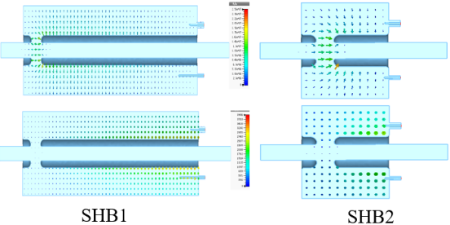
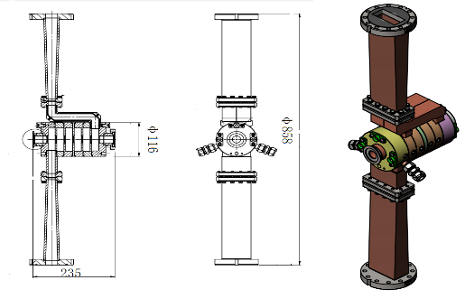
Bunching system
Parameters | Unit | Value
 |  | SHB1 | SHB2
Frequency | MHz | 158.89 | 476.67
Shunt Impedance | MΩ | 1.46 | 2.53
Unloaded Q | - | 8475 | 12431
VSWR | - | < 1.05 | < 1.05
E_{surface, max} @100 kV | MV/m | 6.4 | 6.1
Required power @100 kV | kW | 10 | 7
RF Structure type | - | Re-entrant SW | Re-entrant SW
Sub-harmonic buncher (SHBs)
  Capacitively loaded structure
Buncher
  Travelling wave
  2π/3
  β=0.75, 6 cells
The same as HEPS only frequency a little difference
Parameters | Unit | Value
Frequency | MHz | 2860
Phase advance | - | 2π/3
Cell number | - | 6
Phase velocity | - | 0.75
Group velocity | - | 0.0193
Attenuation constant | Np/m | 0.147
Shunt impedance | MΩ/m | 33.2
Unloaded Q | - | 11083
Bunching voltage (Max) | MV | 1.2
VSWR | - | <1.2
Input power | MW | 6
RF Structure type | - | TW/CI

Slide 14
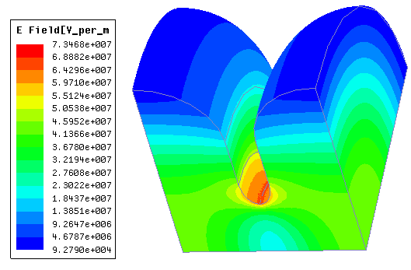
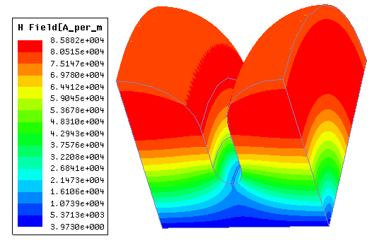
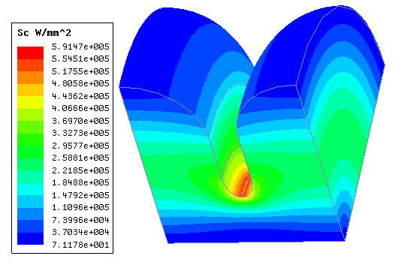
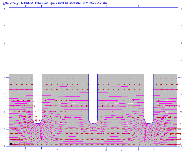
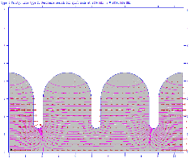


S-band accelerating structure
Parameters | Values | Unit
No. of Cells | 84+2couplers | -
Phase advance | 2π/3 | rad
Total length | 3.1 | m
Length of cell (d) | 34.988 | mm
Disk thickness (t) | 5.5 | mm
Shunt impedance (Rs) | 60.3~67.8 | MΩ/m
Quality factor | 15465~15373 | -
Group velocity: Vg/c (%) | 2% ~ 0.94% | -
Filling time (t_{f} ) | 784 | ns
Attenuation factor (τ) | 0.46 | Np
Power (@30MV/m) | 74 | MW
3-meters long constant gradient structure
  Cavity shape optimization
  Rounding the cell
    Improve the quality factor by >12%
    Reduce the power consumption
    Increase the shunt impedance by ~10.9%
  Elliptical the irises shape (r2/r1=1.8)
    Reduce the peak surface electrical field by 13%
E_peak=73 MV/m
H_peak=86 kA/m
Sc_max=0.59 MW/mm²
Surface electric field
Surface magnetic field
Modified Poynting vector
  Superfish is used to optimize the single cell

Slide 15
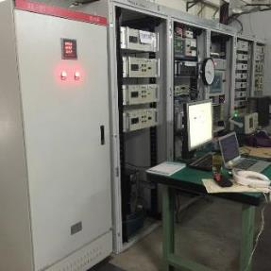
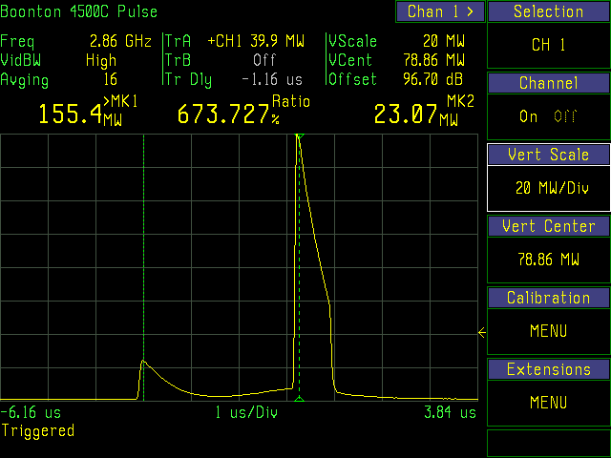
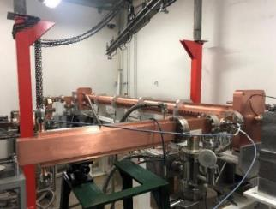

S-band accelerating structure
High power test result
  The tested average gradient has reached 33 MV/m at high power test (with SLED)
  Meet the requirement of linac application
  This familiar design (the frequency is deferent) also used in HEPS and now the gradient is 26MV/m with beam (Limited by the power)
The input power with SLED
Modulator and klystron
High power test bench

Slide 16
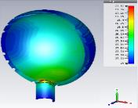
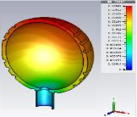
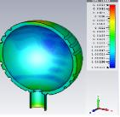
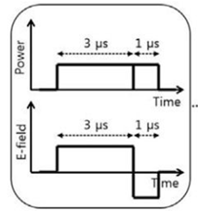
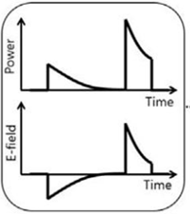
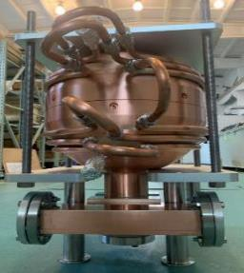
S-band pulse compressor
Dual cavity structure technology is traditional and mature
Spherical cavity pulse compressor(TE ₁₁₃)
  Finished RF simulation, thermal stress, vacuum pumping speed and vacuum level analysis
  The prototype has completed
  S-band 80MW klystron high power test bench is ready, high power test will be conducted recently
Parameter | Value
Klystron output power | 80 MW
Pulse width | 4 μs
Pulse repetition rate | 100 Hz
AS Filling time | 780 ns
Temperature
Deformation
Stress
4uS→0.8uS
HEPS pulse compressor
Pulse compressor for CEPC

Slide 17
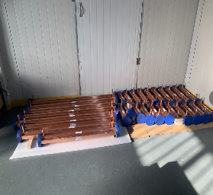
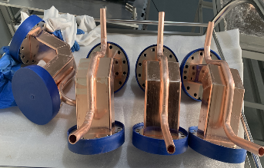
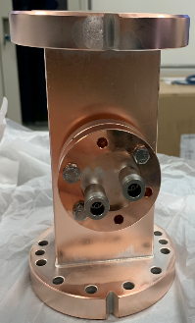
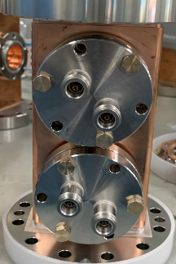
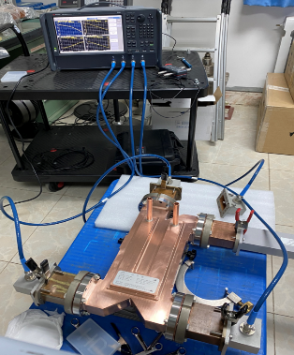
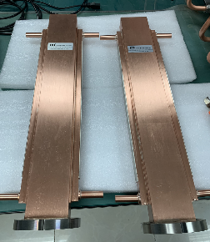
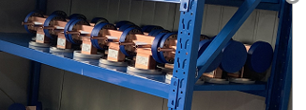
S-band waveguides
Waveguide, load, directional coupler, 3dB power hybrid, extraction waveguide, loads etc. used in HEPS
The directivity of the directional coupler is
about 40dB
Straight waveguide
Bent waveguide
Extraction waveguide
Dummy loads

Slide 18
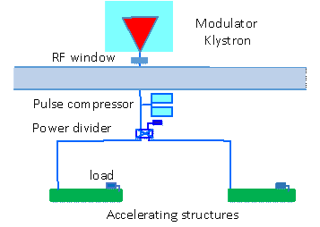
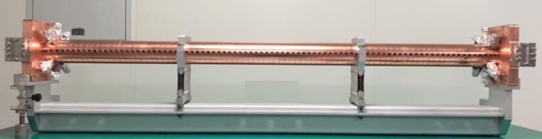
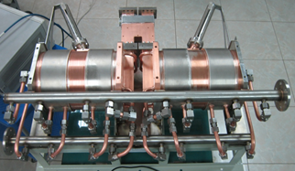
C-band RF system

Slide 19






C-band RF system at SINAP
W.C. Fang
C-band RF accelerating structure and compressor at SARI (SXFEL) Shanghai
One 50MW klystron to two accelerating structures with pulse compressor
Average gradient more than 37.1 MV/m. and maximum gradient 41.7 MV/m
It has long time stable operation now

Slide 20





C-band RF system at Spring8^{1,2}
For SACLA LINAC
  Upgrade from 60Hz to 120Hz, add Disk-loaded type, Quasi constant gradient accelerating structures
  One 50MW klystron to two accelerating structures
  Length: ~2m
  The gradient is 50MV/m at tests bench, 41.4MV /m with beam
T. Sakurai, et al. C-band disk-loaded-type accelerating structure for a high acceleration gradient and high-repetition-rate operation.
PHYSICAL REVIEW ACCELERATORS AND BEAMS 20, 042003 (2017)
2. Yuji Otake, et al. RELOCATION AND IMPROVEMENT STATUS OF THE SCSS TEST ACCELERATOR TO PROVIDE DUAL FEL DRIVERS AT SACLA. IPAC2015

Slide 21



C-band accelerating structure
The R&D of C-band accelerating structure at IHEP
  The beam dynamics of linac based on this design
  Constant gradient, 3π/4 mode, 1.8 meters long (Including mechanical length, Effective length is about 1.7m)
    Round cavity shape
    Racetrack symmetrical magnetic coupling
  High power tests will be performed when C-band power source is available
Cavity shape
The deformation caused by temperature variation

Slide 22
C-band accelerating structure
The design parameters between different lab
  Mode :3π/4, 2π/3, 4π/5
  Length
  Disc thickness
Though the phase advance is deferent, the other key parameters is similar
 | IHEP | Spring8 | SINAP¹
Frequency: f（MHz） | 5712 | 5712 | 5712
No. of Cells | 87+2 | 100 regular cells +2 coupler | 89+2
Phase advance | 3π/4 | 2π/3 | 4π/5
Total length(m) | 1.8 | 2 | 1.784
Length of cell : d (mm) | 19.675 | 17.495 | 20.994
Disk thickness: t (mm) | 4.5 | 4 | 5
Average aperture: 2a (mm) | 14.04 | 15.938~12.107 | 15
Average diameter : 2b (mm) | 45.6 | 43.196~41.869 | -
Shunt impedance(average) : Rs (MΩ/m) | 66.05 | 66 | 62
Quality factor : Q | 11358~11186 | 9300/8900(measured) | 10470
Group velocity: Vg/c (%) | 2.8% ~ 0.96% | 2.3%(average) | 1.7%(average)
Filling time : t_{f} (ns) | 350 | 290 | 330
Attenuation factor : τ | 0.56 | 0.59 | 0.585
Epeak/E0 | 2.57 | 2.6 | 2.6
1. W. Fang, et al. THE C-BAND TRAVELING-WAVE ACCELERATING STRUCTURE FOR COMPACT XFEL AT SINAP

Slide 23






C-band pulse compressor
The model selection of the pulse compressor
  SLAC type (Two cavities)
  BOC type
  Spherical type（new technology）
IHEP C-band SLED
Test results of IHEP C-band SLED
SACLA C-band SLED
IHEP C-band BOC
PSI BOC
Spherical SLED（Xband of SLAC）

Slide 24


Damping Ring RF cavity
D. Wang Y.D. Liu
The total cavity voltage requirement is 2.5MV
5 cell cavity aperture is decided by impedance、HOM and instability threshold
  Taking into account the simulation results for impedance threshold and HOM power, the 5-cell cavity with a 90 mm aperture is considered the best choice
There are also two sets s-band structure at the transport line for energy and bunch length compression and the cavity voltage is about 20MV
  1 meters long S-band accelerating structure with 30MW power source

Slide 25





Damping Ring RF cavity
The design of the 650MHz 5 cell cavity finished
  RF cavity design
  Input coupler and doorknob design
  Vacuum design
  Mechanical design
Parameters | Unit | Value
Operation frequency | MHz | 650
Voltage per cavity | MV | 1.25
Cell length | mm | 5×230.61
Shunt impedance | M | 16
R/(Q×l) | Ω/m | 430
Q factor |  | 32000
Dissipated power per cavity (20% margin) | kW | 59
Emax | MV/m | 8.5
Ion pump distribution
Electromagnetic field distribution
  Mechanical design

Slide 26


Damping Ring RF cavity
P. Zhang
5 cell normal conducting cavity at HEPS booster

Slide 27


LLRF and phase reference line
Low Level RF design
  Based on feedback control in which the RF signal is measured and compared to the desired set-point
  The LLRF system mainly includes the following functions
    Stabilization
    System monitoring and diagnosis
    Klystron linearisation
    Exception handling
    User interface
LLRF algorithm scheme
LLRF firmware scheme
LLRF system scheme

Slide 28





LLRF and phase reference line
LLRF for HEPS
  The digital LLRF has been adopted
  It consists of a 2U MTCA.4 chassis, a MCH, an AMC computer board, a Struck SIS8300-KU card and a Struck DWC8VM1 rear transition-module with supporting clock/local oscillator (LO)/reference generation RF circuits
System works steadily now
Down converter RTM
(For accelerating tube)
Direct-sampling RTM （for SHB cavities）
AMC IO board (used as timing and interlock signal interface )
Local oscillator signal generator
  (Generate 2973.8MHz LO signal and 99.98MHz clock signal for LLRF system from 2998.8MHz reference)

Slide 29


Phase reference line for CEPC Linac
Linac frequency 2860MHz derived from Master oscillator who provides frequency standard of the Main Ring(650MHz), the Booster(1.3GHz) and the Injector(2860MHz);
The whole linac is 1.6 km long, transfer signal by coaxial cable not feasible due to attenuation/EMI...so optical fiber will be used. RF signals transferred by CW laser will be detected by comparing forward and backward optical phase, and compensated by phase shifter. The phase stability of 1.6 km transfer will be less than 0.1degree. Each LLRF will need one channel.
Phase reference line of whole CEPC
~1.6km
CEPC Linac's phase reference line

Slide 30





Phase reference line for CEPC Linac
Status/Success of RF phase reference on HEPS:
700m phase-stabilized optical fiber was used transfering MO 499.8MHz to Linac and booster RF;
in 3 days ±0.02°(±110fs) out-of-loop residual phase drift was achieved by phase detector between Transmit-RF and Receiv-RF; Received RF jitter 36.4fs(10Hz-10MHz);
A new S-band(2856-2998.8MHz) Tx-Rx pair under developed with a little modification: only phase shifter chip replaced from 499.8MHz->2860MHz. Laser, photon-detector, fiber, controller...bandwidth cover S-band without change
typical 68 hours close loop tested
close-loop out-of-loop phase drift：
< ±0.02°@499.8MHz
light blue: 0.5Hz record rate, dark blue: 20 average smooth
compensate phase change: ±1.5°（18ps）
raw data
Received 499.8MHz signal: 36.4fs（10Hz-10MHz）
Tx-Rx pair on HEPS
Temperatur: ΔT±2℃
raw data

Slide 31
Summary
TDR baseline of linac injector is 30 GeV electron and positron
The RF system design goals are well defined. The goals have been reached in the TDR
Regarding the key technology research and development, critical technologies and components of the linac RF & Source are ready, through the R&D program being carried out, or achieved with the HEPS or BEPCII undertaken by IHEP, for the eventual realization of the CEPC

Slide 32
Thank you

