Slide 1



CEPC instrumentation and beam diagnostics development
Yanfeng Sui
On behalf of CEPC BI group
12-16. June. 2023, Hongkong, CEPC Accelerator TDR International Review

Slide 2
Content
The design of CEPC beam instrumentation
  Booster and collider ring beam instrumentation
  Linac and damping ring beam instrumentation
The related R&D of beam instrumentation in IHEP
  Beam position monitor
  Feedback system
  Tune monitor
  ……
Summary

Slide 3
Introduction
This talk is about CEPC beam instrumentation system
This talk relates to the TDR ch4.3.7, ch5.3.6, ch6.3.8 and ch6.4.6
The content relates to the “charge letter” item 3 and 6
  3. Are the accelerator complex design, the key technologies adopted, and the conventional facilities effective for achieving the performance goals?
  6.Regarding the key technology research and development, are critical technologies and components of the CEPC accelerator ready or will they be ready before 2026, through the R&D program being carried out, or achieved with the Light Source project undertaken by IHEP, for the eventual realization of the CEPC?
  …

Slide 4
Requirement List of the Collider Beam Instrumentation
Item |  | Method | Parameter | Amounts
Beam position monitor | Closed orbit | Button electrode BPM | Measurement area (x × y)：±20mm×±10mm Resolution：<1um Measurement time of COD：< 4 s | 4252
 | Bunch by bunch | Button electrode BPM | Measurement area (x × y)：±40mm×±20mm Resolution：0.1mm
Bunch current |  | BCM | Measurement range：10mA / per bunch Relatively precision：1/4095 | 2
Average current |  | DCCT | Dynamic measurement range：0.0~1A Linearity：0.1 % Zero drift: <0.05mA | 2
Beam size |  | Double slit interferometer x ray pin hole | Resolution:0.2 µm | 4
Bunch length |  | Streak camera Two photon intensity interferometer | Resolution:1ps@10ps | 2
Tune measurement |  | Frequency sweeping method | Resolution:0.001 | 2
 |  | DDD | Resolution:0.001
Beam loss monitor |  | PIN-diode | Dynamic range:120 dB Maximum counting rates≥10 MHz | 5800
Feedback system |  | TFB | Damping time<=1ms | 4
 |  | LFB | Damping time<=12ms | 4

Slide 5
Requirement List of the Booster Beam Instrumentation
Item | Method | Parameter | Amounts
Beam position monitor | Button electrode BPM | Measurement area (x × y)：±20mm×±10mm Resolution：<20um(turn by turn) | 2408
Bunch current | BCM | Measurement range：10mA / per bunch Relatively precision：1/4095 | 2
Average current | DCCT | Dynamic measurement range：0.0~1A Resolution:50uA@0.6-8mA Linearity：0.1 % Zero drift: <0.05mA | 2
Beam size | Double slit interferometer x ray pin hole | Resolution:0.2 µm | 2
Bunch length | Streak camera Two photon intensity interferometer | Resolution:1 ps | 2
Tune measurement | Frequency sweeping method | Resolution:0.001 | 2
 | DDD | Resolution:0.001
Beam loss monitor | Optical fiber | Space resolution:0.6m | 670
Feedback system | TFB | Damping time<=3ms | 2
Feedback system | LFB | Damping time<=35ms（50ms） | 2

Slide 6
CEPC BST and collider beam instrumentation design
Beam position monitor
Beam current monitor
Synchrotron radiation based beam diagnostics
  Beam size and bunch length
Feedback system
Tune measurement
Beam loss monitor
Other systems

Slide 7
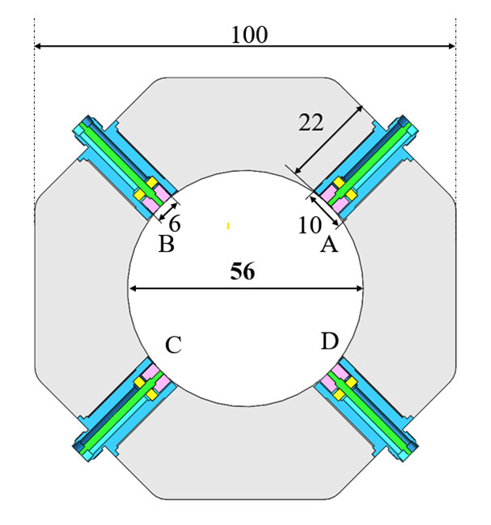
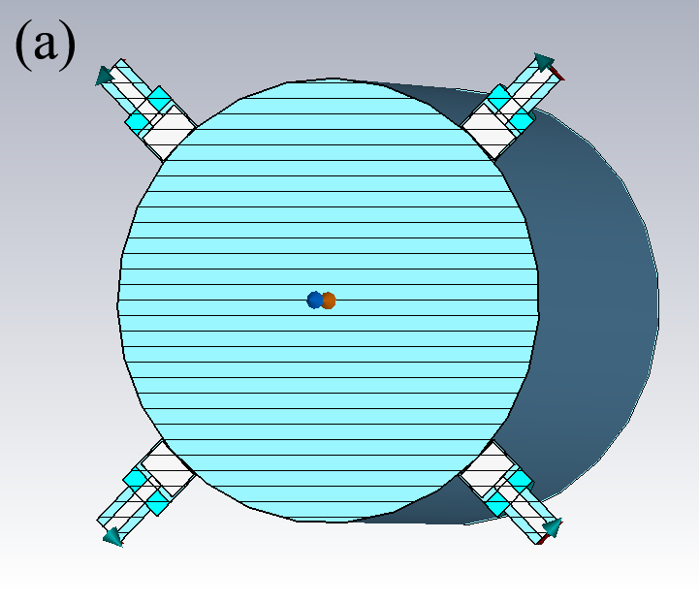
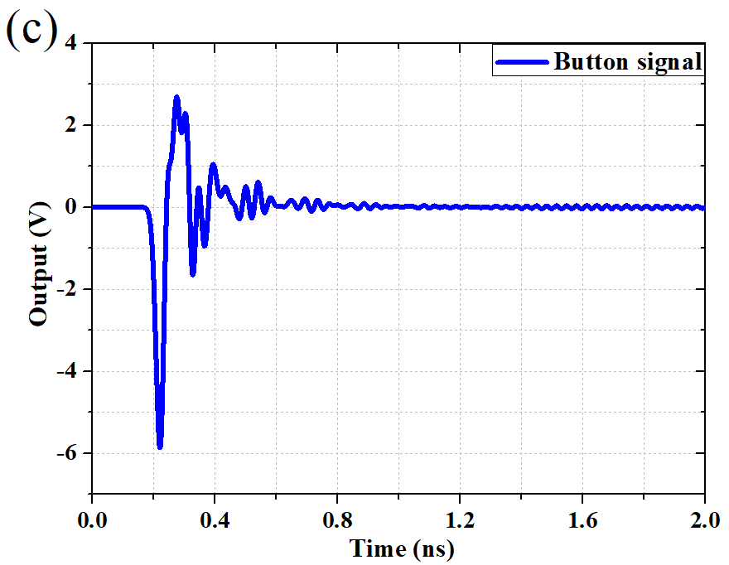
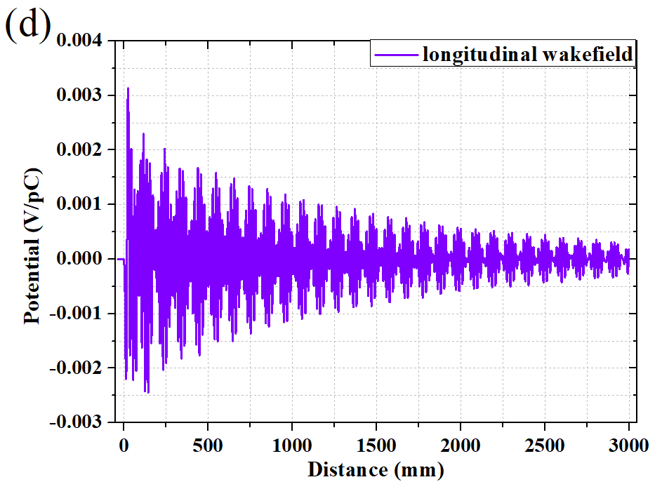
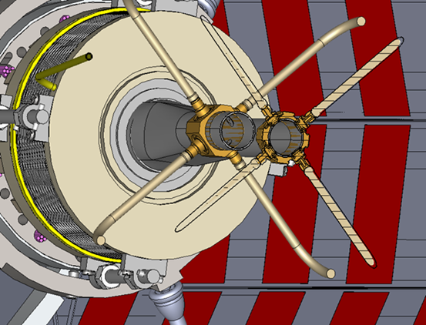
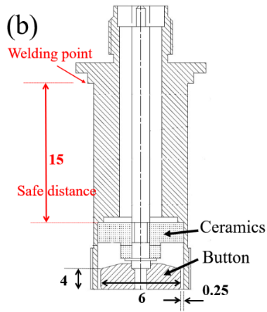
Beam position monitor
With one Beam Position Monitor (BPM) near each quadruple, there will be 4252 BPMs in collider ring and 2408 BPMs in the booster
The best solution is a capacitive monitor with a button-like electrode. The four buttons will be mounted on a machined block of stainless steel welded into vacuum chamber.
The booster beam position monitors are the same as those of collider.
 | ttbar |  | Higgs |  | W |  | Z
 | Real | CST | Real | CST | Real | CST | Real | CST
Charge | 20e10 | 32 nC | 14e10 | 22.4 nC | 13.5e10 | 21.6 nC | 14e10 | 22.4 nC
Bunch length | 2.2/2.9 | 3 mm | 2.3/3.9 | 4 mm | 2.5/4.9 | 5 mm | 2.5/8.7 | 8.7 mm
Vpp | 635V |  | 359V |  | 295V |  | 179V
Z_500M | 0.22Ω |  | 0.22Ω |  | 0.22Ω |  | 0.22Ω
P_500M | -7.3dBm/320mA |  | -12.8dBm/170mA |  | -10.6dBm/216mA |  | -10.4dBm/224mA
Kx=Ky | 19.9mm |  | 19.9mm |  | 19.9mm |  | 19.9mm
Parameters
Bunch | Length | 4.1 mm
 | Charge | 1 nC
Mechanical | r_{b} | 3 mm
 | t_{b} | 4 mm
 | g_{b} | 0.25 mm
 | b | 28 mm

Slide 8
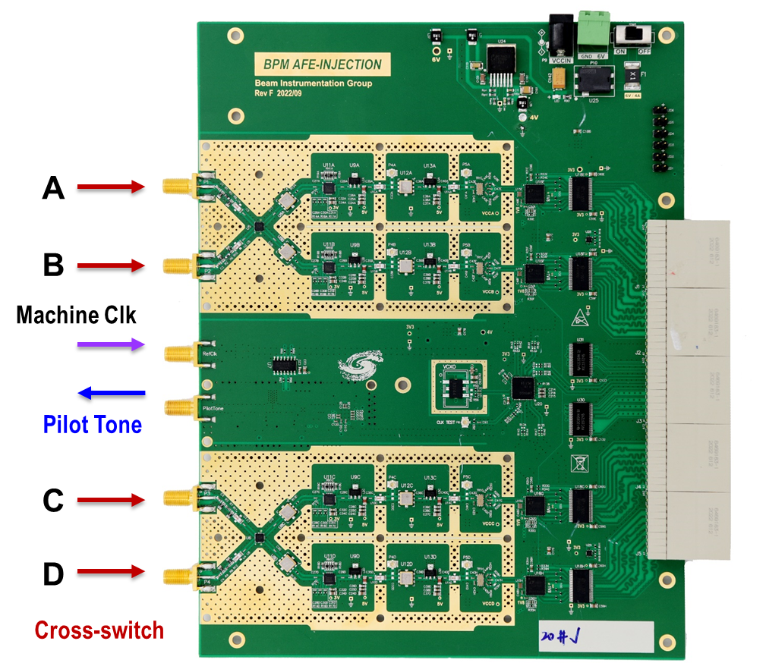
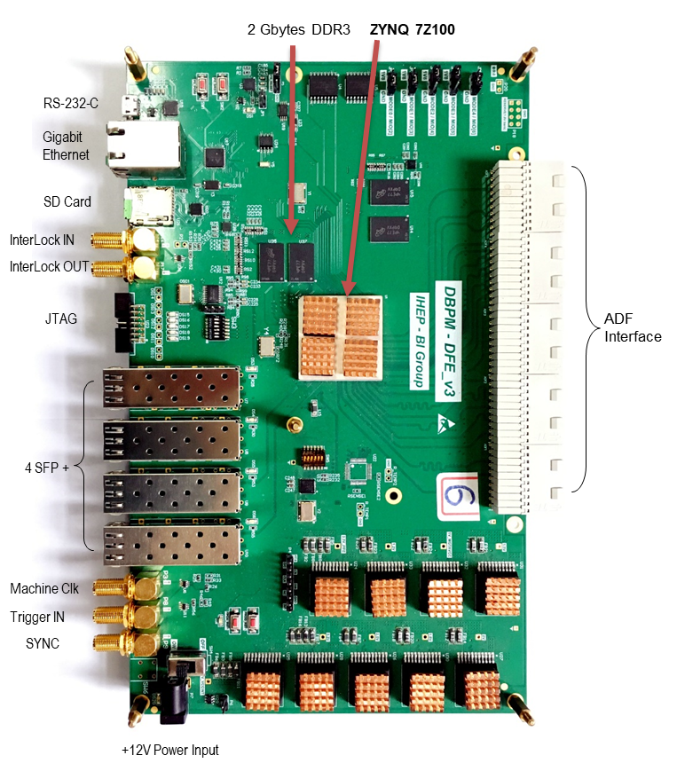
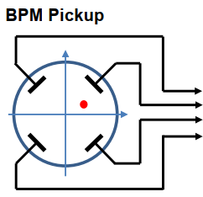
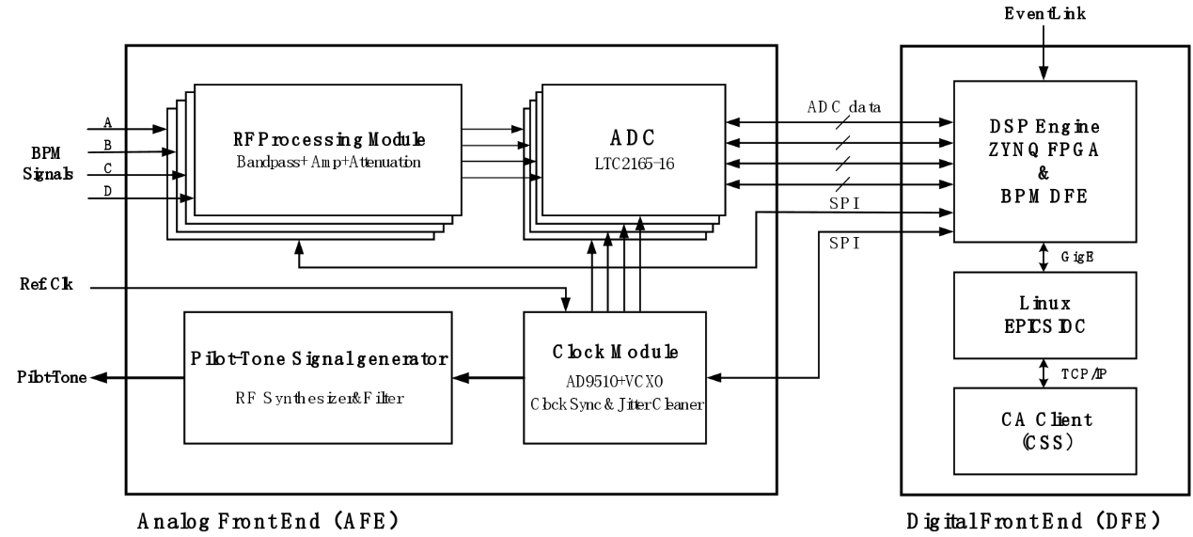
Beam position monitor
The BPM electronics can be categorized into two main parts: the Analog Front-End (AFE) for radio frequency signal conditioning and the Digital signal processing part (DFE).
The AFE consists of the RF signal conditioning module, ADC analog-to-digital conversion module, clock processing module, and pilot signal generation module. On the other hand, DFE includes the BPM signal acquisition module, signal conditioning module, data acquisition and transfer module, EPICS IOC module, and CSS control module.
About 6600 BPM electronics are required in CEPC and will installed in auxiliary tunnels.
Radiation-tolerant design of the electronics, the ADC and FPGA should be radiation resistant.

Slide 9
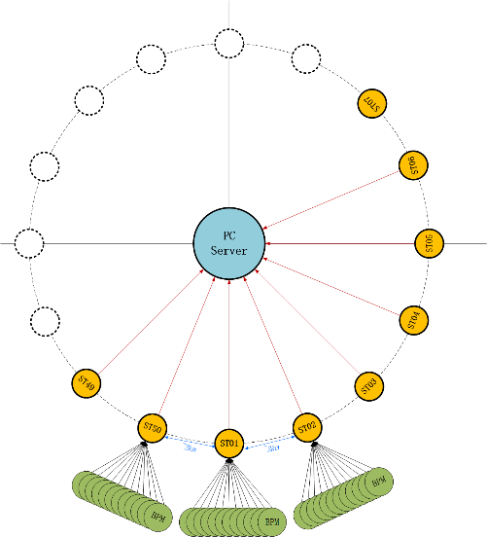
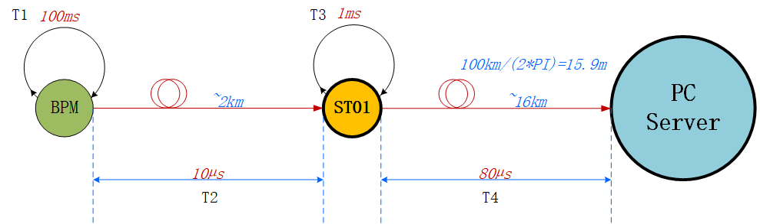
Beam position monitor
50 stations along the storage ring in auxiliary tunnel and connecting with PC sever station with the star topology fiber optic network.

Slide 10
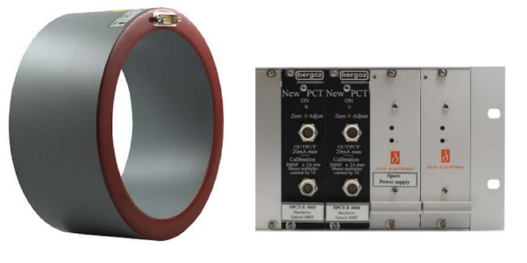
Beam current monitor
Two types of beam current measurement systems are utilized: average beam current measurement and bunch current measurement.
The average current monitor employs Bergoz type DCCT (Direct-current current transformer) sensors.
Bunch by bunch electronics are used for measuring each bunch current.
 | ttbar | Higgs | W | Z
Energy [GeV] | 180 | 120 | 80 | 45.5
Beam current [mA] | 3.3 | 16.7 | 84.1 | 803.5
Bergoz NPCT senor and front-end electronics

Slide 11
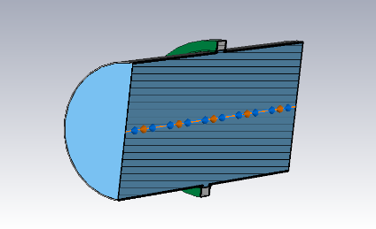
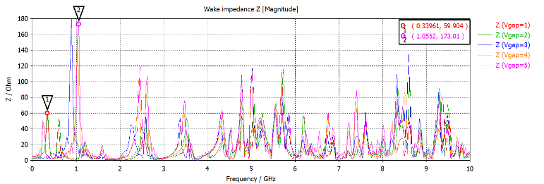
Beam current monitor
Structure of DCCT vacuum chamber and longitudinal wake impedance of the structure
The ceramic gap functions as a capacitor to cut off wall current. The capacitor determines the cut-off frequency, restricting high-frequency signals through the sensor.
Loss factor and longitudinal impedance are simulated by CST Particle Studio for different gap sizes.
The simulation reveals that a 2 mm gap results in low impedance at around 0.3 GHz, while a 10 mm gap produces high impedance at about 1 GHz. In this case, 2mm gap is chosen for the structure.

Slide 12
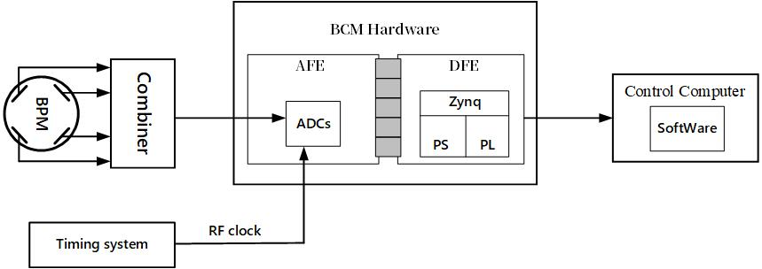
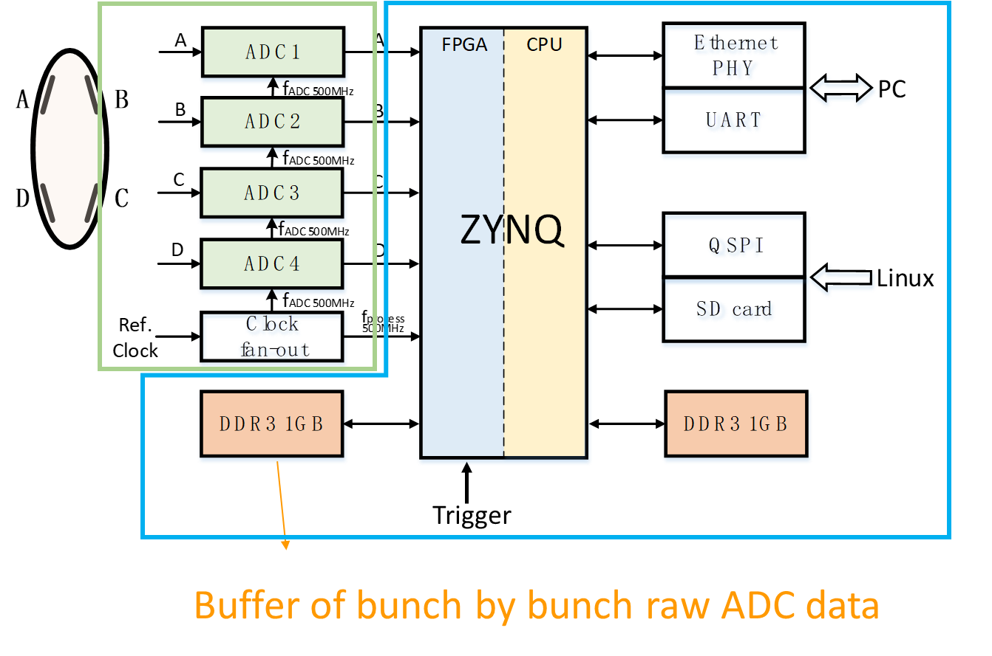
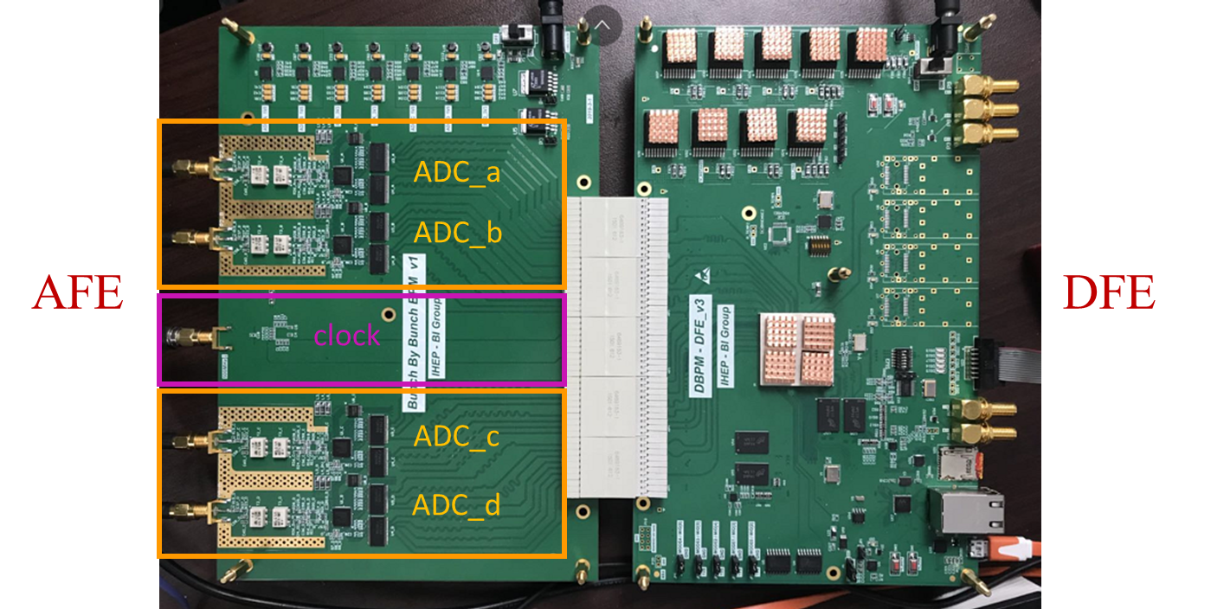
Beam current monitor
A bunch current monitor equipped with a fast ADC sampling BPM sum signal is utilized to measure the bunch current and share the data with the injection control system for bucket selection.
To improve the luminosity, it is necessary to accurately measure and control the charge of each bunch, ensuring that the charge of each bunch in the storage ring is equal.
The core part of the AFE is its high-speed ADC. The front-end circuit receives the sum signal from BPM. The signal is sampled at a frequency of 650MHz. The digitized data is instantly transferred to the DFE.

Slide 13
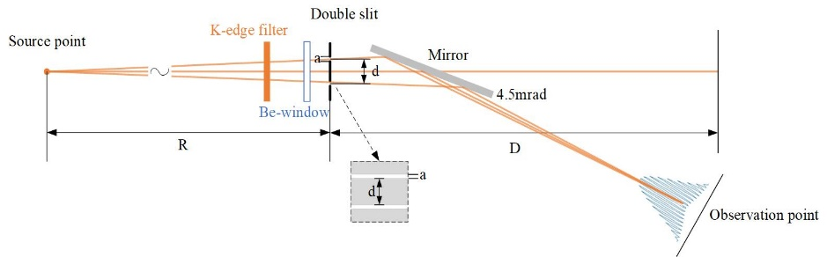
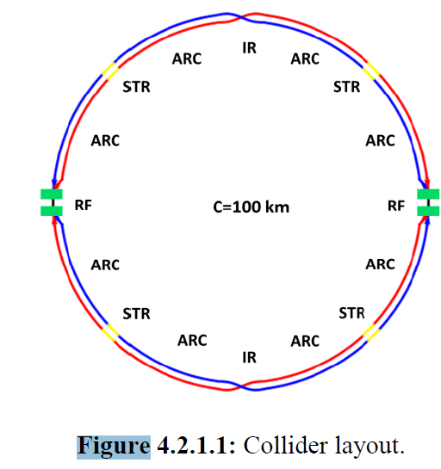
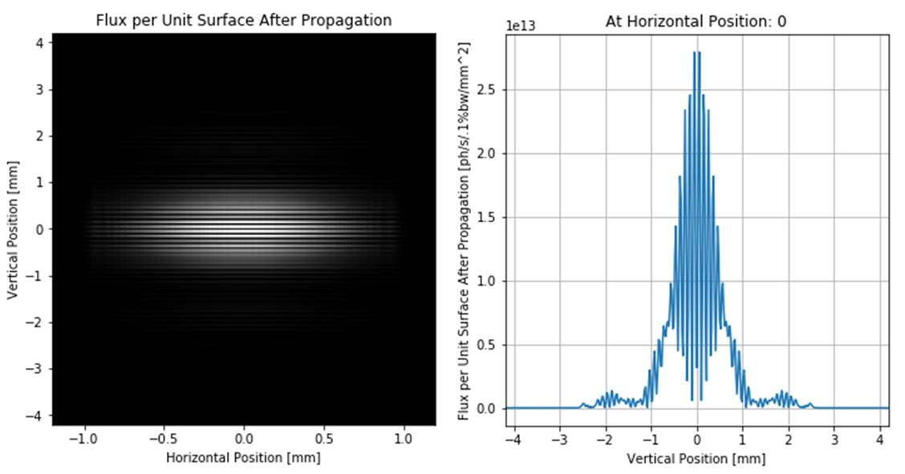
Beam size measurement
For a storage ring with high beam energy and a long bending radius, it can be challenging to separate SR light from the beam over a long distance. This makes it difficult to place diagnostic elements close enough to the source point. To overcome this challenge, the X-ray double slit interferometer is considered the best option for beam size measurement.
In the booster, beam sizes ranging from several hundreds of microns up to millimeters in both x and y directions. A visible light beam line will be constructed for beam size measurement
X ray energy：12keV
Light spot size：x 40e-6m y 5e-6m
Slits：Distance: d=200µm Width: a=8µm
Distance from source to slit: R=100m
Distance between observation point to slit 75m
Configuration for double slit X-ray interferometer
SLDB-P
SLDB-E
The synchrotron light diagnostic beamlines
Typical interferogram and the intensity distribution curve in vertical direction

Slide 14
Bunch length measurement
 | ttbar | Higgs | W | Z
Energy [GeV] | 180 | 120 | 80 | 45.5
Bunch length (SR/total) [mm] | 2.2/2.9 | 2.3/4.1 | 2.5/4.9 | 2.7/10.6
Bunch by bunch measurement system to monitor the bunch length and its lengthening. Visible SR beam line should be necessary.
Resolution about 1ps（~10% of bunch length）, streak camera based on visible light will be used.
In order to protect the extraction mirror from the incidence SR power, only half upper visible light is reflected
The distance from the mirror to the dipole source is about 98m.

Slide 15
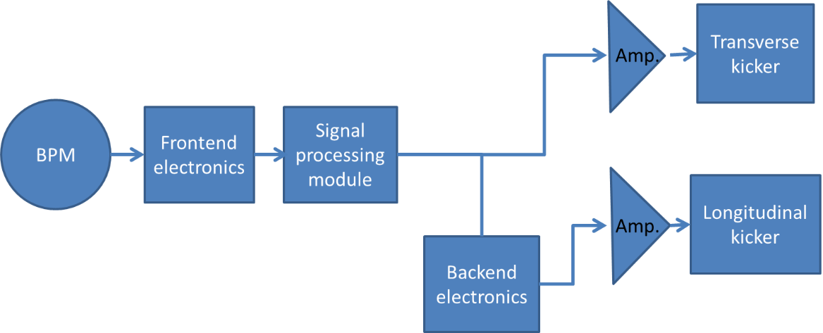
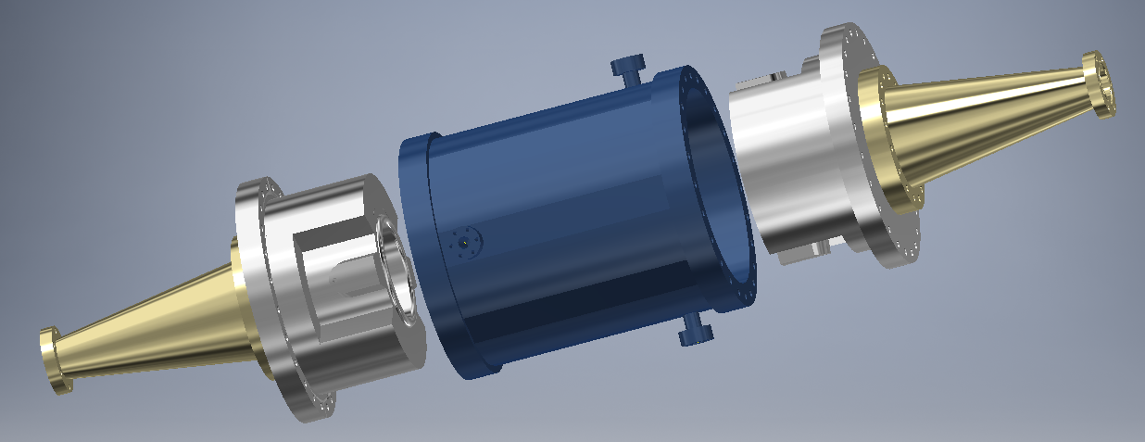
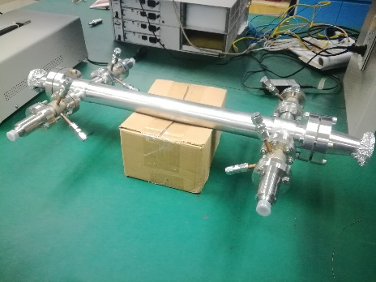
Feedback system
Bunch by bunch system including frontend/backend electronics, digital signal processing electronics, amplifier and kicker. There are 3-directions feedback system in storage ring and booster.
Frontend electronics are frequency down-convert electronics to fit ADC. And back end electronics are frequency up-convert electronics to fit LFB kicker.
Schematic diagram of Feedback system

Slide 16
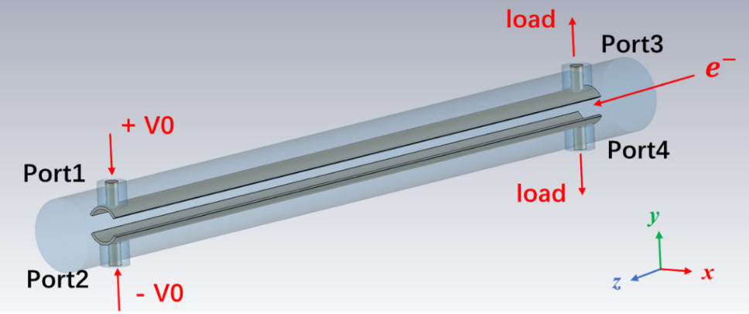
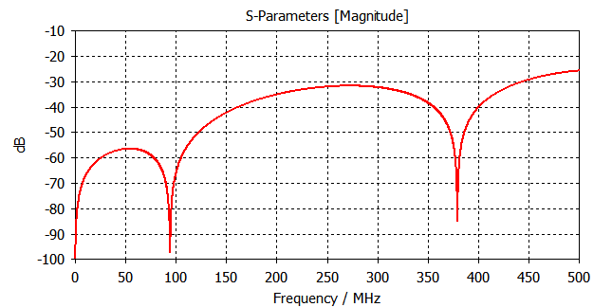
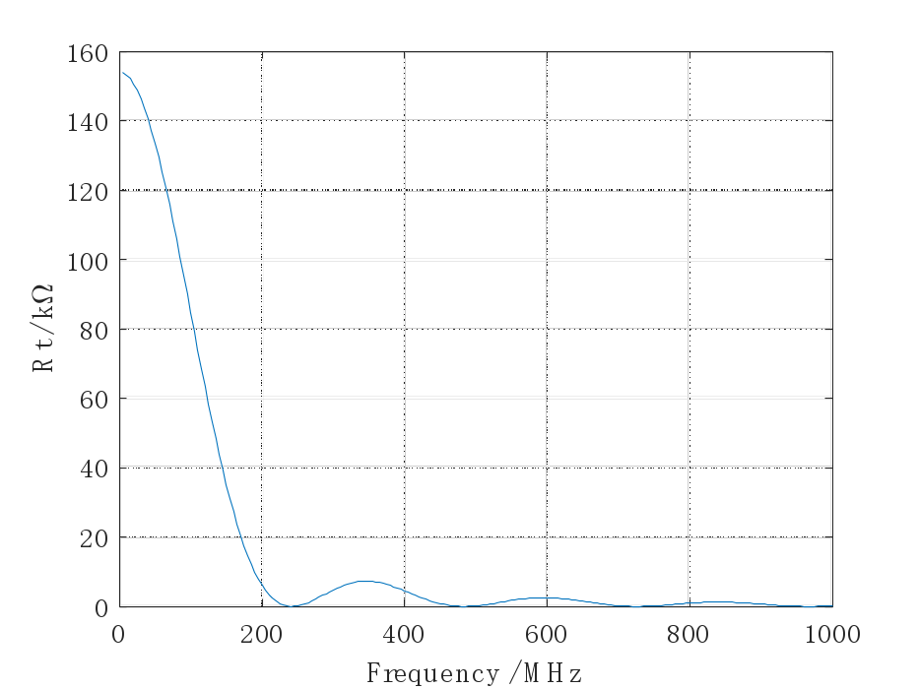
Feedback system
The basic structure of transverse feedback kicker
Reflection parameter S11 of the TFB kicker
Transverse shunt impedance versus frequency. ~140KΩ@25MHz

Slide 17
The power of transverse feedback
Parameter | Higgs | Z
Energy（GeV） | 120 | 45.5
Beta functions at pickup (m) | 250 | 250
Beta function at kicker（m） | 250 | 250
Number of kickers | 4 | 4
Revolution time（ms） | 0.33 | 0.33
RF frequency（MHz） | 650 | 650
Kicker shunt impedance（kΩ） | 140 | 140
Amplitude of oscillation（mm） | 0.2 | 0.2
Damping time（ms） | - | 1.0
Power(w) | - | 1460

Slide 18
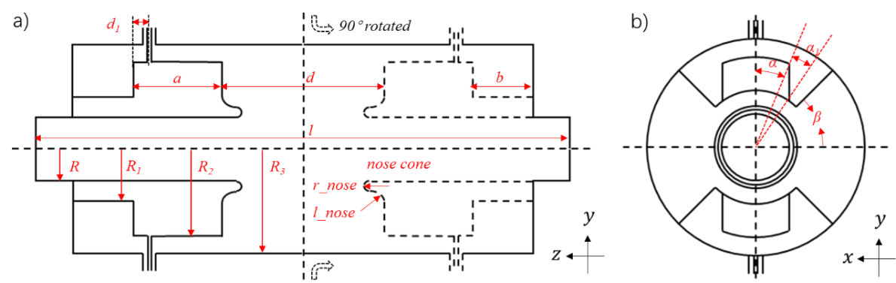
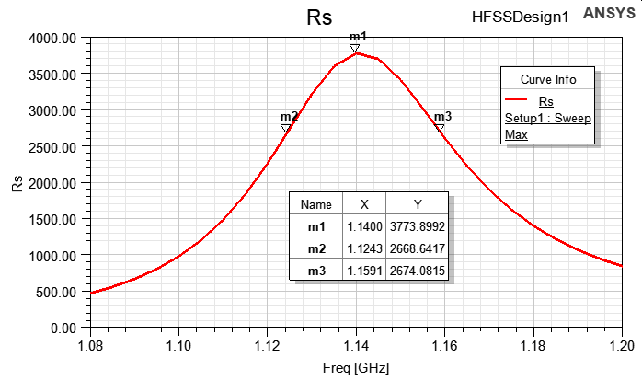
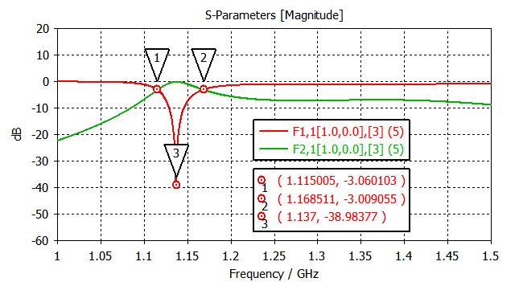
Feedback system
Parameter | Value | Parameter | Value
Beampipe radius R | 28 mm | Back cavity length | 27.44 mm
Back cavity radius | 56 mm | Cavity length | 303 mm
Ridge radius | 82 mm | Port angle | 15.3 deg
Pillbox cavity radius | 90 mm | Port base angle | 6.7 deg
Cavity gap | 91 mm | Barrier angle | 61 deg
Distance of feedthrough | 5 mm | Nose cone radius | 6 mm
Ridge length | 53.56 mm | Nose cone length | 7 mm
The schematic of the longitudinal feedback kicker
The reflection parameter S₁₁ of the LFB kicker
The shunt impedance of the LFB kicker

Slide 19
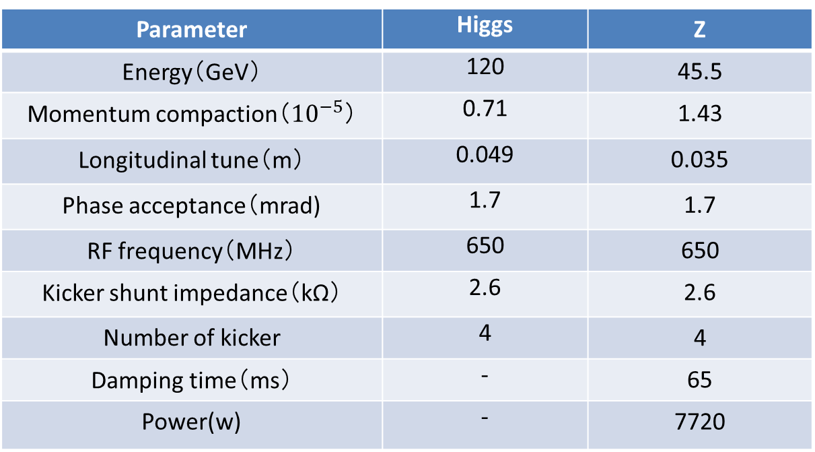
The power of longitudinal feedback
Parameter | Higgs | Z
Energy（GeV） | 120 | 45.5
Momentum compaction（${10}^{−5}$） | 0.71 | 1.43
Longitudinal tune（m） | 0.049 | 0.035
Phase acceptance（mrad) | 1.7 | 1.7
RF frequency（MHz） | 650 | 650
Kicker shunt impedance（kΩ） | 2.6 | 2.6
Number of kicker | 4 | 4
Damping time（ms） | - | 65
Power(w) | - | 7720

Slide 20
Feedback system in the booster
As the beam pipe in booster has same size as it in collider, the design of TFB kicker for booster is the same as for collider. The required working bandwidth of feedback kicker is 20MHz, and the minimum shunt impedance within bandwidth is roughly 150kΩ.
Parameter | Value (z-injection) | Value (z-extraction)
Energy（GeV） | 30 | 45.5
Beta functions at pickup (m) | 120 | 120
Beta function at kicker（m） | 120 | 120
Number of kickers | 2 | 2
Revolution time（ms） | 0.33 | 0.33
RF frequency（MHz） | 650 | 650
Kicker shunt impedance（kΩ） | 150 | 150
Amplitude of oscillation（mm） | 0.3 | 0.3
Damping time（ms） | 10 | 10
Power(w) | 81.7 | 188

Slide 21
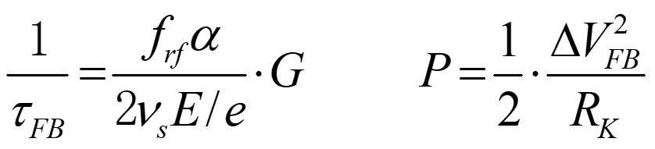
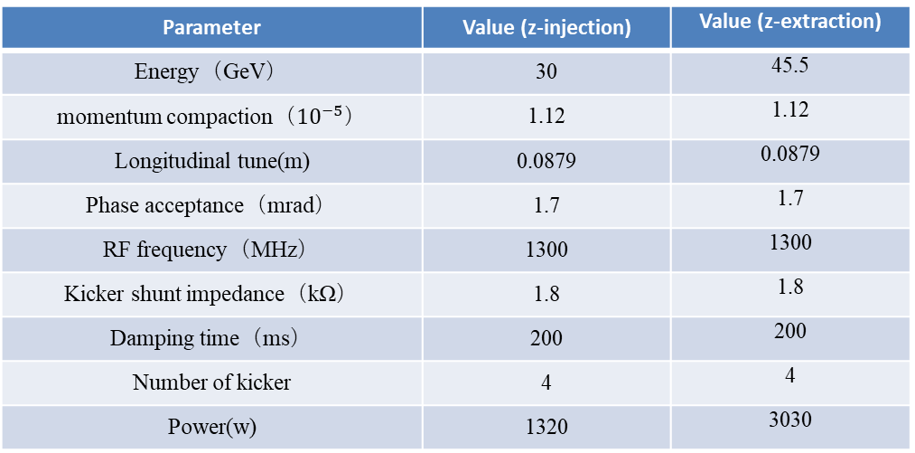
Feedback system in the booster
After optimization, the longitudinal shunt impedance within the required bandwidth of 1.615~1.635GHz for the RF frequency of 1.3GHz in the booster is approximately 1800Ω, with a central frequency of 1.625GHz
Parameter | Value (z-injection) | Value (z-extraction)
Energy（GeV） | 30 | 45.5
momentum compaction（${10}^{−5}$） | 1.12 | 1.12
Longitudinal tune(m) | 0.0879 | 0.0879
Phase acceptance（mrad） | 1.7 | 1.7
RF frequency（MHz） | 1300 | 1300
Kicker shunt impedance（kΩ） | 1.8 | 1.8
Damping time（ms） | 200 | 200
Number of kicker | 4 | 4
Power(w) | 1320 | 3030

Slide 22
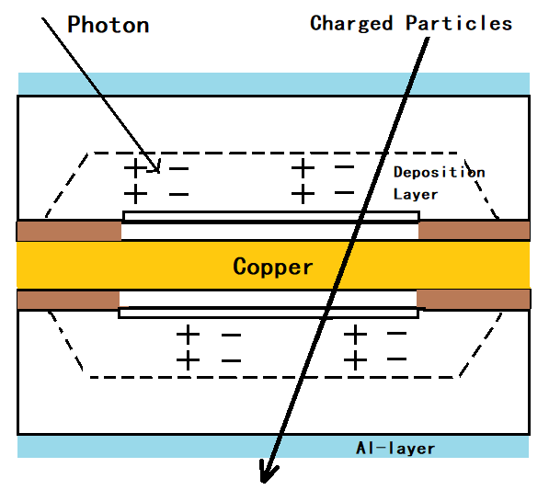
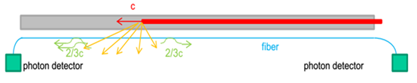
Beam loss monitor
This system can be used to study the beam loss and to understand the beam behavior.
The following important factors are focused for selecting the right type of BLM for a specific application in CEPC: intrinsic sensitivity, dynamic range, radiation hardness, response time and sensitivity to synchrotron radiation (SR).
The improved PIN-photodiode in storage ring and the Quartz Fiber in booster for large range of beam energy

Slide 23
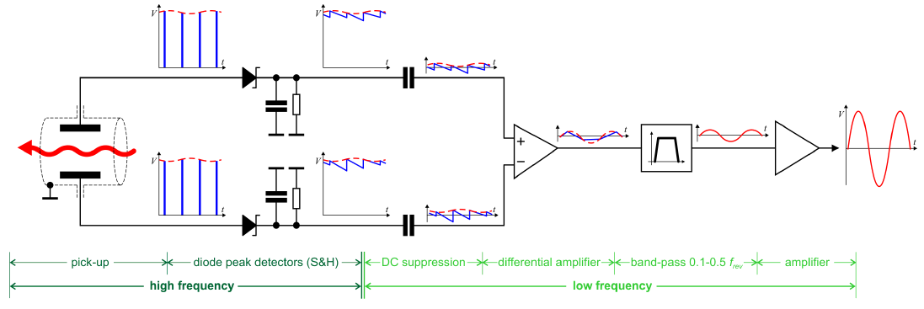
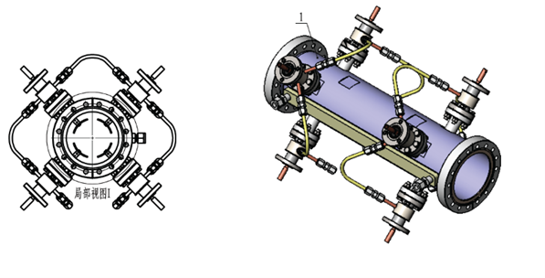
Tune monitor
Frequency sweeping method with gated pulse or FFT analyzing to the data from the digital BPM.
The BPM monitor, signal processing unit and the kicker form the entire system.
Direct Diode Detection（3D）is another choice for tune monitor
Direct Diode Detection method invented by Marek Gasior will be taken.
Sub-micrometer oscillation will be detected.
Pilot bunch exciting method will also be used to measure the tune.
One method is to change the phase in Bunch by bunch feedback filter.
The other is to kick the appointed bunch to get the tune.

Slide 24
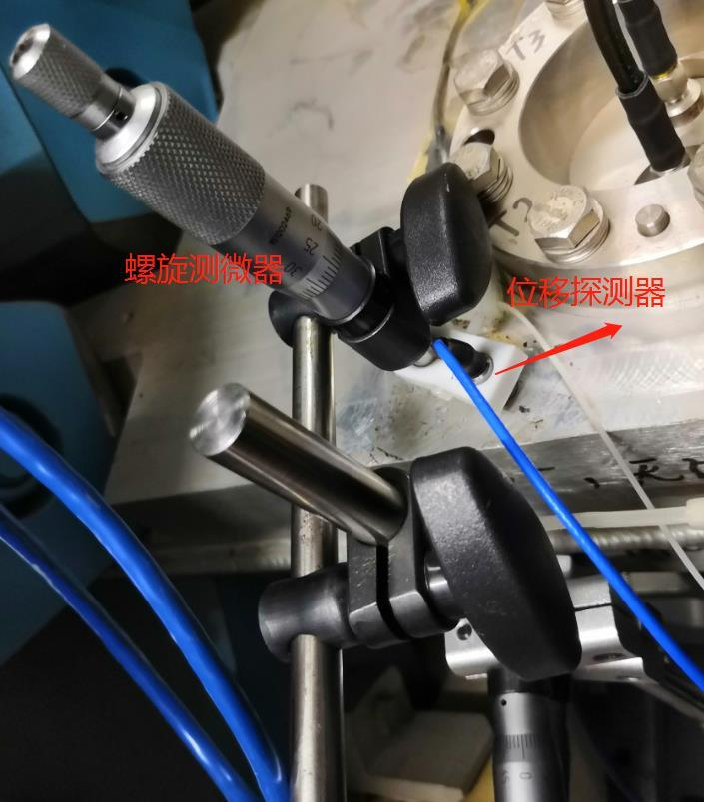
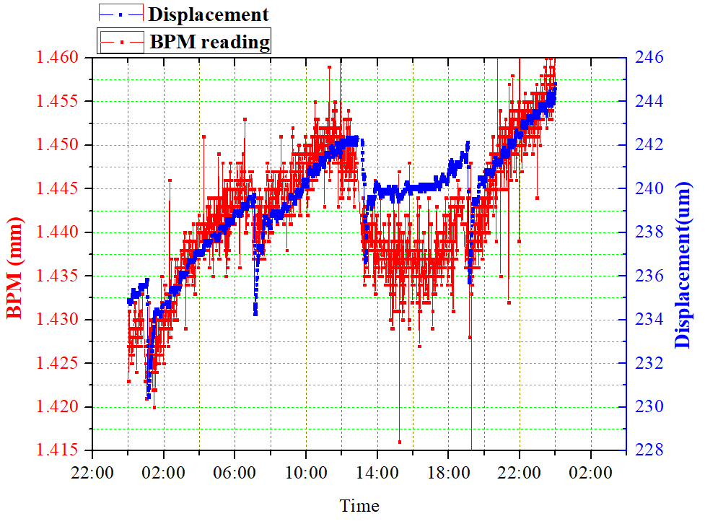
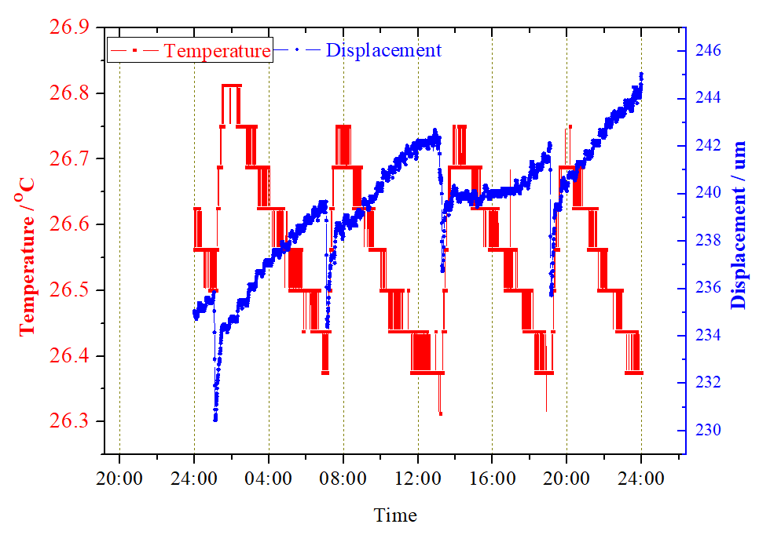
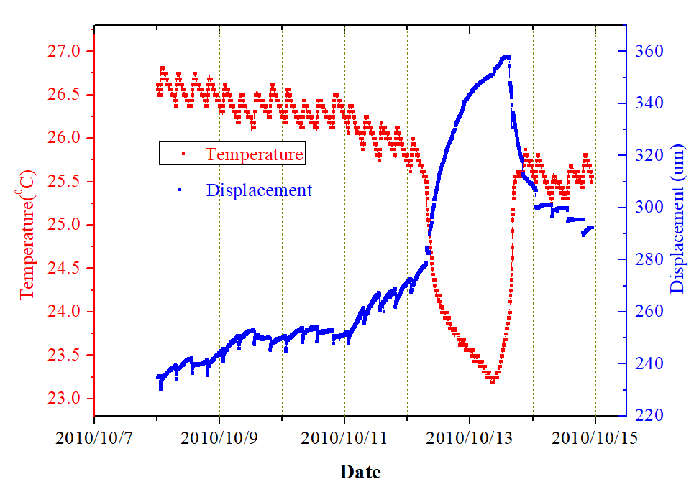
Other systems
Vacuum Chamber Displacement Measurement
  Due to heat effects caused by synchrotron radiation and beam loss, the vacuum chamber will be displaced. In order to calibrate the BPMs, the displacement need to be measured.
  The entire system includes Linear Variable Differential Transformer (LVDT), signal processing unit, computer and network.
  Relevant research has been carried out on BEPCII. The displacement detector uses the DL6230 of Micro with dynamic range 500 μ m and accuracy 1 nm.
  Beam test has been carried out in BEPCII
Re-injection
Shut down
BPM reading Δ40μm ~ displacement sensor reading Δ 15 μm ~ Temperature 0.5 ℃
Notes:
The temperature difference with /without beam is 2 ℃, the difference is much smaller for different current, the position difference is 15 μm in a run (150~250 mA)

Slide 25
The beam instrumentation in CEPC Linac
 | Item | Method | Parameter | Amounts
Linac | Beam position | Stripline BPM | Resolution ：30um | 140
 | Beam current | ICT | 2.5%@1nC-10nC | 42
 | Beam profile | YAG/OTR | Resolution: 30um | 80
 | Beam emittance | Q+PR | 10% | 3
 | Beam energy & spread | AM+PR | 0.1% | 3
Damping ring | Average current | DCCT | Resolution :50uA@0.1mA-30mA | 1
 | Beam position | Button BPM | Resolution : 20um @ 5mA TBT | 40
 | Tune measurement | Frequency sweeping | Resolution:0.001 | 1

Slide 26
Beam position monitor
There are a total of 150 stripline BPMs in the Linac and its transport lines, which are divided into two groups based on the size of the beam-stay-clear area. The beam-stay-clear area with a diameter of 30 mm and 20 mm.
BPM electronics hardware is the same as that of collider ring，but the algorithm is specifically tailored for Linac. Bunch by bunch electronics is adopted for double-bunch acceleration

Slide 27
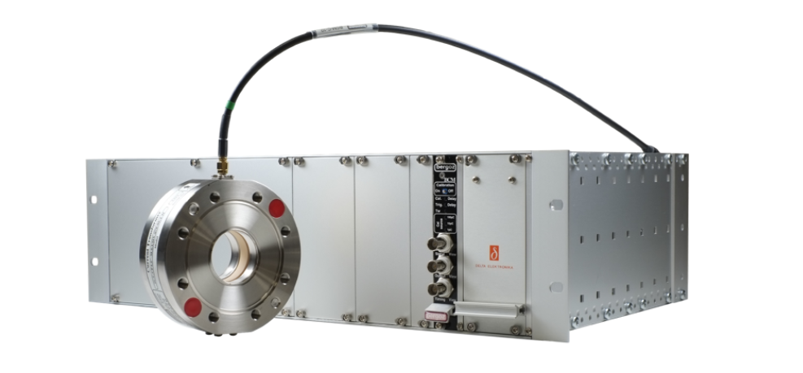
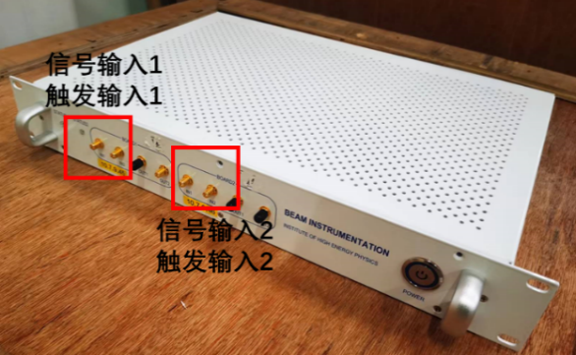
Beam current measurement
In total, there are 42 ICTs installed in the Linac to monitor beam intensity and calculate transmission efficiency.
An in-house signal processing electronics system is designed to adjust the signal from the ICT, performing the functions of filtering and amplification.
The sensitivity of the ICT sensor must take into account the attenuation caused by the transmission cable to ensure accurate measurement results. For this reason, an on-line functional examination and re-calibration can be carried out using the Cali-winding within the sensor.
BCM electronics
A/D
（Local station）
ICT （Tunnel）
Data base

Slide 28
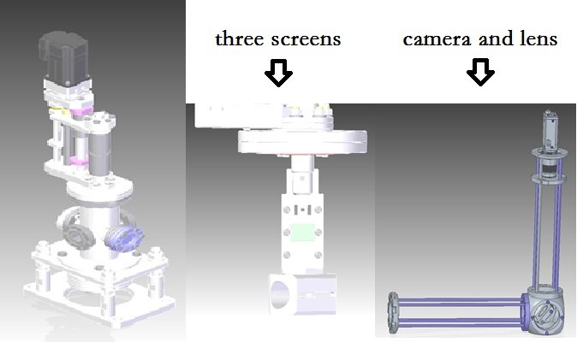
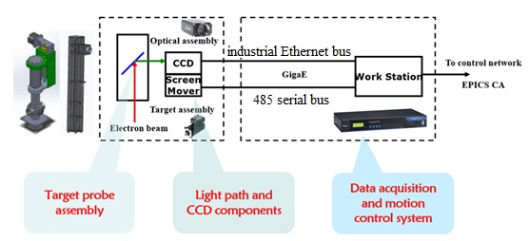
Beam Profile Measurement
The beam profile monitor is designed with three position screens for testing. a YAG:Ce crystal plate for low current commissioning, 100 nm aluminum(OTR) for high energy and calibration screen .
The control system software for the beam profile monitors is based on EPICS
Beam emittance and beam energy & spread measurement are both based beam profile measurement

Slide 29
Beam instrumentation related R&D
The R&D activities based on lepton accelerator beam measurement mainly include the following three aspects.
  The design and fabrication of HEPS beam instrumentation
  The maintenance and upgrade of BEPCII beam instrumentation
  The R&D of CEPC beam instrumentation

Slide 30
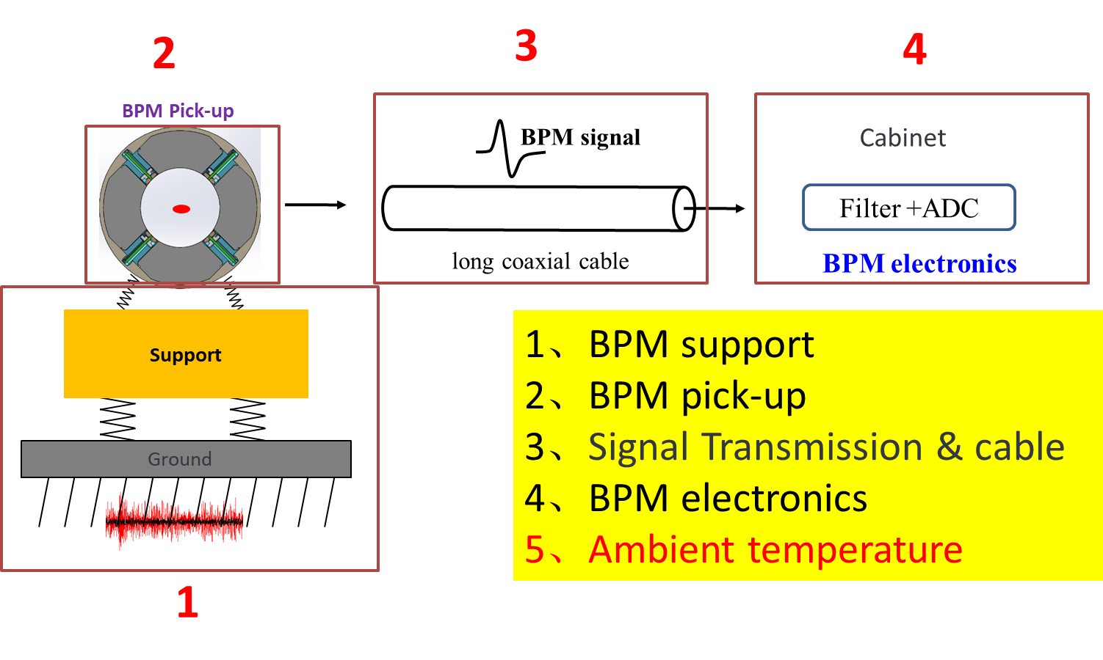
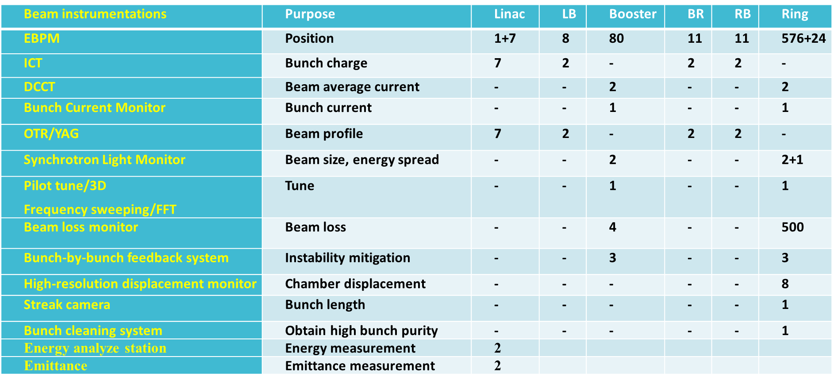
Beam instrumentation related R&D
We designed, manufactured, and calibrated the whole beam diagnostics system for HEPS, including the linac, booster, and storage ring.
In particular, we performed a detailed analysis of factors affecting the resolution of beam position monitor, and through various measures, we achieved the design goals for HEPS BPM, which are higher than those for CEPC.

Slide 31
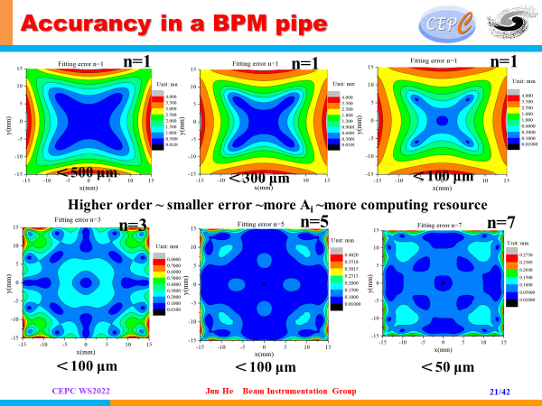
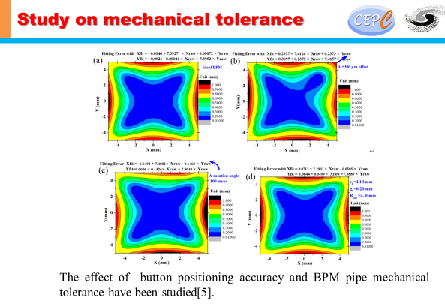
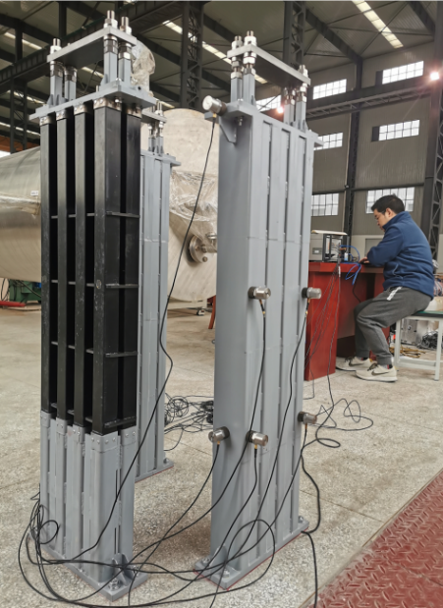





Beam instrumentation related R&D
We have developed button pick-ups BPM for HEPS.
Goubau line based wire calibration system were set to check BPM PU

Slide 32

Digital Front End Board (DFE)
Features:
Xilinx ZYNQ FPGA (XZ7100)
  Hard dual-core ARM A9 processor
  Beam signal processing with DDC+CIC+FIR
  Runs standard Debian based Linux Operating System
  Embedded IOC
Boot via 32Gbyte micro SD-Card
Gigabit Ethernet
2Gbyte DDR3 Memory (SO-DIMM Module)
  Four 6.6Gbps SFP modules
  Embedded Event Receiver
  Fast Orbit Feedback
32Mbit FLASH memory
2 Gbytes DDR3
ZYNQ 7Z100
RS-232-C
Gigabit Ethernet
SD Card
InterLock IN
InterLock OUT
JTAG
ADF Interface
4 SFP +
Machine Clk
Trigger IN
SYNC
+12V Power Input

Slide 33


Analog Front End Board (AFE)
Performance Features
P1dB = +18.5dBm (at ADC Input)
IP3 = +39 dBm (at ADC input)
NF =6.0dB (LPF and SAW Filter)
Channel to Channel Isolation > 40dB
Phase difference < 10°
Amplitude difference < 5%
-3dB Bandwidth ≈ 20MHz
A
B
Machine Clk
Pilot Tone
C
D
Cross-switch
Receiver S-Parameter Characterization

Slide 34


Analog Front End Board (AFE)
Rms jitter = 174fs
(10Hz-10MHz)
A
B
Machine Clk
Pilot Tone
C
Hole space: S ≈ 4D to 10D
More than 2 rows Ground Via needed;
Vias on Adjacent rows are interlaced placed;
Less λ /4 Via to Via space in one row.
Clock Power Supply factors cannot be ignored！
D
Cross-switch

Slide 35
Digital Signal Processing Block
DDS
DDC BPM block
COD BPM block
RAW
ADC
FIR Filter
Bandpass
×
IQ Data
CIC Filter
Decimator
Compensating
FIR Filter
CORDIC
BPM Calc.
TBT Data
220 kHz
LFSR
CIC Filter
Decimator
Compensating
FIR Filter
Programmable
FIR Filter
BPM Calc.
FA Data
22 kHz
 | DBPM@BEPCII | DBPM@HEPS
TbT Data | 1.2621MHz | 220kHz
FA data | 10kHz | 22kHz
COD data(SA) | 10Hz | 10Hz
CIC Filter
Decimator
Compensating
FIR Filter
Programmable
FIR Filter
BPM Calc.
SA Data
10 Hz
The DDC algorithm module mainly consists of modules such as NCO, CIC, and FIR. In the first stage, a BPF is used to remove the baseline of ADC data and reduce the difference between the four channels of data. The algorithm module mainly generates TbT, FA, and SA data. The digital signal filtering mainly consists of an extraction filter composed of CIC and FIR
LFSR: Linear Feed-back Shift-Register
FIR filter : Finite Impulse Response filter
CIC filter : Cascaded Integrator-Comb filter
DDS : Direct Digital Synthesis

Slide 36
Data Acquisition Module
Data Acquisition function block.
  EPICS Device Driver
  Linux Kernel Driver
  Data Acquisition DMA/FIFO
  Data base logic
  Graphical User Interface
EPICS BPMApp IOC
EPICS Device Driver
EPICS Device Driver
EPICS Device Driver
EPICS Device Driver
Linux Kernel Driver
Linux Kernel Driver
Linux Kernel Driver
Linux Kernel Driver
DMA
FIFO
FIFO
FIFO
ADC RawData
TBT Data
FA Data
SA Data

Slide 37


ADC Performance Analysis
ADC SNR vs Input Frequency vs Clock Jitter
A
B
Raw ADC FFT
 | SNR | ENOB | SFDR | SINAD | THD
ADC | 60.3 | 12.2 | 75.5 | 52.2 | -56.1
C
D
ADC test results
ADC histogram

Slide 38



BPM electronics test in Lab
TBT RMS (X=767nm,y=786nm)
SA RMS(X=30nm,Y=38nm) 10points STD
Performance
TBT data rms xpos ≈767nm, ypos ≈786nm;
FA data rms xpos ≈103nm, ypos ≈98nm;
SA data rms xpos ≈30nm, ypos ≈38nm;
Kx=Ky=8.26mm;
FA RMS (X=103nm,y=98nm)

Slide 39


BPM Processor Performance Testing
(IHEP&&commercial products)
40nm
35nm
40nm
40nm
** BPM electronics
IHEP BPM electronics

Slide 40


Real beam test in BEPCII
BPM 1O_03 (IHEP&&commercial products)
70nm
80nm
90nm
70nm
** BPM electronics
IHEP BPM electronics

Slide 41



BPM electronics application
We successfully solved the issue of mass production of BPM electronics and the home-made BPM electronics were used in BEPCII collider ring operation and HEPS linac commissioning
There will be ~600 sets self-developed BPM electronics in HEPS storage ring.

Slide 42




Beam instrumentation related R&D
Optical fiber based BLM test in BEPCII
Bunch by bunch electronics are used to measure beam oscillation
The 3D tune measurement system beam test in BEPCII

Slide 43



Beam instrumentation related R&D
Multi-feedback systems can be used to improve the performance of particle accelerators. At BEPCII, the double feedback technique was successfully implemented, and the results showed that the damping times are almost equal to the sum of the two feedback systems. This demonstrates the effectiveness of multi-feedback systems in improving the stability and performance of particle accelerators in one direction.
The damping time of two TFBs

Slide 44


Beam instrumentation related R&D
Study of feedback system kicker
Resonant strip-line type longitudinal kicker

Slide 45
Summary
We have reviewed and improved the design report of the system based on the latest parameters and suggestions from IARC
We have thoroughly understood the measurement requirements of CEPC and conducted extensive research on key technologies.
Through our research and development activities, we have trained our personnel and mastered the necessary technology, which has prepared us for the construction of the project.
Thank you for attention！

