Slide 1



Upgrade to SPPC
TANG, Jingyu (USTC)
for the SPPC study group
12-16. June. 2023, Hongkong, CEPC Accelerator TDR International Review

Slide 2
Content
The upgrading phase - SPPC
Main design features of the SPPC at TDR
Compatibility with CEPC
Technical issues
Injector chain
Summary

Slide 3
From CEPC to SPPC
SPPC is the second phase of the project, differing by 10-15 years
Use the same CEPC tunnel to build SPPC, exploring new physics beyond SM and also precision Higgs
Center-of-Mass energy larger than 100 TeV with IBS magnets
Keep the e-/e+ rings when adding the SPPC
Collisions possible: pp, e-/e+, ep, pA, eA, AA
Build a new injector chain for SPPC (proton and ions)
Independent physics programs for the accelerators of the injector chain

Slide 4
SPPC design evolutions
Parameter | Unit | Value
 |  | PreCDR | CDR | TDR
Circumference | km | 54.4 | 100 | 100
C.M. energy | TeV | 70.6 | 75 | 125
Dipole field | T | 20 | 12 | 20.3
Injection energy | TeV | 2.1 | 2.1 | 3.2
Number of IPs |  | 2 | 2 | 2
Initial luminosity per IP | cm⁻²s⁻¹ | 1.2e35 | 1.0e35 | 4.3e34
Beta function at collision | m | 0.75 | 0.75 | 0.5
Circulating beam current | A | 1.0 | 0.73 | 0.19
Bunch separation | ns | 25 | 25 | 25
Bunch population |  | 2.0e11 | 1.5e11 | 0.4e11
SR power per beam | MW | 2.1 | 1.1 | 2.2
SR heat load per aperture @arc | W/m | 45 | 13 | 27

Slide 5
Collider Ring - Parameter List

Slide 6
Design features at 125 TeV (CoM)
Use iron-based HTS magnets
  The development on IBS in the last years is encouraging, though a long march and huge technical challenges ahead
  Discussions about using 20-24 T directly (formerly called ultimate stage), to reach C.o.M. energy of 125-150 TeV, and decision to adopt 20 T / 125 TeV option.
Compatibility with CEPC
  Currently taking the full CEPC tunnel, but a bypass scheme is always possible in the future in order to keep the whole CEPC (including detectors) when building SPPC
Synchrotron radiation problem
  Radiation power per particle increased by 7.7 times (∝ γ4) vs CDR
  Cutting circulating current largely (from 0.7 A @CDR to 0.19 A)
  SR power per aperture at arcs: 26 W/m (vs 12.8 W/m CDR)

Slide 7
Luminosity and pileup problem：significant reduction in initial luminosity due to smaller particle number, recovery measures taken already
  Higher bunch population helps on luminosity, but introduces data pileup problem (current LHC: ~30 per cross, HL-LHC: 140-200, possible ~400-500 in the future, goal for FCC-hh; eventually >1000)
    Keeping the same bunch number (spacing of 25 ns) but lower bunch population (1.5➔0.4) *10^11
  Luminosity optimization and leveling with dynamic β* and emittance shrinking
  Nominal B-B parameter increased from 0.015 to 0.03 (two IPs)
  Beta* dynamically changing from 0.5 m to 0.25 m (initial β*=0.75 @CDR)
  Smaller initial emittance (2.4➔1.0 μm, at p-RCS)
  Best scenario: peak lumi. 1.9*10^35, average lumi 0.62*10^35 (~46% of that in CDR), annual integrated 0.60 ab⁻¹ (best CDR: 1.3 ab⁻¹)

Slide 8
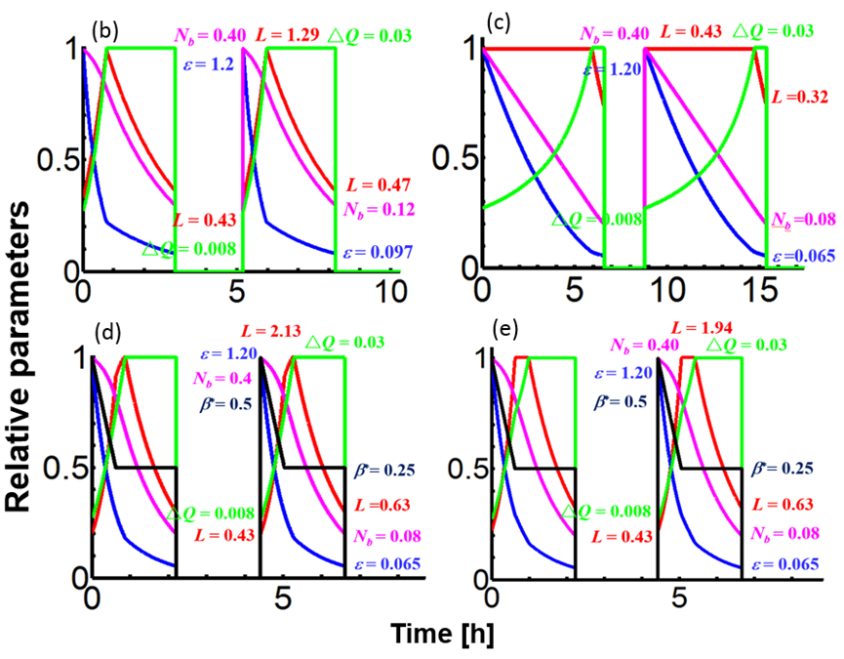
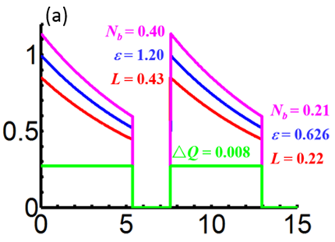
Luminosity optimization and levelling scenarios
Pileup: 483
Pileup: 160
Pileup: 160
Pileup: 795
Pileup: 727

Slide 9
Other accelerator physics studies
For CDR at 75 TeV,
  Collider ring lattice and dynamic aperture
  Beam collimation
  Longitudinal beam dynamics for the whole accelerator chain
  Beam-beam effects and luminosity levelling
  Beam screen related
  Parametric design for the injector accelerators
  (Several journal papers published)
For TDR at 125 TeV,
  Similar work to be done, but little completed
  Actually: lattice design optimization, DA, errors and orbit correction, longitudinal beam dynamics, synchrotron radiation and beam screen, p-RCS lattice, etc.

Slide 10
Optional High-Lumi Operation
The design scheme of CDR with 75 TeV can be kept as an optional operation mode for high-luminosity experiment
  Significantly lower energy, but the luminosity is almost doubled with higher beam current (intentional, non-trivial)
  Injector chain: same bunch intensity as in CDR, higher energy at SS
Parameters | @75 TeV | @125 TeV | Unit
Dipole field | 12 | 20.3 | T
Initial luminosity per IP | 1.0×10³⁵ | 4.3×10³⁴ | cm⁻²s⁻¹
Annual integrated luminosity | 1.24 | 0.6 | ab⁻¹
Circulating beam current | 0.73 | 0.19 | A
Bunch population | 1.5×10¹¹ | 4×10¹⁰
Normalized emittance | 2.4 | 1.2 | mm-mrad
Stored energy per beam | 9.1 | 4.0 | GJ
SR power per beam | 1.1 | 2.2 | MW
SR heat load at arc per aperture | 12.8 | 27.4 | W/m

Slide 11
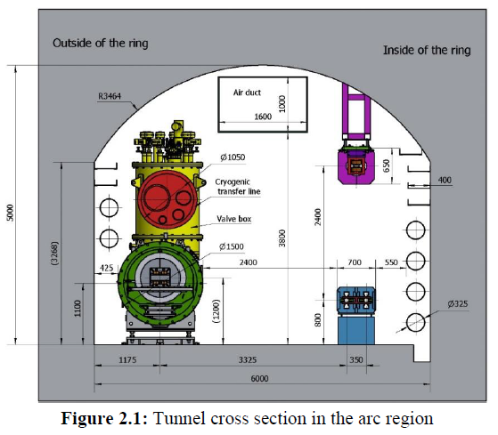
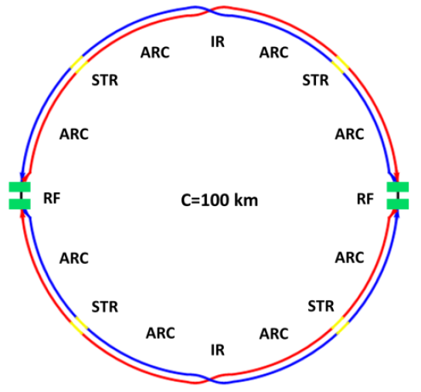
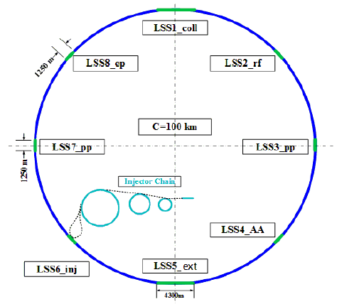
CEPC-SPPC compatibility
Geometry compatibility between CEPC and SPPC
  SPPC will share the same tunnel of CEPC, trying to keep the CEPC rings during upgrading
  SPPC locates outside of CEPC
  8 arc regions, 4 longer LSS and 4 shorter LSS (distance of machine centers=3.5m) : CEPC has evolved the LSS design in the last years, SPPC adapted to the changes.
  Bypass scheme: keeping all the CEPC detectors and detouring the SPPC (under study), but not in the baseline design. Additional civil engineering needed.
Tunnel in the ARC
CEPC Layout
SPPC Layout
IP1
IP1
IP4
IP2
IP4
IP2
IP3
IP3

Slide 12
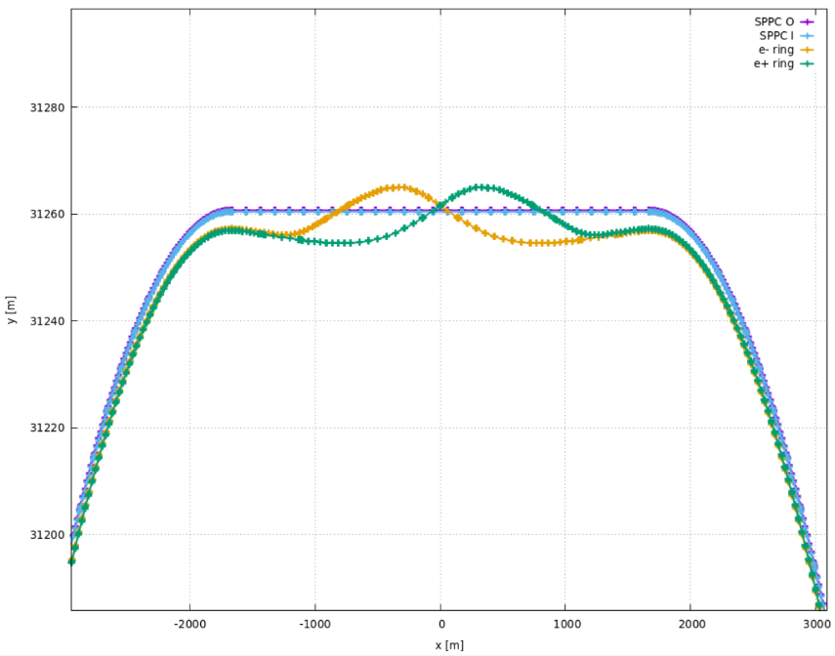
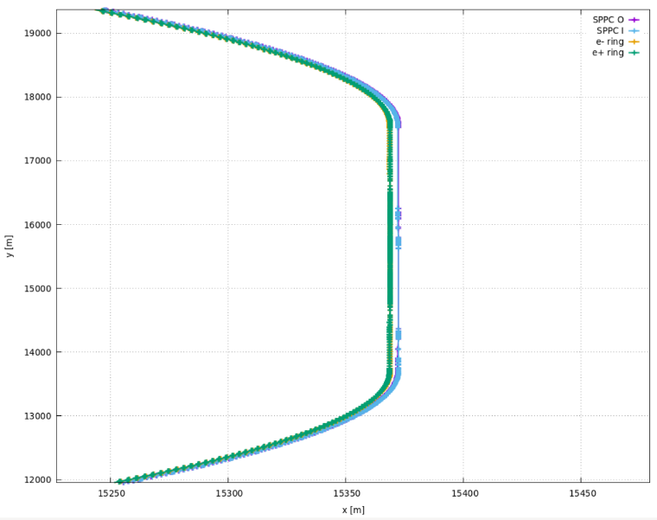
SPPC Section Lengths and Comparison with CEPC
Arcs 1/4/5/8 | 10188.55 | 10185.70
Arcs 2/3/6/7 | 10273.29 | 10270.44
Arc cell length | 219.32 | 54.63
LSS1/LSS5 (CEPC IP) | 3337.13 | 3337.13
LSS3/LSS7 (SPPC IP) | 3776.90 | 3776.90
LSSs 2/4/6/8 | 986.84 | 986.84
Circumference | 100022.78 | 100000.0
IP1 / IP3
IP2 / IP4
*Arc including DIS sections; inner and outer rings are averaged

Slide 13
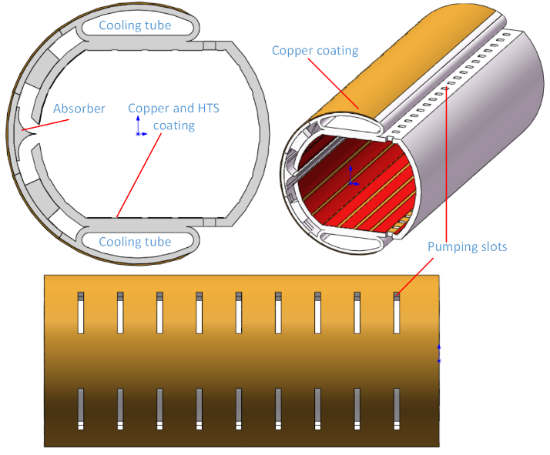
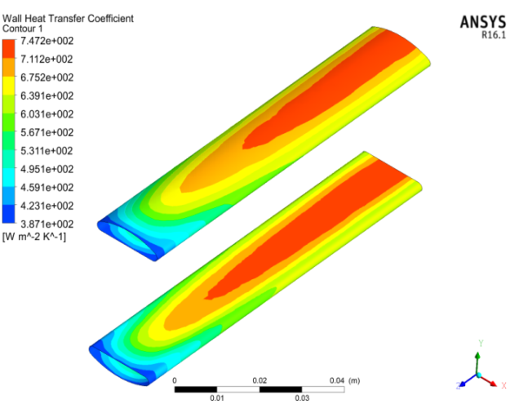
Technical challenges and R&D requirements
The most difficult is the high-field superconducting magnets: in Qingjin Xu’s talk
Beam screens
  With the new design scope, SR power will be 27 W/m, should be a very critical issue (LHC: 0.2 W/m)
  Different effects combined: impedance, electron cloud, vacuum, magnet quenches, cooling etc.

Slide 14
Other important technical challenges
  Collimation system: new materials to reduce impedance and tolerate more heat deposit
  Very large scale cryogenics system: SC magnets, beam screens, SRF
  Vacuum: needing a solution if the temperature is increased from 1.9 K (following IBS magnets)
  Sophisticated beam feedback system: to control the emittance heat-up and suppress beam instabilities
  Machine protection system: fast detection of abnormal function, reliable beam abort (kickers and septa)
  There are also many technical challenges in building high-power injector chain: e.g. RF systems for p-RCS and MSS, fast ramping SC magnets for SS

Slide 15
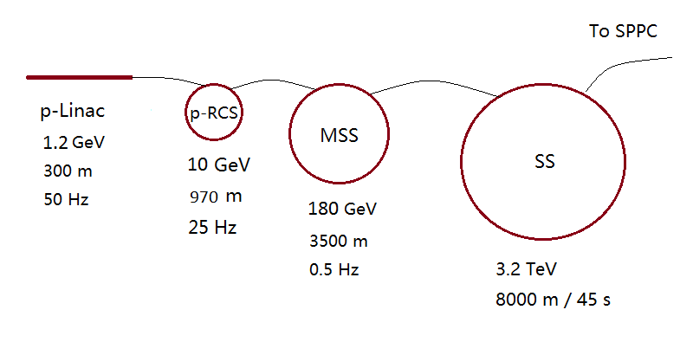
About the injector chain
Injector chain almost unchanged (vs CDR) except the energy of the last stage SS increased from 2.1 TeV to 3.2 TeV (larger ring and higher field, 8 T➔11 T)
p-Linac: proton superconducting linac
p-RCS: proton rapid cycling synchrotron
MSS: Medium-Stage Synchrotron
SS: Super Synchrotron

Slide 16
Main parameters for the injector chain
 | Energy | Current | Circum | Rep. rate | Max. power/store energy | Field | Duty into next
 | GeV | mA | km | Hz | MW/MJ | T | %
p-Linac | 1.2 | 1.4 | 0.3 | 50 | 1.6/ | - | 50
p-RCS | 10 | 0.34 | 0.97 | 25 | 3.4/ | 1.0 | 6
MSS | 180 | 0.02 | 3.5 | 0.5 | 3.7/ | 1.4 | 13.3
SS | 3200 | - | 8.0 | 1/45 | /52 | 11.3 | 0.74

Slide 17
Summary
Major change for SPPC from CDR is the increased CoM energy: 125 TeV with 20-T magnets (original ultimate stage)
  Basically no show stopper
  Sacrifice on luminosity
Compatibility between CEPC and SPPC layouts is ok for the moment
Optional operation (CDR design, @75 TeV) as the high-luminosity mode
SPPC design work continues but at low strength
Welcome comments and suggestions!

