Slide 1



R&D Status of the High Field
Model Dipoles for SPPC
Qingjin XU
for the Superconducting Magnet Group,
Accelerator Division, IHEP-CAS

Slide 2
Introduction
This talk is about the high field superconducting magnet R&D for SPPC
This talk relates to the TDR chapter 8.3 HIGH-FIELD SUPERCONDUCTING MAGNETS
The content relates to the following “charge letter” items
1. Are the accelerator system design goals well defined? Have the goals been reached in the TDR?
3. Are the accelerator complex design, the key technologies adopted, and the conventional facilities effective for achieving the performance goals?

Slide 3

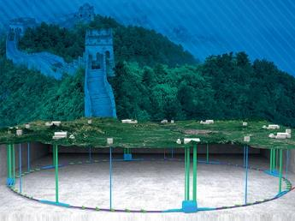
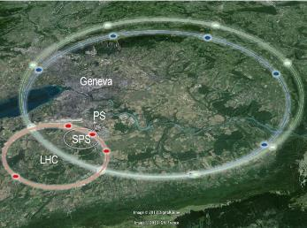
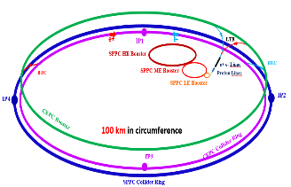
Magnet Design Scope for SPPC
High Energy Circular Colliders for next decades | SPPC | FCC
Proposed institution | IHEP-CAS, China | CERN, Europe
Proposed dates | 2012 | 2013
Site of the project | China | Europe
Baseline technology | IBS 20~24 T to reach 125-150 TeV, Nb₃Sn etc as options | Nb₃Sn 16 T to reach 100 TeV
Timeline | Construction at 2040s | Construction at 2050-60s
Cost | * | **

Slide 4
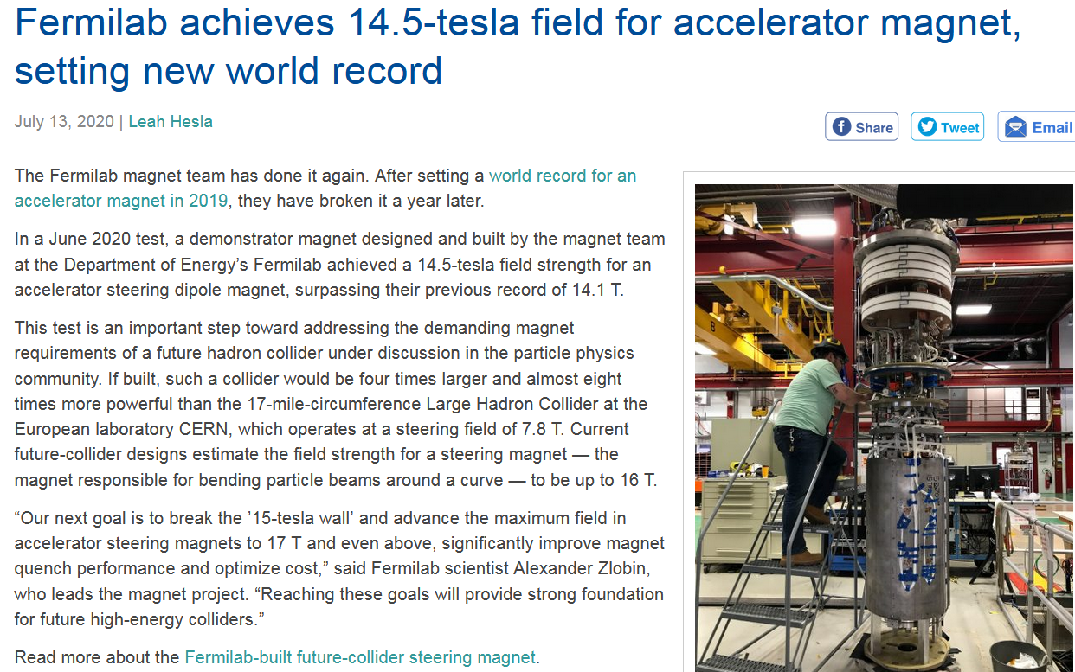
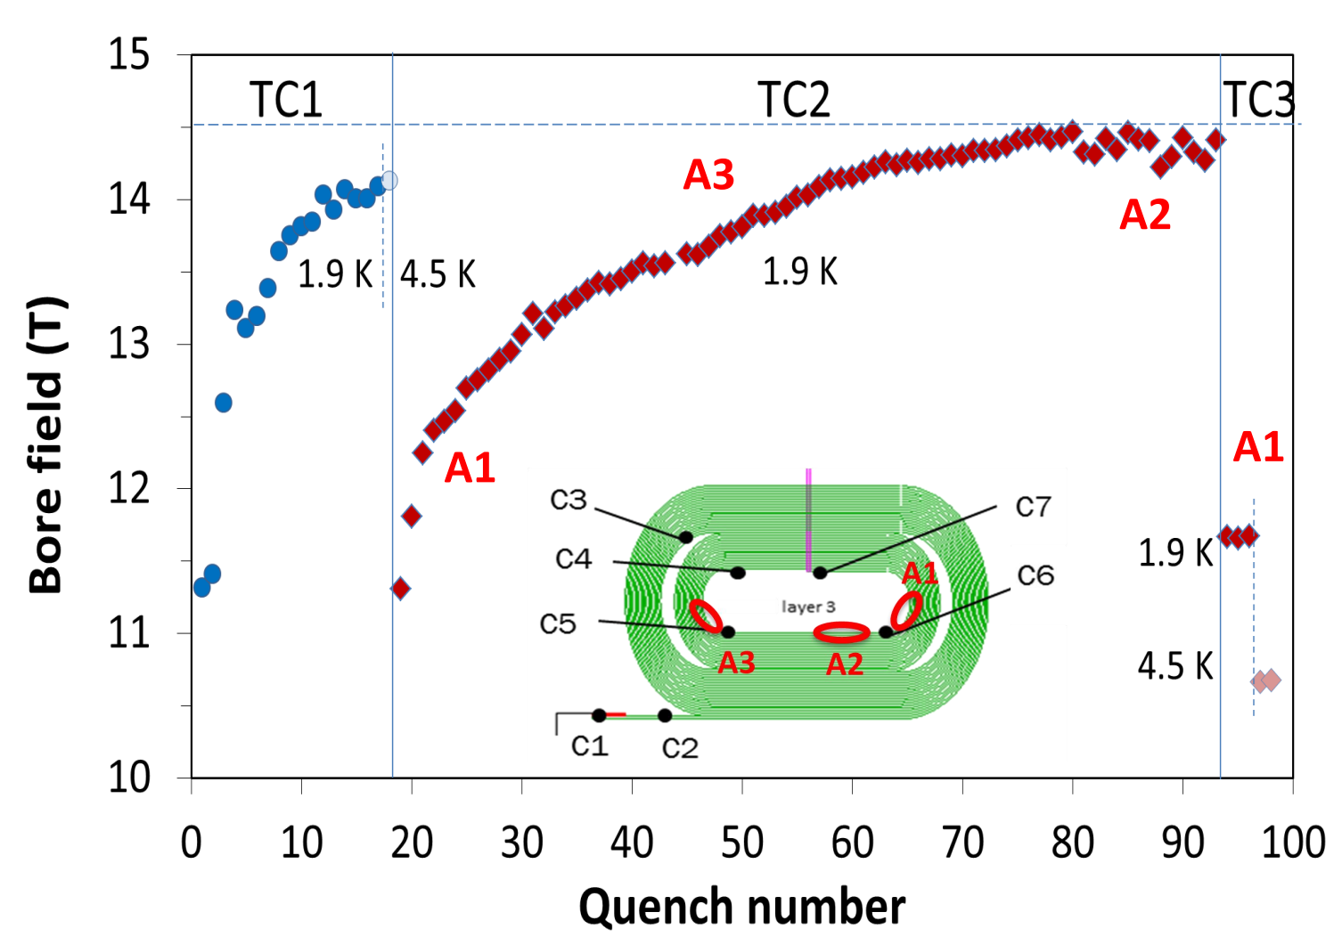
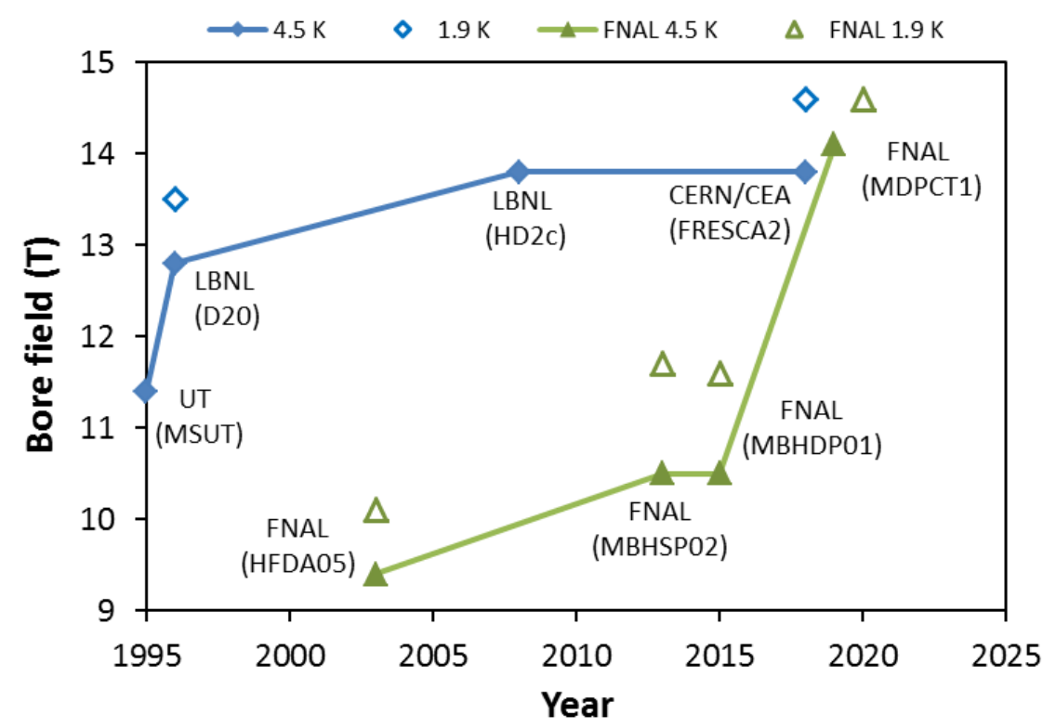
New Record：14.5 T Dipole by Fermilab in 2020
But with ~20% performance degradation after thermal cycle!
A. V. Zlobin, Fermilab
4

Slide 5
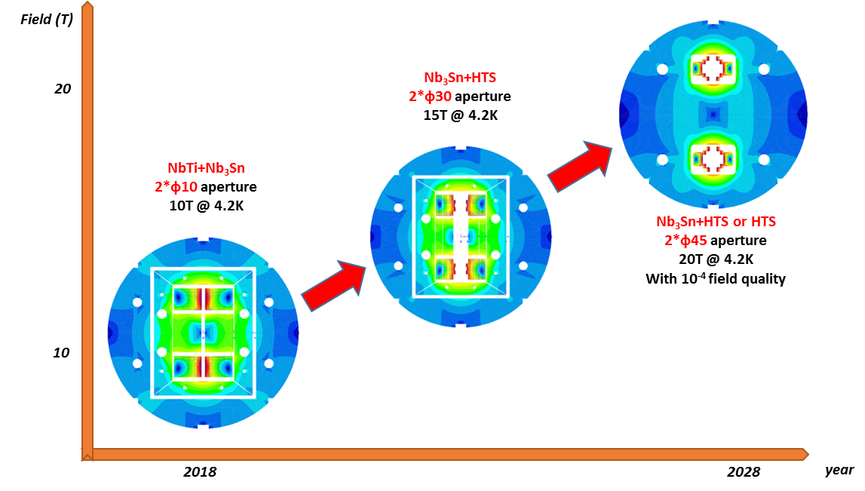
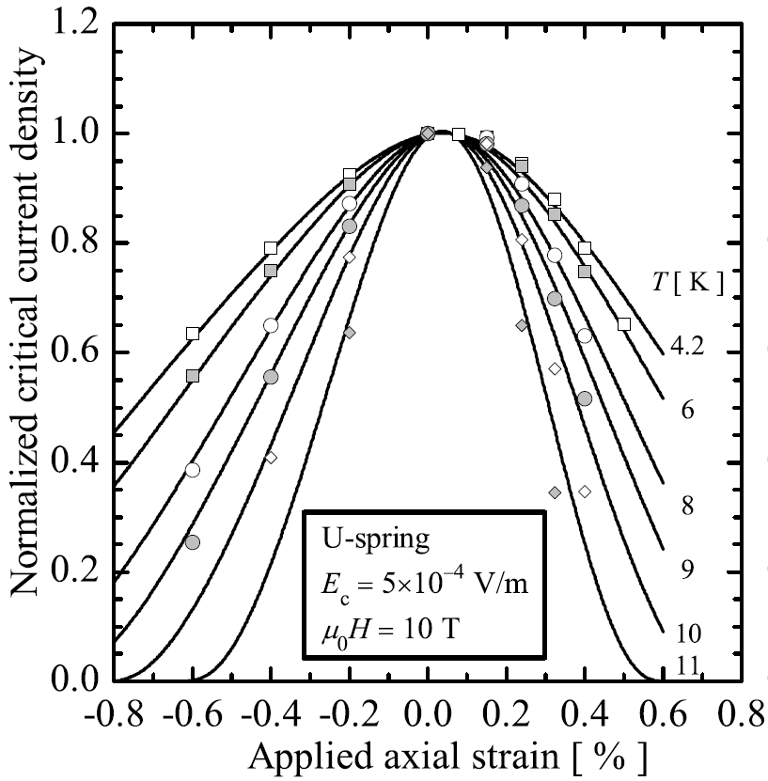
R&D of the High Field Model Dipoles
Roadmap for High Field
Dipole Magnet R&D
Challenges: Stress control, quench protection, field quality control,……
5

Slide 6
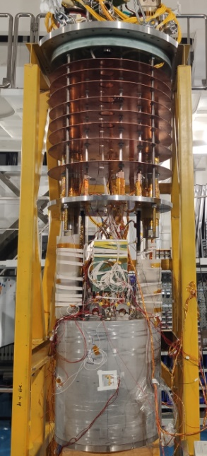
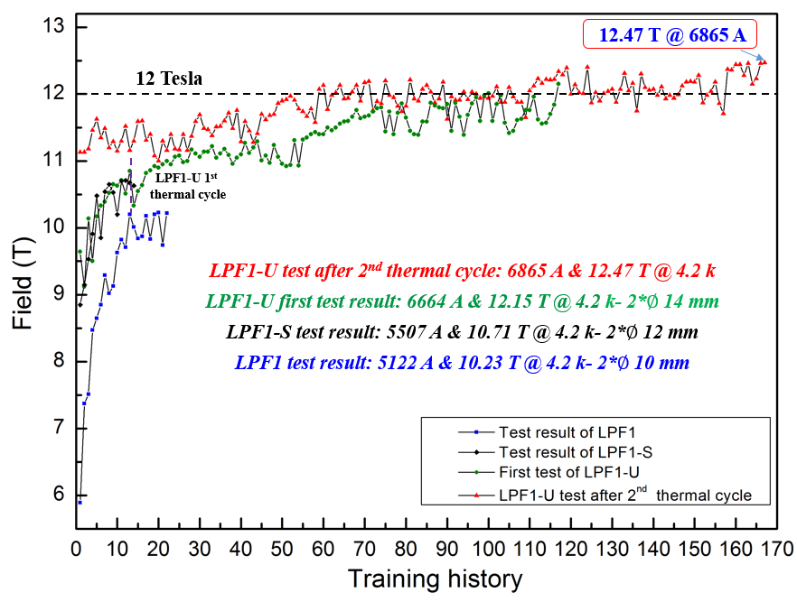
R&D of the High Field Model Dipoles
~90% SSL
2021
2019
Training history at 4.2 K
2018
6

Slide 7
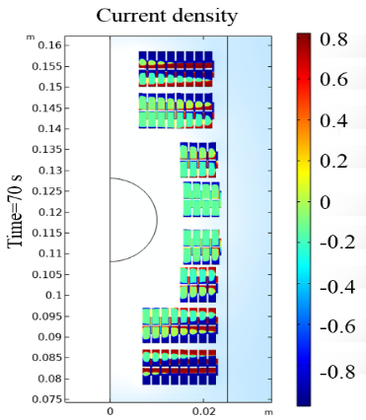
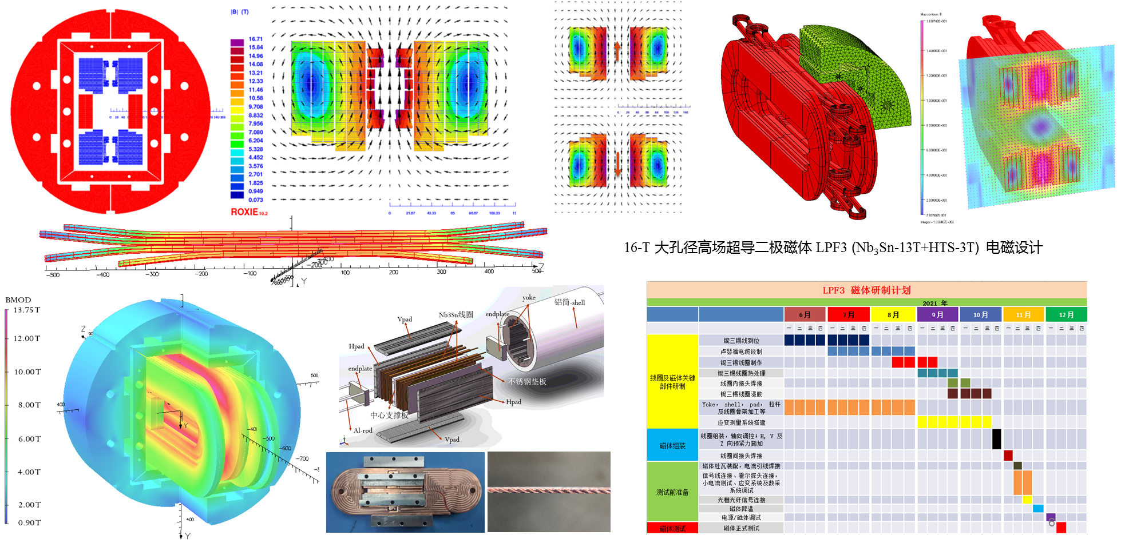
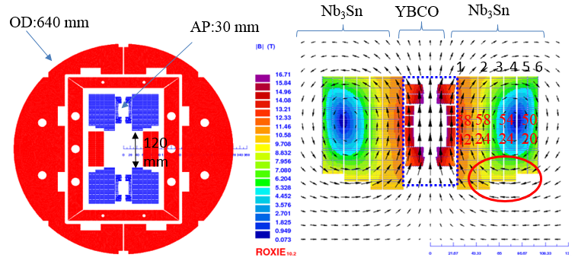
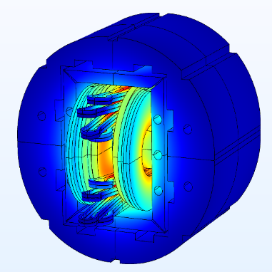
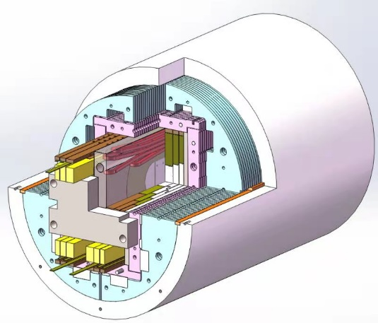
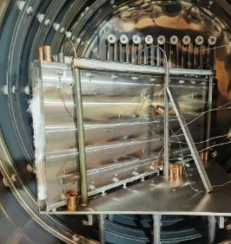
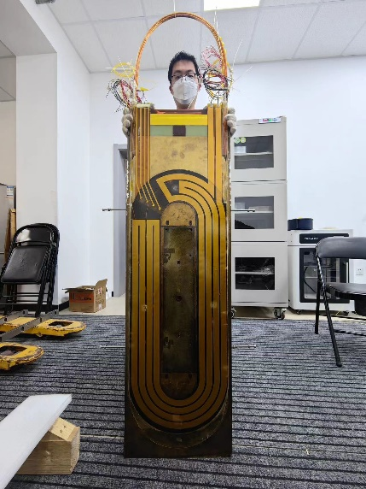
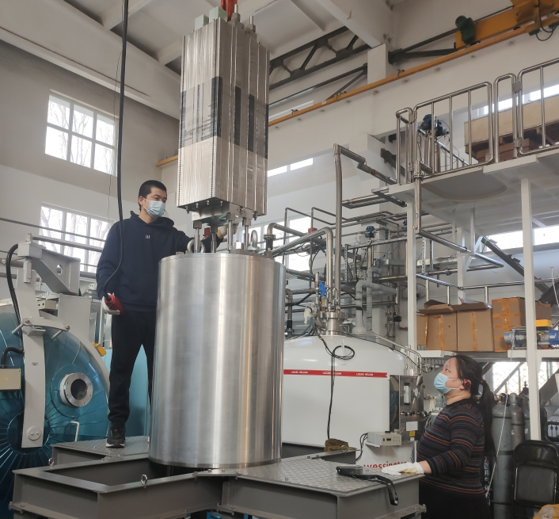
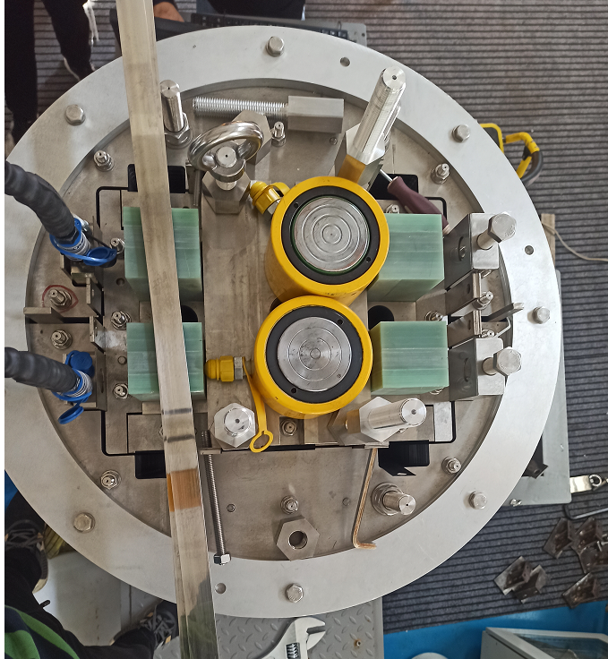
R&D of the High Field Model Dipoles
16 T Model Dipole: Nb₃Sn 12~13 T + HTS 3~4 T
7

Slide 8
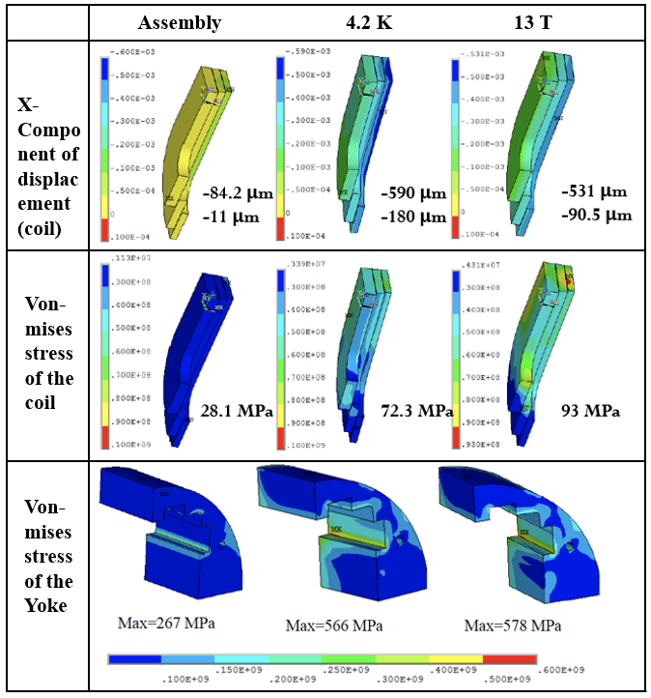
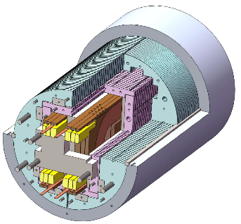
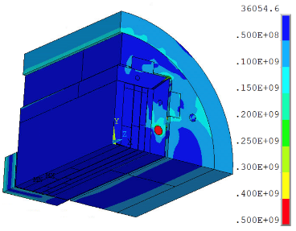
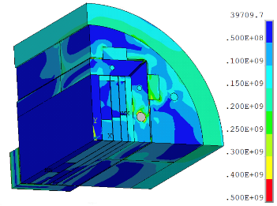
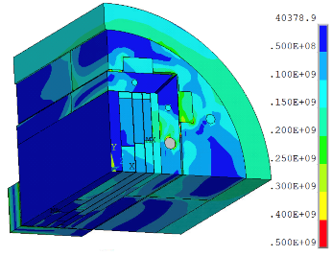
R&D of the High Field Model Dipoles
Stress distribution in different loading steps
Assembly
13 T
4.2 K
8

Slide 9
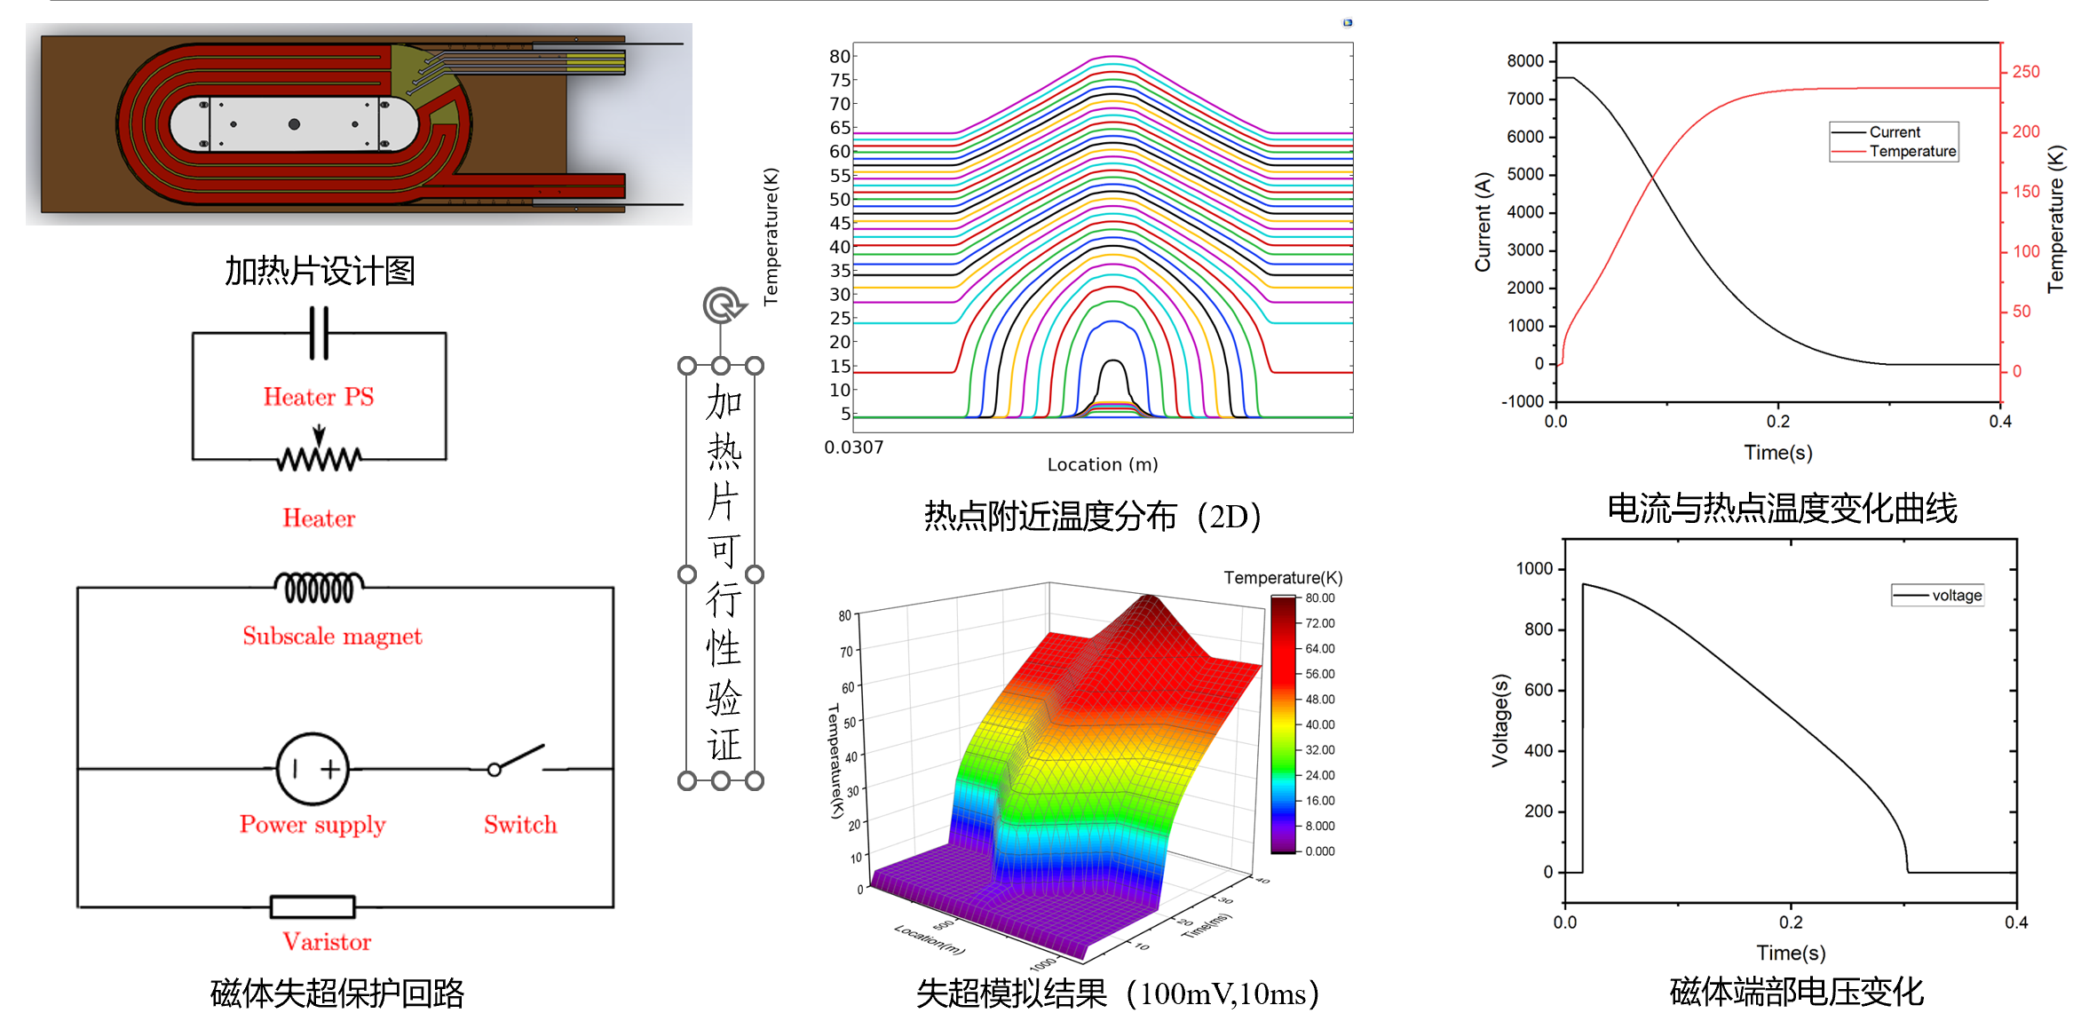
R&D of the High Field Model Dipoles
The calculation indicates that the temperature of hot spot is 237 K and the max voltage is 952 V. Safe.
9

Slide 10
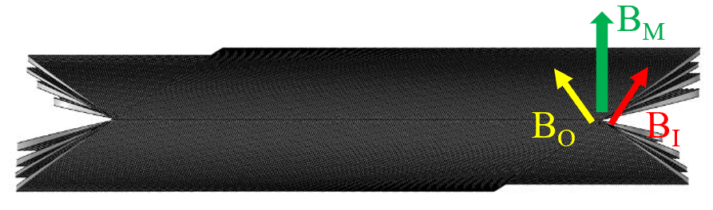
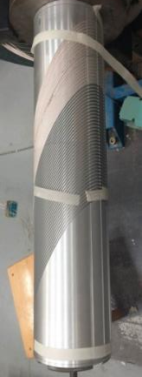
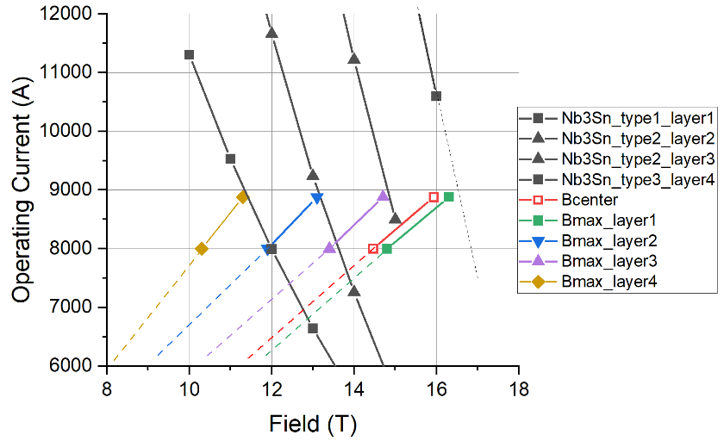
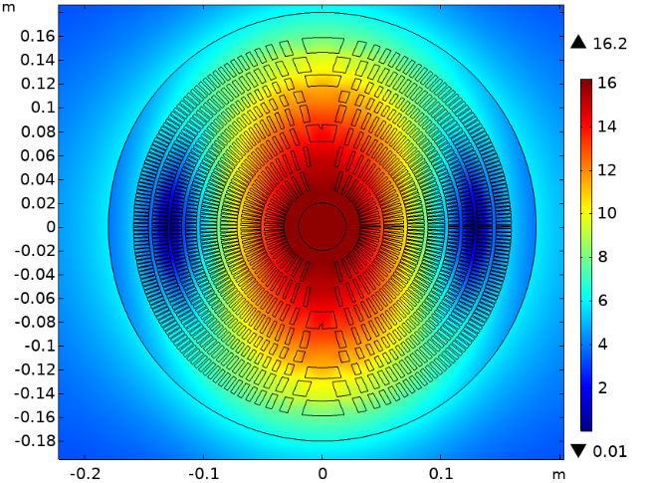
R&D of the High Field Model Dipoles
16-T Dipole with CCT configuration
Canted-Cosine-Theta (CCT) technology;
  Superior field quality;
  Stress management
  Developed industrial assembly line;
Graded Nb₃Sn Rutherford cables;
Multiple replaceable coil modules;
The geometry of the 4 module CCT magnet
CCT subscale
10

Slide 11
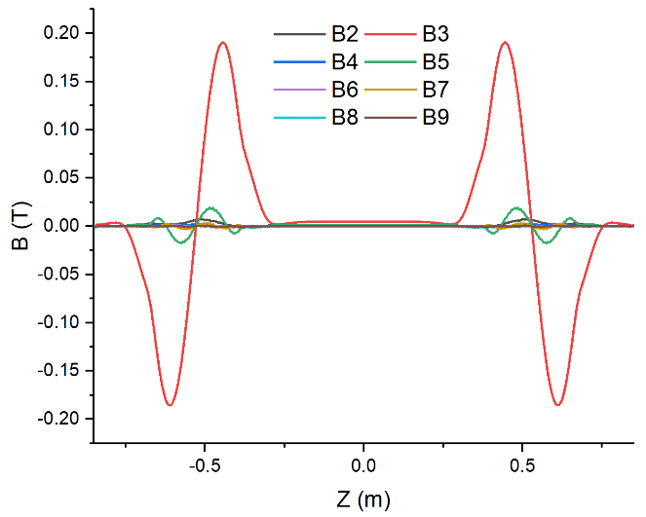
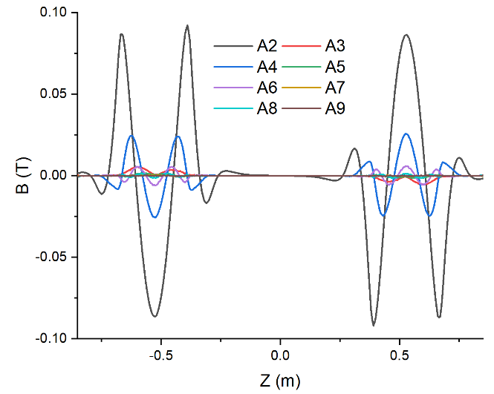
R&D of the High Field Model Dipoles
High-order harmonics along axis - Bn
High-order harmonics along axis - An
Harmonics：10⁻⁴ | b2 | a2 | b3 | a3 | b4 | a4 | b5 | a5 | b6 | a6 | b7 | a7 | b8 | a8
Cross section-2D | 0.6259 | 0.0119 | 2.9824 | -0.0006 | 0.0537 | 0.0002 | 0.5189 | 0.0002 | 0.0183 | -0.0020 | -0.0845 | 0.0016 | -0.0036 | 0.0009
Integrated-3D | 1.5989 | 0.0101 | 3.8649 | -0.0320 | 0.3047 | 0.0802 | 1.4069 | -0.0175 | 0.0750 | -0.3695 | 0.1163 | 0.0734 | -0.0223 | -0.2090
11

Slide 12
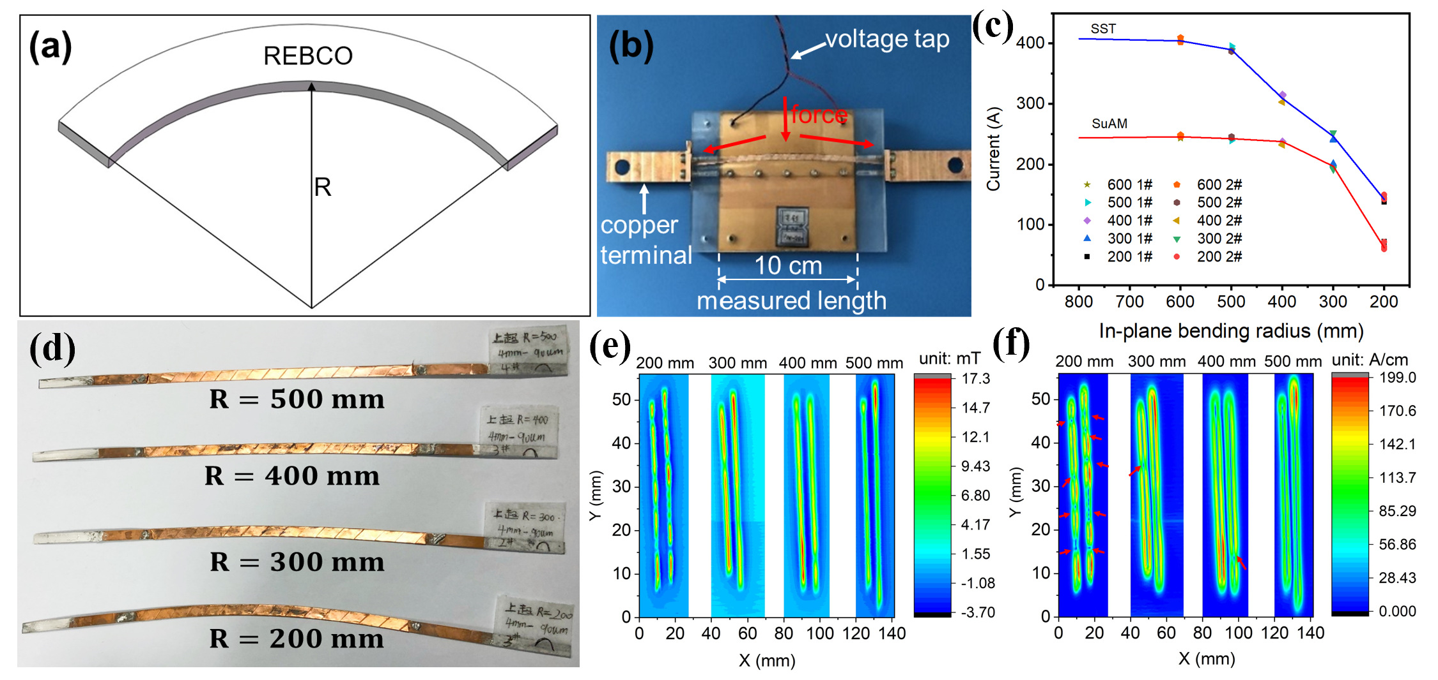
R&D of the High Field Model Dipoles
Development of a Roebel-like Transposed Cable with the in-plane bending of HTS tapes
12
J. Wang et al, Superconductivity 3 (2022) 100019

Slide 13
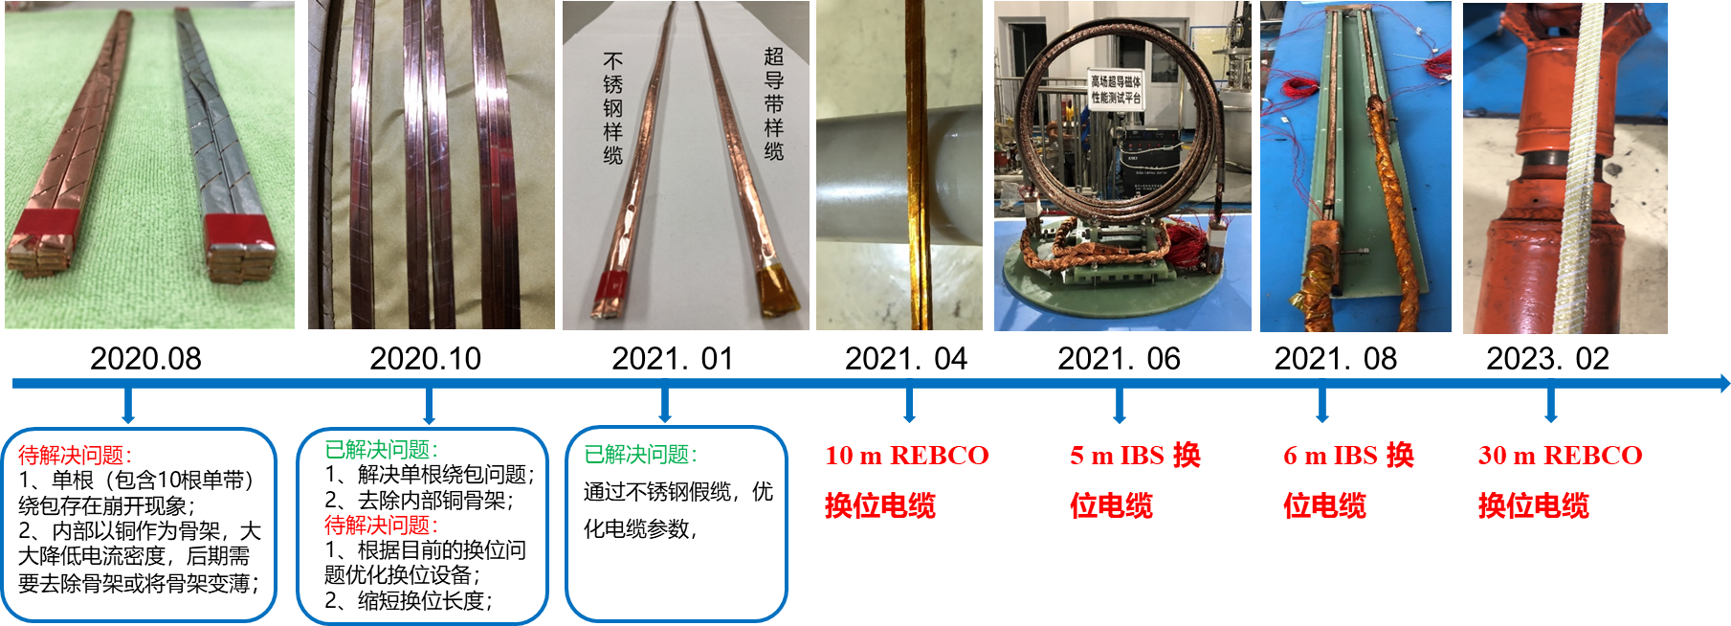
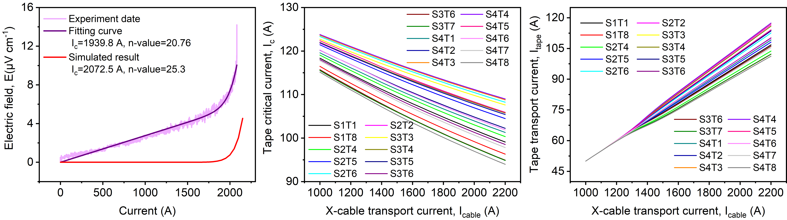
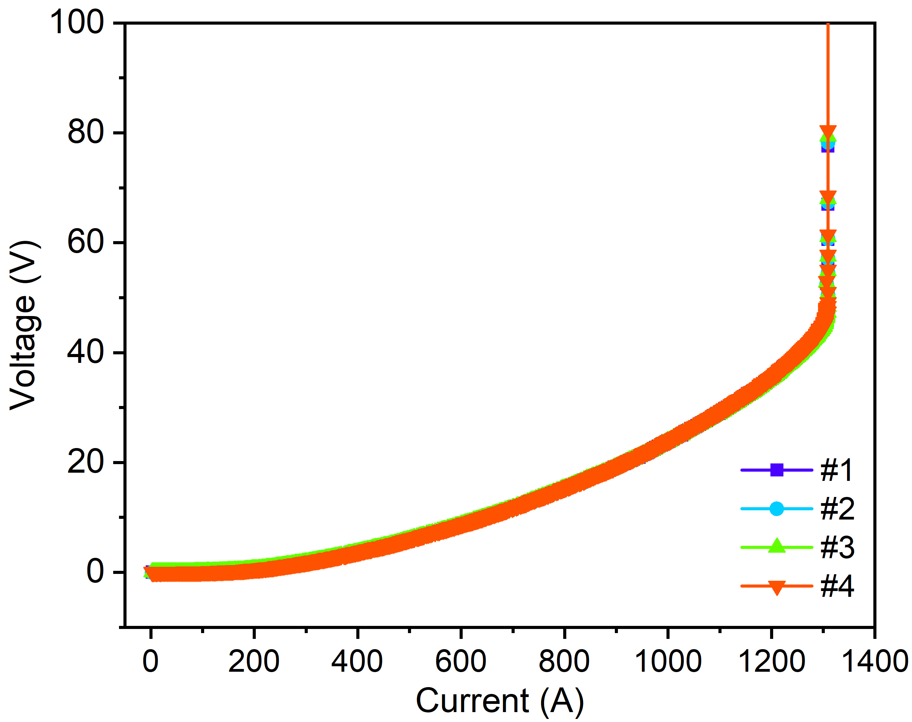
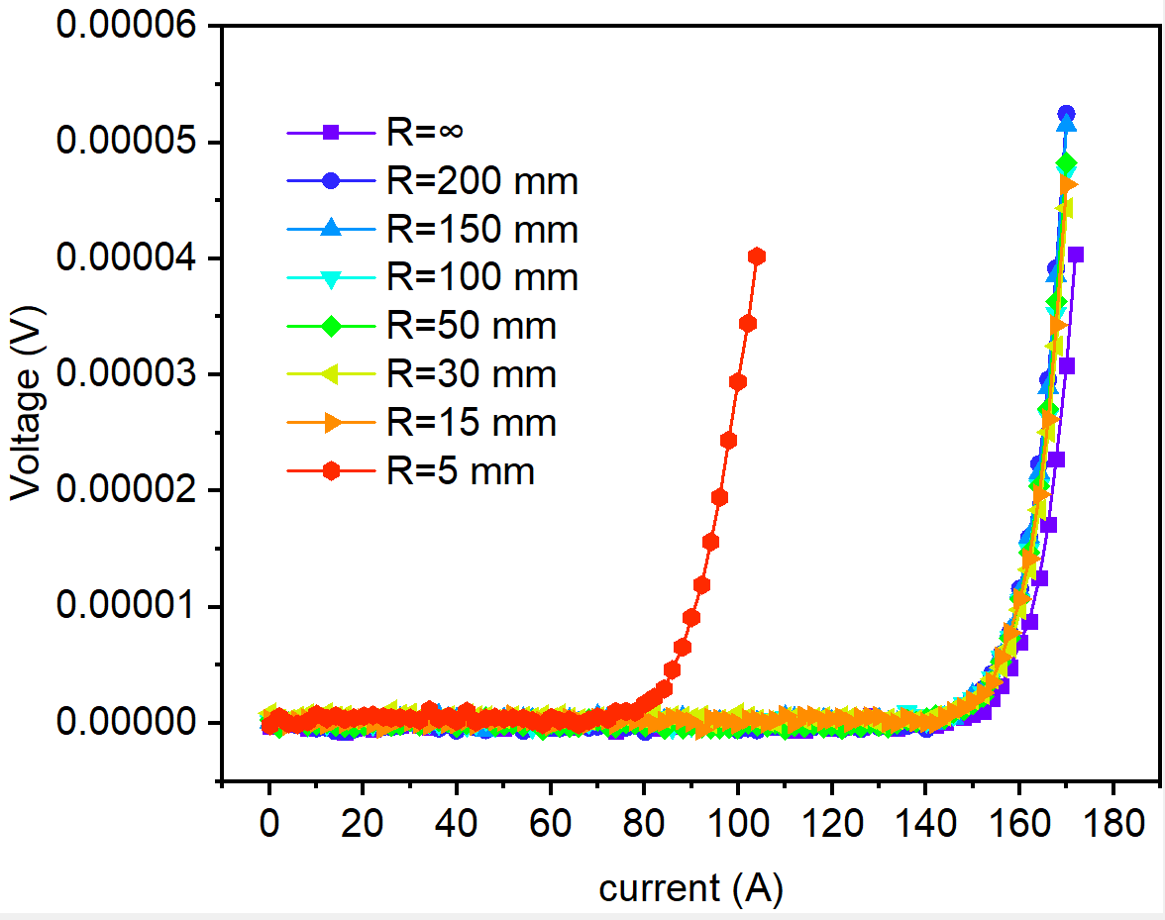
R&D of the High Field Model Dipoles
Development of a Roebel-like Transposed Cable with the in-plane bending of HTS tapes
13

Slide 14
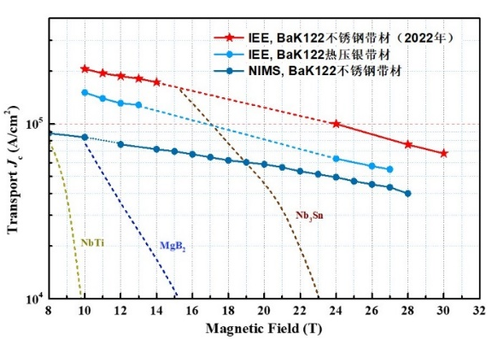

IBS Technology: Status and Outlook
Stainless-steel stabilized IBS tape achieved the highest J_{e} in 2022!
Significantly reduced the cost and raised the
mechanical properties.
IBS 2025
IBS 2022
IBS 2019
IBS 2016
14

Slide 15
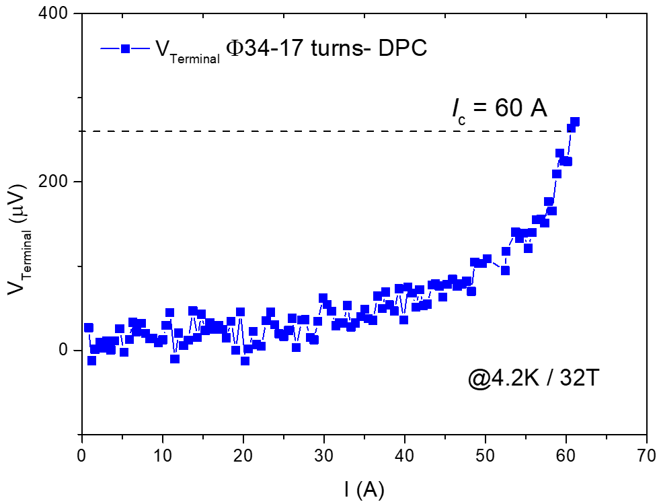
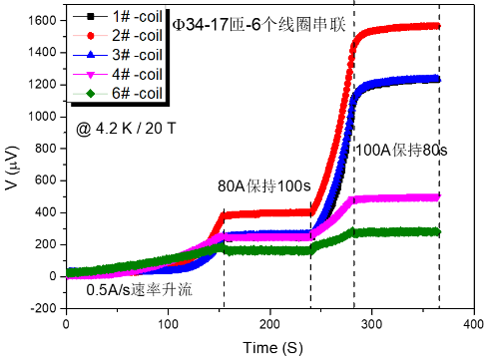

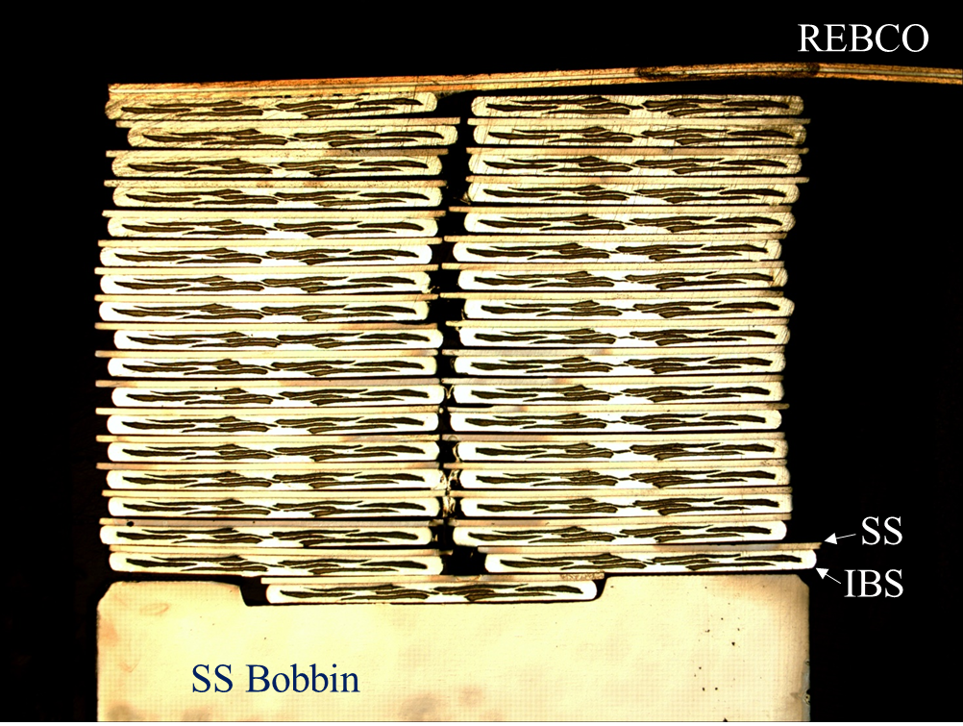

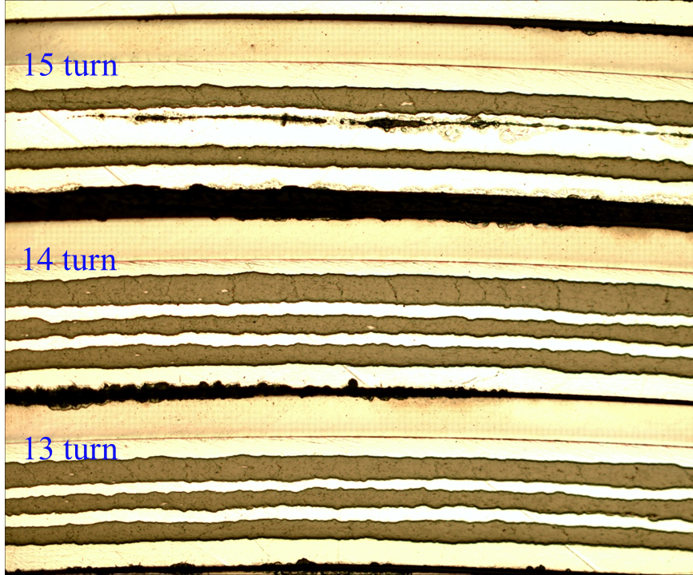
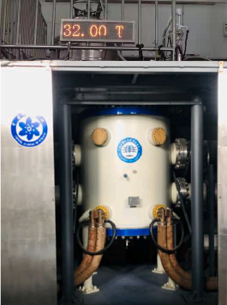
IBS Technology: Status and Outlook
The First IBS Solenoid Coil at 32 T background field
I_{c} of Φ34mm-17 turns-DPC reached 60 A at 4.2 K and 32 T, world’s highest record up to now.
15

Slide 16
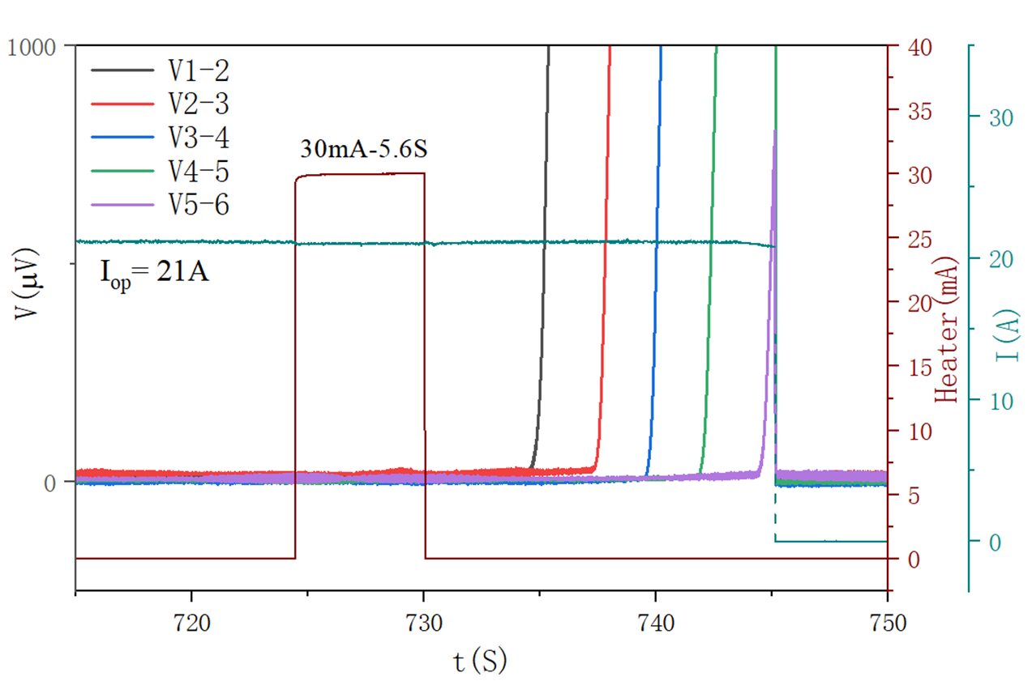
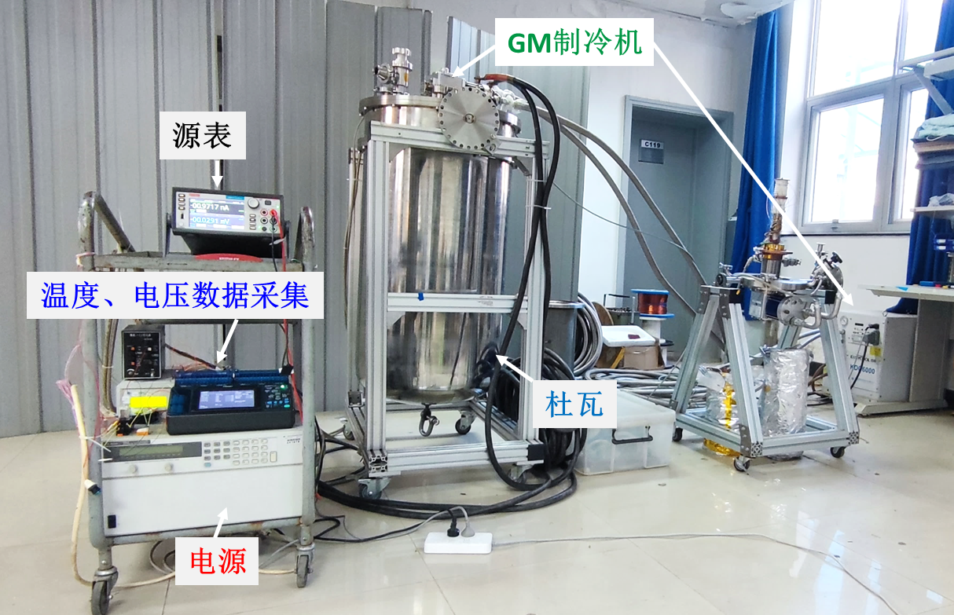
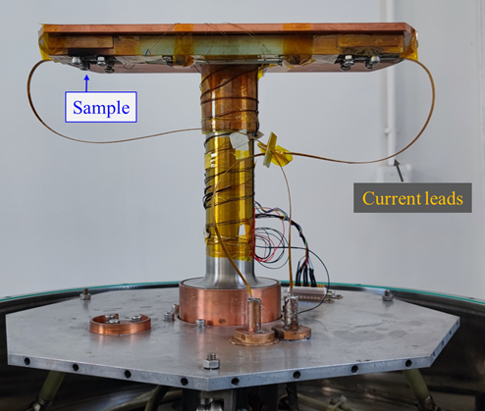
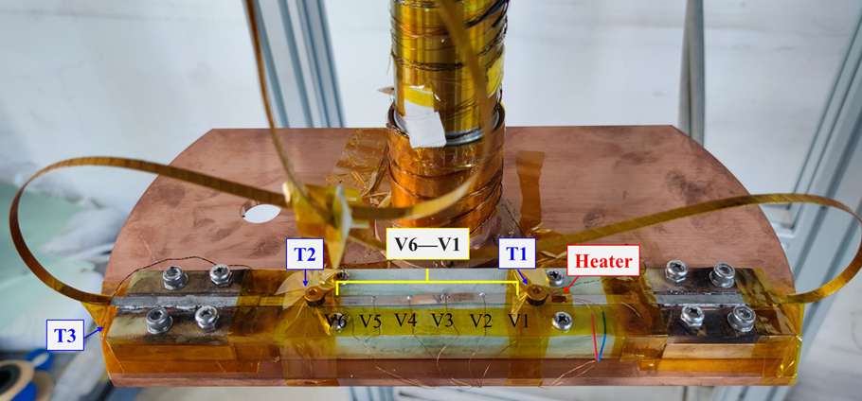
IBS Technology: Status and Outlook
Quench propagation study of the IBS coils
Experimental data shows significant quench propagation in the IBS coils! More testing will be carried out.
16

Slide 17
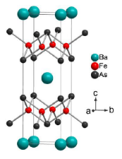
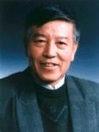
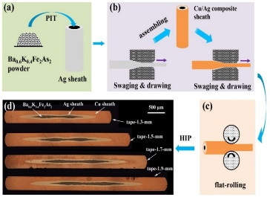
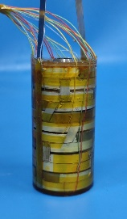

IBS Technology: Status and Outlook
IBS solenoid at 32 T
Racetrack at 10 T
1.3 kA transposed cable
J_{e} > 450 A/mm²
@ 10 T, 4.2 K
100-m 7-core IBS tape fabricated
J_{e}= 100 A/mm²
@ 10 T, 4.2 K
Z. Zhao
IBS (T_{c} 55K)
2008.02
2008.04
2008.09
2016
2018
2020
2022
Discovery of IBS
Discovery of
122 phase IBS
IBS solenoid at 24 T
Racetrack at 8 T
J_{e}= 300 A/mm²
@ 10 T, 4.2 K
H. Hosono
IBS (T_{c} 26K)
J_{e} of IBS expected to be similar as ReBCO in 5 years with better mechanical properties and lower cost
17

Slide 18








Development of CCT Magnets for HL-LHC
China provides 13 units CCT twin-aperture dipole magnets for HL-LHC
To be installed in the ATLAS & CMS interaction regions, help to raise the luminosity by 5 times
The 1st time CCT type magnets applied to an operating accelerator.
All the magnets delivered to CERN passed the performance double-check at 1.9 K.
Test results of the 1st full-length prototype from China:
“Each aperture, individually and combined, arrived to ultimate current without quench”
“Operation range test checked without quench”……
18

Slide 19




Development of CCT Magnets for HL-LHC
Items | Values
CCT skew angle | 30°
No. of turns per layer | 365
Slot size in former (mm) | 2×5
Spacing per turn | 5.222
Inside/Outside diameter of the former (mm) | Inner former:105.35/119.35 Inner former:120.80/134.85
Inside diameter of the groove/slot(mm) | 1st layer: 109.15/119.15 2nd layer: 124.65/134.65
Reference radius (mm) | 35
Diameter of aperture (mm) | 105
Current (A) | 395
Cooling hole
Hole for tie rod
Aperture
Yoke alignment
CCT Coils
Ø 614 mm
Items | Values
Diameter of yoke (mm) | 614
Thickness of yoke lamination (mm) | 5.8
Diameter of aperture (mm) | 167
Position of aperture (mm) | 94.19
Yoke key slot(mm) | 8(3.01) ×6
Diameter of cooling hole (mm) | 110
Position of cooling hole (mm) | 205
19

Slide 20


Training of MCBRD01
Development of CCT Magnets for HL-LHC
Aperture1 of the 1st series magnet
Aperture2 of the 1st series magnet
The 1st practice coil from Bama with new fabrication process wet wind plus 5-bar VPI.
The 2nd coil from Bama with direct wind process plus 5-bar VPI, similar to the process of the 1st prototype.
20

Slide 21






Development of CCT Magnets for HL-LHC
Successful design upgrade to solve the “long training problem”, significantly reduced the times of quench during training, ensured the project progress “on track”.
HL-LHC Schedule for the Collaboration Board 2022
21

Slide 22







Training of MCBRD02 & MCBRD03
Development of CCT Magnets for HL-LHC
AP1(CB12，25 quenches 526A) reached ±422A after 11 quenches.
AP2(CB09, 33 quenches 530A; after thermal cycle ＞500A) reached ±422A without any quenches.
22

Slide 23

Development of CCT Magnets for HL-LHC
Milestone of the HL-LHC CCT Magnet Project
Agreement signed
btw IHEP and CERN
The CCT magnet from China under test at CERN
Installation to tunnel
The qualified prototype delivered to CERN
All the 12 series CCT magnets delivered to CERN
HL-LHC commissioning
23

Slide 24
Summary
Long-term advanced superconducting magnet R&D for future high-energy accelerators is ongoing at IHEP-CAS.
Strong domestic collaboration for the advanced superconductor R&D (HTS & Nb₃Sn): Stainless-steel stabilized IBS tape achieved the highest J_{e} in 2022! Significantly reduced the cost and raised the mechanical properties.
10+ T model dipoles being developed at IHEP, reached 12.47 T at 4.2 K in mid 2021. 16 T (Nb₃Sn+HTS) model dipole under development, and to be tested in 2023. 20+ T accelerator magnets expected to be realized in 2020s.
China & CERN Collaboration on accelerator technology: development of HL-LHC CCT magnets going well.
Thanks for your attention!
24

