Slide 1



CEPC alignment technology development and installation strategy
Wang xiaolong
On behalf of CEPC Alignment and Installation System
12-16. June. 2023, Hongkong, CEPC Accelerator TDR International Review

Slide 2
Content
  CEPC alignment technology development
  CEPC installation strategy
  Summary

Slide 3
Introduction
This talk is about CEPC components installation and alignment.
This talk relates to the TDR ch7.2 Survey and Alignment
The content relates to the “charge letter” item 6

Slide 4
  一、CEPC alignment technology development

Slide 5
Component alignment accuracy requirement
Provide by physics group
Component | Transversal/mm | Vertical/mm | Roll /mrad
Arc Dipole | 0.1 | 0.1 | 0.1
Arc Quadrupole | 0.1 | 0.1 | 0.1
Sextupole | 0.1 | 0.1 | 0.1
IR Quadrupole | 0.1 | 0.1 | 0.1
RF、injection、Linac alignment requirement reference to the arc region components
Error sources
Alignment control network error
Component fiducialization / pre-alignment error
Measurement error
Installation adjustment error

Slide 6
一、CEPC alignment technology development
Key issues of CEPC alignment
For CEPC such big size alignment work, the irregular undulation of the geoid has to be considered. Some global datums need to be established and used for the measurement and data reduction.
According to the rule of control from global to local, deferent levels control network will be needed to control the large range measurement error accumulation and provide position reference for component installation.
By fiducialization, the beam center of a component can be related to its fiducials, and using these fiducials the component can be positioned in CEPC global coordinate system. To realize CEPC alignment accuracy, the fiducialization accuracy must be improved.
Deformation will be an important problem for CEPC such big size machine. Installation monitoring system is an effective method to find where occur the deformation.

Slide 7
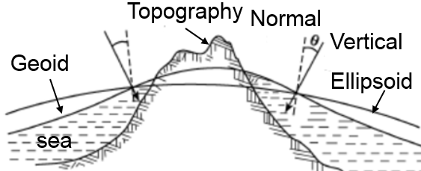
一、CEPC alignment technology development
CEPC alignment global datum
  Reference Ellipsoid: the base to establish projection plane, Quasi-Geoid model and vertical deflection model.
  Quasi-Geoid model: global datum for the height coordinate calculation.
    Vertical deflection model: global datum for the vertical axis of the instrument coordinate system directional in the CEPC coordinate system.

Slide 8
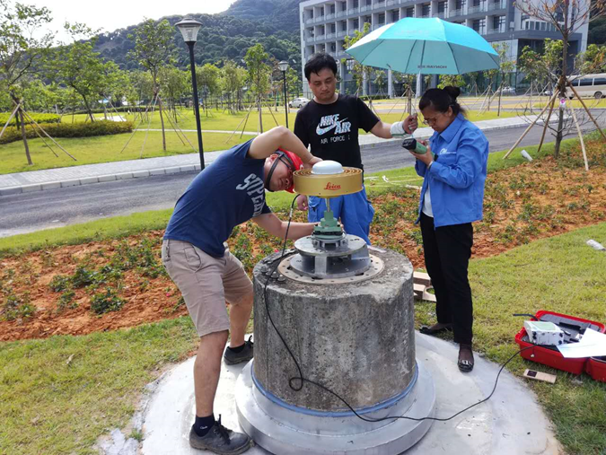
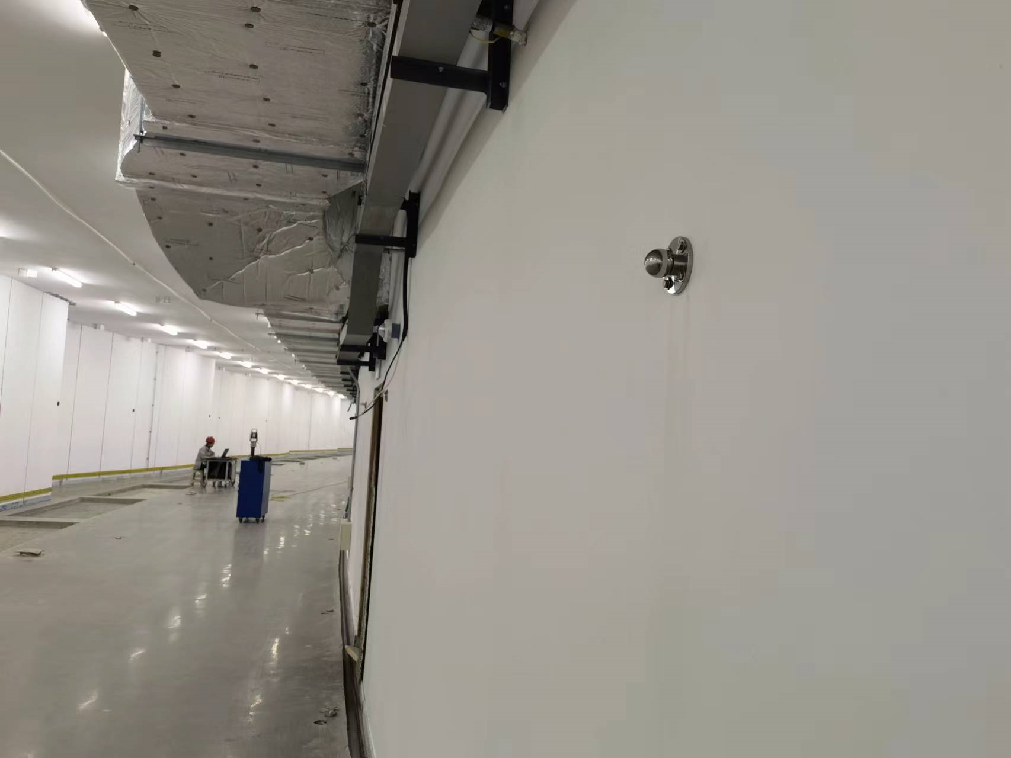
一、CEPC alignment technology development
CEPC alignment control network
Control network：provide an unified location reference frame for CEPC alignment and control the error accumulation；
3 levels control network
  Surface control network
  Backbone control network
  Tunnel control network

Slide 9
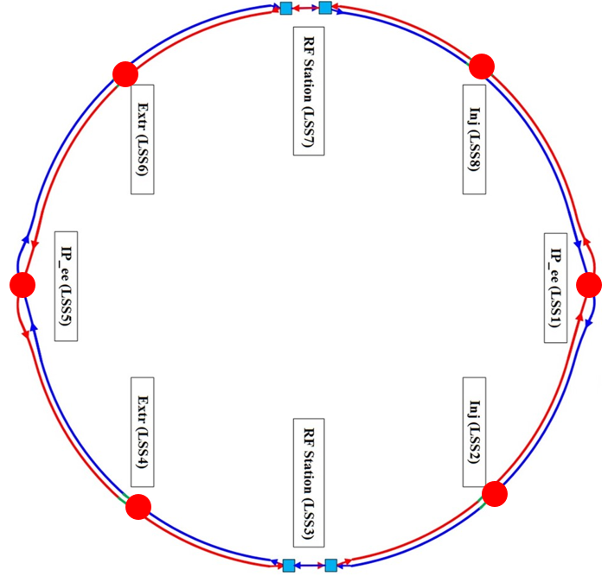
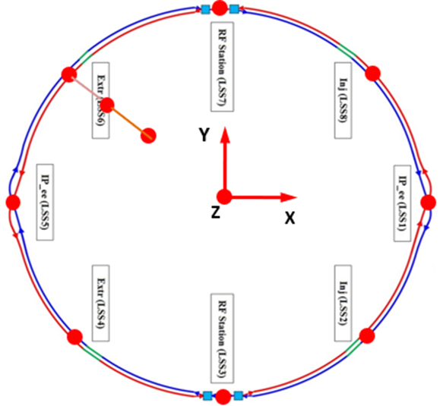
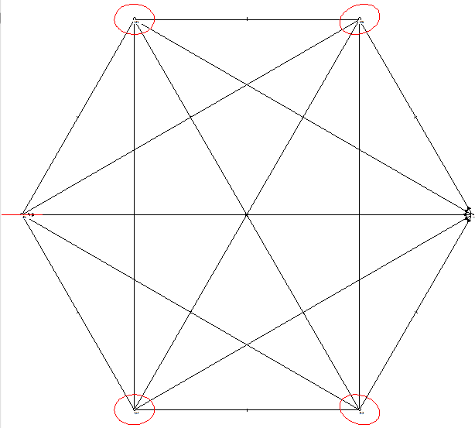
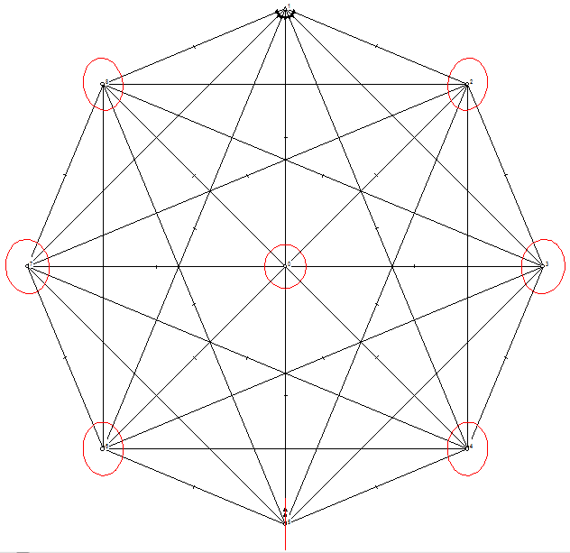
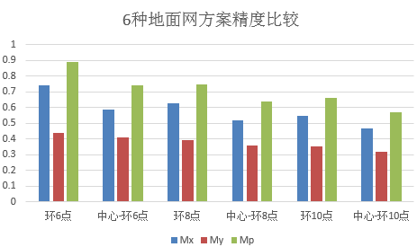
一、CEPC alignment technology development
CEPC global position control, high precision constraint points for tunnel control network.
6 layout schemes have been compared
  Ring 6 points
  Ring 6 points + 1 center point
  Ring 8 points
  Ring 8 points + 1 center point
  Ring 10 points
  Ring 10 points + 1 center point
Surface control network
Accuracy will be improved with the increasing of control points but the effect will wear off

Slide 10
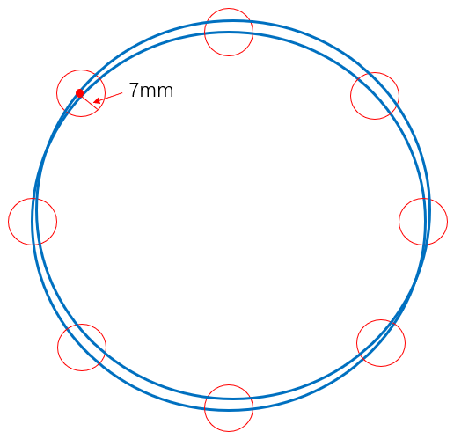
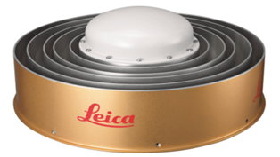
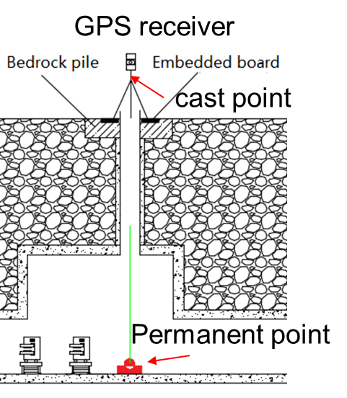
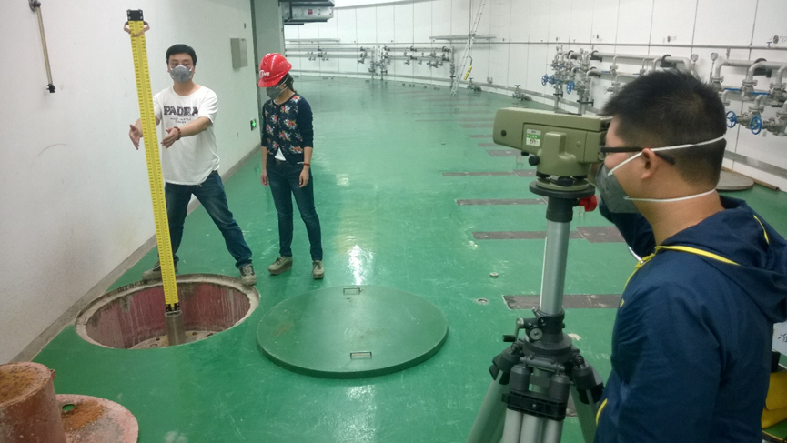
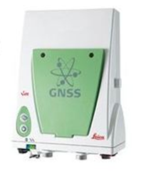
一、CEPC alignment technology development
Considering the cost and the accuracy requirements, the ring 8 points + 1 center point scheme is plan to be adopted.
Surface control network measurement: GNSS and level .
Control point accuracy：7mm；
Surface control network

Slide 11
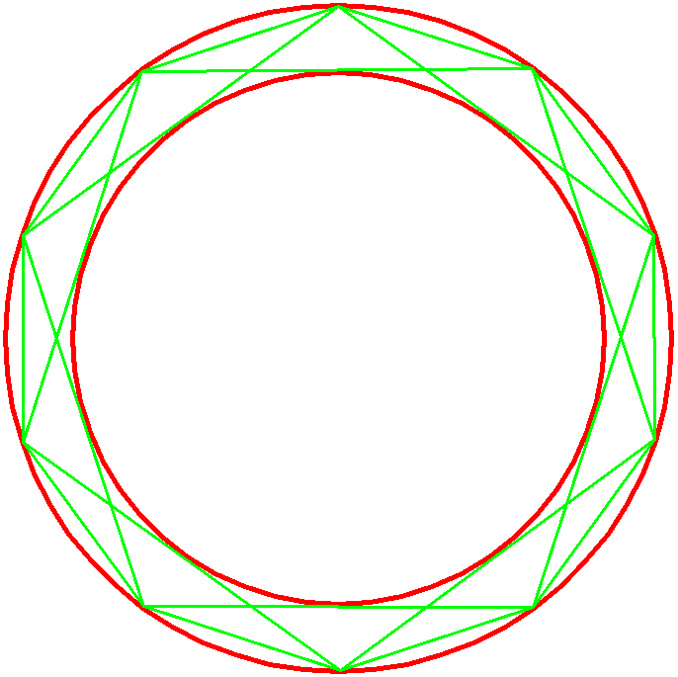
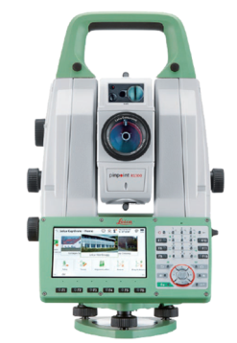
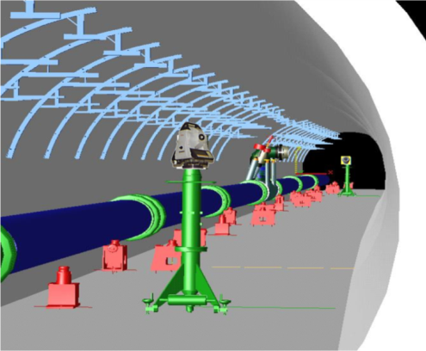
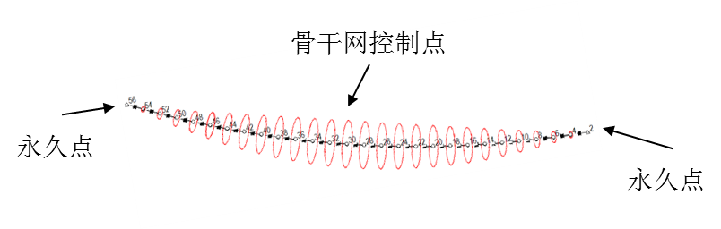
一、CEPC alignment technology development
Backbone control network
Ring tunnel
  Strengthen the tunnel control network，reduce error accumulation.
  Straight line triangulation network，short line 300m，long line 600m.
Sketch map of backbone control network
Control points
total station TS60
Measurement range:1.5m~>3500m
Distance precision：0.6mm+ 1ppm
Angle precision：0.5’’
  Simulation
  Using surface control network point as known point to constrain backbone control network adjustment.
  Distance between adjacent surface control points is 12.5km, measurement 42 stations
  Relative point position error is 0.89mm.
Backbone control network error ellipse
Known point
Known point

Slide 12
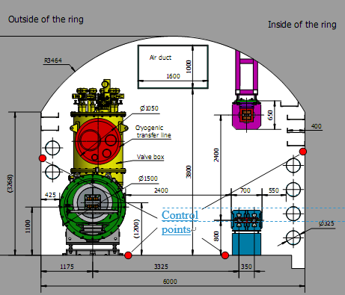
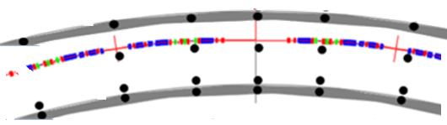
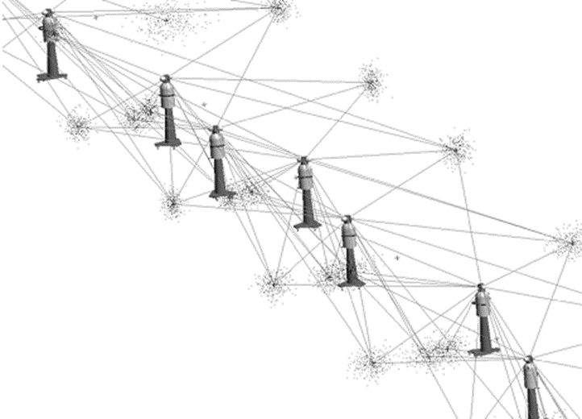
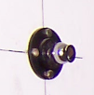
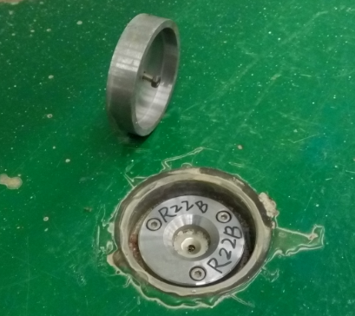
一、CEPC alignment technology development
Tunnel control network
Providing position reference for component installation and alignment
6m
Control points
Using laser trackers and levels carry out tunnel control network survey
Wall control point
Ground control point

Slide 13
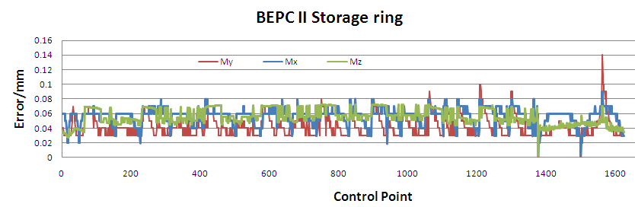
一、CEPC alignment technology development
  Simulation
  Using backbone control network points as known point to constrain tunnel control network adjustment.
  Distance between adjacent backbone control points is 300m, measurement 50 stations.
  The relative point position error is 0.074mm.

Slide 14
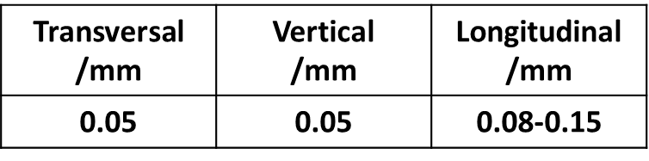
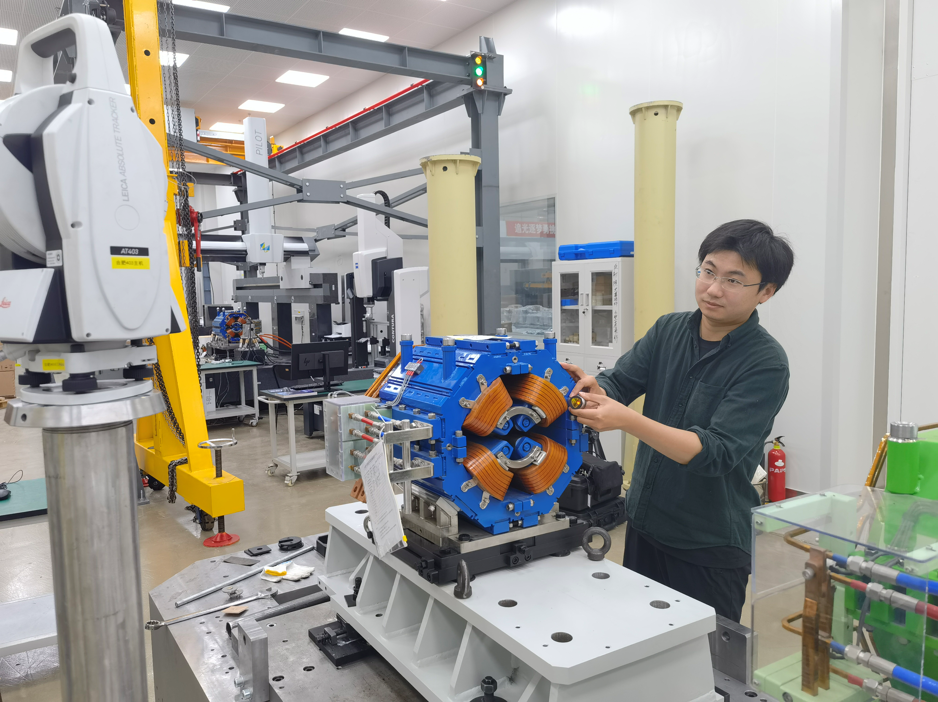
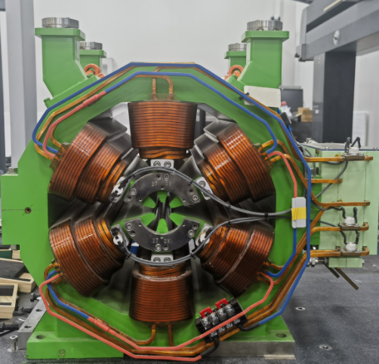
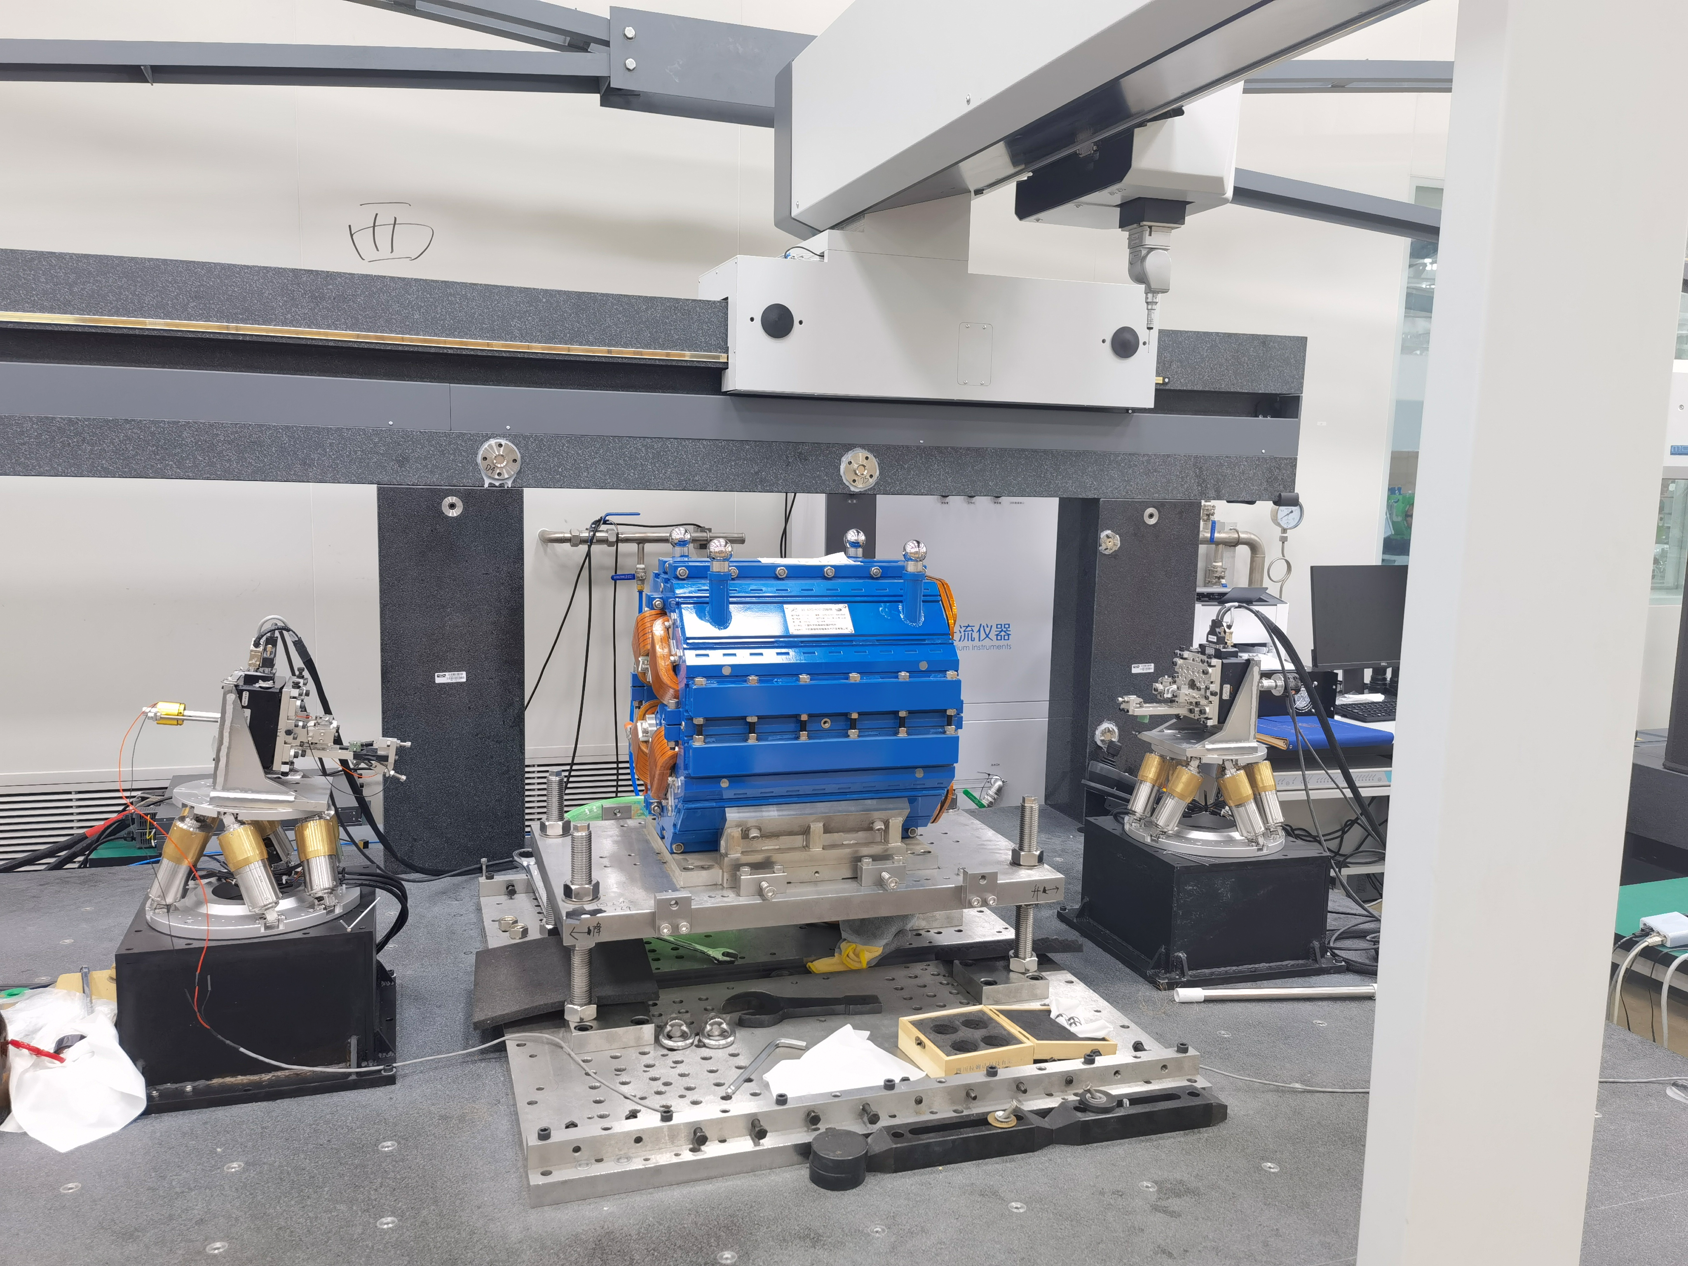
一、CEPC alignment technology development
  Component fiducialization
  Component fiducialization is to relate component beam center to its fiducials, then the fiducial coordinates can be transferred to CEPC global coordinate system and used for component alignment.
fiducials
  Geometric measurement：laser tracker、 Articulated arm
  Magnetic field measurement：rotate coil、vibrating wire、magnetic target cooperated with CMM
Transversal /mm | Vertical /mm | Longitudinal /mm
0.014 | 0.014 | 0.05
Beam center

Slide 15
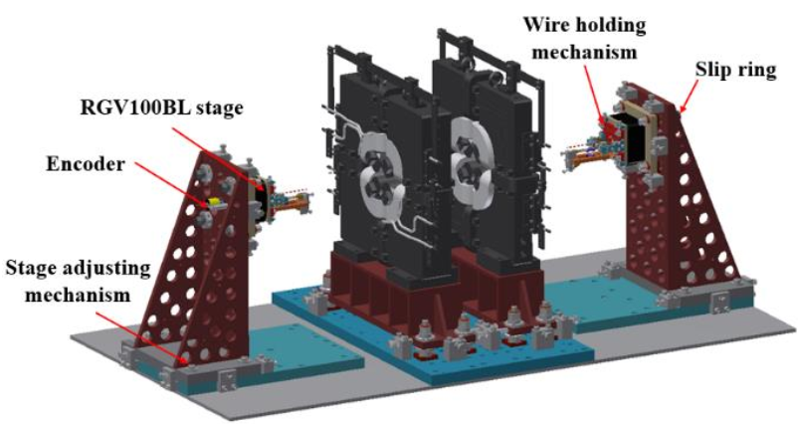
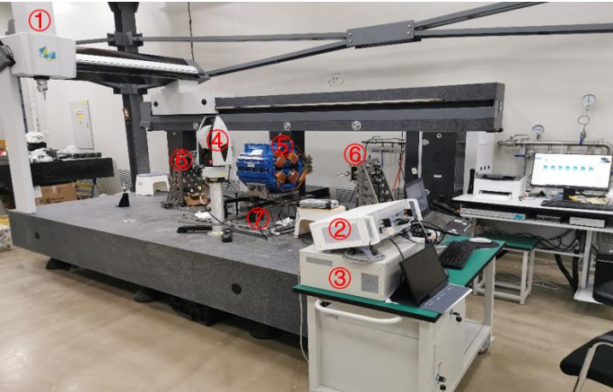
一、CEPC alignment technology development
  A rotating coil magnetic center measuring system has been developed and successfully used for high energy photon sources (HEPS) quadrupole and sextupole fiducialization.
  A contrast measurement result shows the difference between the magnetic center measured by this system and the mechanical center measured by a CMM is within 20μm.
  The magnetic center measurement repeatability is better than 10 μm.

Slide 16
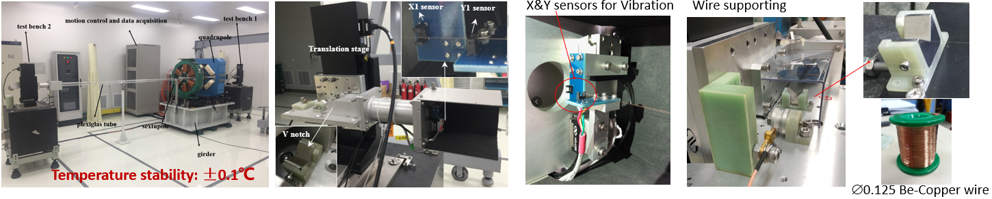
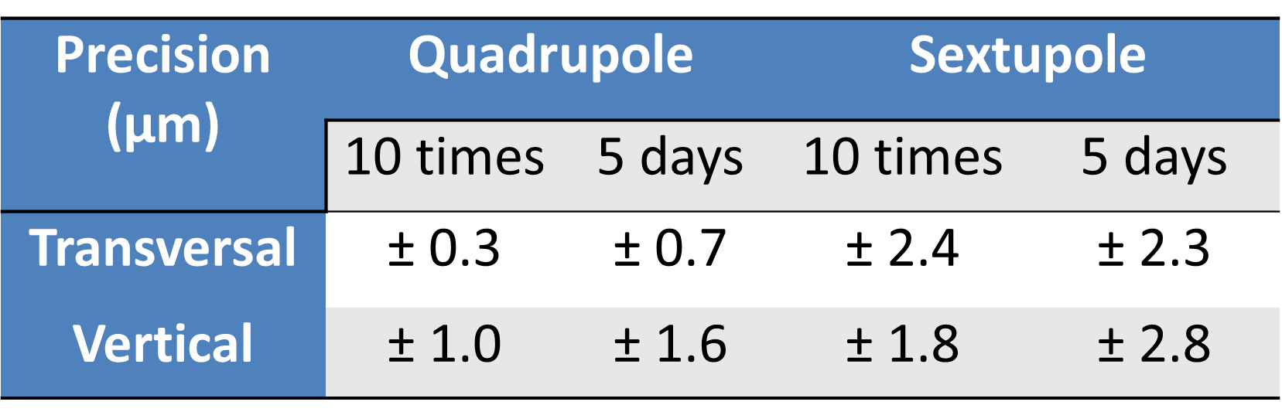
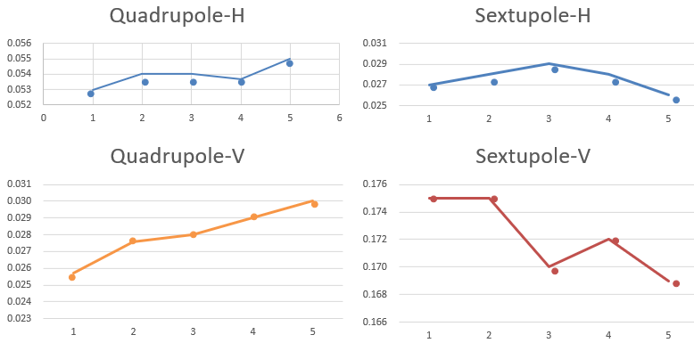
一、CEPC alignment technology development
  A vibrating wire measurement system has been developed.
  Based on magnetic center measurement, the vibrating wire can be used for multipole- magnet pre-alignment with high precision.
  It has been tested by a quadrupole and a sextupole pre-alignment experiment.
  The magnetic center measurement repeatability is better than 3 μm.

Slide 17
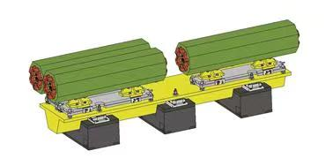
一、CEPC alignment technology development
  Component pre-alignment
Alignment the components on the girder in advance, then the cell can be installed and adjusted as one component in tunnel。
Can get higher relative position accuracy of the components on one girder and can save tunnel installation time.
Sextupoles in the collider ring and the quadrupoles and sextupoles in the IR will adopt the pre-alignment method.
Sextupole unit

Slide 18
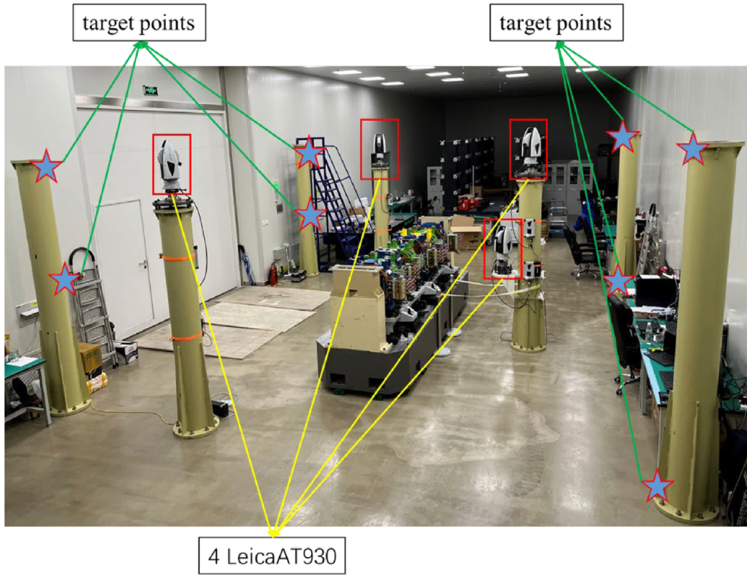
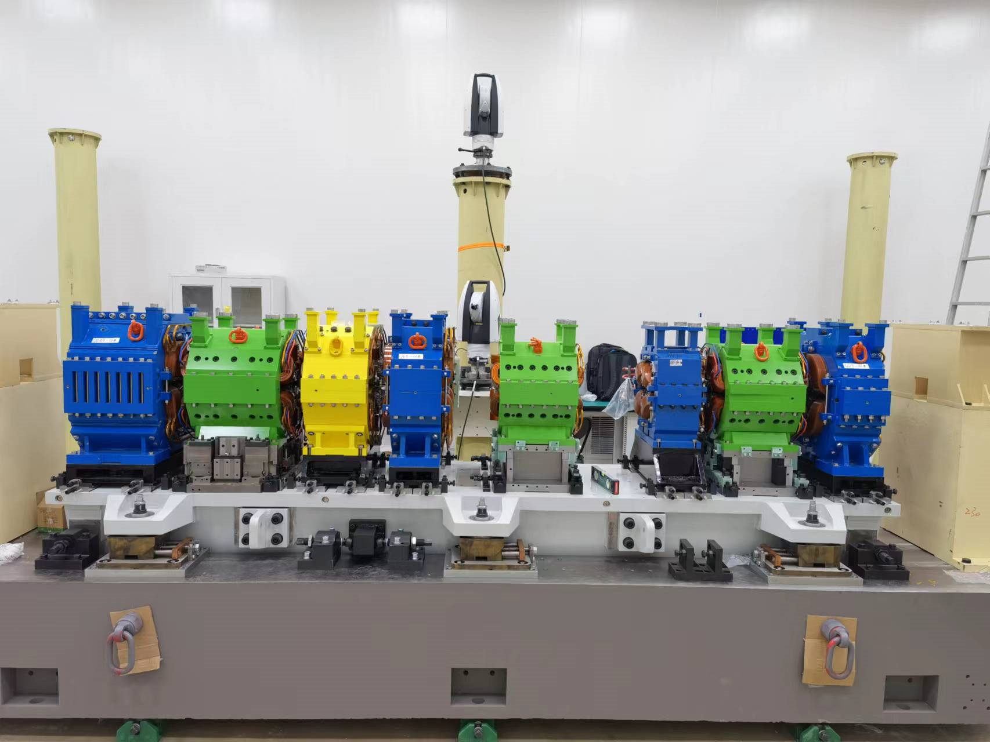
一、CEPC alignment technology development
A laser tracker-based multilateration method for large-scale space high accuracy measurement has been developed.
Take advantage of the high precision characteristics of laser ranging, It achieved 3 μm position measurement accuracy in a 4 m × 1.2 m × 1.5 m volume.
  It has been successfully used for HEPS storage ring magnet pre-alignment and achieved 30 μm pre-alignment accuracy.
HEPS Pre-alignment unite

Slide 19
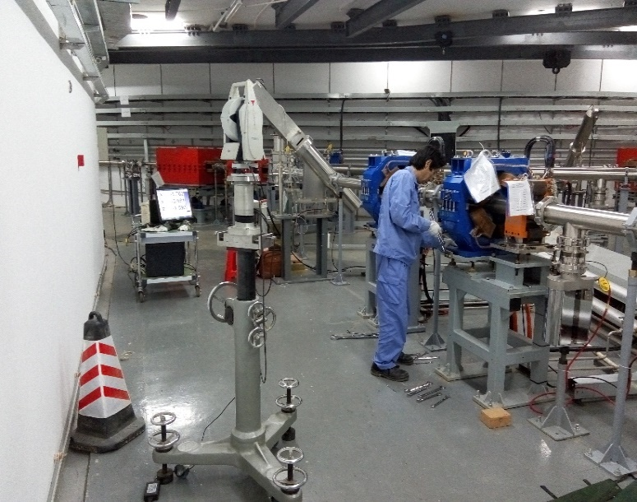
一、CEPC alignment technology development
Tunnel installation alignment
Using tunnel control network and laser tracker to perform tunnel components alignment.
By measuring the tunnel control network and best-fit, the laser tracker can be positioned in CEPC global coordinate system.
Using laser tracker measure the component fiducials to obtain the component position.
Adjust the component to the designed position within the required tolerance.
Fiducialization /mm | Control network /mm | Measurement /mm | Adjustment & fix /mm | Totall (SRSS) /mm
0.014-0.15 | 0.07 | 0.03 | 0.05 | 0.092—0.175

Slide 20
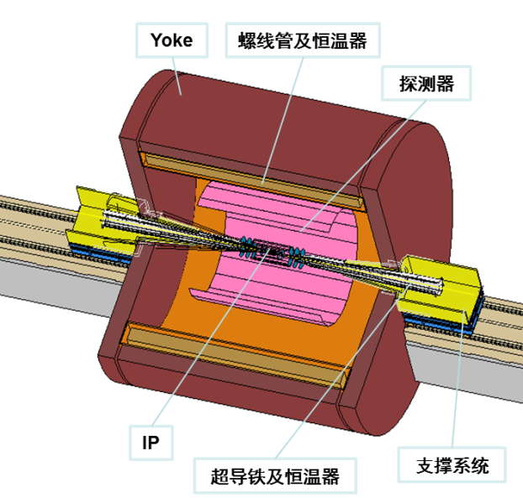
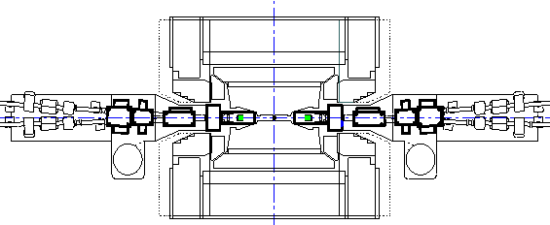
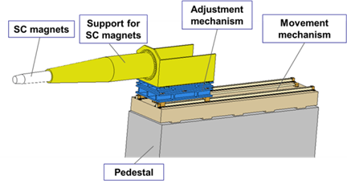
一、CEPC alignment technology development
MDI alignment
Superconducting magnets pre-alignment: vibrating wire, 0.03mm.
Establish a Laser-based alignment system precision:30m error 0.02mm
Use laser-based alignment system as a reference adjust the rail and components to the designed position in vertical and transversal, 0.03mm.
Measurement accuracy: 0.02mm.
Push the cryostat into detector along the rail.
Error item | Error /mm
pre-alignment | 0.030
Laser-based alignment system | 0.020
measurement | 0.020
adjust | 0.030
SRSS | 0.05
rail
rail
Laser-based alignment system
Laser tracker

Slide 21
一、CEPC alignment technology development
CEPC deformation and solutions
  How to find where occur the deformation.
    carry out an overall measurement, compare the measurement result with the previous ones. Has to be carried out in the machine shut down period and takes a long time (12 groups/1 year)
    installation monitor system. can find deformations immediately, no matter operation or shut down.
    using BPM to measure the beam. Immediately, during operation
  When and how to deal with the deformation
    For cost consideration, no auto-adjust mechanism in component stand. Deformation has to be dealt with after the machine is shutdown.
    Carry out measurement in the deformation area and compare the measurement result with the nominal values to get the difference between them.
    Difference values will be sent to the physicist to judge which components need to be adjusted and how about the direction and values of the adjustment.

Slide 22
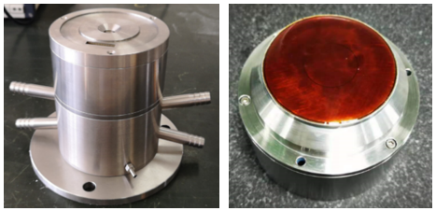
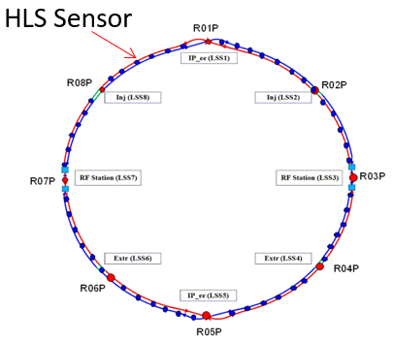
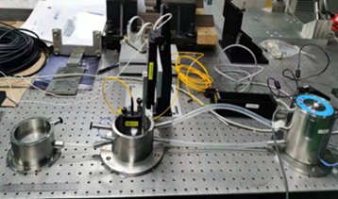
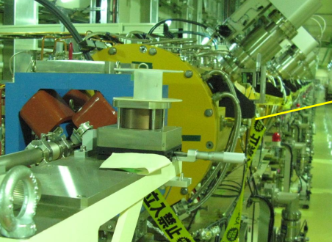
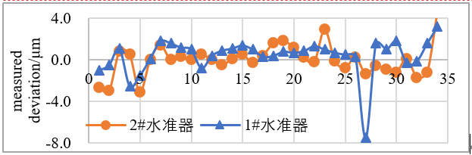
一、CEPC alignment technology development
Capacitive hydrostatic level sensor developed for HEPS
Monitoring system
  Settlement monitor
    Hydrostatic Levelling System(HLS)
    HLS sensors will be installed on the ground near the components.
    Accuracy ±0.01mm
    Component transversal and vertical monitor
    Wire Positioning System (WPS)
HLS
HLS

Slide 23
  二、CEPC installation strategy

Slide 24
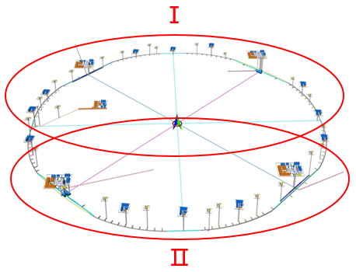
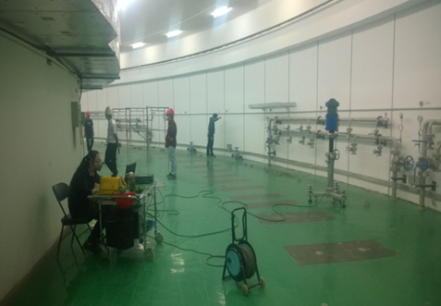
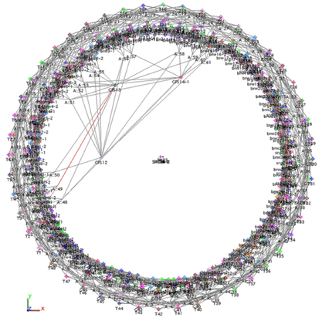
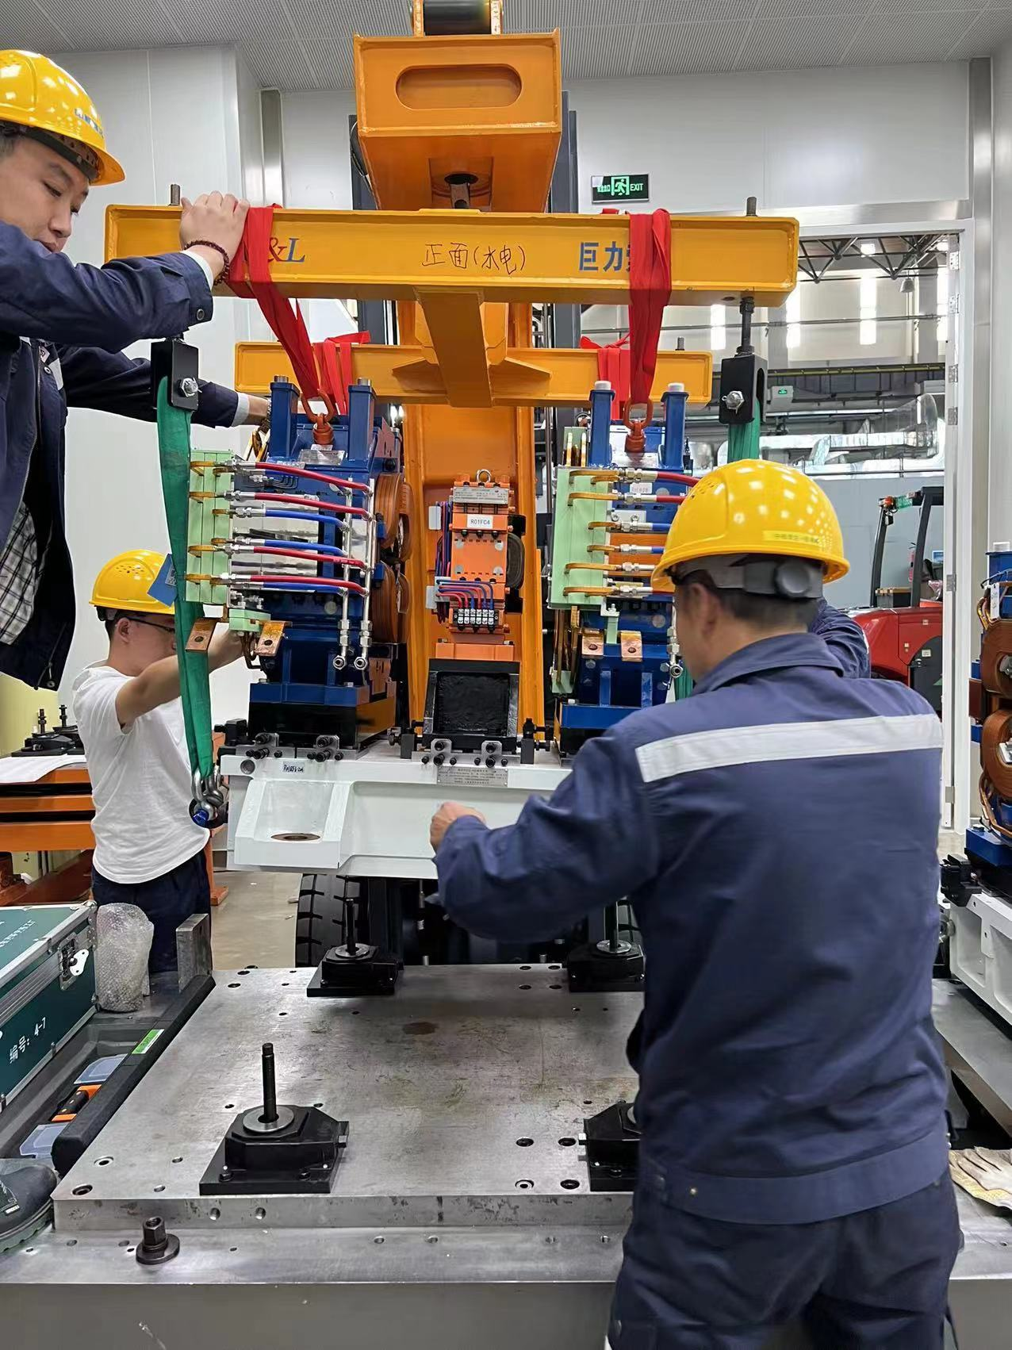
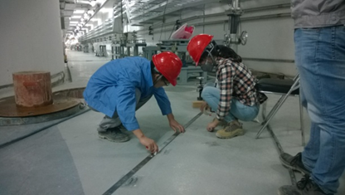
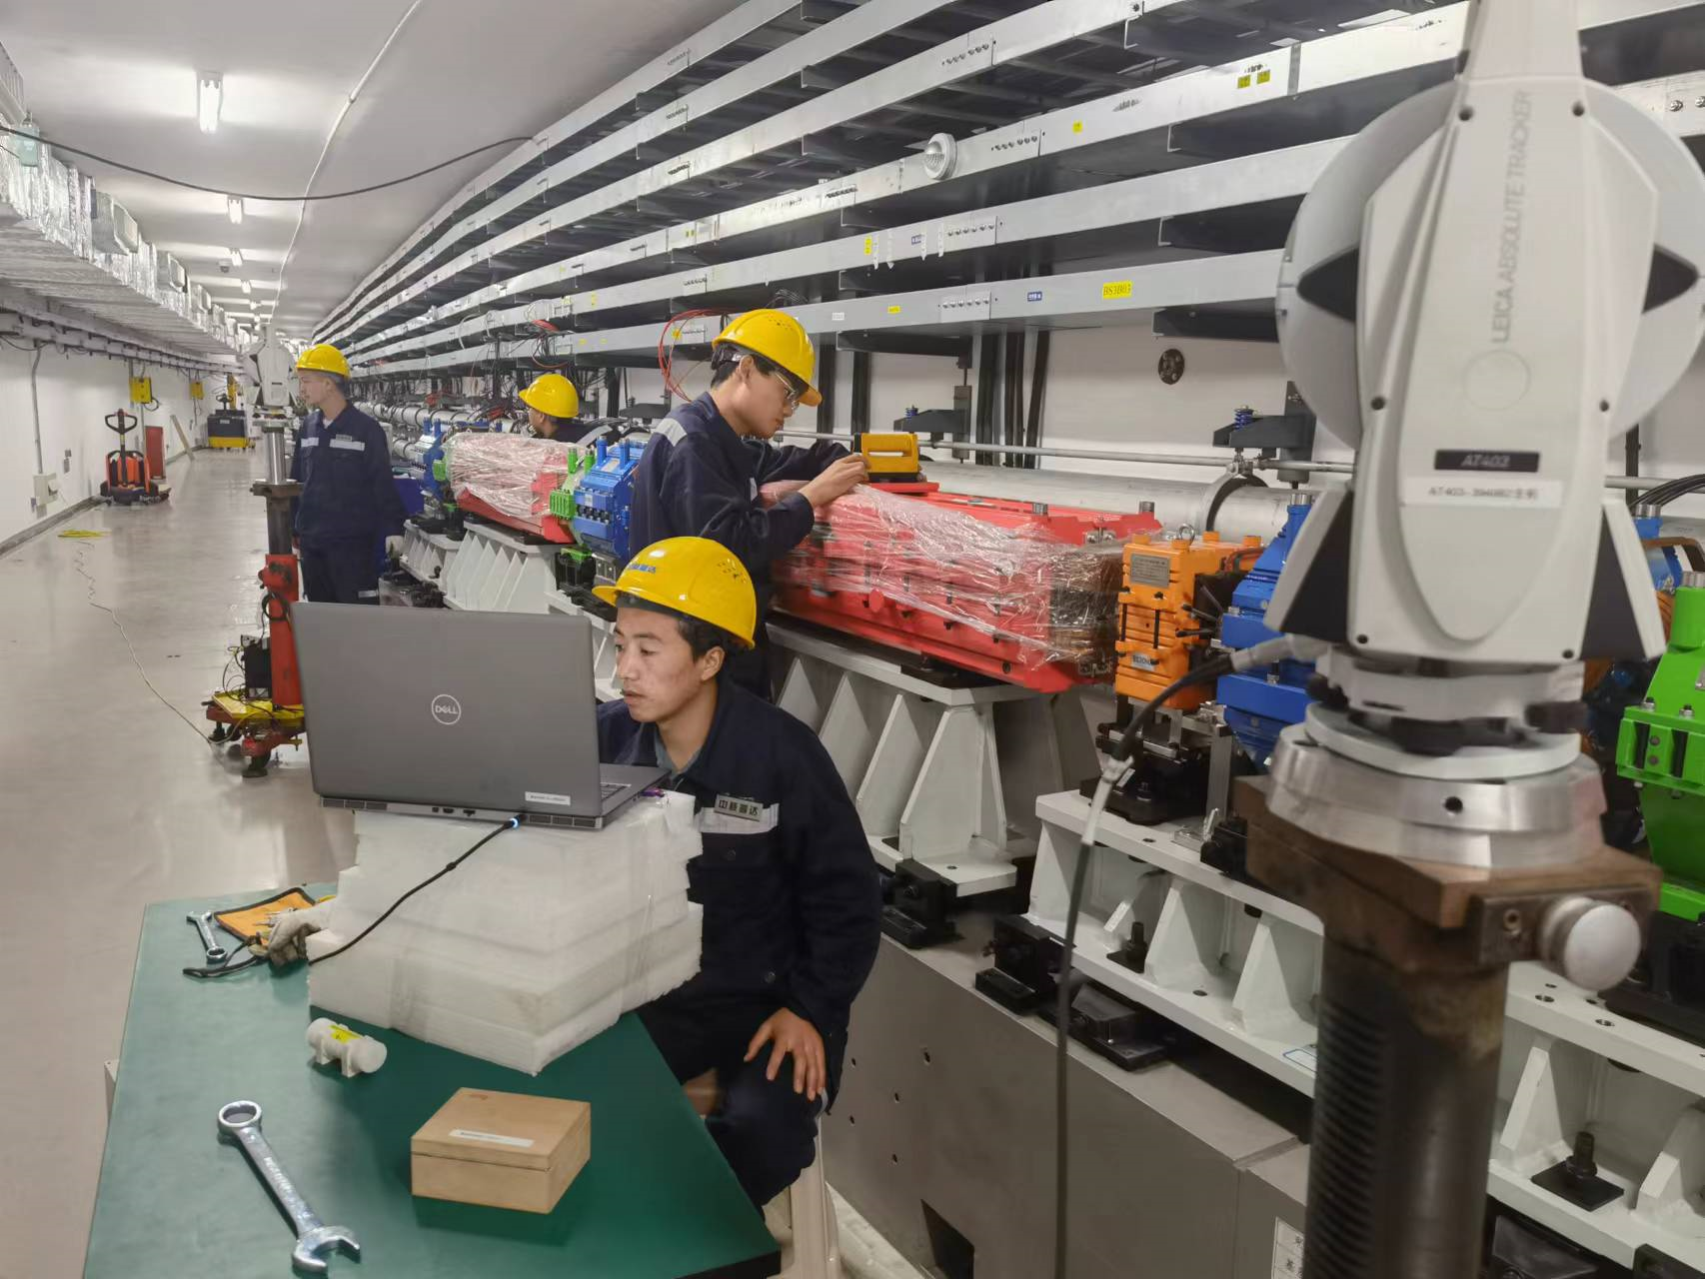
二、CEPC installation strategy
  Installation scheme is made based on the civil construction schedule, includes two phases.
  project period is :3 years and 9 months
  Tasks:
  Control network construction.
  Control network measurement
  Support setting out and installation
  Component fiducialization
  Component installation and alignment.
  Smooth alignment
Control network measurement
Setting out
Installation and alignment

Slide 25
二、CEPC installation strategy
  Start 2 months later than tunnel lining. A parallel installation strategy will be adopted.
  Manpower and time arrangement of ring installation and alignment
Peak time Ⅰ
Peak time Ⅱ
  The peak time Ⅰ, it needs 62 alignment teams and 54 installation teams.
  The Peak time Ⅱ, it needs 46 alignment teams and 46 installation teams.

Slide 26
二、CEPC installation strategy
  Linac, damping ring and transport lines installation will take 2 alignment teams and 2 installation teams work for 1 year.
  2 installation teams and 2 alignment teams will perform the detector installation(part time) ,as well as components testing and other measurement works.
  The component fiducialization schedule is made based on the installation schedule. For the fiducialization speed is slower than the installation speed, the fiducialization work will begin 4 years ahead of the installation and lasting until the last component installation been finished. 16 teams for component fiducialization.
  After the initial installation, an overall survey and smooth alignment will be carried out, 7 months.

Slide 27
二、CEPC installation strategy
  Time estimation of component installation
Collider ring installation and alignment time estimation table
Component | Number | Piece (1 team / day) | Team | Month（25 workdays / month）
Dipole | 3170 (16258 cores) | 3 | 16 | 13.5
Quadrupole | 4148 | 4 | 16 | 2.6
Sextupole | 3176 | 4 | 16 | 2.0
Corrector | 7088 | 6 | 16 | 3.0
BPM\PR\DCCT | 3544 | 6 | 16 | 1.5
Septum Magnet | 68 | 3 | 16 | 1.5
Kicker | 8 | 4
Cryomodule | 40
Electrostatic separator | 32 | 2
Superconducting Magnets | 4
Collimator\ dump | 36 | 4
Total |  |  | 16 | 24

Slide 28
二、CEPC installation strategy
Linac DR BT installation and alignment time estimation table
Component | Number | Piece (1 group / day) | Team | Month（25 workdays / month）
Dipole | 135 | 3 | 2 | 1
Quadrupole | 714 | 4 | 2 | 3.6
Sextupole | 72 | 4 | 2 | 0.4
Corrector | 275 | 6 | 2 | 1
BPM\PR\DCCT | 180 | 6 | 2 | 0.6
Accelerating structure | 577 | 4 | 2 | 3
Solenoid | 37 | 3 | 2 | 0.2
SHB BUN RF Cavity | 4 | 2 | 2 | 0.2
Collimator dump | 8 | 3 | 2
Electron Source | 1 |  | 2 | 1.5
Positron Source | 1 |  | 12 | 1.5
Septum Magnet | 2 |  |  | （16 workdays）
Kicker | 2 |  |  | （2 workdays）
Total |  |  | 2 | 10
Booster installation and alignment time estimation table
Component | Number | Piece (1 group / day) | Team | Month（25 workdays / month）
Dipole | 14844 | 3 | 12 | 16.5
Quadrupole | 3458 | 4 | 12 | 3
Sextupole | 100 | 4 | 12 | 0.1
Corrector | 2436 | 6 | 12 | 1.5
BPM\PR\DCCT | 2408 | 6 | 12 | 1.5
Cryomodule | 12（12m） |  | 12 | 1.5
Septum Magnet | 32 | 2 |  | （16 workdays）
Kicker | 8 | 4 |  | （2 workdays）
Total |  |  | 12 | 24

Slide 29


二、CEPC installation strategy
  An automatic management system from installation schedule to production, logistic and storage is under studying. (by professor Wang Jiabin)
    Operational logic diagram

Slide 30






二、CEPC installation strategy
  A simulation has been made according to the speed of installation, production, logistic , testing and warehouse utilization rate, result shows 9 warehouses should be built in each warehouse area.
  Components will be transported from the warehouse to tunnel through the nearby corridors(slope 5%) or the shafts
    2 types warehouse are optional
    warehouse type1（with shelf）， 3000m²
    warehouse type2（only stacking area），4000m²。

Slide 31



二、CEPC installation strategy
  Component transport, 2 types component need special attention
    Cryomodule （amount: 52 ）
    Collider ring dipole （amount: 3170,length: ＞20m）, long dipole will be divided into 6m long small parts:
Dimension: 10×Ø1.5 m
Weight: 15 T
Dimension: 11×Ø1 m
Weight: 8 T
Collider ring cryomodule
booster cryomodule
Dimension: 5.67×0.7×0.7 m
Weight: 2 T
Long dipole

Slide 32


二、CEPC installation strategy
  Transport requirement
    Compared with other components, the cryomodules demand higher for transport
    Maximum dimensions: length 11m, diameter 1.5m, weight 15T
    Maximum tilt: ＜±15°
    Maximum shock: ＜1.5g in X Y Z direction.
    Special facilities should be made to fix and protect the cryomodule

Slide 33

二、CEPC installation strategy
  650MHz Modul Transport (IHEP to PAPS 80km)
    Module transport on a frame with isolator springs. Three accelerometers attached.
    Max acceleration 0.4g (average 0.1g) in the whole process (< 1.5 g spec)
    Cavity sting vacuum monitored with cold gauge (powered by UPS). No leak.
Special damping support
truck crane
&
air cushion vehicle
Shock log of longitudinal vertical and horizontal

Slide 34



二、CEPC installation strategy
  CEPC 650MHz klystron (Shanghai to Beijing 1300km)
    Transport with wooden box and frame protection
    Max acceleration 2.1g (average 1.7g) in the whole process (< 5 g spec)

Slide 35

二、CEPC installation strategy
  Component transport and installation in tunnel
    Various vehicles and hoisting machineries will be needed
    Electrically driven, emission-free
    Dimension and load should match the tunnel space and the weight of components
    Some need to be customized.
    Collider ring
    Dipole core: 5.7×0.7×0.7 m 2T
    Quadrupole: 3×0.7×0.56 m
    Sextupole: 1.4×0.34×0.34m
    Booster
    Dipole: 5.4×0.65×0.65m 1.6T
    Quadrupole: 2×0.52×0.52 m
Sppc

Slide 36



二、CEPC installation strategy
  Forklift
  Pallet truck
  5T
    Length: 3896 mm
    Width: 1450 mm
    Height: 2369 mm
    Lift height: 3150 mm
    Weight: 7 T
    Load: 5T
    Min. turning radius: 2572 mm
  8T
    Length: 4703 mm
    Width: 2111 mm
    Height: 2838 mm
    Lift height: 3450 mm
    Weight: 14 T
    Load: 8T
    Min. turning radius: 3000 mm
  8T
    Length: 1638 mm
    Width: 176 – 685 mm
    Lift Height: 85 – 195mm
    Load: 8T

Slide 37


二、CEPC installation strategy
  Cantilever mounting car
  3.5T
    Length: 2000 mm
    Width: 1000 mm
    Height: 2000 mm
    Lift height: 2600 mm
    Load: 3.5 T
    Min. turning radius: 1750 mm
  1T
    Length: 1700 mm
    Width: 800 mm
    Height: 1900 mm
    Lift height: 2500 mm
    Load: 1 T
    Min. turning radius: 1750 mm

Slide 38
二、CEPC installation strategy
  Large scale component transport in tunnel
    Specific vehicles need to be R&D for large scale components transport in the long and narrow tunnel, like FCC does.
Picture from FCC

Slide 39
Summary
  A kind of from global to local hierarchical alignment control scheme has been made.
  High accuracy magnetic center measurement systems and large-scale space micron level measurement method have been developed and successfully used for HEPS alignment.
  0.1mm magnet alignment accuracy can be achieved.
  Deformation issue has been considered, A kind of capacitive hydrostatic level sensor has been developed.
  A 3 years and 9 months installation scheme has been made. To increase the installation efficiency, a segments parallel strategy is adopted.
  Logistic and storage are studied, warehouse layout is designed, key parameters for component transport and installation have been investigated.

Slide 40
Thank You !

