Slide 1



CEPC auxiliary facilities and
power consumptions
Huang Jinshu
12-16. June. 2023, Hongkong, CEPC Accelerator TDR International Review

Slide 2
Content
Introduction
Auxiliary facilities design
  Electric engineering
  Cooling water system
  HVAC
  Compressed air system
  Energy saving consideration
Summary

Slide 3
Introduction
This talk is about the design and layout of auxiliary facilities.
This talk relates to the TDR ch10.7-13.
The content relates to the “charge letter” item —“Are the accelerator complex design, the key technologies adopted, and the conventional facilities effective for achieving the performance goals? ”.

Slide 4
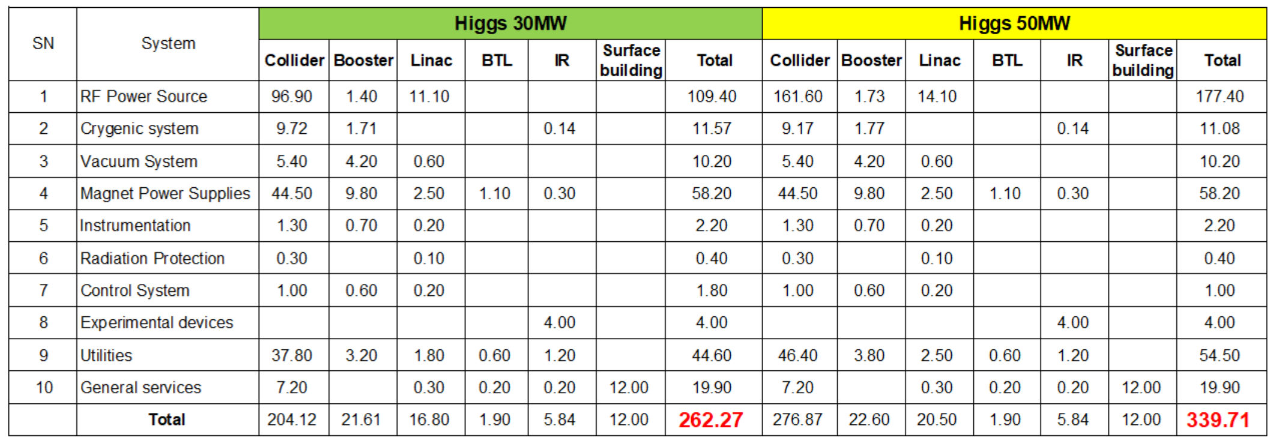
Electric engineering
Power consumption of CEPC
  Higgs

Slide 5
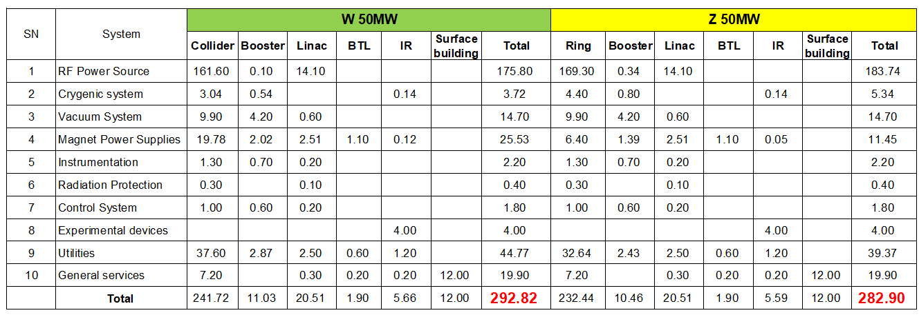
Electric engineering
Power consumption of CEPC
  W and Z

Slide 6
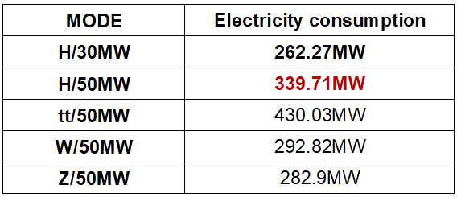
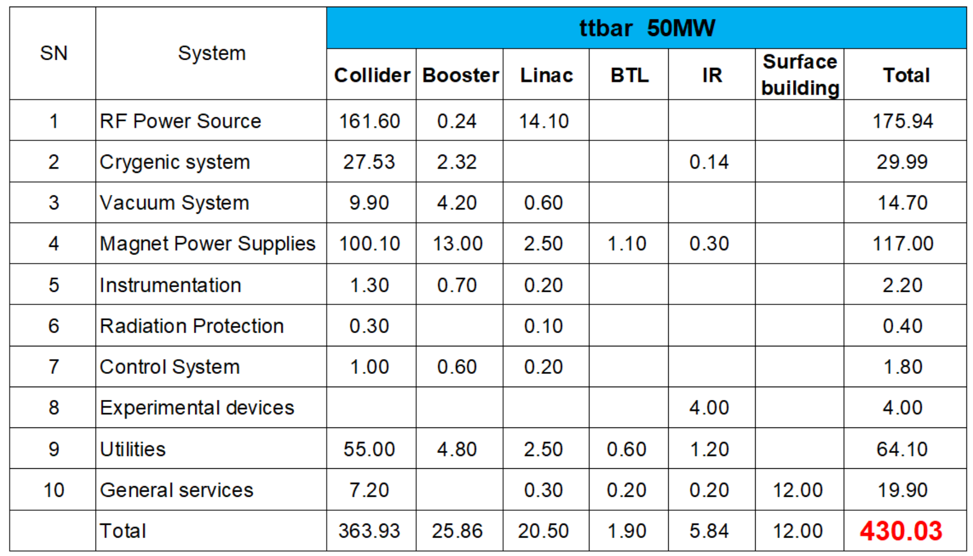
Electric engineering
Power consumption of CEPC
  Design electrical load ：339.7MW
H/50MW

Slide 7
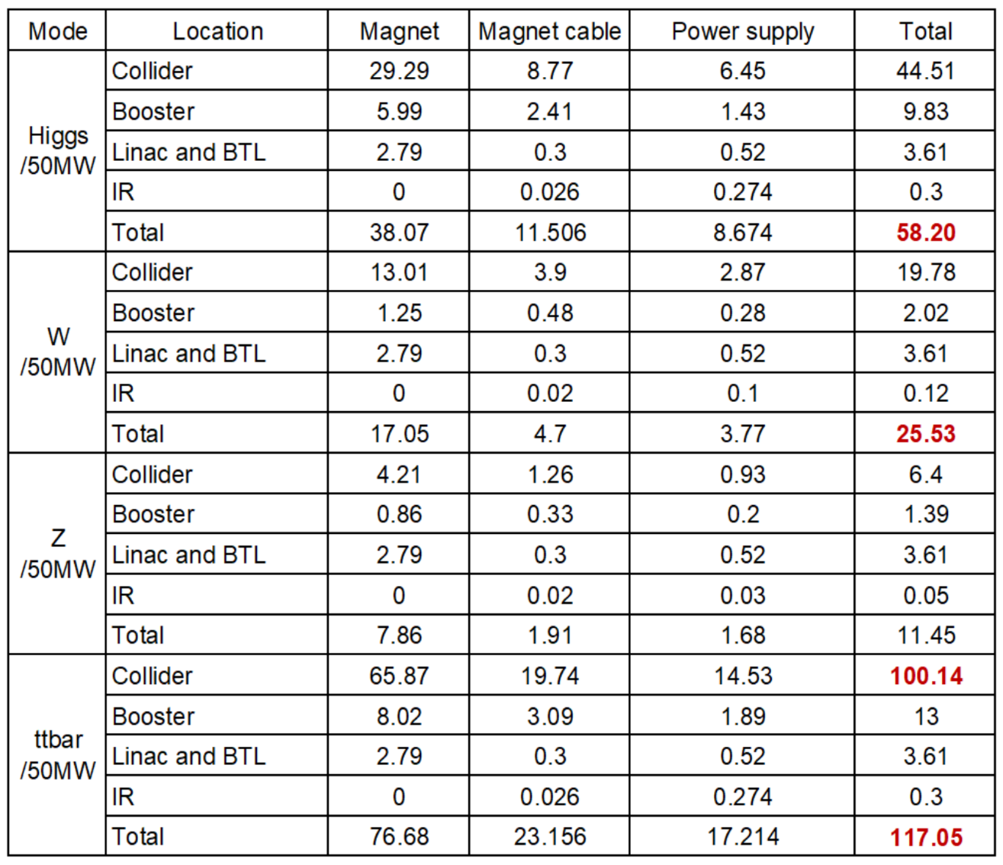
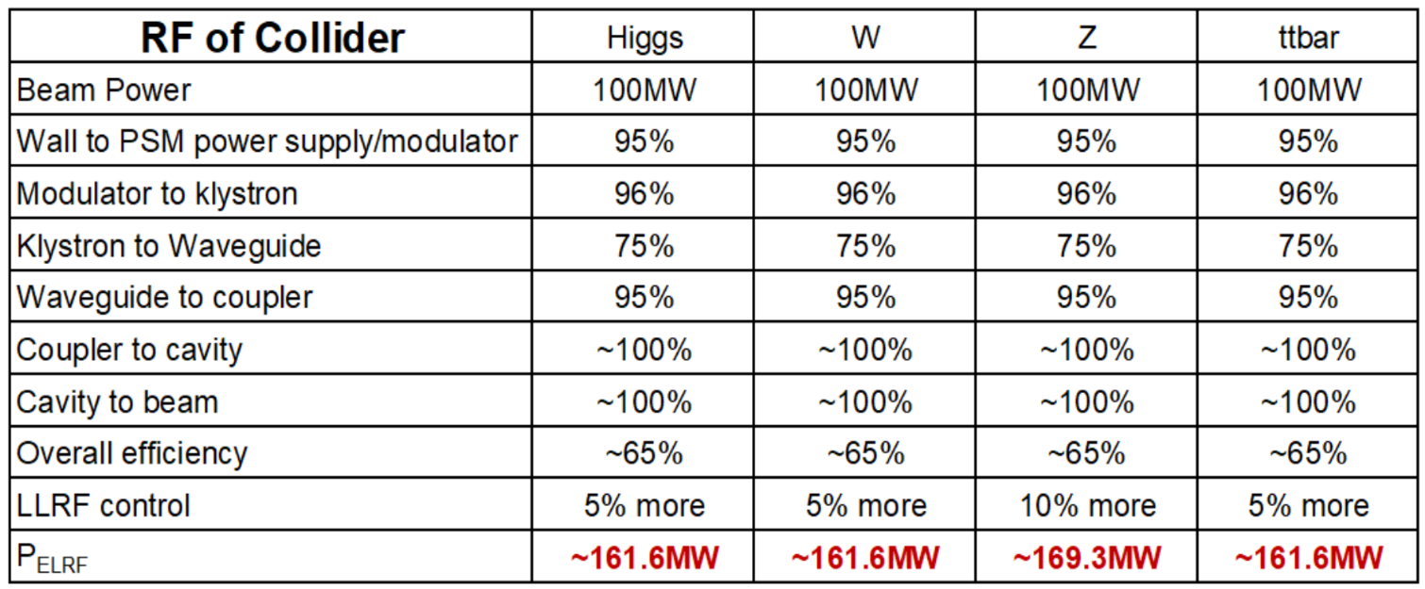
Electric engineering
Major power consumption system
  RF Power source
  Magnet Power Supplies
  Utilities. The power consumption depends mainly on the accelerator's requirements.

Slide 8
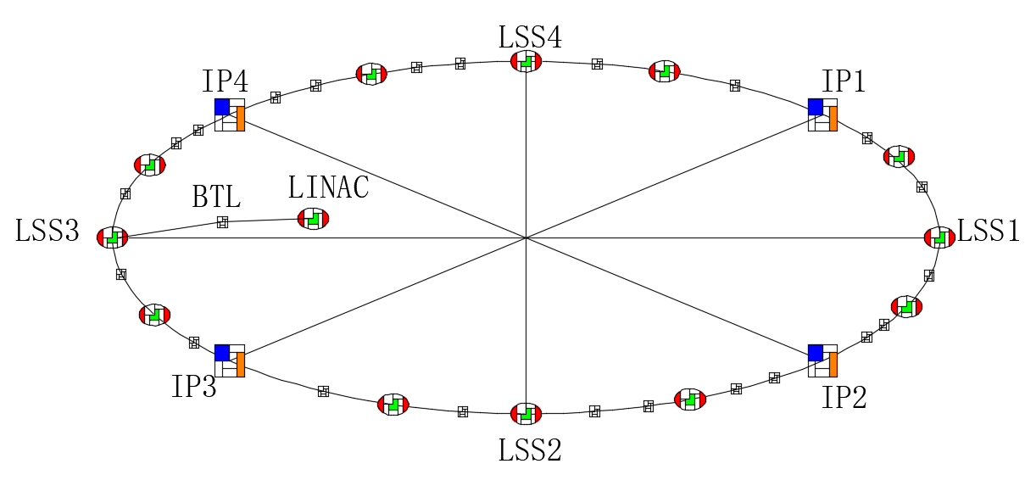
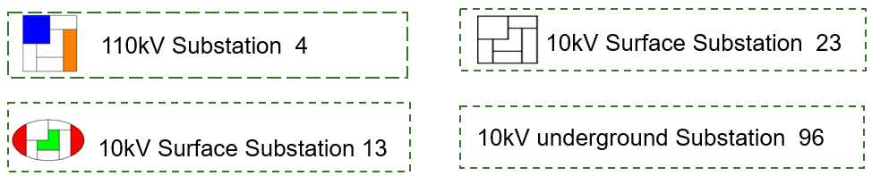
Electric engineering
Power supplies and schemes
  The voltage levels on the site
    220kV incomer of CEPC master substation.
    110kV power distribution system.
    10kV power distribution system for HV power equipment and step-down substation incomer.
    0.4kV power distribution system for dedicated and general services.
  220kV/110kV Master substation
    2 substations
    Rated capacity of transformer: 2*210MVA (220/110kV/10kV).
    220kV feeds connected to grid station nearby (State Grid Corporation of China).
    Three-phase three-volume natural oil circulating air-cooled on-load regulating transformer.

Slide 9
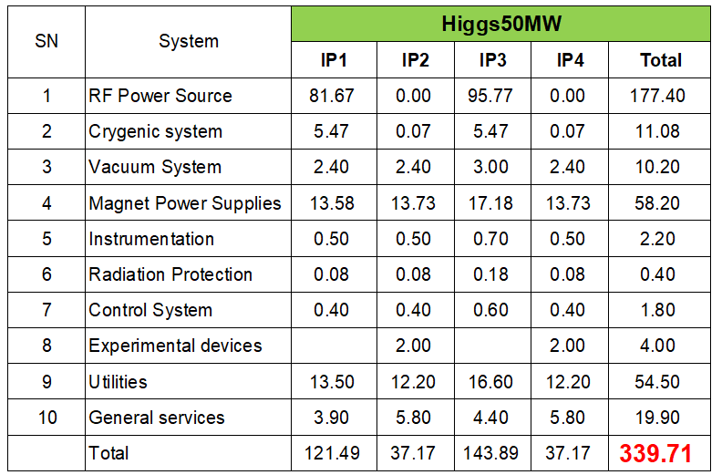
Electric engineering
110kV/10kV step-down substations
  4 substations respectively located in IP1~IP4.
  Total rated capacity of transformer: 680MVA.
  Transformer installation capacity at each point of IP1-4 are as follows:
    IP1: 3*80MVA
    IP2: 2*50MVA
    IP3: 2*50MVA
    IP4: 3*80MVA
  Power load of IP1~4

Slide 10
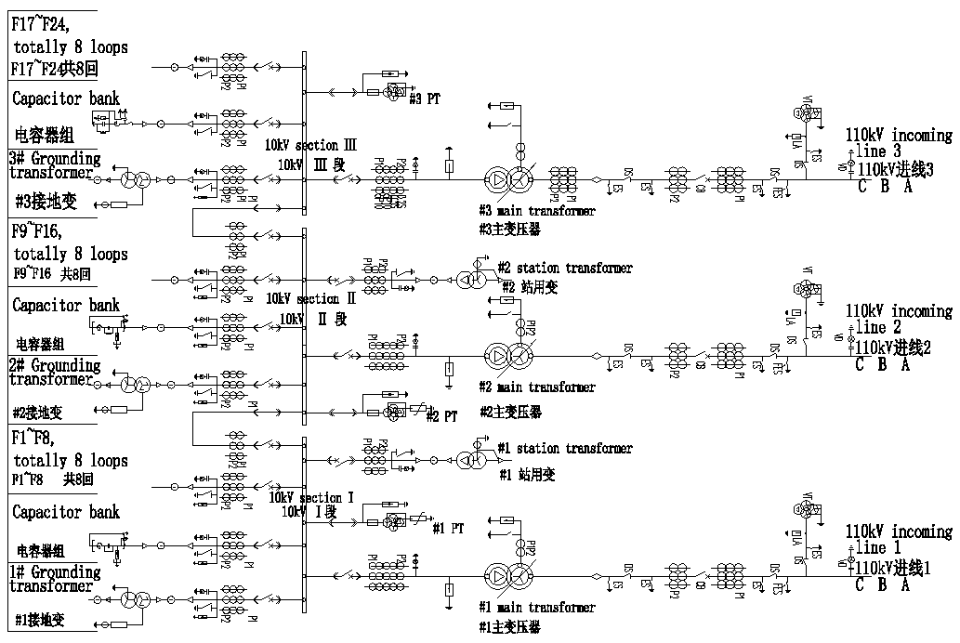
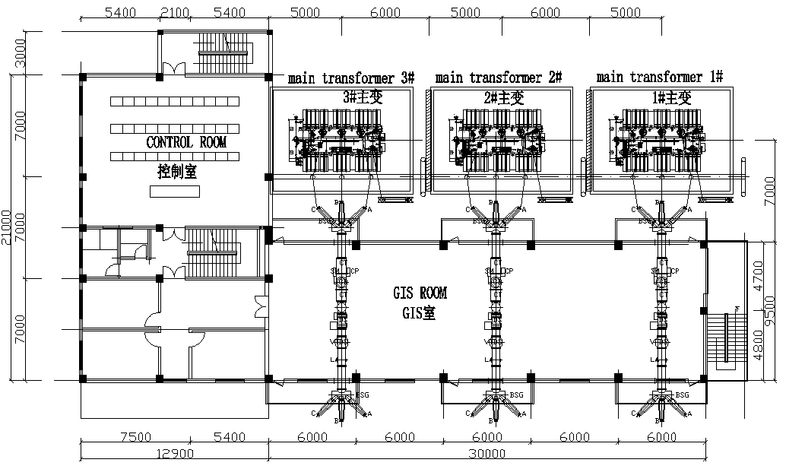
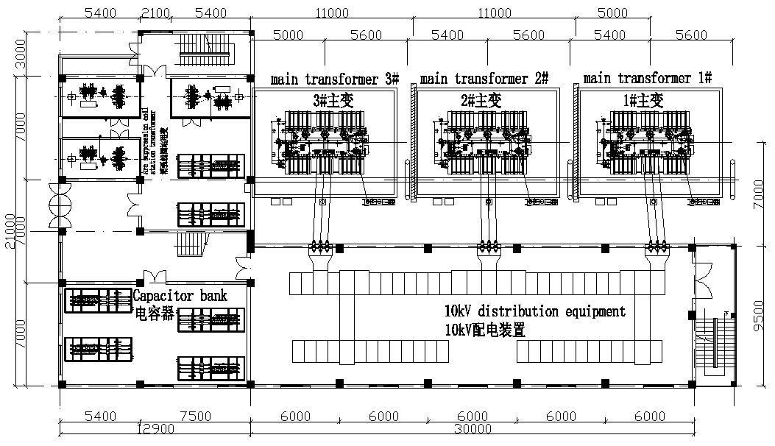
Electric engineering
110kV/10kV step-down substations
  IP1/IP3 110kV/10kV Substation layout
  Substation layout
  Main electrical wiring of 110kV substation
  -- 110kV lines connected by the line transformer bank.
  -- 10 kV lines connected by sectionalized single busbar.
  Main transformer Outdoor;
  10 kV Switchgear indoor
  Double-row arrangement;
  Outgoing line by cables.
  110 kV GIS equipment in single row.

Slide 11
Electric engineering
  10kV step-down substations
Rated capacity of 10kV/0.4kV transformer: 328.3MVA
 | Subsation Name | Num. of Subsation | Diagram of 10kV | Circuit Num. | Load of 10kV Subsation | Scale of Substation（0.4kV） | Location of Subsation
1 | IP1，IP3 10kV Substiaon | 6 | Single Bus section | 3 incoming 24 outgoing | 28.8MW(10kV） 2.5MW（0.4kV） | 2x3150kVA | Nearby 1# &2#RF Power Tunnel 1#~2# Power Hall
2 | IP2，IP4 10kV Substiaon | 2 | Single Bus 2 section | 2 incoming 26 outgoing | 3.8MW(10kV) 4.6MW(0.4kV) | 4x2000kVA | 1# & 2# IR Equipment Hall 3#~4# Power Hall
3 | LSS1~LSS4 10kV Substiaon | 4 | Single Bus 2 section | 3 incoming 10 outgoing | 3.8MW(10kV) 2.7MW(0.4kV) | 2x2500kVA | 5#~8# Power Hall
4 | LINAC 10kV Substiaon （24# ） | 1 | Single Bus 2 section | 2 incoming 10 outgoing | 6MW(10kV) 4.5MW | 2x2500kVA | LINAC Gallery
5 | 1#~23# grounding 10kV Substiaon | 23 | Single Bus 2 section | 2 incoming 10 outgoing | 1MW | 2x1250kVA | Surface Substaion
6 | 1#~96# Auxiliary Tunnel | 96 | Single Bus 2 section | 2 incoming 2 outgoing | 0.8MW | 2x1000kVA | Auxiliary Tunnel

Slide 12
Electric engineering
  10kV step-down substations
    10kV feeders from 110kV/10kV substation nearby.
    Surface 10kV loop : 36
    Underground 10kV loop
    -- 96 substations (10/0.4kV ) along the ring tunnel.
    -- near the load points.
    Dry-type transformers
    Centralized reactive compensation
  Back up diesel generator sets maybe required for personnel safety: lifts, smoke extraction etc.
  Instrumentation and power converter control systems may require uninterrupted power supplies (UPS).
Schematic diagram for the power supply network

Slide 13
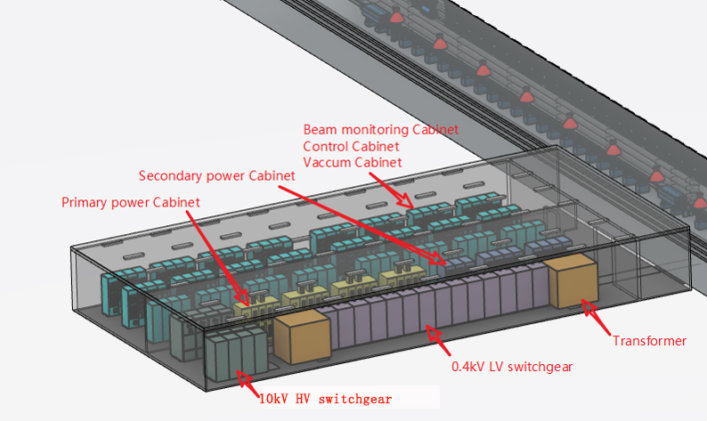
Electric engineering
Electrical equipment general layout in auxiliary tunnel
Description | Qty. | Location
Beam monitoring cabinet | 10 | Control room
Control cabinet | 44
Vacuum cabinet | 42
Primary power cabinet | 4 | Power distribution room
Secondary power cabinet | 11
10kV HV switchgear | 8
10/0.4kV transformer | 2
0.4kV LV switchgear | 12

Slide 14
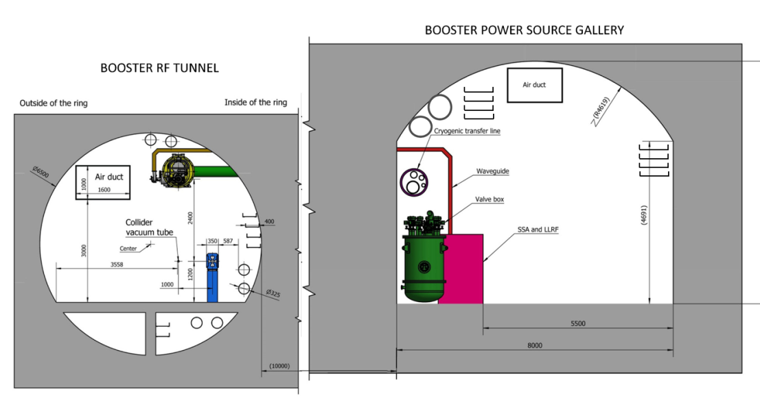
Electric engineering
Cable path
  The routing of cable laying should take into account functionality, aesthetics and economy.
  According to a rough estimate of the number of cables, reserved cable tray.
  General principle
    Cables are classified according to voltage class, load characteristics, cable type, etc.
    Magnet power supply power cable is bipolar output, should ensure that the positive and negative cables close to the same path laying.
    The distance between different types of cables or shielding isolation to reduce or avoid interference to sensitive signals.
    Bridge, tube well, hole and other laying methods, the way into the radiation control area should meet the requirements of radiation protection.
    Do a good job in each area of water pipe, air pipe and bridge pipeline integration.

Slide 15
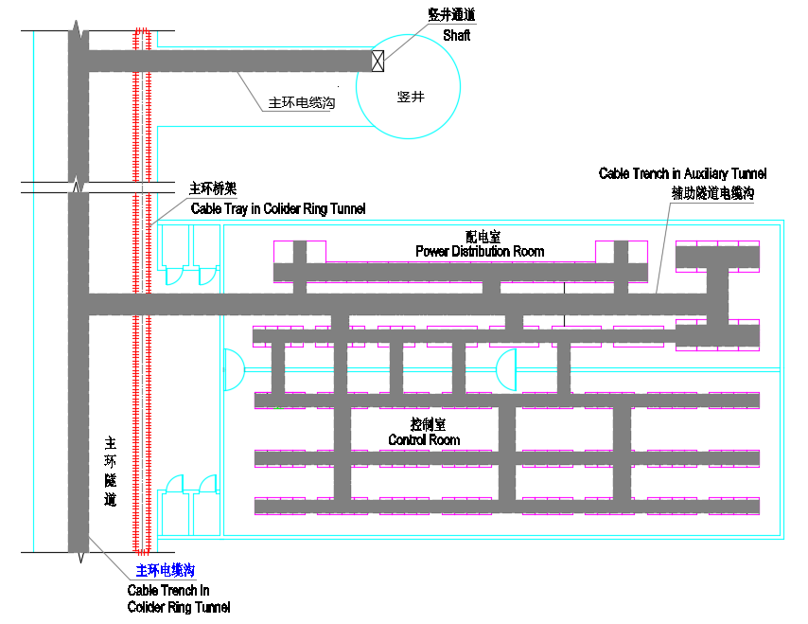
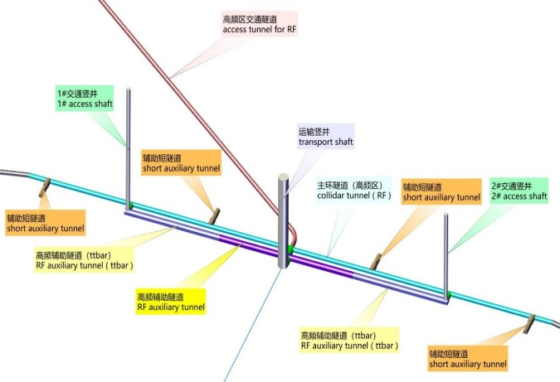
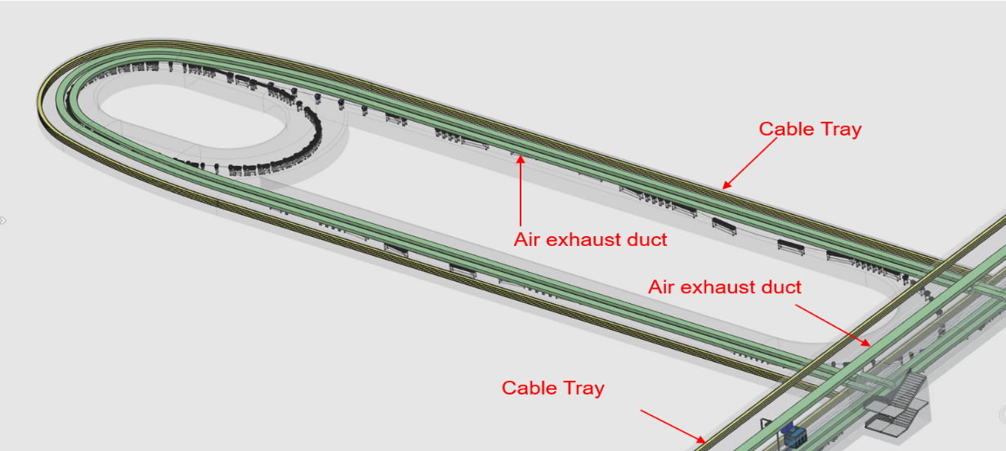
Electric engineering
Cable path
  110kV/10kV cables between substations in ground area shall be arranged in the following way: overhead, gallery, cable trench, or directly buried.
  The cables on the ground (including 10kV distribution cables, etc.) enter the underground building through the shaft, and then connect to the power consumption areas through the cable bridge and cable trench in the tunnel.
Cable path of Collider tunnel
Cable layout in Damping-Ring

Slide 16
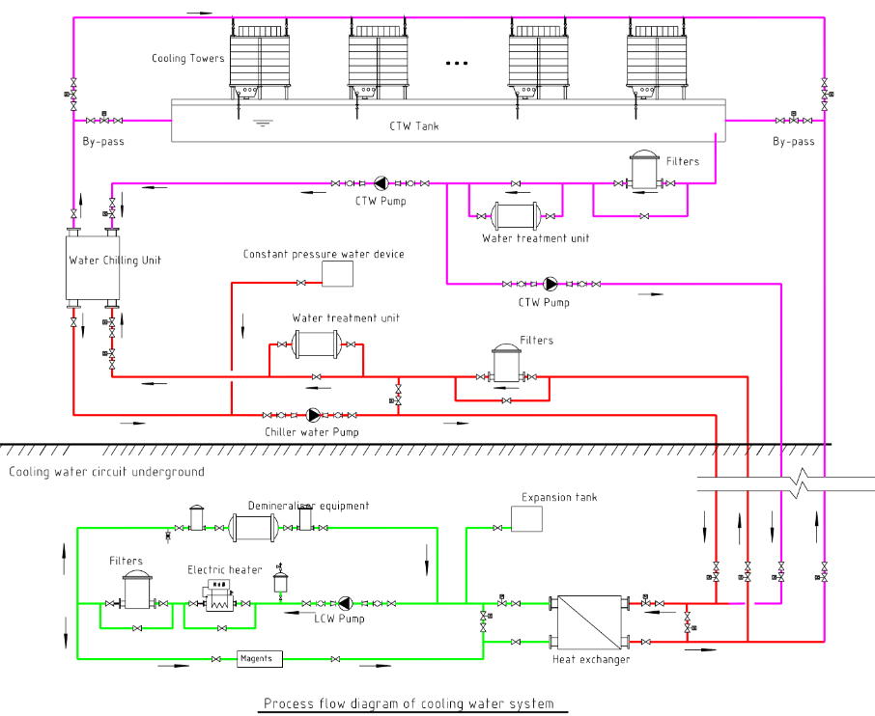
Colling water system
Function
  Absorb heat, cooling process equipment.
  Provide a constant temperature environment.
  Adjusting resonant frequency by water temperature.
  Composition
  Dual circuit cooling mechanism.
  LCW (Low-conductivity water)— Cooling process equipment directly.
  CTW (Cooling tower water)— Provide cold source for LCW.
  DW (Deionized water)— Supply low-conductivity water for makeup.
  Waste water collection and discharge system
  Cooling water control system

Slide 17
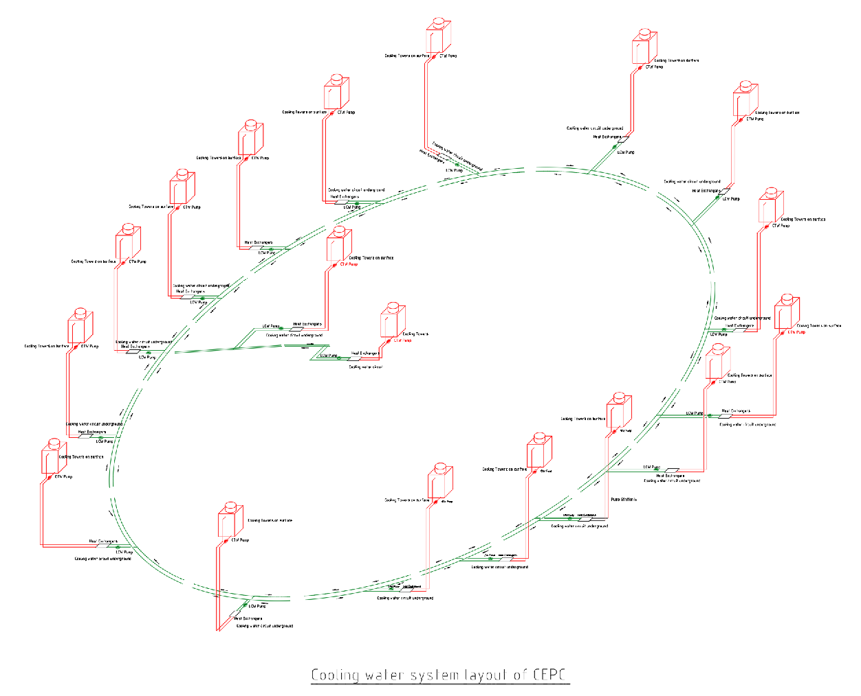
Colling water system
Principle of layout
  Close to the heat load center.
  Relatively concentrated.
  Reasonable water supply radius.
  Minimize operating pressure.
Layout scheme
  CTW and DW on surface.
  LCW are underground.
  Centralized water supply station:20
    Linac—1
    BTL—1
    Collide/Booster—16
LSS4
IP4
IP1
LSS3
BTL
LINAC
LSS1
IP2
IP3
LSS2

Slide 18
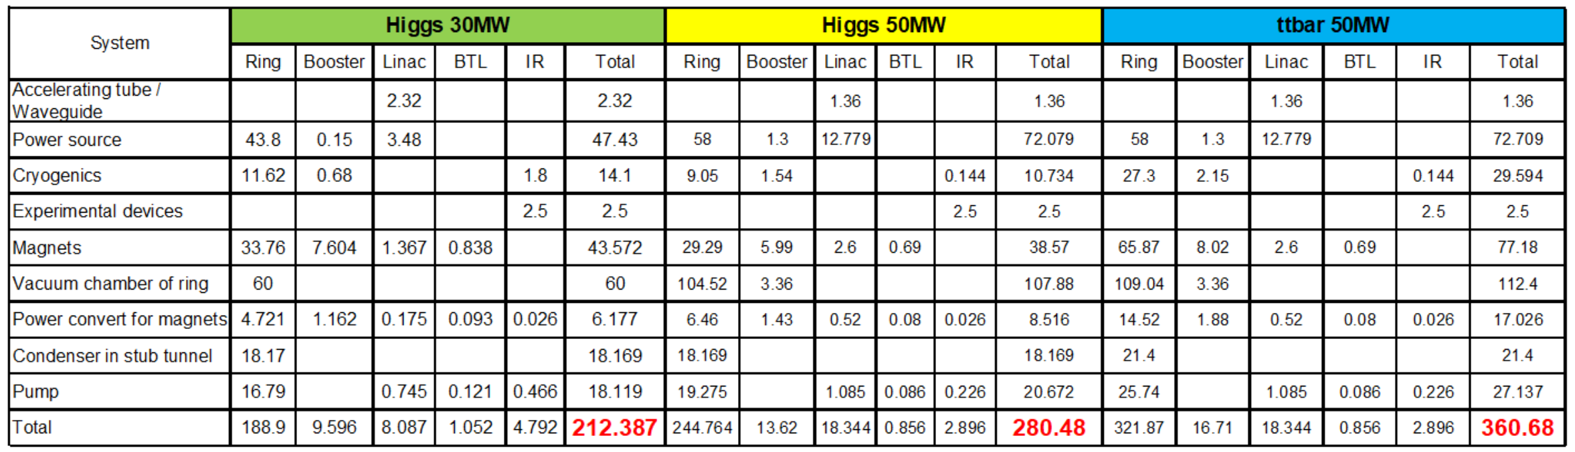
Colling water system
Key requirements and parameters
  Total heat load : 280.48MW (Higgs/50MW)
Heat load of cooling water system

Slide 19
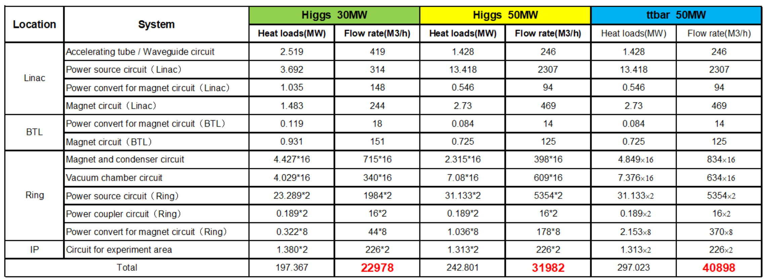
Colling water system
Key requirements and parameters
  Total flow rate of LCW: 31982 m³/h.
  LCW cooling water temperature ＜ 32 ℃.
Parameters of low-conductivity circuits

Slide 20
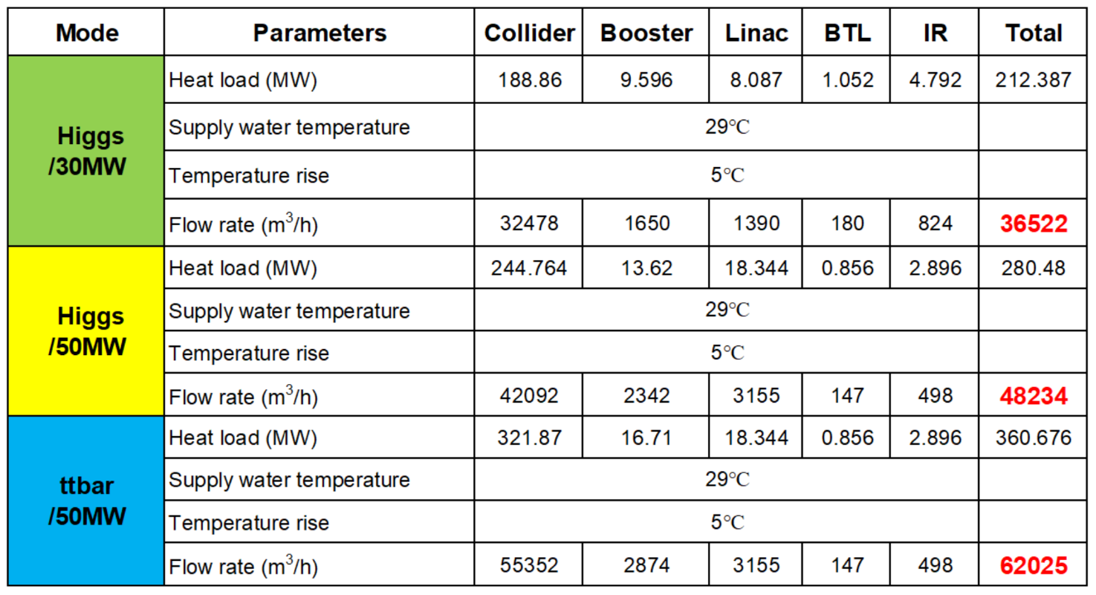
Colling water system
Key requirements and parameters
  CTW
  Total flow rate of CTW: 48324m³/h
  Cooling tower water temperature ＜ 29℃
  (Base on wet-bulb air temperature of 27℃ ambient; machine shut down in summer )
  DW
  Single DW unit can produce 3~5m³/h deionized water with the effluent quality meets the following standards.
  Resistivity reach 18 MΩ•cm
  Other parameters satisfy EW-1 requirements.
  Storage capacity of low-level radioactive wastewater ：5100m3
Parameters of CTW
  Water consumption (1% CTW flow rate and others)：
  Higgs/30MW : 10829m³/d
  Higgs/50MW : 13661m³/d
  ttbar/50MW : 17064m³/d
Need stable water source !

Slide 21
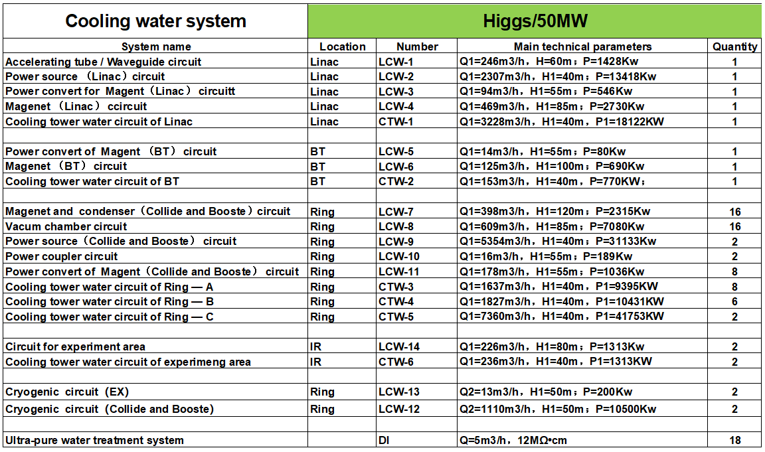
Colling water system
Subsystem partition
  56 closed-loop of LCW
  20 CTW subsystems
  18 DW subsystems
The division of LCW subsystem depends on the demand of water-used equipment:
  Temperature
  Pressure,
  Water quality,
  Radiation dosage
  Location
Subsystem partition of Cooling water system

Slide 22
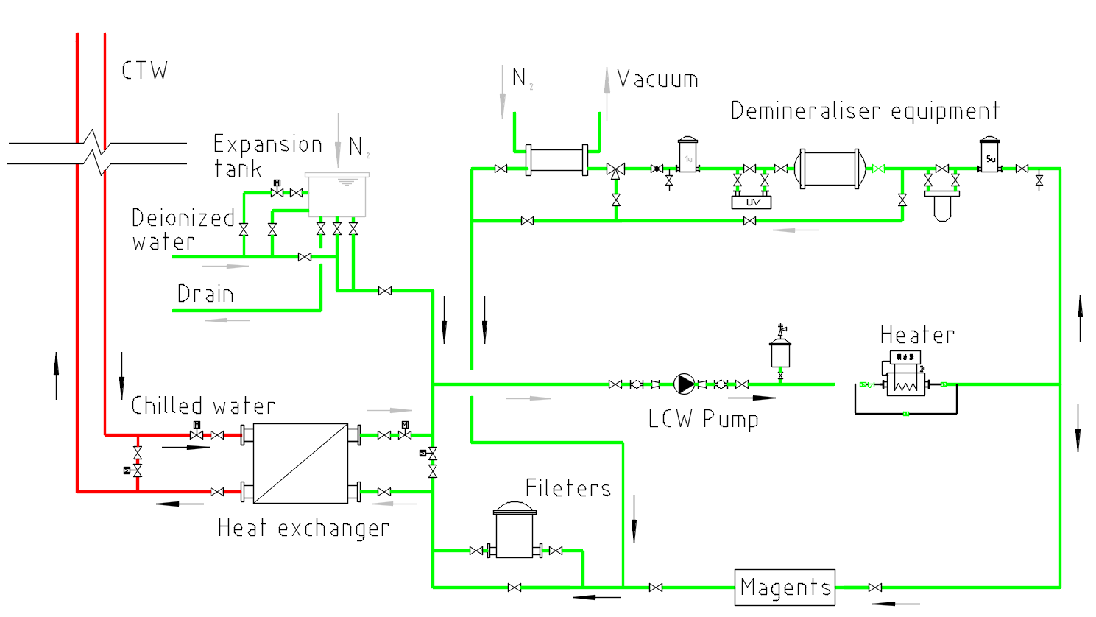
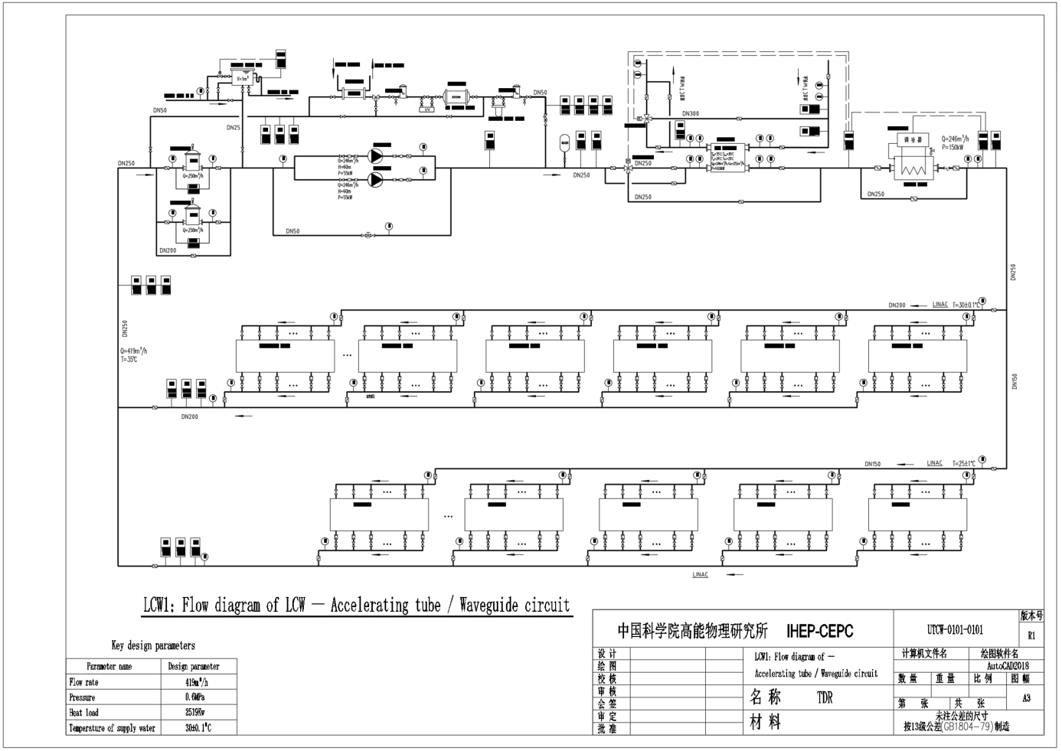
Colling water system
LCW (Low-conductivity water system)
  Main loop
    Various measures are set up to ensure flow distribution and pressure balance.
    Trap particulate matter to prevent process equipment from blocking waterways.
    Keep the system temperature stable through constant temperature control.
  Bypass circulation
    regulate the water quality.
    maintain the microenvironment of the LCW system.

Slide 23
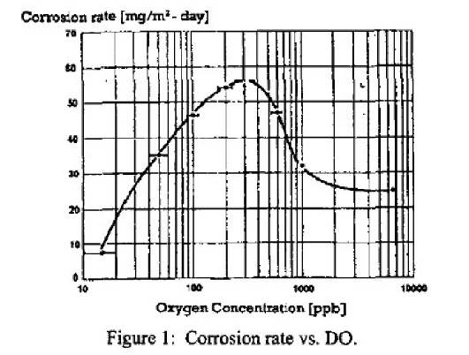
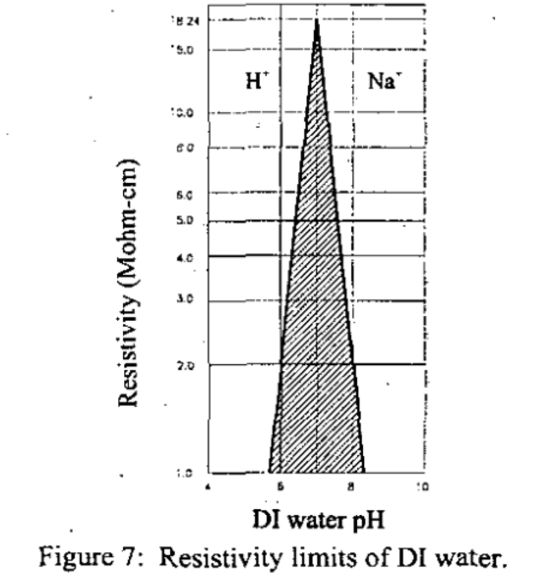
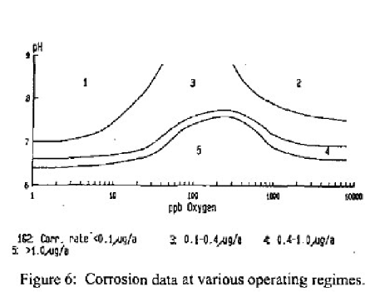
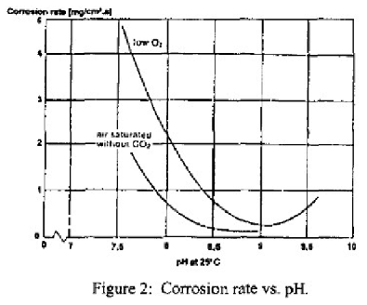
Colling water system
LCW
In order to slow down the corrosion rate of copper, iron and other metals as much as possible, the water quality of the system needs to be stable at a certain level. Specific parameters are as follows：
  Conductivity：0.2~1μS/cm
  PH: 6.7~7.5
  Dissolved Oxygen ≤20ppb
  Total bacteria ≤10 CFU/mL
  TOC ≤ 1mg/L
  Particulate matter(>1um) ≤10/mL

Slide 24
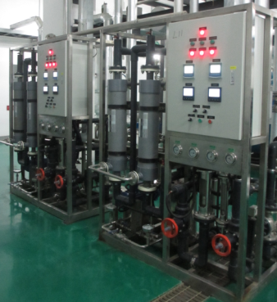
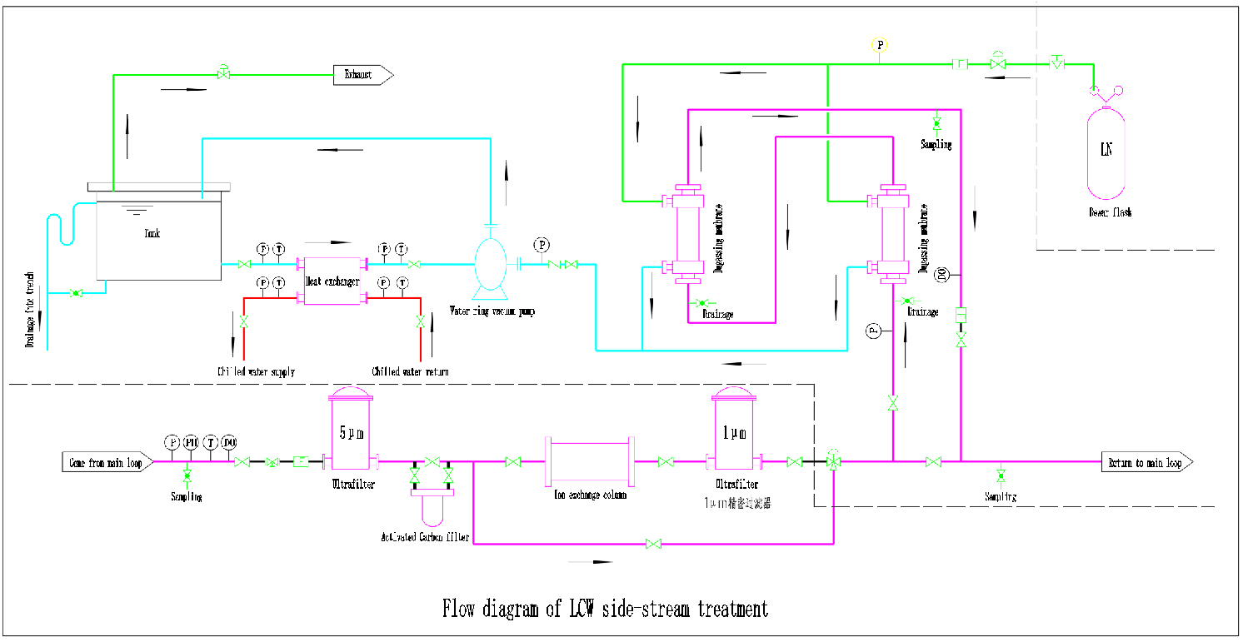
Colling water system
LCW
  A variety of measures will be adopted to achieve these water quality objectives.
  The flow rate through ion-exchange resin is about 1~5% of the total circulation flow rate.
  H⁺ and Na⁺ type resin are used to adjust the PH value of the LCW system.
  Degassing device is designed to remove dissolved oxygen in the LCW system,.
  Nitrogen isolation is adopted to avoid LCW system contact with air.

Slide 25
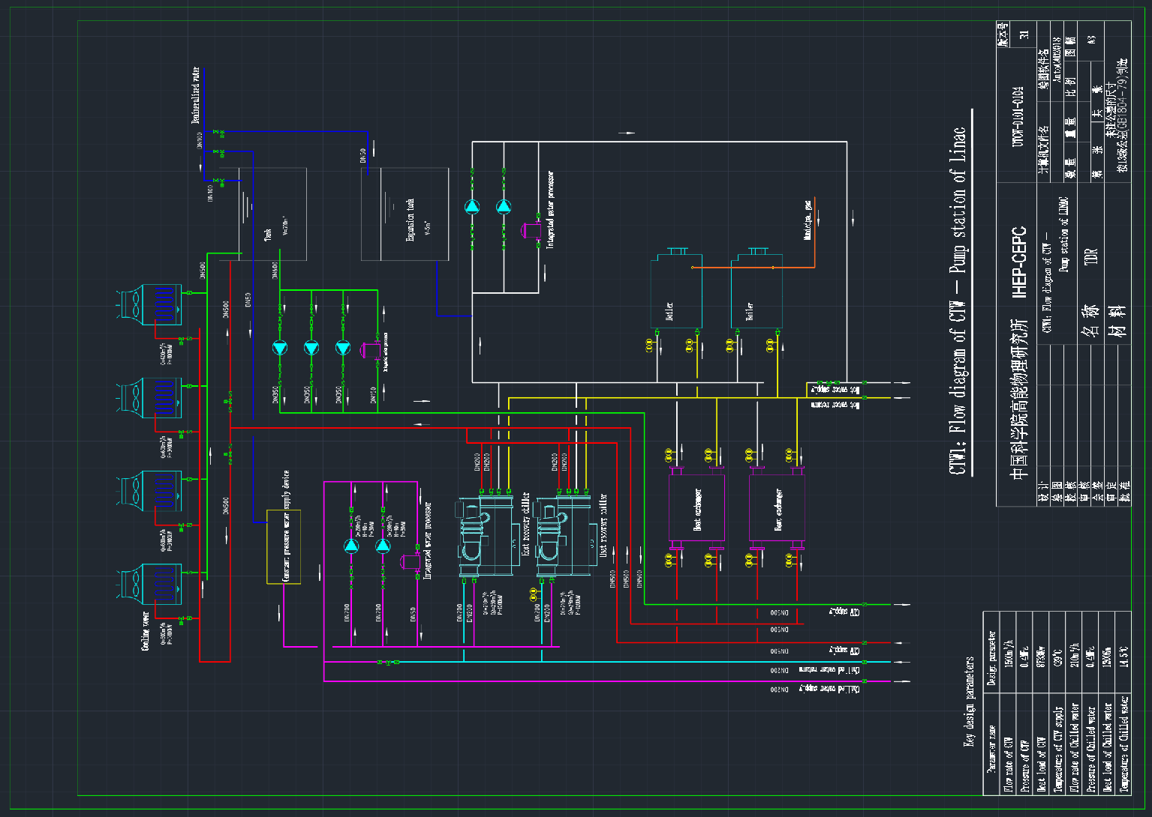
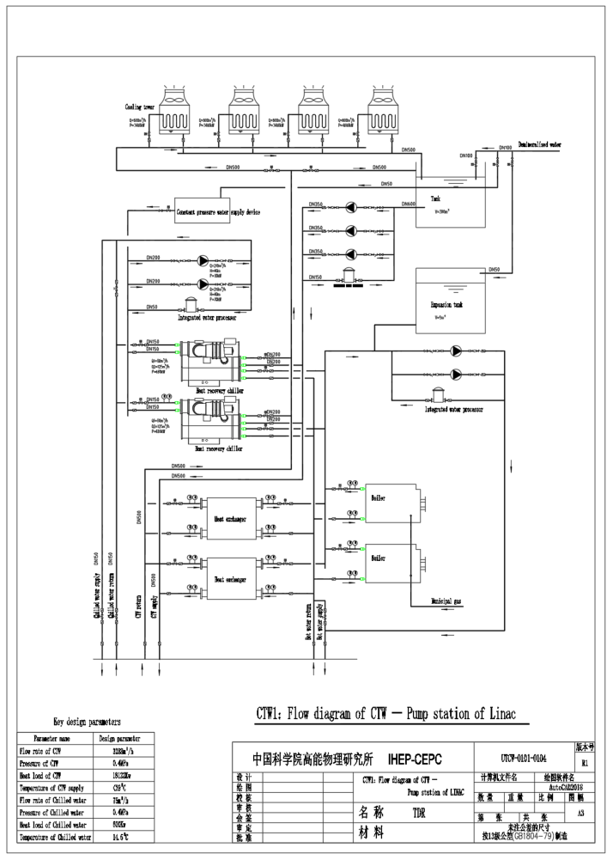
Colling water system
CTW (Cooling tower water)
  Provide cold source for LCW and hot sources for HVAC.
  -- CTW ≤ 29℃ (by cooling tower)
  -- Chilled water ≤ 14.5℃
  (by Heat recovery chiller or cooling tower)
  -- hot water
  (by Heat recovery chiller, heat exchange and backup boil)

Slide 26
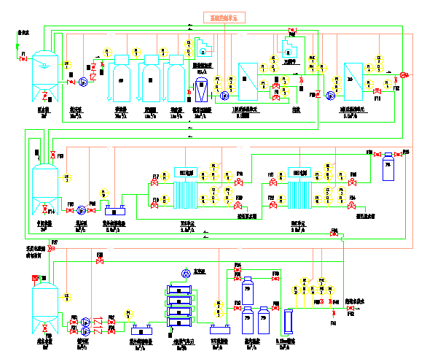
Colling water system
DW
DW system provides deionized water for LCW and laboratory. The system consists of three parts:
  Ultra-pure Water Treatment System
  Adopt two-stage RO(reverse osmosis) and EDI process.
  The device can provide ultra-pure water with a resistivity of 18MΩ•cm.
  Water distribution pipe network
  CPVC, S316L or PVDF
  Experimental water requirements can satisfied by adding terminal filtration and water quality lifting devices.

Slide 27
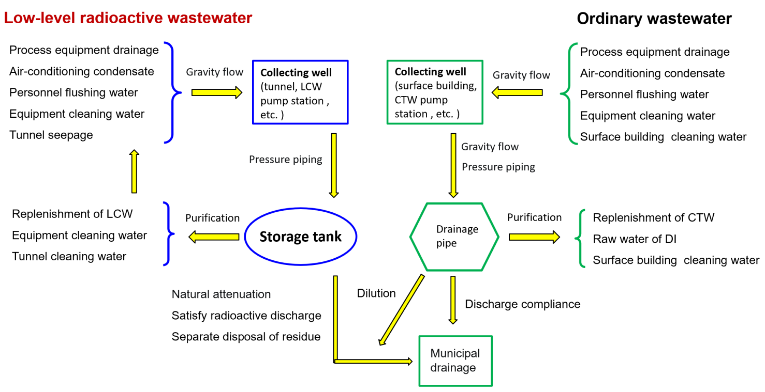
Colling water system
Waste water collection and discharge system
Process wastewater of CEPC
  Ordinary process wastewater is discharged directly or recycled after treatment.
  Low-level radioactive wastewater should be collected and stored for natural attenuation, and discharged or recycled according to relevant national standards and regulations after testing.

Slide 28
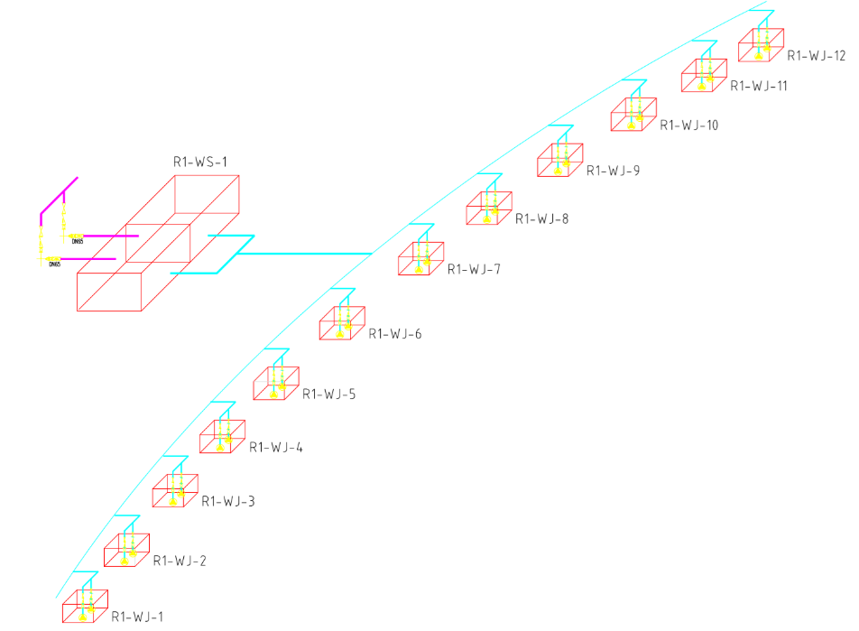
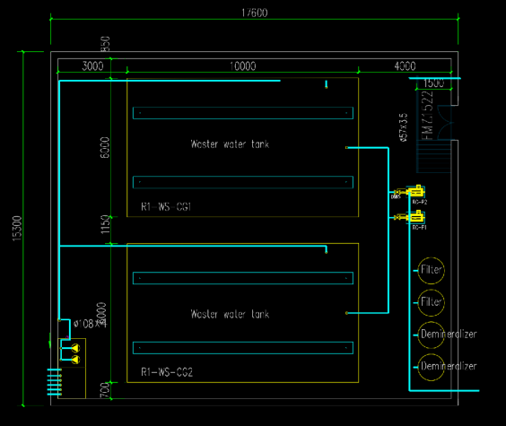
Colling water system
Waste water collection and discharge system
According to the distribution of low-level radioactive wastewater discharge points and the possible discharge volume, many facilities need to be set up to collect and store.
    Drainage ditches and catchment wells need to be set up along the tunnel , with the preliminary design of collecting well(V=2m³) is one every 500 meters, with the drainage slope is about 1‰.
    There are 18 storage areas for low-level radioactive waste water underground. each storage volume is the maximum volume of the water cooling subsystems in the area.
Discharge or reutilization.
Parameters | Collider | Booster | Linac | BTL | IR
Storage volume (m³) | 16×300 | — | 100 | 100 | 2×50
Total (m³) | 5100

Slide 29
Heating Ventilation and Air Conditioning
Estimated cooling loads of HVAC
  Ring tunnel: 14MW
  Service buildings: (200W/m²) 28MW
  Total: 42MW
Coolant for air conditioning: chilled water
Heat source for heating system in winter
  Heat pump -- heat recover from cooling system.
  Backup boiler
Indoor Design Parameters
  Tunnel
    Temperature: within 30-34℃ and shall be kept below 35℃.
  -- Inlet: 18~20℃
  -- Outlet: less than 35℃
    Relative humidity: 50% ~ 60%, and shall be lower than 65%
  Experimental halls
    Temperature: about 26℃(summer), 20℃(winter)
    Relative humidity: 50% ~ 60%, and shall be lower than 65%.
  Control room (or electronics)
    Temperature: about 20-25℃
    Relative humidity: 45% ~ 60%
  Other service building
    Temperature: about 28℃(summer), 18℃(winter),
    Relative humidity: lower than 65%
Design parameter | Unit | quantity
Total cooling load | MW | 42
Total chilled water flow rate | m³/h | 7223
Total cooling tower water flow rate | m³/h | 8667
Total capacity of cooling towers | MW | 50

Slide 30
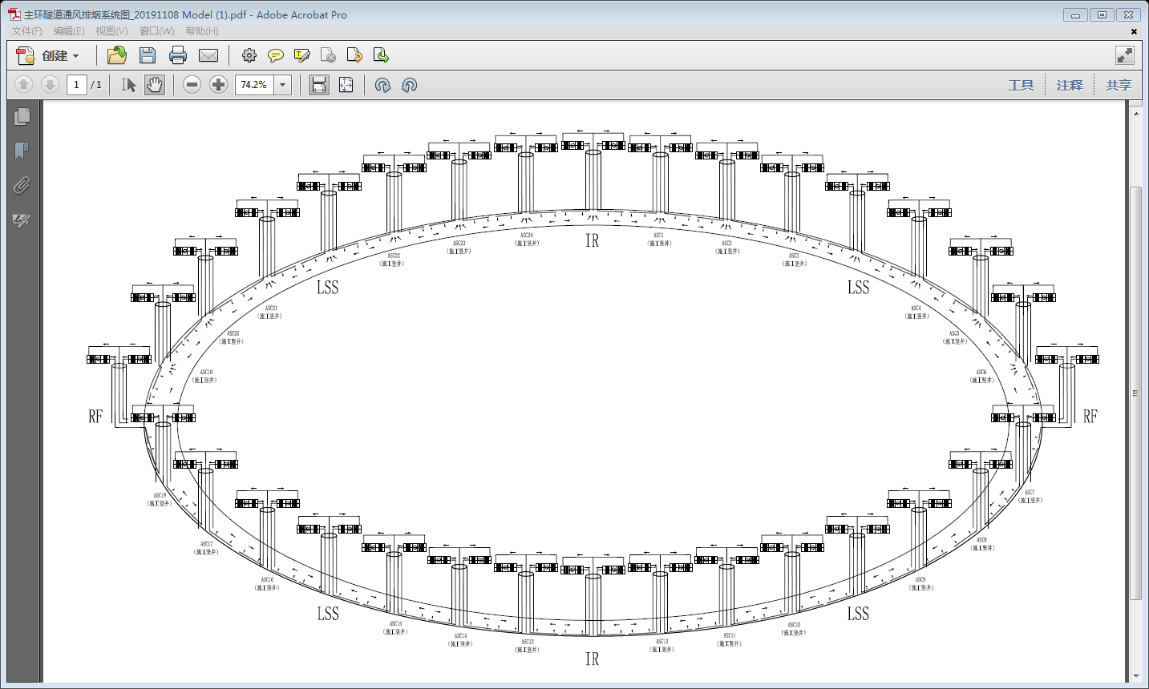
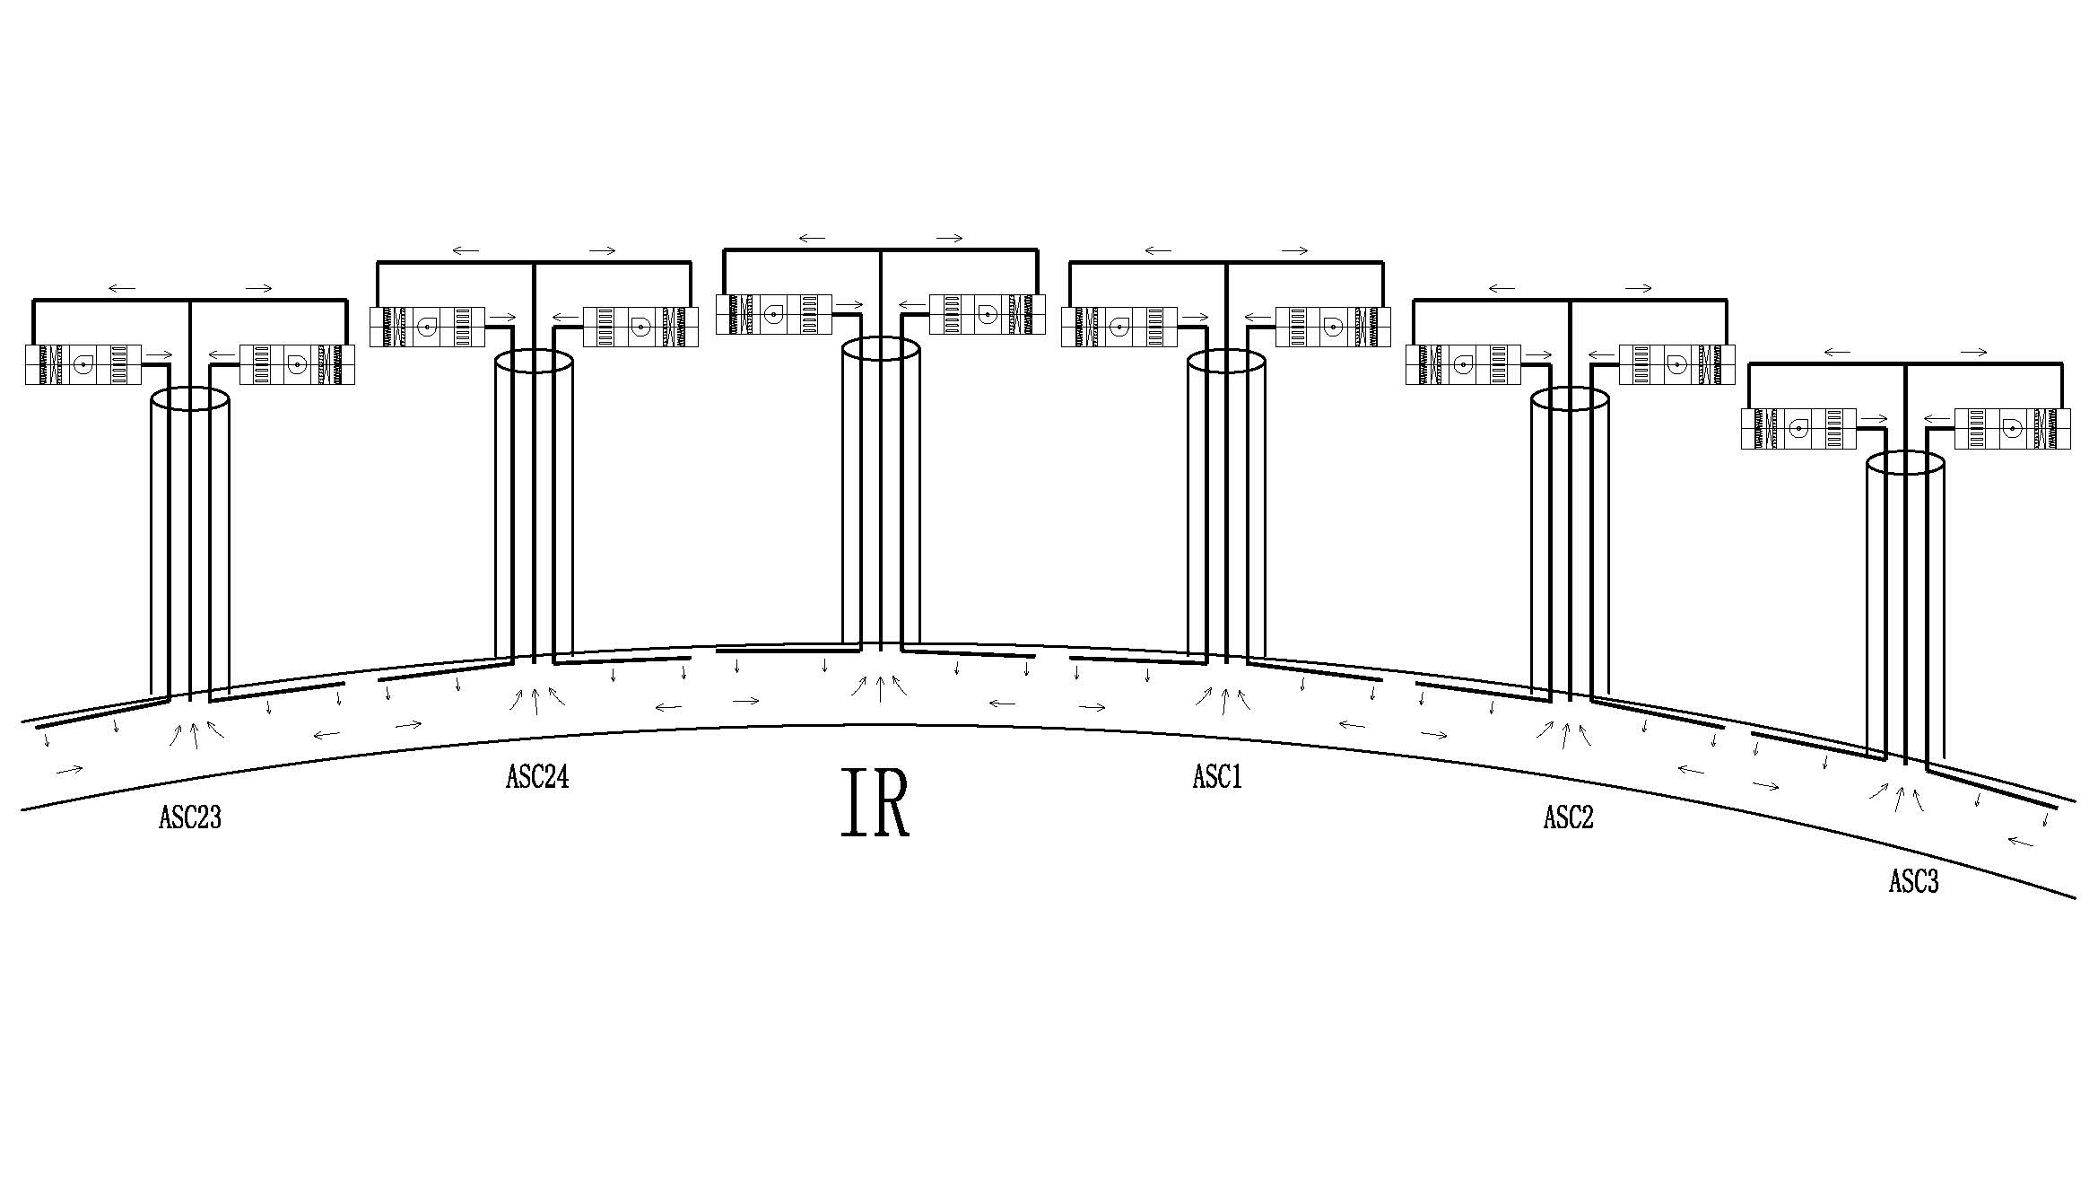
Heating Ventilation and Air Conditioning
Air-conditioning system in tunnel
  Layout
    The ring tunnel is divided into 32 independent sections.
    Each shaft serves as a ventilation and exhaust channel for the underground main ring tunnel, and a ventilation pipe and a smoke exhaust pipe are arranged therein.
  Operation scenario
    Machine operation mode
          -- Temperature and humidity in tunnel are maintained by inlet air.
    Transitional mode
      -- To purge air in the tunnel before access.
    Accessible mode
      -- The air flow rate could be cut down.
    Emergency mode
      -- In case of smoke and gas extraction.

Slide 31
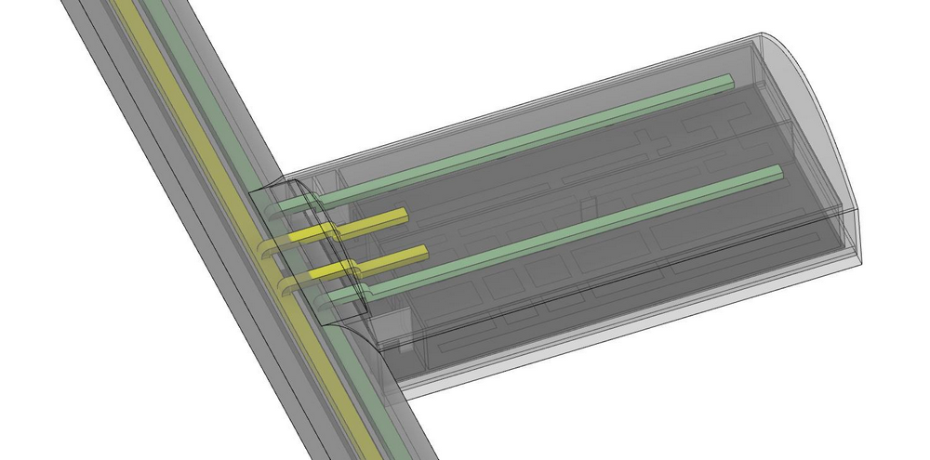
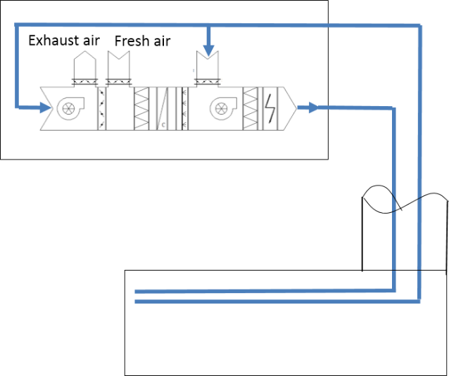
Heating Ventilation and Air Conditioning
RF auxiliary tunnels and experiment hall
  Air conditioned and ventilated by mechanical supply and extraction of air via ducts in access shaft.
  AHU is on ground level.
  Dedicated smoke, gas extraction systems
Auxiliary stub tunnels
  Air supply ducts are led out from the air supply trunk duct in the collider ring tunnel to feed cold air into the auxiliary stub tunnel, and then air exhaust ducts are connected to the air exhaust trunk duct in the collider ring tunnel for exhausting hot air from the stub tunnel.
  Other service buildings
  AHU (air handling Unit)
  fan-coil + fresh air system
Air supply duct
Air exhaust duct
Air supply duct
Air exhaust duct

Slide 32
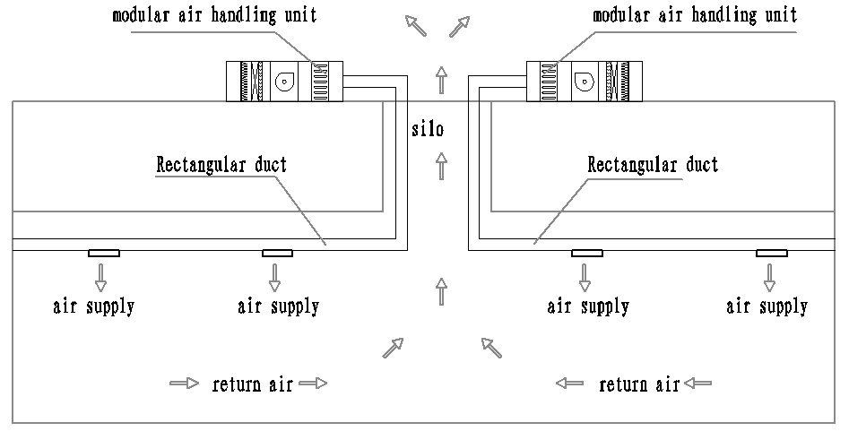
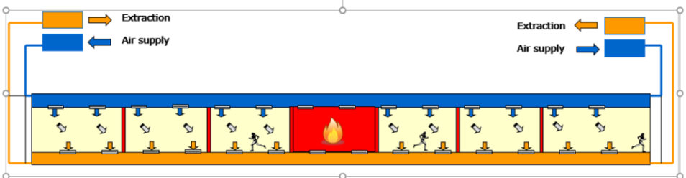
Heating Ventilation and Air Conditioning
Ventilation and smoke exhaustion system
  It is proposed to combine the smoke exhaust system with the mechanical air exhaust system based on the layout features of underground caverns.
  Emergency smoke exhaust is applied to both the collider ring tunnel and the experiment halls.

Slide 33
Compressed air system
Compressed air is considered a safe and reliable source of power for pneumatic equipment. Vacuum valves, cryogenic valves, and other pneumatic equipment used in CEPC extensively rely on compressed air to function.
System Configuration
Operating Pressure
0.6~0.8MPa
Plant Quantities
20
Single Plant Capacity
22.1 m³/min
Particle Removal Efficiency
≥99.98%
Pressure Dewpoint Temp.
-40℃
Oil Content
≤0.01ppm

Slide 34
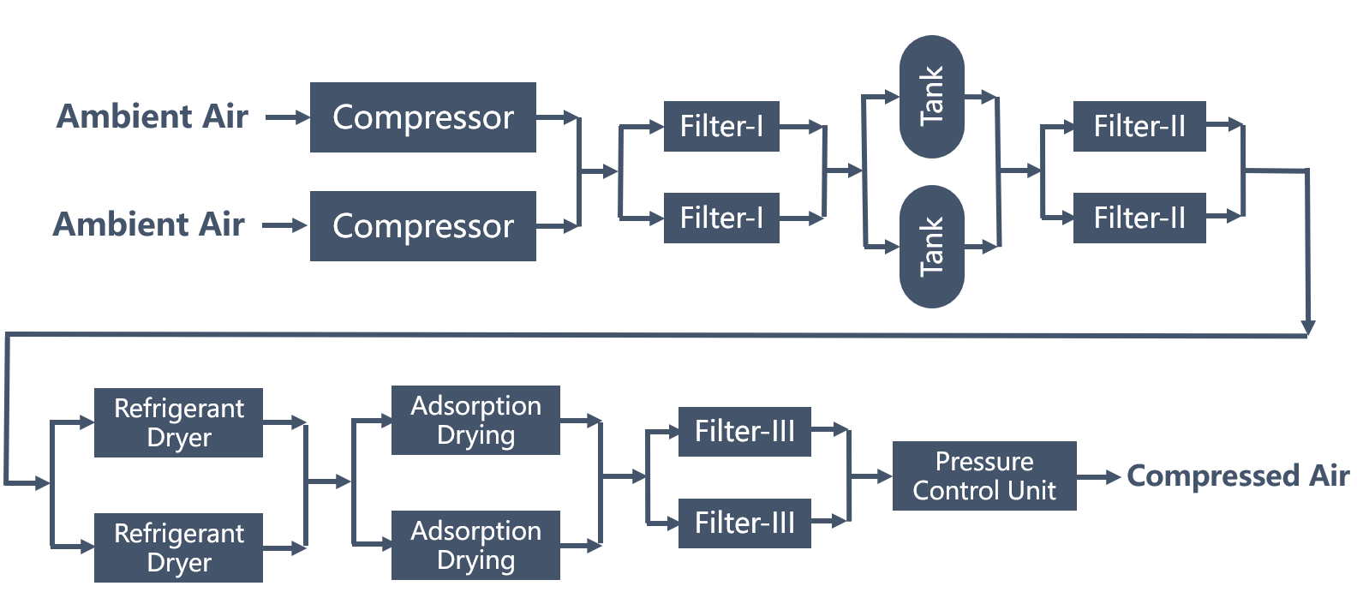
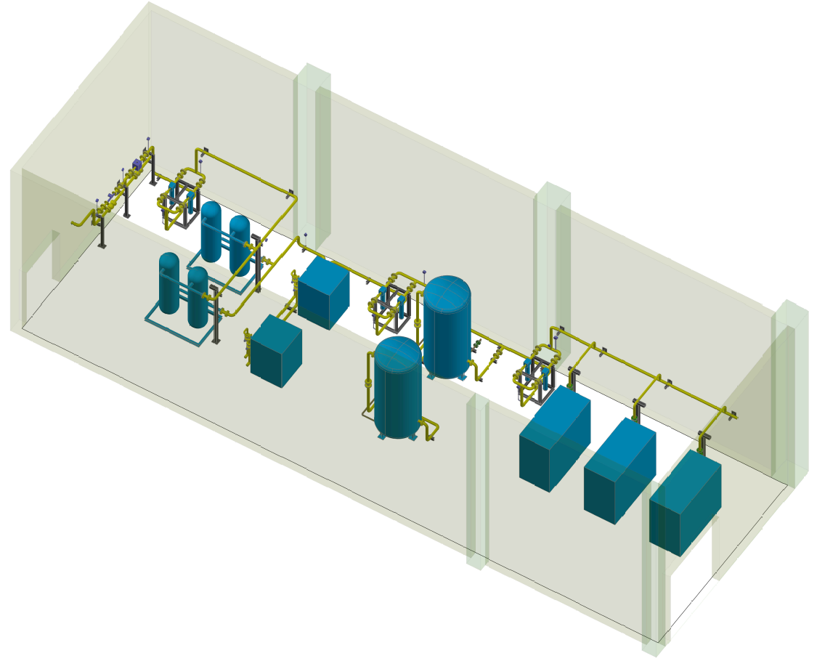
Compressed air system
Plant Design Principle
  Easy to replace any equipment
  Compact procession layout
  Reasonable cooling system
Distribution Design Principal
  Coordinate with other pipeline and accelerator equipment
  Easy to connect pneumatic actuator
Station: 18
  Linac —1
  BTL—1
  Collide/Booster—16
A typical compressed air plant

Slide 35
Energy saving consideration
Power reduction measures
Auxiliary facility should be built near to the heat load center.
Minimize the operating pressure.
Using high efficiency motor and variable frequency motor will help to reduce energy consumption.
Adopting high temperature chiller, the cooling efficiency will increase by 2~3% for every 1℃ increase of water outlet temperature.
Thermal energy recover
Through heat recovery chiller, heat exchanger maximizes the heat absorbed by LCW as several heat sources.
Air conditioning heat source.
Heating source in winter.(If possible, the heat supply could radiate to surrounding residential areas)
Heat recovery and utilization of low temperature hot water is a very complicated and difficult problem.

Slide 36
Summary
According to the requirements of each system, the electricity demand of TDR stage is sorted out and analyzed.
The auxiliary facilities was redesigned according to the process requirements of the TDR phase
The equipment list and cost estimate are prepared.
Next, we need to further discuss the process requirements, operation mode, equipment layout, etc., optimize the layout of the main pipeline, continue to improve the TDR report, and prepare for the EDR work.

Slide 37
  Thank you for your attention!

